Slide 1
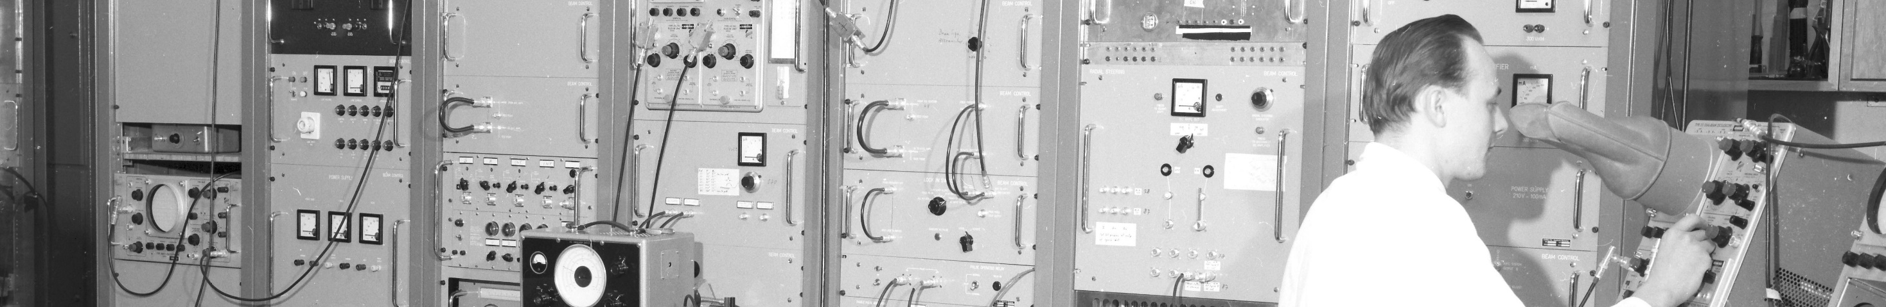
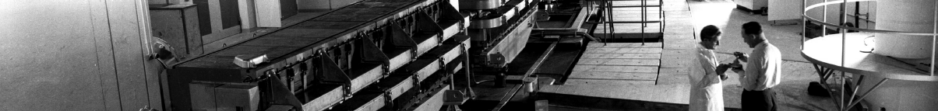
PS Report week 44
Many thanks
to the PS OP and coordination teams as well as all equipment experts and support teams!
A. Guerrero SY-BI

Slide 2
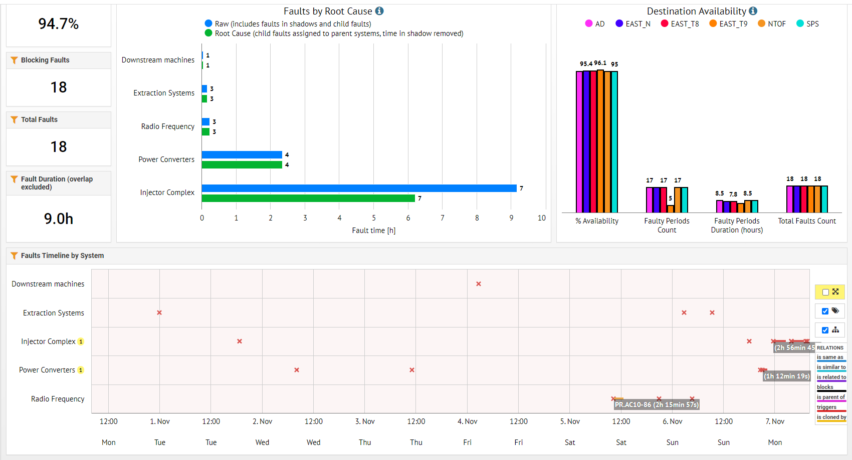
Beam availability
Linac4
PE.SMH16
A. Guerrero SY-BI

Slide 3
Main issues
  We were informed of ions in T8 -> Tuesday 17h24 to 17h34 (10 shots)
    the beam was well from the beginning to EAST_DUMP but when the sequence changed the default destinationT8 took over.
  TE-VSC: vacuum peak lasting a few hours in the night of the 2nd Nov at the beginning of TT2 line. Nothing particular happened, only a loss peak at around the start time of the vacuum level decrease
  Several Kfa 71 module trips causing radiation alarms.
  Radiation alarms due to wrong synchro frequency from the SPS
  Several problems with the 10MHz and 200MHz cavities during the week-end (multiple trips)
    Piquet HLRF intervention for C86 and 91 not following the voltage program
    Cavity 202 in fault
  2 POPS trips:
    (20m) It has to do with the Bmeas received the fault is not the past weeks type. This is also confirmed by the fact the scope on the chassis didn’t trig and the voltages are still clean.
    (15m) induced by a test
  SMH16 non-resettable trip. PIPO intervention for an insulation problem (~1h10). Another intervention will be needed. At the same an issue with kfa45 stopped the beam towards EAST too. A reboot of the FEC solved the issue (~30m)
A. Guerrero SY-BI

Slide 4
Activities
A week full of MDs
  PB80+ injected in PS. Beam accelerated to almost the end of the first ramp, when enough intensity is captured. Poor transmission probably due to large energy spread
Setting up of the MD beams for Wednesday and LHC MD2
  MTE very low intensity (50e10p – 200e10p)
  BCMS & 8b4e beams up to 1.8e1011p/b, 36 & 48 bunches
Ions to SPS in preparation for FT and later for LHC
Work on EAST spill and tail reduction
MTE BB adjustments for loss reduction
T9 beam re-center to maximize secondary particle production
A. Guerrero SY-BI

Slide 5

PS Coordinator for week 45 – Denis Gerard Cotte
Questions and Comments
9:00 Daily Zoom meeting (PS-MPC on Monday morning)
Web address: https://cern.zoom.us/j/9372114100?pwd=L29BcmlHUENCdFBRSytXYVcrM1B4Zz09
Meeting ID : 937 211 4100
Passcode: 525463
A. Guerrero SY-BI

