Slide 1
PSB FOM Report
C. Bracco
for the PSB operations and beam commissioning team

Slide 2
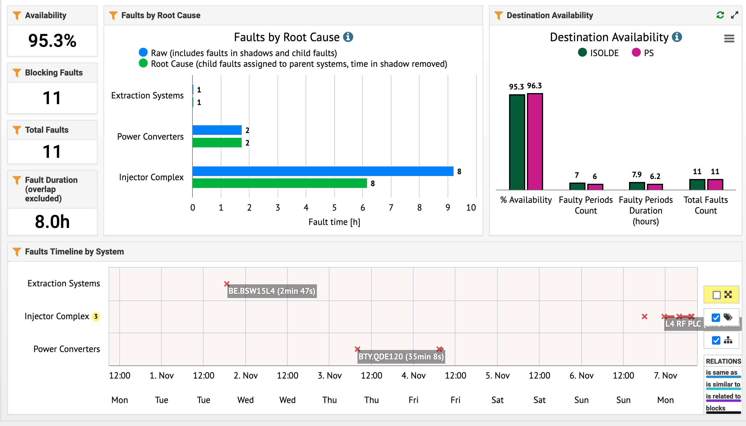
Availability

Slide 3
Report W44
Faults:
  Mainly ISOLDE being affected by problems at two different quadrupoles of the BTY line (trip of BTY.QDE120 and acquisition not following CCV for BTY.QDE151) which required the intervention of the piquet.
  Long stop due to LINAC4 RF issues on Sunday night.
Highlights:
  Successful preparation of all beams for the different SPS and LHC MDs plus VdM scan
  SC with HRS and STAGISO in parallel prepared and fulfilled experiments’ requirements
Next week coordinator: J.F. Comblin (168060)

