Slide 1
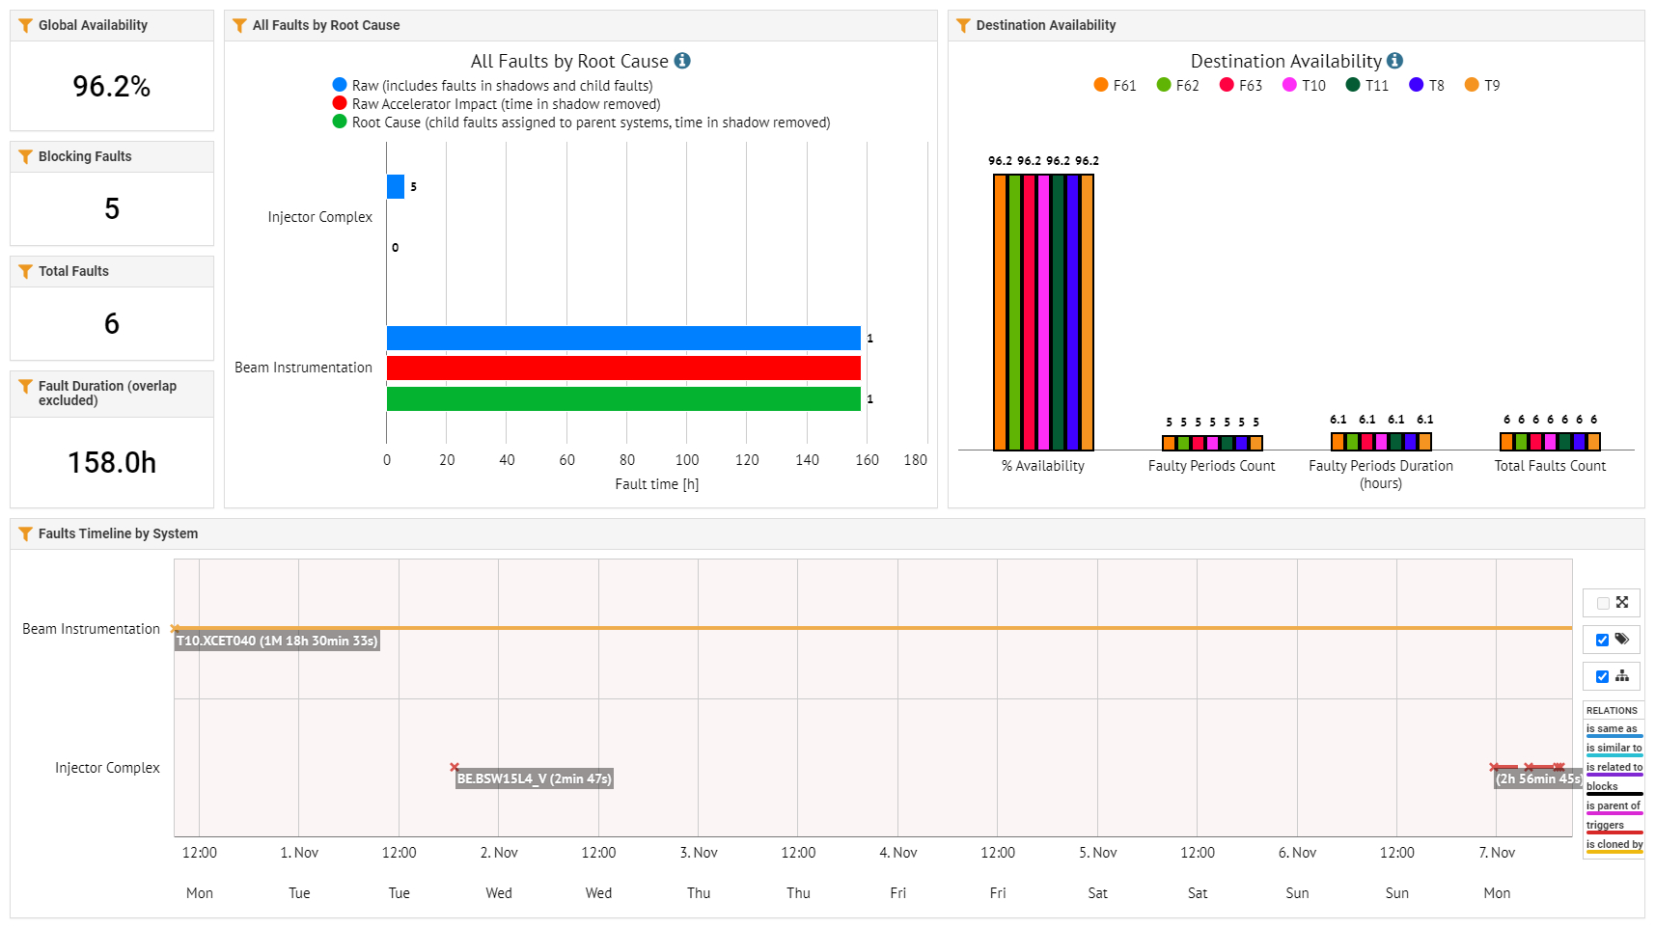
East Area FOM Report

Slide 2
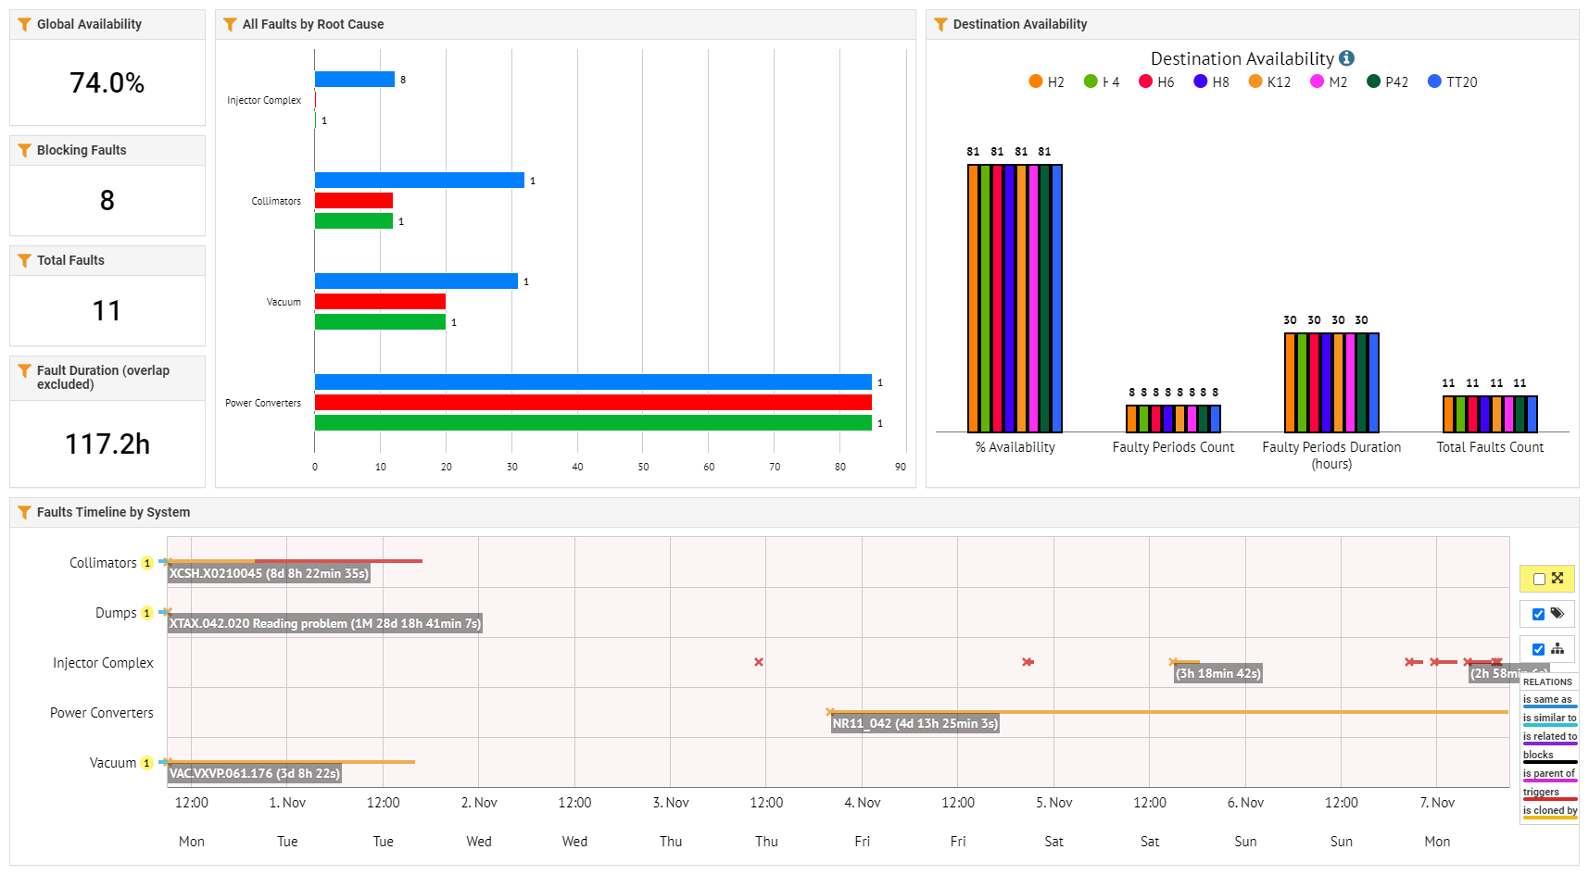
North Area FOM Report
Potentiometer of a Collimator on H2 need to cut NA beam for intervention. Solved (Thanks to experts)

