Slide 1
FOM
SPS machine report – week 44
K. Li on behalf of the SPS Operations and Supervisors Teams
08. November 2022

Slide 2
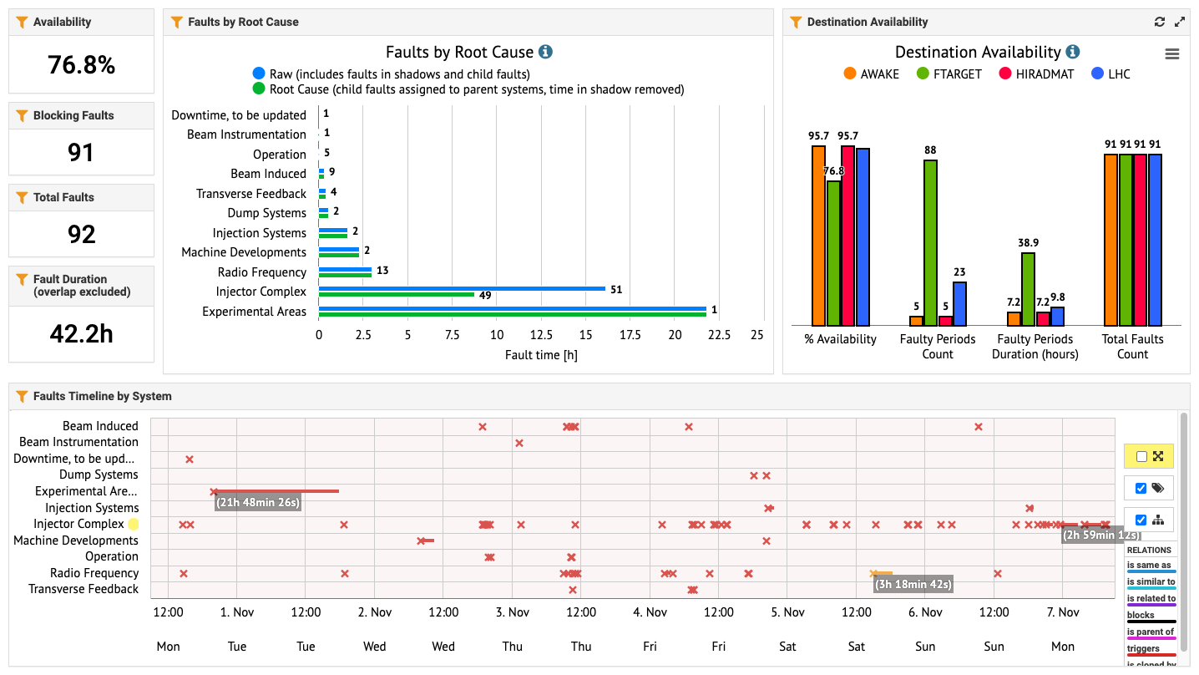

Faults overview
H2 collimator
Injectors
800 MHz

Slide 3
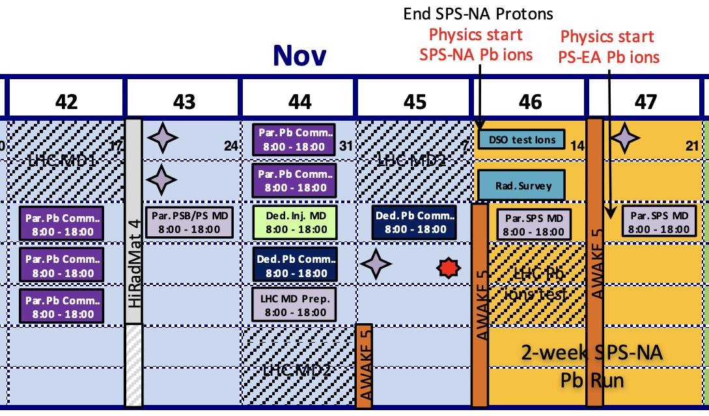
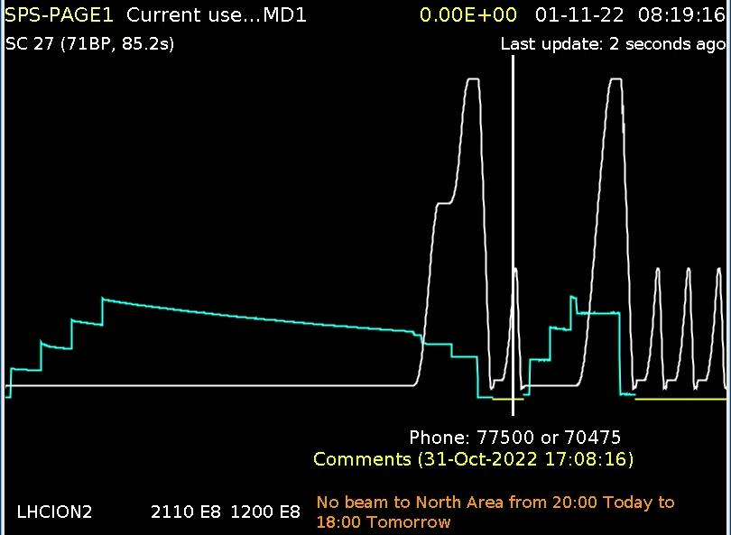
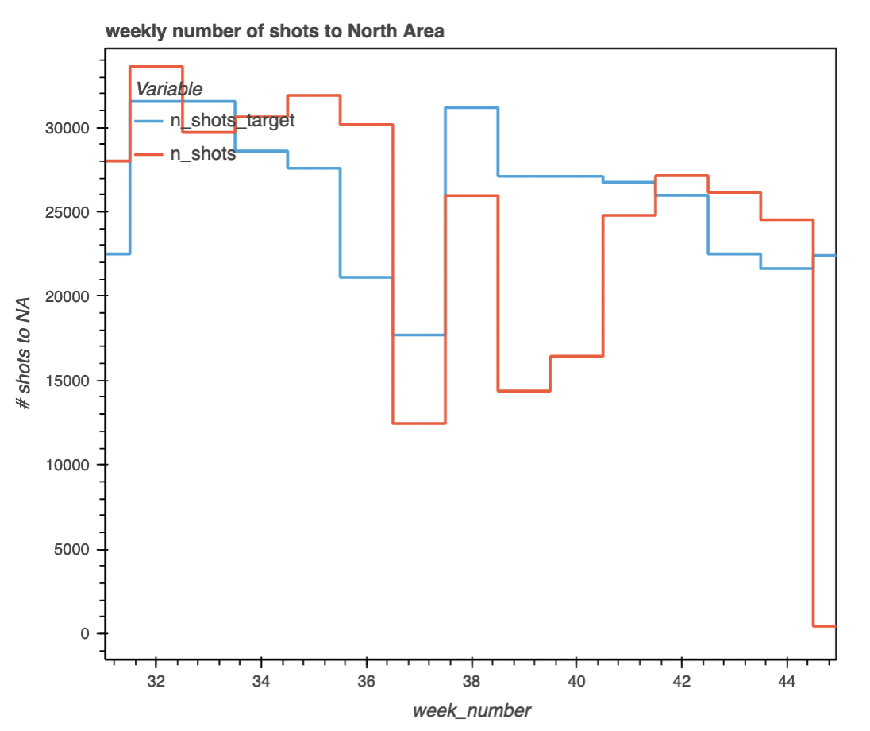
Week 43 / 44 Review
Programme
  Physics:
    Overall good delivery of beams beside very dense program otherwise – physics delivered on target!
    COMPASS lost polarization before weekend – are now trying to catch up for last 2 days of their run!
  MDs
    Difficulties with long ion cycle – debugging tedious due to long low duty cycle; made some progress but needs improvements for next MD
    Successful dedicated MD on crystal channeling – achieved 48% loss reduction in volume reflection mode with non-local crystal
  LHC
    Regular delivery of 36 bunches BCMS beams up to 1.5e11 ppb
    Dedicated fills test still foreseen for one of the upcoming fills
  Ions
    HWC for SFTION progressing slowly; several difficulties and obstacles faced; new FW deployed and being tested today
    No more slots officially foreseen for ion commissioning; will need to find additional time if required
  Interventions
    H2 collimator intervention successfully completed

Slide 4
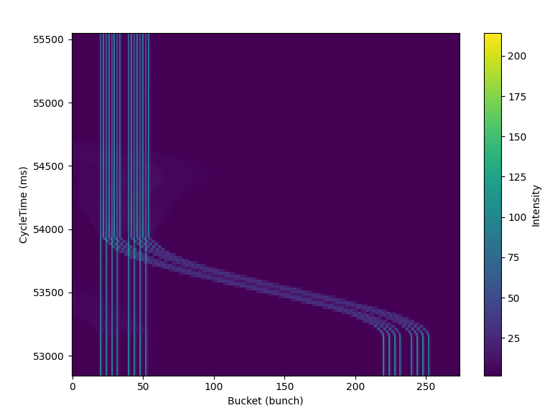
Week 43 / 44 Review
Programme
  Physics:
    Overall good delivery of beams beside very dense program otherwise – physics delivered on target!
    COMPASS lost polarization before weekend – are now trying to catch up for last 2 days of their run!
  MDs
    Difficulties with long ion cycle – debugging tedious due to long low duty cycle; made some progress but needs improvements for next MD
    Successful dedicated MD on crystal channeling – achieved 48% loss reduction in volume reflection mode with non-local crystal
  LHC
    Regular delivery of 36 bunches BCMS beams up to 1.5e11 ppb
    Dedicated fills test still foreseen for one of the upcoming fills
  Ions
    HWC for SFTION progressing slowly; several difficulties and obstacles faced; new FW deployed and being tested today
    No more slots officially foreseen for ion commissioning; will need to find additional time if required
  Interventions
    H2 collimator intervention successfully completed

Slide 5
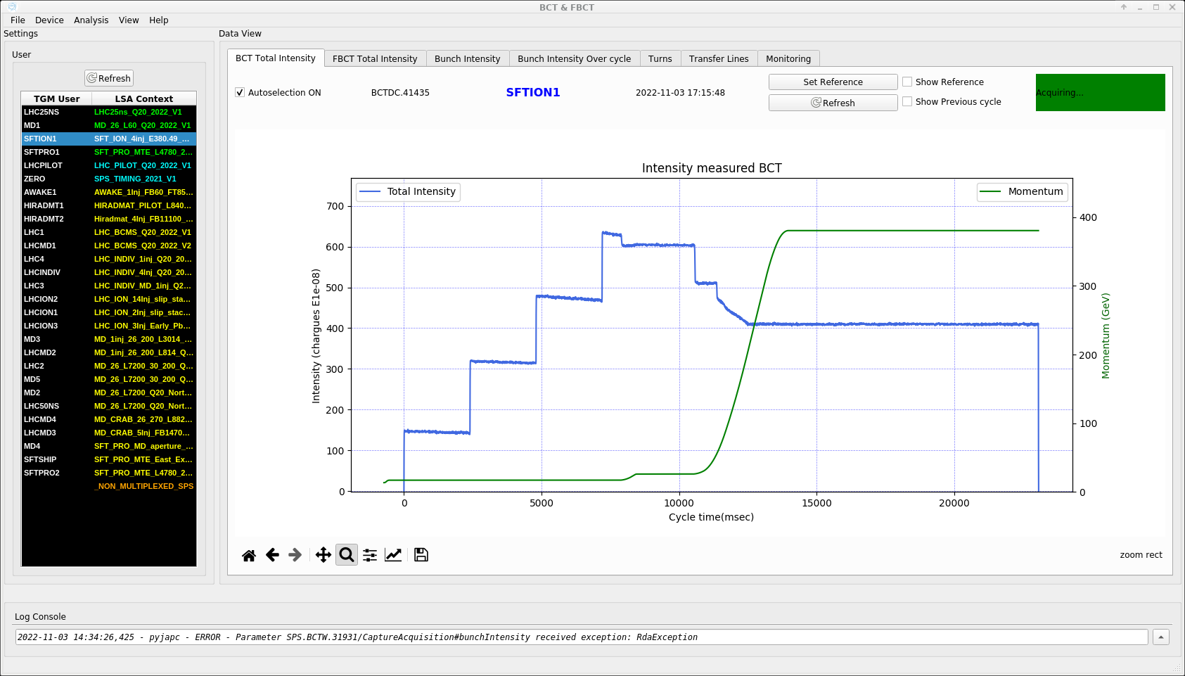
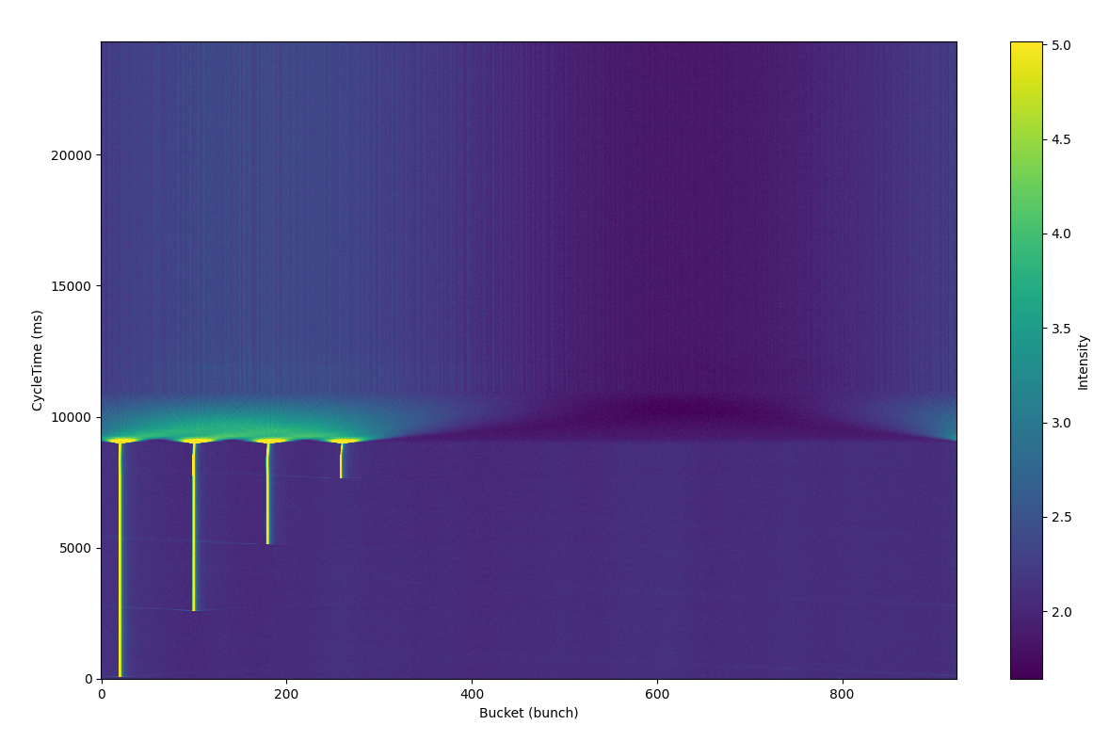
Week 43 / 44 Review
Programme
  Physics:
    Overall good delivery of beams beside very dense program otherwise – physics delivered on target!
    COMPASS lost polarization before weekend – are now trying to catch up for last 2 days of their run!
  MDs
    Difficulties with long ion cycle – debugging tedious due to long low duty cycle; made some progress but needs improvements for next MD
    Successful dedicated MD on crystal channeling – achieved 48% loss reduction in volume reflection mode with non-local crystal
  LHC
    Regular delivery of 36 bunches BCMS beams up to 1.5e11 ppb
    Dedicated fills test still foreseen for one of the upcoming fills
  Ions
    HWC for SFTION progressing slowly; several difficulties and obstacles faced; new FW deployed and being tested today
    No more slots officially foreseen for ion commissioning; will need to find additional time if required
  Interventions
    H2 collimator intervention successfully completed

Slide 6
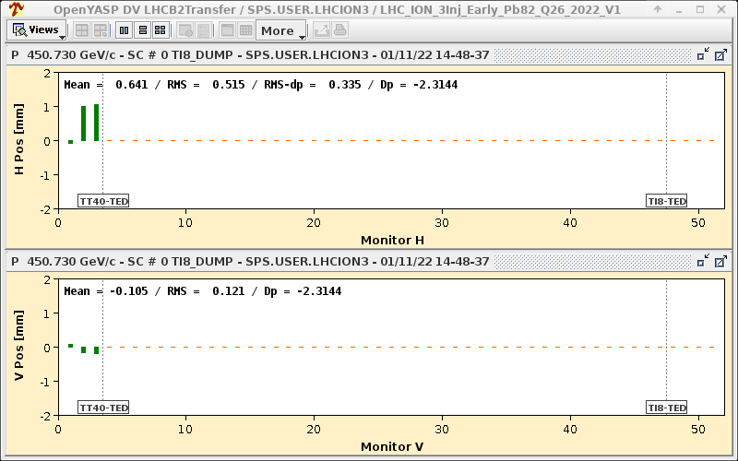
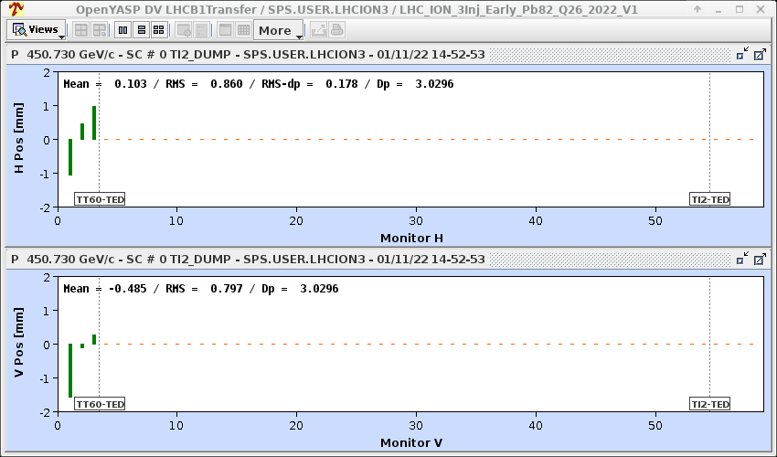
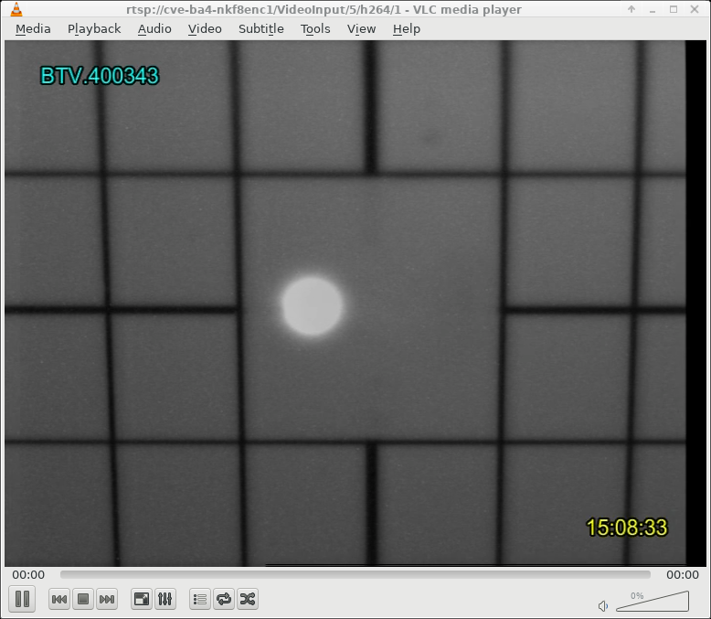
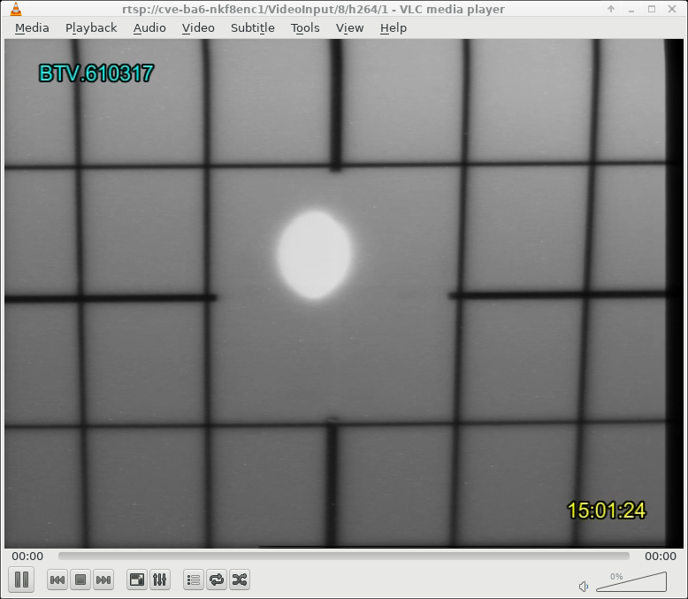
Week 43 / 44 Review
Programme
  Physics:
    Overall good delivery of beams beside very dense program otherwise – physics delivered on target!
    COMPASS lost polarization before weekend – are now trying to catch up for last 2 days of their run!
  MDs
    Difficulties with long ion cycle – debugging tedious due to long low duty cycle; made some progress but needs improvements for next MD
    Successful dedicated MD on crystal channeling – achieved 48% loss reduction in volume reflection mode with non-local crystal
  LHC
    Regular delivery of 36 bunches BCMS beams up to 1.5e11 ppb
    Dedicated fills test still foreseen for one of the upcoming fills
  Ions
    HWC for SFTION progressing slowly; several difficulties and obstacles faced; new FW deployed and being tested today
    No more slots officially foreseen for ion commissioning; will need to find additional time if required
    LHC EARLY ion beams extracted to TEDs

Slide 7
Week 44 / 45 Incoming
LHC MD2 Block
  Preparation of 8b4e could not be completed on Friday → still needs to be slotted in in parallel to ongoing LHC MDs
Additional ion commissioning slots…
  Monday / Tuesday during LHC MDs → bad as last protons for COMPASS
  Oven refill done already last week → Thursday / Friday possibility for additional time – already mentioned at the user’s meeting
AWAKE
  Coming in on the weekend

Slide 8

Questions and Comments
SPS Supervisor of the week 45 – Arthur Spierer
Weekly 08:45 Weekly Coordination Zoom meeting
Web address: https://cern.zoom.us/j/6929444357?pwd=bFk2OHdYUXA4NnhiQjcyQ2p0VGxnZz09
Meeting ID : 692 944 4357

Slide 10
