Slide 1
Linac3 report w45
G Bellodi for the Linac3 team

Slide 2
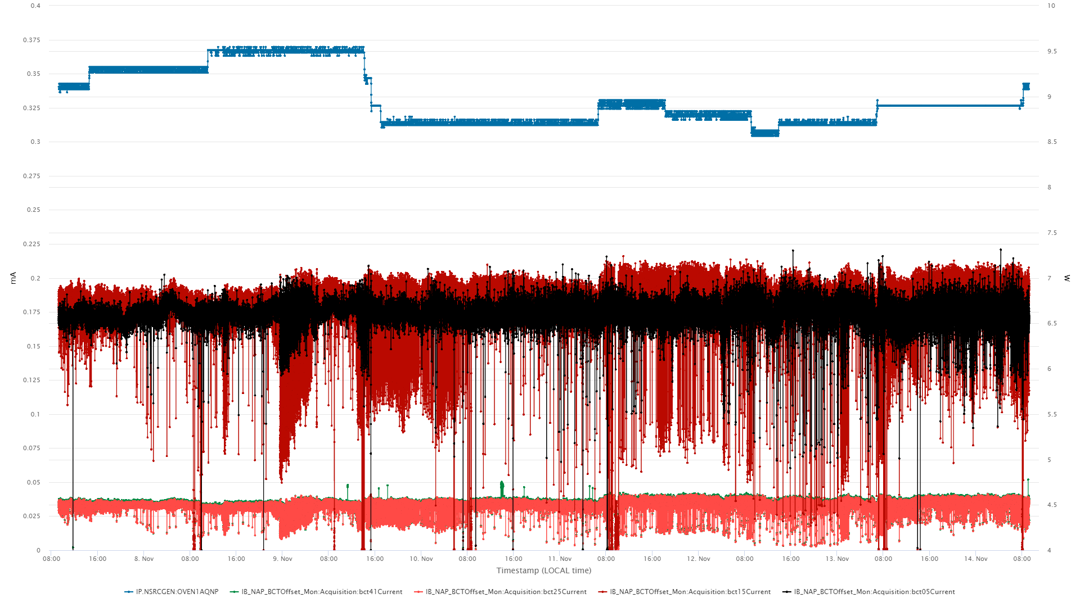
Linac3 delivered on average ~35uA beam currents to LEIR throughout the week without any interruptions.
Intensity fluctuations from the source required daily tuning by the source expert, even outside normal working hours.
The stripping foil was exchanged on Tuesday and daily energy measurements were taken.
Oven1 power
Source, Linac3
LEIR injection

