Slide 1
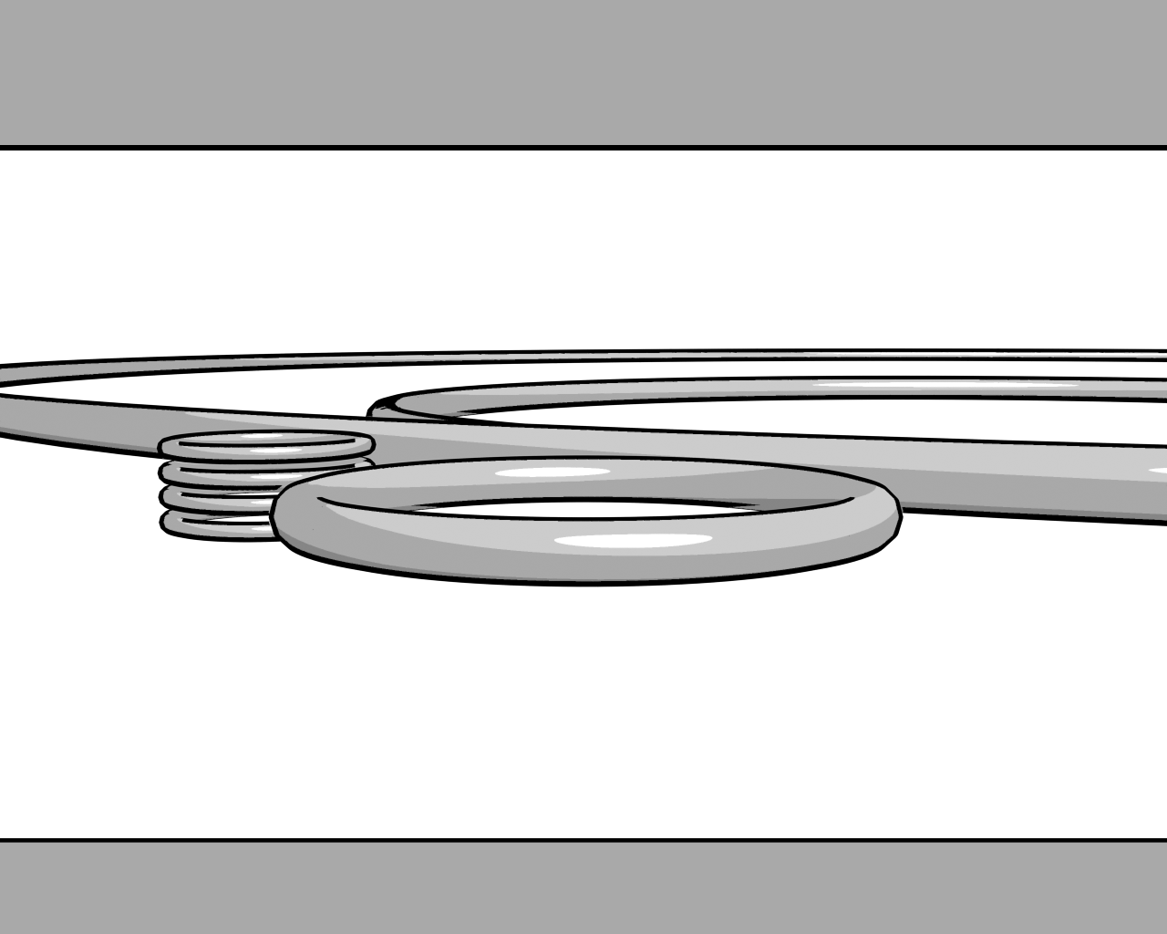



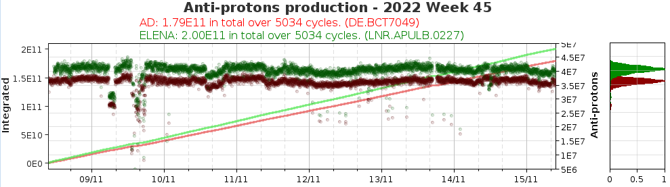
AD-ELENA week 45 summary
1
Both machine are performing well.
A trip of one of the C10 cavity [1]
Set PS proton intensity to 1770E10, maximum regarding radiation threshold in Aegis
A small tricky mistake of the fesa class configuration of the Elena extraction line grids prevent the profile readings during the weekend. Fixed Monday by BI expert.
H- source repaired again after an electronic card was damaged by an arc.

