Slide 1

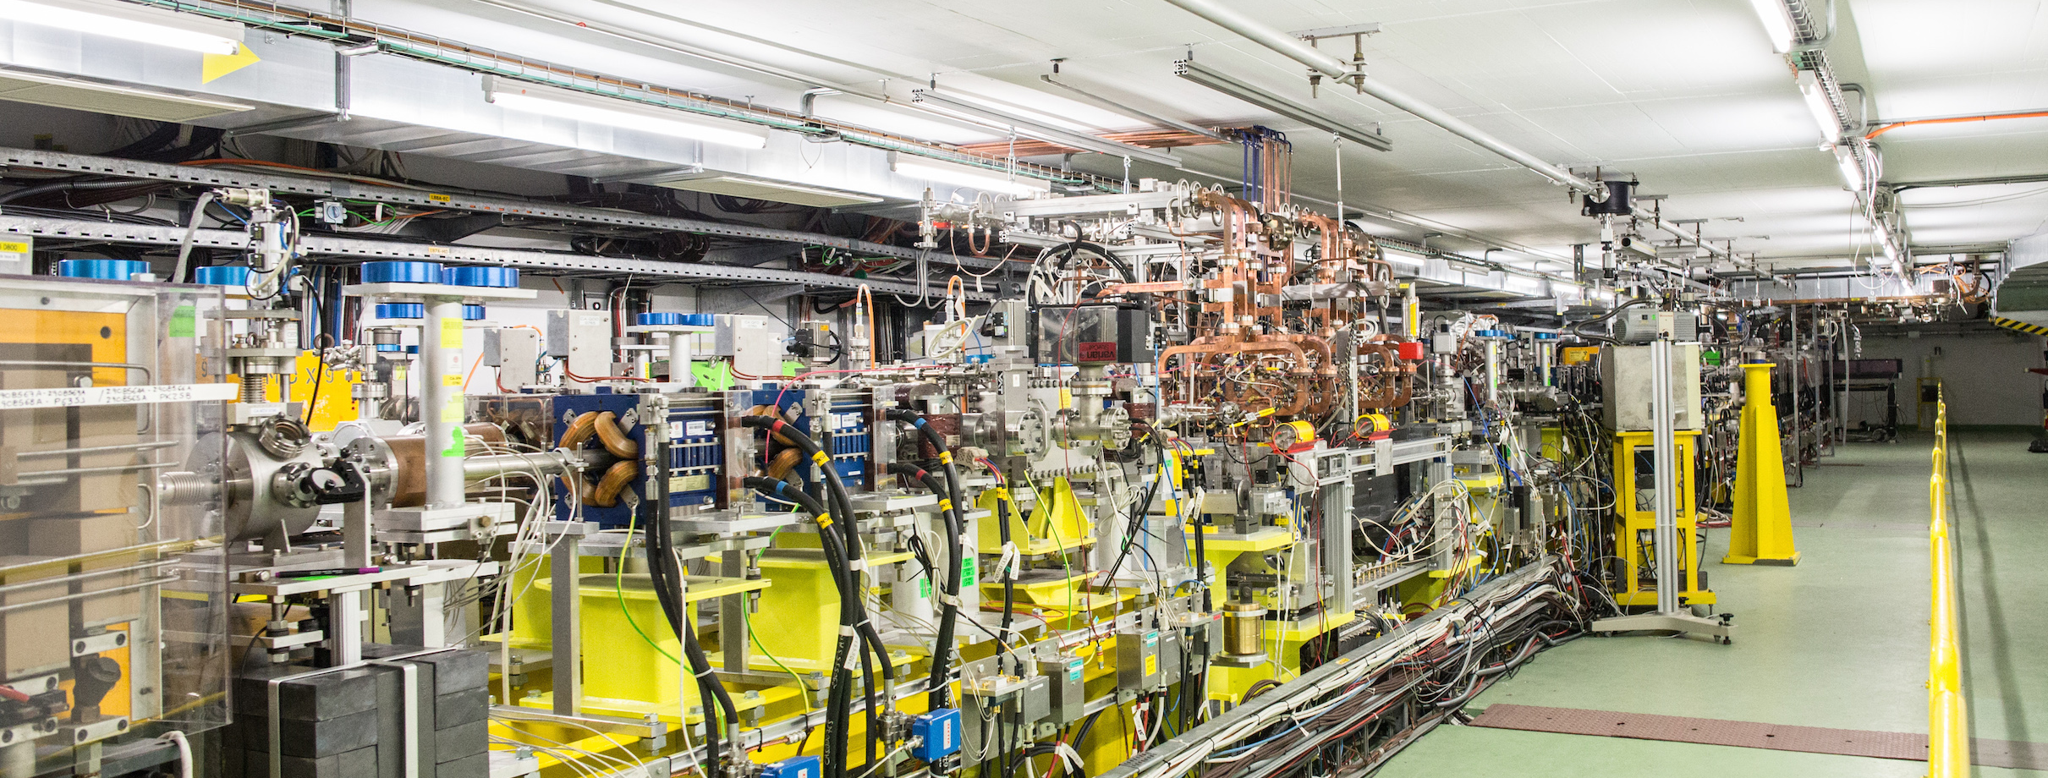
Facilities Operation Meeting
Week 45: 7/11 to 13/11
Weekly supervisor: Wilfrid Farabolini
Speaker: Alexander Malyzhenkov

Slide 2
5 experiments last week:
  Grid collimator and scintillator on optic fiber (Victoria Univ. Canada)
  Optical fibre dosimetry (CERN / Oxford Univ.)
  Conical shaped collimator (CERN / Oxford Univ.)
  ChDR BLM (CERN BI / Oxford Univ.) {After hours / weekend}
  ChDR BPM (CERN BI / Oxford Univ.) {After hours / weekend}
Due to the anticipated CERN accelerators shutdown, a crash program was deployed after discussion with BI, to allow their PhD students before the end of their sojourn at CERN to achieve the experiments that were foreseen during the two first weeks of December, using nights and weekends
7 days of operation last week (~53h). Thanks to all the operators and RP!
Overall stable beam during the operation
Issues
  Several klystron trips (not critical and fast restart)
  Problem with the laser synchronization and amplitude stability (solved by Edu and Miguel quickly)
  Problems with cameras / motor limit switches, etc.
  Changing beam characteristics for the various experiments was time consuming

Slide 3
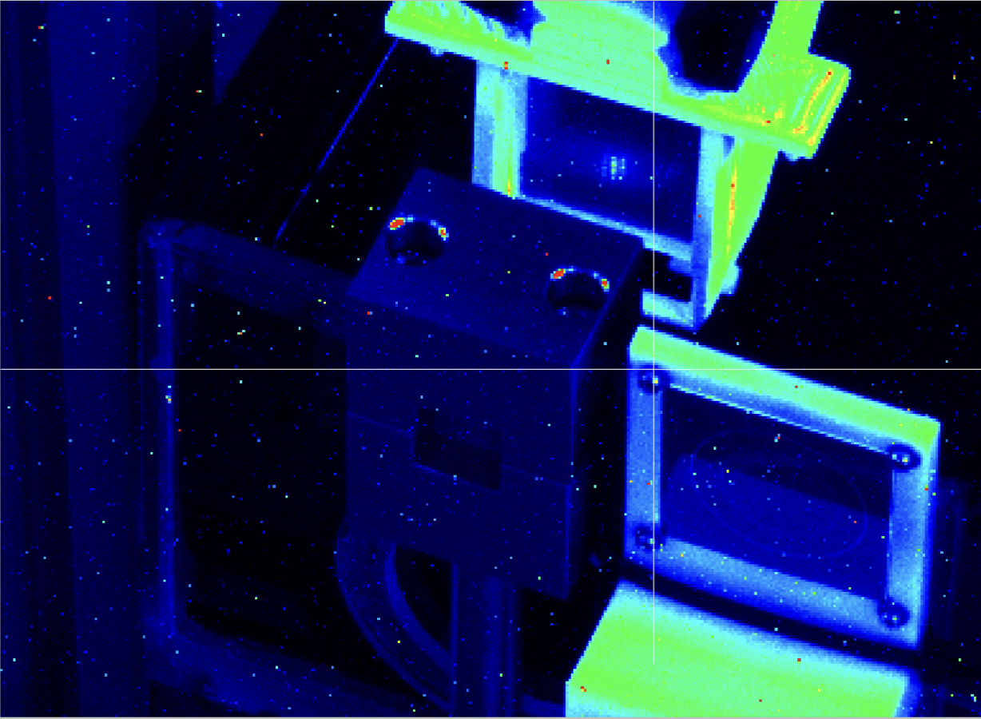
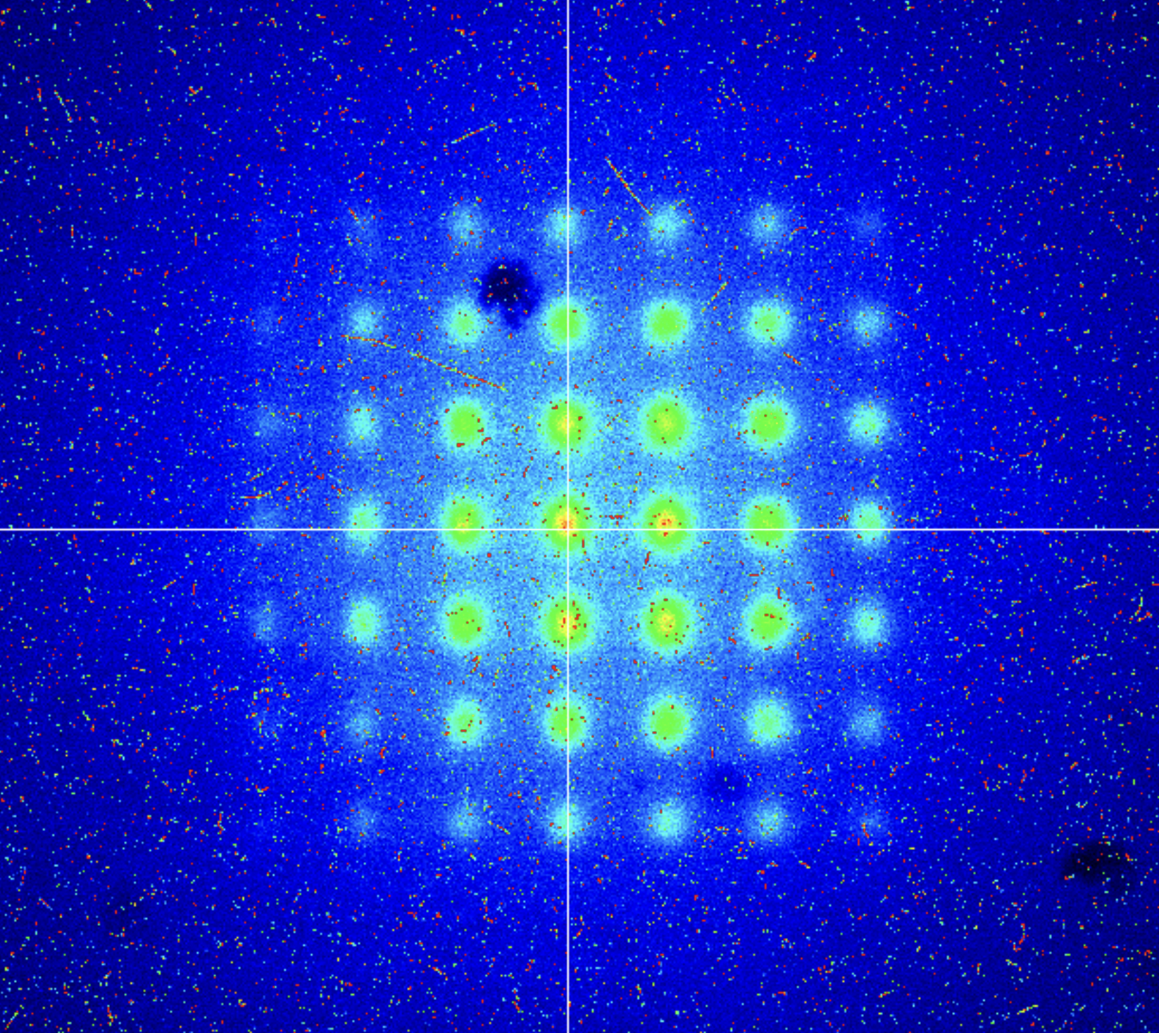
Summary of the results:
  Grid collimator and scintillator on optic fiber: very successful and multiple experiments were done at different energy 70 - 200 MeV range + film irradiations
  Fibre dosimetry: some tests for upcoming conference in Barcelona
  Conical shaped collimator: routine tests as expected
  ChDR BLM: multiple bunch length, interferometric scans, etc.
  ChDR BPM: multiple scans, not symmetric result in two arms

