Slide 1
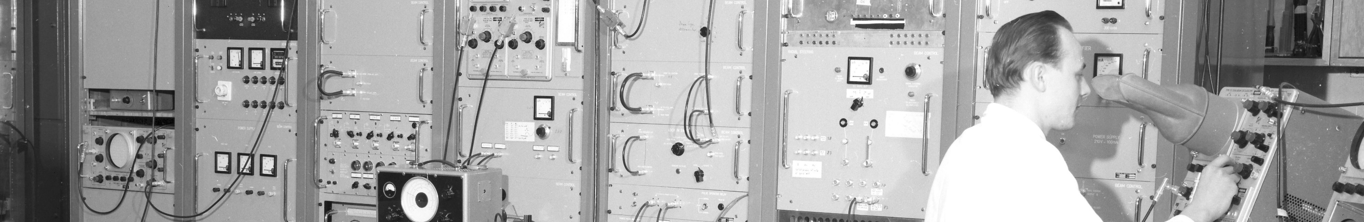
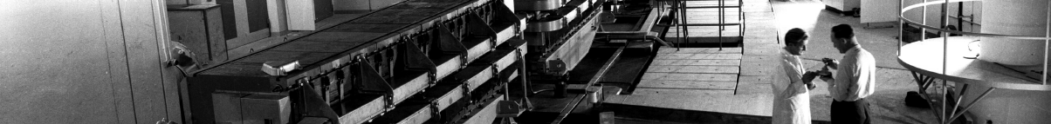
PS Report week 47
Many thanks
to the PS OP and coordination teams as well as all equipment experts and support teams!
A. Lasheen SY-RF-BR

Slide 2
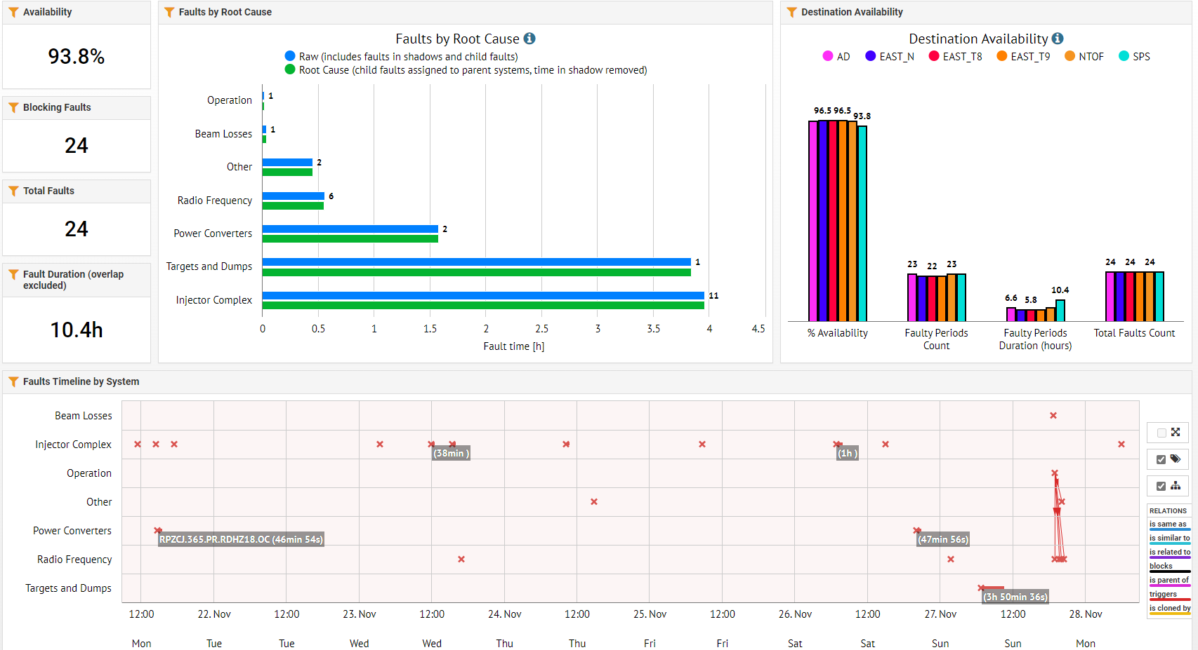
Beam availability W47
LINAC3
LINAC3
F16 BHZ167
Setting fault triggering RF trip
PS Corrector Ejection (p+ only)
TT2 Stripper foil
A. Lasheen SY-RF-BR

Slide 3
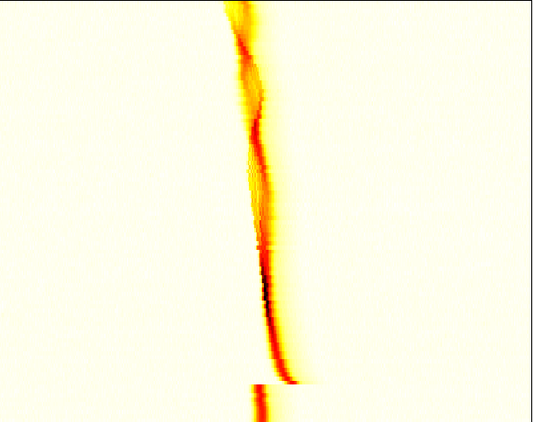
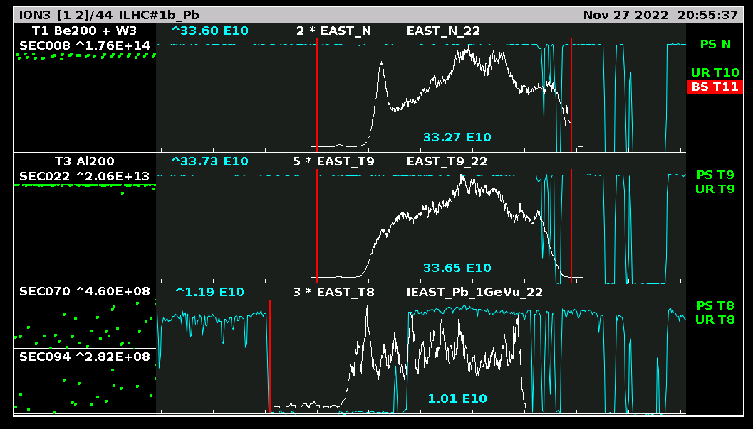
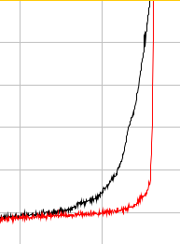
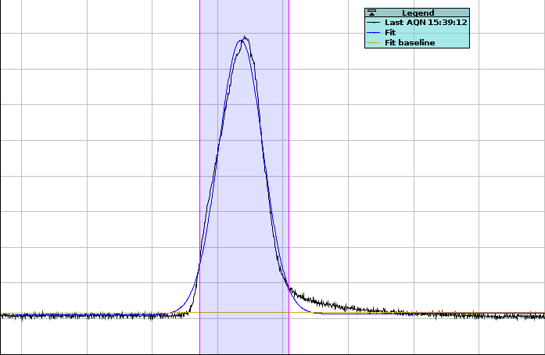
Main issues / updates
Good availability and small number of faults, mostly affecting the ion chain
Beam produced for ion run in EAST and SFTION
  Single bunches sent to SFTION, mitigation of longitudinal instability at transition by increasing the longitudinal emittance.
  Spill at variable energies sent for the CHIMERA run (EAST), three cycles prepared at 0.65, 0.75 and 1 GeV/u.
Optimization of TOF bunch for short bunch extraction
  Optimization of the gamma jump at transition crossing to mitigate transverse instability with small longitudinal emittance
  28ns bunch length at extraction, horizontal beam size OK, smaller vertical beam size
  Bunch rotation adjusted for sharper rising edge of the bunch
Cavity C10-51 in spare until the end of the run (available in degraded mode)
  Mostly affects production of high intensity beams such as AD.
  Was used on Sunday evening after C10-46 couldn’t restart following
  a trip triggered by a settings issue on an MD cycle
SFTION 1b
Microbunching
IEAST_Pb_1GeVu_22
TOF
27.09 ns
A. Lasheen SY-RF-BR

Slide 4
Main issues / updates
Issue with the TT2 ion stripper overnight Saturday -> Sunday
  Manifested as a sudden change in first turn orbit and transmission in TT10-SPS.
  Issue compensated by lowering extraction B field in the PS, requiring important adjustments in the PS-SPS synchronization, but providing with reasonable transmission.
  Beam lost intermittently and then completely on Sunday morning, impossibility to find any good setting in B field and steering.
  Complete beam loss facilitated the understanding that the stripper foil was the root cause of the issue. Replacing with the spare one allowed to resume good operation (many thanks to the operators on shift!).
  Motion and position of the foil doesn’t seem to be the issue according to the controls reading, stripper will be inspected during the YETS.
A. Lasheen SY-RF-BR

Slide 5
Status of operational beams
Fixed target beams | Status | Comment
SFTPRO (core only) | Operational | Available up to 2 ∙ 10¹² p/p
SFTPRO (5 turn extraction) | Operational | Available up to 2.3 ∙ 10¹³ p/p
AD | Operational | Nominal beam (5 bunches)
TOF | Operational | Nominal and parasitic beams
EAST | Operational | IEAST
LHC-type beams | Status | Comment
LHCPILOT, LHCINDIV | Operational
LHC25 (72b) | Operational | Operational at 1.2 ∙ 10¹¹ p/b; Available up to 2.6 ∙ 10¹¹ p/b
LHC25 (12b or 24b) | Operational
LHC25 BCMS (48b) | Operational | Operational at 1.2 ∙ 10¹¹ p/b Available up to 2.6 ∙ 10¹¹ p/b
LHC25 8b4e (56b) | Operational
AWAKE | Operational | Available up to 3 ∙ 10¹¹ p/p
HiRadMat | Operational
ILHC (1b) | Operational | SFTION
ILHC (4b) | Operational
A. Lasheen SY-RF-BR

Slide 6


PS Coordinator for week 48+ – Santa Claus
Questions and Comments
K
Many thanks to you and to the PS operation team for the 2022 run on behalf of the PS coordination team!
Ad-hoc PS Coordination meetings on
Monday 09:00 during the shutdown
A. Lasheen SY-RF-BR

