Slide 1
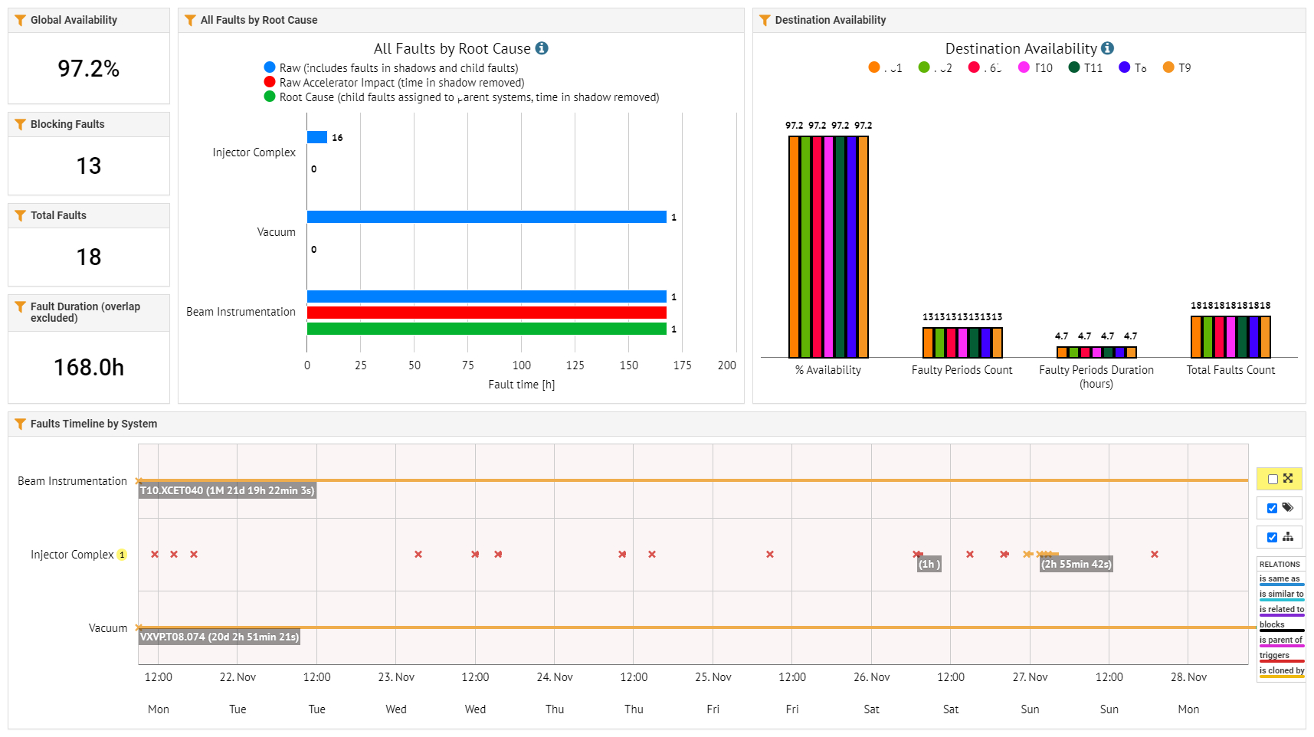
East Area FOM Report

Slide 2
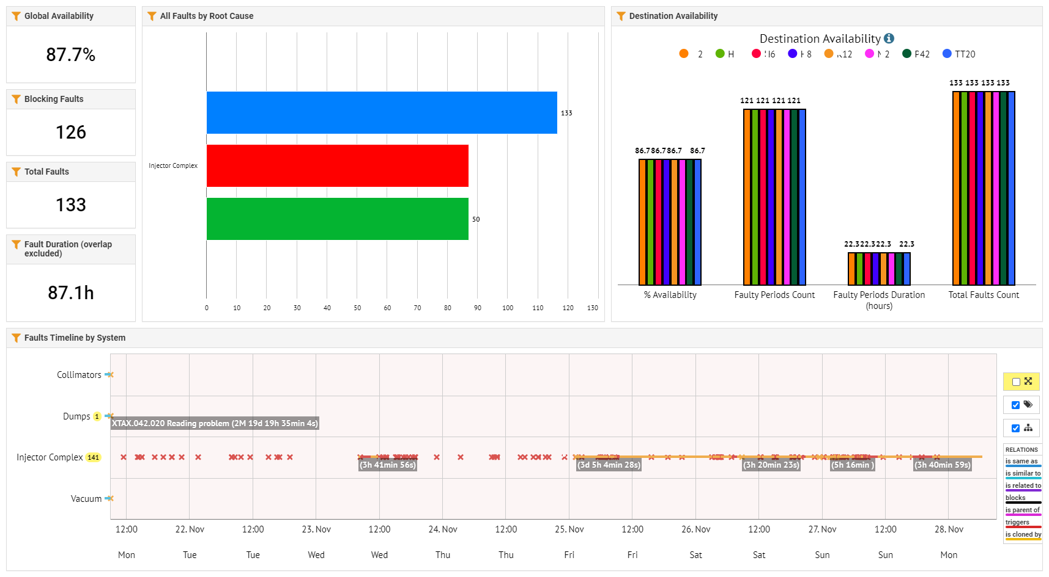
North Area FOM Report

