Slide 1
Politecnico di Torino@CHIMERA radiation test
Beam time
12.2022

Slide 2
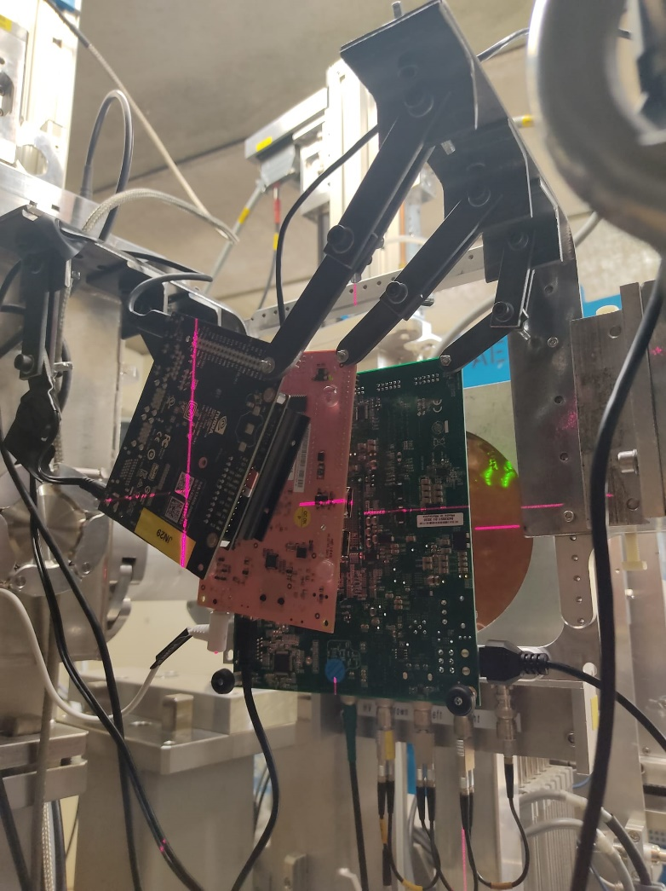
Beam time 12/22 CHIMERA – Hardware Setup
1st board: XCZU7EV
2nd board: Z7020
3rd board: Tegra X1
4th board NG-Medium
5th board: KCU105

Slide 3
Beam time 12/22 CHIMERA – Hardware Setup

Slide 4
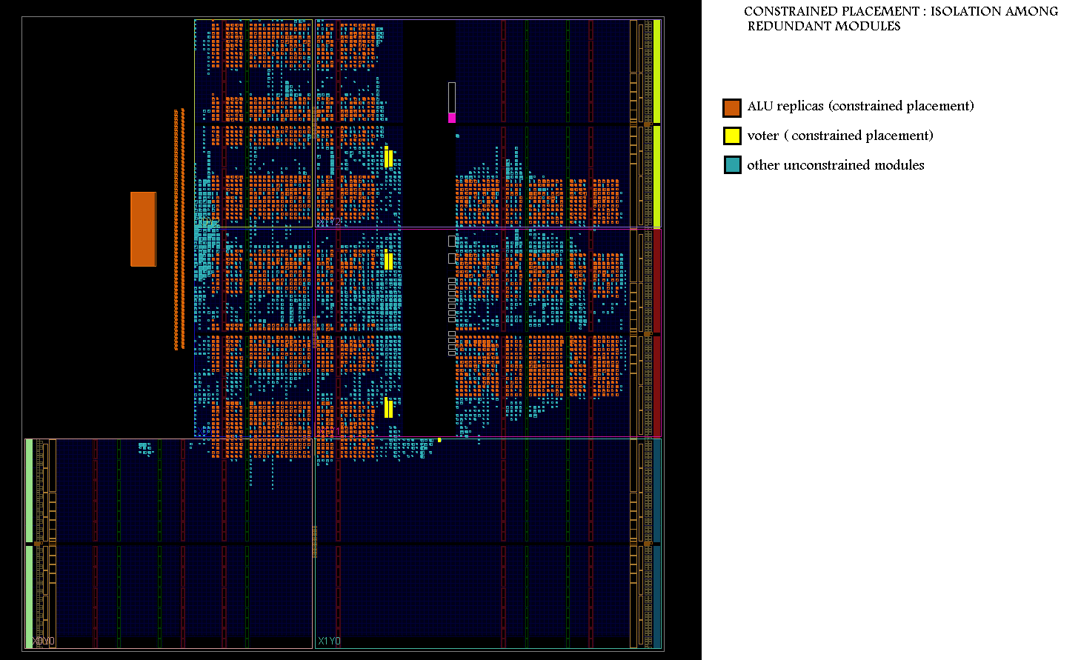
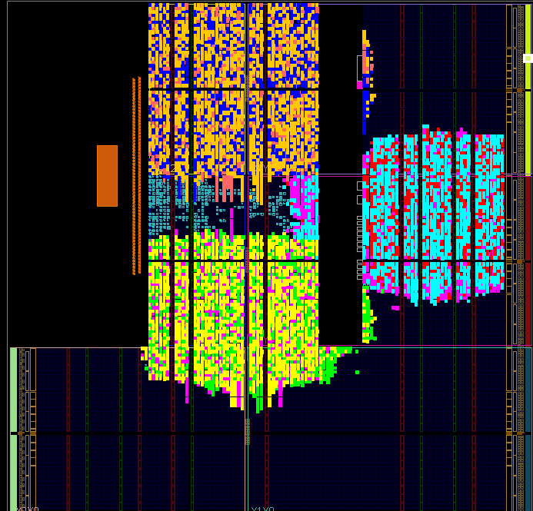
Beam time 12/22 CHIMERA – Circuit Setup
Tensor Processing Units (TPU) on COTS and Rad-Hard FPGAs
  MMU having Matrix Width = 9
HW accelerator setups

Slide 5
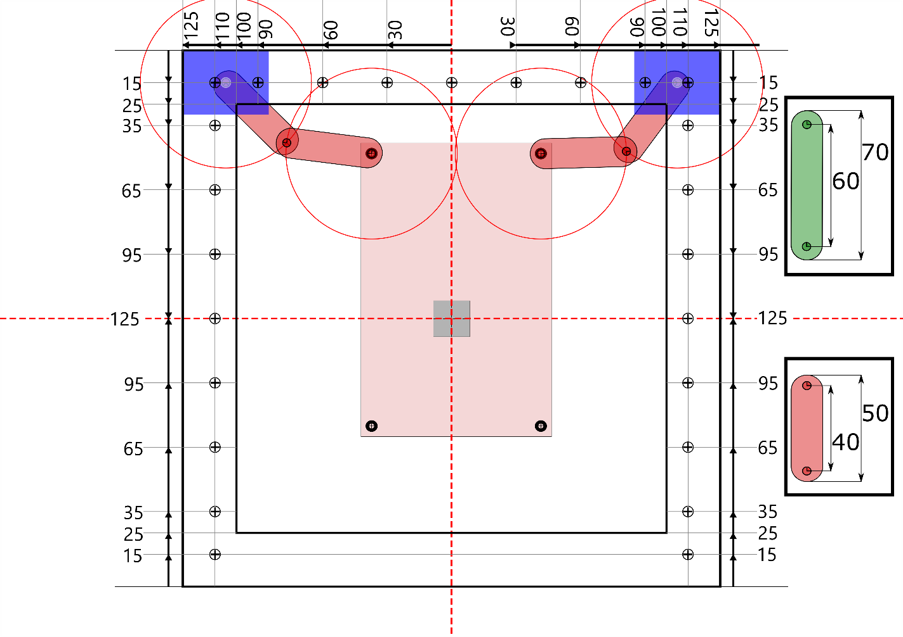
Beam time 12/22 CHIMERA – Hardware Setup

Slide 6
Beam time 12/22 CHIMERA – Monitoring
ZCU104 (XCZU7EV)
  Periodic application transparent readback and counting of configuration memory upset
  Monitoring of each Cordic Core status as functional failure
  Timeout
  SEFI event requiring power cycle
PYNQ-Z2 (Z7020)
  Application triggered readback and counting of configuration memory upset
  Monitoring of circuit functional failure
  Timeout

Slide 7
GPU Monitoring
Jetson Nano (Tegra X1)
  Counting of register, local, shared and global memory upsets
  Monitoring of GPU and host CPU functional failure
  Timeout
  SEFI event requiring power cycle

Slide 8
11.2021@PSI – XCZU7EV cross-section

Slide 9
11.2021 – Z7020 cross-section

Slide 10
11.2021 – Cross-section Comparison
Z7020
XCZU7EV

