Slide 1
The HEPiX IPv6 working group
(Update)
David Kelsey (STFC UKRI)
HEPiX Workshop, Umea, 2 November 2022

Slide 2
On behalf of all co-authors in the HEPiX IPv6 working group
Active in HEPiX IPv6 Working Group – last 12 months
M Babik (CERN), M Bly (RAL), N Buraglio (ESnet), T Chown (Jisc),
D Christidis (U Texas/ATLAS), J Chudoba (Prague), C Condurache (EGI.eu),
P Demar (FNAL), J Flix (PIC), C Grigoras (CERN/ALICE), B Hoeft (KIT), H Ito (BNL),
D P Kelsey (RAL), E Martelli (CERN), S McKee (U Michigan), R Nandakumar (RAL/LHCb), K Ohrenberg (DESY), F Prelz (INFN), D Rand (Imperial), A Sciabà (CERN/CMS), E Simmonds (FNAL), T Skirvin (FNAL)
Many more in the past, and others join from time to time
and thanks also to WLCG operations, WLCG sites, LHC experiments, networking teams, monitoring groups, storage developers…

Slide 3
Overview
IPv6 WG meetings since April 2022 HEPiX workshop
  12 May 2022, 28 & 29 June (CERN), 28 July, 24 August, 28 September,
  26 October (CERN – after LHCOPN/LHCONE)
  (4* 1 hour Zoom & 2 in-person meetings at CERN)
Agenda of 26 October 2022 meeting included: (I will include some of these today)
  News from sites (not shown today)
    KIT, BNL, CERN, RAL, FNAL, ESnet
  News from the 4 LHC experiments
  Dual-stack storage status – WLCG Tier2s
  Monitoring & IPv6
    CERN Monitoring Infrastructure (MONIT) & FTS monitoring
    perfSONAR and ETF (not included in this meeting)
  Discovery and analysis of ongoing use of IPv4
Reminders for WLCG sites & Summary
https://indico.cern.ch/event/1185115/

Slide 4
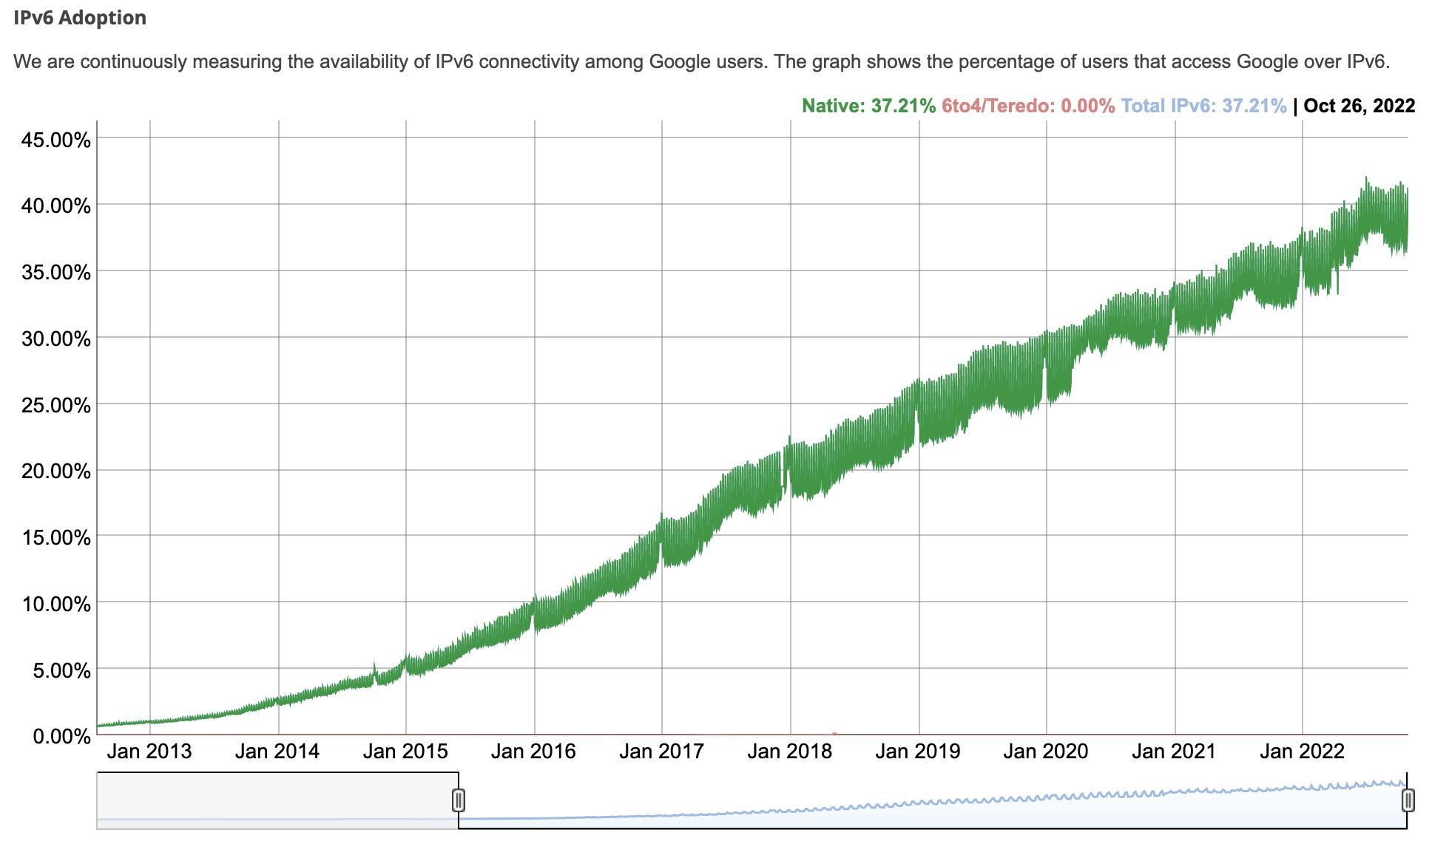
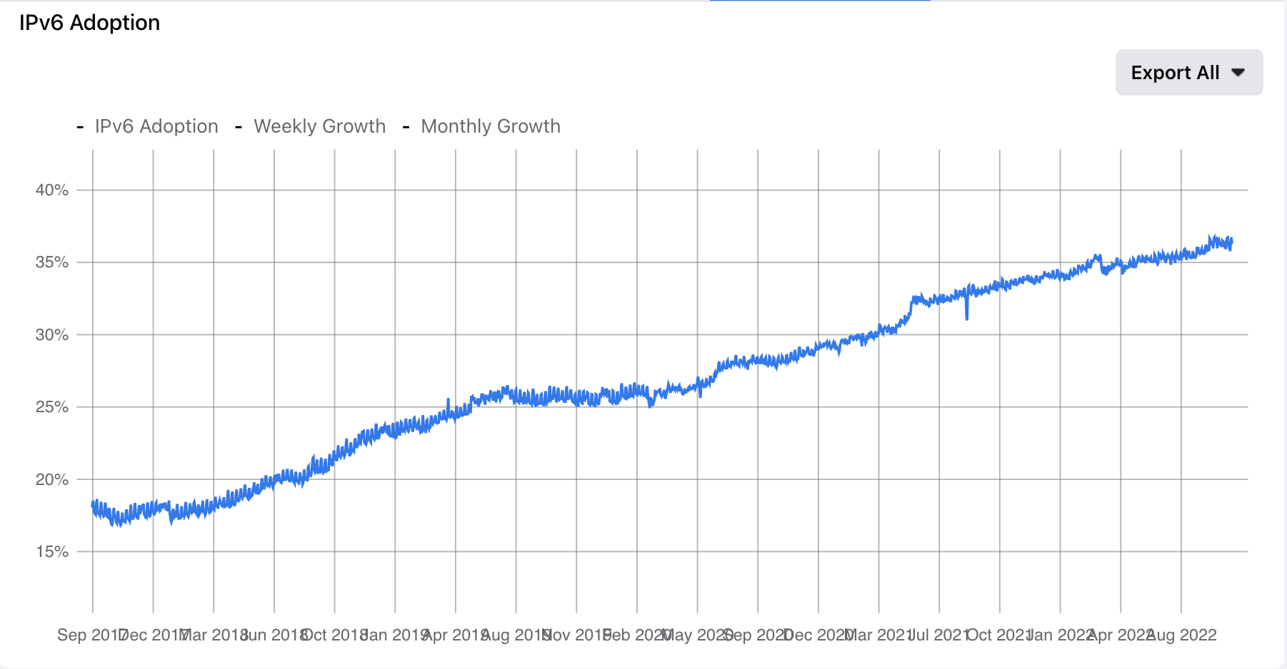
General IPv6 traffic continues to grow
(Google and Facebook)
Facebook
Google

Slide 5
Drivers for IPv6-only networking (2020-)
Still need to be ready for use of (opportunistic) IPv6-only CPU
BUT there are other drivers for IPv6-only:
  lack of public IPv4 addresses in Data Centres (avoid use of NAT)
    Use only IPv6 addresses for external public networking?
  multiONE (several LHCONE for different communities)
    multiple overlay networks
    sites likely have lack of sufficient IPv4 address space to configure these
  SCITAG – packet marking (in header of IPv6 packets) - RNTWG
  USA Federal Government – directive on IPv6-only

Slide 6
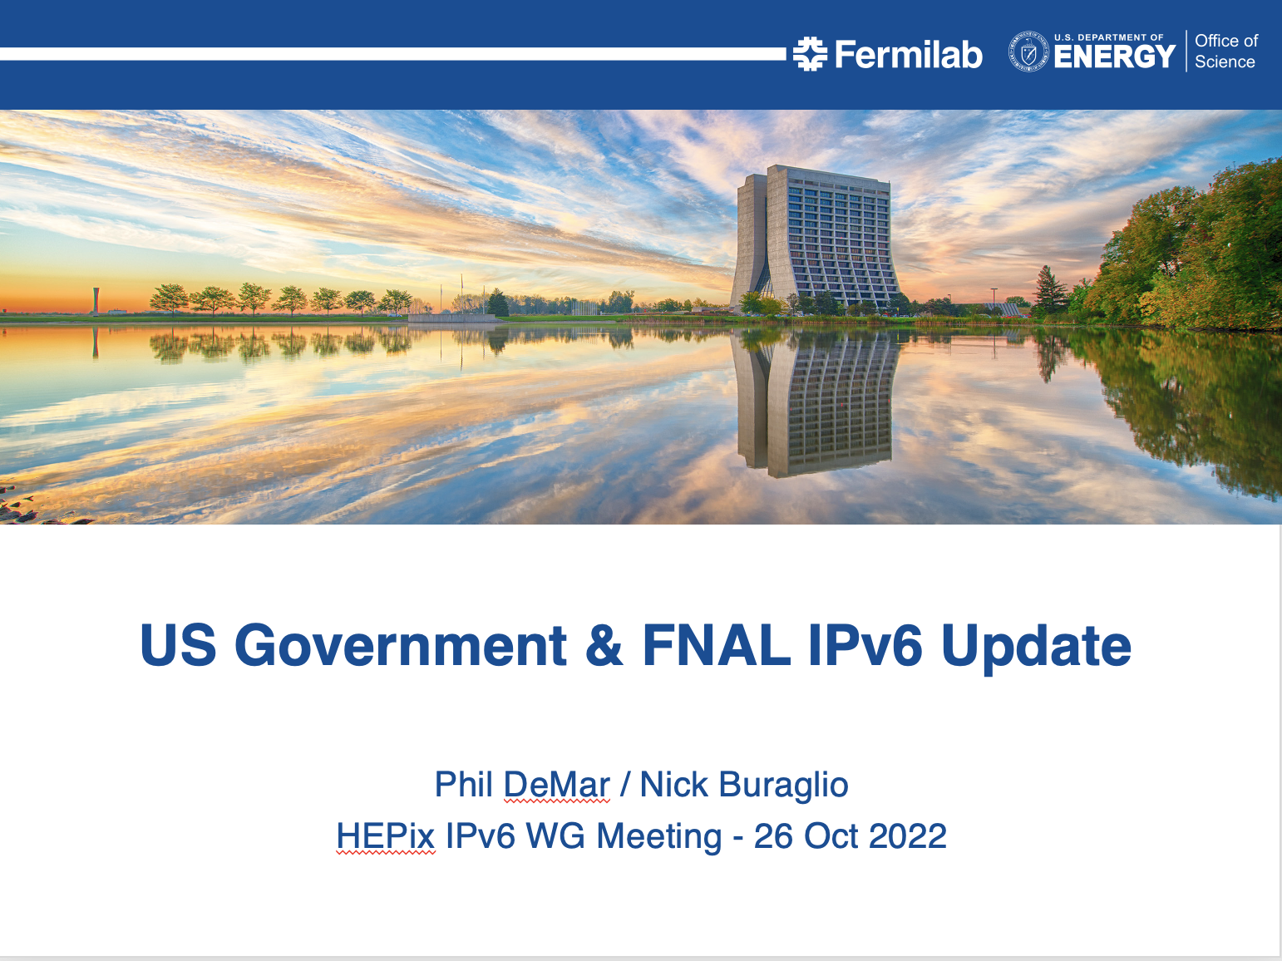

Slide 7
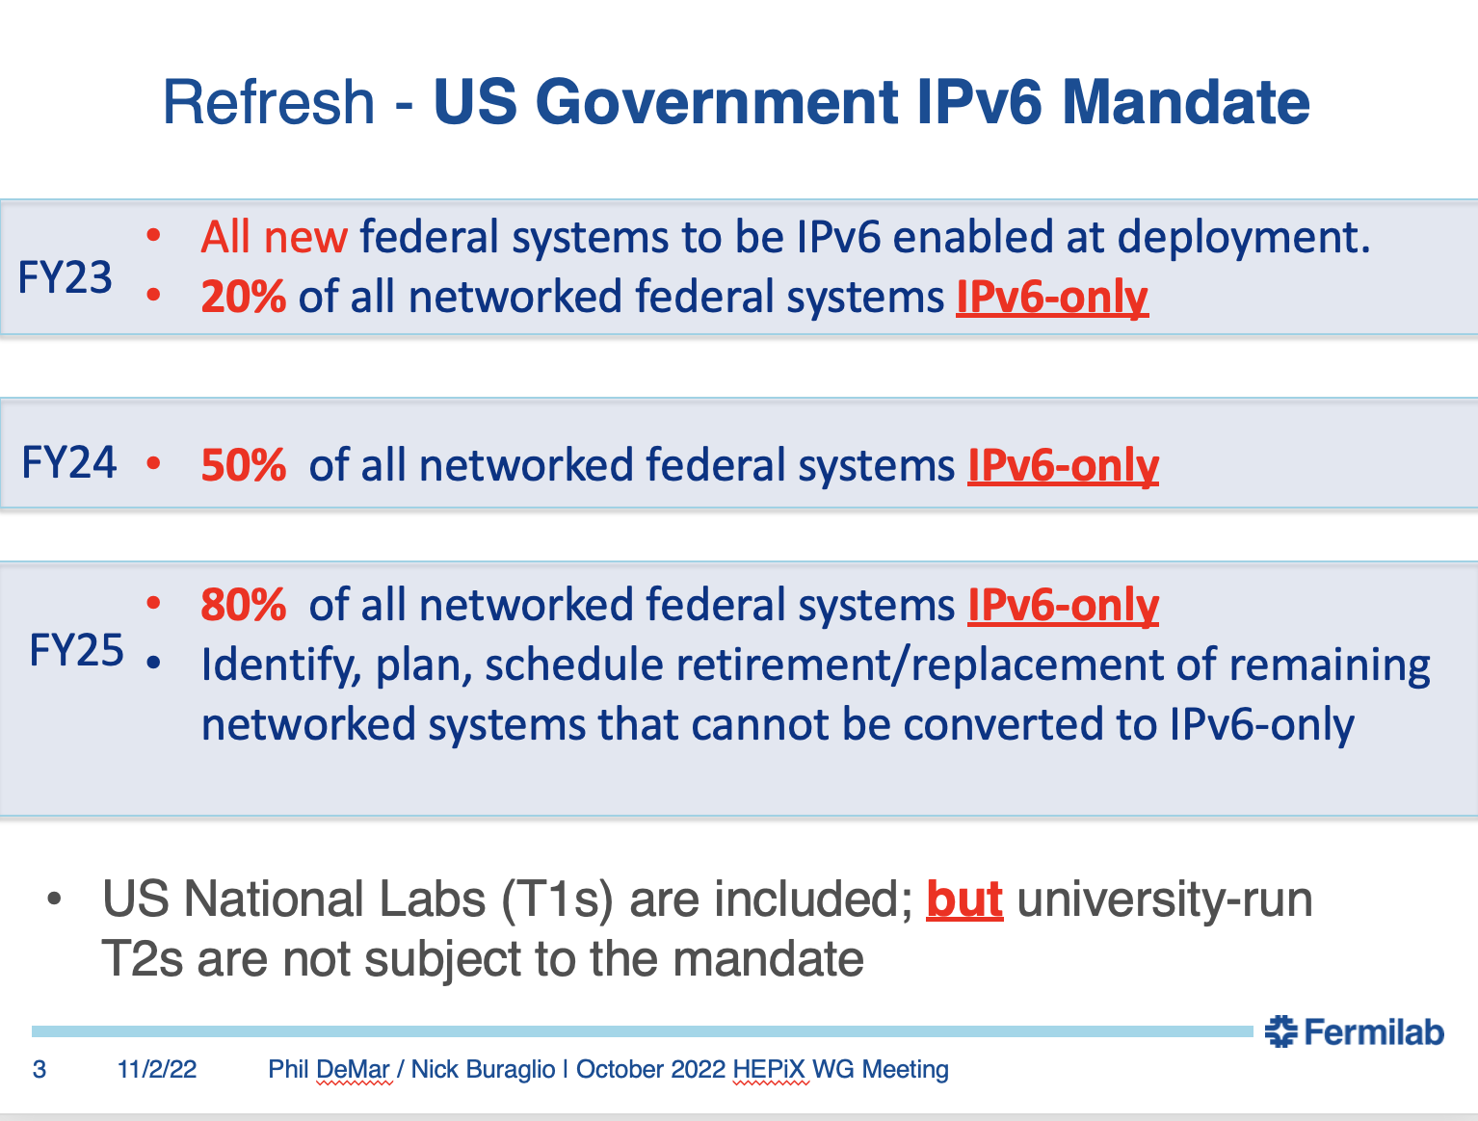

Slide 8
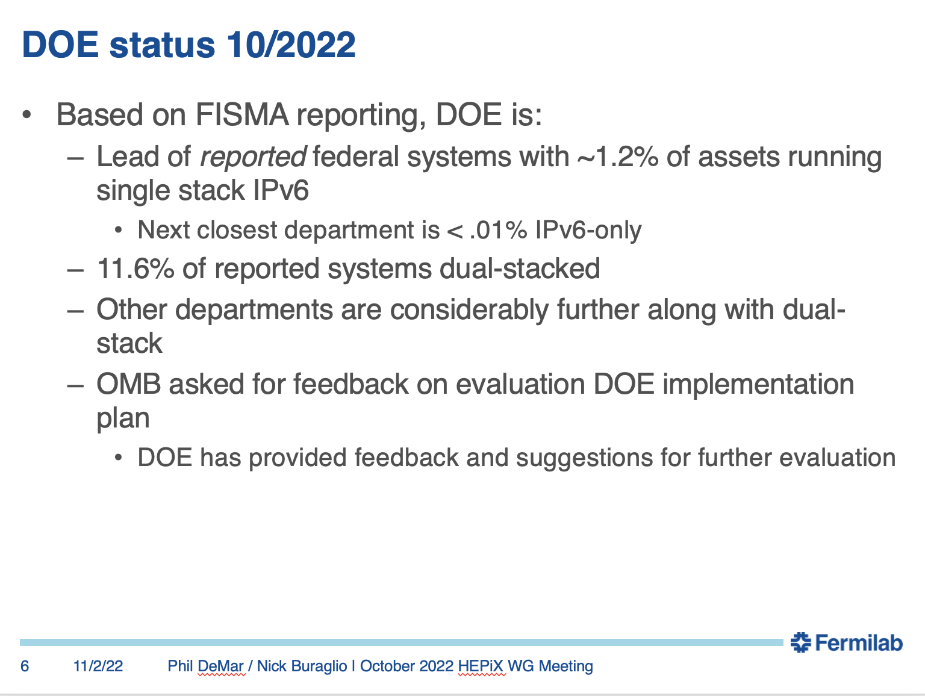

Slide 9
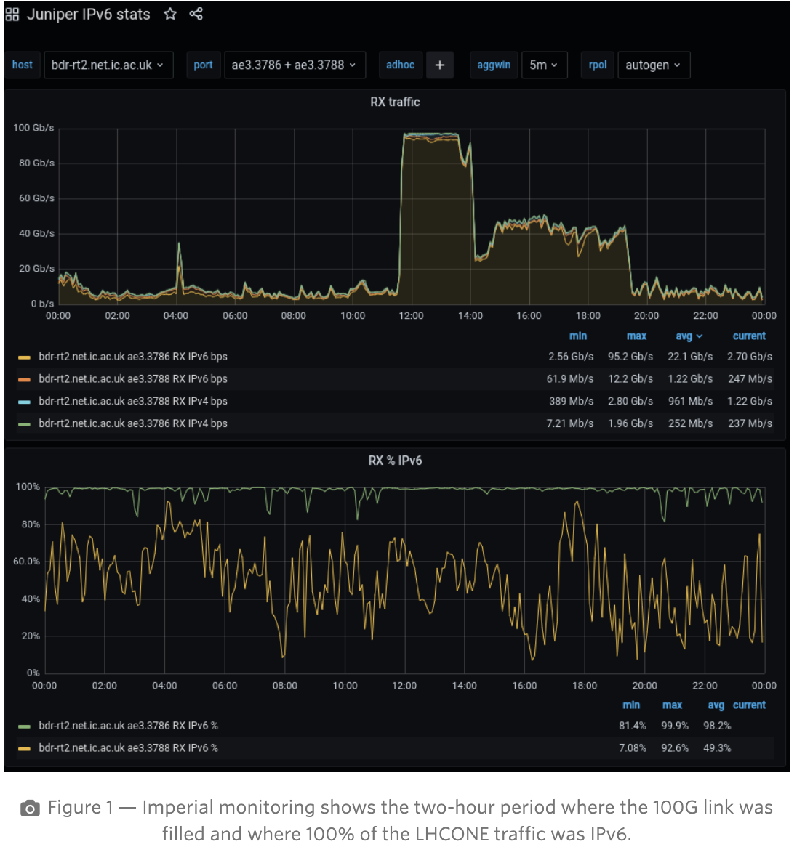
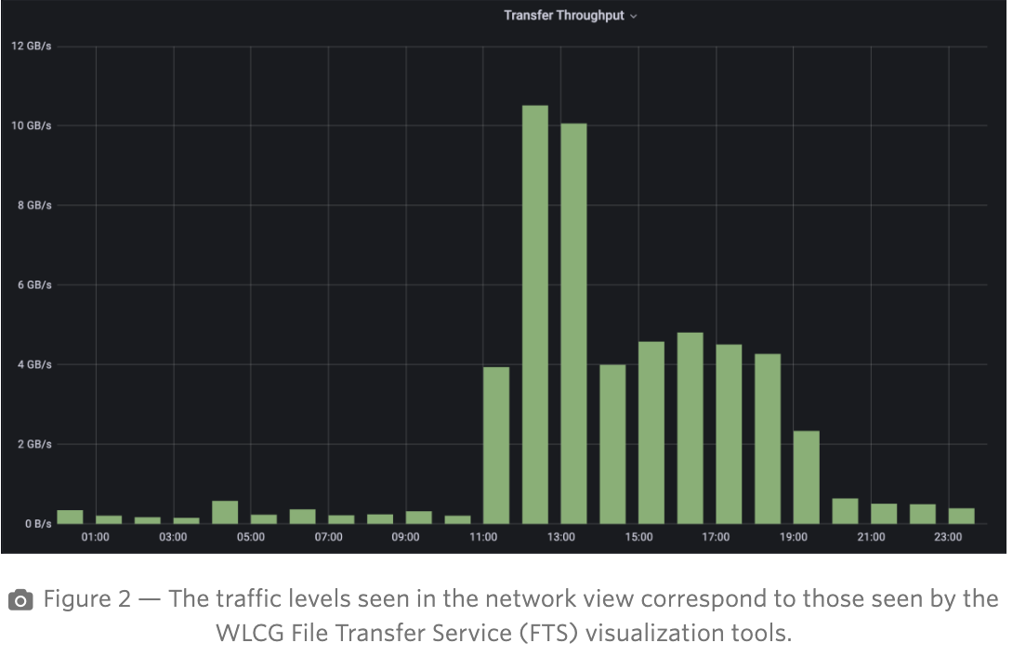
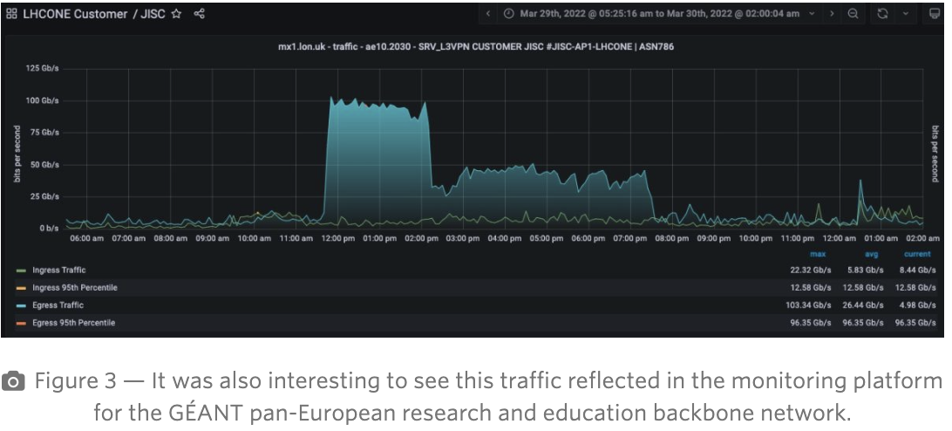
Imperial London - LHCONE - 100 Gbps on IPv6 https://shapingthefutureofjanet.jiscinvolve.org/wp/uncategorized/100gbps-of-cern-data-over-ipv6-on-the-janet-network/

Slide 10
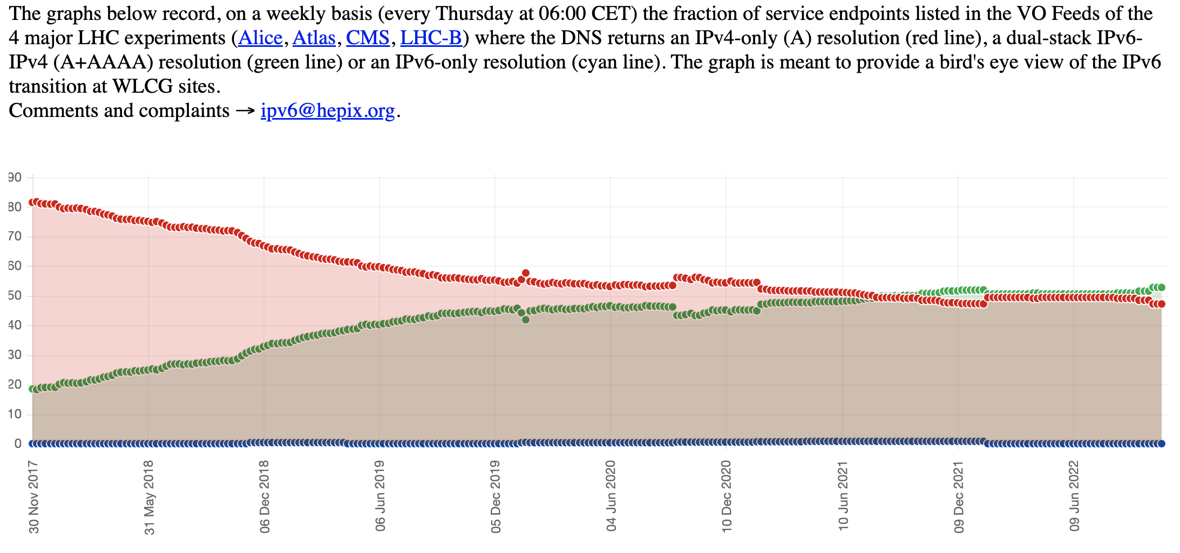
Dual-stack services in WLCG
(green line)
results from the LHC Experiment VO feeds (https://orsone.mi.infn.it/~prelz/ipv6_vofeed/) (~52%)

Slide 11
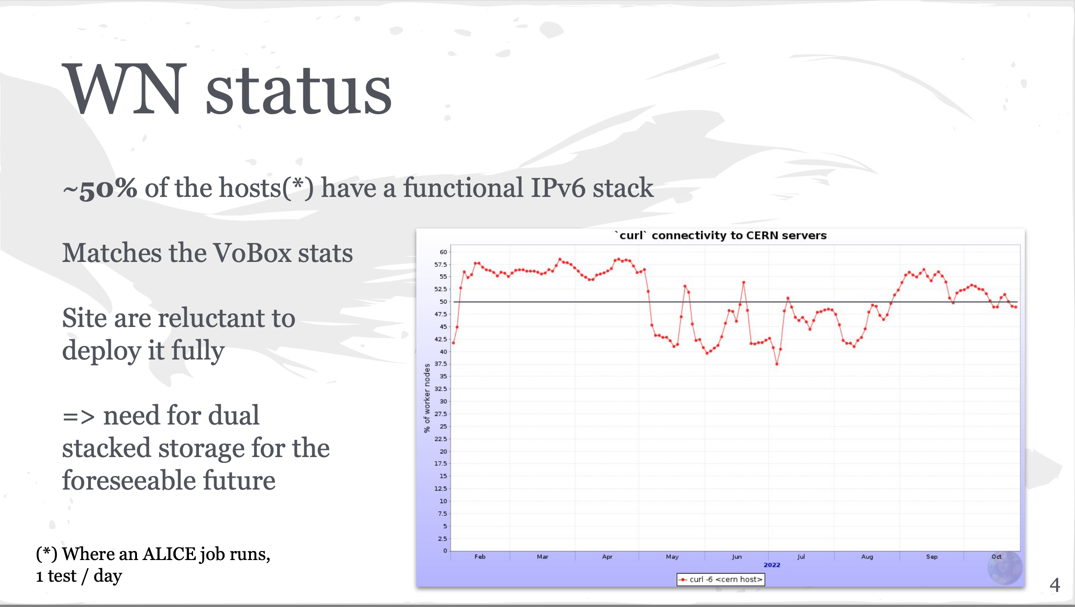
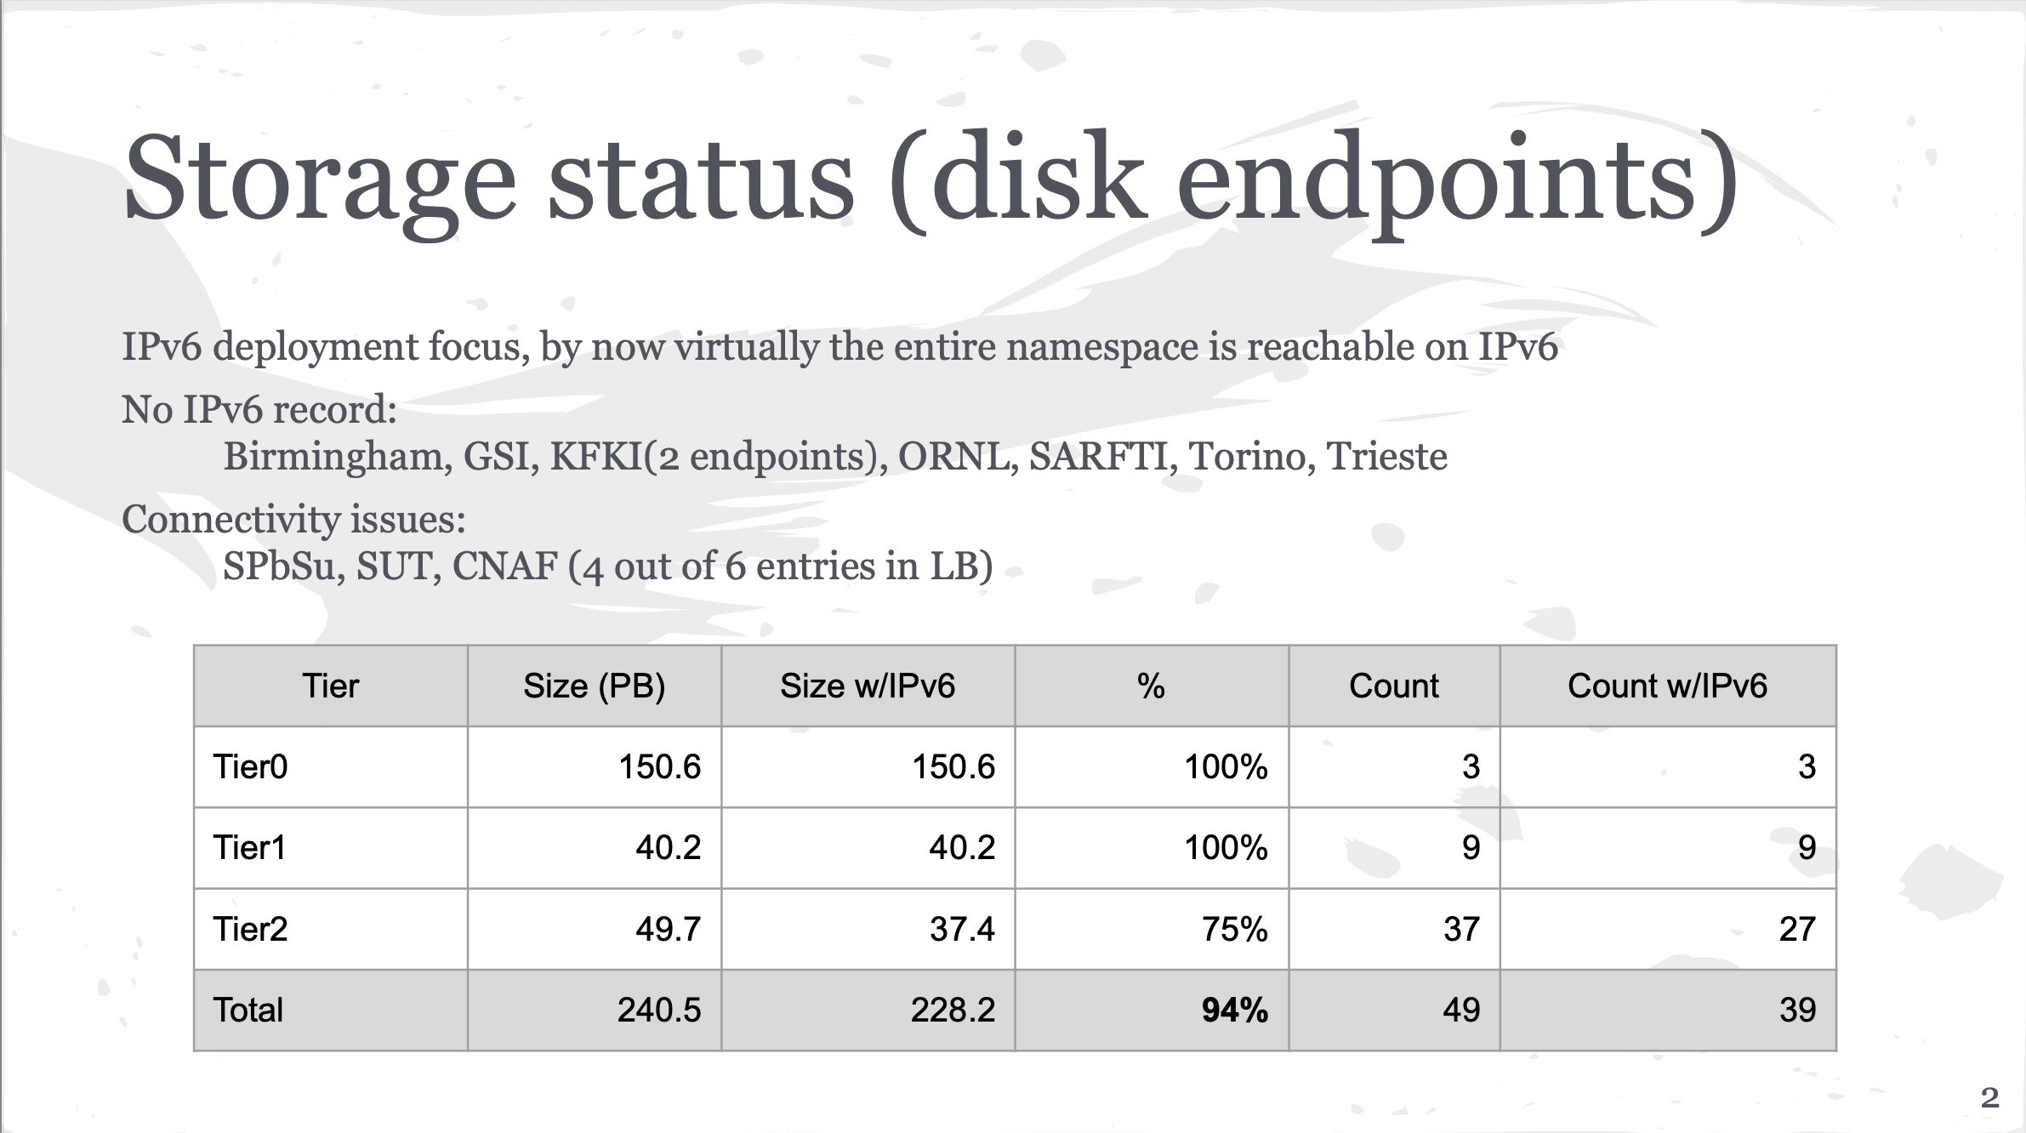
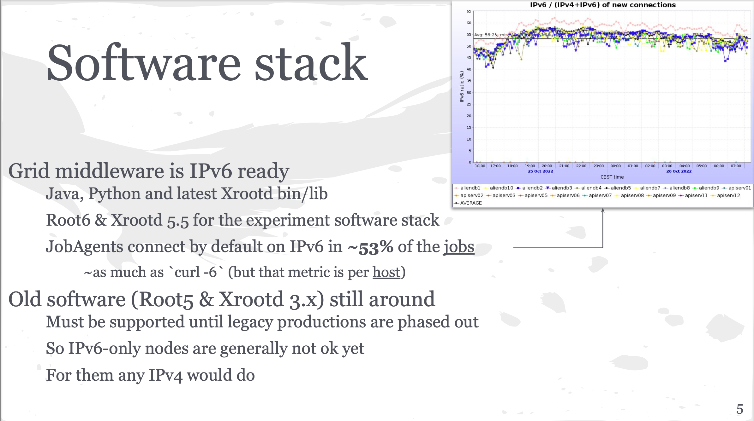
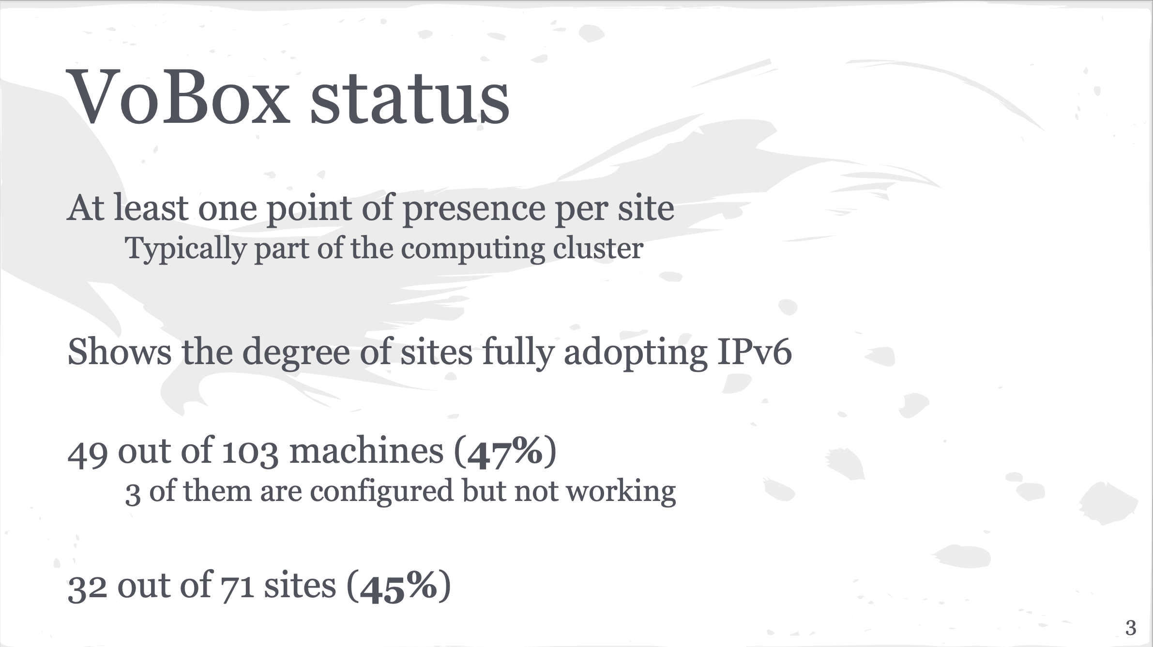
ALICE – Costin Grigoras

Slide 12
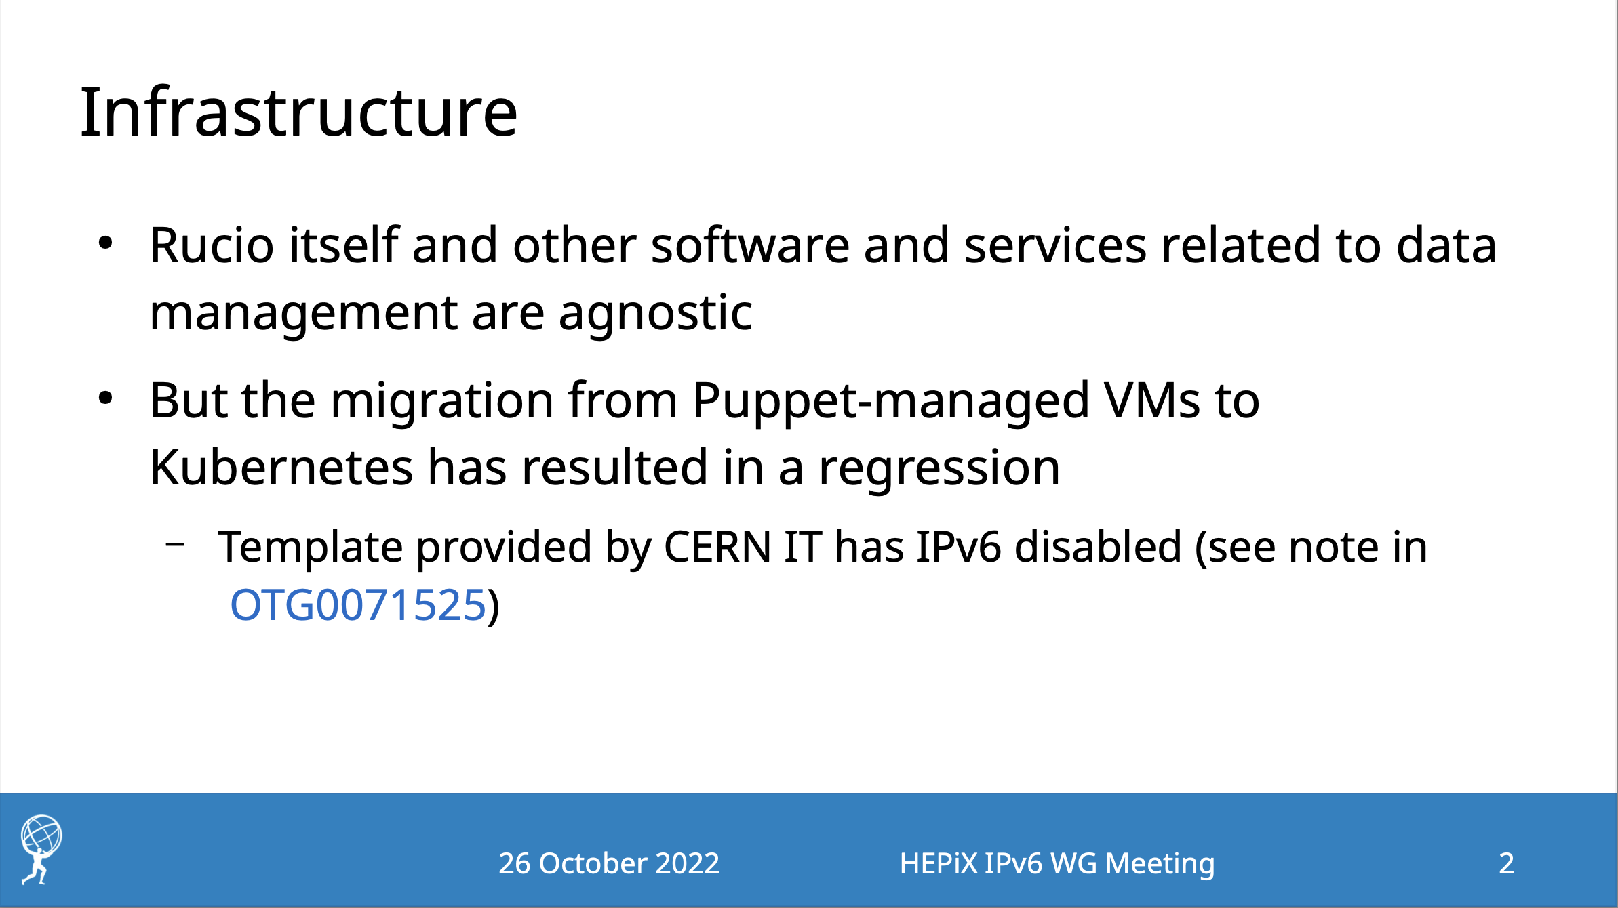
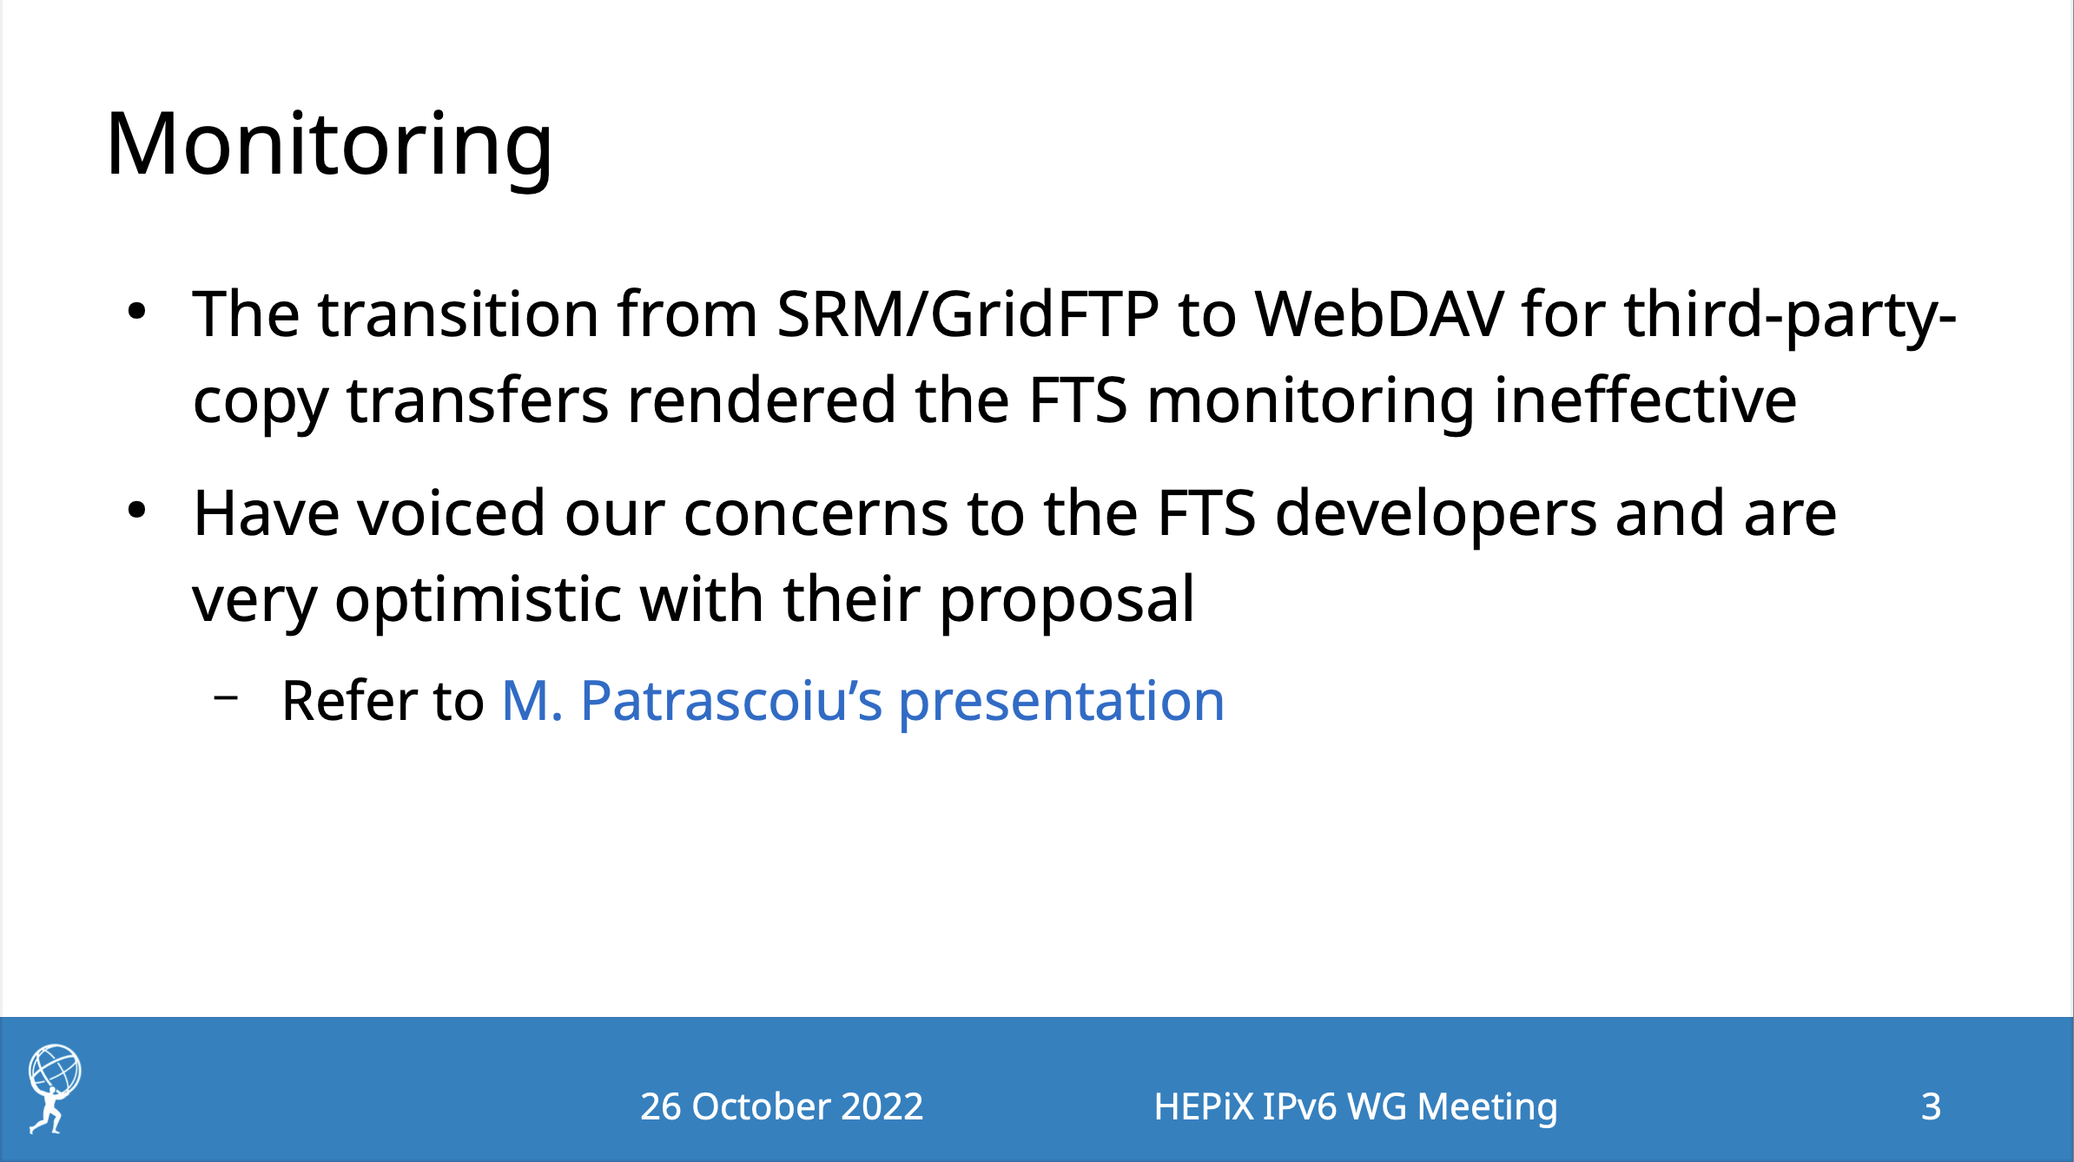
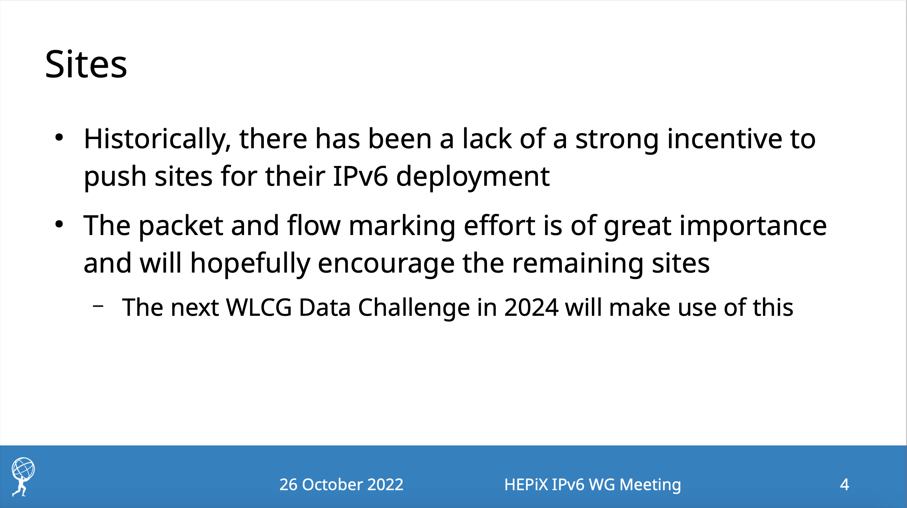
ATLAS – Dimitrios Christidis

Slide 13
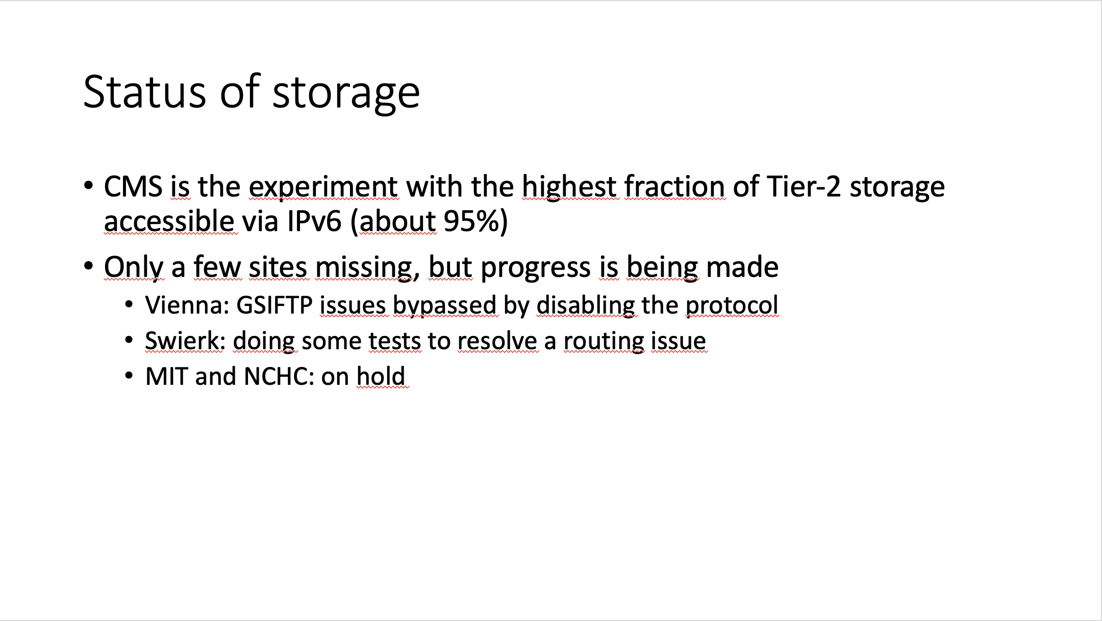
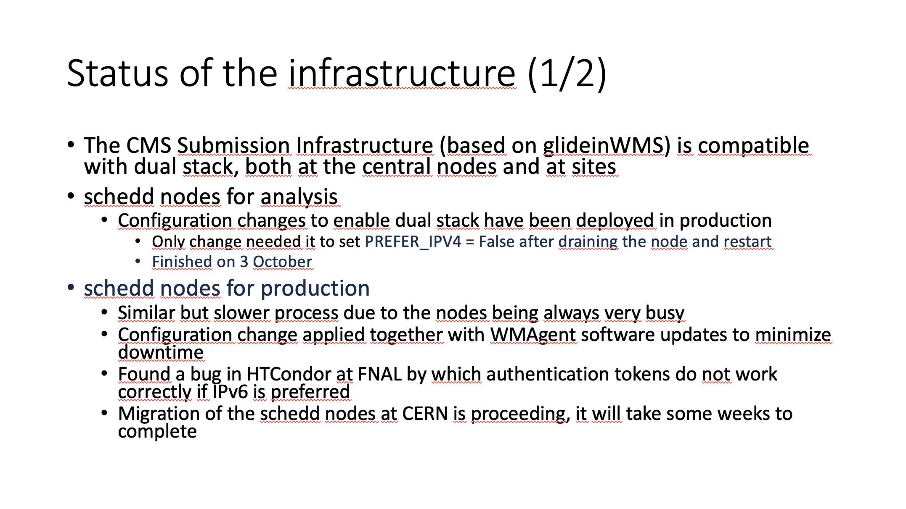
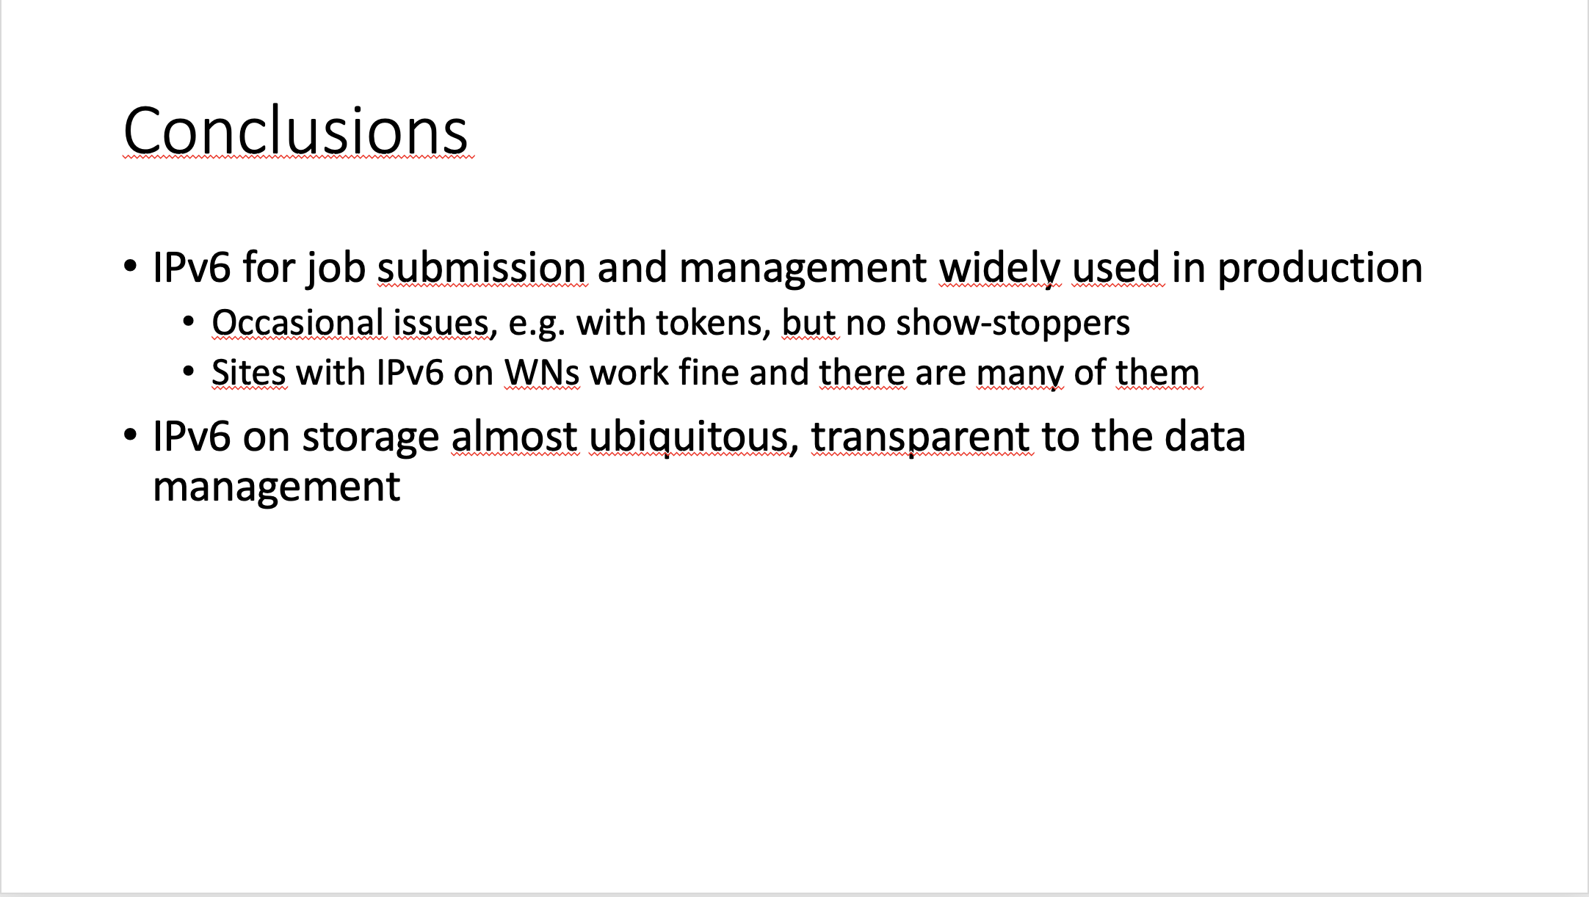
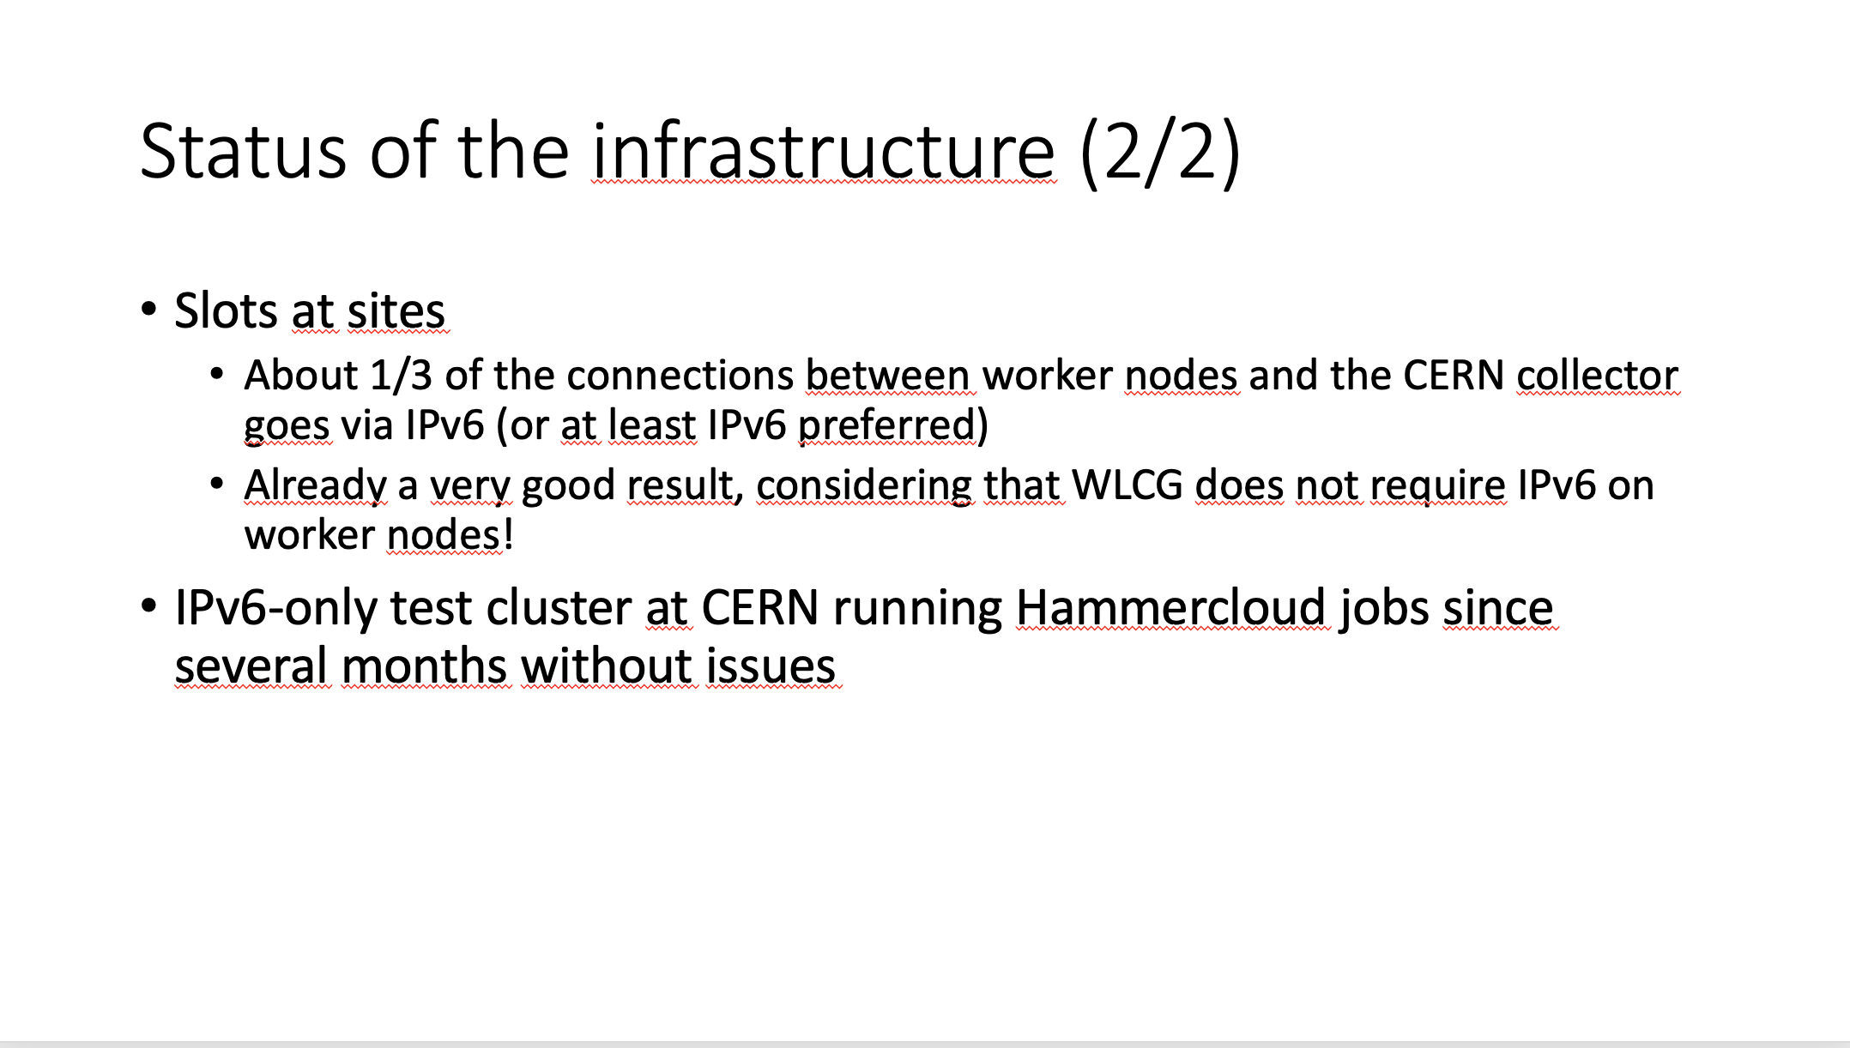
CMS – Andrea Sciaba

Slide 14
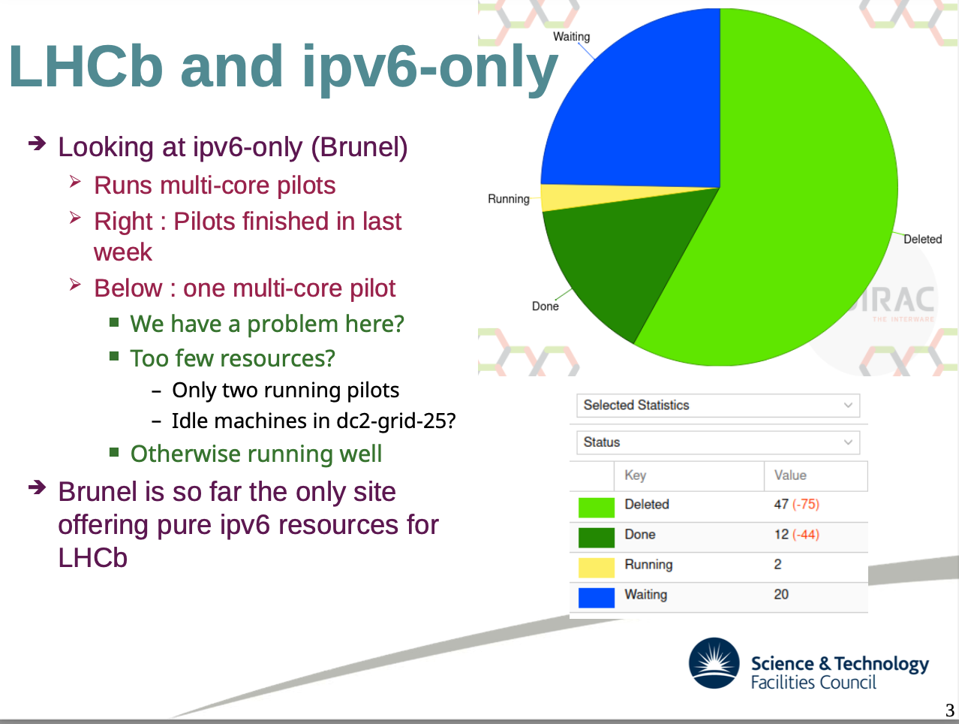
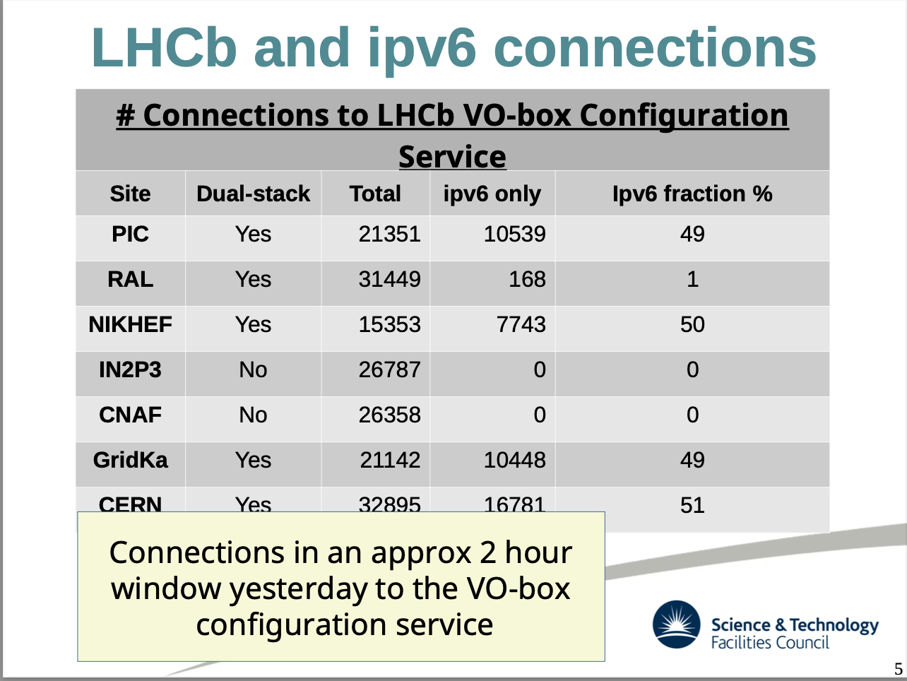
LHCb – Raja Nandakumar

Slide 15
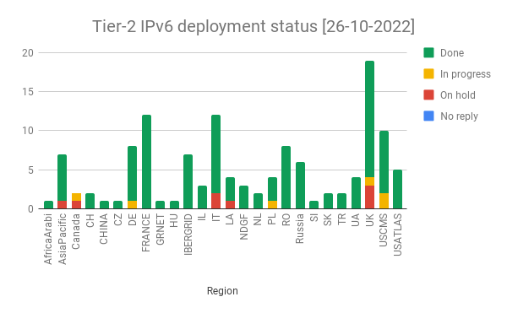
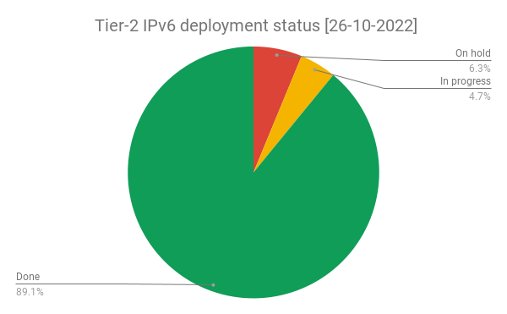
IPv4/IPv6 deployment at WLCG Tier-2 sites
The deployment campaign was launched in November 2017
Steady progress (status)
  ~89% of Tier-2s have dual stack storage
    91% of storage
Experiment | Fraction of T2 storage accessible via IPv6
ALICE | 89%
ATLAS | 89%
CMS | 94%
LHCb | 79%
Overall | 91%

Slide 16
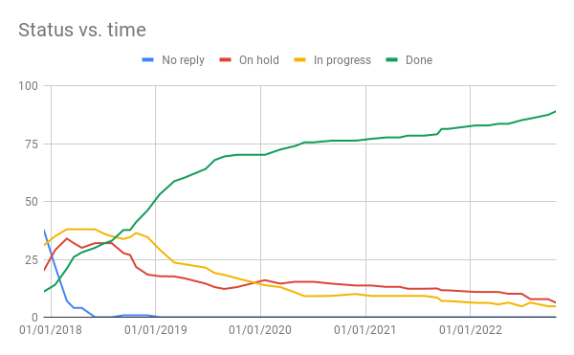
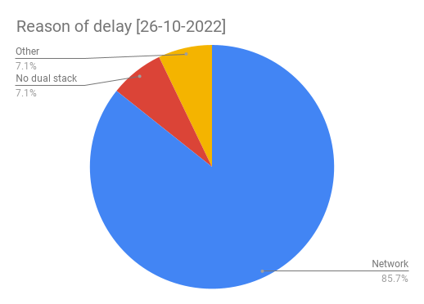
Tier-2 evolution of dual-stack

Slide 17
Monitoring

Slide 18
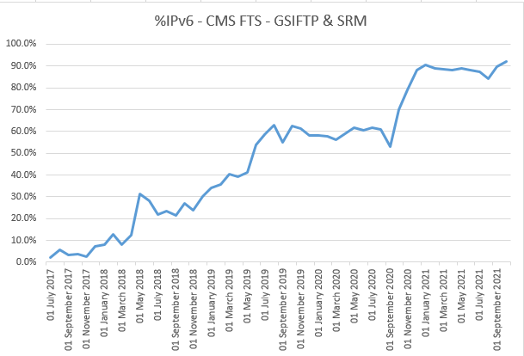
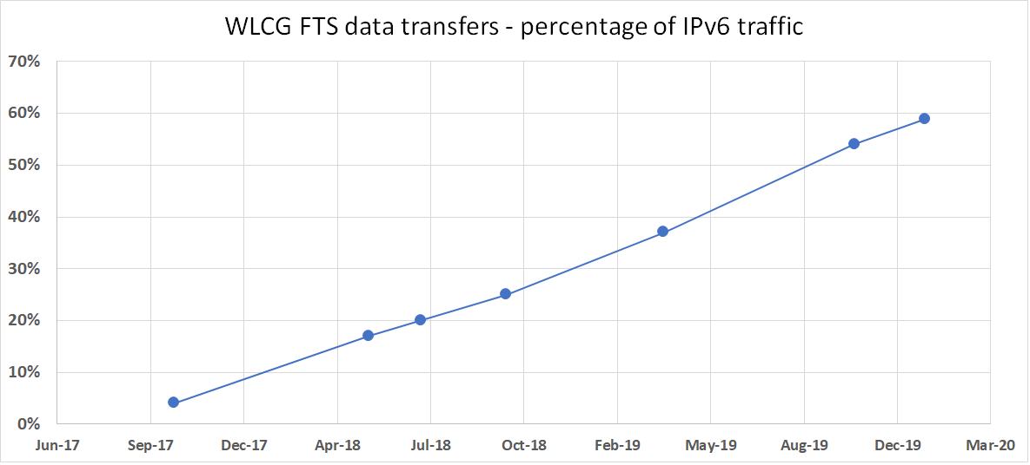
% of (srm & gsiftp) FTS traffic over IPv6 (OLD)
Some FTS protocols, e.g. DAVS still not able to monitor IPv6 traffic
these are excluded from this plot
    And explains end dates!
All protocols & all experiments

Slide 19
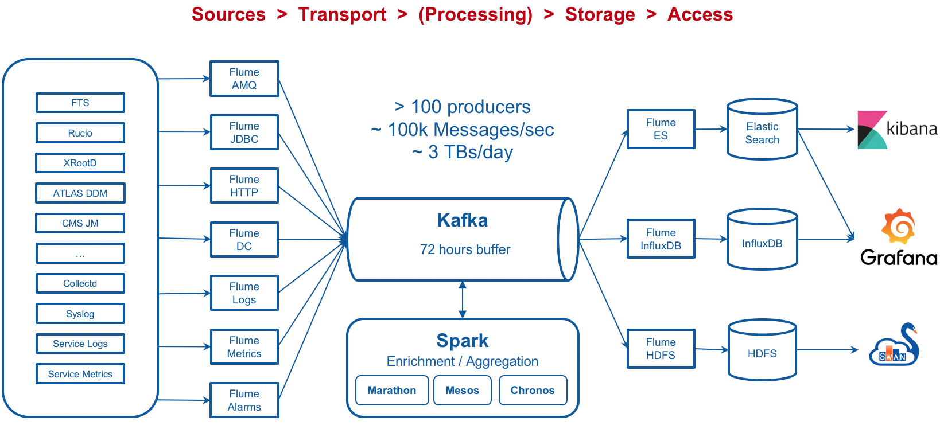
MONIT Architecture (Nikolay Tsvetkov CERN)

Slide 20
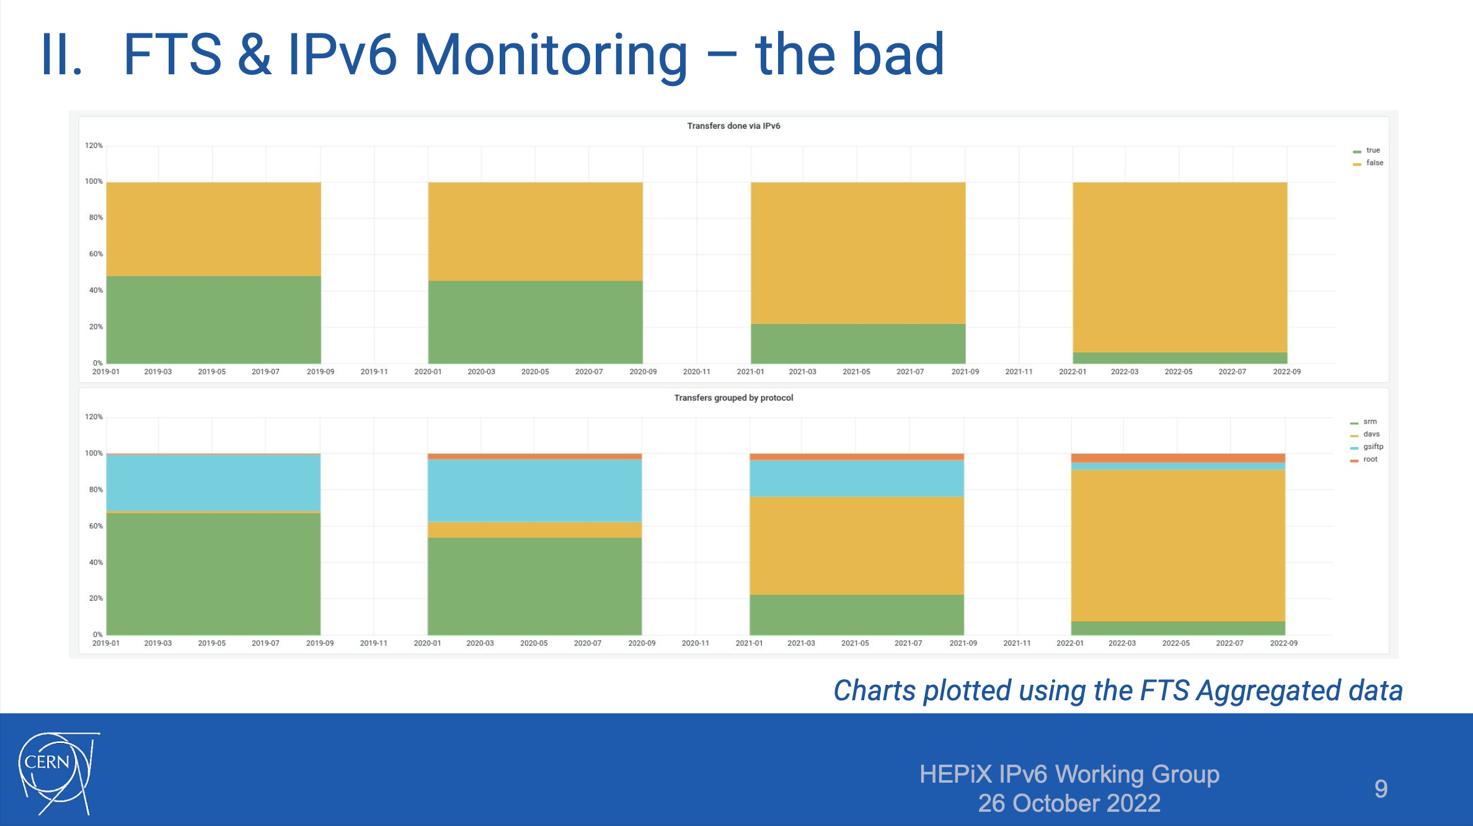
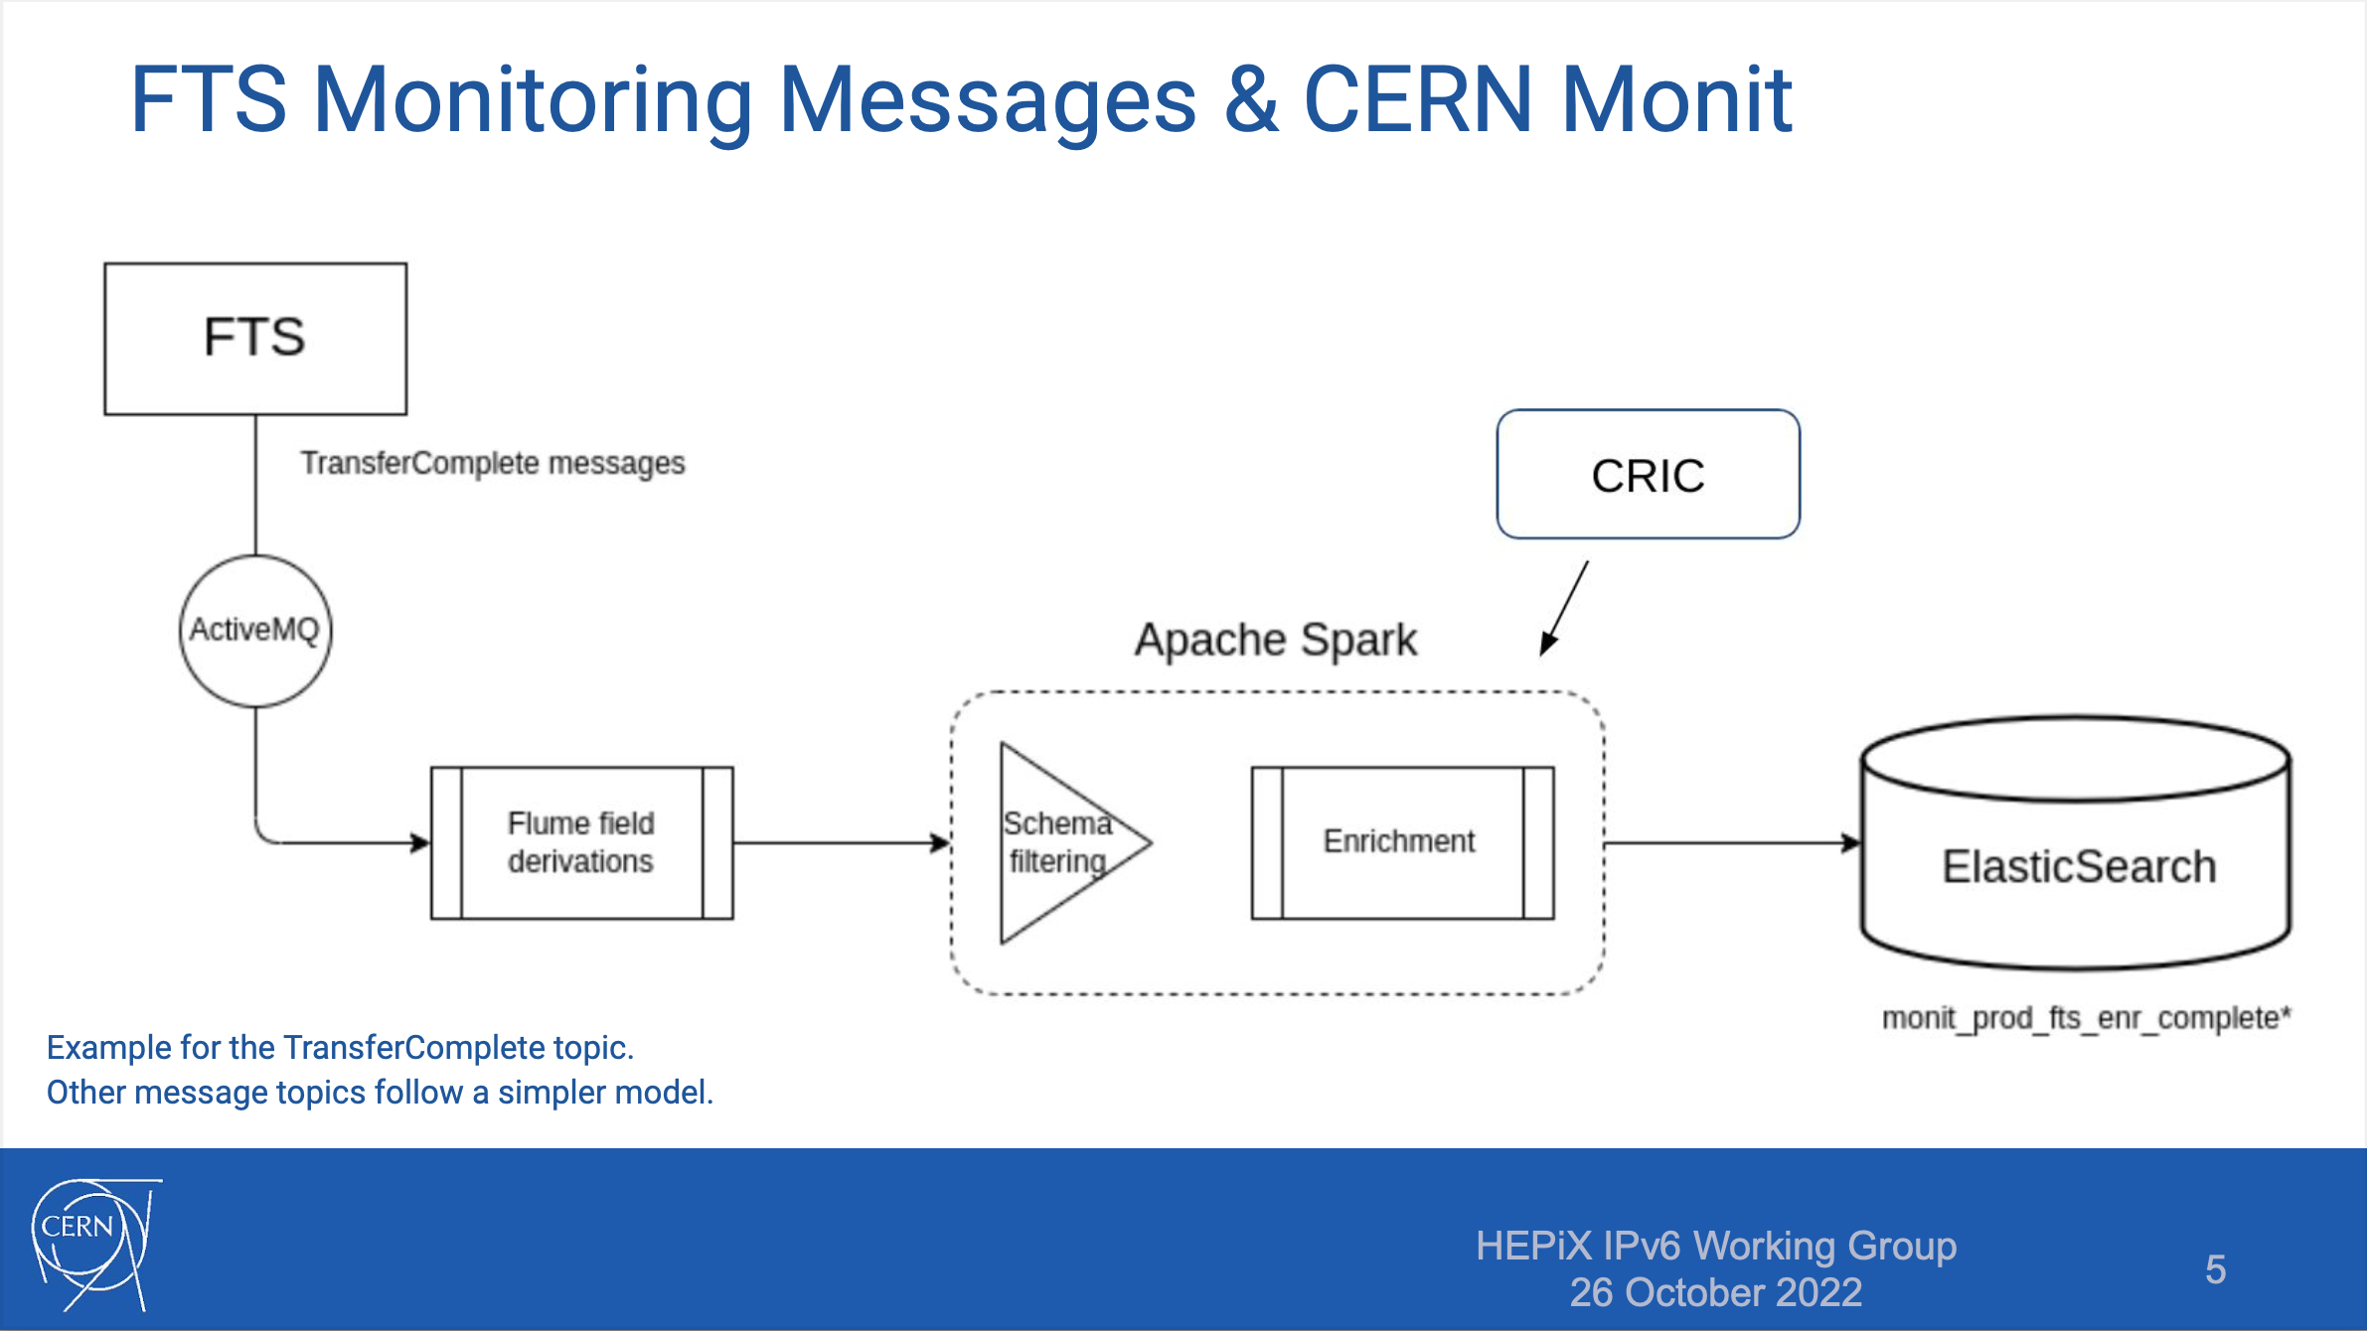
FTS & IPv6 (Mihai Patrascoiu CERN)
2019
2020
2021
2022
IPv4
IPv6
GSIFTP
DAVS
SRM

Slide 21
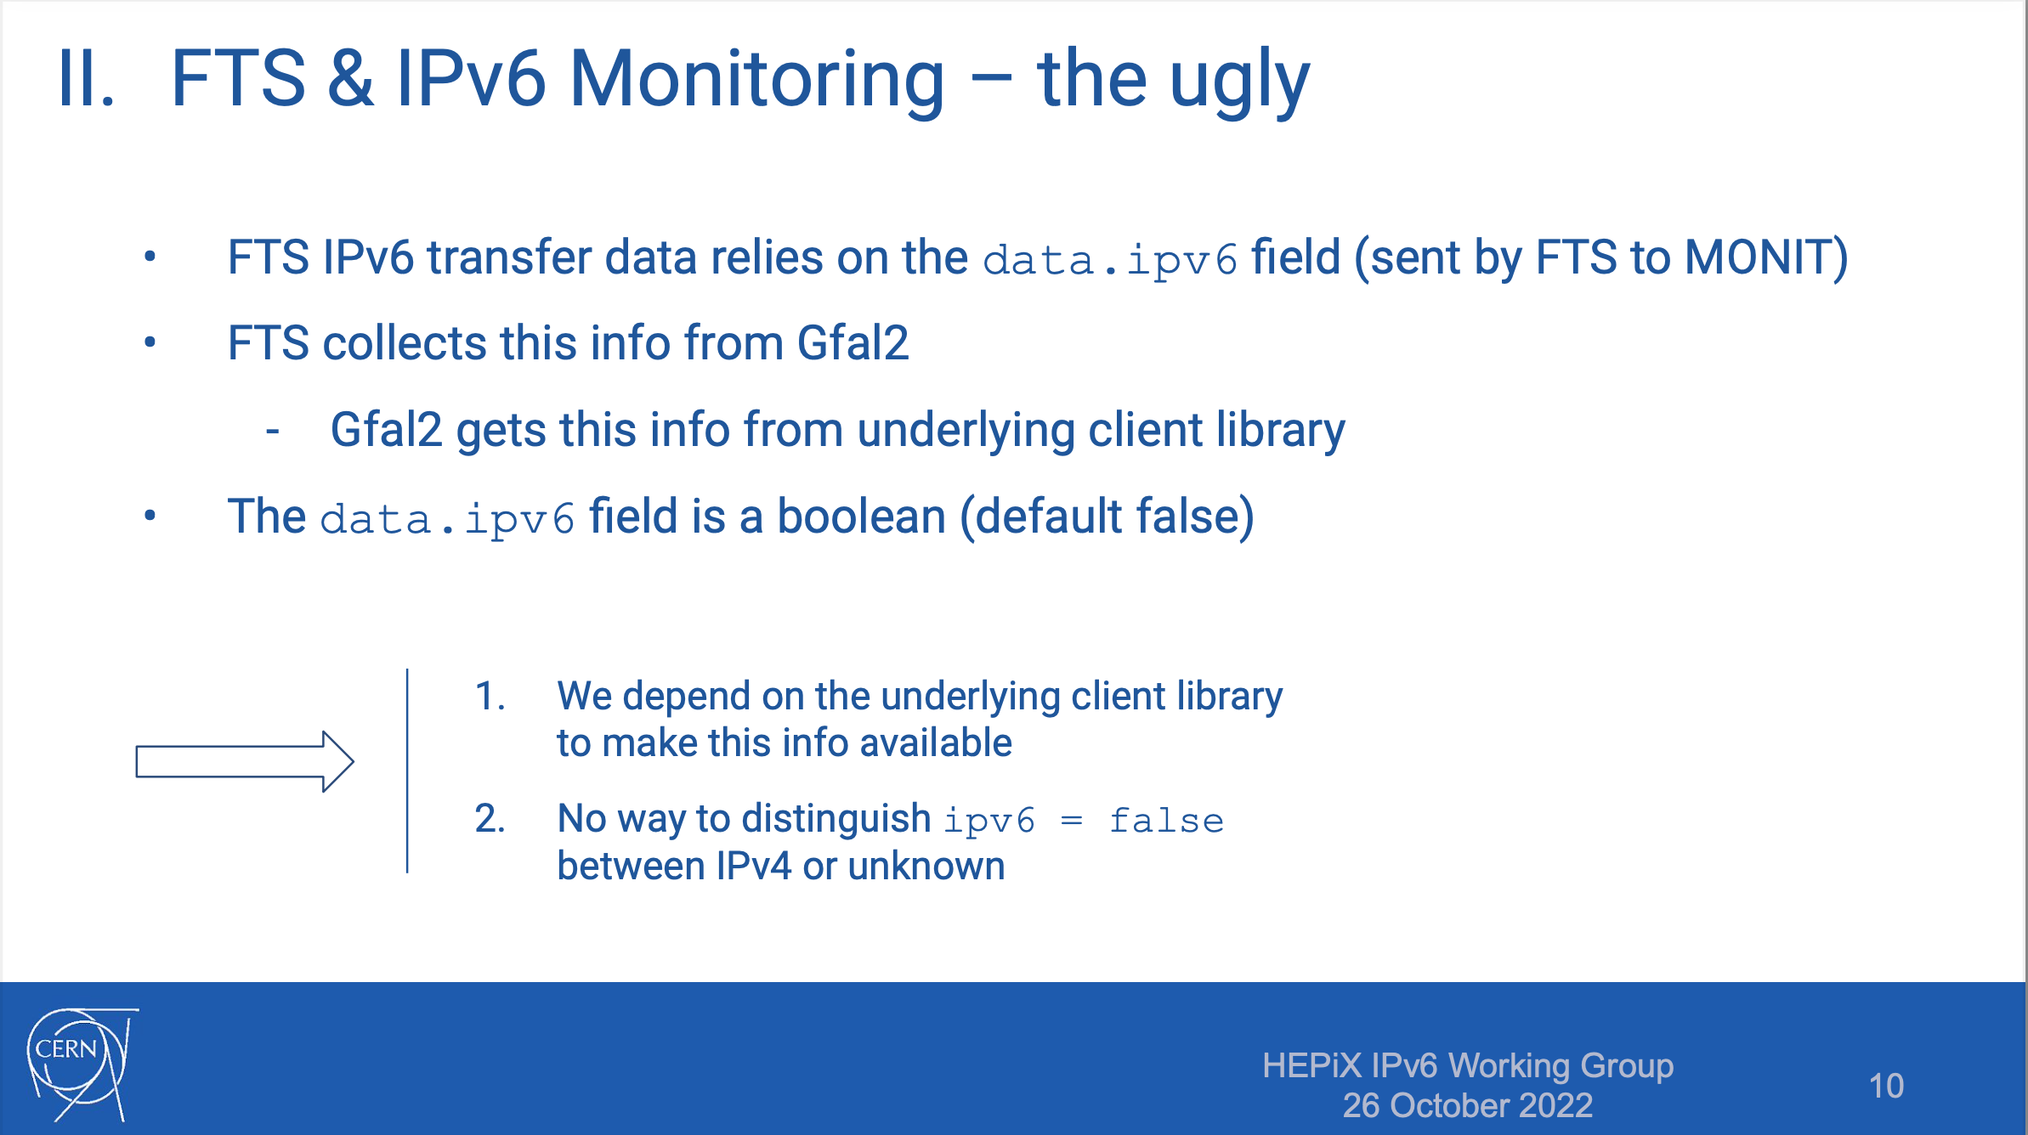
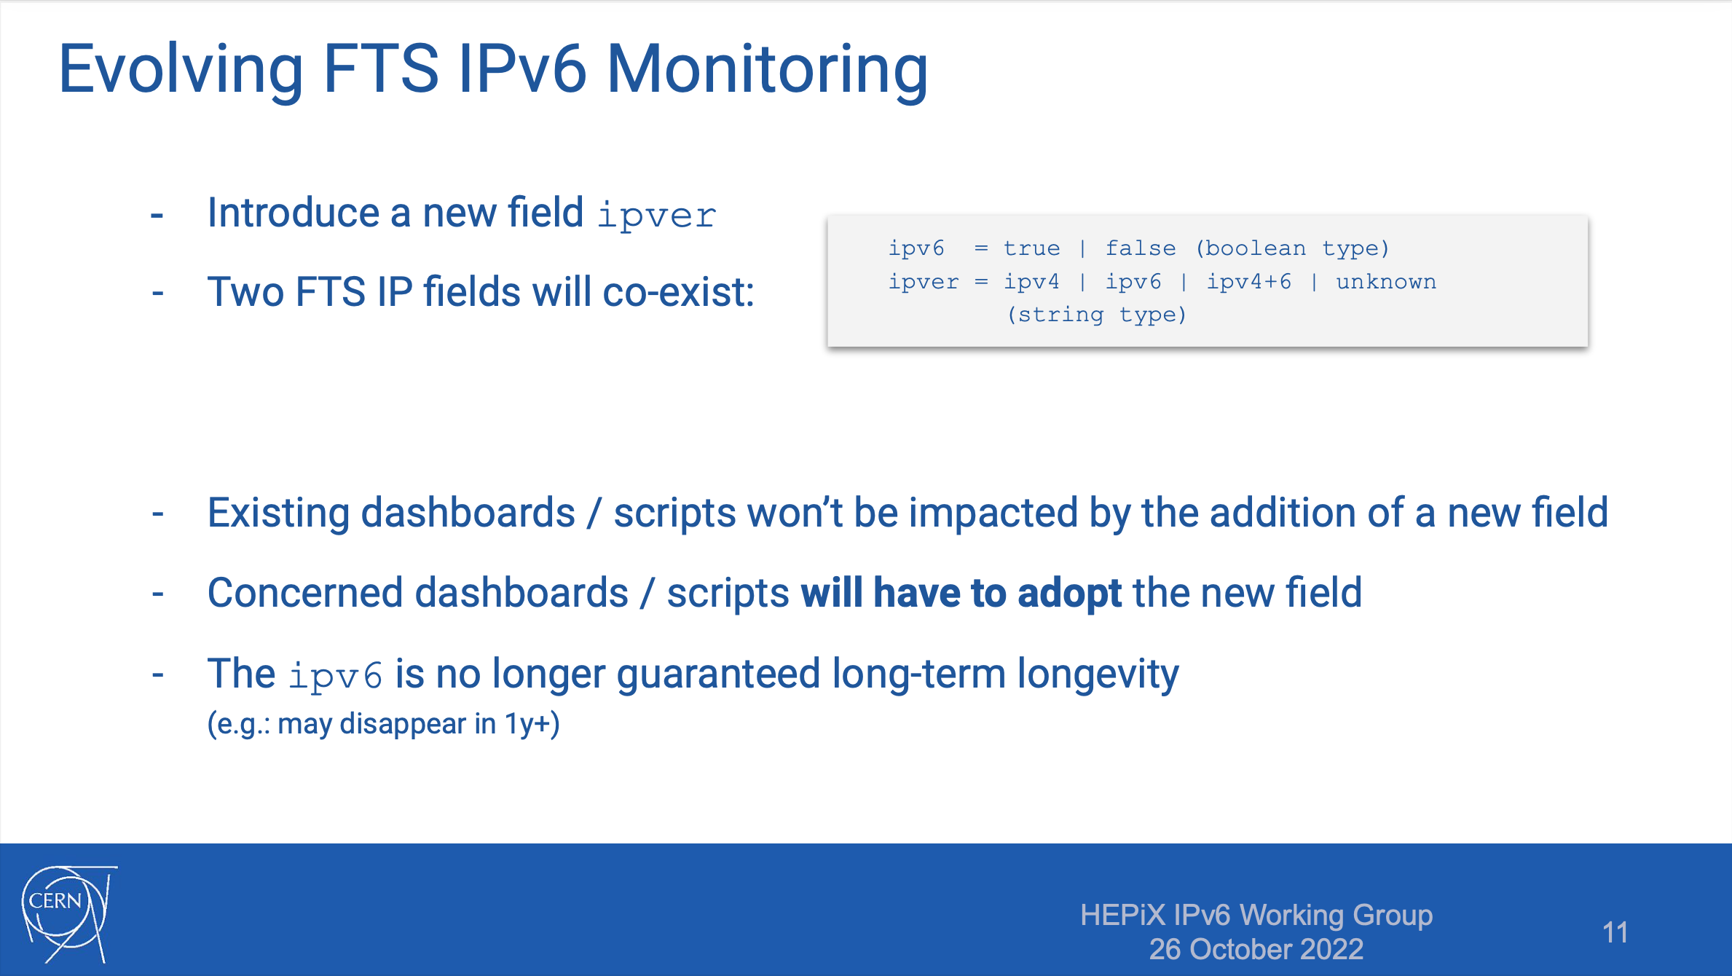
FTS & IPv6 (Mihai Patrascoiu)

Slide 22
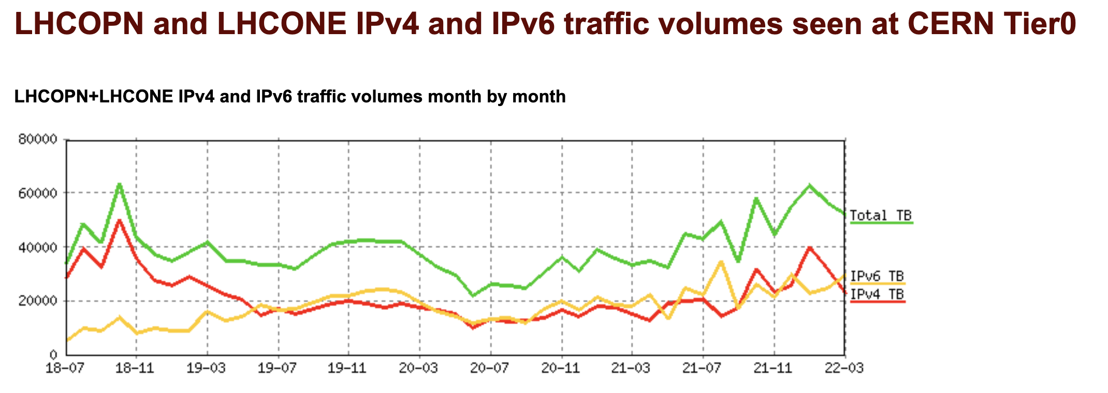
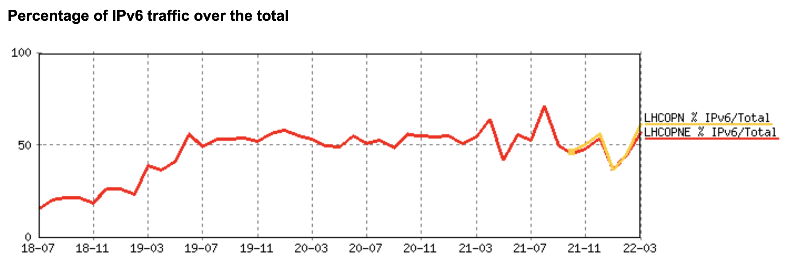
IPv6 traffic on LHCOPN/LHCONE at CERN
LINK to these plots
IPv6 traffic on LHCOPN/ONE as seen at CERN
~40-70% of all traffic is IPv6
from June 2019 onwards
Problems with data from April 2022 – awaiting fix from vendor

Slide 23
Why do we still see IPv4 traffic?

Slide 24
Why: IPv4 transfers on LHCOPN?
Tier1s are dual-stack, but IPv4 often still used for transfers
  Site/experiment issues - some storage end-points not yet dual-stack
    Old software stacks (legacy deployments) are still deployed
  both ends are dual-stack but configuration or request prefers IPv4
  transfers are to/from WN's and the WNs are still IPv4-only
    Difficult to monitor WN IPv6 traffic centrally – can sites monitor?
IPv6 WG has been analyzing Tier-1 top-talkers over IPv4
  We should aim to understand behaviour of each Tier-1
CERN Fellow (Carmen) to perform this analysis
encourage all sites to deploy all WNs as dual-stack
encourage all sites and all experiments to "prefer" IPv6 transfers

Slide 25
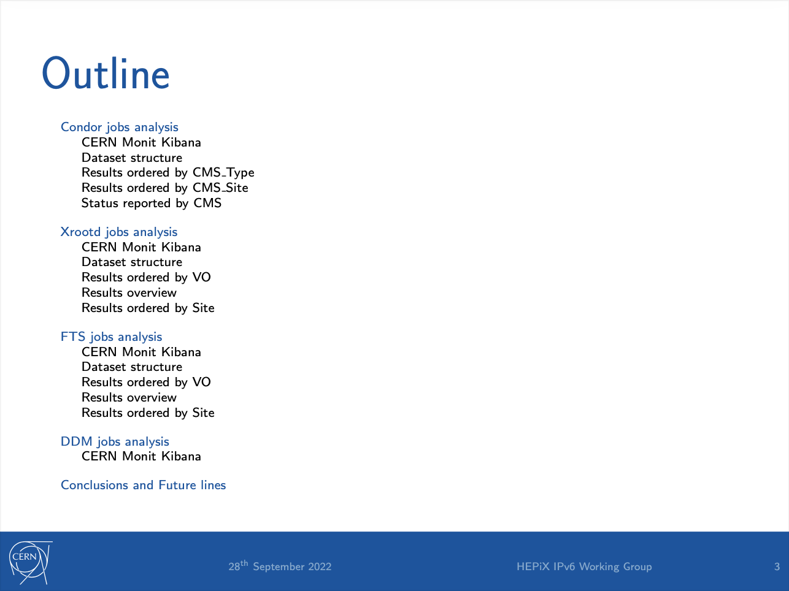
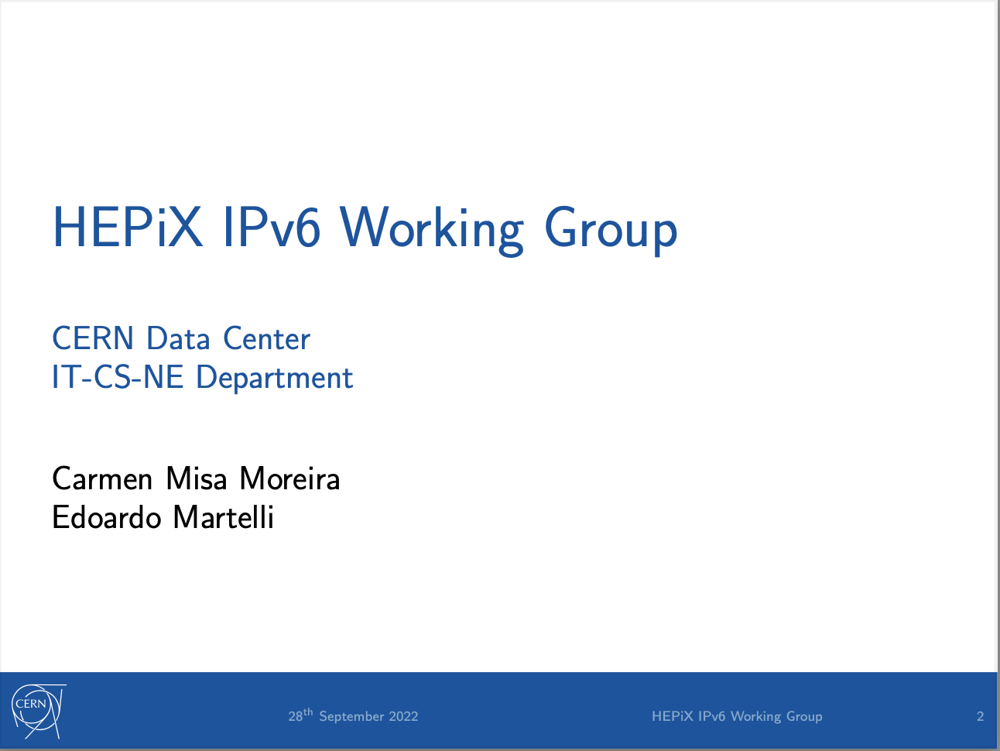
Discovery and analysis of ongoing use of IPv4
(Carmen Misa Moreira)

Slide 26
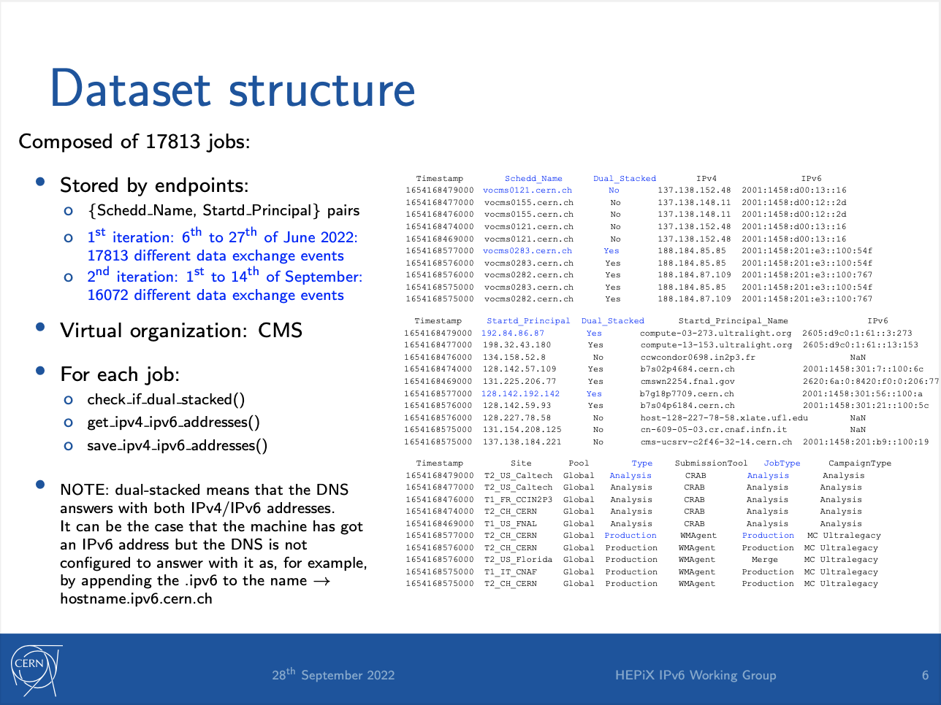

Slide 27
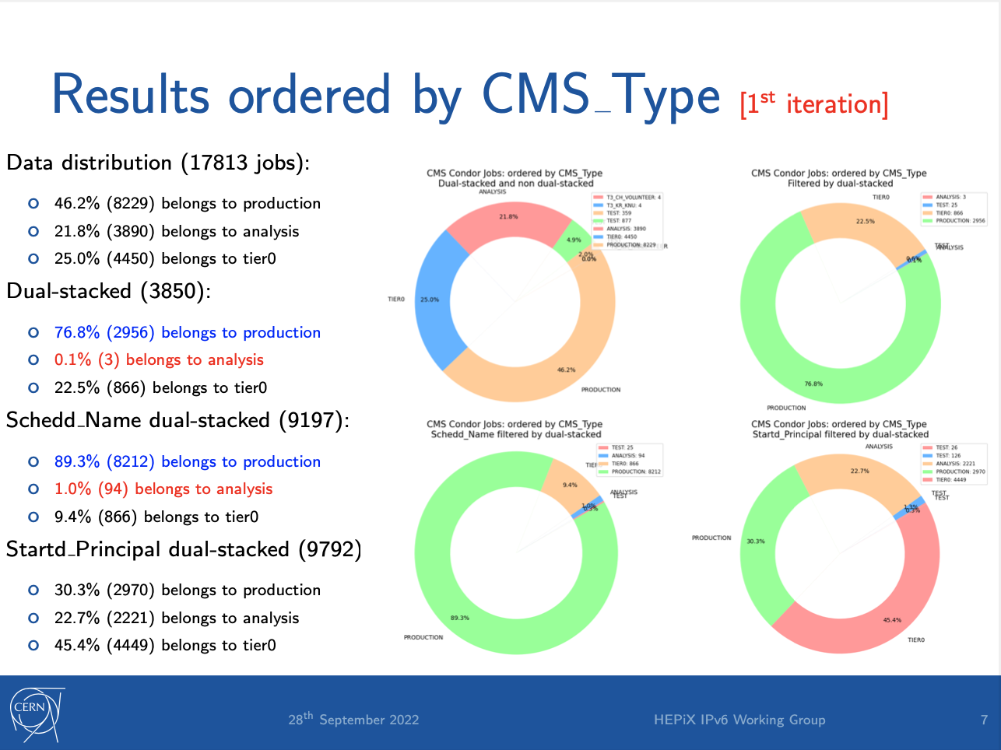

Slide 28
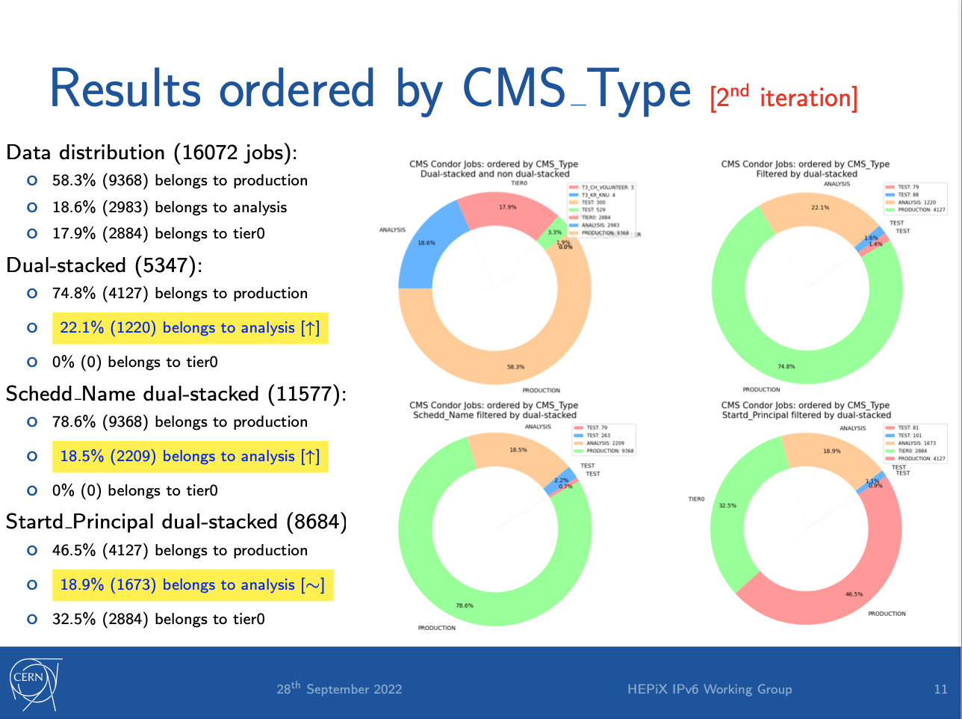

Slide 29
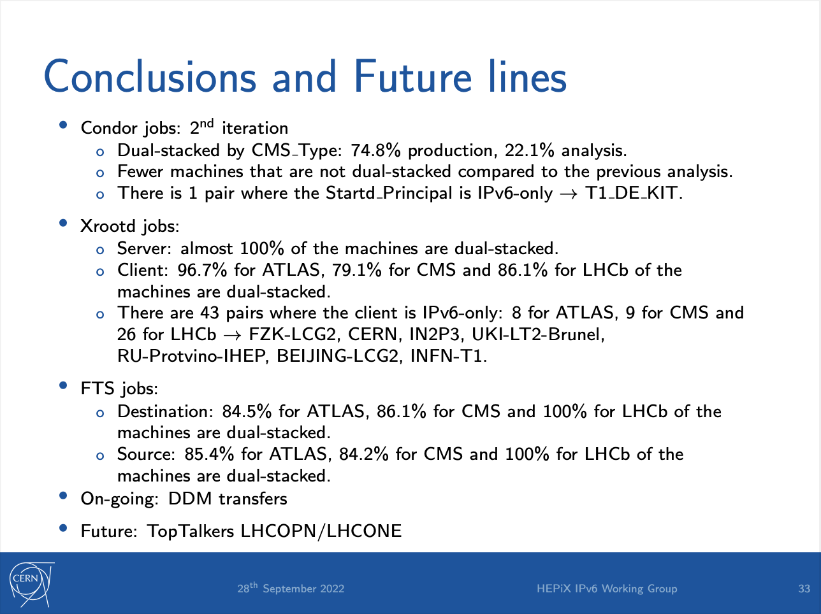

Slide 30
IPv6-only

Slide 31
WLCG - from dual-stack to IPv6-only
(CHEP2019) https://doi.org/10.1051/epjconf/202024507045
Planning for an IPv6-only WLCG
To simplify operations
  Dual-stack infrastructure is the most complex
  Dual-stack is less secure
Large infrastructures (e.g. Facebook) use IPv6-only internally
The plan - the goal we are working towards
  IPv6-only for the majority of WLCG services and clients
  With ongoing support for IPv4-only clients where needed
Timetable to be defined

Slide 32
Messages to WLCG sites
WLCG MB statements (July 2021)
Deployment of dual stack storage remains the priority
  this is a prerequisite to fully supporting IPv6-only WNs
All sites and regions should plan accordingly and as soon as possible
The final goal is IPv6-only (timetable to be agreed later)
Encouragement: IPv6 WG to all sites and experiments
deploy all WN, VM, containers, local services as dual-stack
Configure to enable and "prefer" IPv6 transfers

Slide 33
Summary
WLCG is ready to support use of IPv6-only clients
Tier-1s all have production storage accessible over IPv6
Tier-2s ~90% sites are done
Monitoring data transfers and configuration is essential
Why do two dual-stack endpoints use IPv4 between them?
  A priority for 2022
Phase 3 – we are planning for move to IPv6-only services
  Dual-stack is NOT the desired end-point!
message to new research communities - build on IPv6 from start

Slide 34
Questions, Discussion?

