Slide 1


September 15, 2022
IMCC
Resources : status & plan
Nadia Pastrone

Slide 2
International Community
CONTEXT:
Laboratory Directors’ Group (LDG) initiated a muon collider collaboration July 2, 2020
CERN Medium Term Plan 2021-2025 - dedicated budget line – ~2MCHF/year
International Design Study based at CERN ➔ MoC signed by ???
the project encompasses physics, machine, detector and Machine Detector Interface
European LDG Accelerator R&D Roadmap ➔ implementation after Council Dec 2021
dedicated Muon Beams Panel - but also synergies in High field magnets, RF and ERL
European ECFA Detector R&D Roadmap ➔ implementation after Council Dec 2021 Muon collider @ 10 TeV is one of the targeted facilities emerging from the EPPSU
US SnowMass Muon Collider Forum since 2021 Muon Collider Forum Report Sept 2022
Snowmass/P5 process in the US ➔ ready by Summer 2023
HORIZON-INFRA-2022-DEV-01-01 EU project MuCol for Design Study approved July 2022
Research infrastructure concept development ➔ supported by TIARA
Collaboration Meeting of the Muon Collider Study @ CERN
October 11-14, 2022 https://indico.cern.ch/event/1175126/

Slide 3
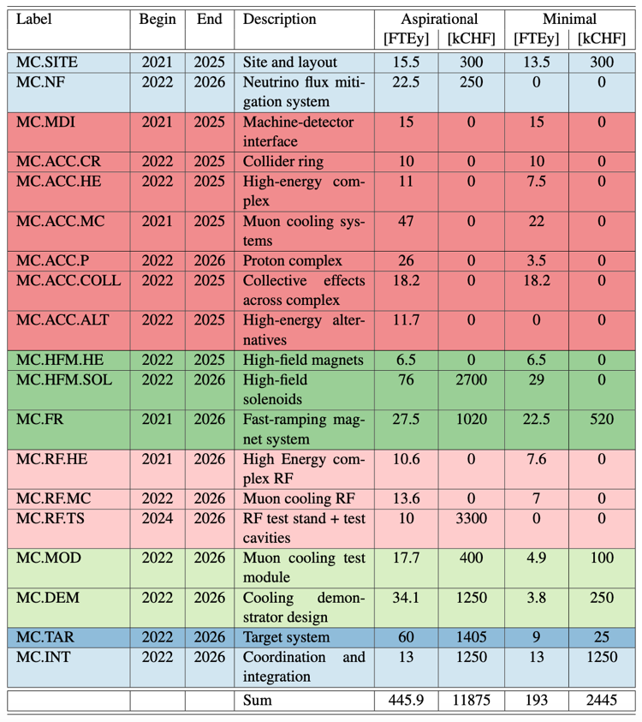
Roadmap Plan
The panel has identified
a development path that
can address the major challenges and deliver a
3 TeV muon collider by 2045
Scenarios
Aspirational |  | Minimal
[FTEy] | [kCHF] | [FTEy] | [kCHF]
445.9 | 11875 | 193 | 2445
~70 Meu/5 years

Slide 4
MTP

Slide 5
MuCol - HORIZON-INFRA-2022-DEV-01-01
WP 2: Physics and Detector Requirements
Leader Univ. PD
WP 3: The Proton Complex
Leader ESS
WP 4: Muon Production and Cooling
Leader STFC
WP 5: High-energy Complex
Leader CEA
WP 6: Radio Frequency Systems
Leader CEA
WP 7: Magnet Systems
Leader CERN
WP 8: Cooling Cell Integration
Leader CERN+Univ. MI

Slide 6
GOALS/main chapters
Physics
Detector R&D
Computing
Proton Complex
Muon Production and Cooling
High-energy Complex
Radio Frequency Systems
Magnet Systems
Cooling Cell Integration

Slide 7
Years – budget categories
<2022
2022
2023
2024
2025
2026
>2026
staff | fellow | student | material
Travel???
Main Institutes + all

Slide 8
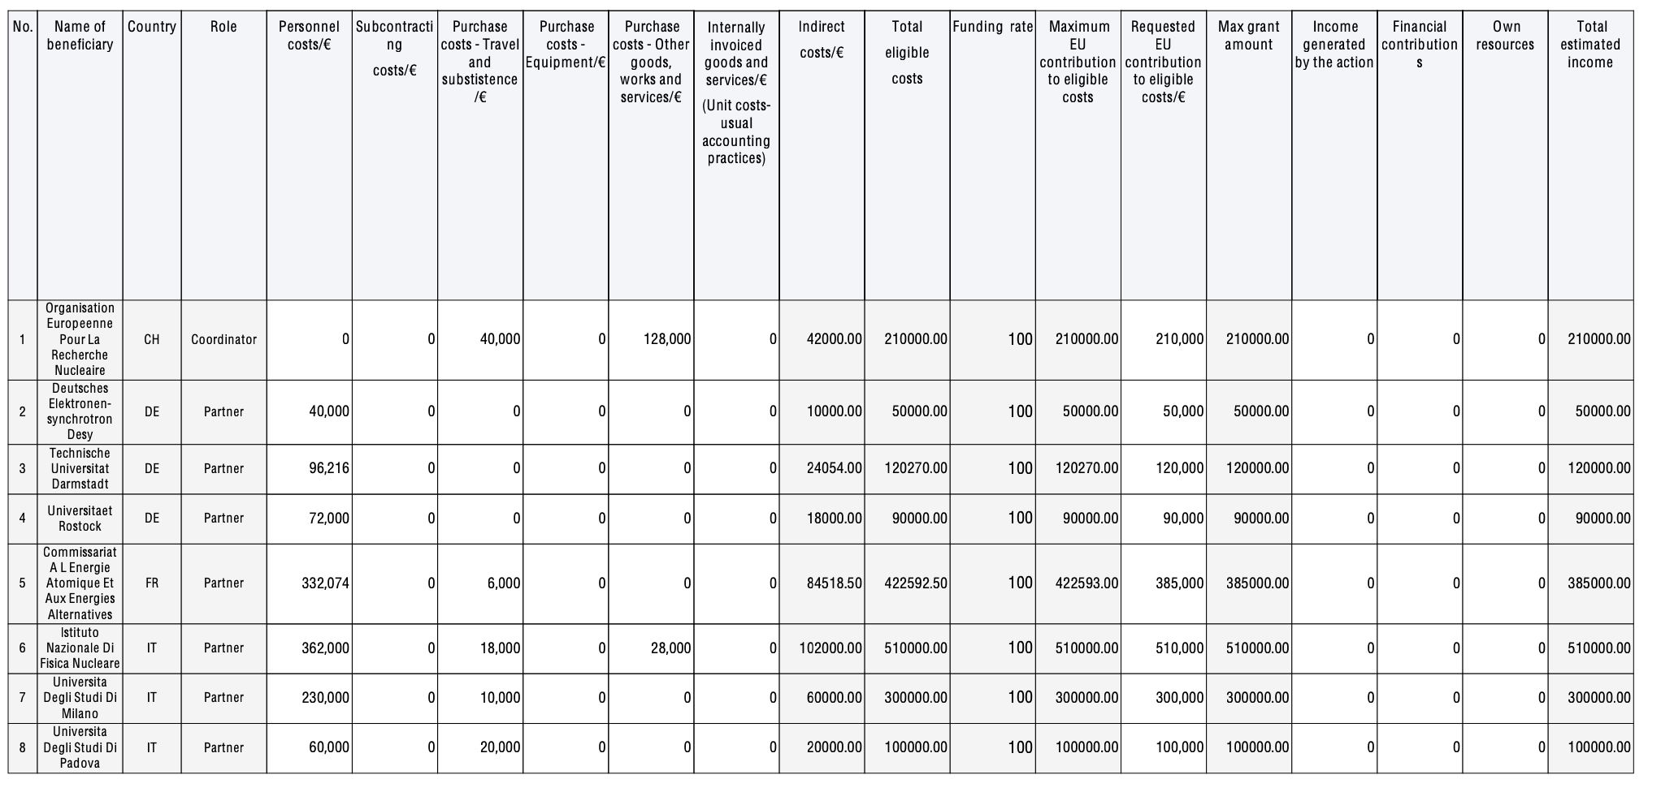

Slide 9
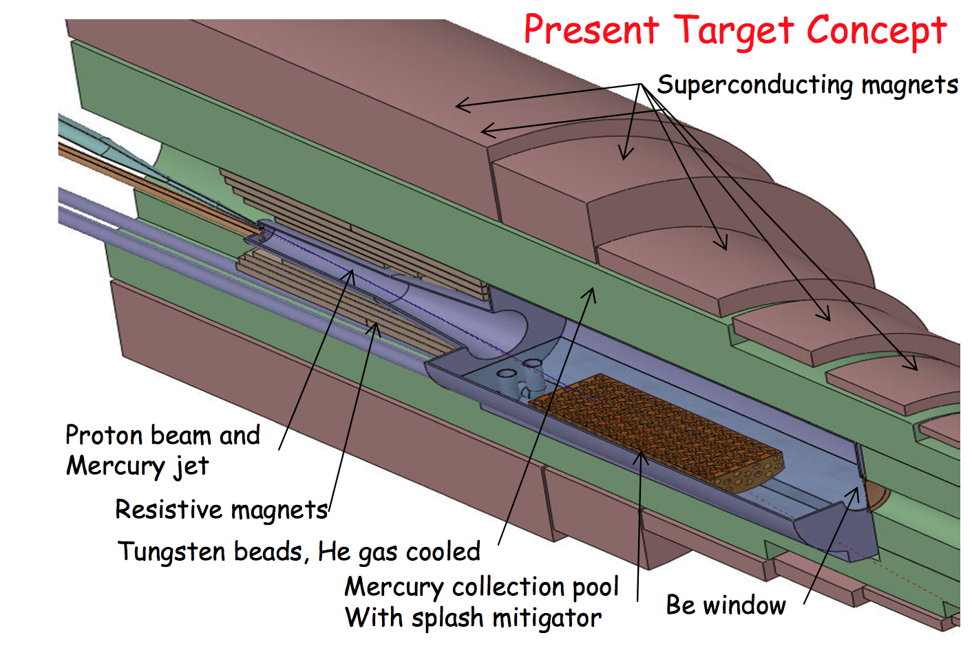
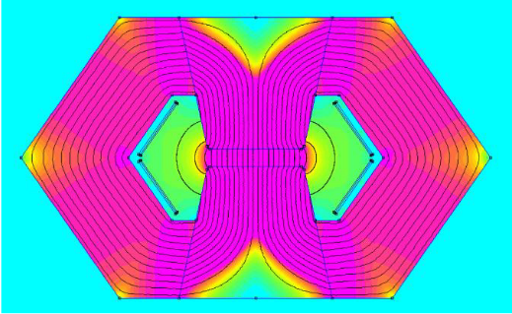
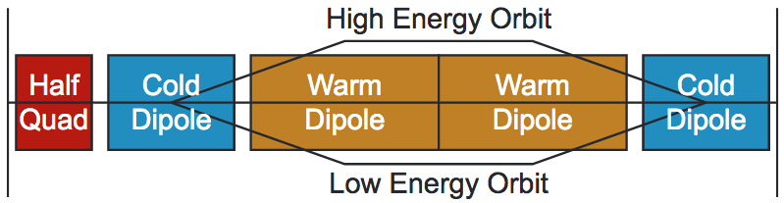
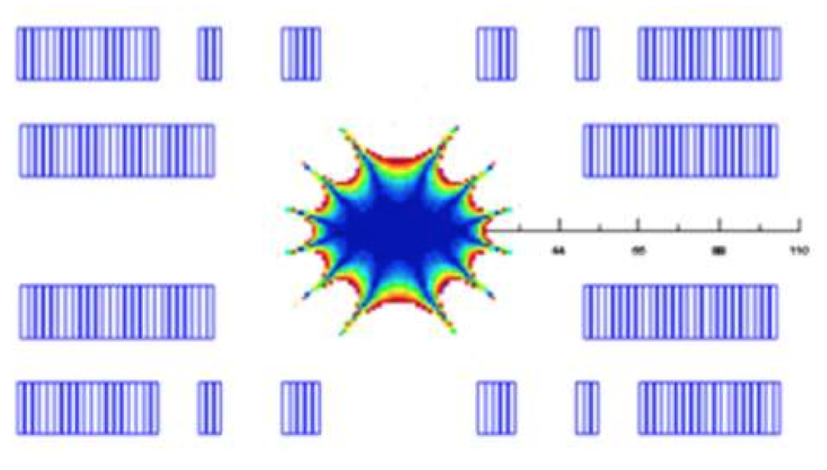
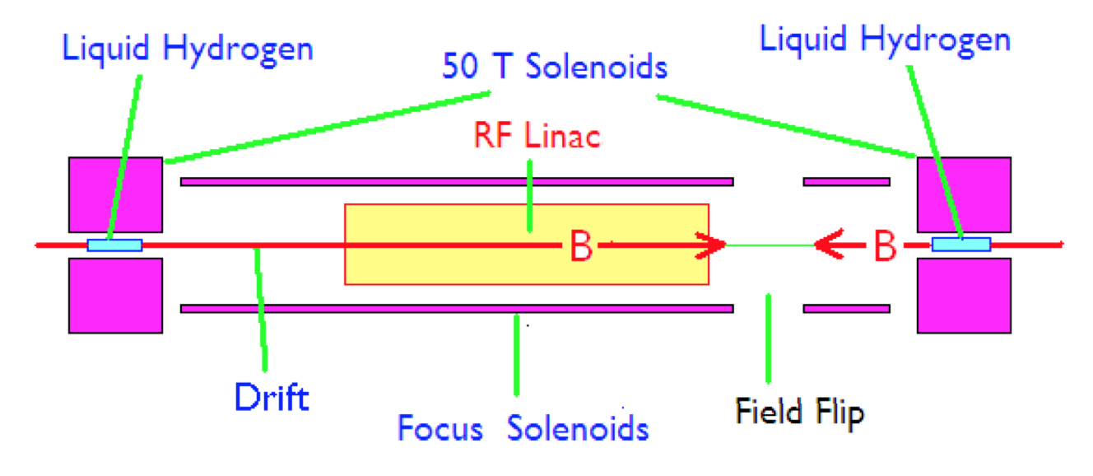
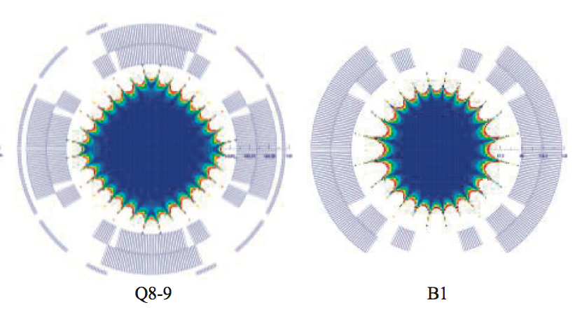
Magnet Demands @ Muon Collider
20 T, 150 mm
High-field and large aperture target solenoid with heavy shielding to withstand heat (100 kW/m) and radiation loads
Combination of DC SC magnets (10 T) and AC resistive magnets (± 2T)
±2 T, 400 Hz
80 mm x 40 mm
10 T
Ultra-high-field solenoids (40…60 T) to achieve desired muon beam cooling
Open midplane or large dipoles and quadrupoles in the range of 10…16 T, bore in excess of 150 mm to allow for shielding against heat (500 W/m) and radiation loads
16 T

Slide 10



MUon collider STrategy network – MUST
INFN – CERN (+BINP) – CEA – IJCLAB – KIT – PSI – UKRI – (USA not beneficiary)
May 1, 2021 – April 30, 2024
Task 5.1
….
It will serve as the common ground for a growing international muon-collider collaboration
MUST will support to establish an international collaboration and develop an optimized R&D roadmap towards a future muon collider, including the definition of optimum test facilities and possible intermediate steps
Detector R&D
1 January 2022 - 31 December 2025 EU RISE project
aMUSE further provides an excellent platform for an ambitious EU-US network to advance the development of muon beams.
Objectives WP3 – leader: Donatella Lucchesi
Study techniques of unstable particles beam cooling muon beams at different energies, aiming to validate the simulation with experimental tests
High energy muon beams: determine the optimal interaction region configuration by studying the beam induced background and new detector technologies able to handle it
Design and simulate detector for different centre of mass energies
Evaluate the radiation hazards related to the neutrino flux emitted by the muon beams.

