Slide 1

Linear
Imperfections
Basic CAS @ online,
May 2022
Jörg Wenninger
CERN Beams Department
Operation group – LHC section

Slide 2

Copyright statement and speaker’s release for video publishing
The author consents to the photographic, audio and video recording of this lecture at the CERN Accelerator School. The term “lecture” includes any material incorporated therein including but not limited to text, images and references.
The author hereby grants CERN a royalty-free license to use his image and name as well as the recordings mentioned above, in order to broadcast them online to all registered students and to post them without any further processing on the CAS website.
The author hereby confirms that the content of the lecture does not infringe the copyright, intellectual property or privacy rights of any third party. The author has cited and credited any third-party contribution in accordance with applicable professional standards and legislation in matters of attribution.

Slide 3
Introduction
Imperfection - sources
Orbit perturbations
Optics perturbations
Linear imperfections and geology
Summary

Slide 4
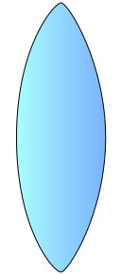
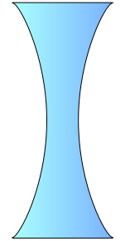
Accelerator lattice cell
An accelerator is typically build using a number of basic ‘cells’.
The cell layouts of accelerators come in many variants.
For today we consider a simple FODO cell containing:
  Dipole magnets to bend the beams,
  Quadrupole magnets to focus the beams,
  Beam position monitors (BPM) to measure the beam position,
  Small dipole corrector magnets for beam steering.
Quadrupole
(focussing)
Quadrupole
(de-focussing)
Dipole corrector
Dipole
Dipole
Dipole corrector
beam
Beam position monitor
Beam position monitor
Schematic of a ½ cell

Slide 5
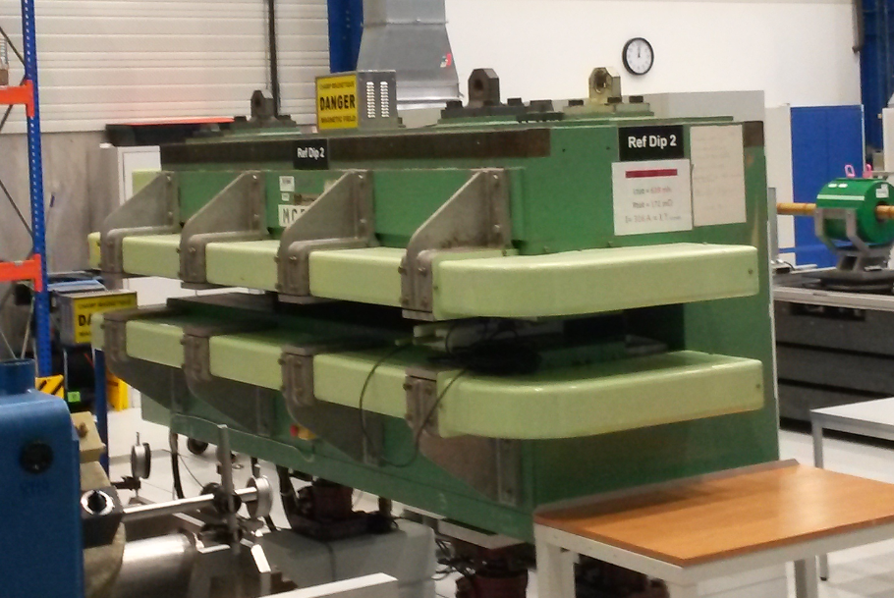
Dipole magnet
The dipole has two magnetic poles and generates a homogeneous field providing a constant force on all beam particles – used to deflect the beam.
  A dipole corrector is just a small version of such a magnet, dedicated to steer the beam.
Lorentz force:
y
Horizontal deflection
Vertical deflection
orthogonal to the speed and magnetic field directions
90° rotation
x
B_{y}
x
F_{y}
F_{x}
x
B_{x}

Slide 6
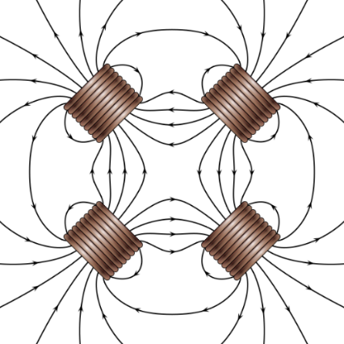
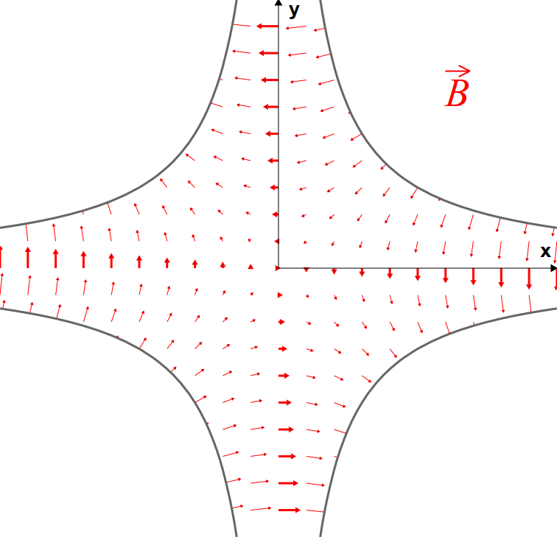
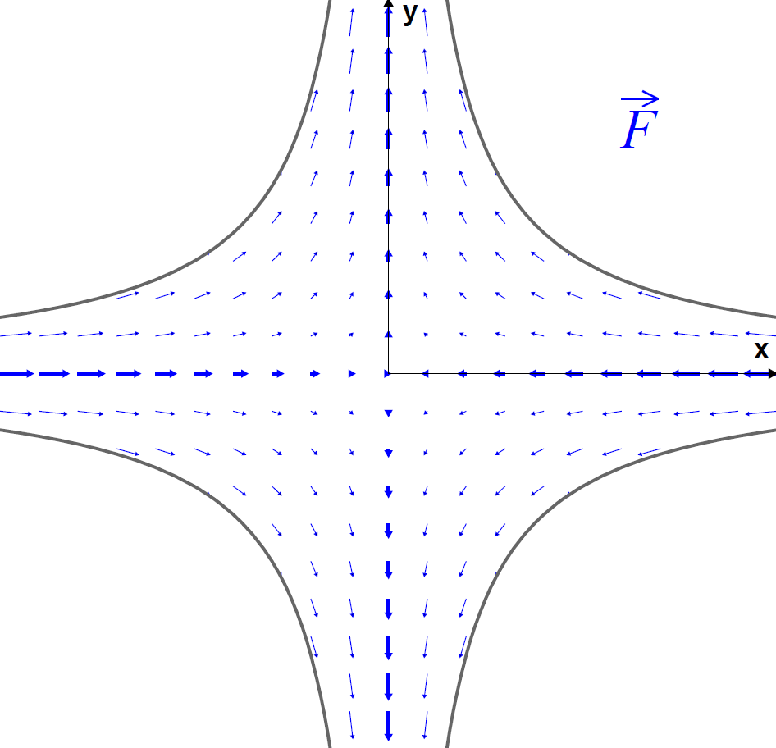
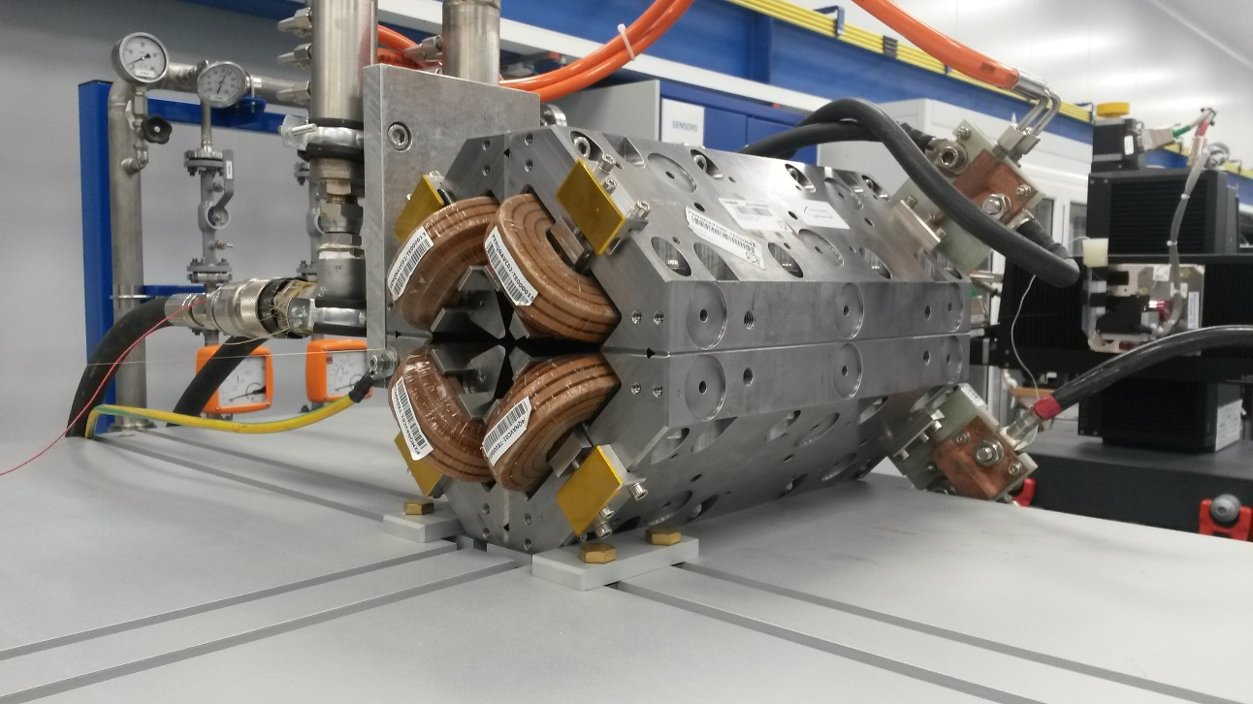


Quadrupole magnet
A quadrupole has 4 magnetic poles.
A quadrupole provides a field (force) that increases linearly with the distance to the quadrupole centre – provides focussing of the beam.
  Similar to an optical lens, but a quadrupole is focussing in one plane, defocussing in the other plane.
Force pushes the particle towards the center → focussing
$$F_{x}=−k x$$
$$F_{y}=k y$$
Force pushes the particle away from the center → defocussing

Slide 7
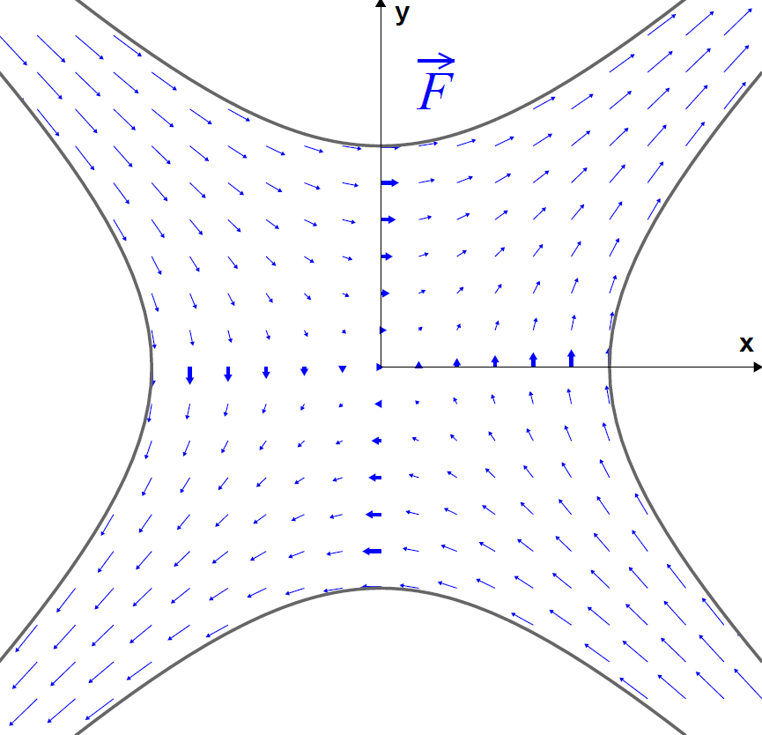
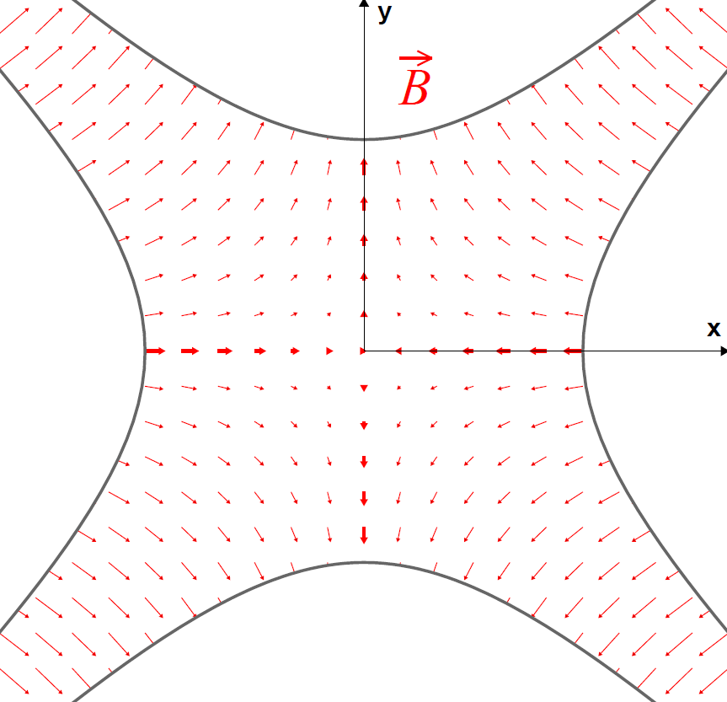
Skew quadrupole magnet
A quadrupole rotated by 45º (‘skew quadrupole’) produces a force (deflection) in x that depends on y and vice-versa: such a magnet couples horizontal and vertical plane.
normal quadrupole
skew quadrupole
F_{x} = -k x
F_{x} = k y
No mixing of planes
Full mixing of planes
F_{y} = k y
F_{y} = -k x

Slide 8
N-pole magnets
The concept of normal / skew quadrupole can be applied to any 2N-pole magnet.
  Normal variant – generally referred to as B_{N},
  Skew variant – generally referred to as A_{N}, rotated by 180°/2N wrt B_{N}.
Examples:
Sextupole N=3
Dipole N =1
Quadrupole N=2

Slide 9
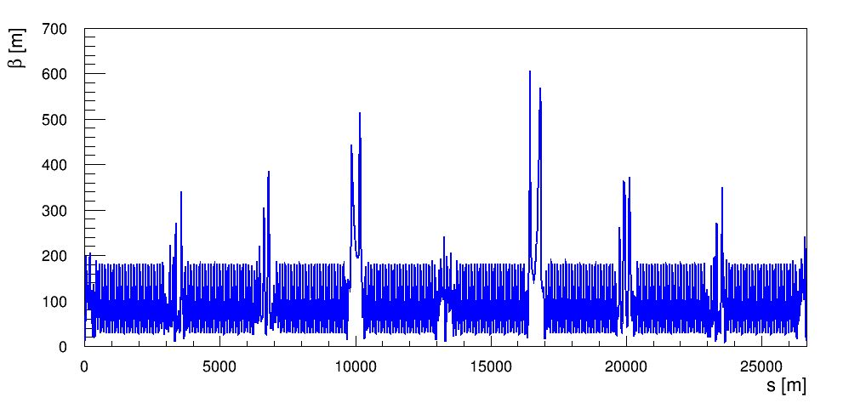
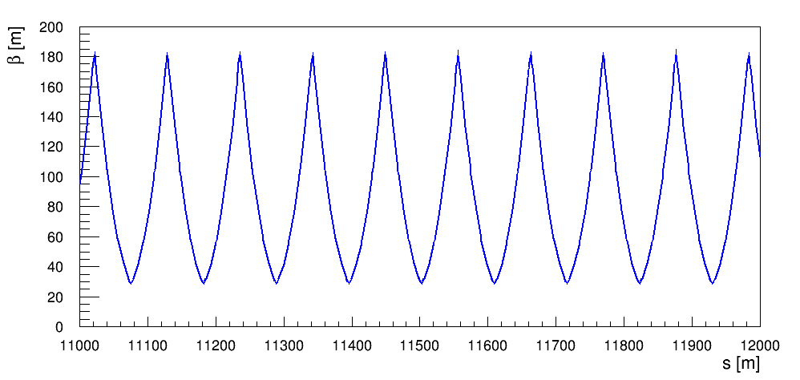
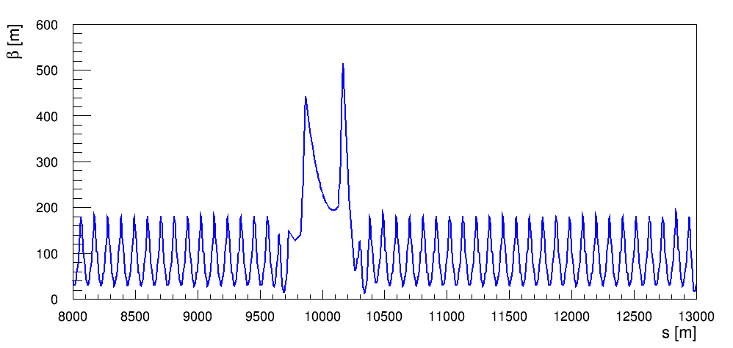
Recap on beam optics
Quantities related to a beam optics in a circular accelerator will be needed for the lecture:
  The betatron function (β) that defines the beam envelope,
    Beam size / envelope is proportional to √β
  The betatron phase advance (μ) that defines the phase of an oscillation.
LHC optics at injection
one cell
zoom
zoom

Slide 10
Recap on beam optics
Consider a particle moving in a section of the accelerator lattice. The focussing elements make it bounce back and forth.
one cell
one cell
…
Another section of the accelerator
Another section of the accelerator
This periodic oscillation is called the betatron oscillation.

Slide 11
Recap on beam optics for pedestrians
The number of oscillation periods over one machine turn is called the machine tune (Q) or betatron tune.
  In this example Q is around 2.75 – 2 periods and ¾ of a period.
position
1 period
1 period
1 period
Longitudinal coord. s
With coordinate change (from longitudinal position in meters to betatron phase advance in degrees) this ‘rocky’ oscillation is transformed into a sinusoidal oscillation.
  Convenient and simple way to analyse the beam motion.
position/√β
Betatron phase μ

Slide 12
Introduction
Imperfection - sources
Orbit perturbations
Optics perturbations
Linear imperfections and geology
Summary

Slide 13
Imperfections
The first step in the design phase of an accelerations consists in building an “ideal” accelerator where all magnets have nominal fields and are perfectly aligned along the design trajectory.
But quite rapidly the designer must confront the real world, and tolerances on errors (= imperfections) must be defined to provide specifications for component design, manufacturing and alignment.
  What is the precision on field quality?
  What is the precision and stability of the power converter that feeds current into a magnet?
  What is the tolerance on the component alignment?
  …
This lecture will discuss the impact of the simplest form of imperfections, the linear imperfections.

Slide 14
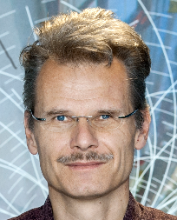
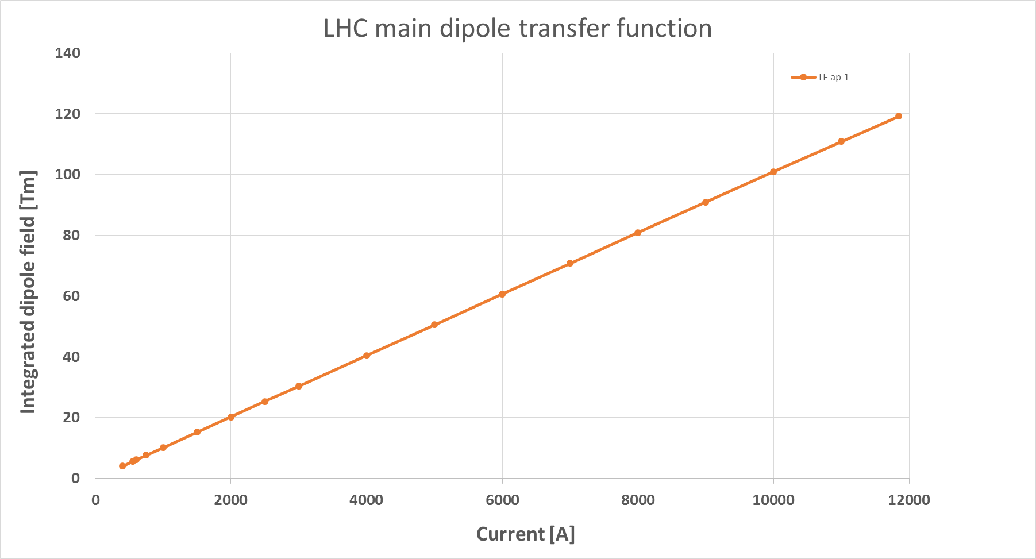
From model to reality - fields
The physical units of the machine model defined by the accelerator physicist must be converted into magnetic fields and eventually into currents for the power converters that feed the magnets.
Imperfections (= errors) in the real accelerator optics can be introduced by uncertainties or errors on:
  Beam momentum, magnetic field model and power converter regulation.
Magnet strength
(angle, focal length…)
Magnetic field or gradient
(T, T/m, T/m²…)
Requested current
(A)
Actual magnet current
(A)
Accelerator physicist
Beam momentum
Magnet
calibration curve (transfer function)
Power converter
Example of the LHC main dipole calibration curve

Slide 15
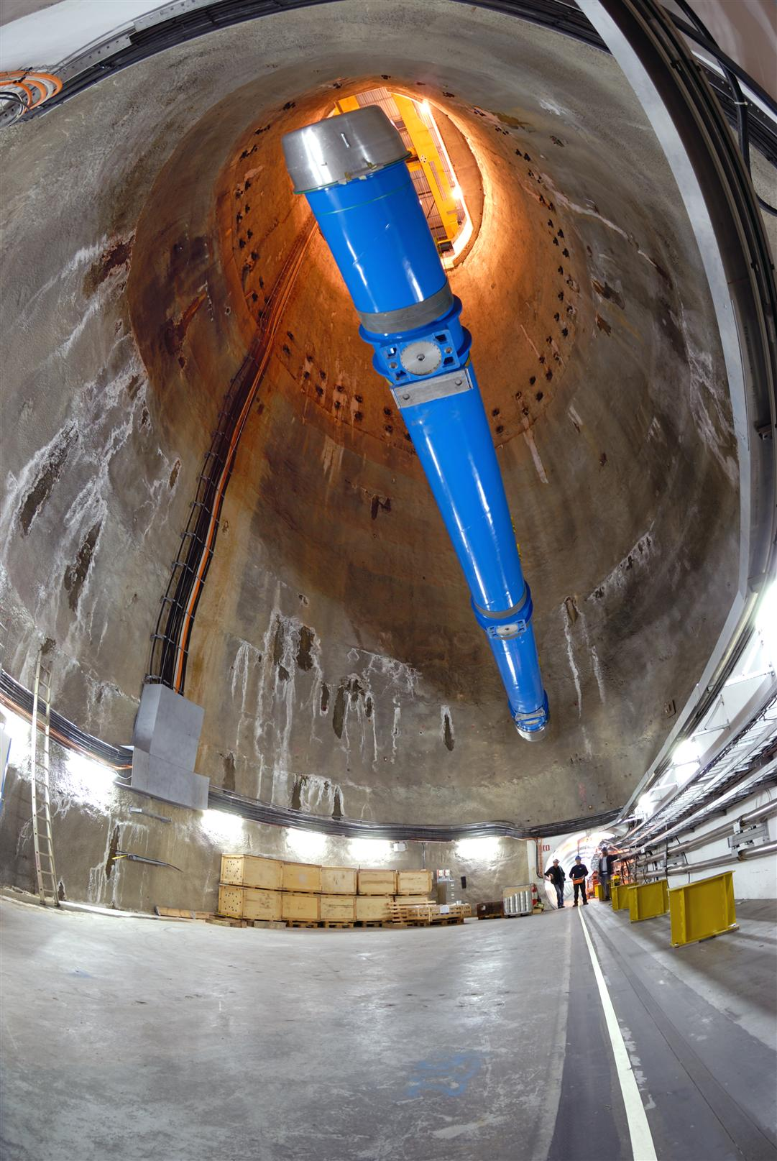
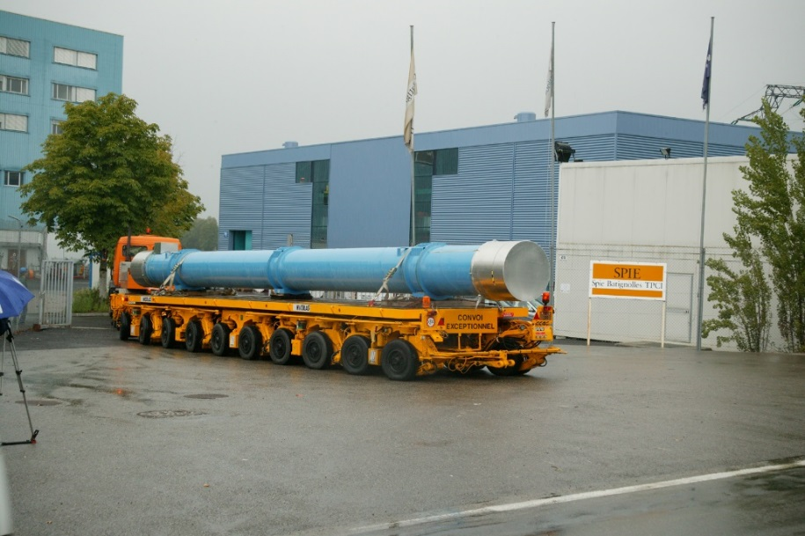
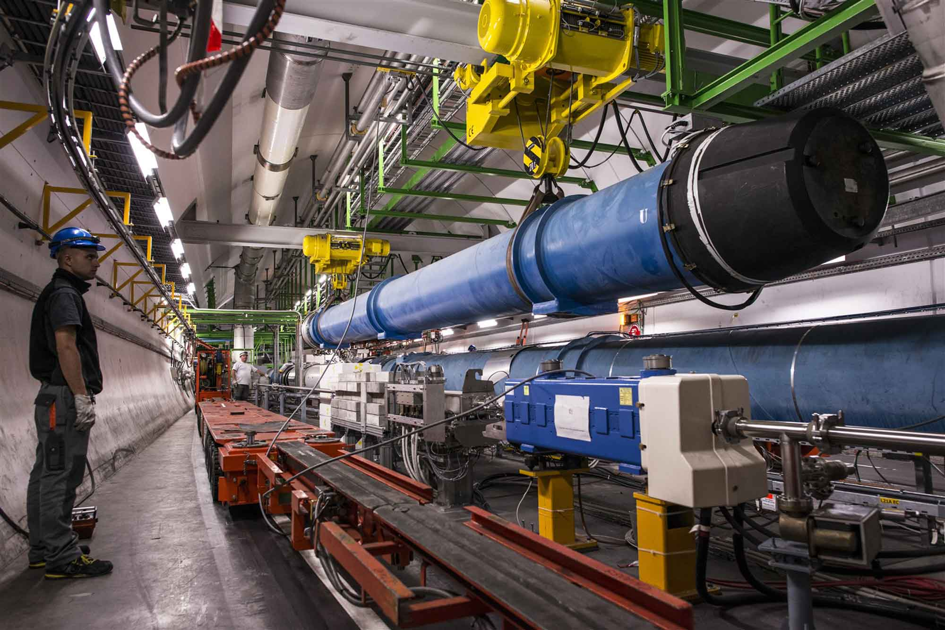
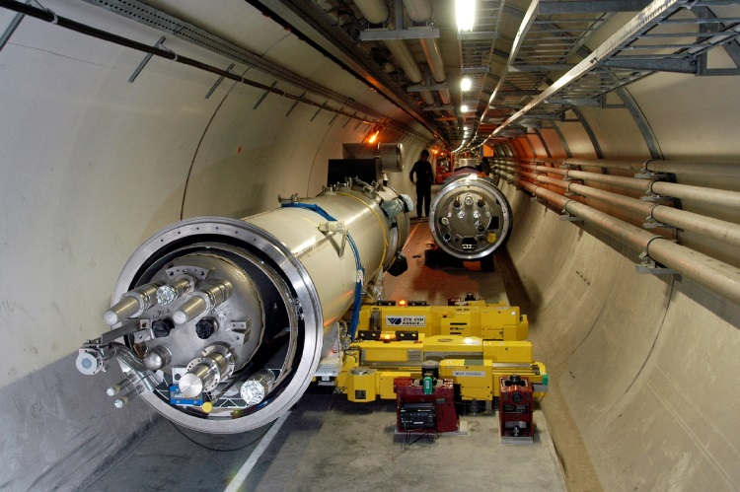
From the lab to the tunnel

Slide 16
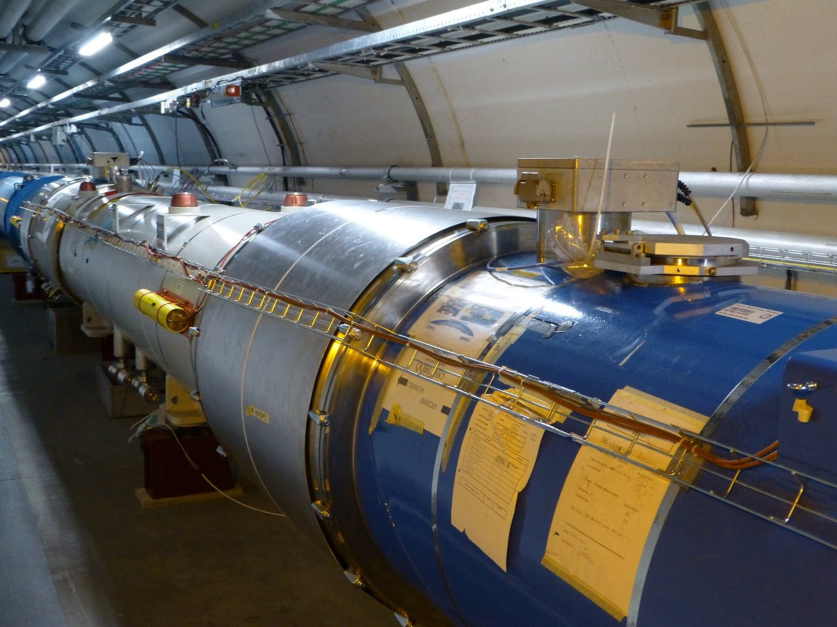
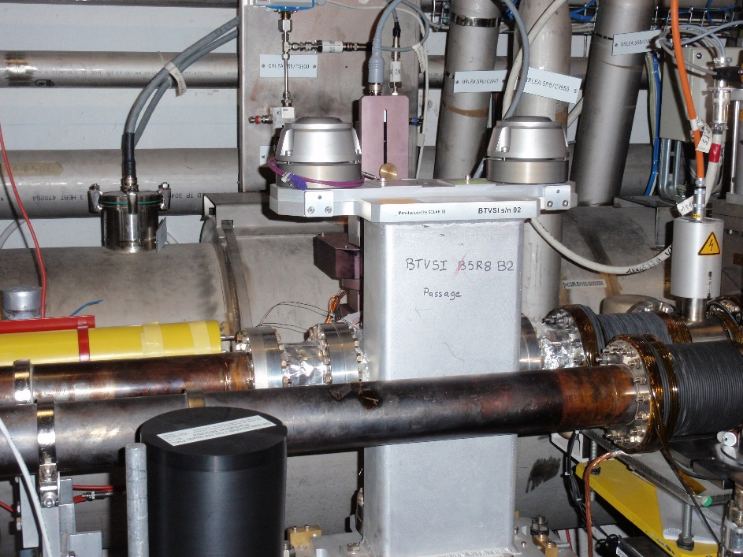
From model to reality - alignment
To ensure that the accelerator elements are in the correct position the alignment must be precise – to the level of micrometres for a linear collider like CLIC !
  At the CERN hadron machines we aim for accuracies of around 0.1-0.3 mm.
The alignment process implies:
  Precise measurements of the magnetic axis in the laboratory with reference to the element alignment markers used by the survey group.
  Precise in-situ alignment (position and angle) of the element in the tunnel.
Alignment errors are a common source of imperfections.

Slide 17
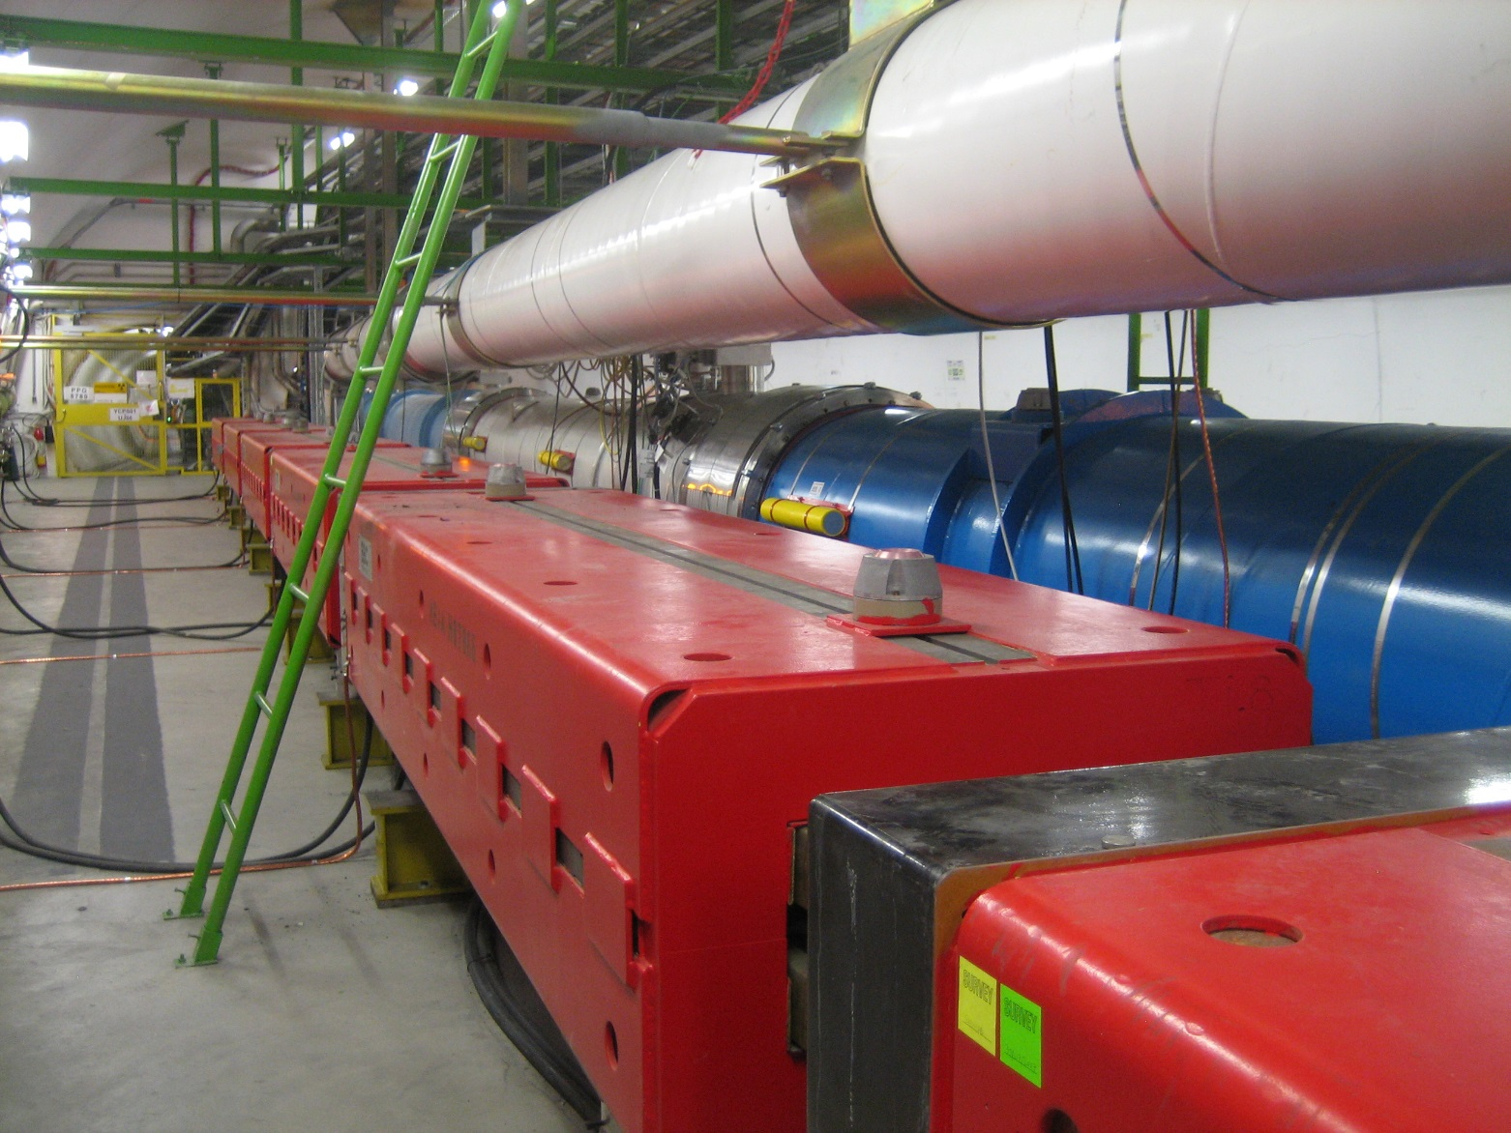


A good attitude in the tunnel
Please remember that accelerator components in the CERN tunnels are carefully aligned – please treat with respect !
Please use the ladder !

Slide 18
Introduction
Imperfection - sources
Orbit perturbations
Optics perturbations
Linear imperfections and geology
Summary

Slide 19
Imperfection – undesired deflection
Linear imperfections are the simplest form of machine errors involving dipole and quadrupole fields – let us start with dipole fields.
The presence of an unintended deflection along the path of the beam is a first category of imperfections.
This case is also in general the first one that is encountered when beam is first injected into a machine, or when a beam is launched into a linac.
The dipole orbit corrector is added to the cell to compensate the effect of unintended deflections.
  With the orbit corrector we can generate a deflection of opposite sign and amplitude that compensates locally the imperfection.
What causes an unintended deflection to appear?

Slide 20
Unintended deflection
The first source is a field error (deflection error) of a dipole magnet.
This can be due to an error in the magnet current or in the calibration table (measurement accuracy etc).
  The imperfect dipole can be expressed as a perfect one + a small error.
real dipole
ideal dipole
small dipole error
=
+
A small rotation (misalignment) of a dipole magnet has the same effect, but in the other plane.
real dipole
ideal dipole
small dipole error
=
+

Slide 21
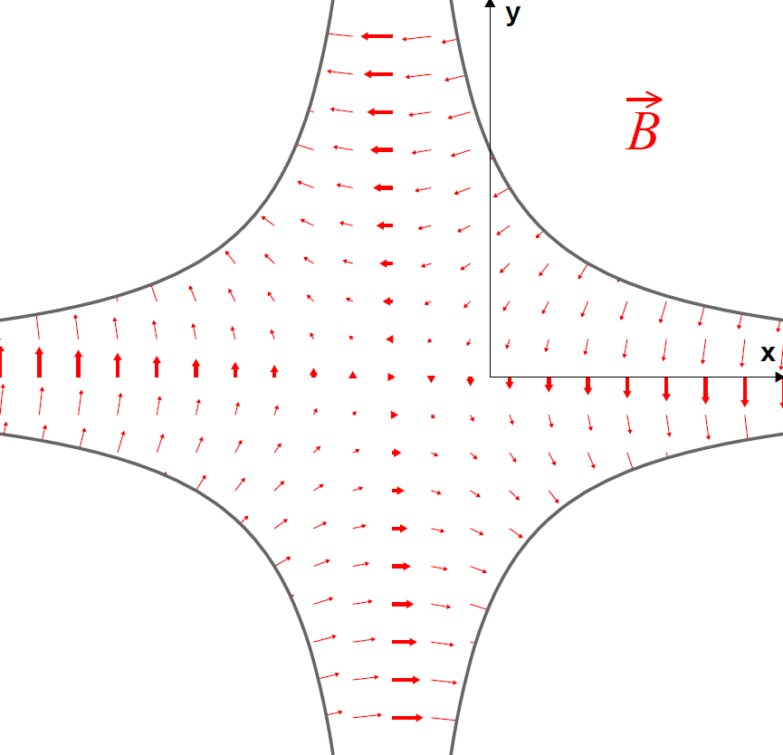
Unintended deflection
The second source is a misalignment of a quadupole magnet.
  The misaligned quadrupole can be represented as a perfectly aligned quadrupole plus a small deflection.
real quadrupole
ideal quadrupole
small dipole error
=
+
Non-zero magnetic field on the beam axis !
No magnetic field on the beam axis

Slide 22
Coupling
A small rotation (misalignment) of a quadrupole leads to coupling between horizontal and vertical plane which is generally not desired.
  The rotated quadrupole can be represented as a perfectly aligned quadrupole plus a small skew quadrupole.
tilted quadrupole
ideal quadrupole
skew quadrupole
=
+

Slide 23
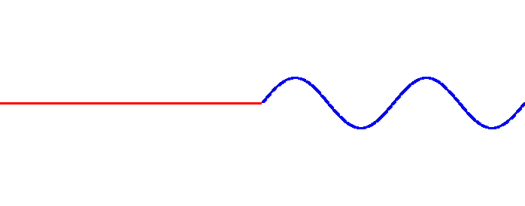
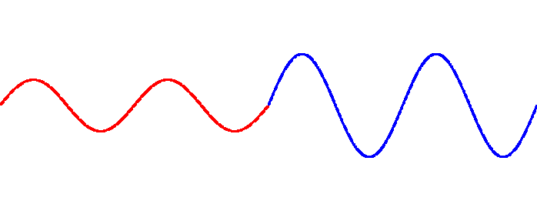
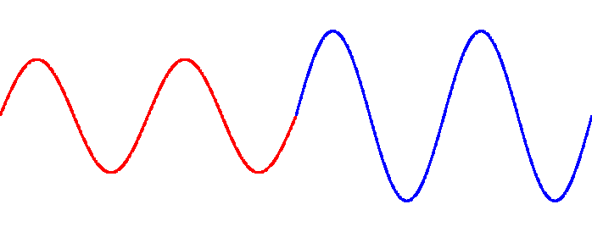
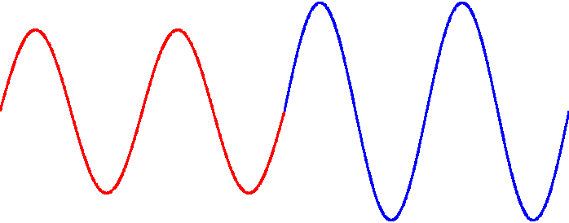
Effect of a deflection
Deflection
Particle direction
We set the machine tune to an integer value:
  Q = n ∈N
Turn no 1
When the tune is an integer number, the deflections add up on every turn !
  The amplitudes diverge, the particles do not stay within the accelerator vacuum chamber.
Turn no 2
Turn no 3
  We just encountered our first resonance – the integer resonance that occurs when Q = n ∈N
Turn no 4

Slide 24
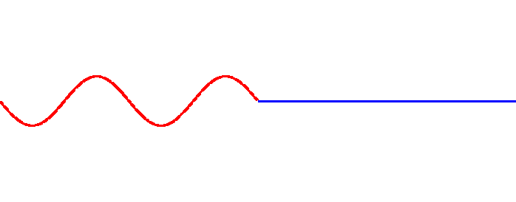
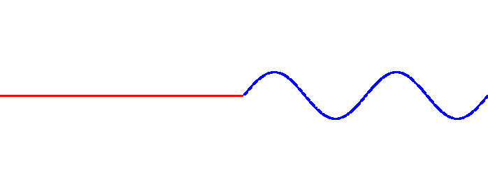
Effect of a deflection
Deflection
Particle direction
We set the machine tune to a half integer value:
  Q = n+0.5, n ∈N
Turn no 1
Turn no 2
For half integer tune values, the deflections compensate on every other turn !
  The amplitudes are stable.
Turn no 3
  This looks like a much better working point for Q!
Turn no 4

Slide 25
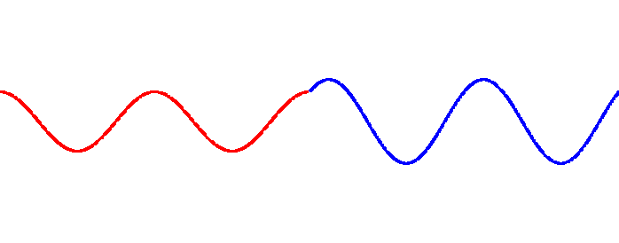
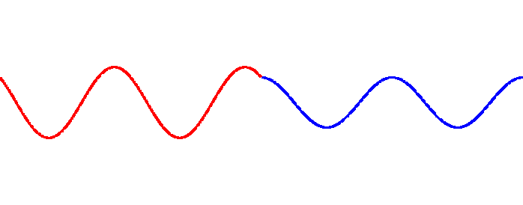
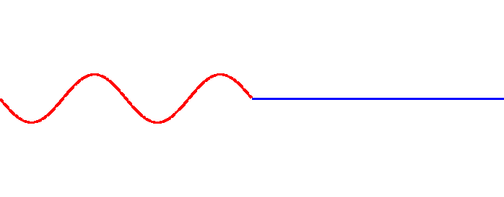
Effect of a deflection
Deflection
Particle direction
We set the machine tune to a quarter integer value:
  Q = n+0.25, n ∈N
Turn no 1
Turn no 2
For quarter tune values, the deflections compensate every four turns !
  The amplitudes are stable.
Turn no 3
  Also a reasonable working point for Q!
Turn no 4

Slide 26
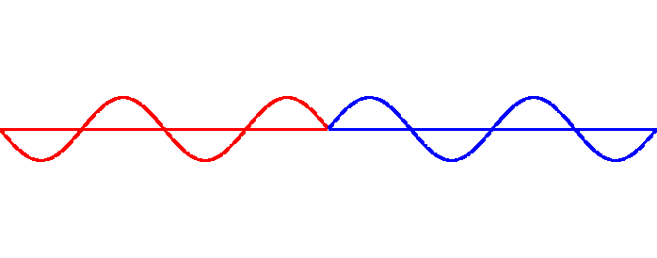
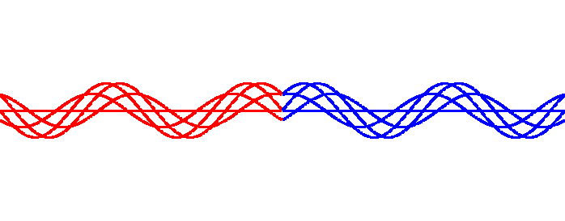

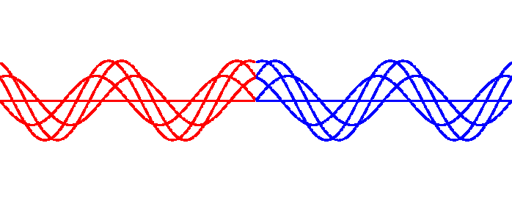
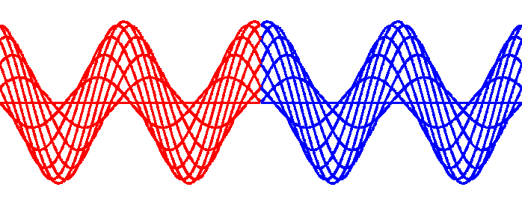
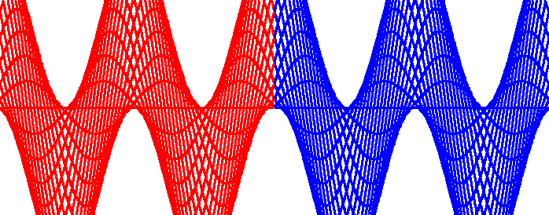
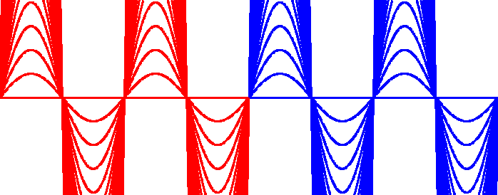
Many turns reveal something
Let’s plot the 50 first turns on top of each other and change Q.
  All plots are on the same scale
Q = n + 0.5
Q = n + 0.4
Q = n + 0.3
Q = n + 0.2
Q = n + 0.1
Q = n + 0.05
Q = n
The particles oscillate around a stable mean value (Q ≠ n)!
The amplitude diverges as we approach Q = n → integer resonance

Slide 27
The closed orbit
The stable mean value around which the particles oscillate is called the closed orbit.
  Every particle in the beam oscillates around the closed orbit.
  As we have seen the closed orbit ‘does not exist’ when the tune is an integer value.
The general expression of the closed orbit x(s) in the presence of a deflection θ is:
kink at the location of the deflection
amplitude modulated by the envelope β
oscillating term
Orbit response
divergence for Q = n

Slide 28
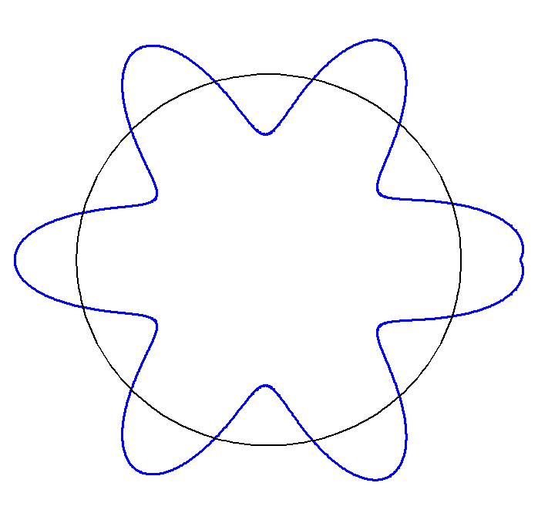
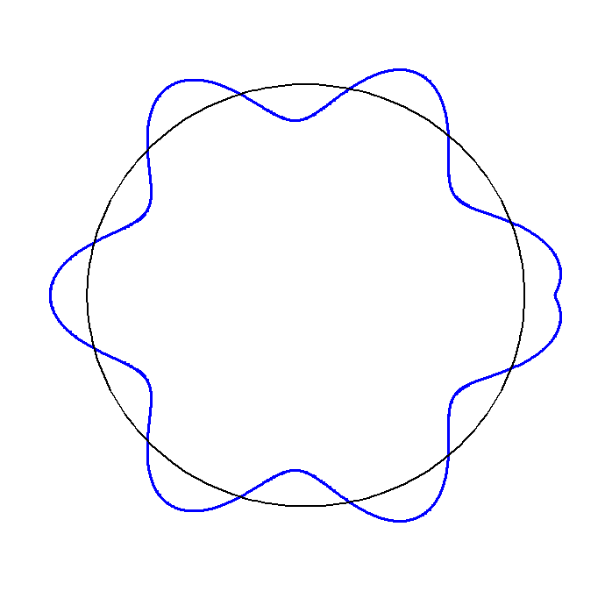
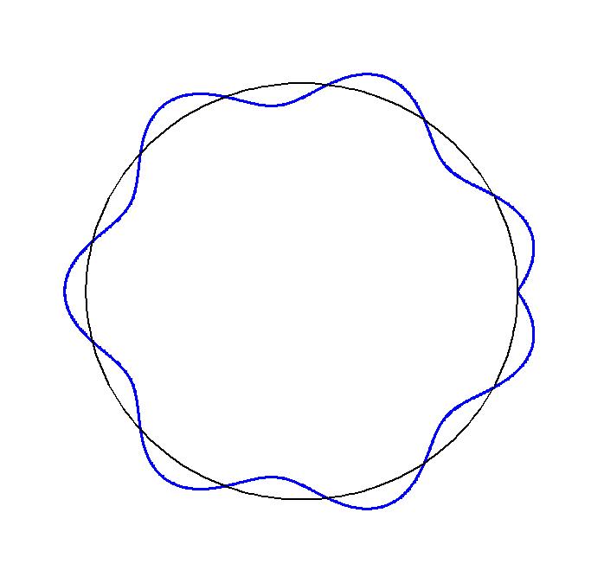
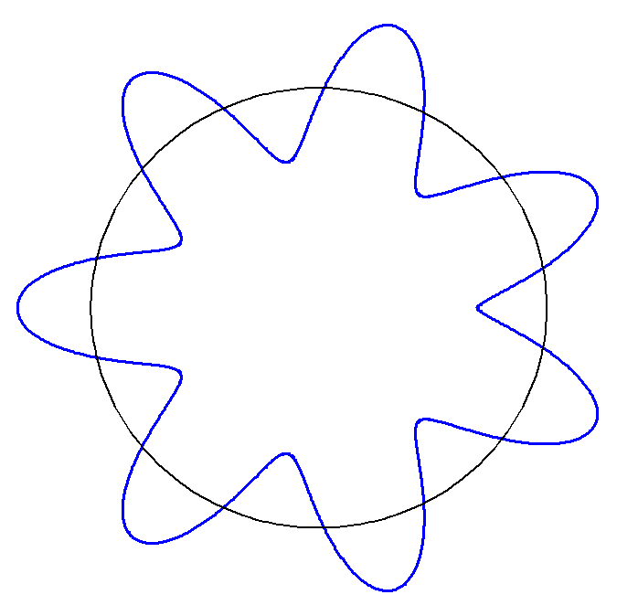
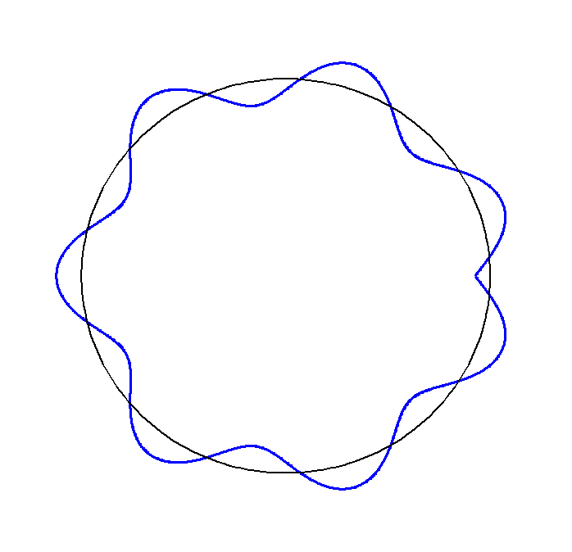
Closed orbit example
Example of the horizontal closed orbit for a machine with tune Q = 6 + q.
The kink at the location of the deflection (→) can be used to localize the deflection (if it is not known) → can be used for orbit correction.
Q = 6.1
Q = 6.2
Q = 6.5
Q = 6.9
Q = 6.7

Slide 29
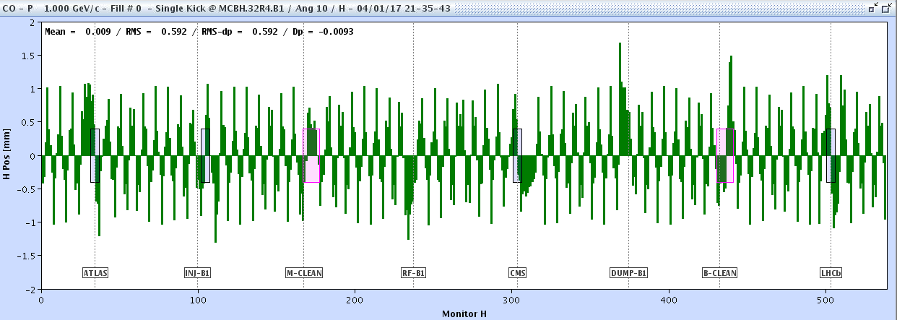
A deflection at the LHC
In the example below for the 26.7km long LHC, there is one undesired deflection, leading to a perturbed closed orbit.
Beam position x (mm)
BPM index along the LHC circumference
Where is the location of the deflection?

Slide 30
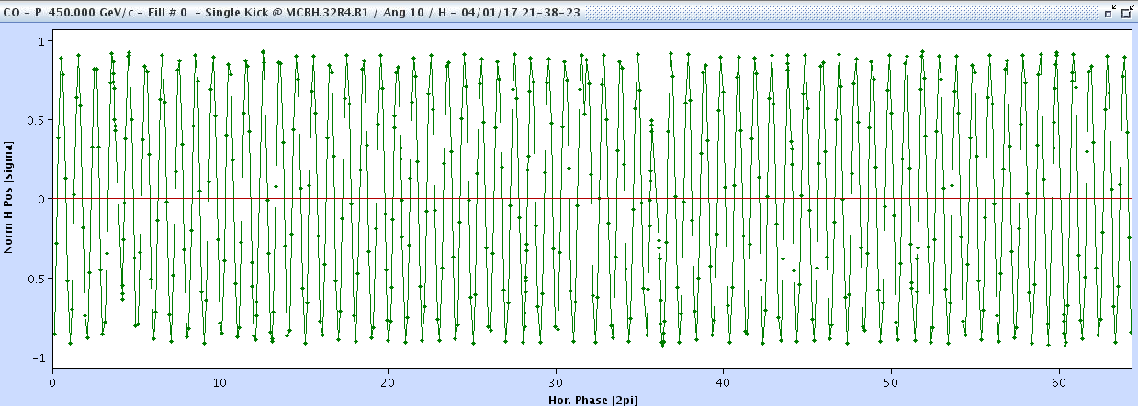
A deflection at the LHC
To make our life easier we divide the position by √β(s) and replace the BPM index by its phase μ(s).
Beam position x/√β
Betatron phase μ
Can you localize the deflection?

Slide 31
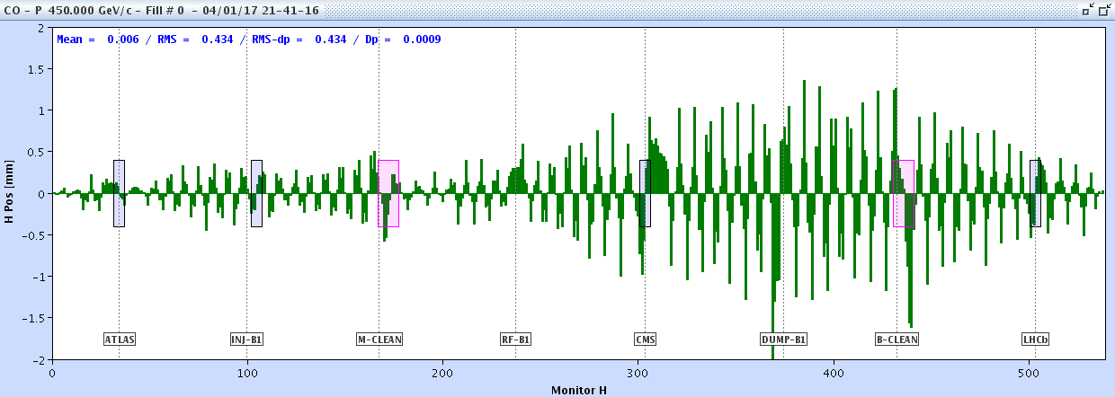
A more realistic case at LHC
Now a more realistic orbit with 100’s of deflections.
How do we proceed to correct?

Slide 32
Orbit correction
Nowadays there are two main approaches for orbit correction:
  Matrix inversion algorithms relying on the knowledge the response R(s).
    R(s) is measured or calculated.
    Popular algorithms: MICADO and SVD (Singular Value Decomposition), both come with many variants.
  Machine learning with a neural network that is trained to find a solution.
    The training may be based on data or on a model, or on continuous reward-like training.
Inversion algorithms have the advantage of higher intrinsic flexibility (correction quality and flexibility, noise reduction,…), they can be reused at different machines without need for tuning – they are ‘universal’.
Machine learning based technique are adapted to situation where the models are difficult to establish, change over time, for example in low energy machines and some linacs. A model trained on a certain machine cannot be reused elsewhere.

Slide 33
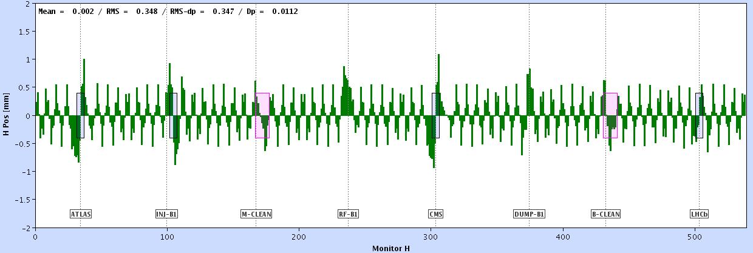
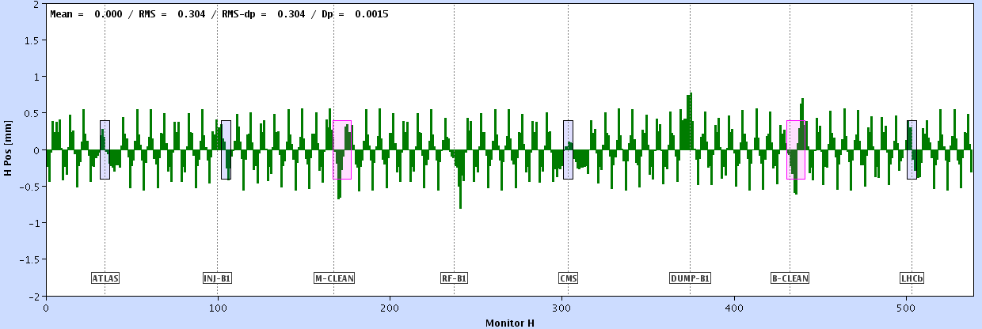
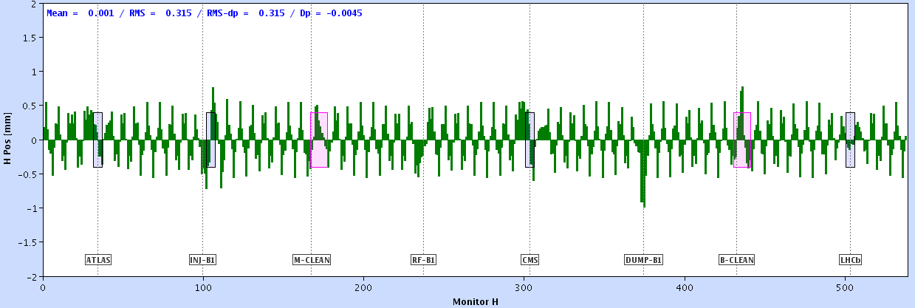
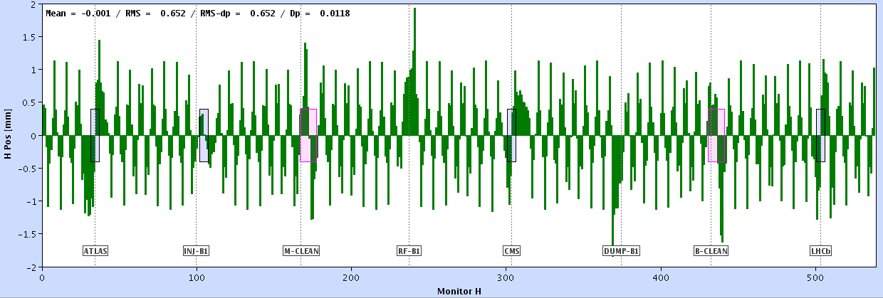
Example of model inversion
Preparation: a model of the machine has to be obtained, i.e. for each orbit corrector the expected orbit response R(s) has to be measured or computed.
Orbit corrector 1
Orbit corrector 2
Beam position
Orbit corrector 3
...
Orbit corrector 14
BPM index

Slide 34
Example of model inversion - MICADO
The MICADO algorithm compares the response of every corrector with the raw orbit.
…
MICADO picks out the corrector that hast the best match with the orbit, and that will give the largest improvement to the orbit deviation rms.
The procedure can be iterated until the orbit is good enough (or as good as it can be).

Slide 35
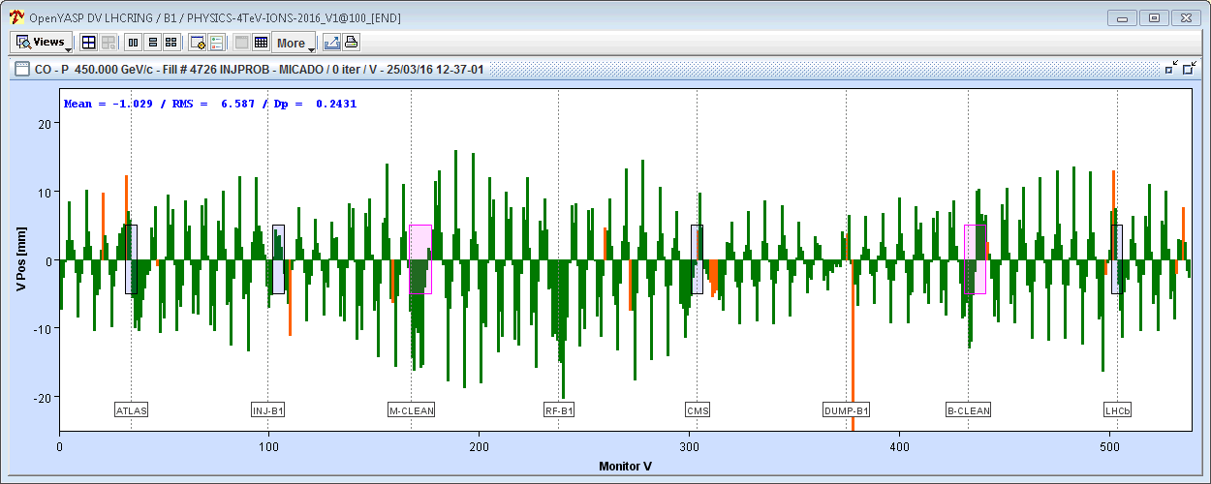


LHC orbit correction example
The raw orbit at the LHC can have huge errors, but the correction (based partly on MICADO) brings the deviations down by more than a factor 20.
Uncorrected horizontal orbit of ring 1
50 mm
MICADO & SVD
Corrected horizontal orbit of ring 1
LHC vacuum chamber
50 mm
34 mm
44 mm
At the LHC a good orbit correction is vital !

Slide 36
Introduction
Imperfection - sources
Orbit perturbations
Optics perturbations
Linear imperfections and geology
Summary

Slide 37
Quadrupole gradient errors
What is the impact of a quadrupole gradient error?
  Let us consider a particle oscillating in the lattice.
Too strong gradient / lens
The oscillation period is affected → change of tune, here Q increases !

Slide 38


Optics perturbation
In a ring a focussing error affects the beam optics and envelope (size) over the entire ring ! It also changes the tune.
Example for LHC: one quadrupole gradient is incorrect
Nominal optics
Perturbed optics
Zoom into a subsection

Slide 39
Optics perturbation
The local beam optics perturbation… note the oscillating pattern of the error.
Nominal optics
Perturbed optics

Slide 40

Optics perturbation
The error is easier to analyse and diagnose if one considers the ratio of the betatron function perturbed/nominal.
The ratio reveals an oscillating pattern called the betatron function beating (‘beta-beating’). The amplitude of the perturbation is the same all over the ring !

Slide 41

Optics perturbation
The beta-beating pattern comes out more clearly when the longitudinal coordinate is again replaced by the betatron phase advance.
The result is very similar to the case of the closed orbit kick, the error reveals itself by a kink !
  Watching closely one can observe that there are two oscillation periods per 2π (360 deg) phase. The beta-beating frequency is twice the frequency of the orbit !

Slide 42

LHC optics correction
Correction strategies for optics / beta-beating rely on similar principles than for orbit correction.
  Inversion algorithms – it is possible to iteratively use the similar algorithms than for orbit correction, although good optics corrections require a larger variety of analysis/fitting tools.
  Machine learning.
Example for optics correction: at top energy of 6.5 TeV, the LHC optics errors cam be as large as 100% before correction.
  Can be corrected to a few % residual error with modern correction algorithms if there are enough quadrupoles that can be individual powered.

Slide 43
Introduction
Imperfection - sources
Orbit perturbations
Optics perturbations
Linear imperfections and geology
Summary

Slide 44

Linear imperfections, geology
and celestial bodies

Slide 45



Earth tides
Tide bulge of a celestial body of mass M at a distance d
Such Earth tides alter the accelerator circumference:
The Moon contributes 2/3, the Sun 1/3.
Not resonance-driven (unlike Sea tides !).
Accurate predictions possible (~%).
θ = angle(vertical, the celestial body)
induces surface deformations and affects the water levels of the oceans.
→ impacts the alignment of a large accelerator !
LEP tide predictions for Nov. 1992
The relative circumference change amounts to ~10⁻⁸ ~ 1 mm – resolution ~ 10⁻¹¹
Gravitational wave detectors achieve sensitivities of ~10⁻²¹ !

Slide 46
Tides observation
At the LHC the beams are ‘captured’ by the RF system which forces the beams to remain synchronous with the RF frequency.
  Because at LHC the speed ≅ c = constant, this fixes the length of the orbit.
When the frequency is well adjusted, the length of the orbit L matches the circumference C.
If for any reason C varies, the beam has to move radially if L is kept constant.
A mismatch between C and L can be observed on the mean radial orbit using the BPMs that move with the ring.
  As a side effect it also changes very slightly the beam energy (level of 0.01%).
L = C
L < C

Slide 47


LHC circumference observations
Tides are observed very clearly on the LHC circumference by measuring the mean radial (=horizontal) beam position.
Measurements
Model
Tide observations (from orbit changes) over one week at 4 TeV in 2016
(expressed in energy change Δp/p)
Earthquake in New Zealand
The pressure waves induce a modulation of the circumference
dp/p
10⁻⁴

Slide 48



Waves from earthquakes
Different types of body (Pressure, Shear) and surface waves (Raleigh, Love), multiple paths and reflections produce a complex signature of earthquakes at seismic measurement stations – also at the LHC.
L. Braille (Purdue U.) / The IRIS (Incorporated Research Institutions for Seismology) consortium

Slide 49





Costa Rica earthquake - 2012
A magnitude 7.6 earthquake in Costa Rica (05/09/2012 @ 14:42:10 UTC) ‘struck’ the LHC in fill 3032 with stable colliding beams.
  Arrival of the first waves at CERN ~15:06 UTC.
1 hour !
Surface
P
zoom
The arrival of the different waves can be observed on the radial beam position – equivalent to largest tides.

Slide 50



… and there’s the man-made waves
HL-LHC has built huge underground structures in LHC points 1 and 5.
Civil engineering is not famous for working ‘quietly’ !
Noise also means vibrations, vibrations mean moving magnets !
CMS experiment cavern
~100 m underground
LHC beam line = LHC magnets

Slide 51


… and there’s the man-made waves (2)
In the early part of the CE work, an important volume of soil was moved around and compacted while LHC was operating.
Ground compactors compact soil by… vibrating.
…and they managed to shake the beams colliding at the IP ~100 m underground.
Mechanism:
The vibrations with frequencies ~20 Hz were transmitted through 100 m of rock to the tunnel magnets and their supports that resonate in the frequency range 8-22 Hz.
The resonant excitation generated ~ micrometer amplitude beam movements that were clearly visible on the CMS experiments luminosity (= rate of collisions).
vibrations
luminosity

Slide 52
Summary
At first order magnetic field and misalignments errors of accelerator components induce:
  Errors on the beam orbit,
  Errors on the optics and the tune.
The errors are often sufficiently large that modern machines operate poorly or not at all.
Fortunately ever improving tools and algorithms have been developed over the past 50 years to correct such errors.
However to minimize the imperfections from the start it is important to have:
  the best possible magnet (component) design,
  well measured magnetic fields,
  precise power converters,
  the best possible machine alignment.
Thank you for your perfect attention !

