Slide 2
Introduction to Cryogenics
T. Koettig, P. Borges de Sousa, J. Bremer
Contributions from S. Claudet and Ph. Lebrun
CAS: Basics of Accelerator Physics and Technology, 2022.

Slide 3

Copyright statement and speaker’s release for video publishing
The author consents to the photographic, audio and video recording of this lecture at the CERN Accelerator School. The term “lecture” includes any material incorporated therein including but not limited to text, images and references.
The author hereby grants CERN a royalty-free license to use his image and name as well as the recordings mentioned above, in order to post them on the CAS website.
The material is used for the sole purpose of illustration for teaching or scientific research. The author hereby confirms that to his best knowledge the content of the lecture does not infringe the copyright, intellectual property or privacy rights of any third party. The author has cited and credited any third-party contribution in accordance with applicable professional standards and legislation in matters of attribution.

Slide 4
Content
Introduction to cryogenic installations
Motivation => reducing thermal energy in a system
Heat transfer and thermal insulation
Helium cryogenics, He I => He II
Conclusions
References

Slide 5
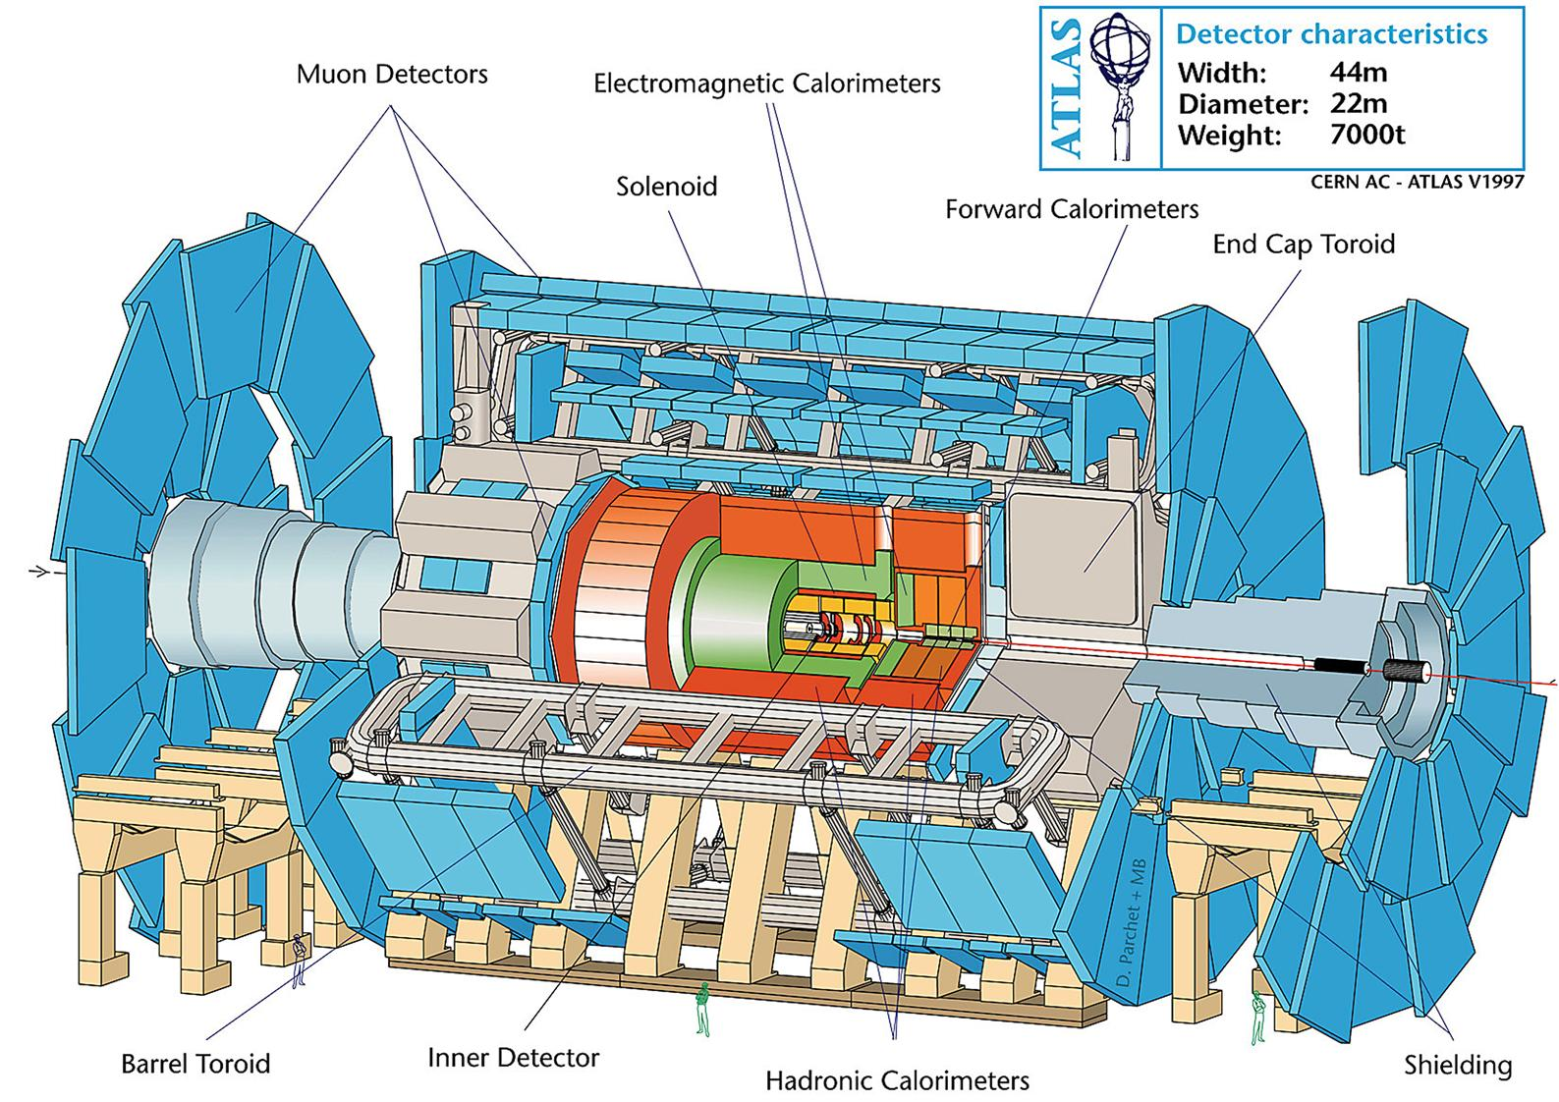
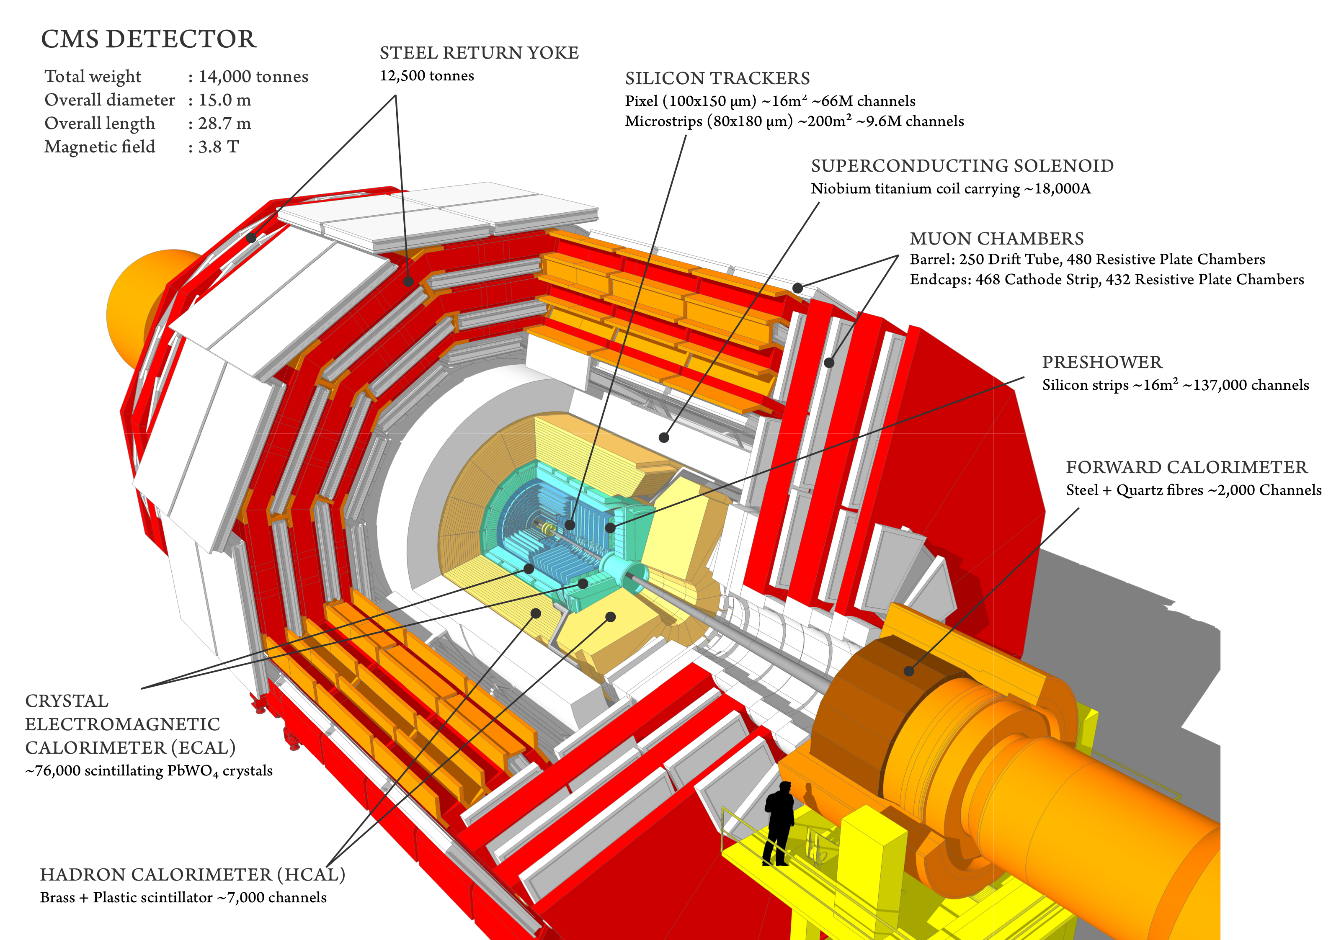
Overview of cryogenics at CERN - Detectors
Superconducting coils of LHC detectors @ 4.5 K (ATLAS, CMS)
LAr Calorimeter - LN₂ cooled
Different types of cryogens (Helium, Nitrogen and Argon)
From: CERN-DI-9803026
From: http://cms.web.cern.ch/news/cms-detector-design

Slide 6
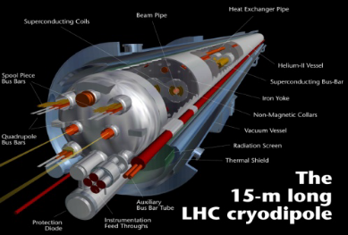
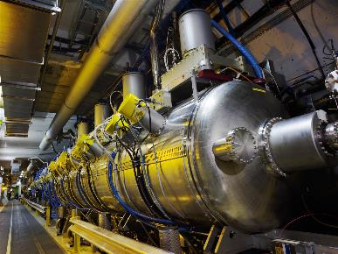
Overview of cryogenics at CERN - LHC
Helium at different operating temperatures (thermal shields, beam screens, distribution and magnets,…)
Superconducting (SC) magnets of the LHC ring
Accelerating SC cavities
CERN CDS-EX-0712013

Slide 7
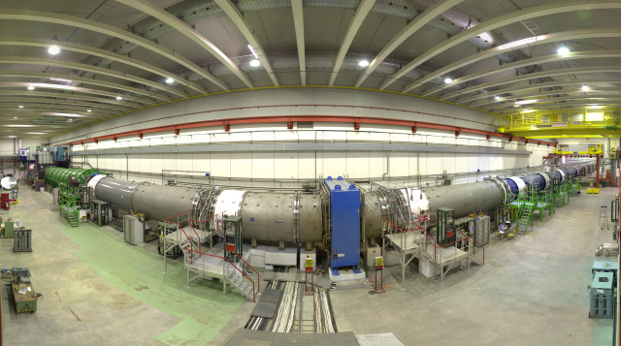
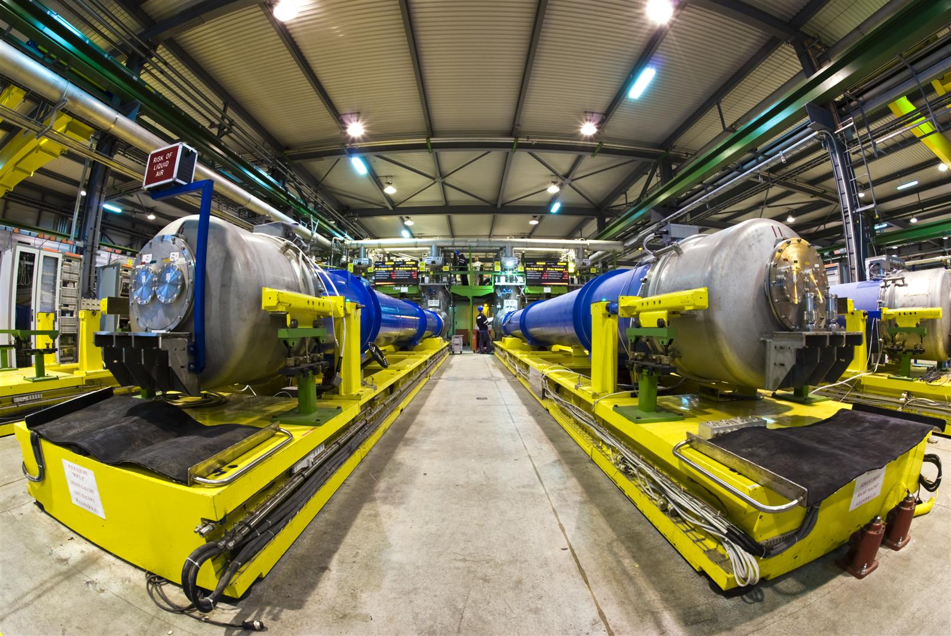
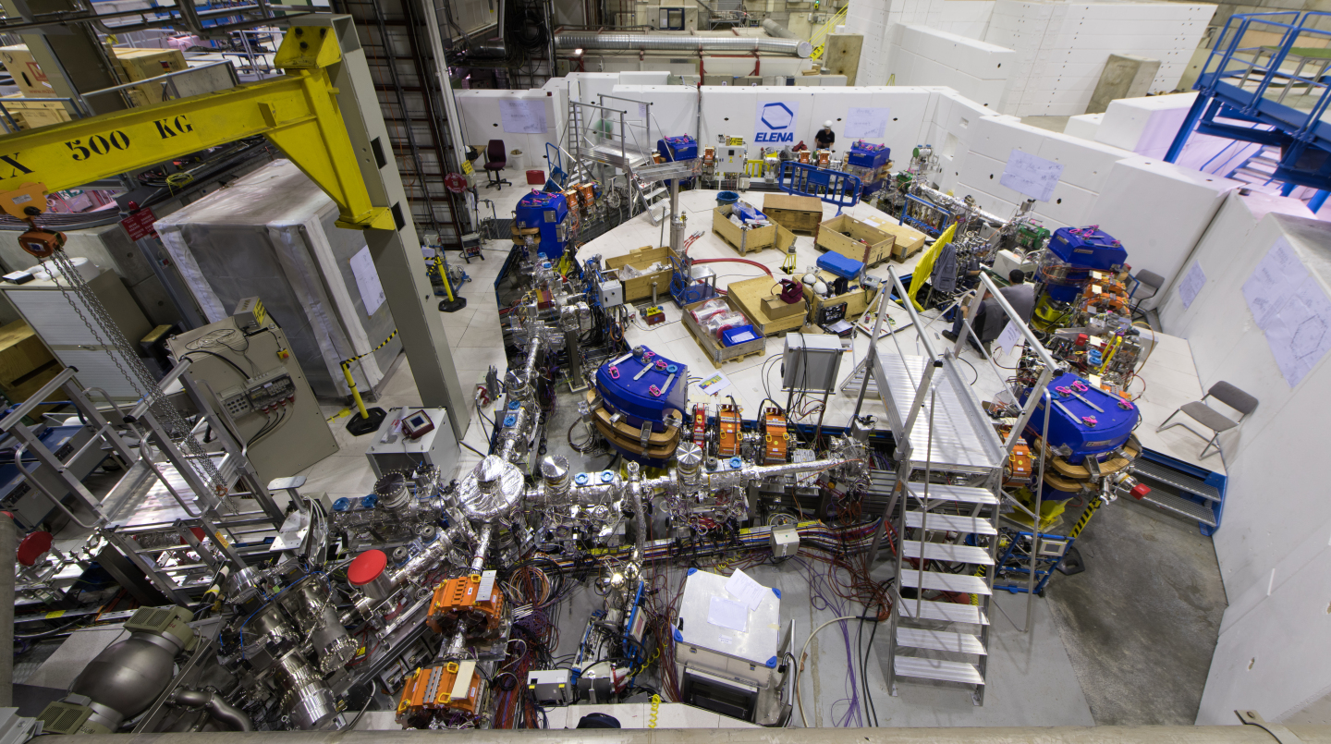
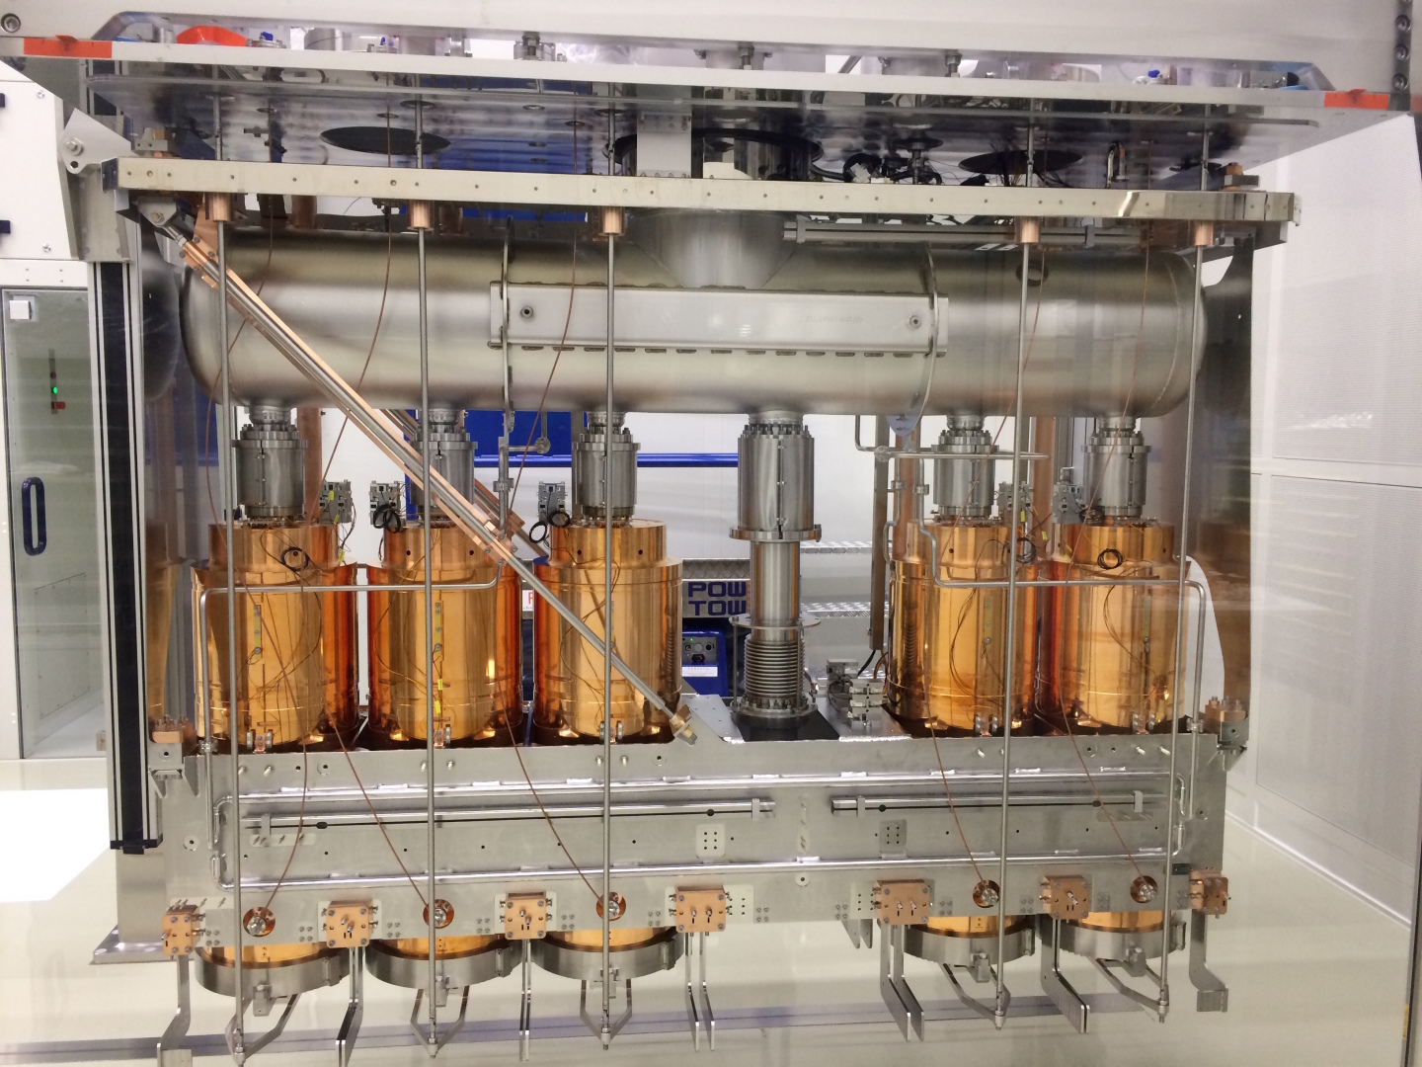
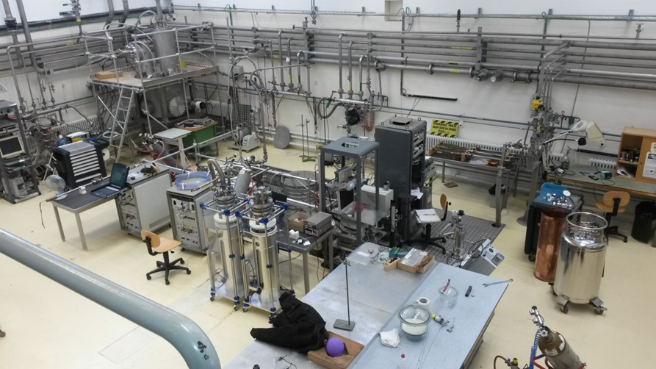
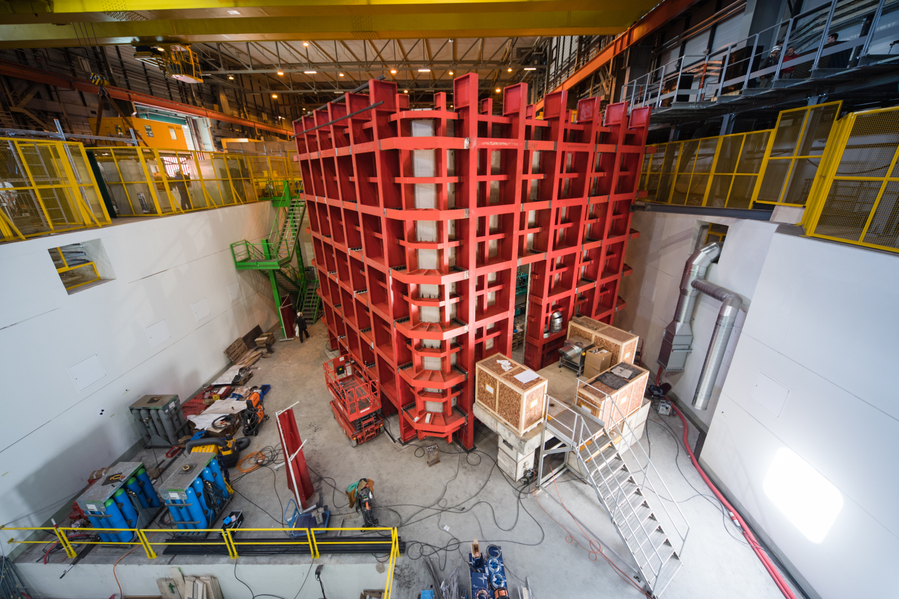
Overview of cryogenics at CERN
North area =>
SM18
Antimatter Factory =>
HIE-Isolde
Test facilities =>
Neutrino Platform
…
Sources: CERN-PHOTO-201509-239, CERN-EX-0606017, CERN-PHOTO-201607-170-3, OPEN-PHO-ACCEL-2016-016-7, CERN-PHOTO-201703-077-4

Slide 8
Cryogenic fluids - Thermophysical properties
Fluid | ⁴He | N₂ | Ar | H₂ | O₂ | Kr | Ne | Xe | Air | Water
Boiling temperature (K) @ 1.013 bar | 4.2 | 77.3 | 87.3 | 20.3 | 90.2 | 119.8 | 27.1 | 165.1 | 78.8 | 373
Latent heat of evaporation @ T_{b} in kJ/kg | 20.9 | 199.1 | 163.2 | 448 | 213.1 | 107.7 | 87.2 | 95.6 | 205.2 | 2260
Volume ratio gas_{(273 K)} / liquid | 709 | 652 | 795 | 798 | 808 | 653 | 1356 | 527 | 685 | -----
Volume ratio saturated vapor to liquid (1.013 bar) | 7.5 | 177.0 | 244.8 | 53.9 | 258.7 | 277.5 | 127.6 | 297.7 | 194.9 | 1623.8
Specific mass of liquid (at Tb) – kg/m³ | 125 | 804 | 1400 | 71 | 1140 | 2413 | 1204 | 2942 | 874 | 960

Slide 9
Cryogenics and Superconductivity

Slide 10
Characteristic temperatures of low-energy phenomena
Phenomenon | Temperature
Debye temperature of metals | few 100 K
High-temperature superconductors | ~ 100 K
Low-temperature superconductors | ~ 10 K
Intrinsic transport properties of metals | < 10 K
Cryo-pumping | few K
Cosmic microwave background | 2.725 K
Superfluid ⁴He | < 2.17 K
Bolometers for cosmic radiation | < 1 K
ADR stages, Bose-Einstein condensates | ~ μK

Slide 11
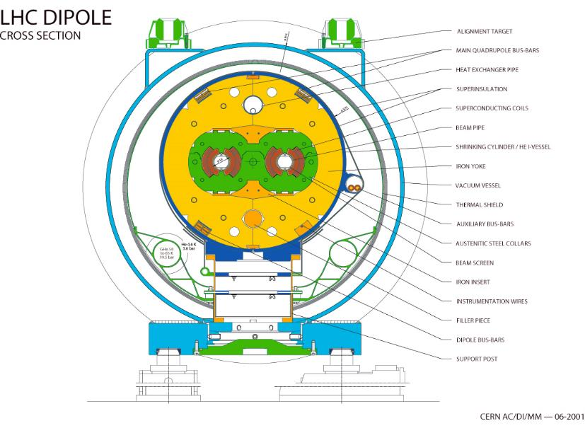
Cryogenic application: Dipole magnets of the LHC
LHC main cryostat
(Cross-section)
Alignment targets
All circuits are cooled by helium
Multi layer insulation (MLI)
Vacuum vessel
Thermal shield
Bottom tray
(50-65 K feed line
~ 19.5 bar)
Beam screen
5-20 K support post
heat intercept
Magnet support posts (GFRE)
External supports (jacks)

Slide 12
Heat Transfer and Thermal Insulation

Slide 13
Cryogenic System Design
Low temperature environment
Source of refrigeration
Heat exchange strategy
Sample environment
Thermal insulation
Structural support
Instrumentation and control
Refrig.
T_{high}
Thermal insulation
Instr. &
Control
T_{low}
Heat load
Vacuum
Structural support

Slide 14
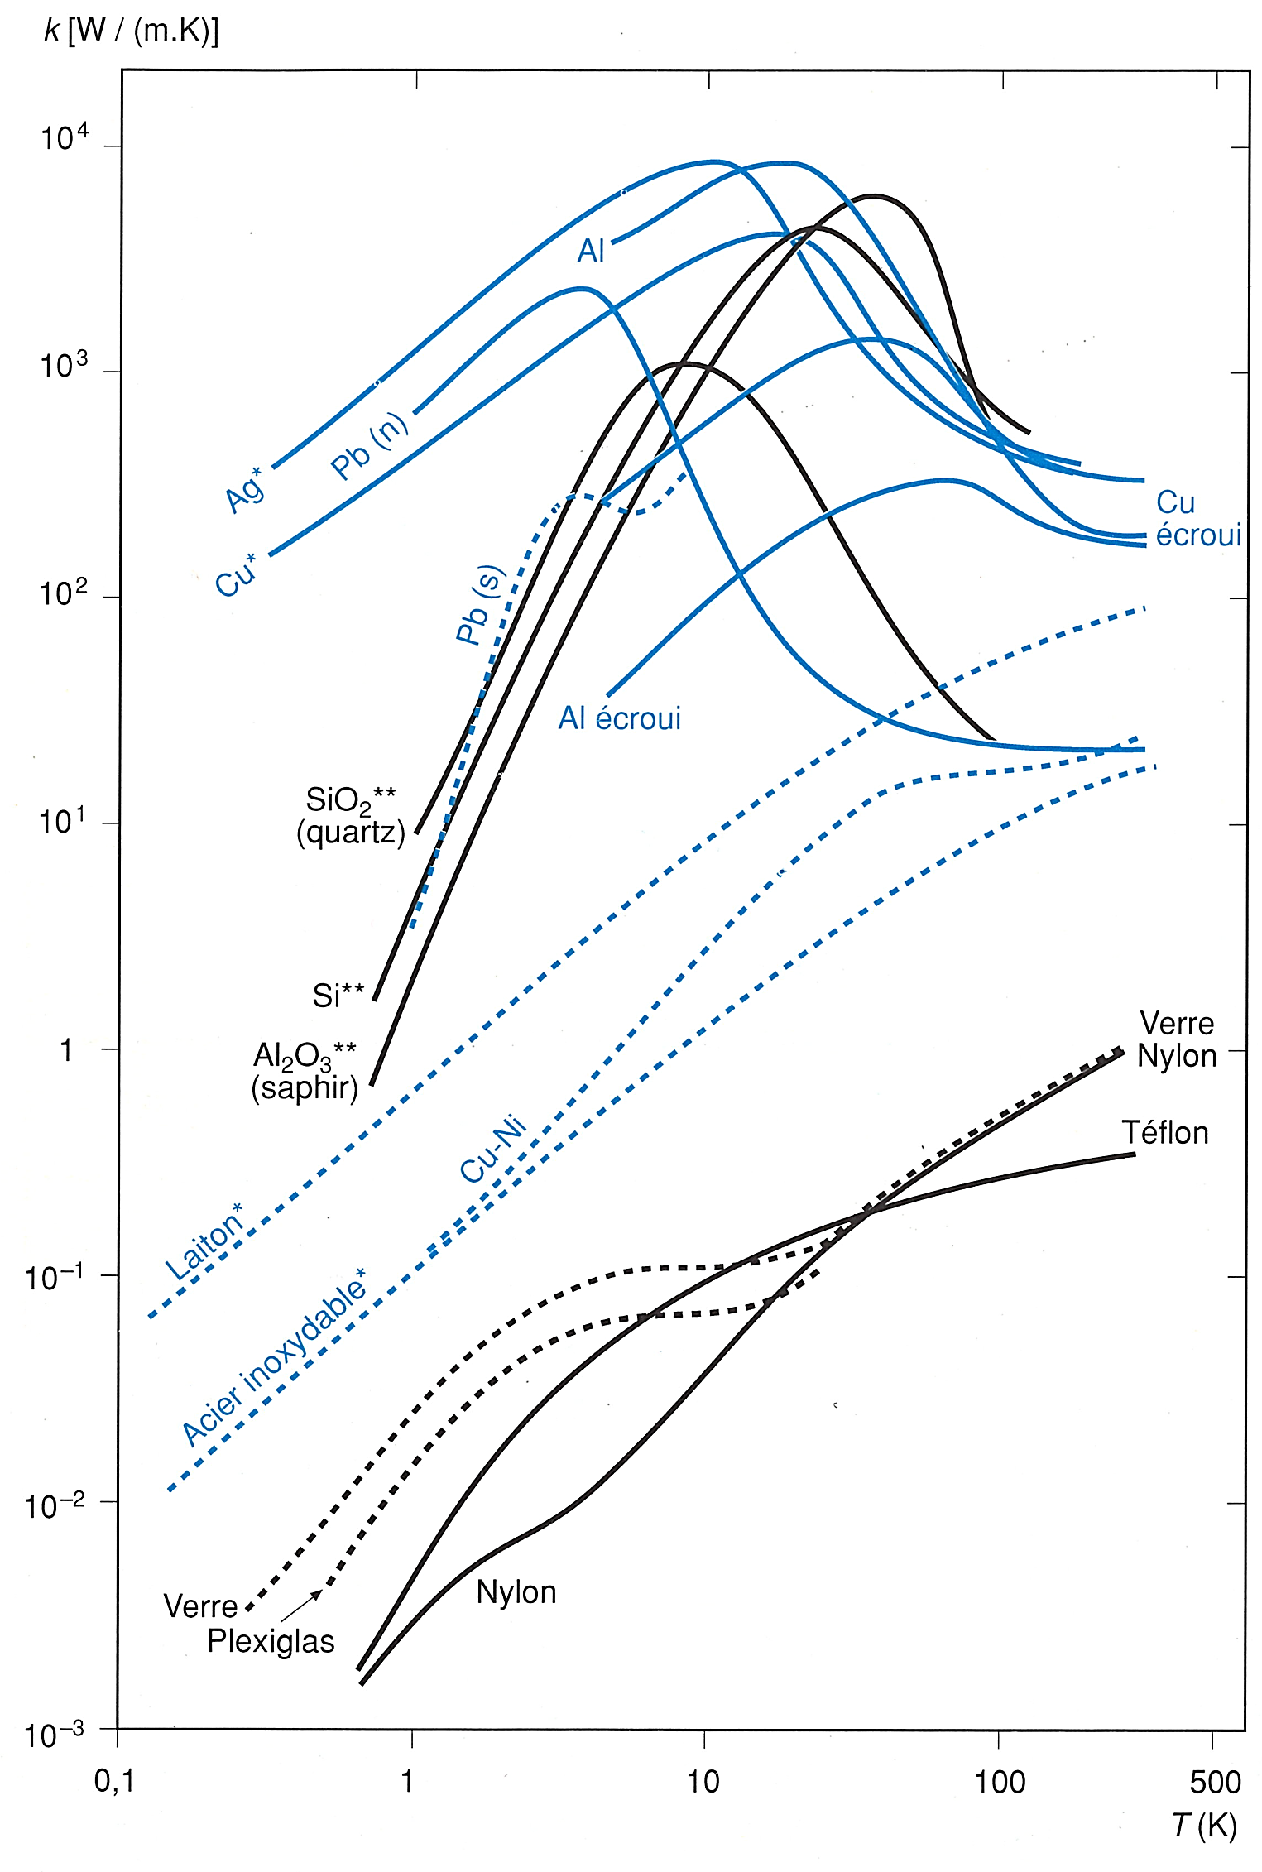



Thermal conductivity, solid conduction – how to cool?
$\text{λ}$ (W/m K)
Heat transport in solids
Fourier's law:
$$\dot{Q}=−\text{λ}\text{(}\text{T}\text{) }\frac{A}{l} ∇T$$
Pure dielectric crystals: phonons
Dielectrics/Insulators: phonons
Pure metals: free electron gas and phonons
Alloyed metals: electrons and phonons
$T$ (K)
From: Cryogenie, Institut International du Froid, Paris

Slide 15
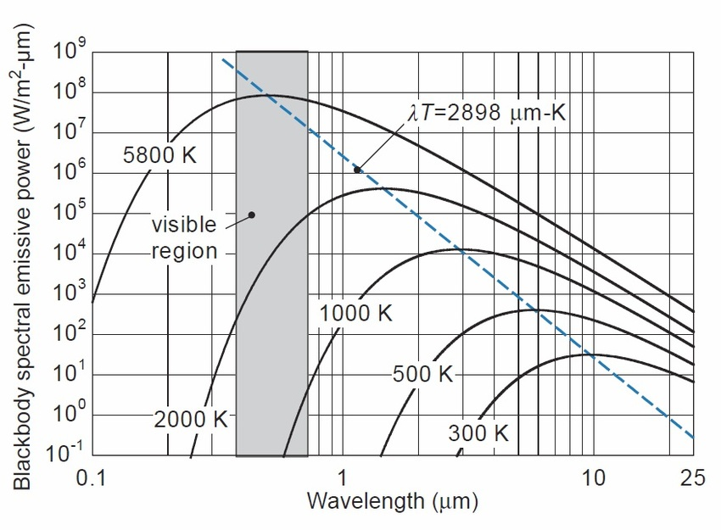
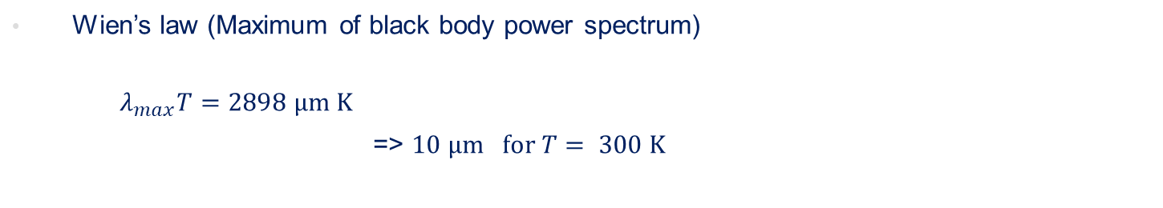
Radiative heat transfer – Black body
Wien’s law (Maximum of black body power spectrum)
  $λ_{max}T=2898 μm K$
  => $10 μm for T= 300 K$
Source: https://www.researchgate.net/figure/Blackbody-spectral-emissive-power-as-a-function-of-wavelength-for-various-values-of_fig4_320298109

Slide 16

Radiative heat transfer – Grey body
Wien’s law (Maximum of black body power spectrum)
  $λ_{max}T=2898 μm K$
  => $10 μm for T= 300 K$
Stefan-Boltzmann’s law
  Black body Q_{rad} = σ AT⁴ σ = 5.67 x 10⁻⁸ W/(m² K⁴)
  (Stefan-Boltzmann’s constant)
  “Grey” body Q_{rad} = ε σ A T⁴ ε - emissivity of surface
  “Grey” surfaces at T₁ and T₂ Q_{rad} = E σ A (T₁⁴ –T₂⁴) E - function of ε₁, ε₂, geometry
.
.
.

Slide 17
Emissivity of technical materials at low temperatures
 | Surface at 77 K | Surface at 4.2 K
Stainless steel, as found | 0.34 | 0.12
Stainless steel, mech. polished | 0.12 | 0.07
Stainless steel, electropolished | 0.10 | 0.07
Stainless steel + Al foil | 0.05 | 0.02
Aluminium, as found | 0.12 | 0.07
Aluminium, mech. polished | 0.10 | 0.06
Aluminium, electropolished | 0.08 | 0.04
Copper, as found | 0.12 | 0.06
Copper, mech. polished | 0.06 | 0.02
From: Ph. Lebrun, CAS School on Vacuum in Accelerators, 2006
Condensed layers from gas phase easily vary these values !

Slide 18
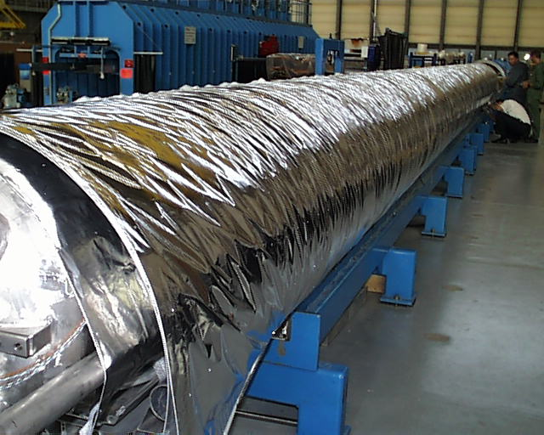
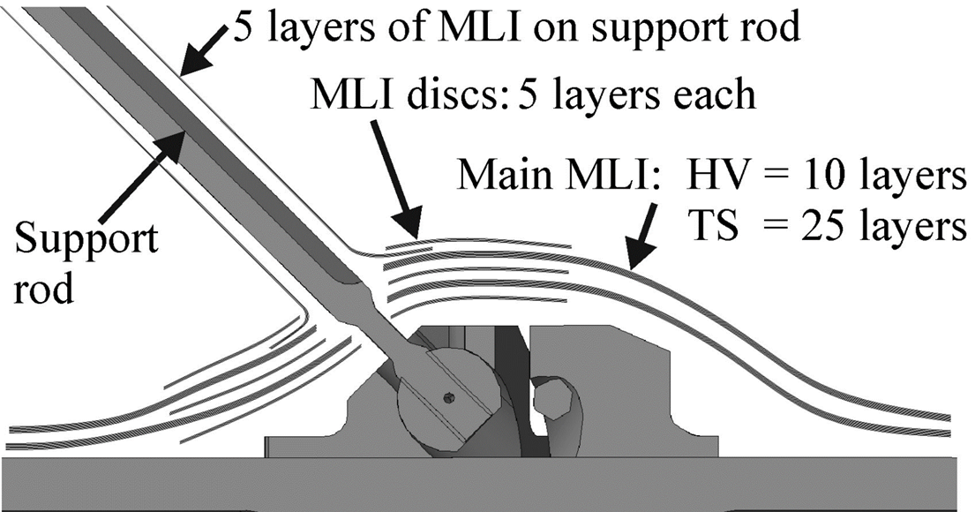
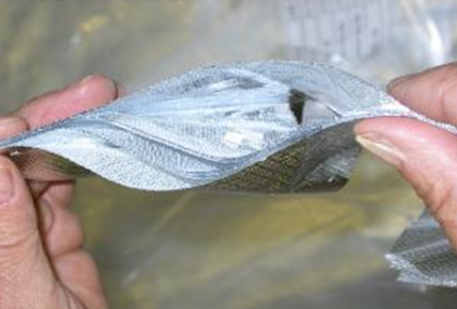
Multi-layer insulation (MLI)
Complex system involving three heat transfer processes
  Q_{MLI} = Q_{radiation} + Q_{solid} + Q_{residual}
  With n reflective layers of equal emissivity, Q_{radiation} ~ 1/(n+1)
  Parasitic contacts between layers, Q_{solid} increases with layer density
  Q_{residual} due to residual gas trapped between layers, scales as 1/n in molecular regime
  Non-linear behavior requires layer-to-layer modeling
Cold surface
Solutions for penetrations and support structures
Large surface application

Slide 19
Typical heat fluxes between flat plates (cold side vanishingly low)
Configuration | W/m²
Black-body radiation from 293 K | 420
Black-body radiation from 80 K | 2.3
Gas conduction (10⁻³ mbar He) from 290 K | 19
Gas conduction (10⁻⁵ mbar He) from 290 K | 0.19
Gas conduction (10⁻³ mbar He) from 80 K | 6.8
Gas conduction (10⁻⁵ mbar He) from 80 K | 0.07
MLI (30 layers) from 290 K, pressure below 10⁻⁵ mbar | 1-1.5
MLI (10 layers) from 80 K, pressure below 10⁻⁵ mbar | 0.05
MLI (10 layers) from 80 K, pressure 10⁻³ mbar | 1-2

Slide 20
Refrigeration and Liquefaction

Slide 21
Thermodynamics of cryogenic refrigeration
Graph for T_{warm} = 300 K
For low temperatures e_{c}=
He @ 1.8 K e_{c}=166 => COP 980
Use of low temperatures if no alternative
Better intercept heat at higher temperatures
He @ 4.5 K e_{c}=65.7 => COP 230
H₂ @ 20 K e_{c}=14
N₂ @ 77 K e_{c}=2.9
2
5
10
300

Slide 22
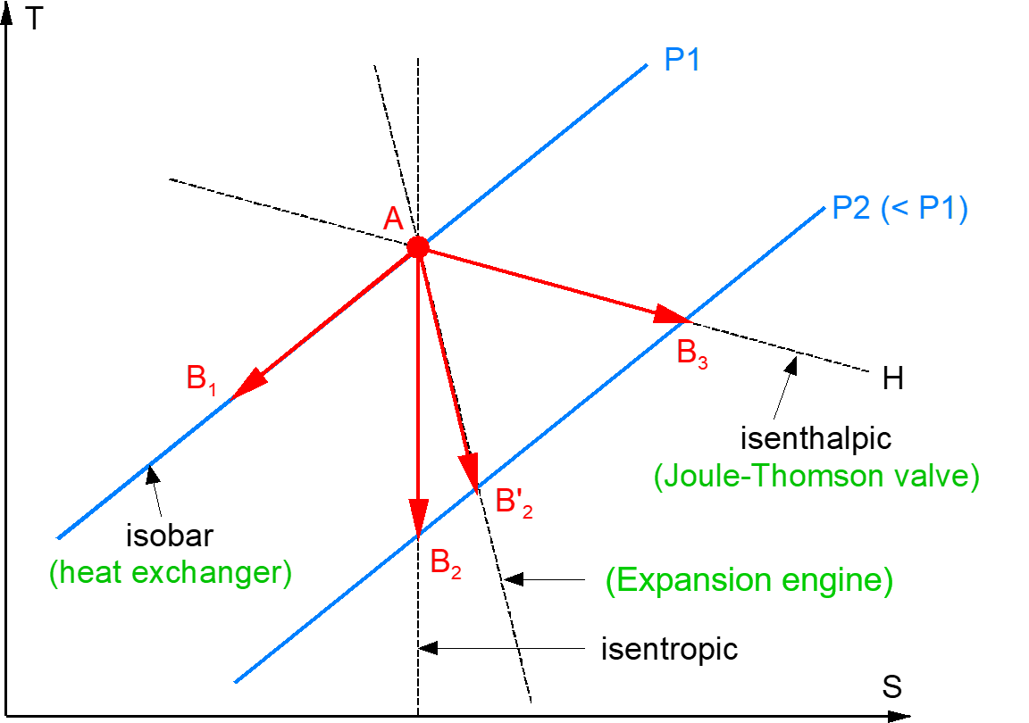
Elementary cooling processes in a T-s diagram
p₁
p₂ < p₁
isobaric

Slide 23
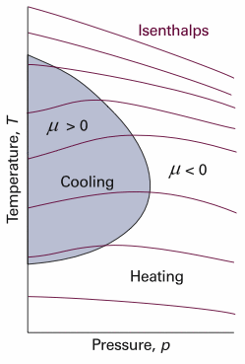
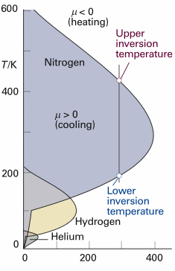
Maximum Joule-Thomson inversion temperatures
p/bar
Source: http://faculty.chem.queensu.ca/people/faculty/mombourquette/
Chem221/3_FirstLaw/ChangeFunctions.asp

Slide 24
Maximum Joule-Thomson inversion temperatures
Cryogen | Max. inversion temperature [K]
Helium | 43
Hydrogen | 202
Neon | 260
Air | 603
Nitrogen | 623
Argon | 723
Source: Refprop® NIST
p/bar
Source: http://faculty.chem.queensu.ca/people/faculty/mombourquette/
Chem221/3_FirstLaw/ChangeFunctions.asp
Air can be cooled down and liquefied by J-T expansion from room temperature,
Helium and hydrogen need precooling down to below the inversion temperature by heat exchange or work-extracting expansion (e.g. in turbines)

Slide 25
Combining all three processes in a cryoplant
p₁
p₂ < p₁
isobaric

Slide 26
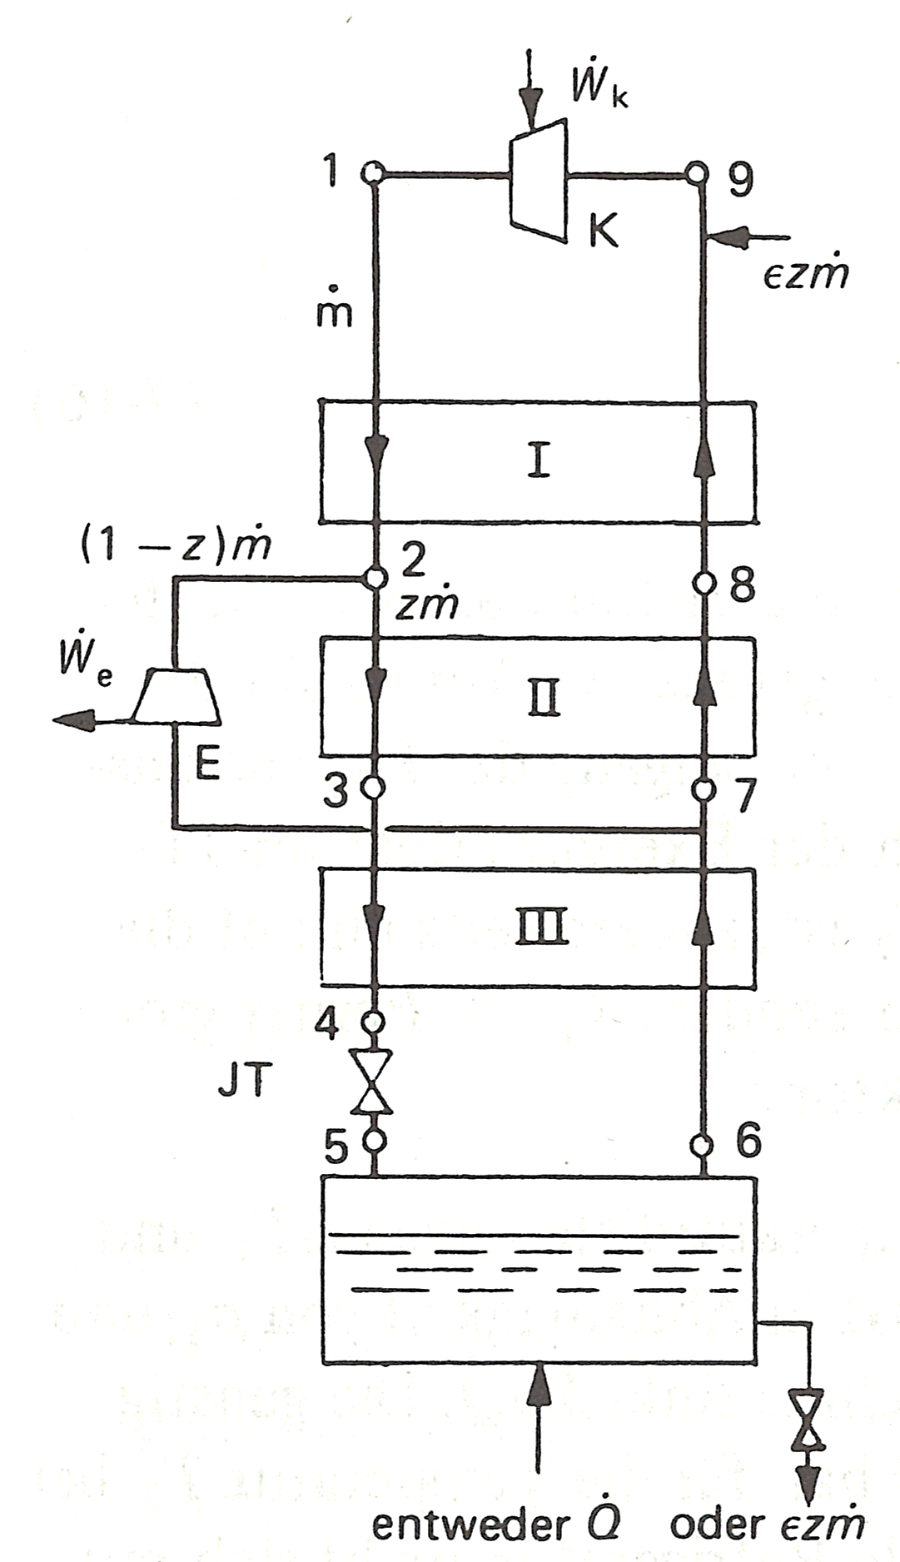
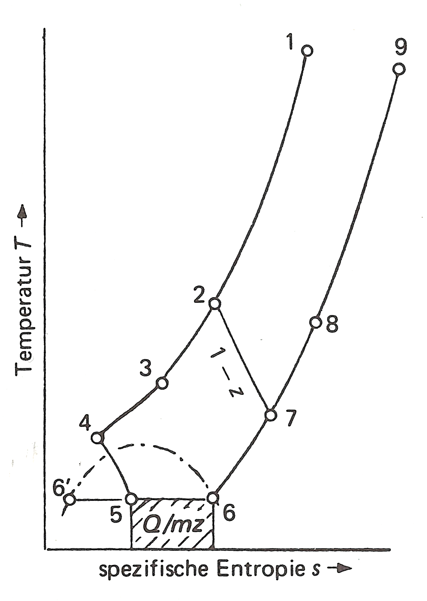

Claude cycle ( Turbo Brayton + JT )
Temperature →
HEX
Turbin
expan.
JT
HEX
${ \dot{Q}}_{in}$
Specific entropy s →
Source: Frey, Haefer, Tieftemperaturtechnologie, VDI Verlag 1981, ISBN 3-18-400503-8, adapted.

Slide 27
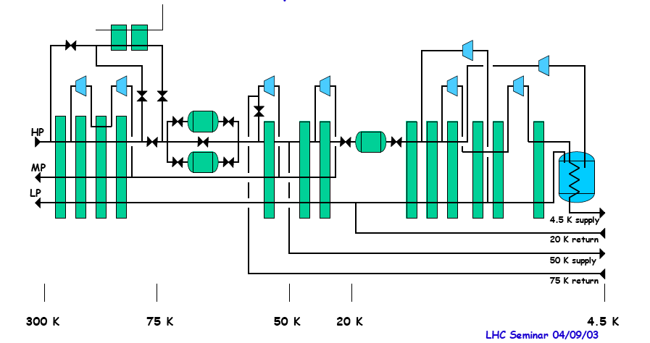
Process diagram, LHC refrigerator 18 kW @ 4.5 K
LN2 (cool-down)
Adsorbers (remove impurities)
Turbines
Heat exchangers

Slide 28
COP of large cryogenic helium refrigerators
Size of the plant matters
Tokamak
in France
Heavy ion
collider US
e⁺e⁻ Accel.
in Japan
LINAC ring
US
Circular acc.
Germany
e⁺e⁻ Accel.
CERN
Hadron Acc.
CERN

Slide 29
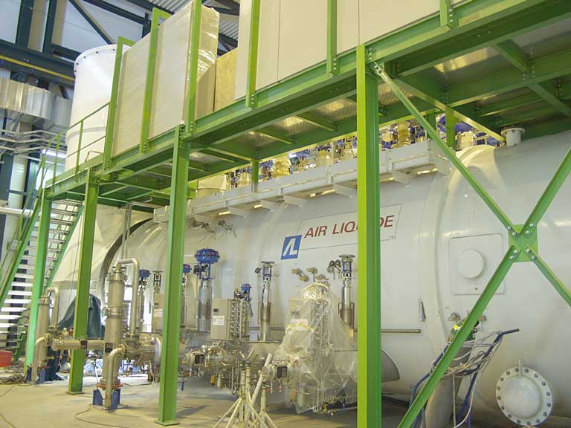
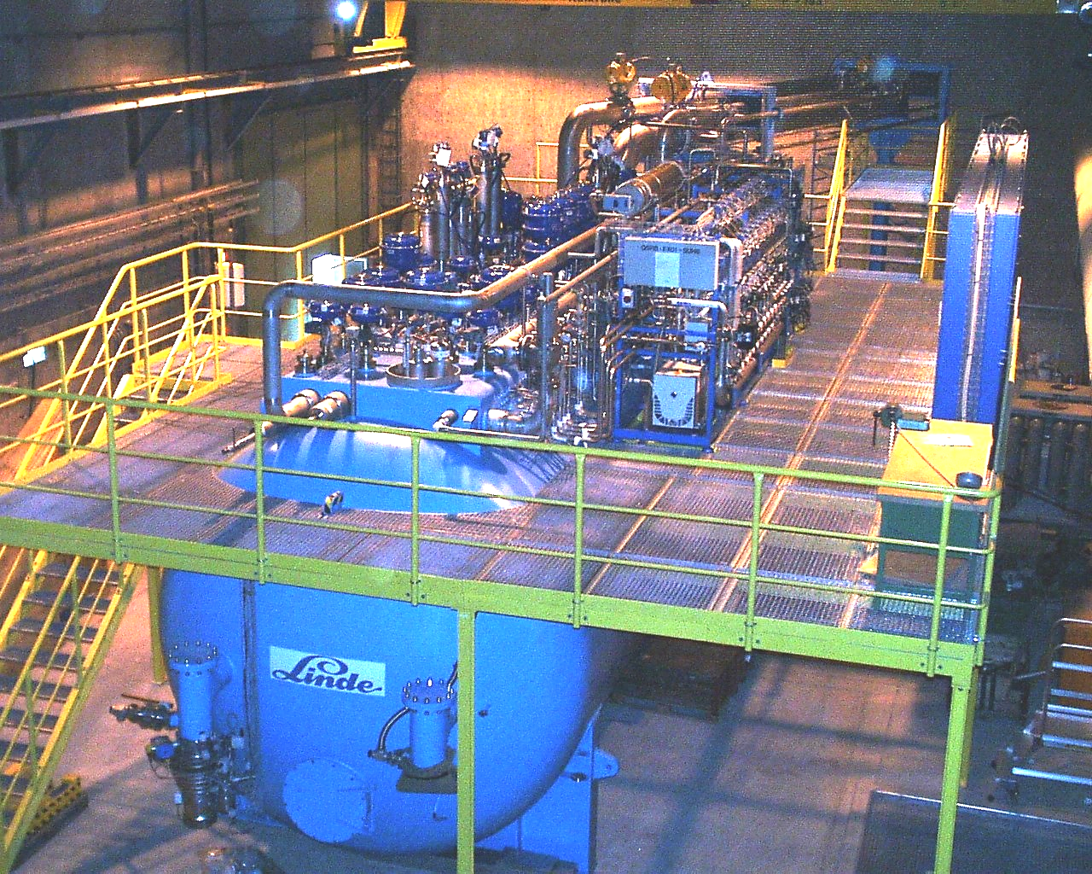
LHC 18 kW @ 4.5 K helium cryoplants
Th. shields: 33 kW @ 50 K to 75 K
Beam screen: 23 kW @ 4.6 K to 20 K
Current leads: 41 g/s liquefaction
4 MW compressor power
COP 220-230 W_{el}/W @ 4.5 K
Air Liquide
Linde

Slide 30
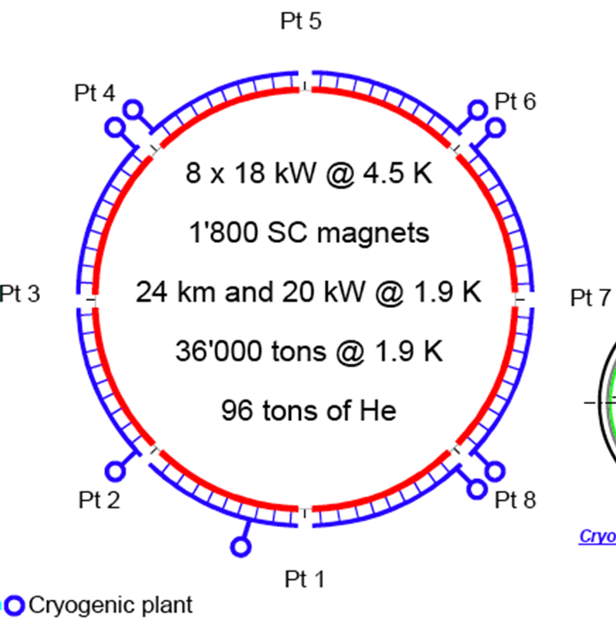
LHC 18 kW @ 4.5 K helium cryoplants
33 kW @ 50 K to 75 K
23 kW @ 4.6 K to 20 K
41 g/s liquefaction
4 MW compressor power
COP 220-230 W/W @ 4.5 K
8 x 18 kW @ 4.5 K
1800 SC magnets
36,000 ton @ 1.9 K
96 ton of He
24 km and 20 kW @ 1.9 K
Air Liquide
Linde

Slide 31
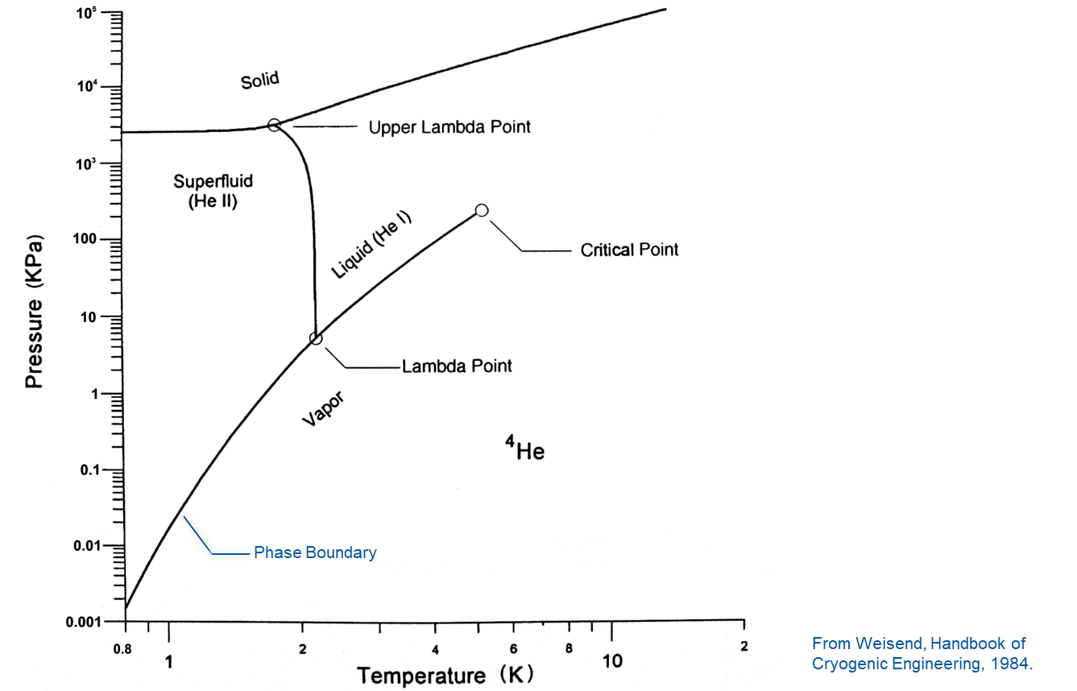
⁴He phase diagram
Pressure (kPa)
Helium has no triple point
Solid He only above 25 bar
Lambda line => He I / He II separ.
He II with very special properties
From Weisend, Handbook of
Cryogenic Engineering, 1984.

Slide 32
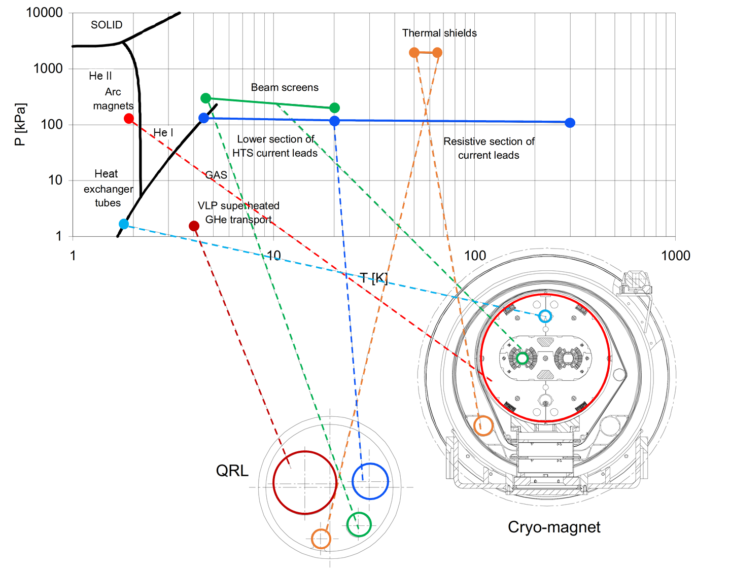
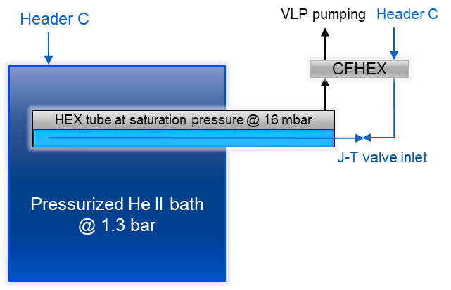
LHC Cooling scheme
From
From
Main supply
Current leads return
SC cavities are cooled in a 4.5 K saturated LHe bath
Header D
20 K return
E
Header B
VLP pumping
Header F
Shield return
Header C
4.6 K, 3 bara
Source: adapted from CERN, LHC design report, ch. 11

Slide 33
Cryogenic Fluid Properties
He I and He II

Slide 34
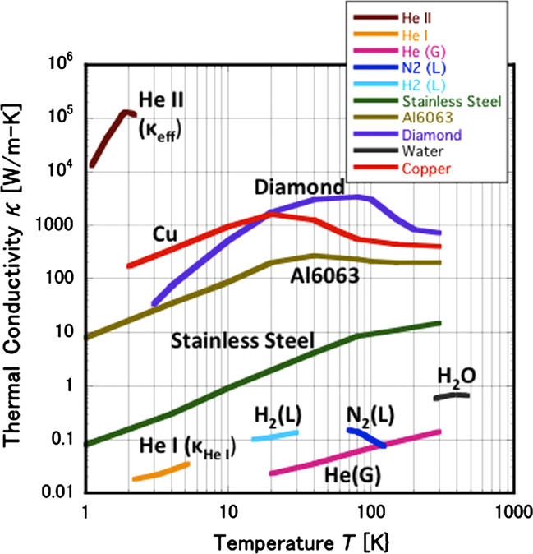
From He I to He II
Normal fluid helium => He I
    Like a standard fluid: viscosity etc.
Superfluid helium => He II
  Temperature < 2.17 K
  Peak in heat capacity c_{p} at T_{λ}
  Very high thermal conductivity
  Low / vanishing viscosity
Murakami, Experimental study of thermo-fluid dynamic effect in He II cavitating flow, Cryogenics, 2012.

Slide 35
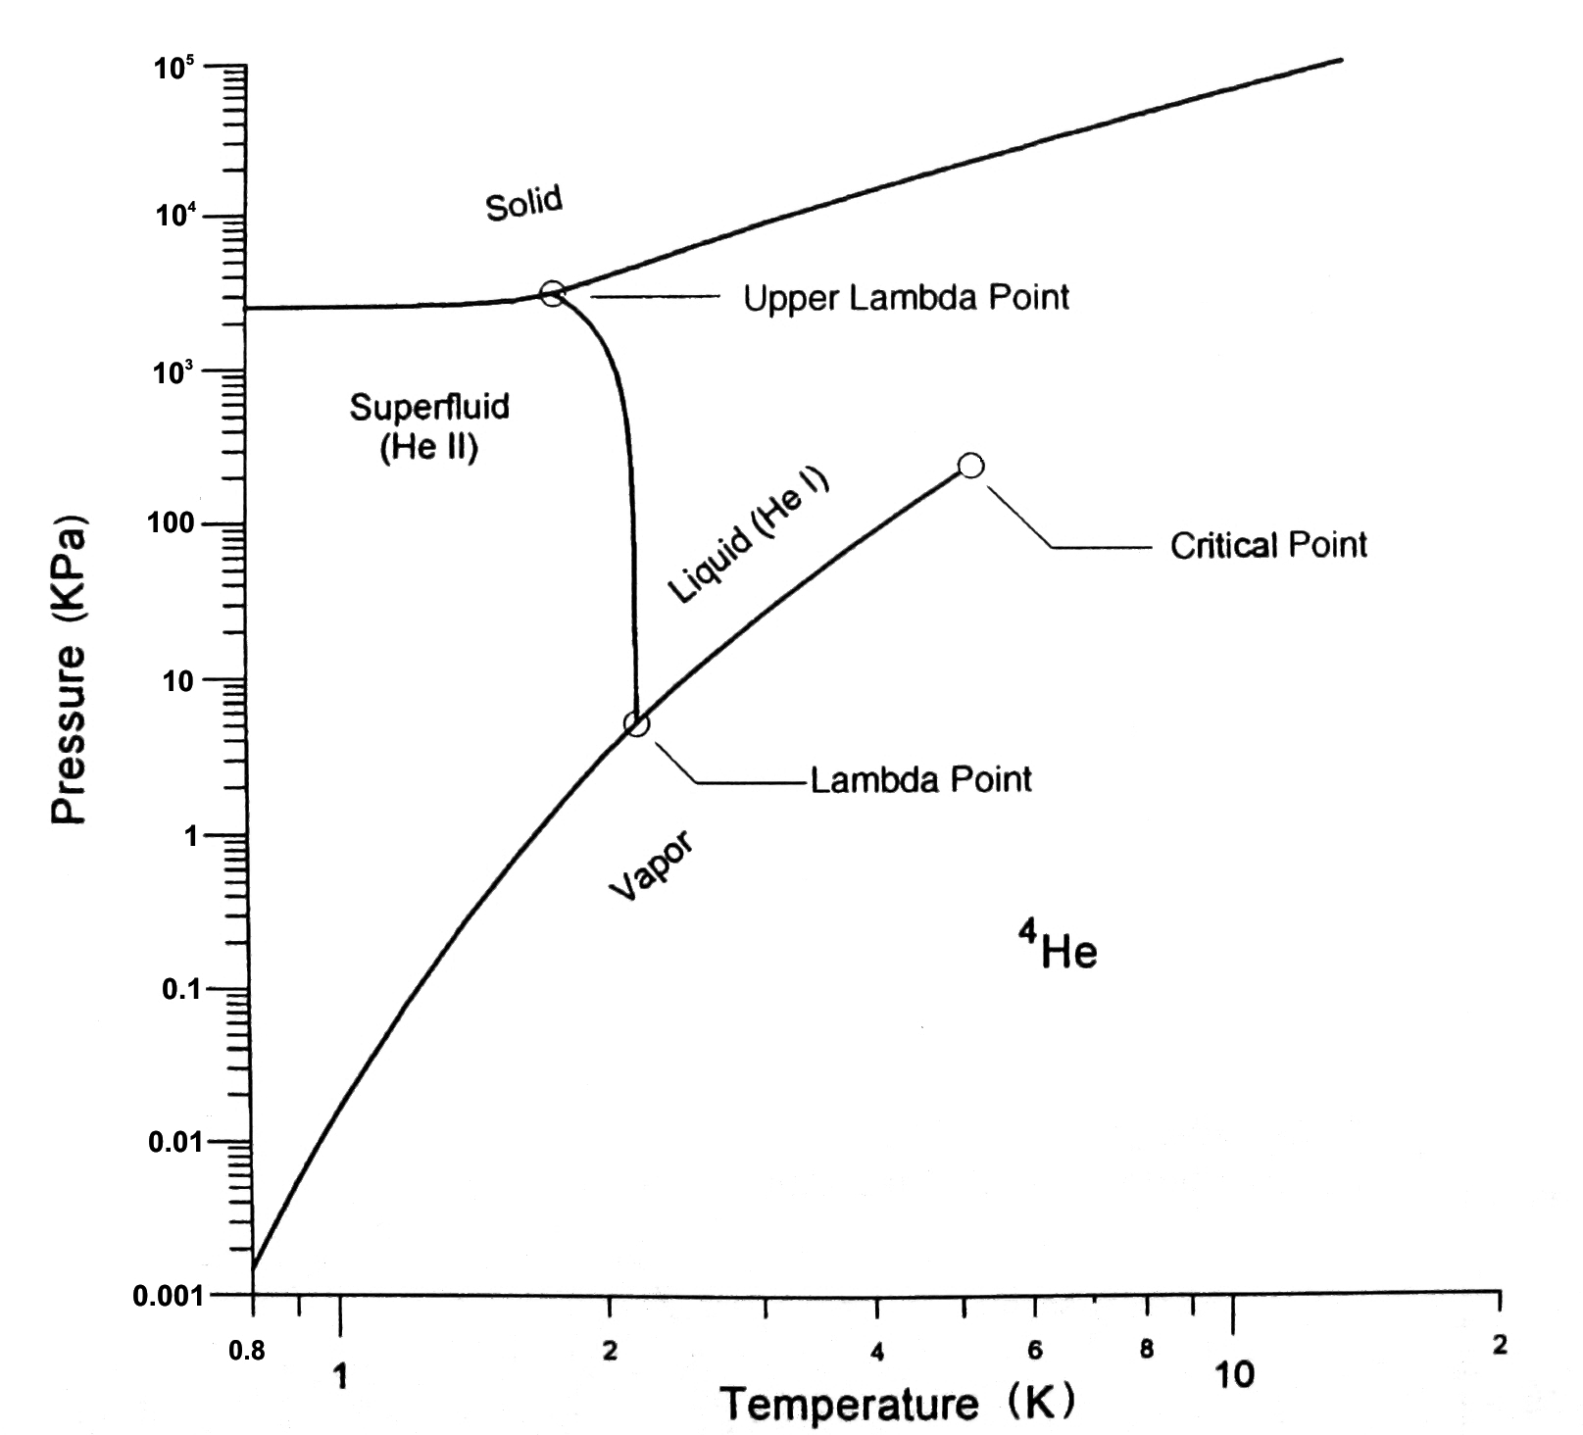
Phase diagram of ⁴He
T_{λ} ≈2.1768 K @
p_{λ} ≈ 50.41 mbar
Phase Boundary
From Weisend, Handbook of
Cryogenic Engineering, 1984.

Slide 36
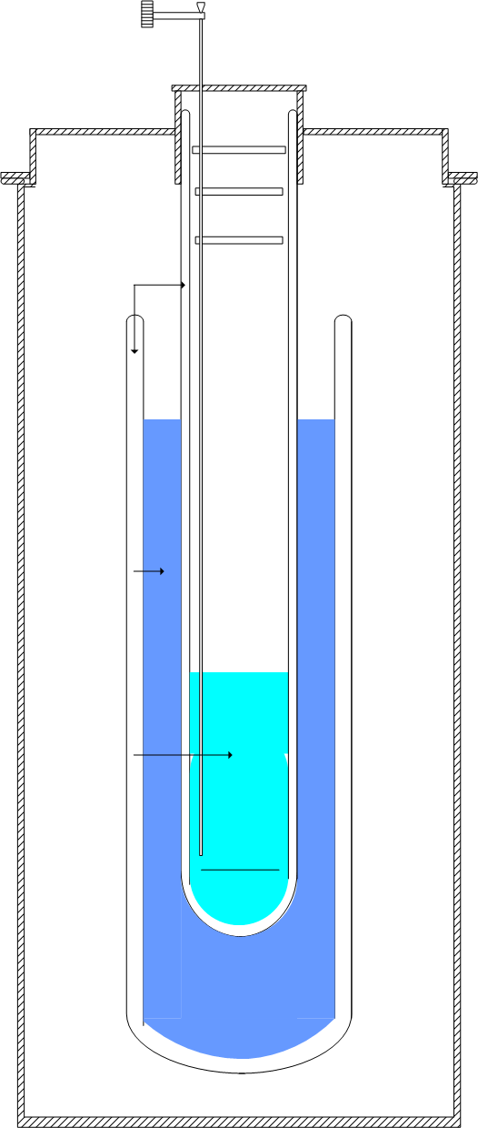
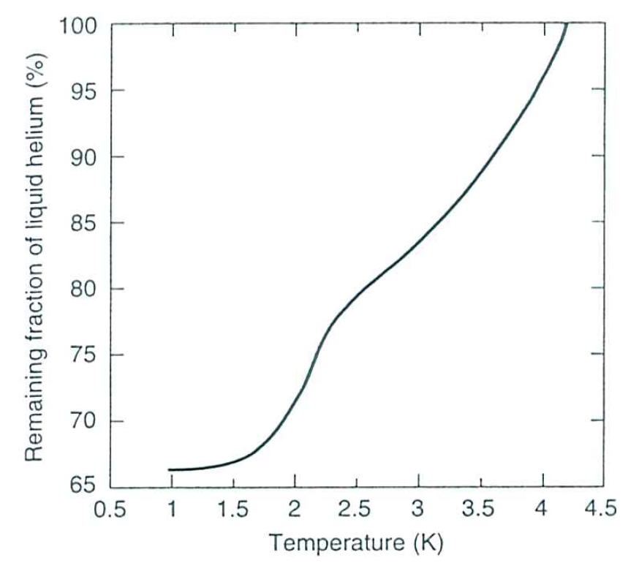
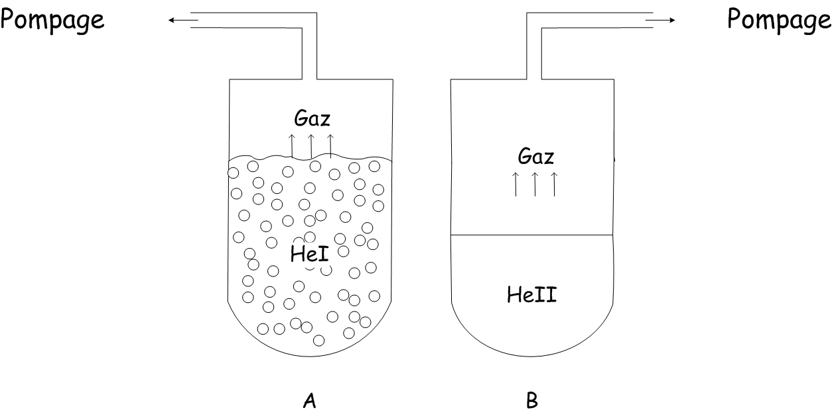
Glass cryostat set-up
Vacuum
pump
Transfer line
Vacuum
insulation
Pumping
Boiling suddenly
stops in He II
LN₂
LHe
Boiling in He I
From Ekin, Experimental Techniques for Low Temperature Measurements, 2006.

Slide 37
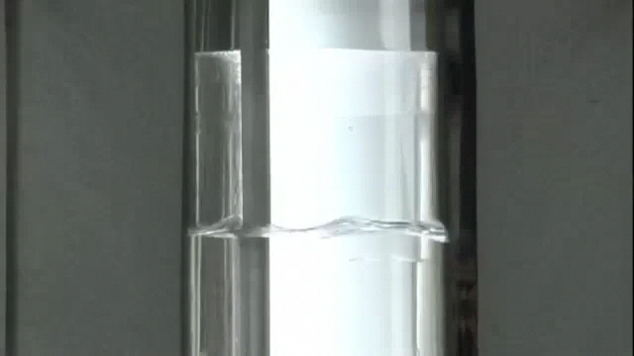
Boiling effects during cooldown / Pumping on the He vapour

Slide 38
How to explain that unique behaviour ?
Two fluid model of L. Tisza:
He II is composed of two components

Slide 39
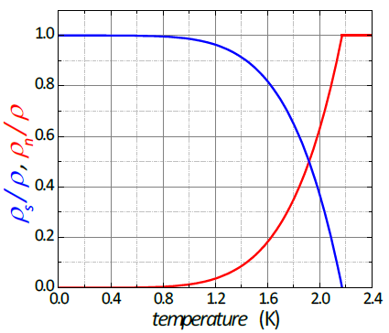
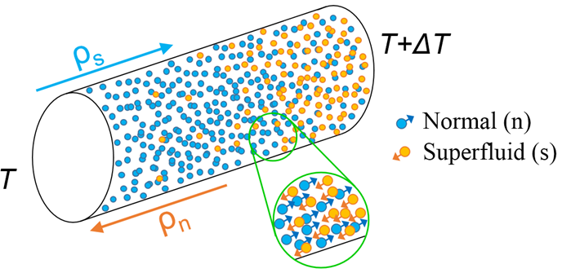
Two-fluid model of He II by Tisza, 1938
ρ_{s}/ρ, ρ_{n}/ρ
From Gross, Marx, Wather-Meissner Institut, 2009.
Superfluid component:
no entropy: S_{s} = 0
zero viscosity: η_{s} = 0
Normal component:
carries total entropy: S_{n} = S
finite viscosity: η_{n} = η_{n}
Temperature / K
Formal description of He II as the sum of a normal and a superfluid component.
Ratio ρs/ρn depends on temperature

Slide 40
He II in practice

Slide 41

Superleak below T_{l}
1963 movie by Alfred Leitner, Michigan State University

Slide 42
Critical heat flux in He II
Power supply
Heat and mass flow are
limited by a critical velocity:
v > v_{cr}
Superfluid behavior becomes
non-linear (mutual friction)
k and η
Formation of vapor bubbles at
the surface of the heater
In He II re-condensation of
the vapor
Surface tension let the bubbles
implode
Implosion speed exceeds v₁
Shock wave => cavitation
He II level
Heater
Cryostat

Slide 43
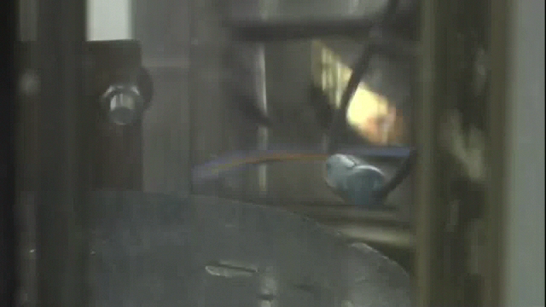
Critical heat flux in He II (T<T_{l})

Slide 44
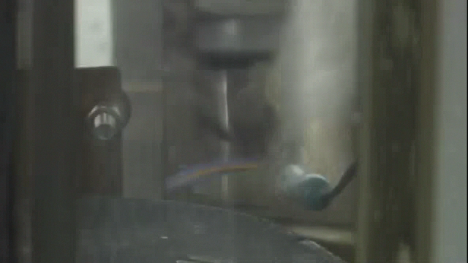
LHe I cooling (T>T_{l})

Slide 45
Concluding remarks
Cryogenics serving superconducting systems is now part of all major accelerators and future projects.
While advanced applications tend to favour “T< 2 K”, many almost industrial applications are based on “4.5 K” and R&D continues for “high temperature” applications.
Even though cryogenic engineering follows well defined rules and standards, there are still variants depending on boundary conditions, project schedule …
I could only recommend that demonstrated experience is evaluated and adapted to specific requirements you may have.

Slide 46
Some references
K. Mendelssohn, The quest for absolute zero, McGraw Hill (1966)
R.B. Scott, Cryogenic engineering, Van Nostrand, Princeton (1959)
G.G. Haselden, Cryogenic fundamentals, Academic Press, London (1971)
R.A. Barron, Cryogenic systems, Oxford University Press, New York (1985)
B.A. Hands, Cryogenic engineering, Academic Press, London (1986)
S.W. van Sciver, Helium cryogenics, Plenum Press, New York (1986)
K.D. Timmerhaus & T.M. Flynn, Cryogenic process engineering, Plenum Press, New York (1989)
Proceedings of CAS School on Superconductivity and Cryogenics for Particle Accelerators and Detectors, Erice (2002)
  U. Wagner, Refrigeration
  G. Vandoni, Heat transfer
  Ph. Lebrun, Design of a cryostat for superconducting accelerator magnet
  Ph. Lebrun & L. Tavian, The technology of superfluid helium
Proceedings of ICEC and CEC/ICMC conferences
CERN, HSE, Cryogenic Safety courses 1-3

Slide 47
Thank you for your attention.

Slide 49
Spare slides

Slide 50
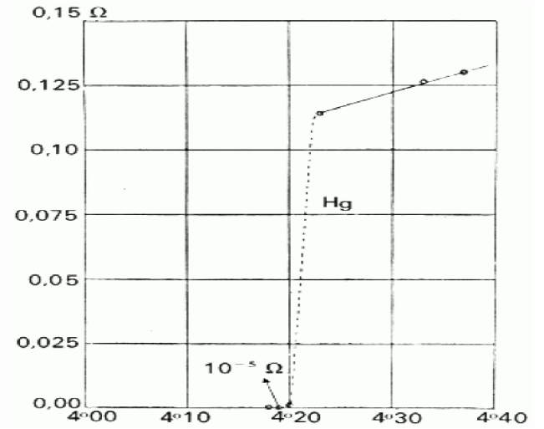
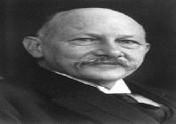
Superconductivity
H. Kamerlingh Onnes
Liquefied helium in 1909 at 4.2 K with 60 g He inventory
Observed in 1911 for the first time superconductivity of mercury
Nobel prize 1913
Historic graph showing the superconducting transition of mercury, measured in Leiden in 1911 by H. Kamerlingh Onnes.

Slide 51
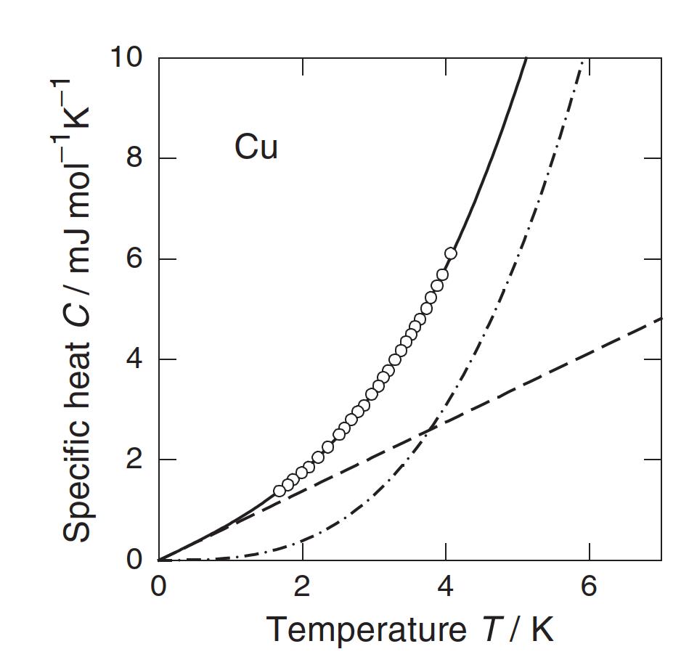
Heat capacity of materials – what to cool?
Discrete lattice vibrations => Phonons
Metals have a contribution of free electron gas => dominant at very low temperature
Source: Ekin, Experimental Techniques for Low-Temperature Measurements.
Source: Enss, Low temperature physics.

Slide 52
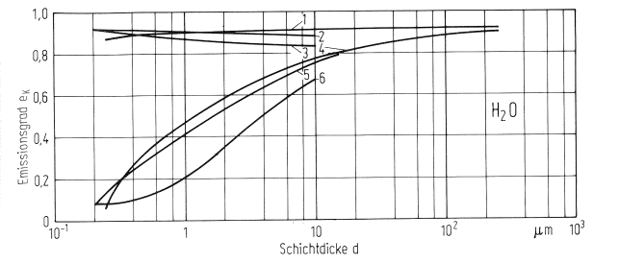
Emissivity of technical materials at low temperatures
Emissivity of cold surface coated with water condensate dependent on layer thickness
Emissivity ε
Source: Haefer, Kryovakuumtechnik, 1981
Layer thickness d
 | Cold surface, 77 K | Gas inlet
1 | Al + Cat-a-Lac | Uniform over time, 0.06 Pa
2 | Ni + Black Velvet 101-C10/3M | Sporadic
3 | Ni + Black Velvet 101-C10/3M | Uniform over time, 0.1 Pa
4 | Al, polished, ε = 0.07 | Uniform over time, 0.06 Pa
5 | Ni, polished | Sporadic
6 | Ni, polished | Uniform over time, 0.1 Pa

Slide 53
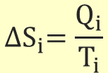
Thermodynamics of cryogenic refrigeration
First principle [Joule]
Second principle [Clausius]
(= for reversible process)
Hence,
which can be written in different ways:
introducing entropy S as
$${∆S}_{i}=\frac{Q_{i}}{T_{i}}$$
Carnot factor

Slide 54
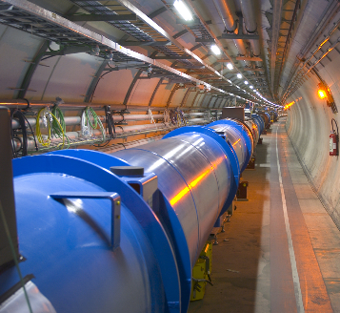
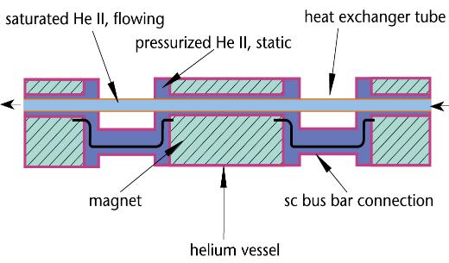
LHC cryogenic distribution scheme - QRL
Q_{dist} = 450 W
Pressurized/saturated He II
Q_{load} = 2400 W
T_{sink} = 1.85 K
T_{load_max} = 1.9 K
37’500 tons at 1.9 K
Source: Ph. Lebrun, Cooling with Superfluid Helium

Slide 55
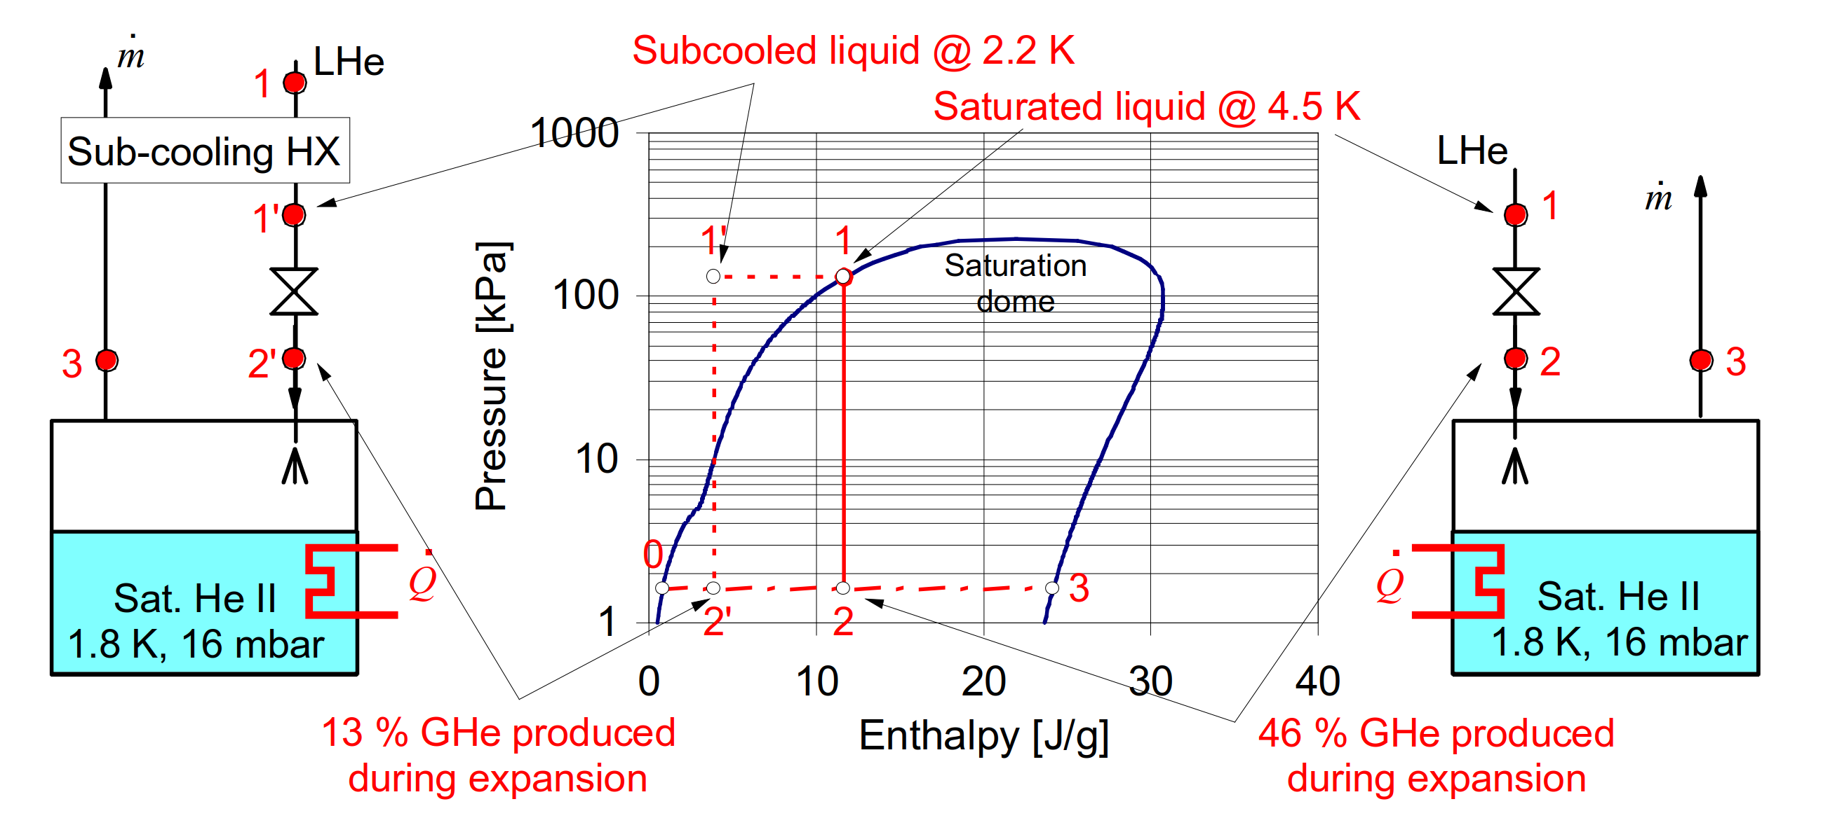
The effectiveness of J-T expansion
Source: Ph. Lebrun, Cooling with Superfluid Helium

Slide 56
Refrigerator Liquefier

Slide 57
Refrigerator Liquefier
For refrigerators/liquefiers with the same efficiency:

Slide 58
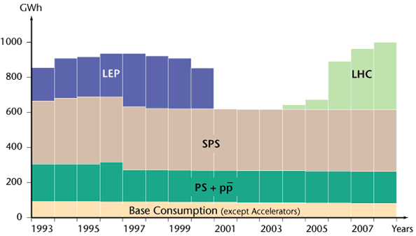
Energy consumption CERN, LHC and Cryo
CERN in total is around 200 MW with LHC contributing by 115 MW
1.25 TWh in 2018
Source: https://www.lhc-closer.es/taking_a_closer_look _at_lhc/0.energy_consumption
When the LHC is up and running the total average power for the whole CERN site will peak during July at about 180 MW of which:
  LHC cryogenics 27.5 MW (40 MW installed)
  LHC experiments 22 MW

