Slide 1
L1Calo Joint Meeting
First time in Cambridge
Thanks to Mark for organizing
pleasant welcome/location/weather

Slide 2
A few random thoughts
LHC/ATLAS startup performance
Old problems
New problems
Upgrade
Meeting format

Slide 3
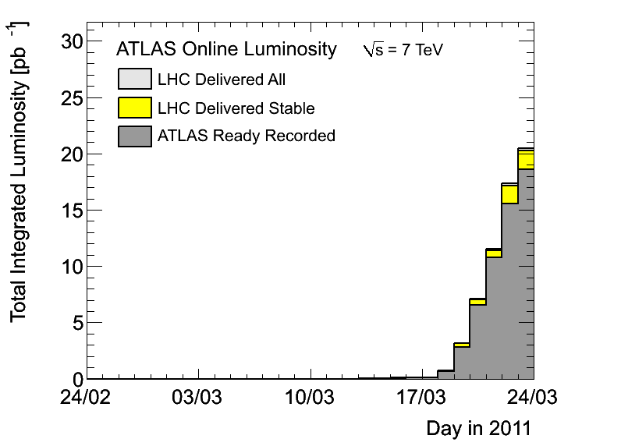
2011 start-up
20 pb⁻¹ delivered in (less than) one week
  14 pb⁻¹ with ATLAS magnets off! ☹
New record luminosity of 2.5x10³² achieved
  With 194 colliding bunches
  75 ns spacing
Large in and out-of-time pile-up
My last shift
Ended here

Slide 4
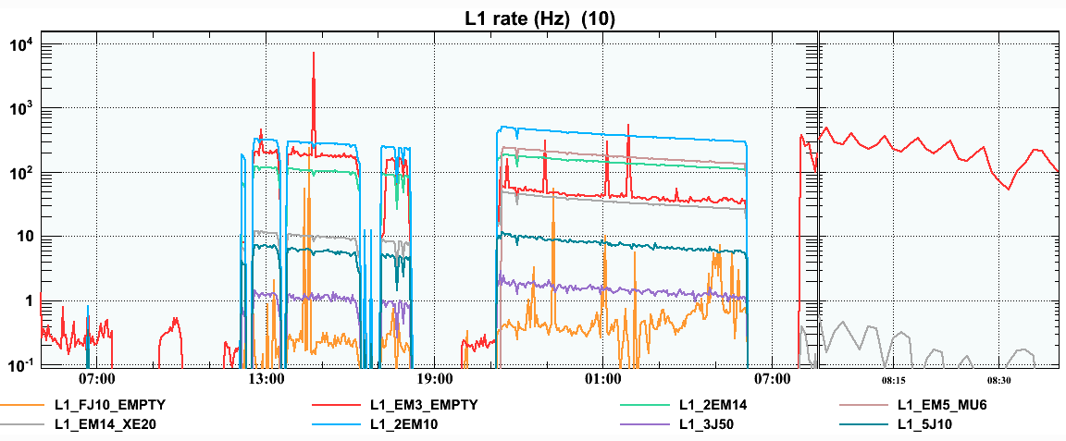
Old favourites: Noise bursts
Some rates @ 8:00 AM
EM3_EMPTY (and other cosmic triggers) are/have always been unstable with beam
  Was mostly stable before beam arrived this year
This morning: 3 kHz input rate coming from one tower in Larg
At least the EMPTY bunch-group is getting smaller…

Slide 5
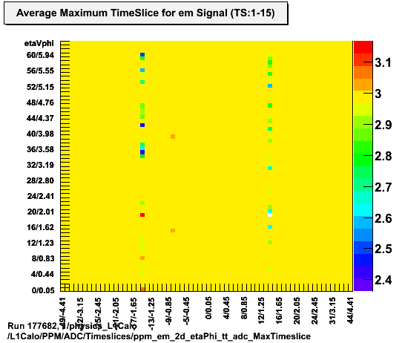
Old favourites: Overlap
The (famous) cables are now cut
As expected, that’s not the end of the story
Dedicated runs over the w/e helped with debugging
Hot news, bug in TBB delay setting found
Damien is working on a new set of delays

Slide 6
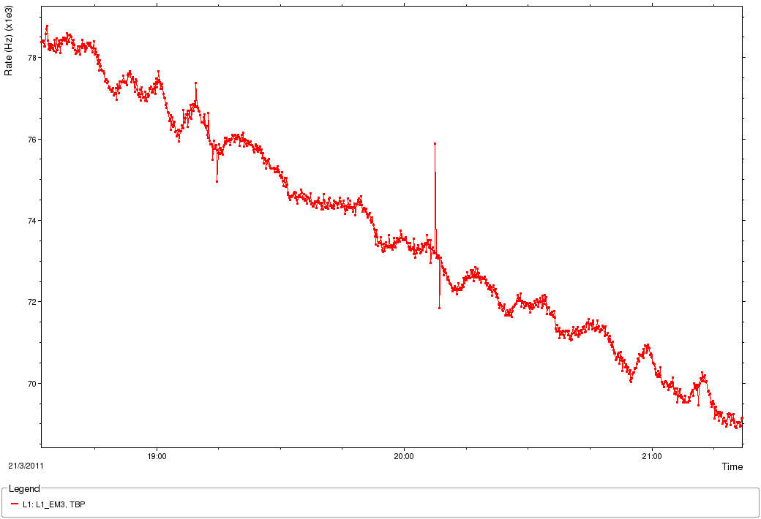
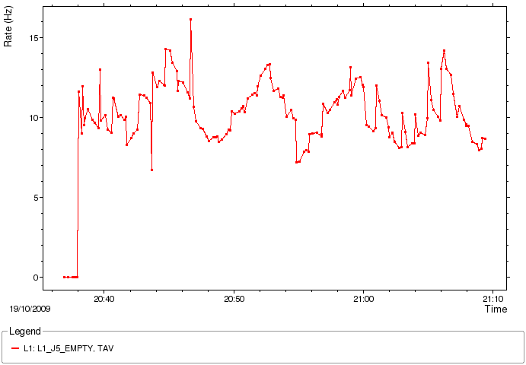
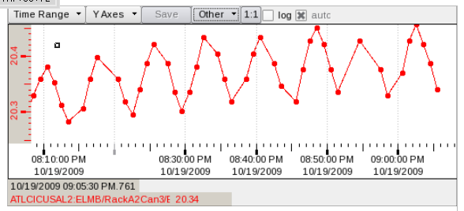
Old favourites: Pedestal Oscillations
Nice plot picked up by an alert shifter
  Note that EM3 rate (70 kHz)
  About 5% of interaction rate
6/7 minute oscillations seen before
Driven by pedestal variation with cooling water temperature
Was this a pedestal drift?
Or is EM3 really on edge with current pile-up?
EM3 yesterday
J5 in 2009

Slide 7
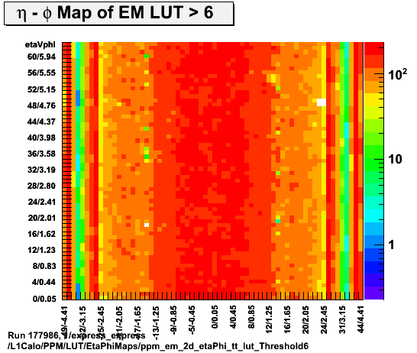
New problems: HV trips
EM energy distribution looks very even
And almost complete
  It was complete last week
But HV gone entirely on 4 towers
  First time this has happened in LArg
HV trip
(both lines)
known
overlap
noise

Slide 8
Upgrade (and Operation)
Our first Upgrade has already happened
  XS trigger implemented/tested/working
Will it open the floodgates:
  XS improvements
  Multiplicity ‘de-scoping’
    Request for only 2 bits for some thresholds
Some improvements are possible with or without:
  CMM++
  Topological Processor
  New MCMs
Long term planning for Phase I and Phase II required
  But let’s not forget L1Calo is needed right now too
  High pile-up samples are arriving as we speak
    They arrive quicker at Point 1 than in MC now
But options improve as we
build more of these

Slide 9
Meeting Structure
Wednesday
  AM: Operation in 2011
  PM: Upgrade
Thursday
  AM: Calibration, Analysis, Physics
  PM: Humboldt and Upgrade Overflow
  PM: Management Meeting
  Group Meal (Emma Hall)
Friday
  Missing Energy Significance and Wrap-Up
Note to speakers:
  Make sure work background is clear
  Try to avoid L1Calo jargon
All sessions on same
EVO meeting ID

Slide 10
Arrangements
Introductions…
Over to Mark…

