Slide 1
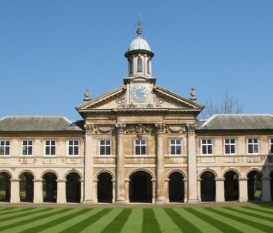
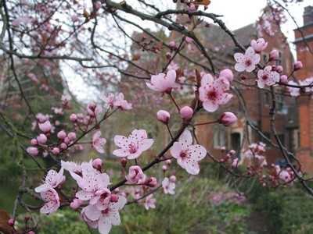
Cambridge Meeting
A Few Opening Words..
Mark Thomson
University of Cambridge

Slide 2
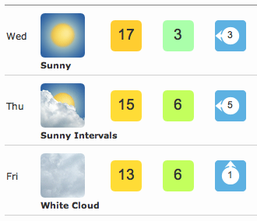
Firstly, welcome to Cambridge !
  this is one of the nicest times of year
    Spring in full flow…
  the town is relatively empty
    most of the undergraduates are on Easter break
    relatively few tourists
  and there is always the weather…

Slide 3
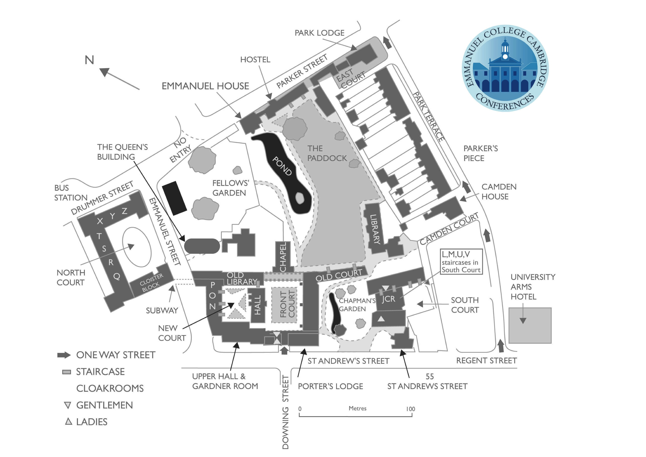
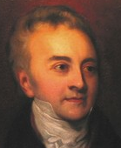
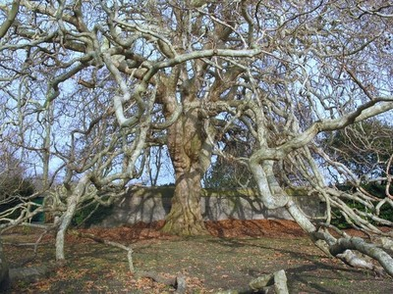

Orientation
Thomas Young formulates
wave theory of light
Thursday/Friday’s
meeting
John Harvard
woz here
Pre-dinner drinks
(Thursday)
Today’s meeting
Breakfast +
Conference Dinner

Slide 4
The important* practical details
Breakfast:
  should all have tickets in either Downing or Emmanuel
Lunches:
  free to roam…
  will post a list of suggestions just before lunch break
Dinner tonight:
  free to sample the delights of Cambridge Gastronomy
L1Calo Banquet Dinner (Thursday):
  pre-dinner drinks in Old Library at 1900
  dinner in Hall at 1930
  special dietary requirements, vegetarian ?
    please let me know by email asap
*Important = food related

Slide 5
££££$$$$CHF*
Payment for accommodation etc.
  Tomorrow morning from 0830-1100 outside lecture theatre
  Being Cambridge we haven’t yet worked out how to use credit
  cards
  Payment by Cash or UK cheque
  Please pay at this time
*also important

Slide 6
Enjoy the meeting…

Slide 7
Lunch
EAT
(sandwiches)
Pret
(sandwiches)
Savino/s
(sandwiches
+ Illy)
YO! Sushi
Wagamama
Eagle
(pub food)
Charlie Chan
(Dim Sum)
Sam Smiley
(takeaway
sandwiches)
Pizza Express
Anchor
(pub food)
Zizzi’s
(pizza)
Granta
(pub food)

