Slide 1
Calorimeter Digitisation Prototype
(Material from A Straessner, C Bohm et al)
Norman Gee
L1Calo Collaboration Meeting Cambridge
23-Mar-2011

Slide 2
Introduction
LAr and Tile calorimeters are planning to upgrade detector electronics in 2020
New electronics will digitise on detector, and stream digital data to RODs in USA15
Calo RODS will preprocess (BCID, Convert E to E_{T}) and provide data needed by L1Calo (minitowers,...). No more analogue signals.
They now propose a pilot project to equip a few calorimeter channels with new digital electronics, send signals to prototype RODs in USA15
  Analogue signals will continue to be provided, the existing L1Calo will continue to provie the ATLAS trigger
  We have an opportunity to connect a prototype Phase II slice
Details follow:

Slide 3
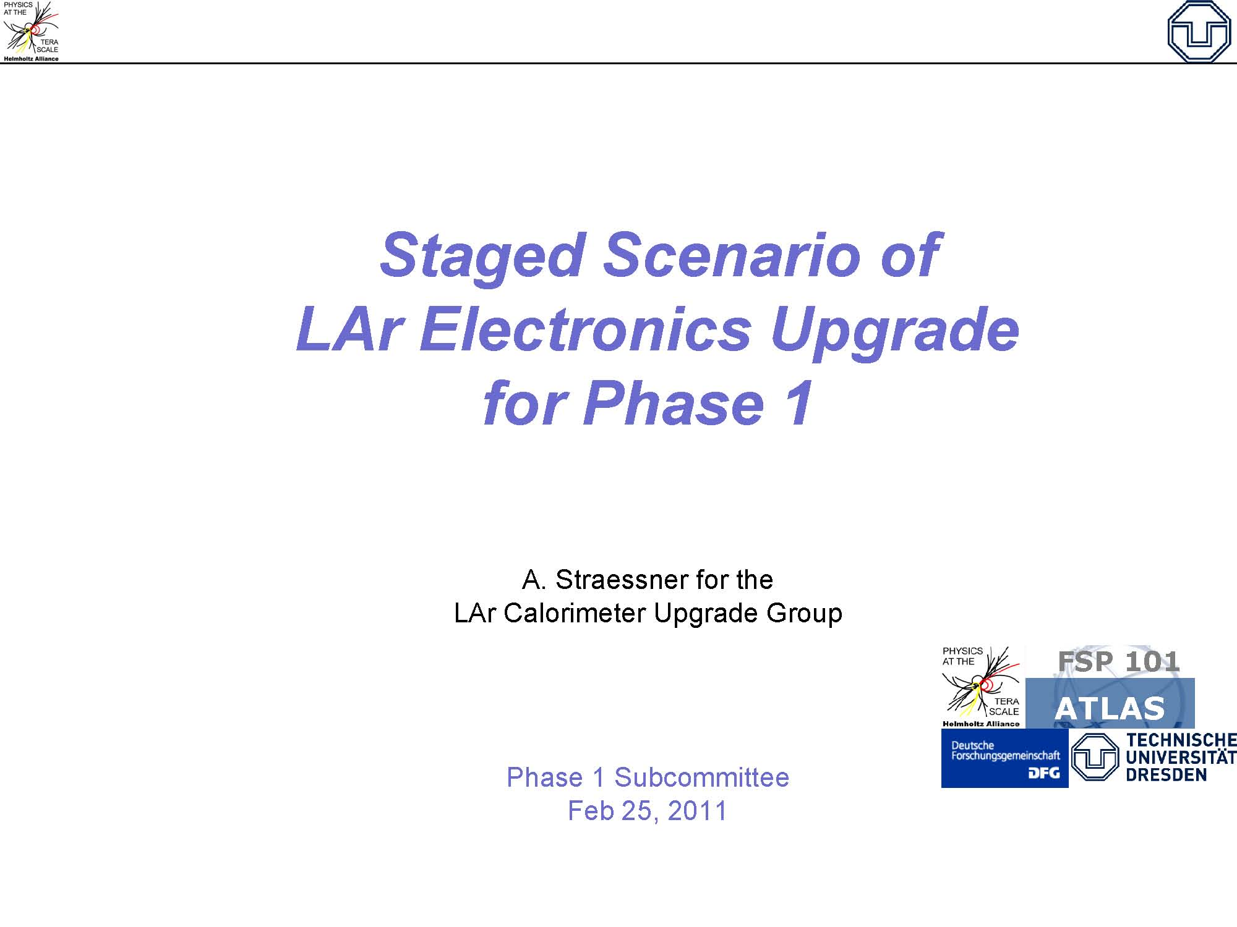

Slide 4
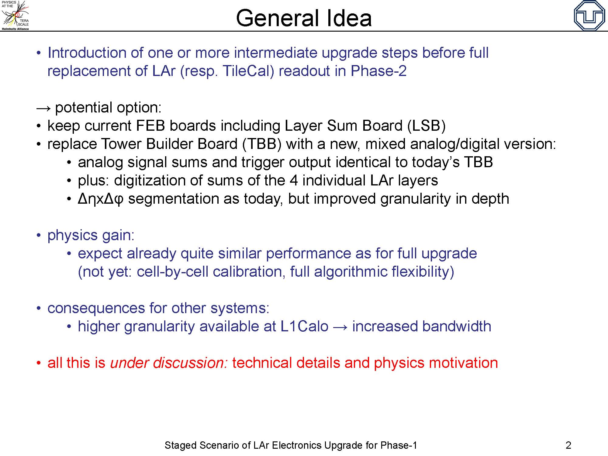

Slide 5
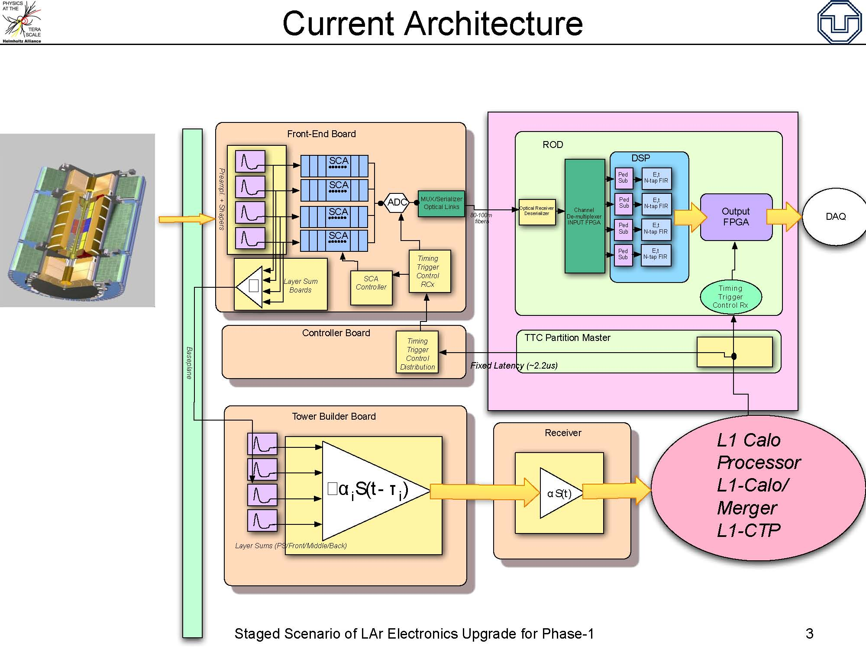

Slide 6
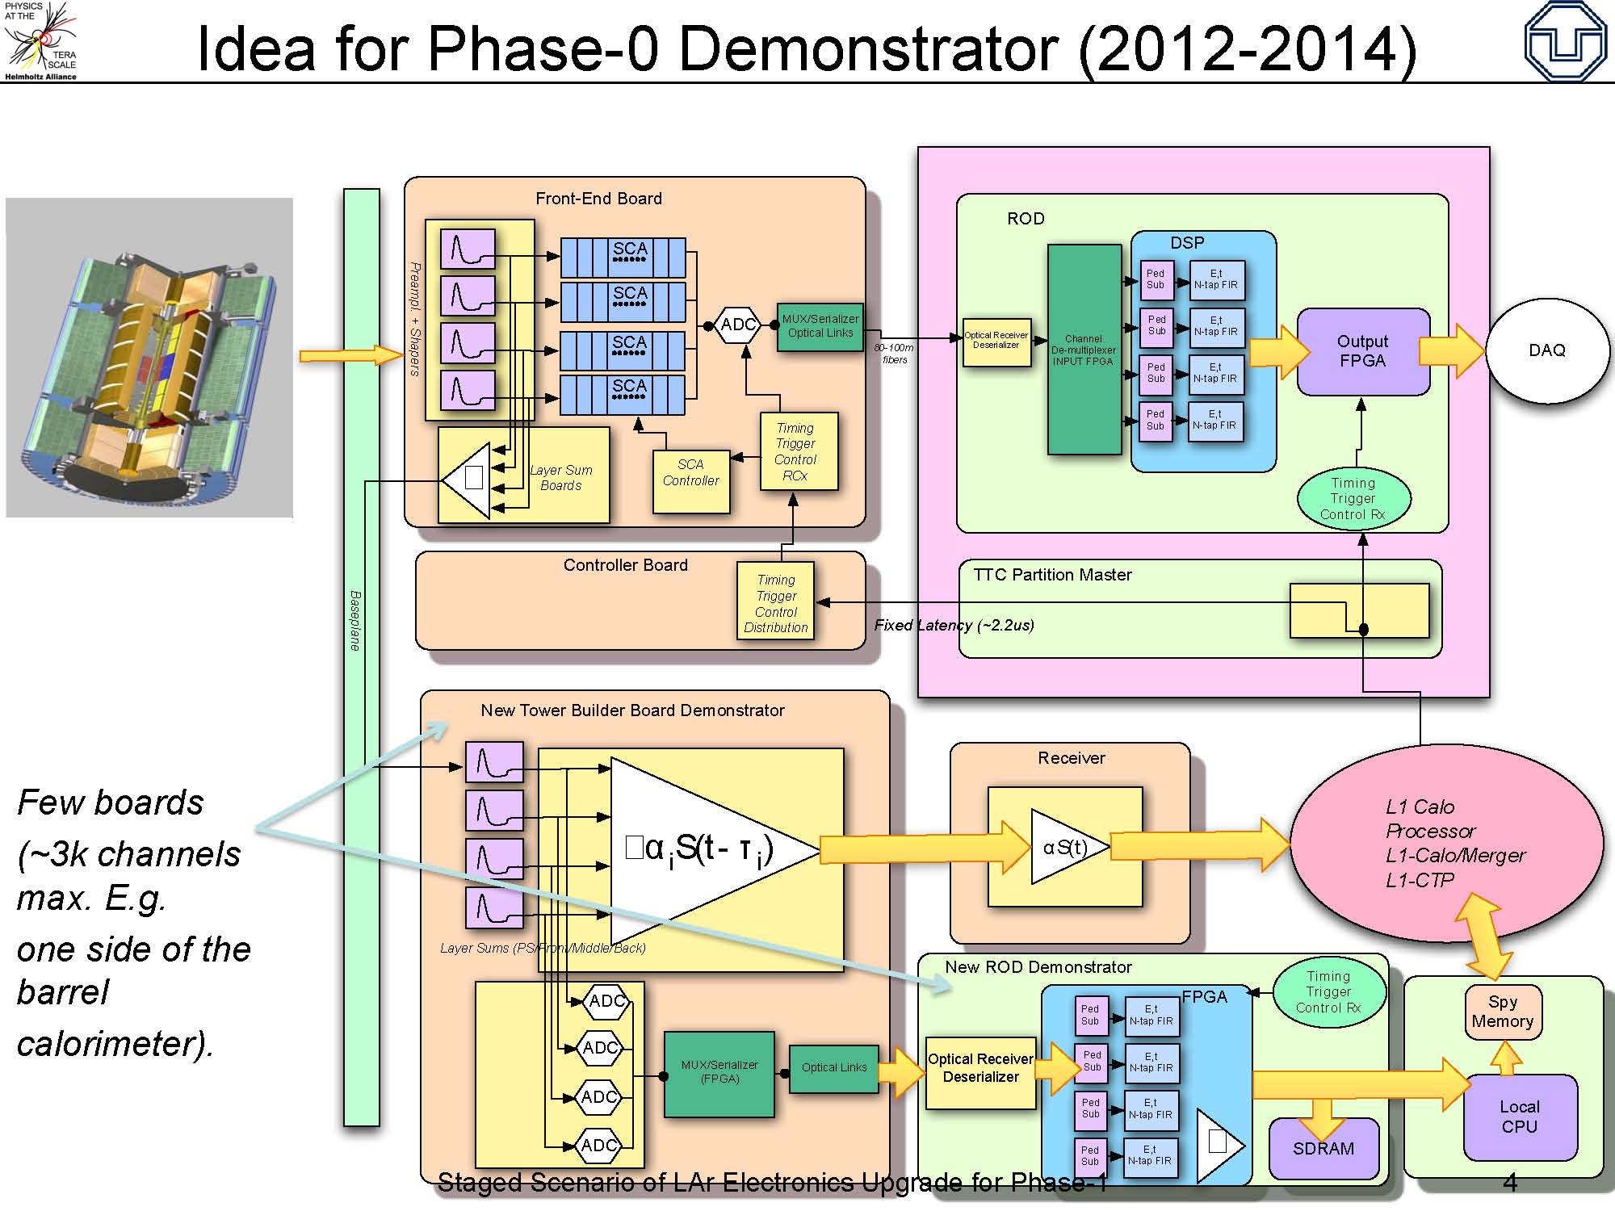

Slide 7
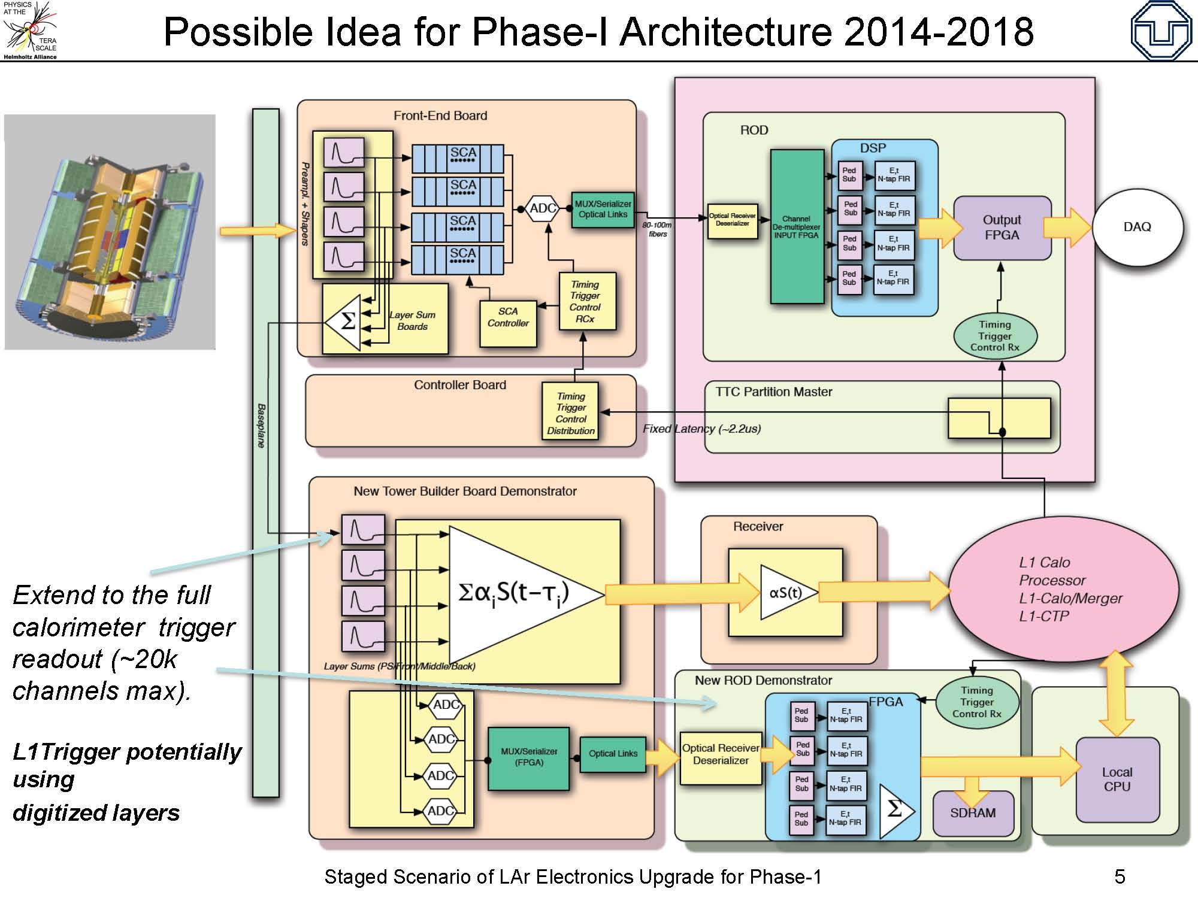

Slide 8
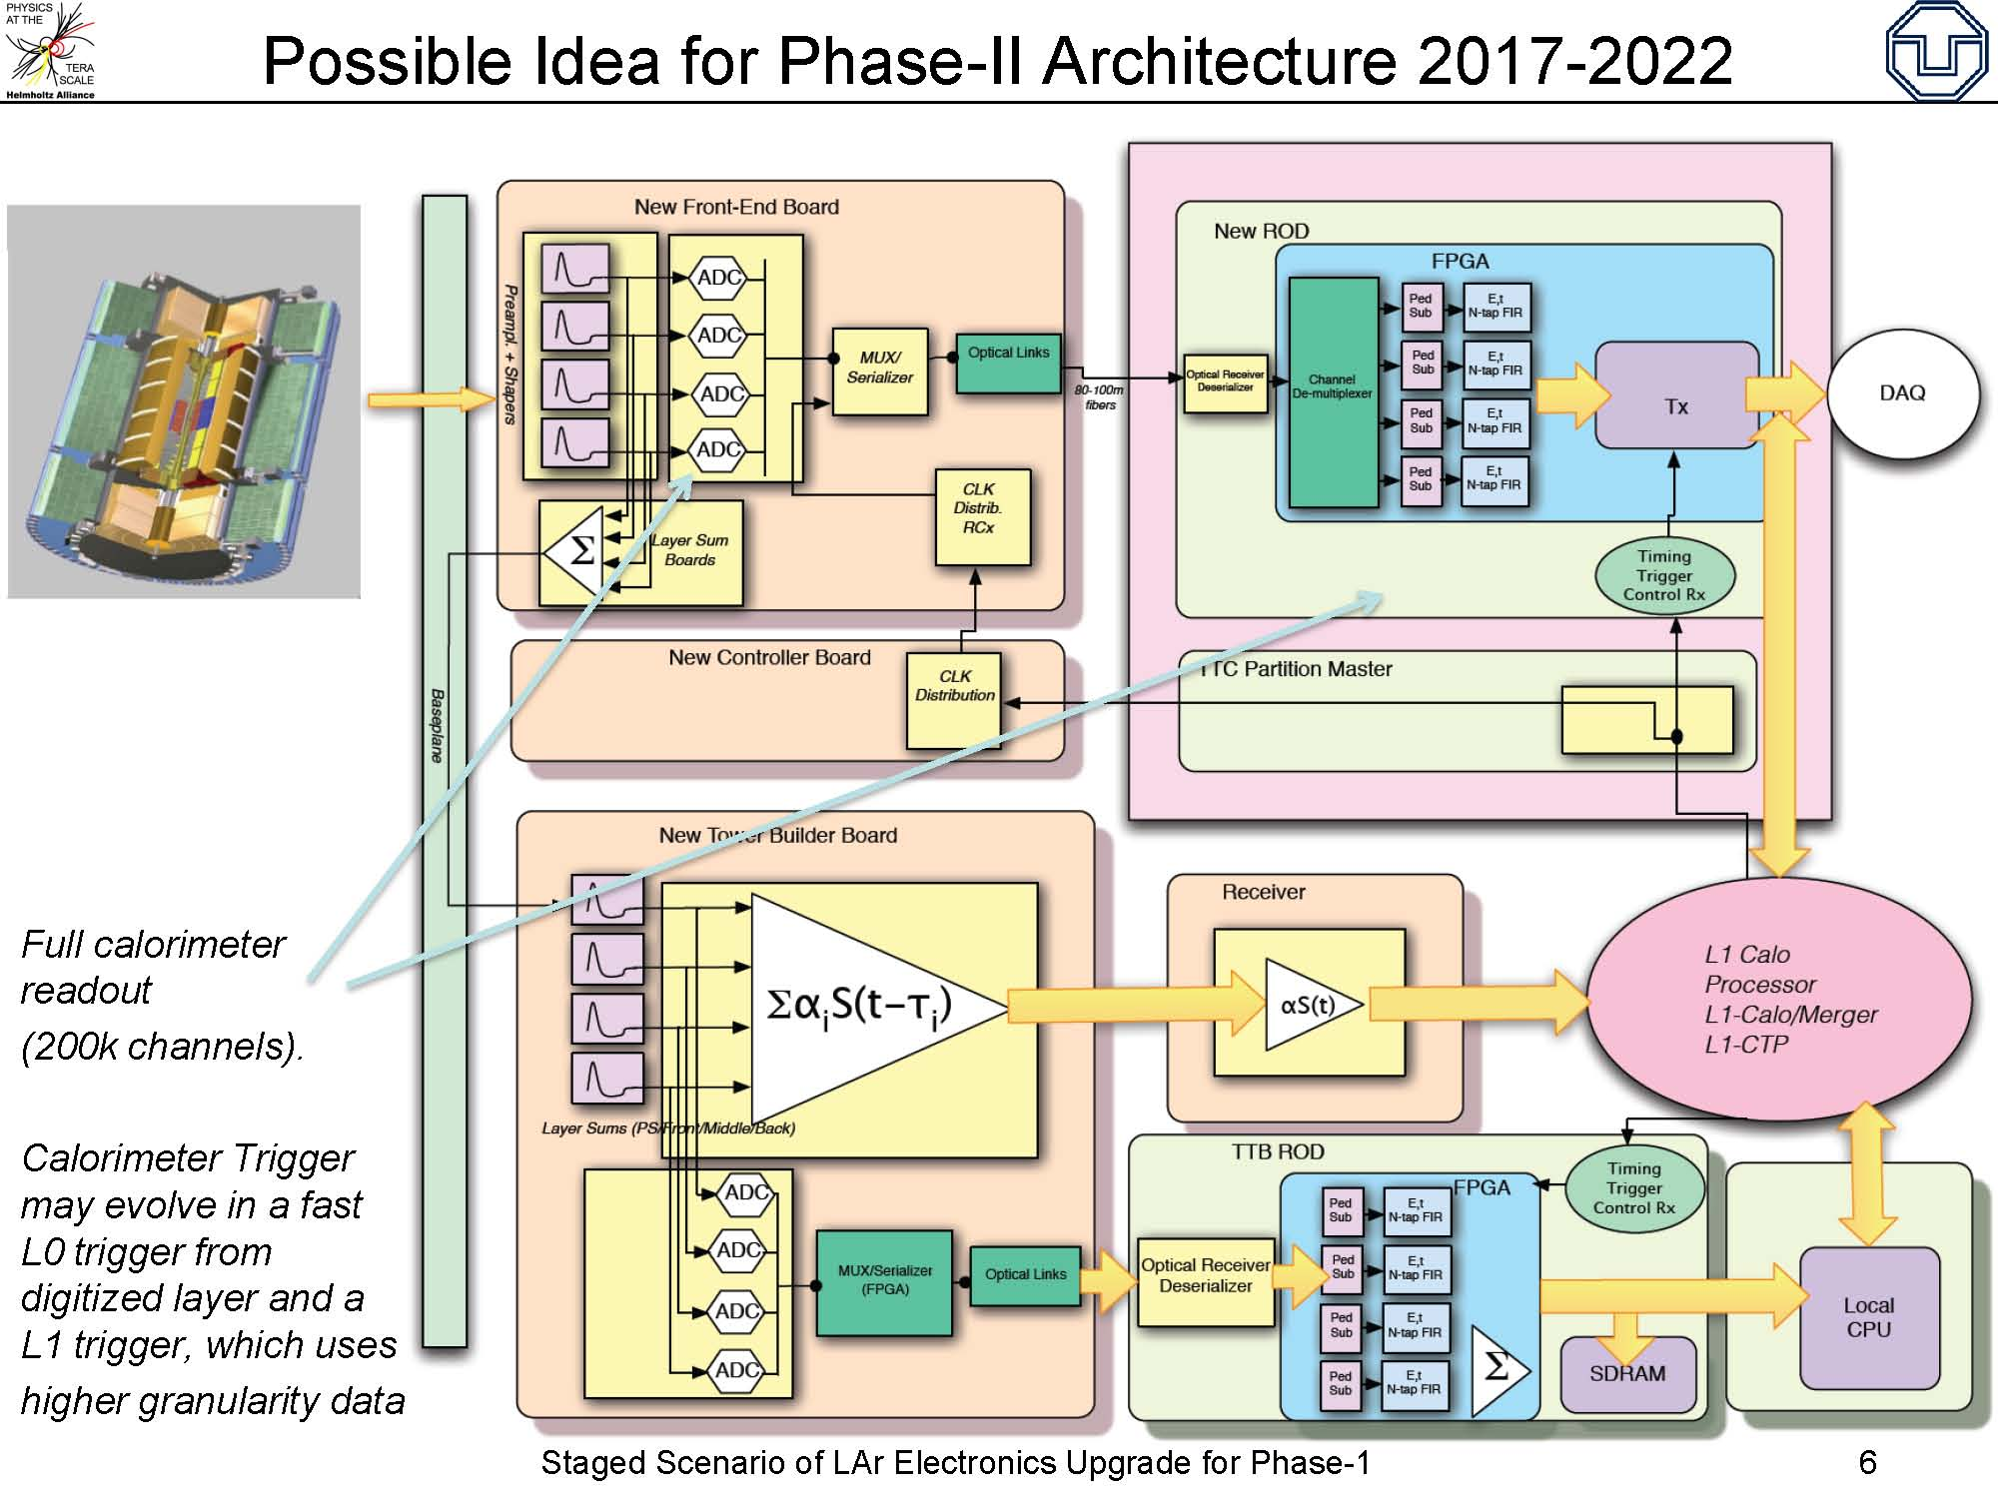

Slide 9
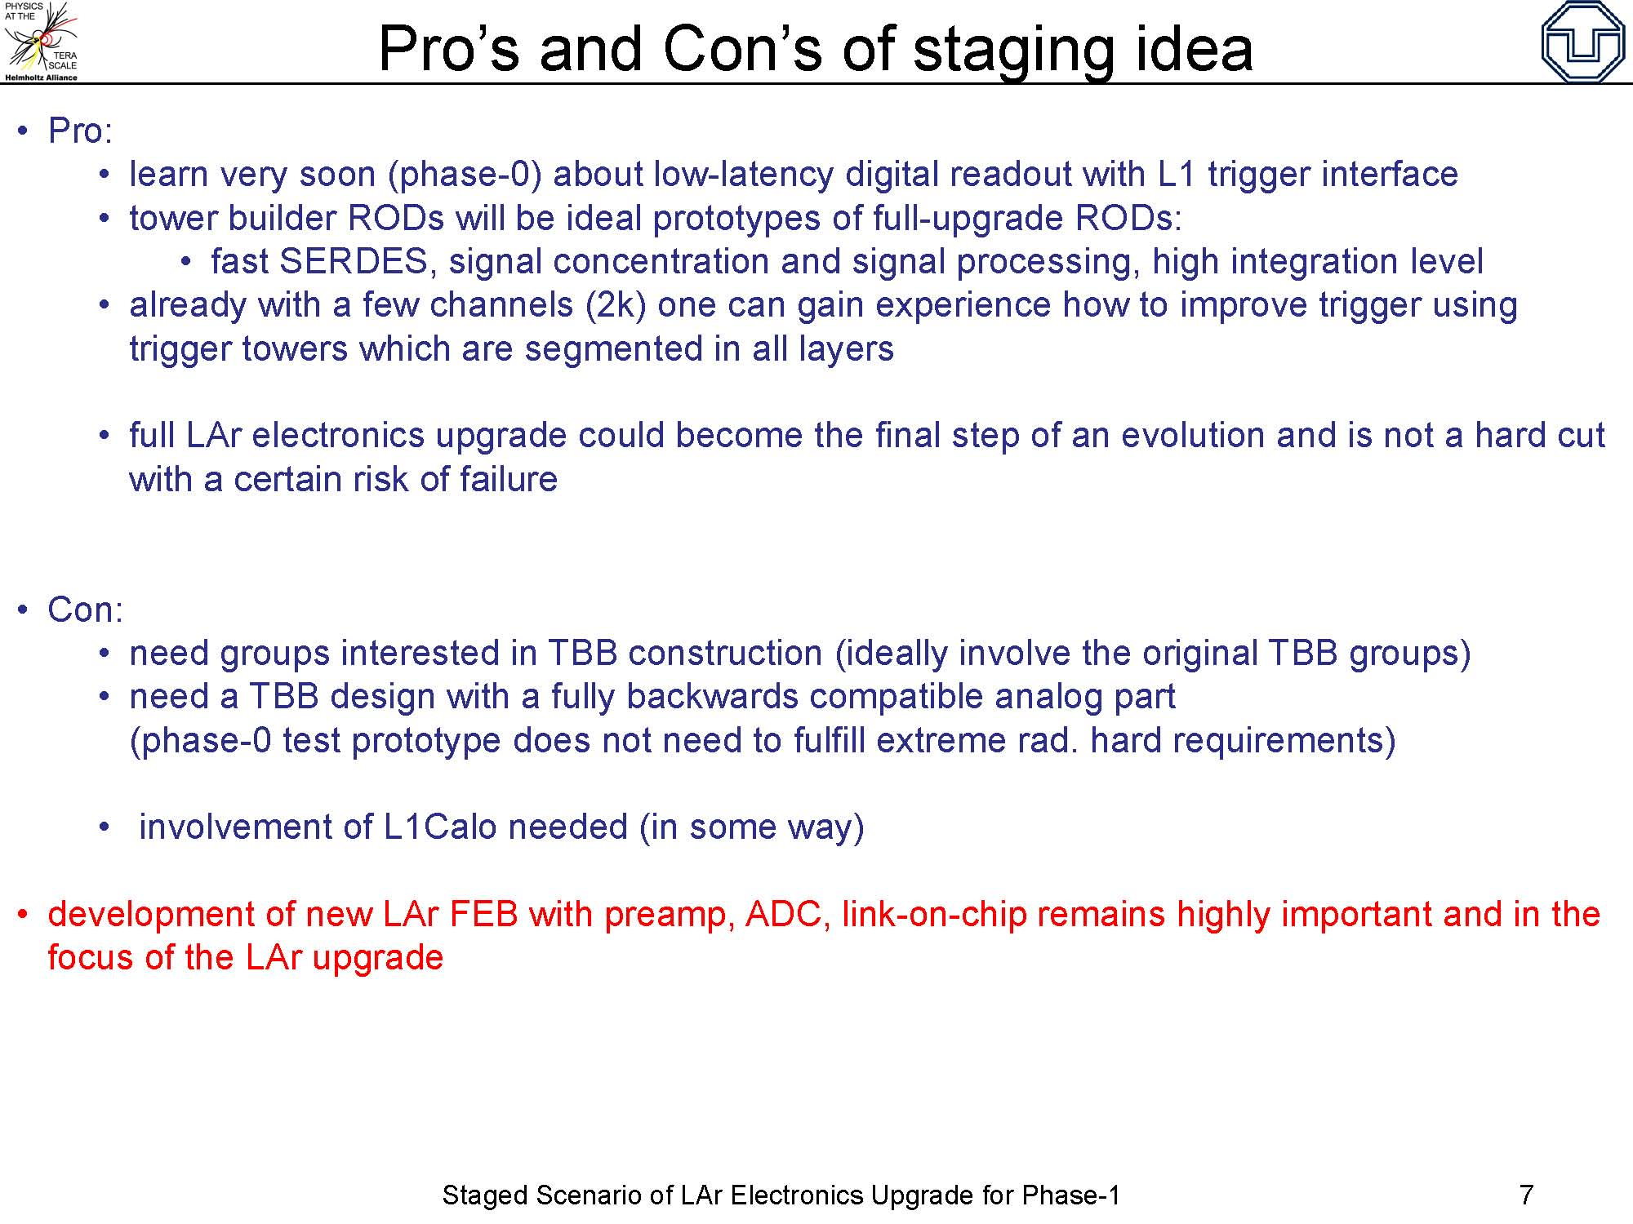

Slide 10
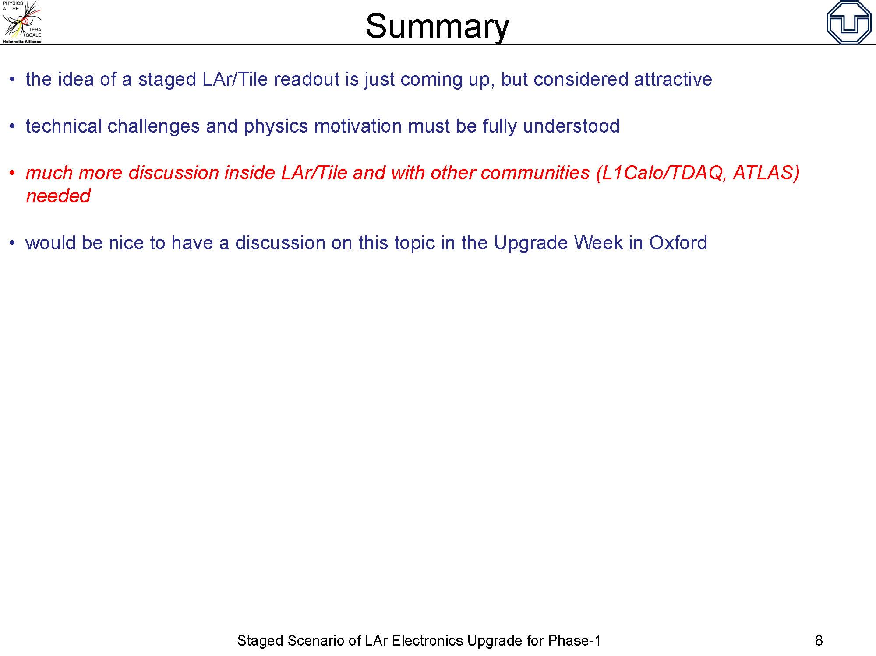

Slide 11
Staged scenario upgrade of the TileCal readout
Christian Bohm for the TileCal upgrade group

Slide 12
Two ways of implementing a analog/digital trigger signal combination
Current drawer electronics with digital readout
New drawer electronics with analog trigger readout, compatible with present trigger

Slide 13
Current drawer electronics with digital readout
The digital readout must then be combined with the trigger summation boards
These would need to expand to house the extended functionality. They would need to contain FPGAs and opto links
Fitting the additional real estate in the drawers could probably be done, but would be far from trivial

Slide 14
New drawer electronics with analog trigger readout, compatible with present trigger
The new drawer electronics would be more compact leaving ample space for the analog trigger summation boards
It would be easier to design since there are less constraints
Being closer to the final design it would provide more useful experience
The reasonable choice although no decision is taken

Slide 15
The Main Board
Converging to a highly redundant design with duplication of fibers and separation of the two readout paths from calorimeter cells
The design must be prepared for a later choice of front-end design
Three alternatives at present:
  A 3-in-1 (present design) based design
  An ASIC based design
  A QIE based design
The 3-in-1 based design has reached a state where it can provide signals to Main Board prototypes

Slide 16
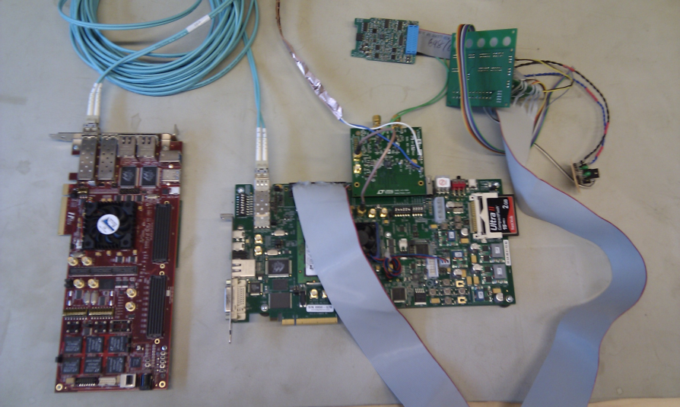
A full slice readout test set-up
Charge injection pulses are produced in a upgraded 3-in-1 FE-board
The MainBoard, emulated by a Linear Technology LTC2264-12 evaluation board, samples the pulses
The daughter board, emulated by a XILINX ML605 FPGA evaluation board, processes the data and transmit it at 4.8 Gb/s via a SFP module
Two way data communication, between the on and off detector electronics, is emulated by a two fiber connection to
The ROD, emulated by a HighTechGlobal FPGA board, receives data and stores it in pipeline memory.
The GBT protocol is used in both ends of the communication link
The ATCA functionality is emulated by a PCIe connection between the HighTechGlobal board and a PC
All critical functionality has been tested separately. Integration is on-going

Slide 17
Program
Build a first advanced prototype of the on-detector main board and its processor board during 2011. Urgent to verify sufficient radiation tolerance in FPGAs
Test it in drawer test benches in building 175 and to build a more developed prototype during 2012.
A drawer with new electronics could be installed and tested in ATLAS during 2013 and part of 2014.
When starting the tests in 2013-14 initially only one drawer with new electronics would be included, but if it operates as expected during tests and during actual data taking a larger section could be populated during Christmas shutdown in the end of 2014.
This assumes that all the necessary fibers have been installed.
In parallel with this there must be a development of the demonstrator ROD. What needs to be proven is that the new DAQ format and precision are compatible with the present one.
However, it is important that this path is open for merging of the results from parallel upgrade R&D projects:
The MainBoard should be prepared for adaption to ASIC and QIE FE-board solutions
The MainBoard design is and should continue to be compatible with a MiniDrawer scenario
The MainBoard electronics should continue to be compatible with different designs of the HV-part
The MainBoard electronics should be compatible with a future improved LVPS solution

Slide 18
Designed in this way the staged demonstrator will provide valuable experience for the final phase II design
It will also minimize the risk involved in the transition from present to upgraded full readout scheme

Slide 19
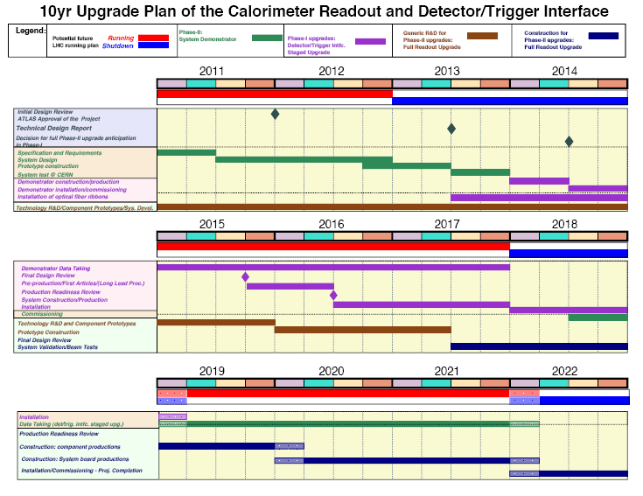

Slide 20
Consequences for L1Calo
Further discussion Lar/Tile/L1Calo parallel session in ATLAS Upgrade week (Oxford), 14:00 29-Mar-2011
My comments:
  Instrumented area should overlap in LAr and Tile !!
  Need at least a 4x4 overlapping em+had area to run present em algo
  But smaller area would allow many non-physics studies
Implies we design and build a slice (See talk from Ian) as a step towards the full Phase II trigger
Needs to be developed concurrently with Phase I upgrade

