Slide 1
Joint Meeting: Highlights
Apologies for errors and omissions
(ie almost everything)

Slide 2
Monitoring and Calibration
Huge leaps forward since 2010 running
  This is not a criticism of work done in 2010
    We had a lot of learning to do
  Now we’re aiming for stable maintainable operation
Continually improving monitoring
  Wider group of people involved
Almost automatic calibrations
  Still work to do, but we’re almost there

Slide 3
Understanding Data
Again we learned a lot in 2010
We have the tools to apply this knowledge to new data
  Quickly (but unfortunately not immediately)
    Need to migrate more from offline to T0/CAF/online?
    Think about best strategy for this
Gradually understanding all the features* of L1Calo
  MCM quirks
  Non-standard Calorimeter towers
  Timing offsets (planned and unplanned)
  Calibration details
  Precise performance measurements
But there’ll always be more to understand
* In the bug sense and otherwise

Slide 4
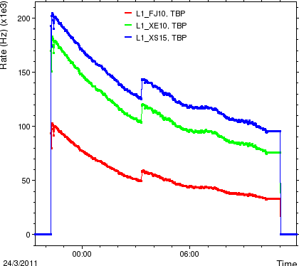
Understanding Data
Again we learned a lot in 2010
We have the tools to apply this knowledge to new data
  Quickly (but unfortunately not immediately)
    Need to migrate more from offline to T0/CAF/online?
    Think about best strategy for this
Gradually understanding all the features* of L1Calo
  MCM quirks
  Non-standard Calorimeter towers
  Timing offsets (planned and unplanned)
  Calibration details
  Precise performance measurements
But there’ll always be more to understand
* In the bug sense and otherwise

Slide 5
Missing Energy Significance
Extremely successful implementation
  Tight schedule
  Much work for several people in L1Calo and outside
  Went extremely smoothly
  Credit to the skills and dedication of people involved
XS is likely to become increasingly important in 2011 and 2012

Slide 6
Upgrade
Hardware is starting to appear
More projects are popping up all the time
  Need to prioritize, agree, and schedule
Reaching the point where formalities start
  TPs, Reviews, serious funding requests
Simulation is fascinating
  It’s probably not right yet
    But it’s getting closer
  Remember the potential cross-over with ‘real’ data

Slide 7
Collaboration
Has just got bigger
I hope it is still a ‘small’ friendly project
On the other hand it’s big enough to worry about organisation
  Upgrade will get a (deputy?) coordinator
  Need to think about representation
    Mostly at Trigger/Trigger Signature Meetings
    But L1Calo impacts in many areas of ATLAS

Slide 8
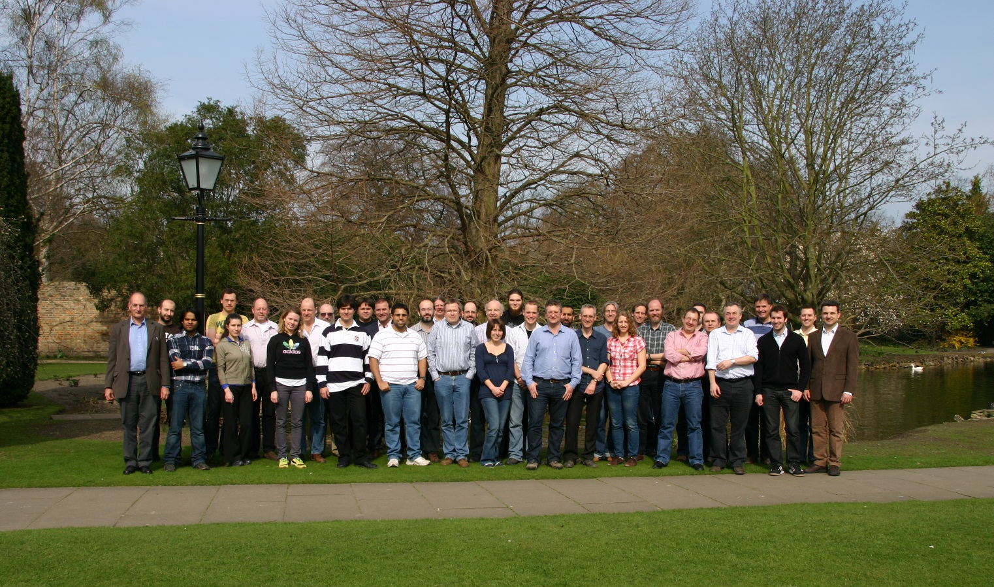
Group Photo

Slide 9
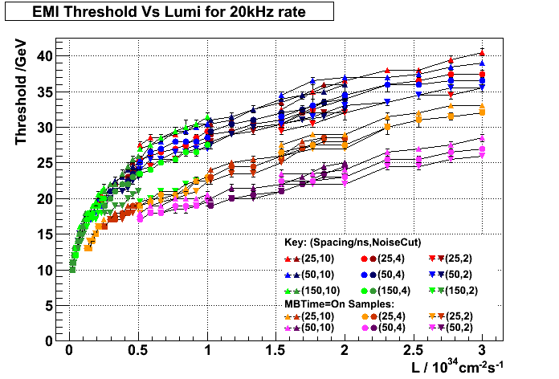
Plot of the Week
Level-1 Upgrade Technical
Proposal: Figure 1A

Slide 10
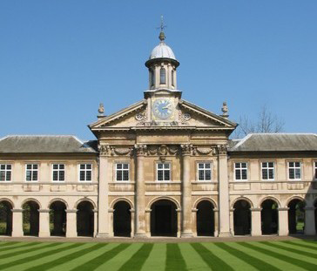
Many thanks to
Our guests
  Diego, George, Chris
Chairmen
  Norman, Alan
But mostly to Mark
  Ran the show almost single-handedly

