Slide 2

Welcome at CERN
Notes:
Kyriaki
Good morning and welcome aboard!

Slide 3
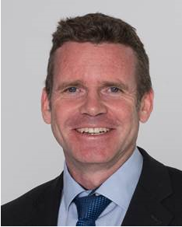
Bienvenue
Welcome
James PURVIS
Chef du département des ressources humaines
Head, Human Resources Department
Link to video on Indico
Notes:
Kyriaki

Slide 4
Welcome Bienvenue
Kyriaki
FAKOURELI
HR Department,
Learning & Development
Erwin
MOSSELMANS
HR Department,
Learning & Development
Notes:
Erwin
Welcome at CERN for your first working day.
Bienvenu au CERN pour votre premiere journee de travail.
I am Erwin, …
I am Kyriaki, ….
We would like this to be a memorable day for you !
Kyriaki: Do you remember your first day at CERN?
Erwin – story:
I can remember mine very well, even if it was more than 20 years ago, I came at 8.30 to an office in Personnel Division, as it was indicated in the letter I received with my contract. A person gave me a checklist of things to do : access card, bank account, etc and a paper map, and off I went on my own for my “arrival circuit”. The last stop was the office of my supervisor, who I had spoken once, at the selection interview 6 month earlier. He brought me to my office, which was equipped with office furniture from the 50ies and a computer. The office was small – 9 m2, but I learned afterwards that I had to feel lucky, since normally an office of that size is shared with 2 or even 3 people. My supervisor gave me another list and about half a meter of paper folders with procedures and documents to read – it would take me at least 2 weeks to read them ! I spend the whole afternoon in my office over these papers, thinking that I had maybe not made the right choice to sign the offer from CERN. I expected something more exciting ! Luckily some new colleagues popped in to say hello and asked if they could be of any help. At the end of the day, I went to the cafeteria in the main building, quite a busy place and discovered that there was a party with free drinks. Maybe CERN was after all not such a bad place ?
I discovered however that the party was rather exceptional : on that day, Charpak returned from Sweden after the ceremony for his Nobel prize.
We would like you to remember this first day in a different way. We start with the party ! In any case, you will start to have plenty of opportunities to share your thoughts and experience with other newcomers.
Welcome at CERN !

Slide 5

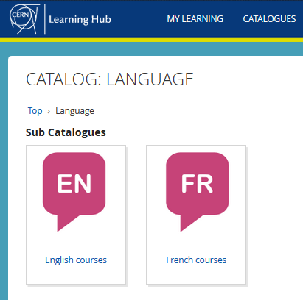

Logistics - language
Classroom courses
cern.ch/learninghub
Tandem
link
Find a partner
to practice speaking
each other’s language
Notes:
Kyriaki
Au CERN, nous avons 2 langues officielles : l’anglais et le francais.
Qui maitrise bien ces 2 langues ?
Aujourd’hui, nous utiliserons principalement l’anglais, mais n’hesitez pas d’intervenir en francais si vous le souhaitez !
CERN has 2 official languages : English and French. Today, we will use mainly English, as from experience we know that not everyone understands French … yet !.
To learn English or French, there are classroom courses organised on the site, which are also open for spouses. You find the details on the CERN learning hub.
And you can also create the opportunities yourself with the tandem website. The aim of the website is to facilitate finding a partner (not to bike together but) to meet and learn by practicing on a voluntary basis each other’s language, not limited to English and French !

Slide 6

Logistics - slides
Available at any time
direct link : https://indico.cern.ch/category/10150/
Notes:
Kyriaki
The slides are available on Indico, which is an event management software tool created at CERN.
Later today, you will receive an email with the link to the slides.

Slide 7
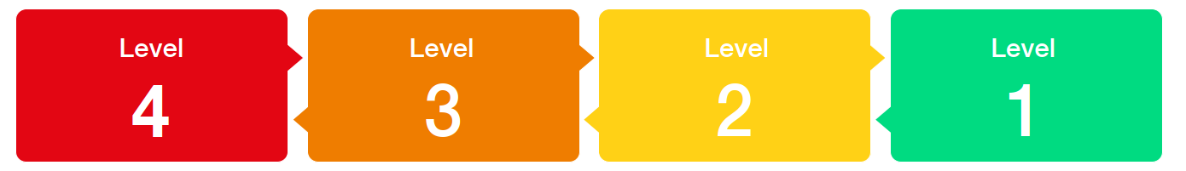
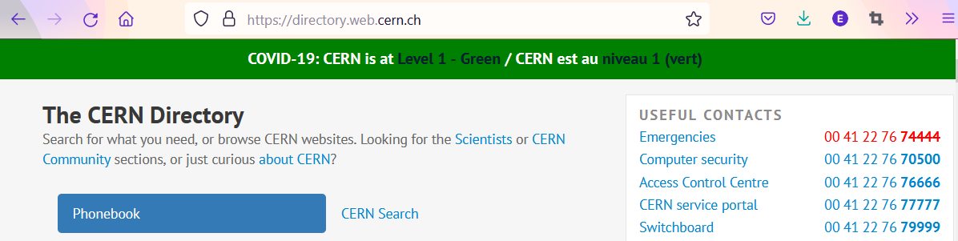

COVID -19
Since
14 March
Mask wearing?
left to the decision of individual ; provided by CERN on request
Notes:
Kyriaki
It is important to stay informed about what is going on at CERN.
There is one central place to find the information about the impact of the Coronavirus for CERN : on the directory page. The information is available in English and in French.

Slide 8
Programme of the morning
08.50 Welcome by James Purvis, Head HR Department
08.55 Quiz – CERN as organization
09.20 Group photo, coffee break and networking
09.50 Quiz – daily life at CERN
10.30 Meet colleagues from your department
Transfer to department
11.00 Welcome in your department
Notes:
Kyriaki

Slide 9


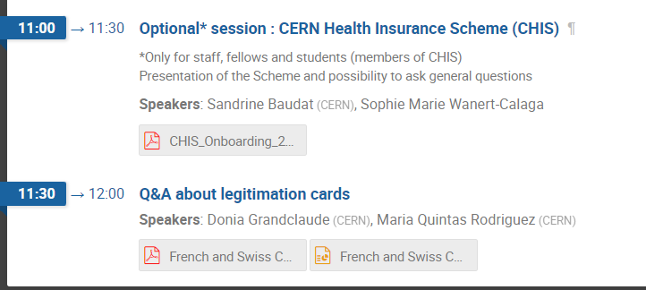
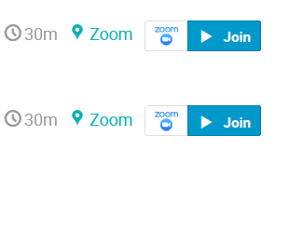
Programme Tuesday 4 October
Notes:
Kyriaki
************************
Program continues tomorrow with 2 short presentations and the possibility to ask questions about legitimation cards and about the CERN Health Insurance Scheme, for those who are covered by it : staff, fellows and students.

Slide 10

Ready to learn
more about CERN
via a quiz ?
Notes:
Erwin

Slide 11
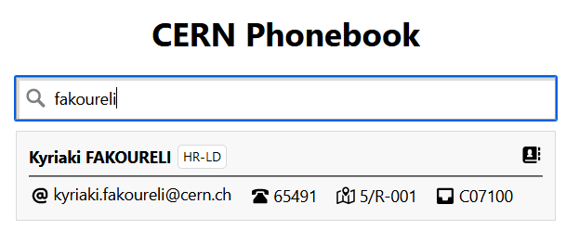
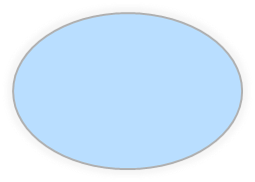
Building 5
Ground floor
Office 001
R = ground floor (Rez de chaussee)
S = basement (Sous-sol)
Notes:
Erwin
In the CERN Phonebook, you can find out where people their phone number, but also where they have their office.
For example, Kyriaki has her office in building 5, on the ground floor, and the office number is 001, in the beginning of the corridor on the side with oneven numbers.
And now your first lesson in French !
R comes from Rez de chaussee, meaning ground floor and the basement is indicated by an S from Sous-sol.

Slide 12
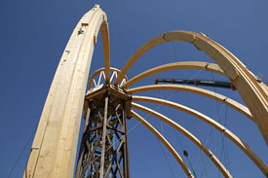
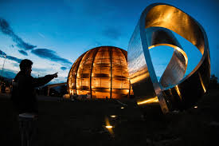
© CERN Photo
https://visit.cern/globe/history-globe
© CERN Photo
Notes:
Erwin
************************
The Globe is building with a history similar to the Eiffel tower.
Built for a national exhibition in Switzerland in 2002, which lasted 6 months, it was located near the lake of Neuchatel and called at that time the Palais de l’equilibre.
This name is however no longer used.
At the end of the exhibition, it was dismantled and the Swiss Governement offered to re-build it on the CERN site.
The building technique is quite unique : they start with top crown, which is on a temporary platform. Once all the beams are put in circle, the platform is dismantled : the crown holds everything together.
The shape of the building represents the planet Earth (outer layer to protect the building against Sun and other elements, just like the atmosphere does).
The Globe has become a landmark in the Geneva area.
If you want to know more about it, here is a link :
https://visit.cern/globe/history-globe

Slide 13

CERN as an international organization
Quiz – part 1
Notes:
Kyriaki
************************
Ready to start with the real quiz ?
We first have a few questions about CERN as an international organisation.

Slide 14






CERN MoP
~16 200
Contractors
> 4 500
Employed MPE
~ 3 450
Associated MPA
~ 12 750
Staff
~ 2 670
Fellows
~ 780
Users
~ 11 200
Associates
~ 1000
Students
~ 550
Notes:
Erwin
Stats 2021 : https://cds.cern.ch/record/2809746/files/CERN-HR-STAFF-STAT-2021-RESTR.pdf
************************
If you answered 2 670, then you probably only took into account the staff members (click).
But on top of the staff, we also have 780 fellows (click).
The staff members and fellows together are the employed members of the personnel or MPE (click): CERN is their employer.
But besides these more than 3 450 people, there are also many people who have a contract with CERN, although it is not an employment contract :
First of all, we have more than 11 200 users (click) who are working in scientific collaborations
And also more than 1000 associates
And more than 550 students
All together approximately 13 000 people who have a contract of association with CERN.
Both MPE and MPA are considered MoP, and you are a member of that big family of more than 16 200 people.
Kyriaki : How many people on the CERN site on an average day ?
Not all users are present at CERN every day. Note also that there is also personnel from contractors which can be working on the CERN site : there are more than 4 500 such people with an active registration, and some of them come here every day while others come only for the duration of a specific intervention.
Presence on CERN site :
before COVID : average of 7200 people on a normal weekday (of which 1800 contractors)
now (May 2022) : average of 6500 people (including 1500 contractors)
(Source : data presented at ED by Katy Foraz).

Slide 15
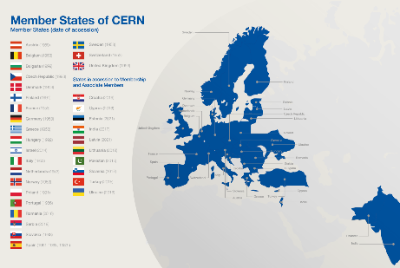
Revenues 2022
Member State contributions 84 %
Associate Member State contributions 2 %
Special contributions 3.7%
(to HL-LHC, specific experiments, from EU)
Other 10 %
(e.g. knowledge transfer, donations, …)
Principle =
proportional to Gross National Income
→ equal effort for every country
Notes:
Kyriaki
************************
Sources :
- https://cds.cern.ch/record/2799098?ln=en (budget 2022)
- https://cds.cern.ch/record/2790156 (map member states)
The CERN member states are indeed providing 84 % of CERN’s budget. (click)
There are today 23 Member states – originally when CERN was founded, there were only 12 countries. (click)
In order to have a fair sharing of the cost, the contributions are calculated as a certain percentage of the National Income.
And were does the remaining 16% comes from ?
Well, CERN also has associated member states, who pay a reduced contribution compared to the members states. This amounts to 2% of the budget.
The remaining 14% of the budget come a variety of sources : special contributions from certain countries or institutes, participation of the European Commission, income from knowledge transfer activities, donations to CERN, …)

Slide 16

CERN’s final budget 2022
~ 140 510 KCHF
~ 1 405 MCHF
~ 1 405 M€
~ 1 405 k₤
Not yet known
Only 1 answer is correct
Notes:
Erwin
************************
- https://cds.cern.ch/record/2799098?ln=en (budget 2022)
The correct answer is indeed 140 million Swiss francs, B.

Slide 17
Budget 2022
Official Currency : CHF
Units
1 kCHF = 1000 CHF = 10³ = one thousand
1 MCHF = 1 000 000 CHF = 10⁶ = one million
1 405 MCHF = 1.405 * 10⁹ = 1.4 billion (1.4 milliard)
Style guide
https://translation-council-support-group.web.cern.ch/style-guides
Notes:
Erwin
************************
CERN has a Medium term plan : The MTP describes CERN’s scientific and financial strategy for the next five years along with a longer-term view over ten years. This plan is updated annually and also includes a precise budget for the following year. This budget is voted by the Council in the year before. So E was not correct.
CERN has its seat in Geneva, Switzerland, only the Swiss franc is udes as its official currency. So you could disregard the answers C and who were expressed in other European currencies.
You will very often see kCHF and MCHF, so it is worth to explain it
The correct answer is B : 1405 million Swiss francs, which is 1.4 billion Swiss francs
4. We have at CERN a styleguide for how to write in CERN publications
https://translation-council-support-group.web.cern.ch/style-guides
Applied here :
Use space as 1000 separator (comma might be misleading)
Up to 4 figures : no space or comma

Slide 18
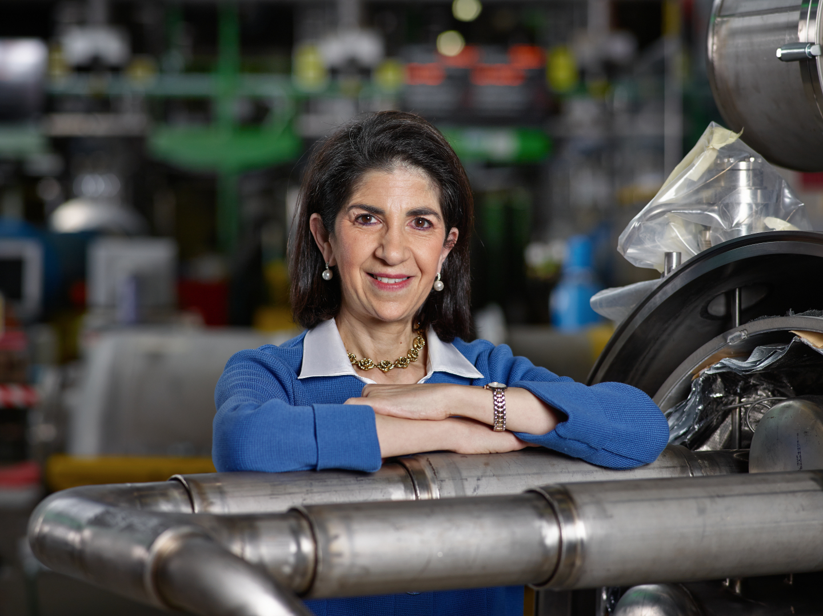
Link to biography
© CERN Photo, 2015
Notes:
Kyriaki
************************
https://press.cern/biographies/fabiola-gianotti-born-1960-Italian
Fabiola Gianotti is indeed CERN’s 1st female Director General, since 1st January 2016. Like all DG’s, she has a mandate of 5 years. In some exceptional cases in the past, this has been extended, but usually we have a new DG every 5 years.
From 2009 to 2013, she was spokesperson for the ATLAS experiment, and had the task of presenting the results on the search for the Higgs boson in a seminar at CERN on 4 July 2012. This discovery led to the Nobel prize for Higgs and Englert.
Gianotti has been awarded several prizes, but not the Nobel prize.
In 2013, she was included among the “Top 100 most influential women” by Forbes magazine, and today she continues to figure in their top 100 of Power Women.
https://www.forbes.com/profile/fabiola-gianotti/?list=power-women

Slide 19
Working at CERN when Nobel prize
1992 : Georges Charpak
1988 : Carlo Rubbia & Simon van der Meer
1984 : Jack Steinberger (with Lederman and Schwartz)
Working at CERN after Nobel prize
1952 : Felix Bloch
1976 : Sam Ting
Nobel prize thanks to discoveries at CERN
2013 : Peter Higgs & Francois Englert
Notes:
Erwin
************************
https://public-archive.web.cern.ch/public-archive/en/About/Nobels-en.html
https://www.nobelprize.org/nobel_prizes/facts/
3 prizes for people who were working at CERN when they received the Nobel prize
1992 : Georges Charpak
1988 : Carlo Rubbia & Simon van der Meer
1984 : Jack Steinberger (with Lederman and Schwartz)
+ 2 Nobel prize winners who worked at CERN
1952 : Felix Bloch, became CERN DG in 1954
1976 : Sam Ting, still works here at CERN on AMS (alpha magnetic spectrometer which is installed on ISS, the International Space Station)
+ 2 Nobel prize winners thanks to discoveries at CERN
2013 : Higgs and Englert

Slide 20
Welcome to HR-PXE colleagues
Opportunity to ask questions during coffee break
Collective induction session by type of contract
  Fellows
  Tech & Admin students in the 2nd week
  Doctoral students
Individually contacted by HRA : Staff
Notes:
Kyriaki

Slide 21






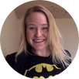




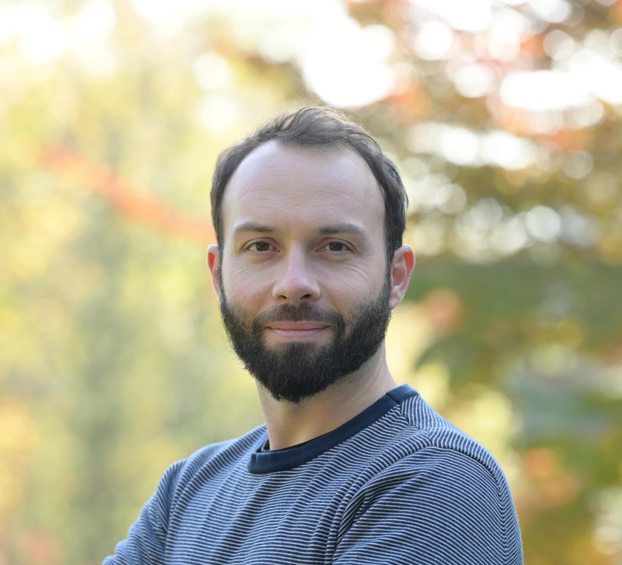



Your contact points at HR PXE
Leadership of the group
=
Human Resources Advisor
Main contact for staff members
Lore Taillieu
Marie-Luce Falipou
=
Contact for
Students and Fellows
Accelerators and Technology Sector
Administrative Sector
Accelerators and Technology (ATS)
Beams (BE)
Director General Office (DG)
Finance and Administrative Processes (FAP)
Human Resources (HR)
Anne-Laure Tantot &
Céline Delieutraz
Aurélie Choy &
Oxana Goponova
Aurélie Choy &
Jenni Suutala
Nina Koivunen &
Jenni Suutala
Marie-Luce Falipou &
Jenni Suutala
Engineering (EN)
Systems (SY)
Technology (TE)
BE
Health, Safety & Environment
(HSE)
Pension Fund (PF)
Pension Fund (PF)
Industry, Procurement and Knowledge Transfer Department
(IPT)
EN
SY
Katharine Thomas-Chevreux &
Oxana Goponova
Sara Krige &
Céline Delieutraz
Anne-Laure Tantot &
Céline Delieutraz
Nina Koivunen &
Jan von der Brelie
Sara Krige &
Jenni Suutala
TE
Benjamin Salignat &
Jan von der Brelie
Sara Krige &
Jenni Suutala
Research & Computing Sector
Site & Civil Engineering
(SCE)
Research & Computing
Sector (RCS)
Experimental Physics (EP)
Anne-Laure Tantot &
Jan von der Brelie
Benjamin Salignat &
Jan von der Brelie
Stefano Fattori, Ronald Moerbeek & Leatitia Breavoine
International Relations Sector
Information
Technology (IT)
Theory Department
(TH)
International Relations (IR)
For Marie Sklodowska Curie fellows & ITN
Benjamin Salignat &
Jan von der Brelie
Stefano Fattori &
Laetitia Breavoine
Marie-Luce Falipou &
Jenni Suutala
Ingrid Haug

Slide 22
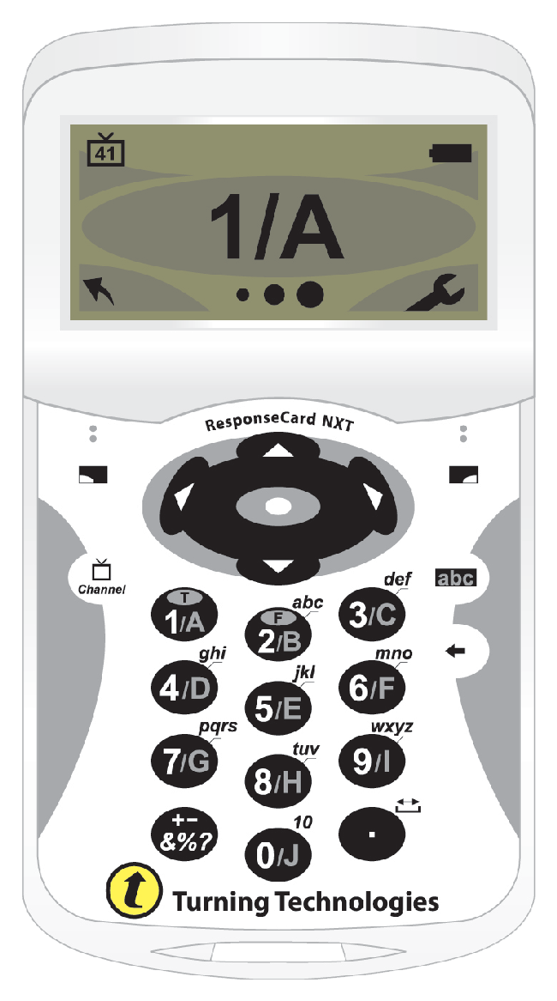
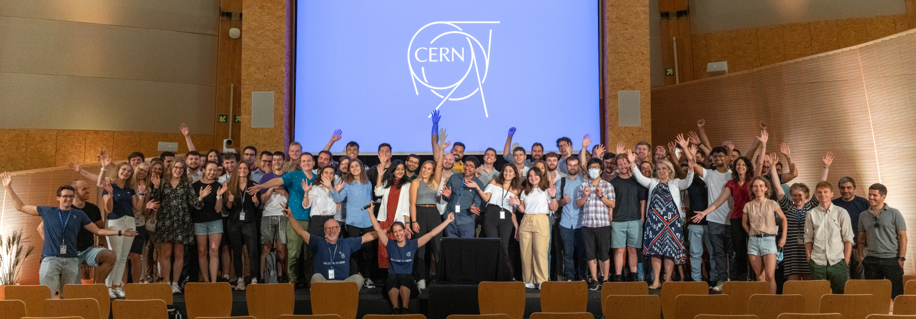
Time for a group photo !
© CERN Photo

Slide 23


Notes:
Kyriaki
Group Photo
Remind about the particle identity – meet with other particles – continue the game.
Back at 9.45

Slide 24
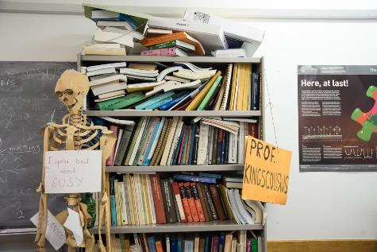
Daily life at CERN
Quiz part 2
Notes:
Kyriaki
************************
We have some questions for you, which will be helpful for your daily life at CERN.

Slide 25
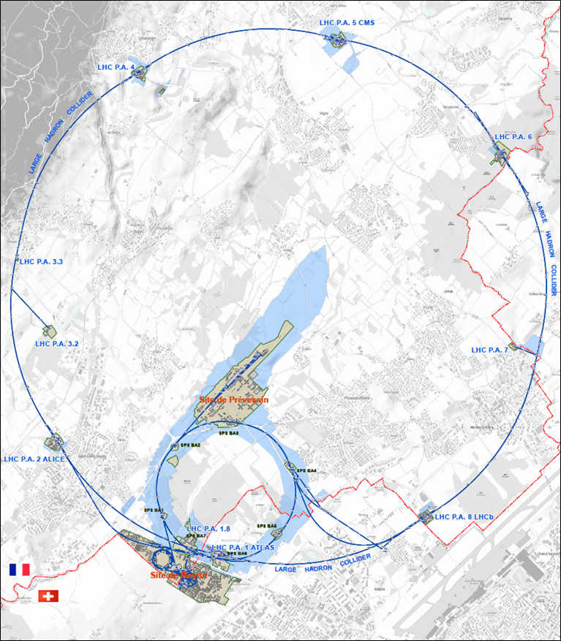




625 ha
515 ha
fenced : 220
110 ha
… 700+ buildings
accounting for
500.000 m²
5 900 parking spots
101 ha
green
spaces
30 km roads
Notes:
Erwin
************************
Source : https://indico.cern.ch/event/669690/contributions/2740056/attachments/1553507/2441980/Mobility_IoT.pptx
CERN is indeed composed of 2 major sites : Meyrin in Switzerland and Prevessin in France. But there are many more smaller CERN sites, especially in France.
CERN has all in all 625 hectares of land, of which 1/3 is fenced. The majority is on the French territory.
There are more than 700 buildings, for a variety of purposes and built in different periods in a variety of styles. Office space as well as parking space are sometimes difficult to find !
There are also 30 km of roads, and normal traffic rules applies. And there is control and sanctions : if you park your car on the footpath, the sidewalk, your car might be towed away.
There also green spaces, especially on the Prevessin site. Some people have the luck to see through their window deers coming out of the wood or a flock of sheep grazing in the prairie next to their office.

Slide 26
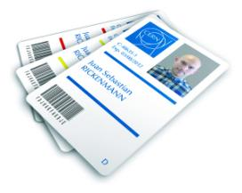
CERN access card
Visitors badge
Validity :
2 working days
CERN access card
Building 55
Working days
from 7:30 to 17:30, non stop
Also
vehicle registration
biometrics registration
https://sce-dep.web.cern.ch/security/access
Notes:
Erwin
If you hurry to get your CERN access card, you might find yourself queuing.
Avoid
Mondays
1st working day of the month
7:30 to 9

Slide 27




Gates | Days
Meyrin A | Mon-Fri | 6-22 |  | 7-19
Porte Jura Bldg 33 |  | 24/24
Meyrin B (Main entrance) |  | 24/24
Meyrin C | Mon-Fri | 6-22 |  | 7-19
Meyrin D (goods only) | Mon-Fri |  |  |  | 08-12 13-16
Meyrin E | Mon-Fri | In : 7-9.30 Out : 16.30-20
Intersites tunnel (restrictions) | Mon-Fri |  |  | 7-18
Prevessin Main entrance |  | 24/24
Prevessin Route du Maroc |  | 24/24
Prevessin Moulin des Ponts |  | 24/24
Notes:
Erwin
************************
There are 7 gates at the Meyrin site, and 3 gates at the Prevessin site.
The Main gates in Meyrin and Prevessin are open 24 hours a day, for pedestrians, bikes and motorized vehicles.
In Meyrin, on top of the main gate, there are 4 other gates for pedestrians, with are open only on workdays and for certain periods. 3 of them are also open for bycicles. With a car, you can get in on workdays during certain hours through 3 other gates.
Meyrin 2 gates with restrictions : entrance D is for goods only, and the intersites tunnel can only be used with a car and being on duty. It can not be used to get to your workplace nor to go home.

Slide 28
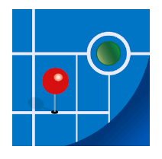
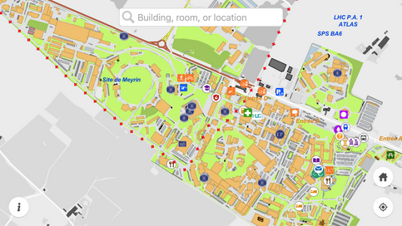
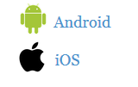
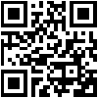
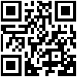
MapCERN
Notes:
Erwin
************************
The app is called MapCERN and is available for Android and iOS.
You can do a quick search, it covers all places at CERN and works offline.

Slide 29
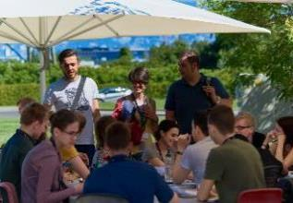
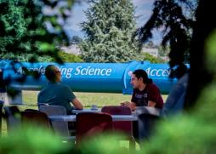
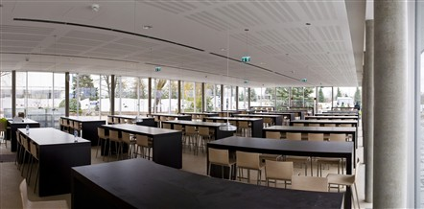
Restaurants
2 in Meyrin (resto 1 & 2)
1 in Prevessin (resto 3)
Cafeteria (snacks)
Building 13, 30, 40, 54, …
© CERN Photo
Notes:
Rocio
************************
There are 3 restaurants on the site. There are always several menus, including a vegetarian.
You can find menus and opening hours in the CERN directory.
There are also microwave ovens, when you heat the food you bring along yourself.
There are also some cafeterias, which often have a reduced offer, and shorter opening hours.

Slide 30
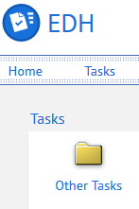
CERN Car
Requires
CERN driving authorization :
Valid driving licence
OK Department Head
Private vehicle
Not requiring registration
  Bike, “trottinette”
Requiring registration
  Registered in member state or EU country
  “Tourist” cars only
  Not allowed :
  Scooter, moto, lorry, bus, …
Notes:
Erwin

Slide 31
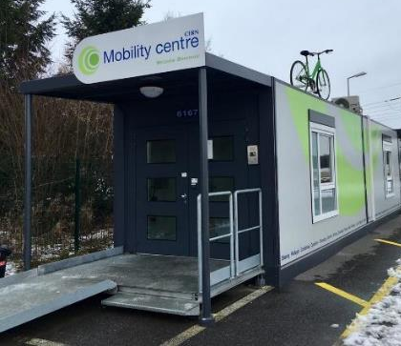
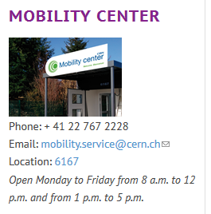
CERN Mobility Centre
Located next to Entrance A
Services offered
Bike rental
Car rental
Car sharing
Bike sharing
Shuttles
….
https://sce-dep.web.cern.ch/campus-life/mobility
Notes:
Erwin
************************
After a long closure owing to the pandemic, the car-sharing service has been up and running again since 14 June 2022.
Following a pilot run in 2021, a new vehicle-booking system using the Glide app and the glide.io website has been introduced. The booking procedure is explained in detail in the comprehensive user’s guide.

Slide 32


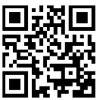
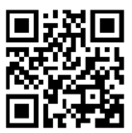
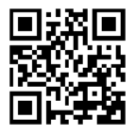
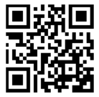
Mobility apps
Car sharing
glide.io
login with CERN SSO
Bike sharing
Urban connect

Slide 33
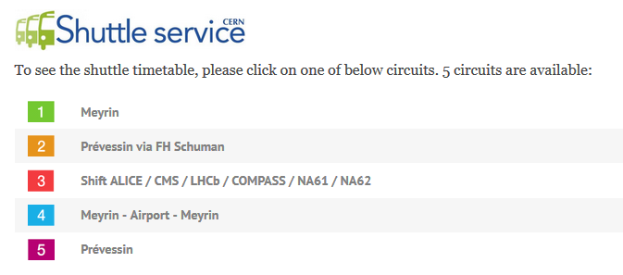
https://sce-dep.web.cern.ch/cern-shuttle-service
Notes:
Kyriaki
Line 4 is temporarily suspended

Slide 34
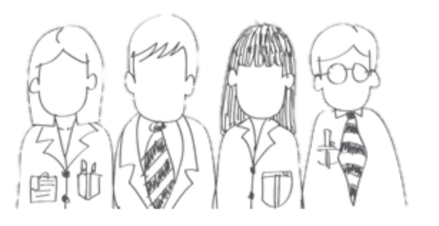

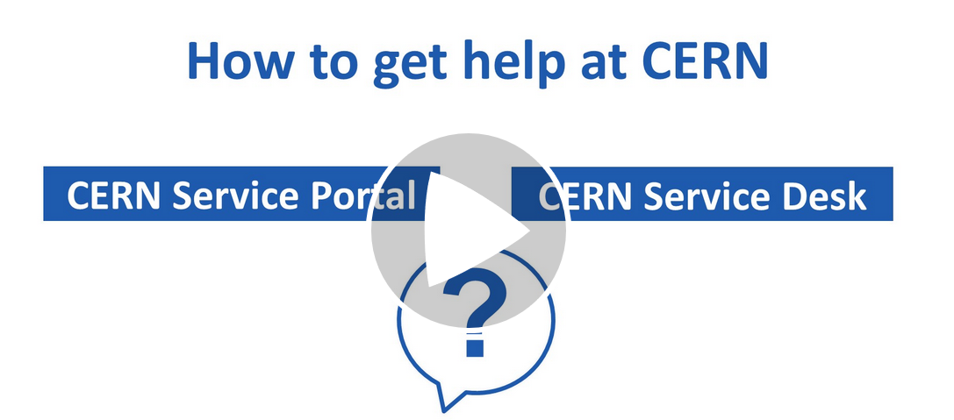




CERN Service Desk
Phone: +41 22 76 77777
Email: service-desk@cern.ch
Monday to Friday
from 7.30 to 18:30
( Geneva time )
CERN Service Portal
Services
Service overview in a glance
Online forms
Report an incident, submit a request
Knowledge articles
Find your answer!
Feedback
Your feedback matters!
https://cern.ch/service-portal
Notes:
Erwin
The CERN service desk will help you with any request, and especially if you do not know which service to contact. They will make sure that your question gets to the right person, and that you get a reply.
Your request will generate a ticket for an efficient follow-up, and you will be informed by mail.
You can contact them by phone or by sending an e-mail.
The CERN service portal, accessible from the directory or from the link below, allows you to search for a service, find out what they offer and make an online request. There are also Knowledge Base articles where you find answers to the most frequent questions.

Slide 35
Accident on site – different cases
In all cases
Inform supervisor
In case of
Injury
Environmental hazard
Disruption traffic
3rd party involved
CERN Fire & Rescue 74444
(+ 41 22 767 44 44)
+
Internal accident report (EDH)
+
European Union Car Accident form
Notes:
Erwin
************************
The correct answer in all cases is to call your supervisor (D) and in some cases (C), the CERN Fire and rescue service, through the number 74444.
Why always your supervisor ?
Internal accident report :
- needs to be signed by your supervisor, so for that reason he must be informed immediately.
- also used to report near-misses -> can be used to avoid further accidents
In certain cases, the CERN Fire and rescue need to be called.
We recommend to add the full number in your mobile phone
+41 22 767 44 44, so you can also call them if you are not connected to the CERN telephone network.
https://admin-eguide.web.cern.ch/node/352
2.2.1 Accident on the CERN site
In the event of injury, disruption to the flow of traffic or involvement of a third party:
The CERN Fire Brigade will go to the scene of the accident, take the appropriate measures required by the circumstances and draw up a call-out report.
The local Gendarmerie/Police will intervene only if so requested by CERN (Relations with the Host States Service or CERN Fire Brigade).
The driver(s) of the vehicle(s) (or, if not possible, the Fire Brigade) must complete a European car accident form (a blue form known as the "Constat européen d'accident automobile"), which must be signed by the parties involved. A copy of page 1 of the form must be sent to the Legal Service and to the CERN's Insurance Manager. If the injured party is a member of the personnel or a family member who is a member of the CERN Health Insurance Scheme, the procedure set out in paragraph 3 must also be followed.
In all other cases, and if the vehicle suffers material damage:
The member of the personnel must draw up a report to which he must attach, where possible, a statement by a witness (the European car accident form may be used). This report (or a copy of the European car accident form) must be sent to the CERN's Insurance Manager together with a statement by the Head of Department or his designated representative, certifying that the journey was made on official duty, or a copy of the official travel form if applicable.

Slide 36
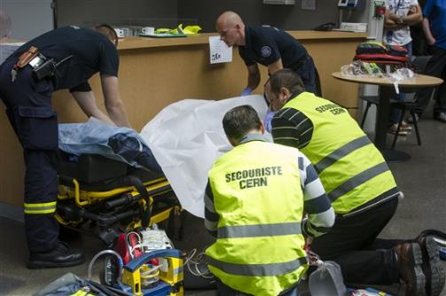
CERN Fire and Rescue Service
assisted by local First Aiders
Find out who
are closest to
your office / usual work places
© CERN Photo
Notes:
Kyriaki
************************
CERN’s Fire and Rescue Service is a team of more than 50 qualified fire-fighters and paramedics. They are available 24h/day, all year long.
They are assisted by more than 150 First Aiders, who are trained volunteers.

Slide 37
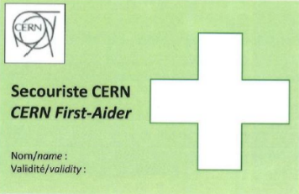
First Aider door sticker
Your safety contacts : http://safety.cern.ch/FirstAid.html
Training available for all All personnel working at CERN : First Aid - Life-Saving Actions (Covid-19)
Notes:
Kyriaki
************************
You can find the first aiders in your building in this link.
And you also spot the green stickers on the doors, indicating that there is a qualified CERN first-aider in that office
Training available for all All personnel working at CERN : First Aid - Life-Saving Actions (Covid-19)
https://lms.cern.ch/ekp/servlet/FORMAT1?CID=EKP000043535&LANGUAGE_TAG=en

Slide 38


Defends all personnel
on a collective and on an individual basis
Become member : Website
Network of people who work(ed) at CERN
Become member : Website
Notes:
Kyriaki
************************
The Staff association defends your rights, they organize regularly public meetings to inform you. The also have a website, and you can become a member by paying a fee.
CERN Alumni is an initiative launched in 2017.
It brings together people who have worked at CERN and those who work today at CERN. As such, you can be a member as from today. Membership is free.

Slide 39
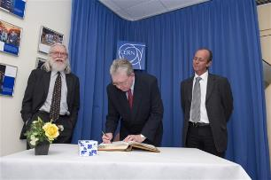
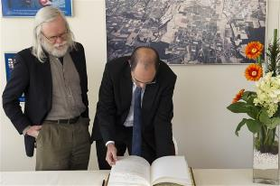
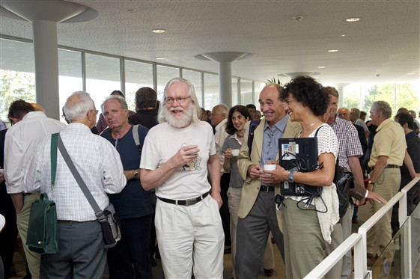
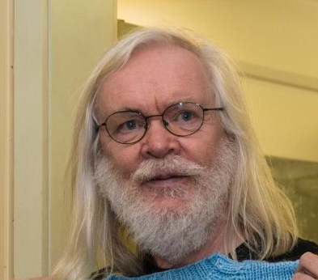
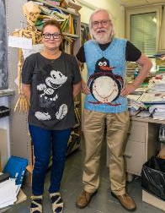
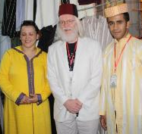
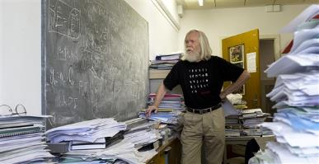
© CERN Photo
Notes:
Erwin
************************
This is John Ellis, a British theoretical physicist.
Employed by CERN, he has been department head of the Theory department, and an advocate for geographical enlargement of CERN.
You can see him
At an official ceremony to sign an agreement, dressed business formal, in a suit and tie
In his office, amongst his papers, casual with pants and a black T-shirt
At another official ceremony, smart casual or business casual, with a shirt and jacket, but no tie
At a Physics School in Morocco, in local traditional clothes, including the fez
Again in his office, with a Finnish teacher who knitted him a pullover with his famous penguin diagram
In 2011, at the coffee break of the colloquium in honor for his 65th birthday
Conclusion:
CERN is very casual
CERN is very tolerant
Recommendations :
Dress according to the situation
Nothing offending other people – T-shirts with text/images

Slide 40

Code of Conduct
cern.ch/codeofconduct
Notes:
Kyriaki
CERN's values are commitment, professionalism, creativity, diversity and integrity. Taken together they provide the basis for respect: respect for others, respect for the Organization and respect for its mission, and underpin the CERN Code of Conduct.

Slide 41

Working from home (teleworking)
Normal framework (Operation Circular 7)
up to 40% of one’s working time in any 2-week period
not an entitlement : to be approved by the supervisor
authorised in advance via EDH https://edh.cern.ch/
More info : https://admin-eguide.web.cern.ch/en/procedure/telework
How to: screenrecording
Notes:
Erwin
Can be removed if departments cover this

Slide 42



CERN tools
Phone (audio only) : CERNphone
  Mobile client (iOS and Android)
  Desktop client (Windows, macOS, Linux)
Videocalls and videoconferencing cern.zoom – FAQ
Messaging – individual and public/private ”channels”
integration with Zoom
dedicated channel New @ CERN
Notes:
Kyriaki
A call is usually more efficient than an email,
So we encourage you to reach out to colleagues, programme cordinators or supervisor, and we give you different options to do so:
If you go for a voice call, we are using CERNPhone
You can access the CERN phone book to find any employee working at cern, and dial her or his number.
For video conference, we use now Zoom on a CERN specific instance cern.zoom (with SSO)
For messaging, you can use Mattermost. You can invite someone for a instant Zoom call from

Slide 43
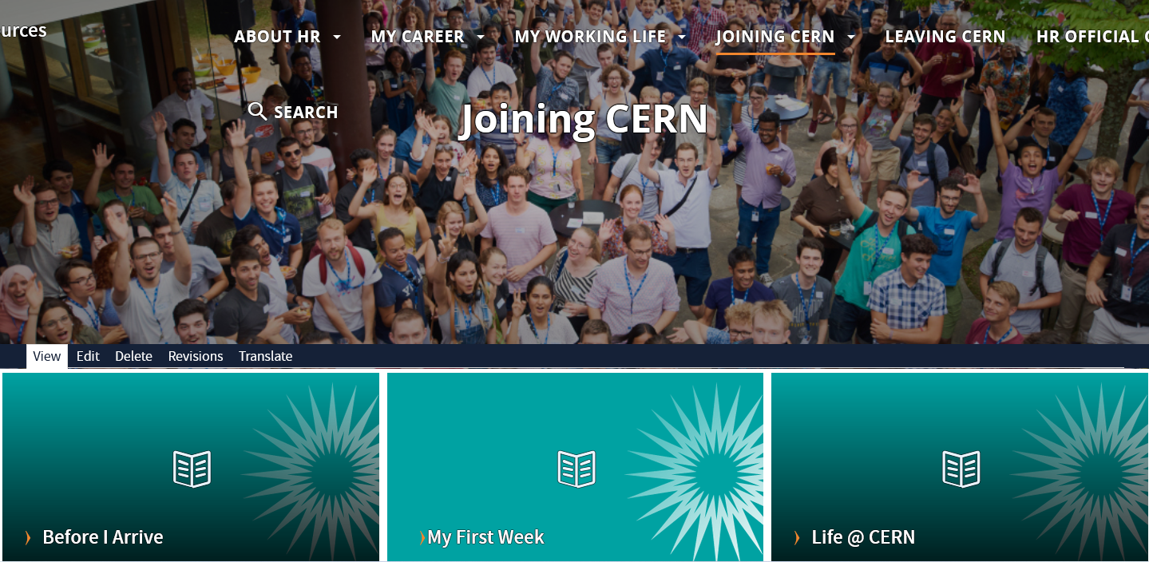
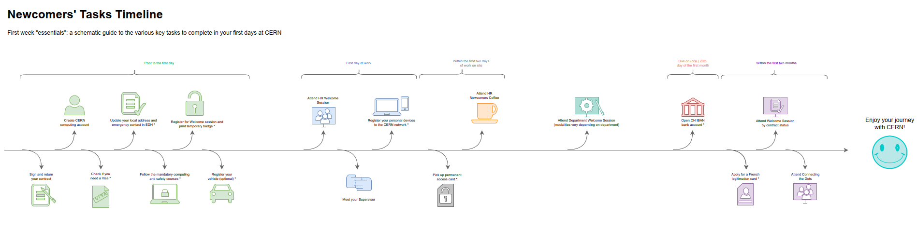
Newcomers website
https://hr.web.cern.ch/joining-cern
Notes:
Kyriaki
************************
On the HR website, you will find the Welcome to CERN pages.
You have already looked at the pages “Before I arrive”, but there is more information for you to discover now under “My first week” and later on under “life@CERN”

Slide 44



Many questions, answers are …
  Your departmental secretariat
  Your supervisor, your colleagues
  Specific question for personal situation?
  → Make appointment with the expert services
  Pension Fund, Health Insurance, Installation Service, Housing Service, Social Service, …
  HR Website > Welcome > my first week
Notes:
Kyriaki
************************
CERN is a big and complex organisation, with more than 60 years of history. Enough to have certain traditions, a certain way to do things, a certain culture.
You will certainly have many questions …
But where to find the answers ?
The departmental secretariat is an important info point about your rights and obligations, and it is close to you. You will meet them later today.
Your supervisor and colleagues will also be able to answer certain of your questions.
On the HR website, there is also the Welcome site with a dedicated section “My first week”
If you have specific questions related to you personal situation, there are expert services at your disposal. You’ll find their contact details on the Welcome pages.
We encourage you to make an appointment with them, why not do it later today ?
The quiz will also be an opportunity for you learn about the how and why of certain things.

Slide 45

Public meetings
Click for past and future events (agenda, slides, recordings)
Directorate every 3 months
Highlights of Council Week and other recent news.
HR ad hoc
Focus on one topic (eg. flexibility)
Staff Association every month
Latest information on priorities and current issues
Notes:
Erwin

Slide 46
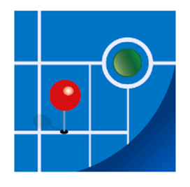

Recap from quiz - recommended
Download CERN map on your smartphone
Enter full number Fire and rescue service in your phone
Find out who are closest first-aiders
+ 41 22 76 74444
Notes:
Erwin
************************

Slide 47
Onboarding continues with …
Welcome session in your department
Meet the experts (online – Zoom)
  CERN Health Insurance (CHIS) Tuesday 4 October, 11.00 – 11.30
  Legitimation cards Tuesday 4 October, 11.30 – 12.00
More short sessions with experts (online – Zoom)
  Computer security* Monday 10 October, 13.30 - 14.00
  Pension Fund* Tuesday 11 October, 13.30 - 14.00
Connecting the dots* Monday 28 November, 14.00 - 18.00 register Learning Hub
Collective induction session or Individual contact by HRA
Visit* of CERN installations – register via Indico
Spouse* welcome session
Part of Welcome session
see Indico
* You will be invited
* You need to register
Notes:
Erwin
Induction sessions by type of contract :
Staff members will be contacted individually by their HRA (Human Resources Coordinator) .
Connecting the dots: you will have the opportunity to learn more about physics and accelerators, meet representatives from several CERN Services and CERN Clubs and network with other newcomers. You will receive an invitation and you will have to choose in which session you will enroll.
Visit of CERN installations open for newcomers and their families

Slide 48
Before joining your Department
Notes:
Kyriaki
************************
For the next step, it is important that you know to which department you belong.
It is not because you are a computing engineer that your department is automatically IT.
Let us look at the organigram of CERN.

Slide 49
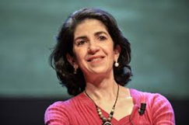
Director General
Health, Safety & Environment
Internal Audit
Legal Service
UNIT
Translation, Minutes & Council support
Accelerators & Technology
Beams
Technology
Finance & Human Resources
International Relations
Research & Computing
Engineering
Finance & Administrative Processes
Industry, Procurement & Knowledge Transfer
Human Resources
Site & Civil Engineering
Experimental Physics
Theory
Information Technology
Systems
Sector
Diplomatic & Stakeholder Relations
Department
Education, Communication, Outreach
Group
Notes:
Kyriaki
The Sectors, Departments and Units have acronyms, which are used more often than the full names.
Here they are.

Slide 50
DG
HSE
Fabiola Gianotti
Benoit Delille
UNIT
ATS
BE
TE
FHR
IR
RCS
EN
FAP
IPT
HR
SCE
EP
TH
IT
SY
Sector
Mike Lamont
Raphael Bello
Charlotte Warakaulle
Joachim Mnich
Rhodri Jones
Florian Sonneman
Manfred Krammer
Department
J. Miguel Jiménez
Christopher Hartley
Gian Giudice
Katy Foraz
James Purvis
Enrica Porcari
Brennan Goddard
Mar Capeans
Notes:
Kyriaki
The Sectors, Departments and Units have acronyms, which are used more often than the full names.
Here they are.

Slide 51
Sector
Director
Department
Department Head
DAO
DPO
DSO
DTO
…
Group
Group
Group
Group Leader
Section
Section
Section
Section Leader
Notes:
Kyriaki
The size of a Department can be from less than 100 people to several hundreds of people.
A Department has usually several groups.
And groups can in turn be composed of several sections.

