Slide 1
Physics education in Slovakia
Marián Kireš
Faculty of Science
P. J. Šafárik University in Košice, Slovakia

Slide 2
Content
How our system of education works
Who is responsible for what
How to achieve a career in physics
Physics as a teaching subject
Pre-service teacher training
In-service teacher training
Popularization of science (physics) in society
What we are doing for gifted children
International cooperation

Slide 3
How our system of education works

Slide 4
How our system of education works
Pre-school training and education (children aged 2 – 6 years)
Part of the pre-school training and education of children is preparation of the child for compulsory school attendance.
Elementary training and education (children aged 7 – 15 years)
is based on scientific knowledge in accordance with principles of patriotism, humanity and democracy,
provides moral, aesthetic, working, health, physical, traffic and ecology education,
enables religious education and sport preparation.

Slide 5
How our system of education works
Secondary general education and training (youth aged 16 – 19 years)
(Gymnasium)
General preparation for study at universities,
Secondary professional education and training (youth aged 16 – 19 years)
(Secondary professional schools )
preparation for professional occupations, including technical, economic, pedagogic, health care, social and legal, administrative, artistic and cultural, as well as for study at universities.

Slide 6
How our system of education works
Higher education (standard length 2 + 3 + 4 years)
the study programmes at three levels:
The Bachelor’s study programme which takes three years at least and four years at most (architecture, fine art and design).
The Magister‘s, Engineer‘s and Doctor’s study programme which takes one year at least and four years at most, so that the standard length of study according to the Bachelor’s study programme represented in total five years at least.
The PhD. study programme which takes three years in full-time form is at least and four years at most, in part-time five years.

Slide 7
How our system of education works
Credit system (since Academic year 2002/2003)
The standard load of the student for the entire academic year is expressed by number of 60 credits, for semester 30 credits.
The grading is on a scale of A-FX:
A (excellent) = 1 (able achievements)
B (very good) = 1,5 (above-average achievements)
C (good) = 2 (average achievements)
D (laudable) = 2,5 (acceptable achievements)
E (satisfactory) = 3 (achievements fulfil only the minimum criteria)
FX (unsatisfactory) = 4 (achievements do not fulfil even the minimum criteria )

Slide 8
How our system of education works
Examina rigorosa
The holders of the academic degree of magister may take examina rigorosa, which includes also the defence of a rigorosa thesis. After its successful completing the higher education institutions award the academic degrees in:
- natural science study programmes RNDr.
- pharmacy study programmes PharmDr.
- social science and art science study programmes PhDr.
- law study programmes JUDr.
- teacher training and sports study programmes PaedDr.
- theological study programmes ThDr.

Slide 9
How our system of education works
15.09.2010
Basic school 2063
28 278 teachers 413 718 pupils
Gymnazium 251
    5961 teachers 89 336 pupils
Vocational school 489
  13 359 teachers 181 334 pupils
University 32
Faculty 125
10 970 teachers 136 121 (Bc. + Mgr.) students
12 182 PhD. students

Slide 10
Who is responsible for what

Slide 11
Who is responsible for what
Ministry of Education, Science, Research and Sport of the Slovak Republic
State Pedagogical Institute
carries out curricular changes, applied educational research, professional and methodological consulting,
provides experimental verification of educational projects, reforms and changes in the content of education,
covers professional and methodological management of schools in particular by developing educational programs, preparation of pedagogical documentation for schools and school facilities in the field of education and training of teaching staff.
Institute of Information and Prognosis in Education
provides operation of the state information system, methodology development and complex information processing in the field of education,
State Vocational Education Institute
provides professional and methodological management of secondary schools, curriculum projects, ensuring of technical-pedagogical and educational activities to dealing with issues of secondary vocational education.

Slide 12
Who is responsible for what
National Institute for Certified Educational Measurements
implementation of certified educational measurements at national level,
preparation of international measurements in accordance with programmes where the Slovak Republic participates and fully complies with the rules,
research and development in the area of measurements and evaluation of the quality of education,
continuous monitoring of the results of education, conditions and development of education at national level as well as its international comparison,
evaluation of the quality of education at primary and secondary schools at the level of national educational programmes.

Slide 13
Who is responsible for what
Methodology and Pedagogy Centre
(Institution for in Service Teachers’ Education and Training)
provides continual education for pedagogical employees and professional employees in schools and school facilities and prepares school leadership,
provides expert methodological activities in the area of continual education of pedagogical and non-pedagogical staff,
carries out research activities in the field of continual education of pedagogical and non pedagogical staff,
Regional Offices for Education
(Bratislava, Trnava, Trenčín, Nitra, Banská Bystrica, Žilina, Prešov, Košice)

Slide 14
Who is responsible for what
IUVENTA Slovak Youth Institute
offers educational, methodical and informational activities for various target groups,
perform tasks resulting from the state policy towards children and youth,
coordinates and implements activities to promote and develop research in the field of youth,
administrates grant programs of the Ministry of Education, Science, Research and Sport of SR (ADAM) and the European Union (Youth in Action),
operates in the sphere of work with talented youth (Olympiads and school subject competitions),

Slide 15
Who is responsible for what
Slovak Research and Development Agency (SRDA)
is the instrument for distribution of public finances for research and development on the competitive basis in Slovakia,
is responsible for research and development promotion in all research fields, including international research cooperation.

Slide 16
How to achieve a career in physics

Slide 17
How to achieve a career in physics
Public universities:
Comenius University in Bratislava
Pavol Jozef Šafárik University in Košice
Constantine the Philosopher University in Nitra
Matej Bel University Banská Bystrica
Trnava University in Trnava
University of Žilina
University of Prešov in Prešov
Slovak University of Technology in Bratislava
The Technical University of Košice

Slide 18
How to achieve a career in physics
  Faculty of Mathematics Physics and Informatics
  Comenius University in Bratislava
  Faculty of Science
  P. J. Šafárik University in Košice
Bachelor degree in Physics
  Physics
  Biomedical Physics
  Renewable Energy Sources and Environmental Physics
Master degree in Physics
  Astronomy and Astrophysics
  Biomedical Physics
  Biophysics and Chemical Physics
  Environmental Physics and Renewable Energy Sources
  Meteorology and Climatology
  Nuclear and Sub-nuclear Physics
  Optics, Lasers and Optical Spectroscopy
  Physics of the Earth and Planets
  Plasma Physics
  Solid State Physics
  Theoretical Physics
Bachelor degree in Physics
  Physics
Master degree in Physics
  Biophysics
  Nuclear and Subnuclear Physics
  Physics
  Physics of Condensed Matter

Slide 19
How to achieve a career in physics
  Faculty of Mathematics Physics and Informatics
  Comenius University in Bratislava
  Faculty of Science
  P. J. Šafárik University in Košice
PhD degree in Physics
Environmental Physics
General Physics and Mathematical Physics
New and Renewable Energy Sources
Condense Matter Physics and Acoustics
Quantum Electronics, Optics and Optical Spectroscopy
Nuclear and Subnuclear Physics
Plasma Physics
Astronomy and Astrophysics
Geophysics
Meteorology and Climatology
Chemical Physics
Biophysics
Theory of Physics Education
PhD degree in Physics
  Biophysics
  Nuclear and Subnuclear Physics
  General Physics and Mathematical Physics
  Physics of Condensed Matter

Slide 20
How to achieve a career in physics
Pre-service teacher training
Bachelor degree
Training of teachers with academic subject specialisation (combination of two subjects)
Interdisciplinary studies of two subjects
Master degree
Teaching primary and secondary subjects (combination of two subjects)
Teaching of Academic Subjects (combination of two subjects)
PhD degree
Theory of Physics Education

Slide 21
Physics as a teaching subject

Slide 22
Physics as a teaching subject
International Standard Classification of Education
ISCED 0 Pre-primary education
ISCED 1 Primary education - first stage of basic education
physical content as a part of subject „Natural science“
ISCED 2 Lower secondary education – second stage of basic education
Physics, Biology, Chemistry = thematic field: Human and nature
ISCED 3A Upper secondary education (Gymnasium)
Physics, Biology, Chemistry = thematic field: Human and nature
Lessons per week 6th 7th 8th 9th
Elementary school 1 1 2 1
1st 2nd 3rd 4th
Gymnasium 2 2 1 in total 30 weeks
per school year

Slide 23
Physics as a teaching subject
National physics curriculum
(upper secondary level)
Subject (Physics) characteristics
searching and identification of relationships between the observed properties of objects around us,
the conceptual understanding of phenomena,
developing positive attitude towards science the scientific knowlege is interpreted as a part of a human culture,
active cognition and systematic inquiry,
In education, the dominant attention should be paid to students independent work – so called activities, i.e. assignments that lead to new knowledge construction.
The stress is put on such forms like discussion, brainstorming, construction of logical patterns, and concept maps and working with information.
Student through physics education gains knowledge to understand scientific ideas and procedures needed for personal decisions and to participate in civil and cultural matters.

Slide 24
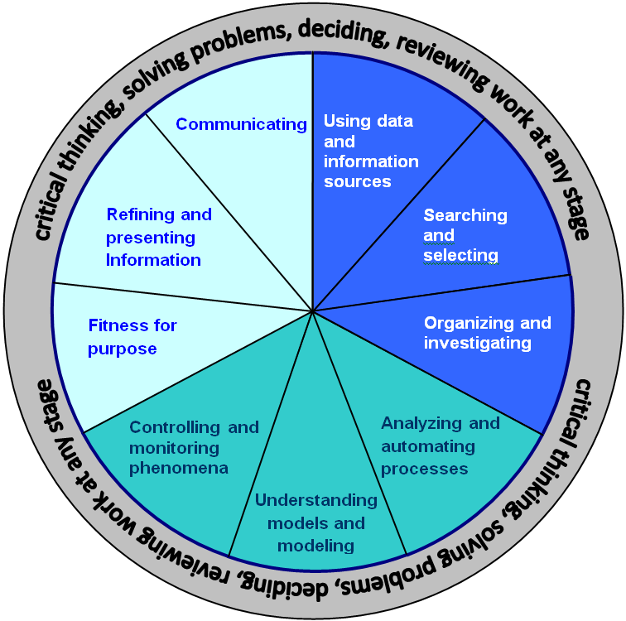
Physics as a teaching subject
Main objectives (upper secondary level)
World around us
Communication
Science knowledge and ideas
Scientific inquiry
Data processing
Experimentation

Slide 25
Physics as a teaching subject
Main objectives (upper secondary level)
A. World around us
at the end of the course student should be able:
  to decribe the ways how science works
  to evaluate profits and drawbacks of science applications
  to discuss ethical and moral questions arising from science
  to discuss how science study is affected by cultural influence
  to understand how differennt sciences are connected and how they are connected with other disciplines
  to consider science as a collaboration activity

Slide 26
Physics as a teaching subject
Main objectives (upper secondary level)
B. Communication
at the end of the course student should be able to communicate ideas, obseravtions, arguments, practical experience:
  using appropiate language and vocabulary
  using tables and diagrams
  using appropriate form of laboratory report
  using appropriate sortware, e.g. wordprocessor, spreadsheet

Slide 27
Physics as a teaching subject
Main objectives (upper secondary level)
C. Science knowledge and ideas
at the end of the course student should be able to demonstrate his knowledge and understanding of:
  the nature ond methodology of science
  scientific facts, definitions, laws, models
  appropriate vocabulary and terminology, including symblos
  how laws, models and opinion have changed in time
  SI system of units

Slide 28
Physics as a teaching subject
Main objectives (upper secondary level)
D. Scientific inquiry
at the end of the course student should be able:
  to formulate a problem, research question, that can be answered by experiment
  to formulate a prediction,
  to test a prediction,
  to plan an appropriate experiment ,
  to formulate a conclusion according to observation and experimentation, to comment on measurement errors,
  to formulate the validity of conclusions based upon a series of measurments,
  to evaluate the overall experiment including the procedures used in it.

Slide 29
Physics as a teaching subject
Main objectives (upper secondary level)
E. Data processing
at the end of the course student should be able:
  to organize, present and evaluate data in different ways
  to transform data presented in a form into another form (including calculs, tables, diagrams)
  to identify possible trends in data
  to create predictions based upon data
  to suggest conclusions based upon data
  to use knowledge to explain conclusions

Slide 30
Physics as a teaching subject
Main objectives (upper secondary level)
F. Experimentation
at the end of the course student should be able:
  to follow written or oral instructions,
  to select and use safely the experimental setup, materials, technology appropriate for measurement
  to carry out the experiment safely, to record data gained by observation and measurement
  to use appropriate tools and technology to collect data,
  to work and cooperate in groups

Slide 31
Physics as a teaching subject
Suggested topics of Physics (upper secondary level)
Observation, measurement, experiment (4+40 lessons)
Force and motion (18 lessons)
Energy around us (18 lessons)
Electricity and magnetism (20 lessons)
Periodic phenomena (15 lessons)
Electromagnetic waves and particles of microworld (20 lessons)

Slide 32
Pre-service teacher training

Slide 33
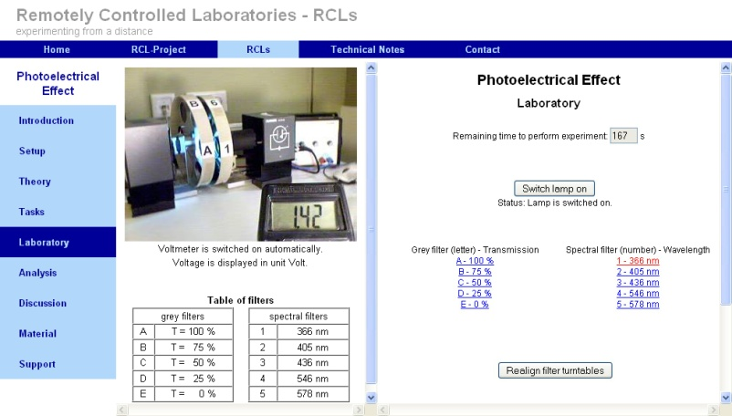
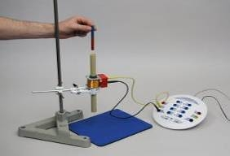
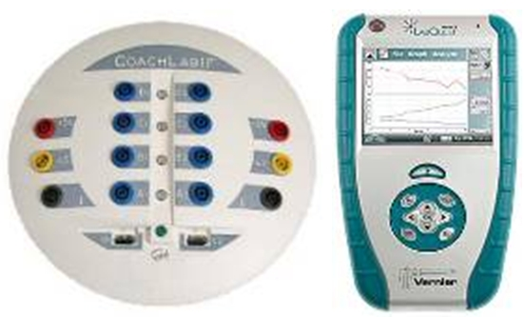
Pre-service teacher training
5 years study planes oriented on:
conceptual understanding of basic physics problems,
experimental skills for school physic experiments,
problem solving through the various methods and approaches,
modern teaching methods (PEER Instruction, Interactive lecture demonstrations, Just in Time Teaching...),

Slide 34
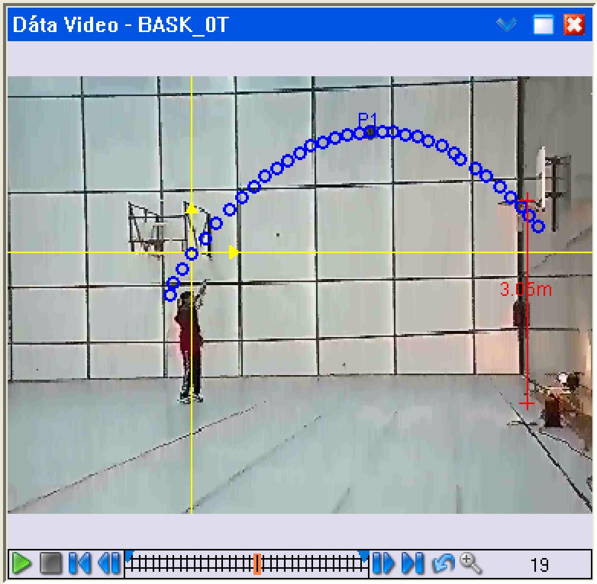
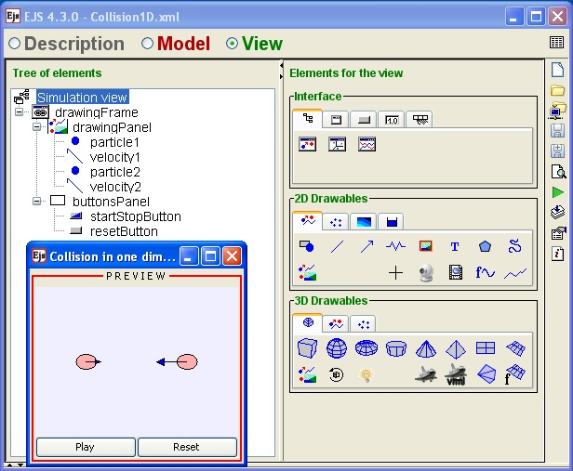

Pre-service teacher training
using of modern technologies in education
(tablet, electronic whiteboard, voting system, )
computer based measurement,
Computer modelling and simulation,
e-learning, LMS for distance education,
gifted student competitions,
informal education,
...

Slide 35
Pre-service teacher training
Actual problems:
weak interest in teaching profession,
decreasing quality of students,
too high average age of school teachers,
lack of job vacancies for young teachers,
high requirements on the teacher's work,

Slide 36
In-service teacher training

Slide 37
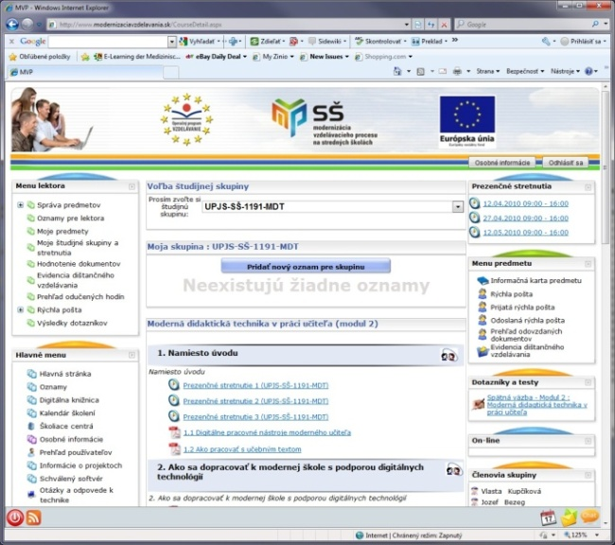
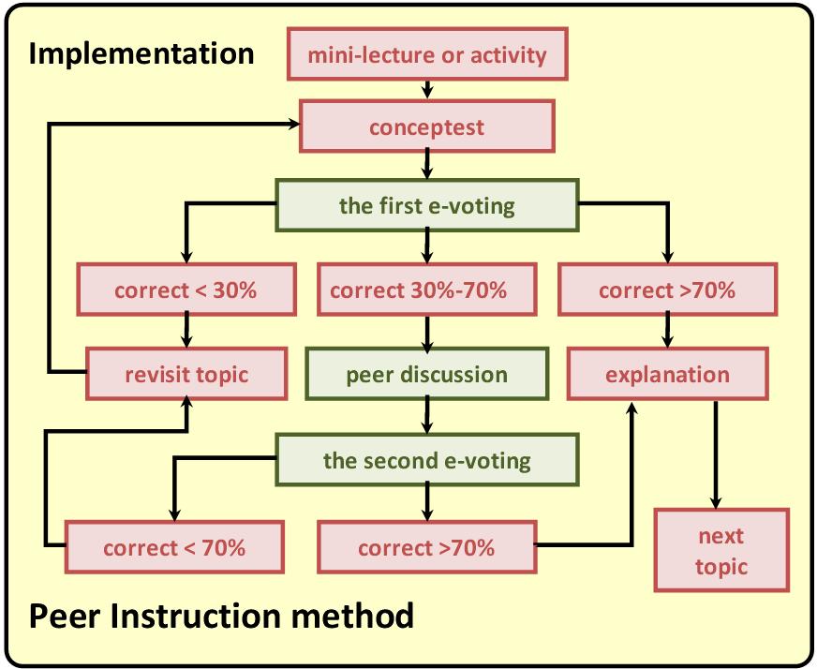
In-service teacher training
National system for teacher personal development,
Credit system for further teacher education
Accreditation commission Ministry of Education
for further education
F2F and distance courses with help of e-learning,
National project:
  Modernization of the education at primary and secondary schools

Slide 38
Popularization of science (physics) in society

Slide 39
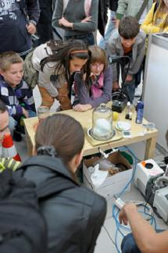
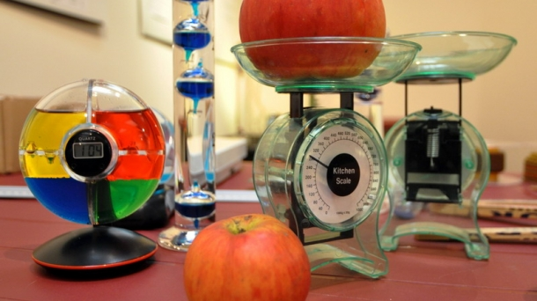
Popularization of science (physics) in society
Science week
Open door University
Science seminars, science cafe, discussion forums,
Research lab open for public
Science show,
Science toy,
...

Slide 40
What we are doing for gifted children

Slide 41
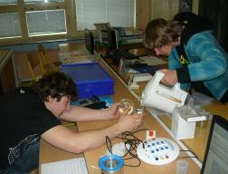
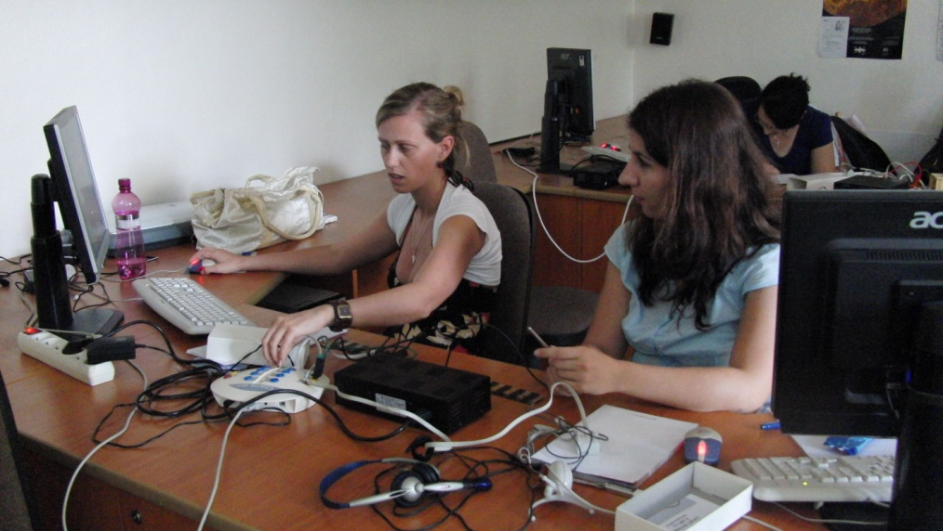
What we are doing for gifted children
Physics Olympiad (52nd year of the competition)
Young Scientists Tournament
Secondary school professional activity
Distance courses for gifted students in problem solving
Summer camps and schools,

Slide 42
International cooperation

Slide 43

International cooperation
FP 7 projects oriented on Inquiry based science education (IBSE methods, pre- service and in- service teacher training):
  ESTABLISH: European Science And Technology in Action Building Links with Industry, Schools and Home
  PRIMAS: Promoting Inquiry in Mathematics and Science education across Europe
  ASPIRE: Assessment Strategy Programmes In Renovating Education

Slide 44
Thank you for your attention
Marián Kireš
Institute of Physics
Faculty of Science
P. J. Šafárik University in Košice
Slovakia
marian.kires@upjs.sk

