Slide 1
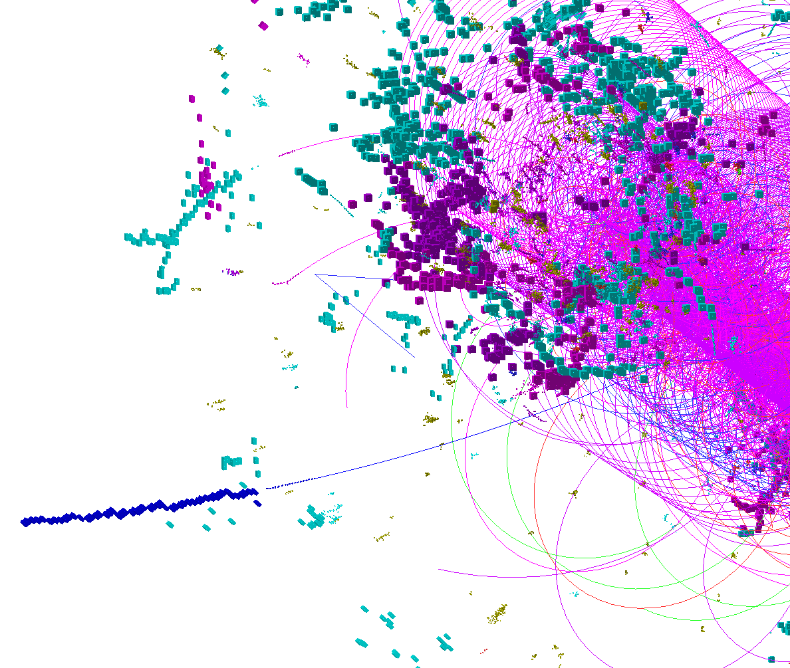
CLIC_ILD_CDR TPC Tracking
Mark Thomson
University of Cambridge

Slide 2
This Short Talk
Very Much Work in Progress: ALL VERY PRELIMINARY
Preliminaries:
  All run with OverlayTiming processor
    full bunch train of gamma gamma to hadrons
    background
  Main questions
    limitations of LEP TPC reconstruction
    what is true limitation

Slide 3
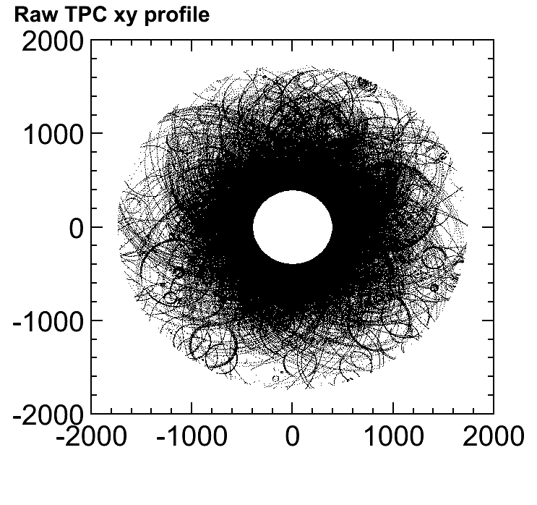
300 BX in TPC
Try to reconstruct full bunch train
  Only gamma-gamma background
  1.8E6 TPC hits
  Underestimate of true occupancy
  LEP tracking code gives up
    even with mods, to common
    blocks need < 100000 hits
  non-negligible voxel occupancy
  in inner parts of TPC
  Reconstruction strategies
    divide TPC into two halves
    in z
    run CurlKillerProcessor
    ignore inner part of TPC for
    track PatRec

Slide 4
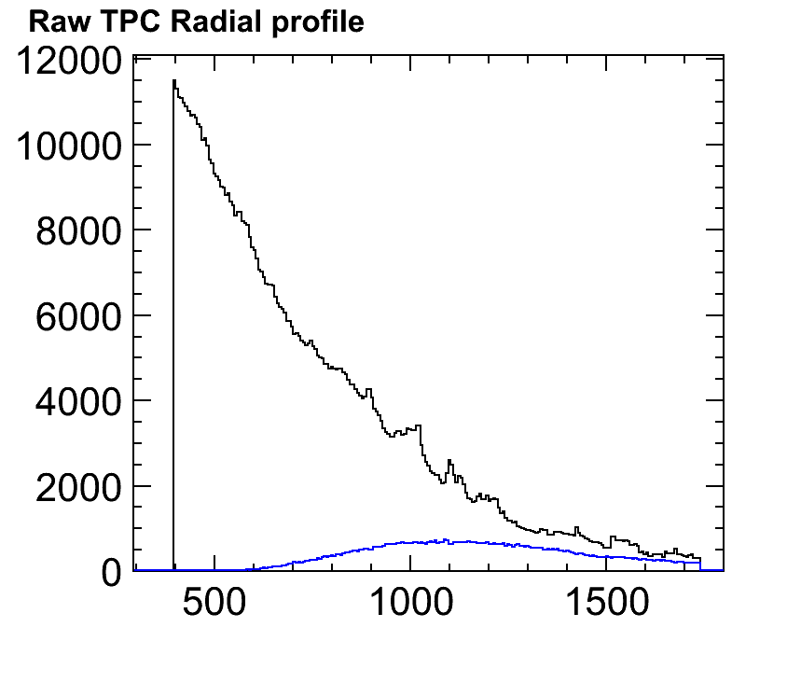
For example:
(z>0, multiplicityCut=2)
  Only 10 % of hits used in Patrec
  LEPTracking runs ~ few minutes
  700 TPC tracks
  but, inner part of TPC not used

Slide 5
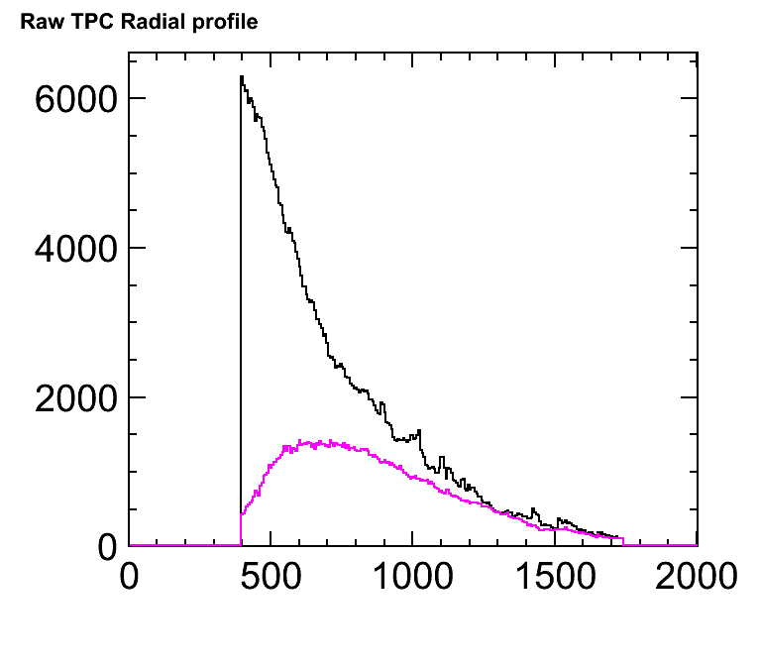
For example (slicing in z):
(0<z<500, multiplicityCut=5, binW=5)
  25 % of hits used in Patrec
  450 TPC tracks
  inner part of TPC partly used
  no feel for efficiency etc.

