Slide 1
SYMBA - Symbolic Computation of Squared Amplitudes
Marco Knipfer
University of Alabama
Google Summer of Code 2022

Slide 2
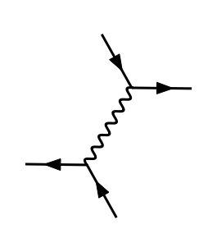
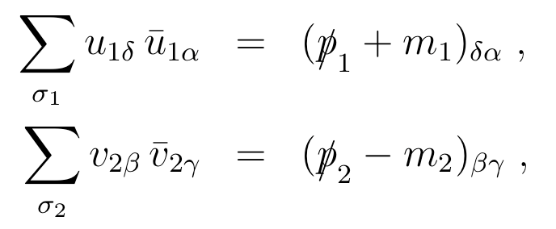






Introduction
M=1/2*i*e^2*gamma_{+%\sigma_73,%gam_55,%eta_12}*gamma_{%\sigma_73,%gam_56,%del_50}*e_{i_3,%eta_12}(p_1)_u*e_{k_3,%del_50}(p_2)_u*e_{l_3,%gam_55}(p_3)_u^(*)*e_{i_5,%gam_56}(p_4)_u^(*)/(m_e^2 + -s_13 + 1/2*reg_prop)
$$e^{−}$$
$$e^{−}$$
M^2=2*e^4*(m_e^4 + -1/2*m_e^2*s_13 + 1/2*s_14*s_23 + -1/2*m_e^2*s_24 + 1/2*s_12*s_34)*(m_e^2 + -s_13 + 1/2*reg_prop)^(-2)
Feynman diagram
Amplitude
squared amplitude
Cross section
$$e^{−}$$
$$e^{−}$$
Sum over polarizations
Lorentz indices
Lots of complicated identities needed
Traces over $γ$-matrices
Longest step on PC
$$σ\left(1+2→1^{′}+2^{′}+…+n′\right)$$

Slide 3





Introduction
$$e^{−}$$
M=1/2*i*e^2*gamma_{+%\sigma_73,%gam_55,%eta_12}*gamma_{%\sigma_73,%gam_56,%del_50}*e_{i_3,%eta_12}(p_1)_u*e_{k_3,%del_50}(p_2)_u*e_{l_3,%gam_55}(p_3)_u^(*)*e_{i_5,%gam_56}(p_4)_u^(*)/(m_e^2 + -s_13 + 1/2*reg_prop)
M^2=2*e^4*(m_e^4 + -1/2*m_e^2*s_13 + 1/2*s_14*s_23 + -1/2*m_e^2*s_24 + 1/2*s_12*s_34)*(m_e^2 + -s_13 + 1/2*reg_prop)^(-2)
Feynman diagram
Amplitude
squared amplitude
Cross section
Or decay width
$$e^{−}$$
$$e^{−}$$
$$e^{−}$$
Sum over polarizations
Lorentz indices
Lots of complicated identities needed
Traces over $γ$-matrices
Longest step on PC
$$σ\left(1+2→1^{′}+2^{′}+…+n′\right)$$
$$Γ(1→1^{′}+2^{′}+…+n^{′})$$

Slide 4

Data Generation
https://marty.in2p3.fr
A Modern ARtificial Theoretical physicist
QED and QCD data, tree level, up to 3→3

Slide 5
Data Generation
Generated QED data >100k
  20h on 19 cores (12900H)
Squared amplitudes simplified with sympy
  10h on 19 cores (12900H)
  Learned how to write parallelized code with timeout in python
QCD data in progress
  10k in 40h

Slide 6
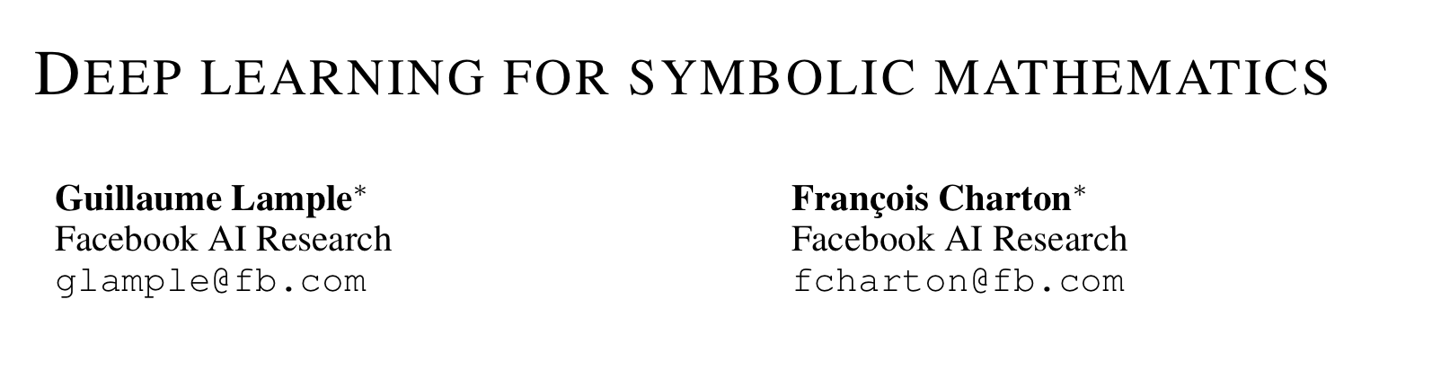
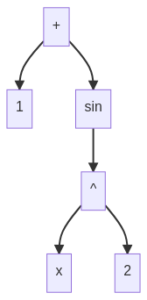
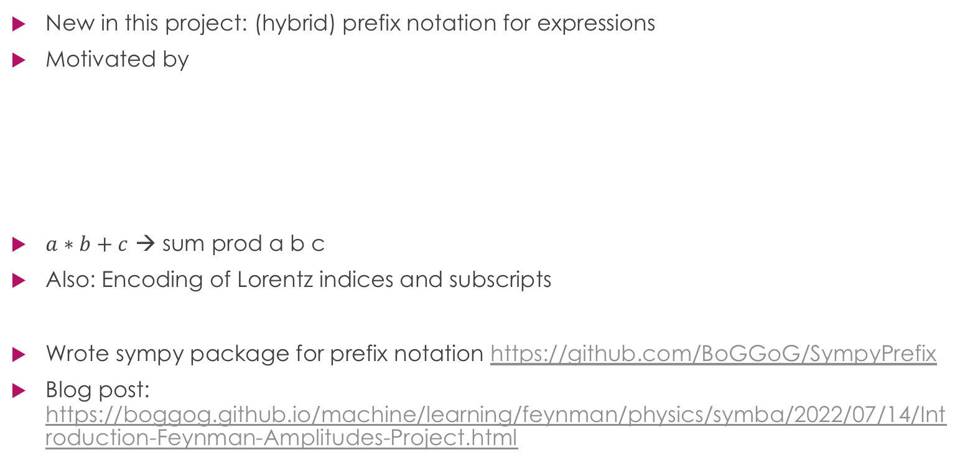
Expression encoding
New in this project: (hybrid) prefix notation for expressions
Motivated by
$a∗b+c$ → sum prod a b c
Also: Encoding of Lorentz indices and subscripts
Wrote sympy package for prefix notation https://github.com/BoGGoG/SympyPrefix
Blog post: https://boggog.github.io/machine/learning/feynman/physics/symba/2022/07/14/Introduction-Feynman-Amplitudes-Project.html

Slide 7
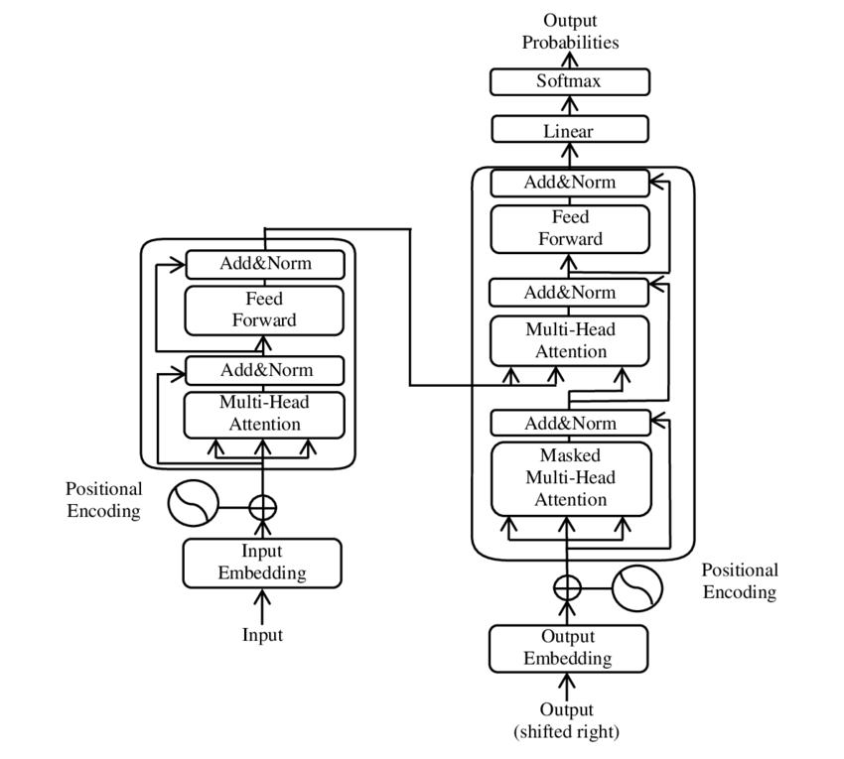
Model: Transformer
predicting one token after the other
maximal sequence length: 350
embed_dim = 256
latent_dim = 2048
num_heads = 8
https://en.wikipedia.org/wiki/Transformer_(machine_learning_model)

Slide 8
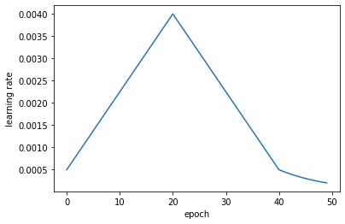
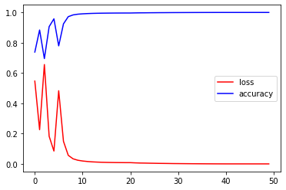

Training & Results (QED)
10h on Google Colab Pro+
next-token accuracy: 99.98%
token accuracy (full expressions, $≤$ 350 tokens)
  train: 0.9812
  test: 0.9655

Slide 9
ToDo until deadline (September 30th)
Train on QCD data
Implement beam search

