Slide 1
RF tuning summary of ELISA-RFQ
& calibration data
11th ELISA technical meeting
Hermann Pommerenke, Mariangela Marchi
29th September 2022

Slide 2
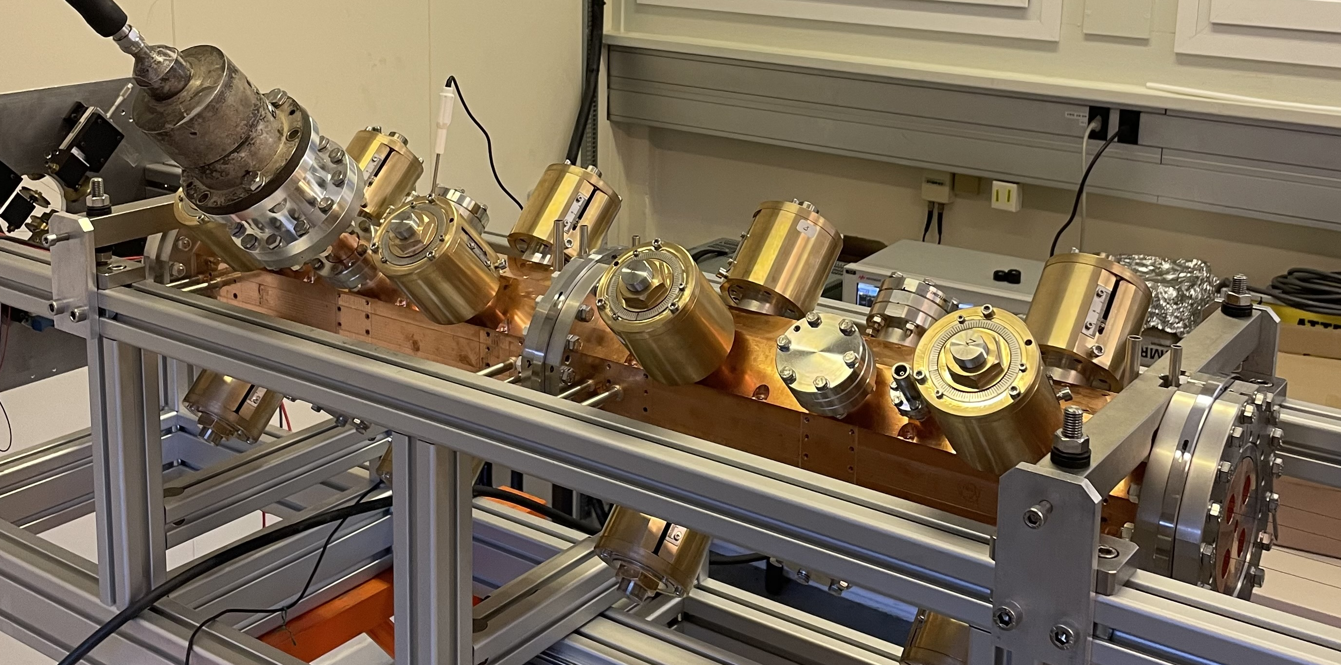

Slide 3
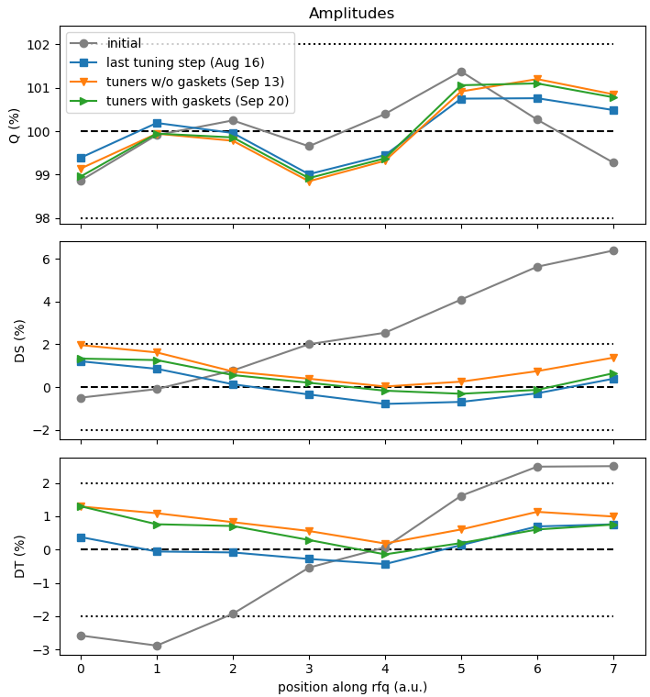
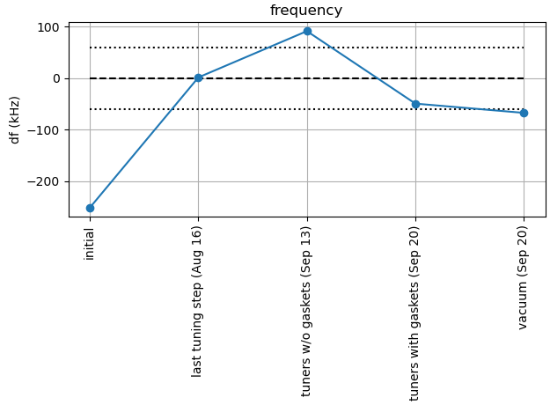
Summary of RF tuning steps
Field amplitudes (quadrupole, 2x dipole) during field tuning
Goals
  Quadrupole = 100 % (± 2 %)
  2x Dipoles = 0 % (± 2%)
  Frequency = 749.48 MHz (± 60 kHz)
4 tuning steps carried out with movable pistons (only last shown here)
some deviations between last tuning step and remachined tuners, with and without gaskets (measurement uncertainty, room climate…)
but within tolerances
final frequency (vacuum, 23 °C) = 749.413 MHz
slightly below target range (likely due to gaskets, machining tolerance)
→ not problematic

Slide 4
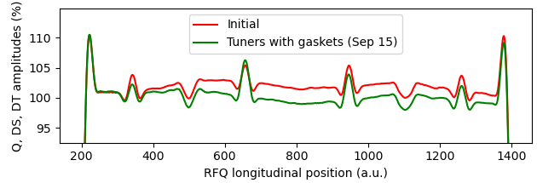
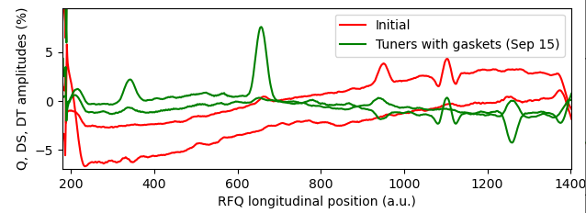
Summary of RF tuning steps, calibration figures
RF tuning step | ΔQ (%) | DS (%) | DT (%) | df (kHz) | Q₀ | β
Initial | 1.4 | 2.9 | 6.4 | +224.6 | 6047 | 1.27
Tuning step 1 | 0.9 | 1.9 | 2.5 | +134.3 | 6044 | 1.23
Tuning step 2 | 1.0 | 1.2 | 1.1 | +62.9 | 6057 | 1.21
Tuning step 3 | - | - | - | -47.5 | 6038 | 1.21
Tuning step 4 | 1.0 | 0.8 | 1.2 | -1.5 | 6052 | 1.21
Tuners remachined | 1.2 | 1.9 | 1.3 | +91.2 | 6051 | 1.19
Tuners with gaskets | 1.1 | 1.3 | 1.3 | -49.3 | 6167 | 1.21
Under vacuum | - | - | - | -67.3 | 6144 | 1.20
Design/target value | 0 | 0 | 0 | 0 | 5995 | 1.25
Target tolerance | 2.0 | 2.0 | 2.0 | ±60 | - | -
Continuous fields before and after tuning
Quadrupole (%)
Dipole (%)
Antenna | S₂₁ to coupler | Power at 65 kW | Rel.
1 | -50.60 dB | 0.57 W | 100.0 %
2 | -50.42 dB | 0.59 W | 104.0 %
3 | -50.51 dB | 0.58 W | 101.6 %
4 | -50.99 dB | 0.52 W | 91.3 %
Design value | -48.13 dB | 1.00 W | -
Calibrated power figures at the RF pickup antennas for the field as tuned above

Slide 5
