Slide 1
FCC-ee Arc Half-Cell Configuration and Mock-up
8th June 2023 / FCC week 2023
F. Carra (CERN)
On behalf of the FCC-ee Arc Half Cell Mock-up Project team

Slide 2
Outline
8th June 2023 / FCC week 2023
Federico Carra / CERN
Arc half-cell mock-up project
Phase I main results
Update on stability studies
Proposed experimental campaign
Conclusions

Slide 3
Outline
8th June 2023 / FCC week 2023
Federico Carra / CERN
Arc half-cell mock-up project
Phase I main results
Update on stability studies
Proposed experimental campaign
Conclusions

Slide 4
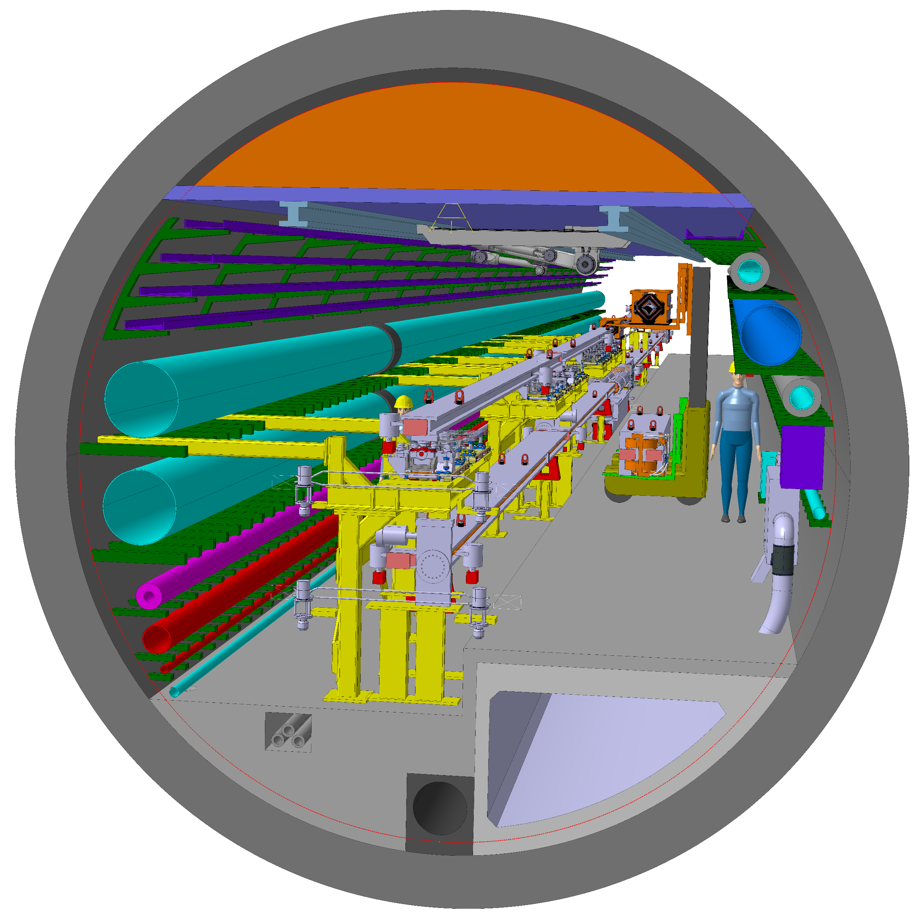
Aim of the project
8th June 2023 / FCC week 2023
Federico Carra / CERN
Arc half-cell: most recurrent assembly of mechanical hardware in the accelerator (~1500 similar FODO cells in the FCC-ee)
Mock-up → Functional prototype(s) → Pre-series → Series
Building a mock-up allows optimizing and testing fabrication, integration, installation, assembly, transport, maintenance, robotics
Working with demonstrators of the different equipment, and/or structures with equivalent volumes, weights, stiffness
Arc perspective view, F. Valchkova-Georgieva

Slide 5
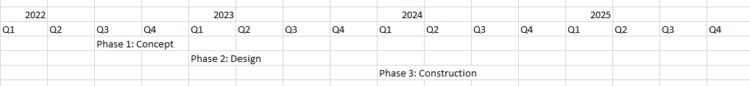
Timeline
8th June 2023 / FCC week 2023
Federico Carra / CERN
T. Raubenheimer
Phase 1
Phase 2
Phase 3
Phase 1: Concept development → functional spec + integration studies. Develop 3D model for ‘representative’ arc half-cell.
Phase 2: Engineering design of half-cell mock-up systems and delivery of 2D functional and fabrication drawings.
Phase 3: Fabrication of half-cell mock-up with tunnel boundary with representative components and systems (non-operational).

Slide 6
Outline
8th June 2023 / FCC week 2023
Federico Carra / CERN
Arc half-cell mock-up project
Phase I main results
Update on stability studies
Proposed experimental campaign
Conclusions

Slide 7
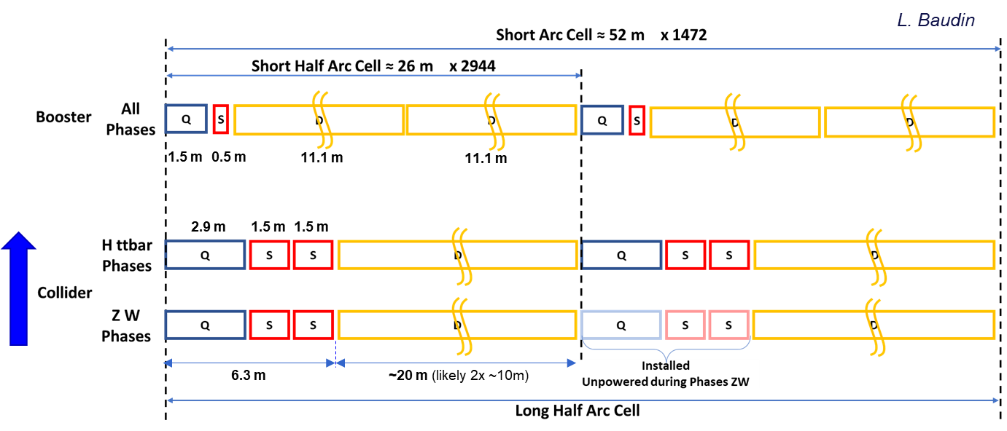
Phase I main results
8th June 2023 / FCC week 2023
Federico Carra / CERN
“FCC-ee Arc Half-Cell Mock-up Project – Phase 1 Summary Report”, CERN EDMS document n. 2817139
“FCC-ee Arc Half-Cell: Preliminary Design and Integration Studies, with Ideas for a Mock-up”, Proc. of IPAC’23 and accepted for publication on IOP special issue
“First Considerations on the Supporting Structures of FCC-ee Booster and Collider in the Arc Regions”, accepted for publication on JINST special issue
Dedicated section in FCC FS Mid-Term Review Report
Booster/collider placement
Configuration of Short Straight Sections
Stability studies
Mock-up proposal
“FCC-ee Arc Half-Cell Configuration Project & Mock-up”, presented at the FCCIS 2022.

Slide 8
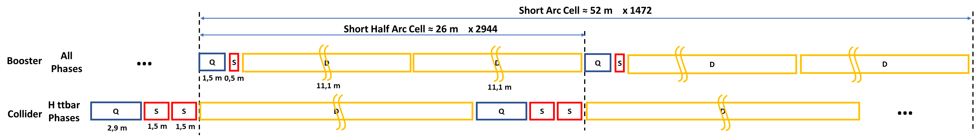
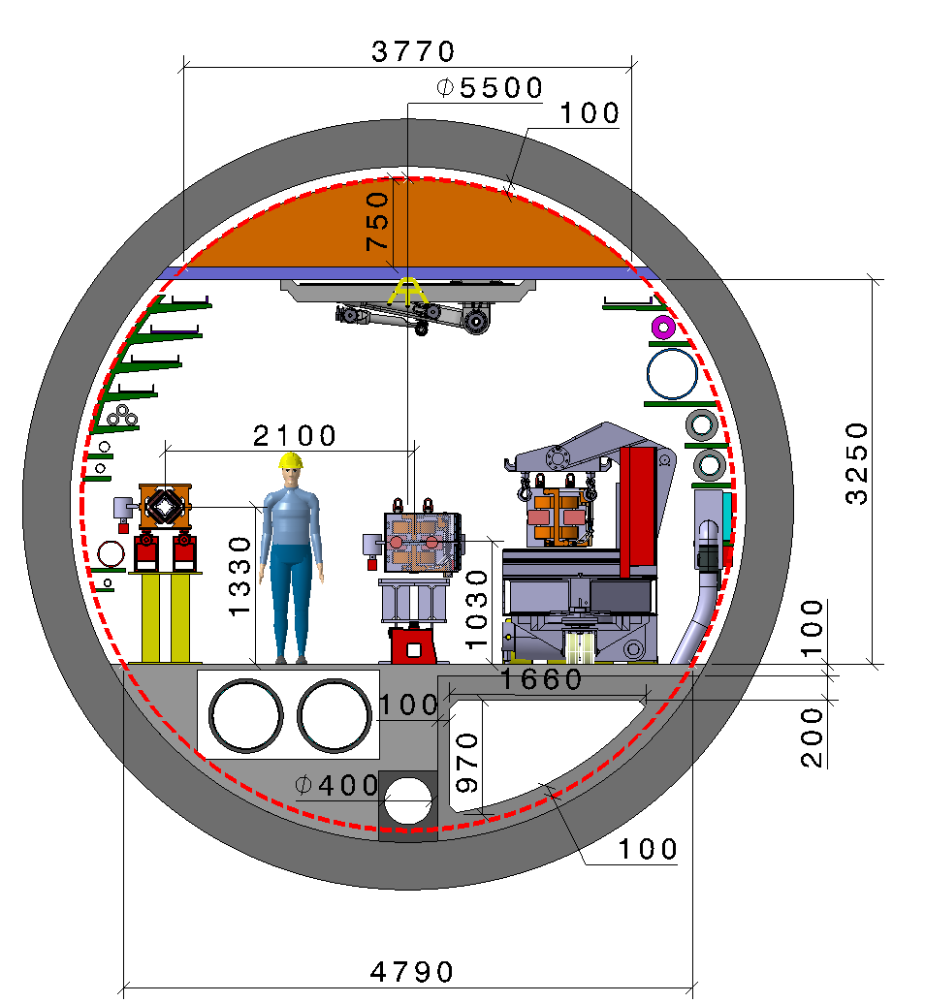
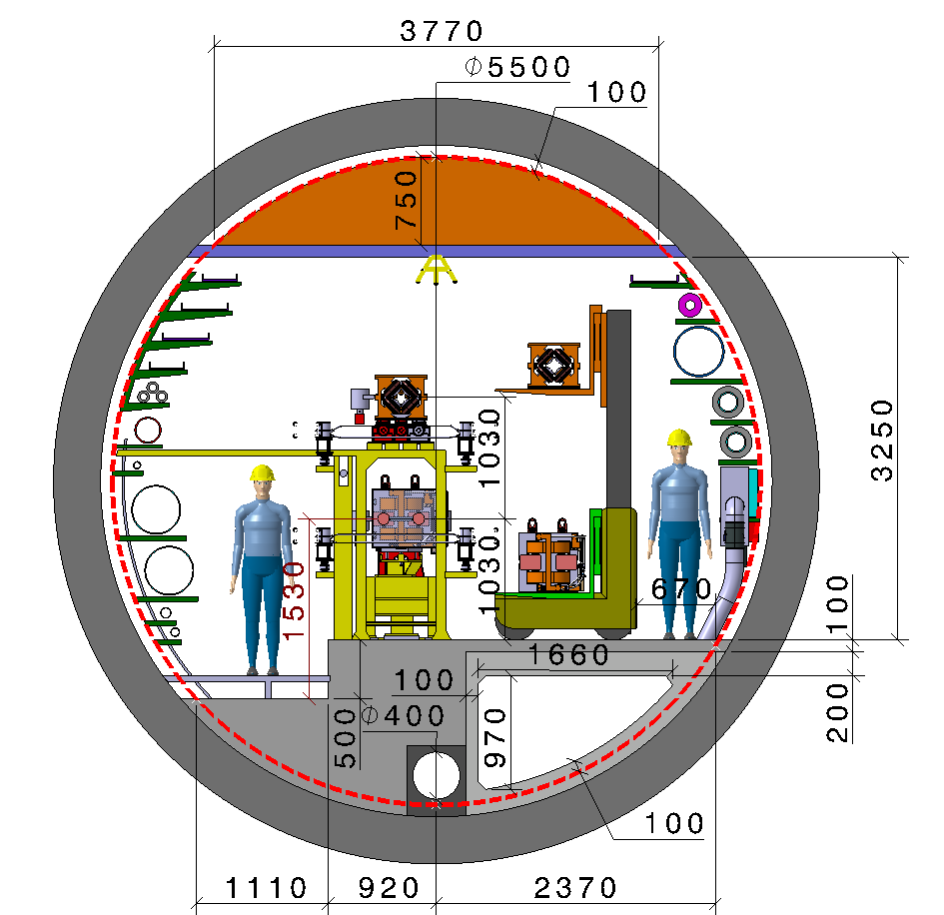
Phase I main results: booster/collider placement
8th June 2023 / FCC week 2023
Federico Carra / CERN
Azimuthal: shift of SSS by maintaining periodicity → more compact, gain of space vertically
H
V
Radial & Vertical: study of best configuration together with FCCIS TI pillar, compared by ranking relevant KPIs
vs.

Slide 9
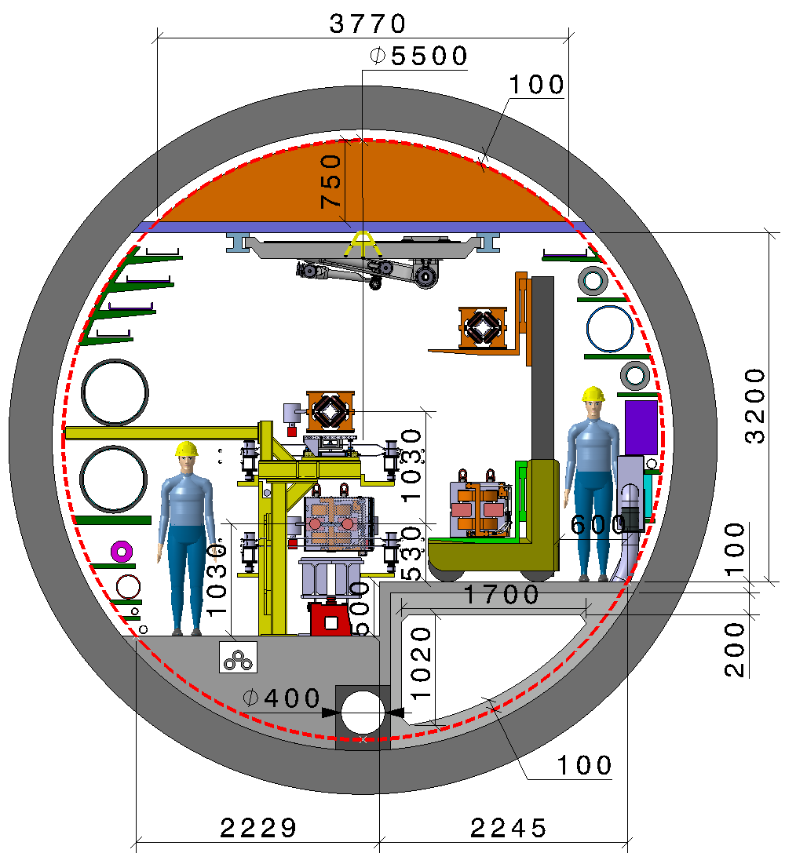
Phase I main results: booster/collider placement
8th June 2023 / FCC week 2023
Federico Carra / CERN
Technical KPI | Horizontal | Vertical
Integration in Ø5.5m tunnel | 1 | 3
Interface with other tunnel regions | 2 | 3
Maintenance | 2 | 2
Transport | 2 | 3
Stability | 3 | 2
Radiation | 1 | 2
Compatibility with FCC-hh | 2 | 3
1 = poor 2 = average 3 = good
H
V
Radial & Vertical: study of best configuration together with FCCIS TI pillar, compared by ranking relevant KPIs
vs.

Slide 10
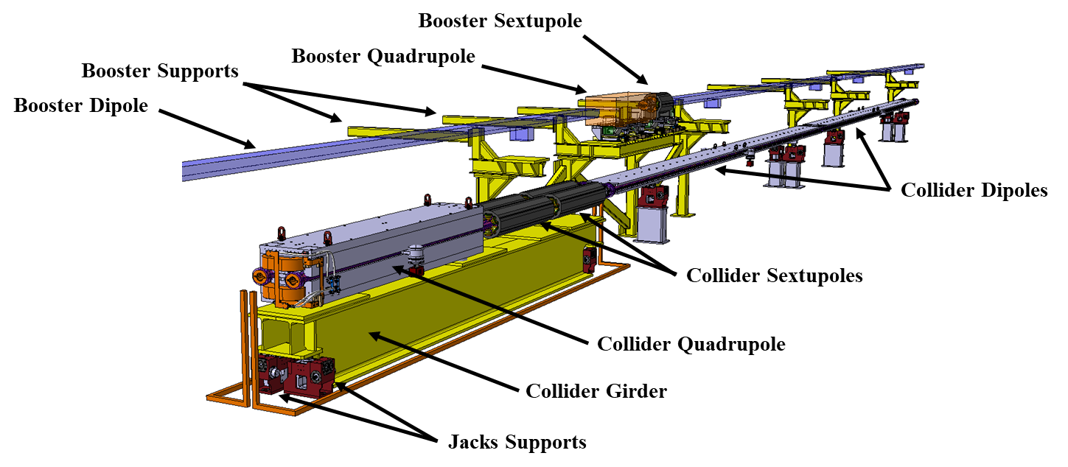
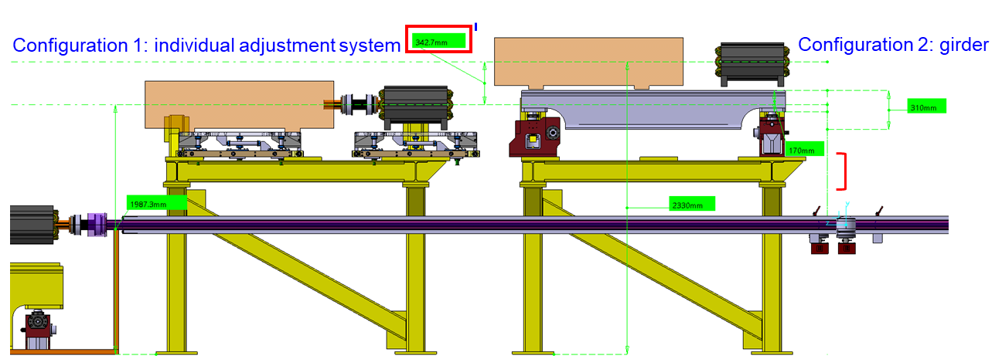
Phase I main results: configuration of the SSS
8th June 2023 / FCC week 2023
Federico Carra / CERN
Preliminary mechanical design of SSS supporting system, using common girders to pre-align magnets with common vacuum chamber in a proper surface facility.
Clean environment, less in-tunnel work, less transports, less bellows, easy replacement / spare management.
Senior Advisors Committee: “Using girders can be an efficient way to install a machine. Pre-assembly can be prepared ahead, with better tools, in a more convenient environment and with more space. Girders allow for reduced installation time and reduced alignment effort in tunnel, since only girder to girder alignment is necessary vs. alignment of each machine component”.
C. Tetrault

Slide 11
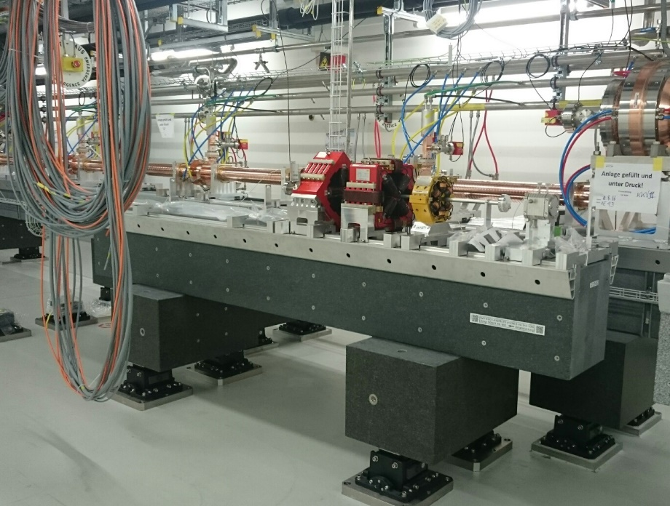
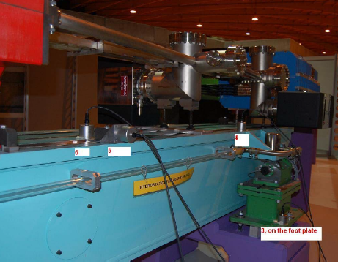
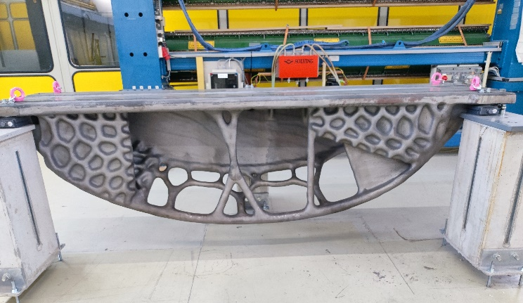
Phase I main results: configuration of the SSS
8th June 2023 / FCC week 2023
Federico Carra / CERN
Preliminary mechanical design of SSS supporting system, using common girders to pre-align magnets with common vacuum chamber in a proper surface facility
Clean environment, less in-tunnel work, less transports, less bellows, easy replacement / spare management.
Optimizing quality-to-cost in collaboration with PSI (J. Wickstroem, M. Wurm) and industry
Granite girder for SwissFEL, courtesy J. Wickstroem
Steel girder for SLS, courtesy M. Wurm
Cast girder for PETRA IV, courtesy R. Losito

Slide 12
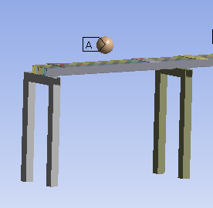
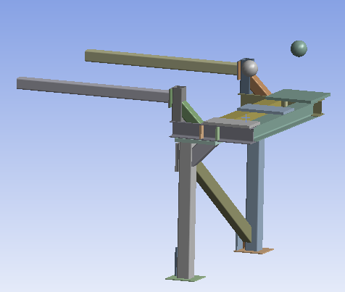
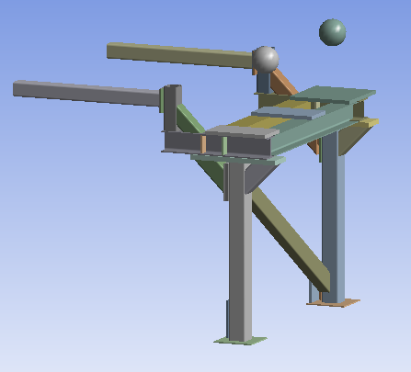
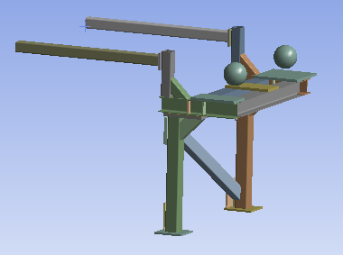
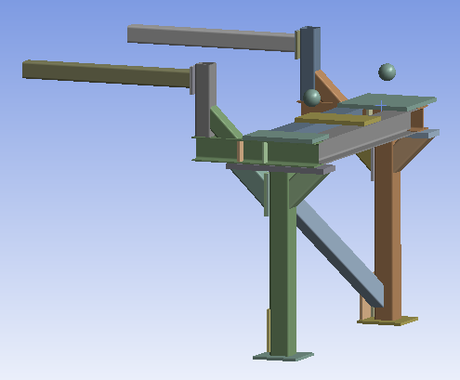
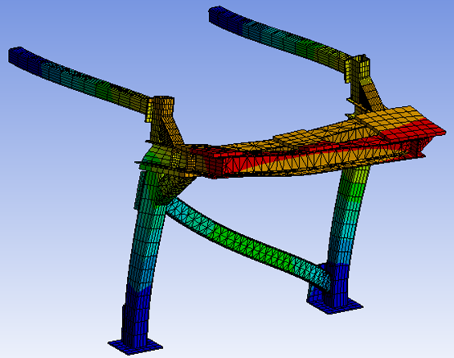
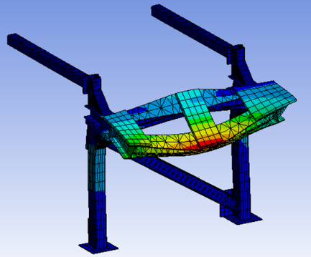
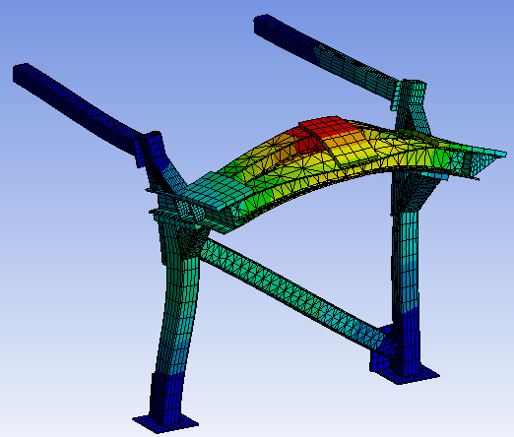
Phase I main results: stability studies
8th June 2023 / FCC week 2023
Federico Carra / CERN
L. Baudin
Optimization leading x15 higher stiffness and x4 higher natural frequencies
Likely conservative (2.5t total magnet weight, 50% less seems feasible)
Reasonably robust result
  PETRA IV girder 46 Hz
  PSB LIU girder 29 Hz
Next steps (see slides on 2022 news)
Add ground motion & harmonic response to evaluate expected vibration amplitude, compare with specs (20 nm @10-100 Hz)
Add collider to the model, to evaluate vibrations crosstalk
Mode Shape | FCC Week ‘22 Frequency [Hz] | First Iteration Frequency [Hz] | Shifted Horizontally Frequency [Hz] | Shifted Vertically Frequency [Hz] | Shifted Vertically & Horizontally Frequency [Hz]
Longitudinal | 7 | 18 | 24 | 21 | 29
Bending Cantilever Arms/ Torsion Horizontal Beam | 7 | 19 | 23 | 29 | 29
Bending Horizontal Beam | 14 | 36 | 41 | 40 | 54

Slide 13
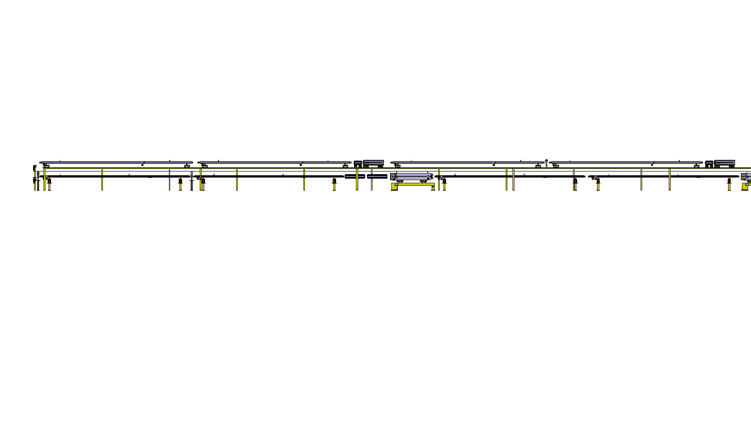
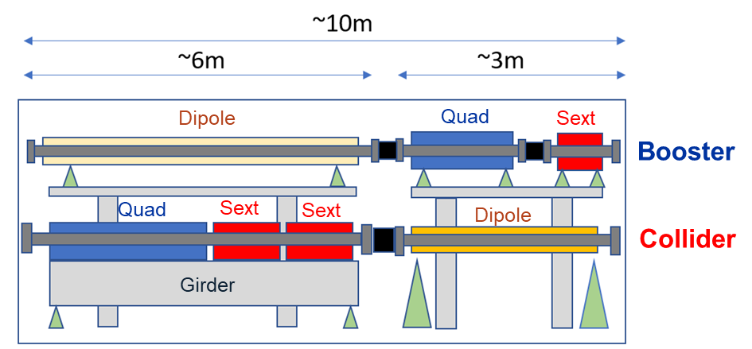
Phase I main results: mock-up proposal
8th June 2023 / FCC week 2023
Federico Carra / CERN
Dipole
Quadrupole
Sextupole
Dipole
Booster ring
Mock-up region
Girder
Main ring
With 0.5% tunnel slope → 5 cm every 10m
Dipole
Quadrupole
Sextupole
Dipole
Characteristic size:
Section: 5.5m diameter tube
Length: ~10m
Functional elements:
Ideally: build magnet/vacuum system prototypes and mock-up as a functional testing platform (last Senior Advisors Panel: technical potential should be exploited as much as possible, F. Lackner). Including alcoves, fire compartmentation?
Lower-budget option: cost-effective solution combining magnet, vacuum, beam instrumentation prototypes and cheap “maquettes” (dipole extra-length, C&V systems, shelves, etc.)
M. Timmins

Slide 14
Outline
8th June 2023 / FCC week 2023
Federico Carra / CERN
Arc half-cell mock-up project
Phase I main results
Update on stability studies
Proposed experimental campaign
Conclusions

Slide 15
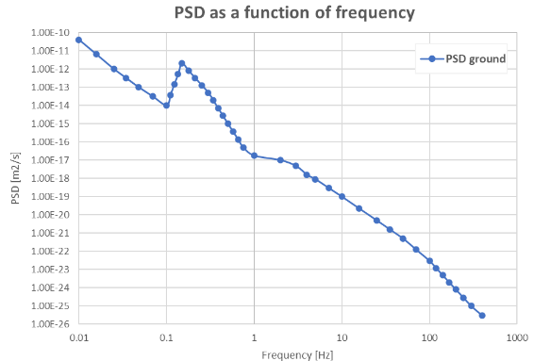
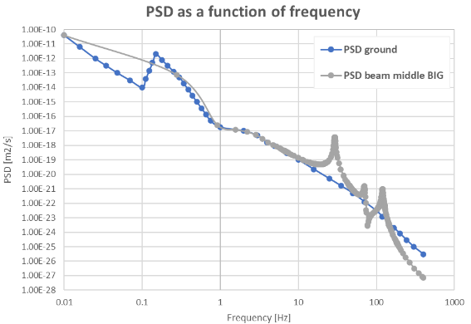
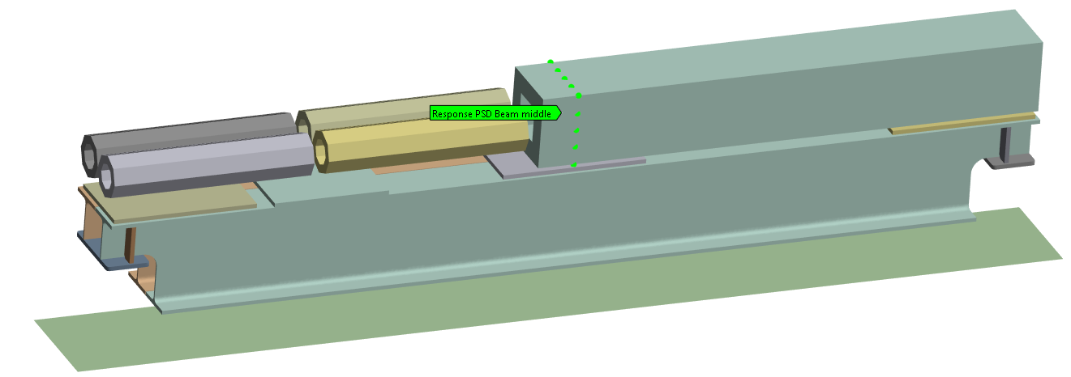
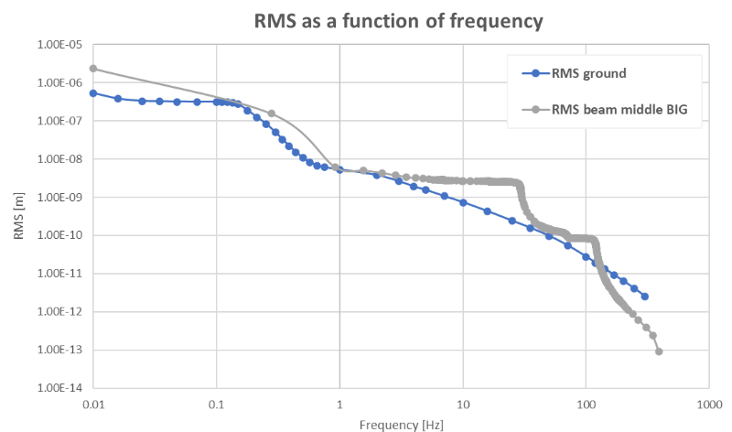
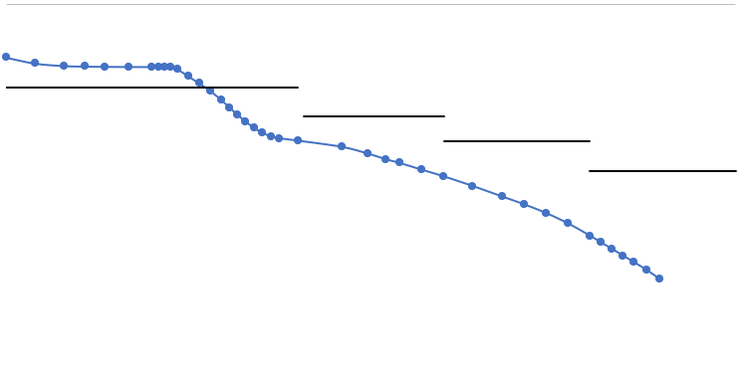
Update on stability studies: collider’s SSS, method
8th June 2023 / FCC week 2023
Federico Carra / CERN
PSD of the ground motion
A. Piccini with L. Baudin & M. Guinchard
PSD at the level of the beamline
Assumptions:
→ Beams model magnets
→ Connection between girder and magnets
→ Value of the stiffness of the jacks
→ Damping of material = 2%
→ PSD input = envelop of measurement graphs
(LHC tunnel measurements)
→ Extrapolated ground motion above 100 Hz
RMS of the ground and the beam
Specifications:
Frequencies | Tolerance
1 > f > 0.01 Hz | 100 nm
10 > f > 1 Hz | 20 nm
100 > f > 10 Hz | 5 nm
f > 100 Hz | 1 nm
PSD = Power Spectral Density
RMS = Root Mean Squared
Courtesy T. Raubenheimer, FCCIS workshop

Slide 16
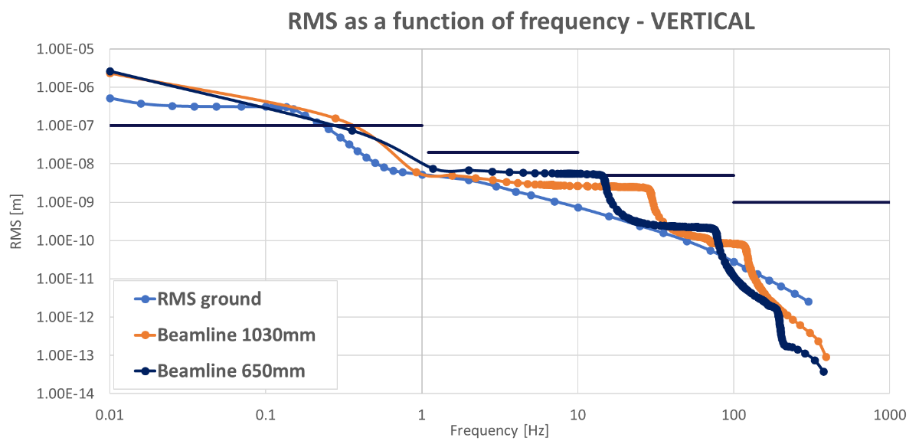
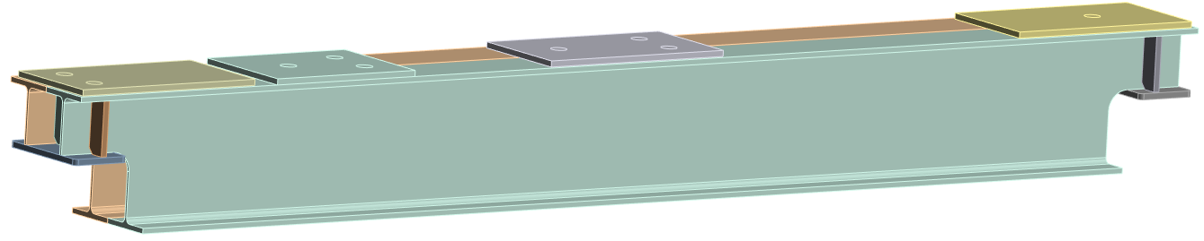
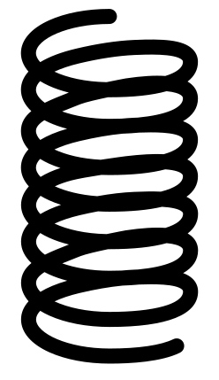

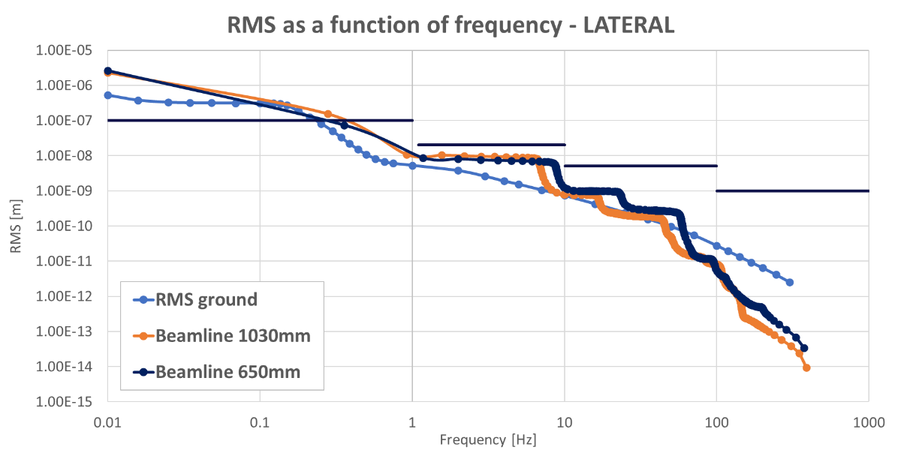
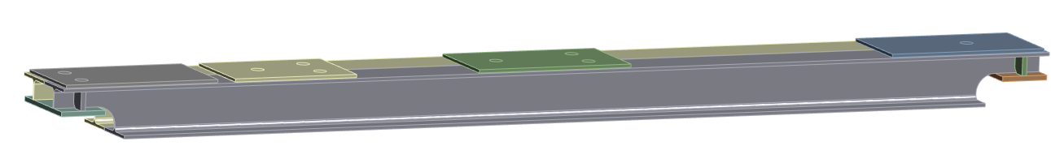

8th June 2023 / FCC week 2023
Federico Carra / CERN
Update on stability studies: collider’s SSS, results
Collider beamline = 1030mm
→ Increase of the RMS when the beamline is lowered
Specifications
Height of the girder | 720mm
Height of jacks | 360mm
Stiffness of jacks | 800kN/mm (vert.) 40kN/mm (long. and trans.)
A. Piccini with L. Baudin & M. Guinchard
→ Decrease of the RMS when the beamline is lowered
Collider beamline = 650mm
Specifications
Height of the girder | 340mm
Height of jacks | 150mm
Stiffness of jacks | 1600kN/mm (vert.) 320kN/mm (long. and trans.)

Slide 17
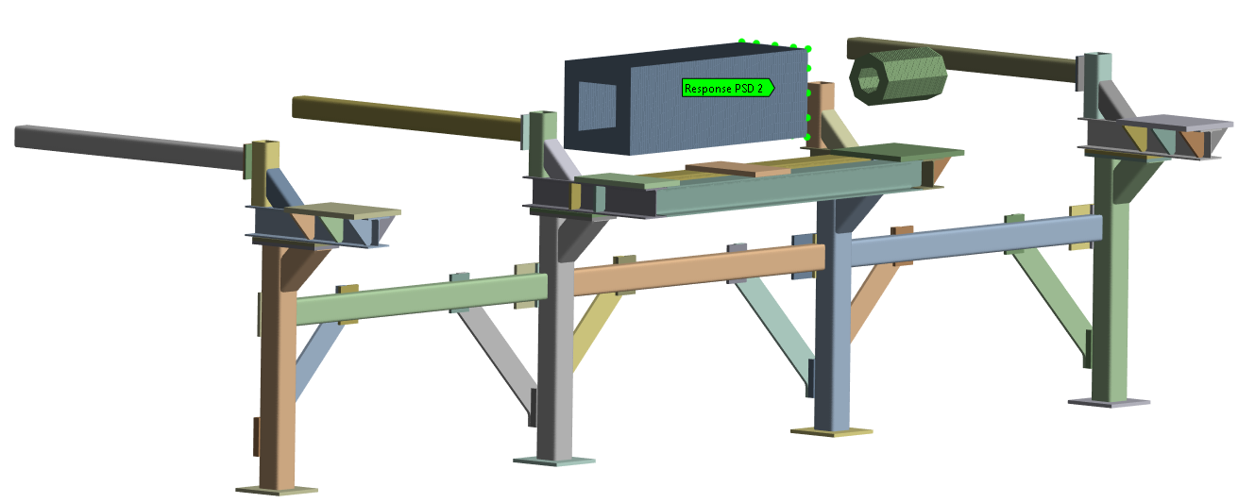

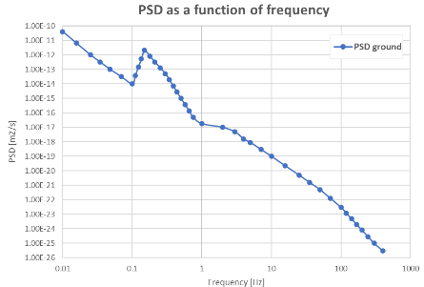

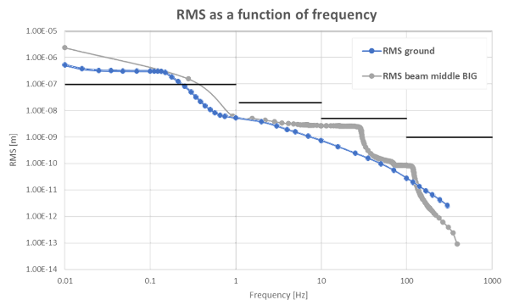
8th June 2023 / FCC week 2023
Federico Carra / CERN
Update on stability studies: booster supports, method
Quadrupole:
Mass = 2000kg
Envelop = 500x500mm
Length = 1500mm
Sextupole
Mass = 200kg
Envelop = Ø300mm
Length = 500mm
Magnets modeled by beams and point mass
½ Dipoles
Mass = 500kg
PSD of the ground
PSD at the level of the beamline
Contacts between magnets and the girder → Fixed
RMS of the ground and the beam
Assumptions:
→ Beams model magnets
→ Connection between girder and magnets
→ Damping of material = 1%
→ PSD input = envelop of measurement graphs
(LHC tunnel measurements)
→ Extrapolated ground motion above 100 Hz
A. Piccini with L. Baudin & M. Guinchard

Slide 18
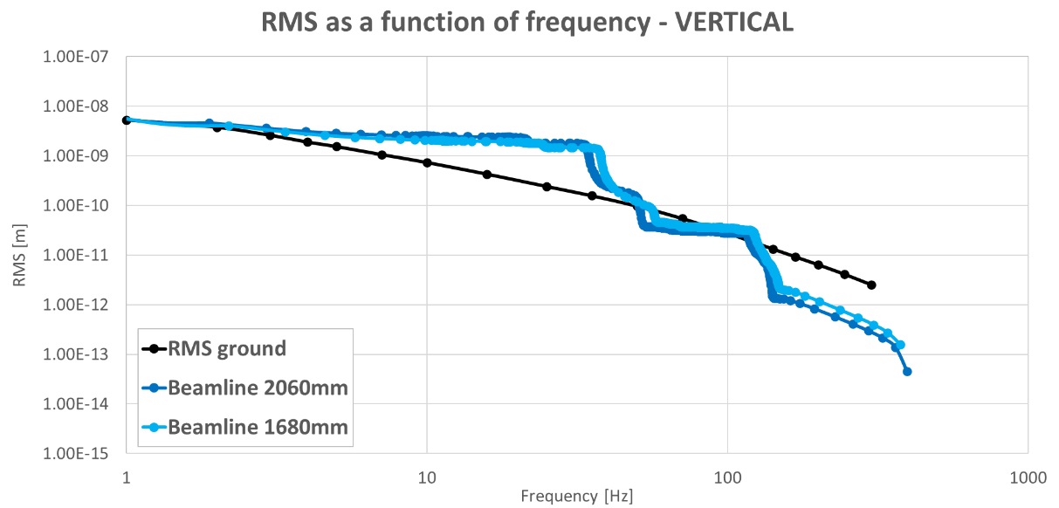
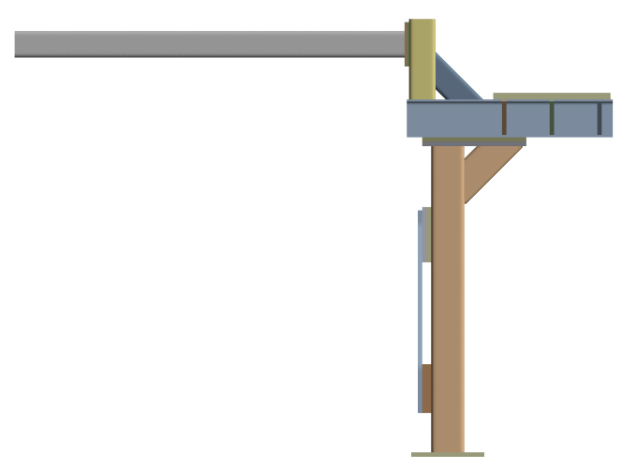
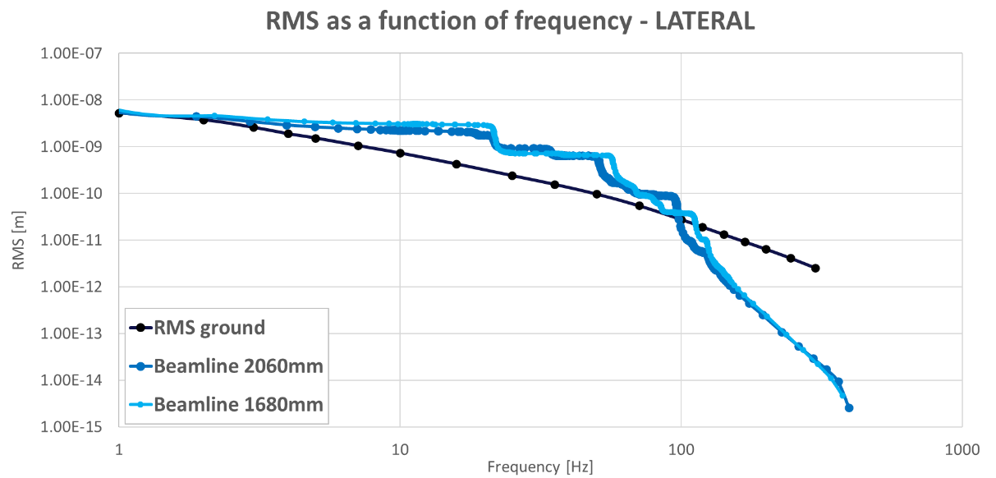
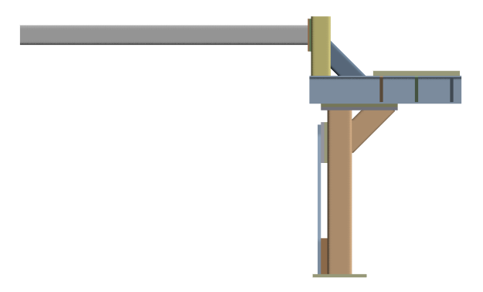
8th June 2023 / FCC week 2023
Federico Carra / CERN
Update on stability studies: booster supports, results
Beamline of the booster = 2060mm
BIG – Shifted
≈1800mm
Beamline of the booster = 1680mm
SMALL – Shifted
≈1400mm
Beamline of the collider 650mm

Slide 19
Update on stability studies: (intermediate) conclusions
8th June 2023 / FCC week 2023
Federico Carra / CERN
First time performing vibration simulations on the current supporting system for booster and collider SSS in the arcs → results look promising (order of magnitude), however…
…flexibility / transfer function of several links of the chain to be added (will worsen the stability results):
Yellow: average uncertainty
Red: strong uncertainty
+ booster / collider vibrational crosstalk!
1. Ground
2. Jacks
3. Girder
4. Individual adjustment system
5. Magnet
6. Magnet mech. axis to beam axis
LHC ground footprint…
HL-LHC jacks…
Assumptions on damping ratio…
Not modelled, shims assumed so far…
Dummy geometry…
Not considered so far…
Measurement campaign proposed to improve the stability model and refine preliminary results (addressing «red» items first) → iterations and design work in the next months/years!

Slide 20
Outline
8th June 2023 / FCC week 2023
Federico Carra / CERN
Arc half-cell mock-up project
Phase I main results
Update on stability studies
Proposed experimental campaign
Conclusions

Slide 21
8th June 2023 / FCC week 2023
Federico Carra / CERN
Proposed experimental campaign
Goal: determine stability and stiffness of the different «links of the chain» from ground to magnetic axis.
Identification of weakest link → i.e. where to invest most of the efforts!
Improvement / validation of the system stability model and architecture.
Magnet’s model
Proposed experimental campaign program:
Adjustment platforms
Step | Timeline
Quadrupole prototype characterisation | 2023 Q3
Adjustment platform characterisation | 2023 Q4
Characterisation of a simplified collider Short Straight Section | 2024 S1
Characterisation of a simplified booster Short Straight Section | 2024 S2
Girder
Contacts between the girder and the ground → Springs with stiffness equivalent to jacks

Slide 22
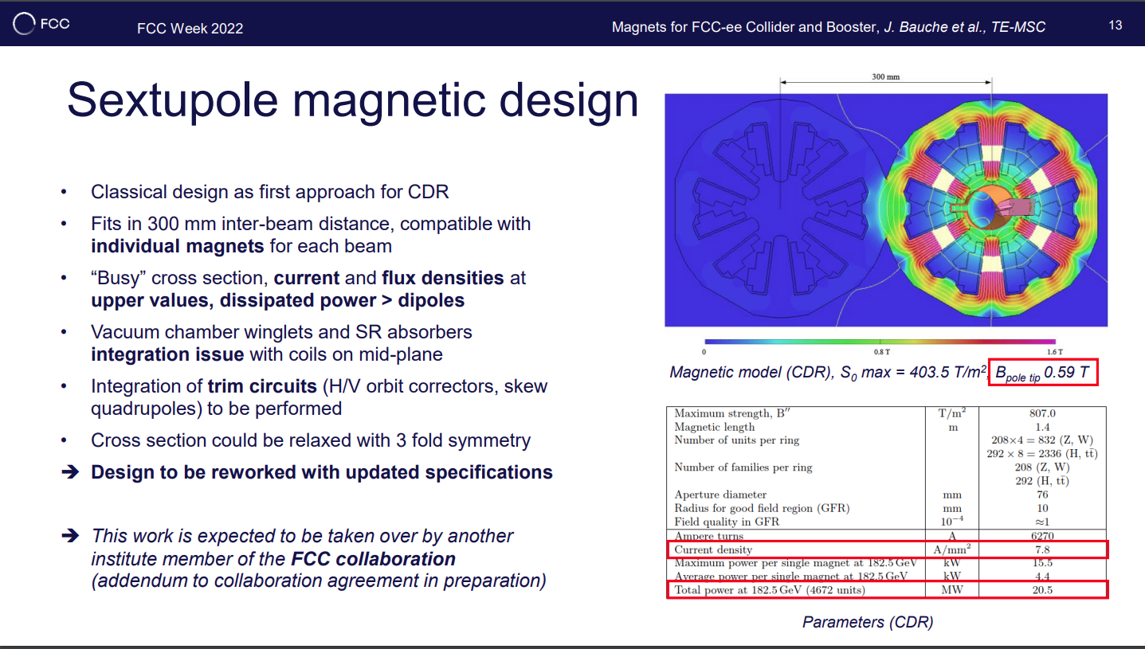
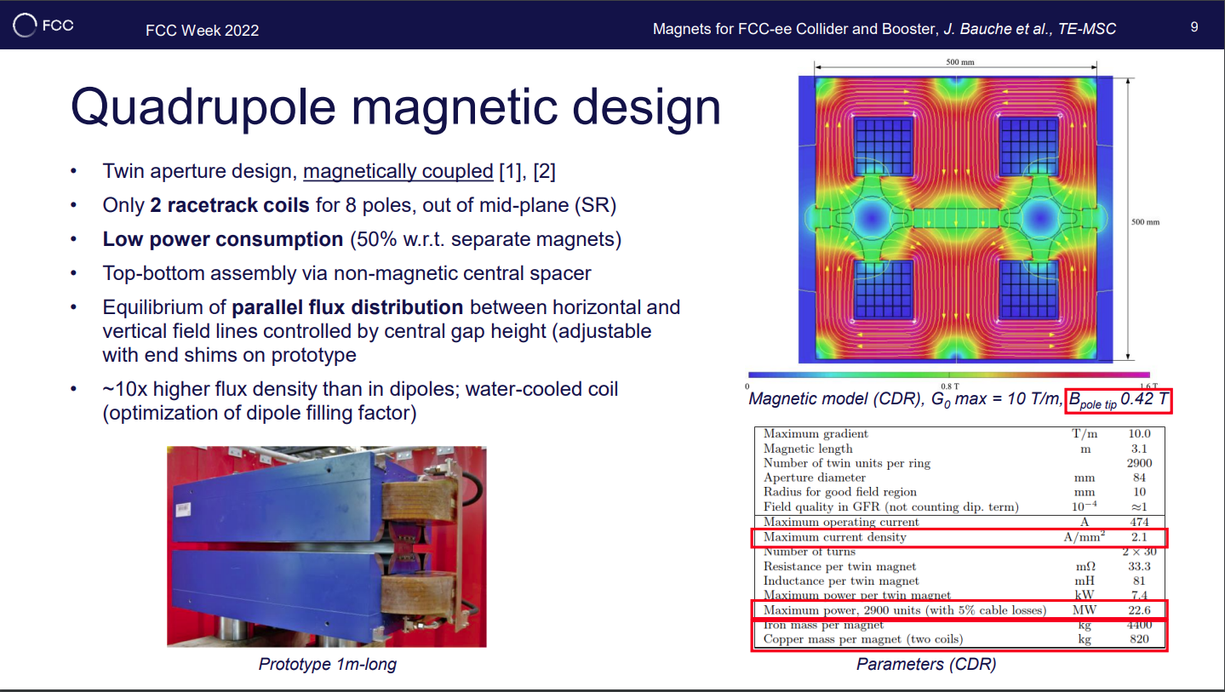
8th June 2023 / FCC week 2023
Federico Carra / CERN
Proposed experimental campaign: Step 1
Goal: Quadrupole prototype characterization (2023 Q3)
1m-long Quadrupole Prototype already existing at CERN, built by TE-MSC based on design parameters of CDR (1.5 t)
How:
  Instrument it and perform experimental modal analysis
  Comparison with numerical simulations
  Definition of simplified model with response equivalent to that measured, for use in global stability model
500 mm
300 mm
240 mm
180 mm
Cross section of the stainless steel beams used as models of the SSS magnets in current studies, A. Piccini

Slide 23
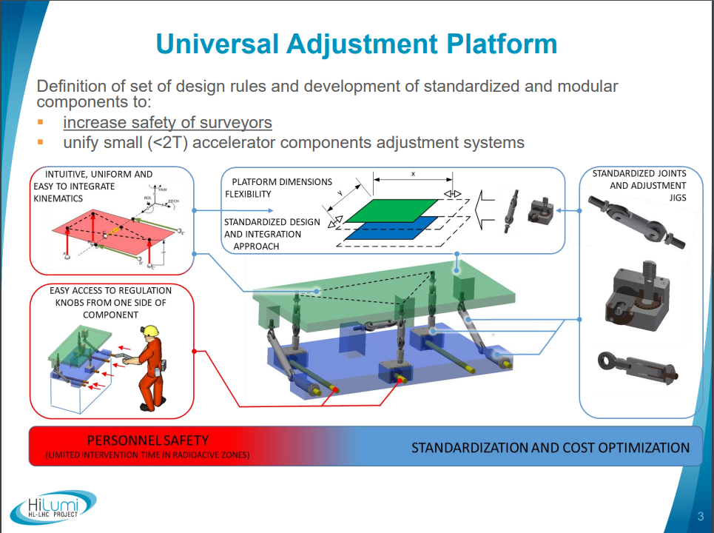
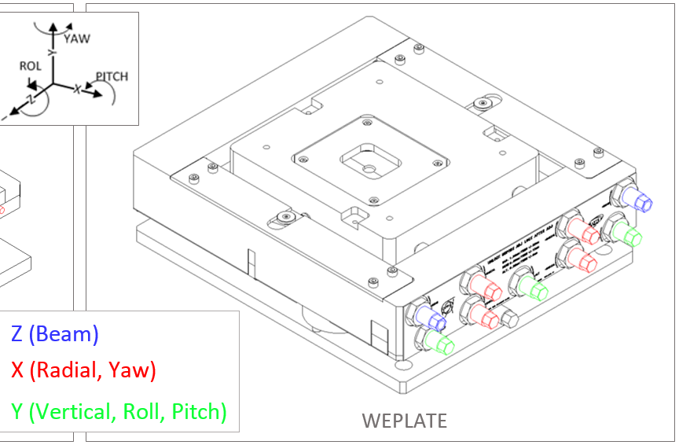
8th June 2023 / FCC week 2023
Federico Carra / CERN
Proposed experimental campaign: Step 2
Goal: Adjustment platform characterization (2023 Q4)
WEPLATE and BIG UAP are existing adjustment platforms developed at CERN BE-GM, BE-EA
BIG UAP is compatible with Quadrupole Prototype of FCC-ee (< 2t); WEPLATE possibly as adjustment system for a dummy sextupole (500 kg max)
Ideally test existing equipment
How:
  Instrument them and perform experimental transfer function measurements
  Comparison with numerical simulations???
  Definition of simplified model with response equivalent to that measured, for use in global stability model
5DOF/6DOF Platform
WEPLATE
Courtesy M. Sosin, F. Sanchez Galan and A. Piccini

Slide 24
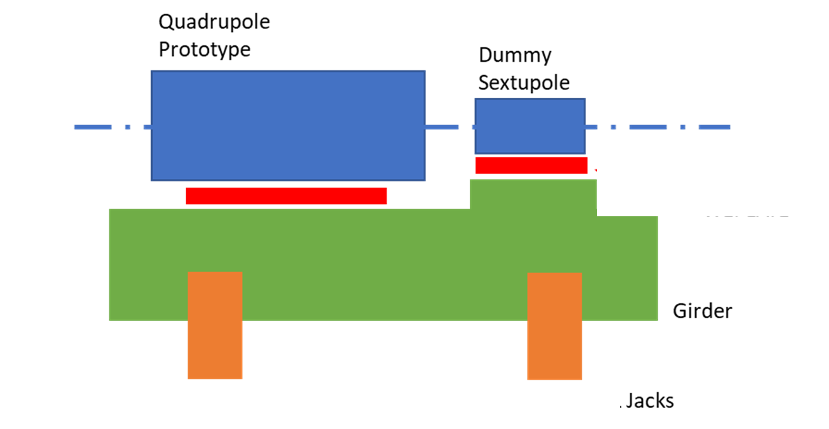
8th June 2023 / FCC week 2023
Federico Carra / CERN
Proposed experimental campaign: Step 3
Goal: characterization of simplified collider SSS (2024 S1)
Construction of cheap 2m dummy girders (steel, mineral cast, hybrid)
Existing HL-LHC jacks or production of SwissFEL PSI – like jacks
Adjustment Platforms or shims (existing UAP and WEPLATE)
Quadrupole Prototype (existing) + dummy Sextupole
How:
  Measure dynamic response progressively at different assembling steps (i.e. first jacks + marble, then girder on ground, then girder on jacks, etc.)
  Compare with numerical model, built also through Steps 1 and 2
  Extrapolate numerically to a longer SSS (2m to 6.5m)
Courtesy A. Piccini
Preliminary 2m-long collider SSS prototype

Slide 25
8th June 2023 / FCC week 2023
Federico Carra / CERN
Proposed experimental campaign: Step 4
Goal: characterization of simplified booster SSS (2024 S2)
Re-use of elements of Step 3 + construction of booster support
Maybe booster prototype magnets available? If not, dummy magnets
How:
  Same as step 3, except that here we don’t need to extrapolate, since real booster SSS is of the same length (2m)
  This structure could also eventually be direct part of the final arc mock-up… if behaviour satisfactory!
Preliminary 2m-long booster SSS prototype

Slide 26
Outline
8th June 2023 / FCC week 2023
Federico Carra / CERN
Arc half-cell mock-up project
Phase I main results
Update on stability studies
Proposed experimental campaign
Conclusions

Slide 27
8th June 2023 / FCC week 2023
Federico Carra / CERN
Conclusions
The Phase I of the Arc Half-Cell Integration & Mock-up project has been succesfully completed in 2022 and results reported in a number of documents and papers.
Phase II has started in 2023, initially focusing on the validation of the supporting system proposed for the Short-Straight Sections of the arcs.
Preliminary vibrations results have been presented; however, experimental tests are needed to evaluate the dynamic behaviour of several of the elements from the ground to the magnet axis. These will be launched in the second half of 2023.
The working group also collected the information needed to allow a cost estimation of the current support and girder system, providing inputs to the mid-term review (M. Timmins).
Several collaborations have been defined or are under definition: LAPP (FR), PSI (CH), University of Malta (MA) and University of La Sapienza - DIMA (IT).

Slide 28
Thank you for your attention.
8th June 2023 / FCC week 2023
Federico Carra / CERN
28
28

Slide 29
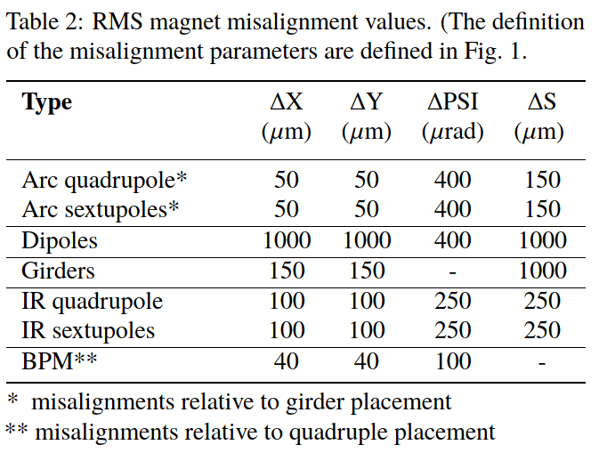
Status
2nd June 2022 / FCC week 2022
Federico Carra / CERN
Arc configuration: CDR (2019) + updates during FCC feasibility study
Conceptual design to fabrication
  Confirmation/update of the functional specifications
  Arc integration study
  Engineering design of systems and interfaces
For collider AND booster
300
T. Charles et al., “Update on the Low Emittance Tuning
Of the e+/e- Future Circular Collider,” IPAC’21
T. Charles, "Optics correction studies", FCC week, 31st May 2022.

Slide 30
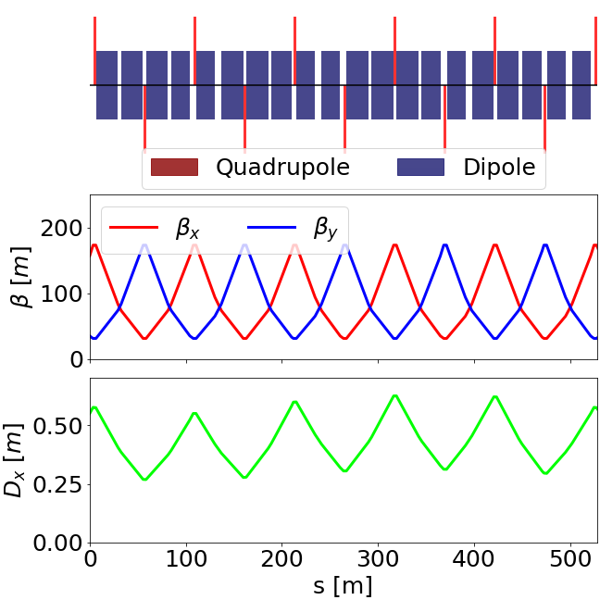
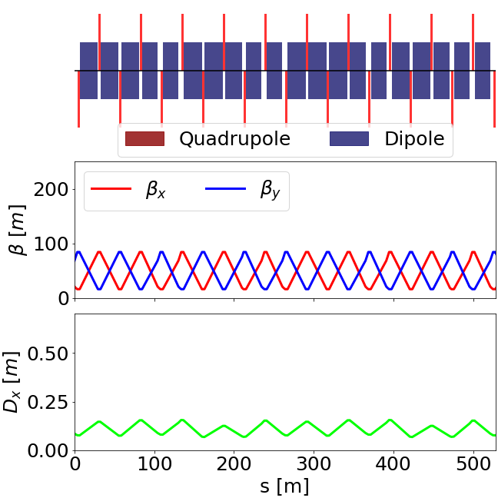
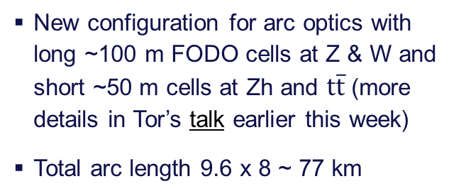


Arc cell configuration(s)
8th June 2022 / FCC week 2023
Federico Carra / CERN
T. Raubenheimer, "Accelerator Overview", FCC week, 30th May 2022.
M. Hofer, "Baseline optics and layout of the FCC-ee collider ring", FCC week, 31st May 2022.
$$Z$$
$$t\overline{t}$$
New configuration for arc optics with long ~100 m FODO cells at Z & W and short ~50 m cells at Zh and $t\overline{t}$ (more details in Tor’s talk earlier this week)
Total arc length 9.6 x 8 ~ 77 km
FCC arcs are constructed from roughly 750 long cells or 1500 short cells
Integration study (Phase I): to give also inputs on how to best evolve from long cell (low energy) to short cell

Slide 31
Phase I main results: configuration of the SSS
8th June 2022 / FCC week 2023
Federico Carra / CERN
Preliminary mechanical design of SSS supporting system, using common girders to pre-align magnets with common vacuum chamber in a proper surface facility.
Clean environment, less in-tunnel work, less transports, less bellows, easy replacement / spare management.
Senior Advisors Committee: “Using girders can be an efficient way to install a machine. Pre-assembly can be prepared ahead, with better tools, in a more convenient environment and with more space. Girders allow for reduced installation time and reduced alignment effort in tunnel, since only girder to girder alignment is necessary vs. alignment of each machine component”.
C. Tetrault

Slide 32
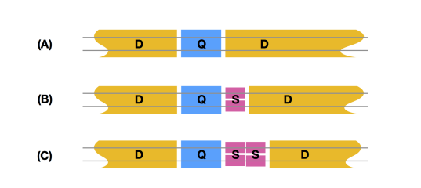
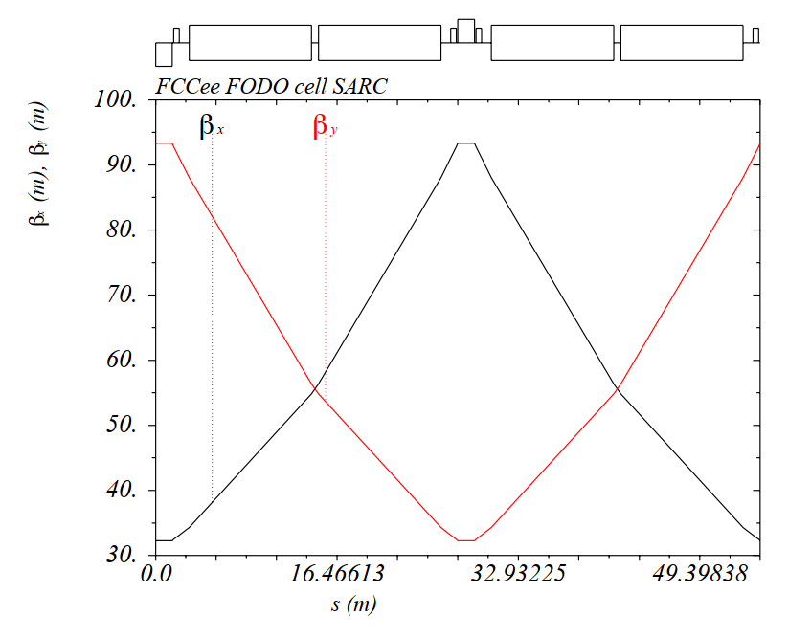
Arc cell configuration(s)
2nd June 2022 / FCC week 2022
Federico Carra / CERN
Arc half-cell
  1 Quadrupole
  0, 1, 2 Sextupoles
  Up to ~24 m Dipoles (segmented, variable length)
F. Valchkova-Georgieva
Booster

Slide 33


Arc cell configuration(s)
2nd June 2022 / FCC week 2022
Federico Carra / CERN
“Case A”: quadrupole followed by 24.432 m dipole(s)
Side view
0.15 m
0.89 m
1.5 m
0.5 m
7.4 m
0.32 m
0.32 m
7.4 m
2.9 m
7.94 m
7.94 m
0.3 m
0.3 m
0.3 m
F. Valchkova-Georgieva

Slide 34

Arc cell configuration(s)
2nd June 2022 / FCC week 2022
Federico Carra / CERN
“Case A”: 1 quadrupole followed by dipole(s)
3.5m
2.9m
0.3m
0.3m
Girder
Quadrupole
Corrector
Dipole
F. Valchkova-Georgieva

Slide 35

Arc cell configuration(s)
2nd June 2022 / FCC week 2022
Federico Carra / CERN
“Case B”: 1 quadrupole + 1 sextupole, followed by dipole(s)
5.5m
0.3m
2.3m
2.9m
Dipole
Sextupole
Girder
Quadrupole
F. Valchkova-Georgieva

Slide 36

Arc cell configuration(s)
2nd June 2022 / FCC week 2022
Federico Carra / CERN
“Case C”: 1 quadrupole + 2 sextupoles, followed by dipole(s)
7.2m
1.9m
0.2m
1.9m
0.3m
2.9m
Dipole
Sextupoles
Girder
Quadrupole
F. Valchkova-Georgieva

Slide 37

Arc Half-Cell Mock-up Project (Phase I)
2nd June 2022 / FCC week 2022
Federico Carra / CERN
* Extract from T. Raubenheimer’s presentation at the Arc Half-Cell Mock-up kickoff
Mandate*
  Develop an optimal integrated solution for the mechanical layout of an Arc Half-Cell considering machine performance, installation, operation, and maintenance, as well as necessary technical infrastructure in the tunnel.
  Identify the components of a representative Arc Half-Cell that will verify the key challenges.
Main deliverables
  3D model + 2D cross-section drawings of arc region
  Compact report explaining main choices
  To be presented at FCCIS meeting in December ‘22
F. Valchkova-Georgieva
Collider Center

Slide 38
Needed studies and challenges (Phase I)
2nd June 2022 / FCC week 2022
Federico Carra / CERN
Needed studies & challenges*
  Horizontal separation of the e+ and e- rings in the arcs
  Vertical placement / separation between collider and booster (and: is vertical superposition the only solution?)
* More detailed list & Project structure in T. Raubenheimer’s presentation at the Arc Half-Cell Mock-up kickoff

Slide 39





Needed studies and challenges (Phase I)
2nd June 2022 / FCC week 2022
Federico Carra / CERN
Dipole / Vacuum flange
Needed studies & challenges*
  Horizontal separation of the e+ and e- rings in the arcs
  Vertical placement / separation between collider and booster (and: is vertical superposition the only solution?)
  Define preferred dipole length (and: continuity or separation between dipoles/busbars?)
  Design interfaces between magnet and vacuum systems
D-D interface
L=8, 12, …?
F. Valchkova-Georgieva
See also presentations from J. Bauche, C. Garion (yesterday morning, Technology R&D session)

Slide 40


Needed studies and challenges (Phase I)
2nd June 2022 / FCC week 2022
Federico Carra / CERN
J. Bauche, C. Eriksson
Needed studies & challenges*
  Horizontal separation of the e+ and e- rings in the arcs
  Vertical placement / separation between collider and booster (and: is vertical superposition the only solution?)
  Define preferred dipole length (and: continuity or separation between dipoles/busbars?)
  Design interfaces between magnet and vacuum systems (and: integration of correctors, beam instrumentation, …)
  Optimize the power & cooling connections for the magnets, vacuum, and beam diagnostics
  Develop supporting system in line with installation and alignment procedures (w. girder)
  And… booster elements!!!
300 mm beam separation
350 mm beam separation

Slide 41





Design standards
2nd June 2022 / FCC week 2022
Federico Carra / CERN
D. Perini
Quality standards for the design of components must be used at the earliest stage
EN-MME quality manual available (EDMS 1724368)
To be linked/integrated with guidelines for robot-friendly design (from Remote maintenance code of practice*)
*see M. Di Castro, "Code of practice for robotic-friendly design“, 2nd Coordination of FCC Technology R&D programme meeting.
M. Di Castro

Slide 42

Novel concepts: Digital Twins
2nd June 2022 / FCC week 2022
Federico Carra / CERN
D. Smakulska, M. Garlasché

Slide 43
Novel concepts: Digital Twins
2nd June 2022 / FCC week 2022
Federico Carra / CERN
See also the interesting presentations from yesterday afternoon on alignment, vibrations (FCC-ee afternoon session)
Digital Twin IS MORE than just
data acquisition & monitoring
a set of simulations
experience from historical
OUTPUT
Normal Operation:
Determine system state through data acquisition
Real time, ALSO for parameters not directly acquired
Failure:
Forecast system state, real time interpretation
Repair scenarios: real time analysis, system-wide
Complexity of the system is tailored to the specific needs
  To be considered for mock-up girder and magnets: displacements, vibrations, strains, temperature, etc.
D. Smakulska, M. Garlasché

Slide 44
Conclusions
2nd June 2022 / FCC week 2022
Federico Carra / CERN
The design and construction of a mock-up of an arc half-cell of the FCC-ee is proposed, in order to investigate aspects such as fabrication techniques, integration, installation, assembly, transport, maintenance.
The project is divided into three phases:
  Phase I (end of 2022) focuses on the integration studies of the arc configuration and the interfaces between its systems
  Phase II (2023-2024) will tackle the engineering design of each element
  Phase III (2024-2025) will involve fabrication and assembling steps
Concepts such as robot-friendly systems and digital twins must be taken into consideration already during the early stage of the design.
Strong interaction and feedback from Accelerator and Infrastructure Pillars, and in particular with Integration, Technology R&D, Collider Ring Optics, Booster Ring, Geodesy and Survey, will be key
Phase I has started, and a platform for discussion has been set (https://indico.cern.ch/category/15513/) → contact us to discuss inputs and ideas!

