Slide 1
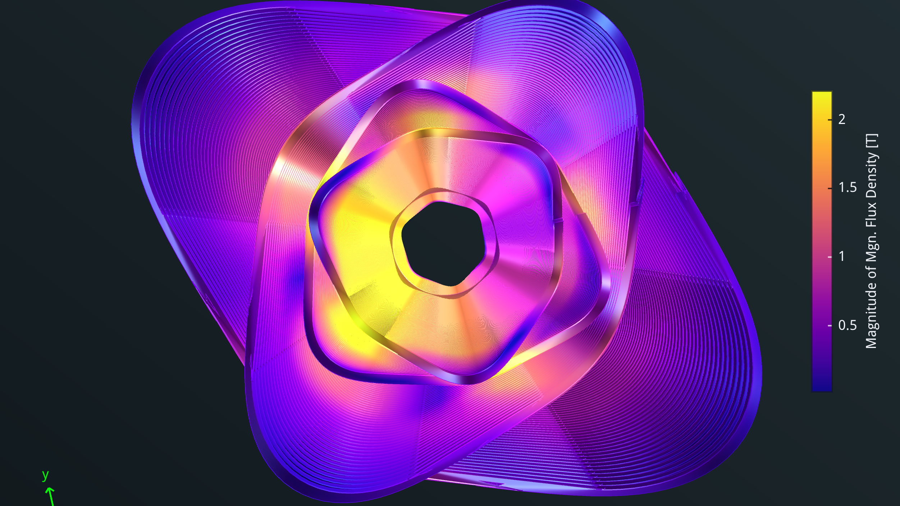




The FCCee-HTS4 project
M. Koratzinos
FCC week, London
07/06/2023
This work is performed under the auspices and with support from the Swiss Accelerator Research and Technology (CHART) program (www.chart.ch).

Slide 2
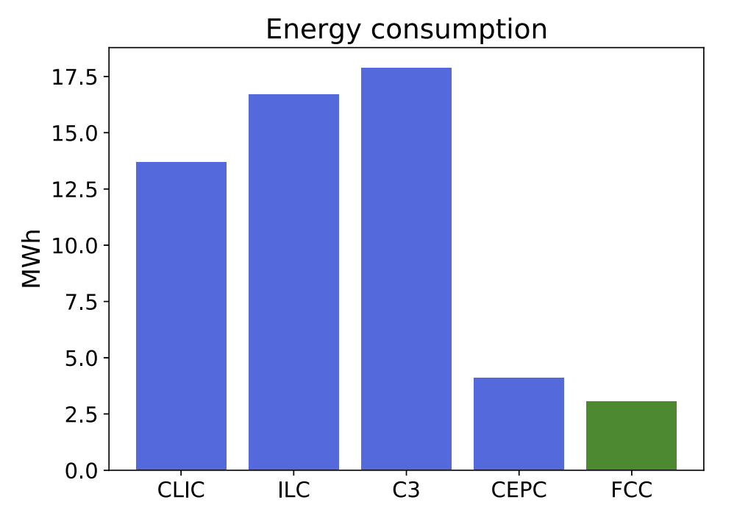
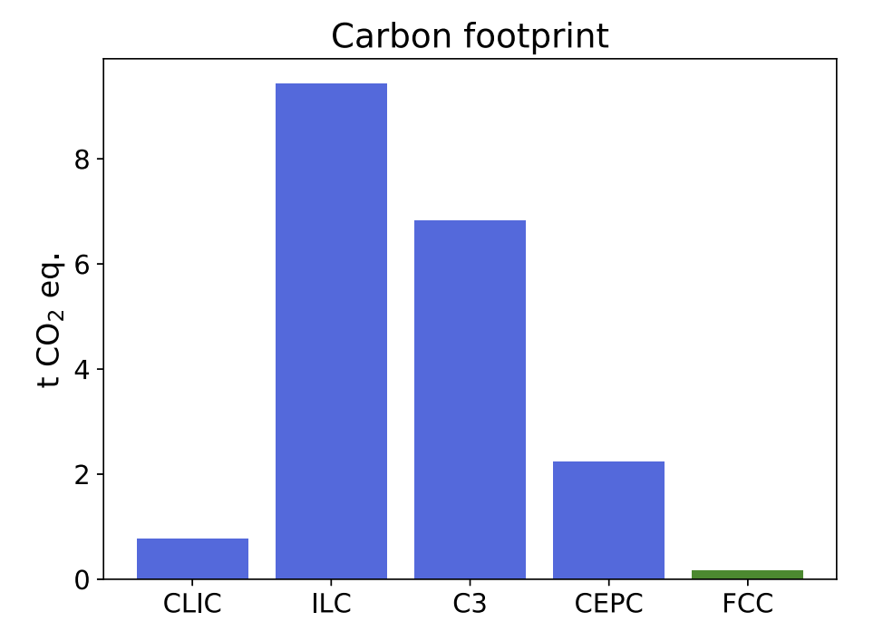
Abstract
FCC-ee is the most energy-efficient accelerator proposed (and the one with the smallest CO2 footprint (see “the carbon footprint of proposed e+e- factories”, Janot and Blondel, https://link.springer.com/article/10.1140/epjp/s13360-022-03319-w
This is an attempt to make FCC-ee even more sustainable and at the same time increase performance by looking at the main magnet systems of FCC-ee
We re also looking into increasing the relevance of FCC to society by adopting state-of-the-art technologies and trying to play a leading role in our respective fields

Slide 3
Power consumption – collider main magnet systems
See presentation of Jean-Paul Burnet (CERN) at FCC week 2022:
We pay twice for normal conducting magnets: one through ohmic losses, and again for removing the heat with our cooling and ventilation (CV) system.
Storage Ring | Z | W | H | TT
Beam Energy (GeV) | 45.6 | 80 | 120 | 182.5
Magnet current | 25% | 44% | 66% | 100%
Power ratio | 6% | 19% | 43% | 100%
Dipoles (MW) | 0.8 | 2.6 | 5.8 | 13.3
Quadrupoles (MW) | 1.4 | 4.3 | 9.8 | 22.6
Sextupoles (MW) | 1.3 | 3.9 | 8.9 | 20.5
Power cables (MW) | 1.2 | 3.8 | 8.6 | 20
Total magnet losses | 4.8 | 14.7 | 33.0 | 76.4
Power demand (MW) | 5.6 | 17.2 | 38.6 | 89
CV needs to remove the heat of the storage and booster magnets (100MW at top), storage and booster RF (148 at top) and experiments (8MW). Total is 256MW
The share of storage ring magnets on CV is 35%, or 14MW
Cooling and ventilation |  | Z | W | H | TT
Beam energy (GeV) |  | 45.6 | 80 | 120 | 182.5
Pcv (MW) | all | 33 | 34 | 36 | 40.2
Total contribution of the collider ring magnets is therefore ~100MW at the top, 76% of which comes from the quads and sextupoles

Slide 4
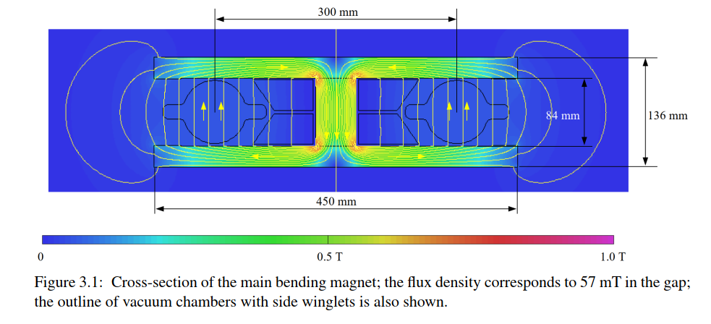
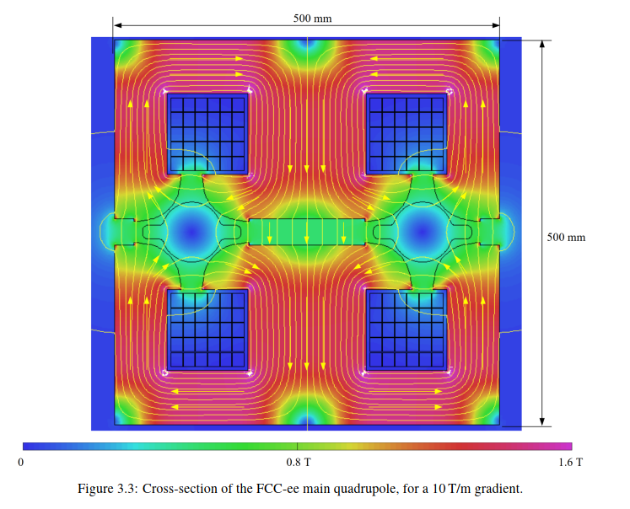
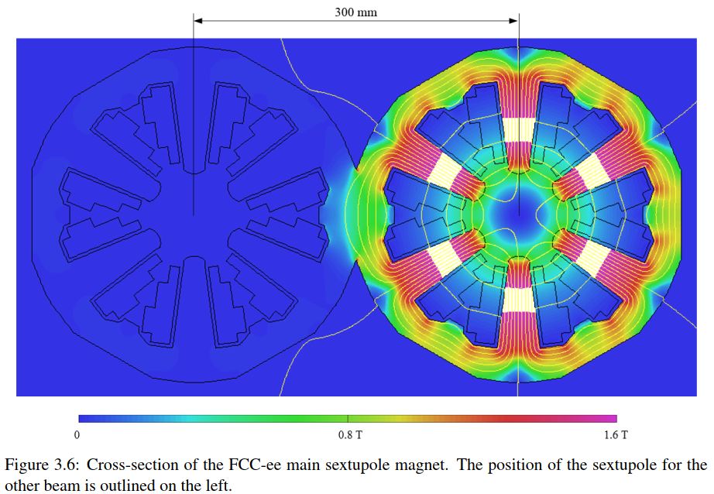
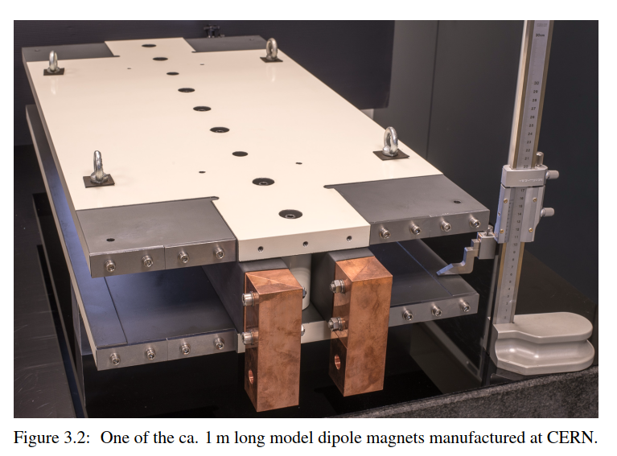
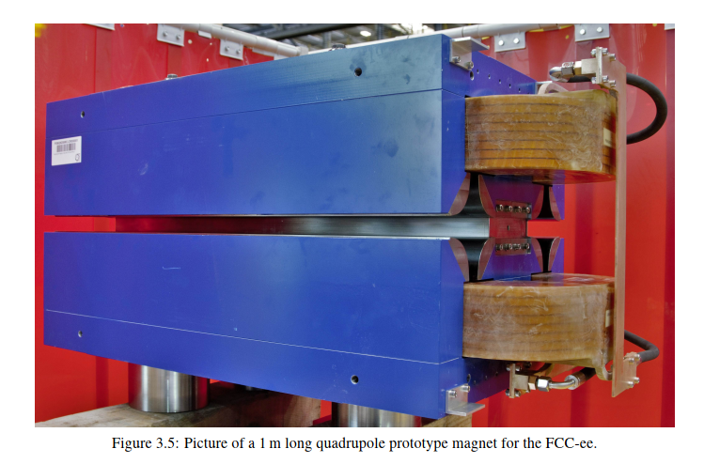
FCC-ee: The power challenge
CDR: FCC-ee is a conventional (warm) accelerator, much like LEP (CERN, 1989-2002)
The situation at the Conceptual Design Report:
The FCC-ee CDR has 2900 (20m-long) dipole, 2900 quadrupole and 4704 sextupole magnets, all normal conducting
Every effort was made to have a “power saving” design for the quads (50% saving, but with some compromises)
This power loss is dominated by the quadrupole and sextupole magnets.
CDR
CDR
CDR - prototype
CDR - prototype
(no prototype exists yet)
Big, heavy quads and sextupoles

Slide 5
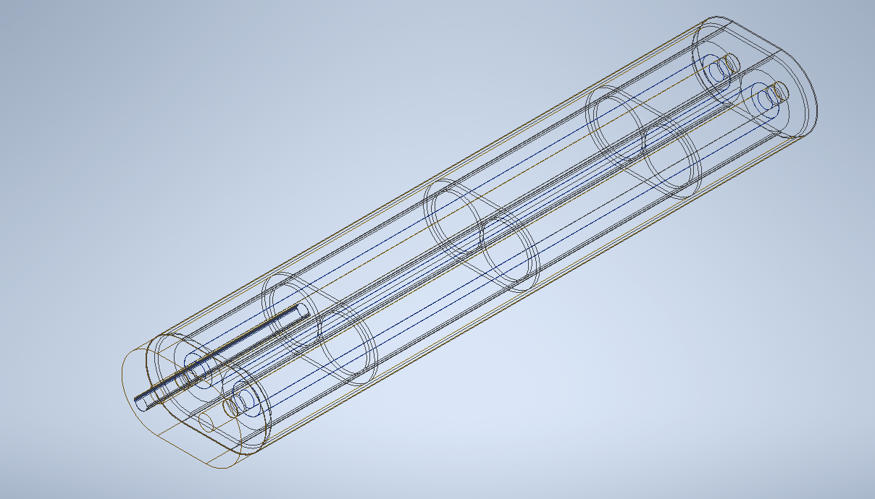
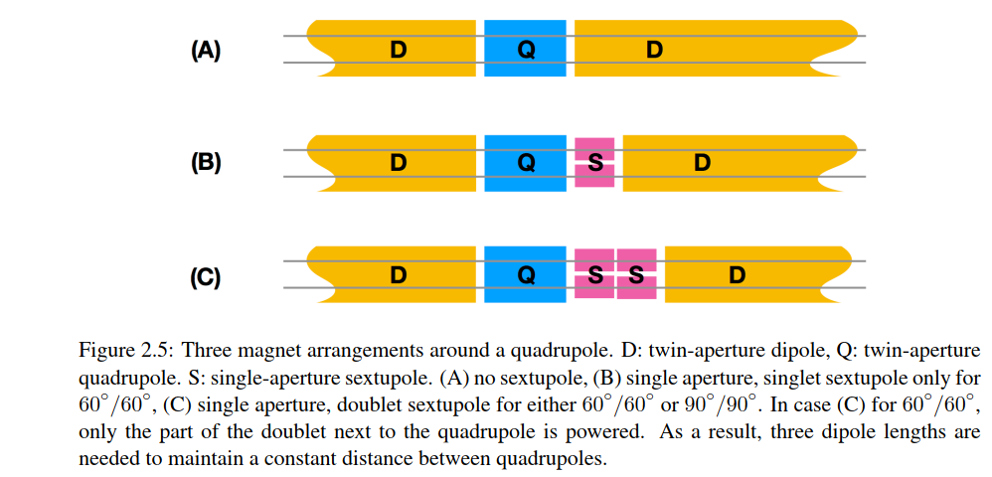
FCC-ee: The power challenge
Can we do better?
Yes! Make the magnets superconducting. Then, energy is only spent cooling the magnets (zero Ohmic losses).
Also, we can “nest” the magnets, so that they take less space
This means that there is more space available for bending, so performance of the accelerator also increases.
Potential power reduction for these systems: ~90%
2900 cryostats, 3.5m long each
Many additional benefits: increase packing factor (and luminosity) by 7%, increase optics flexibility (next slide)
CDR
CDR
This proposal
Half cell length: 27.9 m
Half cell length: 27.9 m

Slide 6
Other potential gains
Apart from the power consumption reduction, the gains of a nested system are:
The packing factor increases by 7%, so for the same luminosity RF power can be reduced by 7%
The higher packing factor also reduces the total voltage needed by the RF by 7%
Total gain ~14% in the price of the RF system (which is O(1BnCHF). If the price of the magnet systems concerned is ~25% of the price of the total RF system, then ~40% of the cost of the SSSs would come from the reduction in the RF costs!
We aim to produce the superconducting SSSs in the same price envelope as in the CDR.
The optics design is much more flexible:
  No requirement for fixed polarity electron/positron quadrupoles
  Sextupoles available in all SSSs
  Opens the path for 100% filling factor and tapering management (see next slide)
It should be made clear that this is a big change in the design of FCC-ee and many systems are affected, for instance photon stopper design, radiation environment in the tunnel, BPM design, girder design, optics, etc.

Slide 7
Can we do even better?
Move the power supply inside the cryostat instead of the traditional cold magnet/warm power supply (FCCee-CPES project, discussed later)
This system can naturally be adapted to also have a nested dipole covering the entire length of the SSS (another potential gain of 7% in packing factor, reaching almost 100%).
A nested dipole system (which will be individually powered) will also solve all our tapering needs (maximum dipole strength needed at the top is ~30%).
The inclusion of a nested dipole system is not the baseline solution now, but it is useful to keep it in mind as a possible improvement (plus also an extra complication!).

Slide 8
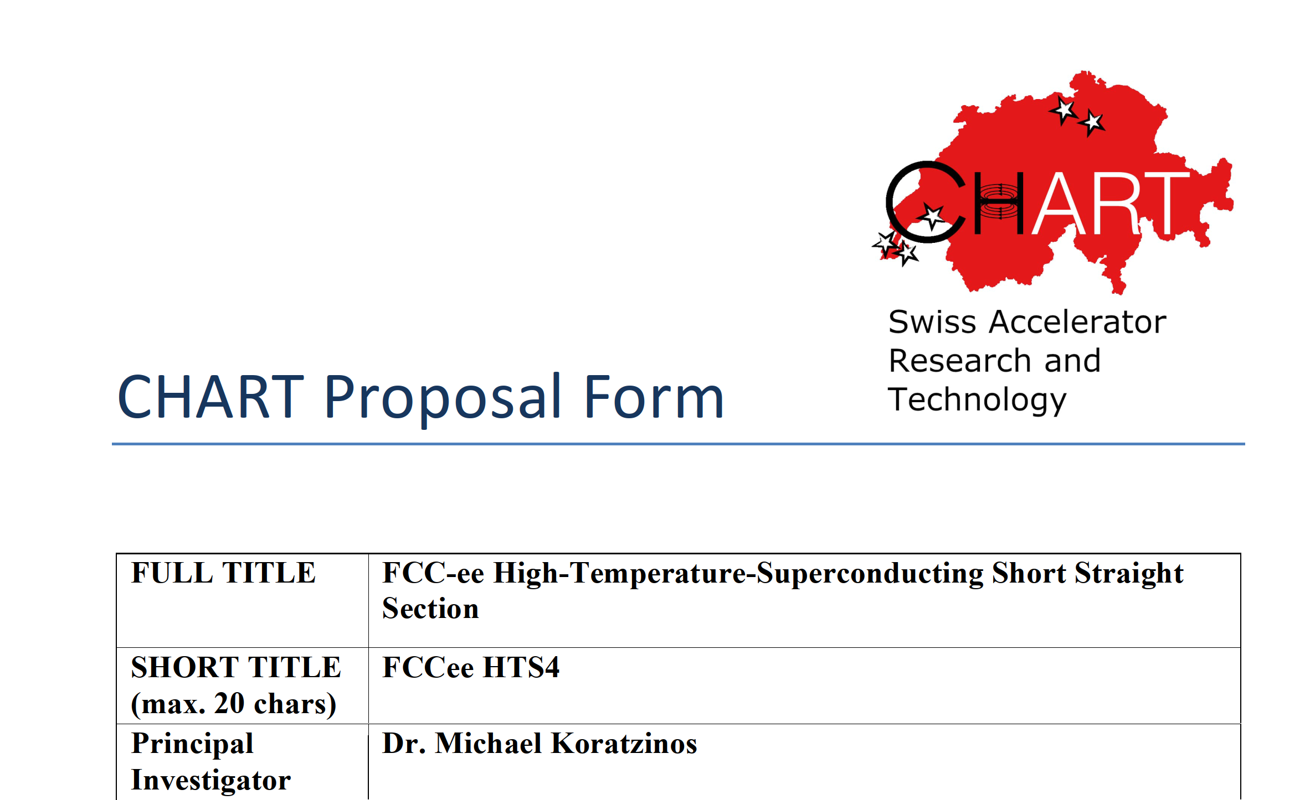
The proposal
A proposal was submitted and approved by the Swiss accelerator research and technology forum CHART in April 2022:
FCCee-HTS4 are: B. Auchmann, J. Kosse, V. Batsari, A. Thabuis (from 1/9/2023), M.K.
Our sister project, FCC-ee CPES, investigating the possibility of a cold power supply system, was also approved at the same session.

Slide 9
FCCee-HTS4 in a nutshell
Investigate the replacement of all FCCee short straight sections (SSSs) that contain arc quads, arc sextupoles and assorted correctors by superconducting ones.
Nest the sextupoles and quadrupoles in the same unit.
Use HTS conductors (ReBCO tapes)
Operate at around 40K
Investigate all integration issues
Produce a ~1m prototype
(superconducting arc dipoles as well as a dipole component in the SSS to be used for tapering also, is beyond the scope of this phase of the project)

Slide 10
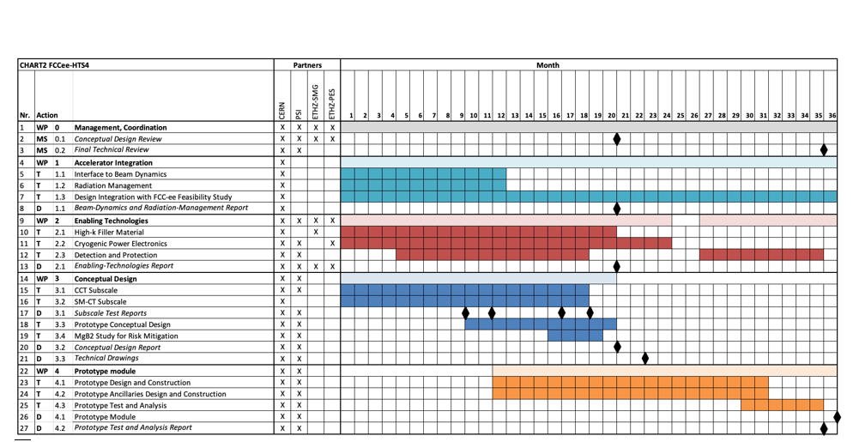
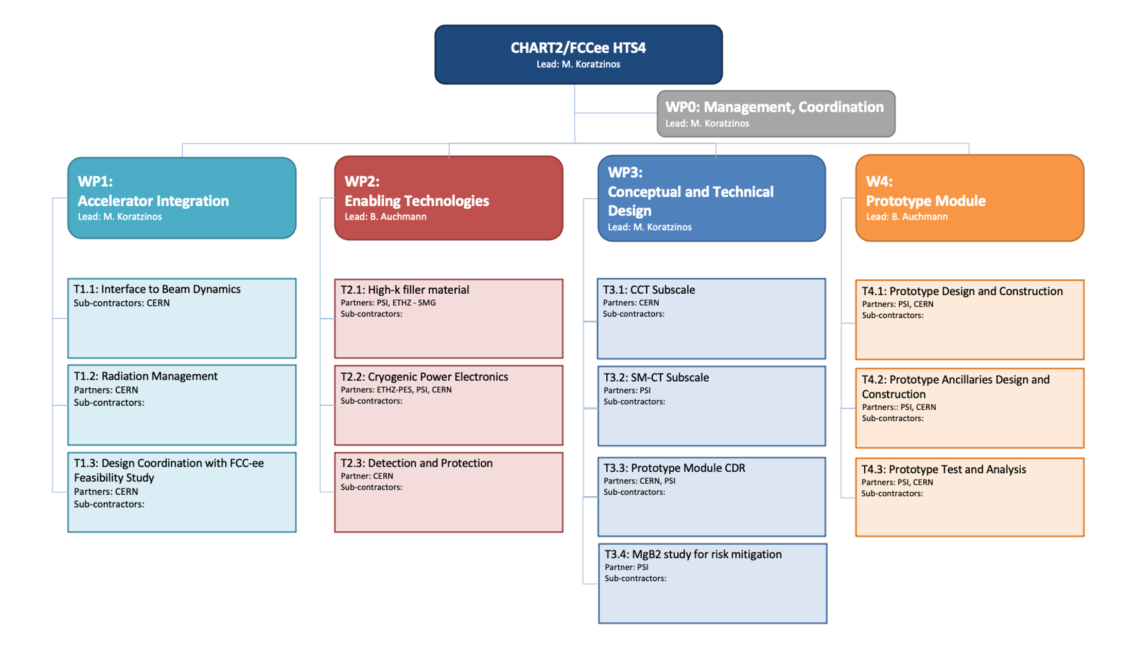
The project
Project duration: 3 years (starting 1/7/2022)
Deliverables:
Beam dynamics report
Enabling technologies report
One or more demonstrator hardware
One prototype designed, manufactured and tested

Slide 11
SSS main parameters
The latest optics design layout has the following specifications:
Length of quads is 2.9m (from 3.2m). Quads should not be shorter, due to SR issues
Strength of quads is 11.84 T/m at tt (was 10T/m)
Length of sextupoles is 1.5m. Sextupoles can be made stronger and shorter at will.
Strength of sextupoles is 812 T/m^2 at tt.
Together with necessary gaps and with all services, the length of the SSS will be 3.5m

Slide 12
Choice of aperture
First design choice is aperture: we have chosen a 90mm aperture magnet.
(inner diameter of the beampipe in the CDR is 70mm, with a lively debate if we should go to 60mm or not)
What is important in our case is not only the beam pipe diameter, but also the position of the last photon stopper: photons that have just missed the photon stopper are at an angle of ~2.5mrad. As the distance of the last photon stopper to the end of the SSS is ~4m, the radius of the aperture needs to be ~10mm larger than the position of the stopper
Strength of the sextupole (closest to the beam pipe): 1000T/m2 (specification is 812T/m2, but we have made the magnet can be made shorter)
If there is a firm decision to go to 60mm beam pipe, we will reduce our aperture accordingly

Slide 13
Photon stoppers, winglet, impedance
How much would this idea increase the resistive wall impedance budget (and, therefore, wasted power) of the machine?
Since space is at a premium, this idea accommodates much smaller winglets than the CDR design (110mm to 86mm) for the entire length of the SSS (3.5m)
It also calls for photon stoppers that protrude more into the beam pipe than the CDR design
A complete study using CST studio suite 2020 was performed

Slide 14
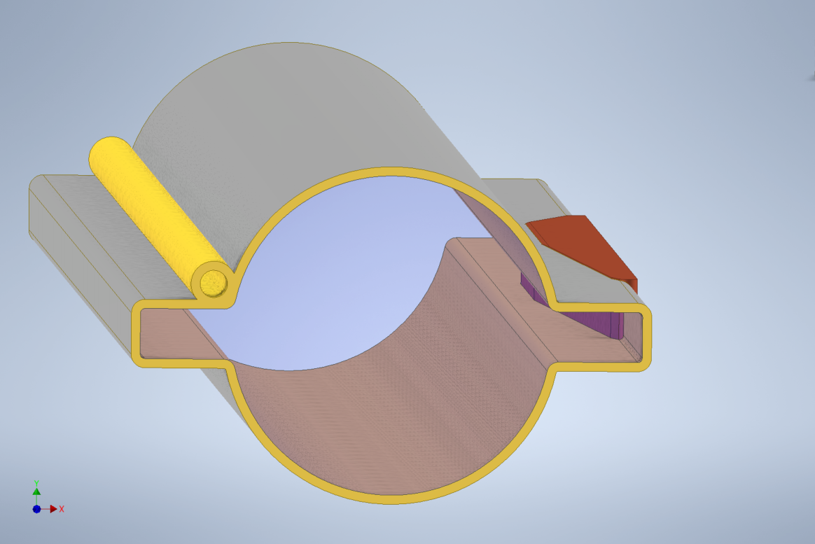
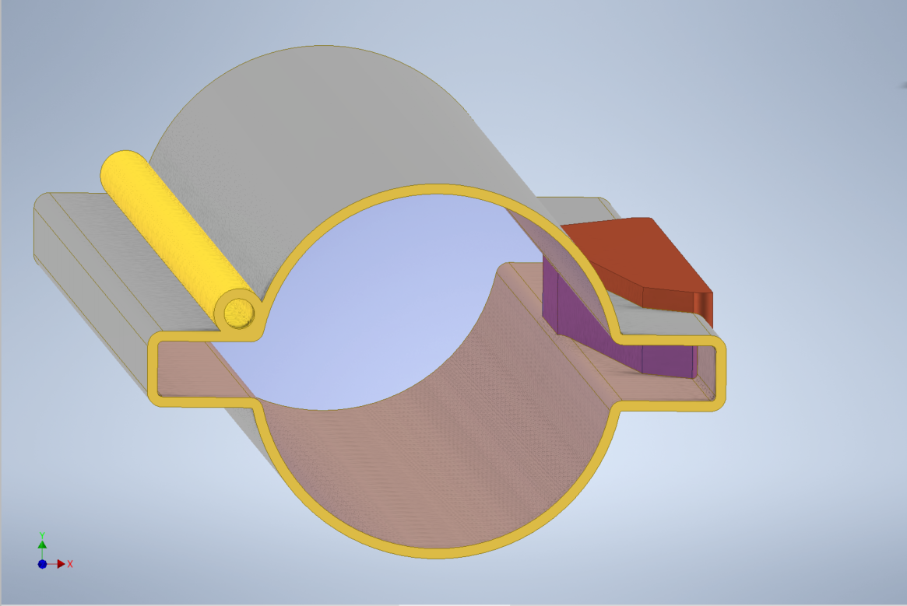
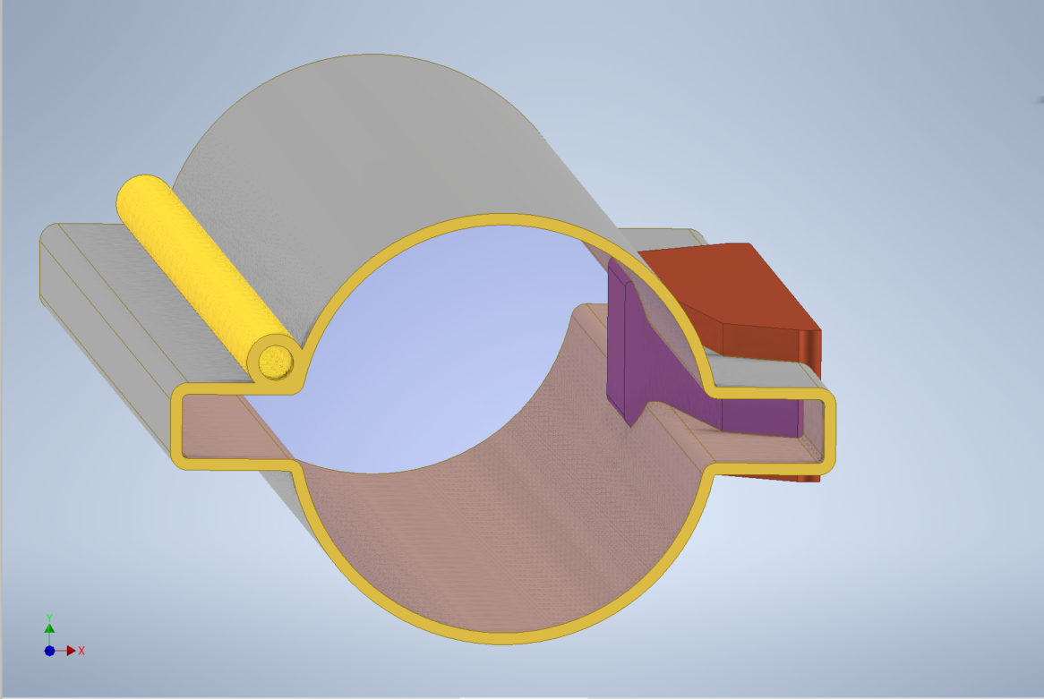
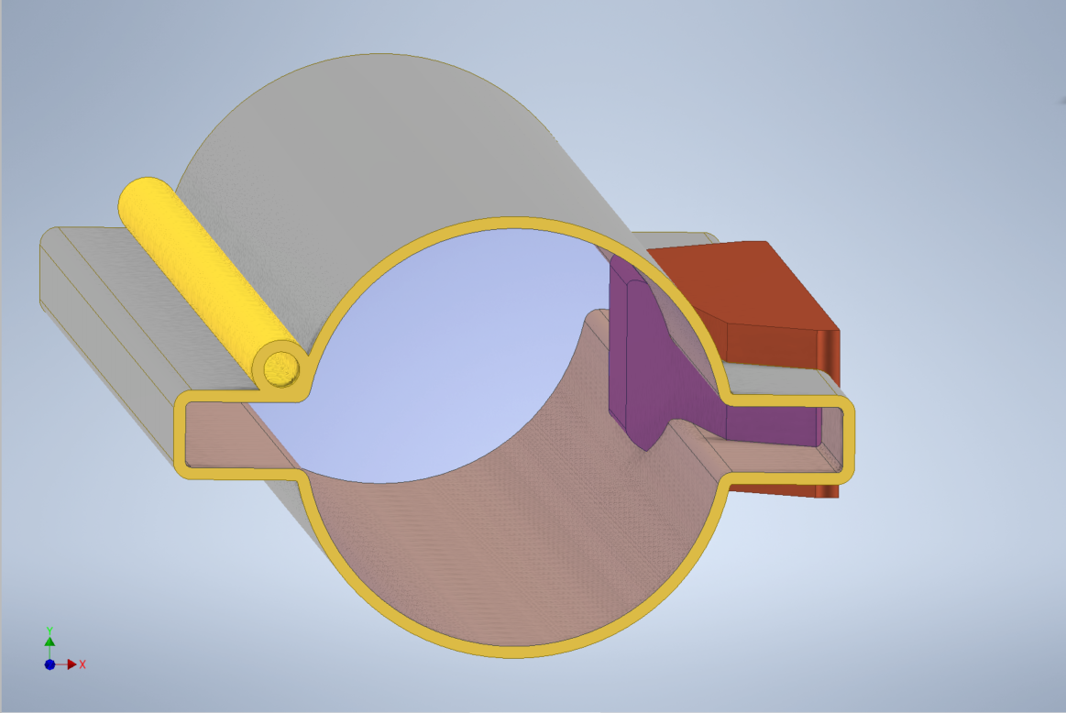
Variable stopper sizes
We tried different stopper protrusions to see their effect on impedance
d is distance from the beam:
d=42.5 (CDR)
d=35
Choice for this proposal
CDR
d=32
d=30
No stopper
Beam pipe radius
N. Nikolopoulos

Slide 15
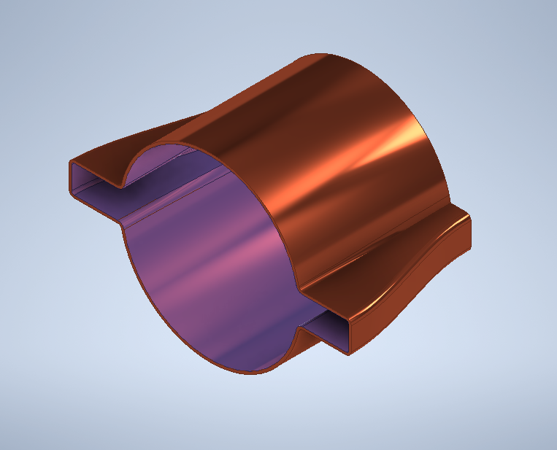
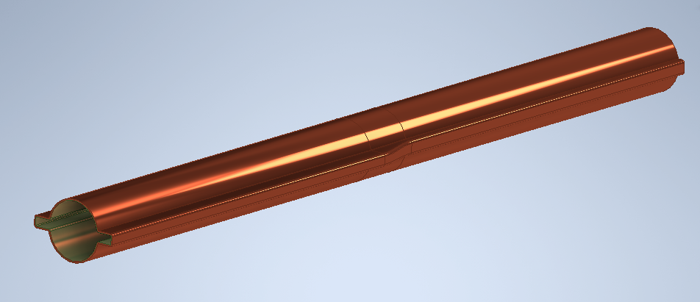
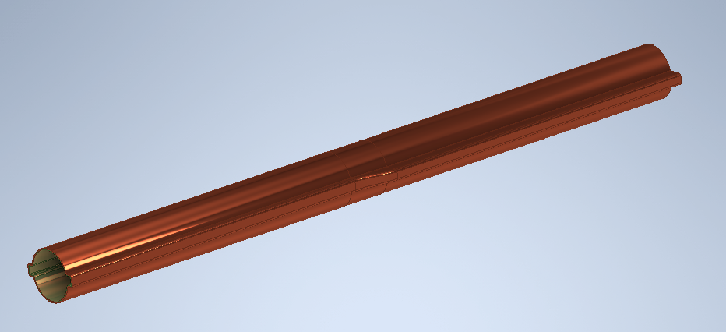
Transitions
A smooth transition between a 110mm winglet to a 86mm winglet was developed
110mm
85mm
85mm
110mm

Slide 16
Results of impedance calculations
A copper 35mm radius round pipe has a loss factor of 3.6×10⁻⁴ V/pC at the Z. This corresponds to a total power of 2.3MW for both beams
A 35mm inner diameter pipe with winglets has a loss factor of 3.7×10⁻⁴ V/pC, close to the totally round case.
Having a stopper as in the CDR increases the impedance of a 1m pipe to 4.7V/pC
Results indicate that the premium we need to pay in terms of power for this design is minimal (0.15MW on top of 2.73MW or 5%) even for a stopper @29mm from the beam
 | This proposal |  |  |  | CDR
 | k factor / m | no. of units (m) | k 100km ring | power two rings (MW) | k factor/m | power two rings (MW) | Premium (MW)
35mm pipe with winglet 110mm | 3.67E-04 | 83250 | 30.55 | 2.31 | 3.67E-04 | 2.31 | 0.00
beam pipe with stopper @29mm | 1.05E-03 | 2900 | 3.05 | 0.23 | 4.70E-04 | 0.10 | 0.13
transition 110mm to 86mm | 4.40E-04 | 2900 | 1.28 | 0.10 | 3.67E-04 | 0.08 | 0.02
35mm SSS pipe with winglet 86mm | 3.72E-04 | 5800 | 2.16 | 0.16 | 3.67E-04 | 0.16 | 0.00
transition 86mm to 110mm | 4.04E-04 | 2900 | 1.17 | 0.09 | 3.67E-04 | 0.08 | 0.01
totals |  | 97750 |  | 2.89 |  | 2.73 | 0.15

Slide 17
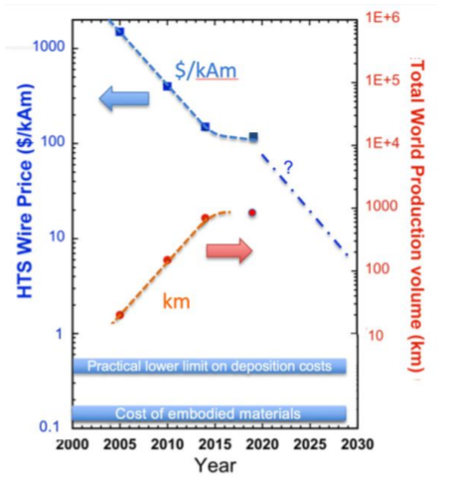
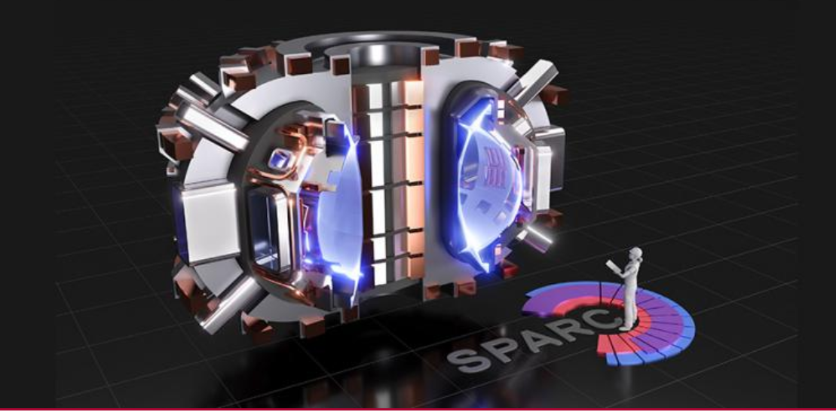
A question of cost
https://www.snowmass21.org/docs/files/summaries/AF/SNOWMASS21-AF7_AF0_Vladimir_Matias-251.pdf
The cold SSS idea cannot cost more than the price of the normal conducting system. The major cost driver today is the HTS condutor
For the above to be the case, we need a reduction in price of HTS tapes of about 3-4 compared to now in 20 years.
We believe that the advent of fusion projects will help reduce the price of HTS by a factor 10 in 20 years, so we think we are competitive.
Synergies with Fusion projects
Cf: SPARK fusion project needs 10,000 kms of HTS cable ~today
Nature, Scientific Reports | (2021) 11:2084 | https://doi.org/10.1038/s41598-021-81559-z

Slide 18
Cooling the SSS
The current design calls for individual dry cooling, using commercially available cryocoolers
Questions to be answered:
  Need to have adequate mean-time-between-failures
  Need to consume as little as possible
  Need to ensure operation in the harsh radiation environment of the tunnel
  Are there any vibration issues?

Slide 19
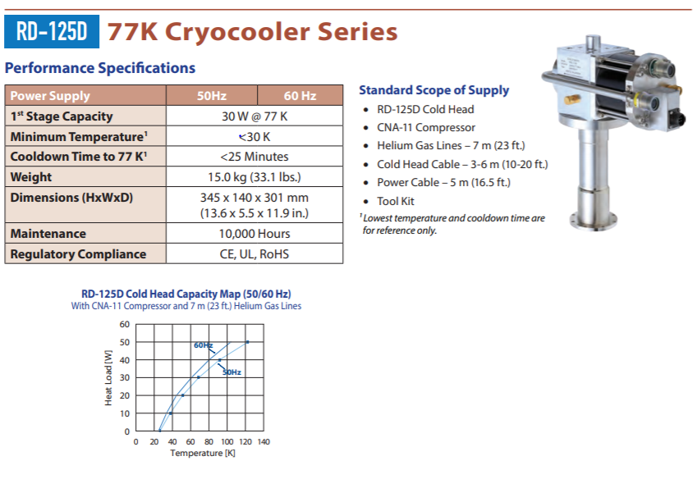
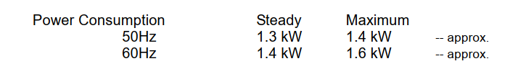
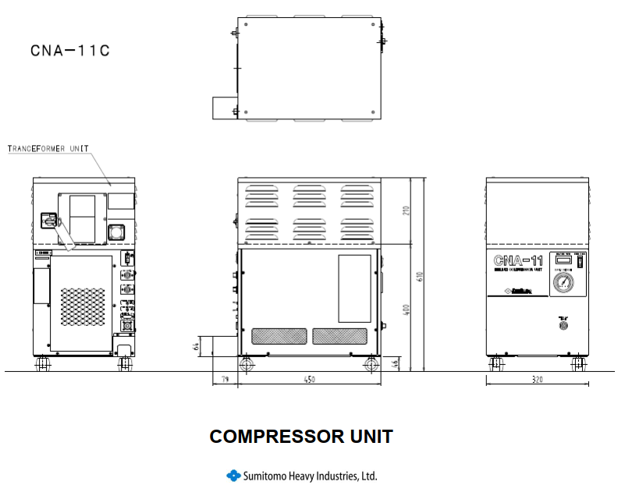
Example cryocooler from SHI cryogenics
Cooling capacity:
33W@77K,
12W@40K
Power consumption: 1.3kW,
Price today: 15.5k euros ready to cool
Power consumption of 2900 units: 4.1MW power or 20GWh per year
This is ~5% of the warm magnets consumption at the top
Size of unit is 320 X 450 X 610 mm

Slide 20
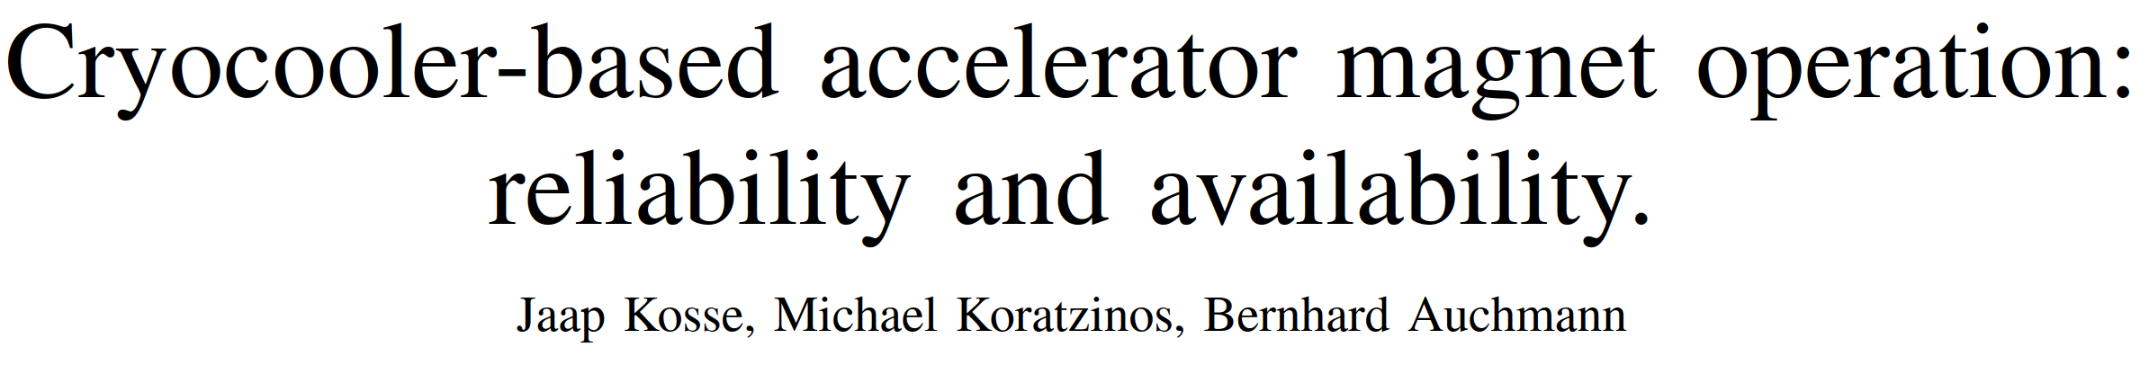
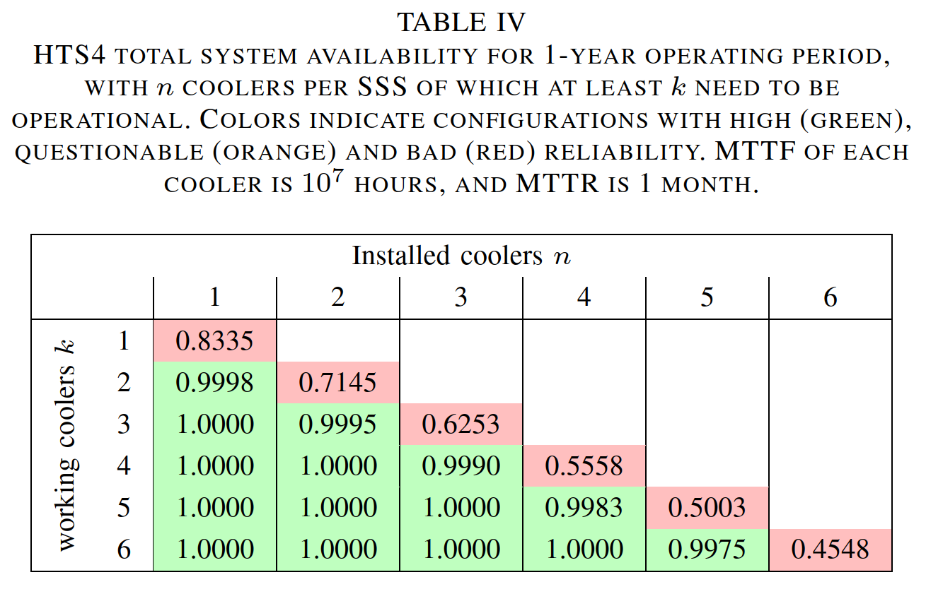
Reliability
We are estimating the mean time to failure (MTTF) given a mean time to repair (MTTR)
Paper in preparation
MTTF of 10⁷ hours means that the failure rate within a 30.000 h maintenance interval is 1.5% (this is a real life scenario of six MD-120 coldheads-which in the application of cryopumping all need to operate (k = n = 6) coupled to a TM-30 compressor.
Jaap Kosse

Slide 21
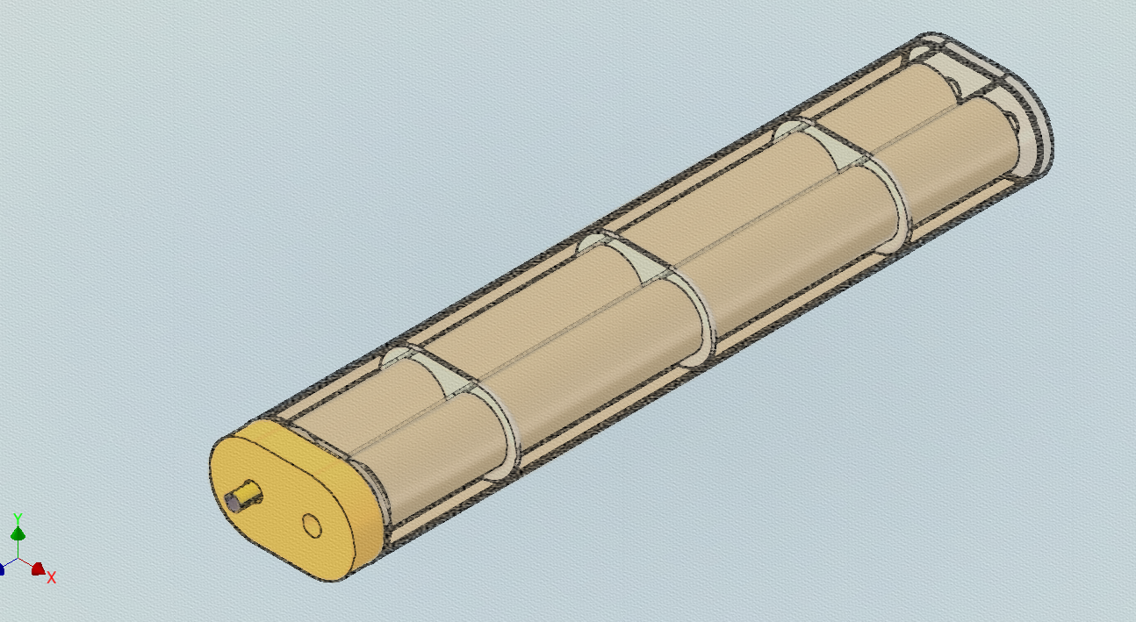
Heating budget
We need to pay attention to the following:
Resistive wall heating due to the extra photon stoppers and different beam pipe design (not a problem – see slides before)
Heat losses of the cryostat – radiation and conduction through supports (calculated to be ~12W)
Cryostat heating due to debris from photon stoppers (calculated to be <2W)
Conduction and ohmic heating of current leads – our sister project FCCee CPES aims at a value of ~10W)
First model of cold SSS with magnet formers, cryostat, beam pipe, absorber

Slide 22
Radiation environment
The FCC-ee tunnel is a harsh radiation environment.
We need to ensure that:
  The cryostat is protected from radiation which will increase thermal loads
  Any associated equipment with electronics (power supply, cryocoolers) will continue functioning for the lifetime of the accelerator.
We have performed an exercise of including extra radiation shields around the photon stoppers in an attempt to see how low we can push the radiation reaching our cryostats and electronic equipment of the cryocoolers

Slide 23
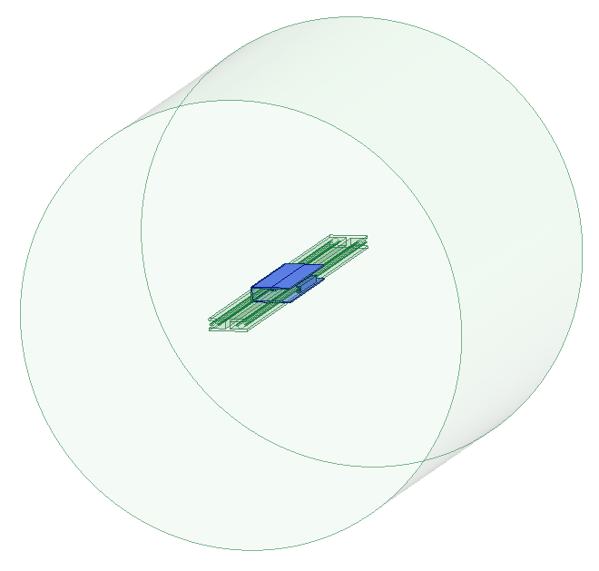
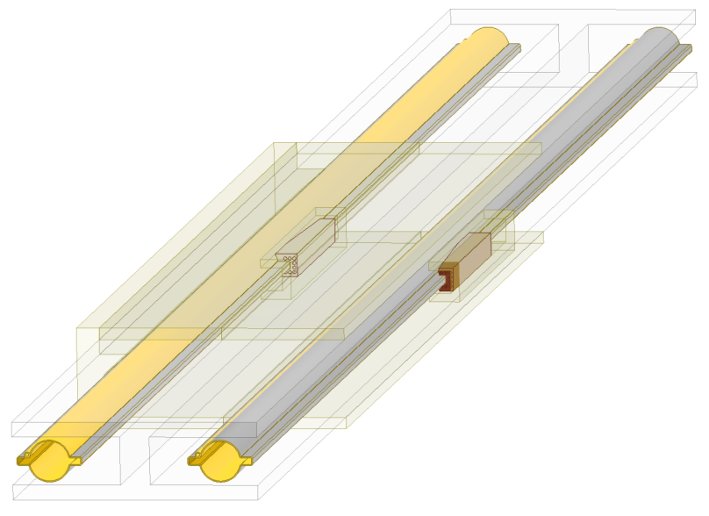
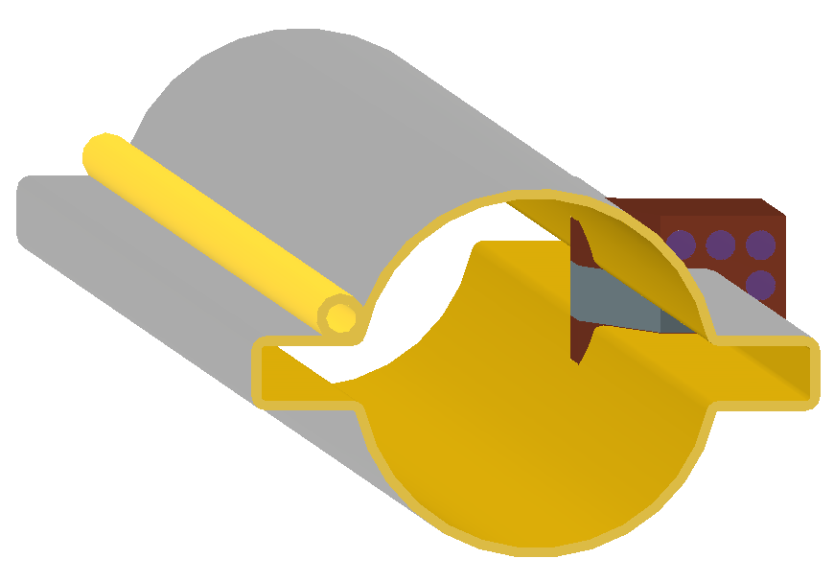
Radiation in the tunnel
See old presentation by N. Nikolopoulos https://indico.cern.ch/event/1113474/ in 2022
A full system with tunnel, dipoles, beam pipe, photon absorbers, shields was simulated in FLUKA
We have used tungsten for the extra shielding, which however can be replaced by lead of 1.5 times the thickness

Slide 24
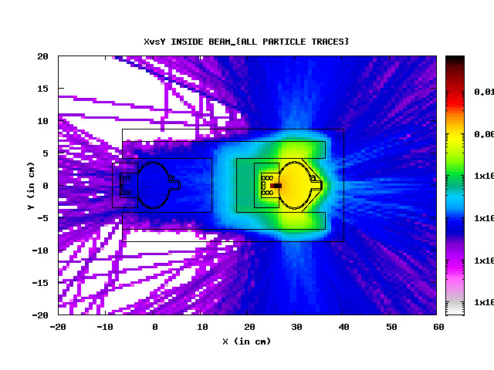
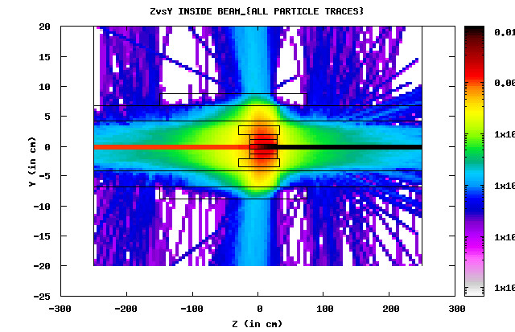
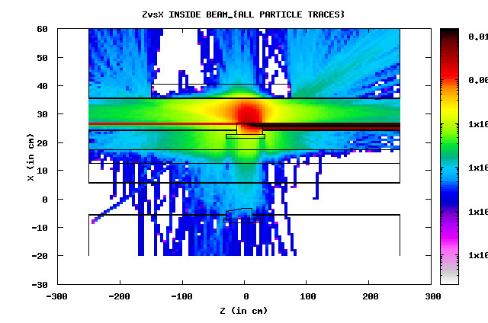
FLUKA results, inside beam
>99% of energy absorbed by various absorbers, beampipe or magnet

Slide 25
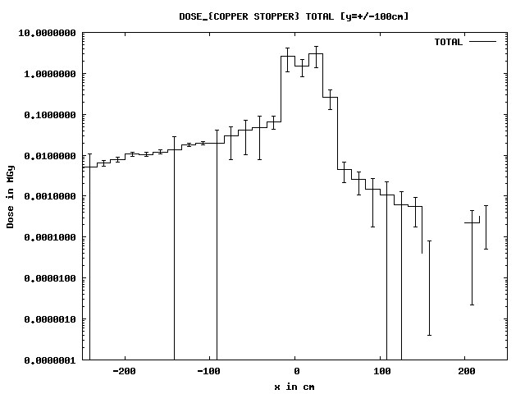
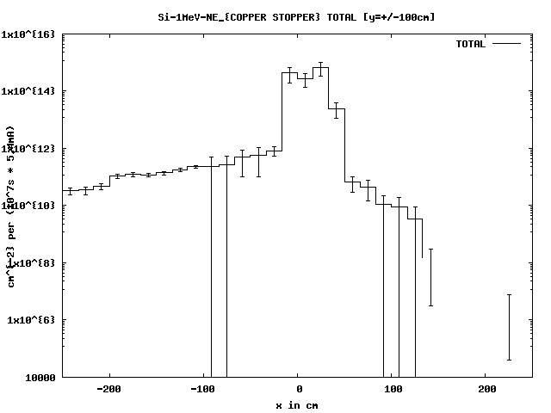
Both beams – dose and 1MeV n equiv. per year
Dose: 1m from the beampipe, inside: ~600Gy
1m from the beampipe, outside: ~10kGy
1MeV n equiv.: 1m from the bp, inside: ~1E10
1m from the bp, outside: ~2E11
Doze can be <1kGy per year 1m off the accelerator plane. This analysis will be verified as design evolves

Slide 26
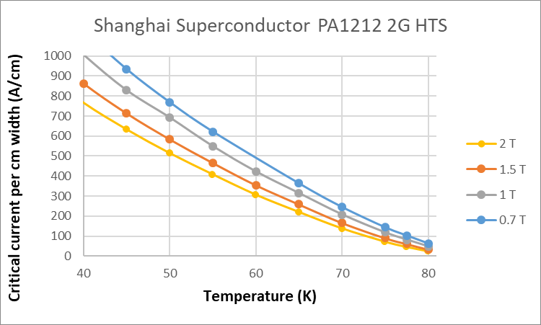
Choice of operating temperature
HTS performance at 40K compared to 77K differs by a factor ~10
The cost of cryo cooling, only increases by a factor ~2
Heat losses do not change significantly (due to the fourth power law of black body radiation)
We aim to work at ~40K at the top energies
Note that at 40K, materials still possess some heat capacity, so there will be no LHC-type quench problems
Above is typical ReBCO technology performance, all HTS companies will be considered (but difference in performance and price/performance is small.
We are using 4mm ReBCO tape

Slide 27
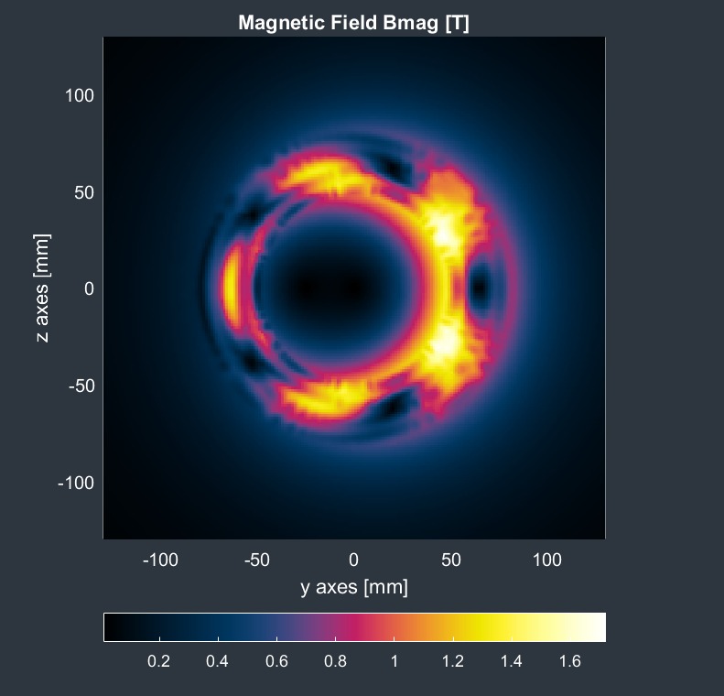
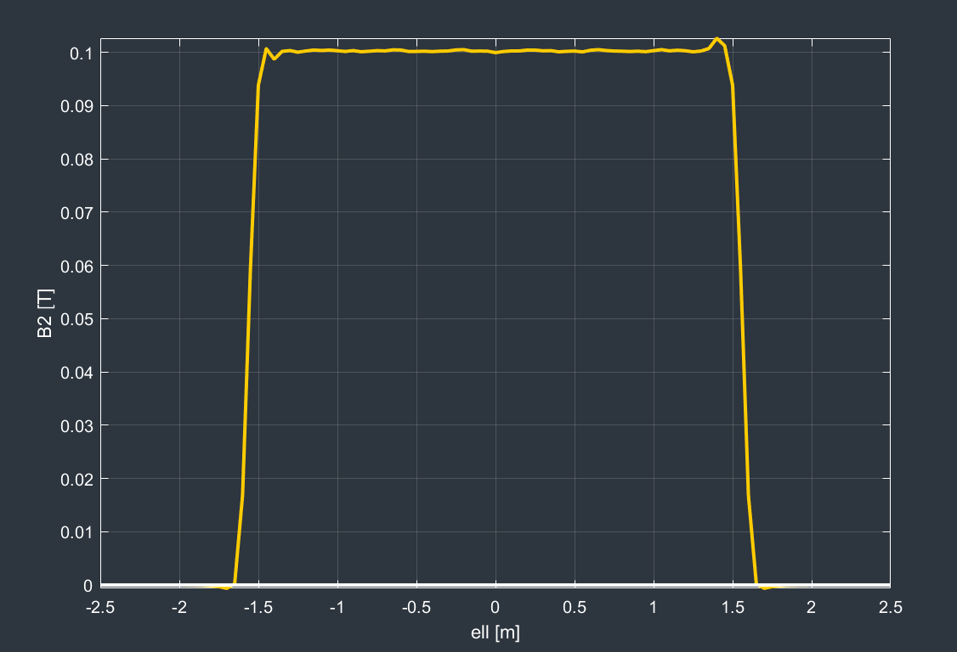
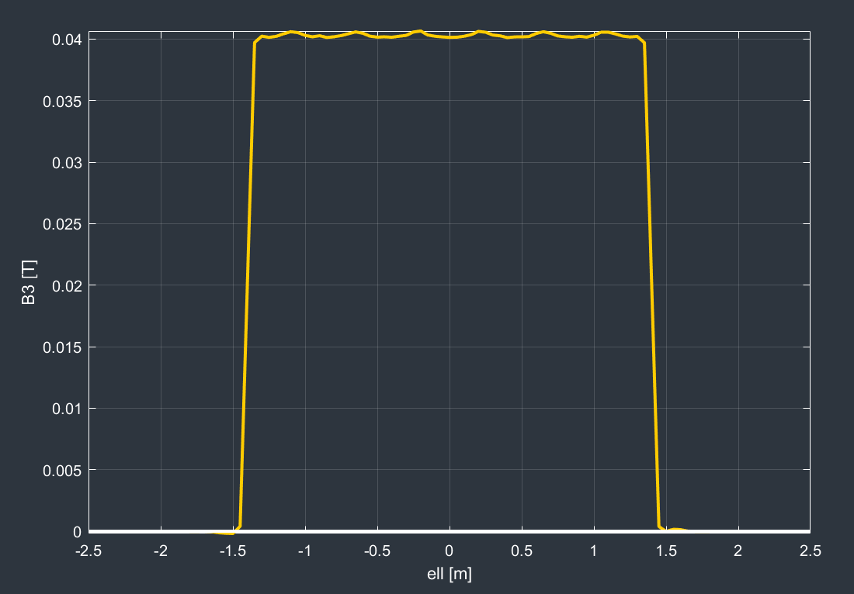
Magnetic analysis
Quad and sextupole at full strength
This is a low field application (1.7T max) gradients: 12T/m; 1000T/m²
There is no problem attaining the performance with today’s HTS tapes
The question is only related to cost: the higher the performance, the lower the length of HTS tape needed, the lower the cost
B2 @10mm: 0.1T; B3 @10mm: 0.04T

Slide 28
Demonstrator
Since we are dealing with a new technology (quads and sextupoles using HTS conductor) one (or more) short-length demonstrators are needed to prove that our technology choices are correct.
A sextupole demonstrator has been designed and is being manufactured
The sextupole was chosen since in a nested (quad/sextupole) system, the higher order multipole goes closer to the beam pipe
Progress:
  Magnetic design finished using the RAT GUI from Little Beast Engineering (https://rat-gui.ch/)
  CAD design finished
  Material ordered
  Waiting for manufacturing in the CERN main workshop

Slide 29
Demonstrator – choice of technology
We have chosen a CCT magnet layout due to
  Ease of construction
  Good field quality
  Quick design cycle
Other approaches (i.e. standard cosine-theta) will also be considered
The use of HTS tape makes the design non-trivial compared to a round-conductor CCT, like the final focus prototype quadrupole already constructed and tested at warm.

Slide 30
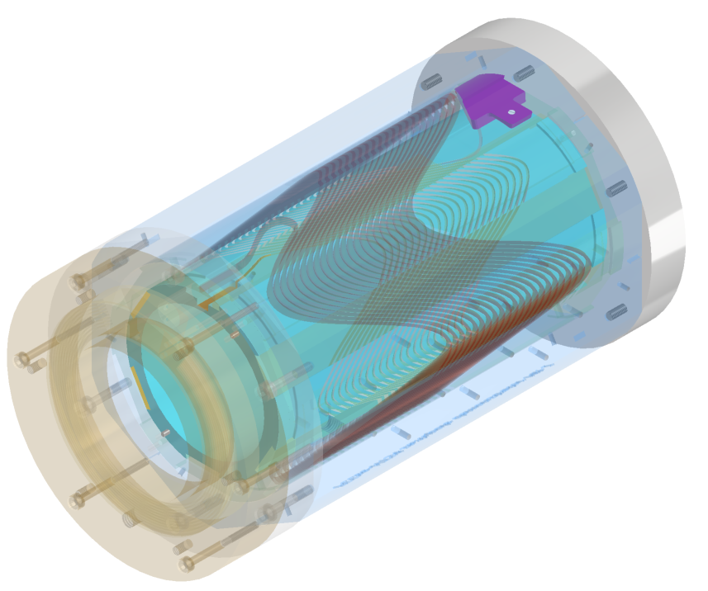
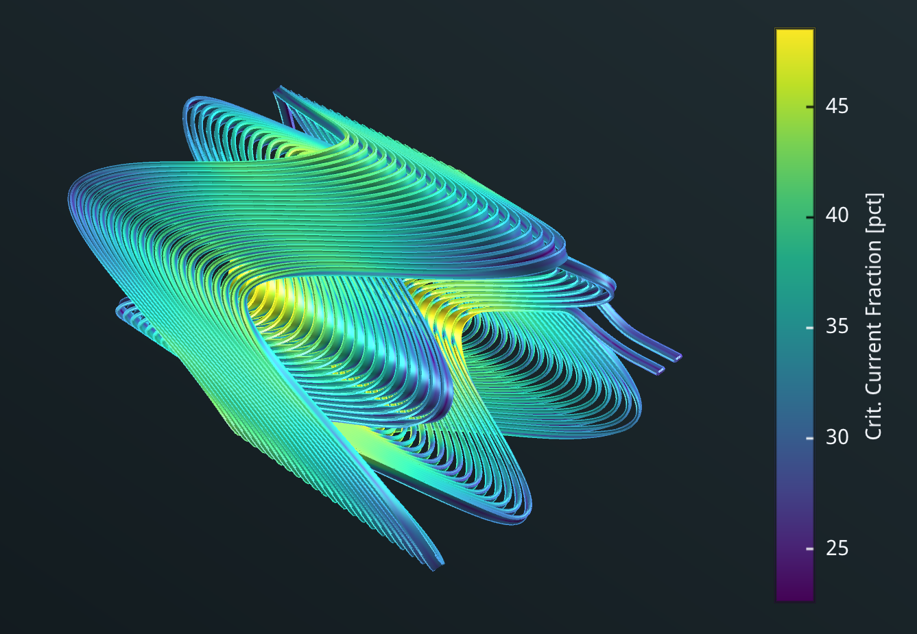
CAD design of sextupole demonstrator
Specifications:
Aperture: 90mm
Current: 260A
Temperature: 40K
Field gradient: 1000T/m2
Max. field @conductor:1.5T
Crit. Current fraction: 49%
Temp. margin: 14K

Slide 31
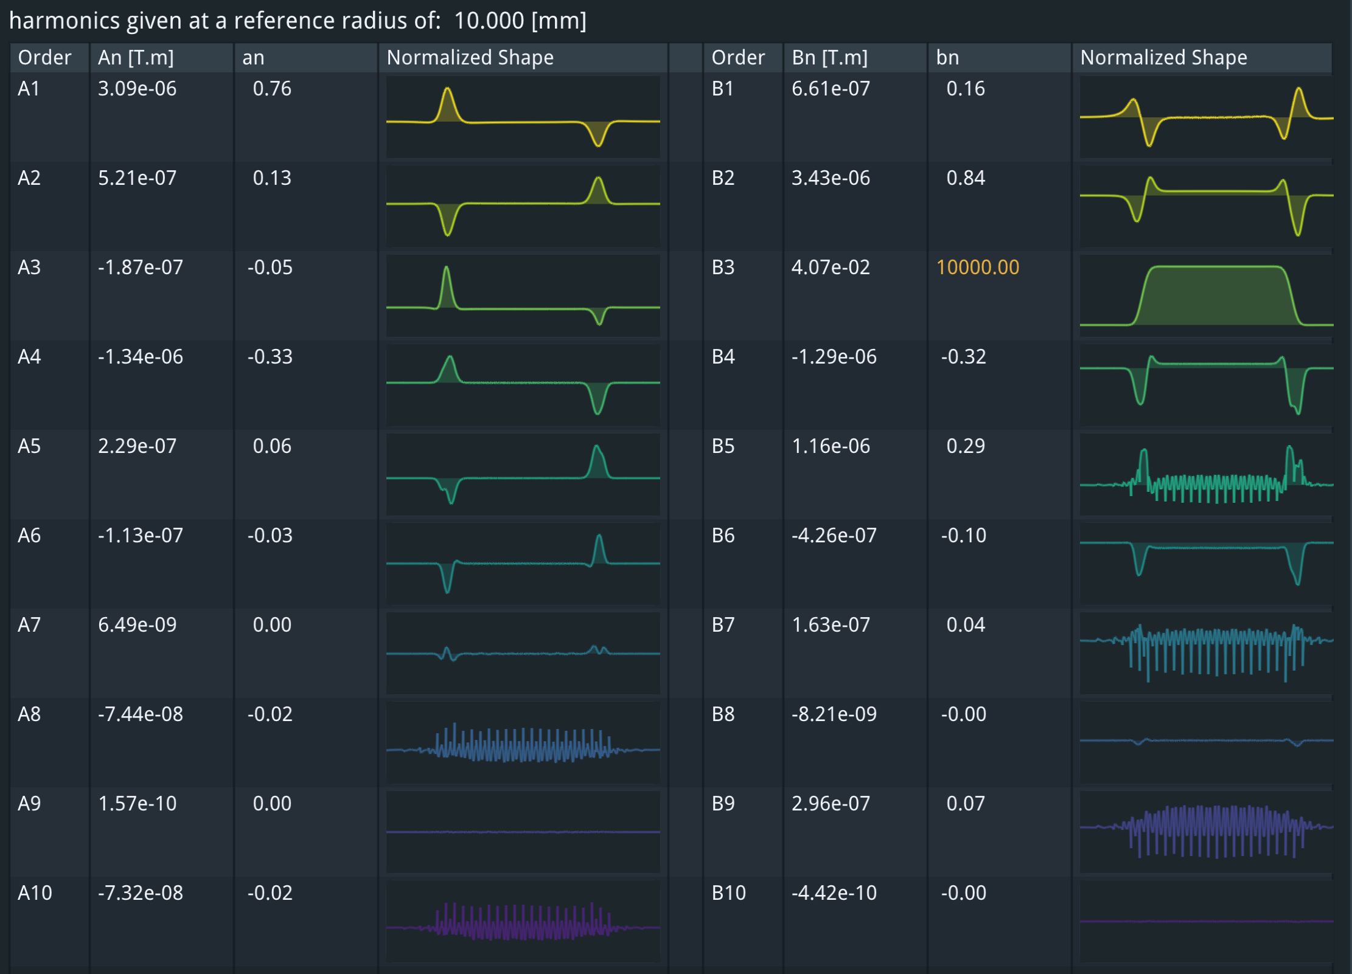
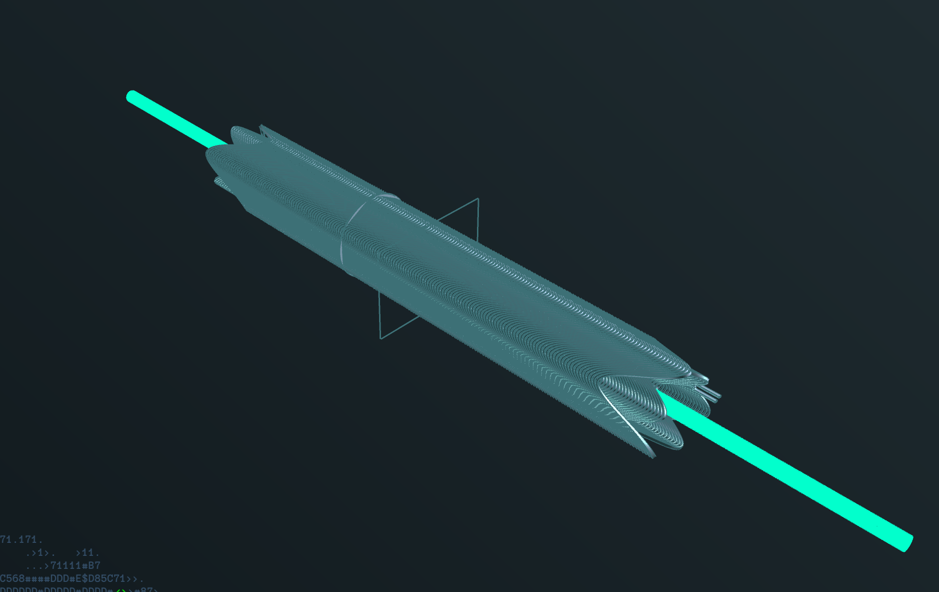
Multipole errors - sextupole
A CCT magnet can very easily correct for multipole errors, which are in any case small.
B3dl corresponds to a strength of 1000T/m2

Slide 32
Manufacturing
For the prototype stage, there are two main manufacturing techniques:
Additive manufacturing (metal 3D printing)
  Advantages: any geometry is realizable
  Disadvantages: surface roughness
Subtractive manufacturing (CNC machine milling)
  Advantages: mirror-like finish
  Disadvantages: not all geometries realizable
We are actively looking at both techniques

Slide 33
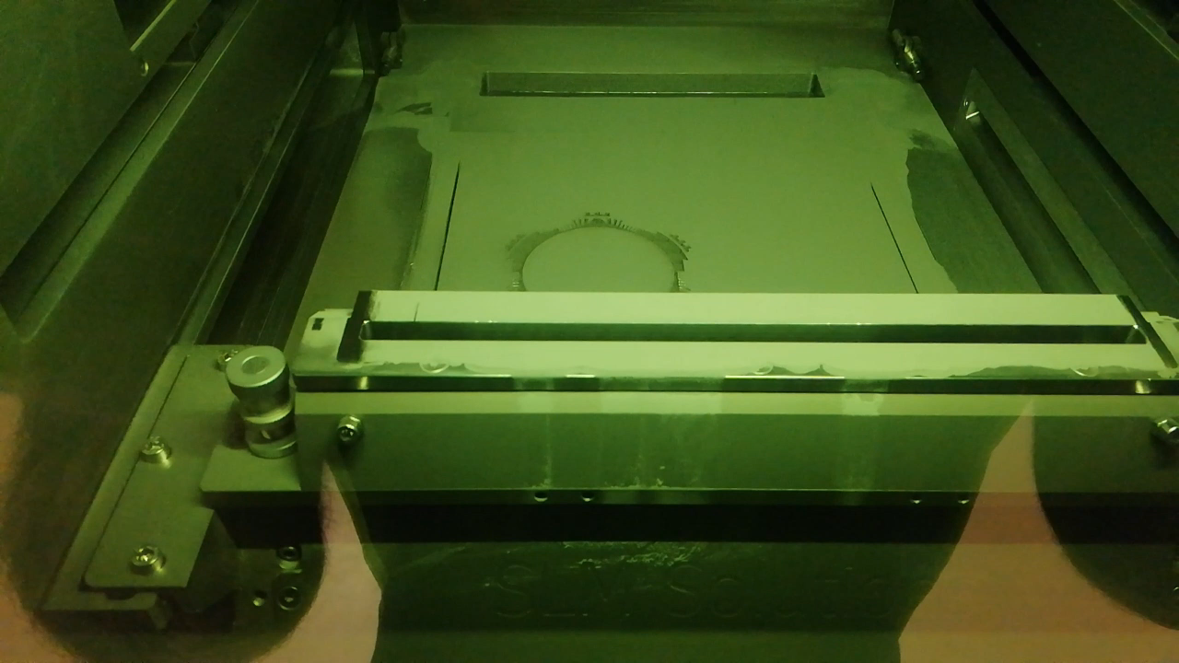
Romain Gerard, Numan Ghazali (EN-MME-FW)

Slide 34
What about the arc dipoles?
The dipoles are not part of the scope of FCCee-HTS4
However, a very simple and elegant system of two HTS transmission lines can be envisaged: warm magnet, cold conductor (transmission line style)
We can leave the rest of the design as is
Need to investigate if conductor can be placed in the mid plane
C.f.: maximum current is 1900 A

Slide 35
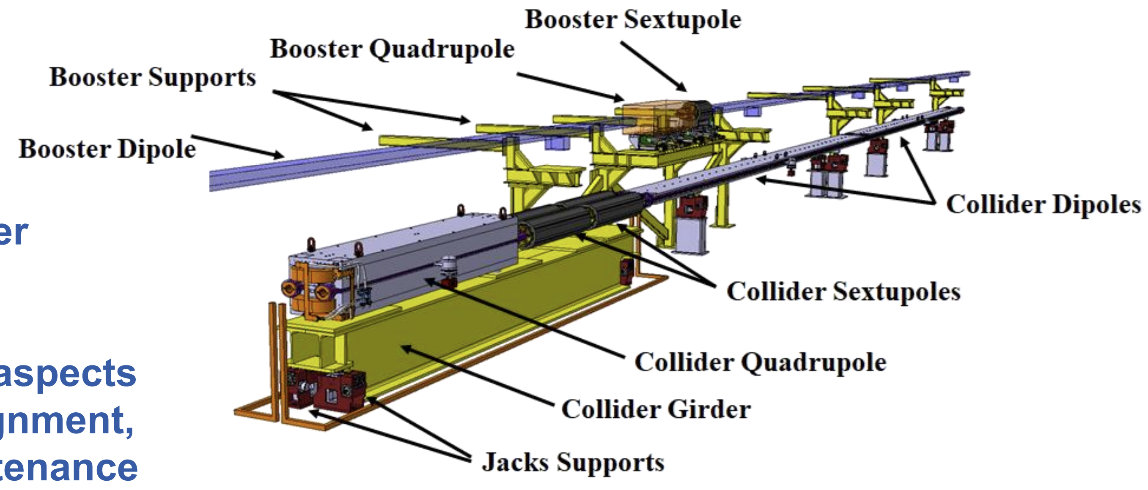
The girder and alignment
For the CDR, the quad and sextupole magnets will be mounted on a girder (in yellow, below), alignment presumably done before transportation to the tunnel.
Then the girder, as a whole, will be aligned in situ.
In the case of HTS4, the weight of the SSS is substantially reduced
Having a much lighter and nested (therefore shorter) system would greatly reduce the cost of the girder and alignment uncertainties.
The girder will be a very simple object – an SSS cryostat mechanical support
Tor Raubenheimer

Slide 36

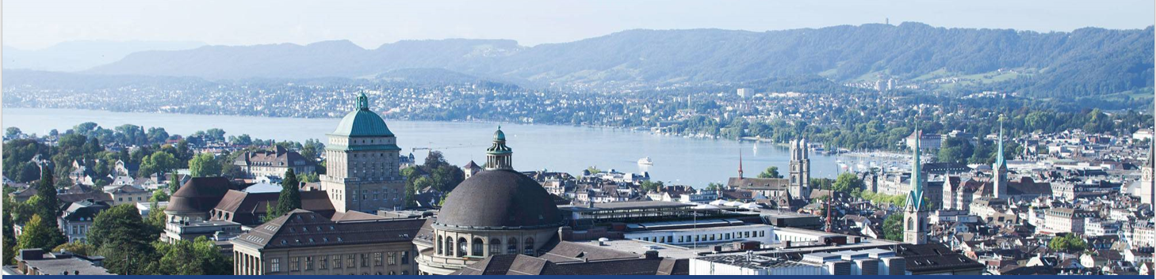
Cold power supply
Our sister project: FCCee CPES (PES, ETHZ) Jonas Huber, Danqing Cao, Daifei Zhang

Slide 37
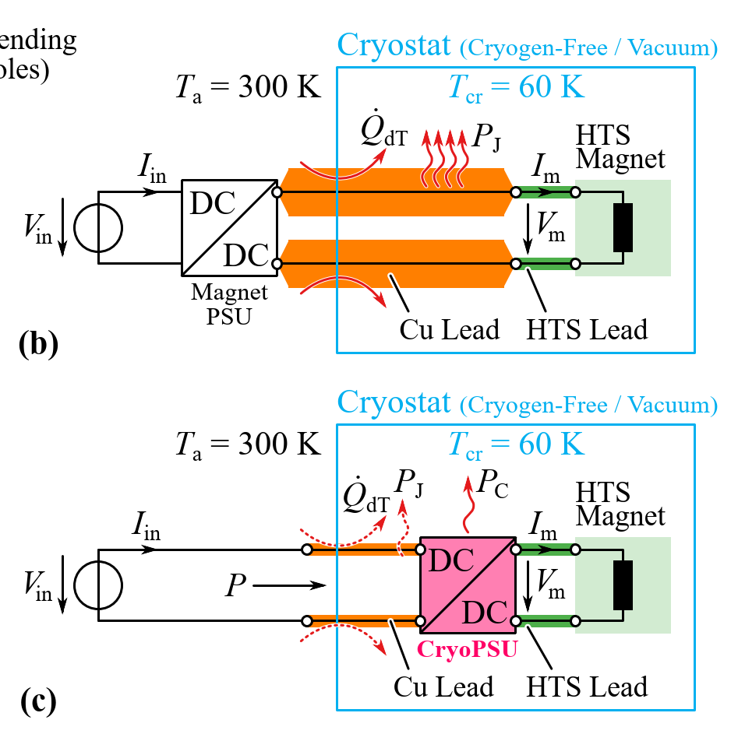
The idea behind FCCee-CPES
Traditional systems have a heat loss due to the copper power supply leads of ~90W/kA (two leads) see https://arxiv.org/abs/1501.07166.
Although we have pushed the current down to 250A (at the expense of more coil windings), this still corresponds to a heat budget of 45W for four current leads.
By comparison, the heat load due to radiation and conduction through the feet of the cryostat are expected to be ~12W
By moving the power supply inside the cryostat and operating it at 60-70K, we need only very thin wires to the outside word (this is a DC application with long charging times).
the aim of the project is to decrease power consumption roughly five-fold.
Traditional system:
This proposal:

Slide 38
Conclusions
The idea of cold Short Straight Sections has substantial electrical power reduction and cost benefits, while increasing the performance and flexibility of the accelerator.
The FCCee-HTS4 project aims at demonstrating that this idea is feasible.
Our sister project FCCee CPES goes a step further and reduces cooling costs by developing a power supply that will operate at cryogenic temperatures.
These projects will increase the sustainability credentials of FCC-ee as well as increase performance.

Slide 39
Thank you

