Slide 1
Preliminary layouts and designs for two of the FCC surface sites
Damian DOCKERY (Fermilab)
Andrew FEDEROWICZ (Fermilab)
Brian RUBIK (Fermilab)

Slide 2
Overview
CERN x FNAL Collaboration
Background on Collaboration
  FNAL Team, CERN Visit
Scope of work
SITE PA (Experiment Site)
SITE PB (Technical Site)

Slide 3
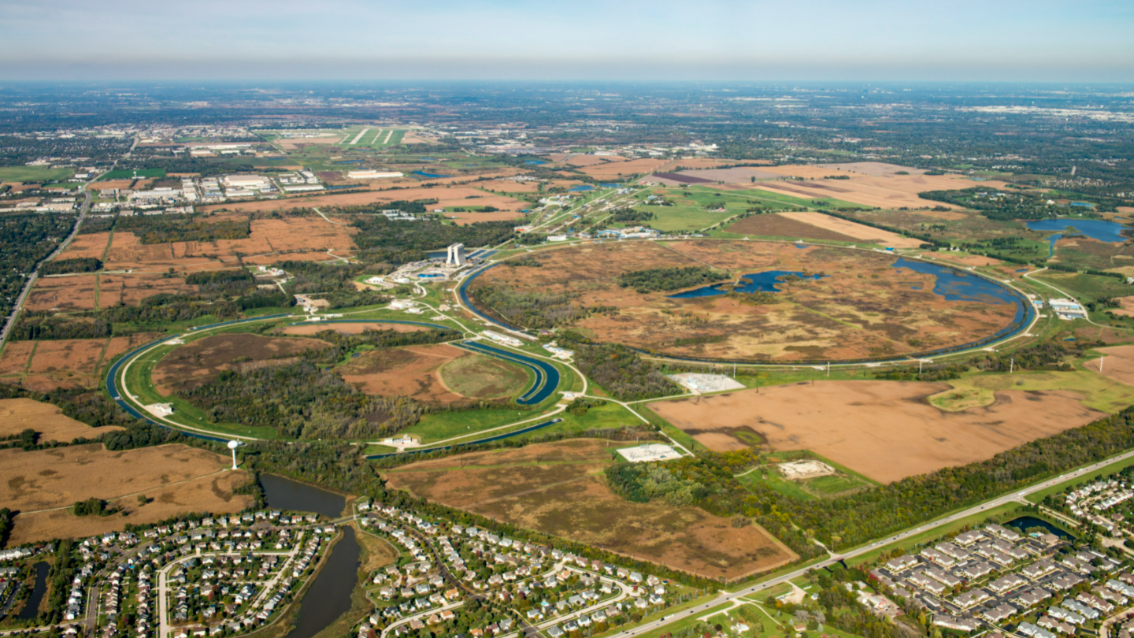

Aerial view of Fermilab campus. Fermilab is America's particle physics and accelerator laboratory. We bring the world together to solve the mysteries of matter, energy, space and time.
Notes:
Our site, shown on this slide, is about 10sq miles (or ~26 sq kilometers) in size.
When built in the early 1970’s, the lab was surrounded by farmland but now it’s pretty much surrounded by residential and low-rise industrial facilities. The two circles shown on this slide indicate the locations of our underground particle accelerators. Most of our infrastructure was built 50-60 years ago, which presents energy efficiency and resiliency challenges, especially as we experience more climate-related severe weather events. Also, the type of research we do consumes vast amounts of energy, and we’re continually adding new experiments to our work portfolio.
Despite this, we see ourselves in a position of great opportunity. As our infrastructure ages, we have the chance to repurpose and improve our existing facilities, upgrade or replace our utility infrastructure, and take better advantage of our campus as a whole in ways that are more efficient, effective, and have a more positive impact on our environment and community.

Slide 4
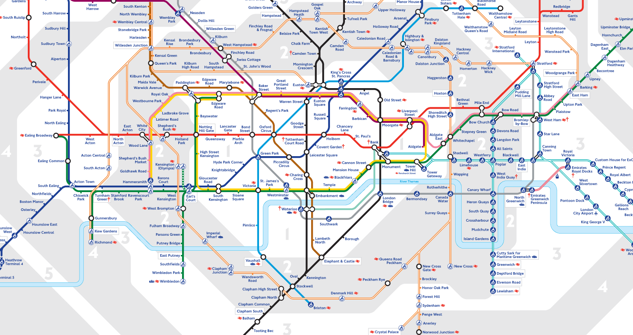




Background on Collaboration
The route to FCC Week 2023
TODAY!
APR 2022
JUNE 2022
NOV 2022
JAN 2023
Draft agreement CERN & DOE
FNAL project team on board
FNAL Visit CERN
Start of Conceptual Design Development

Slide 5

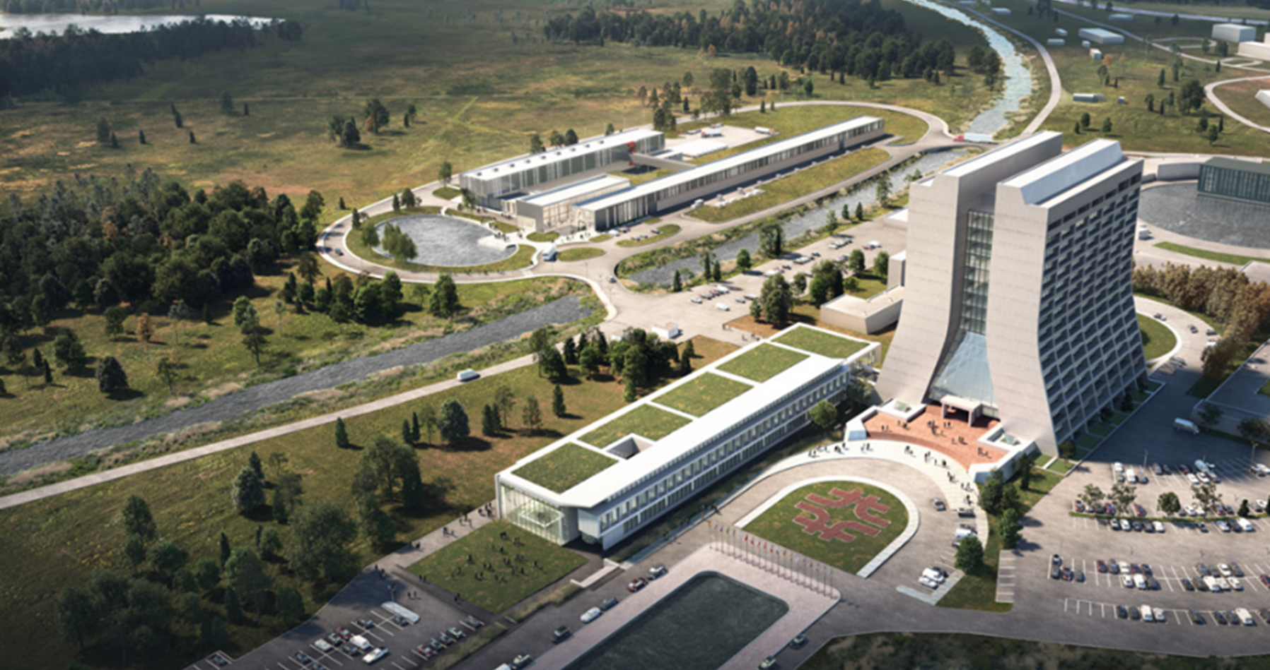
Background on Collaboration
The FNAL Team
ISD Infrastructure Services Division
Engineering Group
Fermilab’s in-house Architectural/Engineering (A/E) firm. The Engineering Department provides expertise for conventional facility design and construction activities and directs outside A/E services.
Tracy Lundin
Senior Strategic Planner
Damian Dockery
ISD/Deputy Director
Andrew Federowicz
Senior Architect
Brian Rubik
Senior Structural Engineer
Jacquelyn Dragovich
BIM Manager / Architect
LBNF Long Baseline Neutrino Facility
Near Site Conventional Facilities
Thomas Hamernik
LBNF-NSCF Project Manager
Kennedy Hartsfield
LBNF-NSCF Deputy Project Manager
Fermilab Campus located 65km outside Chicago. Above: Aerial view of new buildings recently completed in the central campus surrounding Wilson Hall. Bottom Left: Integrated Engineering Research Building (IERC). Top Left: PIP-II Complex

Slide 6
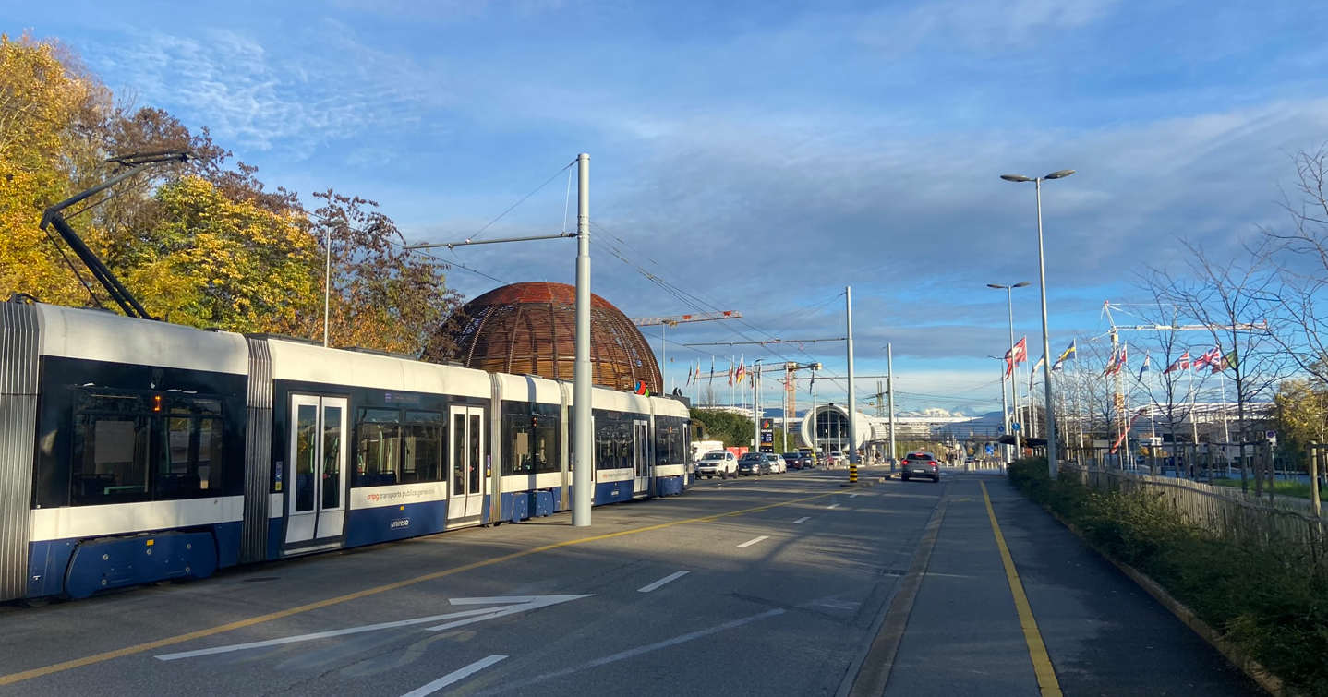


Background on Collaboration
CERN Trip: November 14-19th
Total of 3 FNAL staff spent one week at CERN visiting LHC locations and proposed FCC sites with SCE team Tim Watson and Antoine Mayoux.
The trip’s intent and itinerary at a glance:
Meeting with CERN staff and FCC stakeholders to tour existing LHC facilities.
Gain better understanding of the CERN building types, construction methods, and unique challenges at LHC surface sites.
Locations visited and meetings with FCC stakeholders

Slide 7


Background on Collaboration
CERN Trip: November 14-19th
  LHC Point 1 - ATLAS
  LHC Point 2 ALICE
  LHC Point 5 – CMS
  LHC Point 8
  Experiment and Cryo requirements
  Requirements for Energy Management
  Cooling, Ventilation, Cryo Requirements
  Site and Civil Engineering Requirements
  Building 30
  Building 54
  Medical & Fire Station
  Technical Infrastructure Coordination
  SCE overview of drafting and Revit Standards
  Safety Requirements
Locations visited and meetings with FCC stakeholders

Slide 8
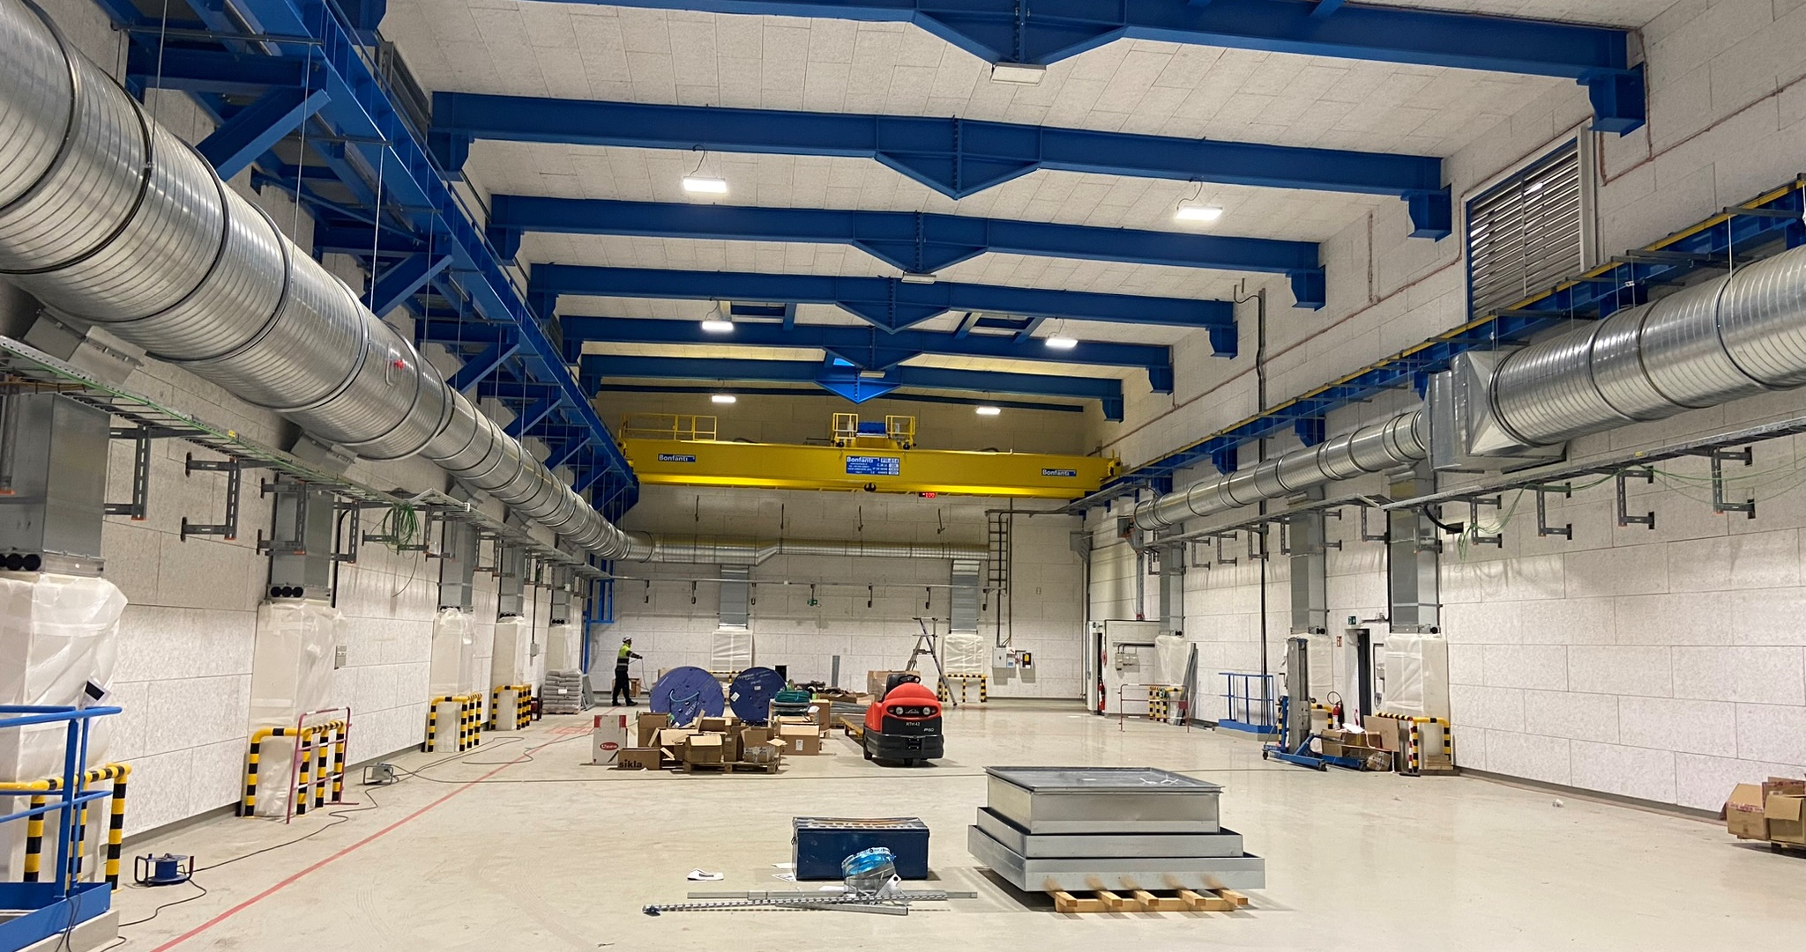
Scope of Work
Site Visit: November 2022
New construction at LHC Point 5. Knauf acoustic panels lining the interior walls is one strategy used to control sound levels
Notes:
BIM integrates structured, multi-disciplinary data to produce a digital representation of an asset across its lifecycle, from planning and design to construction and operations

Slide 9
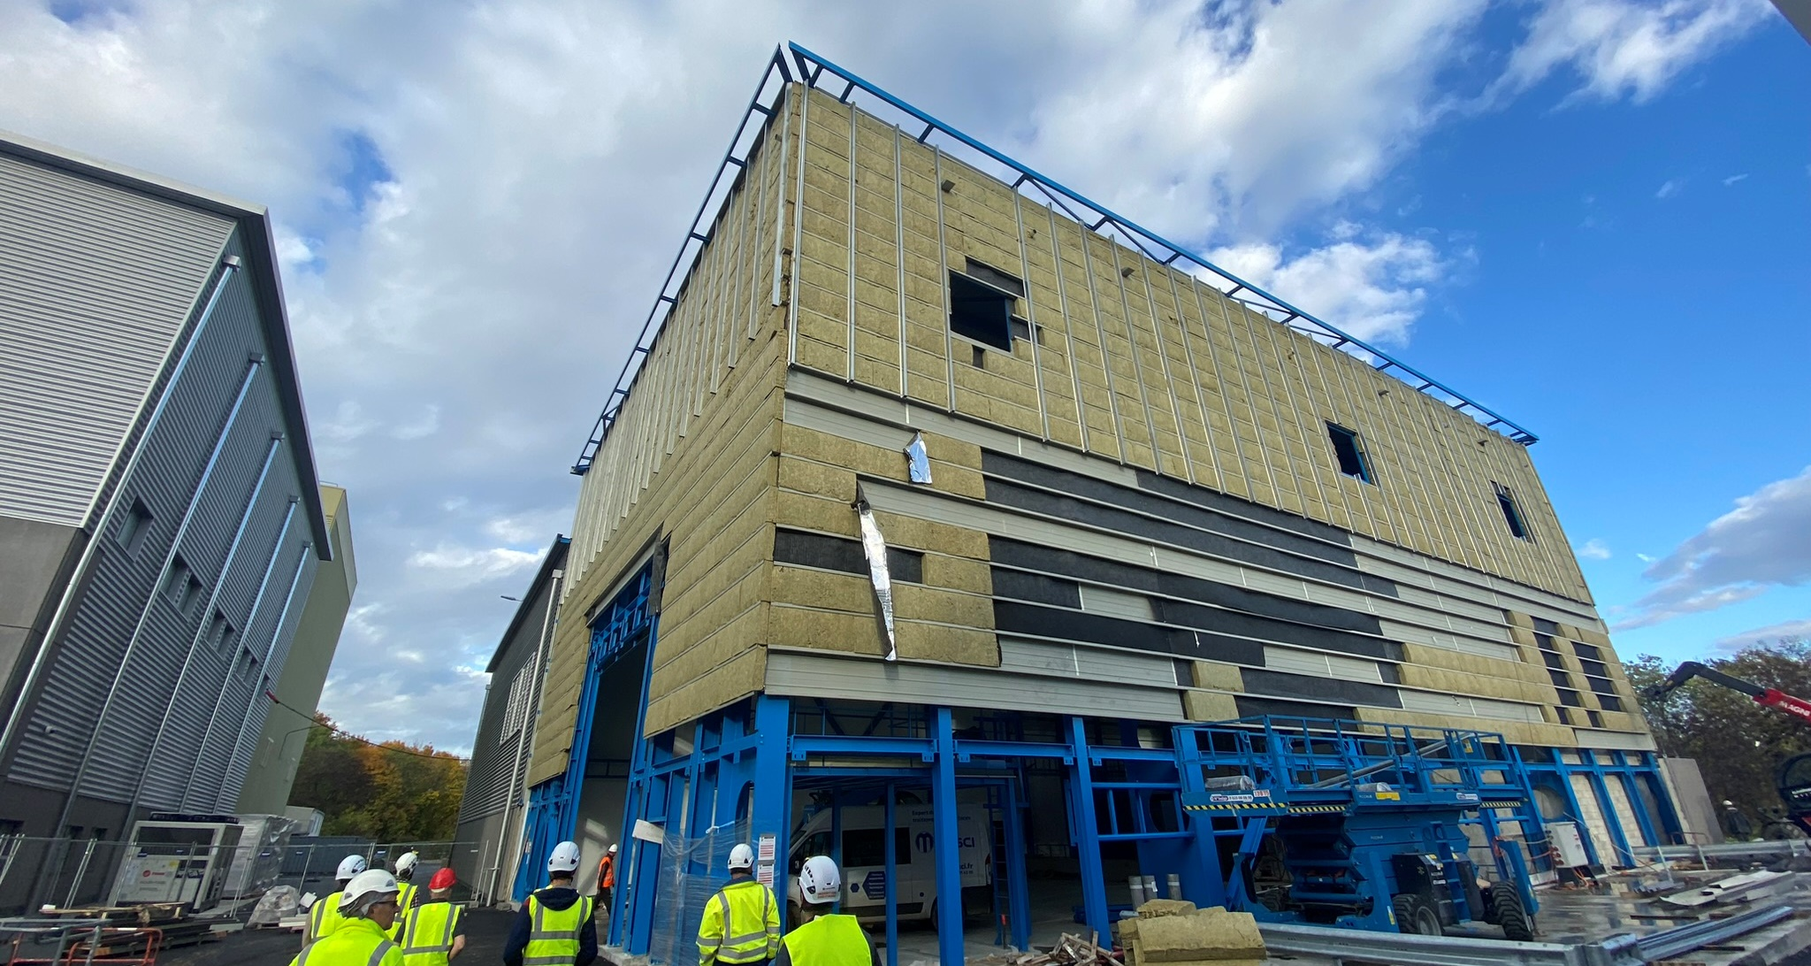
Scope of Work
Site Visit: November 2022
New construction at LHC Point 5. Installation of exterior building envelop

Slide 10
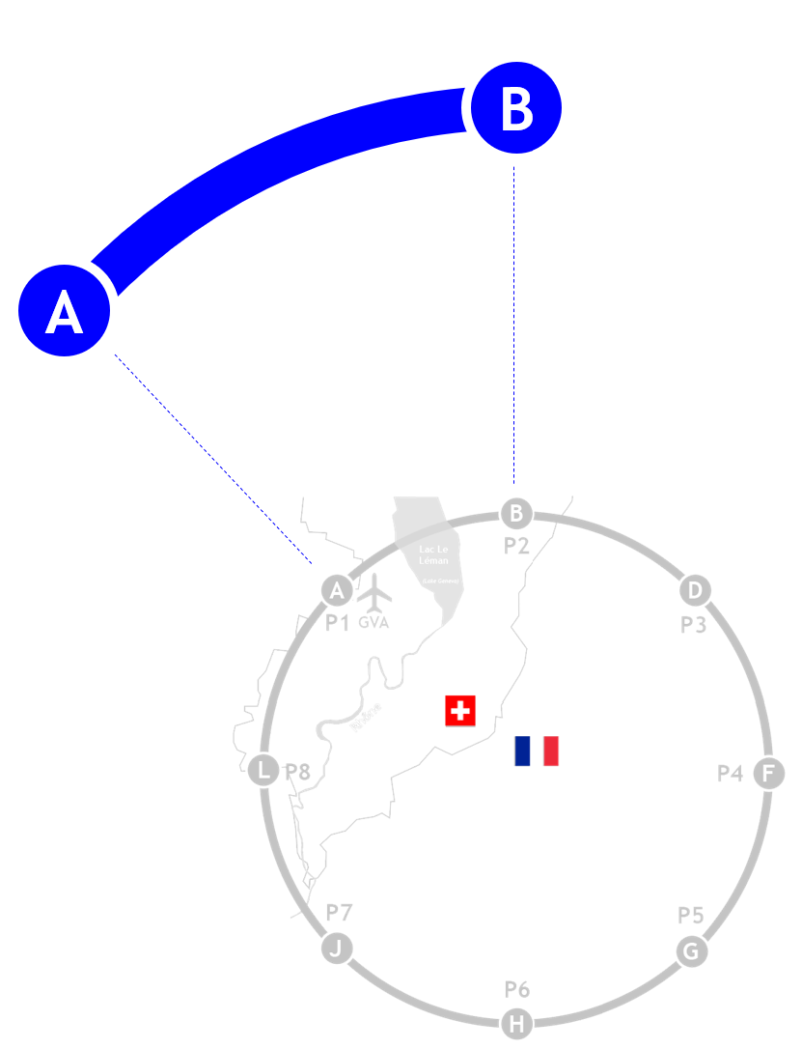
Scope of Work
Site PB
(Technical)
Site PA (Experimental)
Deliverables: General Requirements
Develop building design and site layout for 2 surface sites.
These sites would be used a basis for estimating all 8 sites.
Final Deliverable includes:
Preliminary Drawings w/specifications
Bill of Quantities
Architectural Visualizations
FNAL deliverables are a collaboration with CERN that coordinates with SCE department strategy document describing industry standard contracting practices for large scale civil engineering projects.
All renderings are conceptual and will be developed further as the study evolves
Surface sites PA and PB (FNAL deliverables)

Slide 11
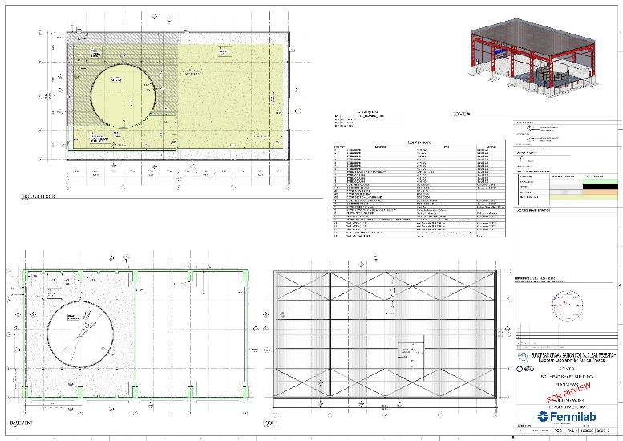
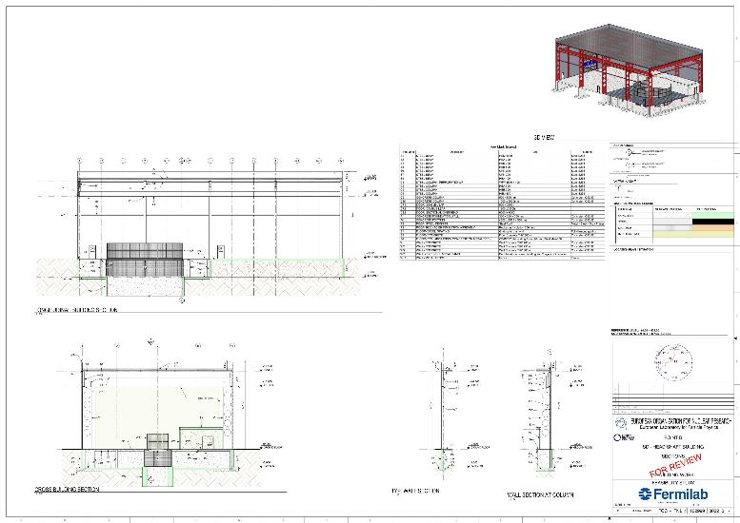
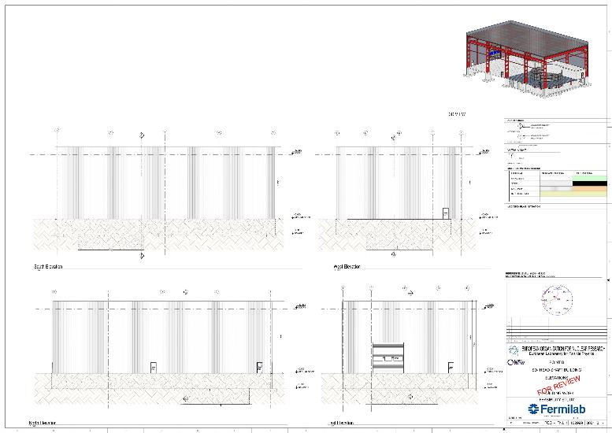
Scope of Work
Deliverables: Preliminary Drawings
Technical drawings for buildings developed using BIM software Autodesk Revit in accordance with SCE drafting standards
Plans: Grounds/Foundation/Basement/Roof
Sections: Building, Typical Wall
Elevations: North/South/East/West

Slide 12

Scope of Work
Deliverables: Bill of Quantities / Technical Report
Based on Revit model output + some manual entry for quantities not able to be modeled
Quantities of each material for all buildings (steel, concrete, insulation, paving, excavation, etc)
Combined with Technical Report will allow for a cost estimate to be generated for each site (and extrapolated to other sites)
Uses standards established by the Civil Engineering Standard Method of Measurement (CESMM4) by the Institution of Civil Engineers

Slide 13
Site PA
Experimental Site (Ferney-Voltaire, France)

Slide 14
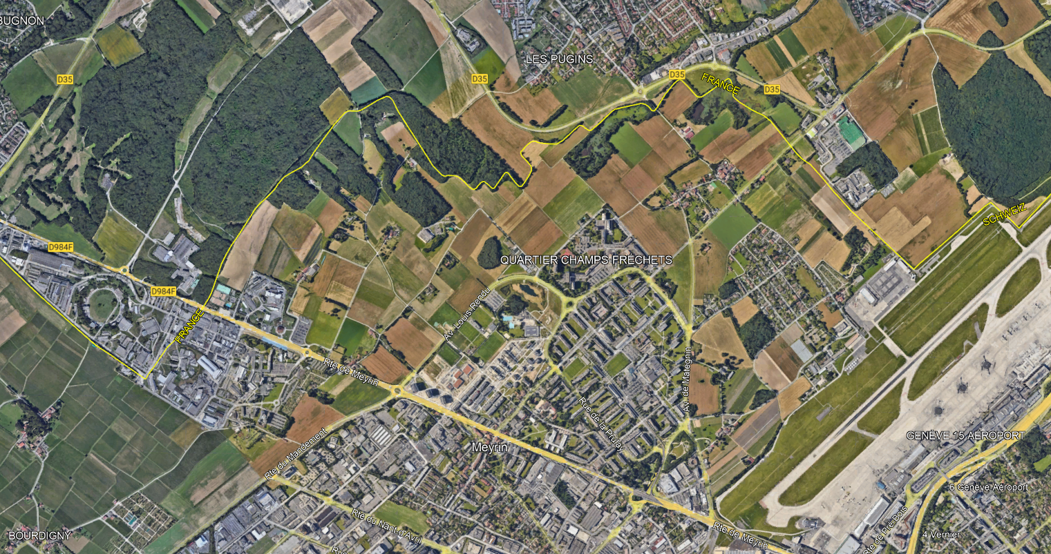
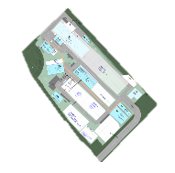

SITE PA
Existing Site: Local Area
~5.5 ha site located in France near semi-urban development
5km northeast of CERN campus
2km west of Geneva Airport
Neighbors existing LHC surface site (Point 8)
LHC P8
Geneva Airport
Localized Plan of surrounding area at Site PA.

Slide 15
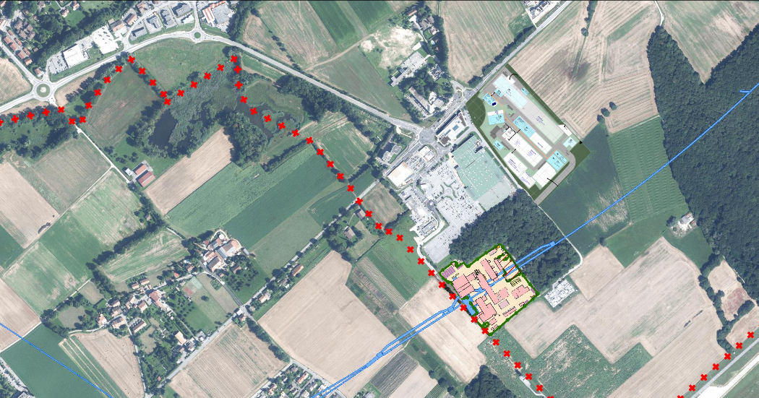
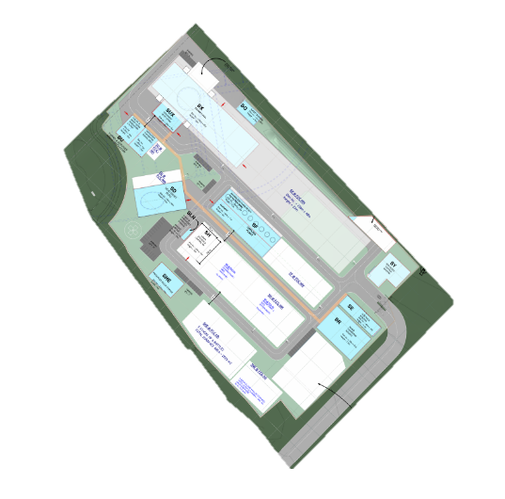
SITE PA
Existing Site: Local Area
~5.5 ha site located in France near semi-urban development
5km northeast of CERN campus
2km west of Geneva Airport
Neighbors existing LHC surface site (Point 8)
LHC Point 8
Localized Plan of surrounding area at Site PA.

Slide 16
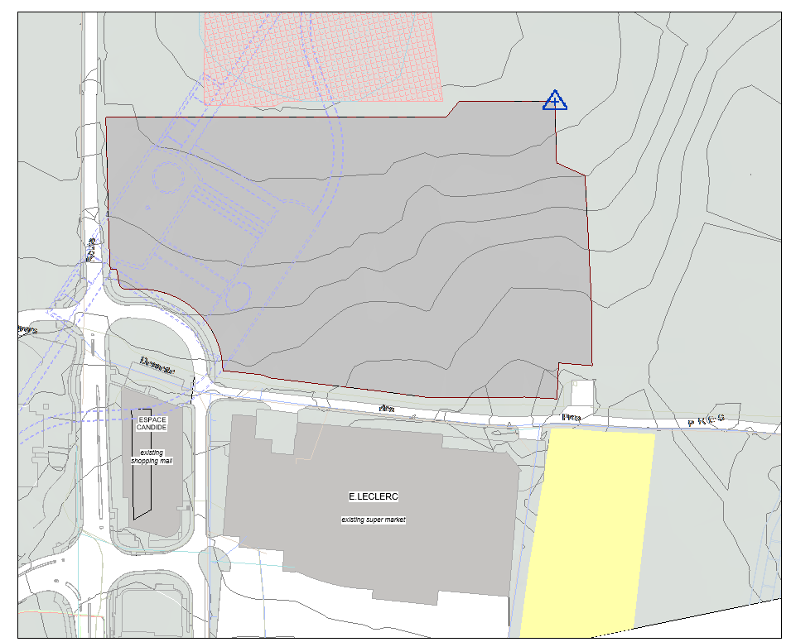


SITE PA
Protected habitat zone to the north
Existing Site: Constraints & Considerations
Zone Humide
Constraints identified by CERN SCE :
Located in semi urban area
Ongoing construction projects
Protected “Zone Humide” and compensation zone north of parcel
Gas Pipeline south of parcel
Required site access along east side of parcel
Considerations identified by CERN SCE:
Maintain visibility from the adjacent road toward the Alps.
Proposed building heights should be similar to existing structures in area
Permeable Fence at perimeter allowing animals to pass through
Preserve the existing view of Alps
(as much as possible)
“Green” parking areas (Permeable Pavers)
Main Access
Existing Commercial
Mall
Existing supermarket
Height ~10m
Le Clerc
N

Slide 17
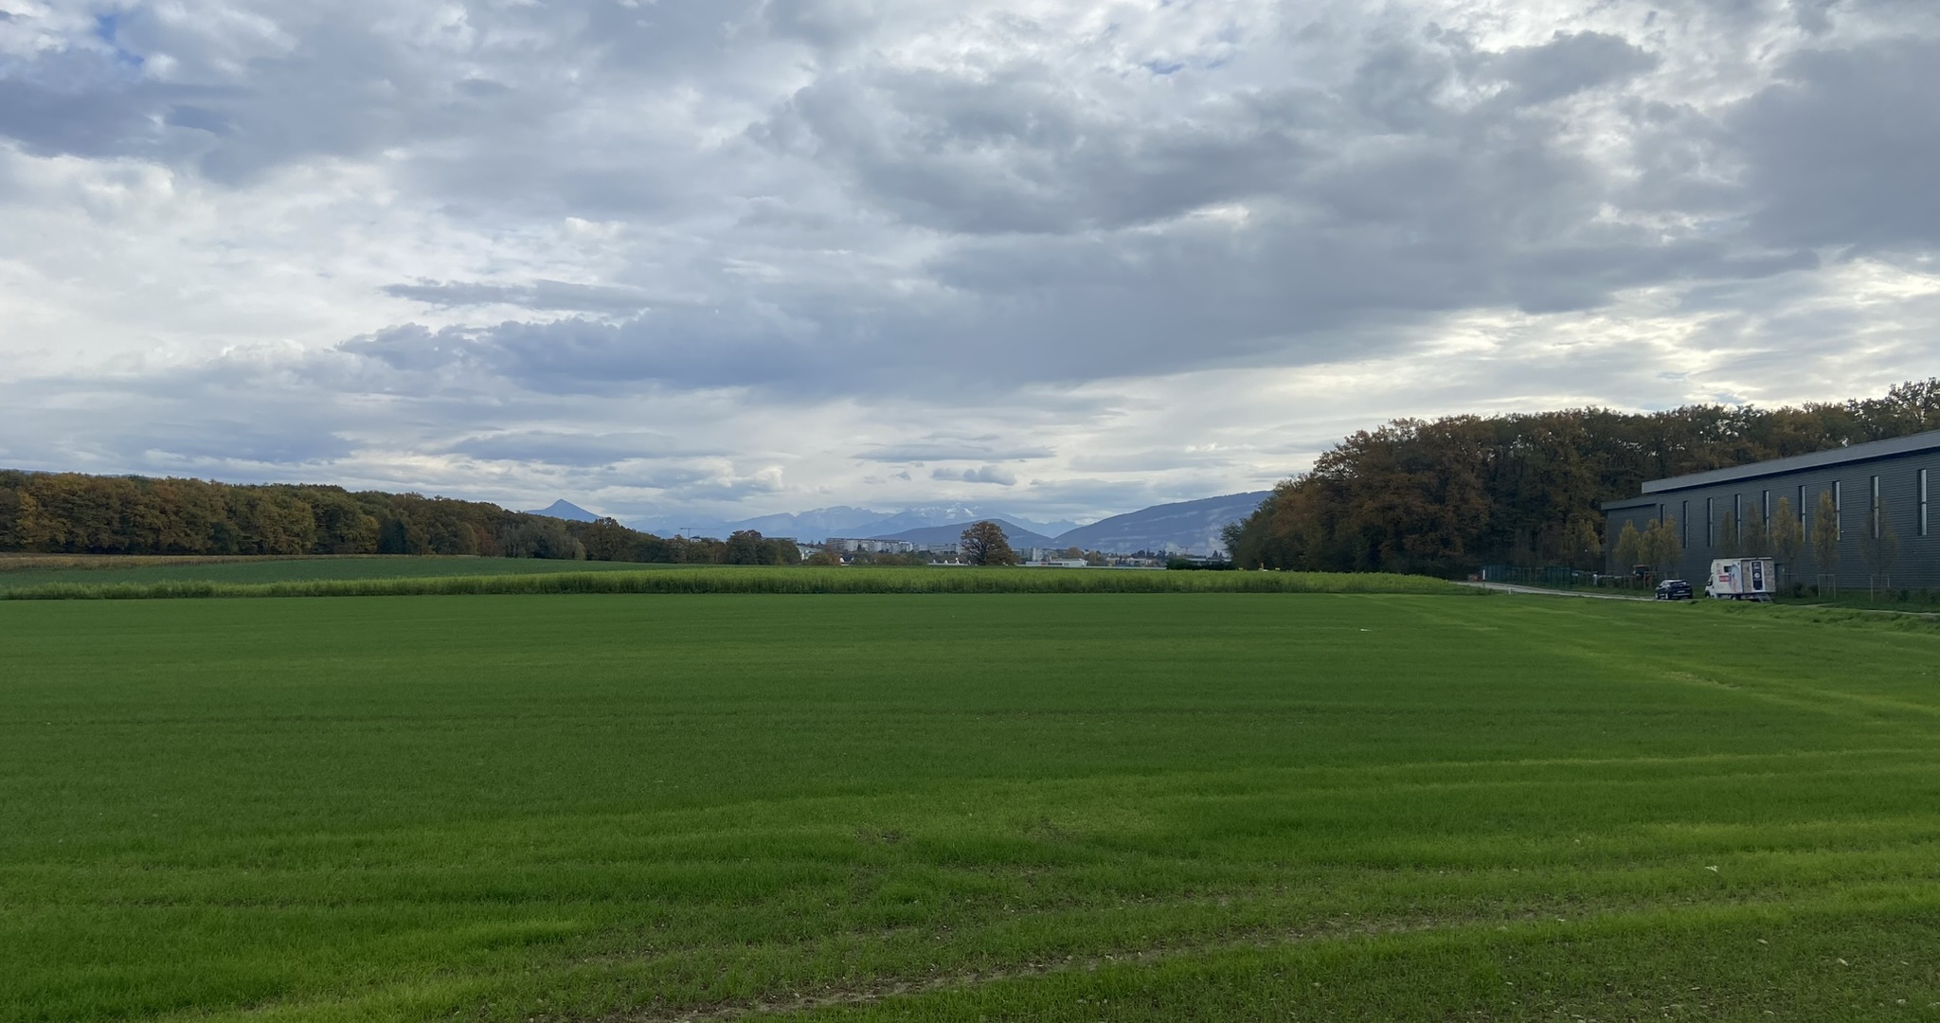
Existing viewshed of the Alps from Site PA

Slide 18
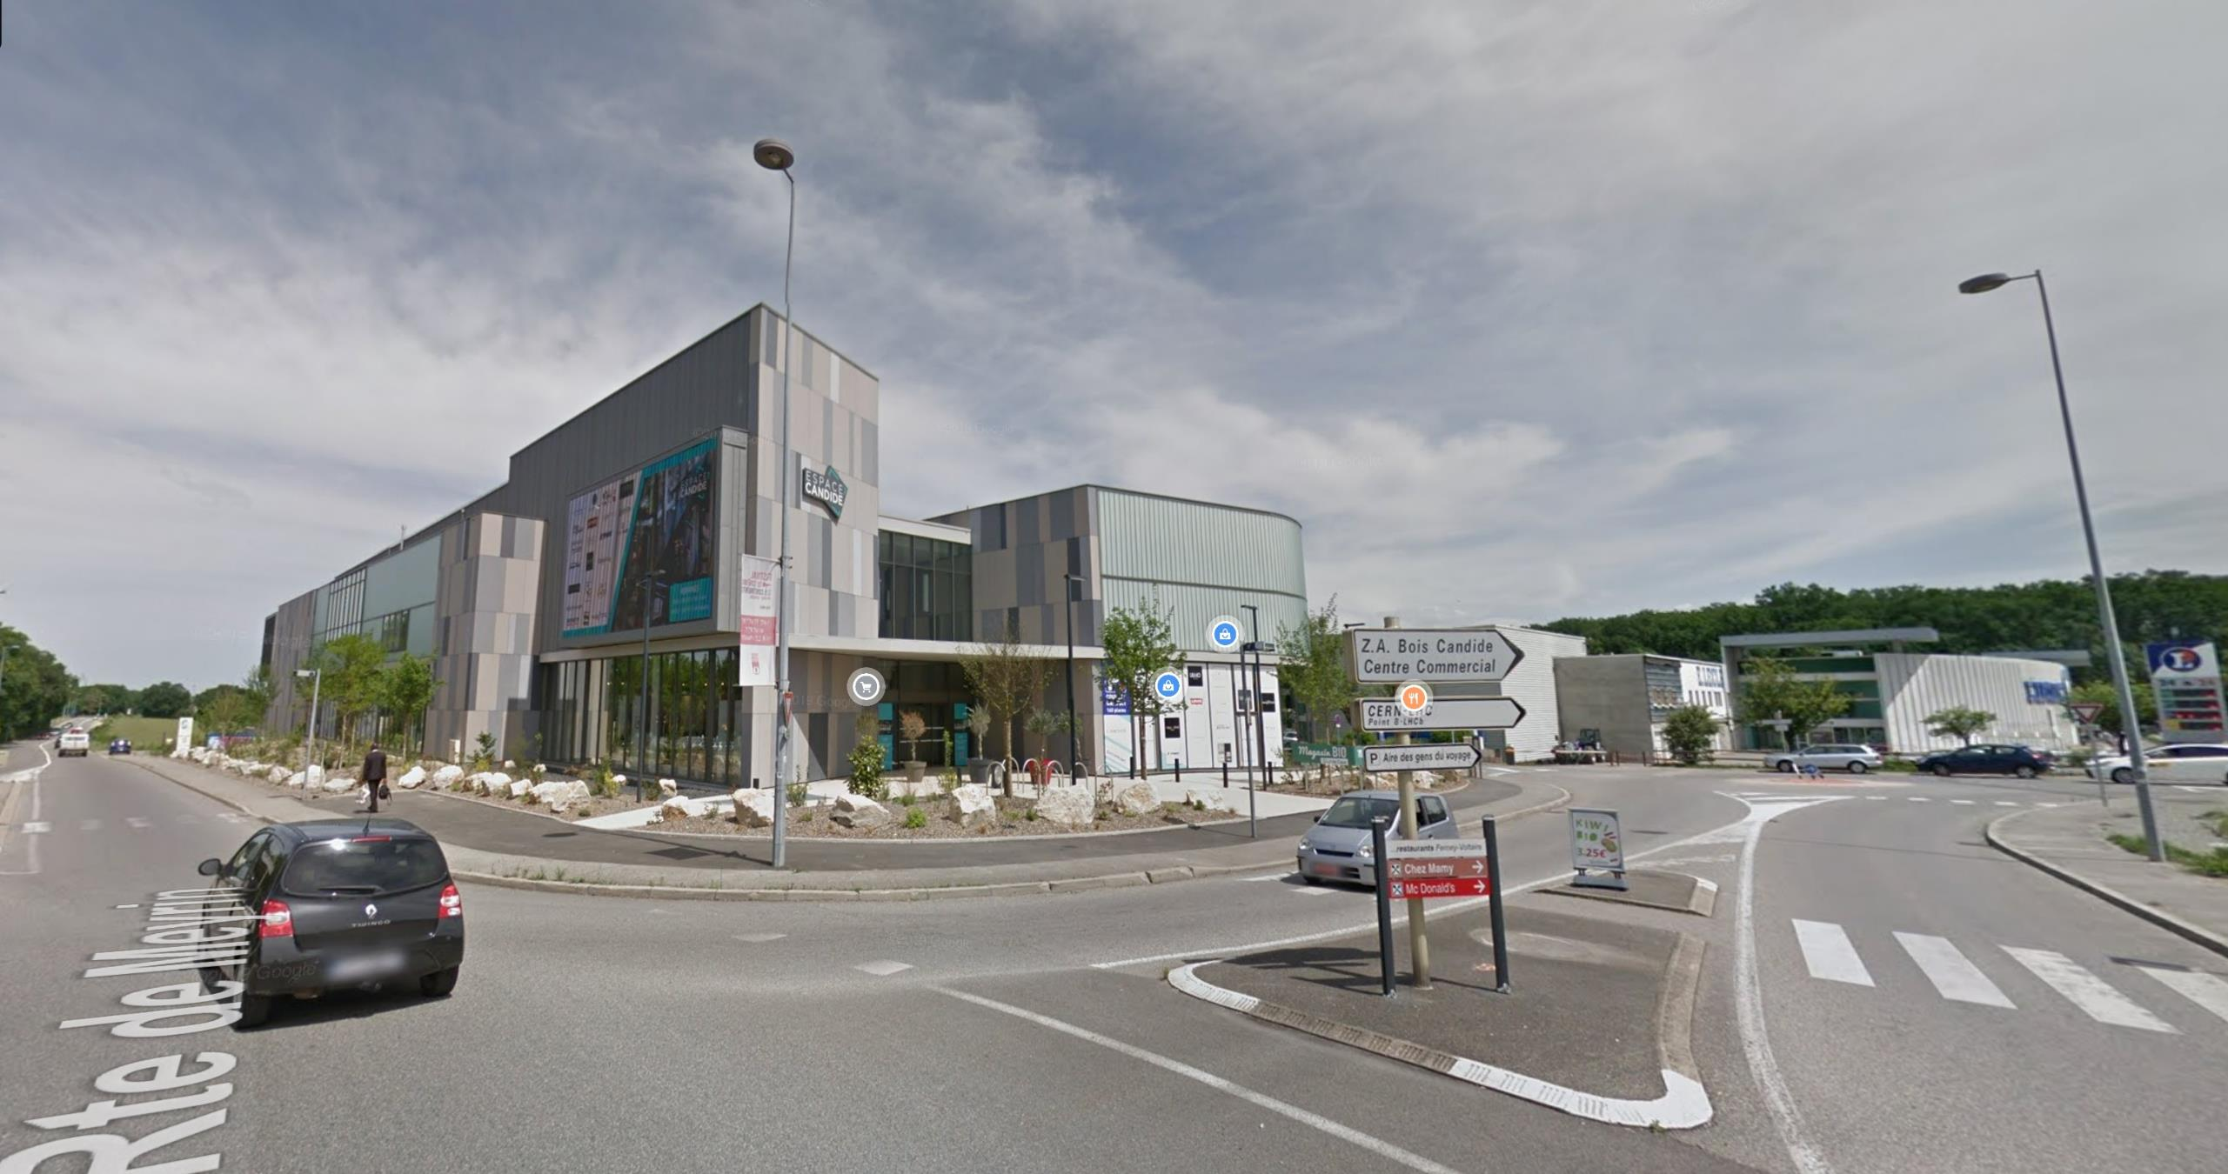
Existing semi urban development located south of proposed Site PA

Slide 19
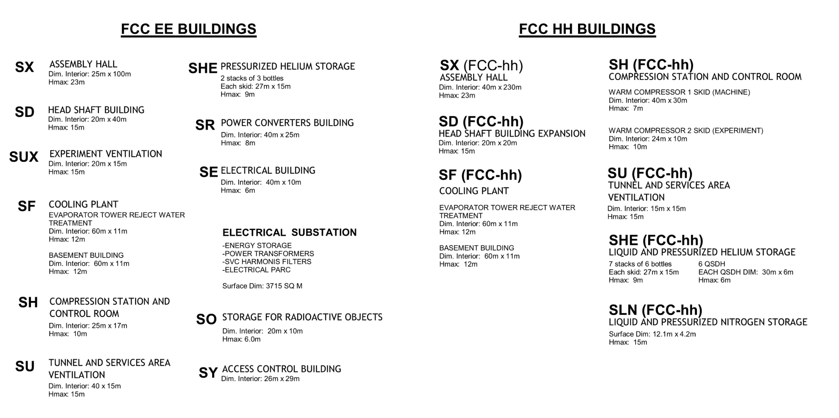
SITE PA
Proposed Site: Buildings
FCC-ee Buildings
FCC-hh Buildings

Slide 20
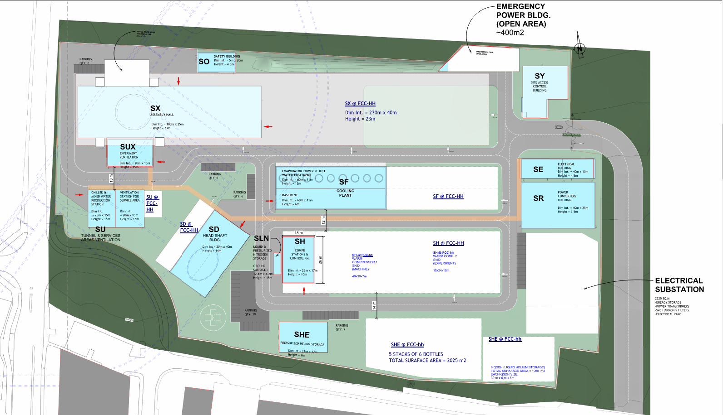
SITE PA
Proposed Site: Layout
Responding to existing constraints and general considerations
FCC-ee structures shown in blue
FCC-hh structures shown in white

Slide 21
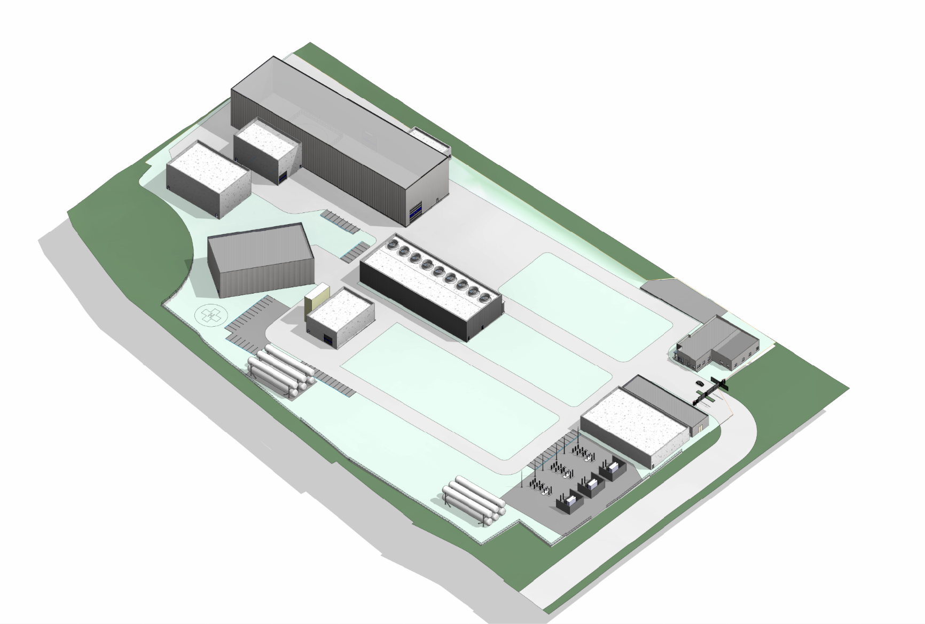
SITE PA
Proposed Site: Layout at FCC-ee

Slide 22
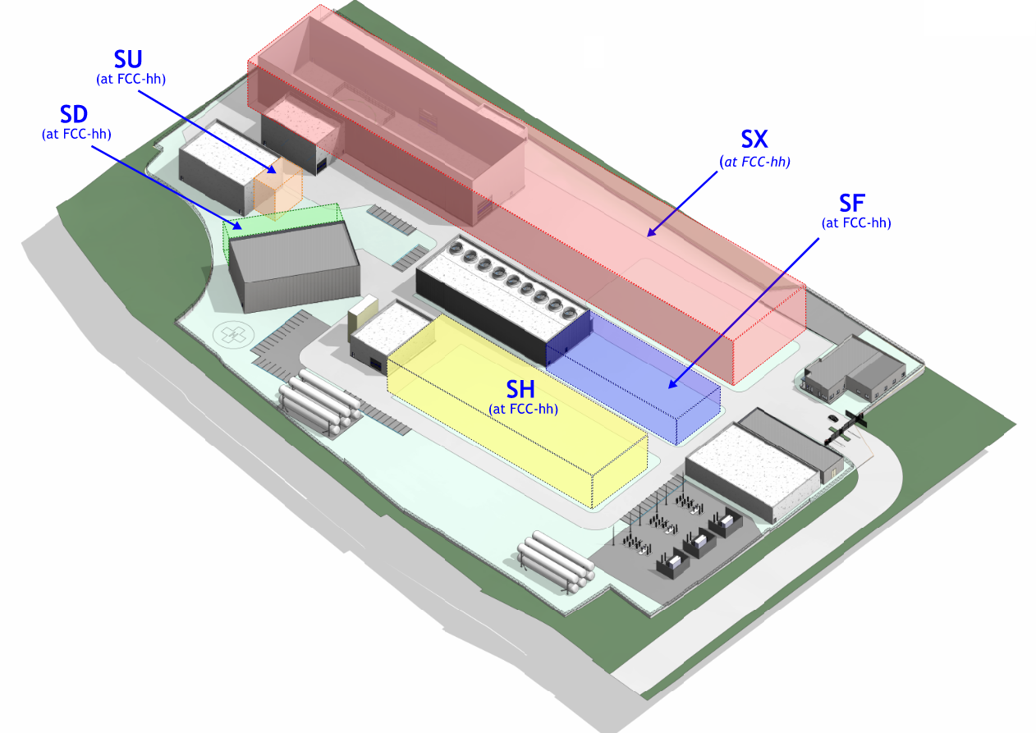
SITE PA
Proposed Site: Layout at FCC-hh

Slide 23
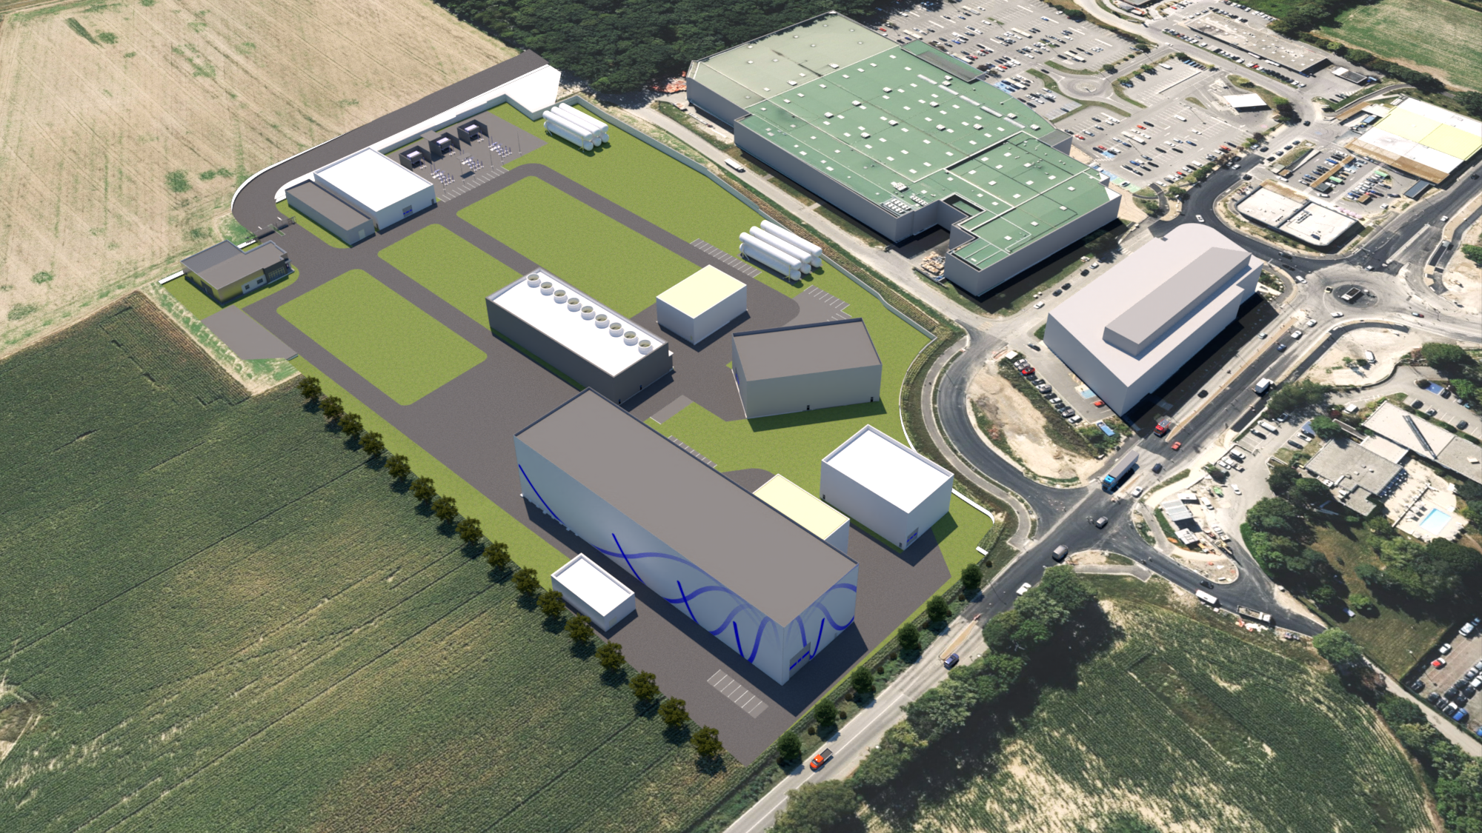
Aerial view of proposed Site PA

Slide 24
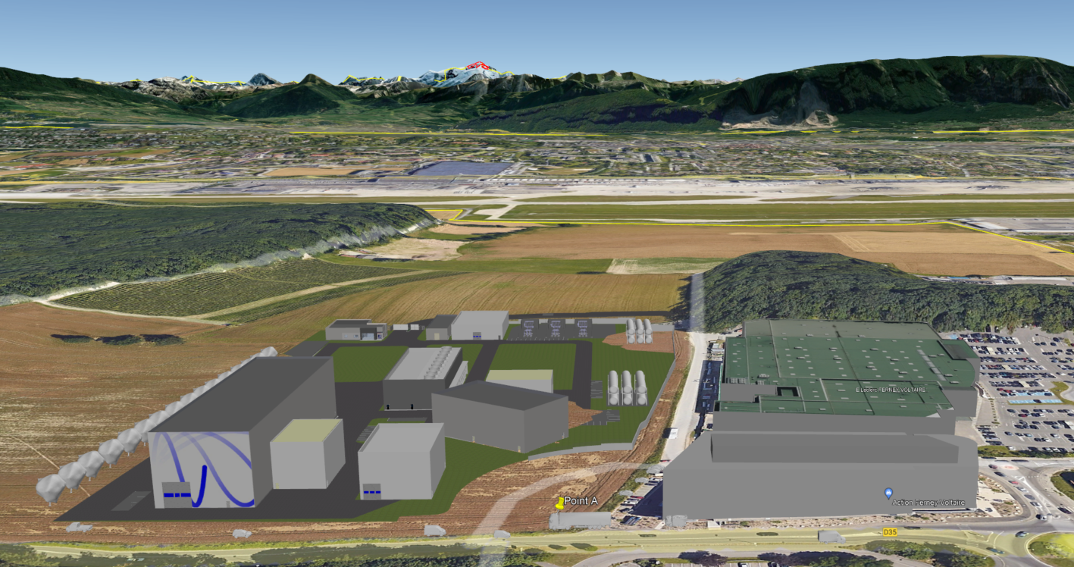
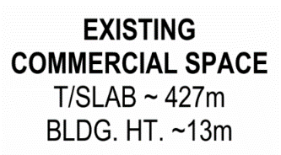

Existing heights of surrounding buildings

Slide 25
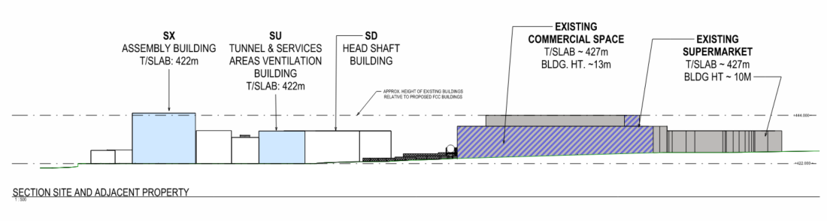
SITE PA
Proposed Site: Building Heights
SX
Assembly Building
T/SLAB: 422m
BLDG. HT 23m
BLDG HT~13m
BLDG HT~10m
+444m
23m
+422m

Slide 26
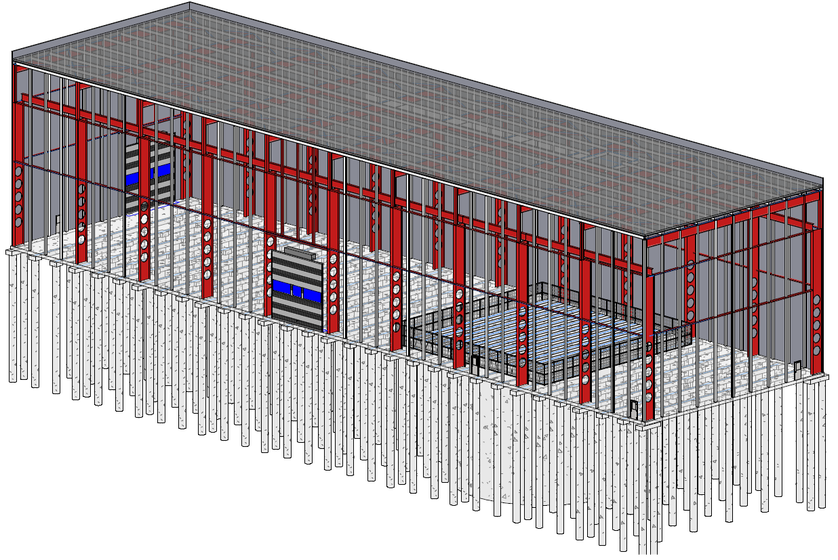
SITE PA
SX Assembly Building: Structural System
Reinforced concrete foundation: piles, grade beams, slab
Steel superstructure and roof decking
Perforated steel columns to allow for mechanical / electrical services to pass through
Steel panel cladding with insulation
Precast concrete shielding blocks over shaft opening
Steel columns support a 120 tonne overhead crane

Slide 27
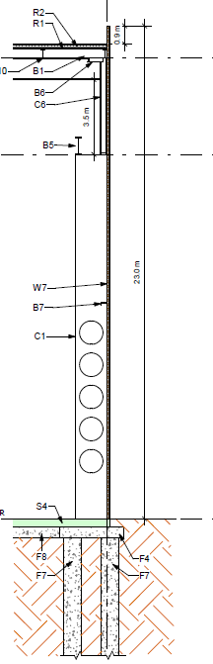
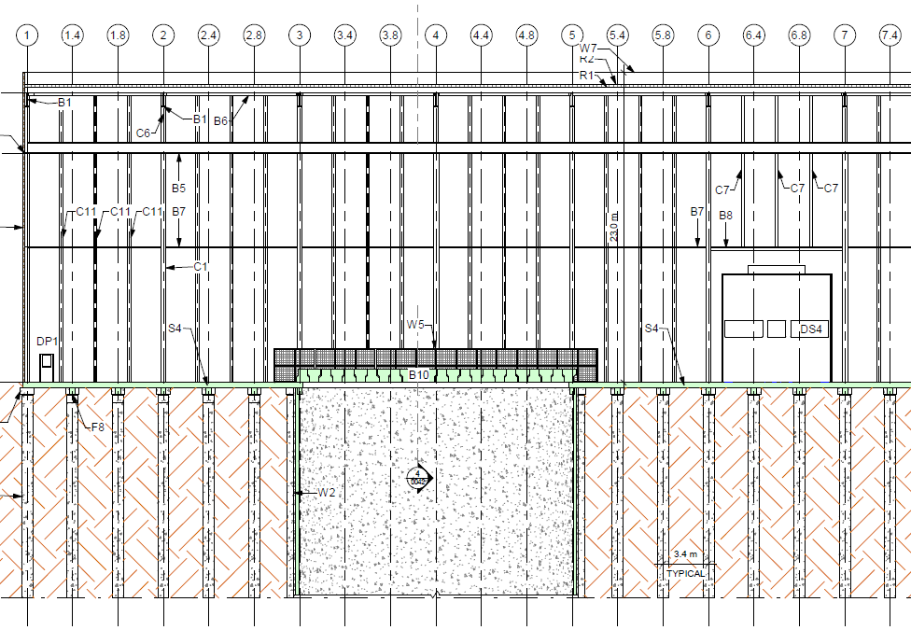
SITE PA
SX Assembly Building: Structural System
Crane support beam
Perforated column
Concrete pile foundation

Slide 28
SITE PA
North limitations: Protected habitat area
West limitations: Roadway
Thoughts/Considerations/Recommendations
Challenges:
FCC-hh footprint expansion
  Further study needed on site layout to verify ee and hh layouts will fit on parcel.
  Need to further study synergies with LHC Point 8
  Limited opportunity to increase building heights. Stacking building programs on multiple levels below grade could be an option.
East:
Open land
South limitations: shopping center
LHC Point 8
Expansion options surrounding Site PA.

Slide 29
Site PB
Technical Site (Switzerland )

Slide 30
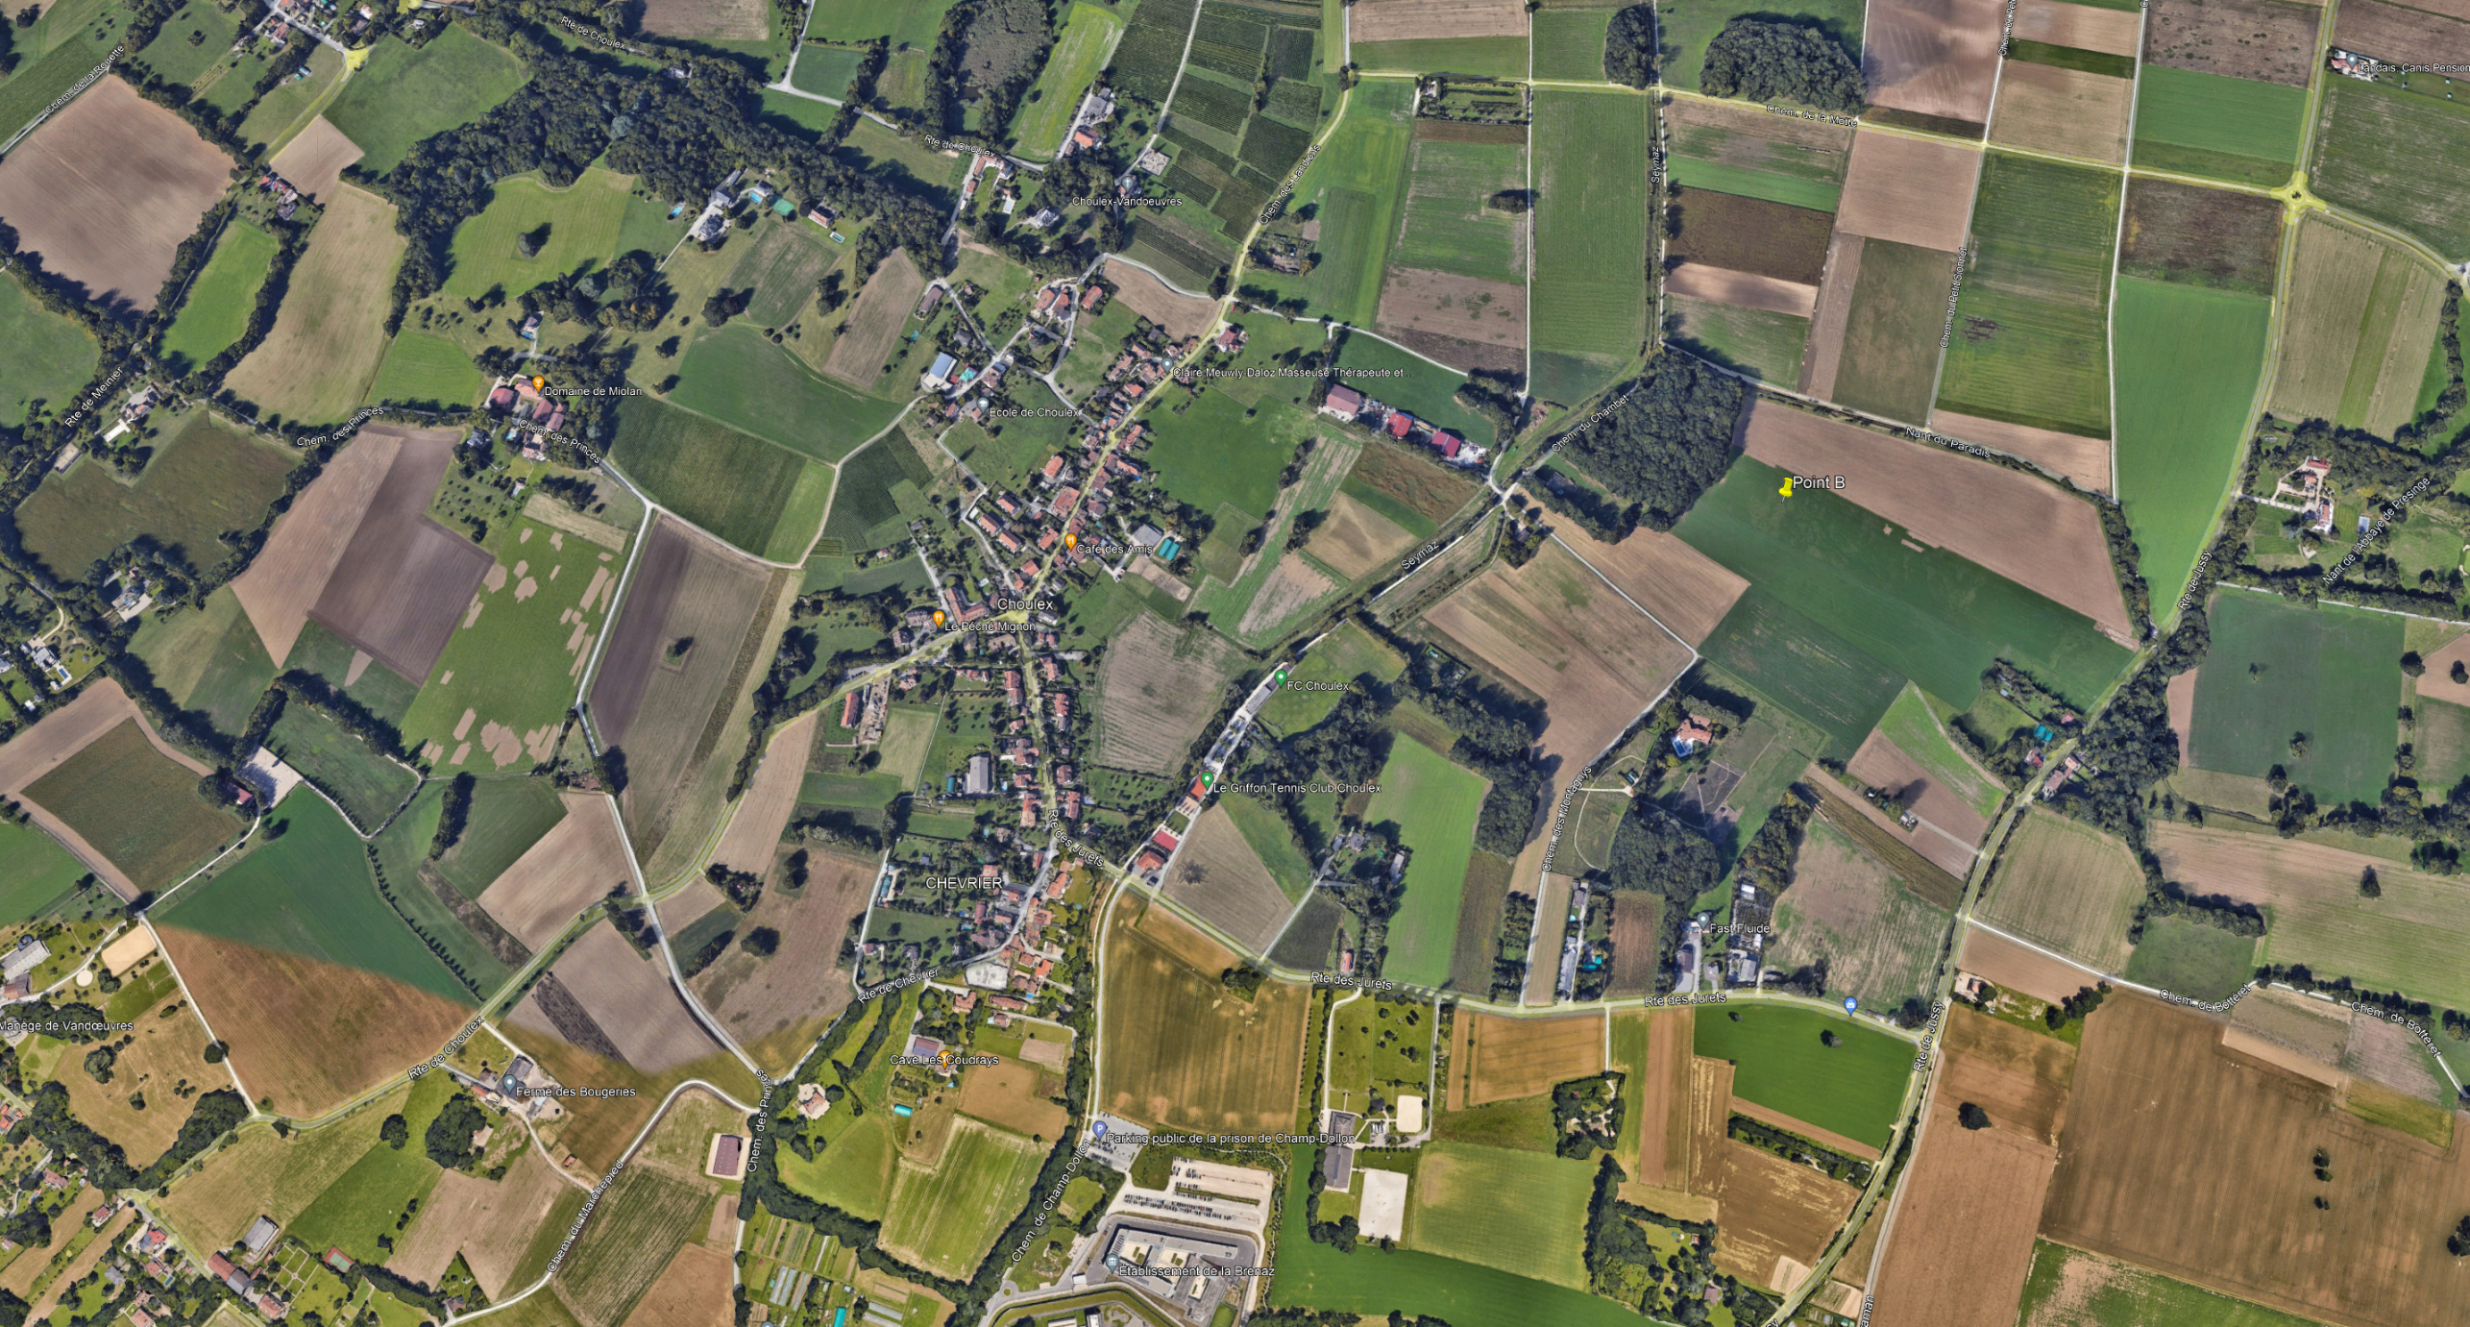
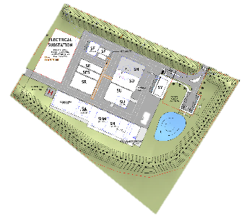
SITE PB
Existing Site: Overview
~4ha site located on Swiss rural land approximately 15km east of the CERN campus
Local opposition to new industrial buildings by is anticipated.
Choulex

Slide 31
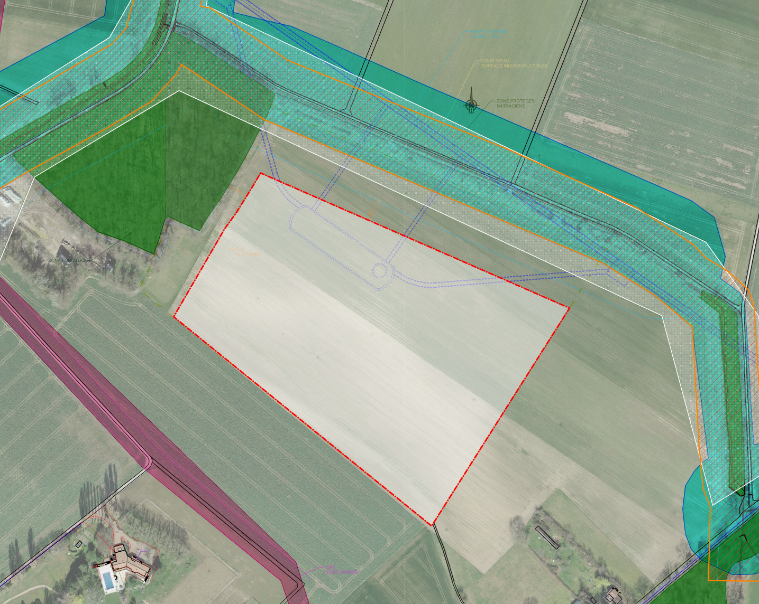


SITE PB
Watercourse
Watercourse (Non-buildable)
Existing Site: Overview
Protected Amphibian Zone
Constraints identified by CERN SCE :
Located on Swiss rural land with expensive properties in surrounding area opposed new “industrial buildings”
Protected forest (west), Protected stream (north), Buried gas pipeline (south)
Considerations identified by CERN SCE:
Entrance to site located on the NW side of site. Road external to site will follow path of existing track.
Forest
Site PB
Gas Utility

Slide 32
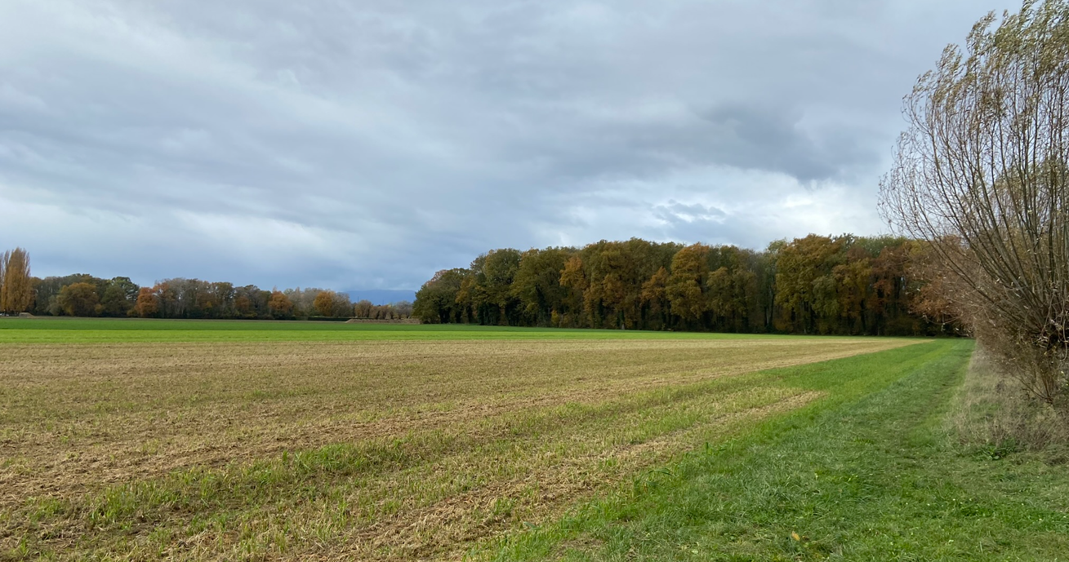
Existing view at Site PB

Slide 33
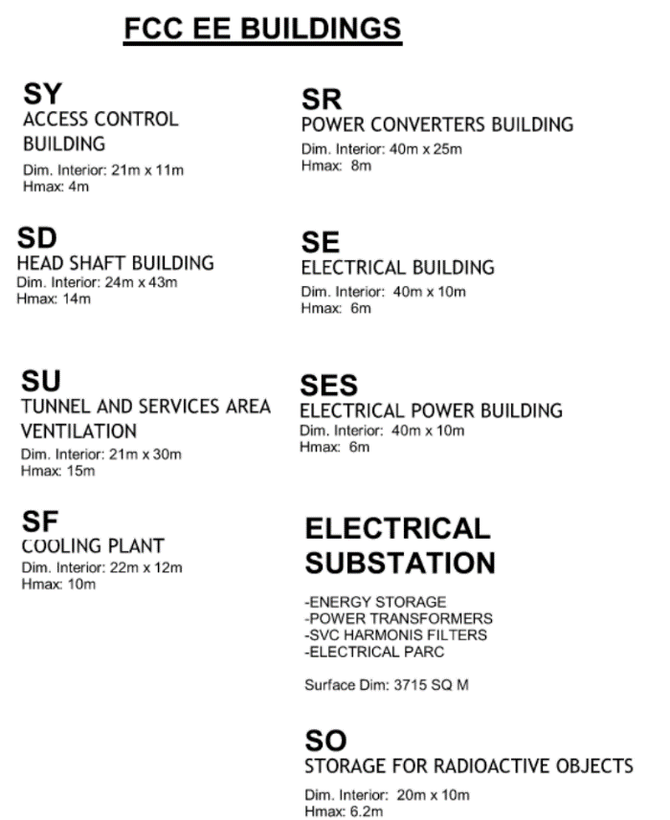
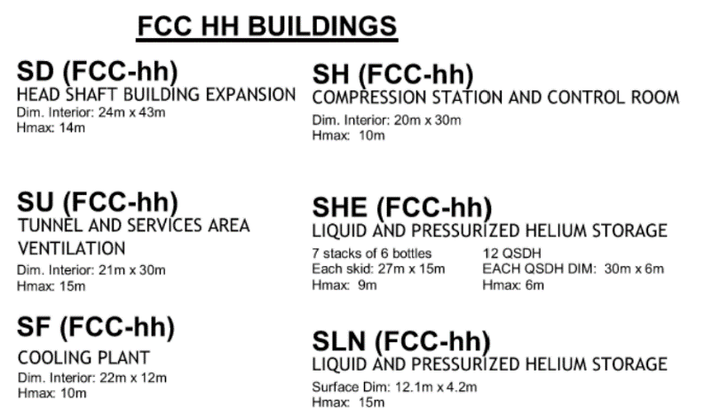
SITE PB
Proposed Site: Buildings
FCC-ee Buildings
FCC-hh Buildings

Slide 34
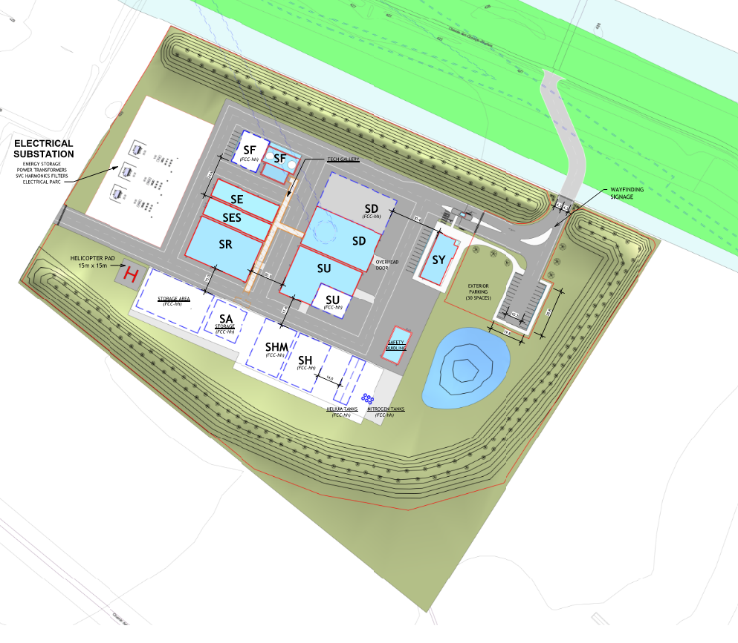
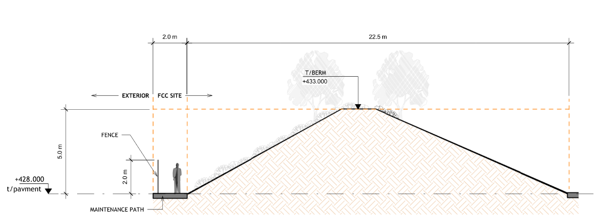
SITE PB
Proposed Site: Layout
Responding to existing constraints and general considerations

Slide 35
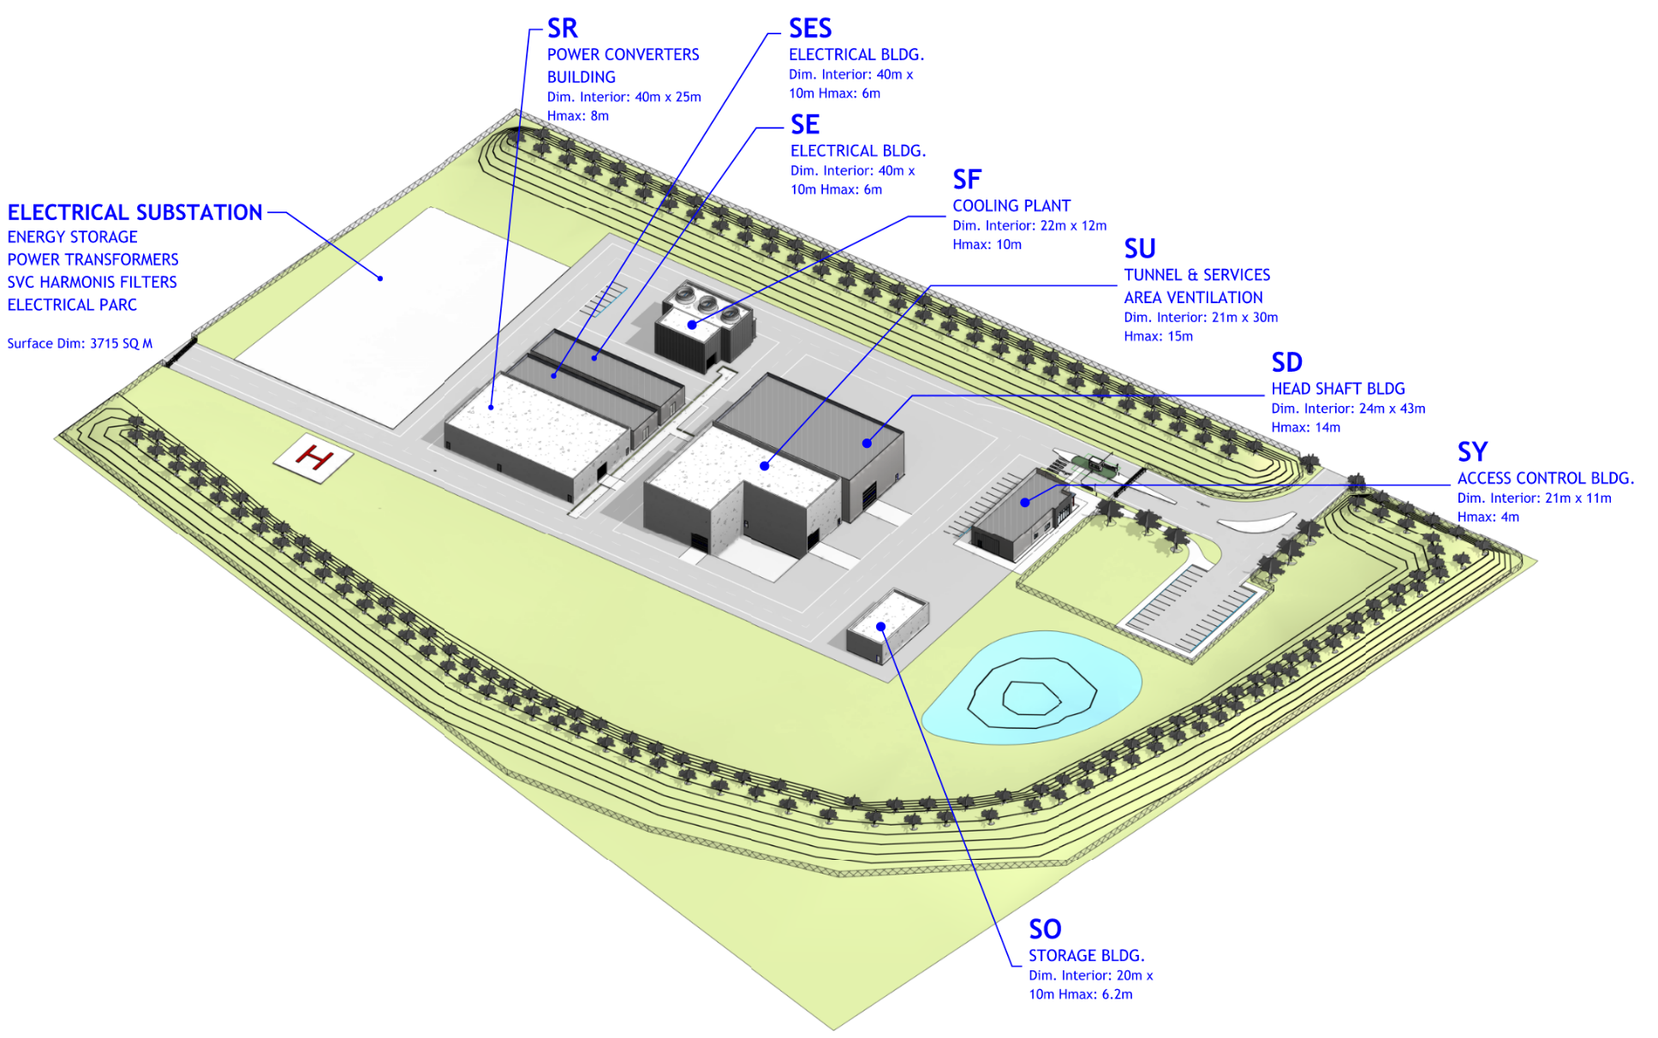
SITE PB
Proposed Site: Buildings at FCC-ee

Slide 36
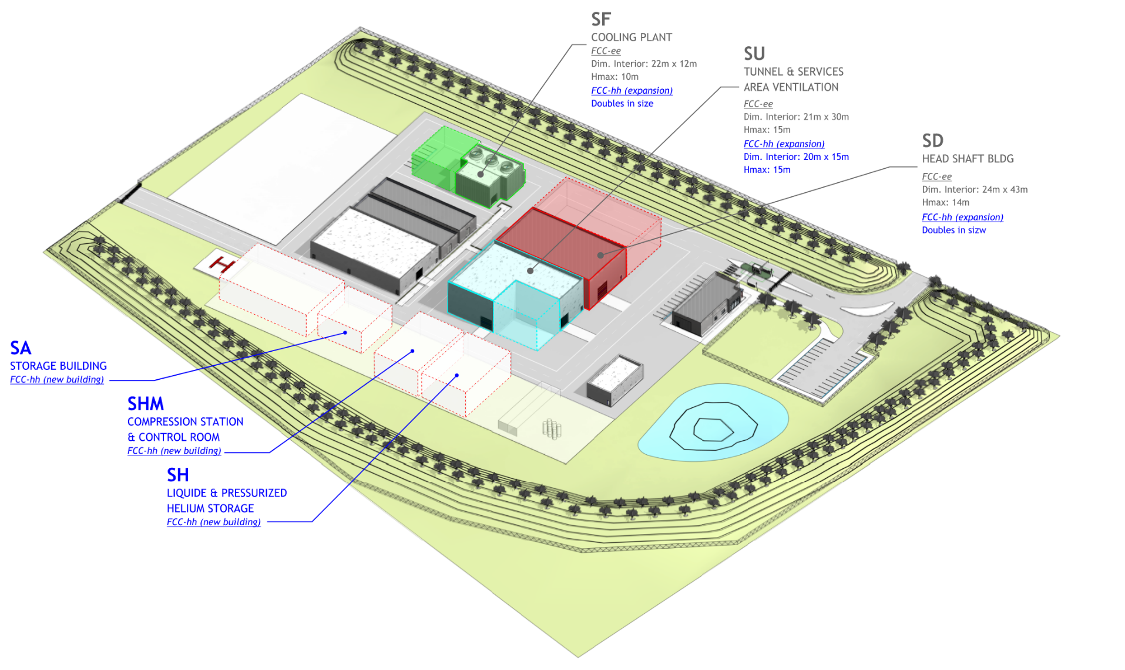
SITE PB
Proposed Site: Buildings at FCC-hh

Slide 37
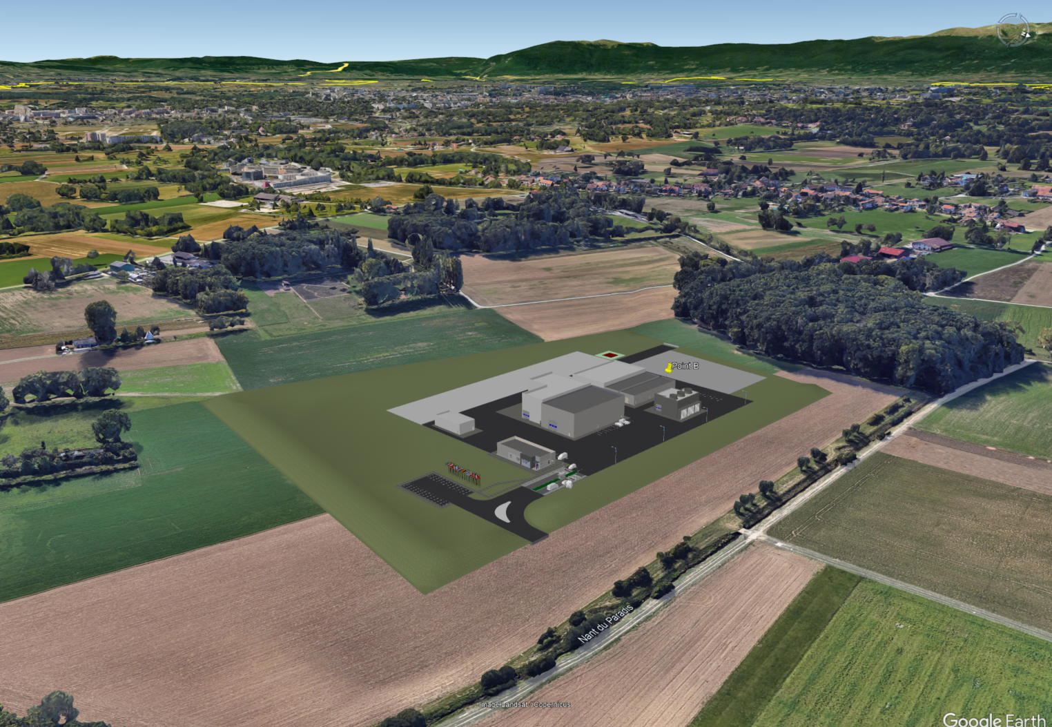
Aerial View of Proposed Site PB

Slide 38
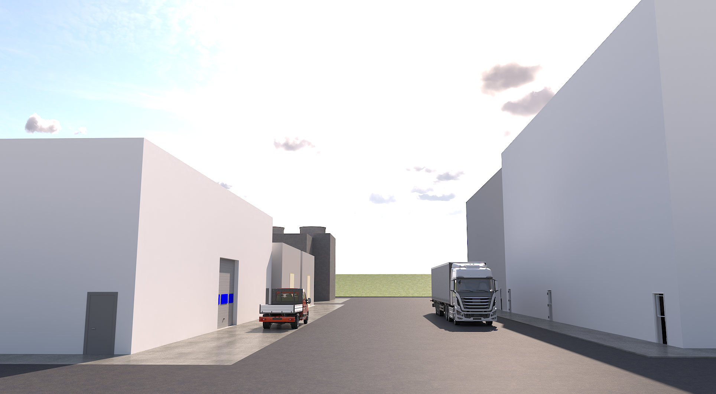

Slide 39
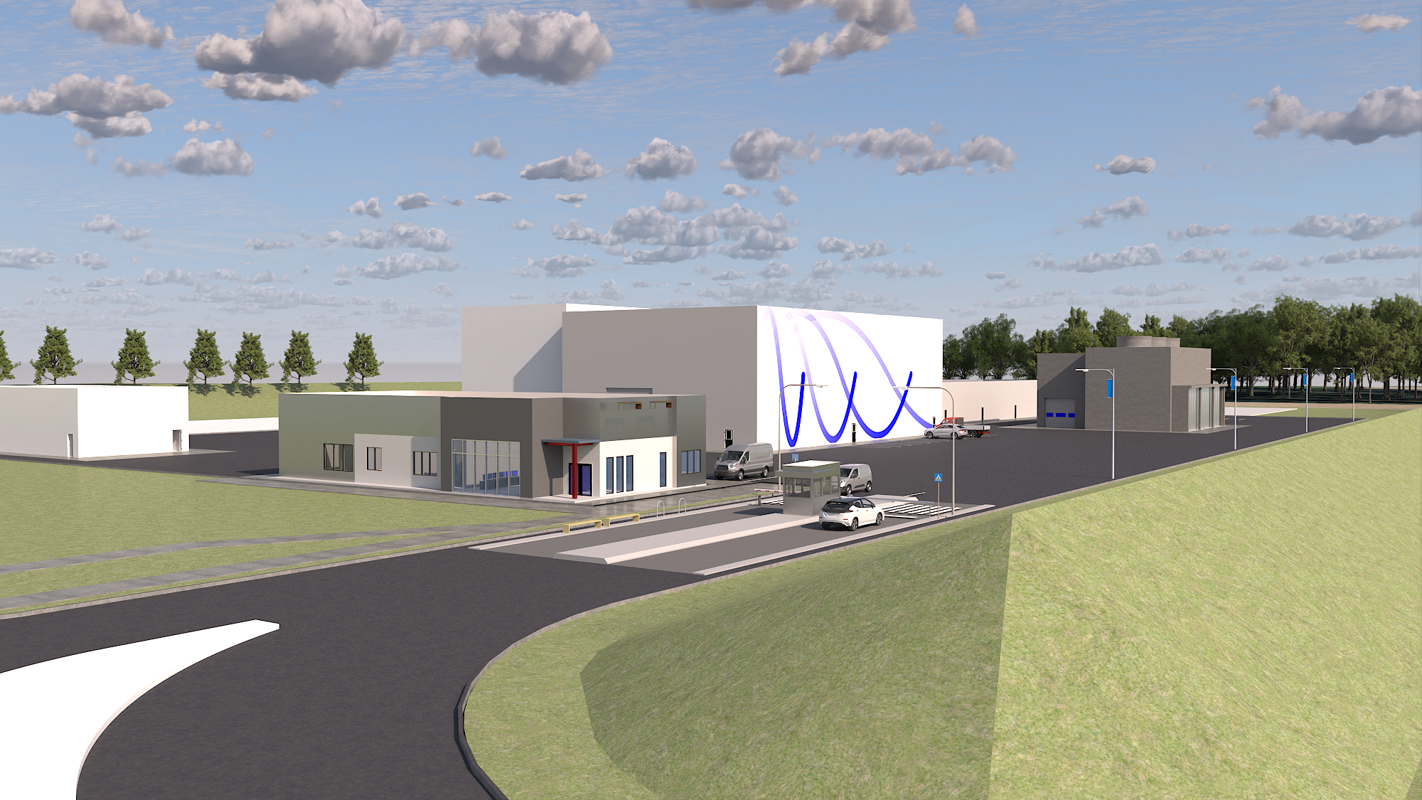
View from main gate of proposed Site PB
View overlooking Site PB entrance

Slide 40
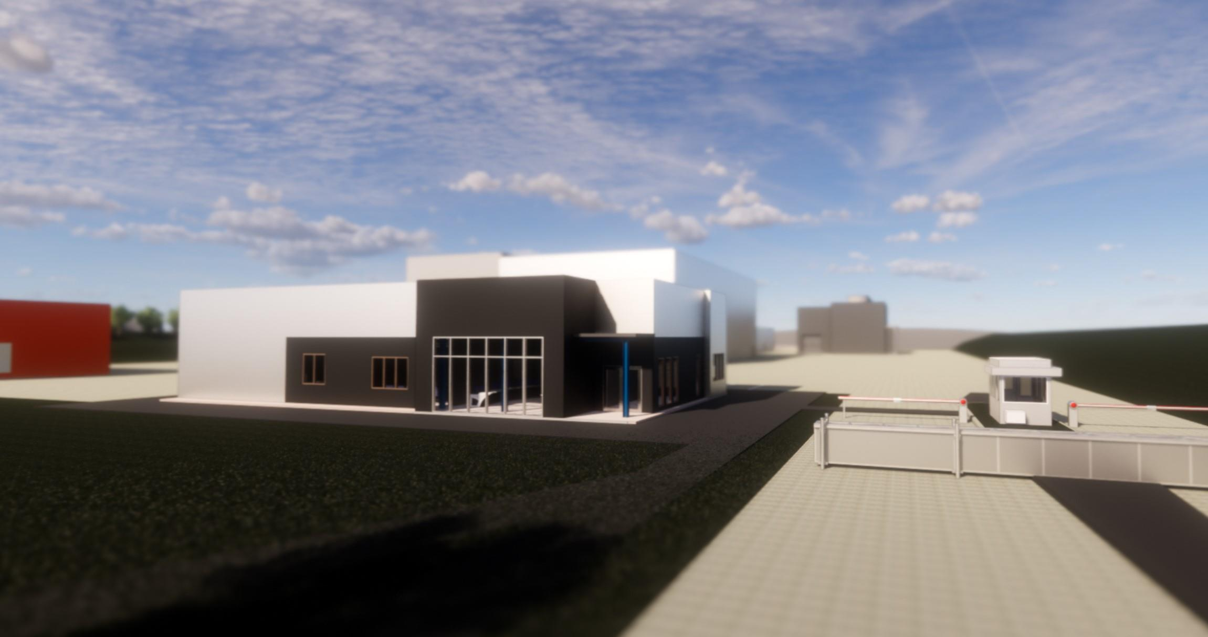
SY Access Building
SY Access Control Building shown adjacent to the main site entrance

Slide 41
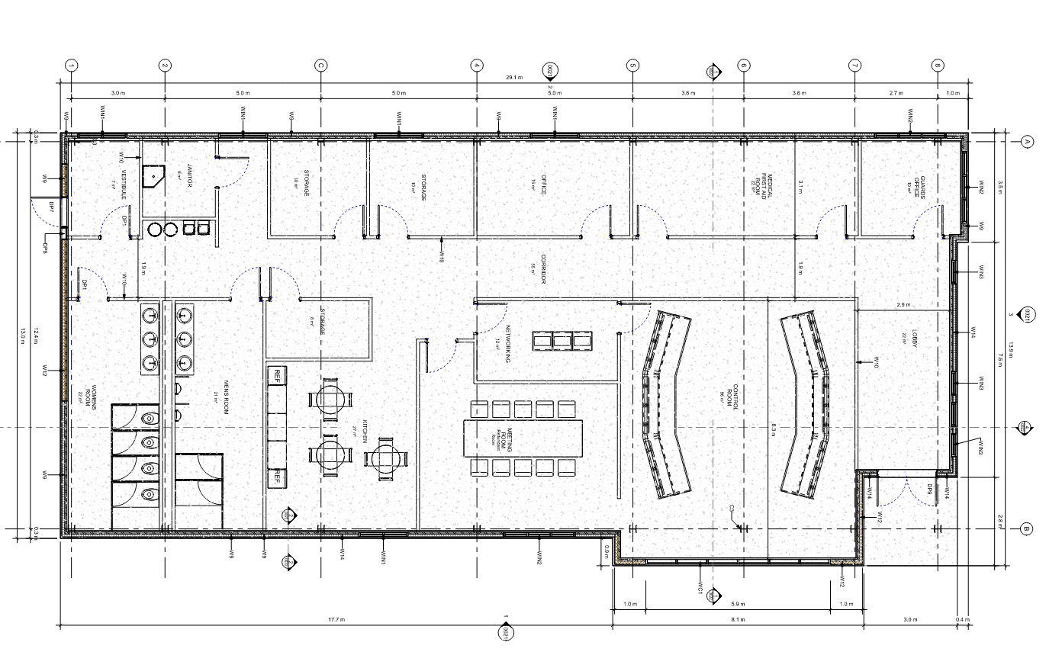
SY Access Building
Building Program
2
12
8
6
9
Main Entrance
Secondary Entrance
Lobby/Display Area
Control Room
Networking/Data Room
Medical First-aid Room
Conference Room (10 People)
Private Offices
Security Guard Office
Kitchenette/Break Room
Restrooms
Storage
1
2
3
4
12
5
5
6
10
4
3
7
11
7
8
9
10
1
11
12
SY Access Control Building Plan

Slide 42
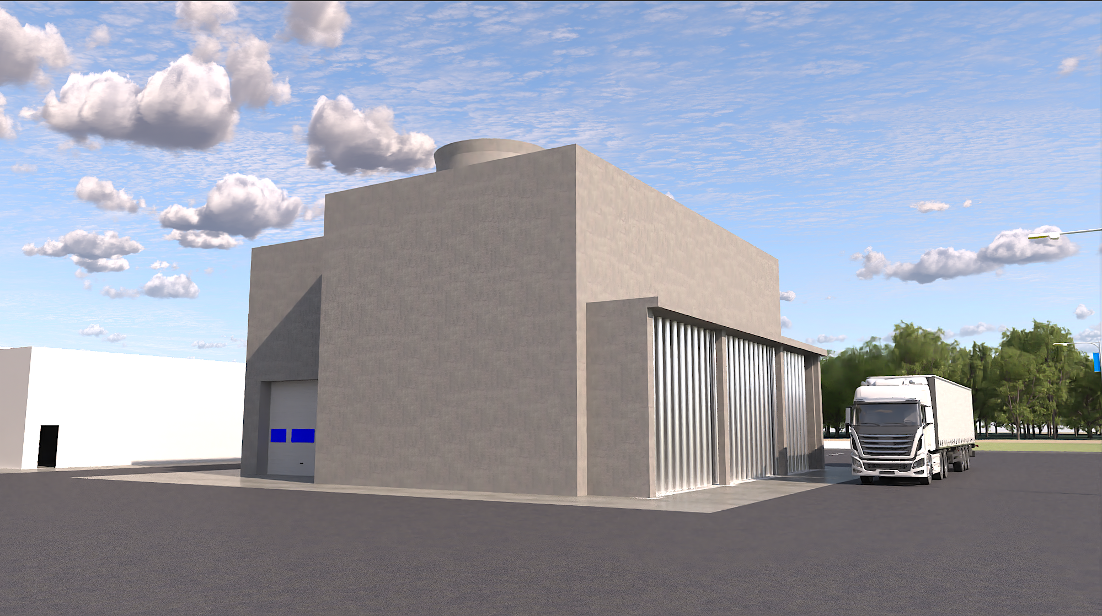
Site PB / SF Cooling Plant
The SF building host the cooling tower structures that are required to extract the heat loads from the machines for the underground.

Slide 43
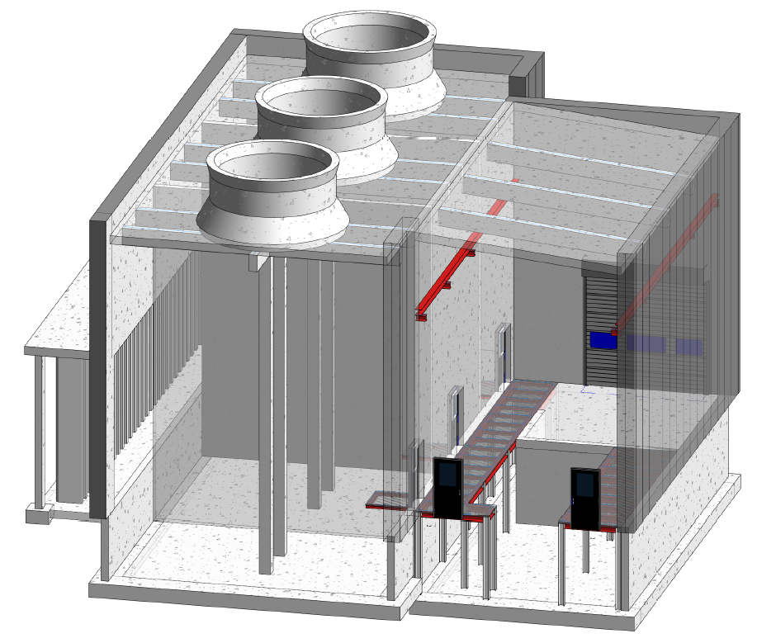
Site PB / SF Cooling Plant
Proposed Structural System
Reinforced concrete foundation: spread footings, slab on ground
Reinforced concrete superstructure to help with sound attenuation
Acoustic insulation panels on the interior walls to further reduce noise transmission to exterior
Prefabricated concrete exterior wall panels with insulation
Crane support beams for 3.5 tonne overhead crane
Steel grating “false floor” to allow easy access to basement equipment level

Slide 44
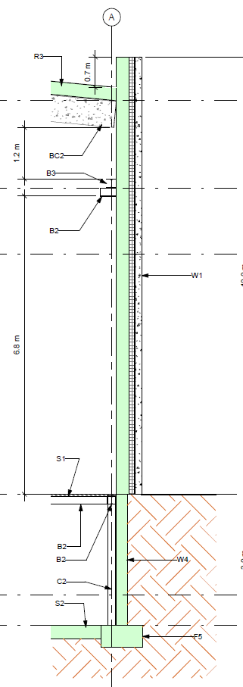
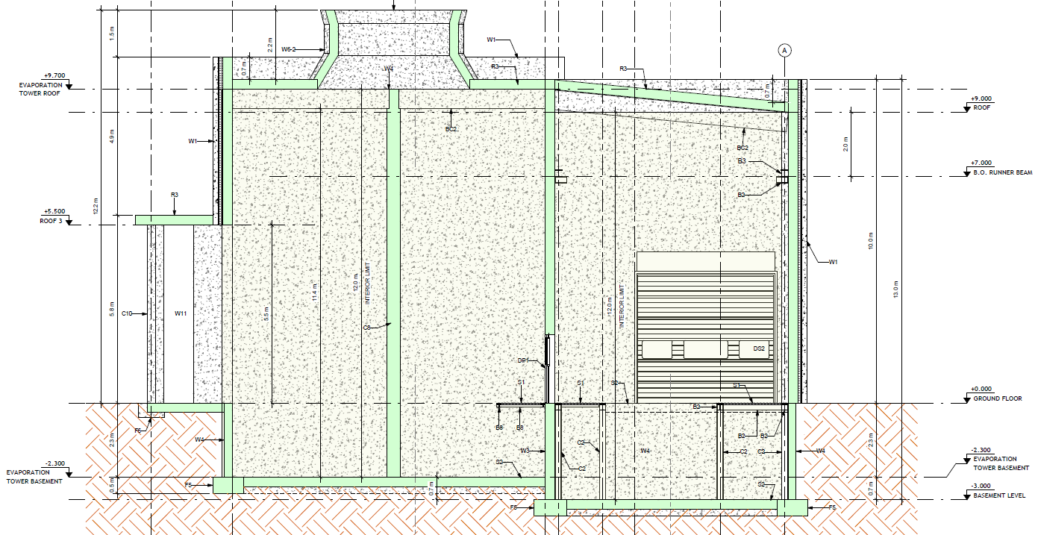
Site PB / SF Cooling Plant
Proposed Structural System
Crane support beam
Steel grating “false floor” with basement below

Slide 45

Conclusion
All deliverables (Revit models, preliminary drawings, bill of quantities, technical report) have been transferred to CERN
CERN has contracted a cost estimating firm to take this information and generate cost and schedule estimates that will be incorporated into the overall FCC feasibility study
We’ve thoroughly enjoyed this opportunity for continued collaboration with our CERN colleagues and hope to remain a part of this effort in the future
Special thanks to our CERN colleagues: Tim Watson, Antoine Mayoux, Ludovic Barthelemy, Angel Navascues Cornago.
    ISD Infrastructure Services Division

