Slide 1
Mechanical model of the MDI

Slide 2
Table of content
Introduction | 3 | Double bellows | 12
MDI Mechanical Model | 4 | Crotch chamber | 14
Central Chamber | 5 | Support tube | 16
Trapezoidal chamber | 6 | Structural optimization of Support Tube flanges | 21
Thickness of the chamber | 7 | Conclusion | 23
Structural analysis – chamber | 8
Bellows constraint configuration | 10
Single bellows | 11

Slide 3
Introduction
Since the FCC week 2022 some steps have been taken; some discussions were held during the MDI session.
The main themes are related with:
The modification of the central chamber design according to the Inner Vertex design.
The design of the trapezoidal chamber and its cooling according to the LumiCal requirements.
The IR bellows configuration.
The crotch chamber.
The concept of Support Tube and the integration with Inner, Middle, Outer Vertex and Vertex Disks.
The proposal of an assembly strategy.
The structural optimization of IR support structure.

Slide 4
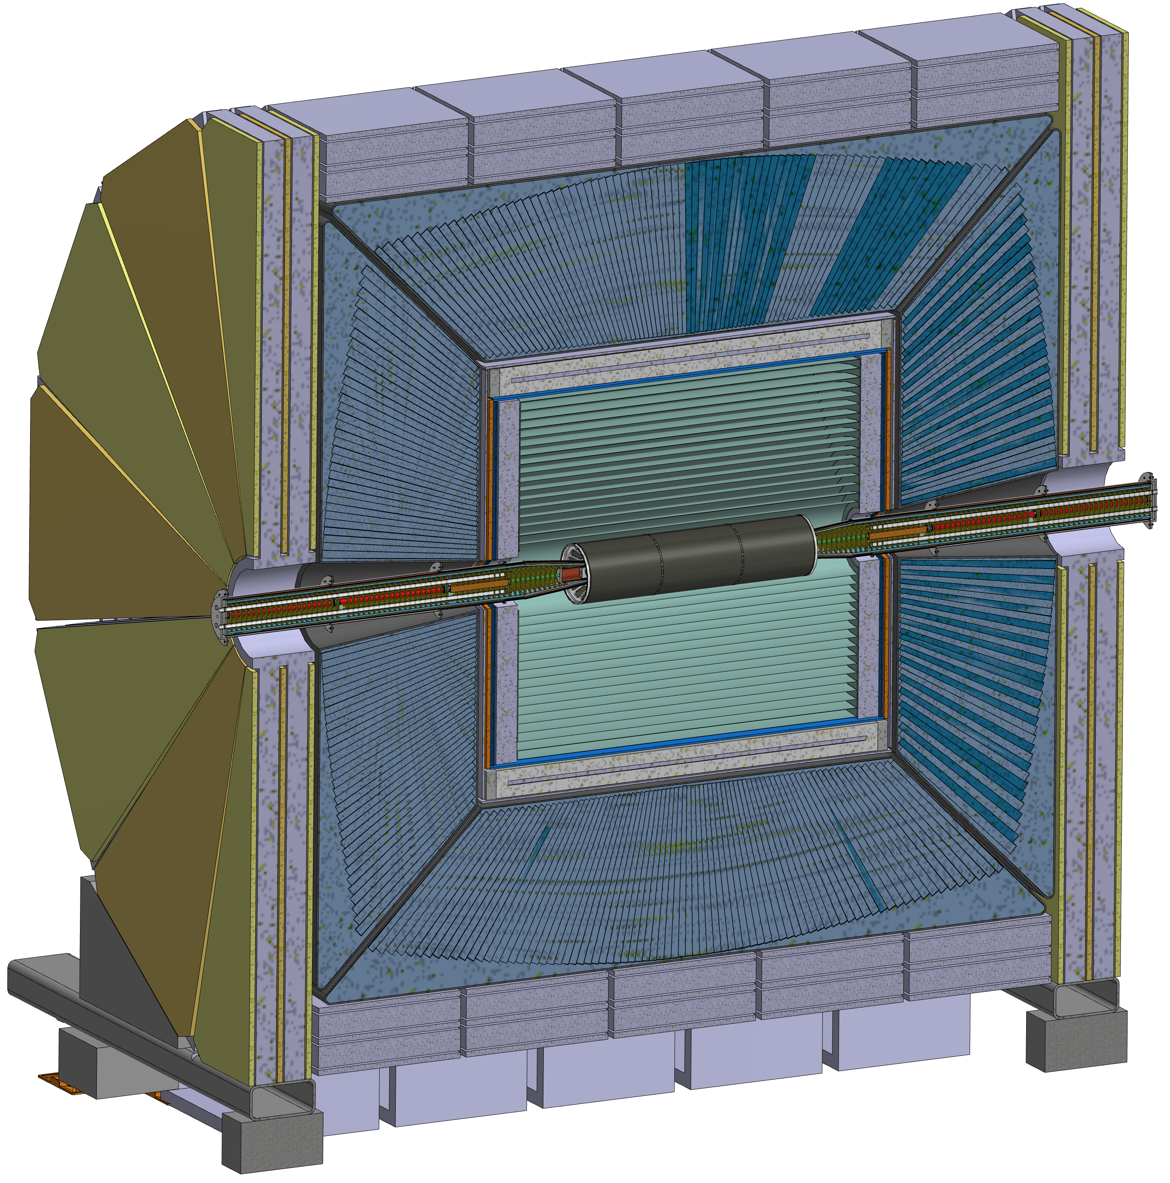
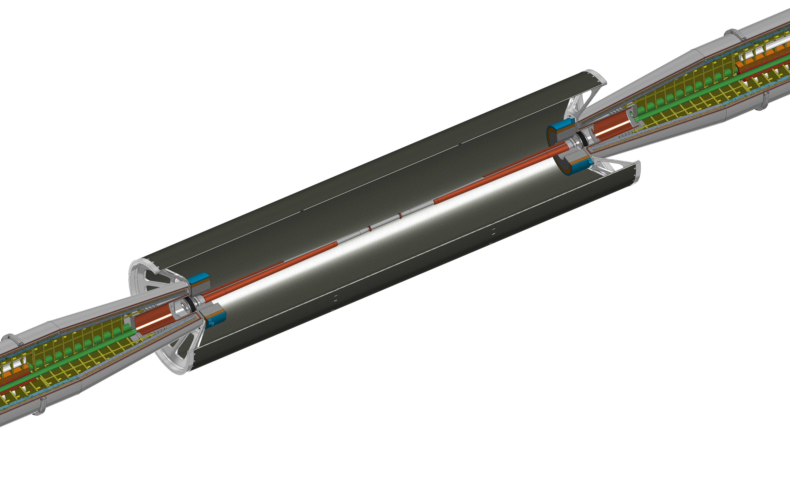
MDI mechanical model
This design is based on the IDEA detector concept, in fact we are working in close contact with INFN-Pisa integrating their Inner, Medium, Outer Vertex and Vertex Disks.
Support tube
Cryomagnet
Bellows
Cooling
Central chamber
Trapezoidal chamber
LumiCal
IDEA detector

Slide 5
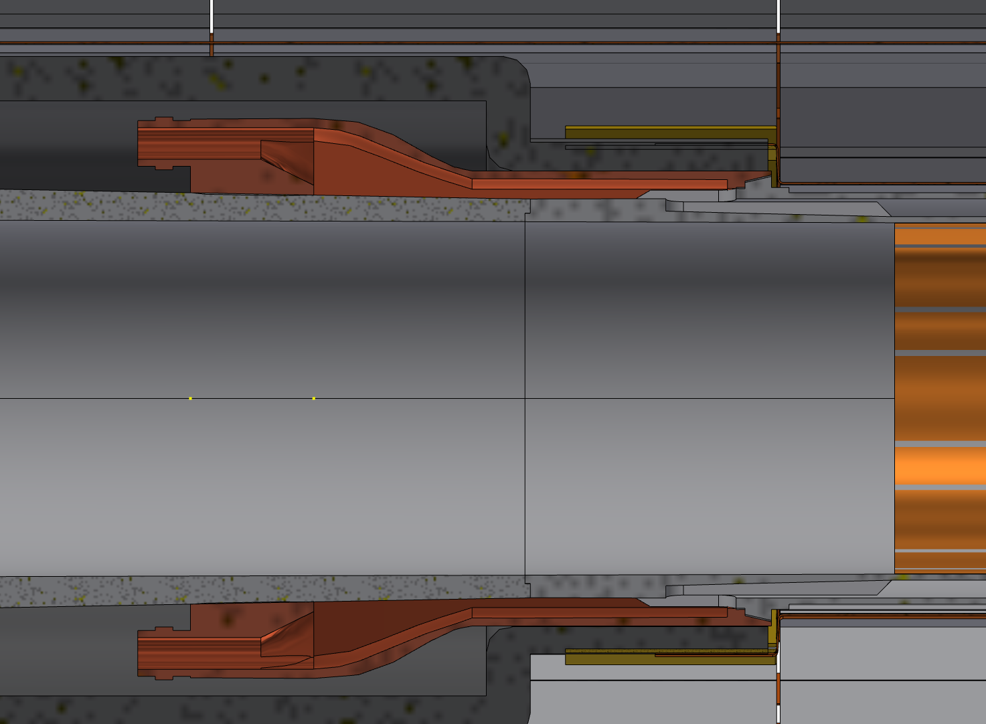
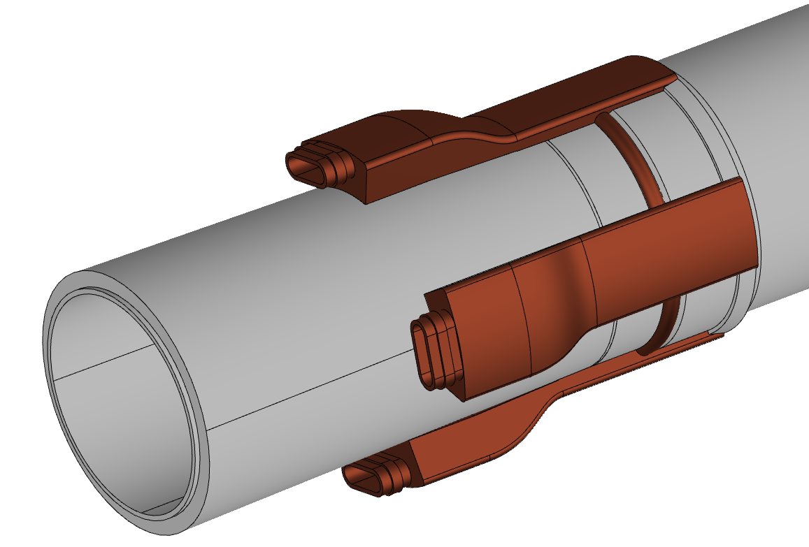
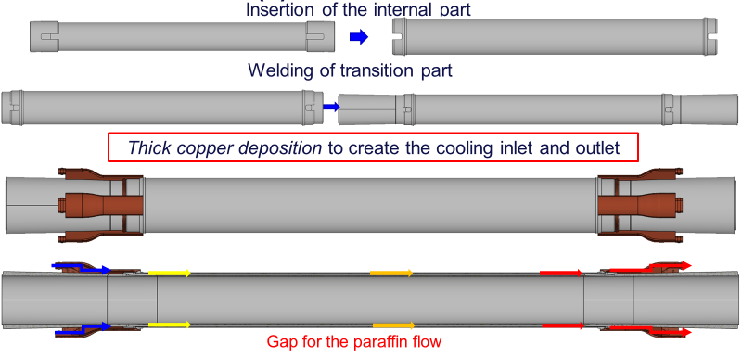
Central chamber
1st layer Inner Vertex
The central has the following characteristics:
AlBeMet 162 as main material
Three layers from 0-90 mm from IP
0.35 mm of AlBeMet162
1 mm gap for Paraffin
0.35 mm of AlBeMet162
Paraffin as coolant
Geometry studied to integrate the central chamber with the Inner Vertex (200 µm of clearance between central chamber and Inner Vertex support)
Central chamber
Inlet/outlet
Inlet/outlet for paraffin cooling

Slide 6
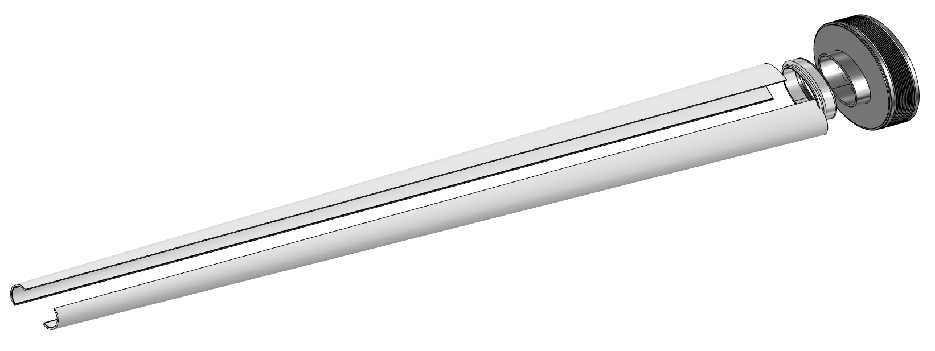
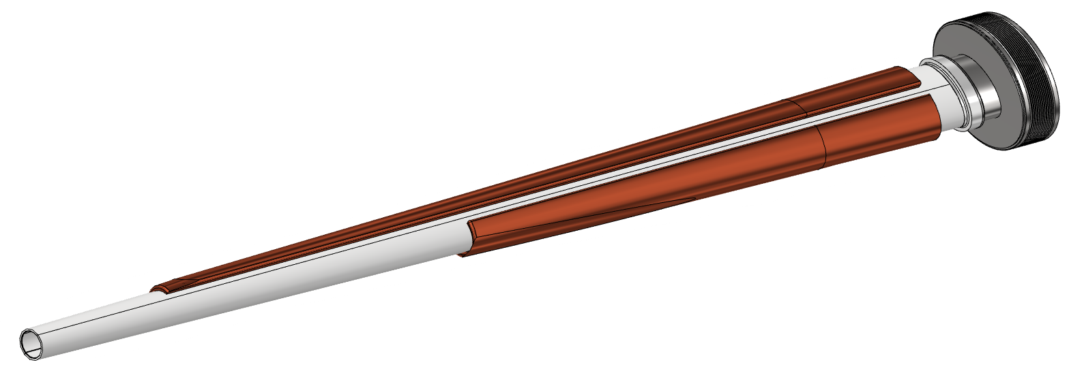
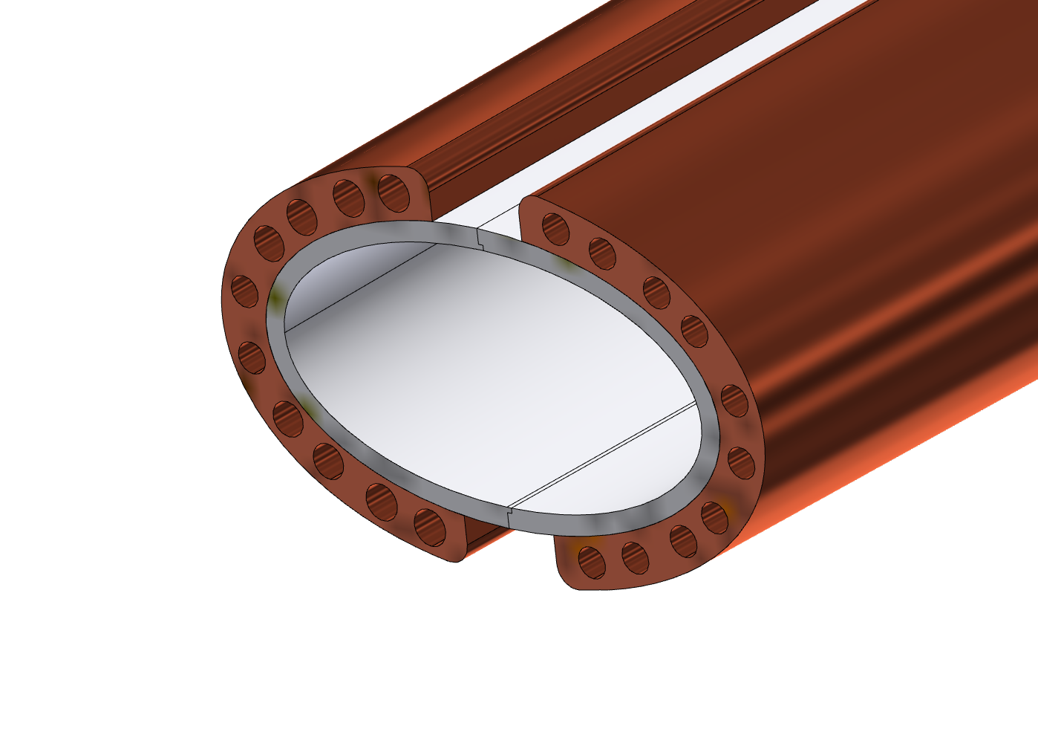
Trapezoidal chamber
Main characteristics:
AlBeMet162 as main material
Chamber in two halves and assembled using EBW
Copper cooling system
Bellows
Transition
Two halves AlBeMet pipe
EBW
A-A
A
EBW
Thick copper deposition
A
The cooling is based on an asymmetric solution, using the 50 mrad cone as the cutting profile, to assure the respect of the spatial constraint due to the LumiCal requirment.
To reduce the cooling material, the design provides five couples of channels for each side; in this way is possible to use the needed quantity of coolant and reduce the material, creating a light structure.

Slide 7
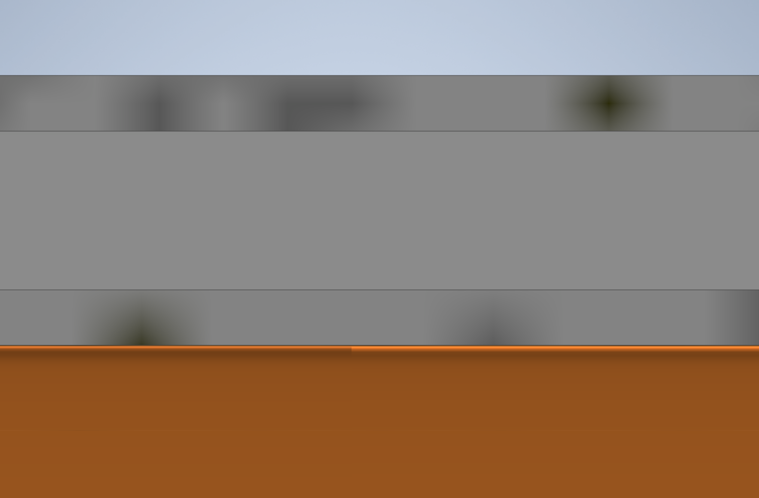
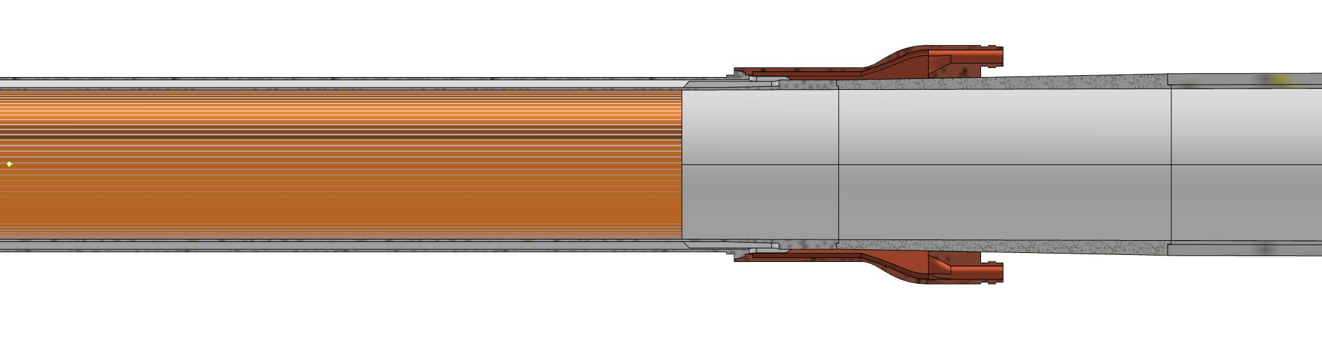
Thickness of the chamber
Uniform thickness of the trapezoidal chamber set at 2 mm
0,35 mm
1 mm
0,35 mm
1,5 mm
2 mm
90 mm
115 mm
156 mm

Slide 8
Structural analysis – chamber
Loads, constraints, characteristic parameters, design
FEA (Ansys)
Temperature distribution, stress and displacement along the pipe
Paraffin flow (central chamber)
Flow rate: 0,015 kg/s
Section:68,17 mm²
Velocity: 0,3 m/s
Inlet temperature: 18°C
Convective coefficient: 900 W/m²K
Water flow (trapezoidal chamber)
Flow rate: 0,0019 kg/s
Section: 9,62 mm² (20 different channel)
Velocity: 0,2 m/s
Inlet temperature: 18°C
Convective coefficient: 1200 W/m²K
Heat load
54 W central
130 W AlBeMet162 for each part
From CST calculations (Alexander Novokhatski (SLAC))
Weight
chamber
Inner Vertex first layer
Constraint
Cantilevered, simply supported configuration
Hypothesis:
Perfect thermal contact between the materials
Chamber design (until the bellows)
RESULTS

Slide 9
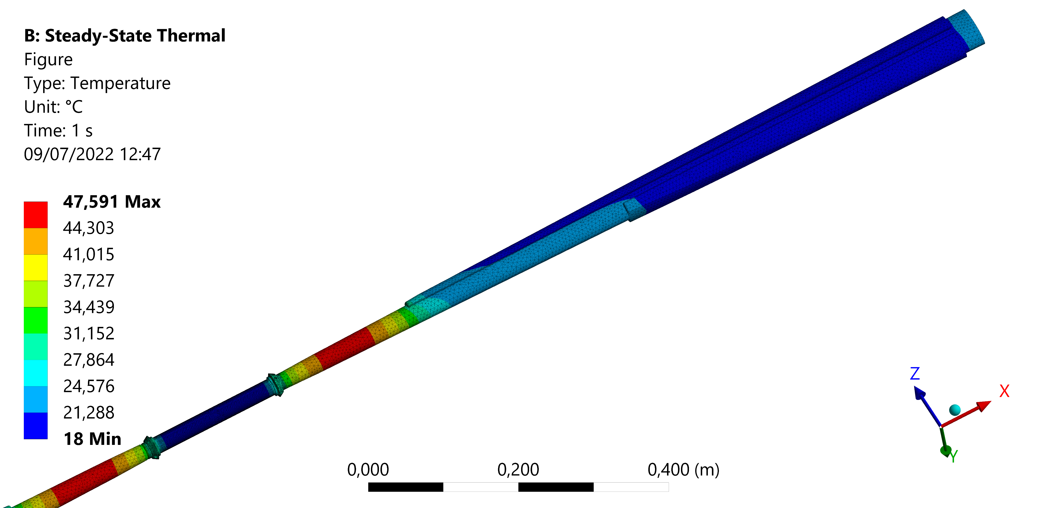
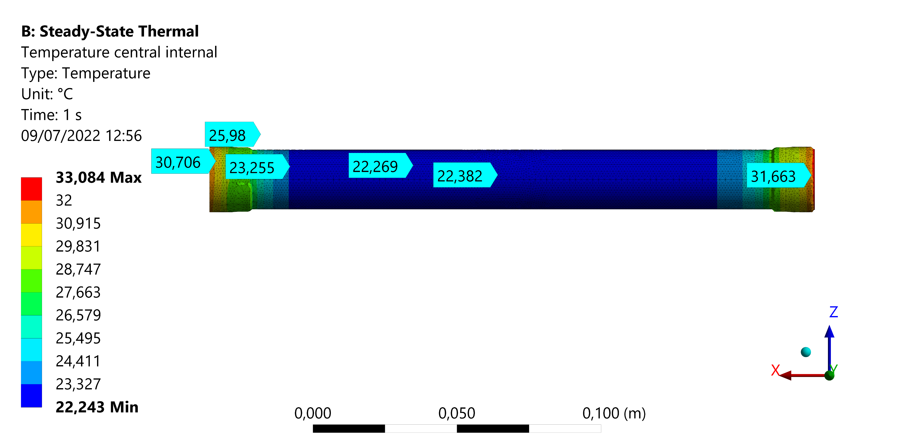
Structural analysis - chamber - results
 | Trapezoidal chamber | Central chamber
Coolant | Water | Paraffin
Maximum chamber temperature [°C] | 47,6 | 33,1
T_out coolant [°C] | 20,5 | 20,1
Von Mises stress [MPa]
 |  | Trapezoidal SX | Trapezoidal DX | Central IN | Central EX
BEAM | Fixed ends | 22,07 | 21,86 | 46,8 | 38,9
 | Fixed+displ | 14,65 | 10,63 | 9,69 | 17
Maximum displacement [mm]
 |  | X | Y
BEAM | Fixed ends | 0,031 | 0,07
 | Fixed+displ | 0,1 | 0,29

Slide 10
Bellows – constraint configuration
The use of Support Tube is designed to avoid overloads on central chamber during assembly and operation (thermal expansion). This solution has been obtained using two kind of bellows for the two sides of the support tube.
To understand the constraint configuration, it is useful to create a simplified scheme with bellows, support tube and chamber.
Chamber
End cap
End cap
1st Bellows
(named single bellows)
2nd Bellows
(named double bellows)
IP
Support tube
In short, in this way we can:
Protect the central chamber during the assembly procedure
Support properly the chamber bellows-to-bellows, containing the deformation
Allow the thermal deformation without compromising the chamber

Slide 11
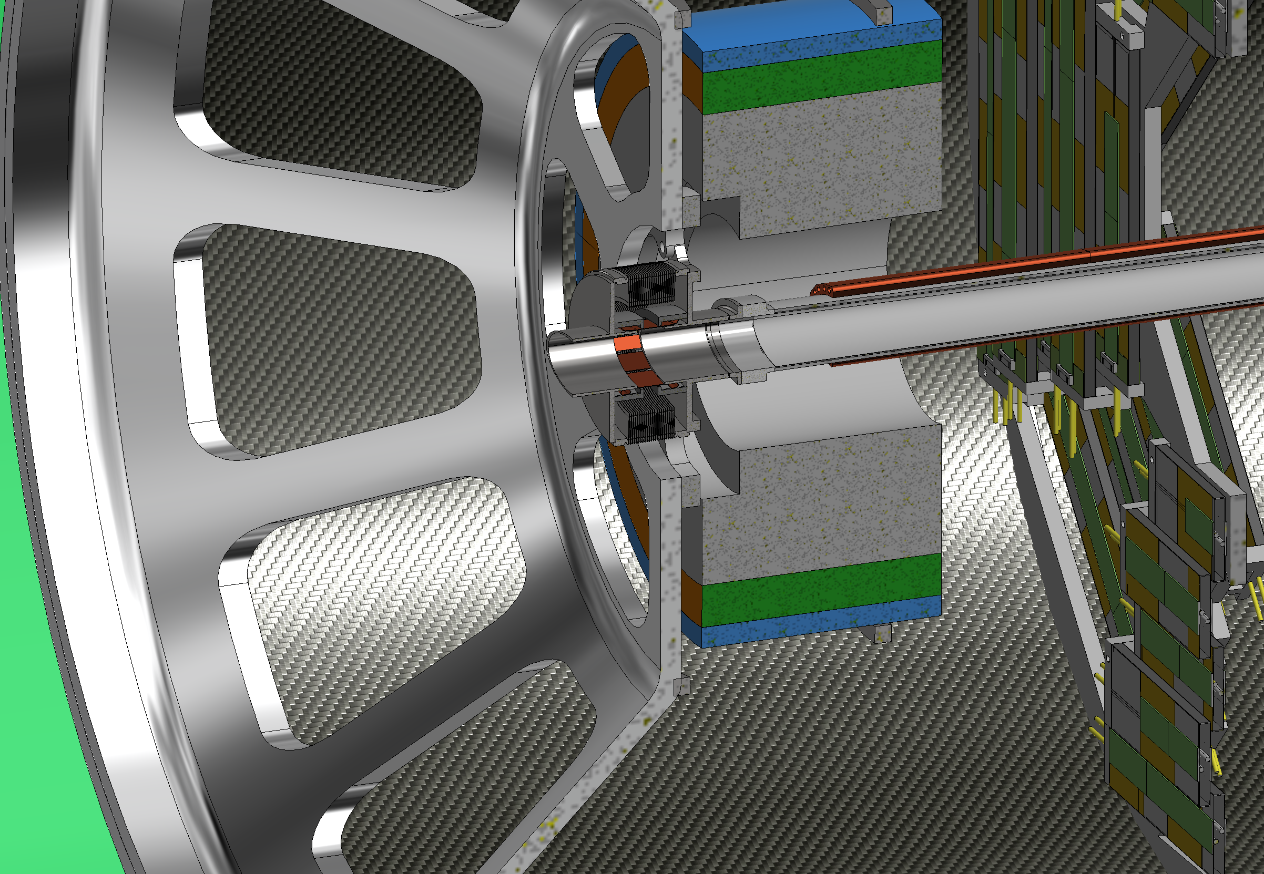
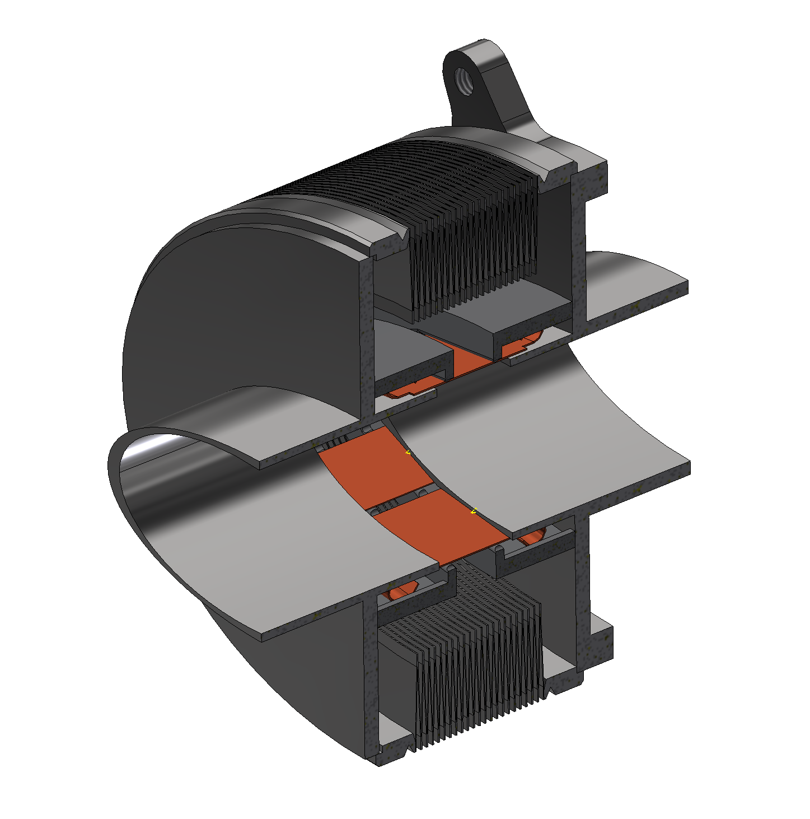
1st Bellows (Single bellows)
Anchoring flange to Support Tube
IP SIDE
Convolutions to compensate
Cryostat expansion and assembly
IP SIDE
CRYOSTAT SIDE
CRYOSTAT SIDE

Slide 12
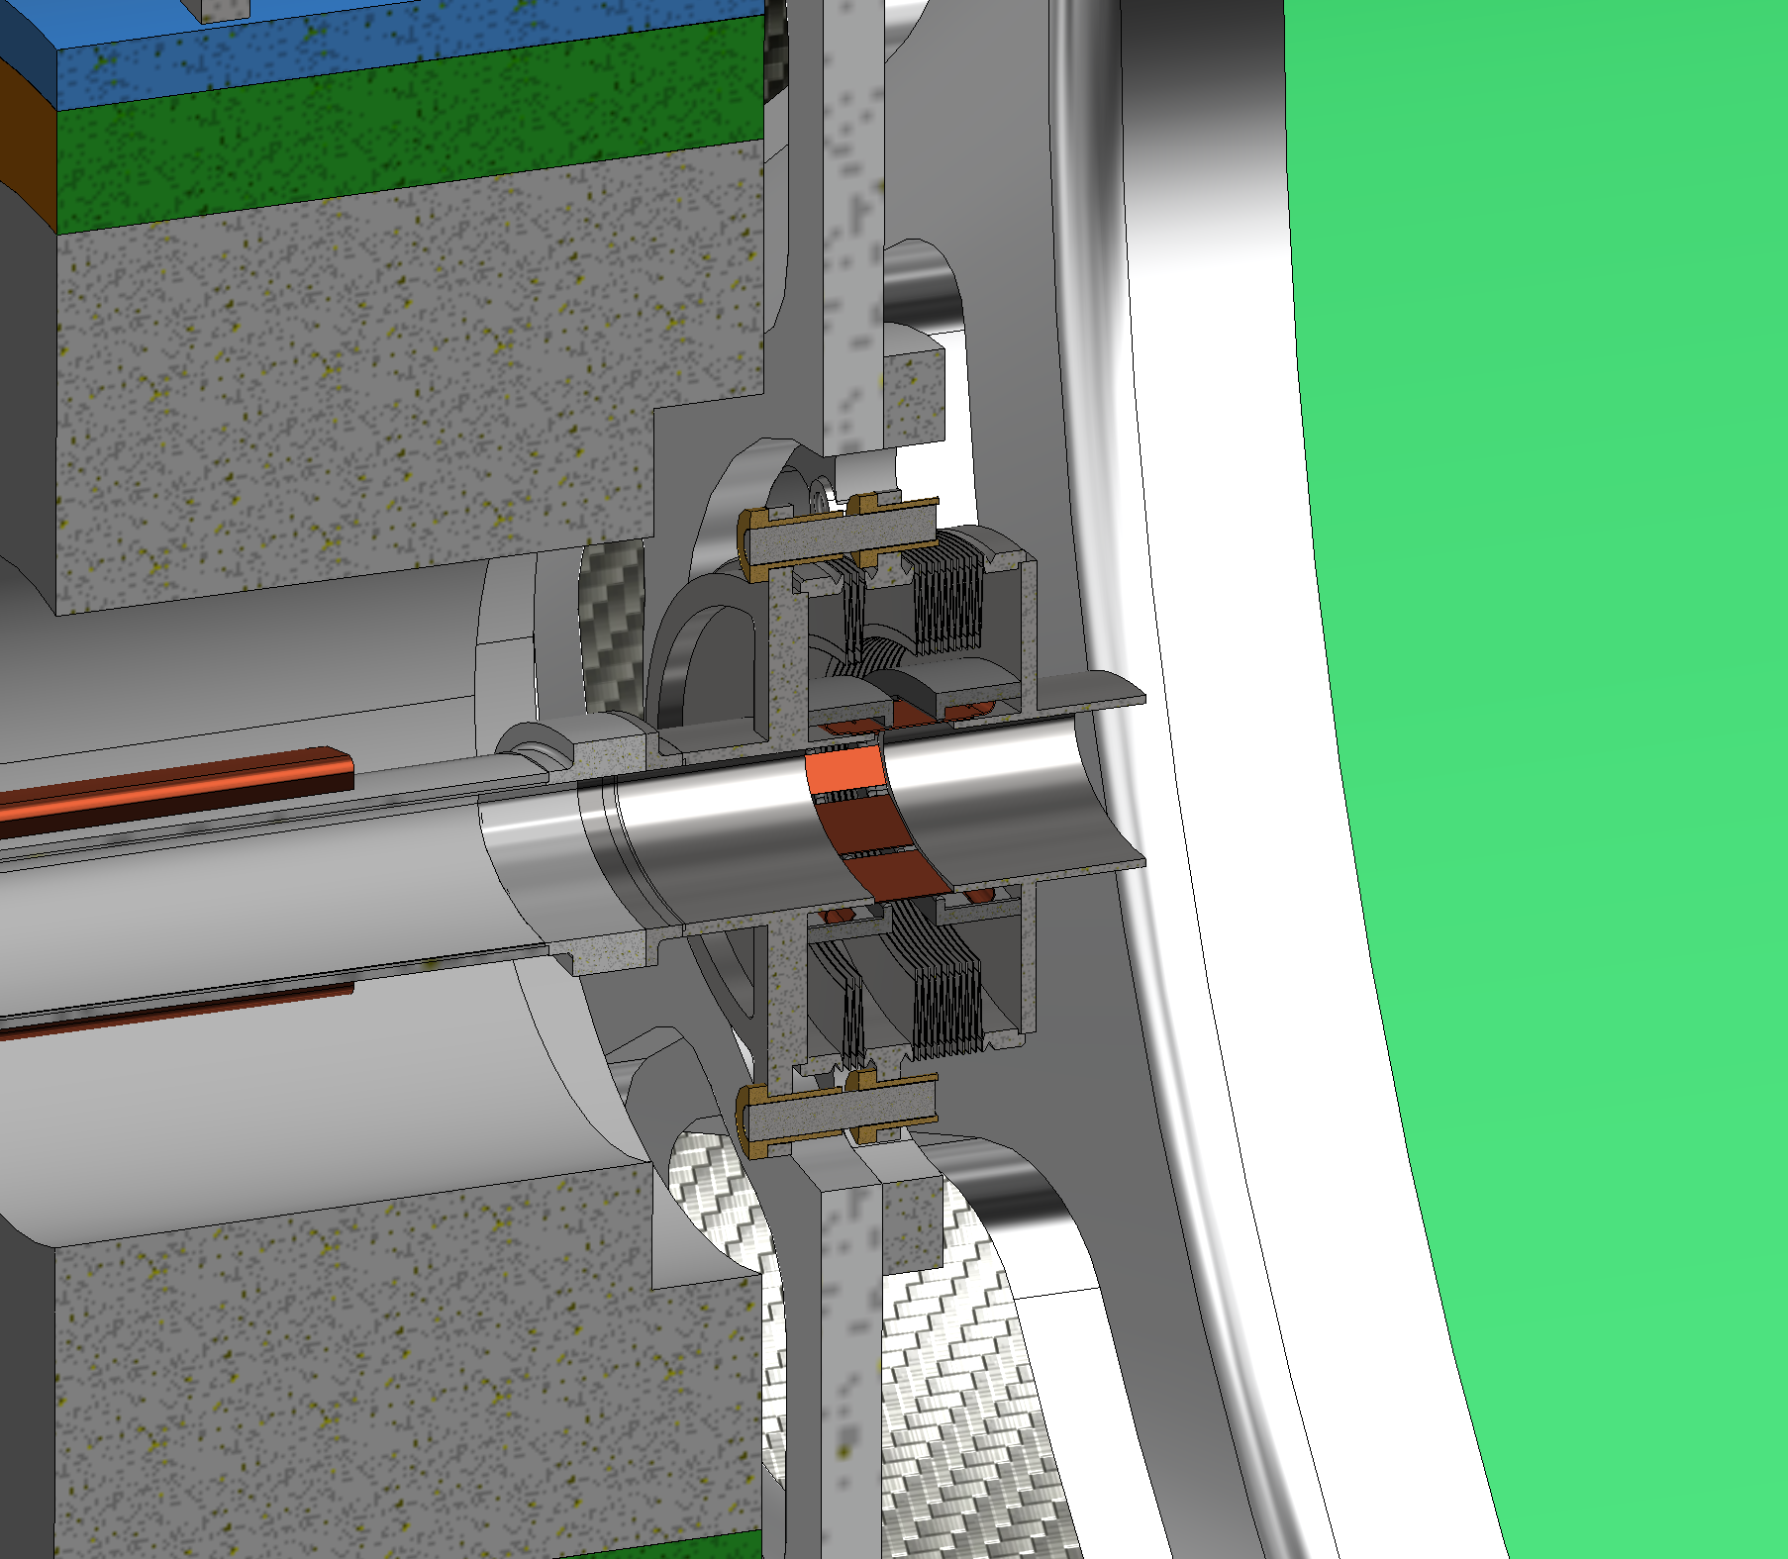
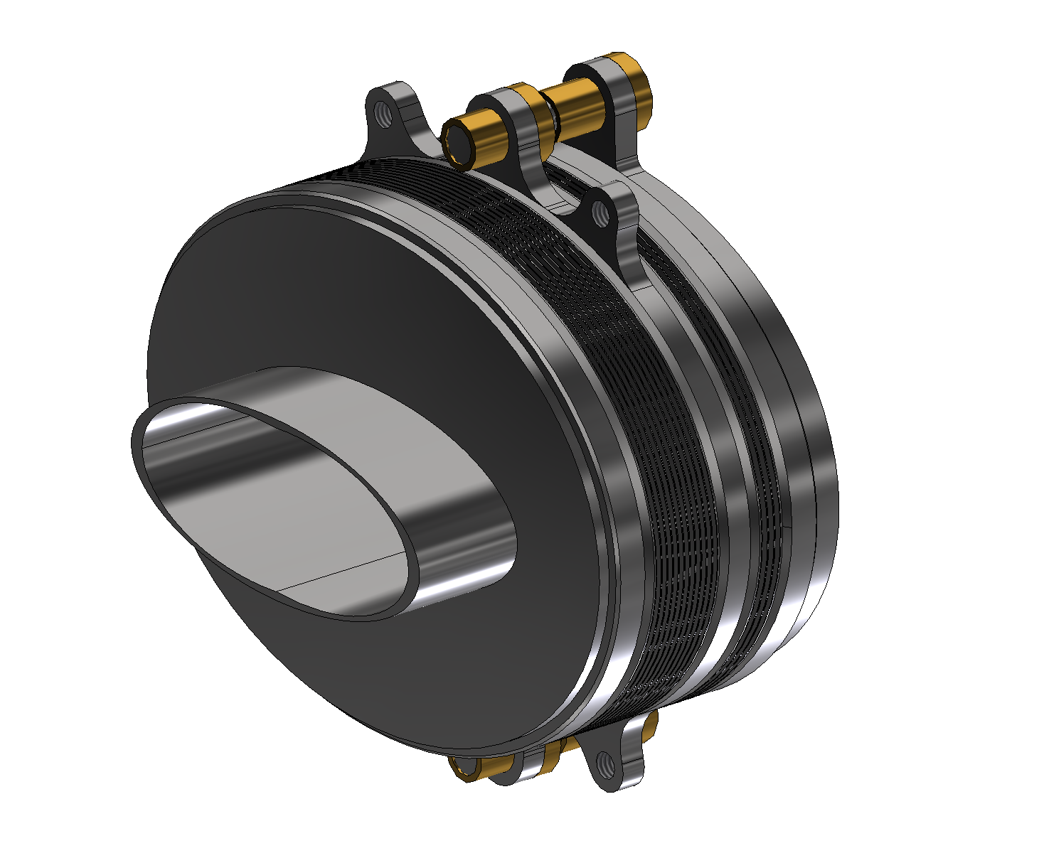
2nd Bellows (Double bellows)
Anchoring flange to Support Tube
CRYOSTAT SIDE
Linear bearing system
Convolutions to compensate
Cryostat expansion and assembly
IP SIDE
CRYOSTAT SIDE
Few convolutions inside Support Tube
for thermal expansion
IP SIDE

Slide 13
Bellows design considerations
The design is still in progress, some modifications have to be done to optimize the shape and dimensions.
It is necessary to:
insert the cooling system;
improve the supporting flanges design;
check properly the internal design in term of impedance and wake fields. (CST calculations by Alexander Novokhatski in progress);
optimize RF contact with FEA analysis.
Summary table
 | Single bellows | Double bellows
 |  | Cryostat side | Chamber side
Axial Stroke (z) [mm] | -15/+9 | -10/+6 | -2.3/+1.4
Angle [deg] | 12 | 8 | 2
Radial offset (x) [mm] | 1.15 | 0.5 | -----
Radial offset (y) [mm] | 1.54 | 0.7 | -----

Slide 14
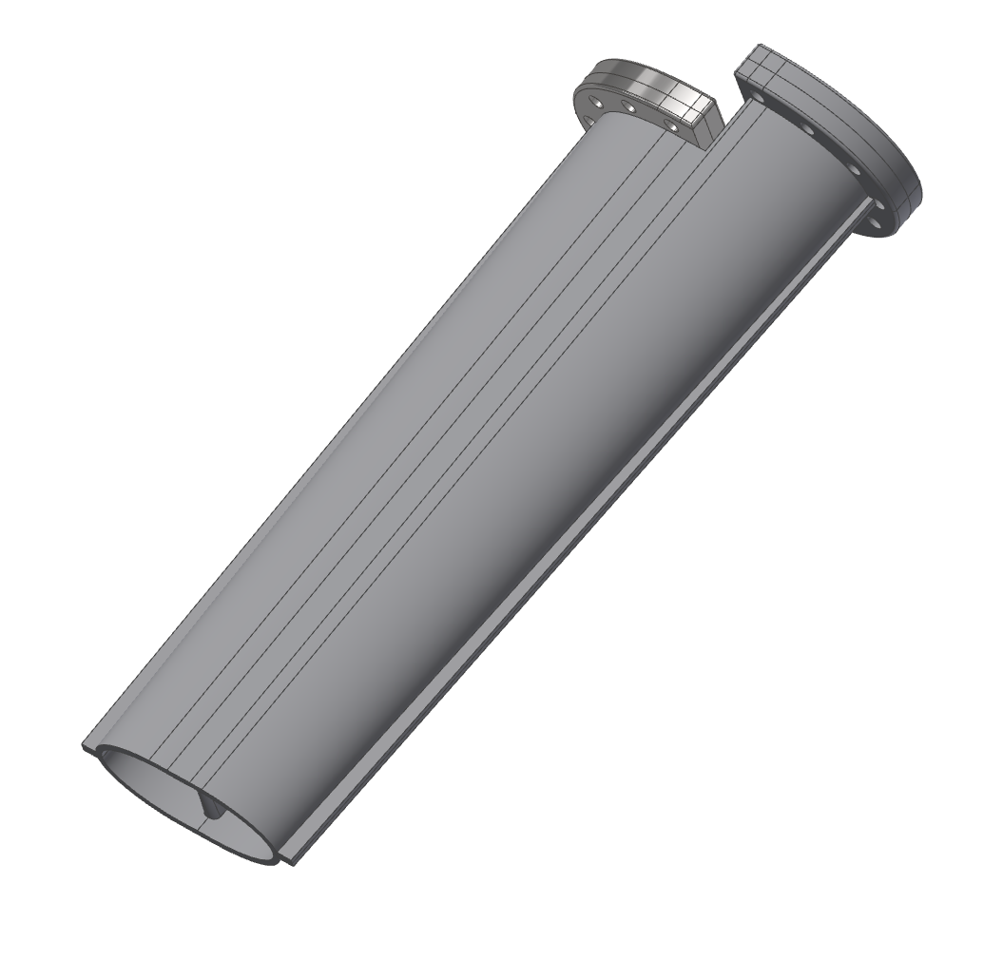
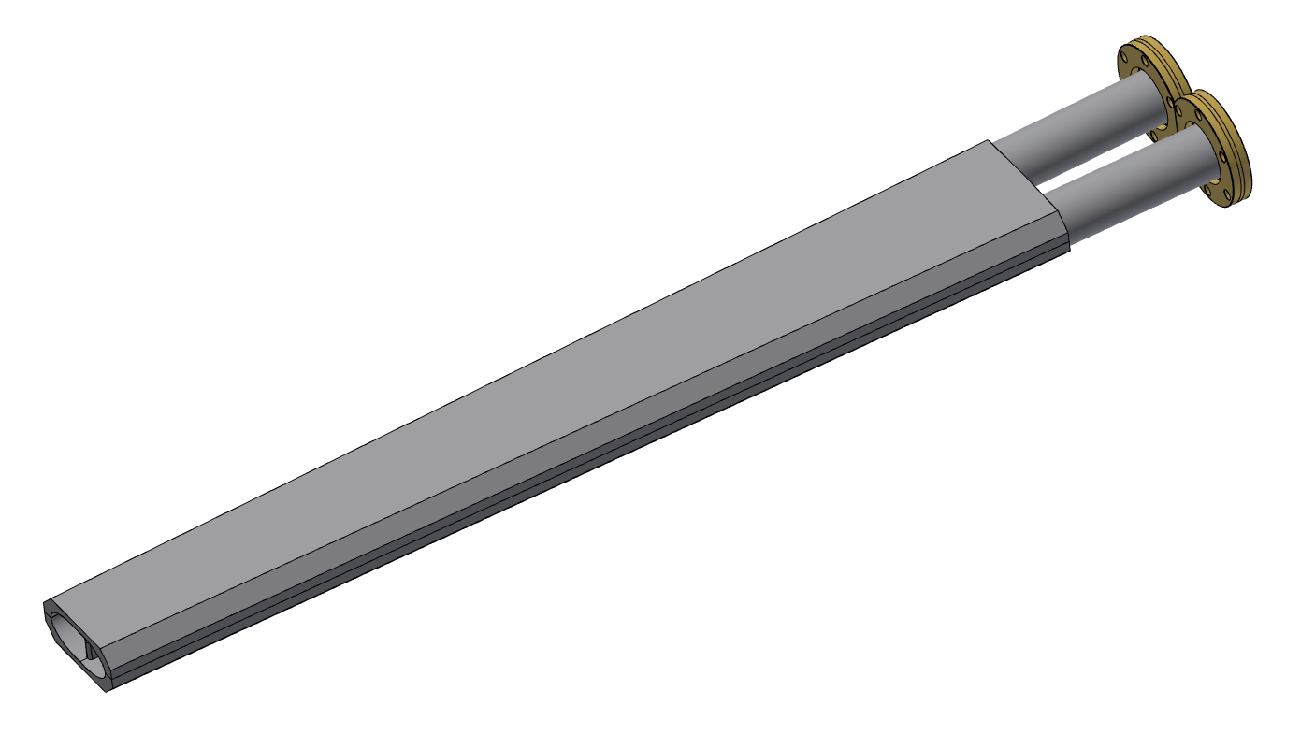
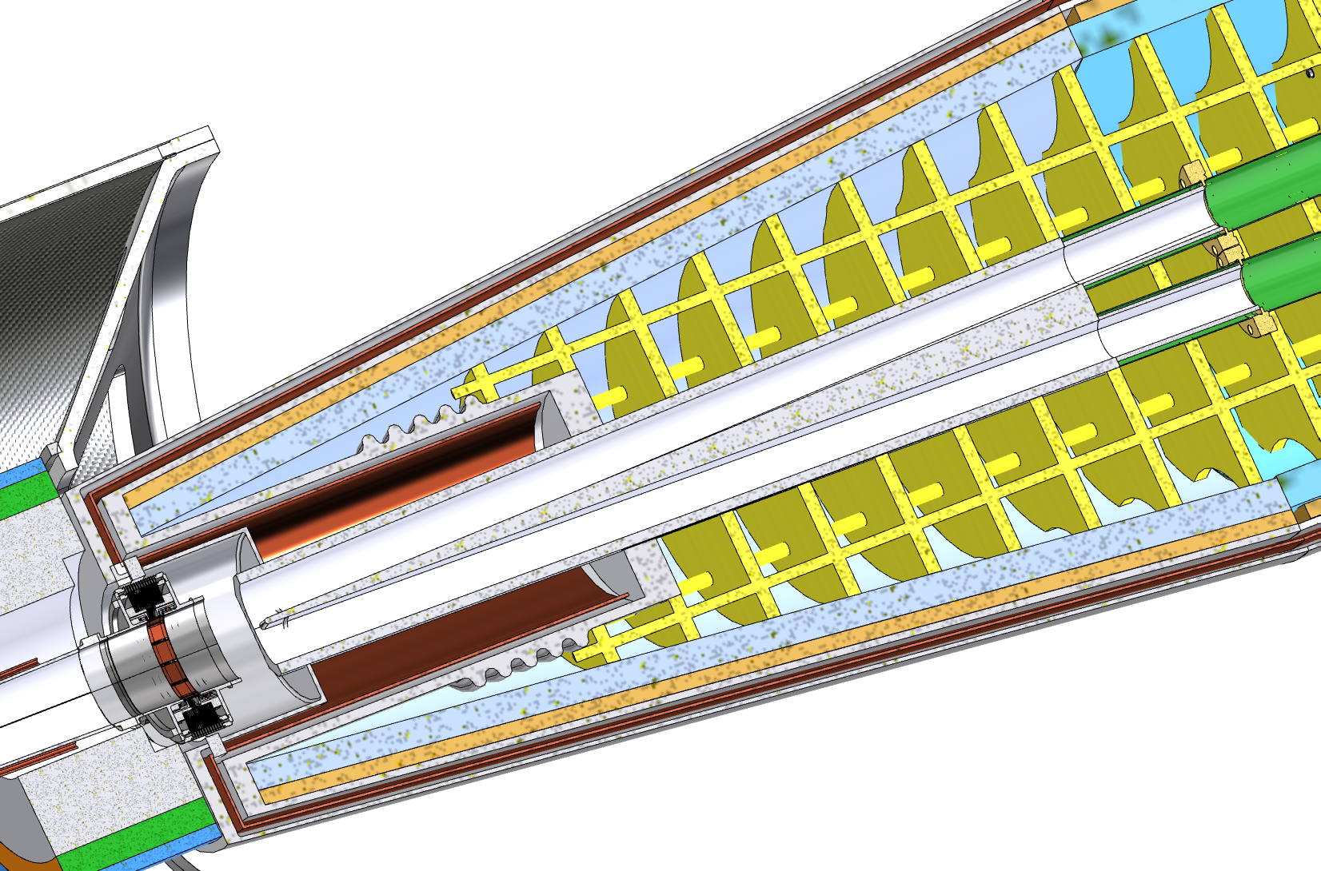
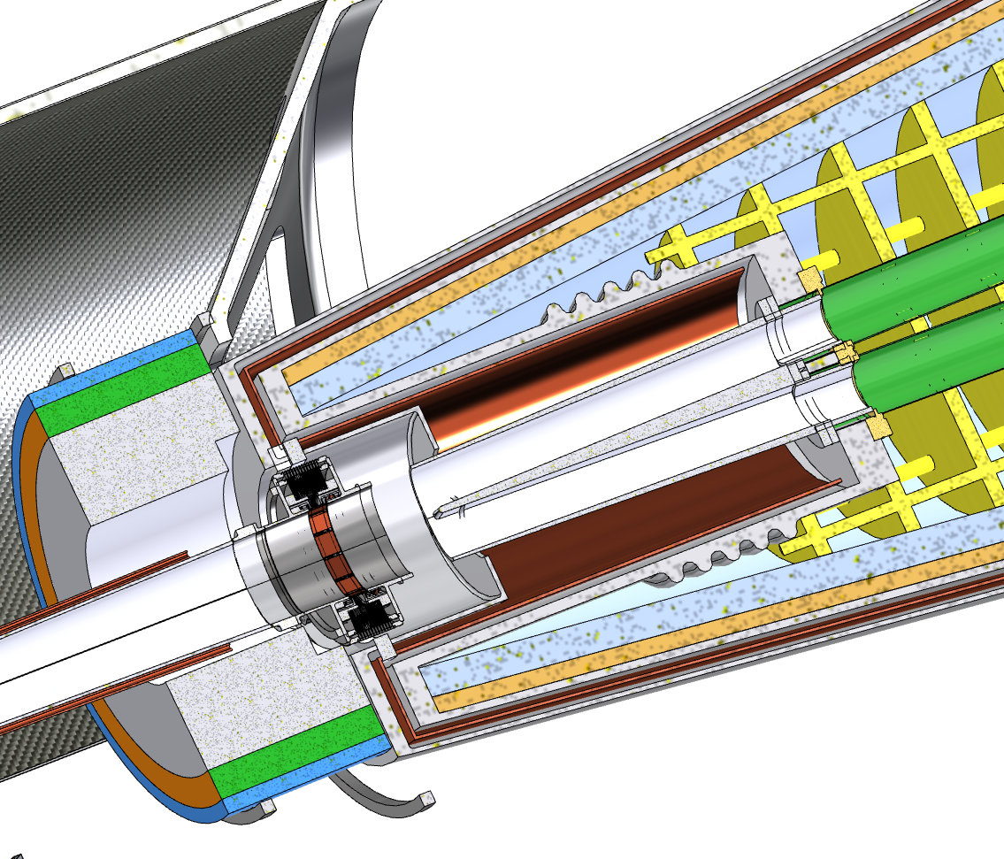
Crotch chamber
-1175 mm
Work in progress
Solution A
Solution B
Solution A:
Standard flanges
More space available for the crotch
Flanges in Helium
Solution B:
Flanges not in contact with Helium
Shorter chamber than solution A
Non standard flanges
Remote vacuum connection

Slide 15
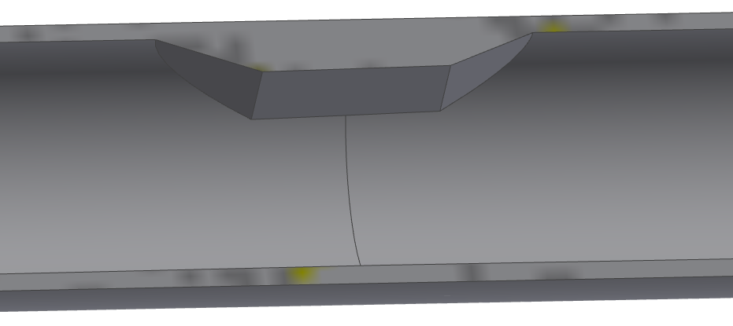
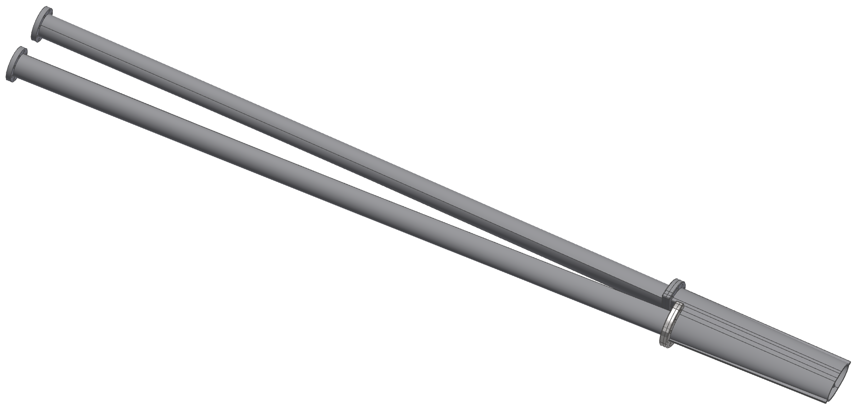
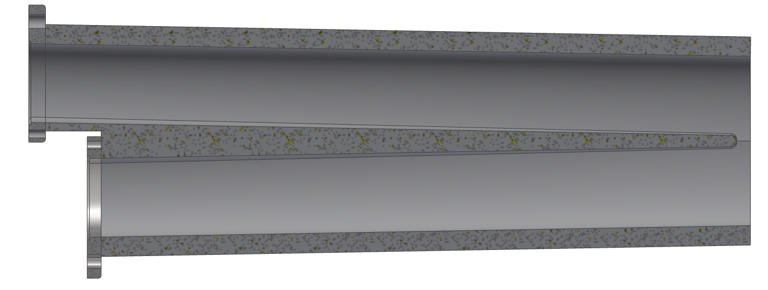
Start of circular pipe at 2550 mm from IP
SR MASK 2060 mm from IP
2550 mm
Very preliminary design
Not regular shape
Custom flanges
It is a work in progress:
Shape
Flanges geometry
Interface with Remote vacuum connection
REMOTE VACUUM CONNECTION BLOCK
Shifted flanges
IP

Slide 16
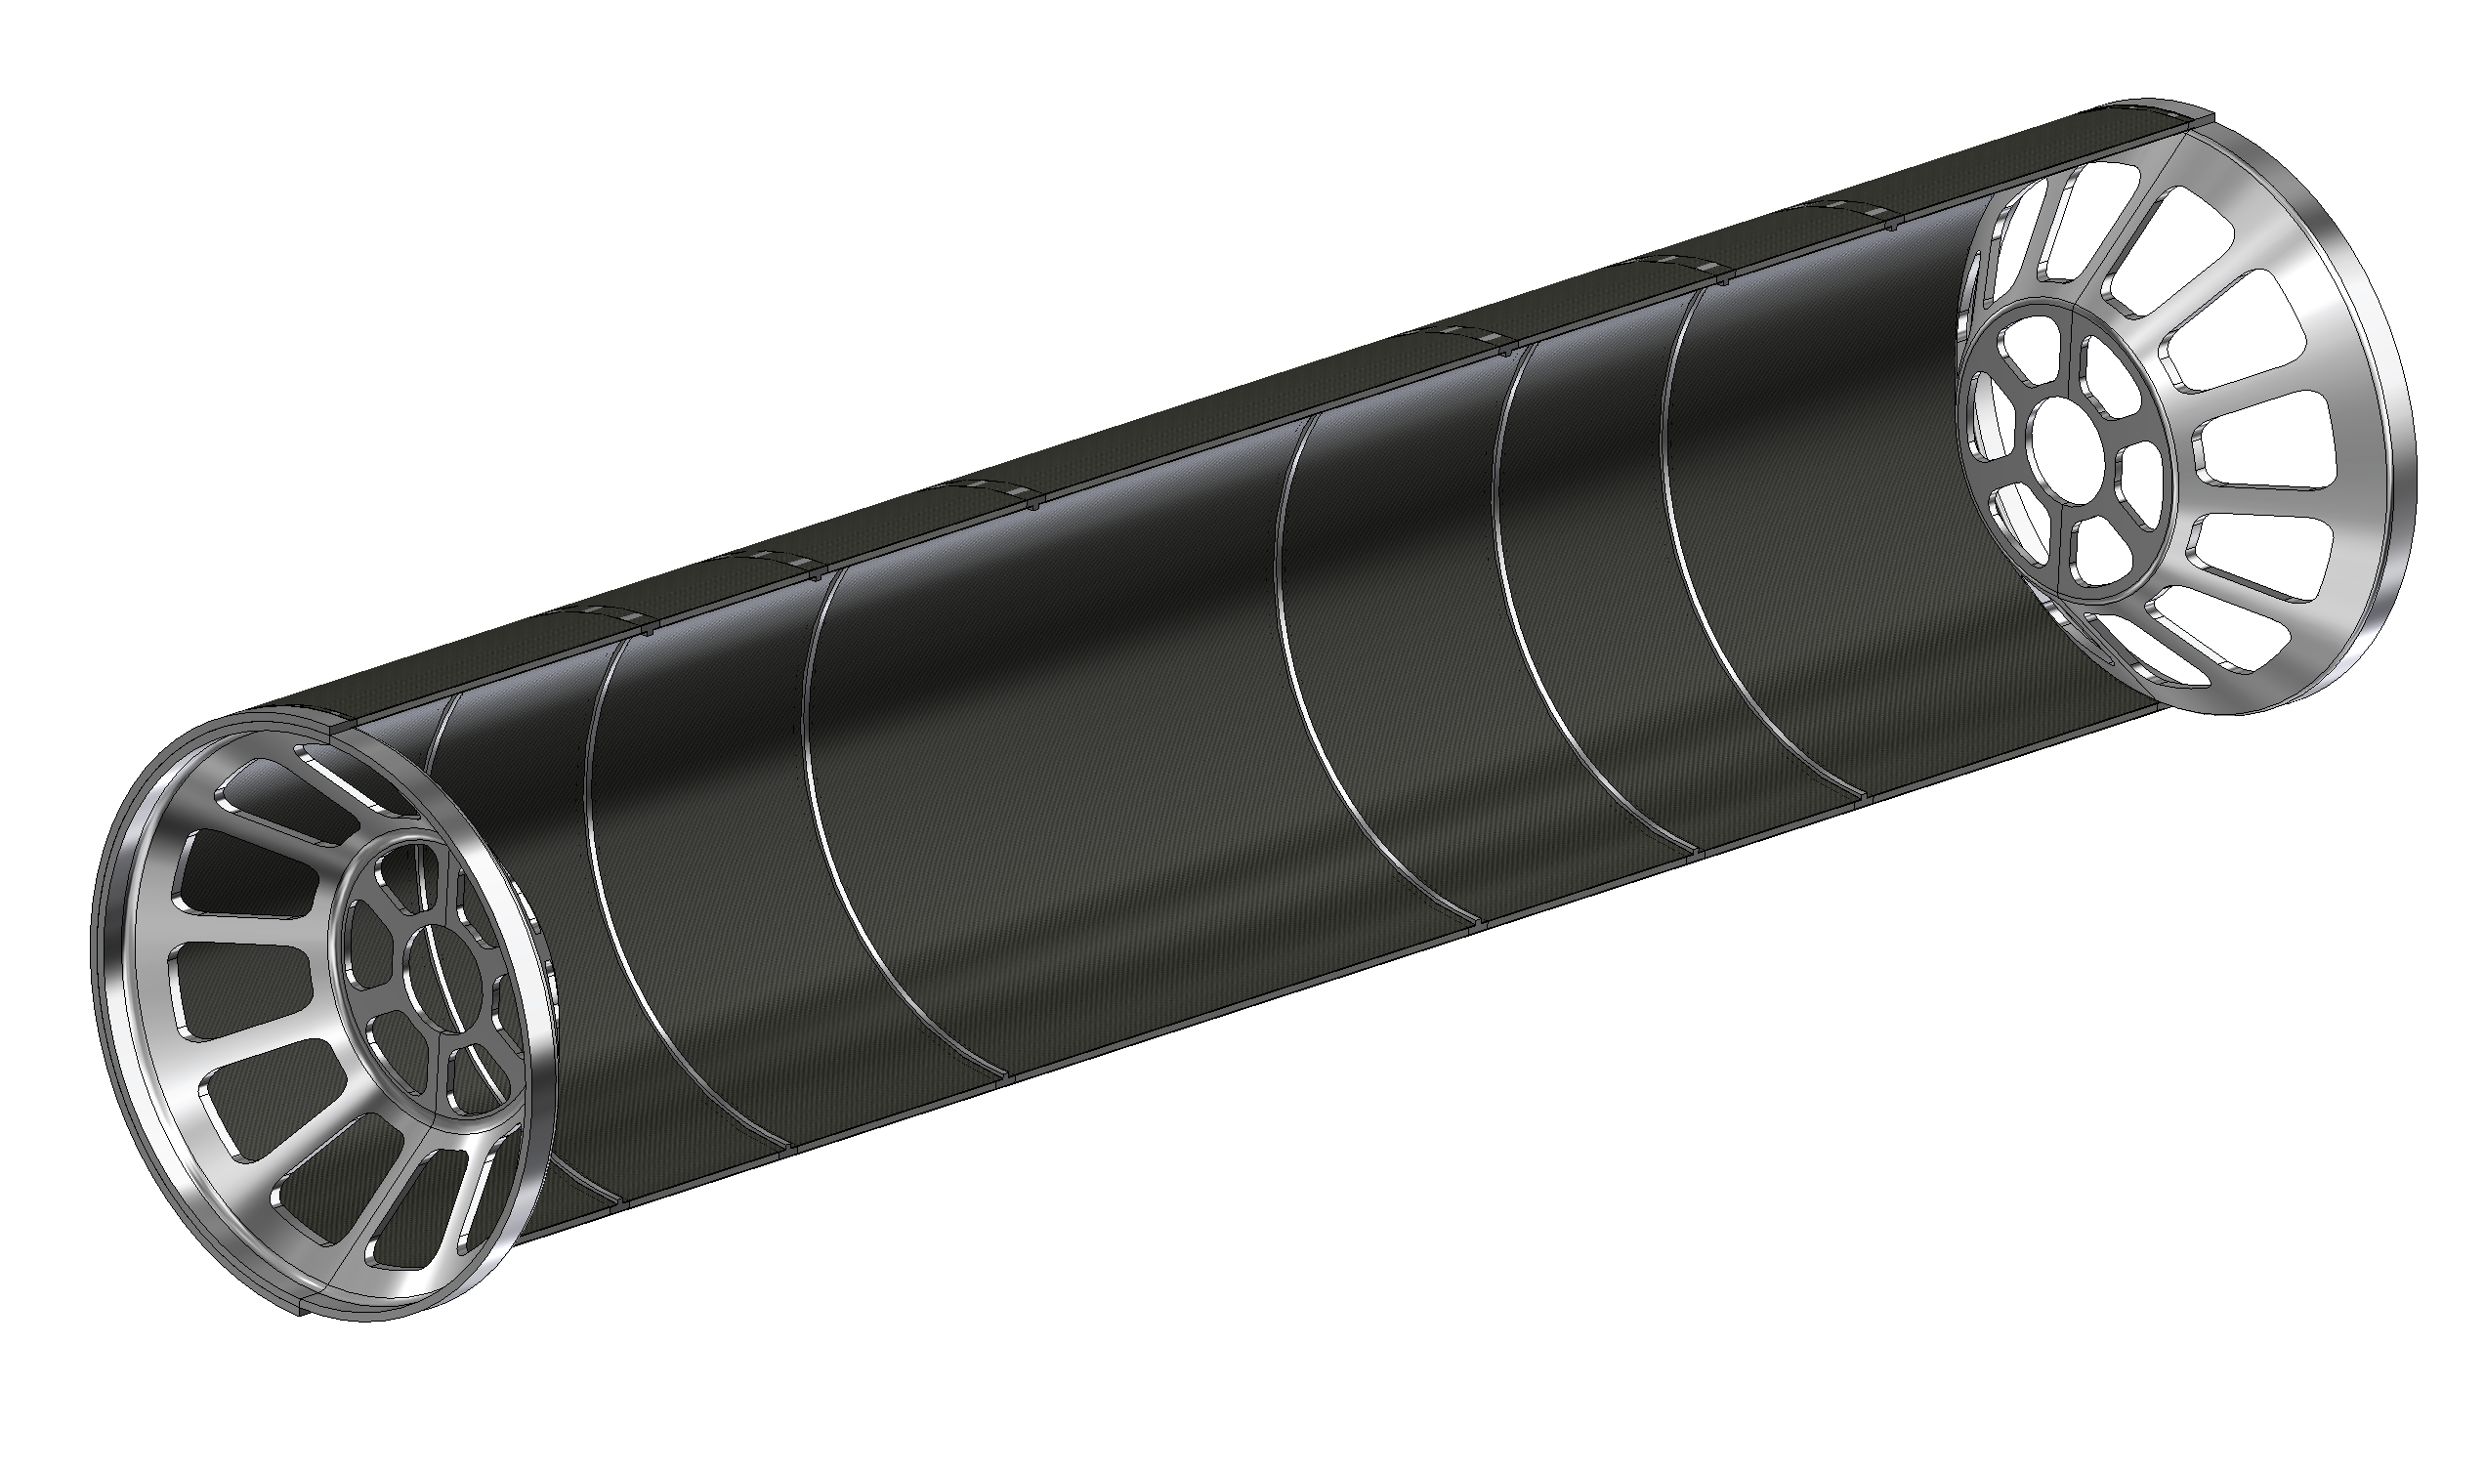
Support tube – description
The support tube aims to :
Provide a cantilevered support for the pipe.
Avoid loads on thin-walled central chamber during assembly or due to its own weight
Support LumiCal.
Support the Medium, Outer Vertex and Vertex Disks.
The structure is made with a multiple layer structure:
1mm CF + 4mm HC + 1mm CF
To allow the support of the disks are necessary 6 reinforcement ribs.
The cylinder is split in two halves to simplify the assembly procedure
The Aluminium endcaps support the LumiCal and the beampipe
Aluminium endcaps
CF=carbon fibre
HC=honeycomb
Aluminium ribs

Slide 17
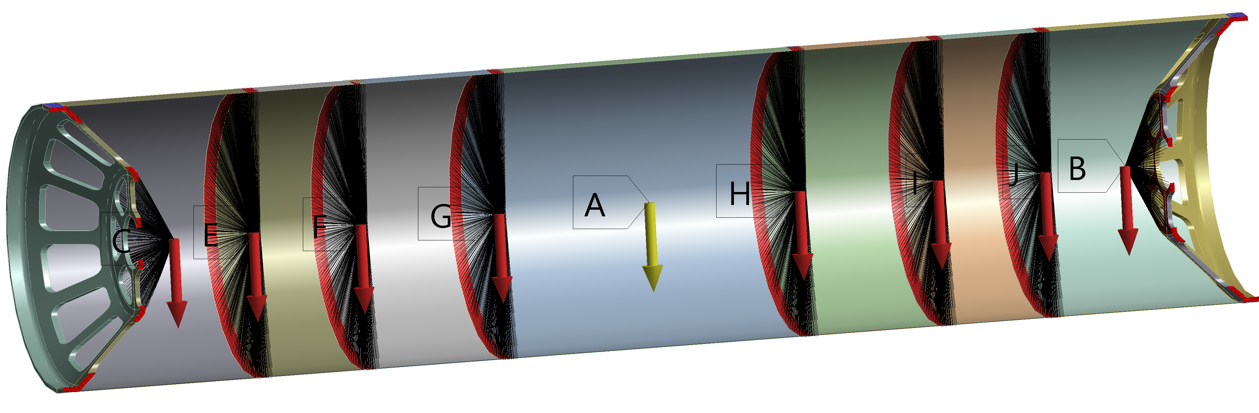
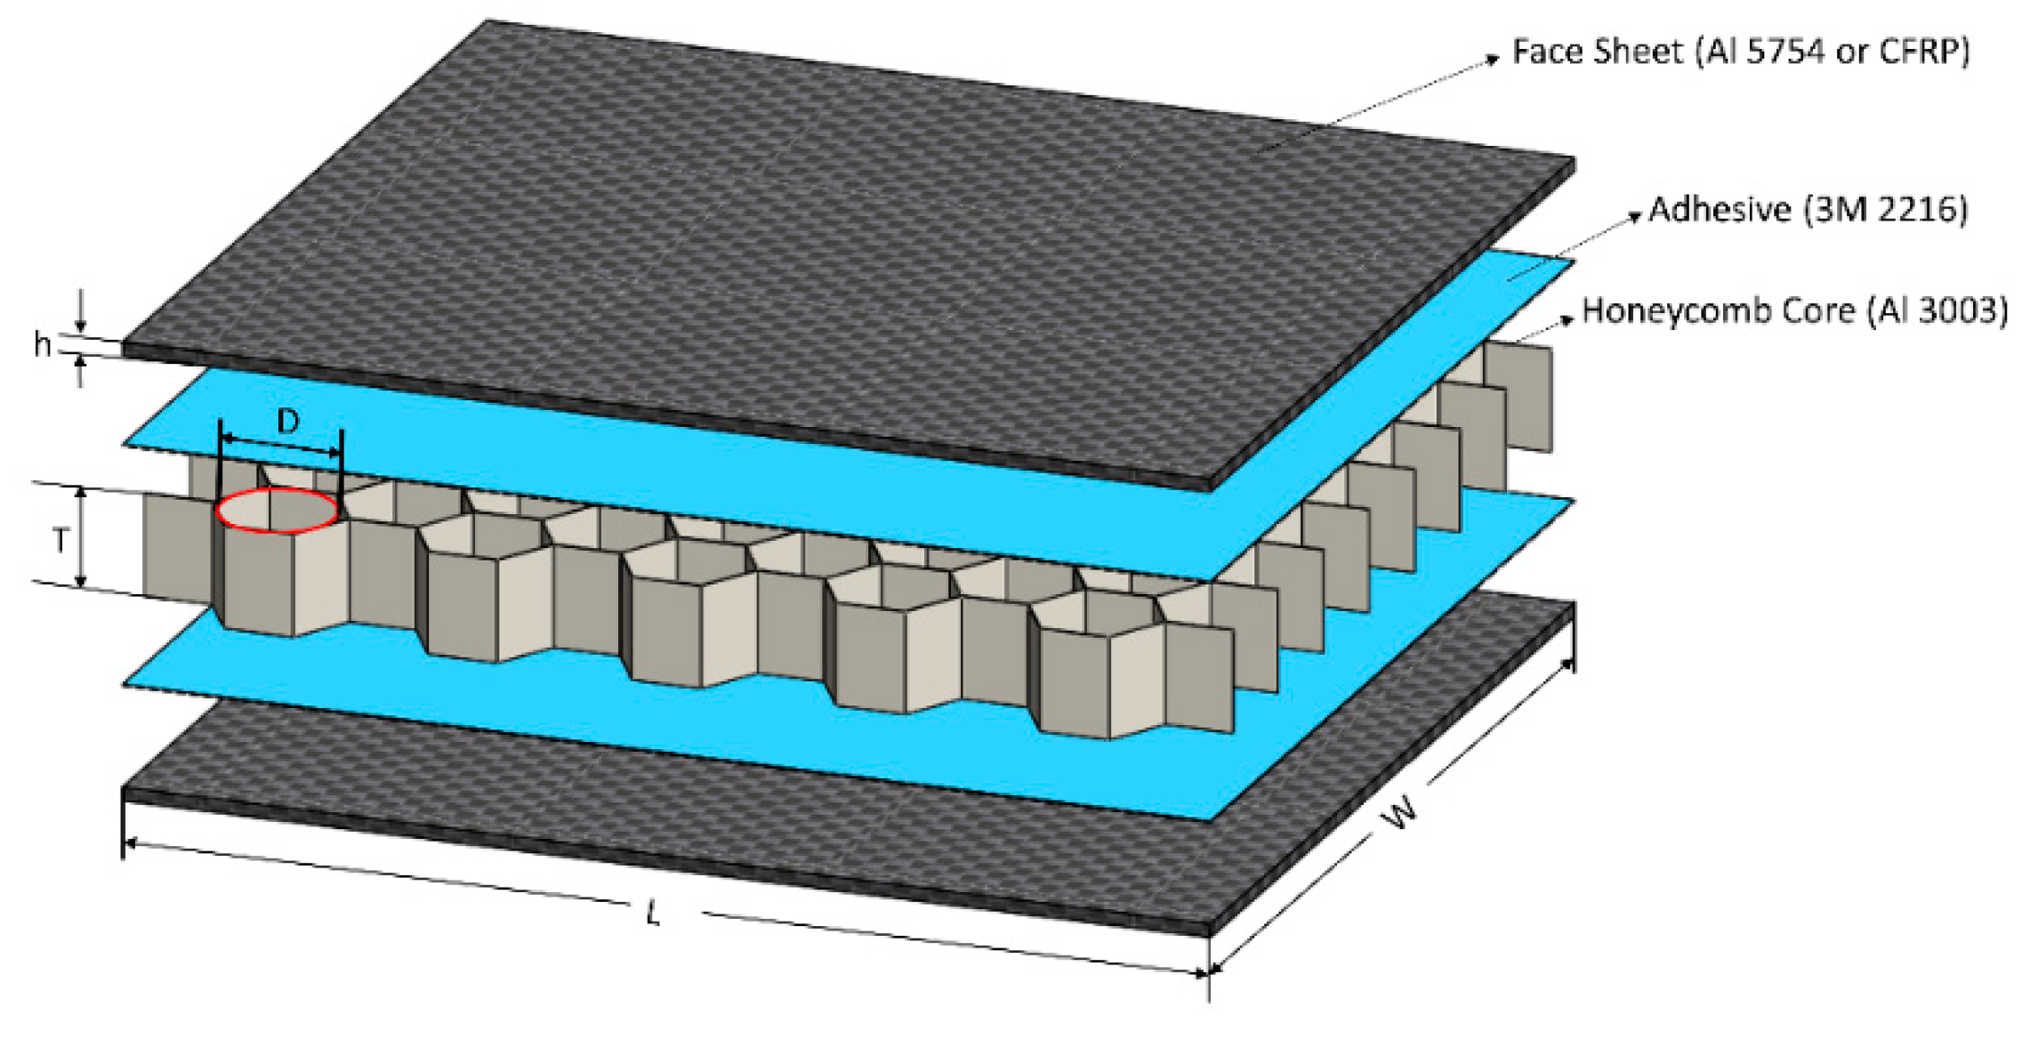
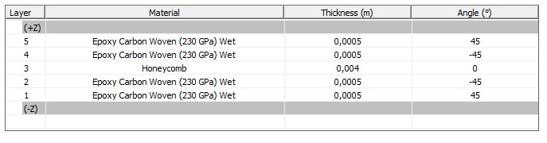
Support tube – loads and constraints
The aim of this analysis is to calculate the stress and displacement in each part of the cylinder (Al reinforcement, carbon fiber, honeycomb).
It is necessary to set:
Chamber | 50 kg
LumiCal | 70 kg + 70 kg
Vertex Disks | 6*10 kg
Outer Vertex | 15 kg
Medium Vertex | 7 kg
First guess loads (overestimated)
Constraint configuration → double fixed ends
Loads configuration
Carbon fiber/ honeycomb creation → layered section

Slide 18
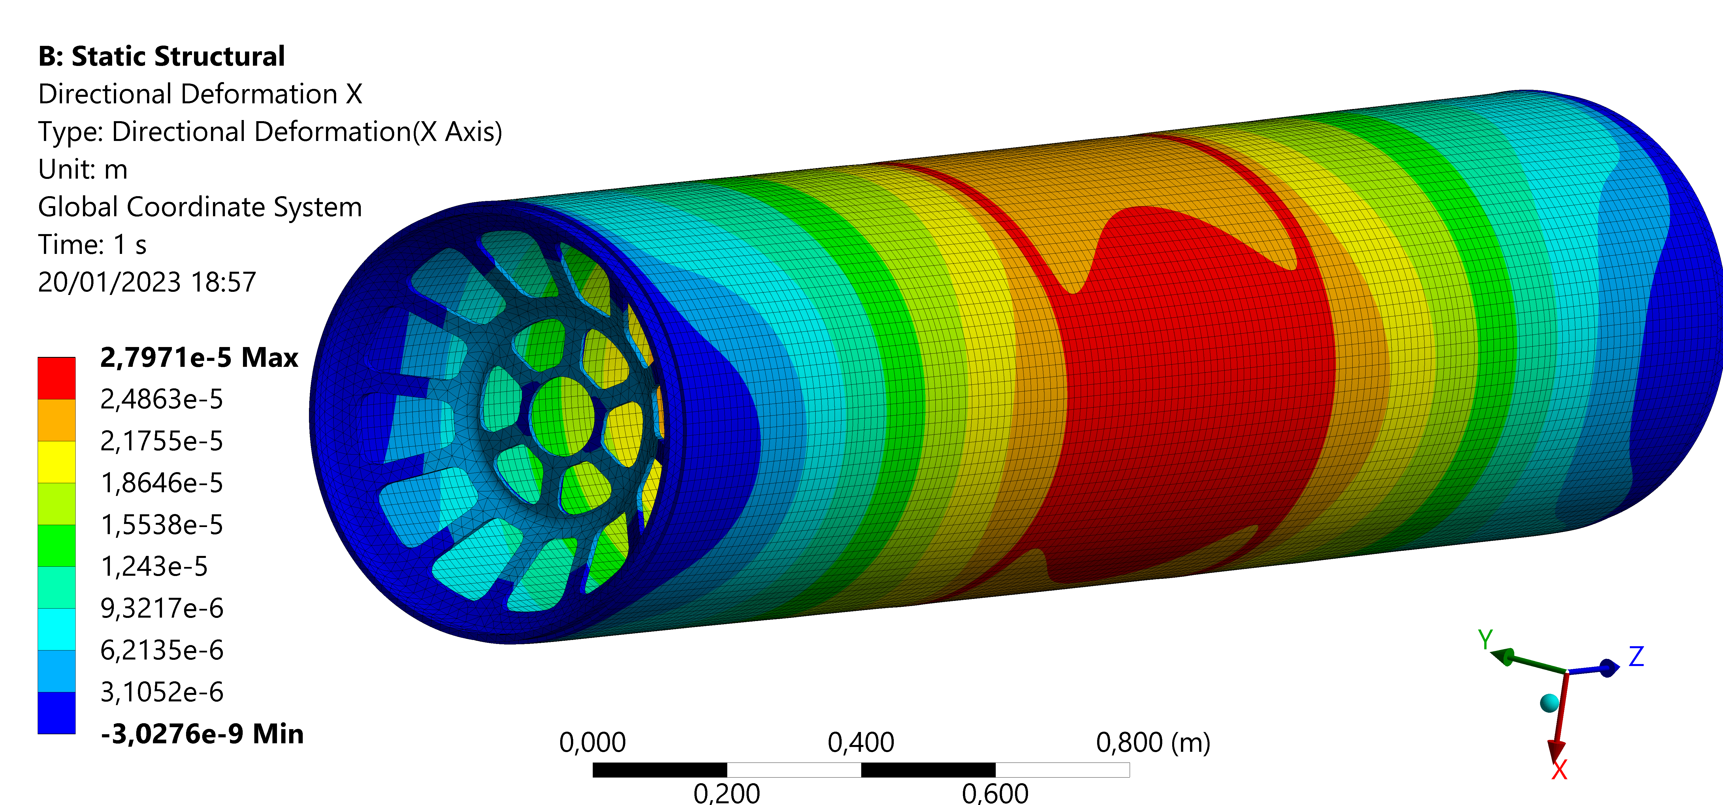
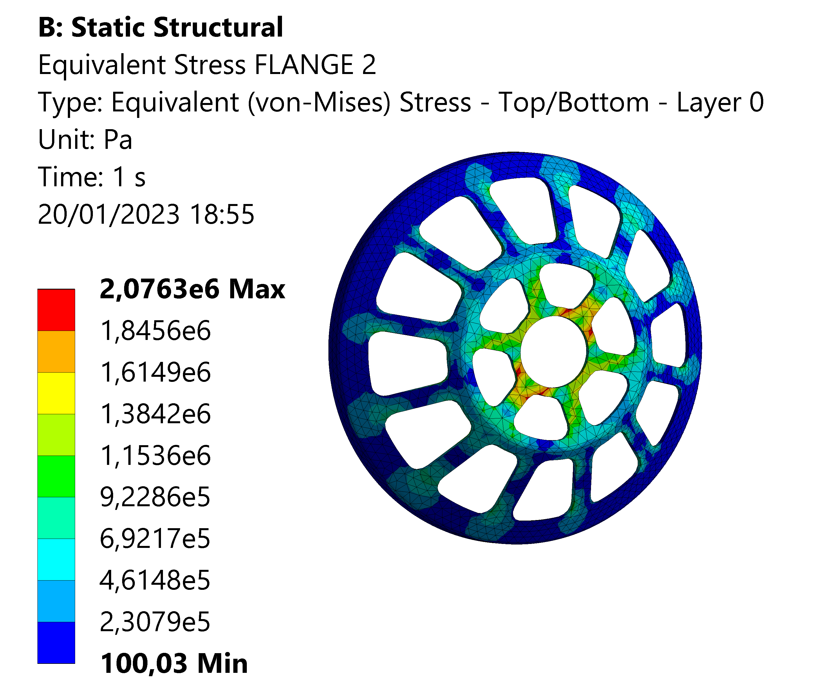
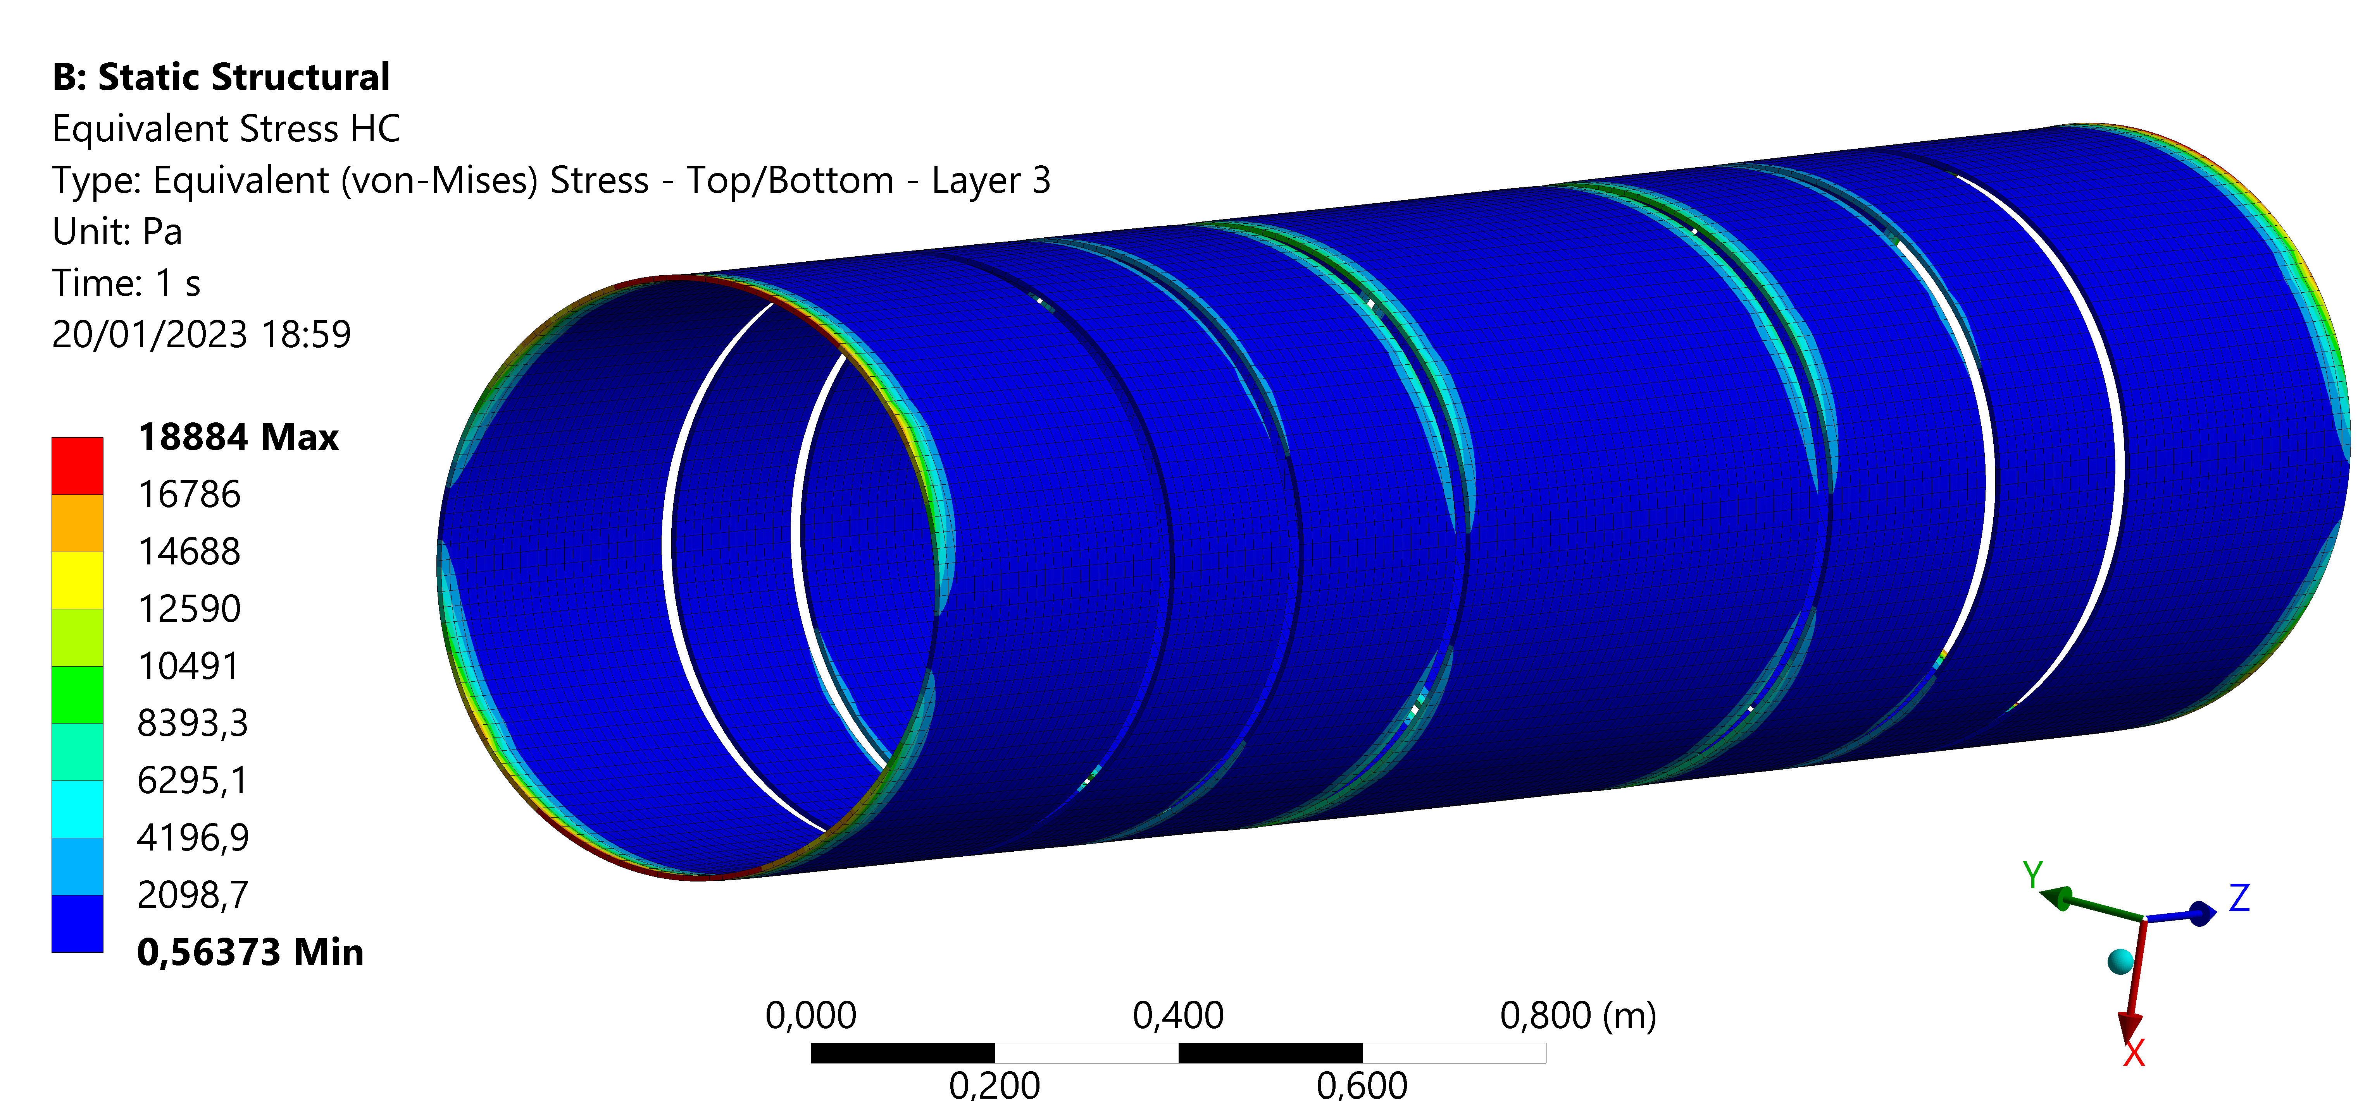
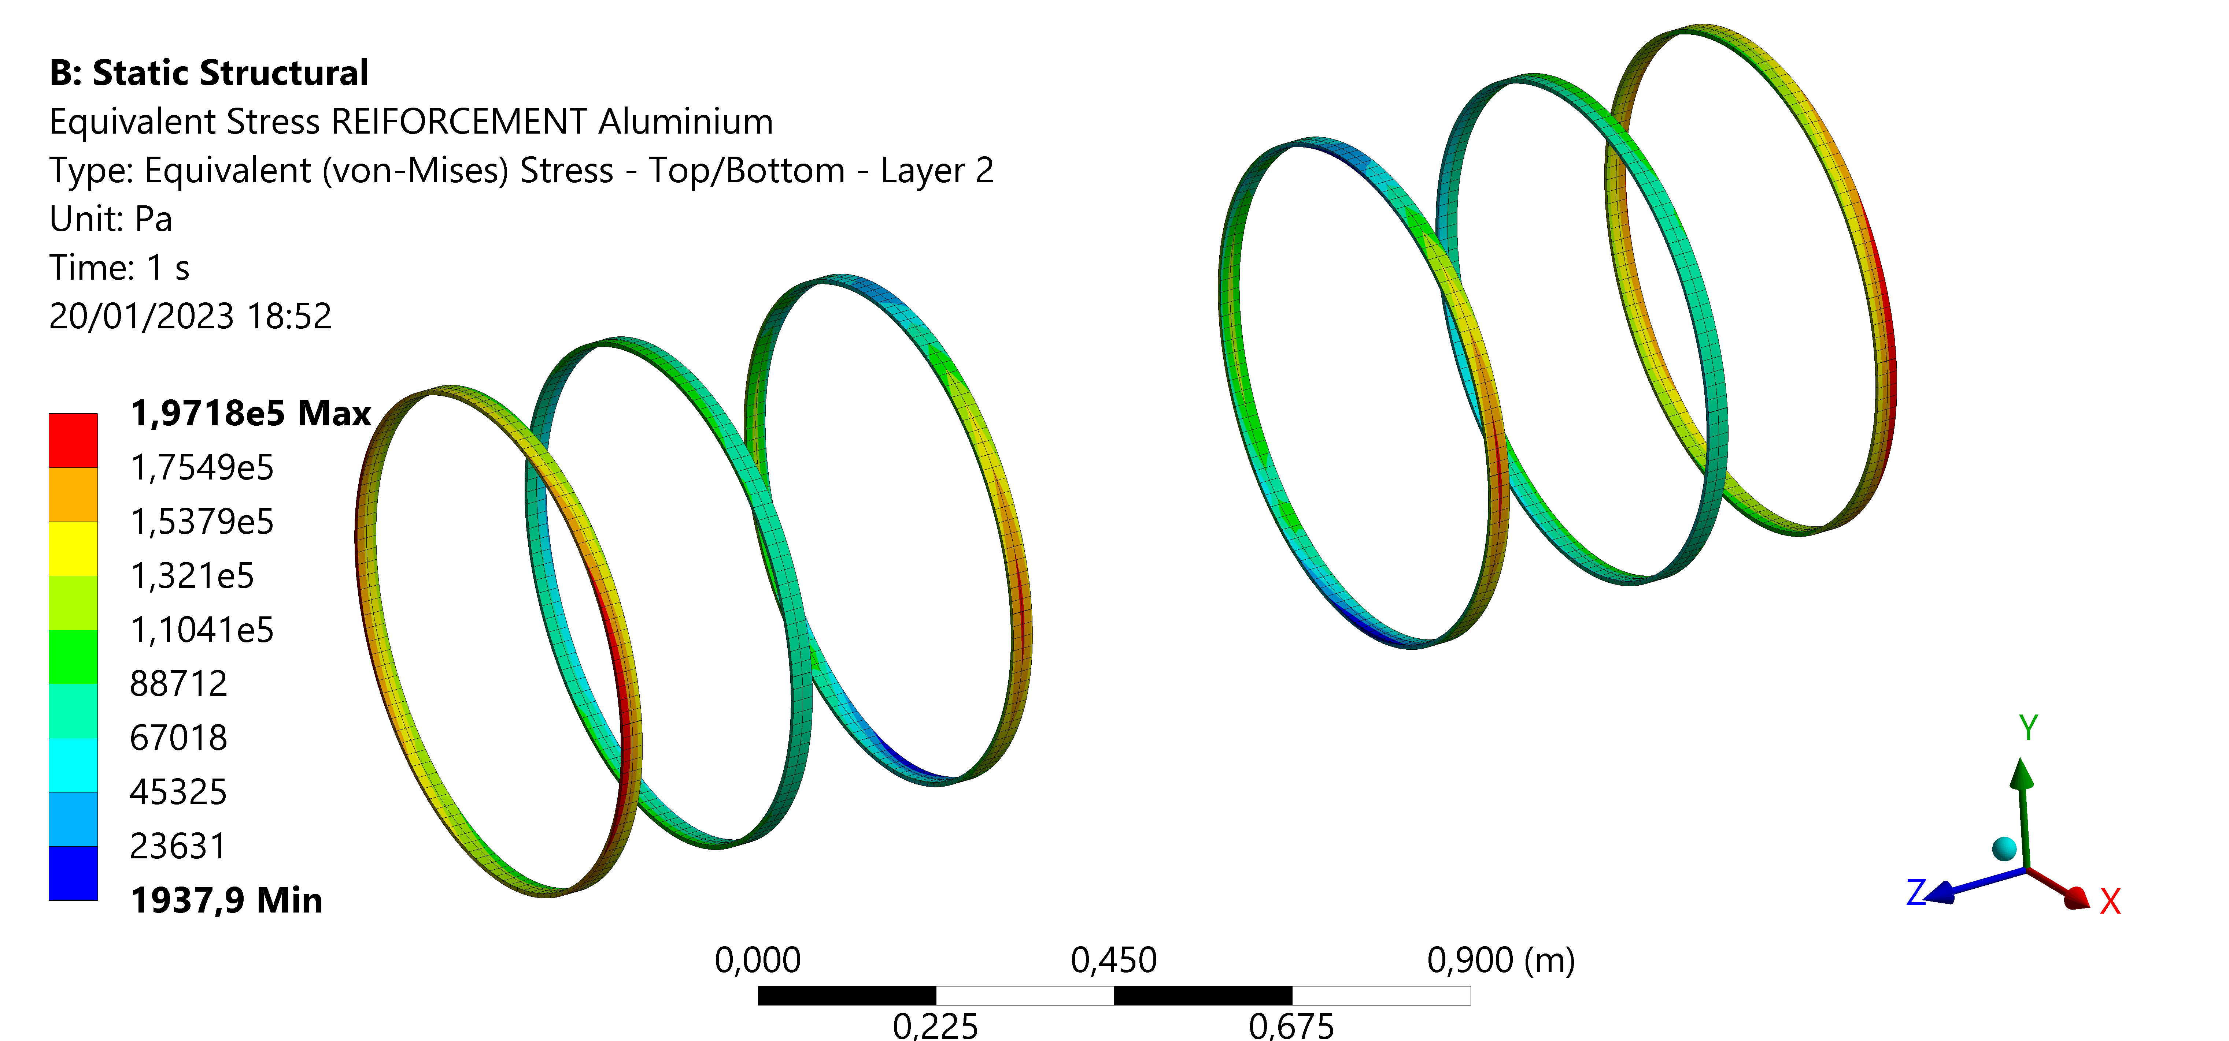
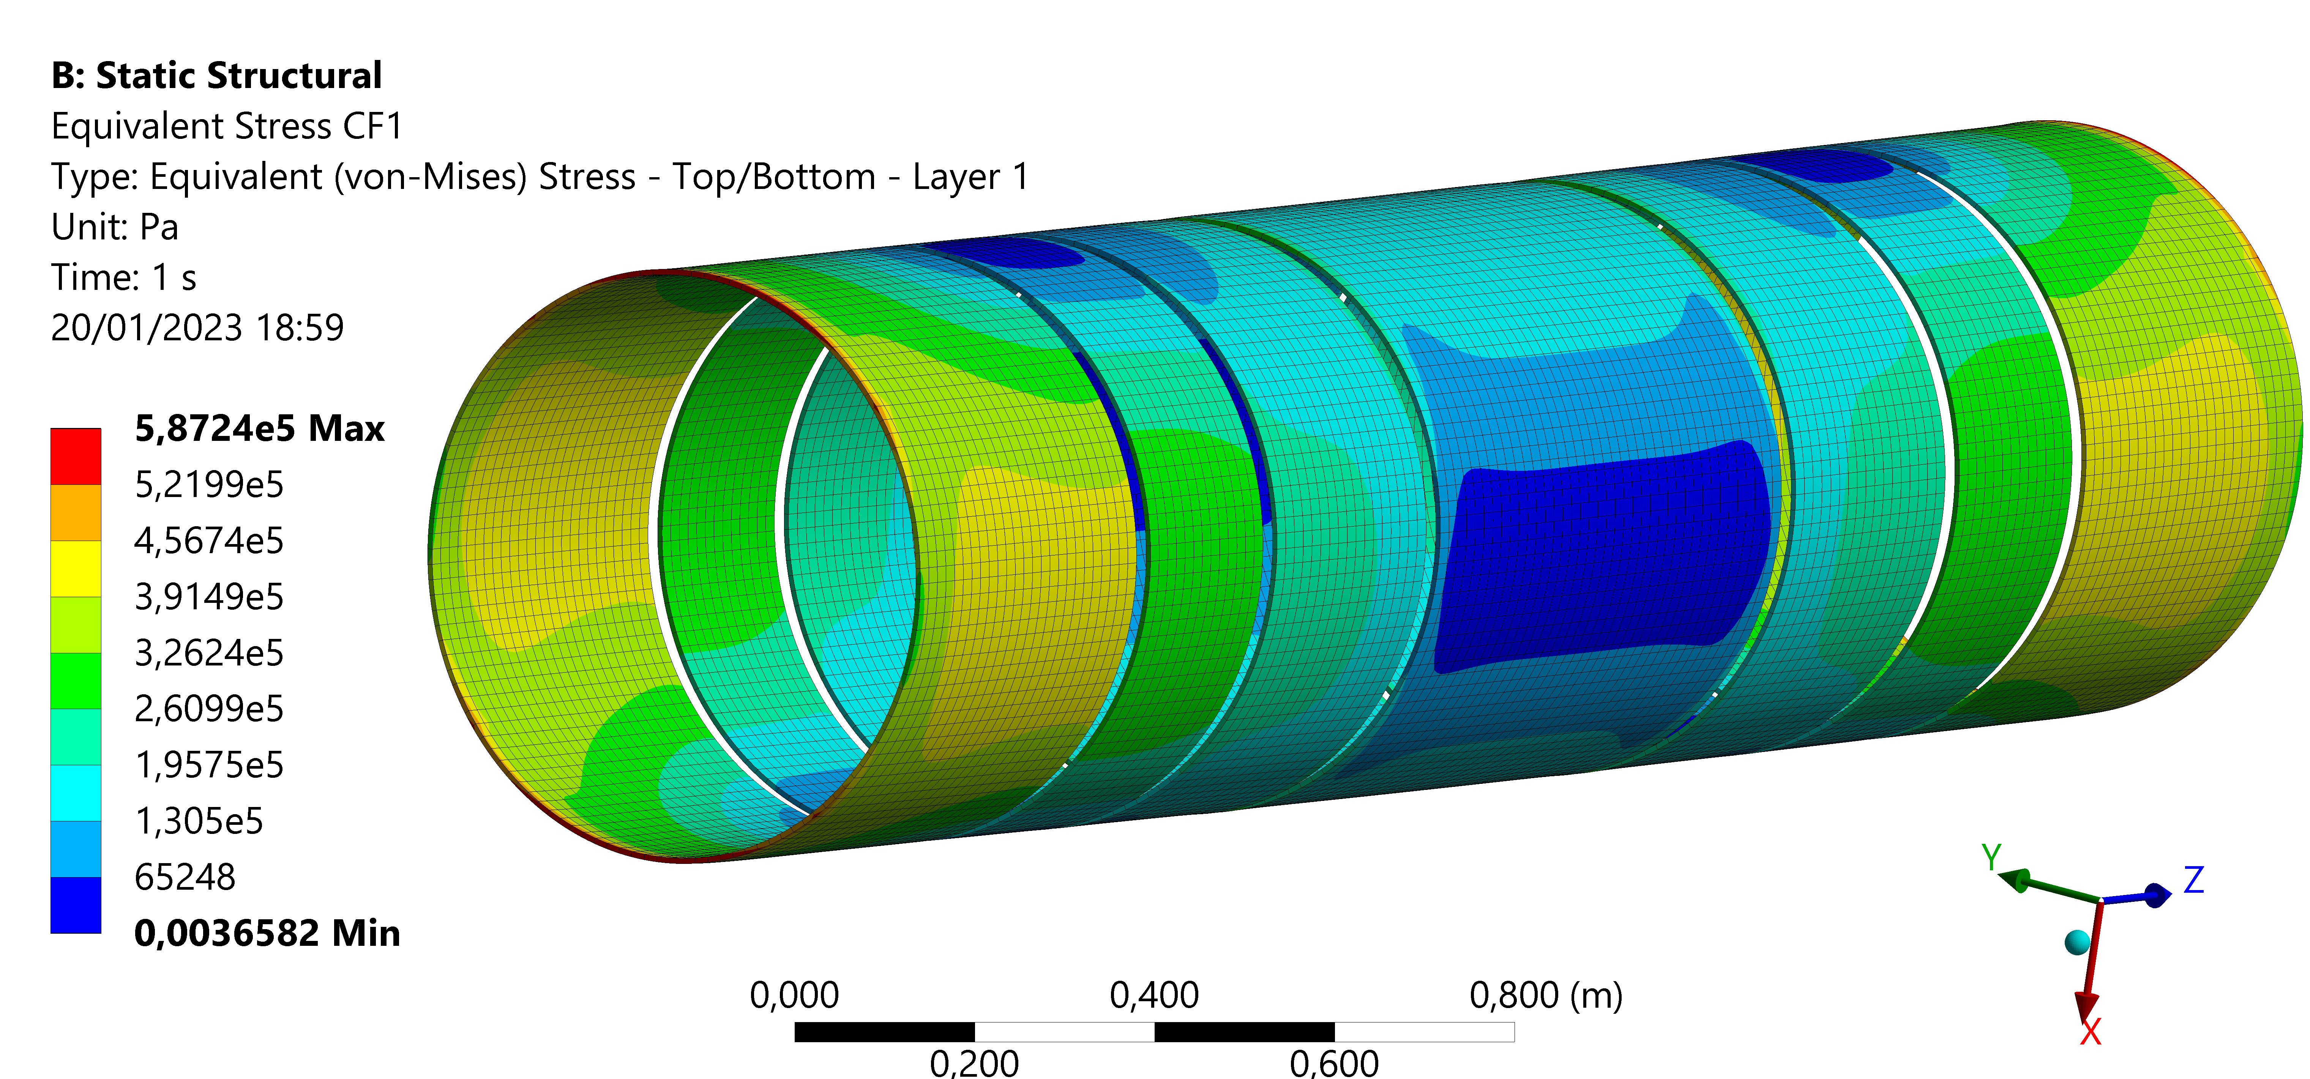
Support tube – Structural analysis – results
 | Maximum stress [MPa]
Aluminium flanges | 2.08
Aluminium ribs | 0.20
Honeycomb | 0.02
Carbon fiber | 0.60
 | Maximum displacement X [mm]
Aluminium flanges | 1.34 e-2
Aluminium ribs | 2.62 e-2
Composite | 2.80 e-2

Slide 19
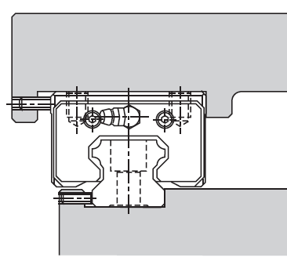
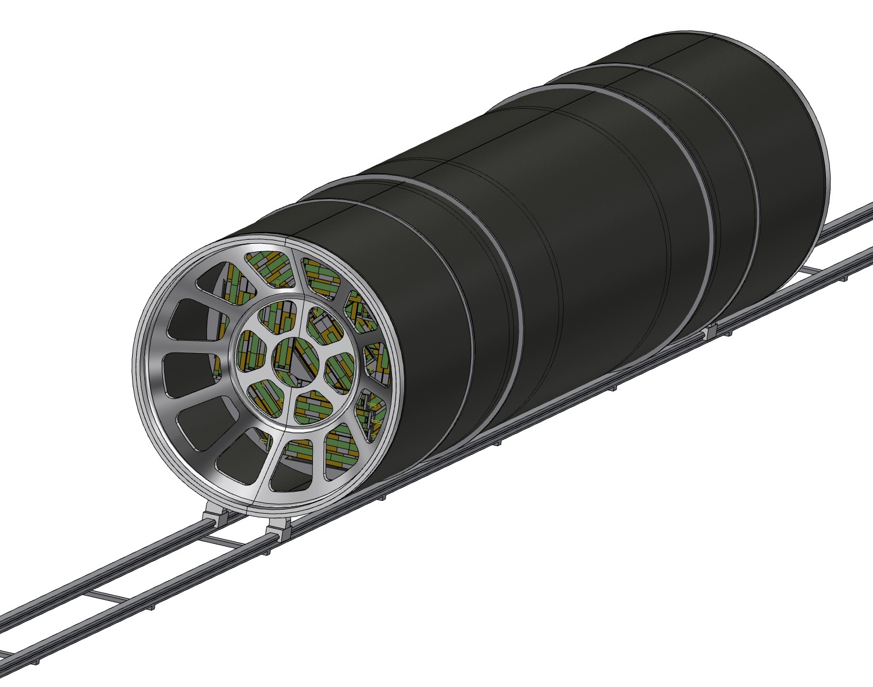
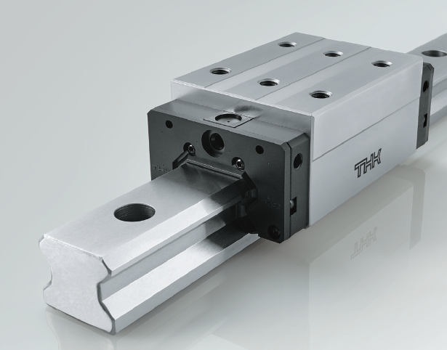
Support tube – Rail
SECTION
The support tube needs to be inserted into the main detector; the idea is to use a rail, starting from the outside of the detector to allow the sliding of the cylinder.
To assure a good precision and appropriate support it is necessary to use the linear bearings; different types are available, the choice has to be made considering:
Required positioning precision
Weight of the whole structure
Necessary degrees of freedom
After the positioning the rail will be removed, and the support tube attached to the detector

Slide 20
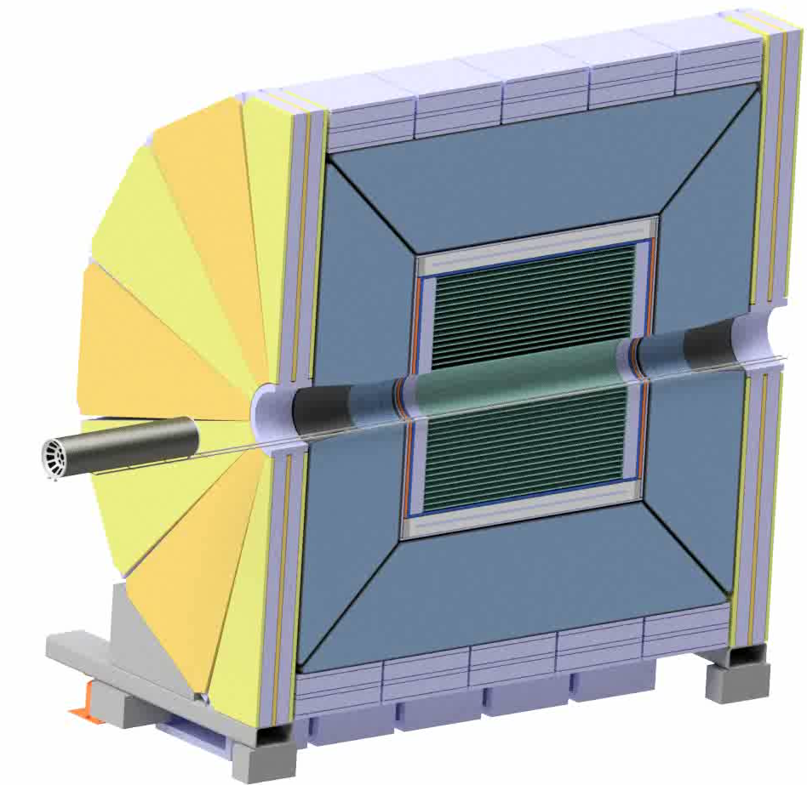
Under study:
Rail support
Rail anchoring
Rails length
Geometry of the rail section
Linear bearing type
Positioning system
Hypothesized anchoring point
To continue the design, it is necessary to know:
Allowable anchoring point from detector side
Allowable space (internal detector diameter and geometry)

Slide 21

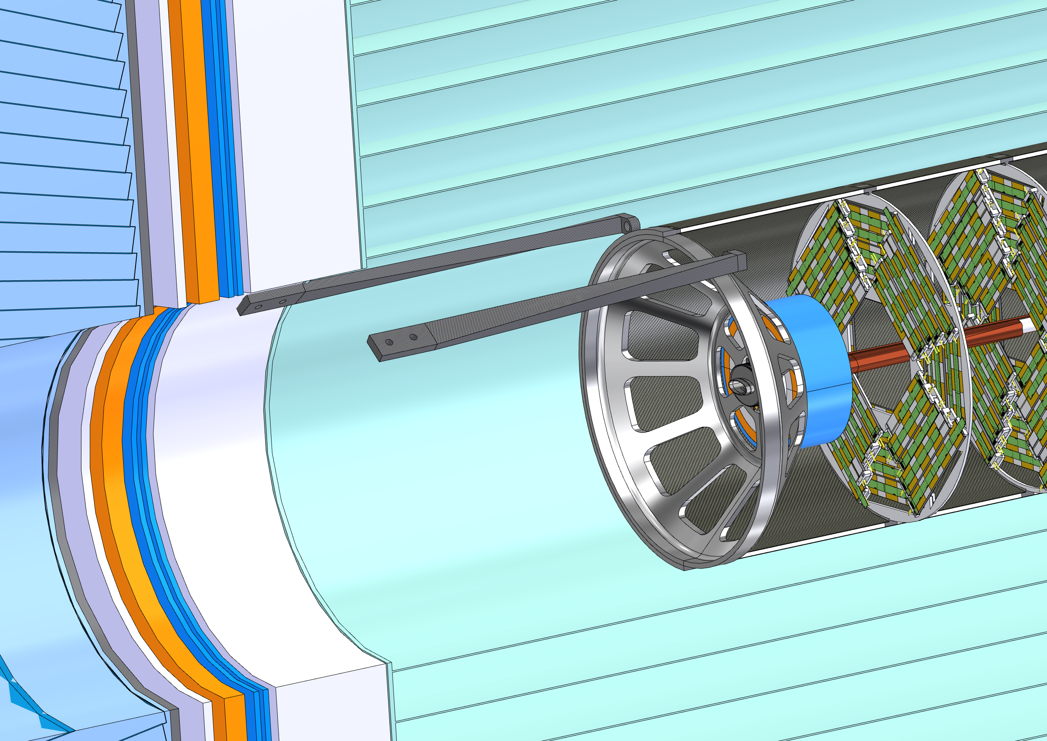
Structural optimization of Support Tube flanges
The FCC project is a precious opportunity to use the most innovative techniques in mechanical design.
The structural optimization is a field in rapid developing, different techniques have been validate and more are in progress. At the moment have been evaluated three main approaches to reduce the mass maintaining the requirement in term of stress and displacement. The analysis is in progress, and this is a report of the current state of the work.
The SIMP algorithm, based on the concept of penalty.
The Generative Design method, capable of creating a structure from an initial shape and from imposed spatial constraints.
The lattice structure with Field Driven design allows to create an infill or some area using lattice structure to maintain the geometric continuity using porous area.

Slide 22
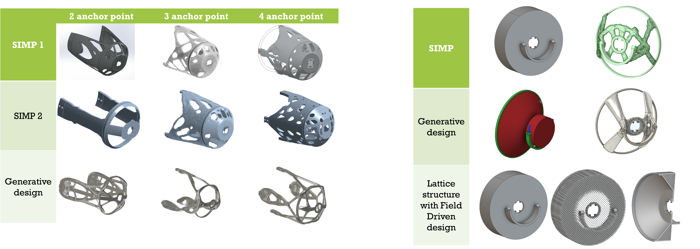
These methods have been used to optimize the interface between the Support Tube of the FCC Interaction region and the detector. The first step made is a preliminary analysis to study the number and position of anchoring point for the Support Tube. After the choice of the best configuration has been performed three structural optimization for each design, using two different SIMP algorithm and a Generative Design algorithm.
After the comparison of these design has been performed a study of the final flange of the support structure, using the SIMP algorithm, the Generative Design and the lattice structure with Field Driven design.
Chamber anchor
LumiCal anchor

Slide 23
Conclusion
The current central chamber design is now compatible with the Inner Vertex design.
The design of trapezoidal chamber is now compatible with LumiCal requirements.
The preliminary design of crotch chamber has been proposed.
The concept of Support Tube has been introduced and the proposal of an assembly strategy as well
The structural optimization of IR support structure is started.
Future steps
Central chamber: inlet and outlet (thick copper deposition), cooling system
Welding for elliptical shape
Prototyping
Integration of CLD detector
Increase the level of detail of the crotch chamber and support structure
Develop of remote vacuum connection
Most urgent

Slide 24
\

