Slide 1



EPOL:
The roadmap to the final report
Jacqueline Keintzel and Guy Wilkinson
On behalf of the
FCC-ee EPOL working group
FCC Week 2023
London, United Kingdom
June 08, 2023
FCCIS – The Future Circular Collider Innovation Study. This INFRADEV Research and Innovation Action project receives funding from the European Union’s H2020 Framework Programme under grant agreement no. 951754.
jacqueline.keintzel@cern.ch
guy.wilkinson@cern.ch

Slide 2
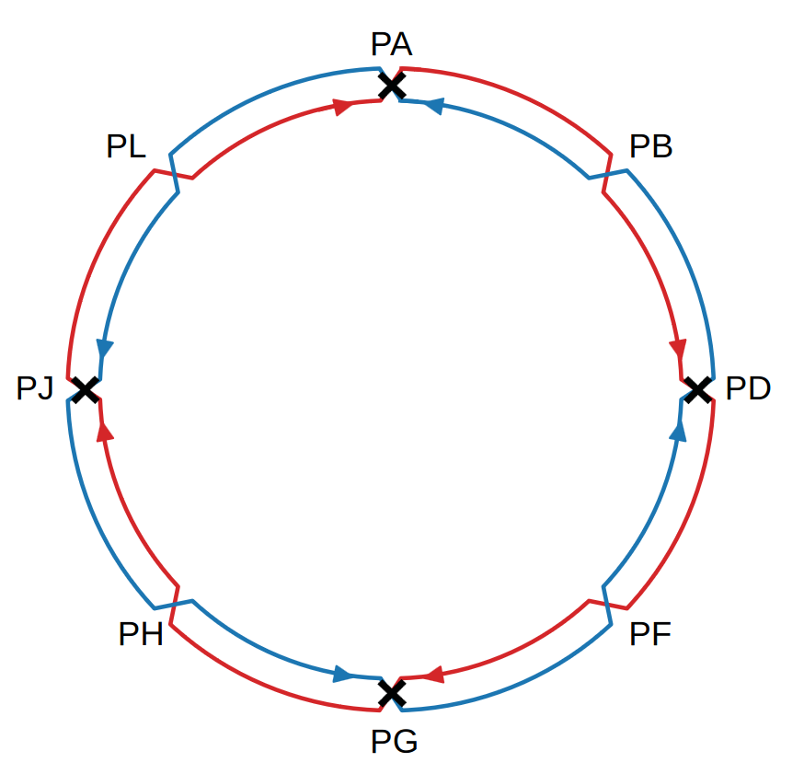
FCC-ee Overview
Particle Physics:
Higgs and electro-weak factory
4 baseline beam energies and diverse particle physics program
  45.6 GeV: Z-pole
  80 GeV: W-pair-threshold
  120 GeV: ZH-production
  182.5 GeV: top-pair-threshold
High number of statistics
Accelerator Physics:
4-fold super-symmetric layout
  Up to 4 Interaction Points (IPs)
  1 RF-section per beam
  1 collimation section
  1 section for injection and dump
Nanometer beam size at IPs
Strong synchrotron radiation
Precision particle physics experiments Center-of-mass energy determination

Slide 3
Center-of-mass Energy Uncertainty
Absolut scale error (abs)
Point-to-point errors (ptp)
True
E_{cm} (abs)
0
E_{cm} (EPOL) - E_{cm} (True)
E_{cm} (EPOL)
Measured
E_{cm} (abs)
E_{cm} (ptp)
0
m_{Z}
E_{cm} (True)
98.5
103.5
107.5
E_{cm} (True) in units of spin tune
Error between measured and true E_{cm}
Large effect on mass measurement
Stems from systematic errors
Fluctuation between measurements
Large effect on resonance width measurements
Stems from variability of measurement conditions
Courtesy: A. Blondel

Slide 4
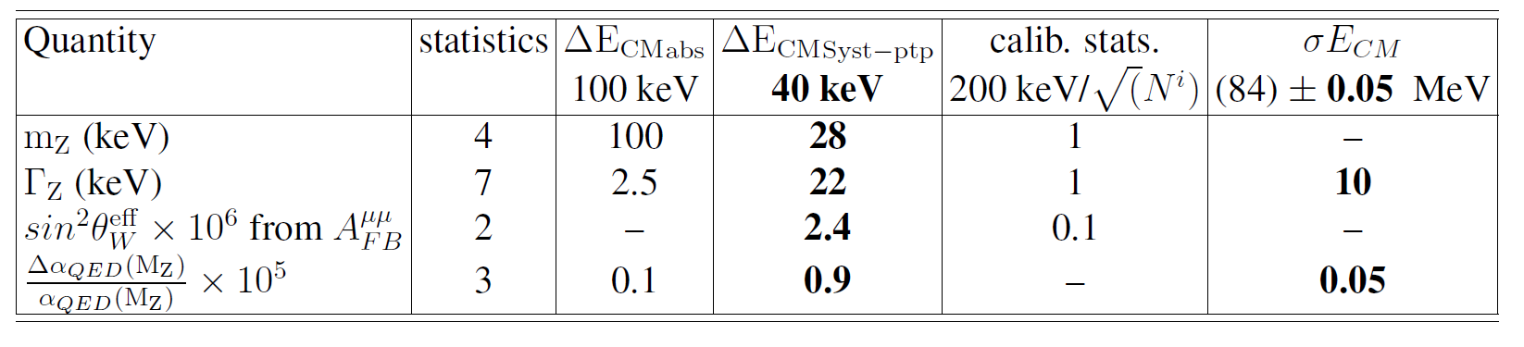
Expected Precision
4
4
2
3
Z
Further clarification ongoing 300 keV 150 keV
m_{W}(MeV) 0.200 (?) 75 keV?
Γ_{W} (MeV) (75?) small OK
WW
Large expected luminosity → huge statistics → small statistical error: 4 / 100 keV per Z / W - boson
Aim to achieve same order of magnitude for systematic errors → Scope of the EPOL working group
EPOL: Energy calibration, polarization and monochromatization
arXiv:1909.12245

Slide 5
How to?
Detector
input
Special mode:
monochromatization
Polarization
build-up
Depolarization
Polarimetry
ECM
Resonances
Wigglers
Beam tests
Resonant depolarization
Free spin precession
Polarimeter incl.
laser, Si-detectors
e.g. EIC experience
Systematic errrors
Statistical errors
Accurate models

Slide 6
Polarization Build-Up
Statistically every 10^{10th} emitted synchrotron photon flips the spin
Probability depends on the initial spin orientation
Leads to a natural polarization build-up over time
Orientation is anti-parallel to the guiding magnetic field
Maximum theoretical polarization of 92.4 %
Spin precesses through the lattice → Spin tune
N
More likely
(by factor ~25)
S
N
Less likely
S
ν = a * γ_{Rel}
a … gyro-magnetic anomaly
γ_{Rel} … Lorentz-factor

Slide 7
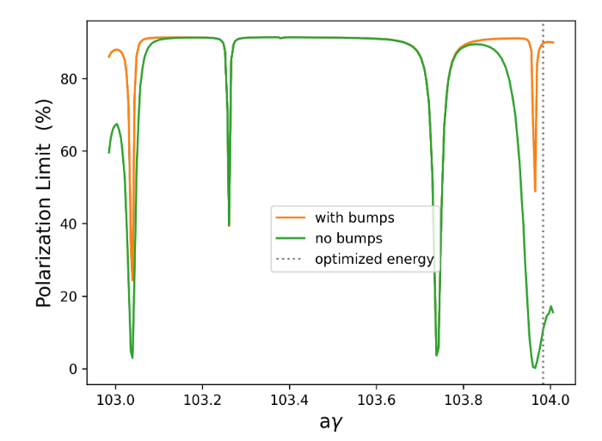
Resonances and Orbit Bumps
Polarization decreases with resonances, orbits, machine errors etc.
Improved with special closed-orbit bumps
Example: at 45.394 GeV → ν = 103.016
Maximum polarization improved from 60 to 87 %
Requires orbit and angle measurement between dipoles
What is the max. allowed closed orbit for polarization?
How many BPMs are needed where, with which precision?
Can this scheme be tested somewhere?
Courtesy: Y. Wu

Slide 8
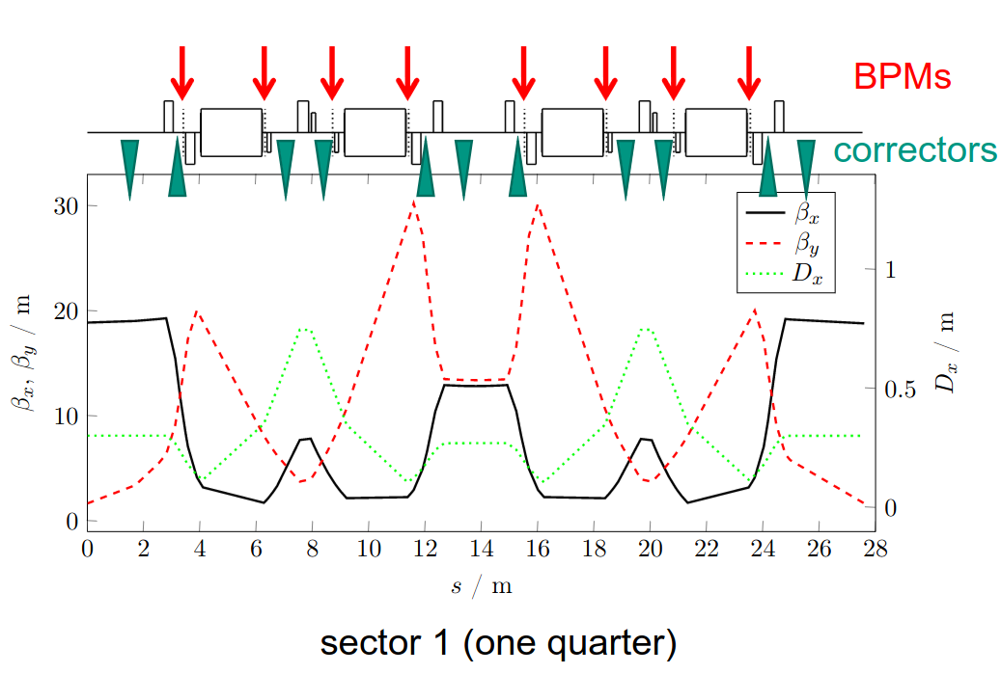
Beam Test Polarization and Bumps
KARA at KIT, polarization time ~ 10 min
Polarization measurements via Touschek lifetime change
Possible beam test:
Generate strong depolarizing source
Find orbit bumps to increase max. polarization
Can FCC-ee orbit bumps be tested at KARA?
Possible long term idea: Is it possible to install and test an FCC-like polarimeter?
Courtesy: B. Härer, E. Blomley

Slide 9
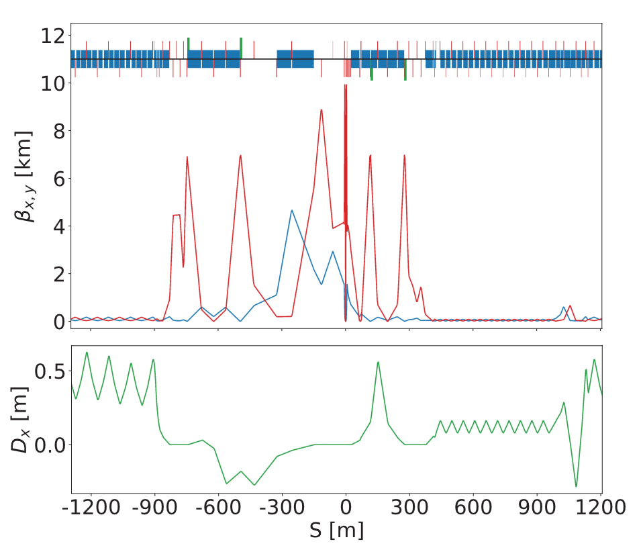
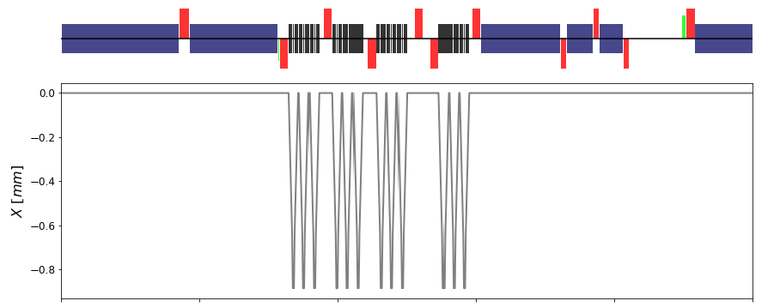
Wigglers
Blue: Dipoles; Red: Quadrupoles
Beam
β_{x}
β_{y}
Large orbit
Emitted ~MeV photons
Courtesy: M. Hofer
At 45.6 GeV energy: Polarization time of 248 h
Solution: wiggler magnets
  Reduce polarization time to 12 h
  Increase energy spread by factor ~ 3.5
Aim to have a realistic design of wiggler magnet.

Slide 10
Operational Scenario
Inject a few (100-200) non-colliding pilot bunches (~10¹⁰ ppb)

Slide 11
Operational Scenario
Inject a few (100-200) non-colliding pilot bunches (~10¹⁰ ppb)
Switch on wigglers until ~5-10 % vertical polarization reached

Slide 12
Operational Scenario
Inject a few (100-200) non-colliding pilot bunches (~10¹⁰ ppb)
Switch on wigglers until ~5-10 % vertical polarization reached
Switch wigglers off

Slide 13
Operational Scenario
Inject a few (100-200) non-colliding pilot bunches (~10¹⁰ ppb)
Switch on wigglers until ~5-10 % vertical polarization reached
Switch wigglers off and inject ~10⁵ colliding bunches (~10¹¹ ppb)

Slide 14
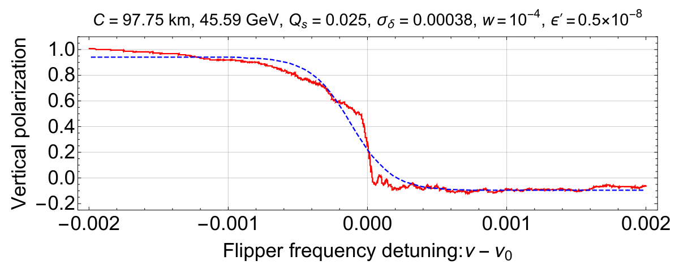
Operational Scenario
Inject a few (100-200) non-colliding pilot bunches (~10¹⁰ ppb)
Switch on wigglers until ~5-10 % vertical polarization reached
Switch wigglers off and inject ~10⁵ colliding bunches (~10¹¹ ppb)
Measure beam energy with pilots while collisions take place
What is the minimum required polarization level?
Which pilot bunch intensities are required?
What is their lifetime and do they need to be topped-up?

Slide 15
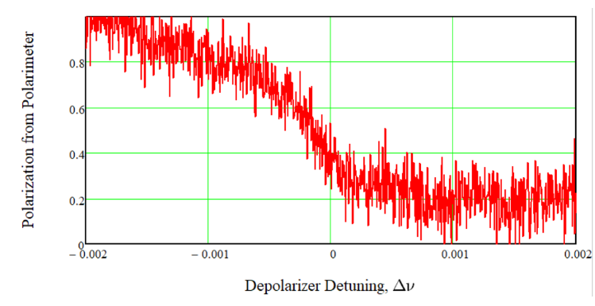
Resonant Depolarization
Independent depolarizers per beam
Easily accessible for maintainance
TEM wave propagating towards a pilot bunch
Varying exciting frequency
Exciting frequency = spin tune = depolarization
Where is the best location for depolarizers?
Do we need to scan in opposite directions simultanesouly? (2 depolarizers per beam?)
Z-pole
Natural width ~ 200 keV at Z
And 1.4 MeV at W
WW
Courtesy: I. Koop

Slide 16
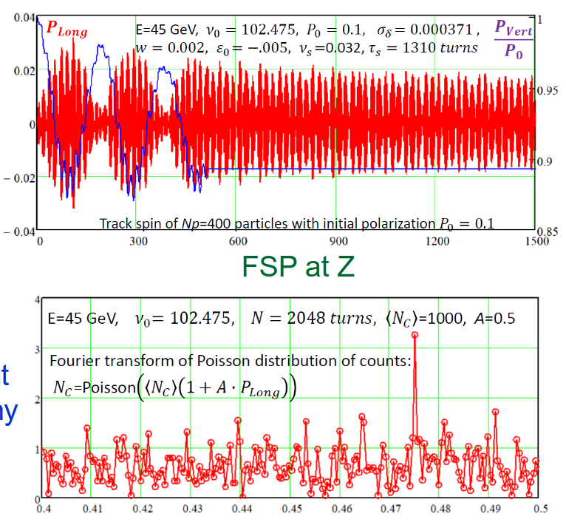
Free Spin Precession
Stronger depolarizer kicks the vertical spin into other plane
Observation of oscillation between these planes
Spin tune obtained via Fourier Transform
Yields the full spin spectrum
Is this technique feasible in a realistic machine?
How often should this be performed?
Can we flip the spin and re-use the same bunches?
Courtesy: I. Koop

Slide 17
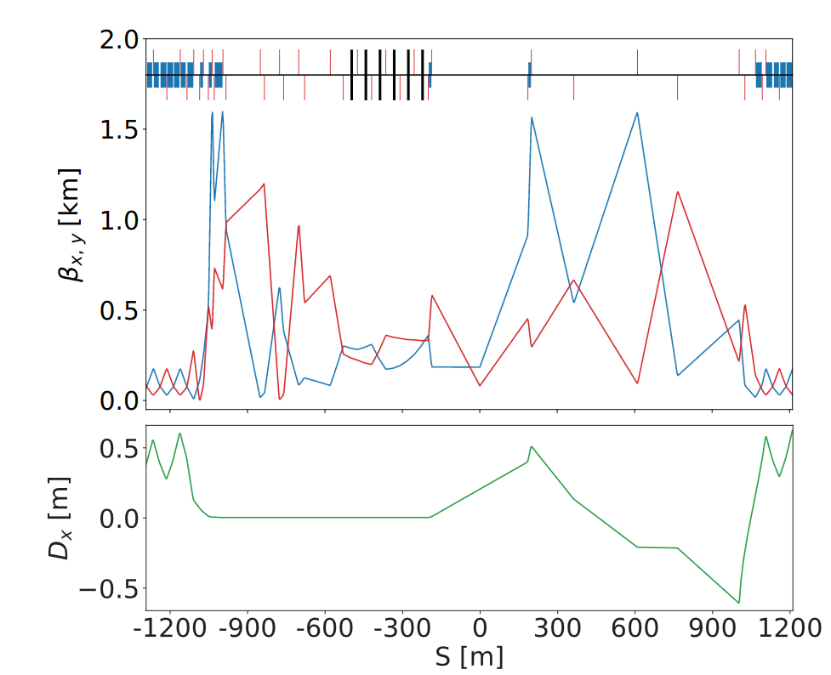
Polarimeter
In present experimental interaction region design space foreseen, but possibly more space in RF-section
Where is the best integration point for the polarimeters?
Blue: Dipoles; Red: Quadrupoles
Blue: Dipoles; Red: Quadrupoles
Beam
β_{x}
β_{y}
EIR
RF-Section

Slide 18
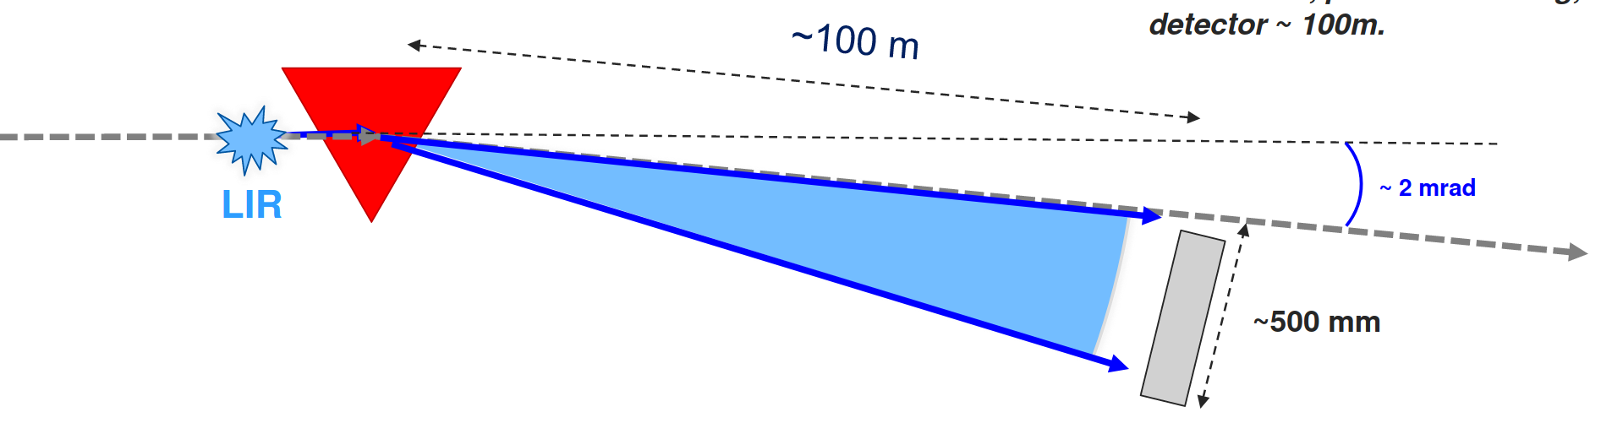
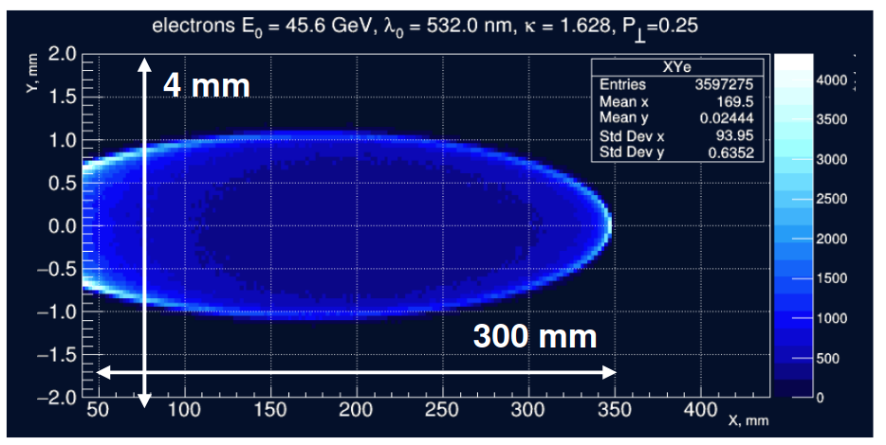
Polarimeter
~ 520 nm circular polarized laser interacts with beam
Back-scattered photons sufficient for resonance measurement
Additional measurement of scattered electrons for 3D spin vector
At least 1 polarimeter per beam
What can be gained more polarimeters?
Can we learn from other projects, such as from EIC-experts?
~2 mrad Dipole
Laser
Scattered electrons to be measured by Si pixel detector
Backscattered photons
~2m Laser Interaction Region
Laser interacts with beam
Beam
Courtesy: M. Hofer and J. Wenninger
Scattered electrons
with minimum energy
Courtesy: N. Muchnoi

Slide 19
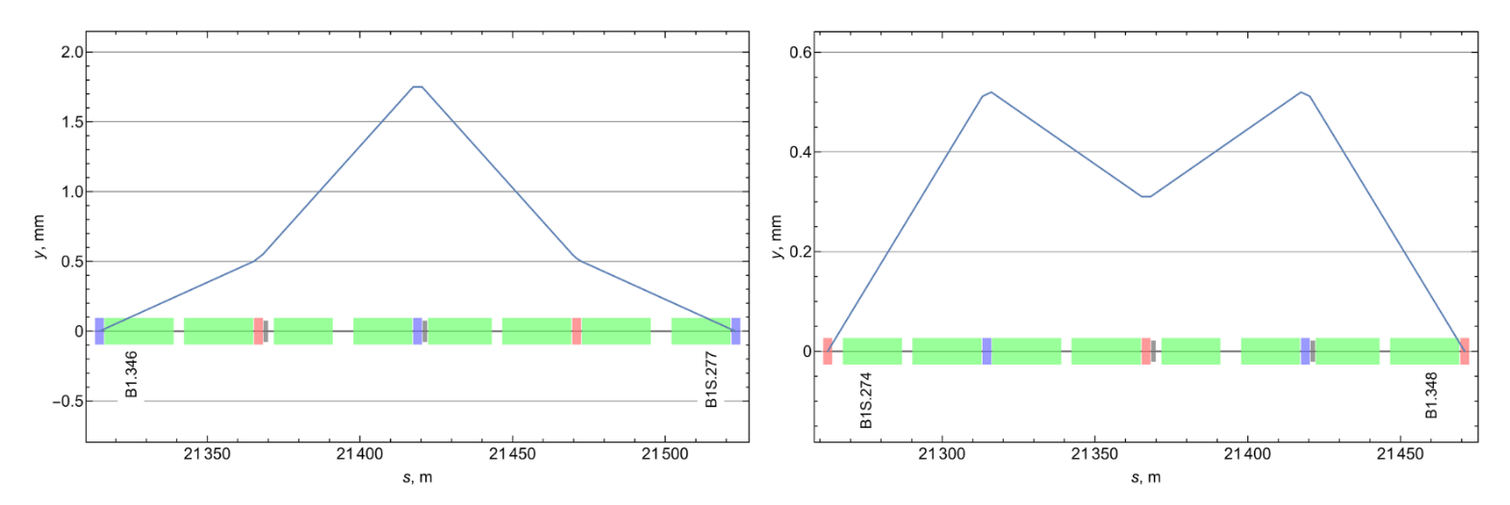
Colliding Bunches Polarization
Take away message:
Longitudinal polarization could spoil measurements and must be < 10-5
Depolarizers must also act on colliding bunches → Consider closed-orbit bumps to avoid impact at IP
To be measured also with polarimeters
What could be the impact of RF-kickers acting on colliding bunches?
Which RF-kicker and polarimeter design is the most suitable for pilot and colliding bunches?
Courtesy: I. Koop

Slide 20
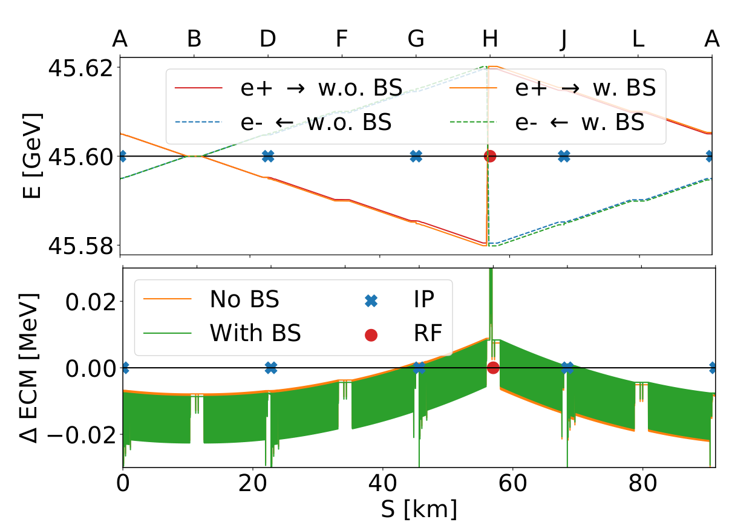
From Beam Energy to E_{CM}
40 MeV synchrotron radiation losses per turn
Additional beamstrahlung (BS) (synchrotron radiation due to
field of colliding bunch) ⪅ 0.62 MeV/beam/IP
Same RF-section for both beams to compensate losses
ΔE_{cm} ~ -8 keV (PA, PD) and ~0.7 keV (PG, PJ)
Boosts ~ +/- 10 MeV (PA, PD) and ~ +/- 30 MeV (PG, PJ)
Pilot and colliding bunches have different local energy
Accurate models essential
What are the systematics between pilot bunches and colliding ones?

Slide 21
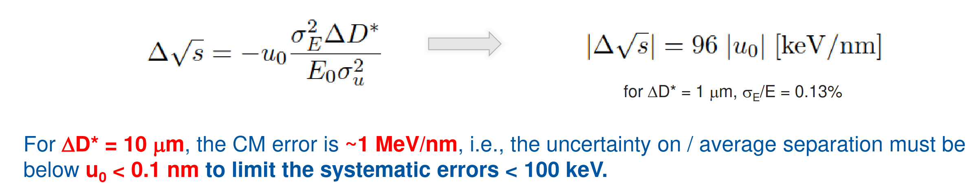
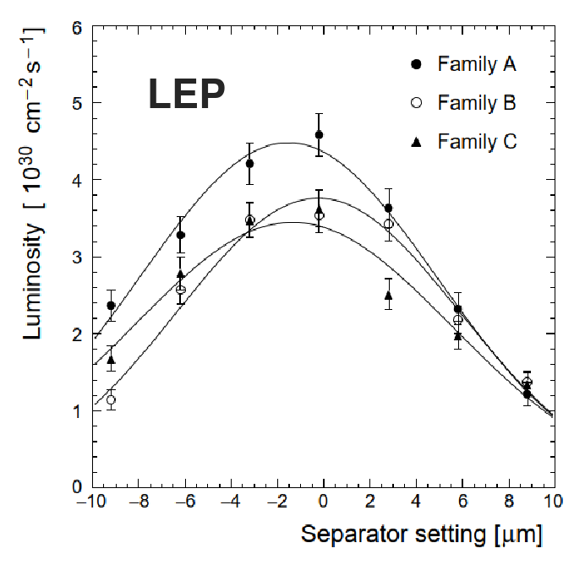
Dispersion and Collision Offset
D… Dispersion
σ_{u} … transverse beam size
u₀ … collision offset
Measurement and control of dispersion and collision offsets at IP essential
  ΔD < 1 µm relaxes requirements on collision offsets
Can it be demonstrated that collision offsets can be controlled to ~0.1σ_{y}?
How can we best measure dispersion at the IP? (RF-shift, orbit bump)
J. Wenninger: Beam-beam and OSVD

Slide 22
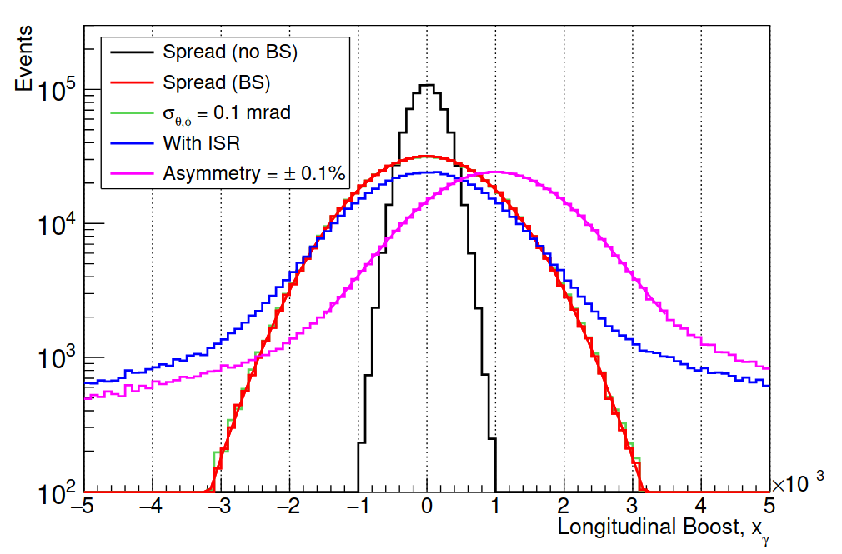
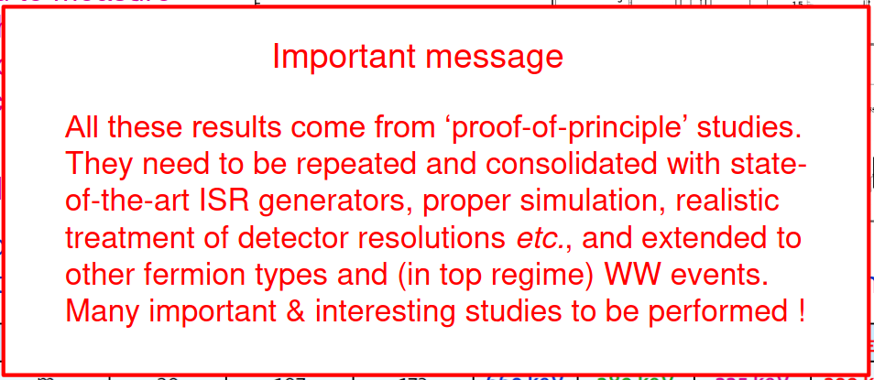
Experiments
G. Wilkinson: Di-muon events - “The gift that keeps on giving”
Reliable and frequent logging of parameters essential
Possibility to measure Z-bosons from higher E_{cm} events
One million di-muon events per 8h shift
~ 5 keV statistical precession achievable
10⁶ dimuon events at Z-pole: e+e- –> μ+μ- (γ)
(γ)… Initial-State-Photon (ISR)
Boost reconstruction from di-muon events
arXiv:1909.12245

Slide 23
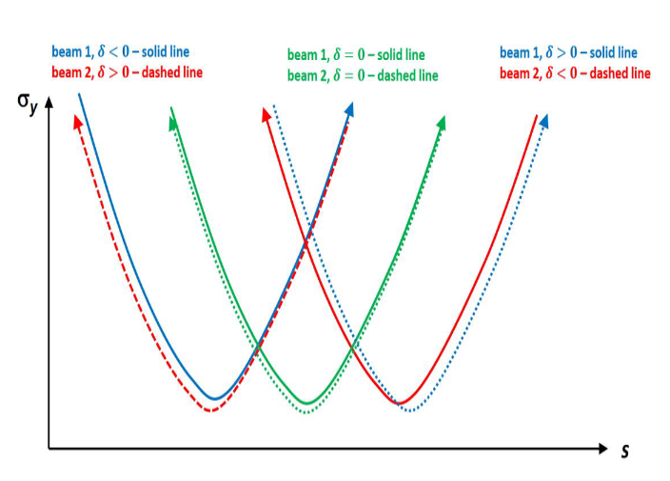
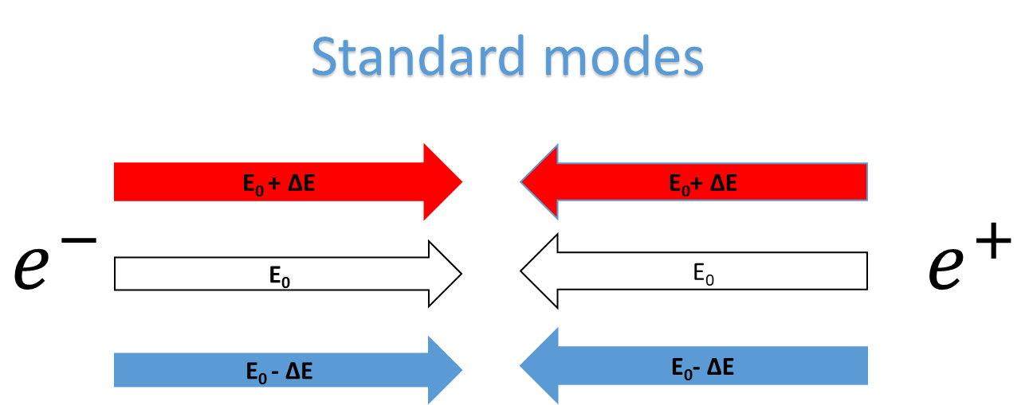
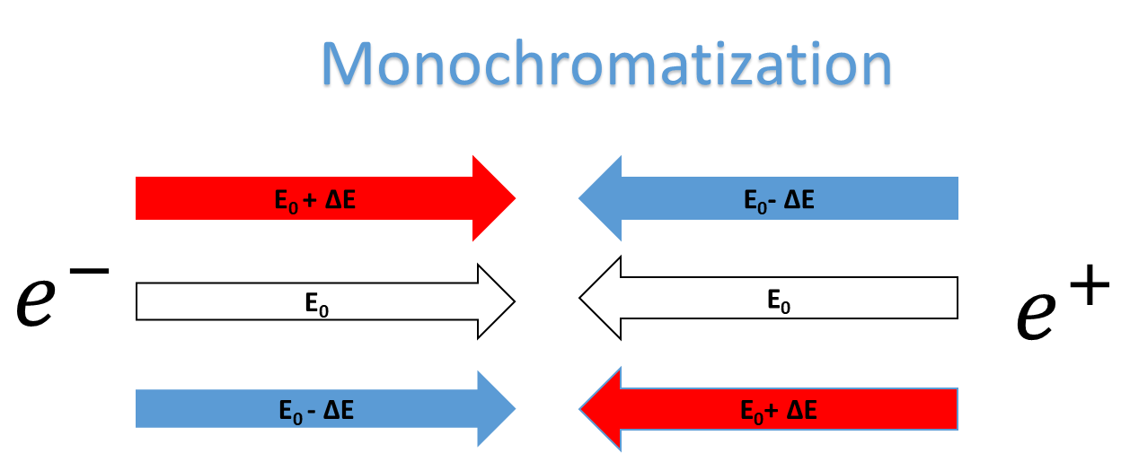
Monochromatization
62.5 GeV beam energy corresponds to the peak of Higgs-production with narrow width of 4.2 MeV
For minimization of collision energy spread –> monochromatization techniques required
What is the most suitable monochromatization technique and how can it be implemented?
Introducing dispersion
Introducing chromaticity
Same sign dispersion at the interaction point leads to change of E_{CM}
Opposite sign dispersion helps reducing E_{CM} spread
Non-zero local vertical chromaticity to reduce collision energy spread presently explored
Courtesy: A. Faus-Golfe, H. Jiang and P. Raimondi

Slide 24
Summary
High precision particle physics experiments require excellent determination of E_{cm} and collision boosts
Presently aimed to achieve 4 / 100 keV systematic uncertainty for the Z- / W- mass –> EPOL
A lot of great results produced so far and summarized in the mid-term report and FCC-note
Many questions aimed to be answered until the end of the feasibility study, including beam tests
Regular EPOL meetings:
indico.cern.ch/category/8678/
Typically every second Thursday 16:30-18:30
Mailing list:
fcc-ee-PolarizationAndEnergyCalibration@cern.ch
Self-subscription from:
https://e-groups.cern.ch/e-groups/EgroupsSearch.do
Any help is welcome!

Slide 25
Thank you!
EPOL: The Roadmap to
the final report
Jacqueline Keintzel and Guy Wilkinson
On behalf of the
FCC-ee EPOL working group
FCC Week 2023
London, United Kingdom
June 08, 2023
FCCIS – The Future Circular Collider Innovation Study. This INFRADEV Research and Innovation Action project receives funding from the European Union’s H2020 Framework Programme under grant agreement no. 951754.
jacqueline.keintzel@cern.ch
guy.wilkinson@cern.ch

Slide 26
