Slide 1
SPS pre-booster option
H. Bartosik, O. Etisken, Y. Papaphilippou,
with input from
F. Antoniou, JP. Burnet, A. Chance, P. Craievich, B. Dalena,
A. Grudiev, R. Kersevan, G. Le Godec, F. Zimmermann
June 2023, FCC week, London

Slide 2

Introduction
The Super Proton Synchrotron (SPS, 1976)
serves the North Area with slow extracted beam
and as LHC injector (protons and ions)

Slide 3
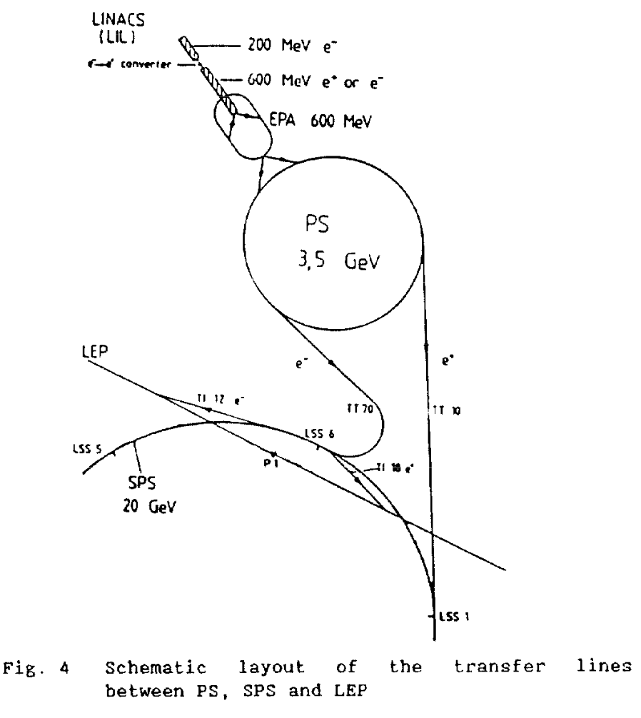
Introduction
The Super Proton Synchrotron (SPS, 1976)
serves the North Area with slow extracted beam
and as LHC injector (protons and ions)
The SPS served as injector for LEP in the past
(accelerating e⁺/e⁻ from 3.5 GeV to 20 GeV)
K. Cornelis, R. Schmidt, “Commissioning the SPS as LEP injector”

Slide 4
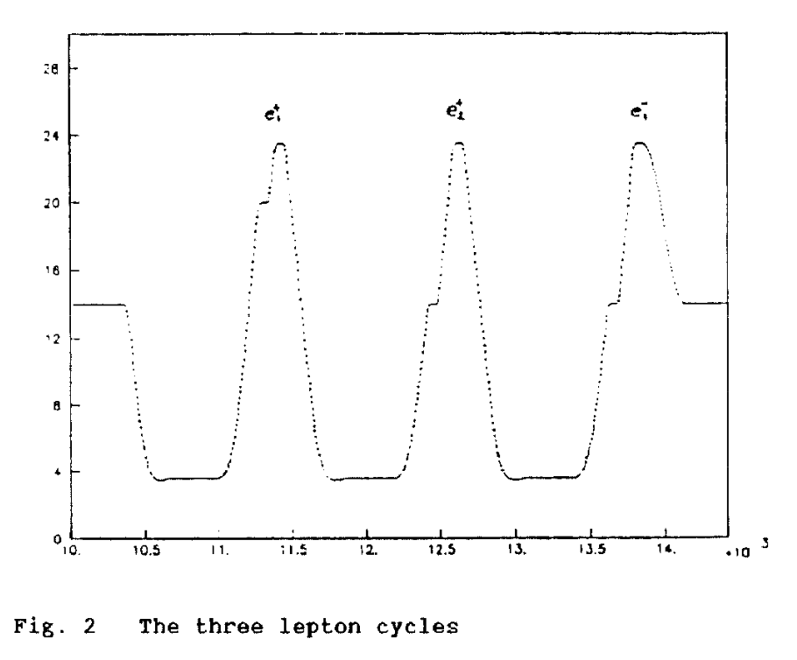
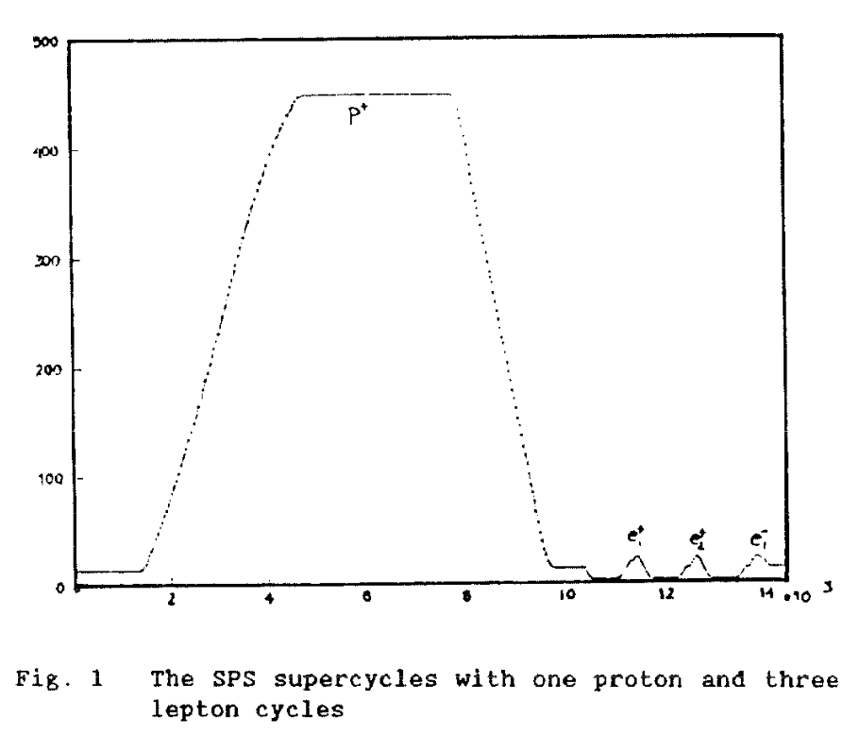
Introduction
The Super Proton Synchrotron (SPS, 1976)
serves the North Area with slow extracted beam
and as LHC injector (protons and ions)
The SPS served as injector for LEP in the past
(accelerating e⁺/e⁻ from 3.5 GeV to 20 GeV)
  To achieve a precision of ΔI/I < 10⁻³ for dipoles and quadrupoles at injection, low-level current control loops were switched between proton and lepton cycles
  Synchrotron radiation required installation of masks both inside and outside the vacuum chamber to protect main magnets, and shutters for extraction septa
  The SPS travelling wave cavities are “directional” and could only be used for positrons – additional 200 MHz standing wave cavities were installed for electrons, and a superconducting cavity at 352 MHz for acceleration of positrons to 20 GeV
K. Cornelis, R. Schmidt, “Commissioning the SPS as LEP injector”

Slide 5
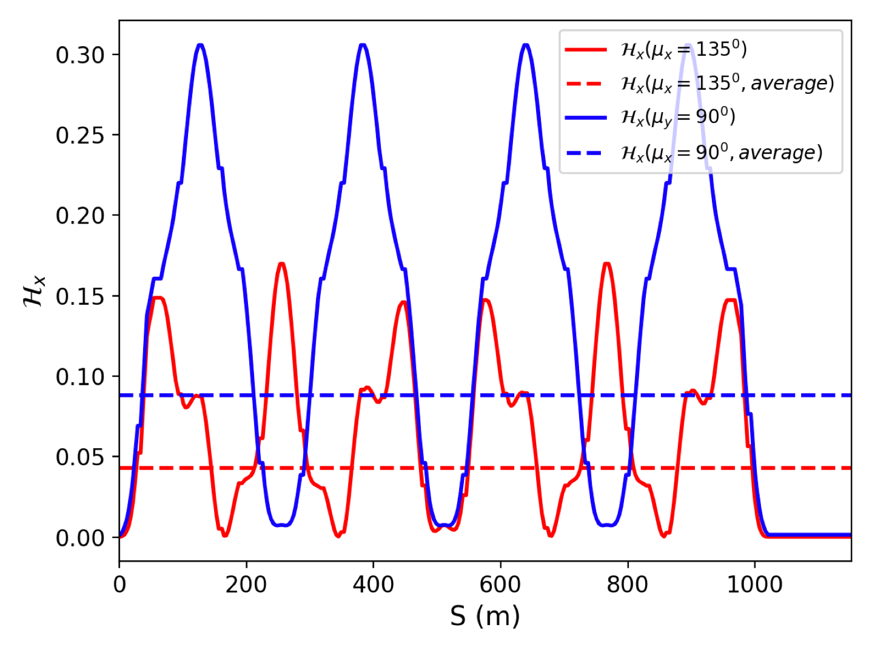
Optimization of SPS optics
The SPS consists of regular FODO cells with 6-fold symmetry (90 degree phase advance)
Horizontal phase advance of 135 degree optimizes horizontal emittance
  But still large emittance @extraction and damping time @injection (instabilities)​
SPS Parameters * *phase advance is close to 135⁰ |  | Requirements
SPS Bending radius [m] | 741.63
SPS injection energy [GeV] | 6
SPS extraction energy [GeV] | 16
Dipole length | 6.26
Bending field @ injection [Gauss] | 269.811
Bending field @ extraction [Gauss] | 899.3703
Emittance @ injection [m.rad] | 4.8x10⁻⁹
Emittance @ extraction [nm.rad] | 34 | 5
Energy Loss / turn @ injection [MeV] | 0.154
Energy Loss / turn @ extraction [MeV] | 7.8
Transverse Damping time @ injection [s] | 1.79 | 0.1
Natural chromaticity h/v | -72/-40
Energy acceptance at @ injection | 1%

Slide 6
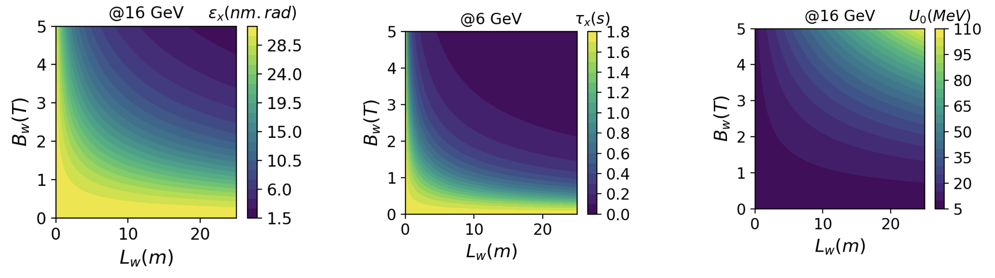
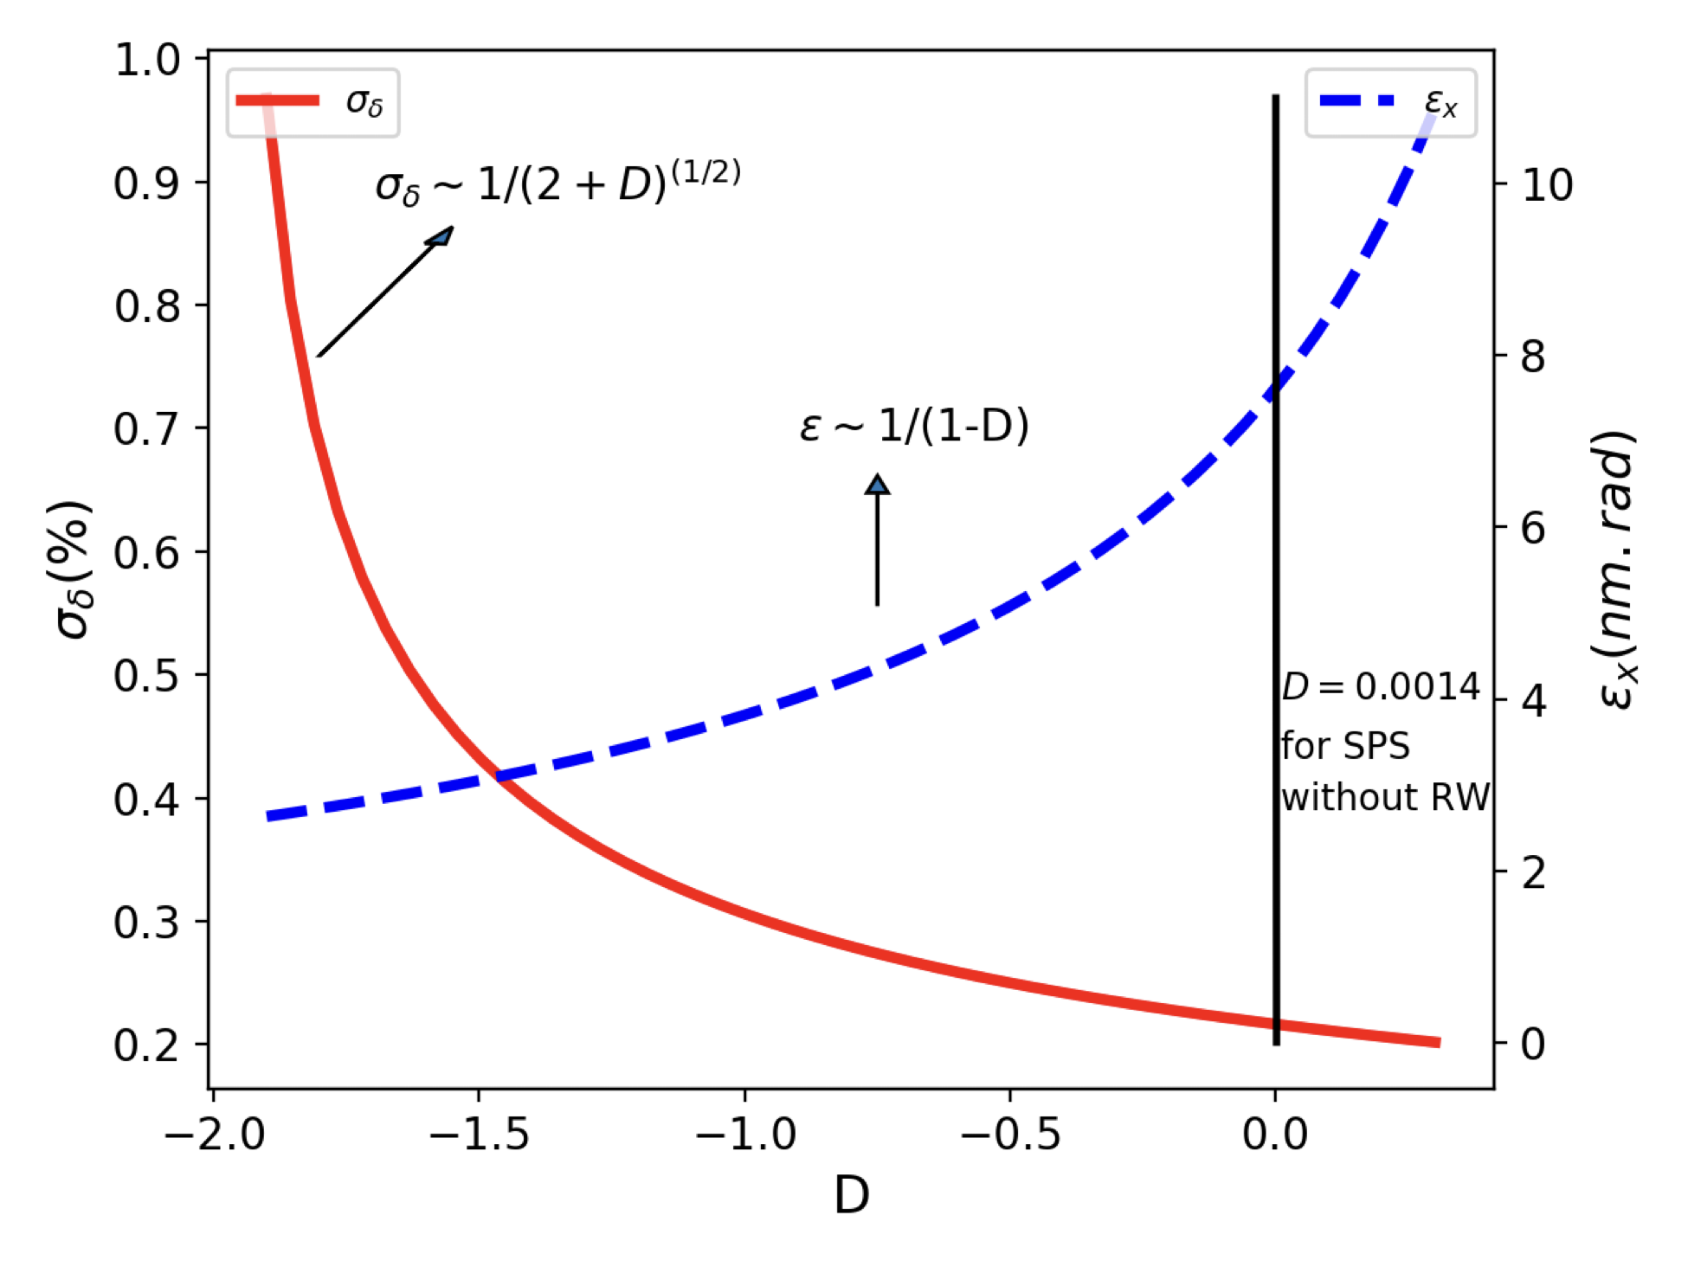
Installation of damping and Robinson wigglers
Smaller horizontal emittance at extraction and damping time at injection can be achieved with a wiggler of length 23 m and 3.5 T peak field
Energy loss per turn is however very large (>60 MeV)
Damping wigglers also needed to mitigate coherent instabilities, in addition to feedback ​
Robinson wiggler studied to further reduce horizontal emittance (but larger energy spread)
Effect of damping wigglers
Effect of Robinson wiggler

Slide 7
Extraction energy considerations
The CDR extraction energy is 20 GeV
As this however leads to a very large energy loss per turn, different extraction energy options were investigated
The 16 GeV option provides a reasonable energy spread, energy loss per turn and emittance
 | 20 GeV option |  |  |  | 18 GeV option |  |  |  | 16 GeV option
 | @ injection |  | @ extraction |  | @ injection |  | @ extraction |  | @ injection |  | @ extraction
 | w/ wiggler | w/o wiggler | w/ wiggler | w/o wiggler | w/ wiggler | w/o wiggler | w/ wiggler | w/o wiggler | w/ wiggler | w/o wiggler | w/ wiggler | w/o wiggler
Horizontal emittance* (nm.rad) | 1.03 | 4.88 | 5.92 | 54.25 | 0.95 | 4.88 | 5.60 | 43.9 | 0.73 | 4.88 | 5.64 | 34.7
Energy loss per turn (MeV) | 9.96 | 0.15 | 128.0 | 19.09 | 6.97 | 0.15 | 73.9 | 12.5 | 3.49 | 0.15 | 31.5 | 7.82
Damping time** (s) | 0.012 | 1.79 | 0.003 | 0.048 | 0.01 | 1.79 | 0.005 | 0.06 | 0.03 | 1.79 | 0.01 | 0.09
Energy spread*** (%) | %0.3 | %0.01 | %0.60 | %0.06 | %0.35 | %0.01 | %0.5 | %0.05 | %0.3 | %0.01 | %0.38 | %0.05
RF Voltage (MV) | 35 |  | 160 |  | 30 |  | 90 |  | 25 |  | 45
Damping wiggler B[T] / L [m] | 6 / 12.15 |  |  |  | 5 / 12.15 |  |  |  | 3.5 / 12.15
Robinson wiggler B[T] / L [m] | 0.5 / 12 |  |  |  | 0.5 / 12 |  |  |  | 0.5 / 6

Slide 8
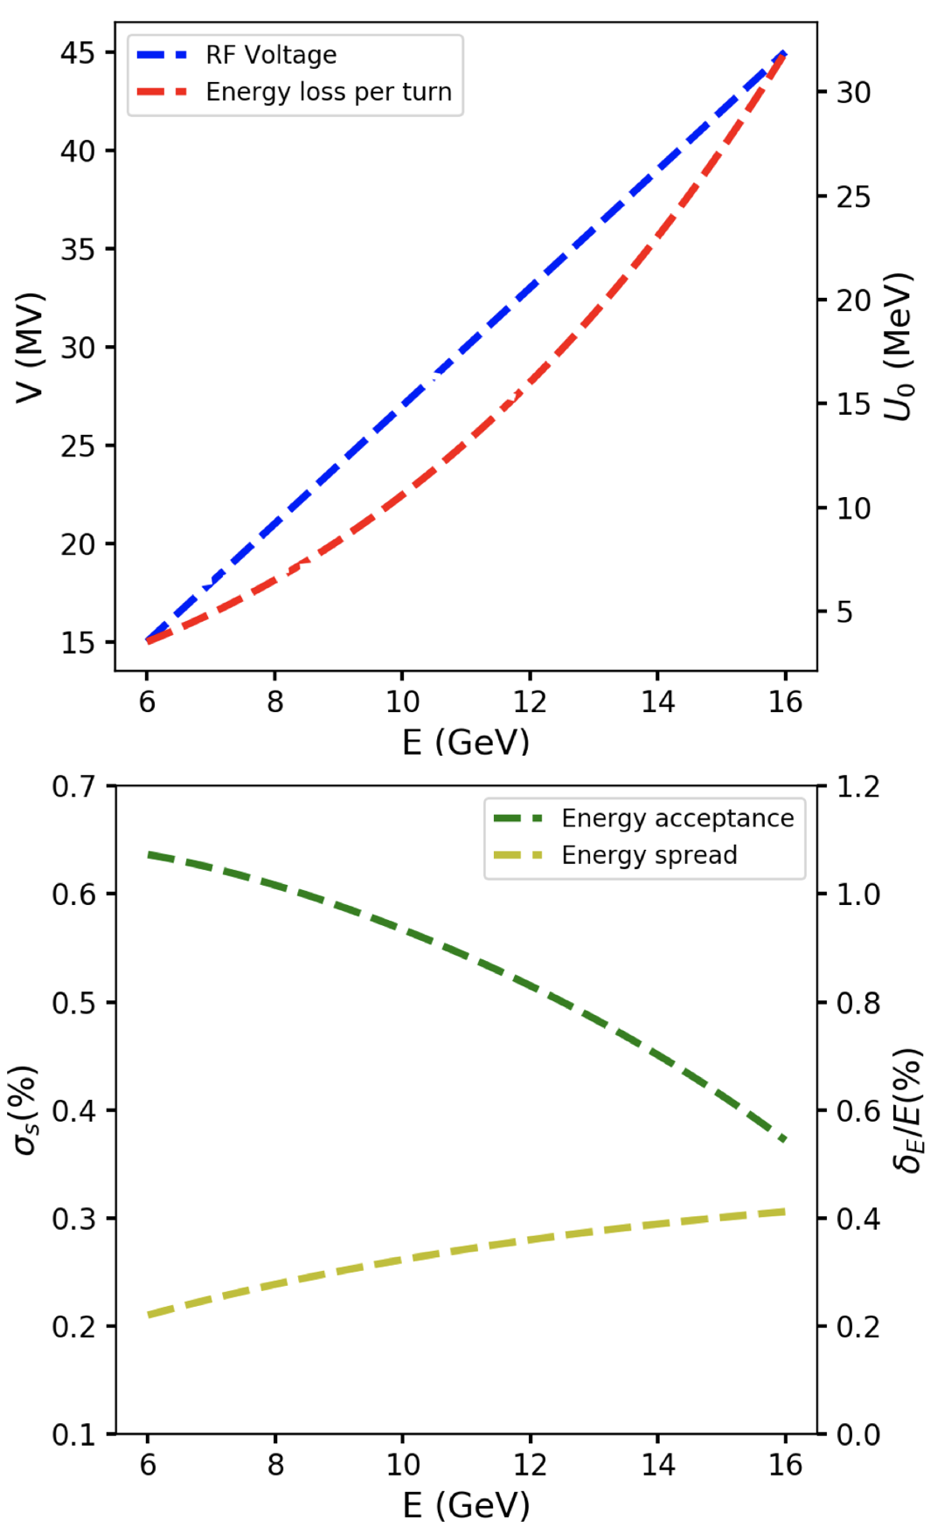
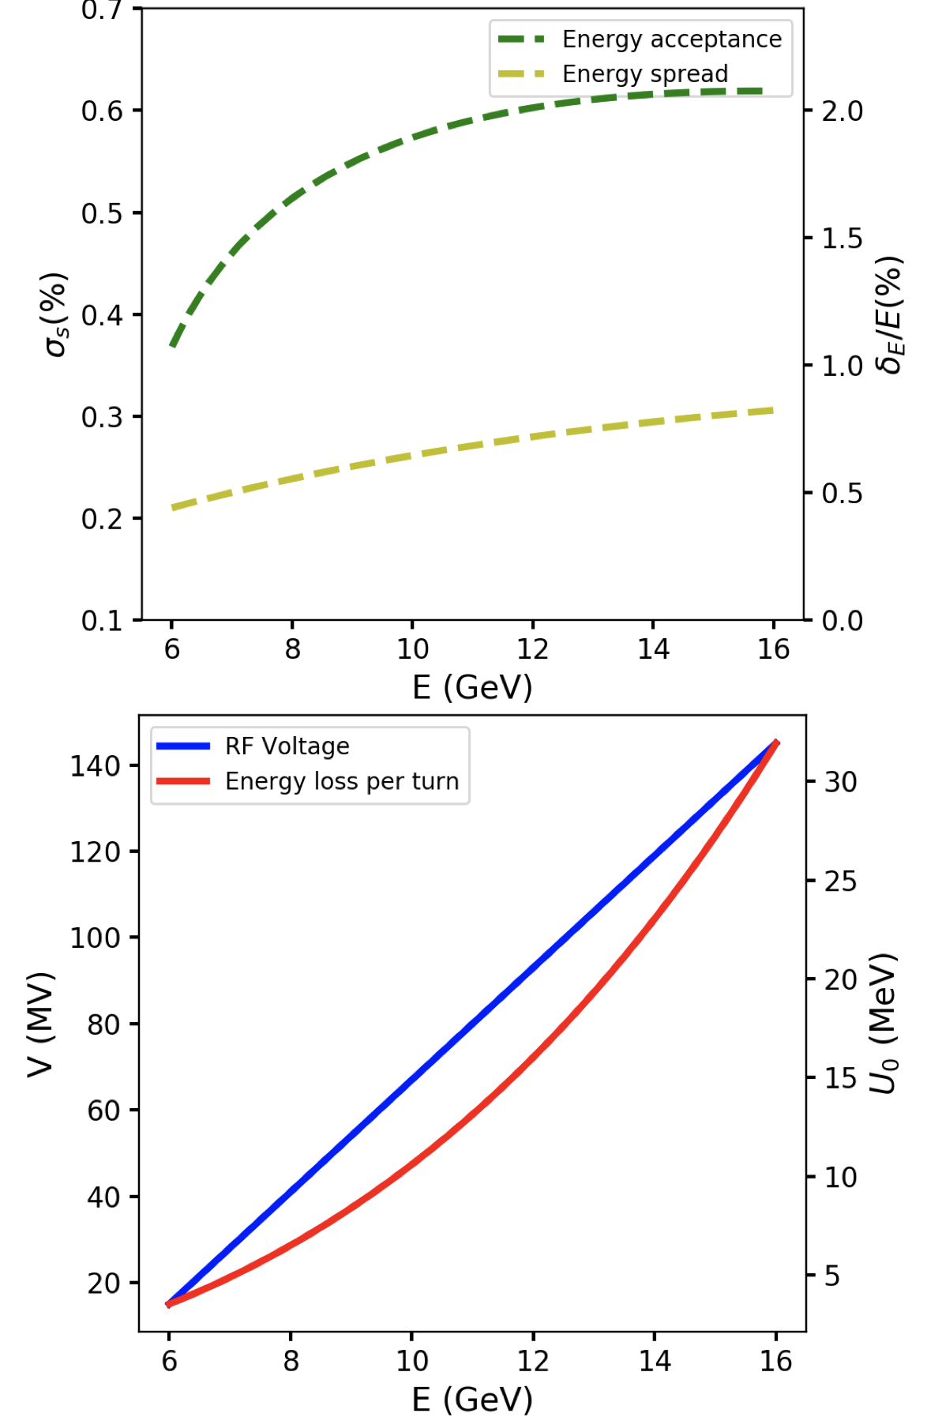
Energy acceptance and RF voltage
At 16 GeV extraction the minimum RF voltage increases up to 45 MV
  δE/E=0.55% for σ_{s}=0.3%
  → this is probably too optimistic
  Updated RF voltage requirement to 140 MV at 16 GeV with wigglers
Option without wiggler (at least at flat top) seems more interesting due to significantly smaller RF voltage required (basically what was done for LEP) – to be further studied with booster compatibility

Slide 9
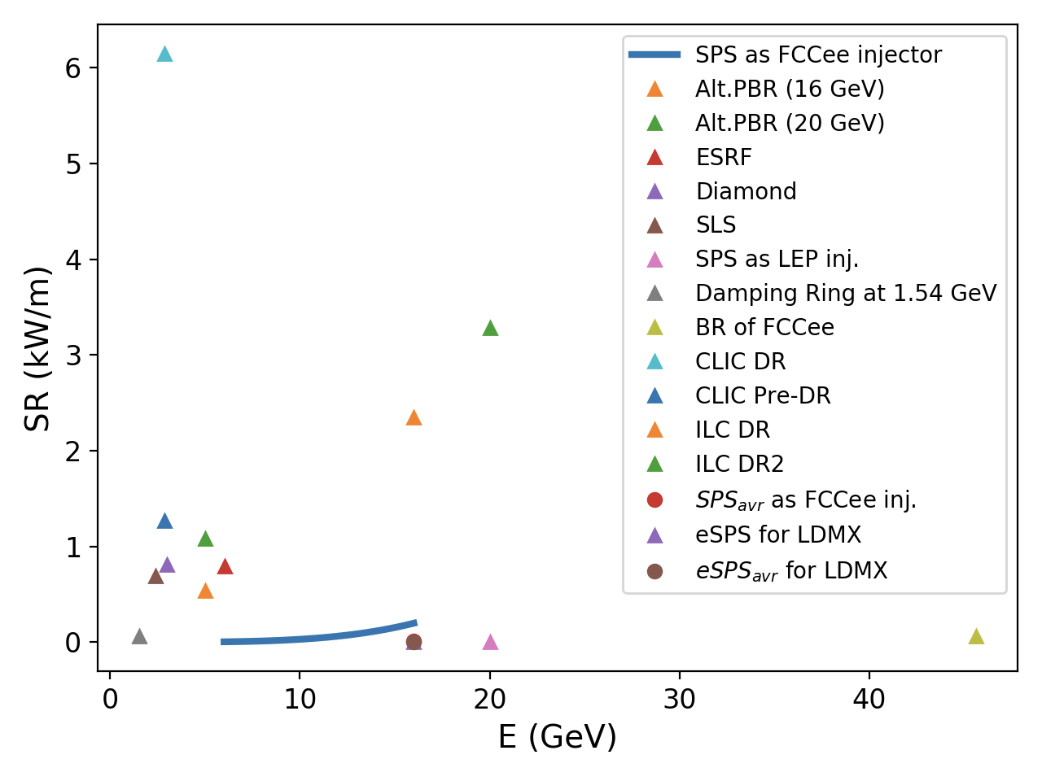
Synchrotron radiation power
The present SPS machine layout cannot sustain the SR power
Need absorbers and possibly a new vacuum system with cooled chambers
  During LEP times had masks in front of magnets and movable shutters to protect proton septa
  Ongoing studies by vacuum experts – to be seen if a solution can be found that does not require replacing the entire vacuum system (vacuum chambers are integral part of SPS bending magnets, coils are in the median plane of the magnets), but would also need significantly improved vacuum levels to avoid fast ion instabilities
  Special absorbers for wiggler magnets also to be implemented
Parameters | SPS for LEP | SPS for FCC
Extraction energy [GeV] | 20 | 16
SR - dipole magnets only (W/m) | 1.85 | 198
Averaged SR- dipole magnets only (W/m) | 0.024 | 8.1
SR - dipole and damping wiggler (W/m) | - | 809
Averaged SR - dipole and damping wiggler (W/m) | - | 107
Beam current (mA) | 0.45 | 160

Slide 10
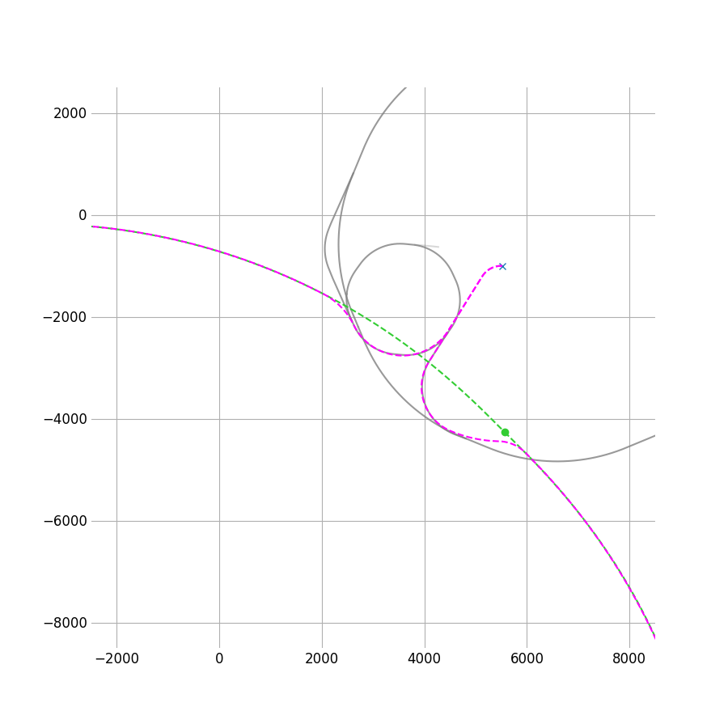
Power converter modifications
SPS mains (Thyristor based) are not able to operate at the low current needed for leptons
  During LEP times, there were bleeders installed on the mains to create an offset in current
  In order to achieve the required precision on the regulation, additional DCCTs and power converter regulation electronics were installed with a system to switch between proton and lepton operation
  All these systems have been decommissioned and are not available any longer.
As FCCee injector, a similar system of bleeders and additional regulation electronics would be needed
  This could even allow for bipolar operation for electrons/positrons in the same direction of the ring (e.g. injection in BA4, extraction in BA4 and BA6)
W. Bartmann

Slide 11
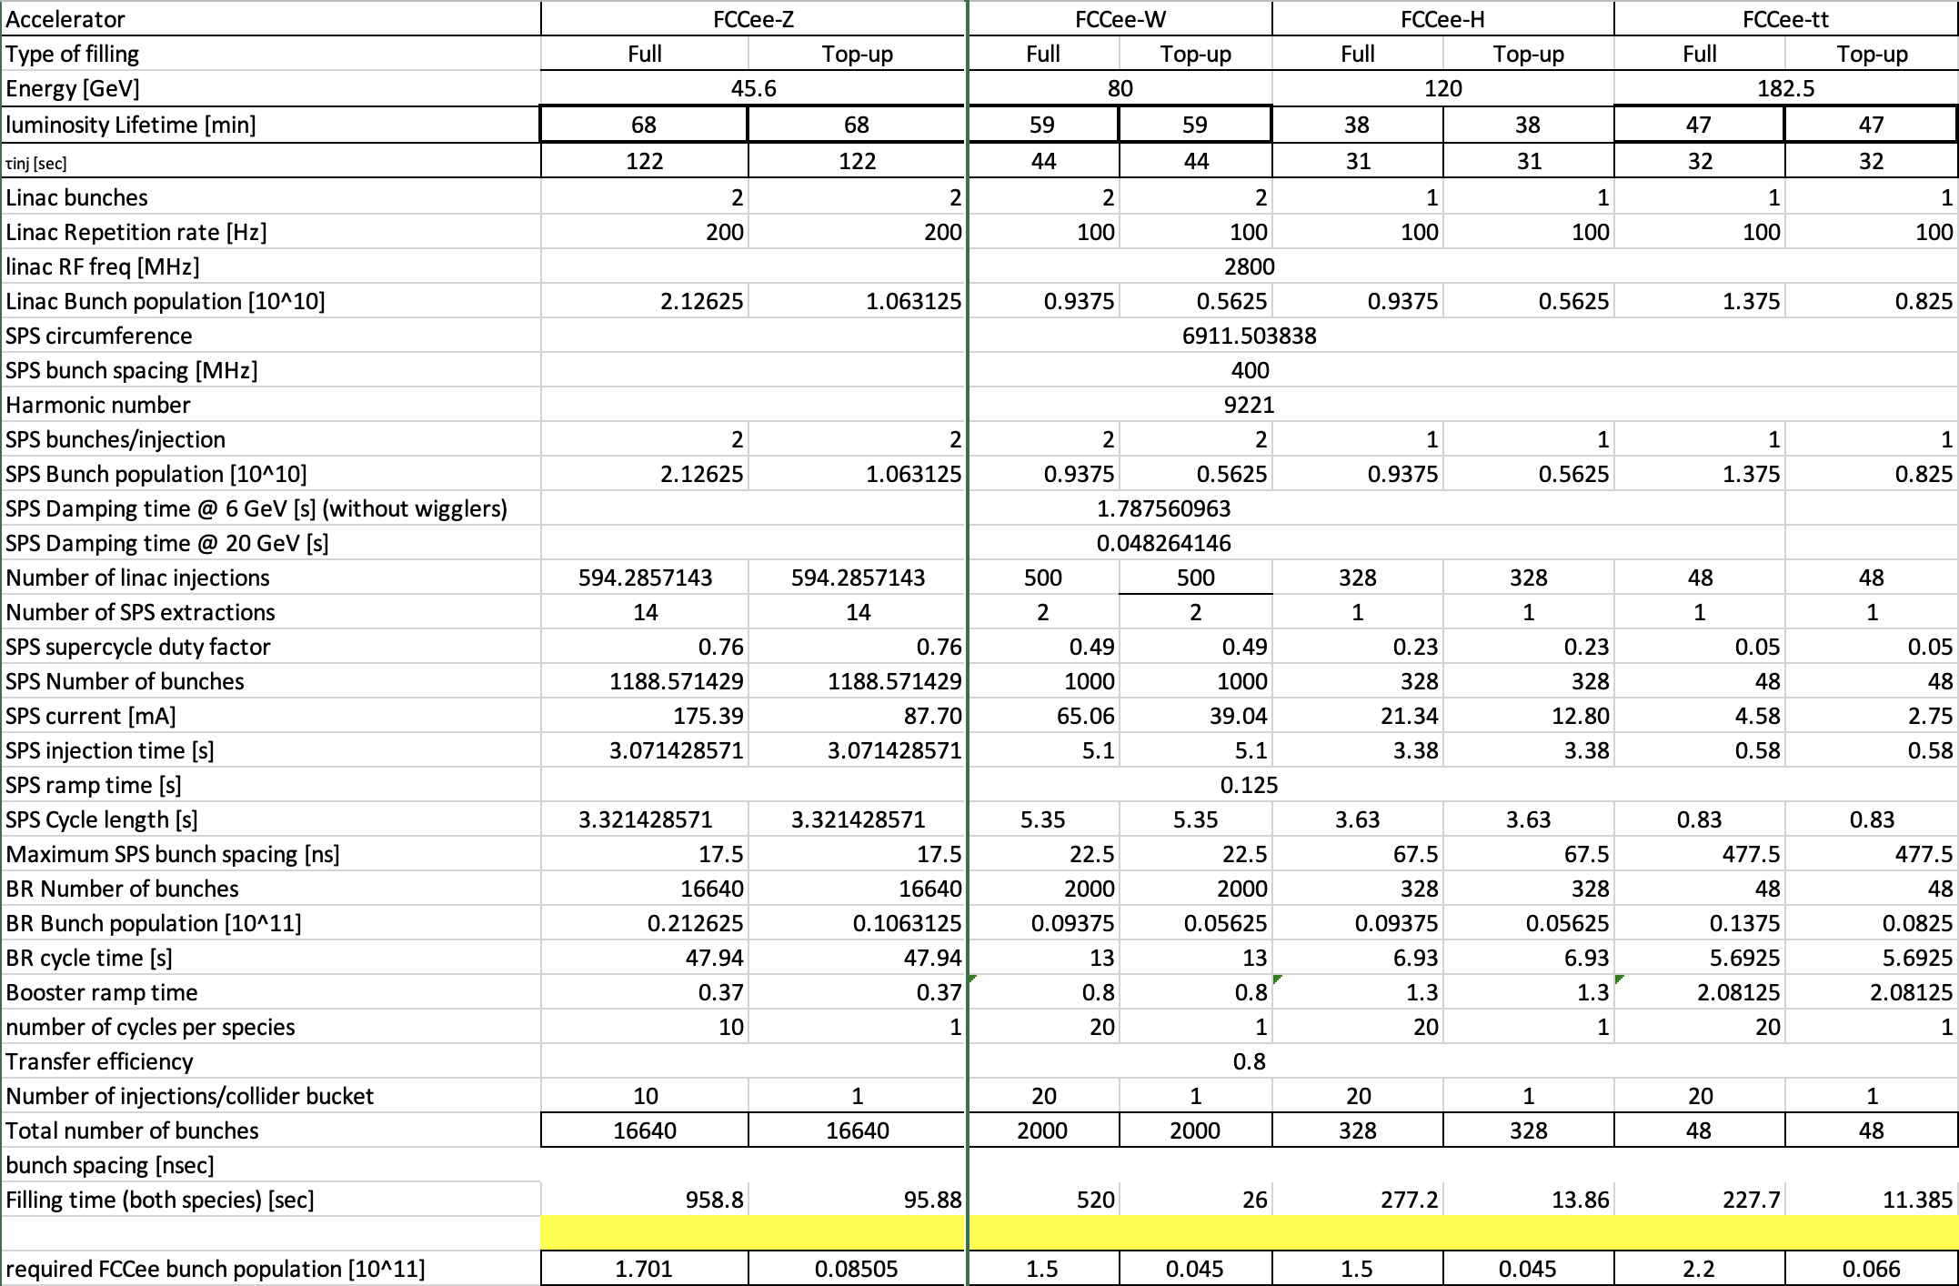
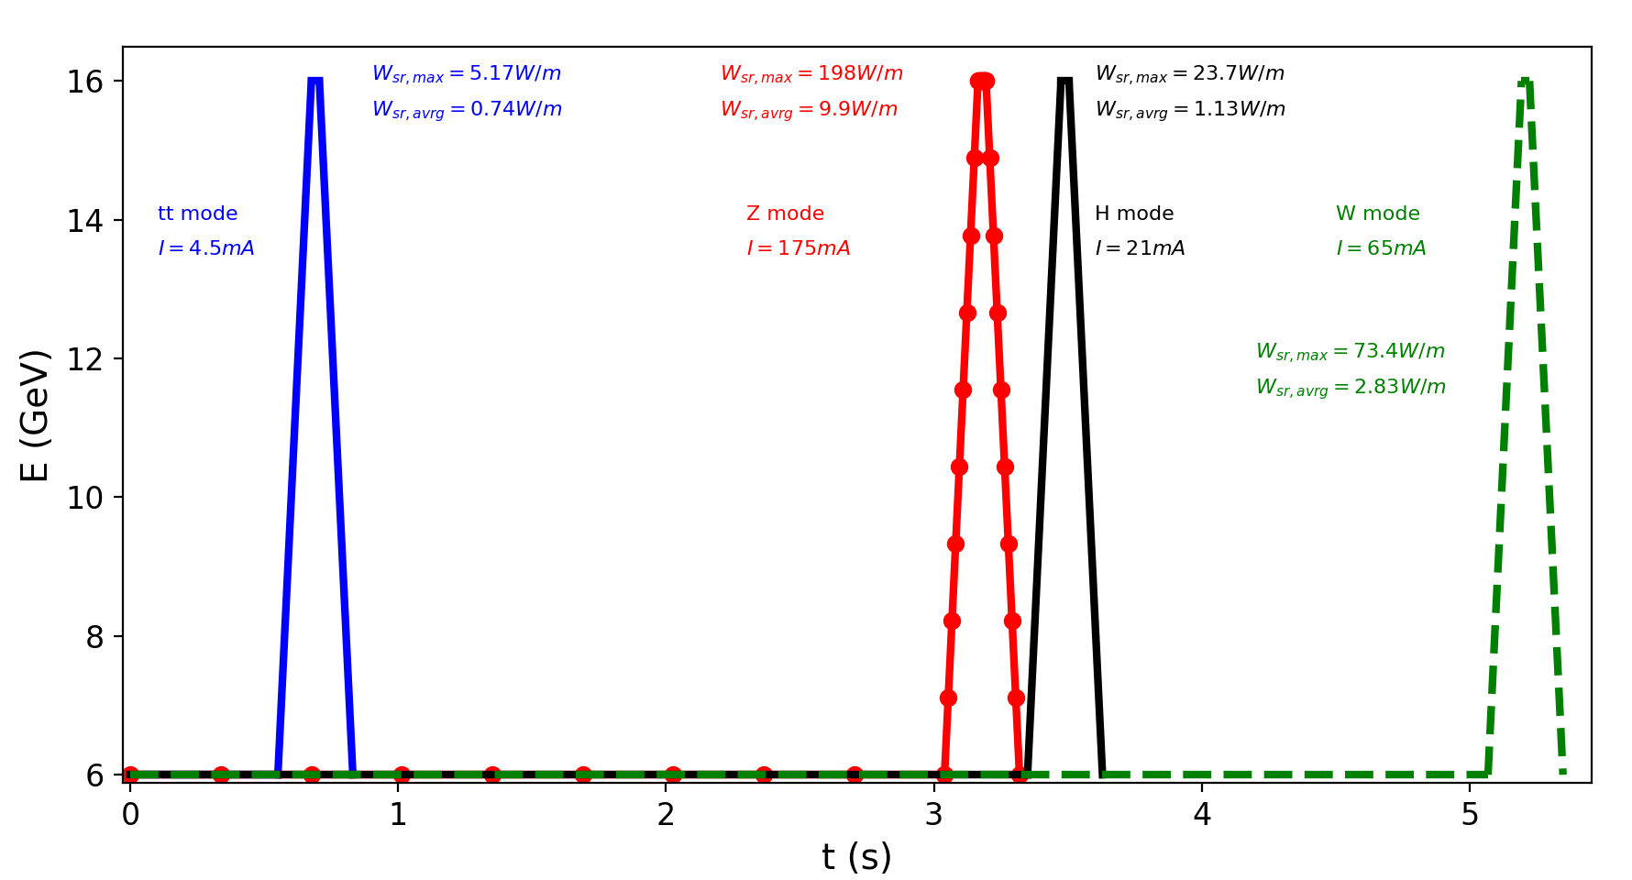
Filling time studies
Ramping of SPS magnets from 6 GeV to 16 GeV is relatively fast (~0.125 s)
Long accumulation time (e.g. 3 s for Z mode) to fill the ring, acceleration time is ~negligible
  Similar filling time as for HE-Linac option, details to be worked out for latest parameter set
During Z mode operation, not much machine time left for protons
  High duty factor (>76%) for leptons and continuous top-up

Slide 12
Other points
Aperture
  Studies indicate Dynamic Aperture is OK (but errors not included yet) even for off axis injection
  Acceptable emittance in horizontal and vertical planes are 15 and 60 nm.rad respectively assuming 0.3% rms energy spread of the incoming beam
Injection schemes
  ON-axis injection: short pulse kicker (10-20 ns) is possible with high repetition rate (100-200 Hz) according to PSI kicker specialist
  OFF-axis injection: seems also feasible
Extraction
  Fast extraction channels in BA4 and BA6 are available from protons – maybe could be re-used
Collective effects
  Studies for various collective effects highlight potential limitation from TMCI
  SPS vacuum needs to be considerably improved to cope with fast ion instability even with radiation damping and feedback system

Slide 13
Conclusions
Ongoing work to consolidate the option of using the SPS as FCCee pre-booster for cost comparison to HE-Linac option at mid-term review
We consider the 16 GeV extraction energy as most interesting
High synchrotron radiation power and required vacuum levels are challenging – ongoing work by vacuum experts
Installation of damping wigglers (and Robinson wiggler) might be required – ongoing studies by booster colleagues if larger horizontal emittance could be accepted
Additional RF system would be required – with very high voltage at extraction when using wiggler magnets
Modification of power converters for bi-polar operation seems feasible
Collective effects to be further studied (in particular the fast ion instabilities and TMCI)
Filling time compatible with collider request (at least for latest parameter set)

