Slide 1


Slide 2
The FCCee SRF system: machine layouts and cryomodules
6 June 2023 / FCC Week 2023 (London, UK)
Vittorio Parma, CERN
Vittorio Parma,
with contributions from: O. Brunner, B. Bradu, K. Brodinski, O. Capatina, L. Delprat, A. Foussat, B. Naydenov, E. Montesinos, F. Peauger, M. Timmins, K. Turaj, F. Valchkova-Georgieva, CERN
and input from discussions with: S. Barbanotti/DESY, K. Jensch/DESY, T. Petersen/SLAC, P.Pierini/ESS,

Slide 3
Outline
The RF System Layout: Baseline
Alternative Layout architectures:
  Segmented to continuous cryostats and comparison
  Cold quads
  CM repair intervention comparison
Effect of alternative architectures on tunnel integration
Summary and next steps

Slide 4


Cavities and Cryomodules
366 CM (3 types), 1’464 SRF cavities (4 cavities/CM, present assumption):
  400 MHz single-cell (Nb/Cu), 4.5 K: 28 CM, 112 cavities (removed after Z)
    400 MHz two-cell (Nb/Cu), 4.5 K: 66 CM, 264 cavities
    800 MHz five-cell (bulk Nb), 2 K: 272 CM, 1’088 cavities
By machine:
  Collider (ttbar): 188 CM (264 cavities 400 MHz, 488 cavities 800 MHz)
  Booster (ttbar): 150 CM (600 cavities 800 MHz)

Slide 5
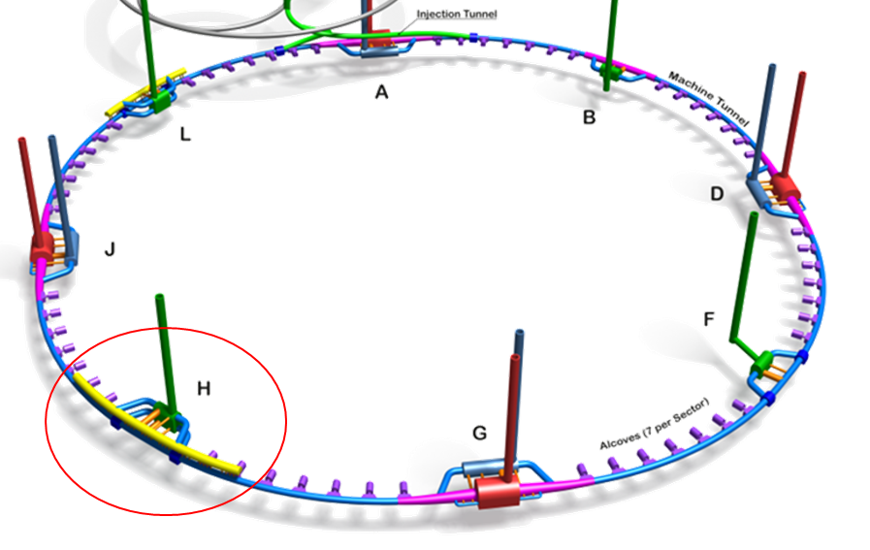

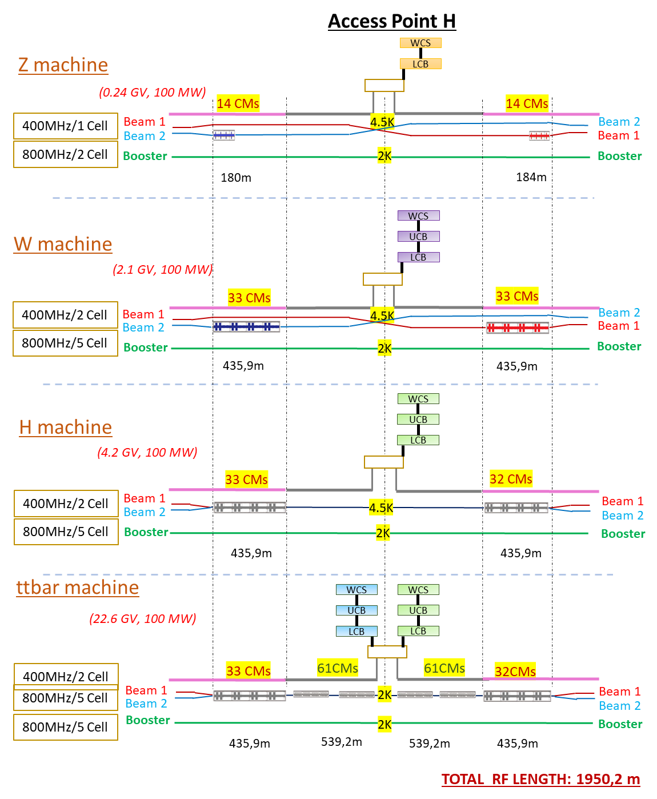
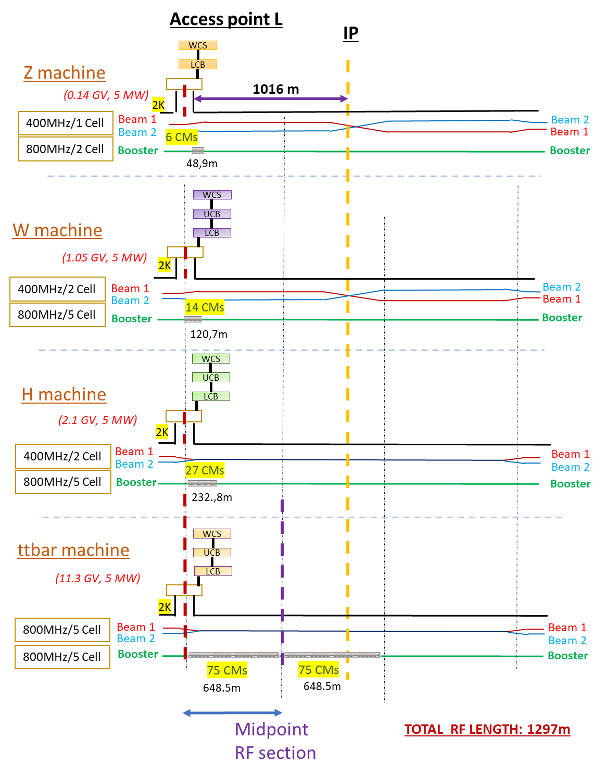
TLSS length: 2032 m
Collider
TLSS length: 2032 m
Booster
F. Valchkova-Georgieva (23/05/23)

Slide 6
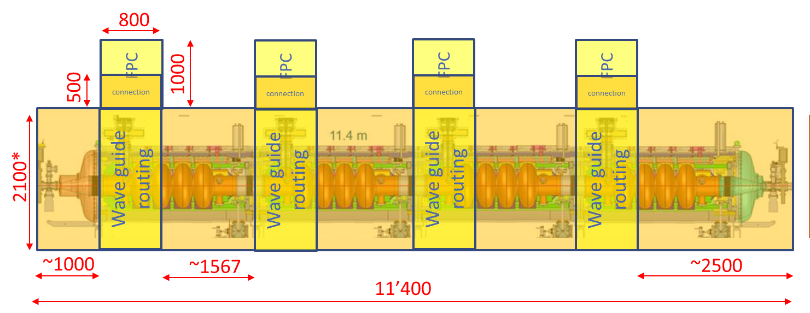
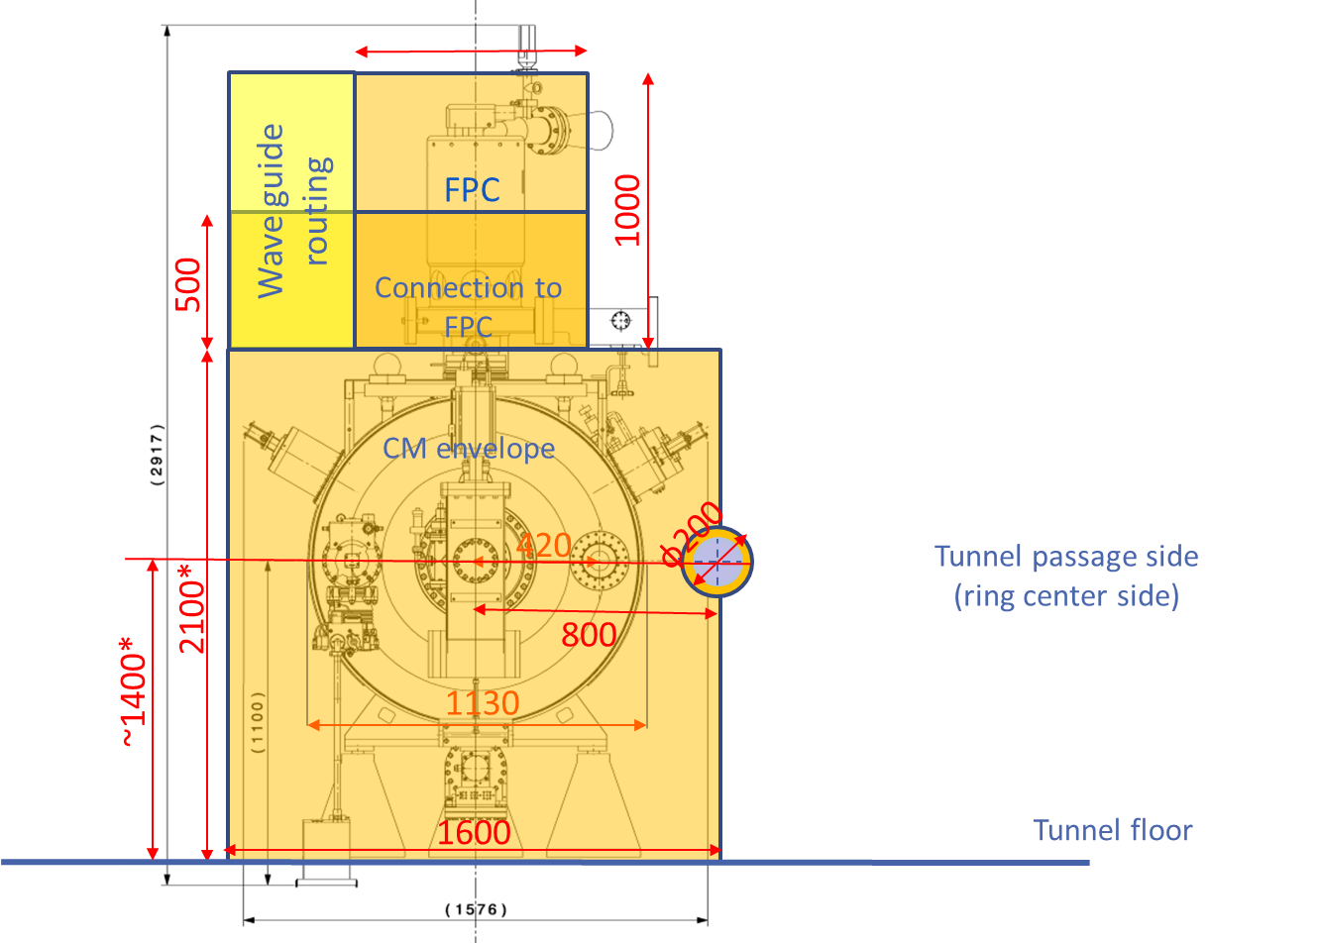
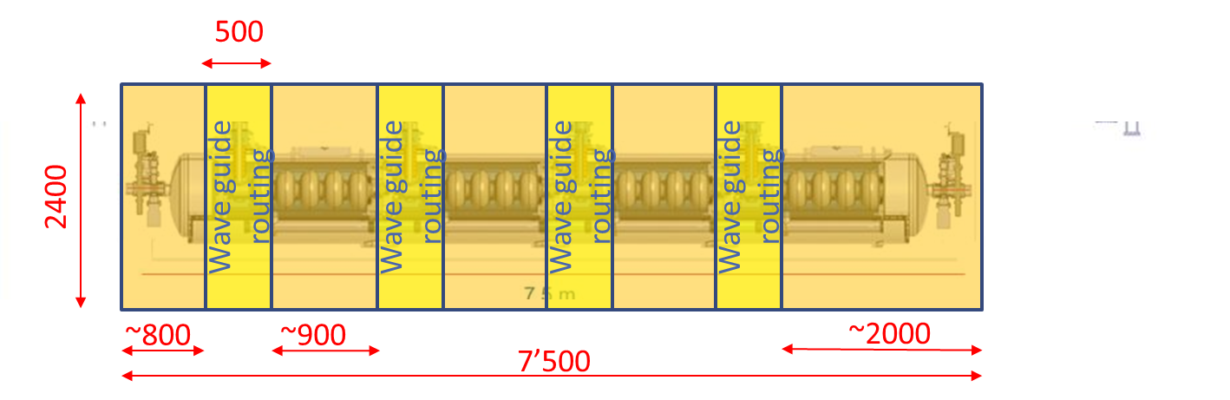
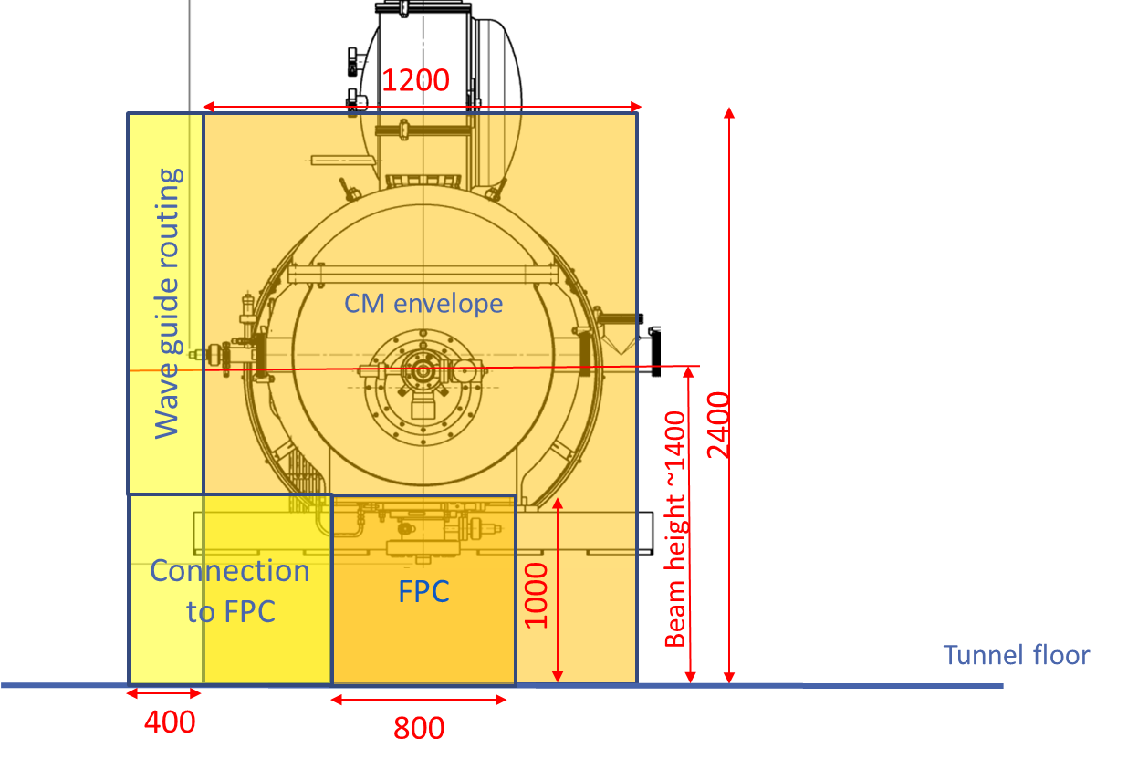
Baseline: CM space occupation for integration study
400 MHz Cryomodule (based on LEP, 4-cell cavities)
800
800 MHz Cryomodule (based on SPL, 704 MHz)

Slide 7
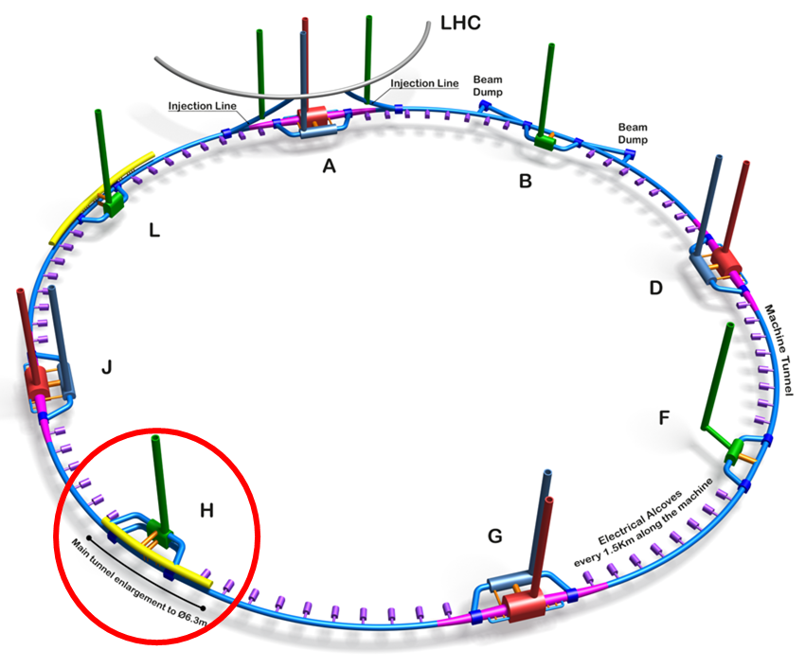
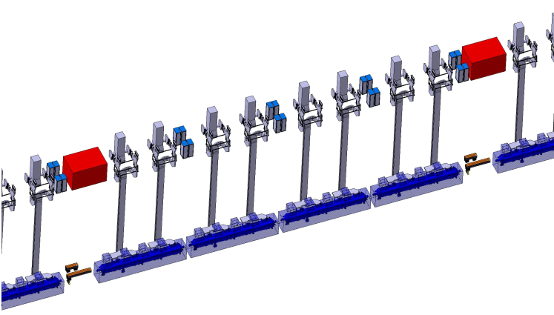
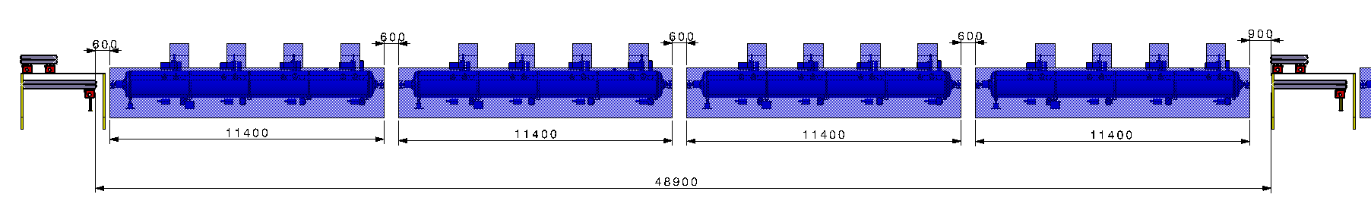
  Collider, 400 MHz CMs segment between quads (ttbar machine)
Klystron, circulator & rack
Bunker
Quadrupole magnets
Collider 400 MHz Cryomodules (standalone, with cryogenic distribution line, not shown)
F. Valchkova-Georgieva

Slide 8
Other preferable architectures ?
Baseline: segmented (CM “standalone” connected to cryo line)
Drivers for alternatives:
  Cost containment for large machines (CapEx)
  Energy efficiency (reduce cryo-power and Opex)
  Compactness: tunnel integration
Options:
  2 continuous cryostat variants:
    Continuous vacuum (insulation and beam vacuum)
    Continuous vacuum + cryomodule integrated cryogenic lines

Slide 9
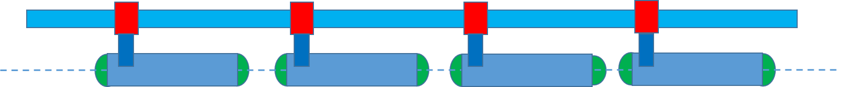
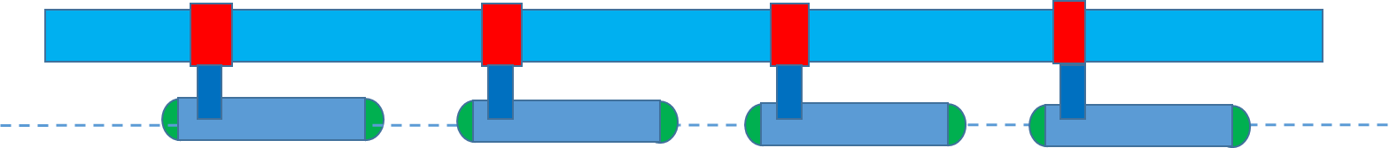


Collider architecture options (top view, ½ LSS, quads not shown)
A1 (baseline): fully segmented with separate cryo line
Pt
center
400 MHz, 4.5 K
800 MHz, 2 K
AC2: 800 MHz cont. with integr. cryo lines
Pt
center
400 MHz, 4.5 K
800 MHz, 2 K
AC3: 400 MHz cont. vac. with cryo line; 800 MHz cont. with integr. cryo lines.
Pt
center
400 MHz, 4.5 K
800 MHz, 2 K
AC4: 400 MHz and 800 MHz cont. with integrated cryo lines;
Pt
center
400 MHz, 4.5 K
800 MHz, 2 K
(quads not shown)
End Cap module
CM interconnection
Service Module
Vac.Barr.
Jumper

Slide 10
Collider Architecture | Advantages | Drawbacks
A1 (baseline: fully segmented) | Easy staged Installation (CM sorting if needed) Maintainability (single CM intervention) reduced # cavities at risk of contamination from accidental venting (warm gate valves) | Higher CapEx (more HW, cryoline, valves, CWT) Highest static HL (highest OpEx) Lowest reliability (higher complexity from more equip.) Higher risk of cavity contamination through CWT and adjacent warm equipment
AC2 (400 MHz segmented, 800MHz continuous) | No cryo line for 800 MHz Lowest 2 K static HL (lower OpEx) Cryogenic separation of 400 MHz and 800 MHz linacs → maintainability Compactness on 800 MHz tunnel sec. Advantages of A,1 limited to 400 MHz | Drawbacks as A1 but limited to 400 MHz part
AC3 (400 MHz vac. continuous with cryo line, 800MHz continuous) | Lower CapEx: no CWT, longer cryo cell possible i.e. reduced cryo equip) Lower HL (4.5 K) | 400 MHz still needs cryo line (marginally) longer CM replace requires WU of the ins vac. Sector (100m long?)
AC4 (400 and 800 MHz continuous) | Lowest CapEx (least HW) Lowest static HL (lower OpEx) Compactness on 400 MHz tunnel sec. ? | Large 400 MHz CM (integrated cryo lines) Linac (marginally) longer CM replacement requires WU of the whole 400 MHz linac (~436 m)

Slide 11
Booster architecture options (top view, ½ LSS, quads not shown)
A1 (baseline): fully segmented collider with separate cryo line
Pt
center
800 MHz, 2 K
AB1: 800 MHz cont. with integr. cryo lines
Pt
center
800 MHz, 2 K
(no quads shown)
End module
CM interconnection
Service Module
Vac.Barr. Module
Jumper

Slide 12
Booster Architecture | Advantages | Drawbacks
A1 (baseline: fully segmented) | Easy staged Installation (CM sorting if needed) Maintainability (single CM replacement) reduced # cavities at risk of contamination from accidental venting (warm gate valves) | Higher CapEx (more HW, cryoline, valves, CWT) Highest static HL (higher OpEx) Lowest reliability (higher complexity from more equip.) Higher risk of cavity contamination through CWT and adjacent warm equipment
AB1 (400 and 800 MHz continuous) | Lowest CapEx (least HW) Lowest static HL (lower OpEx) Transversal compactness (Cryo line limited to 800 MHz length) | Larger 800 MHz CM (integrated cryo lines) (marginally) longer CM replacement requires WU of the whole 800 MHz linac (~1100 m)

Slide 13
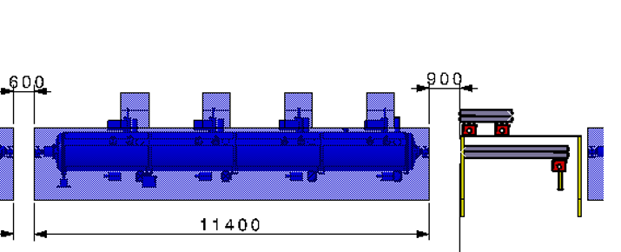
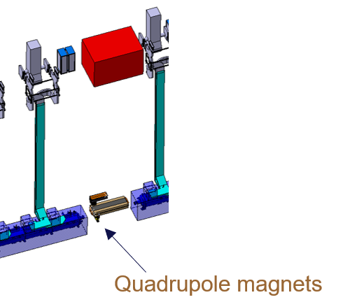
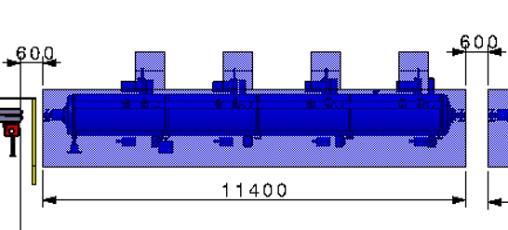
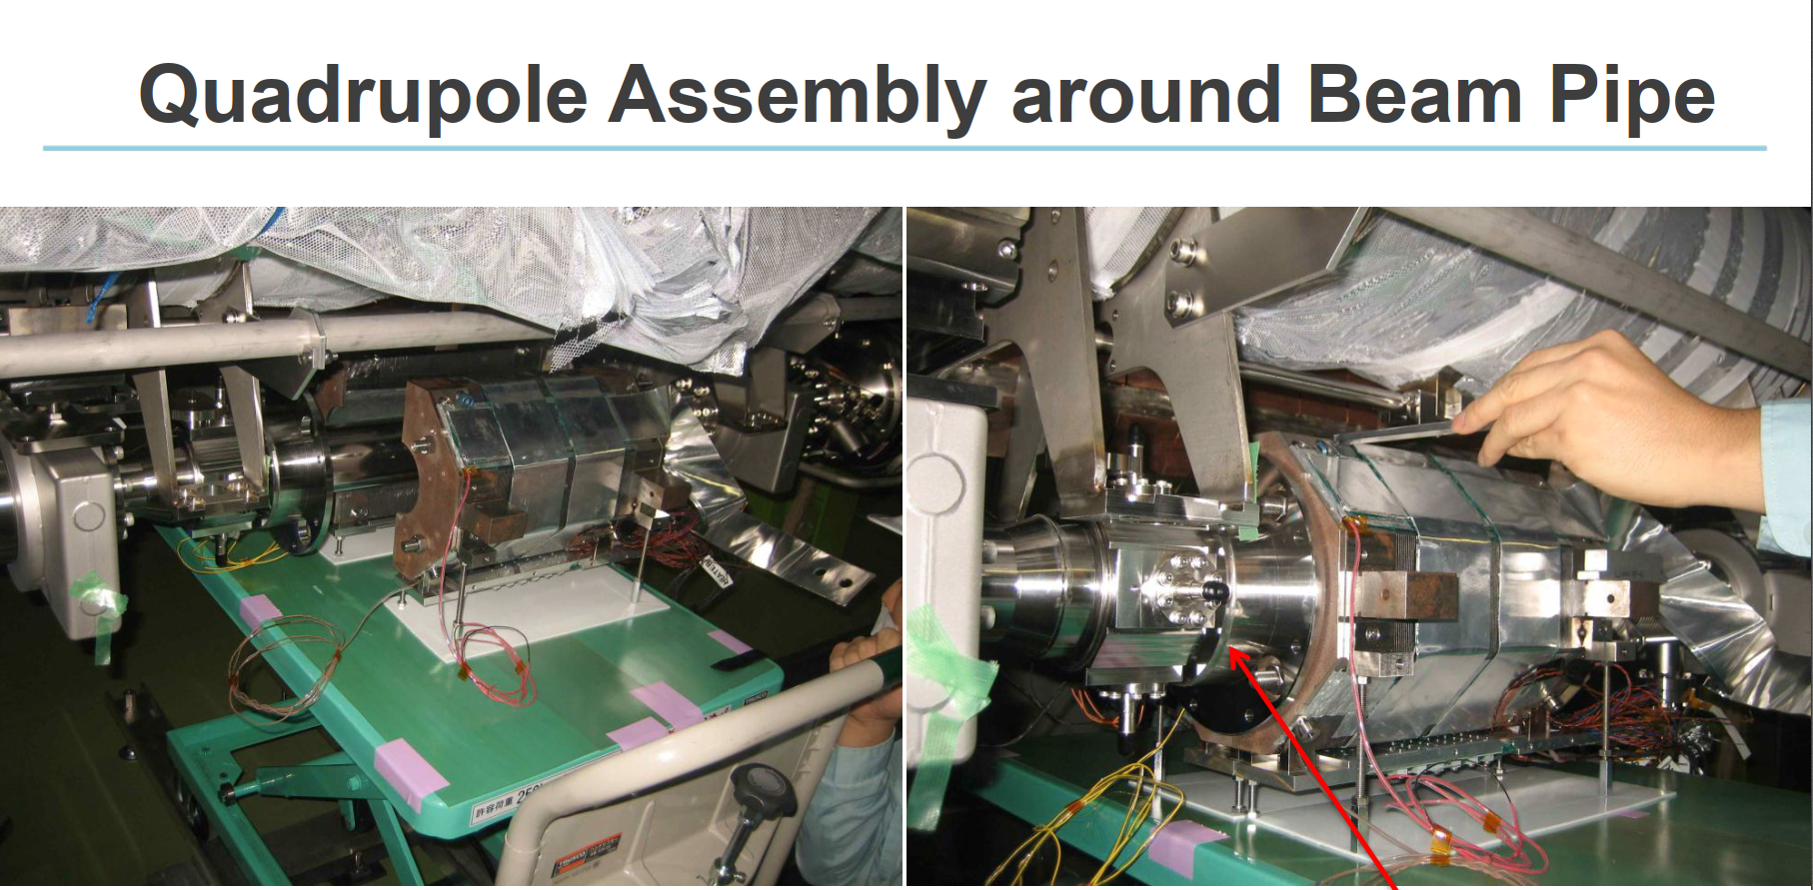
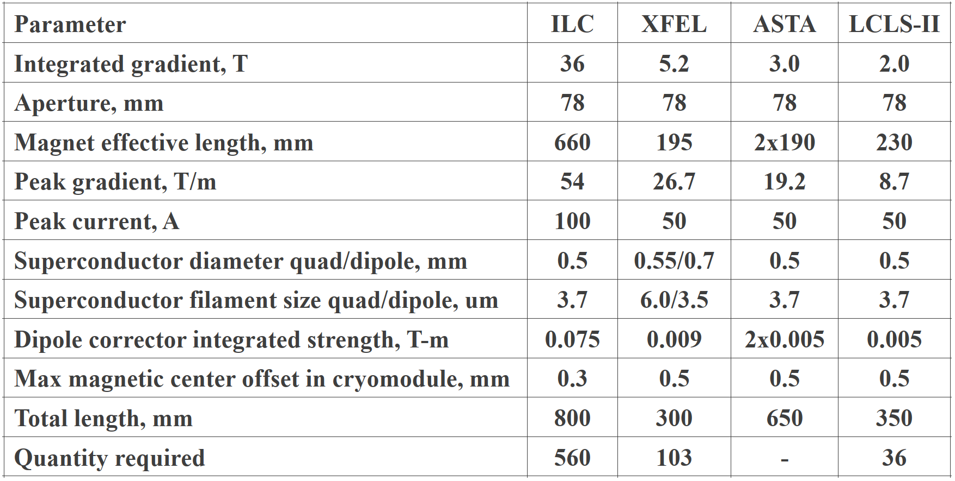
Continuous cryostat needs cold quads
Warm quads (today’s baseline in segmented architecture)
3.1 m
G-= 10 T/m; L_{m} = 3.1 m,
SC quads (in dedicated compact cryostats)
G = 30 T/m; L_{m} = 1 m : SC conv. Tech. possible (A.Foussat, TE/MSC)
Cold Quads in cryomodules of other machines
< 2 m
CM
IC
Q
IC
CM
1 m
→ SC quads is a possible option
Example: Split quad, cond.cooled
(A.Yamamoto et al.)

Slide 14
In-tunnel repair on CMs (400 MHz)
Intervention needing WU and ins.vac.vent. (e.g. tuner, HOM, coax cables connectors), assuming 1 day repair
 | In-tunnel CM repair (Collider, 400 MHz) | Baseline | comments | AC3: continuous with cryo line | comments | AC4: continuous with integrated cryo line | comments
# | Operation | No.work days |  | No.work days |  | No.work days
1 | Warm up of CM | 3 | Estimate. 1 CM, cryoline cold | 7 | Estimate. 10 CM (¬150 m ins. Vac.), cryoline cold | 14 | Entire linac (33 CM)
2 | Vent CM Ins.vac. | 0.5 |  | 2 | venting only ins.vac. Sect. | 5 | Entire linac (33 CM)
3 | Repair | 1 | assumption | 1 | assumption | 1 | assumption
5 | Pump down ins.vac. | 2 | 1 CM | 5 | 10 CM | 7 | Entire linac (33 CM)
6 | Cool down CM | 2 | Estimate. 1 CM | 5 | Estimate. 10 CM | 10 | Entire linac (33 CM)
7 | Cavities RF conditioning | 21 | LHC CM experience | 21 | with parallel automated RF conditioning | 21 | with parallel automated RF conditioning
 | Total | 29.5 |  | 41 |  | 58
 | Total # weeks | 4.2 |  | 5.9 |  | 8.3
Intervention time up to ~6/8 weeks (AC3/AC4) (including RF conditioning)
All architectures compatible with 17 weeks yearly shut-downs

Slide 15
Replacement of CM (400 MHz)
 | Exchange of 1 CM (Collider 400 MHz) | Baseline | comments | AC3: continuous with cryo line | comments | AC4: continuous with integrated cryo line | comments
# | Operation | No.work days |  | No.work days |  | No.work days
1 | close 4 warm gate valves of CM | 0.5
2 | Close cryo valves to isolate CM | 0.5
3 | Warm up of entire linac (33 CM) | 14 | Estimate. No cutting with cold cryo line. | 14 | Estimate. No cutting with cold cryo line. | 14 | Entire linac (33 CM)
4 | CM Ins.vac.venting | 0.5 |  | 2 | venting ins.vac. Sect. | 2 | venting ins.vac. Sect.
5 | Dismount warm beam lines | 0.5
6 | Open jumper IC and cut cryo lines | 3 |  | 3
7 | Open 2 IC, beam vac.line only |  |  | 1.5
8 | Open 2 IC, beam vac.line + cryo lines |  |  |  |  | 5
9 | Exchange of CM | 1 |  | 1 |  | 1
10 | Close jumper (weld cryo lines +th.shields,etc.) | 2 |  | 2
11 | Close 2 IC, beam vac.line + cryo lines |  |  |  |  | 5
12 | Close 2 IC, beam vac.lines only |  |  | 2
13 | Mount warm beam lines, vac.cond. and pumping | 2
14 | Pump down ins.vac. and purge cryo lines | 7 | Entire linac (33 CM) | 7 | Entire linac (33 CM) | 7 | Entire linac (33 CM)
15 | Cool down CM | 10 | Entire linac (33 CM) | 10 | Entire linac (33 CM) | 10 | Entire linac (33 CM)
16 | Cavities RF conditioning | 21 | LHC CM experience | 21 | with parallel automated RF conditioning | 21 | with parallel automated RF conditioning
 | Total Work days | 62 |  | 63.5 |  | 65
 | Total # weeks | 8.9 |  | 9.1 |  | 9.3
CM replac: 8.5 d
CM replac: 9.5 d
CM replac: 11 d
Intervention time up to ~9/10 weeks (AC3/AC4) (including RF conditioning), no advantage in segmented baseline (cutting cryo lines with cold adjacent equip. not allowed)
All architectures compatible with 17 weeks yearly shut-downs
Notes:
XFEL (estimate): WU/vent/pump./CD/RF.cond: ~ 7-9 weeks (WU of linac: 3-4 w; ins.vac.vent.:1-2 d; ins.vac.pump.: ~5 d; CD of linac: 3-4 w; RF cond.: 1-2 d)
LHC dipole replacement: WU/vent/pump./CD: ~ 10 weeks (WU sect.:3.5 w; ins. ins.vac.vent.:~3 d; ins.pump.: 5 d; CD: 6.5 weeks); dipole replacement: ~ 5 weeks

Slide 16
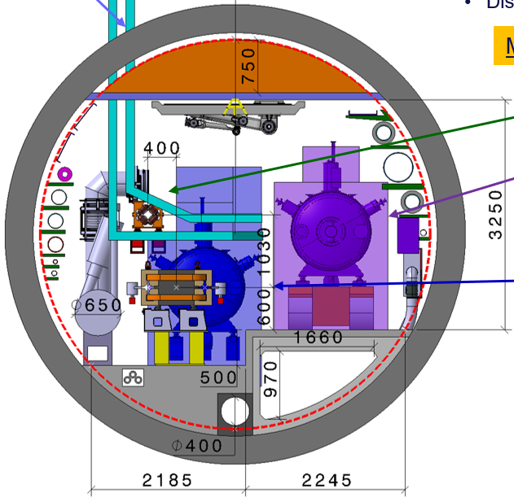
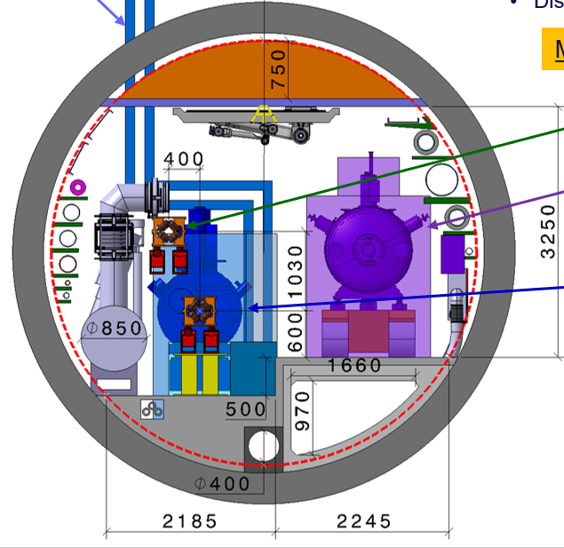
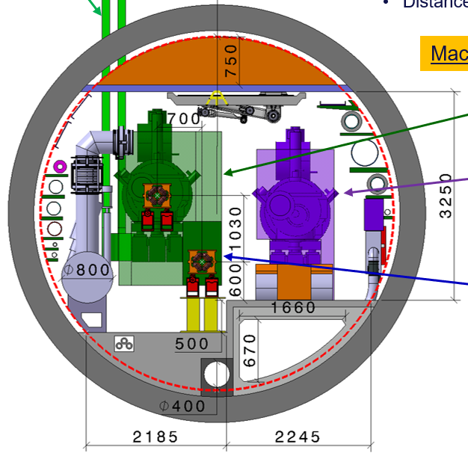
Benefits on Cross Sections (AC3, AB1)
Collider
(AC3, 400 MHz cont.vac.+cryoline, 800 MHz cont.)
Baseline
400 MHz
AC3
Baseline
800 MHz
AC3
No change
Booster (AB1, 800 MHz cont)
No large cryo line, no jumper
Small transfer line (400 MHz feed)
CM envelope TBC (integr. cryo lines)
Substantial integration simplifications
Baseline
800 MHz
AB1
No cryo line, no jumper
CM envelope TBC (integr. cryo lines)

Slide 17
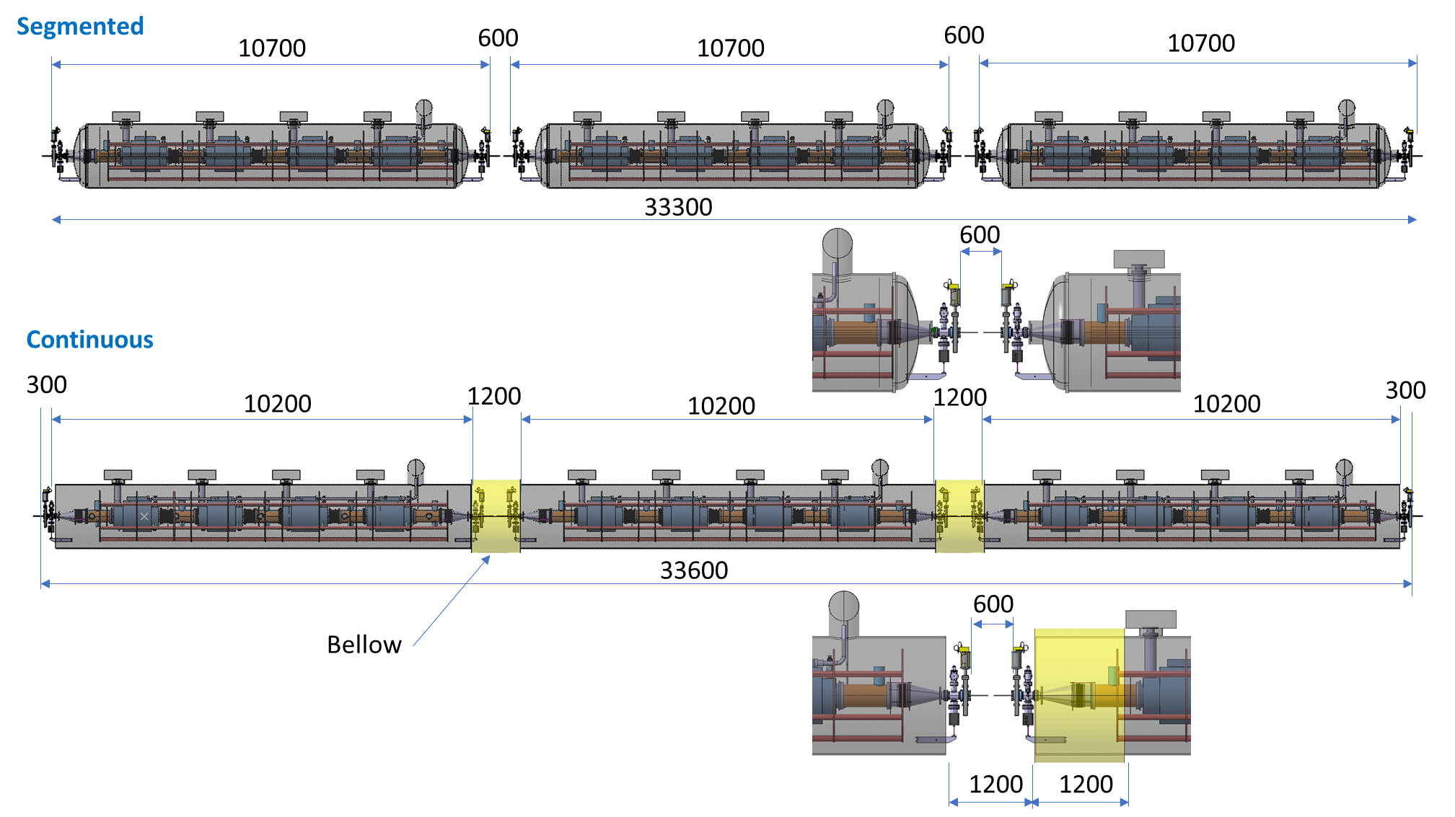
(2 cell) string 400 MHz: segmented vs continuos
Continuous is marginally longer
M. Timmins

Slide 18
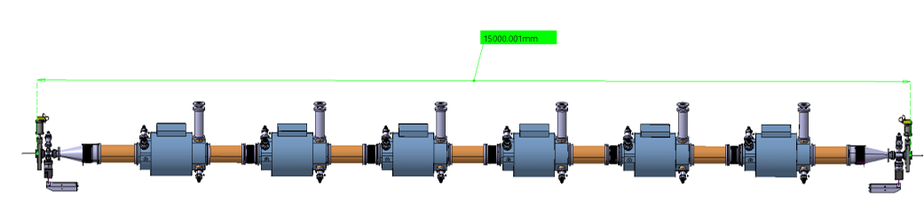
Increasing the no. of 400 MHz cavities per CM ?
400 MHz (2 cell cavities): 4 to 6 cavities ?
  6 cavities is at the limit for road transport (15m LHC dipoles) and handling (overhead cranes >15t, tunnel shafts ~ 16m)
10.7 m
← keep 4 cavities (for now)
15 m
M. Timmins

Slide 19
Increasing the no. of 800 MHz cavities per CM ?
800 MHz (5 cell cavities): 4 or 6 or 8 cavities ?
  Provisional, only RF design (no mechanics yet) :
7.2 m
← Baseline
10.9 m
← 6 cavities reasonable
14.2 m
M. Timmins

Slide 20
½ LSS Collider length (ttbar), by architecture
Length [m], 1/2 LSS Collider, ttbar |  | A1 (baseline) |  |  | A1 (revised CM lenght) |  |  | AC2 |  |  | AC3/AC4 |  |  | AC3/AC4 (6 cav. 800 MHz)
 |  | 800 MHz (seg) | 400 MHz (seg) |  | 800 MHz (segm) | 400 MHz (segm) |  | 800 MHz (cont) | 400 MHz (segm) |  | 800 MHz (cont) | 400 MHz (cont) with/no cryo line |  | 800 MHz (cont) | 400 MHz (cont) with/no cryo line
N (#cavityies/CM) |  | 4 | 4 |  | 4 | 4 |  | 4 | 4 |  | 4 | 4 |  | 6 | 4
Standalone CM lenght (flange to flange) for N cavity |  | 7.5 | 11.4 |  | 7.18 | 10.70 |  |  | 10.70
Cont.CM lenght (flange to flange) for N cavity |  |  |  |  |  |  |  | 7.53 |  |  | 7.53 | 10.70 |  | 10.87 | 10.70
No. cavities |  | 244 | 132 |  | 244 | 132 |  | 244.00 | 132 |  | 244.00 | 132.00 |  | 244.00 | 132.00
No.CM |  | 61 | 33 |  | 61 | 33 |  | 61.00 | 33 |  | 61.00 | 33.00 |  | 41 | 33.00
Total lenght of CMs |  | 457.5 | 376.2 |  | 437.98 | 353.1 |  | 459.33 | 353.1 |  | 459.33 | 353.10 |  | 442.05 | 353.10
Total length of IC |  | 33.43 | 21.12 |  | 33.43 | 21.12 |  | 33.43 | 21.12 |  | 33.43 | 21.12 |  | 22.10 | 21.12
No.quads |  | 9 | 7 |  | 9 | 7 |  | 9 | 7 |  | 9 | 7 |  | 9 | 7
Quads spacing |  | 52 | 52 |  | 52 | 52 |  | 52 | 52 |  | 52 | 52 |  | 52 | 52
Quads length |  | 3.1 | 3.1 |  | 3.1 | 3.1 |  |  | 3.1
Cold quad length (+ 1 IC) |  |  |  |  |  |  |  | 1.85 |  |  | 1.85 | 1.85 |  | 1.85 | 1.85
No.of CM between quads |  | 6.93 | 4.56 |  | 7.24 | 4.86 |  | 6.91 | 4.86 |  | 6.91 | 4.86 |  | 4.78 | 4.86
Total lenght of quads space |  | 27.9 | 21.7 |  | 27.9 | 21.7 |  | 16.65 | 21.7 |  | 16.65 | 12.95 |  | 16.65 | 12.95
Cryo valve/Jumper box length |  |  |  |  |  |  |  | 0.75 |  |  | 0.75 | 0.75 |  | 0.75 | 0.75
No. valve boxes |  |  |  |  |  |  |  | 9 |  |  | 9 | 7 |  | 9 | 7
Cryo cell length (assumption) |  |  |  |  |  |  |  | 51.04 |  |  | 51.04 | 50.44 |  | 49.12 | 50.44
No.CM per cryo cell |  |  |  |  |  |  |  | 6.78 |  |  | 6.78 | 4.71 |  | 4.52 | 4.71
Total length of Jumper/valve boxes |  |  |  |  |  |  |  | 6.75 |  |  | 6.75 | 5.25 |  | 6.75 | 5.25
Vac.Barrier box length (+ 1 IC) |  |  |  |  |  |  |  | 2.35 |  |  | 2.35 | 2.35 |  | 2.35 | 2.35
Vac.sectorisation length (assumption) |  |  |  |  |  |  |  | 100 |  |  | 100 | 100 |  | 100 | 100
No.of Vac.sectorisations |  |  |  |  |  |  |  | 6 |  |  | 6 | 4 |  | 5 | 4
No.of Vac. Barrier boxes |  |  |  |  |  |  |  | 4 |  |  | 4 | 2 |  | 3 | 2
Total length of Vac.Barrier boxes |  |  |  |  |  |  |  | 9.4 |  |  | 9.4 | 4.7 |  | 7.05 | 4.7
Total lenght of 2 end of cryostat boxes |  |  |  |  |  |  |  | 4 |  |  | 4 | 4 |  | 4 | 4
Contributions 800 MHz & 400 MHz [m] |  | 519 | 419 |  | 499 | 396 |  | 530 | 396 |  | 530 | 401 |  | 499 | 401
Total length 1/2 LSS [m] |  | 938 |  |  | 895 |  |  | 925 |  |  | 931 |  |  | 900
Revised CM lengths provide 4% reduction to baseline length
Continuous cryostats are (marginally) longer (effect of additional HW)
Increasing # cavities/CM reduces linac length, compensating continuous cryostat overlength
→ AC3 (or AC4) with 6 cav./CM 800MHz yields a 4% length reduction (900 m) wrt the baseline
Note: for Booster, see spare slides

Slide 21
Summary and next steps
Baseline is fully segmented linacs, for both Collider and Booster
Continuous cryostat architectures interesting both for capital and operation cost reductions. Quantitative assessments as next steps.
Architecture developments to continue to integrate cryogenic and vacuum cells (cryo valves, vac.Barrier, beam pumping etc.). Beam instrumentation also to be defined (BPMs, etc.).
Tunnel cross sections: 800 MHz continuous with integrated lines more compact (no cryoline and jumpers)
Linacs lengths. With updated CM lengths, increased # cavities/CM (4→6) of the 800 MHz, linac lengths are shorter even though continuous cryostats are (marginally) longer. At this stage of the design study, some margin should be kept.

Slide 22
Thank you for your attention.

Slide 23
Spare slides

Slide 24
Possible layout for Collider AC3
400 MHz
800 MHz

Slide 25
Booster length (ttbar), by architecture
Long. length [m], Booster linac (Point L), ttbar |  | A1 (baseline) |  | A1 (revised CM lenght) |  | AB1 (4 cav. 800 MHz) |  | AB1 (6 cav. 800 MHz)
 |  | 800 MHz (seg) |  | 800 MHz (segm) |  | 800 MHz (cont) |  | 800 MHz (cont)
N (#cavityies/CM) |  | 4 |  | 4 |  | 4 |  | 6
Standalone CM lenght (flange to flange) for N cavity |  | 7.5 |  | 7.18
Cont.CM lenght (flange to flange) for N cavity |  |  |  |  |  | 7.53 |  | 10.87
No. cavities |  | 600 |  | 600 |  | 600 |  | 600
No.CM |  | 150 |  | 150 |  | 150 |  | 100
Total lenght of CMs |  | 1125 |  | 1077.00 |  | 1129.50 |  | 1087.00
Total length of IC |  | 83.01 |  | 83.01 |  | 83.01 |  | 55.16
No.quads |  | 9 |  | 9 |  | 9 |  | 9
Quads spacing |  | 52 |  | 52 |  | 52 |  | 52
Quads length |  | 3.1 |  | 3.1
Cold quad length (+ 1 IC) |  |  |  |  |  | 1.85 |  | 1.85
No.of CM between quads |  | 6.93 |  | 7.24 |  | 6.91 |  | 4.78
Total lenght of quads space |  | 27.9 |  | 27.9 |  | 16.65 |  | 16.65
Cryo valve/Jumper box length |  |  |  |  |  | 0.75 |  | 0.75
No. valve boxes |  |  |  |  |  | 9 |  | 9
Cryo cell length (assumption) |  |  |  |  |  | 125.50 |  | 120.78
No.CM per cryo cell |  |  |  |  |  | 16.67 |  | 11.11
Total length of Jumper/valve boxes |  |  |  |  |  | 6.75 |  | 6.75
Vac.Barrier box length (+ 1 IC) |  |  |  |  |  | 2.35 |  | 2.35
Vac.sectorisation length (assumption) |  |  |  |  |  | 100 |  | 100
No.of Vac.sectorisations |  |  |  |  |  | 13 |  | 12
No.of Vac. Barrier boxes |  |  |  |  |  | 11 |  | 10
Total length of Vac.Barrier boxes |  |  |  |  |  | 25.85 |  | 23.5
Total lenght of 2 end of cryostat boxes |  |  |  |  |  | 4 |  | 4
Total length 1/2 LSS [m] |  | 1236 |  | 1188 |  | 1229 |  | 1159
Revised CM lengths provide 4% reduction to baseline length
Continuous cryostats are (marginally) longer (effect of additional HW)
Increasing # cavities/CM reduces linac length, compensating continuous cryostat overlength
AB1 with 6 cav./CM 800MHz yields a 6% length reduction (1159 m) wrt the baseline

Slide 26
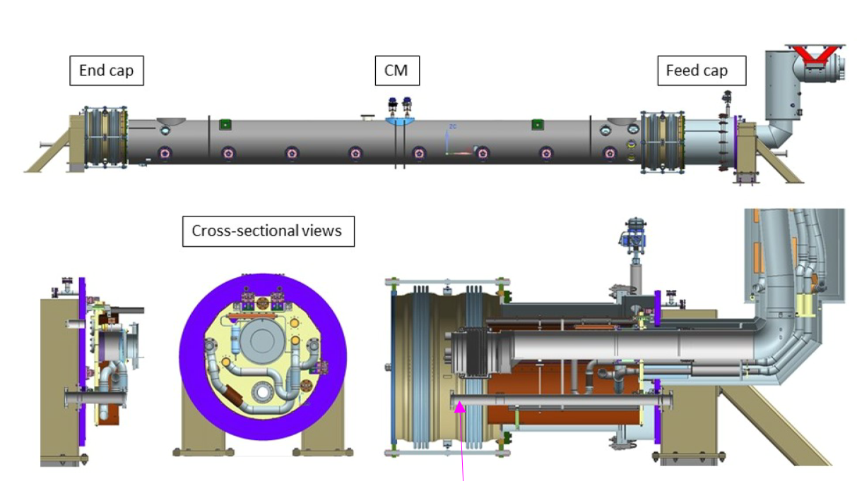
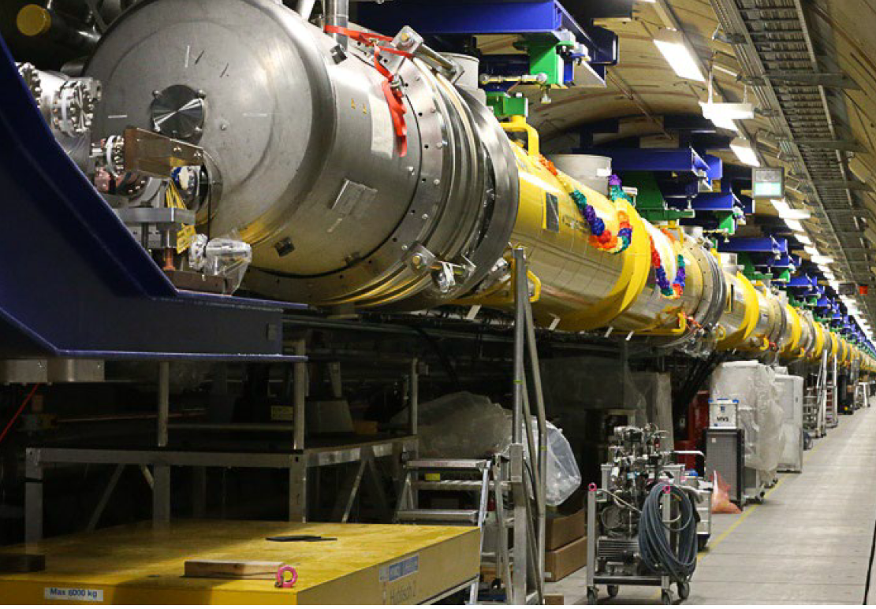
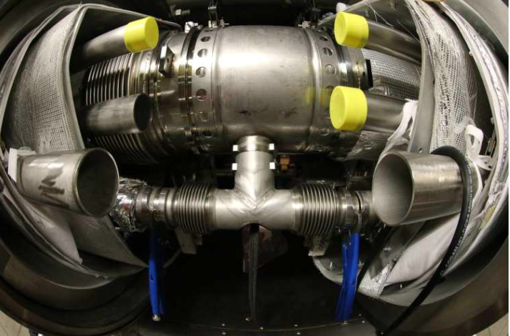
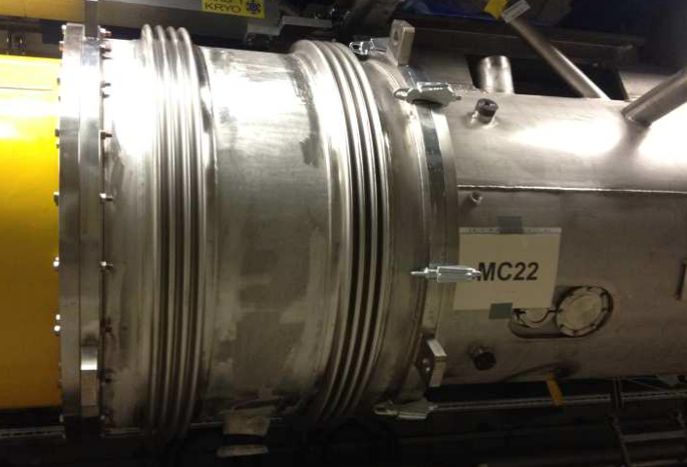
Pictures/drwgs from XFEL and LCLS-II machines
End/feed caps, LCLS –II (courtesy T. Petersen/SLAC)
end cap, XFEL (courtesy K. Jensch/Desy)
IC XFEL (courtesy K. Jensch/Desy)

Slide 27
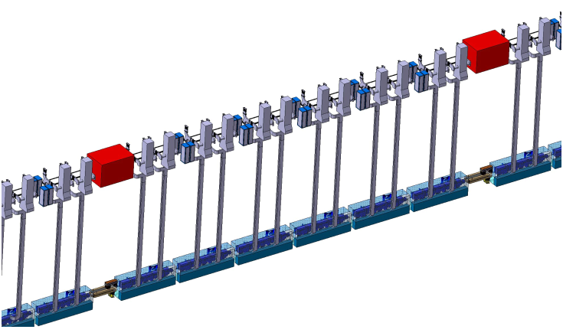
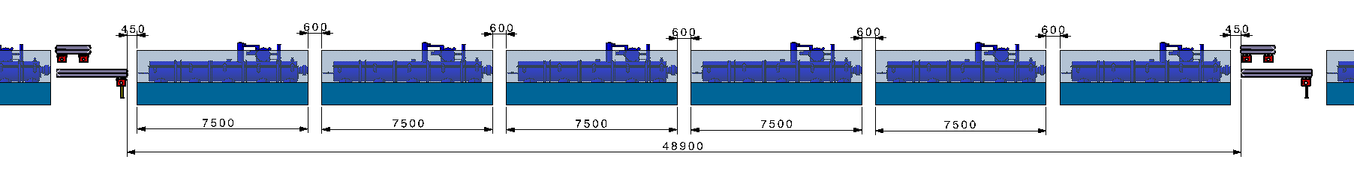
  Collider, 800 MHz CMs segment between quads (ttbar machine)
Klystron, circulator & rack
Bunker
Quadrupole magnets
Collider 800 MHz Cryomodules
F. Valchkova-Georgieva

Slide 28
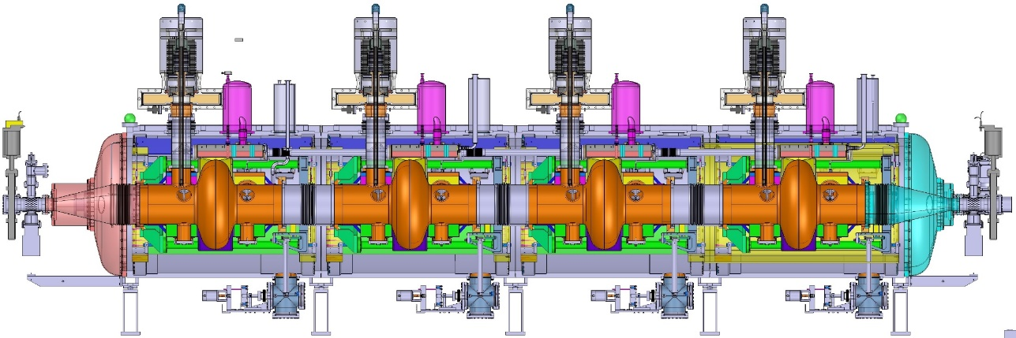
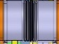
Interconnections IC length
IC opening
space
IC bellows
CM length
CM length
Opening of IC requires sliding length along cylindrical CM vessel

Slide 29
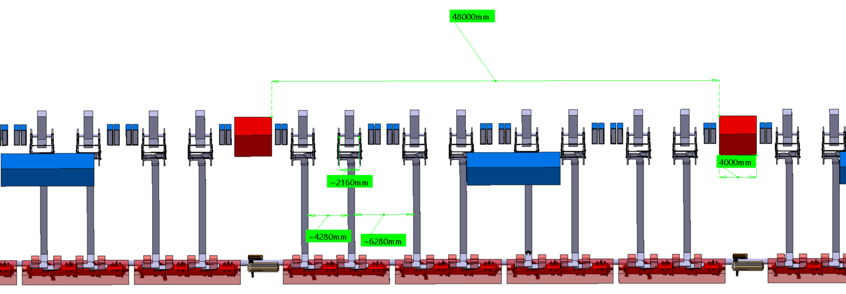
Klystron gallery, side view (400 MHz)
F. Valchkova-Georgieva

Slide 30
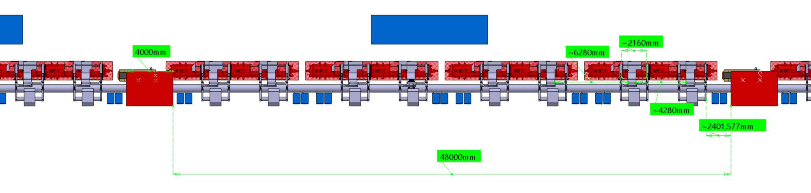
Klystron gallery, top view (400 MHz)
F. Valchkova-Georgieva

Slide 31
Continuous cryostat options (top views)
Continuous vacuum and cryogenic distribution line
SM
Cryogenic distribution line (QRL)
SM
JC
ECB
IC
CM
IC
Cryogenic cell (every N CM)
Continuous vacuum and integrated cryogenic lines
SM
ECB
IC
SM
CM
IC
VB
Cryogenic cell (every N CM)
CM: cryomodule
IC: interconnection
SM: Service Module
Only possible with IC circular bellows → i.e. cryostat vacuum vessel are cylindrical ! (e.g. LHC, XFEL)
VB: Vacuum Barriers
JC: jumper connection
ECB: End Cap Box (restrains high ins. vac. forces)

Slide 32
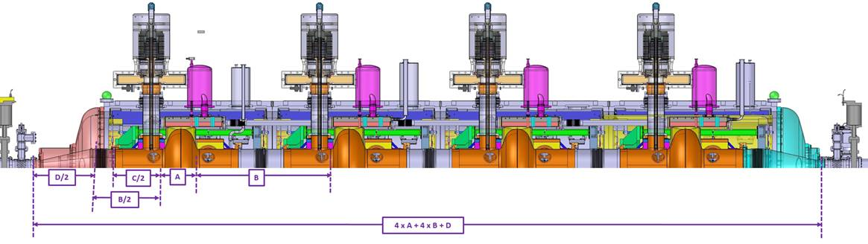
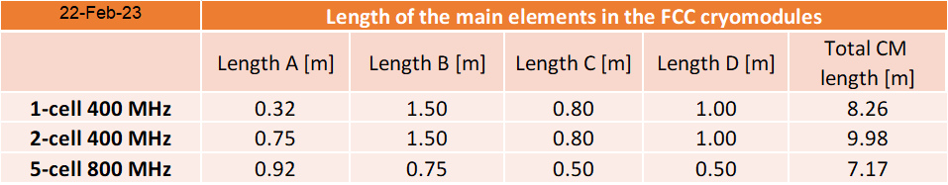
Cavity spacing (SRF lengths only)
Note:
Present assumption is 4 cavities/CM. More cavities/CM is an option
F. Peauger

