Slide 1
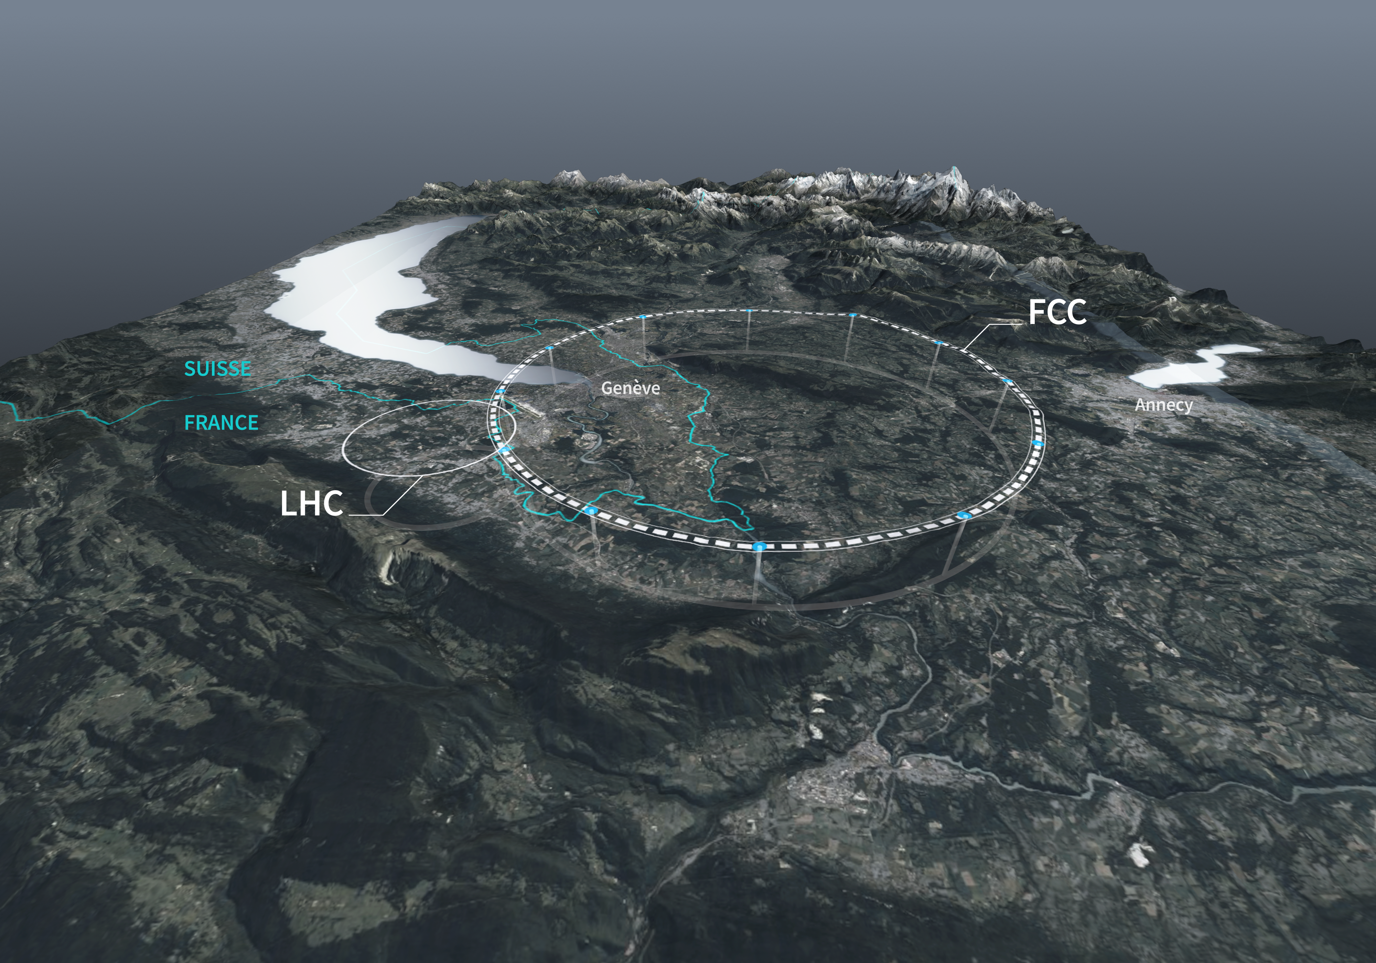









Monochromatization Optics for FCC-ee Lattices
Z. Zhang (IJCLab & IHEP), A. Faus-Golfe (IJCLab)
H. Jiang, B. Bai (HIT)
F. Zimmermann (CERN)
K. Oide (UGE & KEK)
P. Raimondi (SLAC)

Slide 2
Outline
Introduction: Physics Requirements
Transverse Monochromatization Principle
FCC-ee Monochromatization Self-consistent Parameters
FCC-ee Monochromatization Schemes
  Asymmetric
  Symmetric
FCC-ee Monochromatization Optics Design
  Asymmetric
  Symmetric
Summary and Outlook

Slide 3
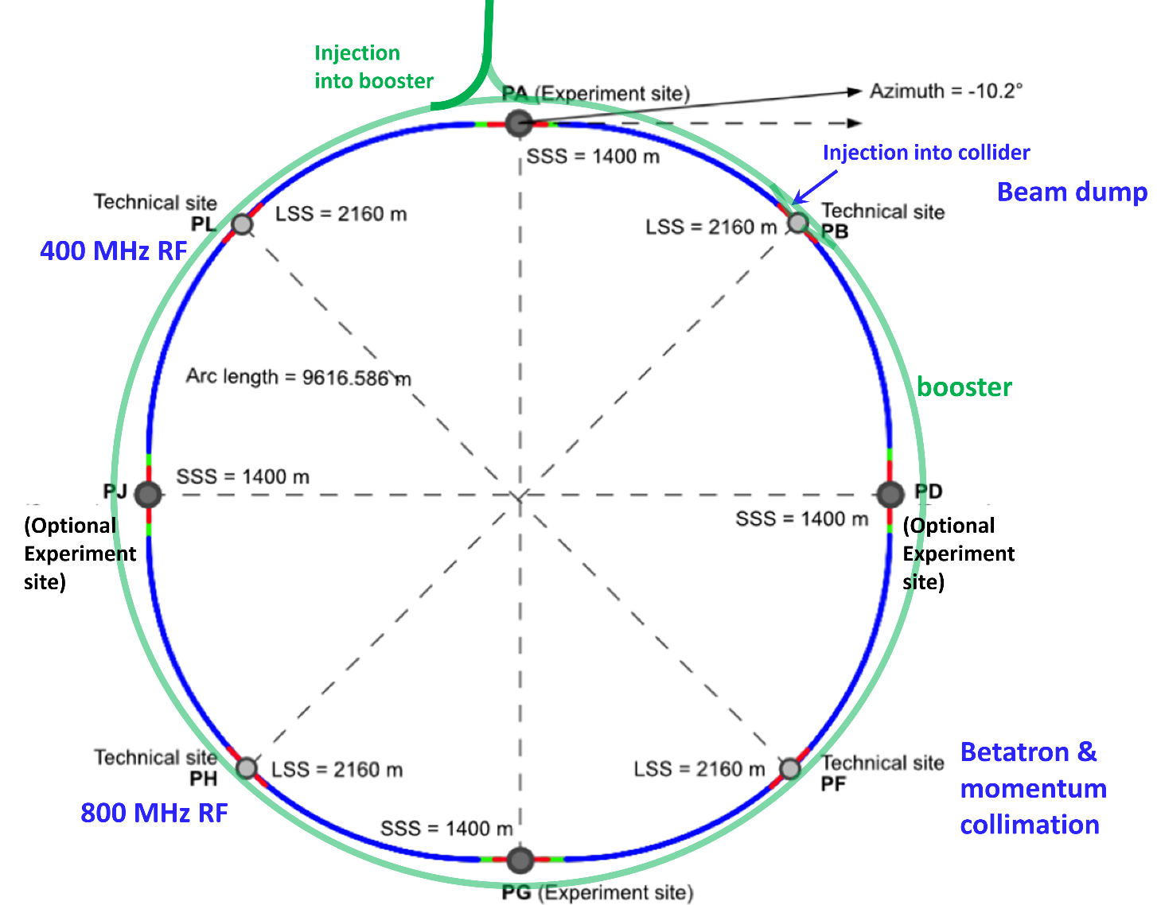
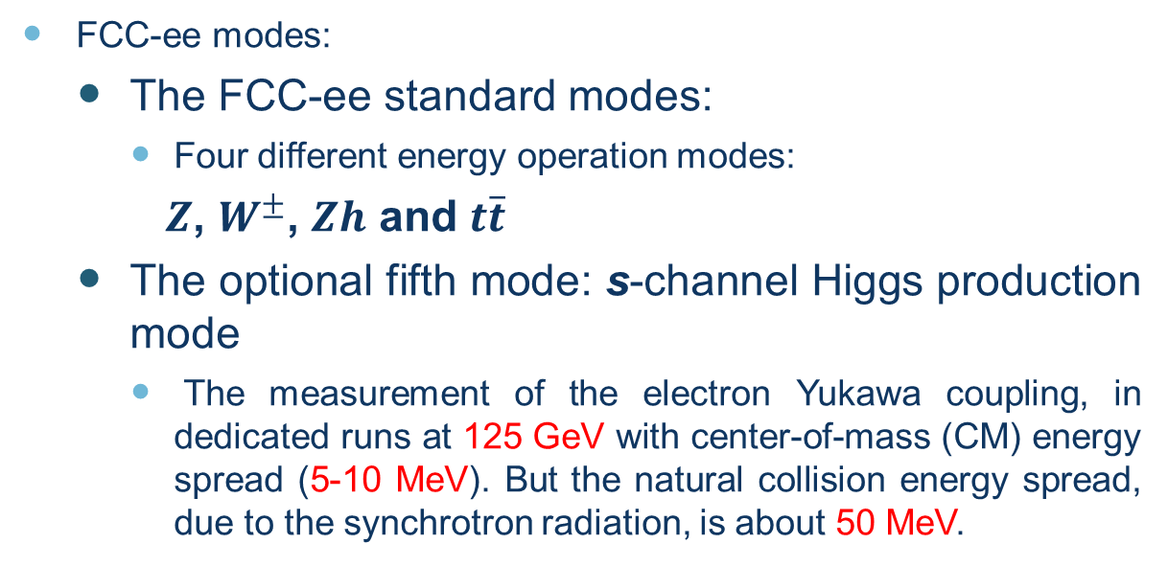
Introduction: Physics Requirements
FCC-ee modes:
  The FCC-ee standard modes:
    Four different energy operation modes:
    $Z$, $W^{±}$, $Zh$ and $t\overline{t}$
  The optional fifth mode: s-channel Higgs production mode
    The measurement of the electron Yukawa coupling, in dedicated runs at 125 GeV with center-of-mass (CM) energy spread (5-10 MeV). But the natural collision energy spread, due to the synchrotron radiation, is about 50 MeV.
Requirements:
  Reduce the CM energy spread from 50 MeV to 5 MeV, which is comparable to the resonant width of the standard model Higgs Boson itself (4.2 MeV)

Slide 4

Transverse Monochromatization Principle
Standard
D*_{x,y}=0
  Monochromatization
D*_{x+} = - D*_{x-}= D*_{x}
D*_{y+} = - D*_{y-}= D*_{y}
correlation between transverse spatial position and energy deviation
Opposite correlations between transverse spatial position and energy deviation
IP
IP
Dispersion function at the IP created by bending dipoles, when different from zero contribute to the beam size
e⁺
e⁻
e⁺
e⁻
$$w=2(E_{b}+∆E)$$
$$w=2E_{b}+O{(∆E)}^{2}$$
CM energy
Monochromatization factor
CM energy spread
Revolution frequency
Number of bunches
Particles per bunch
  Enhancement of energy resolution, and sometimes increase of the relative frequency of the events at the center of of the distribution but luminosity loss !!!!
Luminosity
Betatronic beam sizes at the IP
Dispersive beam size at the IP
  σ*_{x,y}$=$ $\sqrt{ {β_{x,y}^{∗}ε_{x,y}+\left(D_{x,y}^{∗}σ_{δ}\right)}^{2}}$
Notes:
To achieve this monochromatization, opposite correlations between the transverse spatial position and the energy deviation are induced in the colliding beams as sketched in right Figure. In beam-optics terms, this requires generating a dispersion function of opposite signs for the two beams, at the Interaction Point (IP). Nonzero dispersion function at the IP will contribute to enlarge the IP transverse beam size (σ*_{x} or σ*_{y}) and could also have an impact in the luminosity (L$∝$ 1/ (σ_{x} σ_{y})). Consequently the design of a monochromatization scheme has to consider not only the IR beam optics design, but the optimization of the rest of collider parameters to keep luminosity as high as possible.
Opposite dispersions at the IP enhance energy resolution without detriment of the differential luminosity while dispersion which have the same sign degrade both differential and total luminosity

Slide 5
Monochromatization Self-consistent Parameters
Taking into account the baseline optics layout and parameters of the FCC-ee, featuring a large crossing angle of 30 mrad at the IP, a parametric study of monochromatization for FCC-ee has been made at 125 GeV collision energy. The results calculated with the simulation code Guinea-Pig are summarized below.
Parameters | Unit | Horizontal Dispersion | Vertical Dispersion
Beam energy (E) | GeV | 62.5 | 62.5
Horizontal, vertical emittance (ε_{x,y}) | nm | 0.51, 0.002
Energy spread (σ_{δ}) | % | 0.052
Beam length (σ_{δ}) | mm | 3.3
IP Beta function (β*_{x,y}) | mm | 90, 1
IP RMS beam size (σ_{x,y}) | μm | 55, 0.045
Crossing Angle (θ_{c}) | mrad | 30
Vertical beam-beam parameter (ξ_{y}) | / | 0.106
Beam current (I₀) | mA | 395
Bunch population (N_{b}) | 10¹¹ | 0.6
Bunches per beam (n_{b}) | / | 13420
IP Dispersion (D*_{x,y}) | m | 0.105 | 0.001
Monochromatization factor (λ) | / | 8.1209 | 11.6705
Monochromatization factor
Because the vertical beam size at the IP is much smaller than horizontal beam size, about ten times smaller vertical dispersion is needed to get the same monochromatization factor compared with the horizontal one.

Slide 6
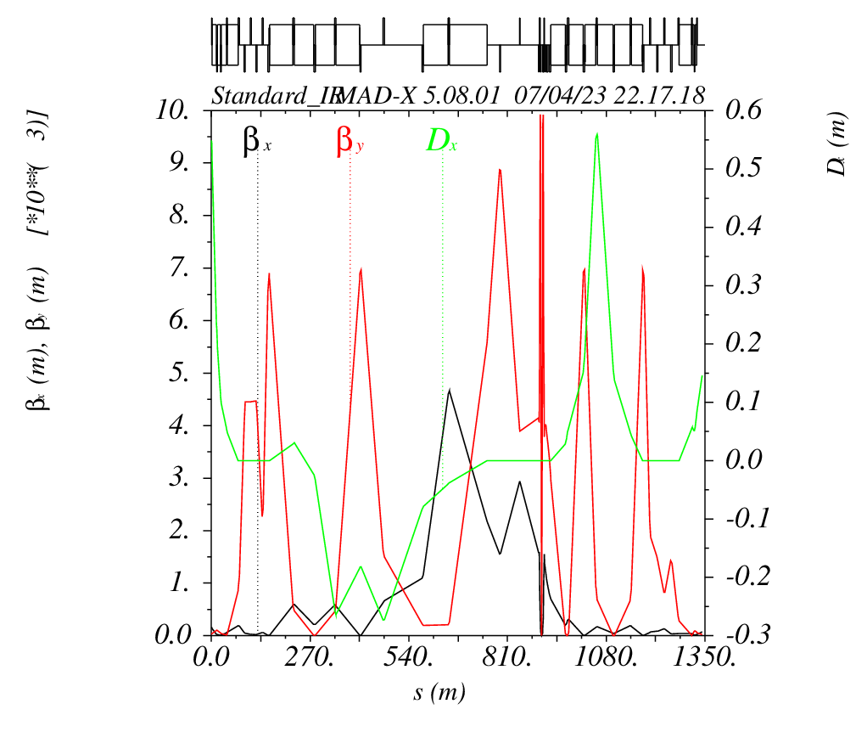
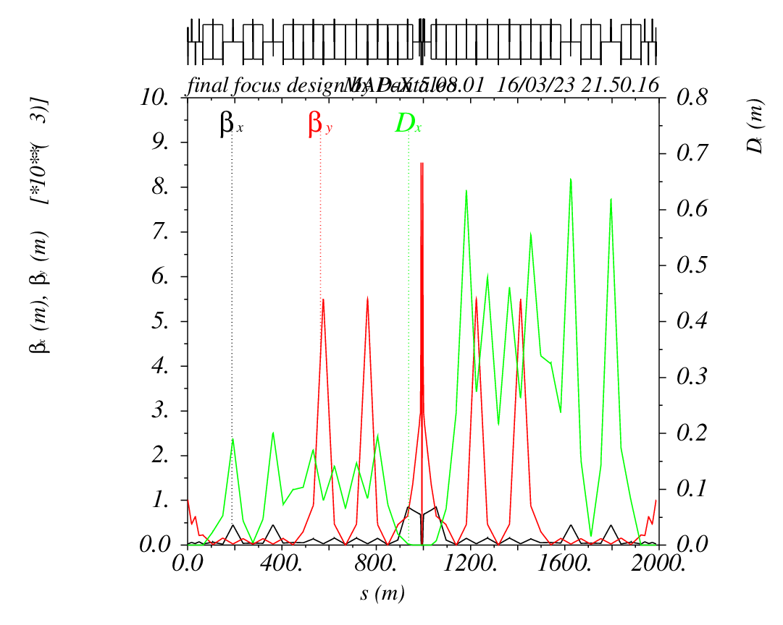
FCC-ee Monochromatization Schemes
Scheme for Asymmetrical Standard IR Optics (K. Oide)
Scheme for Symmetrical Standard IR Optics (P. Raimondi)
e⁺
e⁺
D*_{x} = 0 at IP
Creating horizontal dispersion (D*_{x} = 0.105 m )
Creating vertical dispersion (D*_{y} = 0.001m )

Slide 7
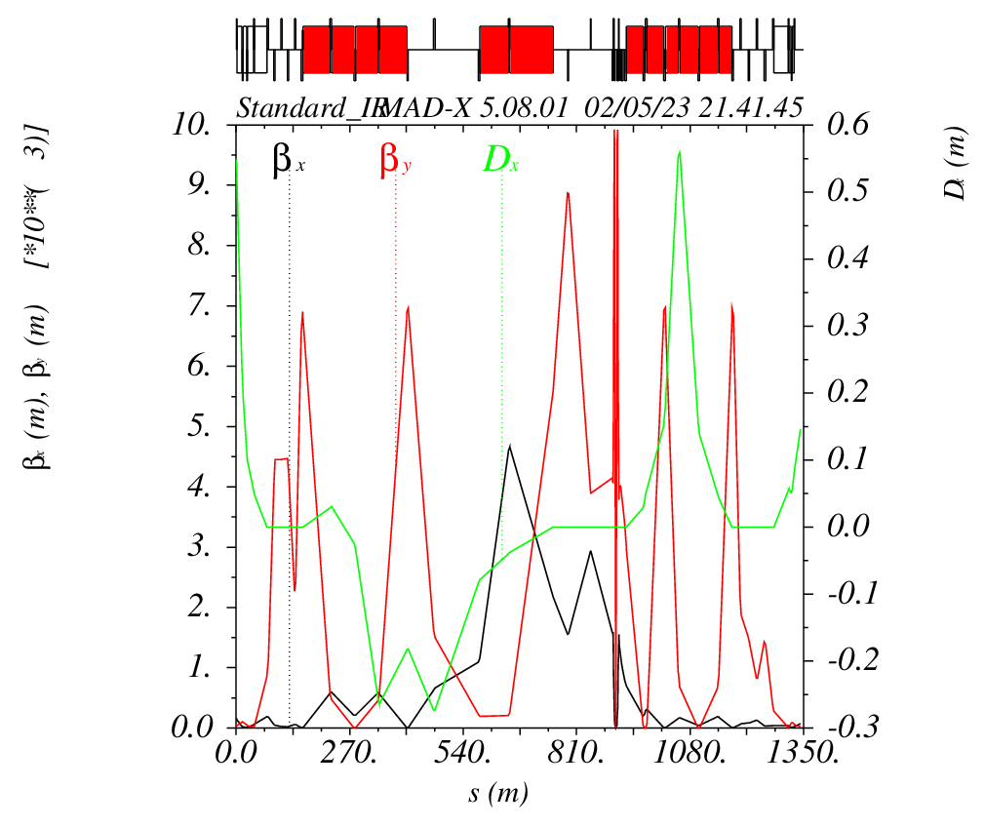
Scheme for Asymmetrical Standard IR Optics
First Optics Design
All local vertical chromaticity horizontal dipoles (LOC H-dipole) in standard IR Optics are cut into three pieces and quadrupoles are inserted between them. One half-chicane is implemented in the last dipole in each upstream and downstream to create the dispersion at the IP to match the dispersion in the arcs.
e⁺
LOC H-dipole cutting and chicane implementation
Inserted quadrupoles
e⁺
MonochroM Orbit
Standard Orbit
Angle 1
Angle 2
Chicane

Slide 8
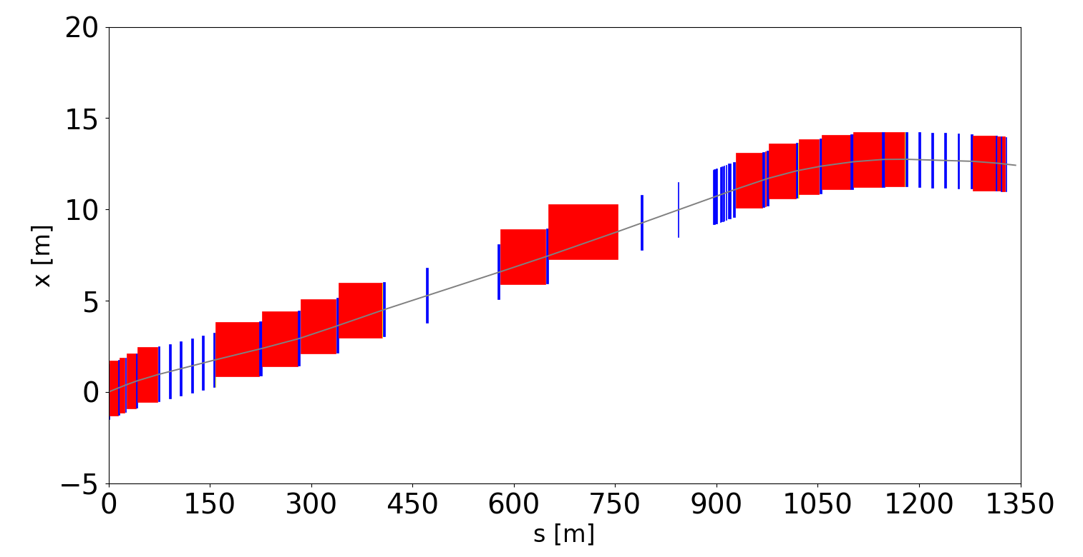
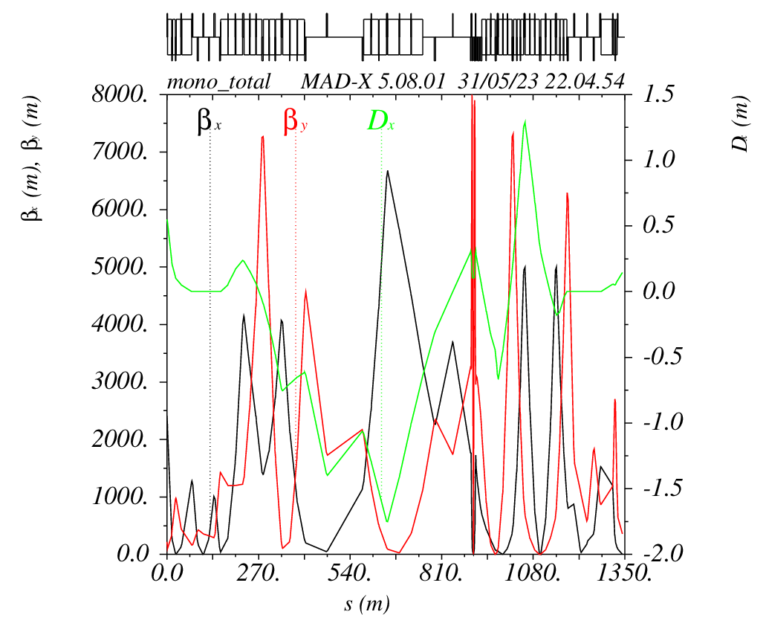
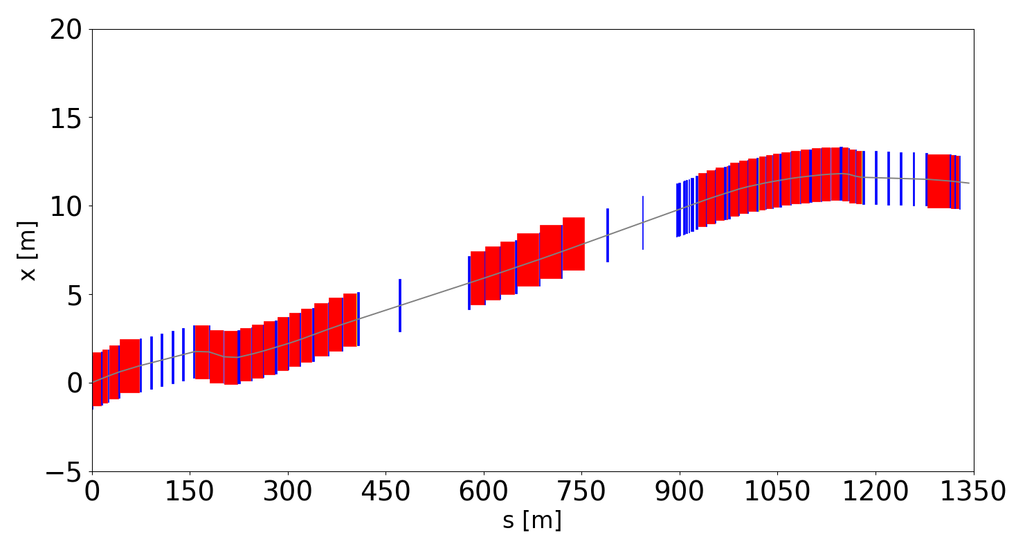
Scheme for Asymmetrical Standard IR Optics
The dispersion at the IP is successfully matched to 0.105m, but the orbit is changed at the position of the two half-chicane.
Standard Survey Plot
e⁺
Monochromatization Survey Plot
e⁺
Half-Chicane
Half-Chicane

Slide 9
Scheme for Asymmetrical Standard IR Optics
First Optics Design Orbit Closing
One another kind of chicane is implemented in the last dipoles in each upstream and downstream to chose the orbit.
e⁺
LOC H-dipole cutting and chicane implementation
Inserted quadrupoles
e⁺
MonochroM Orbit
Standard Orbit
Angle 1
Angle 3
Angle 2
Chicane

Slide 10
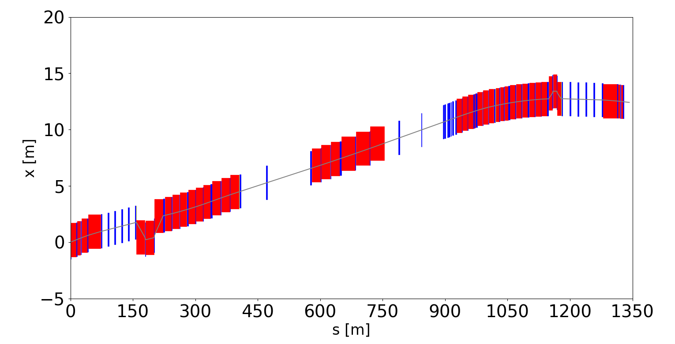
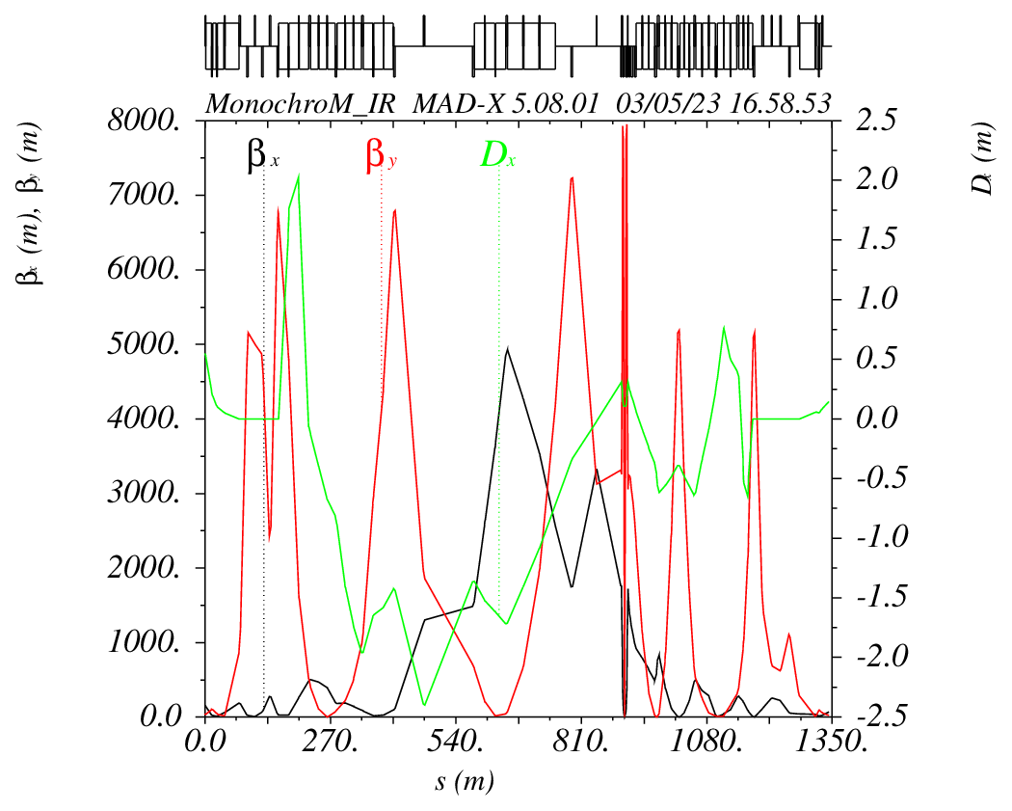
Scheme for Asymmetrical Standard IR Optics
The survey plot shows that the monochromatization orbit is different from the standard one only at the position of the two chicanes. However, the angle of chicane is too high for the synchrotron radiation control.
Standard Survey Plot
e⁺
Monochromatization Survey Plot
e⁺
Chicane
Chicane

Slide 11
Scheme for Asymmetrical Standard IR Optics
Optimization of Chicane Angle
In order to reduce the angle of chicane, the chicane is implemented in the last three dipoles instead of one.
e⁺
LOC H-dipole cutting and chicane implementation
Inserted quadrupoles
e⁺
MonochroM Orbit
Standard Orbit
Angle 1
Angle 2
Angle 3
Chicane

Slide 12
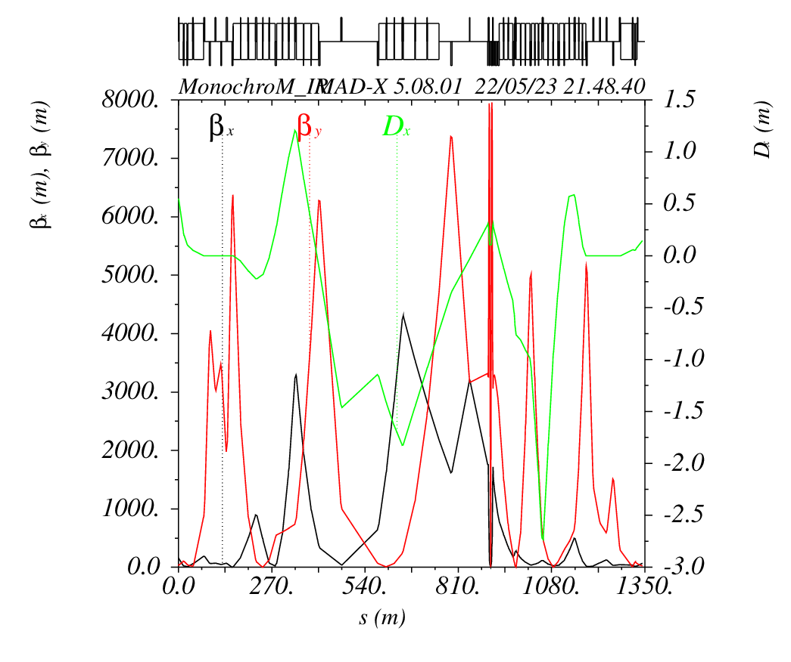
Asymmetrical Monochromatization IR Optics Design
Asymmetrical Monochromatization IR Optics
The beam parameters at the IP are matched to be same with the FCC-ee monochromatization self-consistent parameters.
e⁺
Chicane
Chicane
D*_{x} = 0.105m

Slide 13
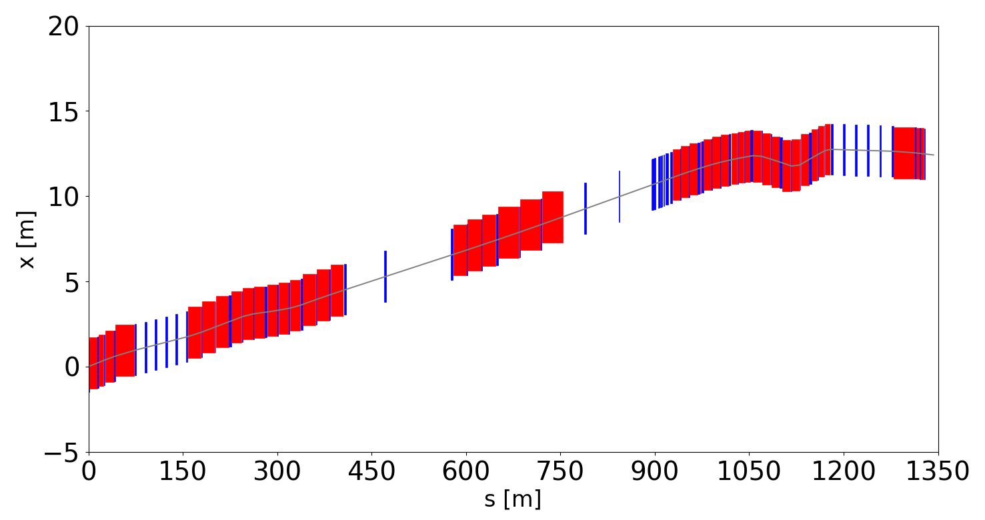
Asymmetrical Monochromatization IR Optics Design
Comparison between standard survey and monochromatization survey
Standard Survey Plot
e⁺
Monochromatization Survey Plot
e⁺
Chicane
Chicane

Slide 14
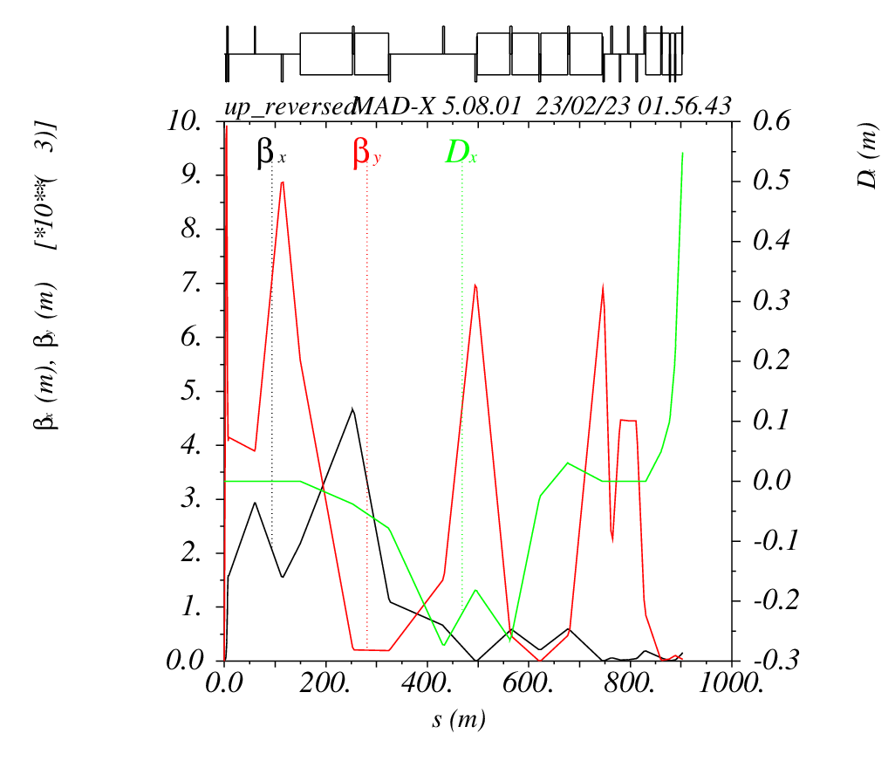
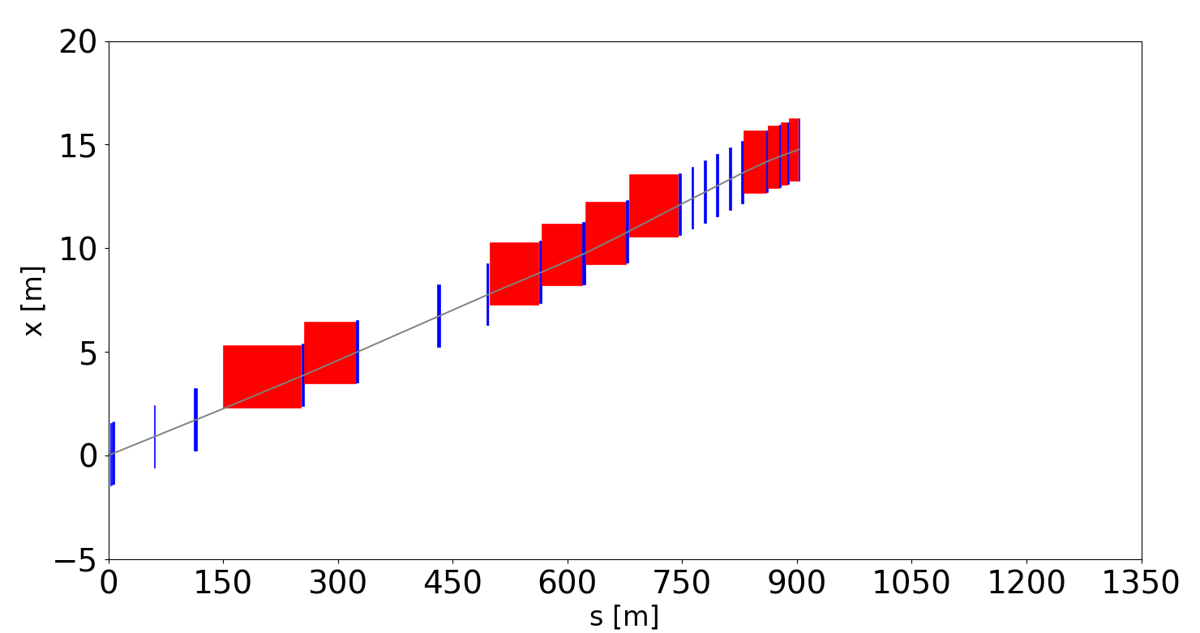
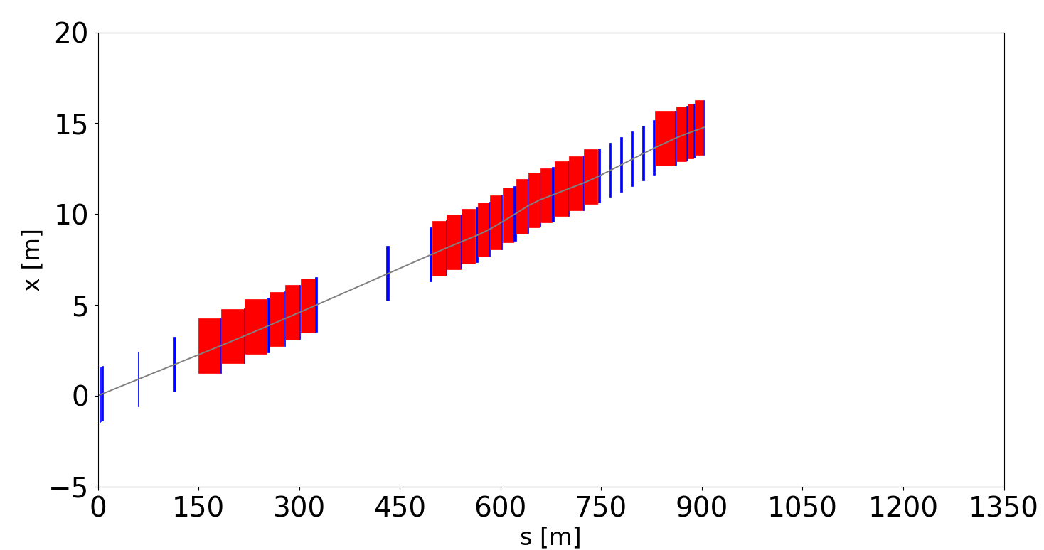
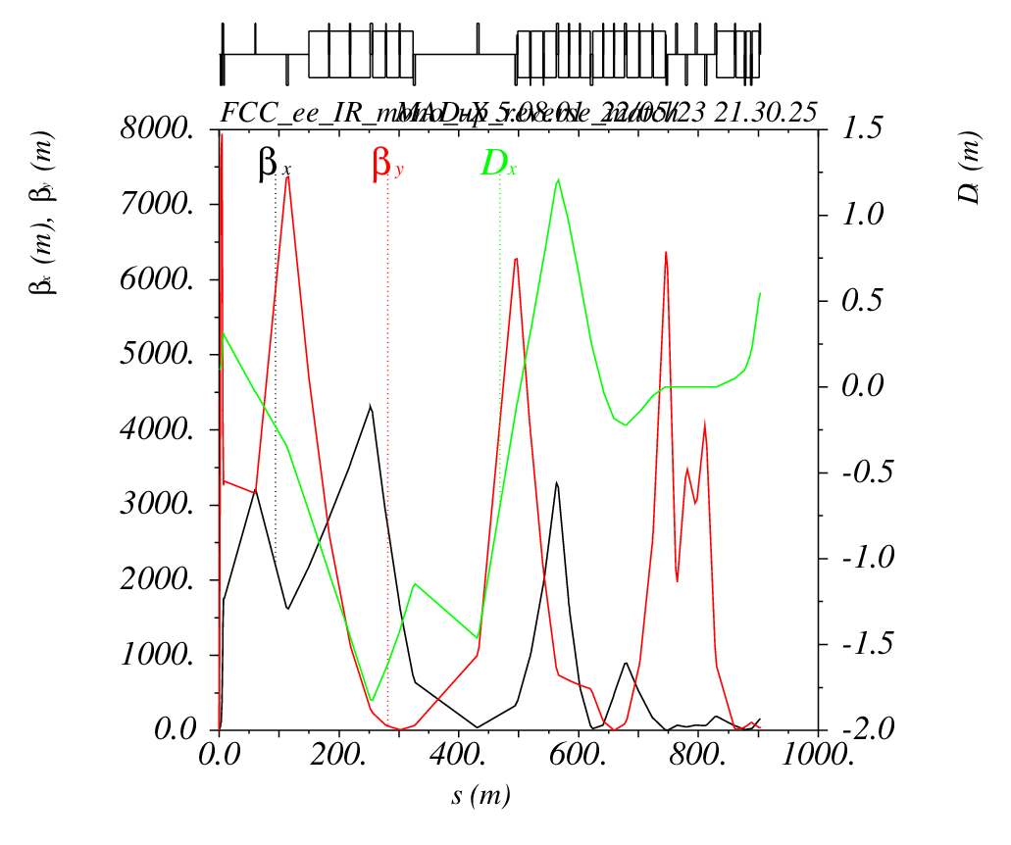
Asymmetrical Monochromatization IR Optics Design
Entrance Survey Point Check and Beam Parameter Check
Standard
e⁺
Entrance survey point check
X = 14.77331827
Angle = 0.013272
Entrance beam parameters check
β_{x} = 156.6587437
α_{x} = -2.264602028
β_{y} = 35.30306244
α_{y} = 0.617284605
D_{x} = 0.5488569734
D_{px} = 0.007526257585
e⁺
Monochromatization
e⁺
Entrance survey point check
X = 14.77329905
Angle = 0.013272
Entrance beam parameters check
β_{x} = 156.658721
α_{x} = -2.264601911
β_{y} = 35.30305802
α_{y} = 0.6172849609
D_{x} = 0.5488569538
D_{px} = 0.007526259165
e⁺

Slide 15
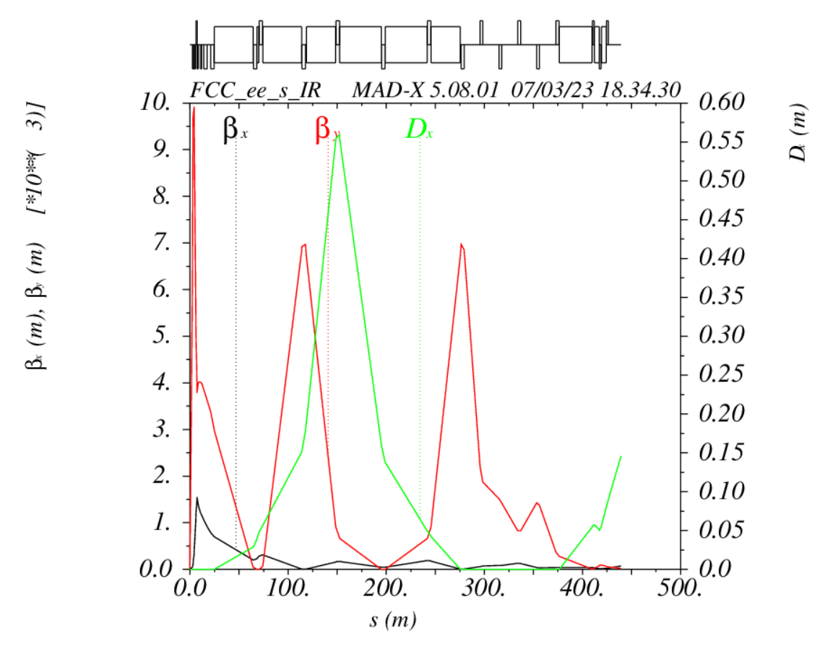
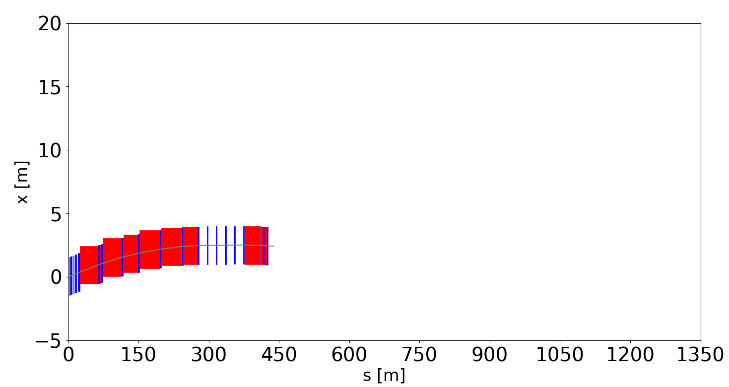
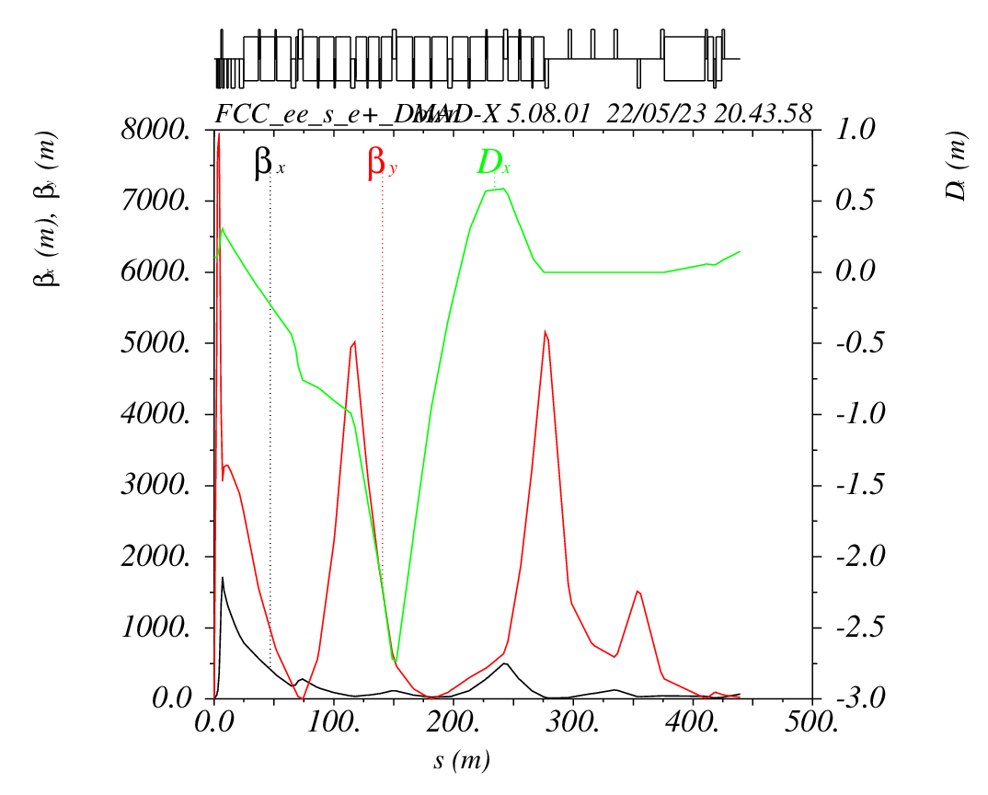

Asymmetrical Monochromatization IR Optics Design
Exit Survey Point Check and Beam Parameter Check
e⁺
Standard
Exit beam parameter check
β_{x} = 70.69329
α_{x} = -2.0980736970165381
β_{y} = 21.4996407
α_{y}= 0.81240088314360692
D_{x} = 0.14579546
D_{px} = 0.00429520279
e⁺
Exit survey point check
X = 2.4083046330304256
Angle = -0.0024383648753176683
Monochromatization
e⁺
Exit beam parameter check
β_{x} = 70.69328967393588
α_{x} = -2.0980736921462215
β_{y} = 21.499640414866093
α_{y} = 0.8124009880050117
D_{x} = 0.14579548213956553
D_{px} = 0.0042952063751779106
e⁺
Exit survey point check
X = 2.408308143765483
Angle = -0.0024383648753180066

Slide 16
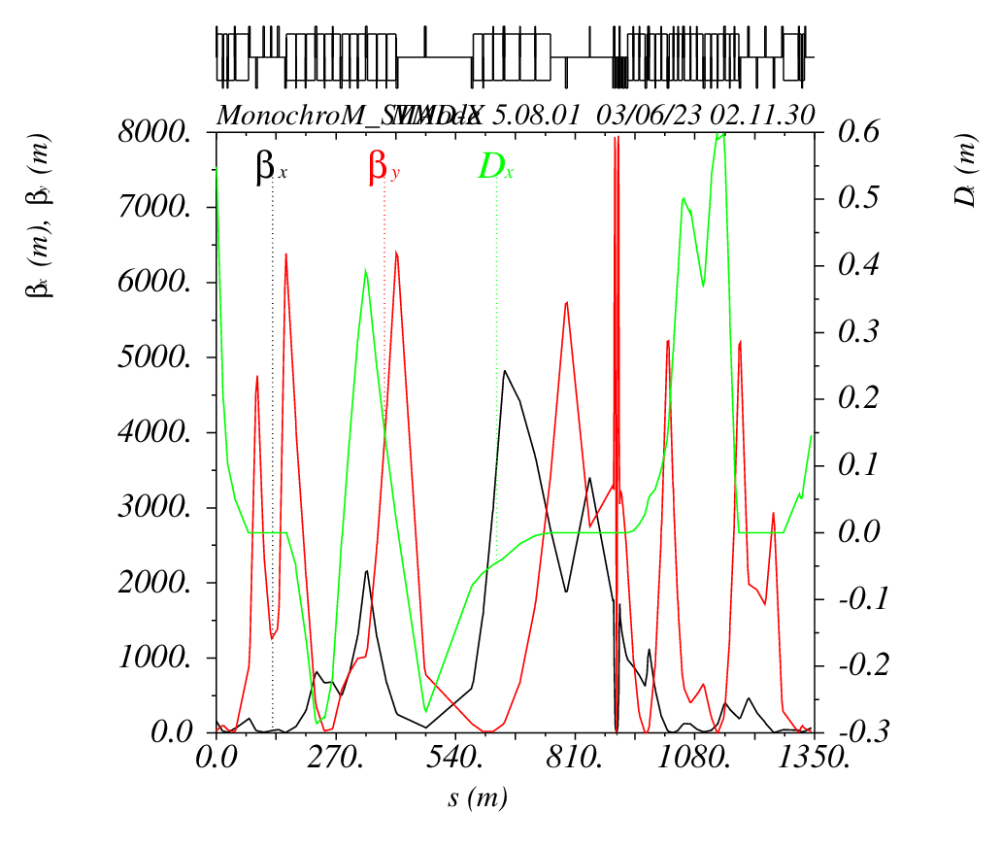
Asymmetrical Monochromatization IR Optics Design
Standard Mode with monochromatization orbit
Frozen the angle of all the dipoles of monochromatization optics (keeping the monochromatization orbit), matching only with the strength of all the quadrupoles to get the dispersion at the IP back to zero.
D*_{x} = 0.105 m Monochromatization mode
D*_{x} = 0 Standard mode
e⁺
e⁺
Next step
Implementation of the monochromatization IR optics in the whole ring and simplification of the dipoles slicing.

Slide 17

Scheme for Symmetrical Standard IR Optics
Preliminary Scheme
Creating the vertical dispersion by adjusting the correctors (red) and skew quadrupoles (blue) around the IP solenoid (yellow). It will take the following five steps to get the vertical dispersion at the IP.
Step 4: Optimized to minimize $ε_{y}$
Step 3: Varied to close the dispersion Dy, Dpy
IP
Bx1p
Bx1m
QD0aL
QD0bL
Bx2m
QF1
Bx3m
QF2
TSKW0L
TSKW1L
-TSKW1L
Step 1: Give Solenoid Horizontal BField component
Step 5: Give the Dy at IP and re-do from Step1.
Step 2: Varied to close the vertical orbit

Slide 18
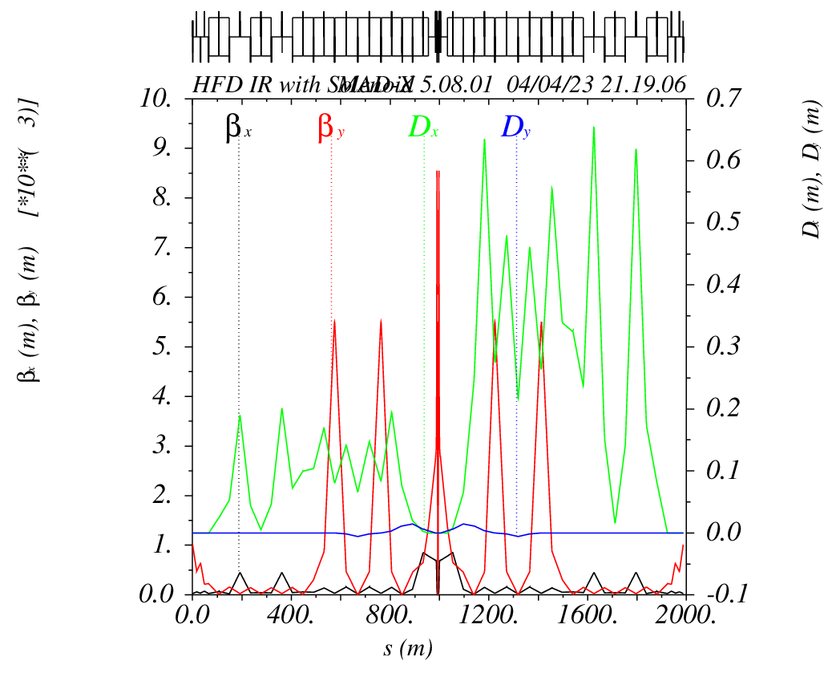
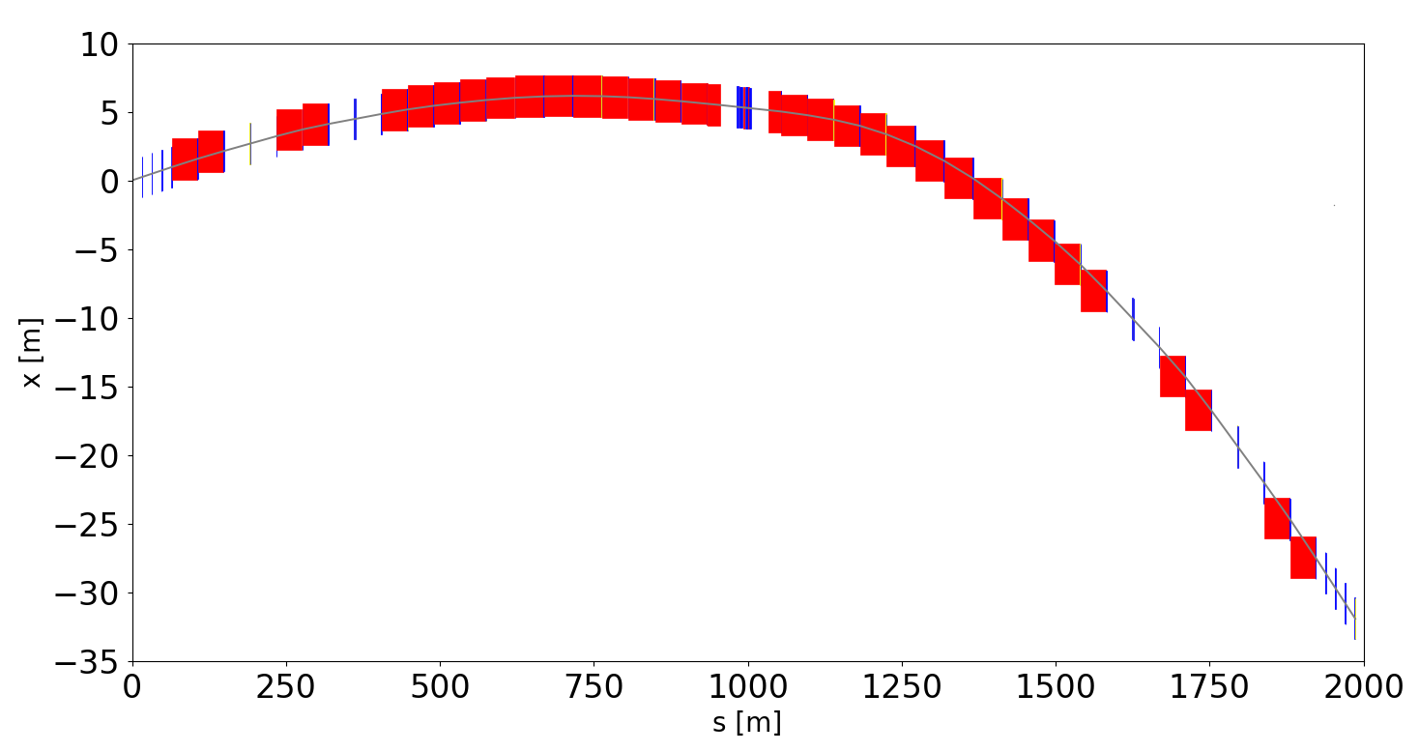
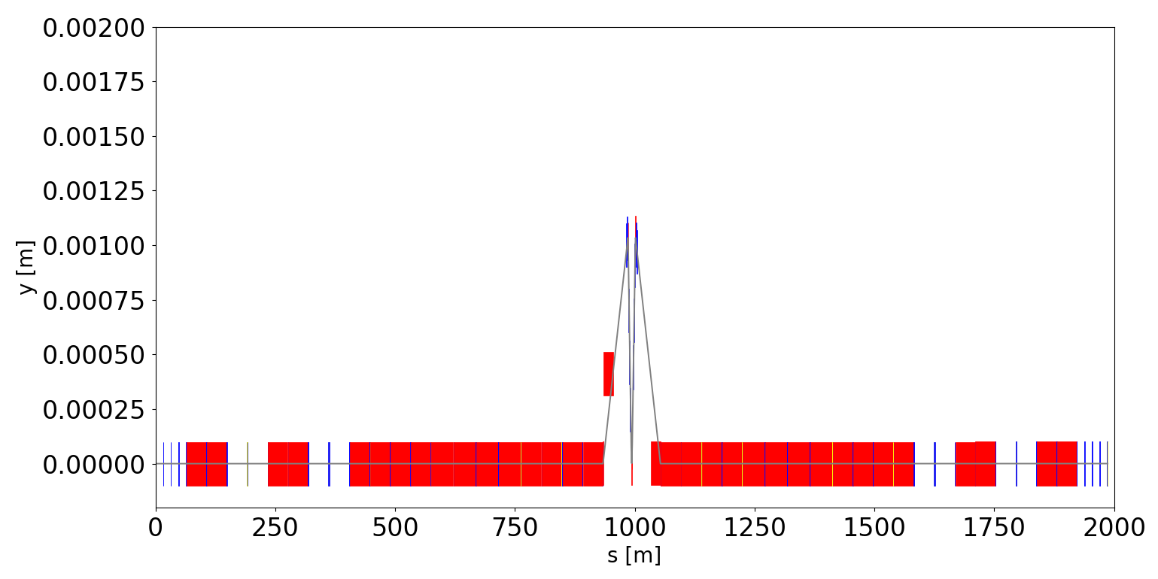
Symmetrical Monochromatization IR Optics Design
Solenoid Implementation
Vertical orbit and vertical dispersion was closed after implementing the solenoid.
Horizontal survey plot
e⁺
Vertical survey plot
Vertical orbit back to 0 after Bx3m
Vertical dispersion closed.

Slide 19
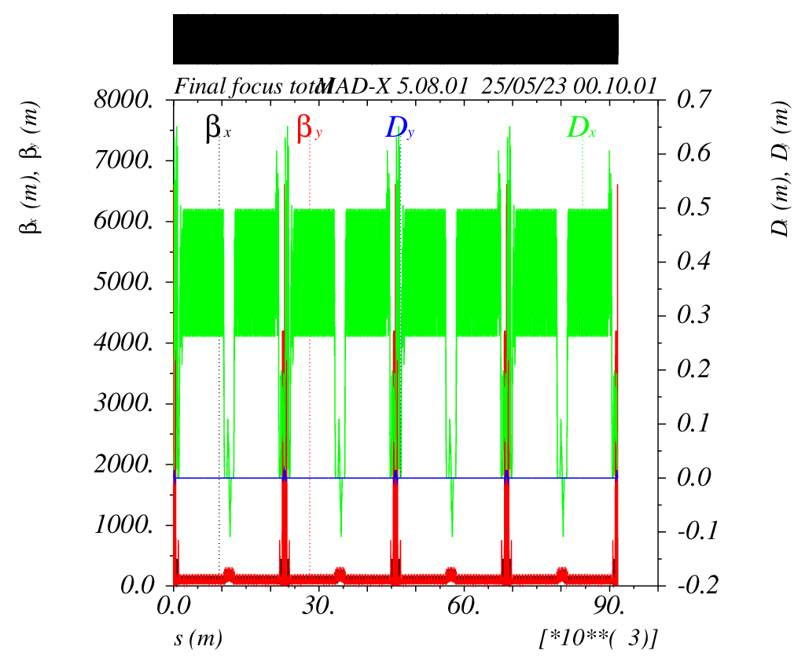
Symmetrical Monochromatization IR Optics Design
Calculation and minimization of the vertical emittance
The IR lattice with solenoid was implemented in the whole ring successfully. A script for the minimization of the vertical emittance is being developed.

Slide 20
Summary and Outlook
Asymmetrical IR Monochromatization Optics design
The monochromatization optics design for positron
Survey plot and beam parameters check
Standard Mode with monochromatization orbit
Implementation of the monochromatization IR optics in the whole ring is in progress
Simplification of the dipoles slicing is in progress
Symmetrical IR Monochromatization Optics design
Solenoid implementation
Closing vertical orbit and vertical dispersion
Calculation and minimization of the vertical emittance is in progress
Experimental proof of concept in DAFNE

Slide 21
Thanks for you attention!

