Slide 1


Positron production, capture and acceleration until the damping ring
Iryna Chaikovska
Laboratoire de Physique des 2 Infinis Irène Joliot-Curie (IJCLab)
CNRS, Université Paris-Saclay
on behalf of the WP3 team (FCC-ee injector update studies)
F. Alharthi, R. Chehab, V. Mytrochenko (IJCLab), S. Doebert, J.-L. Grenard, B. Humann, A. Latina, A. Lechner,
R. Mena Andrade, A. Perillo Marcone, Y. Zhao (CERN), B. Auchmann, P. Craievich, M. Duda, J. Kosse, M. Schaer, N. Vallis, R. Zennaro (PSI), L. Bandiera, M. Soldani, A. Sytov (INFN/Ferrara), A. Bacci, M. Rossetti Conti (INFN/Milano), Y. Enomoto (KEK), P. Martyshkin
This work was done under the auspices of CHART (Swiss Accelerator Research and Technology) Collaboration, https://chart.ch - CHART Scientific Report 2022: https://chart.ch/reports/
FCCIS: 'This project has received funding from the European Union's Horizon 2020 research and innovation programme under the European Union's Horizon 2020 research and innovation programme under grant agreement No 951754.'

Slide 2
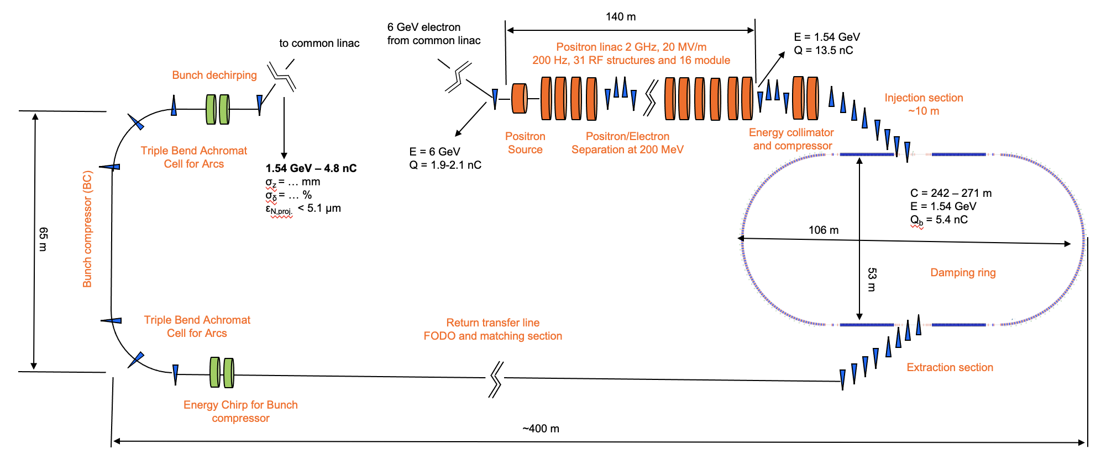
FCC-ee pre-injector layout (positron source)
Talk on DR by C. Milardi (LNF)
Beam energy | 6 GeV
Bunch charge | ~5.6 nC (max)
Bunch length | 1 mm
Bunch transverse size | ≳ 0.5 mm
Nb of bunches per pulse | 2
Bunch separation | 25 ns
Repetition rate | 200 Hz
Beam power | ~13.3 kW (max)
e⁻ drive beam

Slide 3
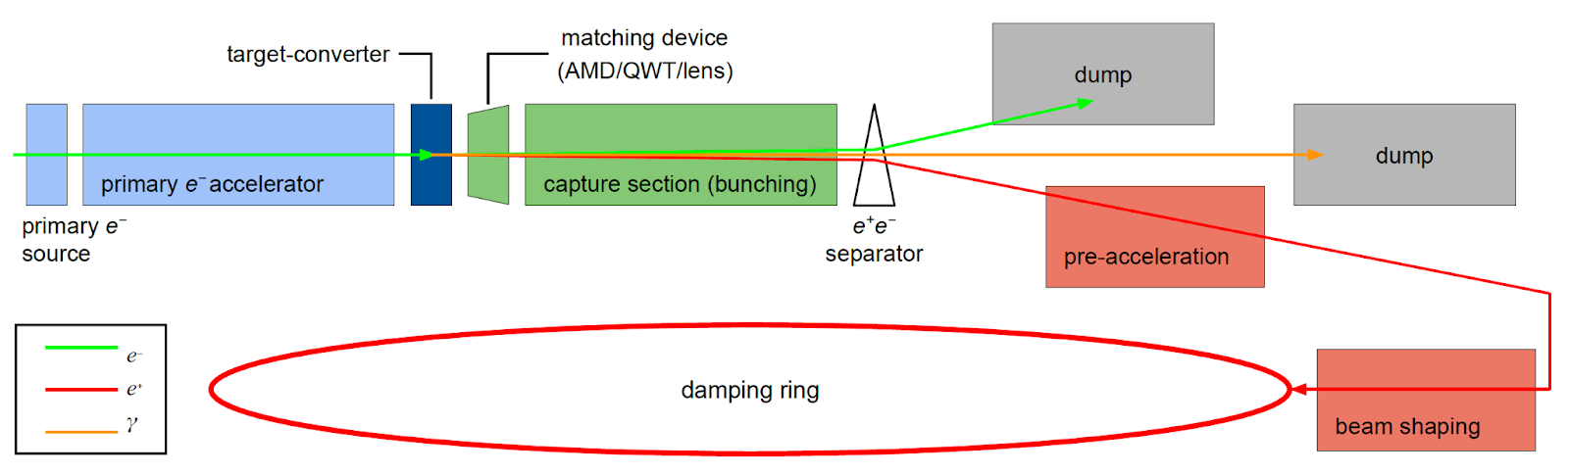

FCC-ee positron source: requirements
Positron source basic scheme
Accepted e⁺ yield is a function of primary beam characteristics + target + capture system + DR acceptance
To estimate the accepted yield:
energy window cut: (1540 ± 58.5) MeV → (±3.8% @ 1.54 GeV)
time window cut: 40° RF (~16.7 mm/c @2 GHz)
The complete filling for Z running => Requirement ~2.75 ⨯ 10¹⁰ e⁺/bunch (4.4 nC) at the linac end
or 5.4 nC accepted in the DR
N_{e-}/bunch ⨯ η^{e+}_{Accepted} ≥ 5.4 nC/bunch ⨯ 2.5
*A safety margin of 2.5 is currently applied for the whole studies.
All the studies are focused on the operation scheme: 6 GeV, 2 bunches/pulse, 200 Hz rep. rate
➜ positron flux of ~1.1⨯10¹³ e⁺/s (⨯2.5). Demonstrated at SLC (a world record for existing accelerators): ~6 ⨯10¹² e+/s

Slide 4
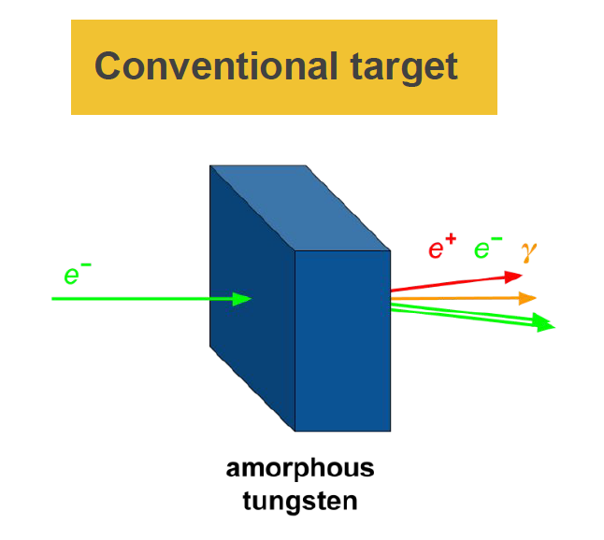
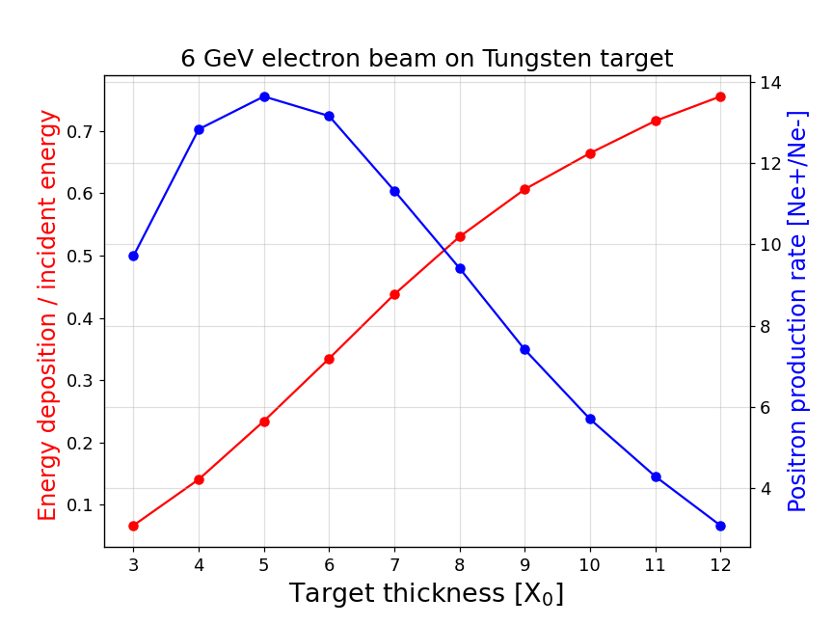
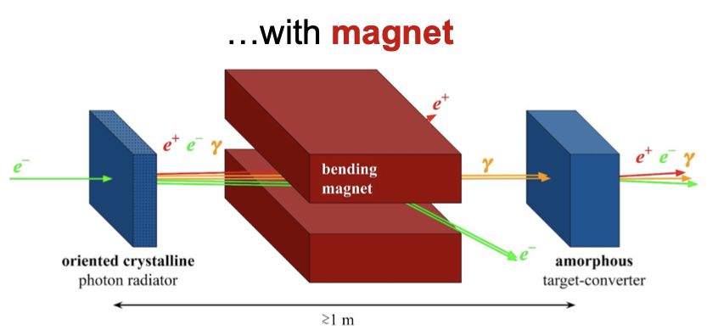
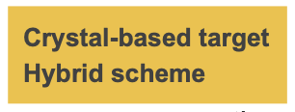
FCC-ee positron source: positron production
Schemes under consideration now
Conventional scheme: bremsstrahlung and pair conversion (mainly studied until now)
Hybrid scheme (crystal-based positron source) use the intense radiation emitted by high-energy (some GeV) electrons channeled along a crystal axis => channeling radiation.
Target thickness | 5 X0 17.5 mm
Production rate | ~14 Ne⁺/Ne⁻
PEDD* | f(e⁻ beam)
Deposited power | f(e⁻ beam)
The final choice will be done based on the simulated performances
Studies on the target-converter shape in progress (tapered target, rod target, granular target)
*According to SLC experience, W₇₄Re₂₆ material has a PEDD limit of 35 J/g (safe value to avoid target failure)

Slide 5
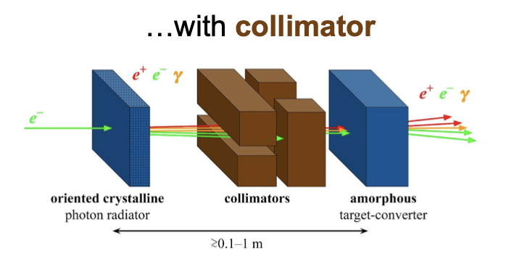
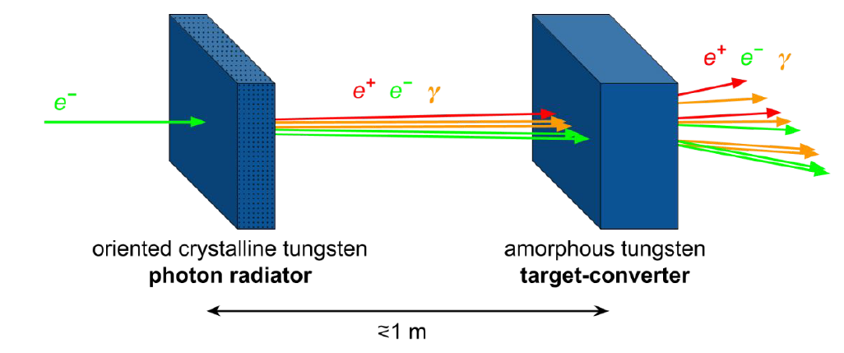
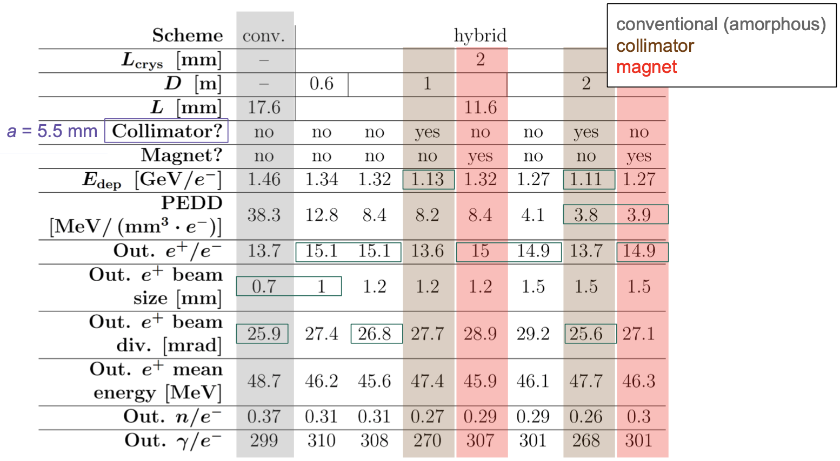
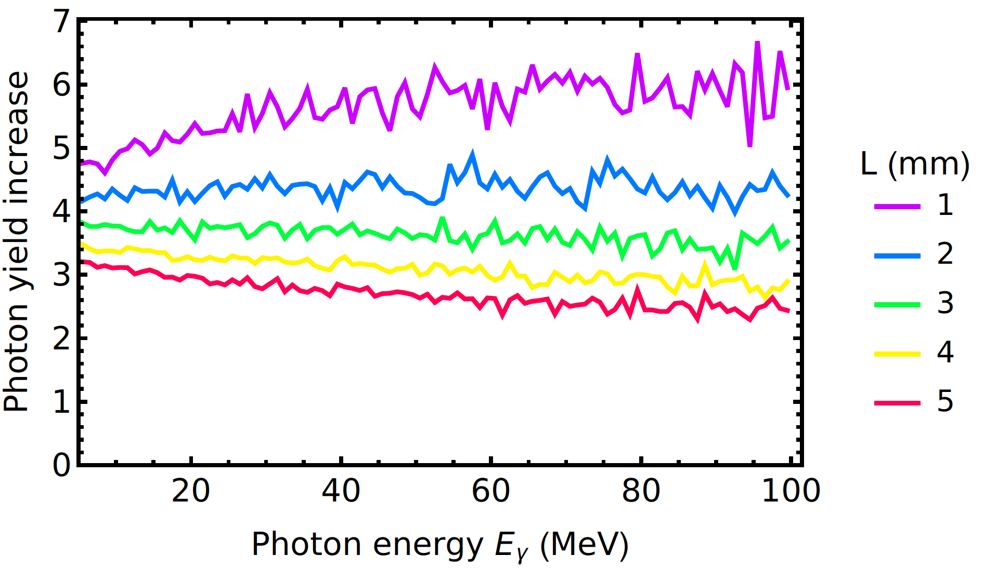
Hybrid scheme: positron production optimization for FCC-ee (in progress)
R. Chehab et al., in Proc. of the 1989 IEEE Particle Accelerator Conf., 1989, pp. 283–285
towards conceptual design
Radiation enhancement in the tungsten (W) crystals aligned along <111> axes
< 100 MeV : photon yield increase ≈ 4.3
Full spectrum : photon yield increase ≈ 3.7
→ Comparable e⁺ production rate but lower thermal load
→ Capture simulations in progress
L. Bandiera et al., Eur. Phys. J. C (2022) 82:699

Slide 6
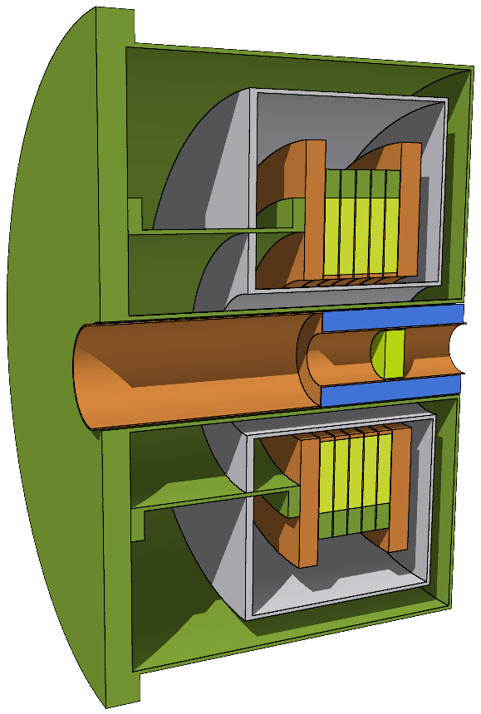
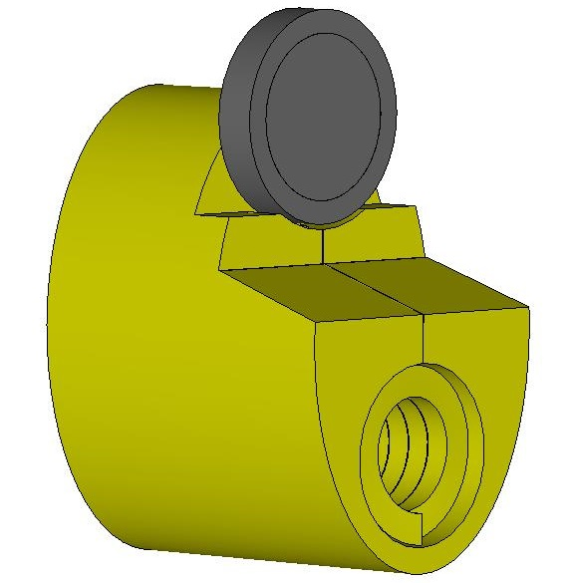
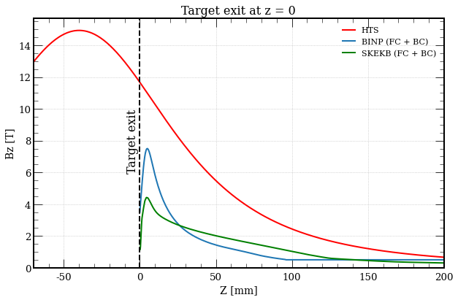
Positron capture: matching device
Matching device => a fast phase space rotation to transform the small size and high divergence in big sizes and low divergence beam.
Flux Concentrator (FC)
Originally designed by BINP (P. Martyshkin). Starting collaboration with KEK and CERN.
High-Temperature Superconducting (HTS) solenoid designed by PSI (J. Kosse, B. Auchmann and M. Duda)
FC: lower peak field and aperture, fixed target position, challenging power source working at 200 Hz, robust and reliable solution…
HTS solenoid: higher peak field and aperture, flexibility on the field profile and target position, DC operation, innovative solution in application for e⁺ capture…

Slide 7
Positron capture: capture linac
The capture linac is encapsulated inside a solenoid with the axial magnetic field of ~0.5 T
Baseline structure: large-aperture (Φ = 60 mm) TW L-band @ 2 GHz, 9π/10, 3-meter long, 20 MV/m. F3 structure designed by H. Pommerenke and A. Grudiev (CERN). 5 RF structures are used to accelerate the e⁺ beam up to ~200 MeV.
Baseline solenoid configuration: 0.5 T NC solenoid. Configuration designed by M. Schaer, R. Zennaro (PSI). For simplification, 0.5 T uniform NC field used (as the difference in final results was found to be small).
F3 structure

Slide 8
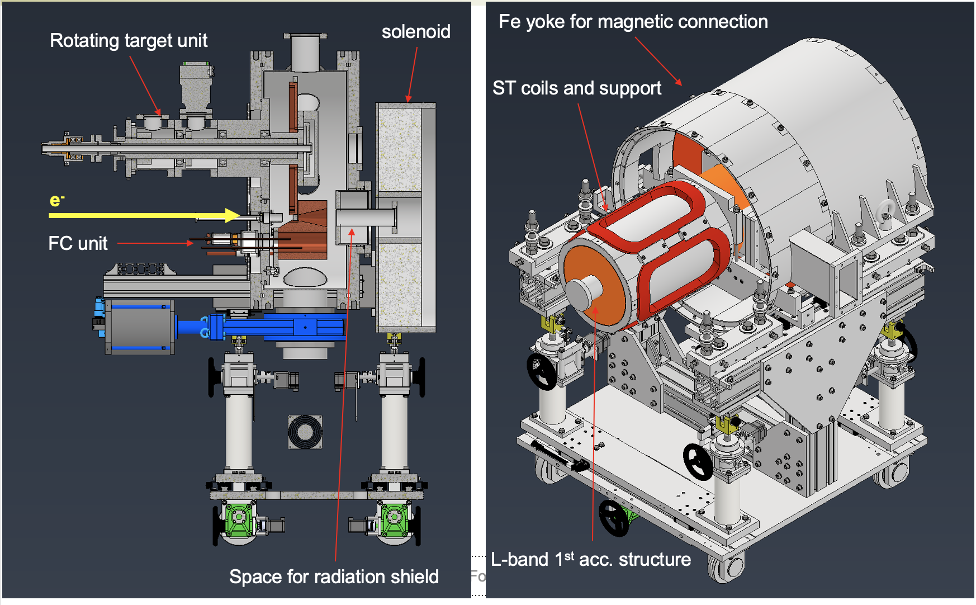
FC-based positron capture system (I)
FCC-ee FC original design is made by BINP. Very simple model (not realistic in terms of ohmic loss and high-power requirement for the pulsed power supply). Needs more realistic simulations.
FC-based capture system successfully works at SuperKEKB → starting point for the FCC-ee capture system studies. FC is currently considered as a baseline for the ILC e⁻-driven and CLIC positron sources.
Prototype of the positron source for ILC
Compared to SuperKEKB FC, high rep. rate (up to 300 Hz) and ideally higher max. field value/aperture are requested for the future collider projects.
Make use of the SuperKEKB experiences and join the effort on the FC design between FCC/ILC/CLIC collaborations to arrive to a more realistic model.

Slide 9
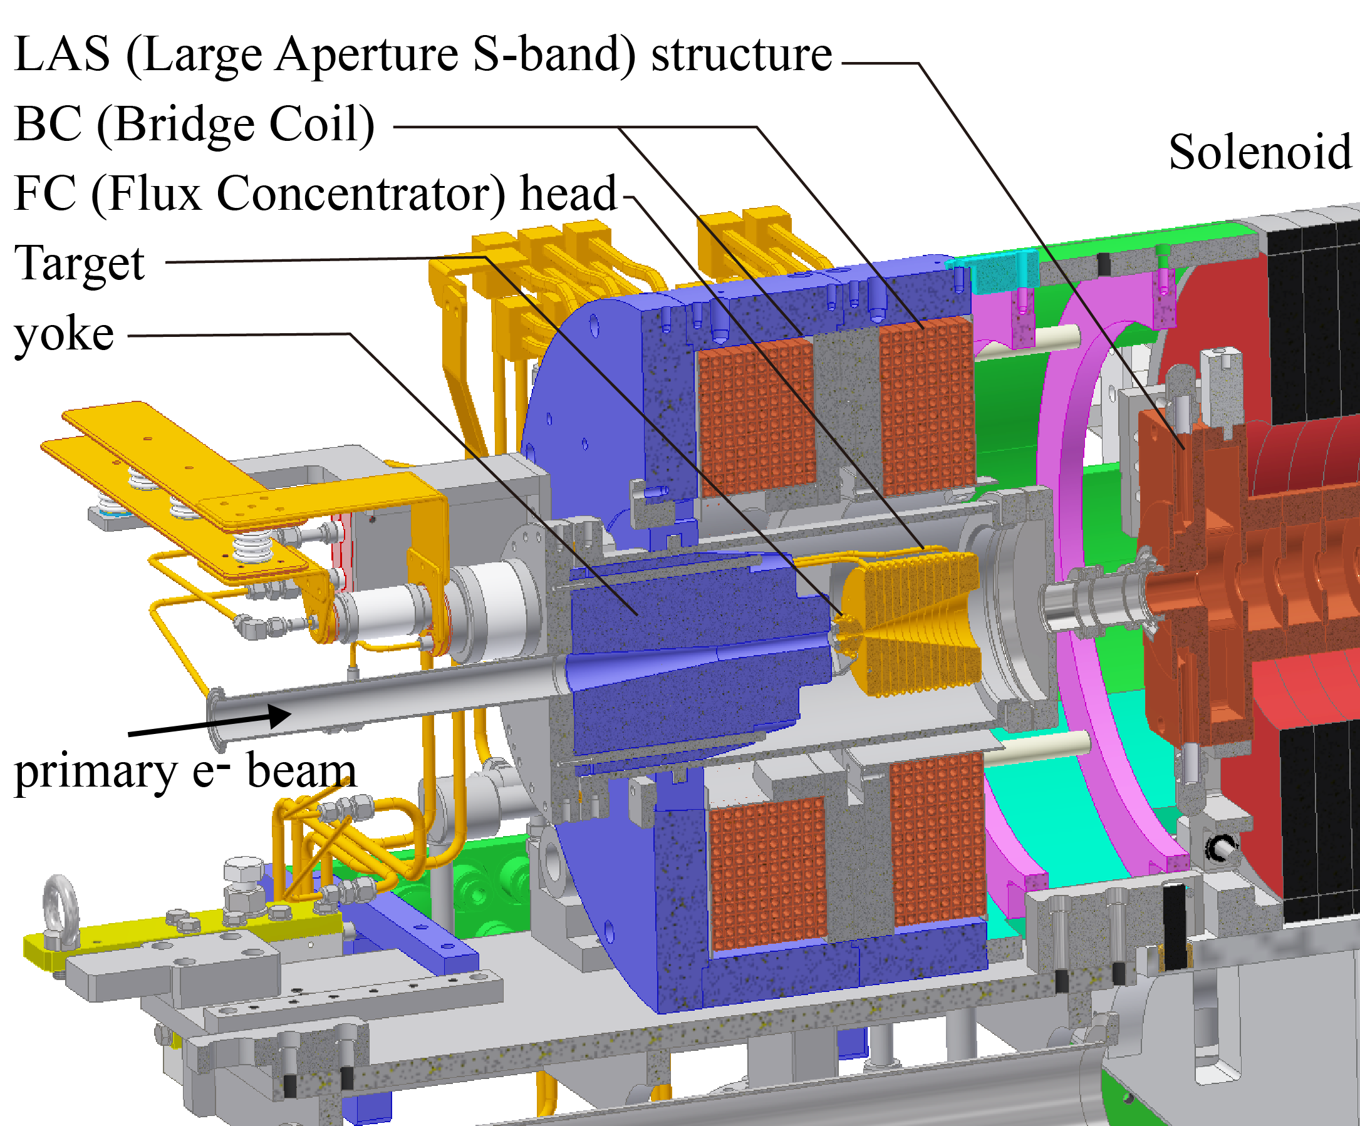
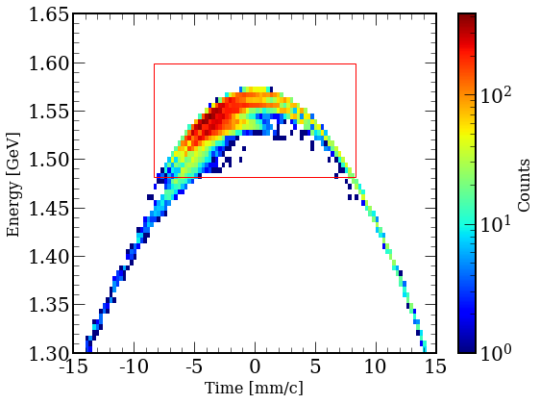
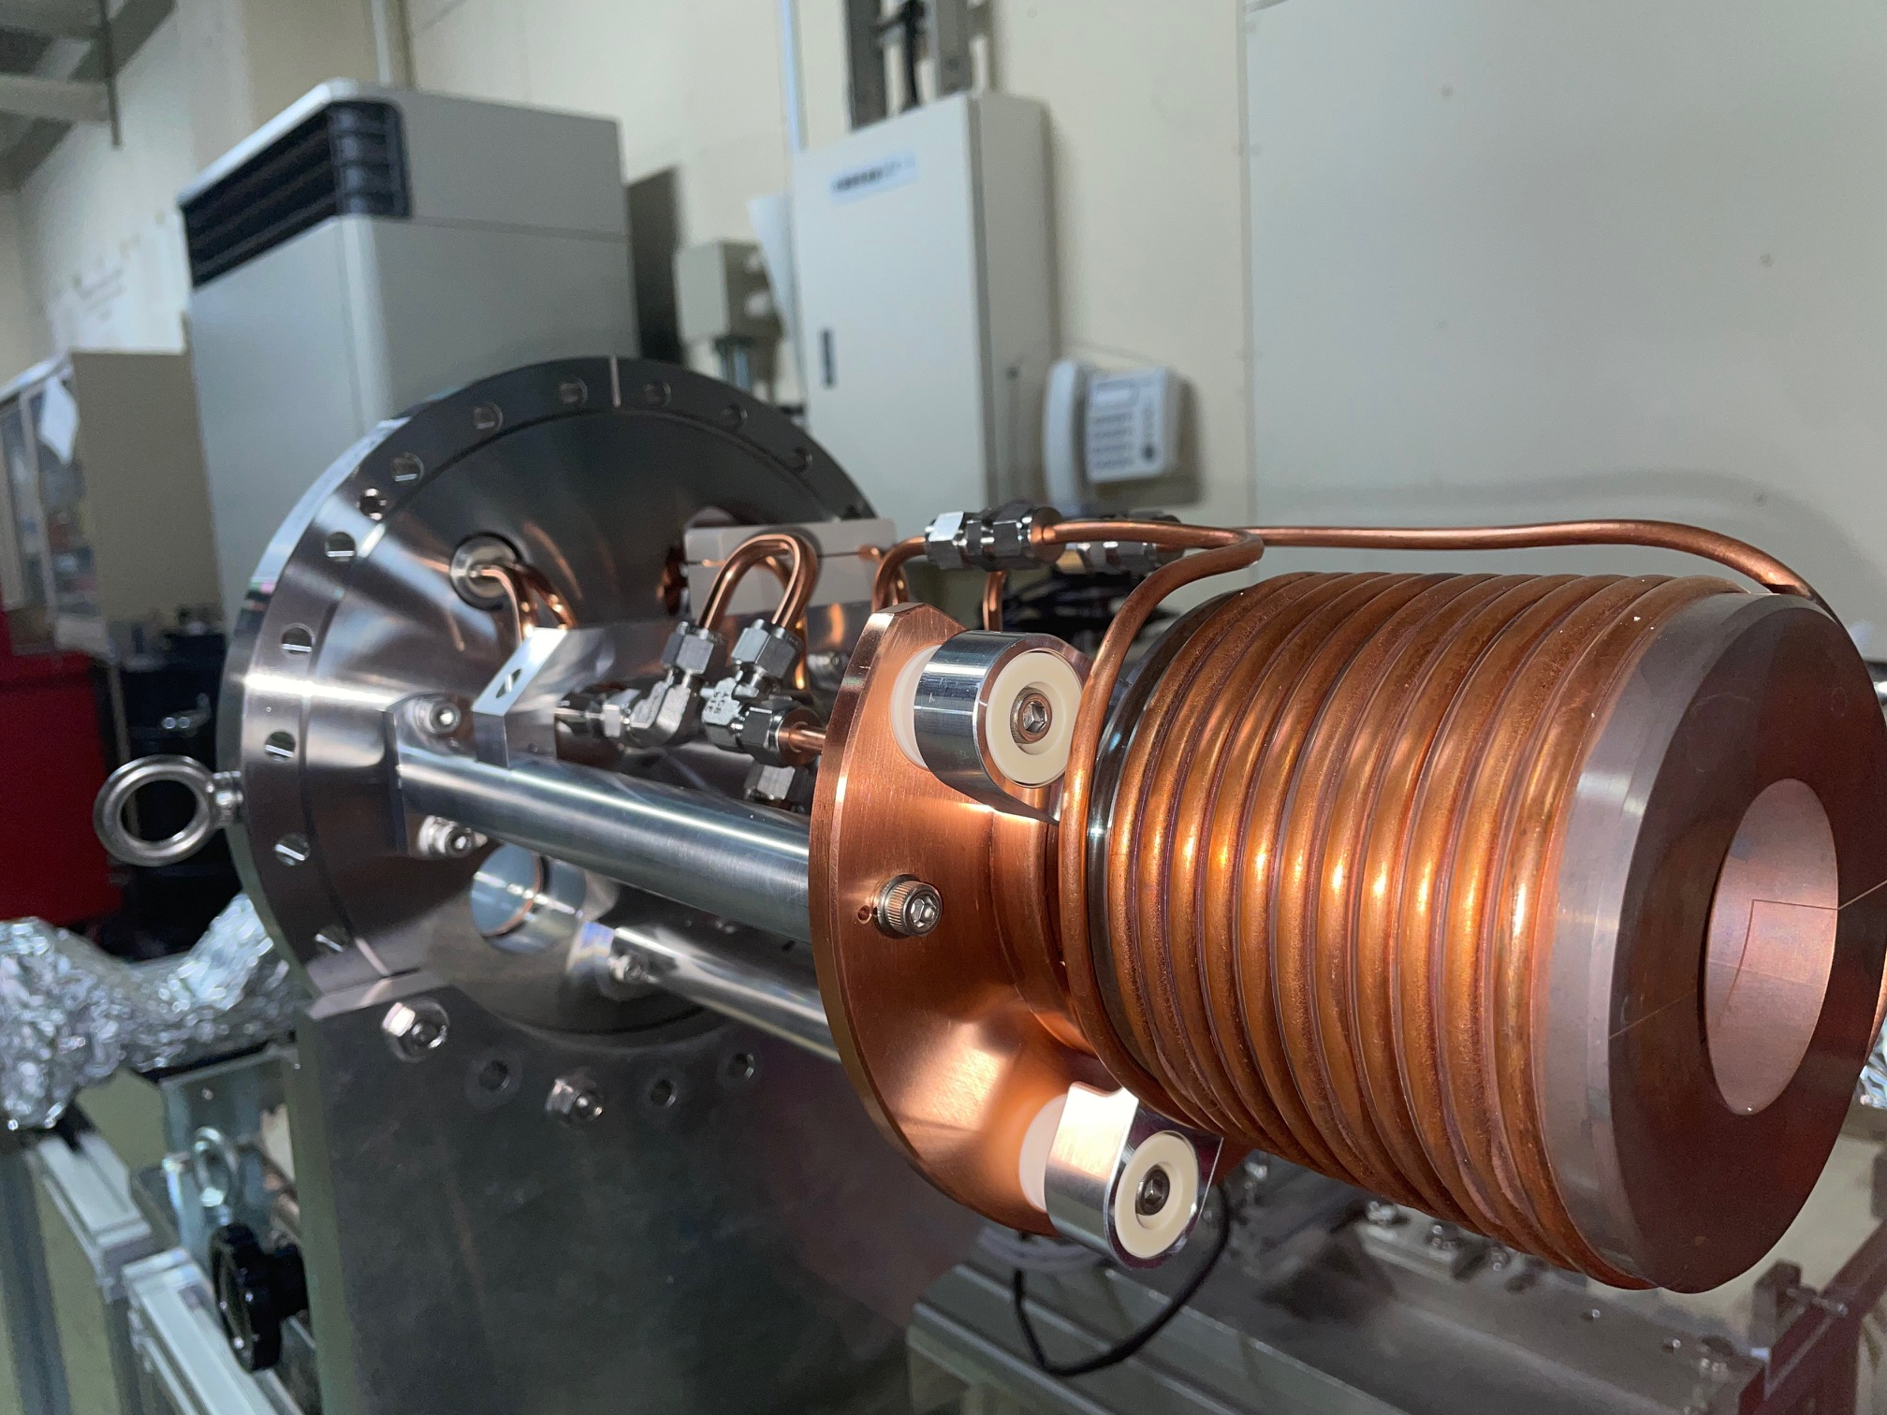
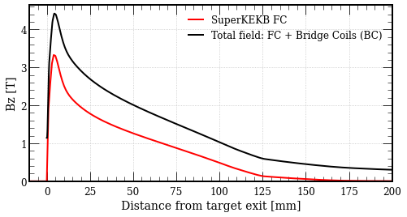
FC-based positron capture system (II)
  Application of the SuperKEKB FC to the FCC-ee positron source
@ 1.54 GeV (DR entrance)
SuperKEKB Flux Concentrator
B_{TARGET} ~1.1 T
Accepted e⁺ yield @ DR | 2.7
Norm. emittance [mm*rad] | 11.9
Energy spread (RMS) [%] | 1.1
Bunch length (RMS) [mm] | 2.6

Slide 10
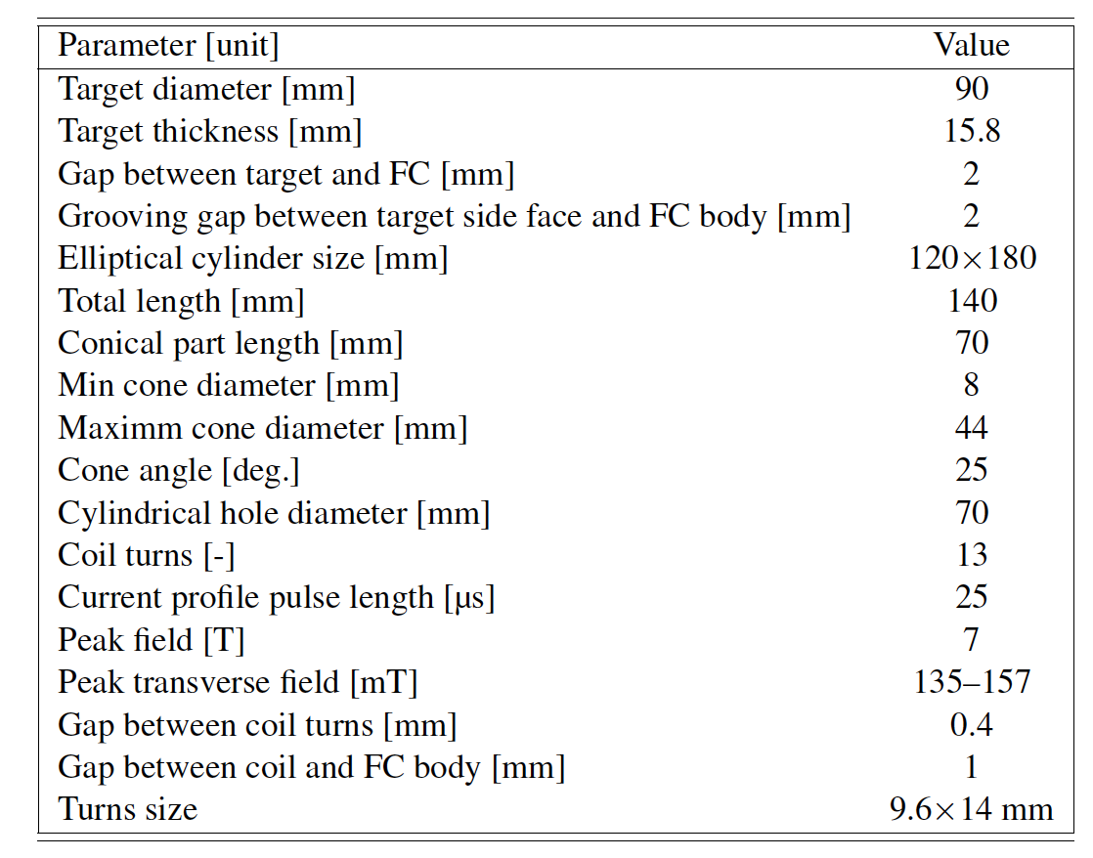
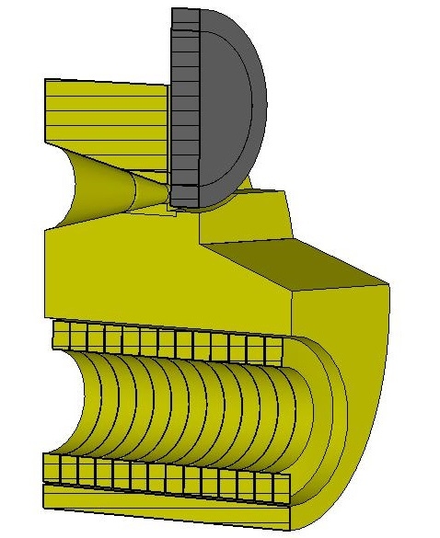
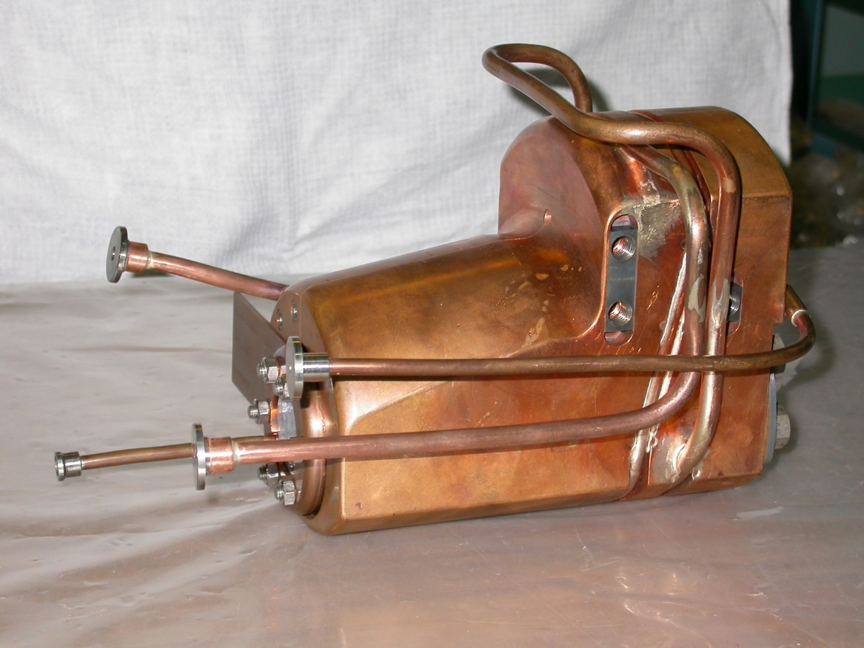
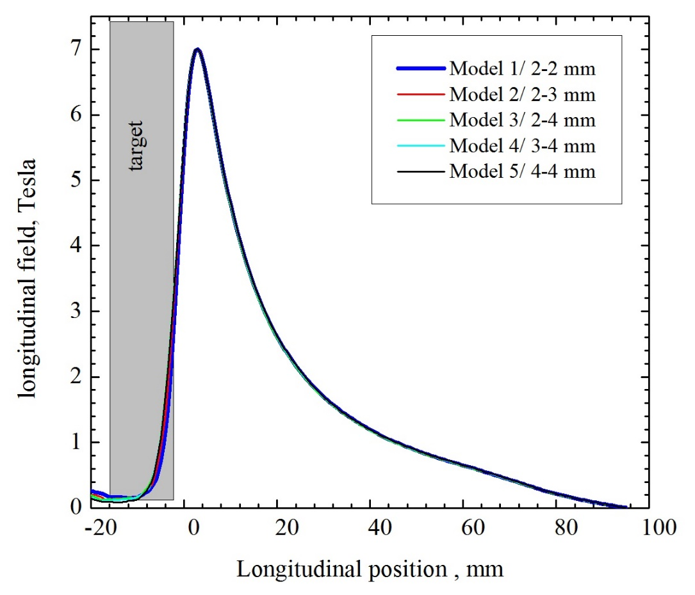
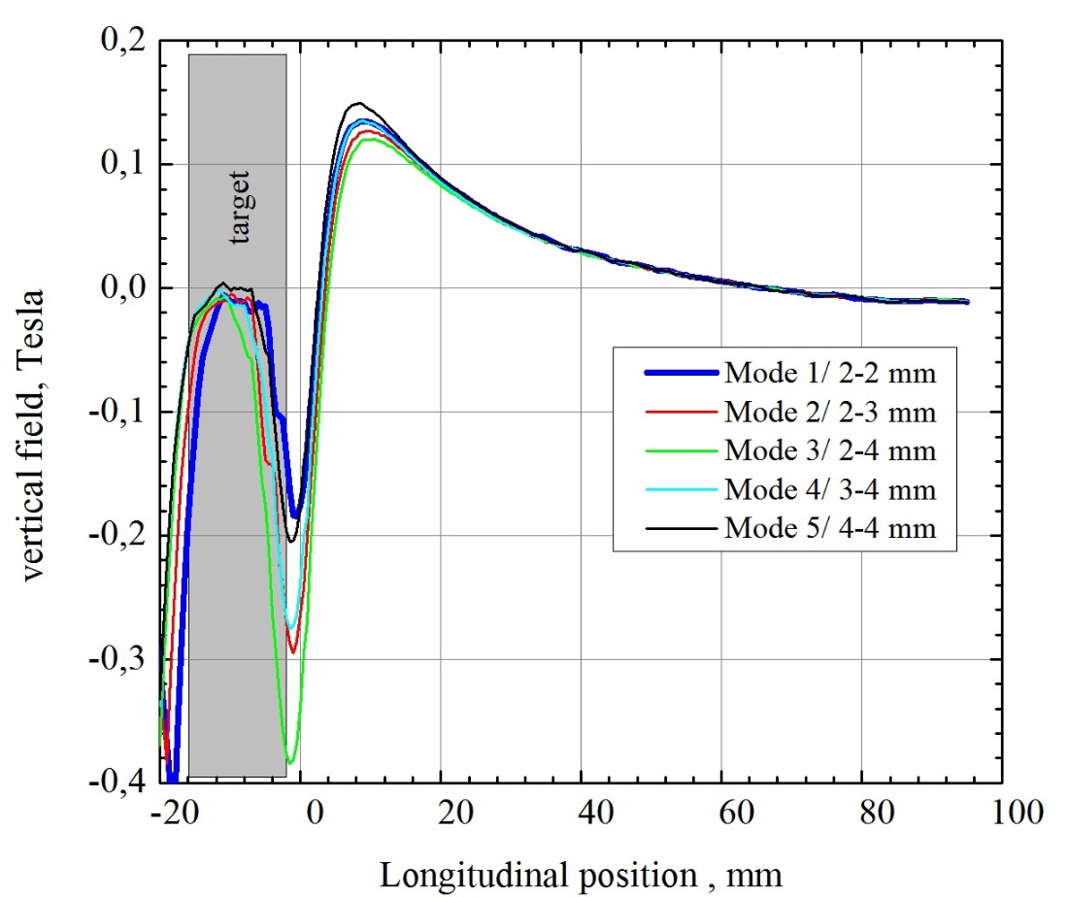
FC-based positron capture system (III)
  In the FCC CDR, the baseline for the capture system is based on the BINP FC
BINP Flux Concentrator
Simulation results update (capture linac)
B_{TARGET} ~3.5 T
Accepted e⁺ yield @ DR | 4.4
Norm. emittance [mm*rad] | 12.2
Energy spread (RMS) [%] | 1.2
Bunch length (RMS) [mm] | 2.9

Slide 11
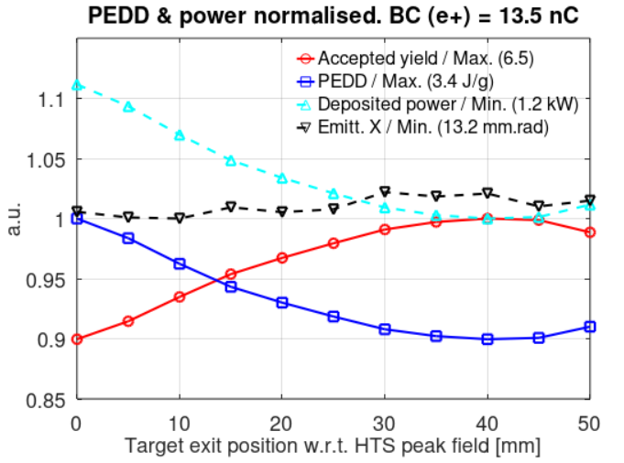
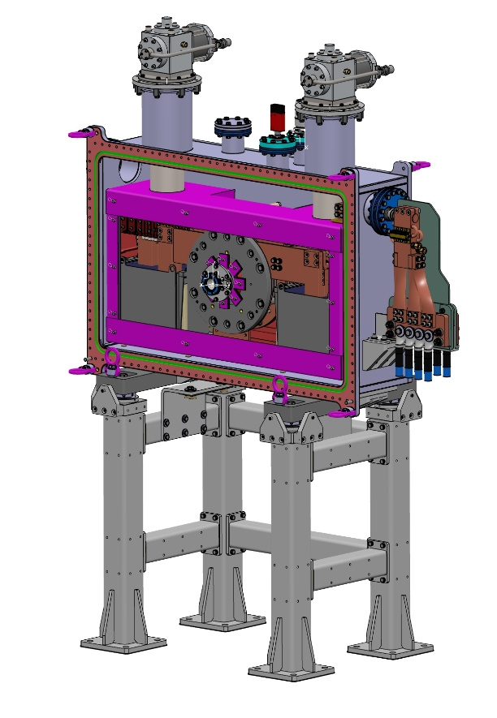
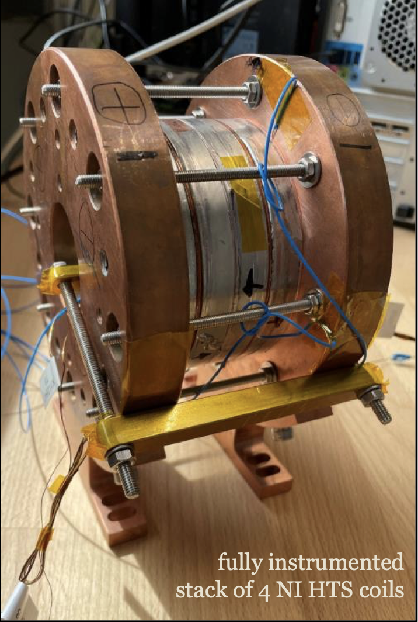
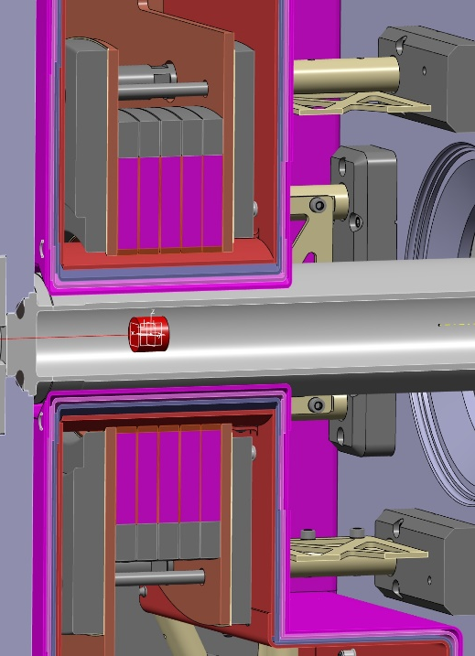
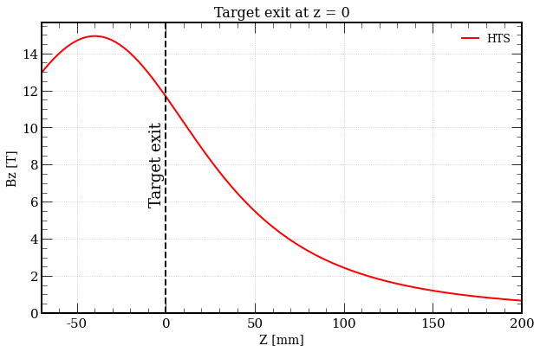
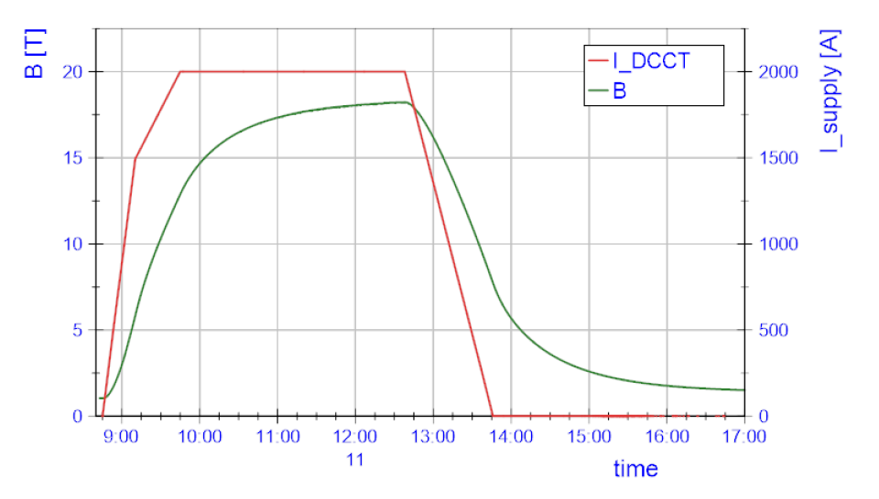
HTS-based positron capture system
  We consider the same HTS solenoid design and cryostat aperture as for P³ e⁺ production experiment at PSI (72 mm)
HTS solenoid integrated in the cryostat
Target
PSI
18.2 T @15K@2kA reached for stack of 4 coils
Optimized target position in HTS
solenoid
High peak field (~15 T, ~12 T at target exit)
Large aperture (Ф = 30-40 mm)
Flexible target position (can be placed inside the bore)
DC operation
B_{TARGET} ~12 T

Slide 12
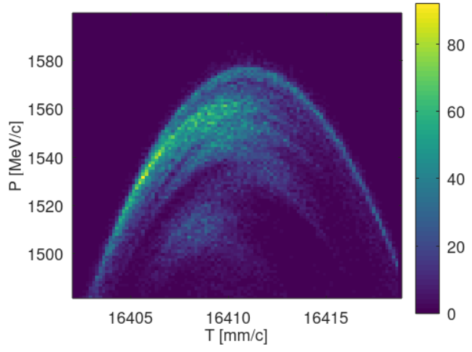
Current baseline: positron capture system –version 1
Capture system -version 1
Positron production: conventional scheme (e⁻ beam size on target = 1 mm rms)
Matching device is based on the SC solenoid (5 HTS coils, 72 mm bore including shielding). Min beam aperture (w/o significant yield loss): 30- 32 mm (Maximum shielding thickness: ~21 mm)
Capture linac is based on the F3 RF structures
NC long solenoid B = 0.5 T (realistic conventional design based on short coils)
@ 1.54 GeV (DR entrance)
Accepted e⁺ yield @ DR | 6.5
Norm. emittance [mm*rad] | 13.7
Energy spread (RMS) [%] | 1.4
Bunch length (RMS) [mm] | 2.9

Slide 13
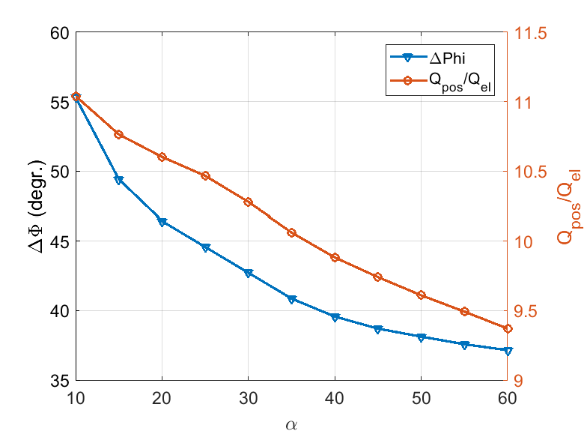
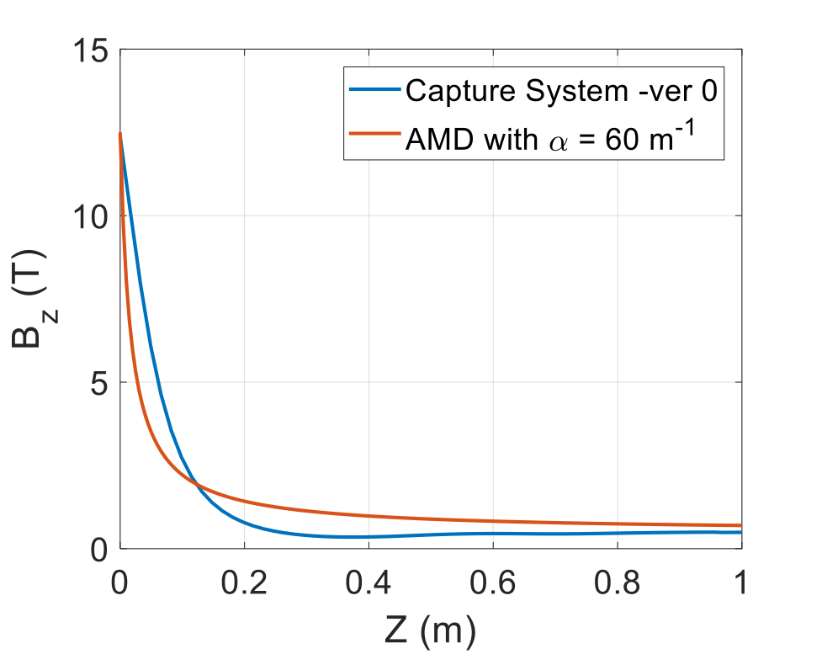

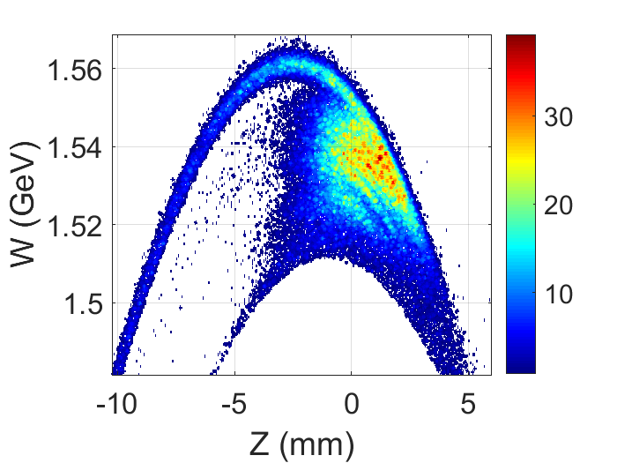
Optimization studies toward better performance
  Target and capture system studies are in progress to provide the optimized positron bunch 6D phase space matched to the positron linac and DR
Overall parameter scanning (target thickness, distances, etc. )
Matching device field profile
RF structure length
Distance between the target and the first RF structure
Overall optimization (GIOTTO, etc.)
…
GIOTTO results:
∆ W/W (1σ) = 0.99 %,
∆ Z (1σ) = 2.4 mm
Beam size (1σ) = 8.7 mm
Acc. Yield = 7
ε_{n rms x,y} = 9.6⋅10³ mm⋅mrad
Capture system –version 0

Slide 14
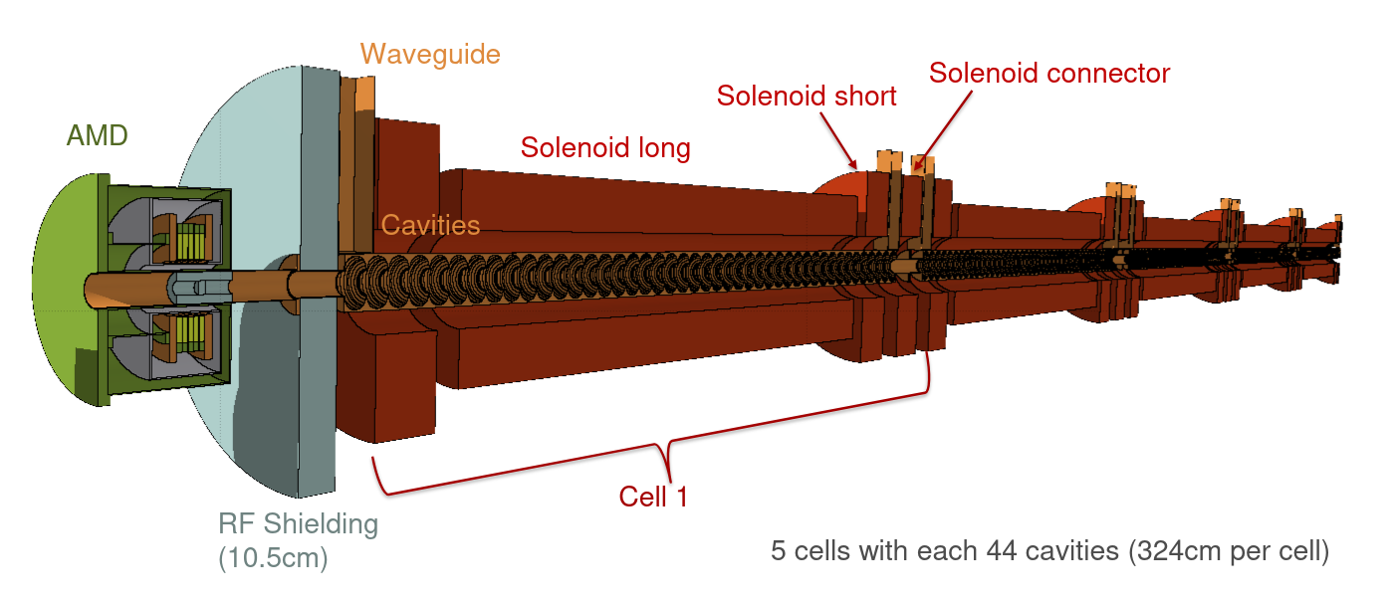
Radiation load studies and status of target design
  Currently, the radiation load and target design studies focused exclusively on the HTS solenoid-based system (capture system –version 1)
Dedicated talk by R. Mena Andrade (CERN)
FLUKA model of the FCC-ee positron source to assess
Heat load on the target/HTS solenoid/capture linac/solenoid
Total deposited power
Power density
Long term radiation effects
Dose
Displacement per atom (DPA)
→ Design feasibility and mechanical integration
→ Reliability of the positron source system

Slide 15
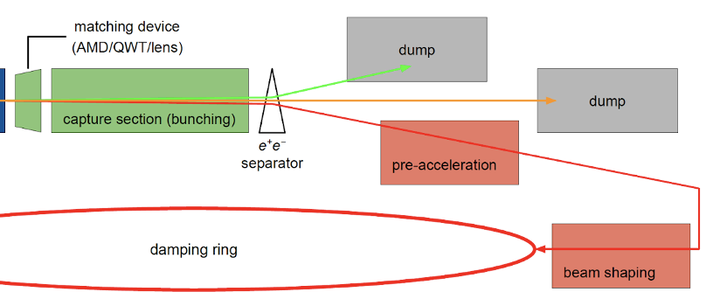
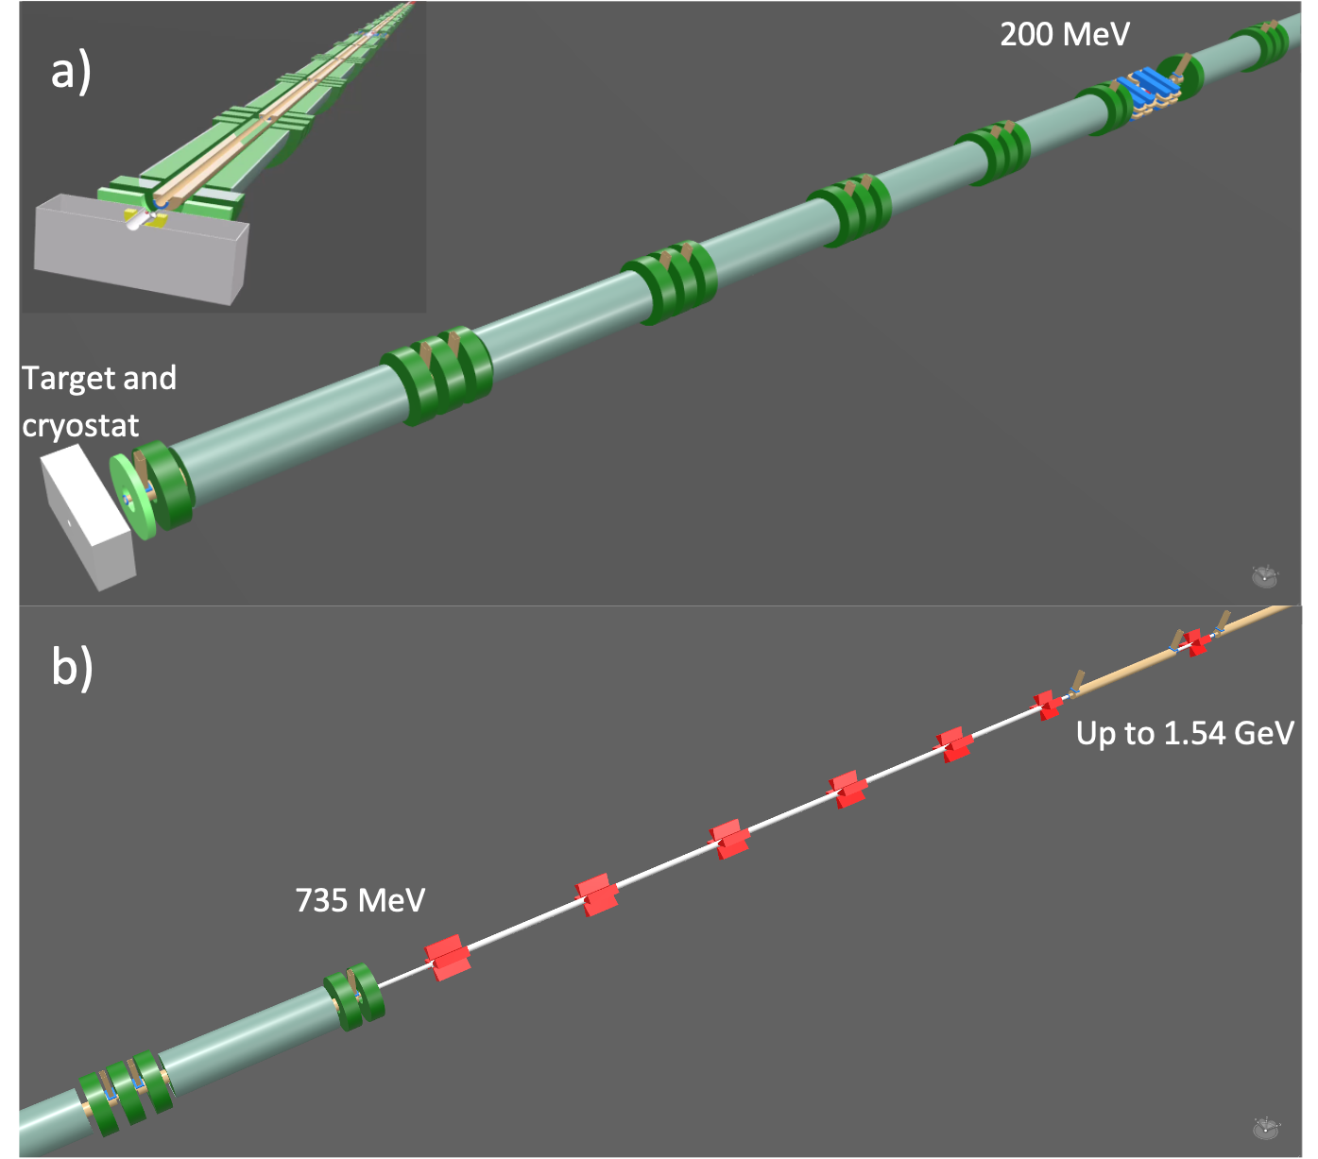
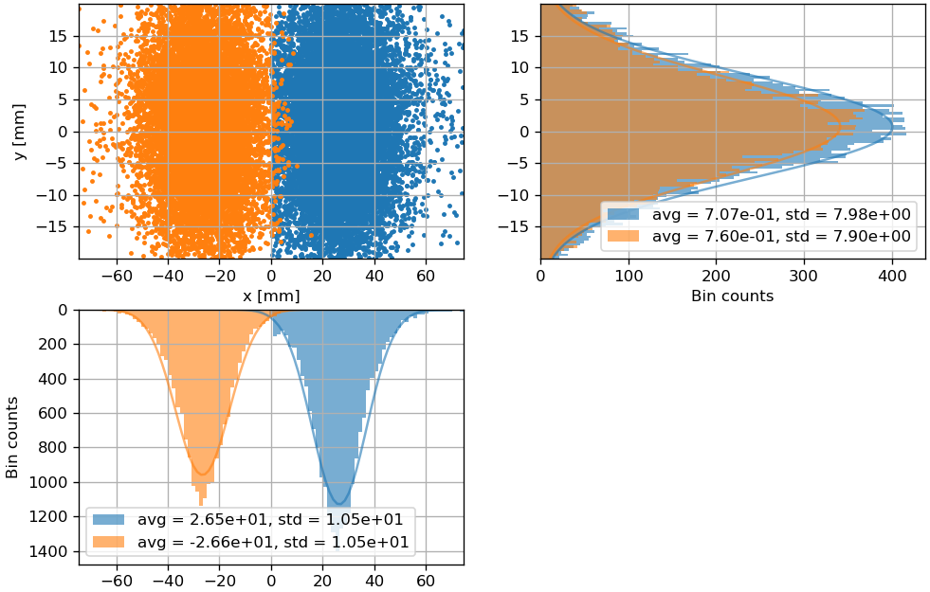
Positron linac up to 1.54 GeV
e⁺ and e⁻ bunches are separated in the end of the capture system by a chicane at ~200 MeV (e⁺ losses limited to ~ 15 %)
Vacuum chamber dimensions
e⁻ absorber
The solenoid focusing is used until ~735 MeV of e⁺ beam energy.
After the matching section at ~735 MeV, the e⁺ beam passes to a quadrupole focusing.
e⁺/e⁻ distributions before e⁻ absorber (chicane center)
ECS is used to increase the number of e⁺ within the DR energy acceptance (±3.8% ).

Slide 16
Summary of the simulation results
Drive beam parameters | Alternative FC-based capture system |  | Capture system –v1
Matching device | BINP FC | SuperKEKB FC | HTS solenoid
Matching device aperture | 2a=8-44mm | 2a=7-52mm | 2a_{min}=30 mm (bore 72mm)
Matching device peak magnetic field (@Target) [T] | 7.5 (3.5) | 4.4 (1.1) | 15 (12)
e- beam bunch charge [nC] / e- beam power [kW] | 3.1 / 7.4 | 5 / 12 | 2.1 / 5
Target deposited power [kW] / PEDD [J/g] | 1.7 / 11.1 | 2.9 / 18.3 | 1.2 / 3.1
Positron yield @CS [Ne⁺/Ne⁻] | 4.9 | 3.3 | 8
Positron yield @DR [Ne⁺/Ne⁻] | 4.4 | 2.7 | 6.5
Normalized emittance (rms) [mm.rad] | 12.2 | 11.9 | 13.7
Energy spread (rms) [%] | 1.2 | 1.1 | 1.4
Bunch length (rms) [mm] | 2.9 | 2.6 | 2.9
e+ beam bunch charge [nC] | 13.5 | 13.5 | 13.5

Slide 17
Conclusions and outlook
The studies on the FCC-ee positron source are well advanced: positron production, HTS technology feasibility for matching device, capture linac (RF structures and solenoid). So far, no showstoppers found that prevent a SC solenoid matching device. Studies ongoing.
FC-based capture system requires a realistic model capable to work at the FCC-ee operation parameters. Collaborative work is very essential.
Two capture system layouts (based on the FC and SC solenoid) will be eventually compared in detail in terms of the performance and cost for the mid-term project review.
Positron linac has a robust design with full tracking simulations from production target to damping ring using the realistic field maps.
Thermal and radiation load studies: FLUKA model is available for capture system –version 1. Still to be developed for the FC-based capture system.
Design and integration of the production target are under investigations and to be studied for both schemes.

Slide 19
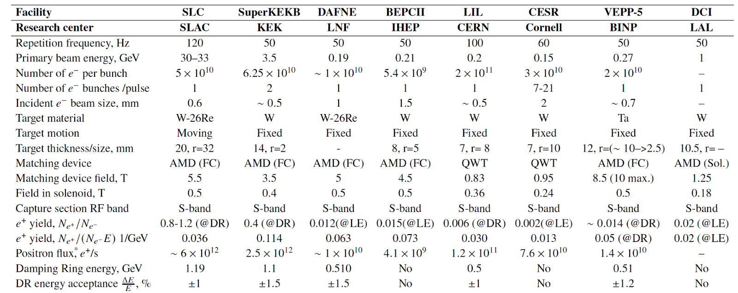
Positron source performances
Demonstrated (a world record for existing accelerators): SLC e+ source ~6e12 e+/s
High intensity
Emittance
Polarization
Reliability and radiation environment
What are the main challenges?

Slide 20
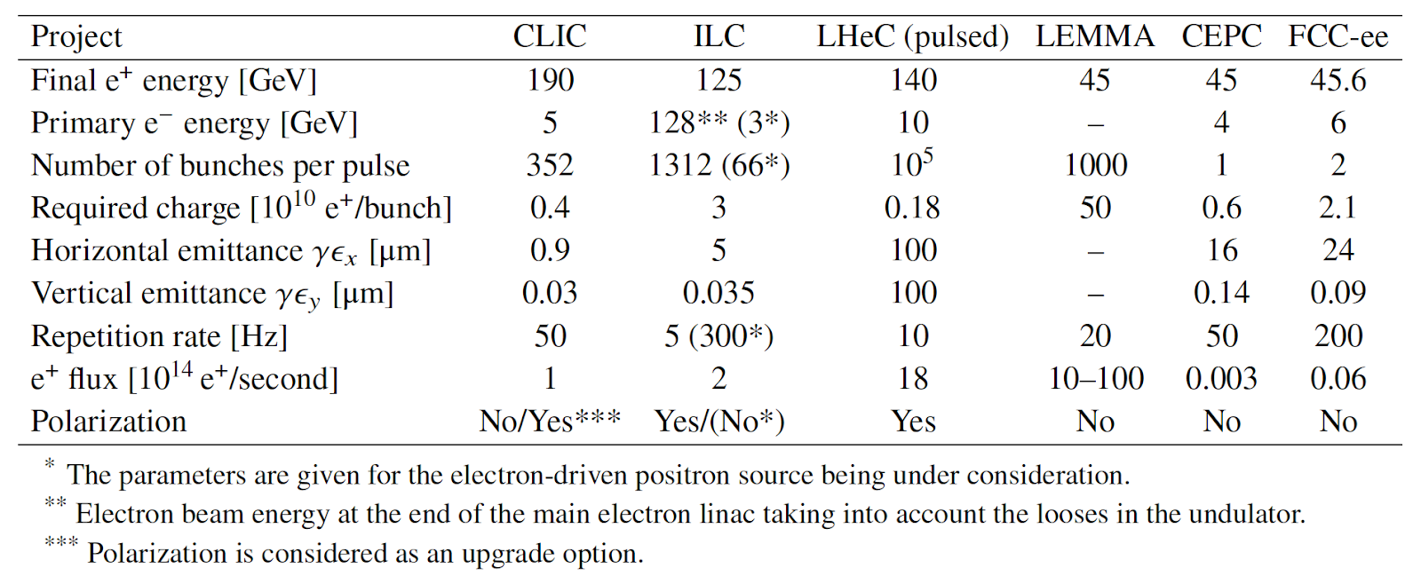
Future collider project challenges
Demonstrated (a world record for existing accelerators): SLC e+ source ~6e12 e+/s
2
1.88
~2.4
100
0.04
~0.1
Linear Collider projects: high request for polarization, requested intensity should be produced in “one shot”.
Circular Collider projects: polarization is under discussion, requirements are relaxed due to stacking and top-up injection

