Slide 1
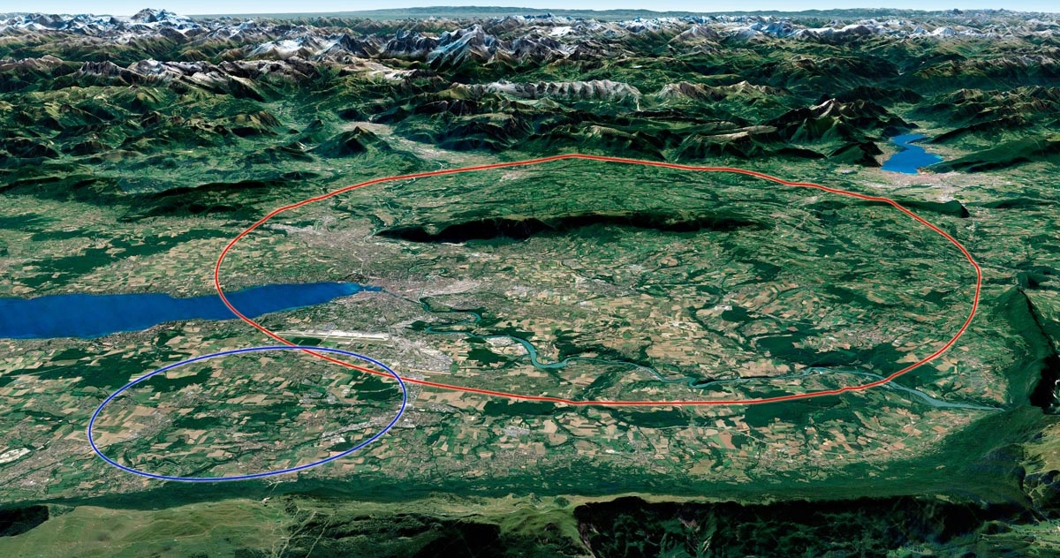
Reference implementation scenario
& work with the host states
J. Gutleber (CERN)

Slide 2
Collaborative work of almost 120 people over several years

Slide 3
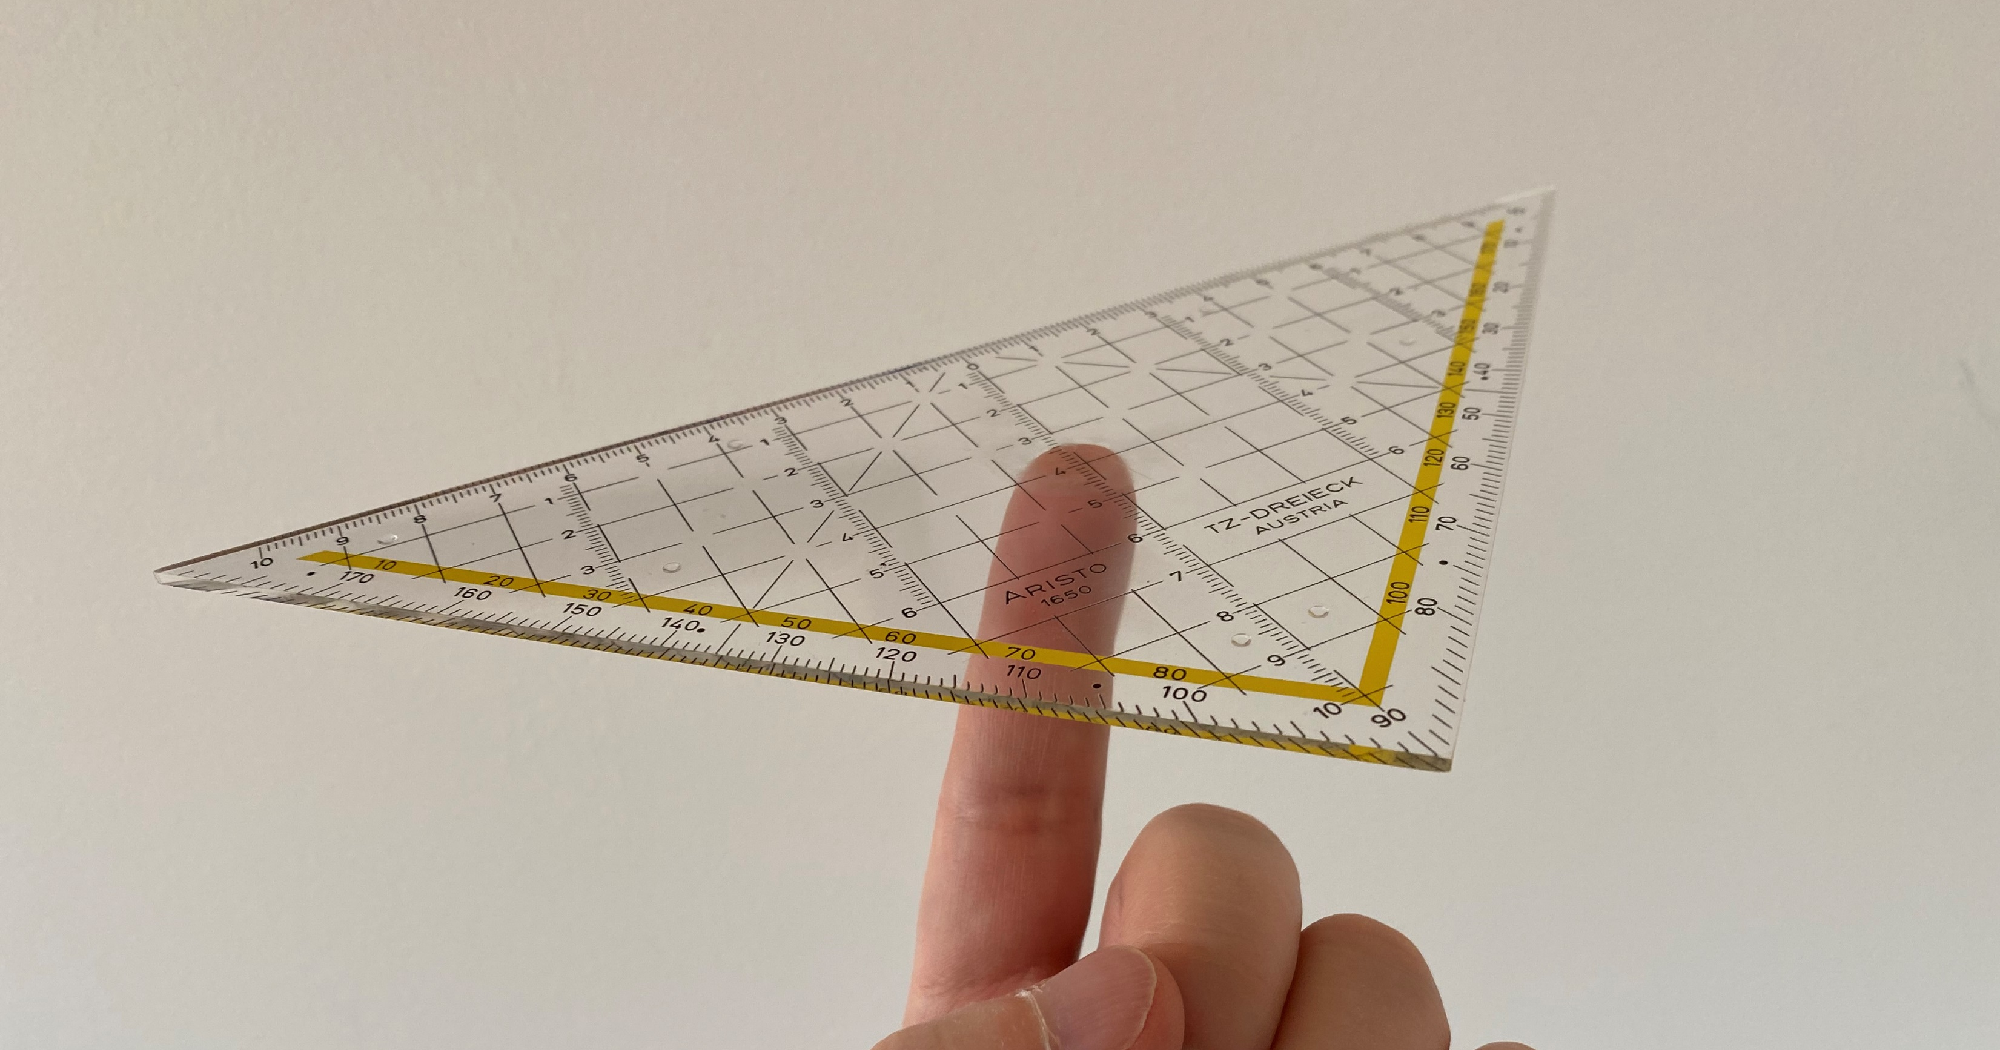
A balance of stakes
« Avoid-Reduce-Compensate » approach
to develop iteratively a well-balanced
reference scenario
Territorial impact limitation leads to
Societal acceptance
Performance of
particle collider leads to
scientific excellence
Technical feasibility and cost control lead to
Acceptable project risks

Slide 4
Approach “Eviter-Reduire-Compenser”
Note: approach required by French environmental law.
Similar concept anchored in swisss project authorisation process.

Slide 5
Reminder of layouts studied
12-site layout:
Mirror geometry
grouping together
three experiment
sites (PL, PA, PB)
8-site layout:
Basic 45 degree sector module
repeated eight times

Slide 6
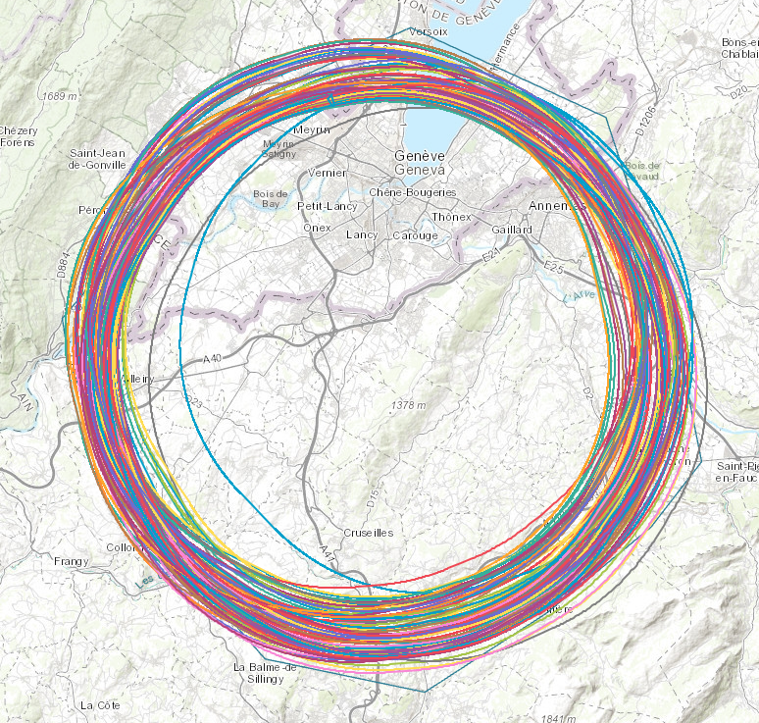
More than 100 scenarios developed & analysed
Multi-criteria approach covering 37 aspects
Legal and administrative aspects – 5 criteria
Connectivity – 2 criteria
Availability of services – 2 criteria
Accessibility of infrastructures – 6 criteria
Land plot related aspects – 9 criteria
Environnement – 8 criteria
Accelerator configuration – 3 criteria
Cost of construction
Risks linked to the construction

Slide 7
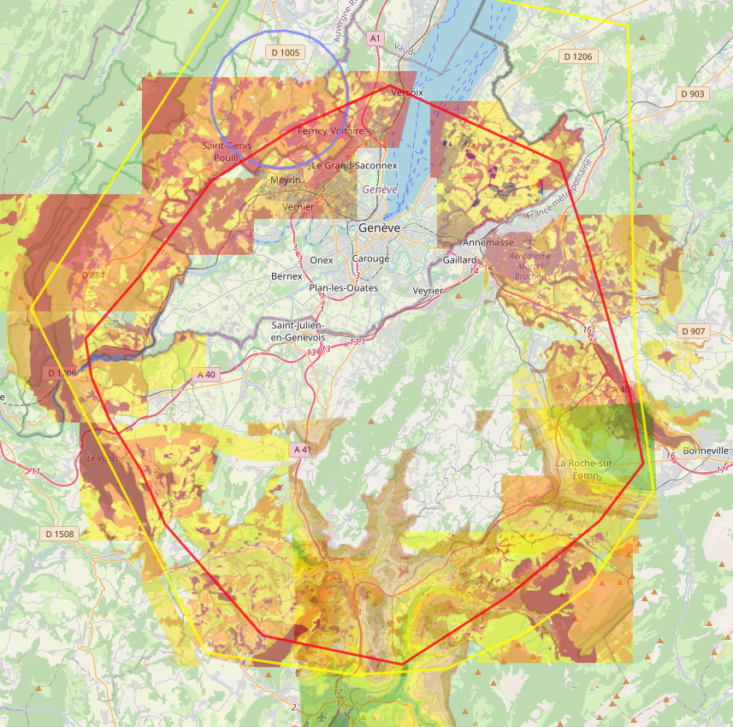
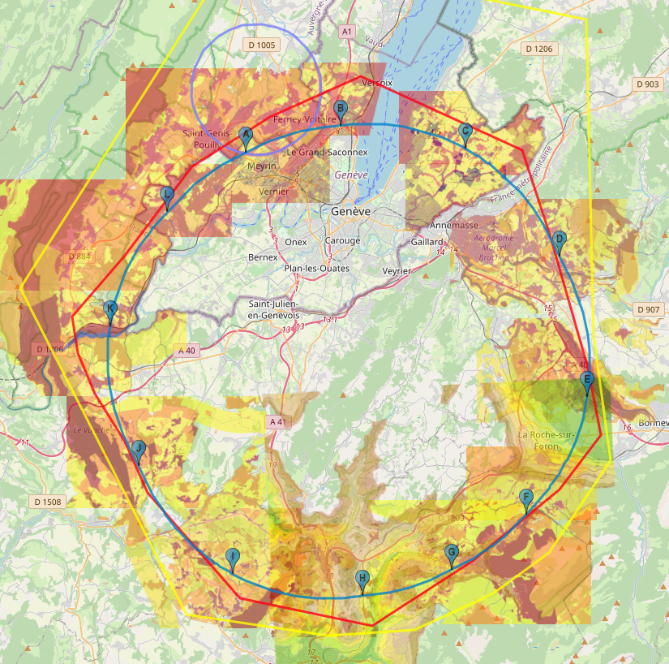


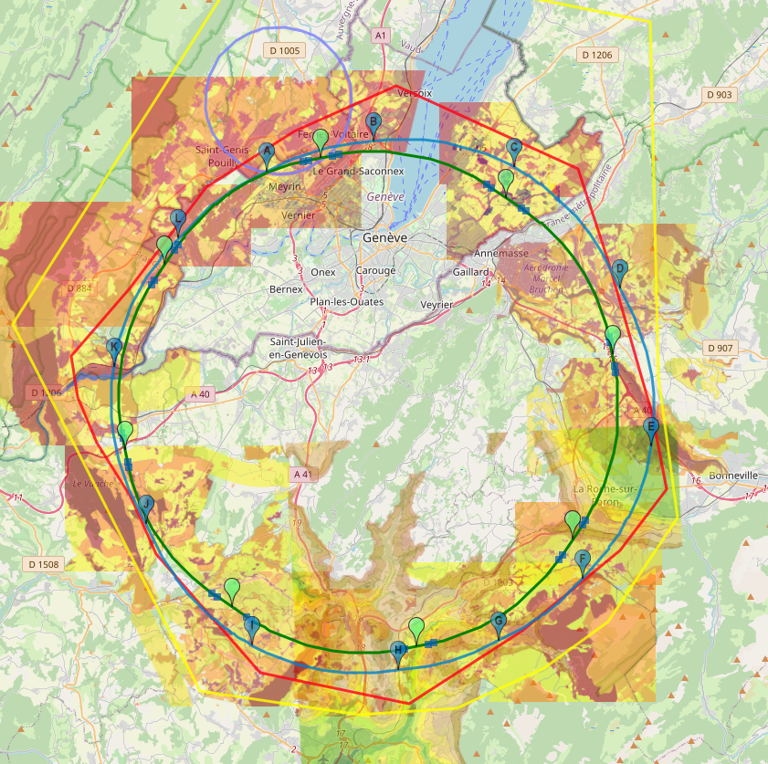
ETAPE 1: PLANIFIER
Identifier les exigences et les contraintes pour la mise en œuvre technique et territoriale nécessaire dans le cadre des études de placement.
ETAPE 2: DEVELOPPER
Adapter les ouvrages souterrains et les sites de surface aux exigences et contraintes identifiés. Enregistrer les incompatibilités techniques rencontrées.
ETAPE 4: AJUSTER
ETAPE 3: CONTROLER
Analyser la pertinence de l'hypothèse de travail. Si le scénario semble inacceptable, l’ajuster (étape 4). Sinon, conserver pour les études plus détaillées.
Développer des mesures « Éviter-Réduire-Compenser » pour répondre aux points inacceptables identifiés dans le scénario (étape 3)

Slide 8
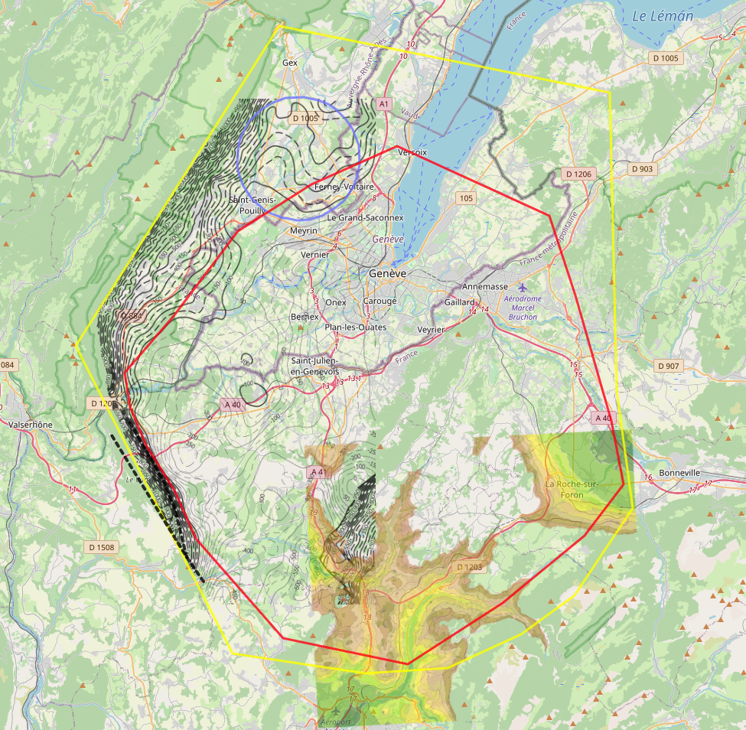
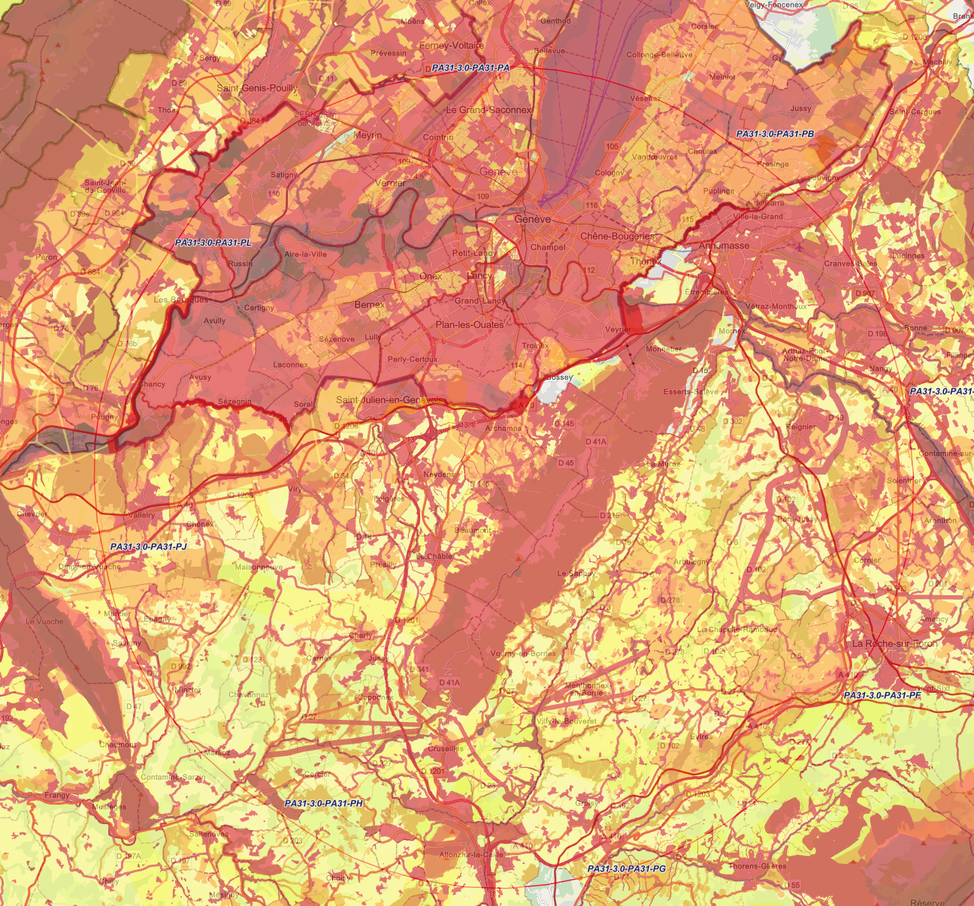

Geology & topography
Territorial constraints
Yellow: Limit of investigation in 2014
Red: Limit of investigation evolved in 2017
Crosses: Elevation unfavourable
RED: AVOID
ORANGE: ONLY IF NOT OTHERWISE FEASIBLE
YELLOW: REDUCE

Slide 9
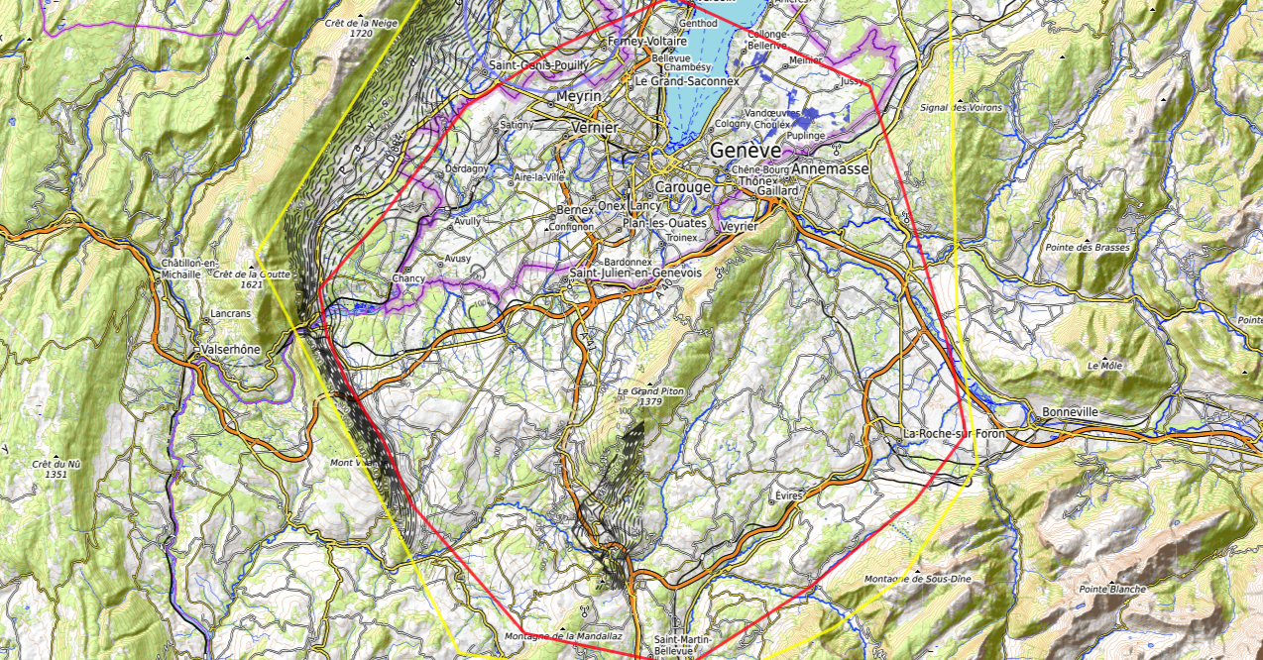
Exclusion zones
Lac trop profond
Urbanisation dense et nature
Zone de protection stricte, du
paysage et de la renaturalisation
Plateau calcaire du Jura
Forêt protégée
Urbanisation dense et
territoires émergents
Urbanisation dense
Zones résidentielles
et zones agricoles
Terrain difficile d’accès
et reservoirs d’eau
Réservoirs d’eau
et nature protégées
Protection des eaux
et zones naturelles
sans accès aménagé
Urbanisation dense et
territoires émergents
Zones de protection
des eaux, du paysage.
Haute altitude
Haute montagne
(900 m)
Failles et formations
calcaires du Vuache
Haute altitude
Densément peuplé

Slide 10
CERN Prevessin,
SPS BA4
Ferney-Voltaire/CERN LHC Pt8
Residual areas
Pallanterie
Choulex/Presinge
Challex au sud de la D884,
à l’est des eaux souterraines
CERN, Meyrin
Quelques parcelles au
sud de Cranves-Salves
Quelques parcelles au
sud de Bonne
Ouest de l’A40
Charvonnex, Groisy,
Villy entre l’A41,
voie ferrée et
route d’Annecy,
au sud de la A410
Quelques parcelles à
Contamine sur Arve
Vulbens/Dingy-en-Vuache,
au nord de l’A40
Quelques parcelles à
Arenthon
Dingy-en-Vuache au
sud de l’A40
Nord & sud de
l’A410 quelques
parcelles isolées
Nord de Roche-s.-Foron et
zone industrielle de Etaux
Ligne de 700 m proche
de la voie ferré au
sud de Roche-s.-Foron
Sectreur Minzier
selon accessibilité
Une parcelle de 3 ha à côté de
la D2 dans le vallé de la Fillière
Nord-est de Choisy
Au nord d’Ollières,
quelques parcelles isolées

Slide 11
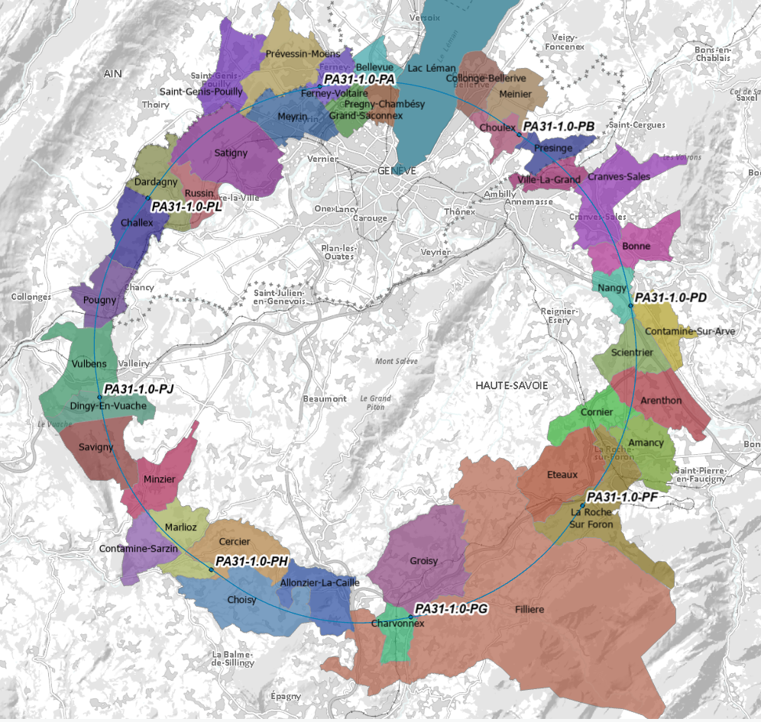
Reference scenario PA31 surface site locations
1. PA – Ferney Voltaire (FR, 01) – experiment
2. PB – Choulex (CH) – technical
3. PD – Nangy (FR, 74) – experiment
4. PF – Etaux/La Roche-sur-Foron (FR, 74) - technical
5. PG – Charvonnex/Groisy (FR, 74) - experiment
6. PH – Cercier/Marlioz (FR, 74) – technical, main RF
7. PJ – Vulbens/Dingy en Vuache (FR, 74) – experiment
8. PL – Challex (FR, 01) – technical, booster RF
PA
PB
PL
PD
PJ
PF
PH
PG

Slide 12
Scenario PA31 parameters
Straight section @IP: 1 400 m
Straight technical section: 2032 m
Sum of arcs: 76 929.609 m
Total length: 90 658.828 m
FCC-hh RF length required is: 90 657.4 m
Therefore some further minor adjustment of the trace is currently taking place to produce an ee/hh integrated trace that meets both requirements and limits the necessary the tunnel widening on both sides of the IPs.
Inclination: 0.5% (about a line from PD to PJ with PA moving upwards and PG downwards)
Shaft depths:
PA: 201 m (2 shafts)
PB: 201 m (1 shaft displaced ca. 150 m along LSS)
PD: 181 m (2 shafts)
PF: 400 m (1 shaft 300 m to 600 m inside the ring)
PG: 226 m (2 shafts)
PH: 235 m (1 shaft)
PJ: 253 m (2 shafts)
PL: 250 m (1 shaft displaced 1 000 m along LSS)

Slide 13
Optimisation of scenario since CDR publication
Element | CDR | Feasibility study | Change | Effect
Number of surface sites sites | 12 | 8 | ▼ | BETTER
Synergies with CERN infrastructures | 1 | 1 (+ Prevessin) | - | NEUTRAL
Land surface needs | 108 ha | ~ 41 ha | ▼ | BETTER
Total circumference | 97.75 km | 90.66 km (-7.25 %) | ▼ | BETTER
Sum of arcs | 83.75 km | 76.93 km (- 8.1%) | ▼ | WORSE
IP straight lengths | 1400 m | 1400 m | - | NEUTRAL
Amount of excavated materials | 9 m³ | 8 m³ | ▼ | BETTER
Possible interaction points for hh/ee | 4/2 | 4/4 | ▲ | BETTER
Lengths of access roads | 3.5 km | 3.5 - 2.5 km | ▼ | BETTER
Number of shafts | 20 | 12 | ▼ | BETTER
Ecological surfaces affected | 23 ha | 8 ha | ▼ | BETTER
Access synergies | 4/12 (33 %) | 7/8 (87%) | ▲ | BETTER
Synergy potentials public infrastructures | 2/12 (16%) | 5/8 (62 %) | ▲ | BETTER
Synergy potentials private structures | 5/12 (41%) | 8/8 (100%) | ▲ | BETTER

Slide 14
PA0-0.1 – the 12 site CDR scenario 2018

Slide 15
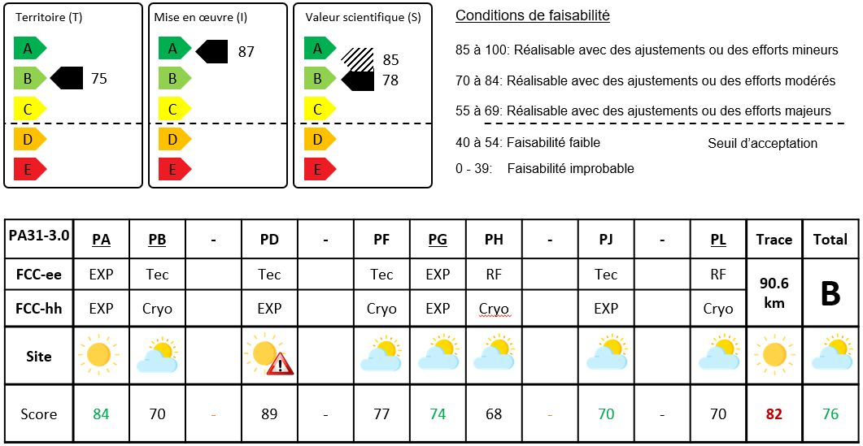
PA31-3.0 – the 8 site reference scenario

Slide 16
Implementation scenario documentation
With the definition of a “reference implementation scenario”,
FCC entered a new phase
Engagement of national actors has started in late 2022
  Communes
  Notified bodies
  Host state government representatives
  Associations
This requires a managed and single source of information to provide national stakeholders with reliable, trustworthy and managed information relevant to them in their language.
The single reference documentation is FCCIS deliverable 3, currently titled “Synthèse des contraintes et opportunités d’implantation”.
Made available via the Zenodo Open Access platform.
Document and data sets are properly versioned and undergo a quality management process.
Geolocalised information is kept in an FCC Environmental Information System, which has been put in place between 2022 and 2023 (to be gradually opened).

Slide 17
https://doi.org/10.5281/zenodo.7614421
Deliverable on the development and feasibility of implementation scenarios developed in the frame of the
EU co-funded H2020 project FCCIS by
CERN, Cerema and Latitude Durable
One scenario (PA31-1.0) is standing out from all the others
First version of the documentation released for work with host states and as project-internal reference
Micro-optimisations with stakeholders
  1.0 – published as reference in February 2023
  2.x – various trials to improve the siting for CE
  3.0 – adjustment of circumference after RF review
  4.0 – result of the optimisation with communes and CE
  to be openly published in autumn

Slide 18
Reference information kept in the document
Scenario development methodology
Summary of project requirements, constraints (invariants)
Territorial description & kown constraints
  Topography, geology, water, urbanism, nature, demography, economy, structured networks
Project risks
Scenario evolution
Detailed placement scenario documentation
Environmental aspects
Infrastructure environmental effects
  e.g. noise, em fields, radiation, traffic, waste
Regulatory and legal aspects to be considered
Real estate aspects
  Needs, available plots, constraints
Water aspects
  Needs, available and protected resources, supply concepts, infrastructures to be built
Electricity aspects
  Needs, available infrastructures,supply concepts, infrastructures to be built
Transport aspects
  Needs, available infrastructures, infrastructures to be built
Civil structure overviews
  Needs on surface and equipment
  Underground structure concepts
Matex challenges and strategy
Synergy and development opportunities

Slide 19
Reference data kept in the EIS
Physical environment
Natural environment
Strategic infrastructures
Human environment
Territorial sensibility
Environmental aspect analysis results
Urbanistic conditions and planning
Geophysical & geotechnical investigation results (to be done, 2024/2025)
Existing pollution
Climate information
Collider traces and their characteristics
Site location options
Technical infrastructure locations & characteristics
Needs of technical annexes (grid connection, water intakes, roads)
Surface site concepts
  Based on simple “blocks”
Road and train accesses
Construction data (TBM, matex, …)
Opportunity locations & capacities
  Water, agriculture, forests, waste heats, schools, public institutions, etc.

Slide 20
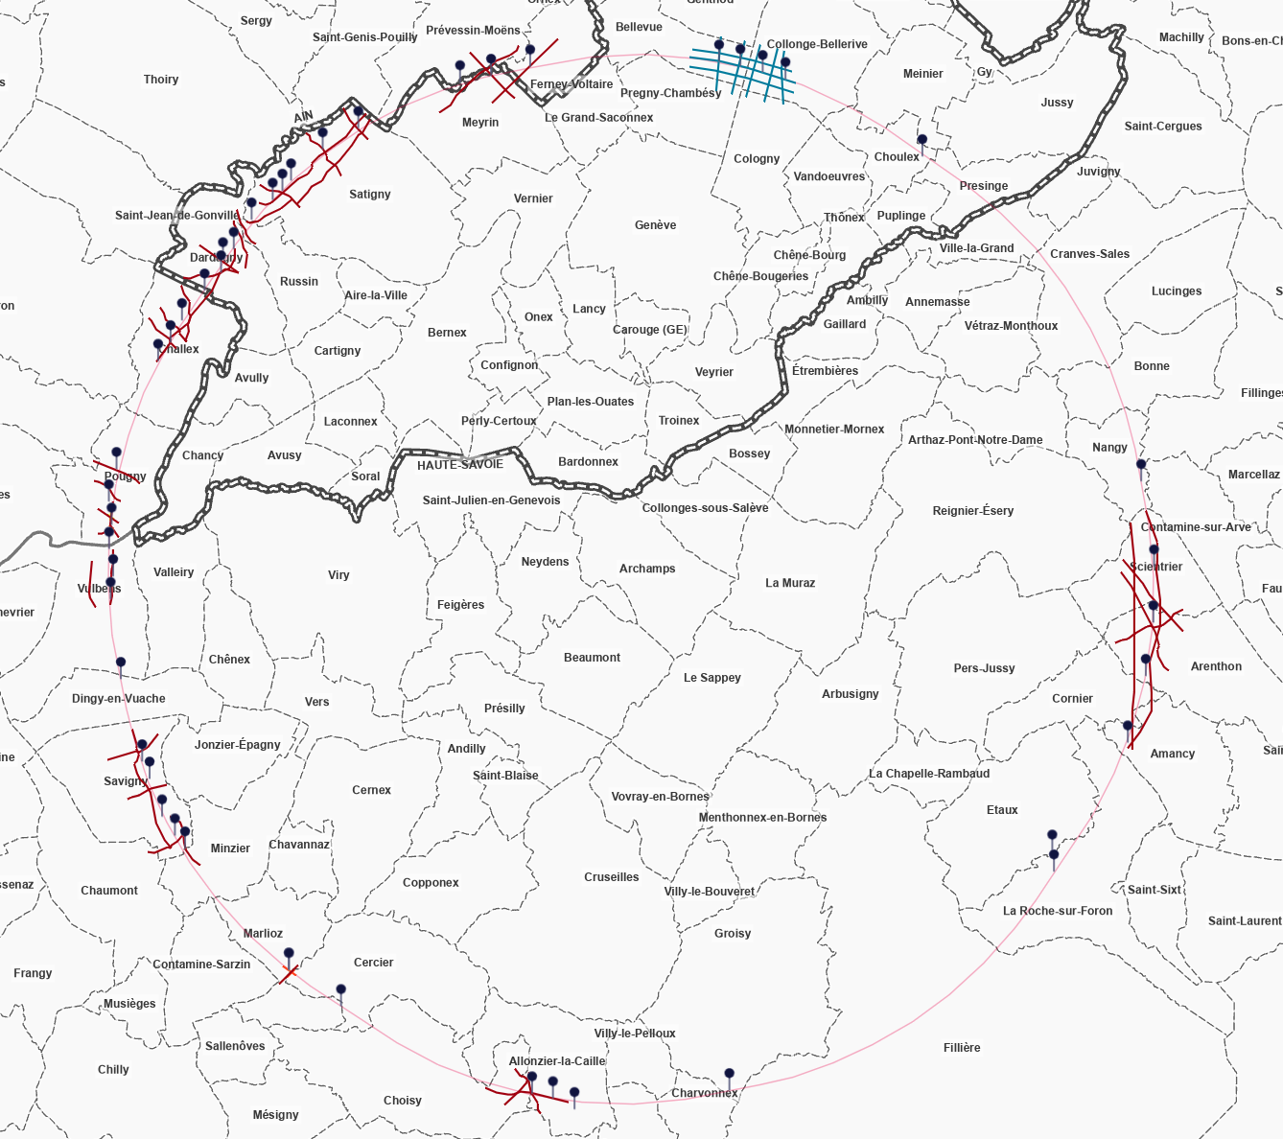
Subsurface investigations
Geophysical and geotechnical investigations in selected zones to understand the stability of the soil and to build a more detailed geological 3D model.
Interactions with host state notified bodies for the authorisations and to optimise the locations to limit the impacts of the campaign.
Interactions with affected land plot owners to obtain the permits and to optimise the locations to limit the impacts of the campaign.

Slide 21
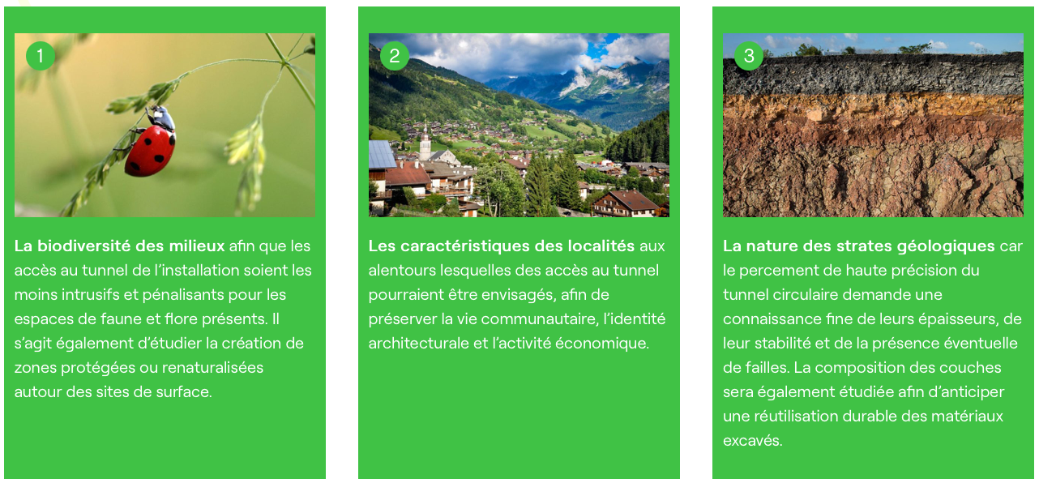
Environmental aspects analysis
The analysis of environmental aspects in zones of surface site candidates is ongoing.
The required environmental analysis for the authorisations of the subsurface investigations has started.
Both activities take place over a time frame of 12 to 18 months. They include continuous and close interactions with local authorities and residents of the territory.

Slide 22
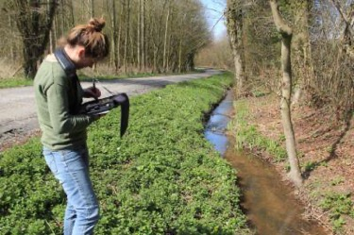
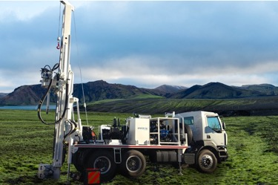
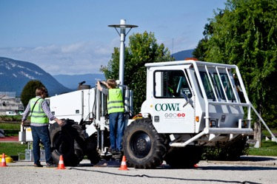
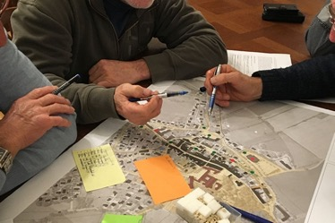
Scheduled activities
2023
Classic nature inventory establishment, endangered species localisation, recordings of environmental conditions, agricultural study, water, air, traffic, noise and light pollution analysis.
Exploration drillings in areas where geological conditions need to be clarified to be able to make reliable cost and CE project schedule estimates.
2024
2024
Acoustic techniques to gather reliable data on the sub-surface conditions without a need for drillings in areas where insufficient information about the geological conditions exist today.
Identification of opportunities and synergies that emerge from an FCC in the region together with territorial stakeholders. Optimise the surface site locaitons and layouts. Analyse the socio-economic impact potentials in greater detail.
2023/24

Slide 23
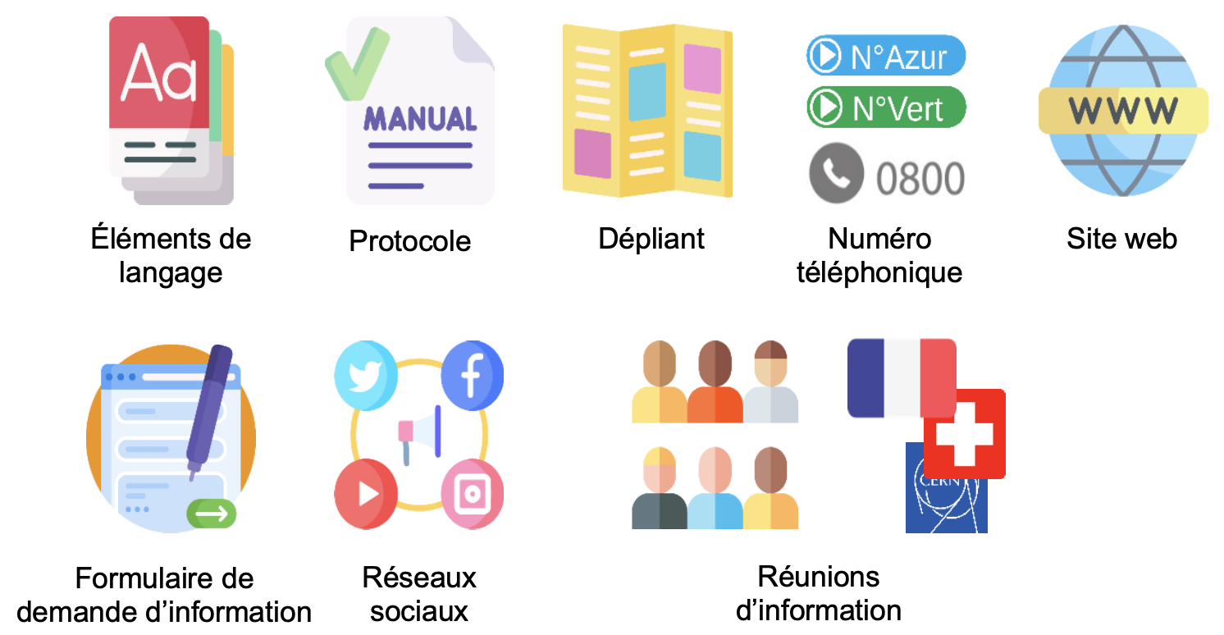
Territorial dialogue
Communication plan established
Tripartite working meetings to assure advancement in phase
Regular visits of territorial stakeholders at CERN
Information “kit” produced and used
Additional info materials (videos, sheets and leaflets) developed as the need arises, e.g.
info about seismic investigation and geotechnical investigations
Socio-economic impact data
Calendar of upcoming visits with descriptions of activities on sites and photos

Slide 24

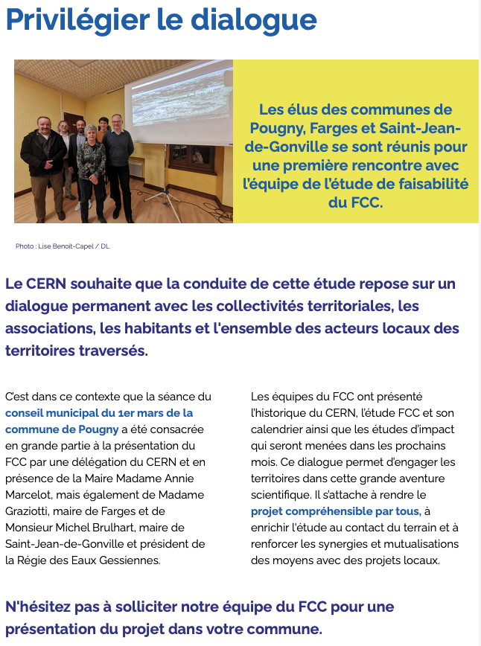
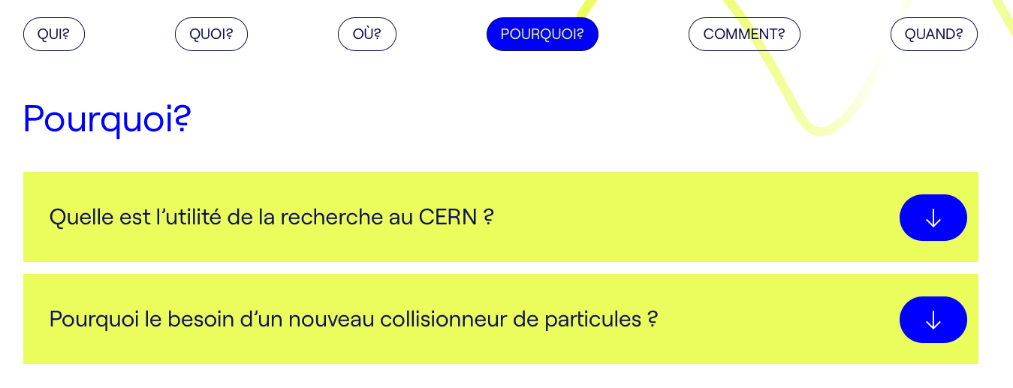
Web site:
fcc-faisabilite.eu

Slide 25
Regular meetings with regional stakeholders
Government services
France:
Region Auvergne-Rhône-Alpes
Prefectures, sous-prefectures
DDT, DREAL
CGDD, CCPG and others coming
Switzerland:
Department of Foreign Affairs
Department of Economic Affairs, Education and Research
State of Geneva
Elected representatives of the people
France:
Conseil dêpartemental Haute-Savoie & Ain
All communes affected by the trace
Communautés d’agglomération
Switzerland:
All communes affected by the trace
A range of interest groups

Slide 26
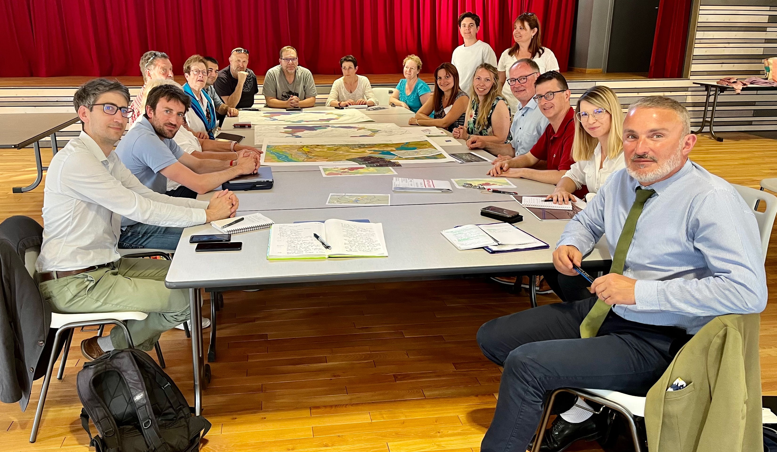
Regular meetings with regional stakeholders
Challex, Ain, France

Slide 27
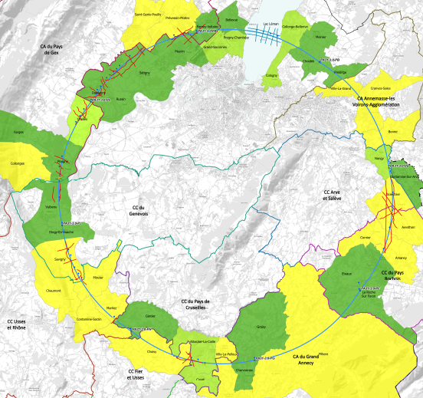
Reference scenario feedback
Feedback from all communes hosting surface sites in France and in Switzerland so far positive.
For surface sites so far no showstoppers.
Some communes enthusiastic about the potentials for co-development.
All communes in France and in Switzerland expressed the need for top-level government support for a project of national and international interest towards the government representatives in the working meetings.
Individual meetings
Meeting planned
Collective meetings

Slide 28
Typical concerns of people that we meet
Concerns/interests typically expressed:
Land consumption (ZAN, SdA)
Management of the excavated materials including their transport
Water consumption
Electricity landlines
Need for creation of local jobs
Housing needs for construction workers and engineers due to already stressed housing situation in the region
Integration with landscape, typical rural architecture
Traffic increase in congested zones
Synergy potentials typically evoked:
Integration of surface sites in local education programmes from children to adult levels
Local employment and service supply opportunities
  as for instance also successfully implemented by SKA in South Africa
Visitor centers and tourism development
Integration into public transport concepts
Integration with public services (healthcare, security, emergency)
Supply of residual cooling water for agriculture and re-naturalisation
Supply of waste heat for heating, food processing and industrial processes

Slide 29
Complementary studies
Carried out:
Mining the Future – technologies for innovative excavated materials re-use > Followup needed
Access to french highway system
Renewable energy source supply feasibility
Job creation
Regional impact on high-tech suppliers
Training value for students and post-docs
Tourism effects
Open ICT development impacts
Common good value
Ongoing or planned:
Access to the french national electricity grid
Local electricity connection
Excavated materials local re-use
Excavated materials deposit
Access to railroad system
Waste heat supply feasibility & socio-economy
Water intake
Supply of residual water

Slide 30
Conclusions
The placement methodology and the evolution of scenarios has been documented.
An Environmental Information System (EIS) is being put in place to document all relevant aspects of the choice and further evolution in detail as required by the legal frameworks.
A reference scenario has been identified and a rationale for its selection has been documented.
The territory is continuously evolving, therefore neither completeness nor correctness of the supplied information can be assured for a long period of time. No obvious alternative scenario potentials have been identified.
Land plot reservation for study purposes started.
Analysis of environmental aspects at the surface site locations has started.
Scenario PA31 has been verified with communes affected by surface site and so far no showstoppers have been identified
Development on synergy potentials with communes has started.
The permitting and authorisation process for the geophysical and geotechnical investigations scheduled for 2024 is ongoing.
Dedicated support and contributions from government services in both countries required to advance on the validation of the scenario and the territorial optimisation for local excavated materials re-use.

