Slide 1


Slide 2
Progress on Civil engineering for the fcc
5 June 2023 / FCC Week
Timothy WATSON
Host States and Civil Engineering Pillar Coordinator

Slide 3
Progress on Civil engineering for the fcc
5 June 2023 / FCC Week
Site and Civil Engineering Department (SCE) team directly supporting the FCC Project
Liam Bromiley
Angel Navascues Cornago
Roddy Cunningham
Antoine Mayoux
John Osborne
Youri Robert
Acknowledging the contributions and presentations made by our external collaborators from Fermilab, ILF, Quantum and UNIGE.

Slide 4
Contents
5 June 2023 / FCC Week
Timothy WATSON
Civil Engineering for Underground Works
Civil Engineering for Surface Works
Staging ee to hh
Progress on Site Investigation
Scheduling and Costing
Look Ahead

Slide 5
Underground Civil Engineering – Main Developments Since CDR
5 June 2023 / FCC Week
Timothy WATSON
Over the last 12 months, significant progress has been made on developing a civil engineering design that satisfies the 8-Point layout for the FCC-ee machine and its associated experimental areas.
The changes to the machine layout and the associated experimental areas has allowed for simplification and to some extent standardization of the underground civil engineering elements of the FCC-ee.
Furthermore, a study has been made to identify those structures that are only necessary for a future FCC-hh machine and to assess which of those structures could be constructed in a post FCC-ee phase and those which should be constructed during the initial FCC-ee construction phase.
The main changes are listed on the following slide:

Slide 6
Rationalization and simplification of the overall layout.
Improved understanding of needs of RF, ee Injection and ee Beam Dump now incorporated into the civil engineering.
Outcomes from the placement studies has allowed surface constraints to be better accounted for in the underground civil engineering.
Circumference of the ring reduced from 97.8km to 90.7km
Number of shafts reduced from 21 to 13.
Beam Dump for ee integrated into a locally widened beam tunnel
Single tunnel for clockwise and anti-clockwise FCC-ee injection
Increase in the civil engineering necessary to house the RF systems
Development of a staged strategy for some structures for transition from ee to hh

Slide 7
Underground Civil Engineering
The mid-term review baseline will include technical solutions, schedule and costing for four Experiment Areas. The impact of reducing this to two experimental areas will be included.
Following the discussions at the October 2022 Review of Experimental Areas, two of the four experimental areas will be designed to accommodate a large detector associated with a potential future FCC hh machine.
The other two experimental areas will be smaller and for the purpose of the mid-term review have been assumed to be similar in size to the current CMS underground complex.
All four cavern complexes will be designed on the basis of a single direct access shaft from the experimental cavern to the surface and a secondary horizontal access from the floor of the experiment cavern to the service cavern shaft. This arrangement has worked well for CMS as it provides access to either side of the detector.
All four experimental areas assume that a 50m wide rock pillar will be required between the detector cavern and the service cavern in order to avoid electro-magnetic interference to the equipment in the service cavern and shaft.

Slide 8
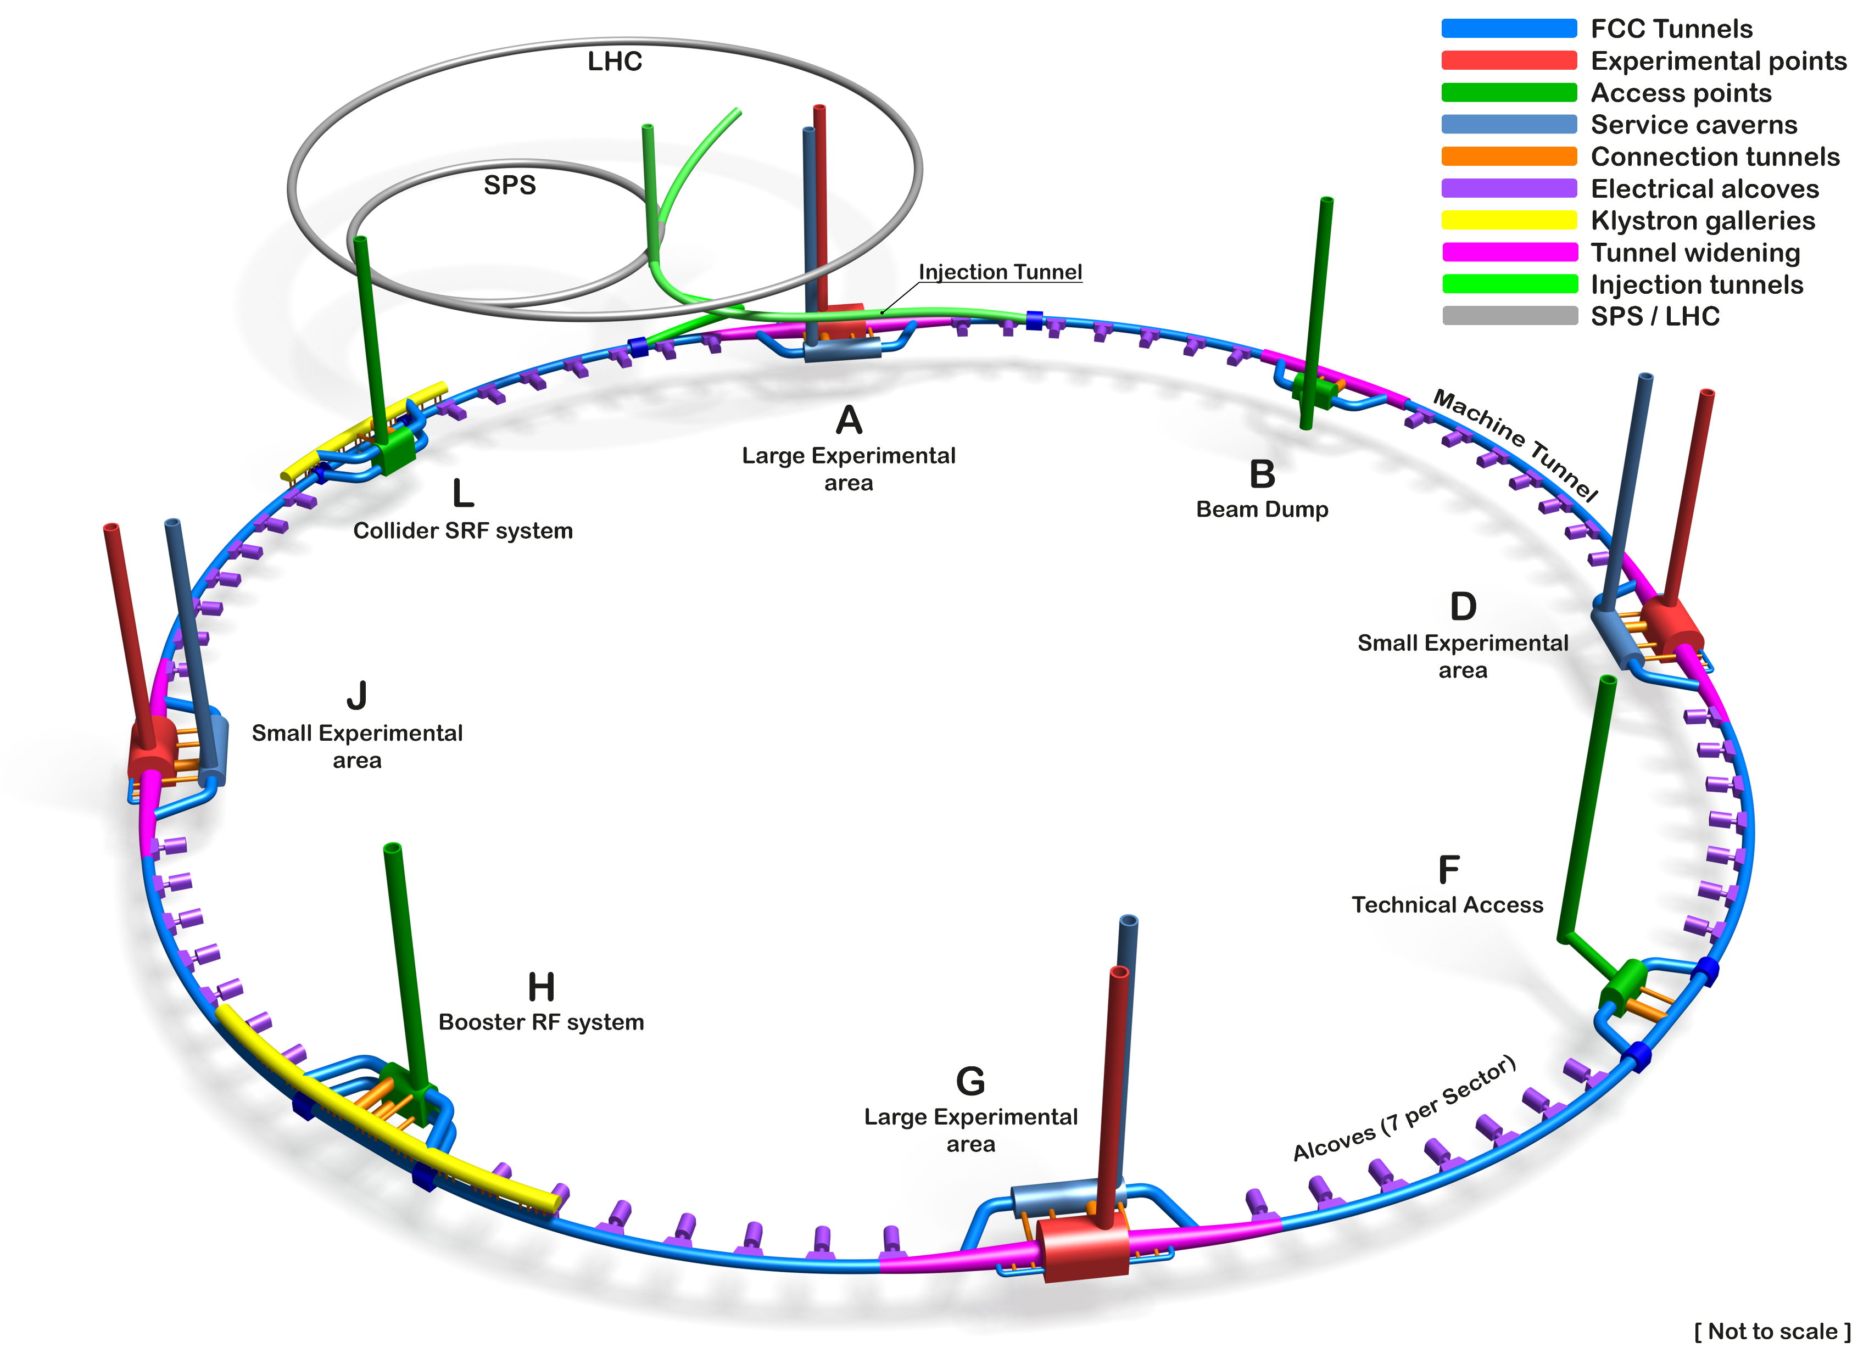
Schematic of the Underground Civil Engineering
5 June 2023 / FCC Week
Timothy WATSON
Tunnel Circumference: 90.7 km
Excavated vol: 6.2M m3 (In the ground)
Access shafts: 12
Construction shafts: 1
Large experiment areas: 2
Small experiment areas: 2
Technical points: 4
Deepest shaft: 400m
Average shaft depth: 243m

Slide 9
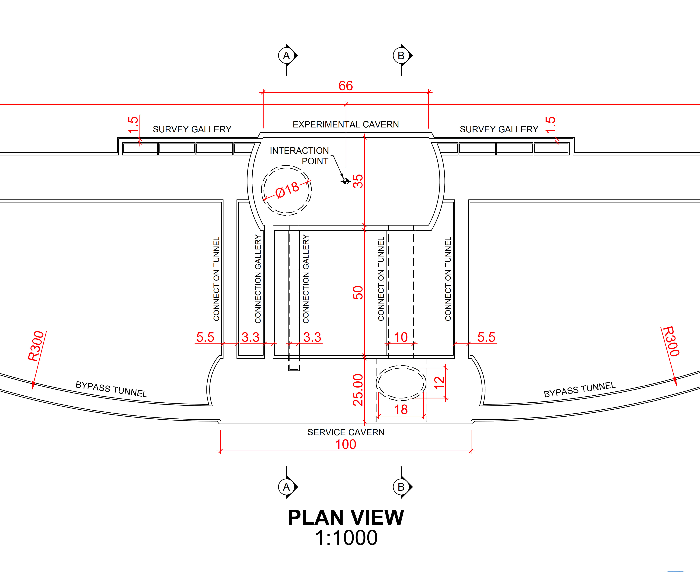
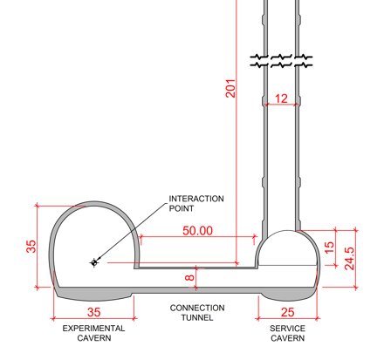
Underground Civil Engineering – Main Features
Two “large” Experiment Areas, each with two shafts for access and two large caverns. Experiment cavern dimensions are 35m x 35m x 66m
Two “small” Experiment Areas each with two shafts and two caverns. Experiment cavern dimensions are 25m x 25m x 66m
Large experiment caverns are slightly larger than the ATLAS cavern and the small experiment cavern is similar in size to CMS cavern.
Deepest experiment cavern is 253m to beamline with shallowest having 181m depth to beam line.

Slide 10
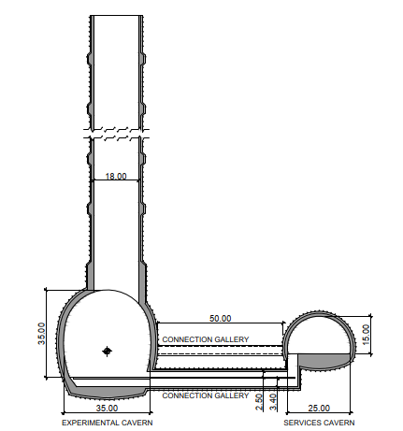
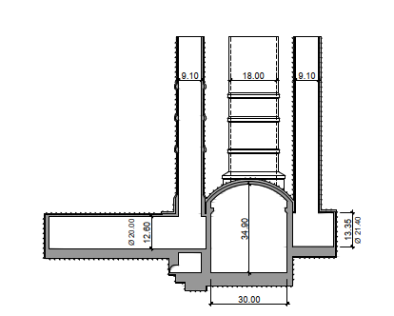
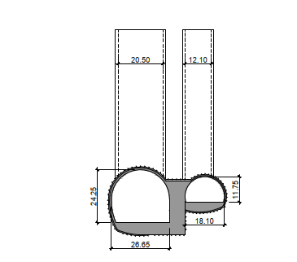
Comparison FCC to ATLAS and CMS Cavern Complexes
FCC
ATLAS
CMS

Slide 11
Underground Civil Engineering – Main Features (ii)
Single injection line tunnel from Prevessin surface site down to FCC Point A via SPS and small bifurcation for anticlockwise injection into FCC.
Possible re-use of Ti8 or CNGS construction shafts.
Simplified Beam Dump layout requiring only tunnel widening over a 660m around the centre-point of the LSS.
Complex “double decker” arrangement of tunnels and connecting shafts for RF at two of the points..
Use of access galleries at three of the four technical areas to overcome the difficulty of siting a shaft and surface buildings over the tunnel alignment.

Slide 12
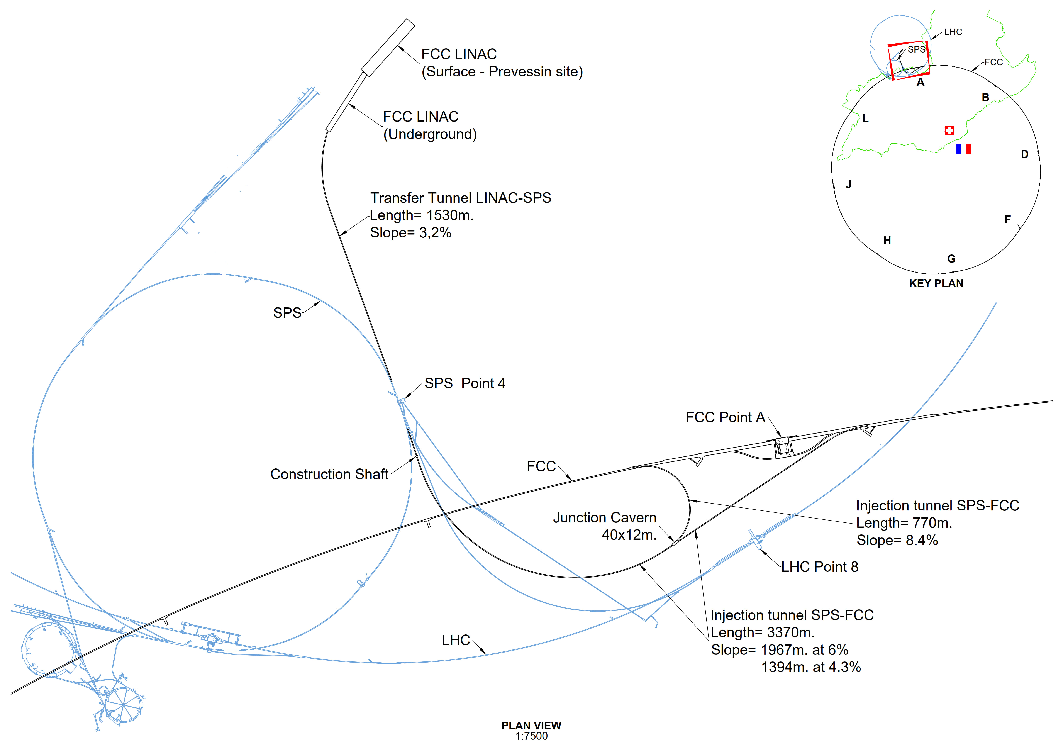
LINAC and Injection Tunnels
Designed to enable injection either from SPS or from a new LINAC sited at Prevessin
Single tunnel with spur to enable anti-clockwise injection
Connection details to SPS and FCC tunnel to be developed.
Layout could facilitate a direct surface to FCC link
Design allows re-use for FCC-hh

Slide 13
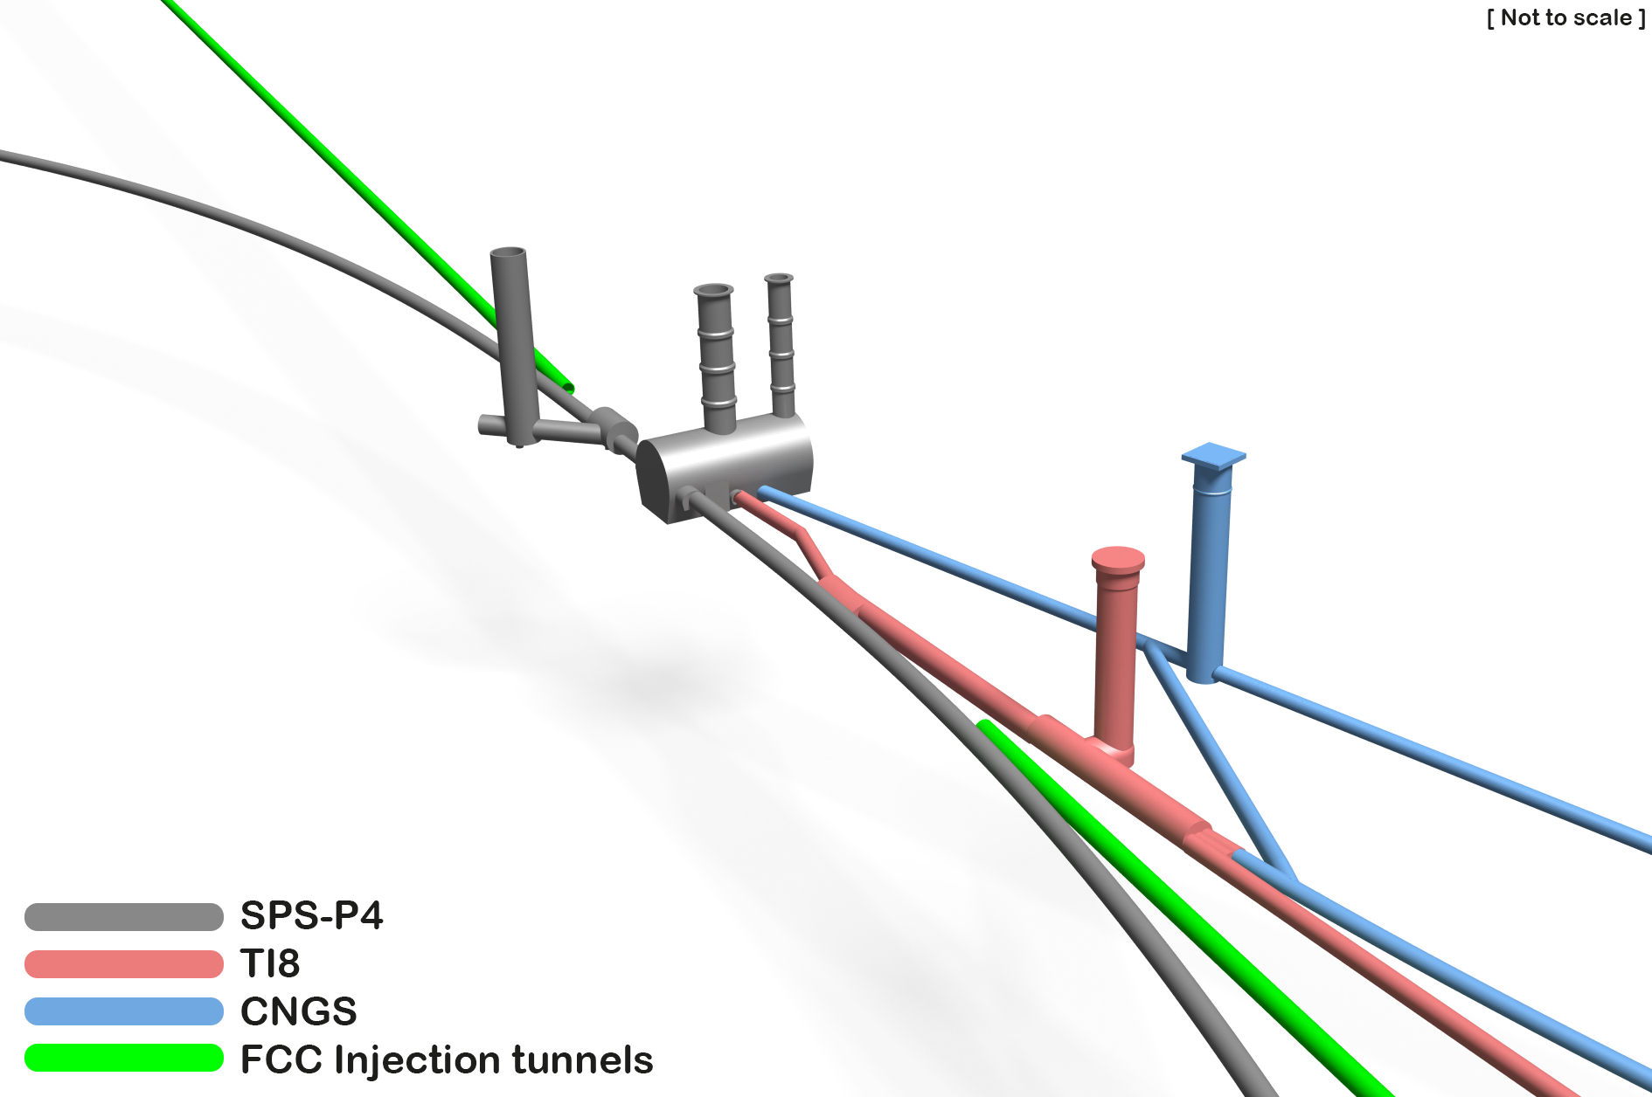
Existing Underground Civil Engineering at SPS Point 4

Slide 14
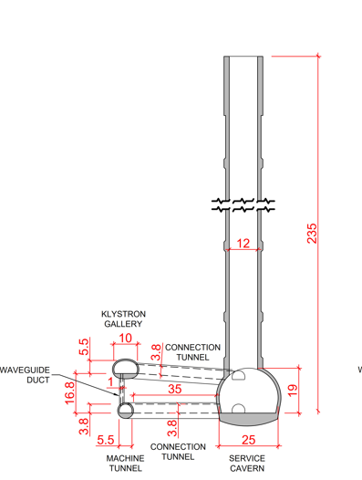
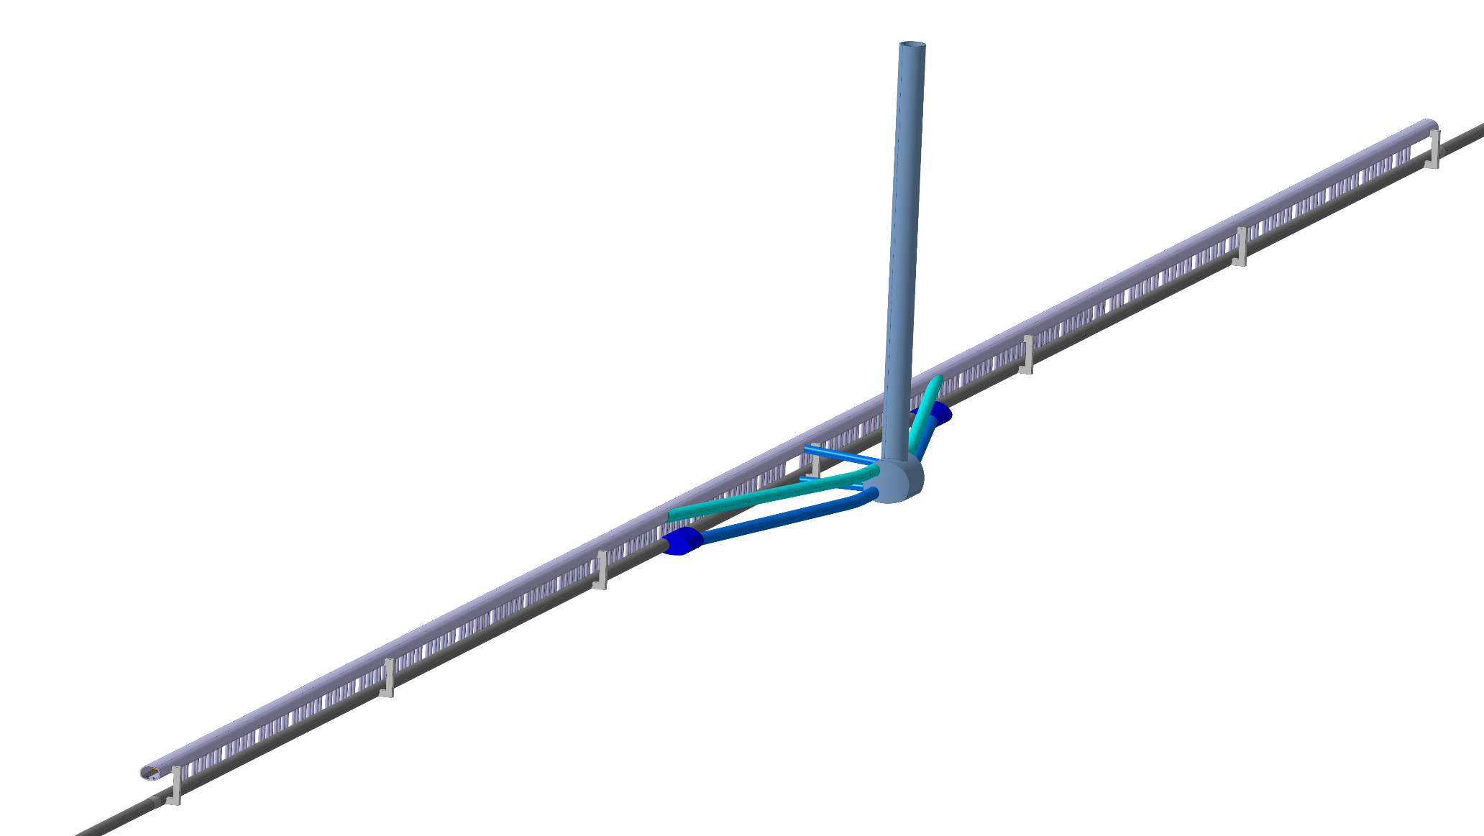
Underground Civil Engineering – Main Features (ii)
Klystron gallery
9.8 x 5.4 m
Service staircase
Technical Point housing RF

Slide 15
Surface Civil Engineering
Preliminary layouts for surface buildings for an Experiment Site and a Technical Site have been developed in conjunction with the Fermilab civil engineering group.
These layouts along with their associated bills of quantities will be used to prepare cost estimates for surface works.
For most of the other surface sites, the FCC civil engineering team has been working on options for surface buildings in order to support ongoing discussions with the local communities which will lead to more definitive layouts being prepared after the mid-term review.
Surface buildings at experimental sites are constrained by the underground caverns and shafts since the experiment access shaft can be located in only one of two positions relative to the Intersection Point.
For Technical sites there is more flexibility as the access shaft can be located further away from the beam tunnel.

Slide 16
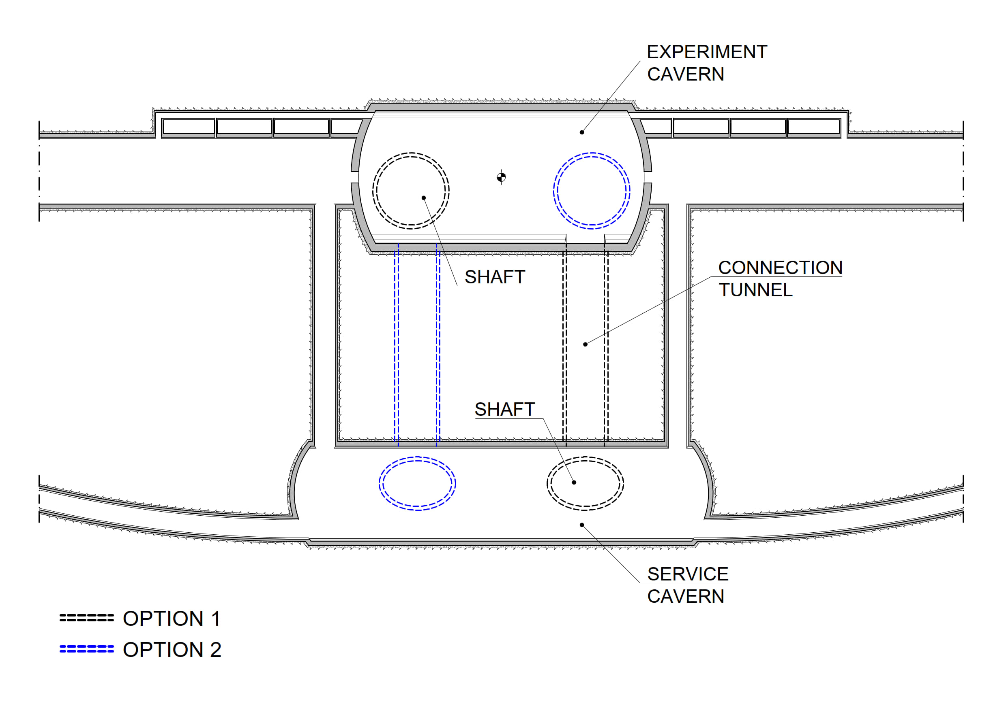
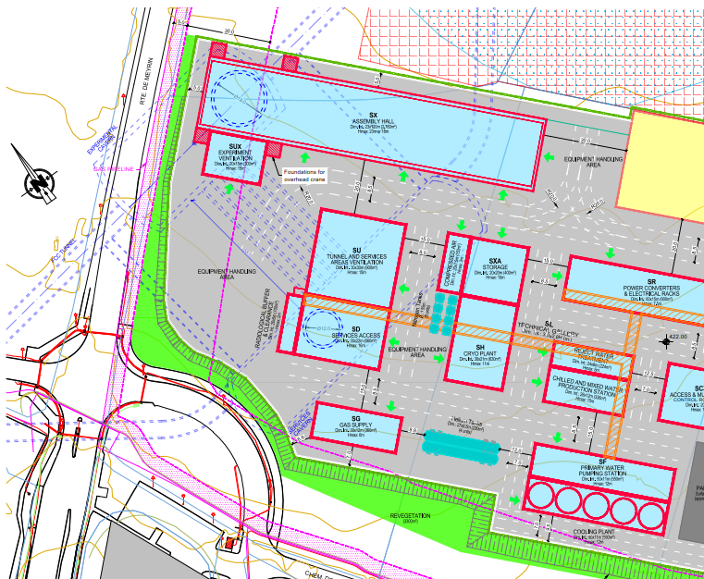
Example of Constraints at Experimental Sites

Slide 17
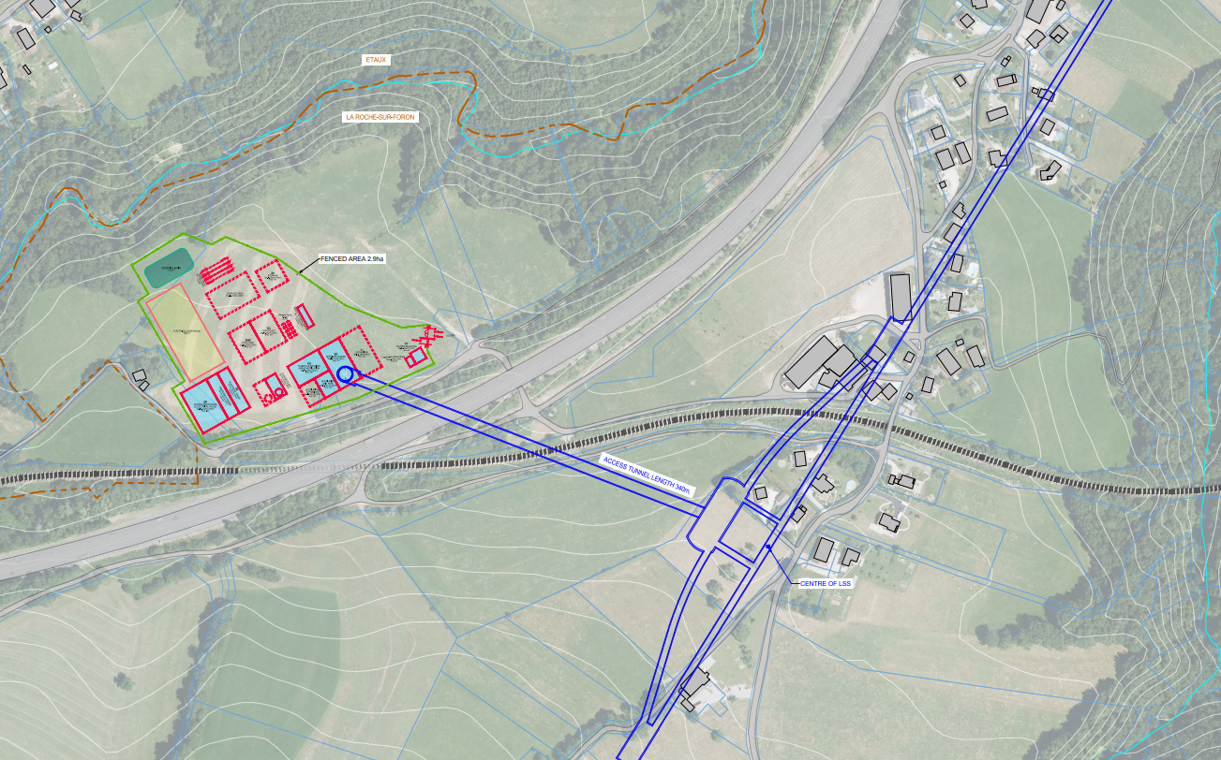
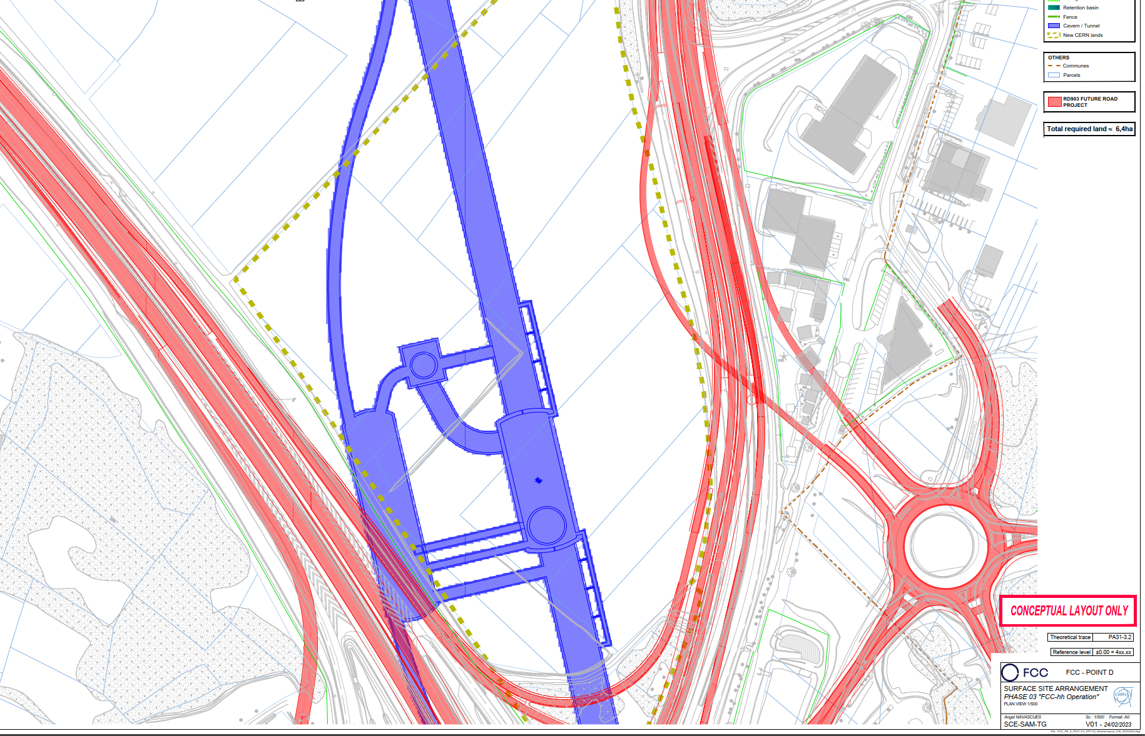
Flexibility at Technical Sites
Future Surface constraints lead to non-standard solutions

Slide 18
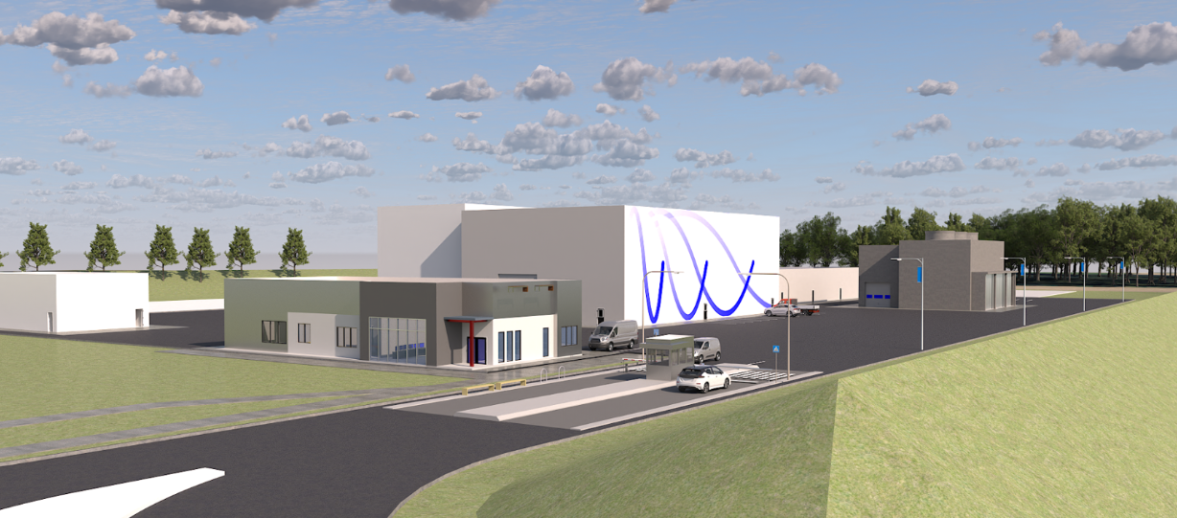
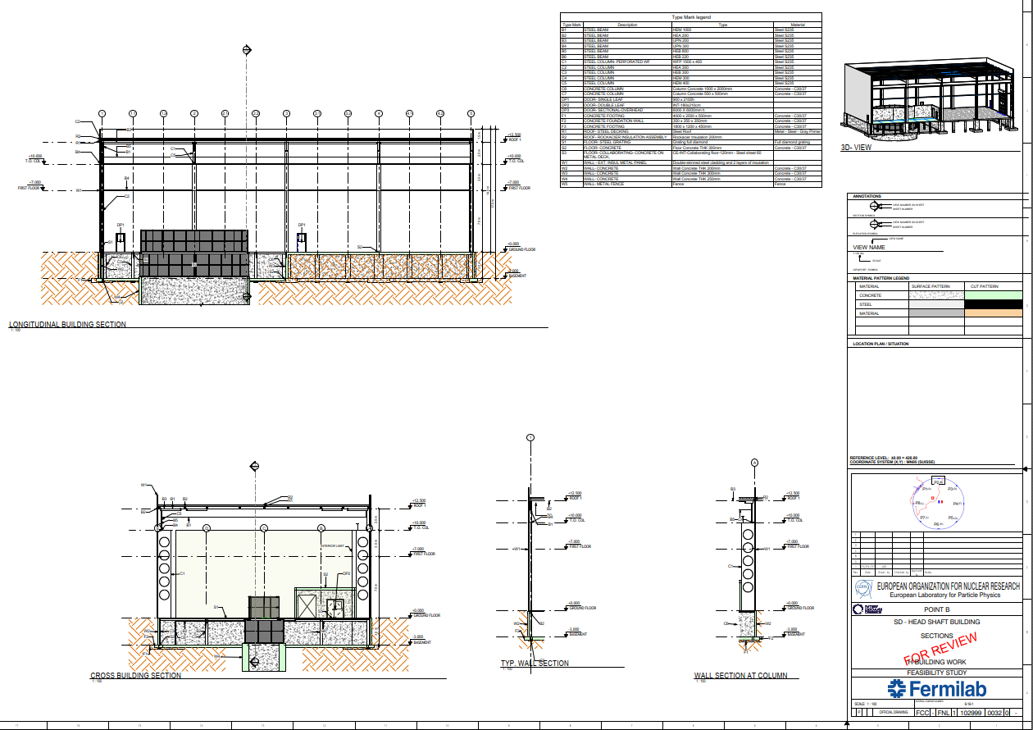
Examples of Fermilab Deliverables

Slide 19
Staging of Civil Engineering
In developing the designs for the civil engineering for the FCC ee machine and experimental areas, consideration of the future needs of an hh machine have been considered.
Engineering judgement has been used to decide whether to include works for hh at ee phase or whether to postpone to a later stage.
For example the experimental caverns for ee could theoretically be smaller but it would not be efficient to construct smaller caverns and the try to enlarge them at a later date.
The Service caverns will be constructed to full size at ee phase even if the space will not be fully utilised until hh phase.
Shaft sizes will take account of hh installations (eg dipole installation)
The following structures are currently considered for construction during/after FCC-operation and prior to FCC-hh operation.

Slide 20
Staging of Civil Engineering
Second hh injection line from the SPS
hh Beam Dump facility which is likely to require tunnels and caverns dedicated to each beam dump.
Additional surface halls for detector manufacture/assembly
Additional surface facilities for cooling and cryoplants
Possible additional surface facilities on Meyrin or Prevessin sites associated with hh operations.

Slide 21
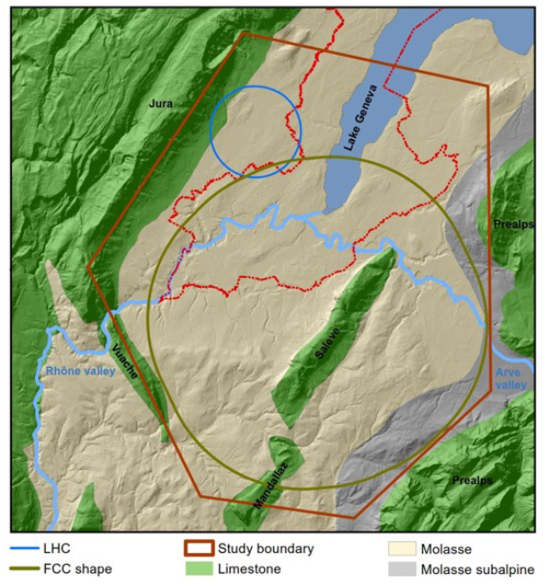
Site Investigation for Areas of Geological Uncertainty
The conceptual design phase identified a number of zones within the FCC Target Area for the FCC where there was a lack of sub-surface data needed to confirm the feasibility of the project.
These zones were primarily under water features (Lake Geneva, Rhone River etc) or close to mountain outcrops where the risk of intersecting limestone rock with high water pressures is high.
In mid-2022 a contract was placed with an external engineering company to prepare a call for tender for site investigation works and to oversight the actual works planned for 2024/2025.

Slide 22
Site Investigation for Areas of Geological Uncertainty
The call for tender documents are now complete and the CfT will be issued shortly with an FC approval for contract award targeted for December 2023.
The site investigation works will consist of:
About 48 cored or non-cored boreholes. These will determine precise locations of the interfaces between the different rock types and testing on samples will provide data for further structural design work for the underground structures.
Around 80 km of seismic reflection lines which will help determine the location of the interfaces between limestone and molasse rock as well as between the molasse and the superficial overlying sand/gravels/silts
In some boreholes it is anticipated to install piezometers for measuring water pressure.
In parallel with the CfT, extensive work is ongoing with CERN staff and other specialist consultancy firm to obtain the necessary permits and authorizations for these site investigation works.

Slide 23
Cost and Schedule
For the underground works a specialist consultancy (ILF) has been engaged to develop a new schedule based on the revised 3D and 2D designs prepared by CERN.
A first draft indicates that in total the civil engineering will take up to 8 years to complete but with a staged delivery which will allow CERN to commence installations of the infrastructure and machine after about 6 years.
The schedule will be used by ILF to develop a “bottom-up” cost estimate for the underground works based on unit costs for labour, material and plant and quantities from the 2D and 3D drawings and time-based costs from the schedule.
The costs will allow CERN to compare the current design with the concept design and to see the impact of inflation on civil engineering costs since 2016 when the Concept design was initially costed.

Slide 24
Basis of Schedule – TBM Drive Sequence
5 June 2023 / FCC Week
Timothy WATSON
Direction of TBM Drive

Slide 25
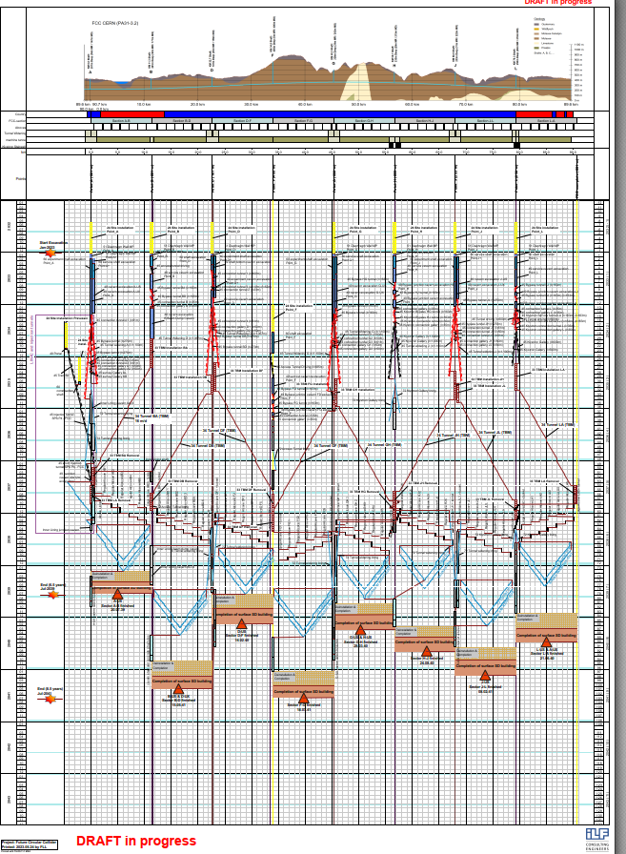
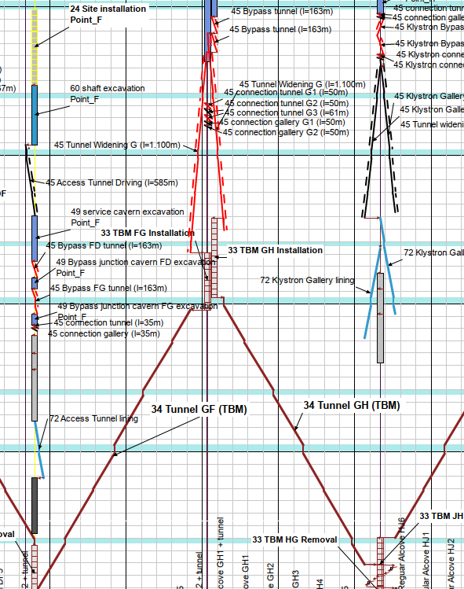
Draft Schedule for Civil Engineering

Slide 26
Cost and Schedule
For the surface works a different approach has been taken given the lower maturity of the requirements and constraints for the surface sites.
The drawings and bills of quantities prepared by Fermilab will be given to an external consultancy firm for costing purposes. Prices applicable to the region will be used. This will give costs for the surface sites PA and PB.
For the other six surface sites, conceptual layouts prepared by CERN will be compared with the more detailed layouts available for PA and PB and approximate cost estimates will be prepared for the six sites.
Given that the surface civil engineering is not expected to exceed about 15% of the cost of the underground, this approach is deemed acceptable for the mid-term review.

Slide 27
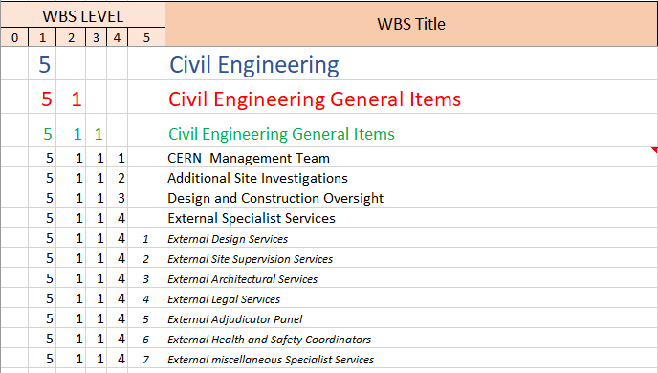
WBS
An initial WBS has been prepared based around the Eight geographical locations and a number of “common” work items. These will be costed for the mid-term C&S review at Level 4 with 280 activities.
Costs reported at Level 4

Slide 28
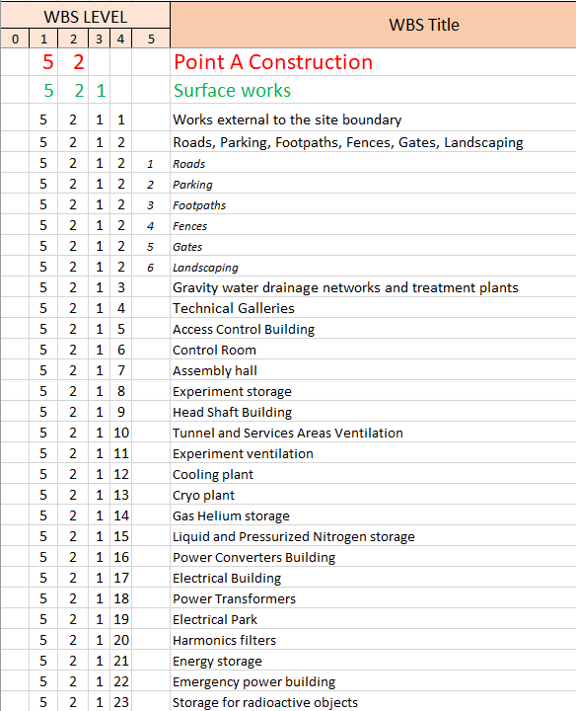
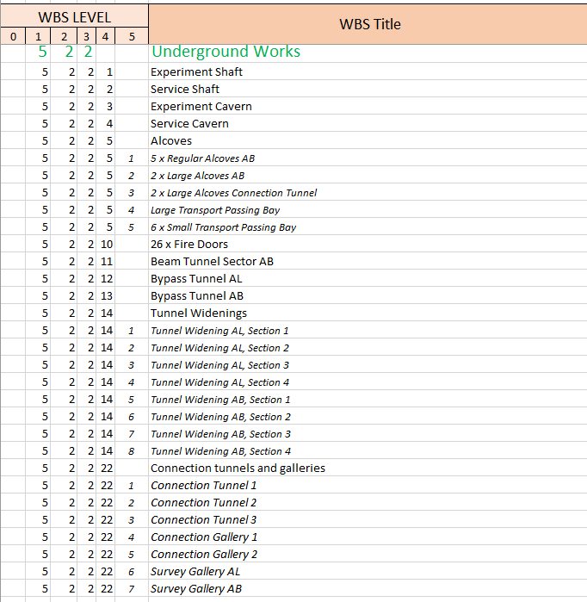
WBS
Costs reported at Level 4

Slide 29
Look Ahead
5 June 2023 / FCC Week
Timothy WATSON
Commence Site Investigation works in the field in 2024 and complete before mid-2025.
Update layouts and designs for the surface buildings at all 8 points taking into account any new requirements or constraints (internal or external).
Refine the current designs for underground by optimizing cavern sizes, tunnel widenings and shaft diameters using more refined requirements from users.
Update (where necessary) the schedule and cost estimates for the final report
Prepare more detailed cost estimates for the surface works
Prepare a schedule for the period of time between end of feasibility study and potential start of civil works (pending project approval).
Review design, estimates and schedule after results from Site Investigation are known (height and inclination of tunnel may need to be adjusted)

Slide 30
Conclusions
There have been significant advances made in the maturity of the study in the domain of civil engineering.
A complete 3D model and a complete set of 2D drawings have been prepared in-house.
Schedule and costing of the new designs/layouts will be included in the mid-term review
Preliminary designs along with associated cost estimates for 2 of the 8 surface sites will be completed for the mid-term review along with extrapolated estimates for the other 6 surface sites.
The definition of the site investigations needed to confirm project feasibility are defined and the contracts needed to carry out the works will be in place by the end of 2023. The necessary permitting/authorisations is also advancing with the concerned Host States authorities.

Slide 31
Civil Engineering Session
On Wednesday 7 June at 13:30 there will be a 1h30’ session dedicated to three aspects of the civil engineering namely:
Overview of the ongoing scheduling work will be presented by ILF
Overview of the surface site designs for PA and PB will be presented by Fermilab
Overview of the ongoing site investigation campaign will be presented by Quantum.

Slide 32
Thank you for your attention.
32

