Slide 1
Klaus Hanke
1
Technical infrastructure
K Hanke, FCC Week 2023, 05/06/2023

Slide 2
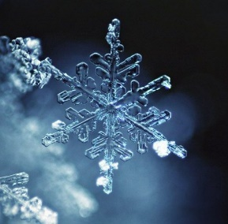
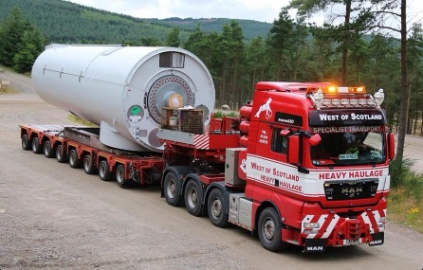
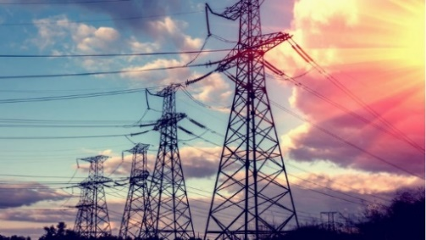
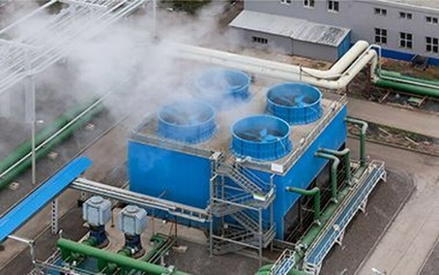
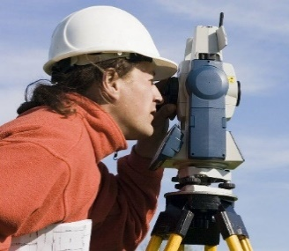
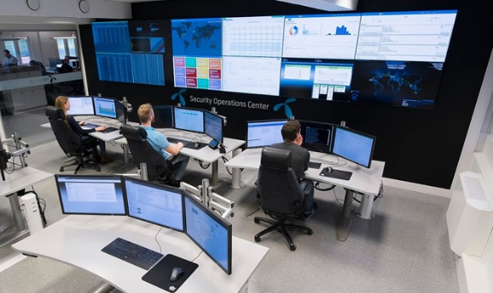
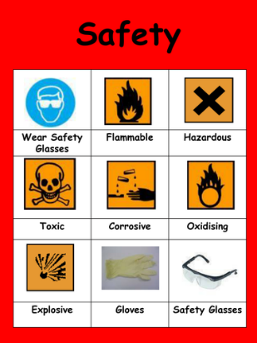
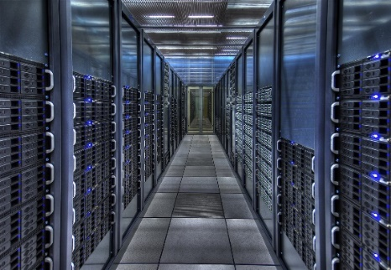
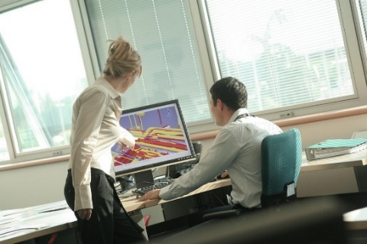
Klaus Hanke
2
FCC Technical Infrastructure
integration ● geodesy ● electricity & energy management ● cooling & ventilation ● cryogenic systems ● computing infrastructure
● safety ● operation & maintenance ● transport, installation & logistics

Slide 3
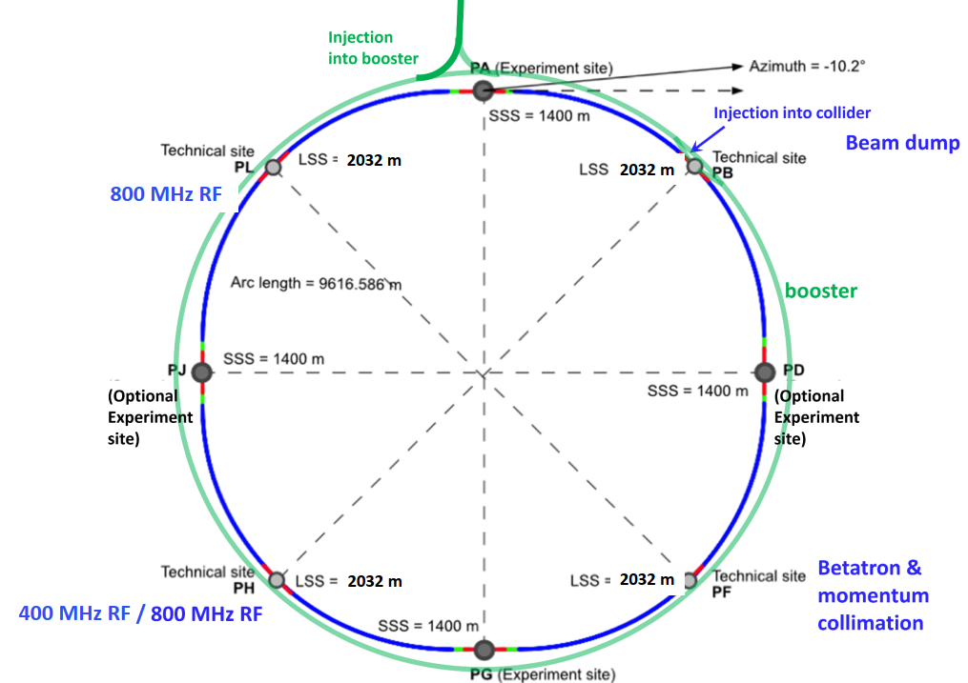
Klaus Hanke
3
Context
Technical Infrastructure based on alignment PA31-1.0, which features eight points with associated surface areas
4 experimental points
4 technical points B, F, H, L
B: Beam dump system
F: Collimation section
H: Collider RF
L: Booster RF
The present study focuses on FCC-ee, but wherever design choices are made which impact FCC-hh (in particular space requirements and dimensions) this is taken into account

Slide 4
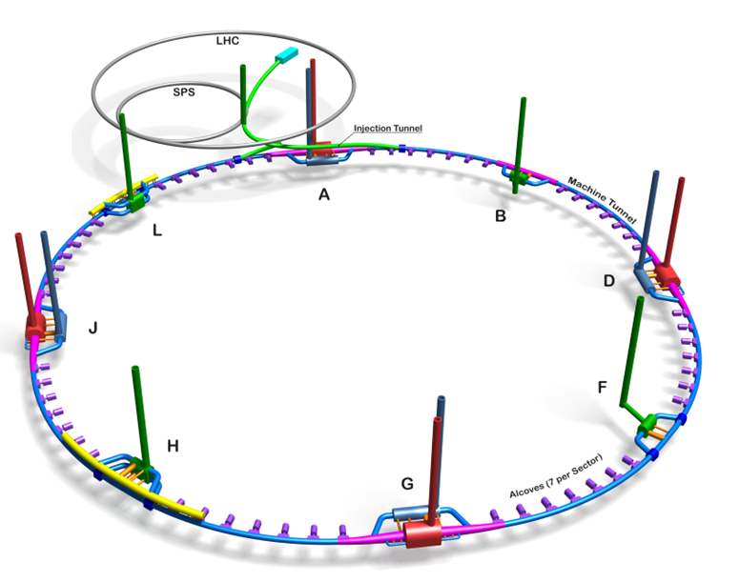
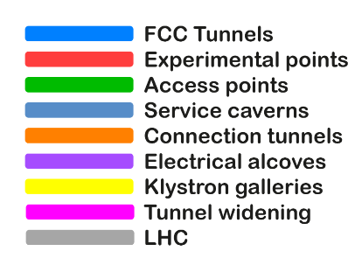
Klaus Hanke
4
FCC-ee Schematic View

Slide 5
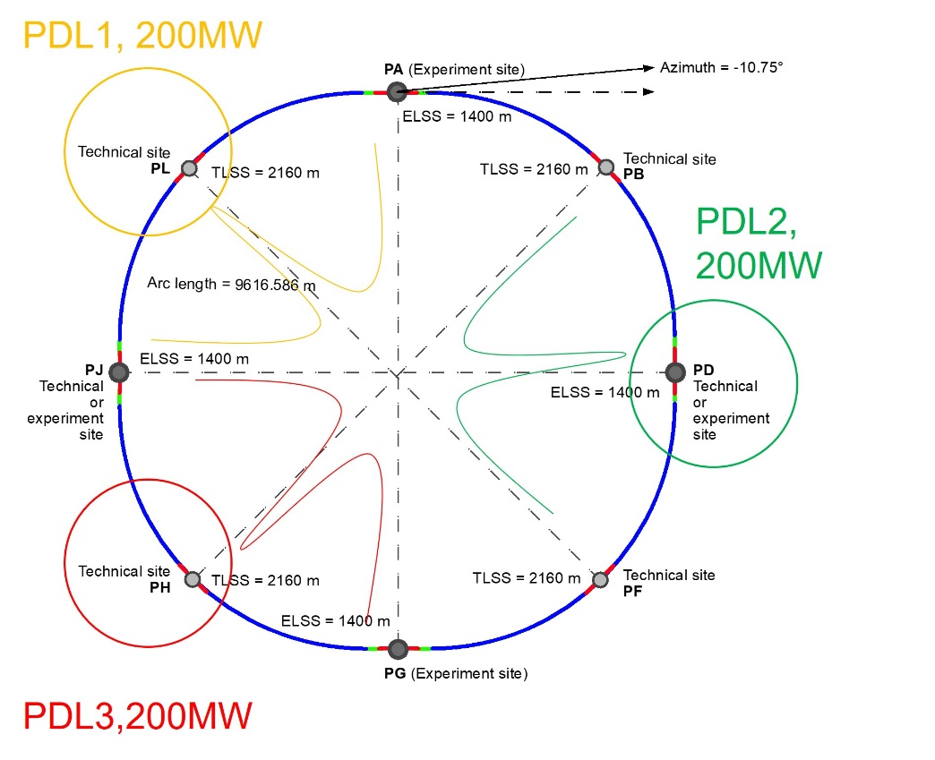
Klaus Hanke
5
Electricity Supply
Electrical Power from the French network fed into the FCC at three points (L, H and D)
Further distribution via the FCC ring
Covers all configurations of FCC-ee without need to built new sub-stations
Possibility to operate the machine without one sub-station, which will ease the maintenance and repairs
Points L, H and D are very close to power lines of the French network operator RTE, and a study has been launched by RTE on how to connect the FCC to the French network
= 2032 m
TLSS=2032 m
= 2032 m
TLSS=2032 m

Slide 6
Alternative with present CERN connection
Klaus Hanke
6
Bois de Serves
69MW (FCC only)
Point L with low charge
Point L has not enough charge to justify a new delivery point.
An alternative would be to reuse present connection (Prevessin) to Bois de Serves (installed power 220MW), and to built a new sub-station at point A.
A new line between Prevessin site and point A is needed (through the road or better through the beam transfer tunnel).
Bois de Serves, with a sub-station covering PJ – PL – PA - PB
Point D, with a sub-station covering PD – PF – PG
Point H with a dedicated sub-station for RF collider
PDL2, 86MW
New RF layout
 |  | Max power (MW)
PDL1 | Bois de Serves | 69
PDL2 | PD | 86
PDL3 | PH | 201
PDL3, 201MW

Slide 7
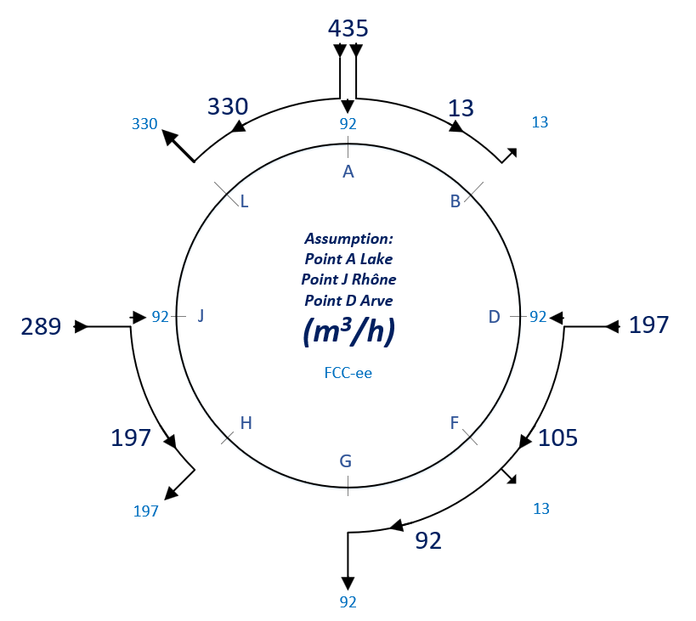
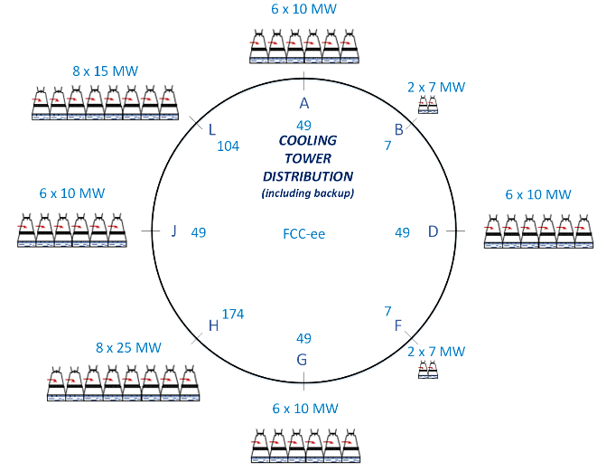
Klaus Hanke
7
Cooling Water
CERN CV Group with Contractors
Potential sources of cooling water Geneva lake (PA), Rhone (PJ) and Arve (PD)
Requested water flow rates have been presented to the authorities
Pipework in the tunnel will connect the remaining points to points A, D and J
As for the water drains, the flow rates will represent around 30 m³/h in the RF points and a maximum of 11 m³/h in the rest of the points

Slide 8
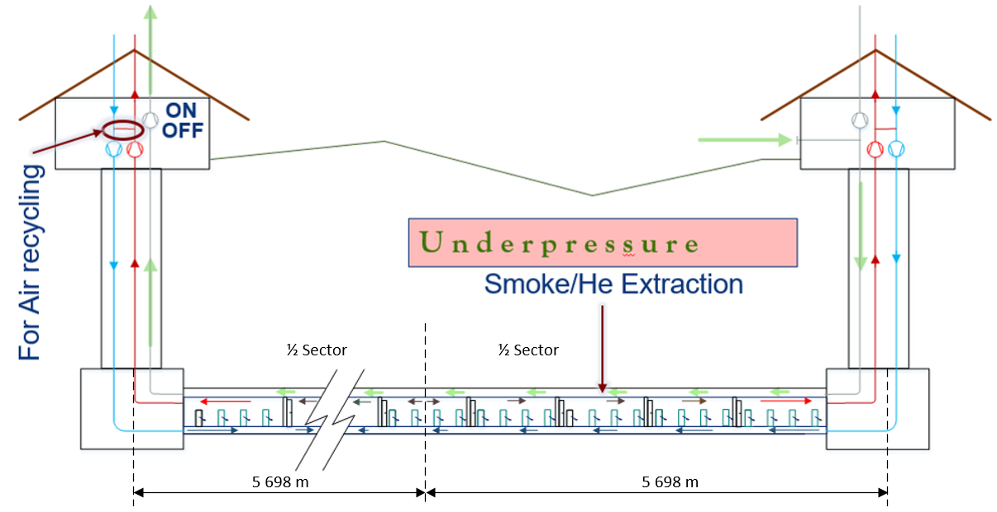
Klaus Hanke
8
Ventilation
Operation of the ventilation elements in one sector of the machine tunnel during normal operation
Smoke and helium extraction in green, general extraction in red and air supply in blue
Also considered special modes, underground caverns, RF sections etc.

Slide 9
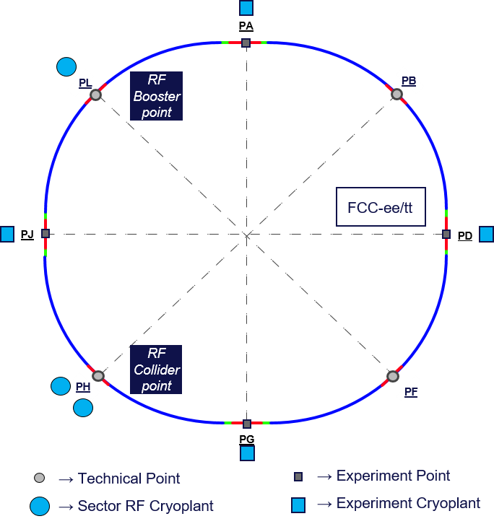
Klaus Hanke
9
Cryogenic Systems
Cryogenic Systems
Technical points PH and PL are associated with the radio frequency (RF) system of the collider and of the booster
Operation at 2 K and 4.5 K for PH, PL only at 2 K
RF points are associated with the biggest cryogenic installations
Experiment points PA, PD, PG and PJ also require an associated cryoplant that covers the needs of the detector magnet, as well as of the Machine Detector Interface (MDI) region magnets
No cryogenics at points PB and PF

Slide 10
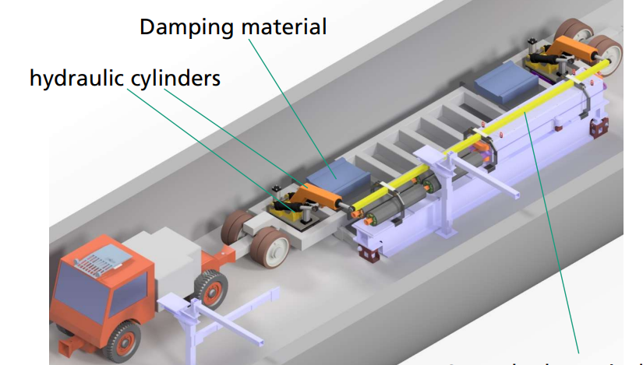
Klaus Hanke
10
Transport: Material Transport
Material vehicle will be a trailer pulled by a battery driven tractor and equipped with two robotic arms
Logistics scenarios based on different boundary conditions such as the number of shafts used to transfer the material and the number of vehicles used to transport it in the underground
Collaboration Fraunhofer-Institut für Materialfluss und Logistik IML, Dortmund, Germany

Slide 11
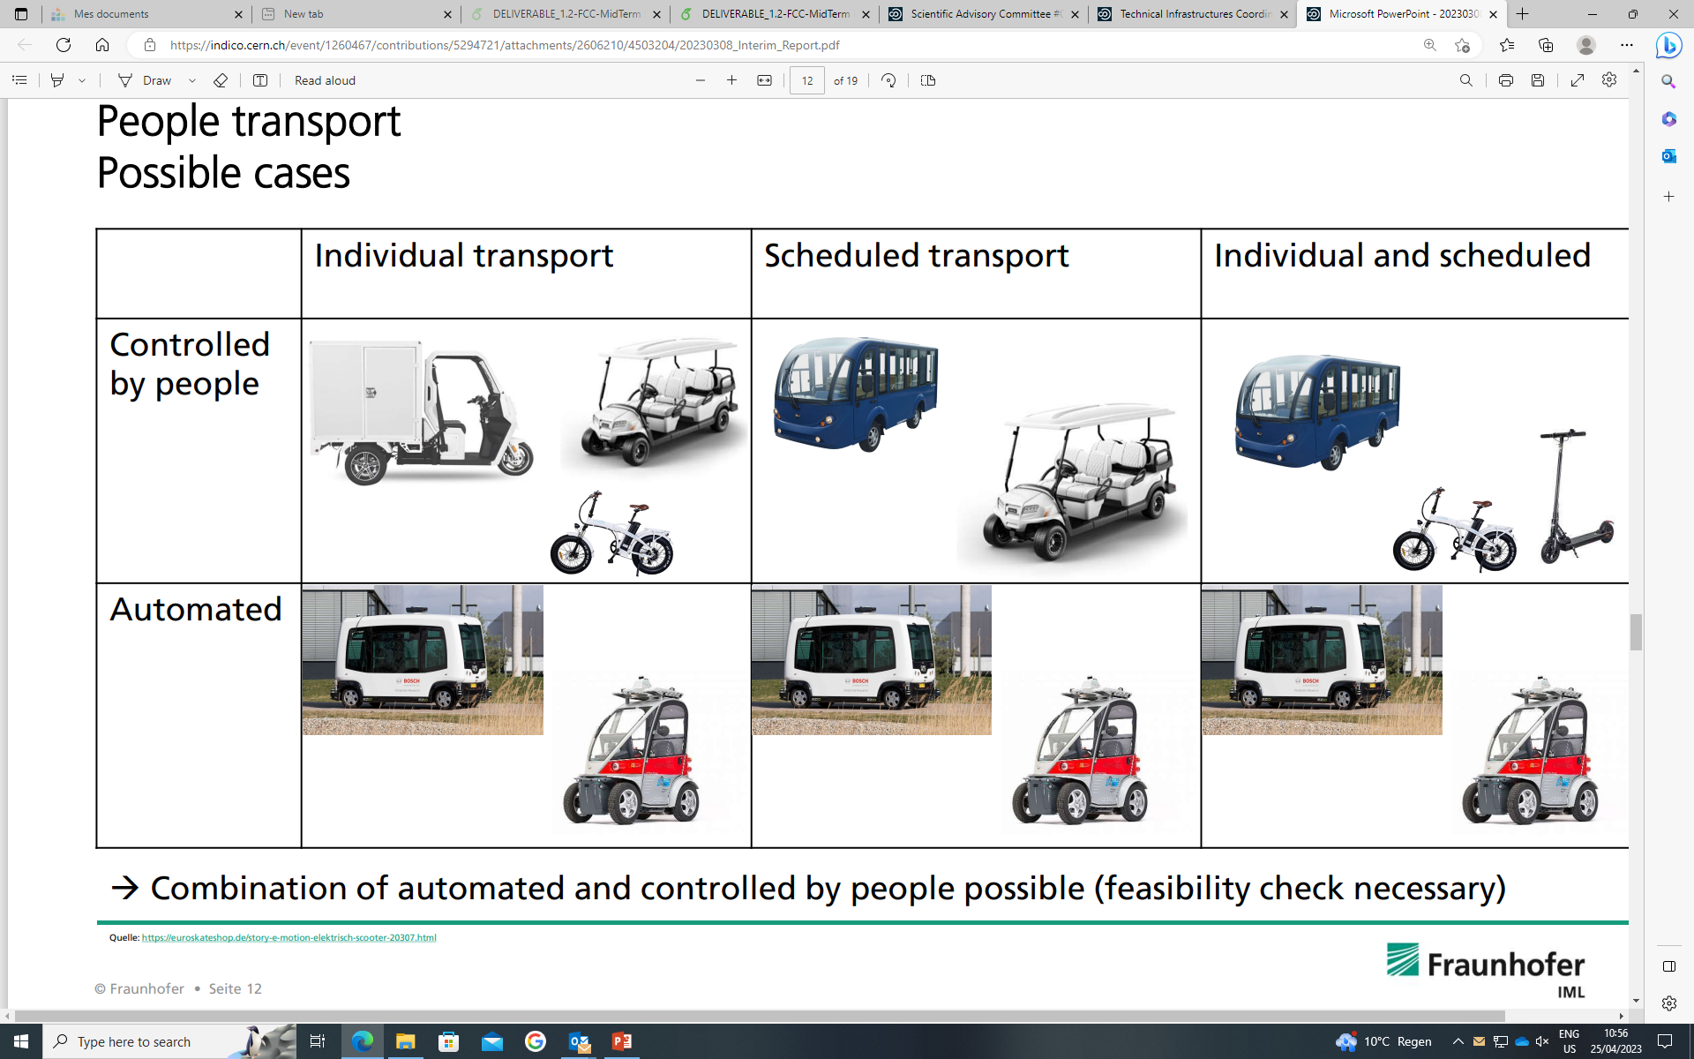
Klaus Hanke
11
Transport: Personnel Transport
Personnel vehicle will be based on an existing solutions and customized to meet the specific requirements and constraints of the FCC tunnel
There will be a mix of individual and scheduled transport systems

Slide 12
Klaus Hanke
12
Safety
Studied evacuation in the underground, namely the minimum size of the safe area in the lift shafts within the designated safety criteria. The results show that having a safe area of 50 m² would be suitable both scenarios, within a 95% confidence level
Started to study the effect of the proposed safety systems in case of cryo leak in the tunnel. CFD simulations of helium releases from SRF cryomodules are being caried out and preliminary results will be available for the mid-term review
First results from simulations of the activation by synchrotron radiation show that ambient dose rates in the arcs of the tt-collider (beam energy 175 or 182.5 GeV) will be in the order of 10 microSv/h in the first hours after stopping the beam. Given the long distances, this would allow short accesses for corrective maintenance only after waiting one or two days
Magnetic stray fields of the detector magnets must be taken into account in the design of electrical and mechanical equipment in the UX caverns. On the surface, the effect of the magnets is of the same order of magnitude as the earth magnetic field and thus negligible

Slide 13
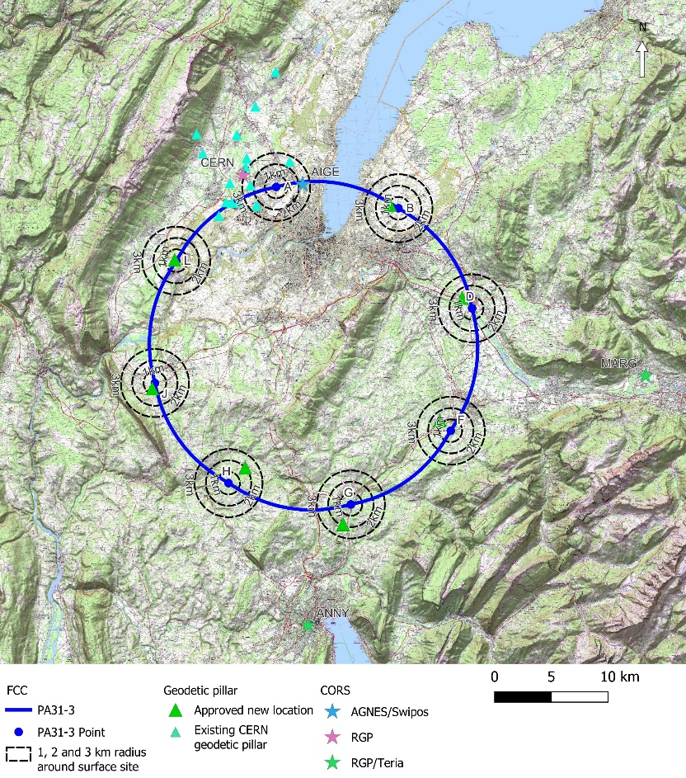


Klaus Hanke
13
Geodesy
Implementation of the primary surface geodetic network
A coordinate reference frame shall be established for the FCC.
IGN and Swisstopo will densify their national geodetic network in the vicinity of the FCC surface sites.
7 new geodetic pillars will be built in the coming months and GNSS observations of the network should be done by the end of the year 2023.
Final results of the geodetic control profil were delivered by ETHZ and Swisstopo (Deflection of the vertical, GNSS, levelling and gravity values).
Initial local geoid model is being computed
Geoid modeling

Slide 14
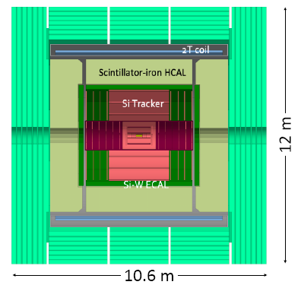
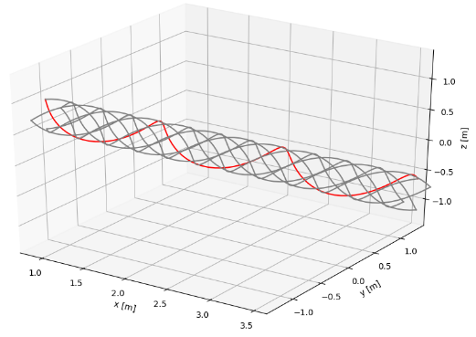

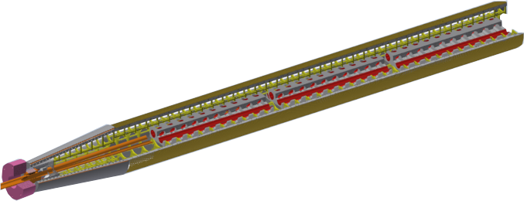
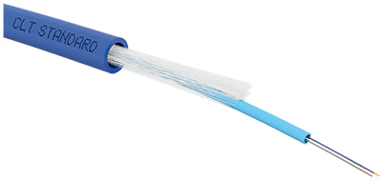
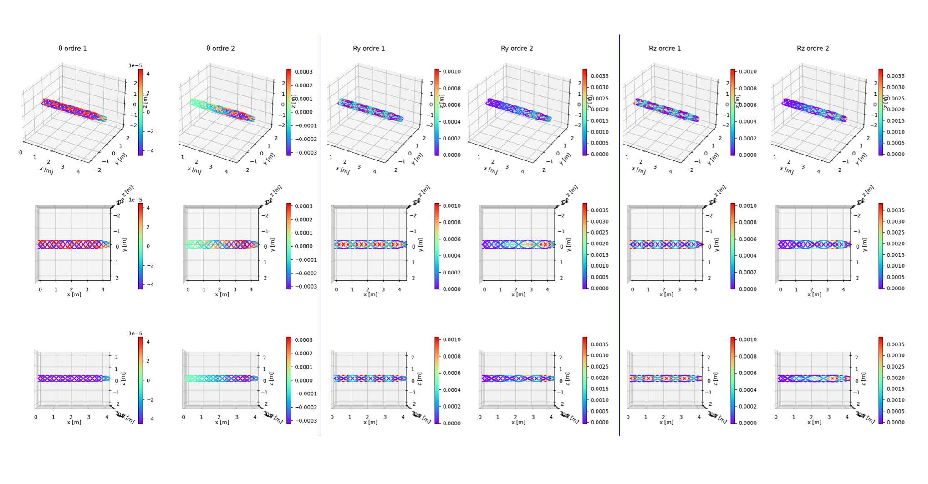
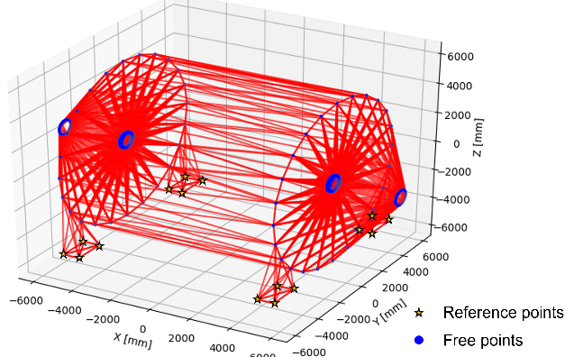
Klaus Hanke
14
FCC-ee Machine Detector Interface Alignment System
Drawing by M. Koratzinos
HOFFMAN, A. C., PARÈS, G., FRITZSCH, T., et al. Detector Technologies for CLIC. arXiv preprint arXiv:1905.02520, 2019.
Working on a alignment monitoring for the MDI, aiming at 30μm for the internal alignment :
- Distance measurement network for the “External monitoring system”
- Deformation monitoring of the skeleton for the “Internal monitoring system” thanks to a in-line multiplexed and distributed sensor based on FSI
Deformation monitoring system, based on an optical fiber network and an in-line multiplexed and distributed FSI sensor.

Slide 15
Klaus Hanke
15
Infrastructure Operation
Input given on various subjects:
Sustainable usage of water
Safety, transport
Remote operations of large electrical networks
Robotics and operations
Documentation of equipment and dependencies
Work on improvements in operations on current accelerators with FCC in mind:
Closer collaboration with robotics, thanks to FCC week! → Now operations group operate the TIM train in LHC tunnel!
Work with experiments to add “powered by” for equipment → Vision is to make it visible in our tools, from what power supply an equipment is powered. This is even more relevant with big machine like FCC, therefore putting it in place already now is very useful
Expand tools for energy monitoring, we work with EN-EL to have a much more clear picture of where the power goes.
Hopes for next years
Expand further ”powered by” featurs, this information can be used many places, one idea is in the IMPACT documents.
Test with TIM train done with success → Next steps of using all 4 trains in works now → Idea: drop drones with train!
Intelligent tools to predict faults, when a pattern of alarms is received we could make suggestions to operators.
Create new role for Energy Monitoring and follow up → Save Energy. Operators are becoming more involved.
New operation models@CERN → Move towards 100% operations from control room, not on the field as today

Slide 16
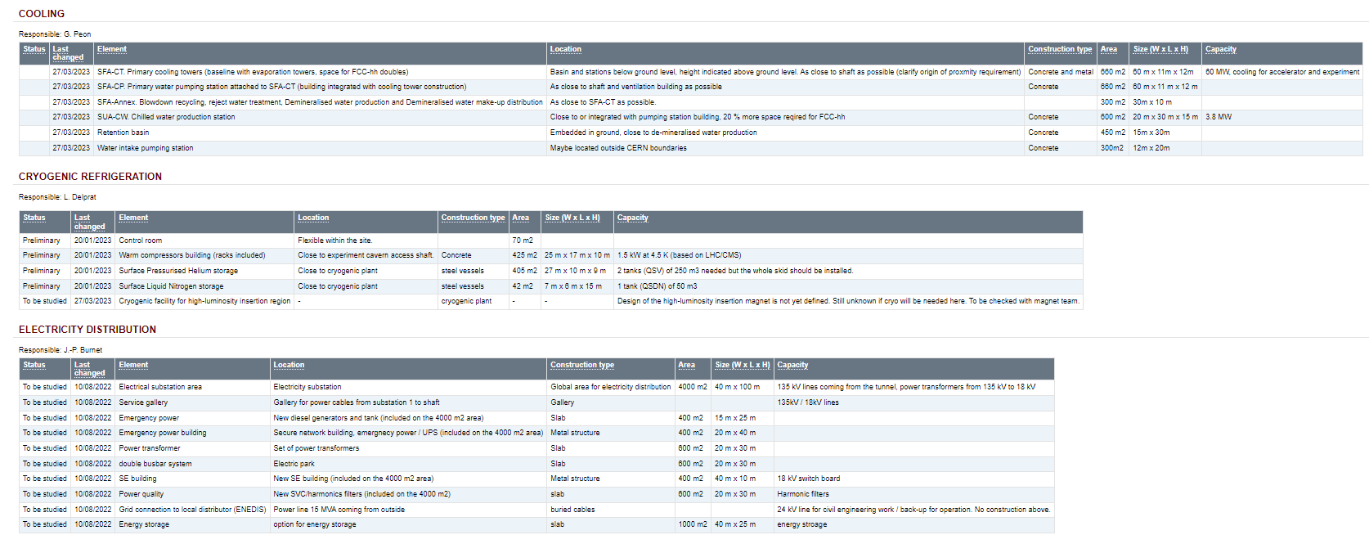
Klaus Hanke
16
Surface Sites
For every point we have compiled the infrastructure:
status / last changed / element / location / construction type / area / size (W x L x H) / capacity
covering all domains (Work Packages)
Example: PA FCC-ee
Based on this information, Civil Engineering is doing the integration of the surface sites

Slide 17
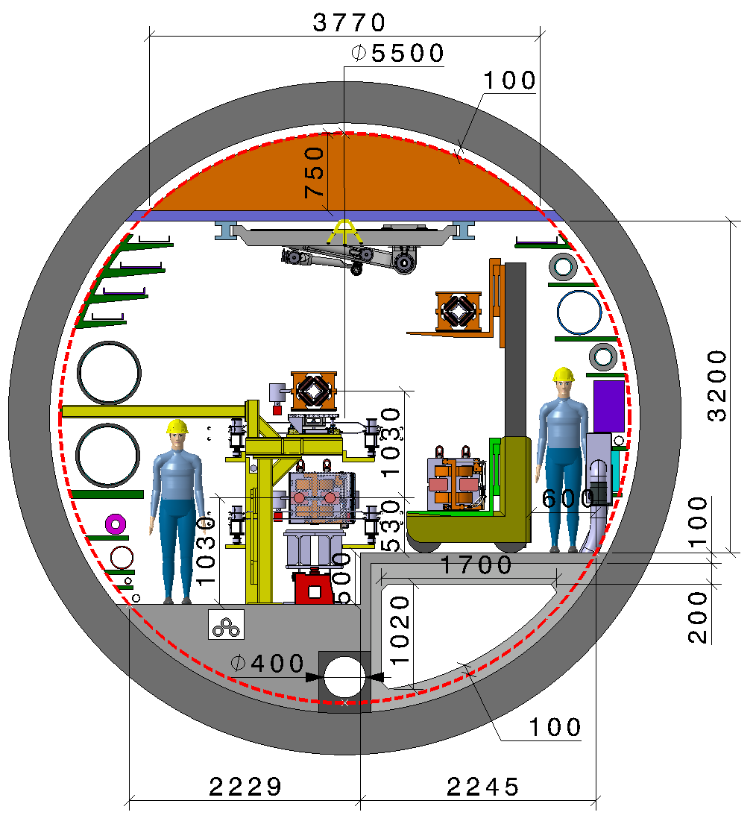
Klaus Hanke
17
Underground Areas: Arcs
Machine tunnel 5.5 m in diameter
Smoke/He extraction
Booster ring
Cable trays:
Fibre optic
LV distribution
Control cables
Cable tray:
MV distribution
Chilled water DN150
Demineralized water DN600
Firefighting/Row water DN400
Leaky feed
Alignment space occupation
Warm He recovery DN200
Compressed air DN80
He DN50
Fresh air diffused
Demineralized water felling DN65
Collider ring
Electrical HV
power transmission
Fresh air duct
Main cross section as for FCC-hh
Main ring below of booster ring
Main ring and booster ring 1.3 m distant
Drain
Collider Center

Slide 18
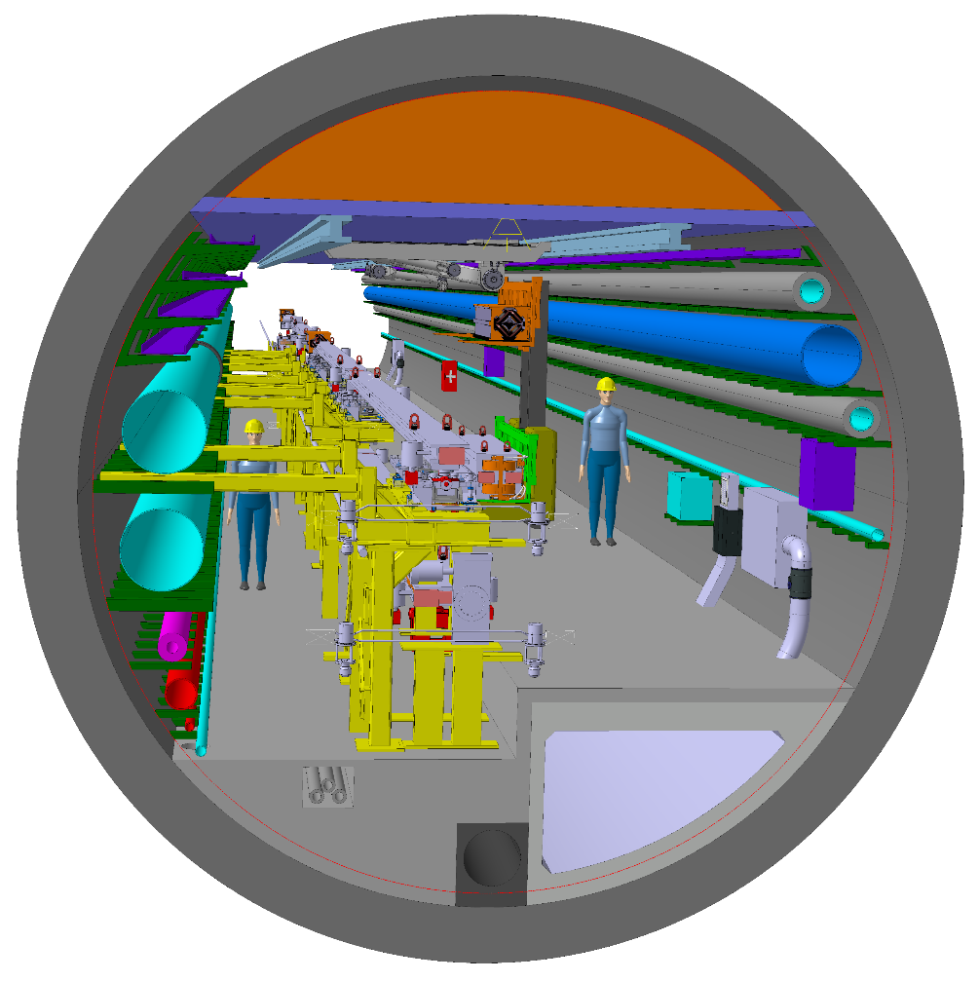
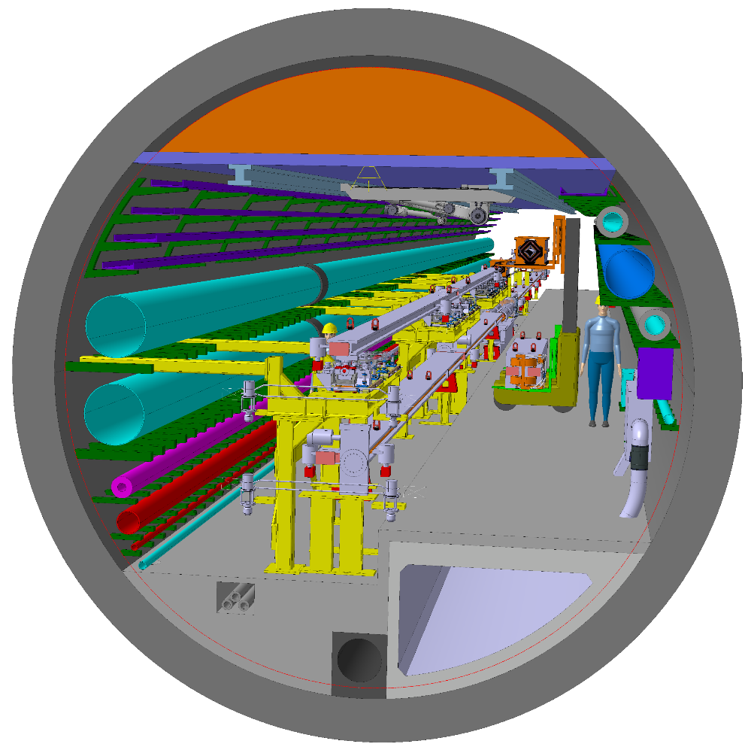
Klaus Hanke
18
Underground Areas: Arcs
Machine tunnel 5.5 m in diameter
Collider Center

Slide 19
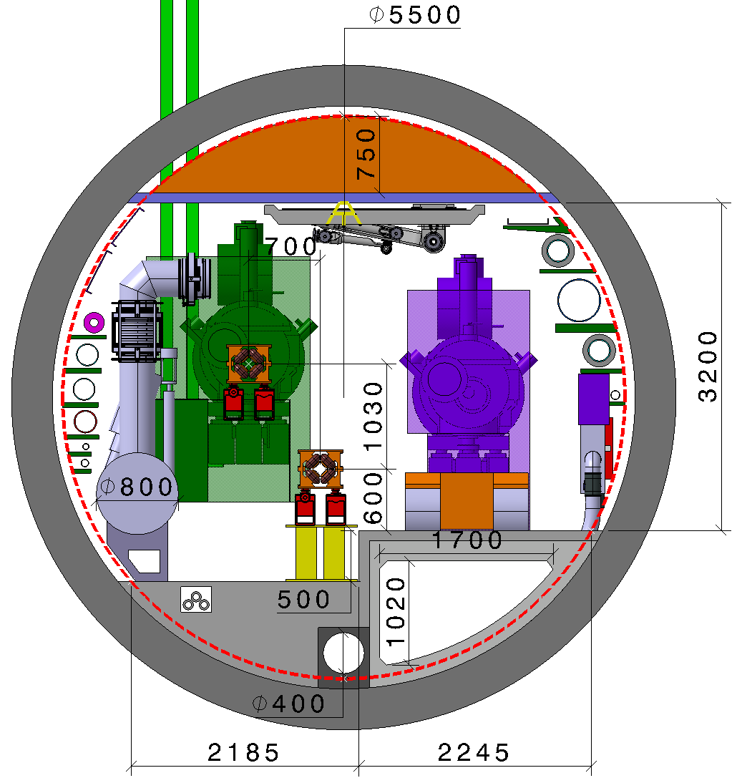
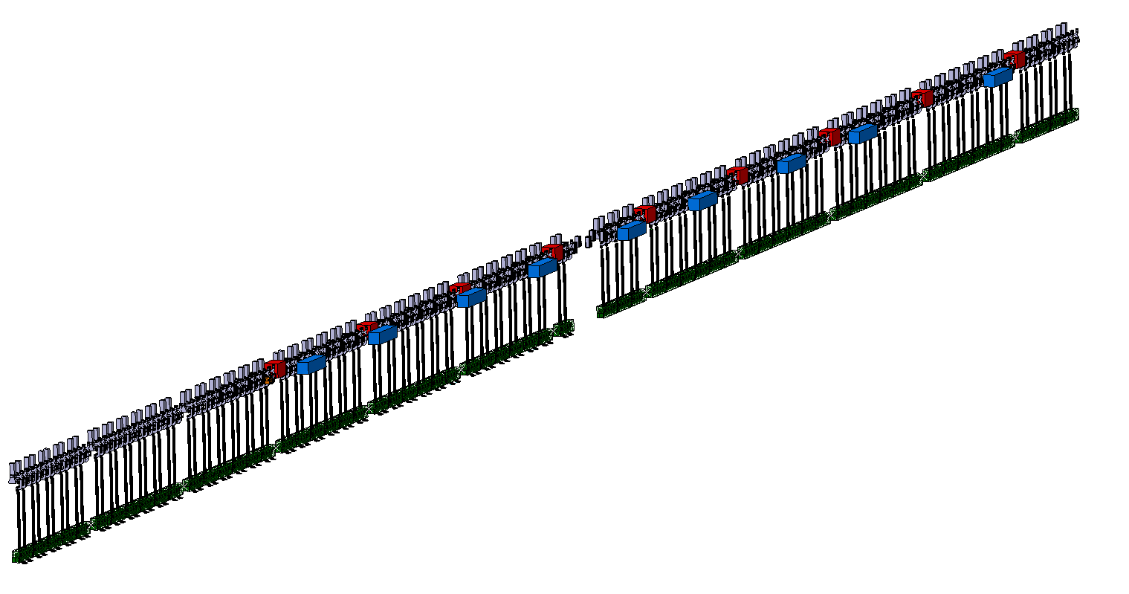
Klaus Hanke
19
Underground Areas: RF Point L
Waveguide
QRL Ø along 800 MHz section 0.8 m
Distance between e⁺e⁻ quadrupoles 52 m, length 3.1 m
Distance between booster quadrupoles 52 m, length 1.5 m
Machine tunnel 5.5 m in diameter
Midpoint RF section
Booster ring
Cryomodule 800 MHz
Transport
Collider ring
Booster 800 MHz Cryomodules
Collider Center

Slide 20
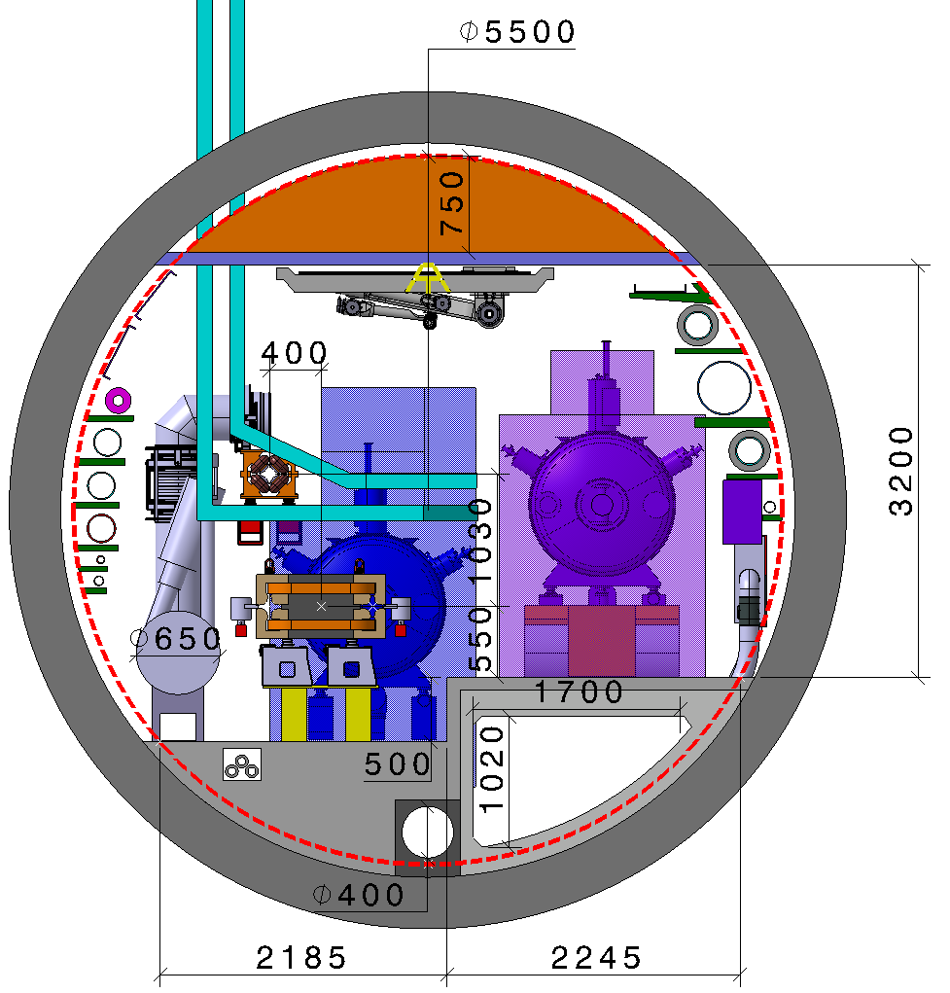
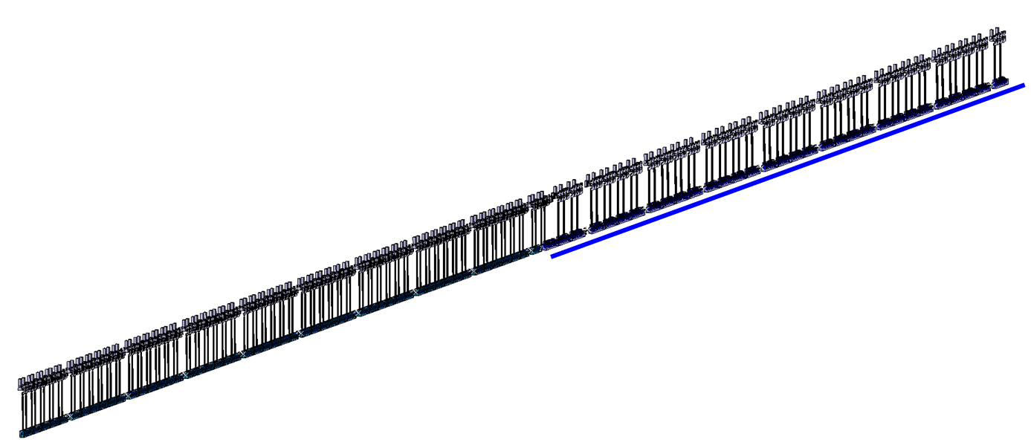
Klaus Hanke
20
Underground Areas: RF Point H
Waveguide
QRL Ø along 400 MHz section 0.65 m.
Distance between e⁺e⁻ quadrupoles 52 m, length 3.1 m.
Distance between booster quadrupoles 52 m, length 1.5 m.
Machine tunnel 5.5 m in diameter
Booster ring
Transport
Collider ring
Cryomodule 400 MHz
IP
Collider 400 MHz Cryomodules
Collider 800 MHz Cryomodules
Collider Center

Slide 21

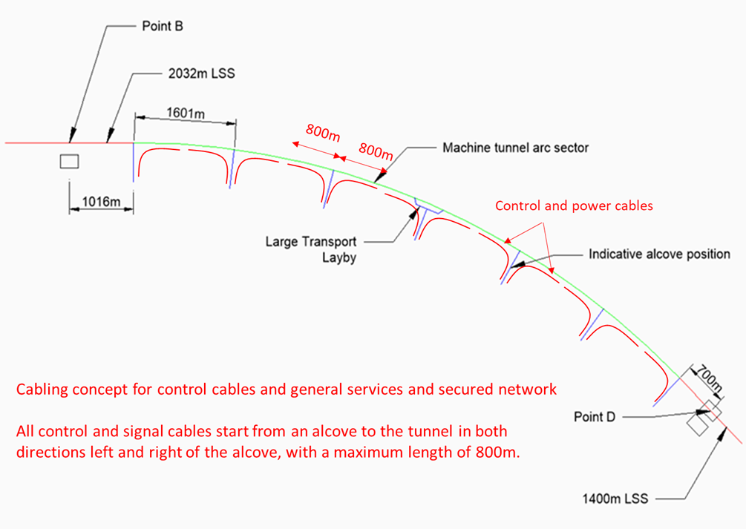
Klaus Hanke
21
Underground Areas: Alcoves and Layby Zones
https://edms.cern.ch/document/2822196/0.2

Slide 22
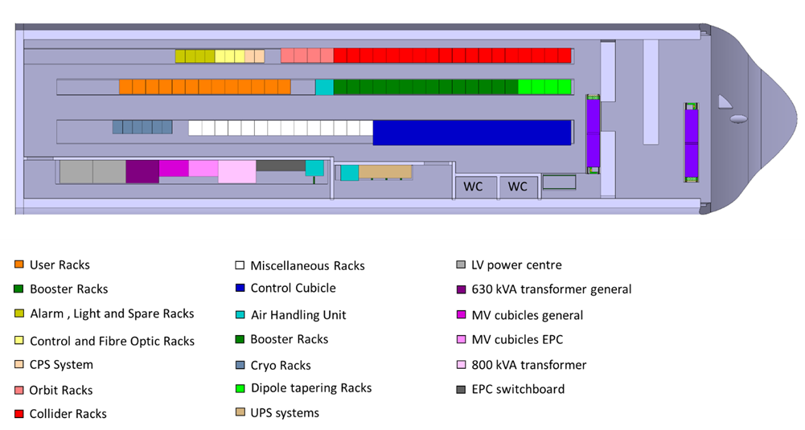
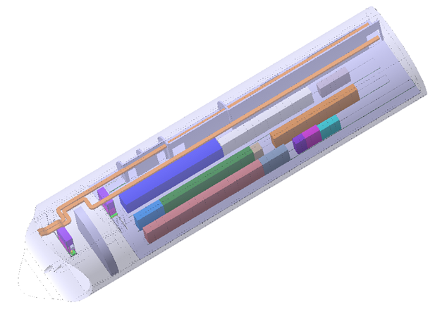
Klaus Hanke
22
Underground Areas: Alcoves and Lay-by Zones

Slide 23
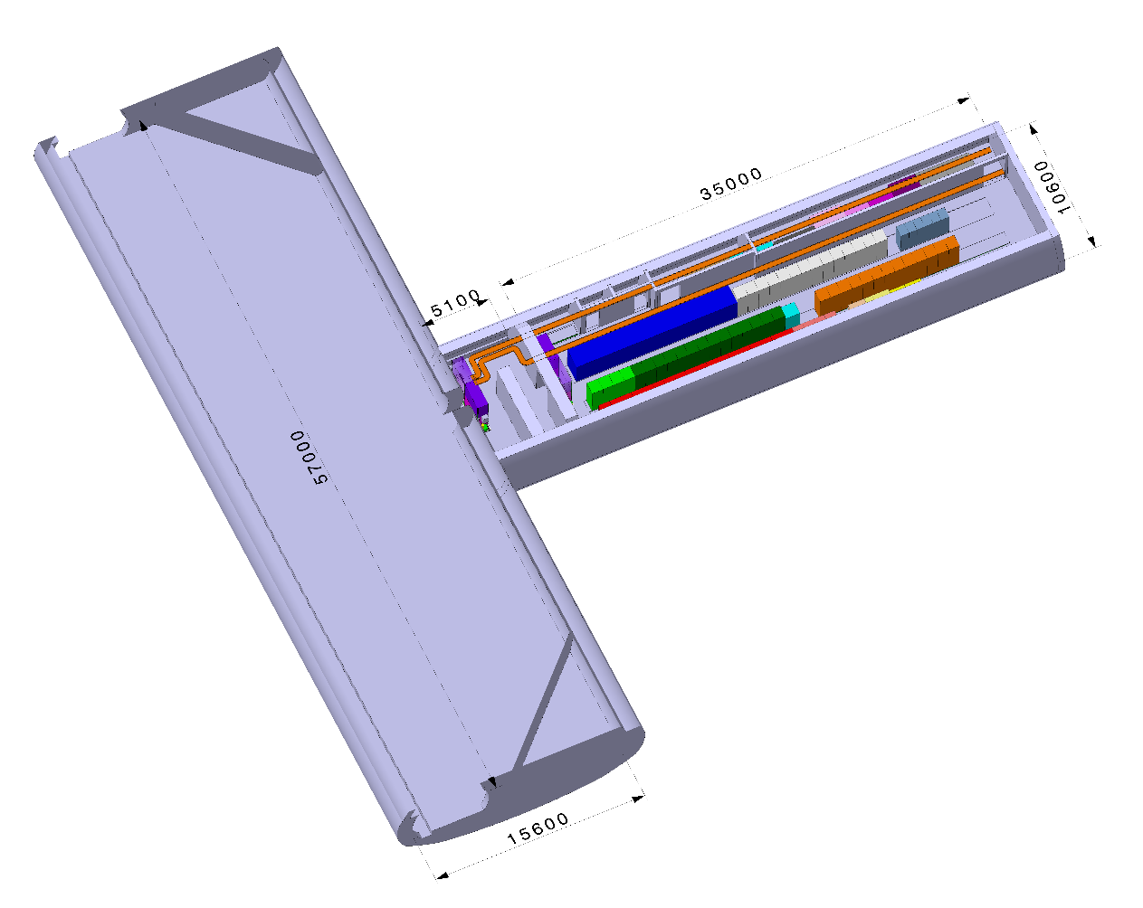
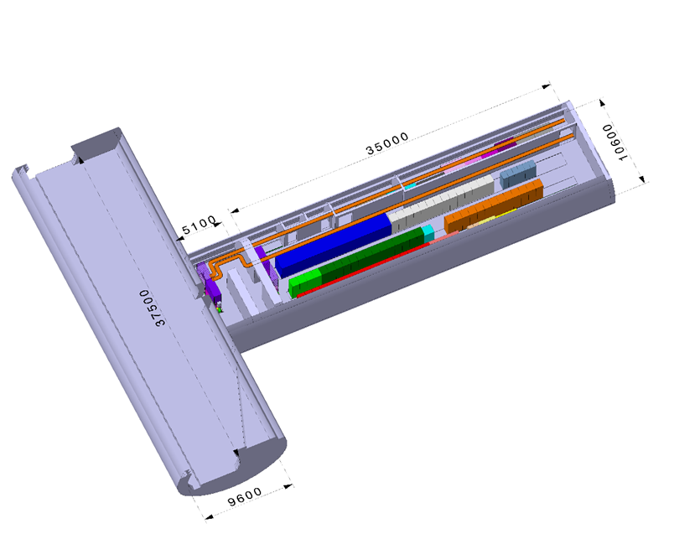
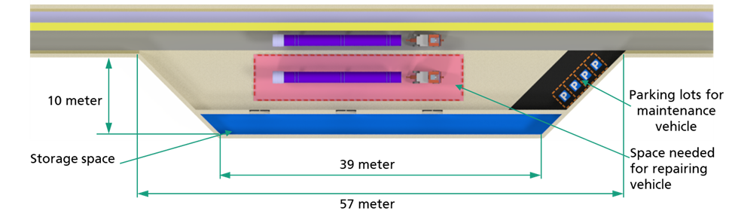
Klaus Hanke
23
Underground Areas: Alcoves and Lay-by Zones
Big lay-by zone
Small «standard» lay-by zone

Slide 24
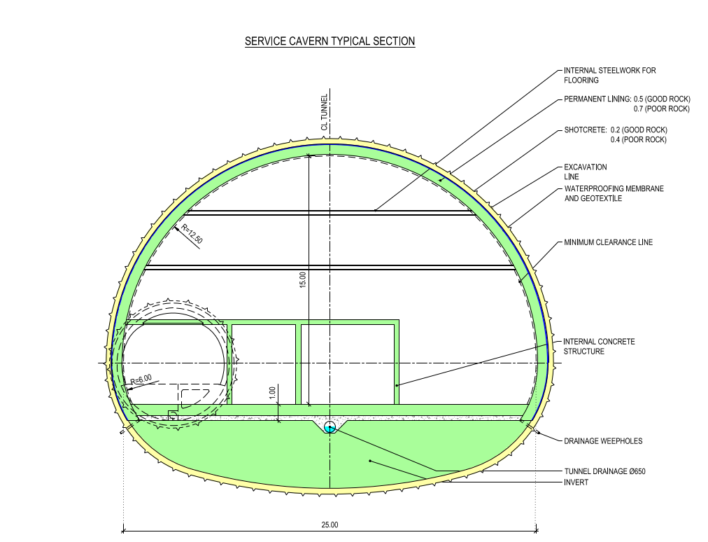
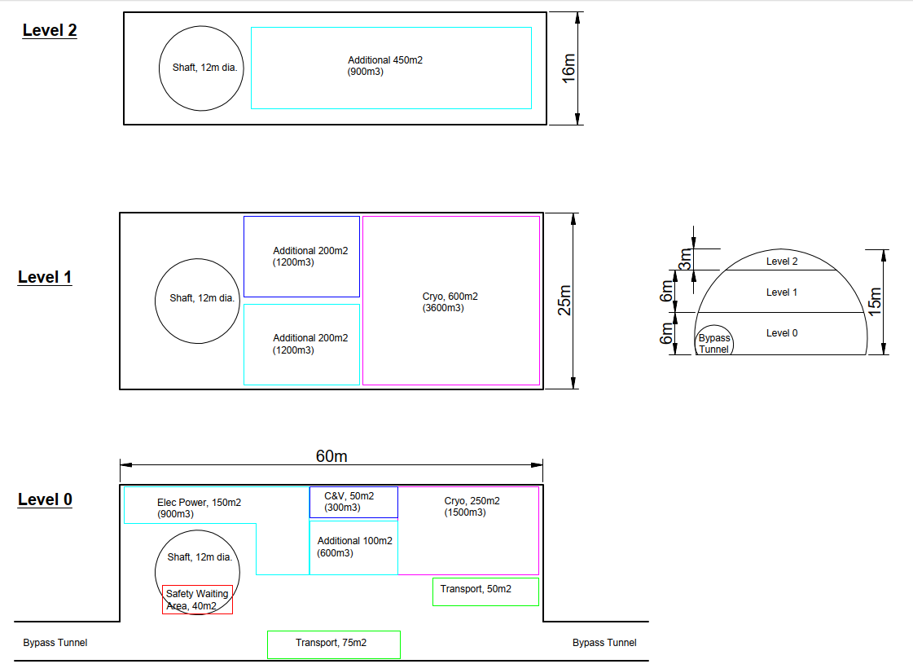
Klaus Hanke
24
Underground Areas: Service Caverns
https://edms.cern.ch/document/2851508/0.4

Slide 25
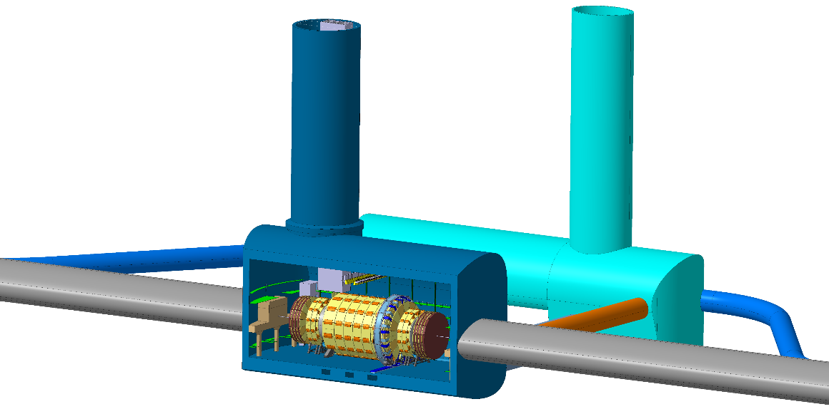
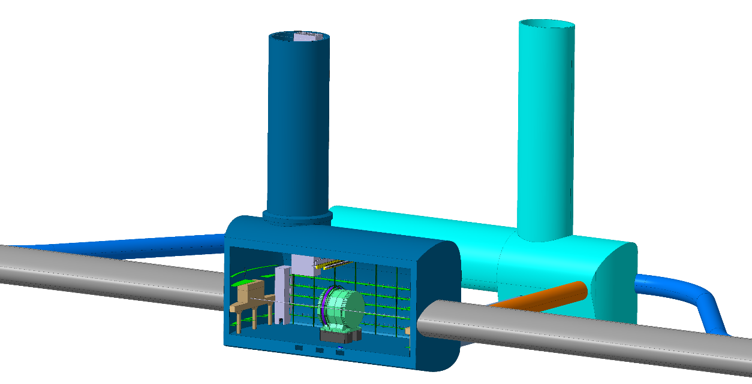
Klaus Hanke
25
Underground Areas: Experimental Caverns
FCC-hh
FCC-ee

Slide 26
Klaus Hanke
26
Summary
Specification of the technical infrastructure for FCC-ee including the experimental and technical sites is well advanced
Design choices have been taken e.g. relative position of Booster and Collider, lay-out of the RF section and klystron galleries, baseline scenarios for electricity supply, water intake and disposal, ventilation, cryogenics, transport
All our work is carefully documented
Next milestone is the mid-term review for which a report is in preparation
Work on the technical details is in progress; four Infrastructure sessions at this conference!

Slide 27

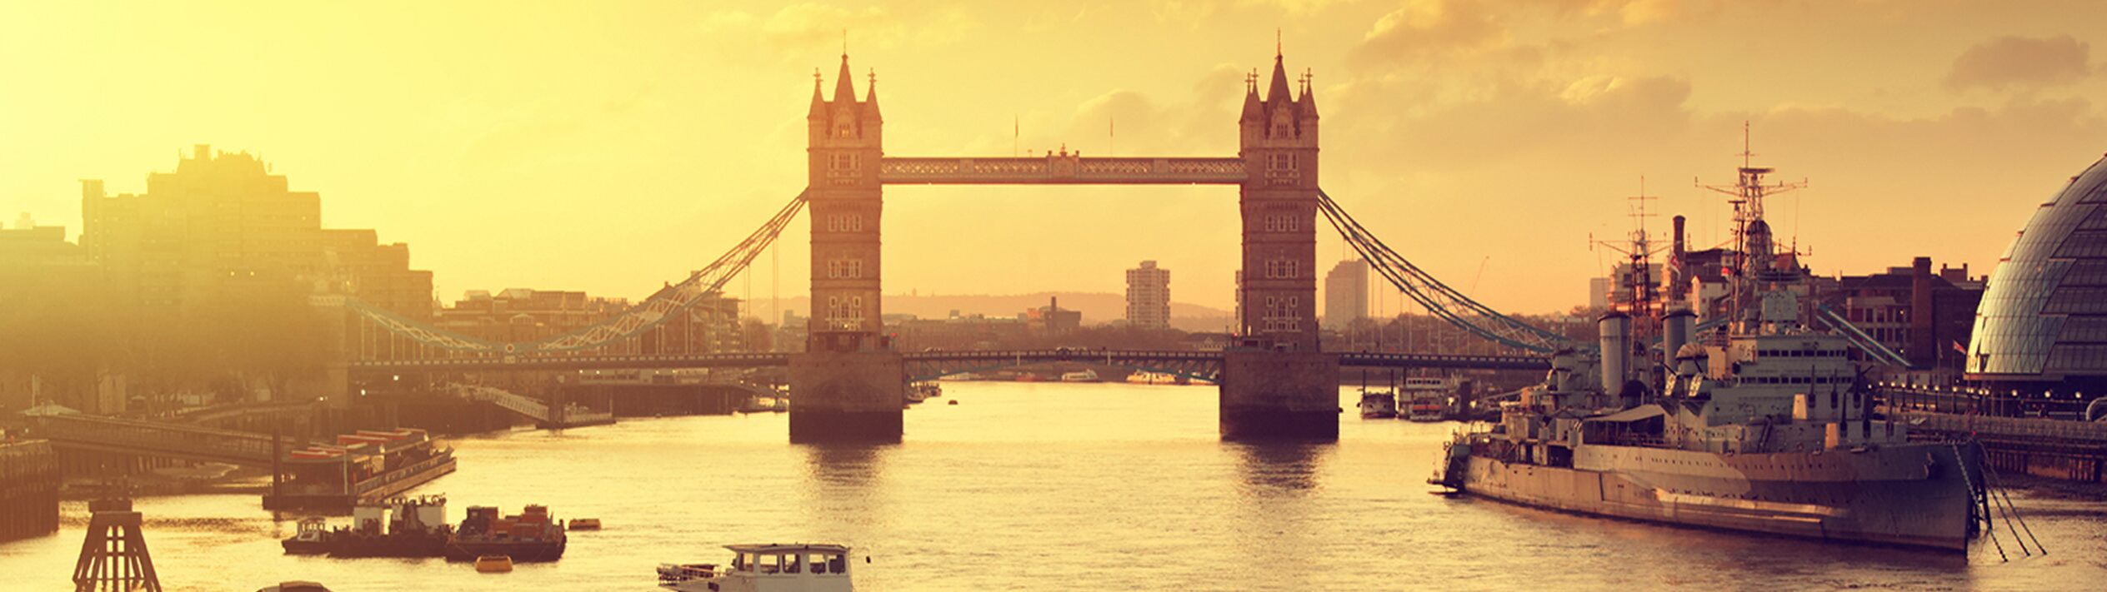
Klaus Hanke
27
27
Thank You

