Slide 1

FCC Feasibility study local communication
2023-06-07 FCC WEEK
Andrea Perez-Fernandez
An evolving strategy
Andrea Pérez
Andrea.perez.fernandez@cern.ch
Local Communications Officer at CERN

Slide 2
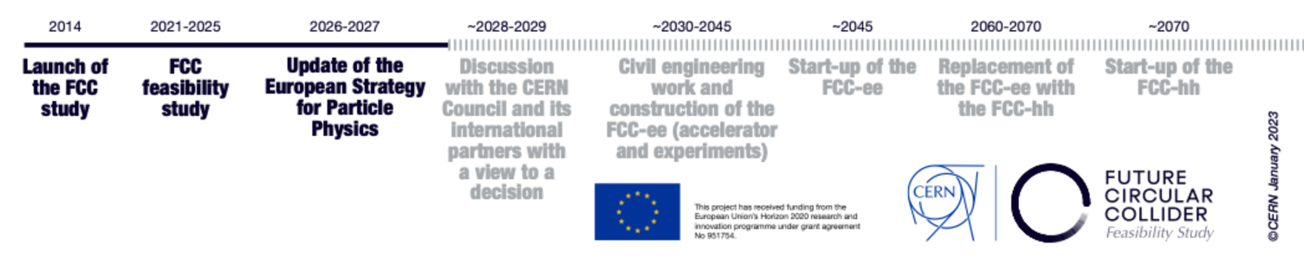
The state of the art in 2020
ESPP 2020 update
Macroscopic communication -> Local communication

Slide 3

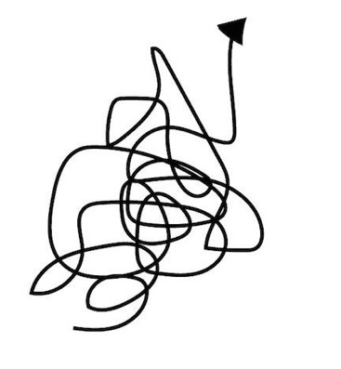
Expectations vs reality in 2021
Expectations
We need new communication materials!
(Brochures, videos, website, visuals)
We need to start dialogue with stakeholders!
Previous CERN experience do not apply to the present context
Communication strategies not adapted to the local area (new messages)
We were trying to communicate about something that might not happen
The communication channels stablished did not reach the new public
Reality
We need a specific local communication strategy focused on the feasibility study

Slide 4
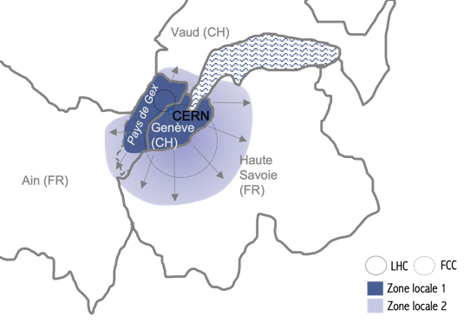
Local communication challenges
2 Countries (different regulations, cultures, concerns)
41 municipalities
A growing and moving population
Different levels of knowledge about CERN
Guarantee a symmetry on communication actions in France and Switzerland

Slide 5
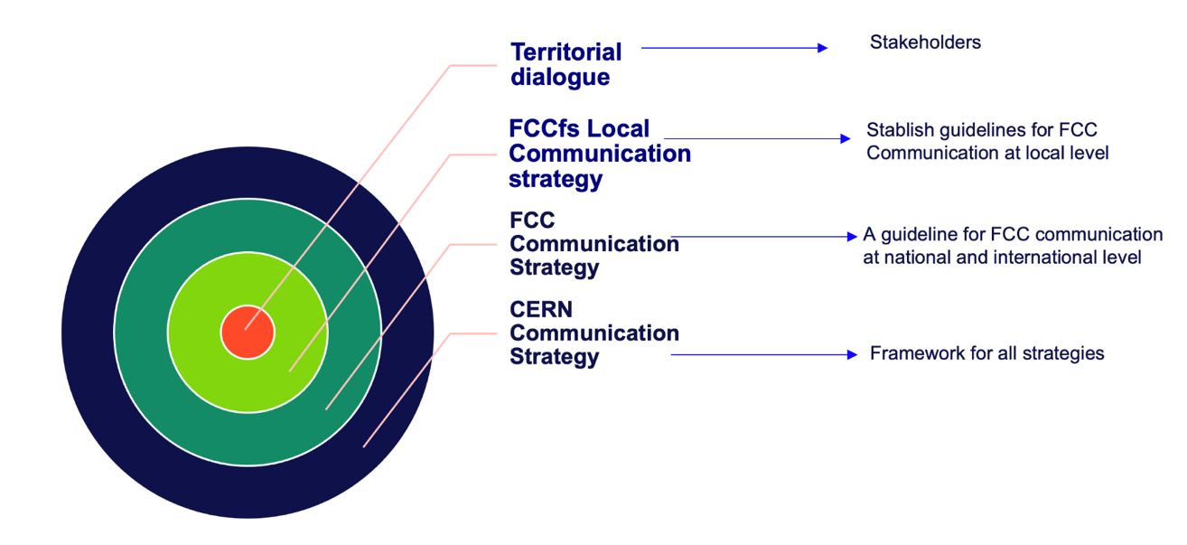
2022 FCC local communication strategy
Notes:
Brochure 2021

Slide 6
2022 FCC Local communication strategy
CERN - FCC
Expert in Territorial Dialogue
(EES)
Give support / Consulting
Territorial Representatives
(Canton de Genève, Mission suisse
Préfecture de la région Auvergne-Rhône-Alpes, CEREMA…)

Slide 7
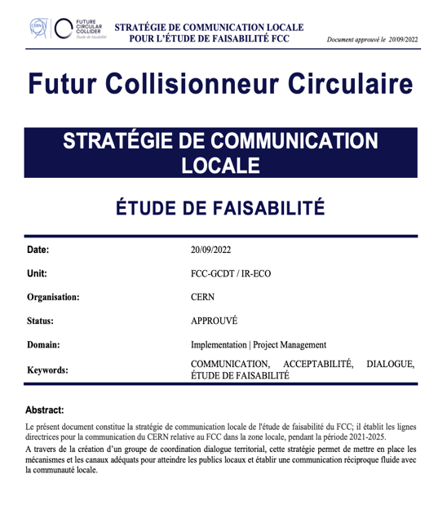
2022 FCC Local communication strategy
CERN - FCC
Expert in Territorial Dialogue
(EES)
Give support / Consulting
Territorial Representatives
(Canton de Genève, Mission suisse
Préfecture de la région Auvergne-Rhône-Alpes, CEREMA…)

Slide 8
2022 FCC local communication strategy
Target audience
Main concerns
Channels
Messages / Target Audience
KPI’s
Communication flow
Social media recommendations
Key messages
FAQ

Slide 9
2022 FCC local communication strategy
Reputational risk!
Key messages focused on the feasibility study
What we do | = What we say
Start of a Feasibility study | FCC is a feasibility study (At the moment)
CERN brings benefits to the local area | FCCfs extend CERN benefits to a wider local area
CERN model Environmental responsibility / Transparent | FCC Environmental responsibility: Avoid Reduce Compensate
What we say/t
Reputational risk!
What we do/t
Adapted from Charles Fombrun, 2015
Notes:
Worst case scenario FCC is not built -> We’ve been coherent with the messaging / CERN needs to keep reputation

Slide 10
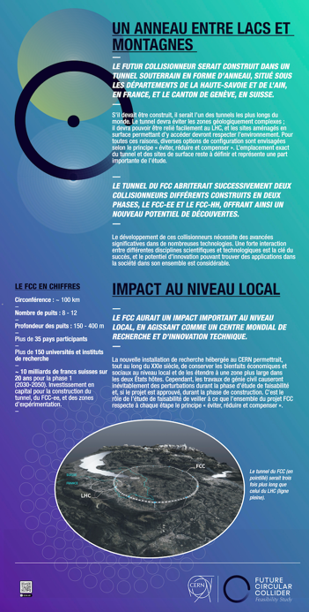
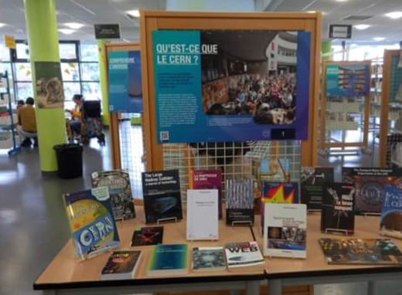
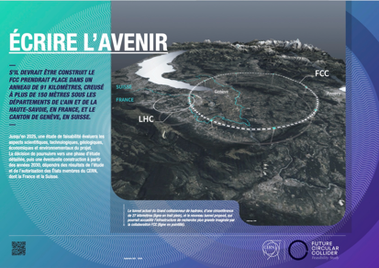
Communication supports

Slide 11

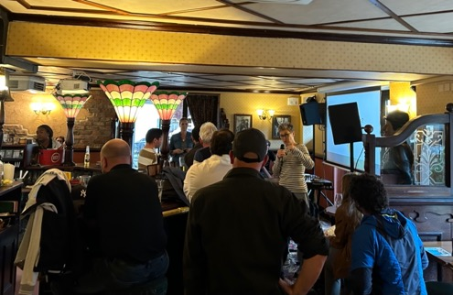
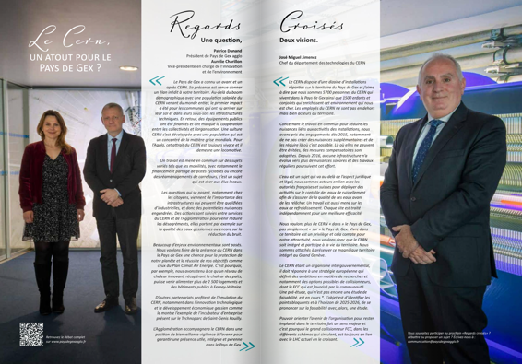
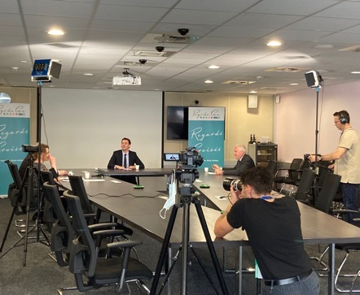
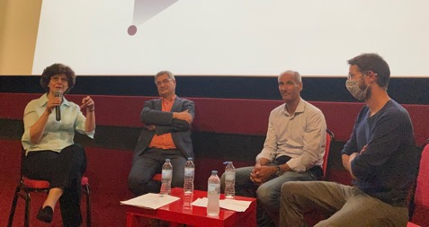
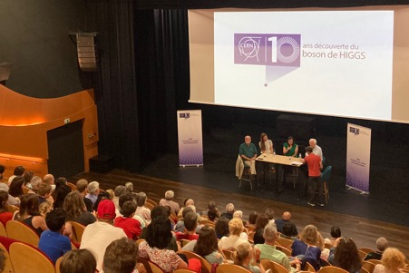
Communication actions

Slide 12
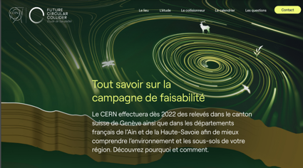

FAQ
https://fcc.web.cern.ch
https://fcc-faisabilite.eu/

Slide 13

FCC local communication strategy: Aims
Transparent and coherent (Communicate what we do)
Sustained in time
Adapting to the needs of the project & updated based on dialogue and feedback
Awareness > Understanding > Acceptance > Commitment > Ownership
What we say/t
You are here
What we do/t
Adapted from Charles Fombrun, 2015

Slide 14
Early stage monitoring
Negative engagement
Not engaged
Positive engagement
Main target (likely to move upstairs)
Supporters
Neutral
Critics
Sceptics
Opponents
Monitoring our messages
Listen to demands
Ambassadors
Image: CERN
FCC – Local communication Strategy 2022
FCC week 2022 – Andrea Perez-Fernandez
Rational reasons
Listen/ Engage / Monitor
Early stage Monitoring= First KPI’s!
Identify concerns -> Finetune messages

Slide 15
Other feedback sources
Local media
Engaged stakeholders
Social media monitoring
CERN Visitors
Local events (questions and surveys)

Slide 16
Early stage monitoring
Do you agree with CERN launching the FCC feasibility study in our region?

Slide 17
Feedback -> Identify main concerns
Energy consumption/supply FCCee and FCChh (CH)
CO₂ emissions (during construction and operation) (CH)
Excavation materials (FR - CH)
Radioactive waste management (CH)
Water supply (during construction and operation) (FR)
Water pollution (CH – FR)
Local Impact / Benefits (FR)
Engagement of young generations (FR - CH)
Employment (FR)
Other investment priorities more urgent than fundamental research (FR – CH)
Public concertation (FR)

Slide 18
Next steps 2023 - 2024
Update messaging FAQ + Key messages with new data (Figures)
    “FCC is the best project for CERN’s future”
Take a more proactive position on FCC communication (Communication strategy + Contact with direct stakeholders)
Obtain quantifiable feedback for next updates-> Establish discussion groups in priority communities
Review Local communication strategy and update it
Develop a new social media strategy for FCC local communication
Communicate to a wider public -> public & educational events in new areas
Proposal for engaging young public in the local area (Local Influencers, educational activities…)

Slide 19
Thank you for your attention.
FCC Week 2023
Andrea Perez Fernandez
19

