Slide 1

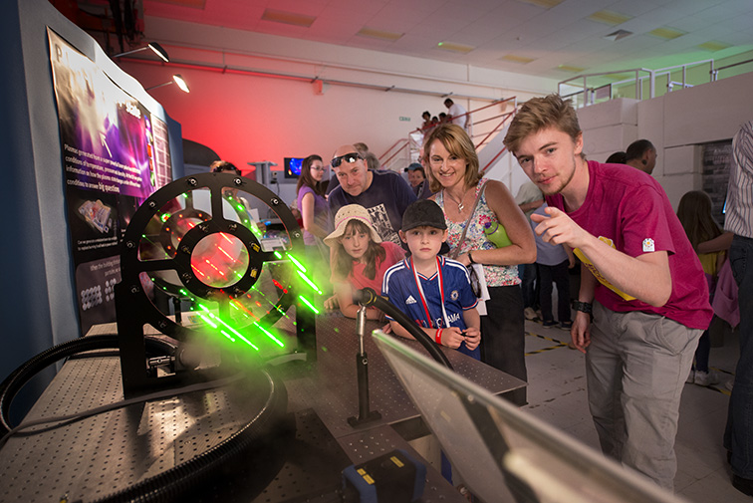
Public Engagement at STFC
Sophy Palmer, Public Engagement Manager (RAL)
sophy.palmer@stfc.ac.uk

Slide 2
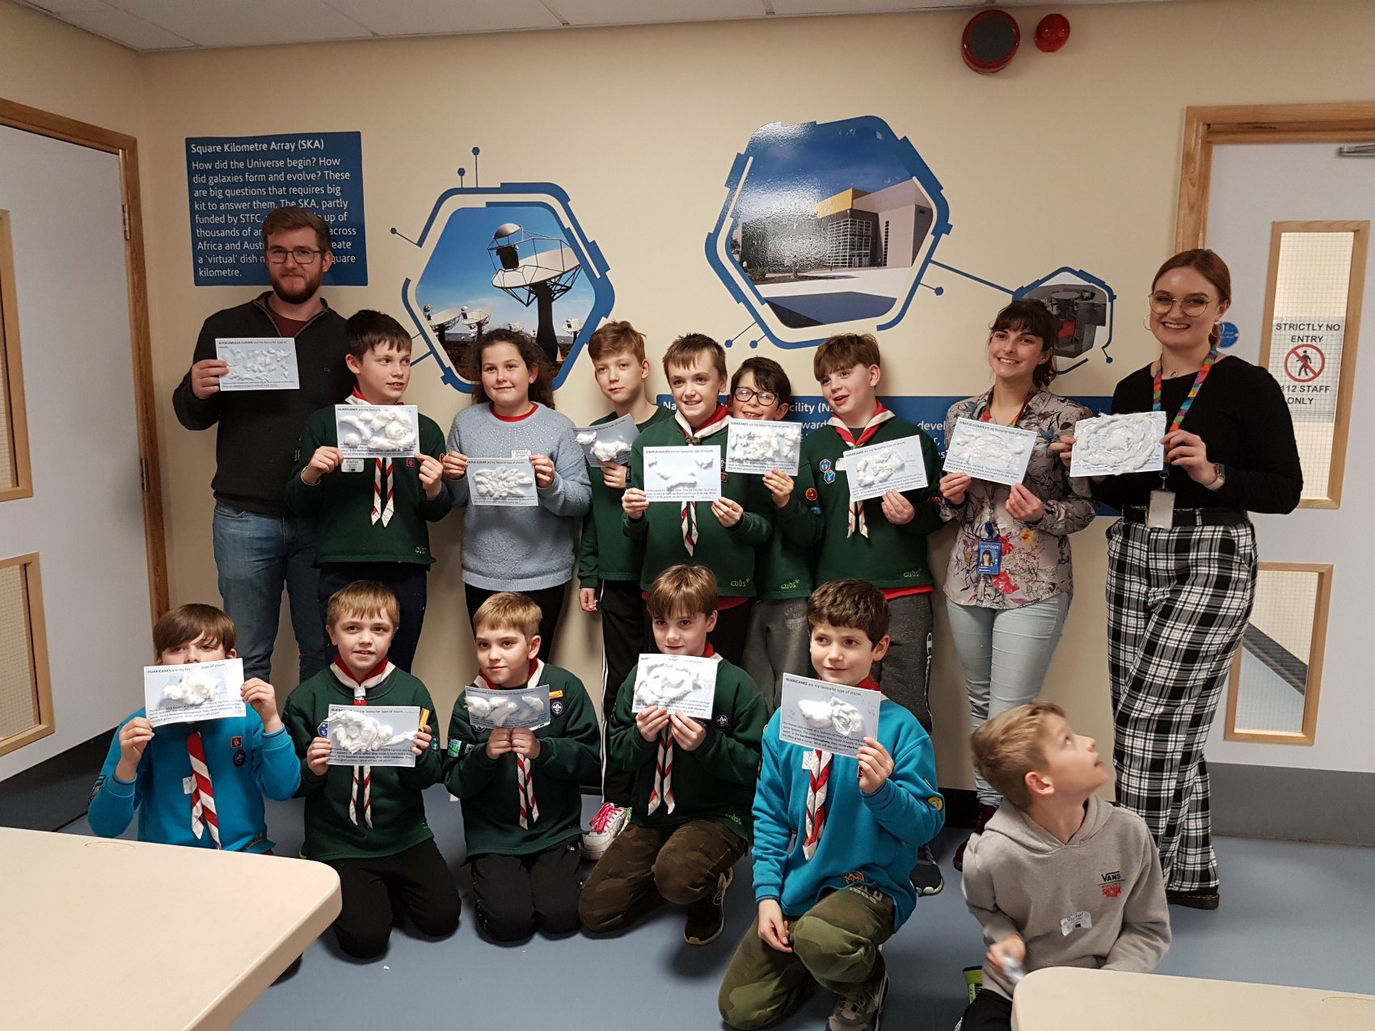

Public Engagement at STFC Rutherford Appleton Laboratory
ESS
LHC
Introduction to Public Engagement at STFC
Local engagement at RAL
National engagement
ESRF
ILL

Slide 3

Science and Technology Facilities Council
STFC’s mission is to deliver world-leading national and international research and innovation capabilities and, through those, discover the secrets of the Universe.
We support research in astronomy, particle physics and nuclear physics
We fund UK participation in large international collaborations
We operate world-class research facilities for the UK
ESS
LHC
ESRF
ILL
Notes:
Image description: Webb’s mid-infrared image of barred spiral galaxy NGC 5068. The galaxy’s core and part of a spiral arm can be seen on a dark background. Web-like clumps and filaments of dust thread through it, represented by the color gray. They form an almost skeletal structure that follows the twist of the galaxy and its spiral arm. Large, glowing bubbles of gas, represented in red, are hidden in the dust. Relatively few bright stars are visible throughout. They are most concentrated in the galactic core, seen as a clump of blue points in the top left quadrant.
Credit: ESA/Webb, NASA & CSA, J. Lee and the PHANGS-JWST Team
https://www.flickr.com/photos/nasawebbtelescope/52945664330/in/album-72177720305127361/

Slide 4
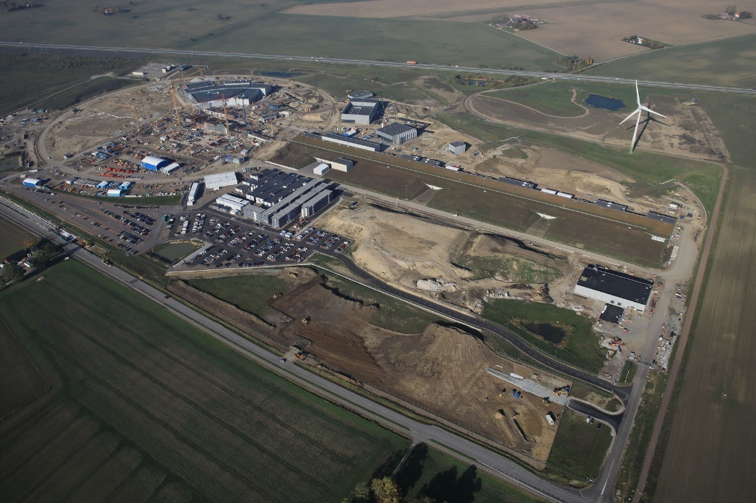
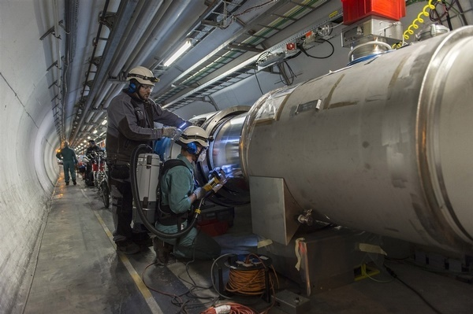
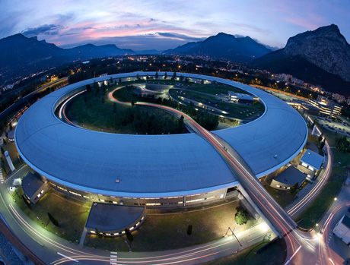
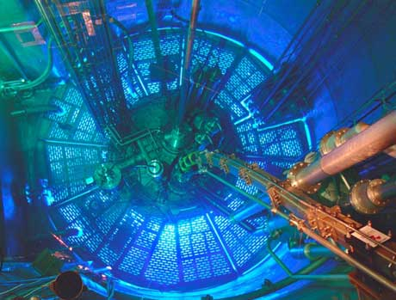
ESS
LHC
ESRF
ILL
Notes:
These are some of the other facilities around the world that we contribute to.
ESS Based on the same principle as ISIS the UK’s neutron source, the ESS will be an accelerator-based facility producing neutrons for a large array of advanced instruments. ISIS and ESS have an extensive programme of technical collaboration ranging from accelerator diagnostics to data analysis and instrumentation. it will provide new opportunities for researchers in a broad range of scientific areas including life sciences, energy, environmental technology, cultural heritage and fundamental physics. ASTeC is leading the UK’s in-kind contribution programme for accelerator system delivery to ESS, harnessing its critical expertise in Radio Frequency (RF) and Ultra-high Vacuum (UHV) science. Integrated partnership with specialist Mechanical, Electrical and Vacuum teams within Technology Department at Daresbury Laboratory.
The STFC coordinates and manages the UK’s involvement and subscription with CERN. UK membership of CERN gives our physicists and engineers access to the experiments and allows UK industry to bid for contracts, UK nationals to compete for jobs and research positions at CERN, and UK schools and teachers to visit. UK scientists hold many key roles at CERN. Particle accelerator, looking at the fundamental building blocks of the Universe,
ILL (Institut Laue-Langevin – neutron scattering) The ILL is a reactor-based facility and is the most intense neutron source in the world. Its purpose is to provide the brightest beams of neutrons possible to a suite of 40 high-performance instruments for use by the international scientific community. The reactor normally functions round-the-clock during four 50-day cycles per year. Every year about 2000 researchers from more than 30 countries visit the ILL to perform over 800 experiments. This usually results in the publication of more than 600 scientific publications per year.
ESRF (The European Synchrotron Radiation Facility (ESRF) is the world’s most intense X-ray source located in Grenoble, France. Giant microscope, like Diamond. The ESRF has an annual procurement budget in the region of 50M€ and is situated on the same site as the Institut Laue-Langevin (ILL). There are many opportunities for UK companies to supply the ESRF with requirements in instrumentation, mechanical engineering, cryogenics, vacuum equipment, optics and electrical engineering among others.)

Slide 5

UK Astronomy Technology Centre
Edinburgh, Scotland
Daresbury Laboratory
Warrington, Cheshire
Boulby Underground Laboratory
Cleveland
Polaris House
Swindon, Wiltshire
Rutherford Appleton Laboratory
Didcot, Oxfordshire
Chilbolton Observatory
Stockbridge, Hampshire
Notes:
So, what is STFC? STFC is sci tech facil council. Long name for an awesome thing. We run labs and sites in the UK and contribute to experiments and facilities around the world (e.g. CERN/LHC). We run or help to run experiments that would be too big or too expensive for business and unis to build individually for world class research. We don’t just have our lab – we have lots of sites all over the UK. 6 in fact! We are all part of STFC. There’s RAL, where I work, DL our other big lab (Gemma), UK ATC up in Edinburgh (space), we have a small team that works on our radio telescope at Chilbolton. We also have Polaris House in Swindon (this isn’t a lab) but where the funding comes from and finally – we have our lab in a mine! This is the Boulby Underground Lab – 1.1 km underground.

Slide 6
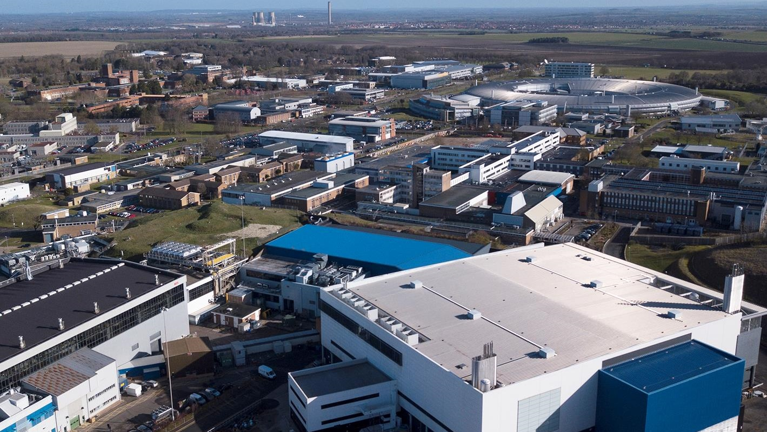
Rutherford Appleton Laboratory, Oxfordshire
RAL Space
Research Complex
Scientific Computing
National Quantum Computing Centre
Diamond
Particle Physics
Technology
Central Laser Facility
ISIS
Notes:
RAL covers all scales of science – from the very smallest building blocks of our world, to the vast scales of astronomy.
PPD (www.stfc.ac.uk/ppd) – particle physics department, works with CERN and other experiments around the world
Diamond (www.diamond.ac.uk) –joint funding venture between UKRI and Wellcome Trust. synchrotron, particle accelerator producing beams of light used for research e.g. structural biology, materials science, physics, chemistry, heritage. They have their own work experience programme!
ISIS (www.stfc.ac.uk/isis) – another particle accelerator. Neutron scattering to study structures of all sorts of things – extremely strong spider webs, historical artefacts, discovering new materials for clean energy.
CLF (www.stfc.ac.uk/clf) – different laser facilities, from some of the most intense lasers on the planet (studying the extremes of physics – laboratory astrophysics, nuclear fusion), to lasers used for biological work
RCAH (http://www.rc-harwell.ac.uk/) – houses some of CLF’s lasers and is a multidisciplinary research laboratory, studying life and physical sciences, and the interfaces between them
RAL Space – carries out world class space research, developing and building instruments for telescopes, testing parts going onto the ISS, over 200 space missions.
Underlying all of this is:
Scientific computing – analyse all the data coming out of the other facilities, including the Large Hadron Collider at CERN.
Technology – provides support to all the other departments, wouldn’t be possible without them. Advanced materials, metrology, cryogenics, microelectronics.

Slide 7
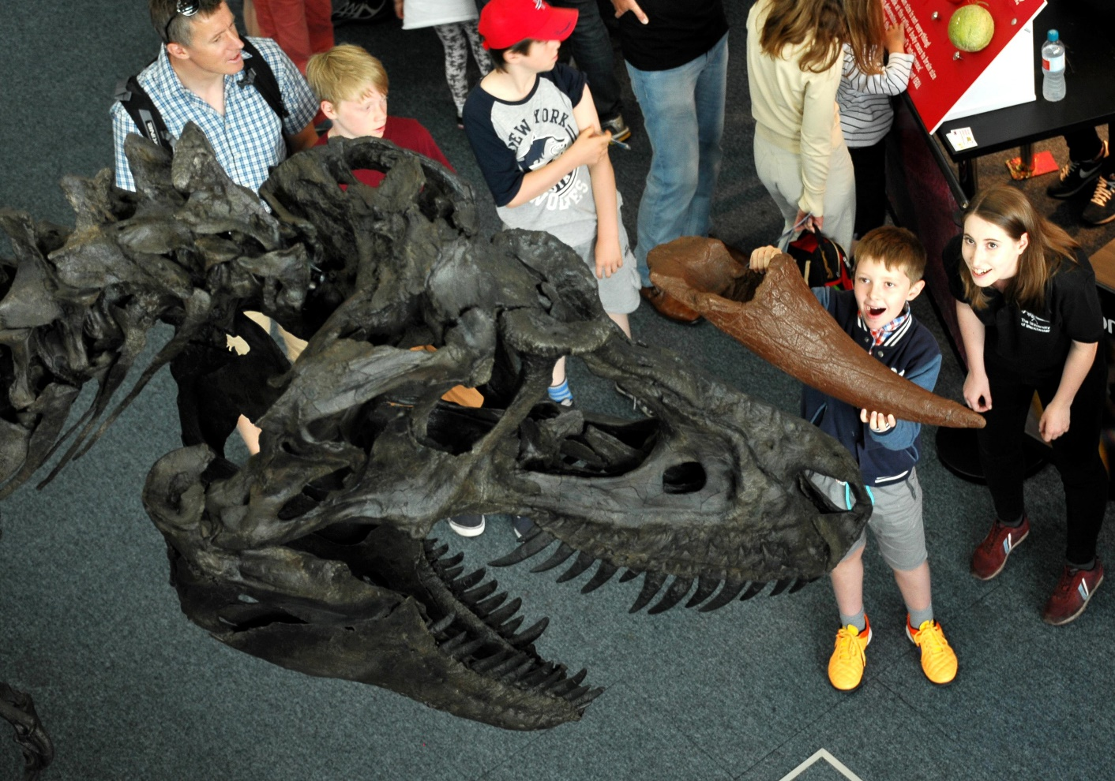
STFC Public Engagement Strategy
Our Vision
A society that values and participates in scientific endeavour.
Our Mission
Using our stories, community and facilities to inspire and involve people with our science and technology.
We are both funders and practitioners.
ESS
LHC
ESRF
ILL
Notes:
Very excited to be working on our new PE strategy at the moment. What I’ll focus on throughout this talk is how we’ve used our current strategy to inform everything we’ve done, at both the local and national level – to shape our programme, and keep momentum in the directions we want to move

Slide 8

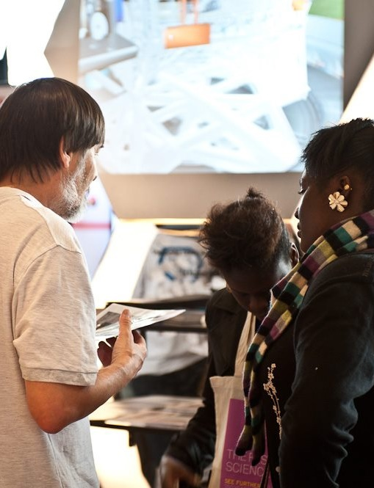
Our aims
1 Showcase STFC science and technology
Using our facilities, stories and community to inspire
2 Build the right partnerships
Improving our reach and impact
3 Develop and support STEM influencers
Creating a network of people passionate about STEM
4 Improving our reach with diverse audiences
A focus on Wonder communities – the 40% most deprived areas of the UK
5 Delivering high quality activities
Making an impact on our audiences

Slide 9

Wonder Initiative
Science capital is science-related knowledge, experience values and attitude. With low science capital, young people are less interested in science careers.​
​
We strive to grow science capital for underserved groups. Those from areas of high deprivation often have low science capital.​
​
Wonder aims to increase engagement from the 40% most deprived areas in the UK, particularly those aged 8-14 and their families with STFC’s work.​
ESS
LHC
ESRF
ILL
Notes:
Wonder came directly out of the strategy – after one or two years we realised we hadn’t made significant progress on this strategy aim, and that it needed additional focus. The result was the Wonder Initiative, which is just coming to end of its first phase and is embedded across all of our programmes.

Slide 10
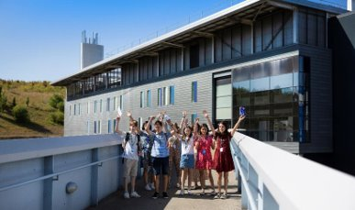
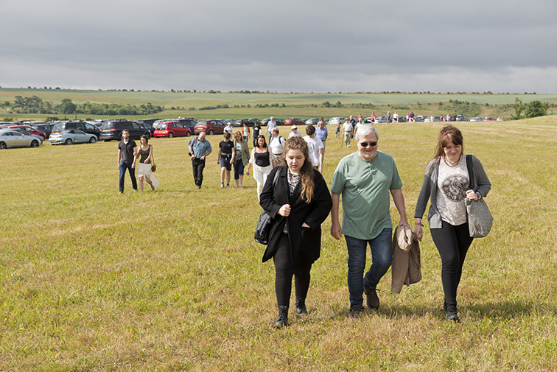

Local Engagement: Public and Communities
Glow Your Own
6 online workshops
2 in-person community events
~200 participants
“I made it work for the first time without Mummy!”
Sharing ​our amazing stories, work and facilities
Going out into the community
Partnerships are essential in everything we do
ESRF
ILL
Notes:
Daresbury Open Week will be this July - Harwell Open Week in July 2024. Put the date in your diaries!

Slide 11


Local Engagement: Teachers
All of our local teacher engagement is through partnerships with local teaching organisations
  Computing at School
  Science Learning Partnership
  Association of Science
ILL
Notes:
STEM Influencers

Slide 12
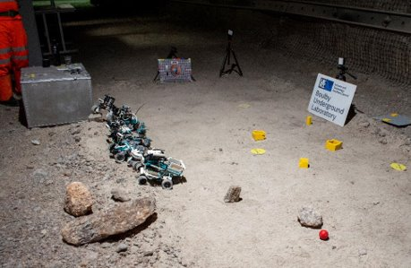
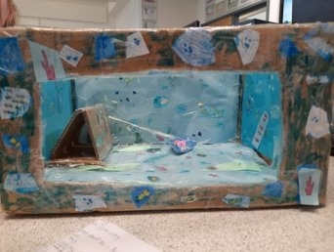
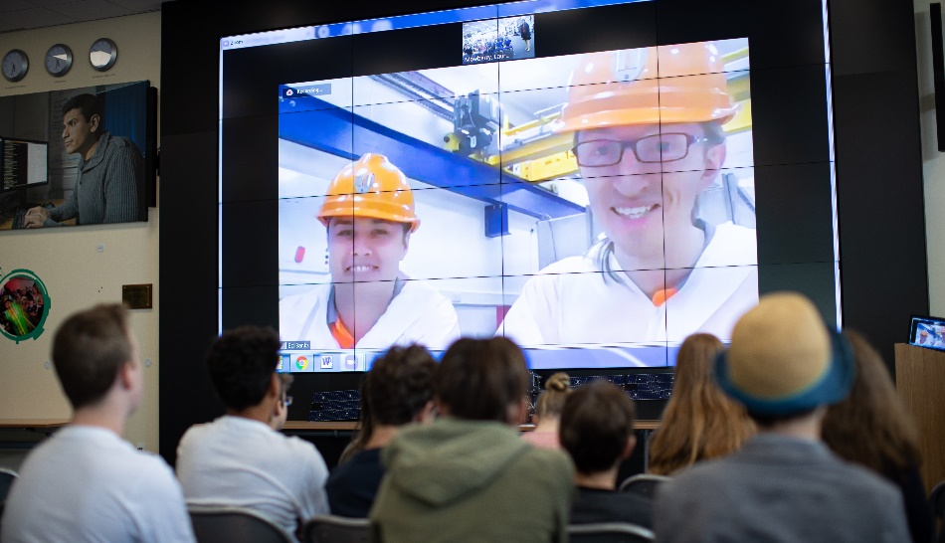
Local Engagement: Schools
Hybrid programme
  Events on site
  Events at schools
  Events online
Multi-intervention projects, co-created with key partner schools
47% engagement with Wonder Schools in 2022
ILL
Notes:
STEM Influencers

Slide 13
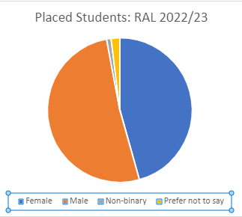
Local & National: Work Experience at DL and RAL 2022
90 online student placements from 732 applications
17 webinars – reaching 177 students, with 471 live webinar views
Excellent outcomes:
  Average satisfaction 4.8/5
  100% felt welcome, able to join in and inspired
“Getting to work with an expert in the field and conducting real science.”
“I struggle massively with social anxiety and being so encouraged and expected to contribute allowed me to develop myself in that area quite quickly.”
Return to in-person placements in 2023: 160 placements from 1000 applications
Notes:
Sense of ownership and belonging
Published papers
Contributed code
2022: 52% female, 44% male
2023: 46% female, 52% male

Slide 14


James Webb Space Telescope: A national campaign
Vision: A society which is engaged with the UK’s contribution to the JWST mission as a source of pride and inspiration and as a springboard for participation in STEM.​
​
​
Mission: To promote, facilitate and support a campaign of public engagement activity across the UK which draws on the UK’s contribution to the JWST mission and those involved ​with it to inspire and engage audiences of all ages.
Notes:
Just finishing up a national programme of engagement around the James Webb Space Telescope – we are working on bringing together all the impacts and learning from this and will be sharing these in due course. This was a unique campaign for many reasons, and it’s unlikely we’ll be able to replicate it – but there is lots to be learnt from the campaign!
As with the local programme, there is a lot of learning and experience of great practice engaging with national and international projects – so there is a lot to build on for any future engagement strategies and programmes.
Stemmed from first aim: Showcasing STFC Science and Technology. Webb was a great opportunity to engage people. The way we went about it was strongly influenced by the strategy.

Slide 15

James Webb Space Telescope: Planned Partnerships
Webb organisations, scientists and engineers
Informal learning: encourage and support
  Planetaria
  Science centres
  Astronomical societies
Formal learning: develop and deliver
  Primary schools
  Secondary schools
  STEM clubs
Notes:
Webb was, and was always planned to be, a partnership programme: shared messaging, shared materials, shared resources. It started with an invitation to a planning workshop – and that invitation went to lots of different groups and people, who all had a voice.

Slide 16
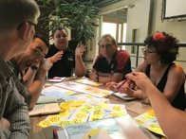
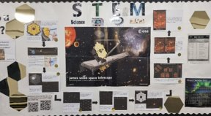
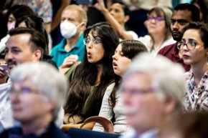

James Webb Space Telescope: A national campaign
Direct reach of over 300,000
Partnership work: co-creation and collaboration
Input of researchers at the start: not just an add-on
Cross-pollination of resources across networks
Putting participants at the heart of the engagement: what is their motivation?
It was like the pupils had collective ownership – the saw the space telescope as being theirs and talked about the mission as though they were part of it. (Teacher, interview)

Slide 17
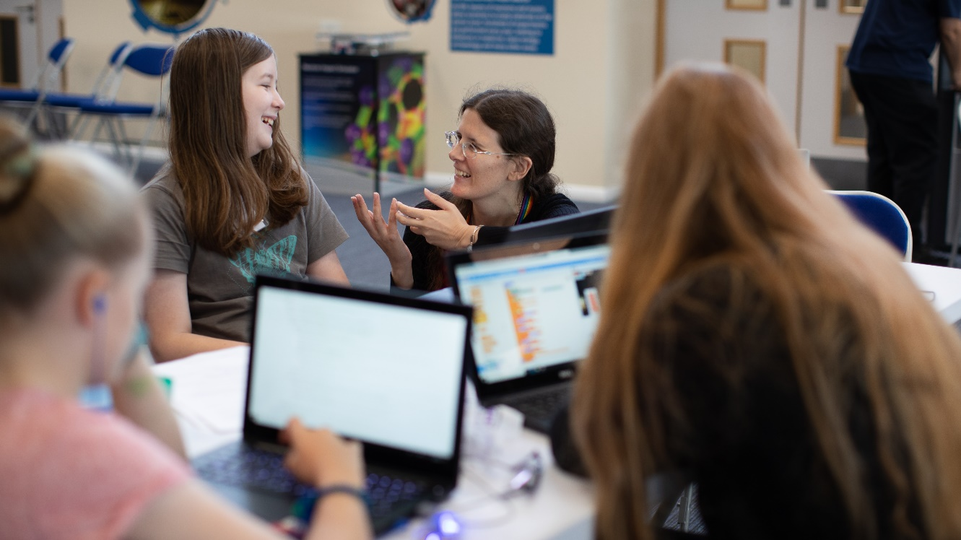

What is the change we want to see?
Strategy
  Embedding engagement
  Stakeholders
  Partnerships
  Shared ownership
ESS
LHC
ESRF
ILL

Slide 18
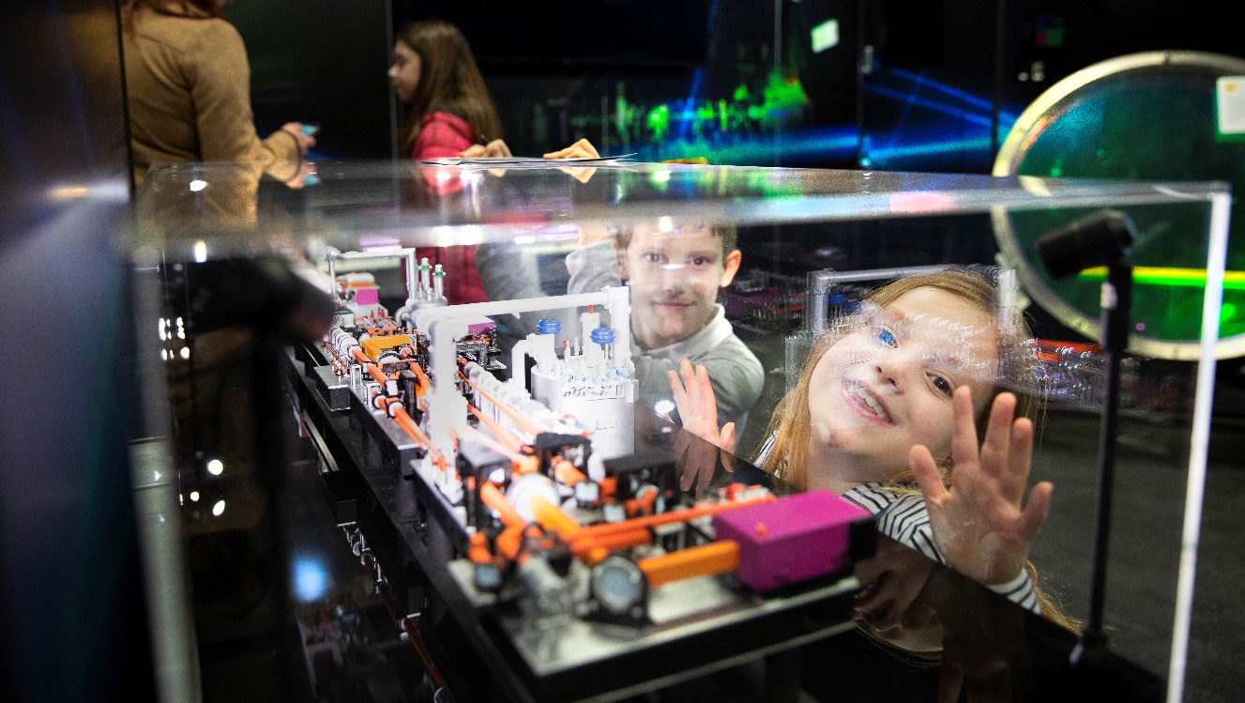
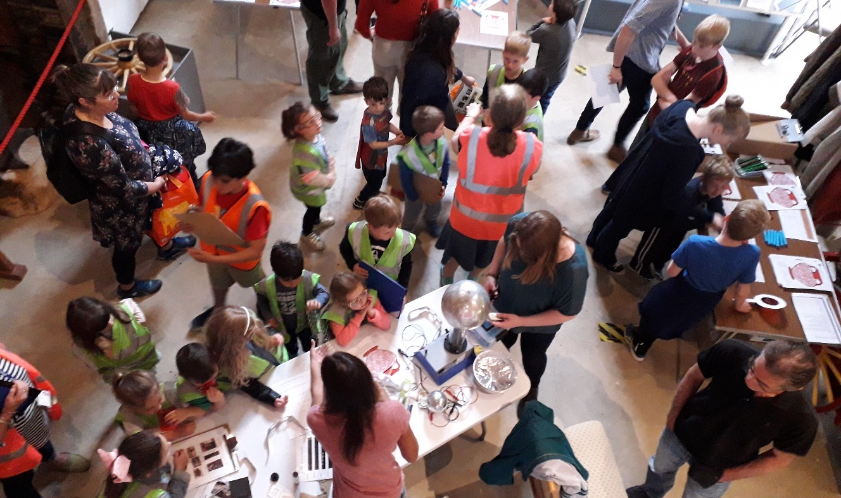
Thank you!
Our strategy has informed all of our engagement, pushing us to try to create a programme that engages and excites our local and national communities, listening and responding to them as our partners and creating a sense of shared ownership
Sophy Palmer
sophy.palmer@stfc.ac.uk
ESS
LHC
ESRF
ILL

