Slide 1
Reflections on CERN's and ESA's communications
Arnaud Marsollier – Head Press & Digital
June 2023

Slide 2
Similarities and Differences
 | CERN | ESA
Management | 1 Directorate – 1 big project | 10 Directorates – many projects
Structure | Single place Laboratory | Multisite Agency
Annual Budget | > 1 billion | > 7 billion
Public interest | High! | High!
Competitors | China? | NASA – China – India…
Project timeline | 20 to 30 years | 5 to 30 years
Local impact on the ground | huge | Very limited
Geostrategic value | Limited | High

Slide 3
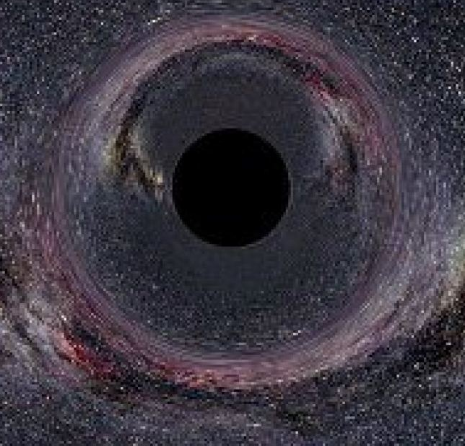
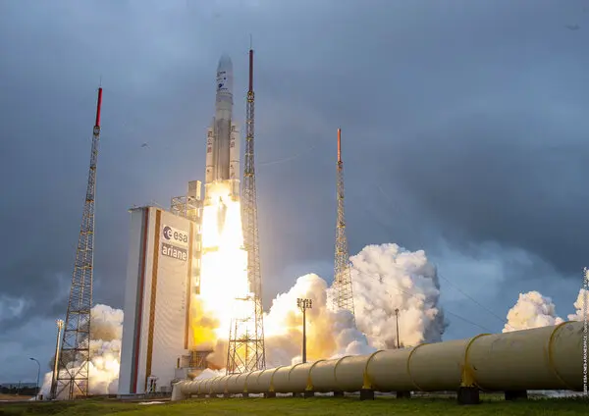
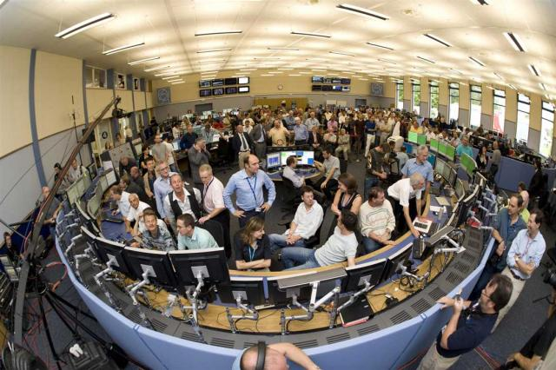
Launching a 10 billion machine
James Webb vs Starting the LHC
Black holes are actually helping…

Slide 4
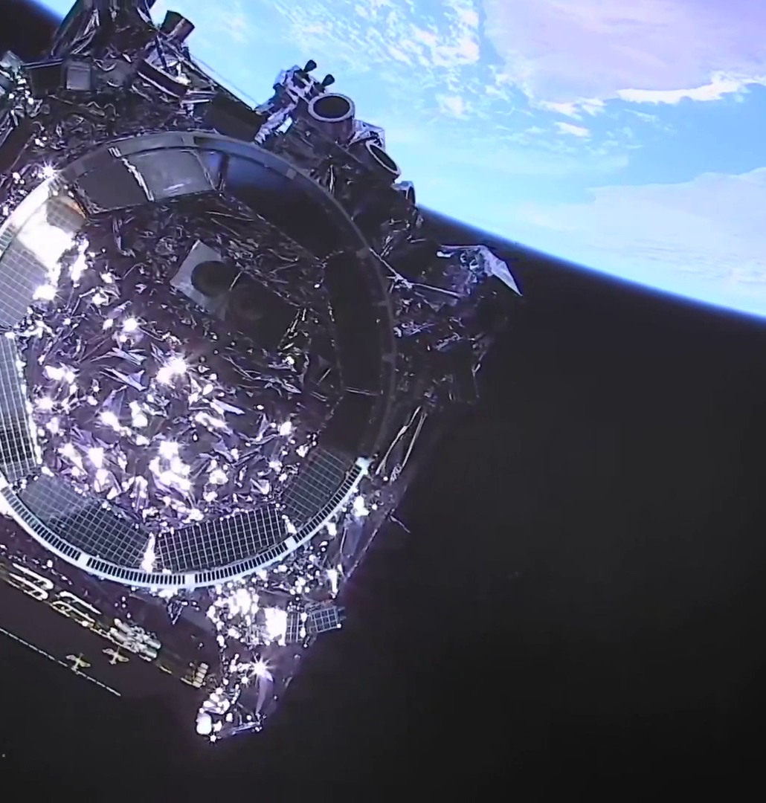
A few key principles
  Develop a strong narrative and story telling (better if you talk about the Universe)
  Don’t be afraid on the fact that so many things can go wrong (that’s actually an asset!)
  Use your partners / your networks
  Invest time and material (Webb launch was 18 months work, including 17 months of negotiation with NASA)
  Share it live and engage!
  Images are essential
  Webb (or even JWST), LHC, LEP, FCC… Or is it actually good to have a weird name…?
  We have to think about a name.

Slide 5


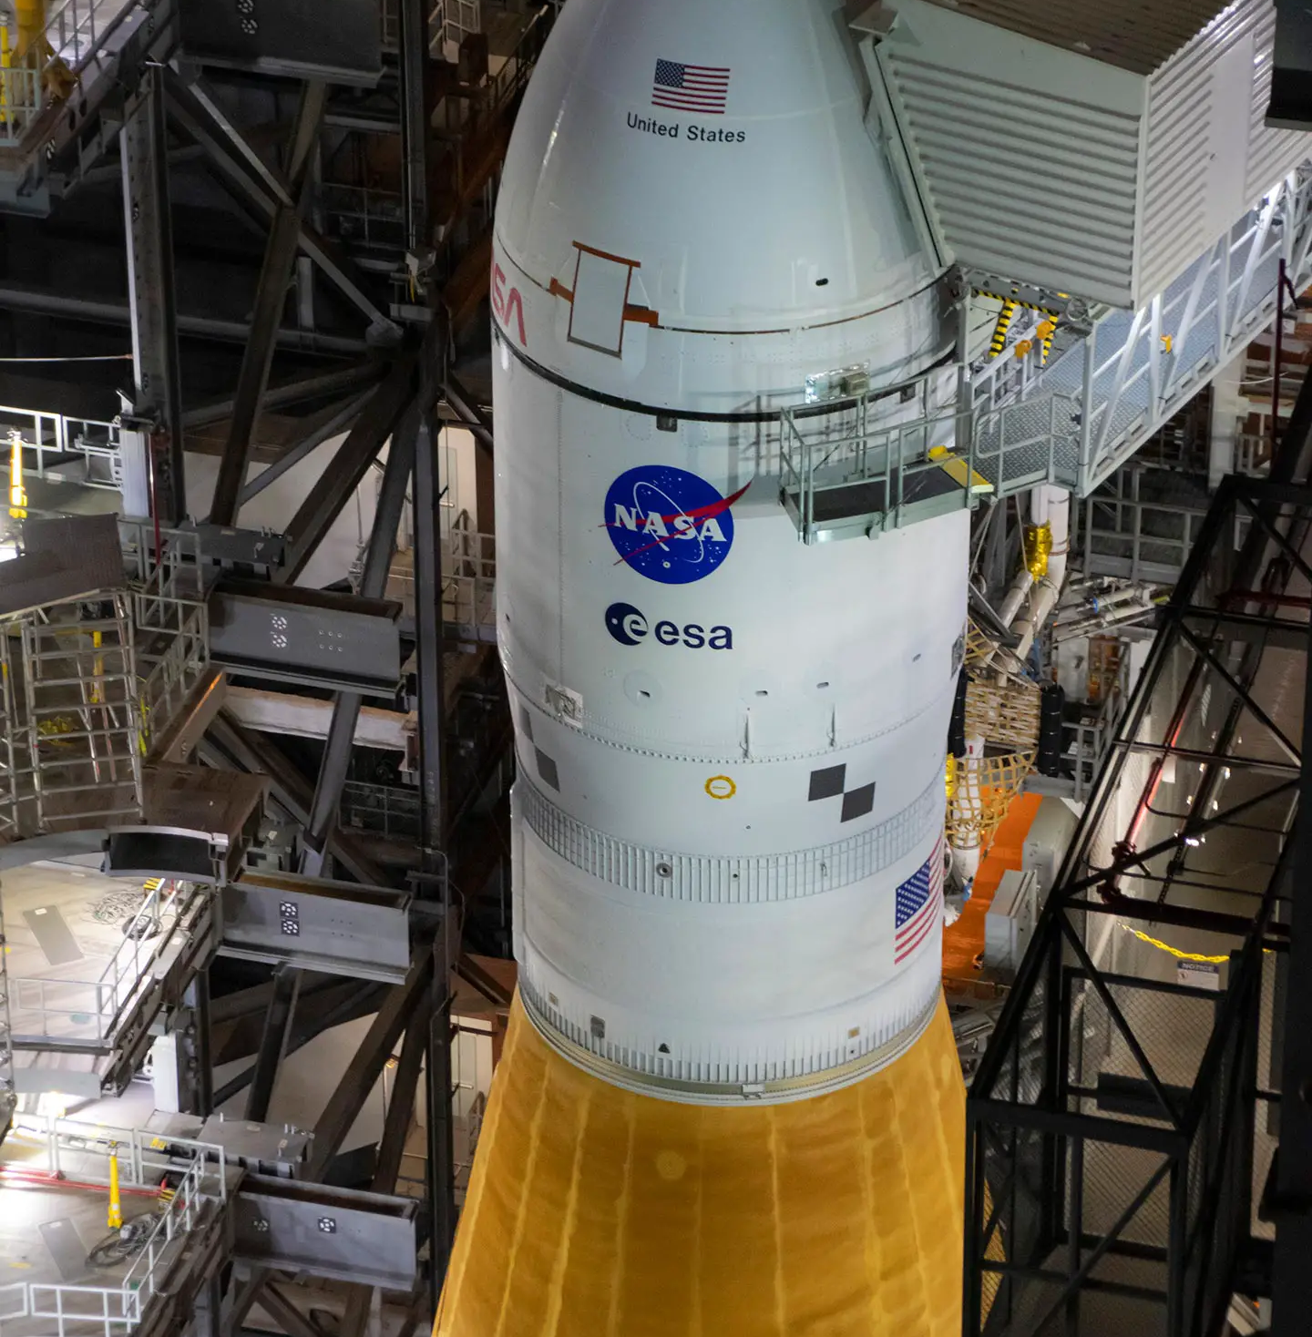
Branding matters
And it does not come for free…

Slide 6
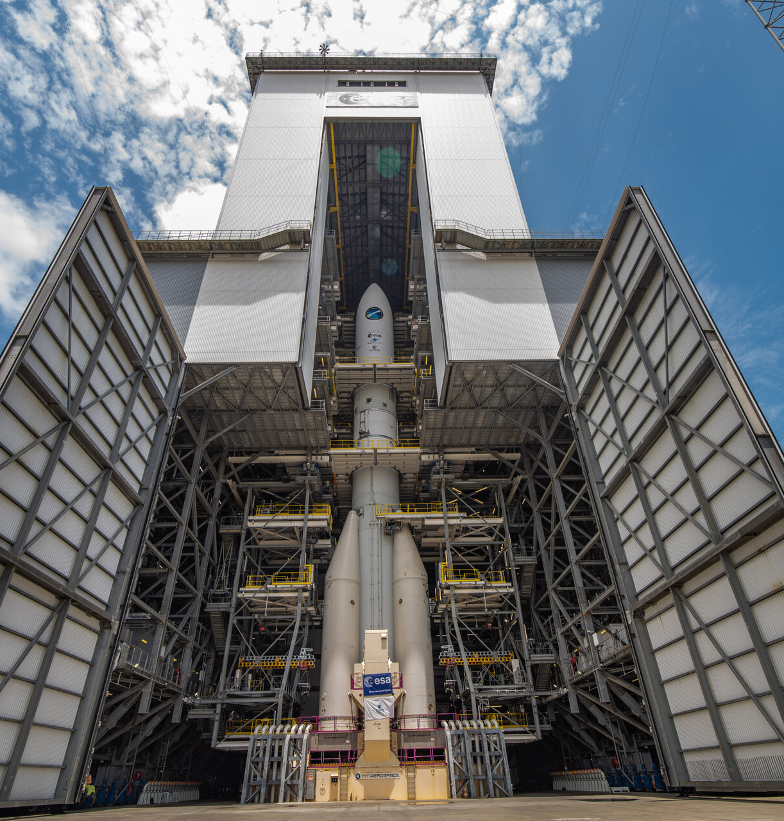
Don’t hide, face the challenge, lead the conversation
. Long term project face technical, funding issues, delays… or other challenges
. Hiding is not an option: transparency and proactive communications are key

Slide 7

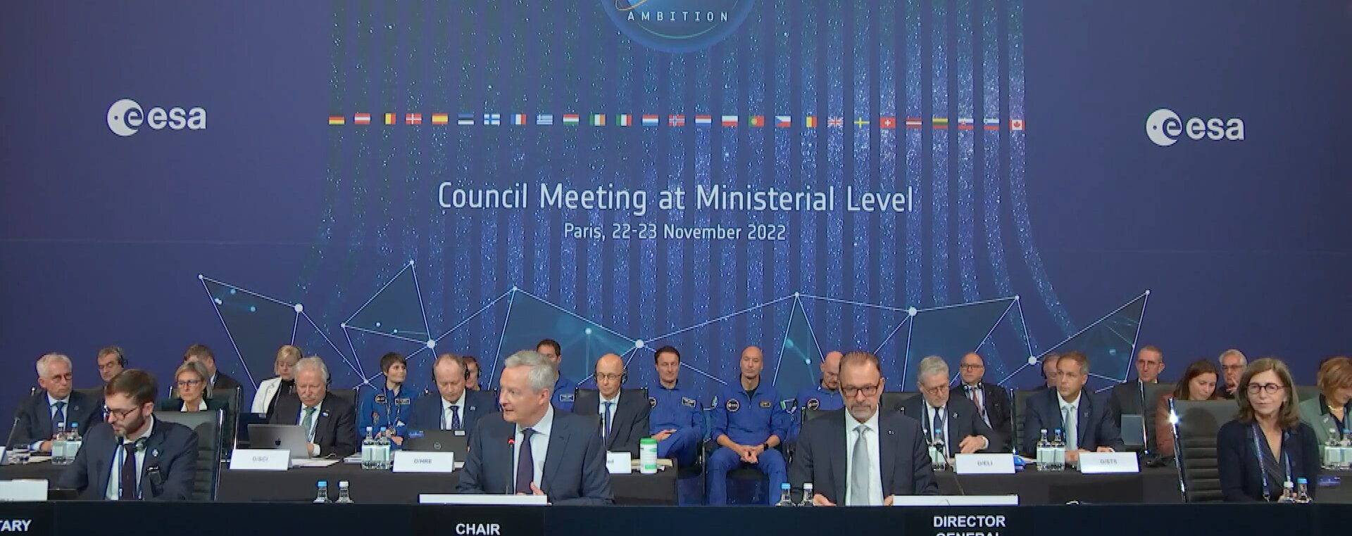
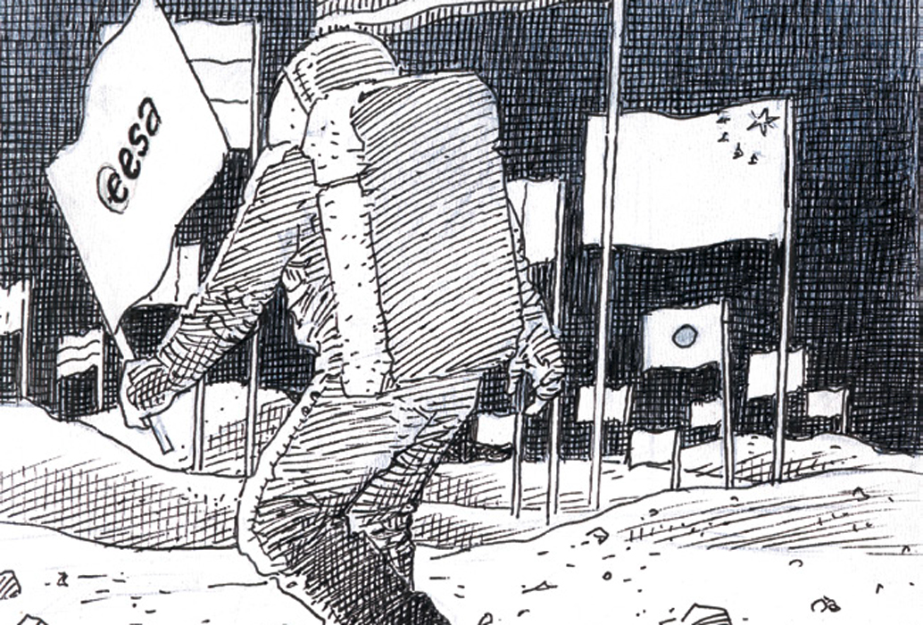
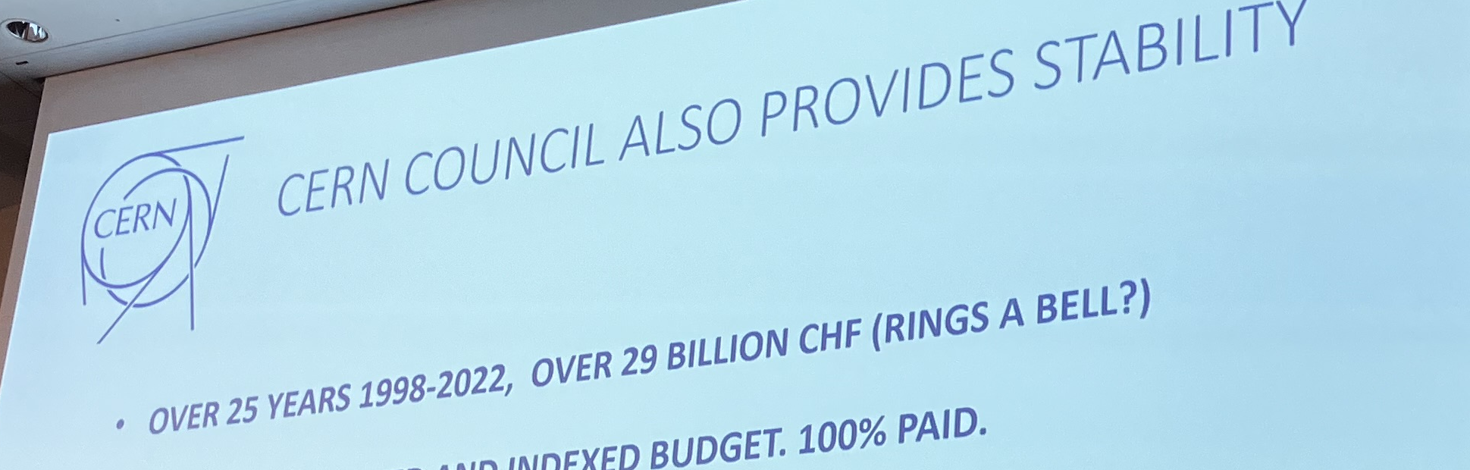
What about long term massive projects?
  Don’t be shy. If you don’t push your project, nobody will do it for you
  Crisis can actually help…
  Competition is a driver
  Bringing the highest political level to the table is key
  Don’t be afraid of big numbers ↓

Slide 8
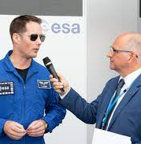
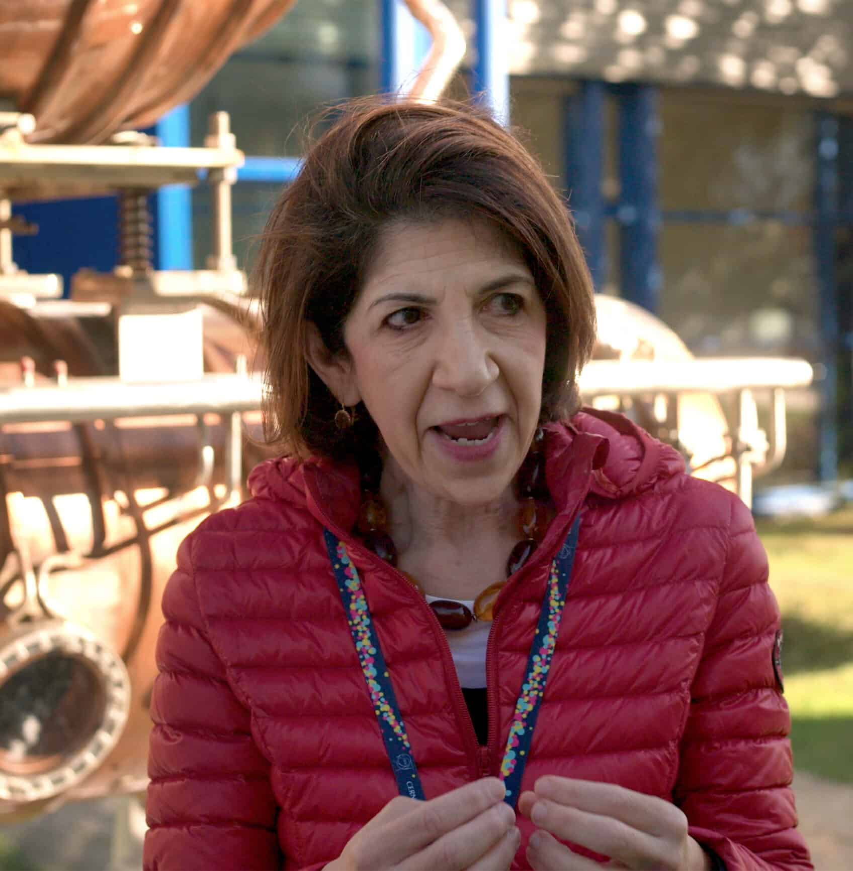
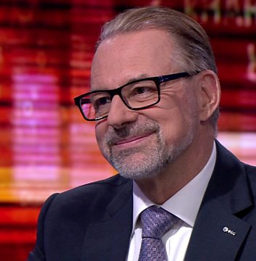
Use your best spokespeople
…and make sure to align messaging to get one strong single voice

Slide 9

Use Public Survey to your advantage
  Polls can help understand the strength of public support… but can also be used to promote a project itself
  It is important to seize opportunities and Hijack news (when relevant of course)

Slide 10
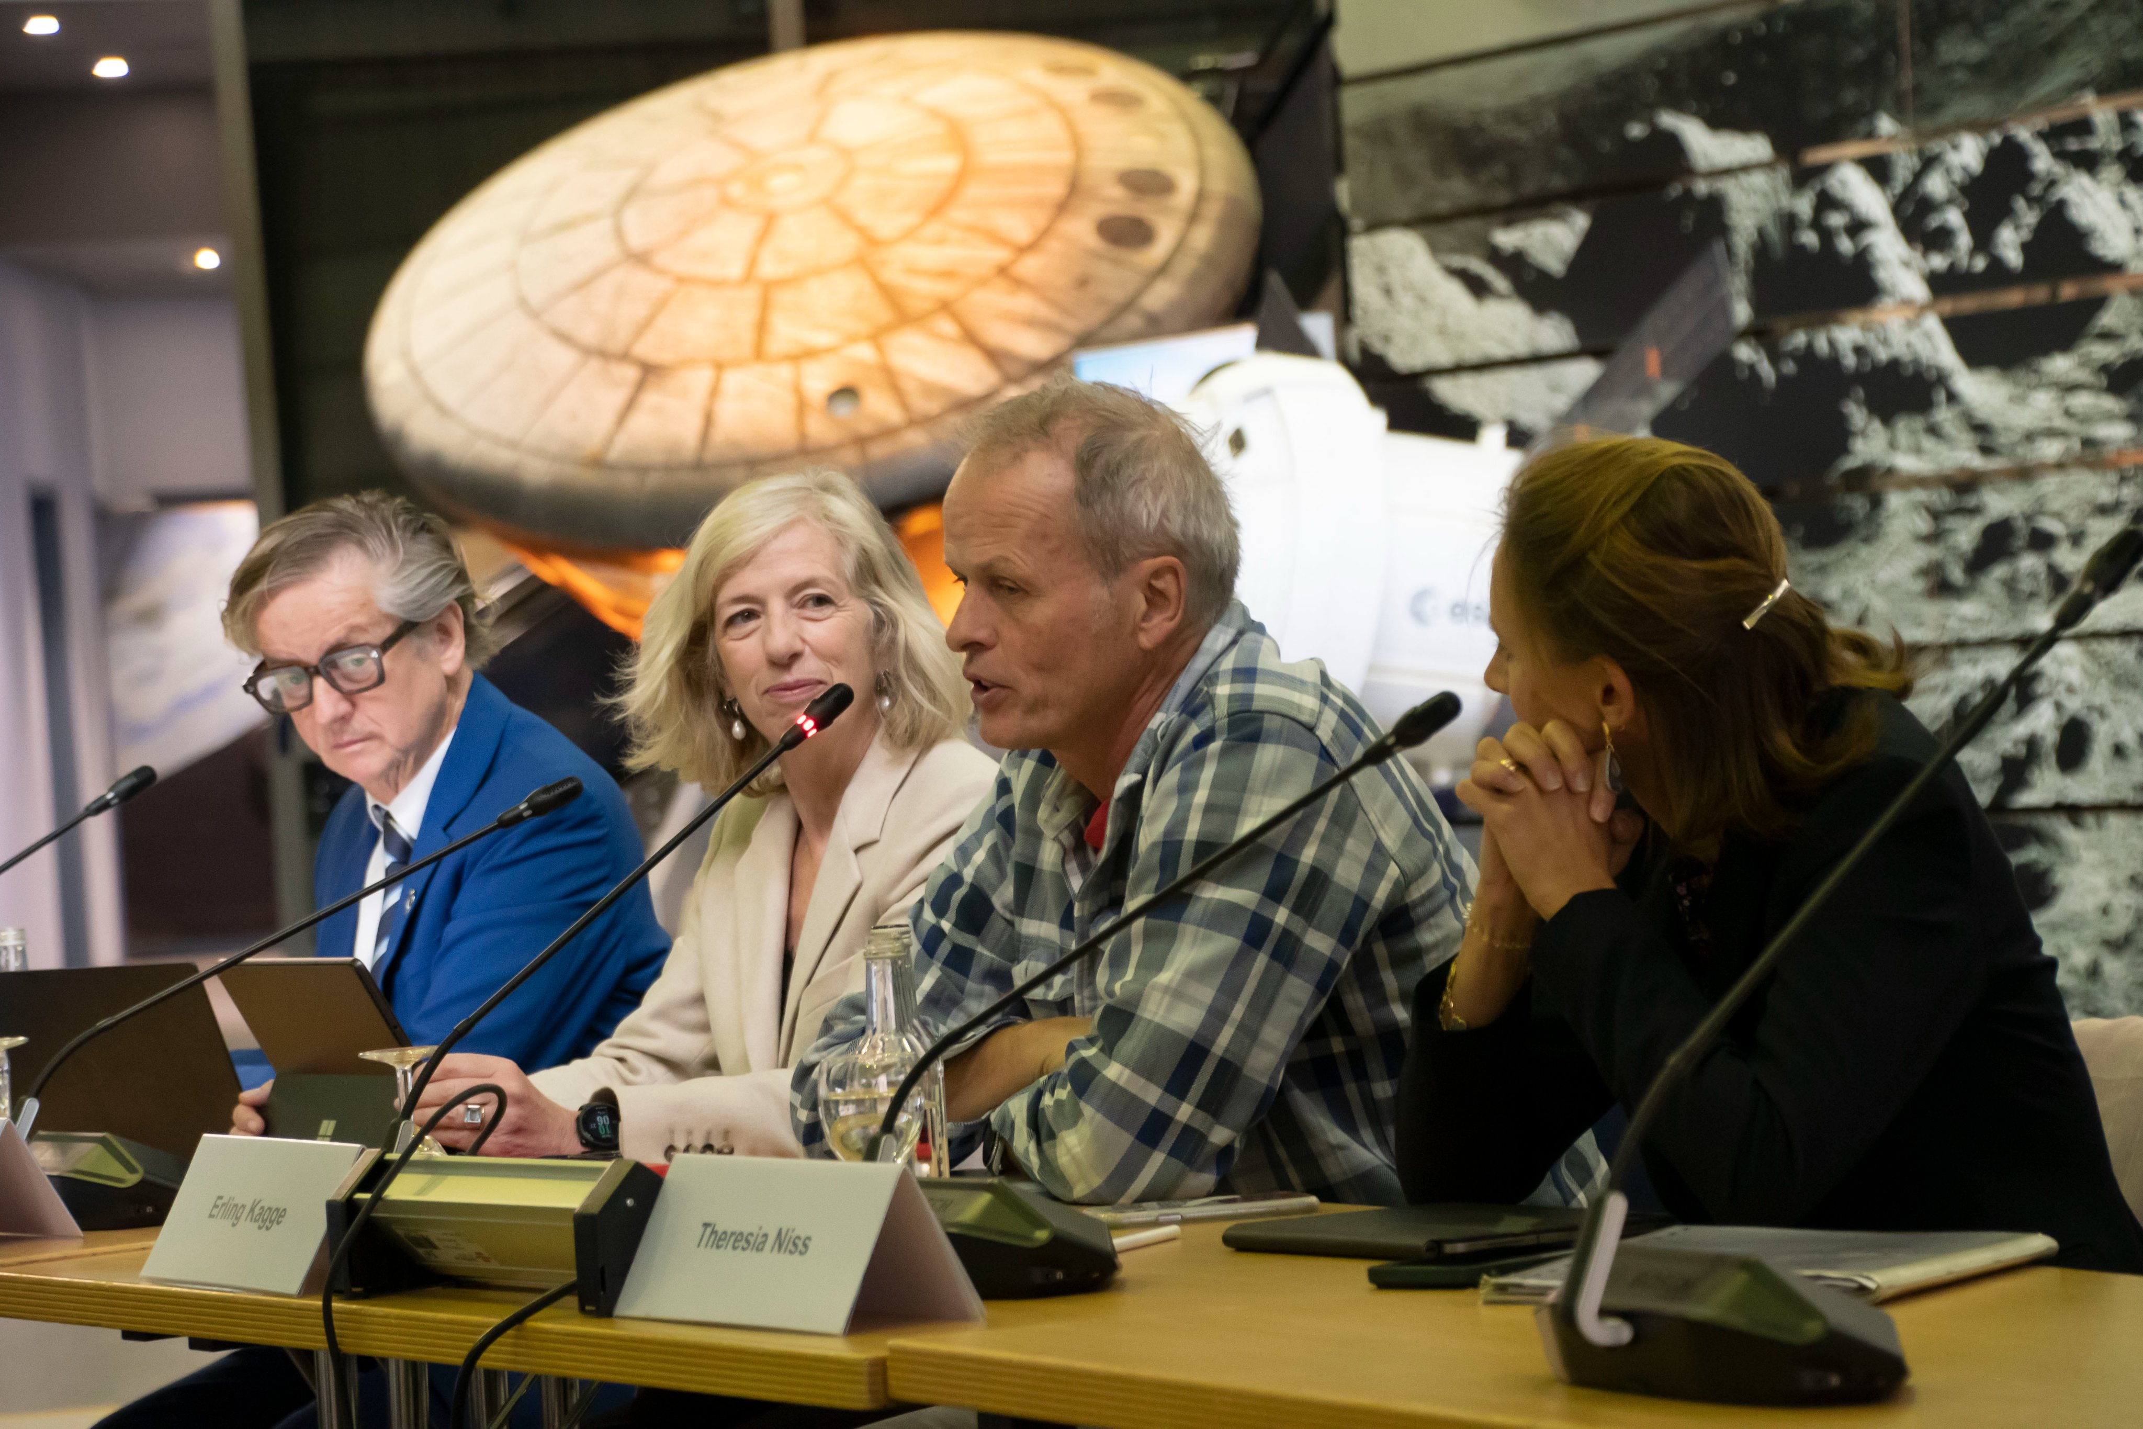

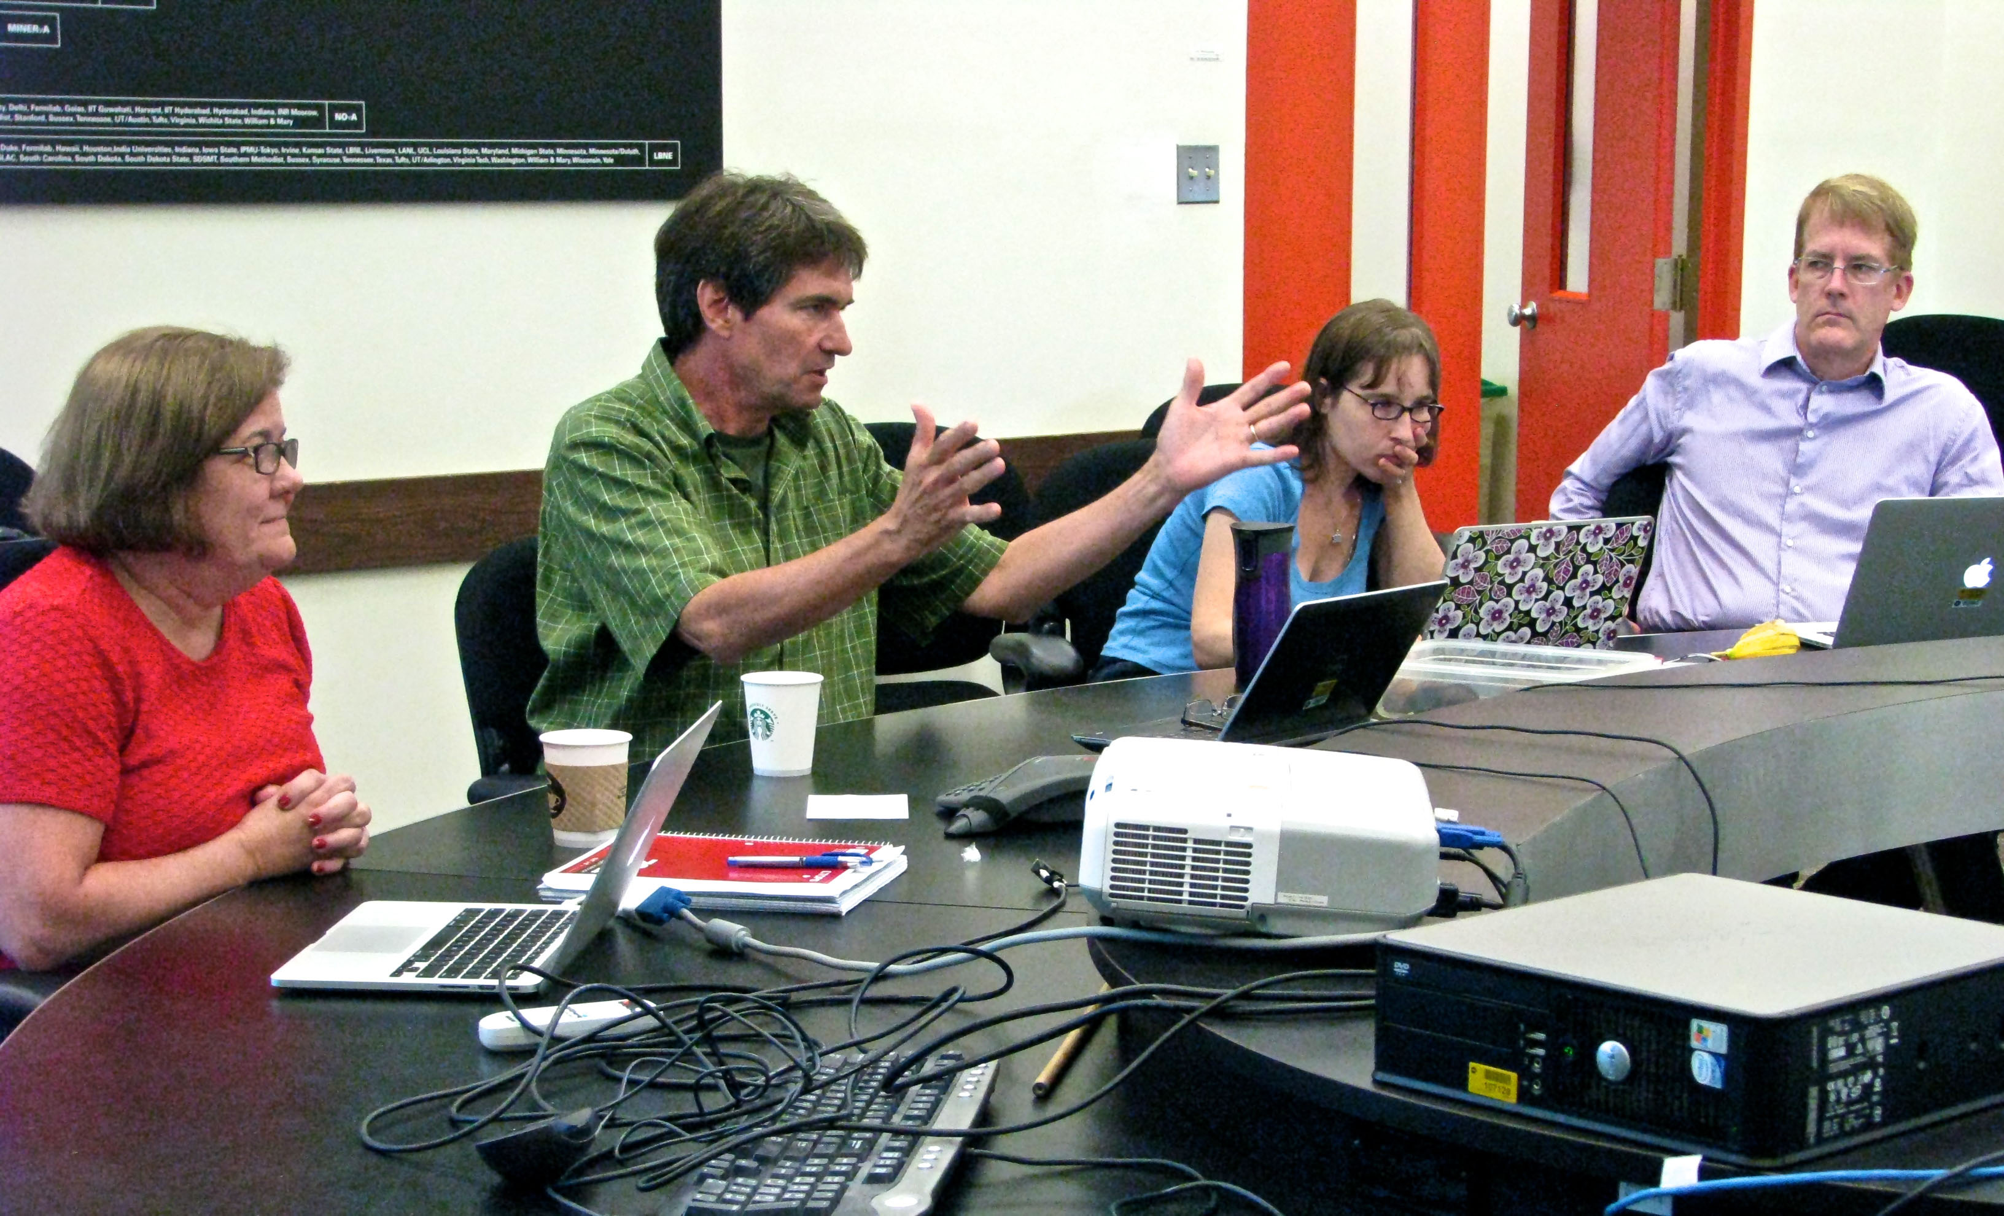
Engaging politicians, neighbours, youngsters…
Some ideas from participative approaches?...
ESA High Level Advisory Group
    Former Ministers, Journalist, Explorer, NATO, UNESCO, WEF…
    Involve civil society influential people in designing recommendations on a big idea
Fermilab Community Advisory Board
    “The main mission of the board
    is to provide ongoing advice
    and guidance related to
    the future of the laboratory…”
Youth Sounding Board
(UN / EU)
    Bringing the voice
    of youngsters
Notes:
The community was kind of consulted through the European Strategy. More will be important to get all onboard. But not enough.
Need to count our friends, to get more friends, from all communities.

