Slide 1
Klaus Hanke
1
Technical infrastructure Summary
K Hanke, J-P Burnet, FCC Week 2023, 09/06/2023

Slide 2
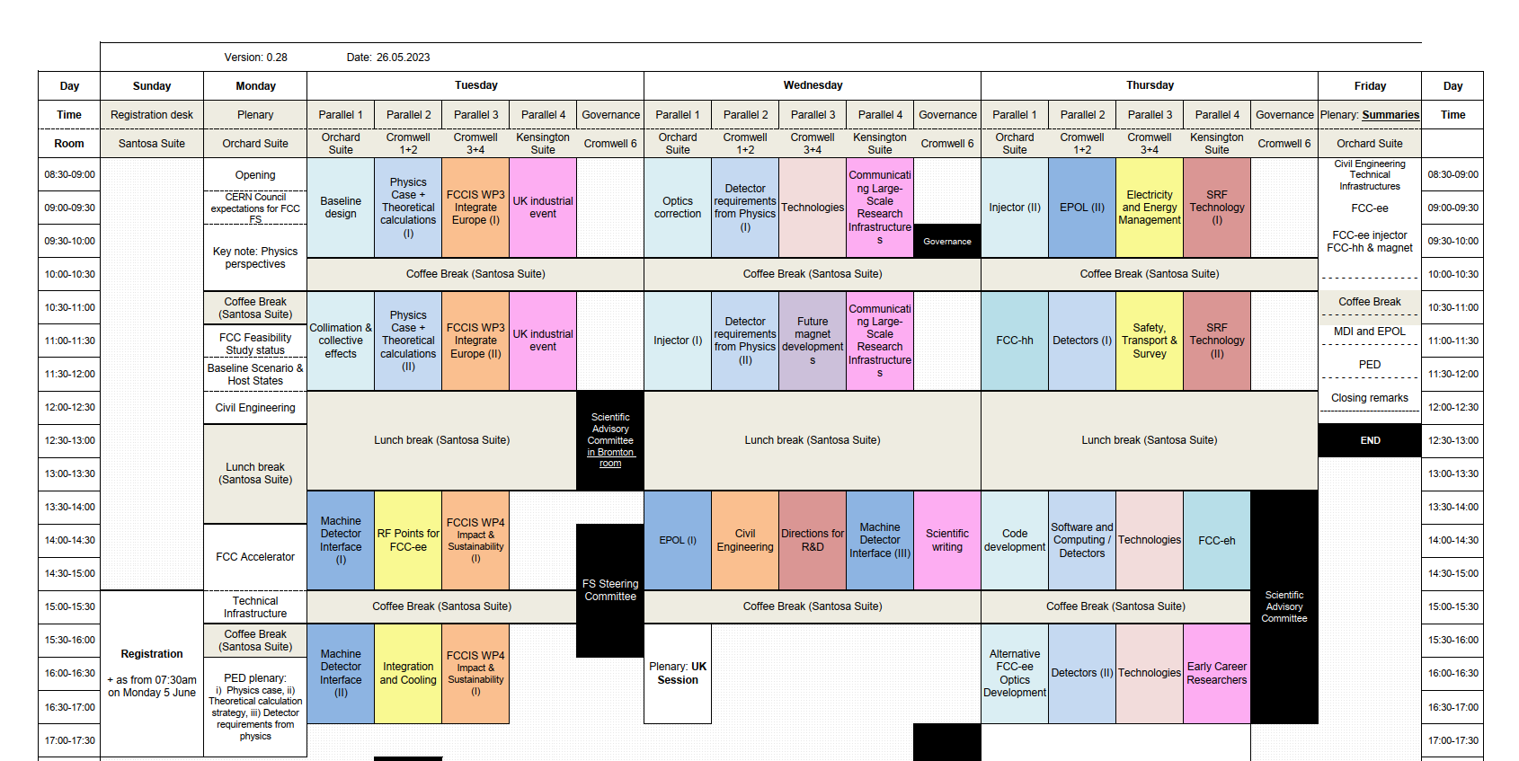
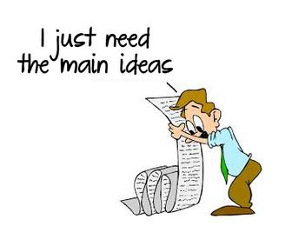
Klaus Hanke
2
4 sessions
19 presentations

Slide 3
Technical infrastructure
RF points
Klaus Hanke
3

Slide 4
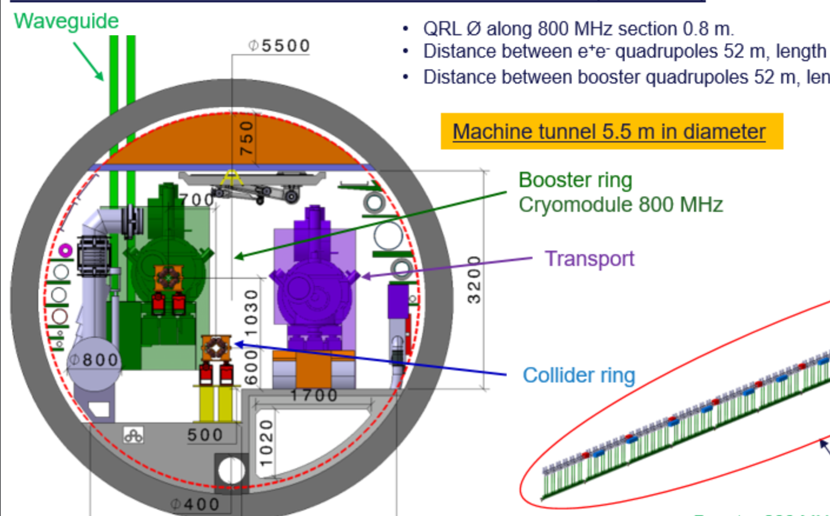
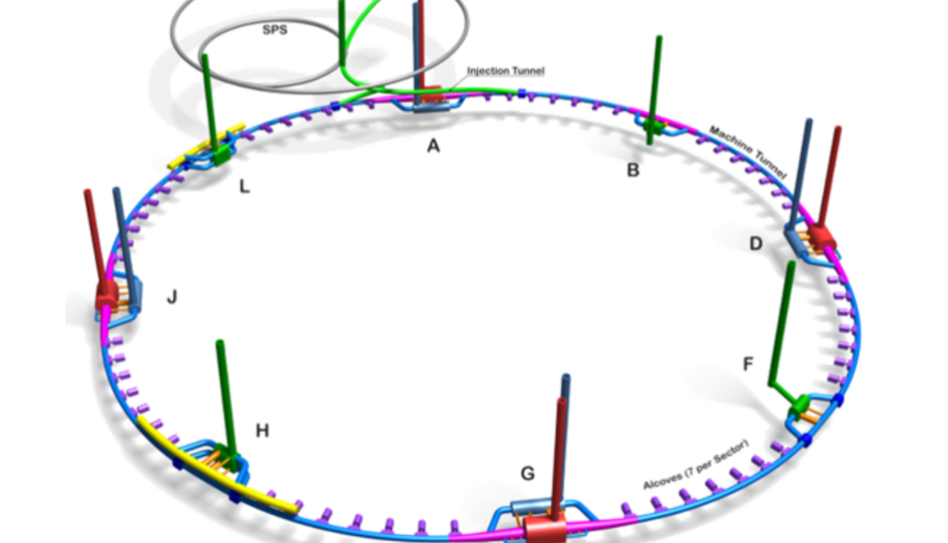
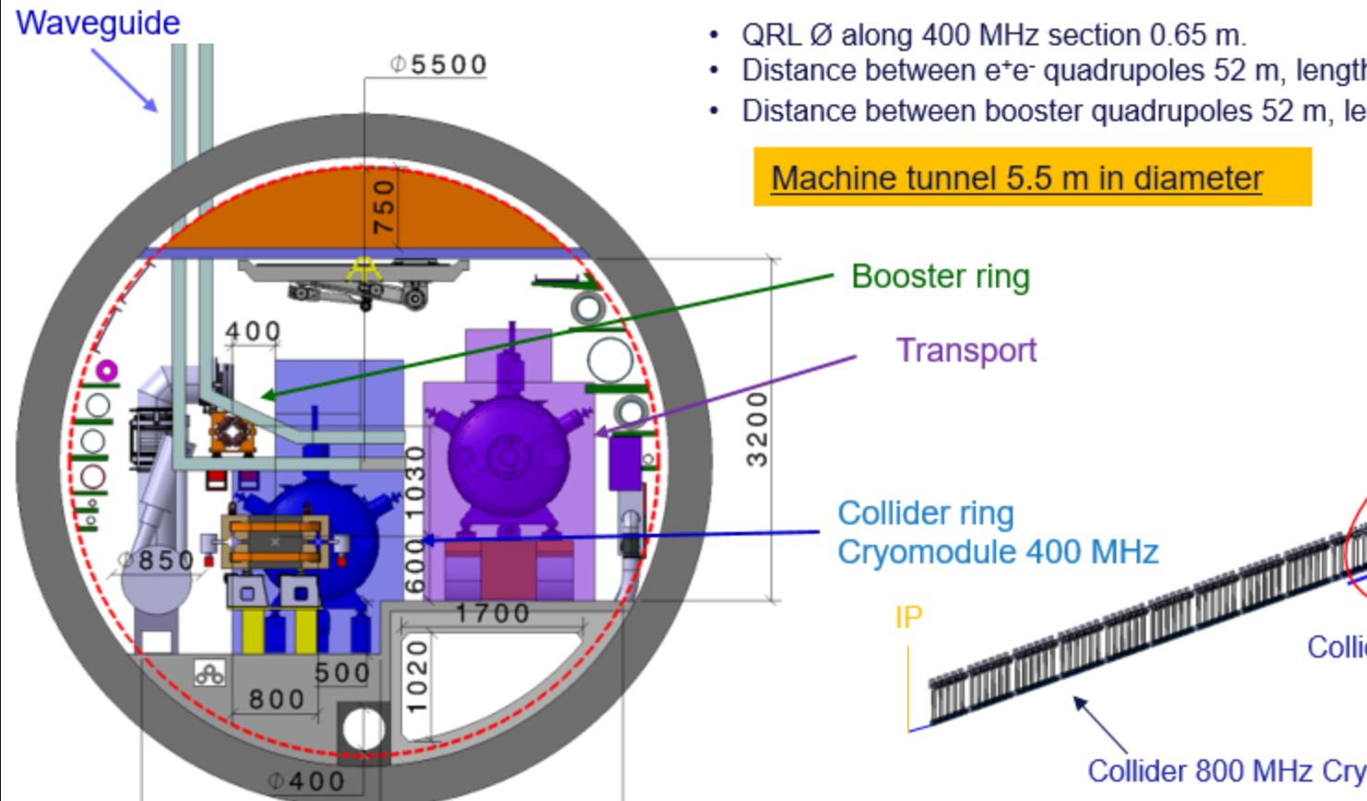
Klaus Hanke
4
General Lay-out, integration update RF systems
Fani Valchkova
Two RF points, Booster and Collider separated
Booster RF, 800 MHz PL
Collider RF, 400 + 800 MHz PH

Slide 5
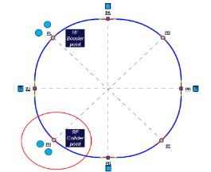
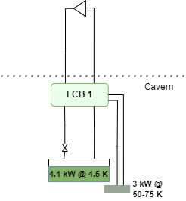
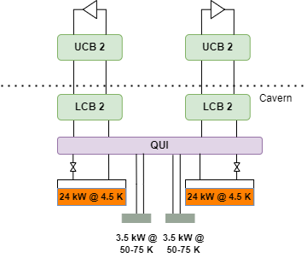
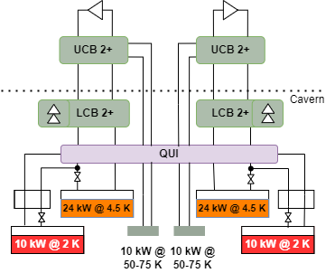
Klaus Hanke
5
FCC cryogenics status, layout, and implementation studies
Boyan-Kaloyanov Naydenov Popov
Staging at point H
    Increased staging complexity.
$Q_{{800MHz}_{Installed}}=3.0E+10$ //$Q_{{400MHz}_{Installed}}=2.7E+9$
Z
➔
W
&
H
➔
ttbar
Ref. ~5 kW eq @ 4.5 K
Replacement of cryoplant
Upgrade
Ref. ~60 kW eq @ 4.5 K
Ref. ~60 kW eq @ 4.5 K
Ref. ~25 kW eq @ 4.5 K
Ref. ~25 kW eq @ 4.5 K
Feasibility TBC !
10 kW @ 2 K included
10 kW @ 2 K
included

Slide 6
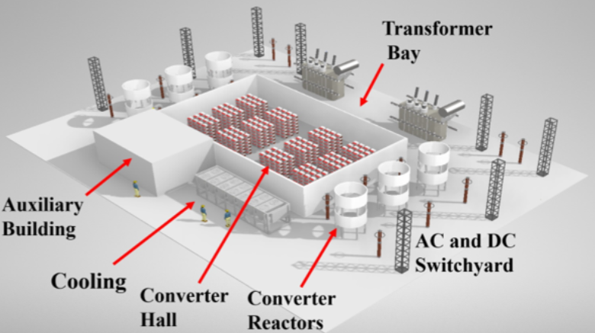
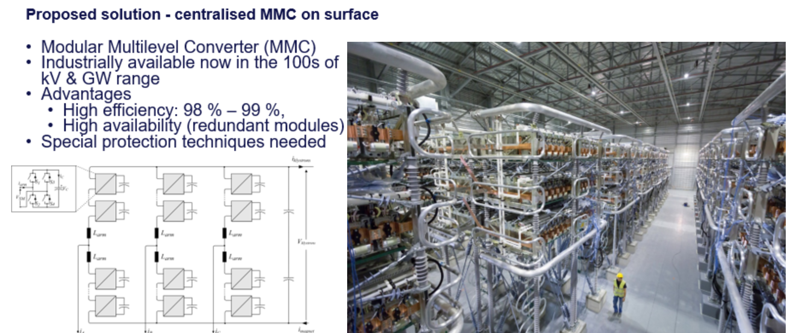
Klaus Hanke
6
Powering of RF systems – Power converters and infrastructure
Davide Aguglia
One PC per klystron vs one centralised PC

Slide 7
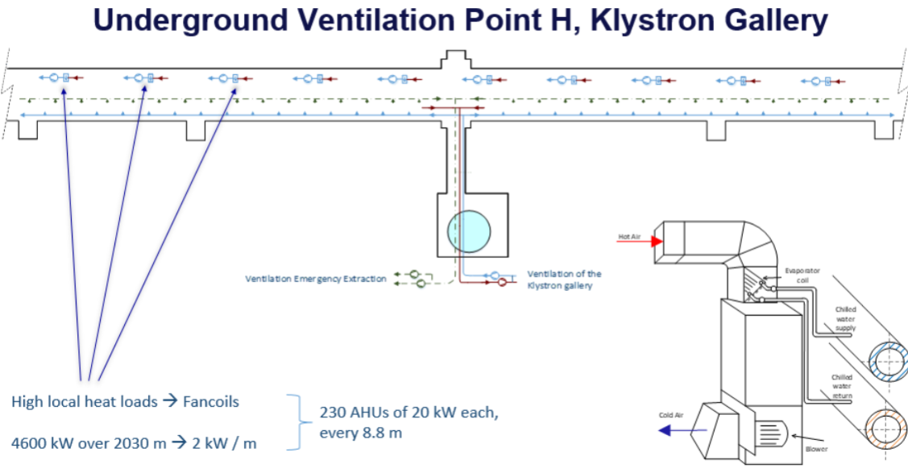
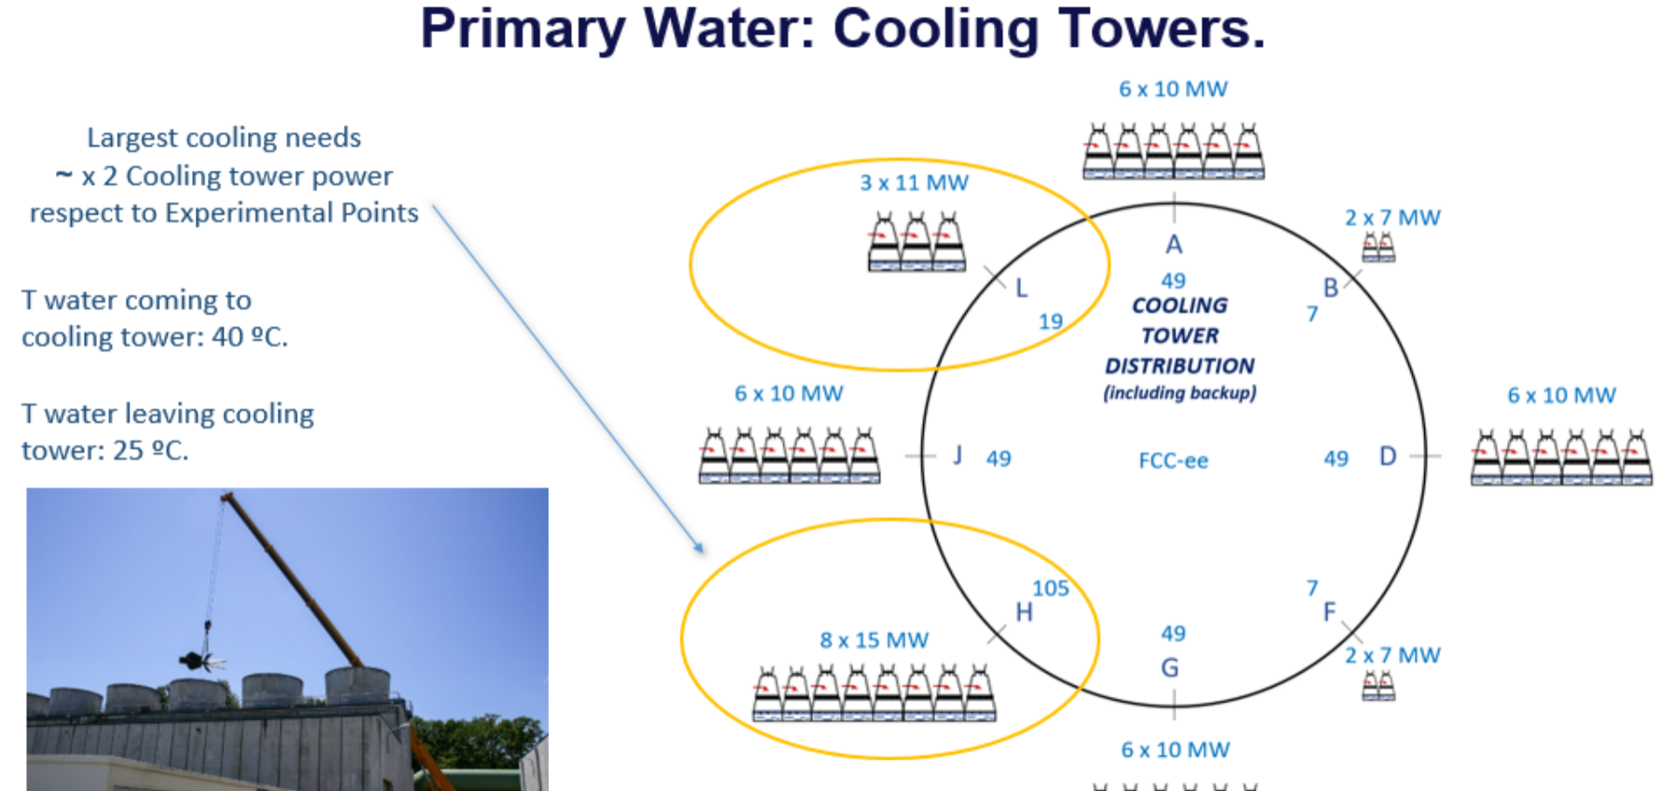
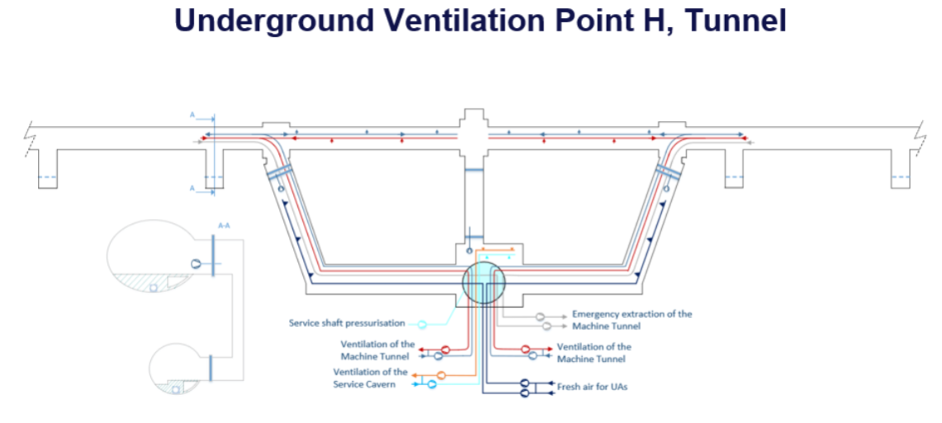
Klaus Hanke
7
Cooling & ventilation for RF systems, surface and klystron galleries
Inigo Martin Melero

Slide 8
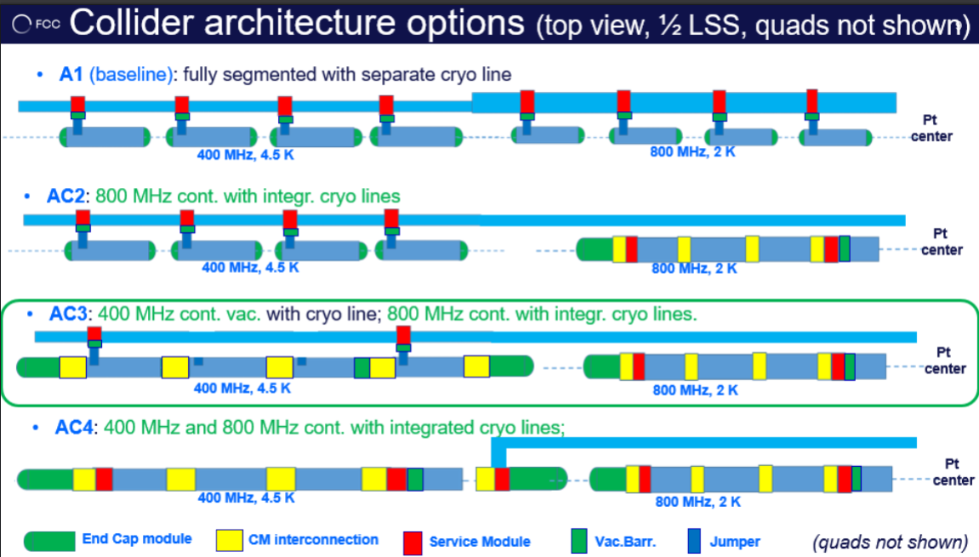
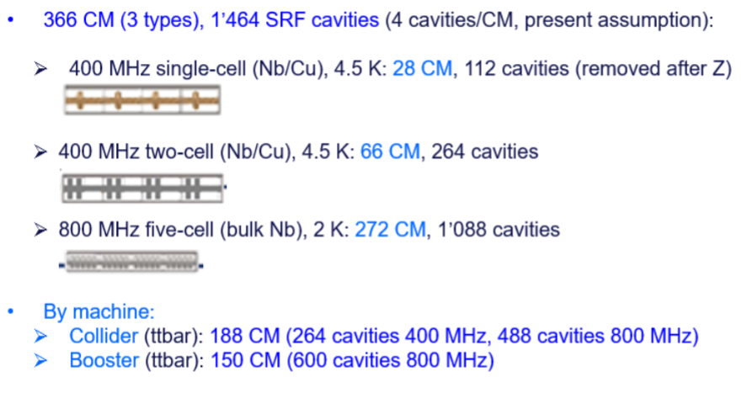
Klaus Hanke
8
RF string or continuous cryomodule, impact on infrastructure and recovery time
Vittorio Parma
Present Baseline

Slide 9
Technical infrastructure
Integration and cooling
Klaus Hanke
9

Slide 10
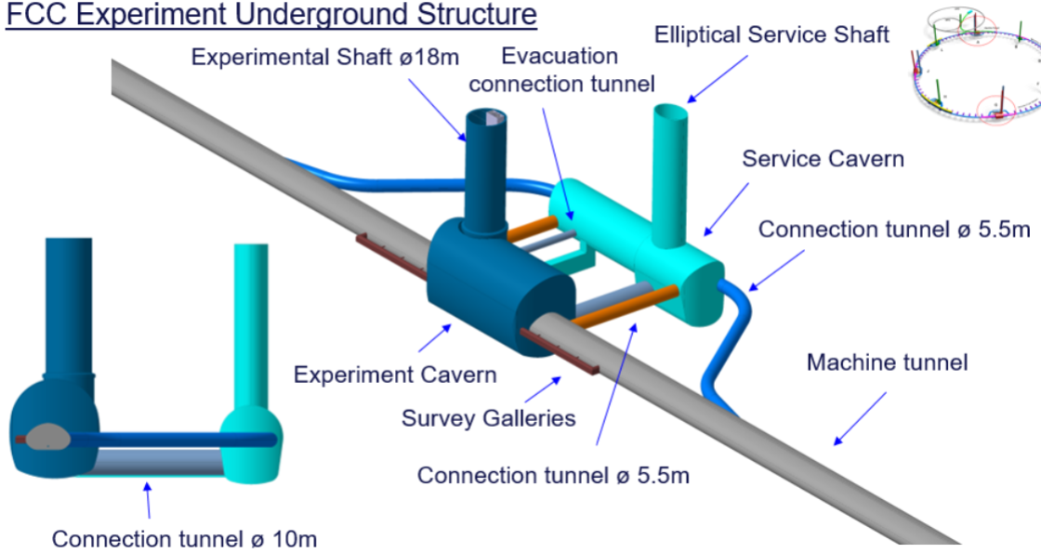
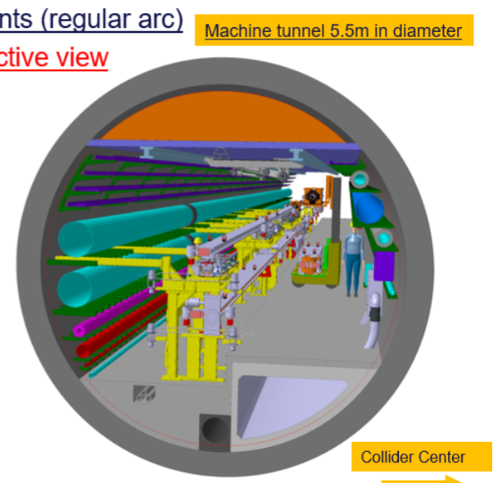
Klaus Hanke
10
Integration update tunnel and arcs, caverns, service caverns, etc.
Fani Valchkova
FCC-ee Regular Arc
Service caverns, alcoves, beam strahlung dump, first look at FCC-hh and transfer line

Slide 11
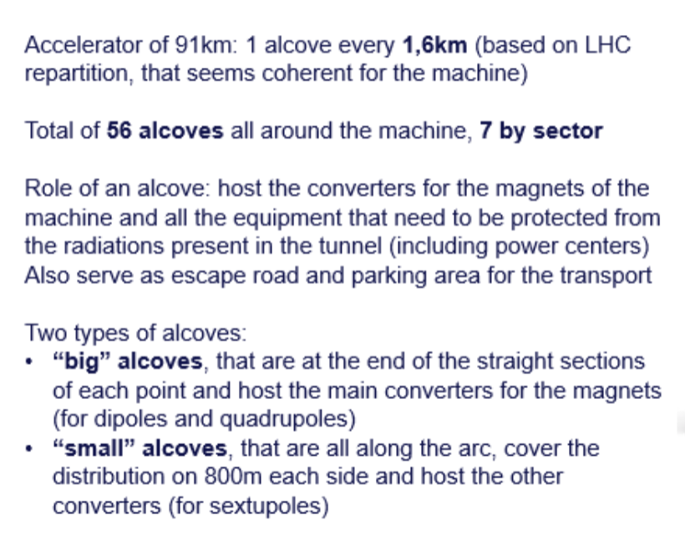
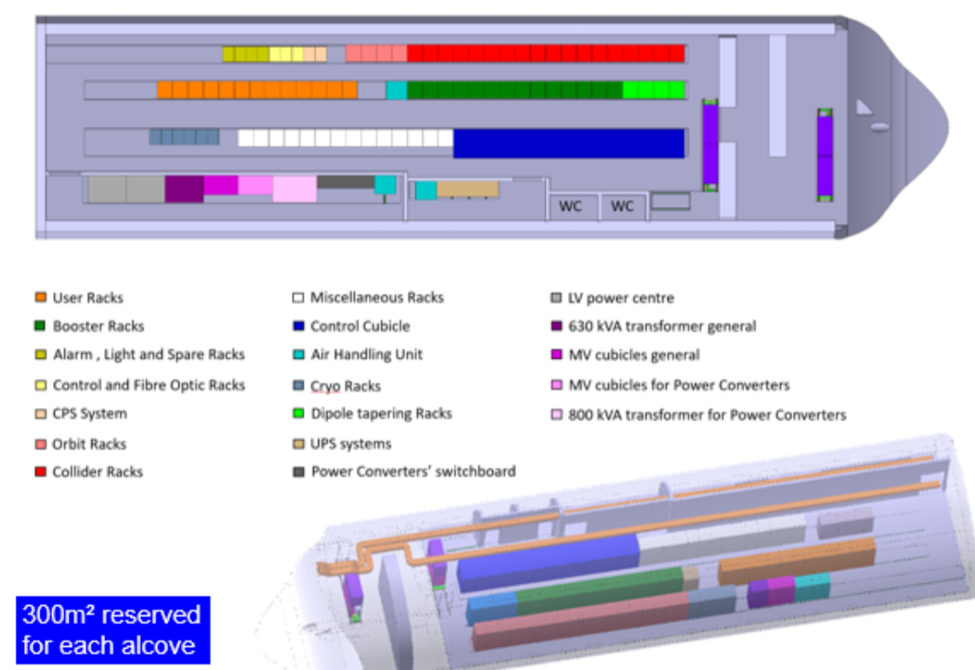
Klaus Hanke
11
Alcoves requirement and integration, cabling concept
Charline Marcel

Slide 12
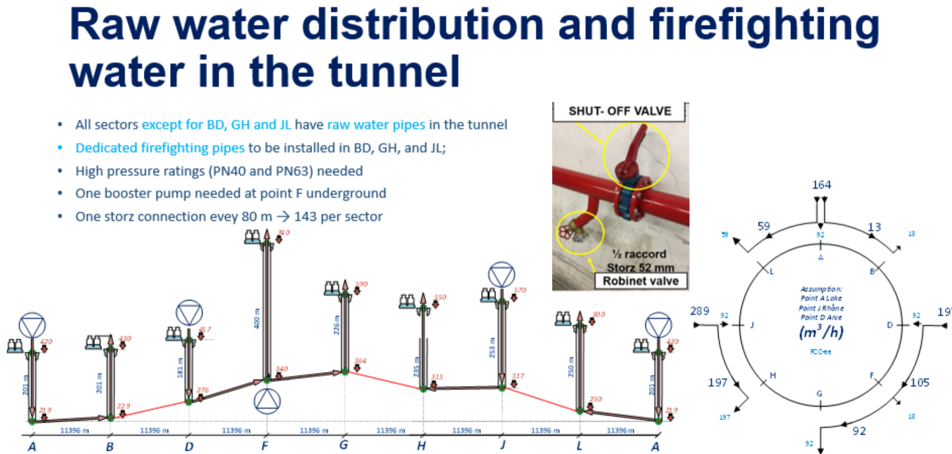
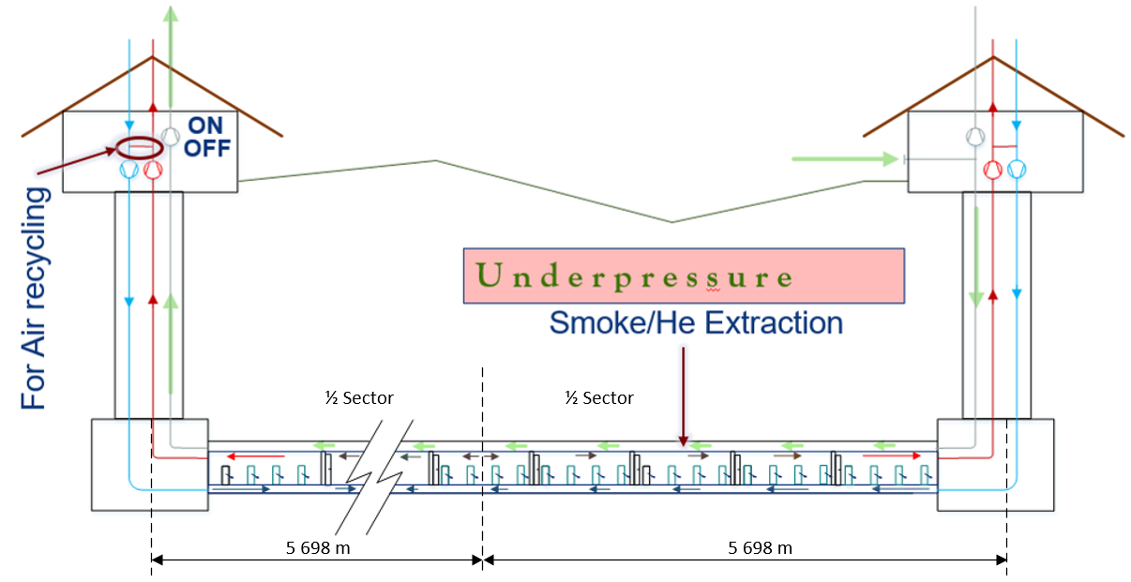
Klaus Hanke
12
General layout and update of cooling and ventilation systems for arcs
Guillermo Peon
Concept for cooling water (raw water, demineralised water, chilled water)
Ventilation, standard operation and special modes

Slide 13

Heat Recovery in the Biogas production
Klaus Hanke
13
Heat recovery perspectives - Guillermo Peon
What to do with the FCC Waste Heat ?
Ref.: Mechanism of waste-heat recovery from slurry by scraped-surface heat exchanger in Applied Energy, Volume 207, 1 December 2017, Pages 146-155
The authors claim that recovering heat from slurry can increase the biogas production up to 8.5%. But similar gains can be obtained when recovering heat from other processes.
Biogas production:
The slurry is transferred to a closed tank (digester);
The anaerobic digestion (AD) process for Biogas production can be
  Mesophilic (Temperature around 37 °C) or
  Thermophilic (55 °C) modes
Recovered Heat from other processes can give the needed energy thus improving the efficiency of the process

Slide 14
Technical infrastructure electricity and energy management
Klaus Hanke
14

Slide 15
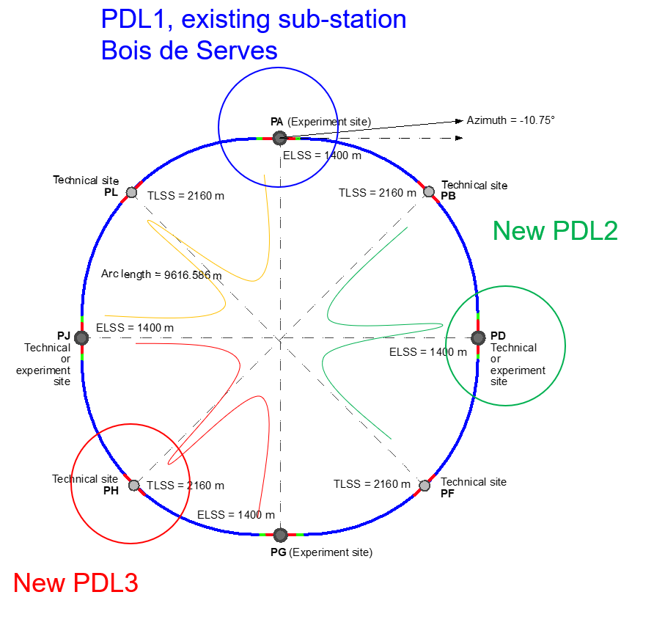
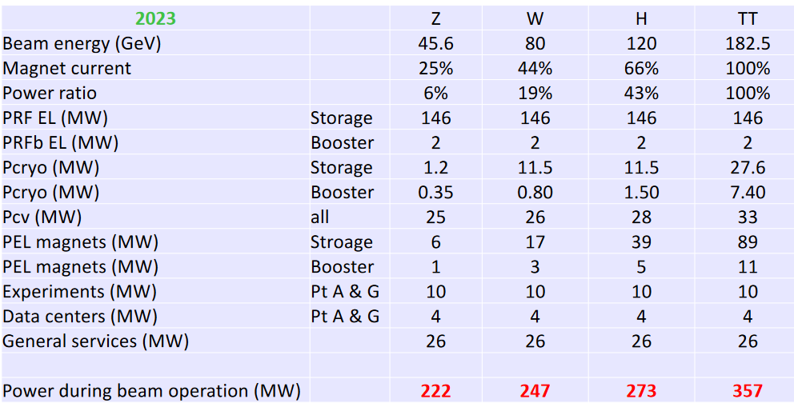
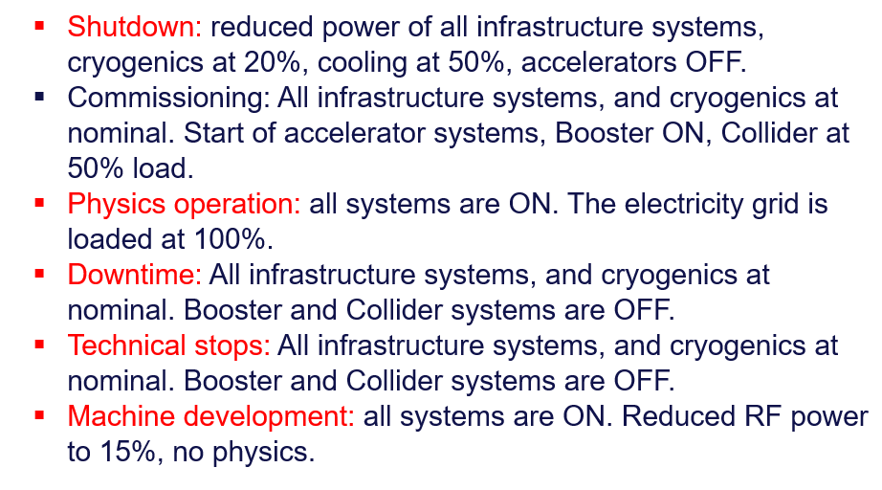
Klaus Hanke
15
Update of the power demand and energy consumption, grid connection
Jean-Paul Burnet

Slide 16

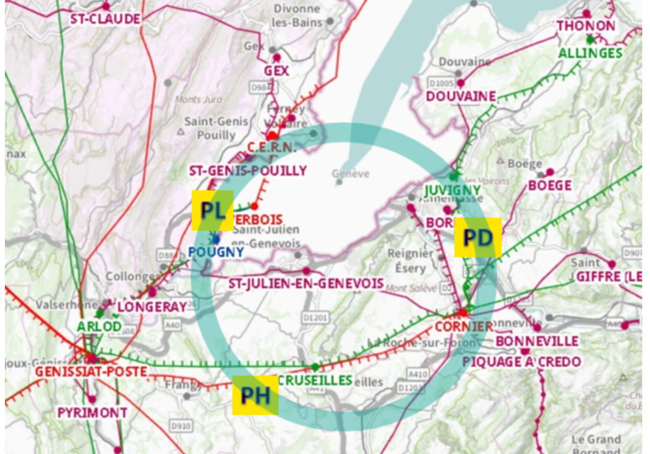
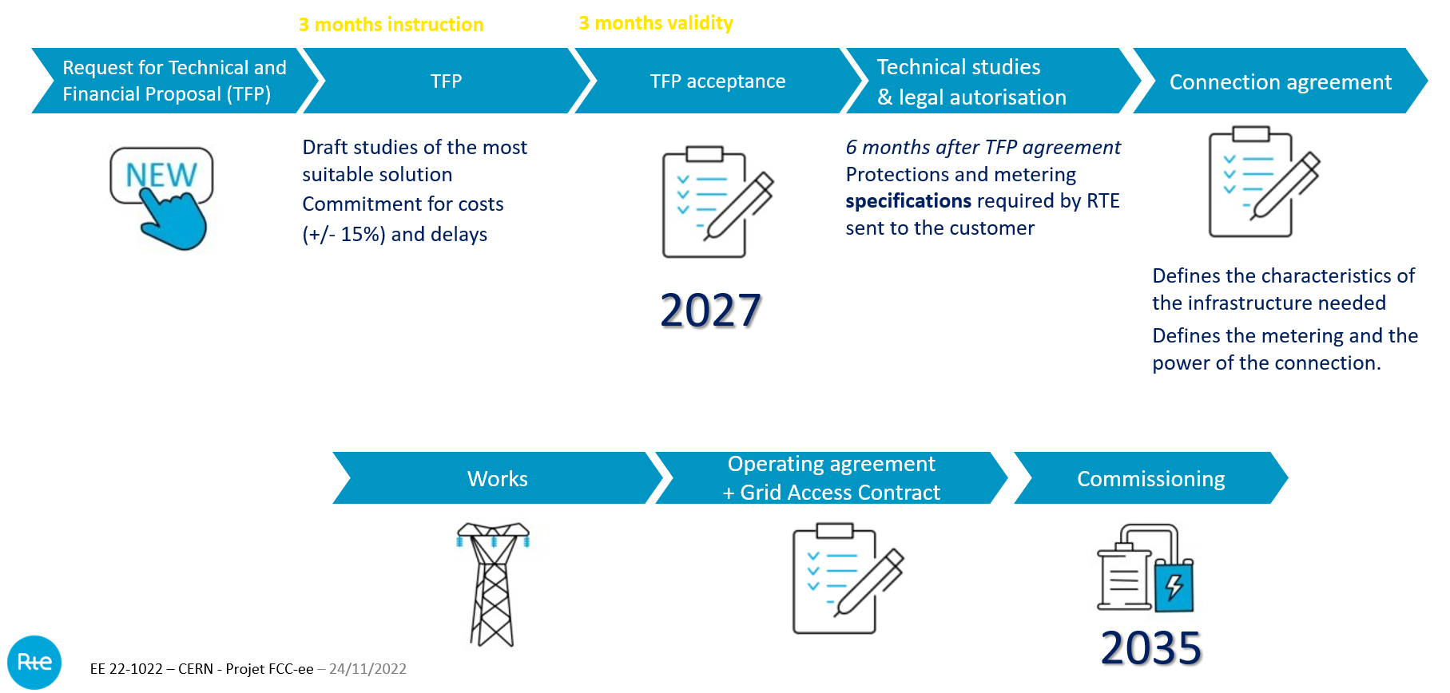
Klaus Hanke
16
RTE preliminary study for grid connection
Jean-François Billerot

Slide 17
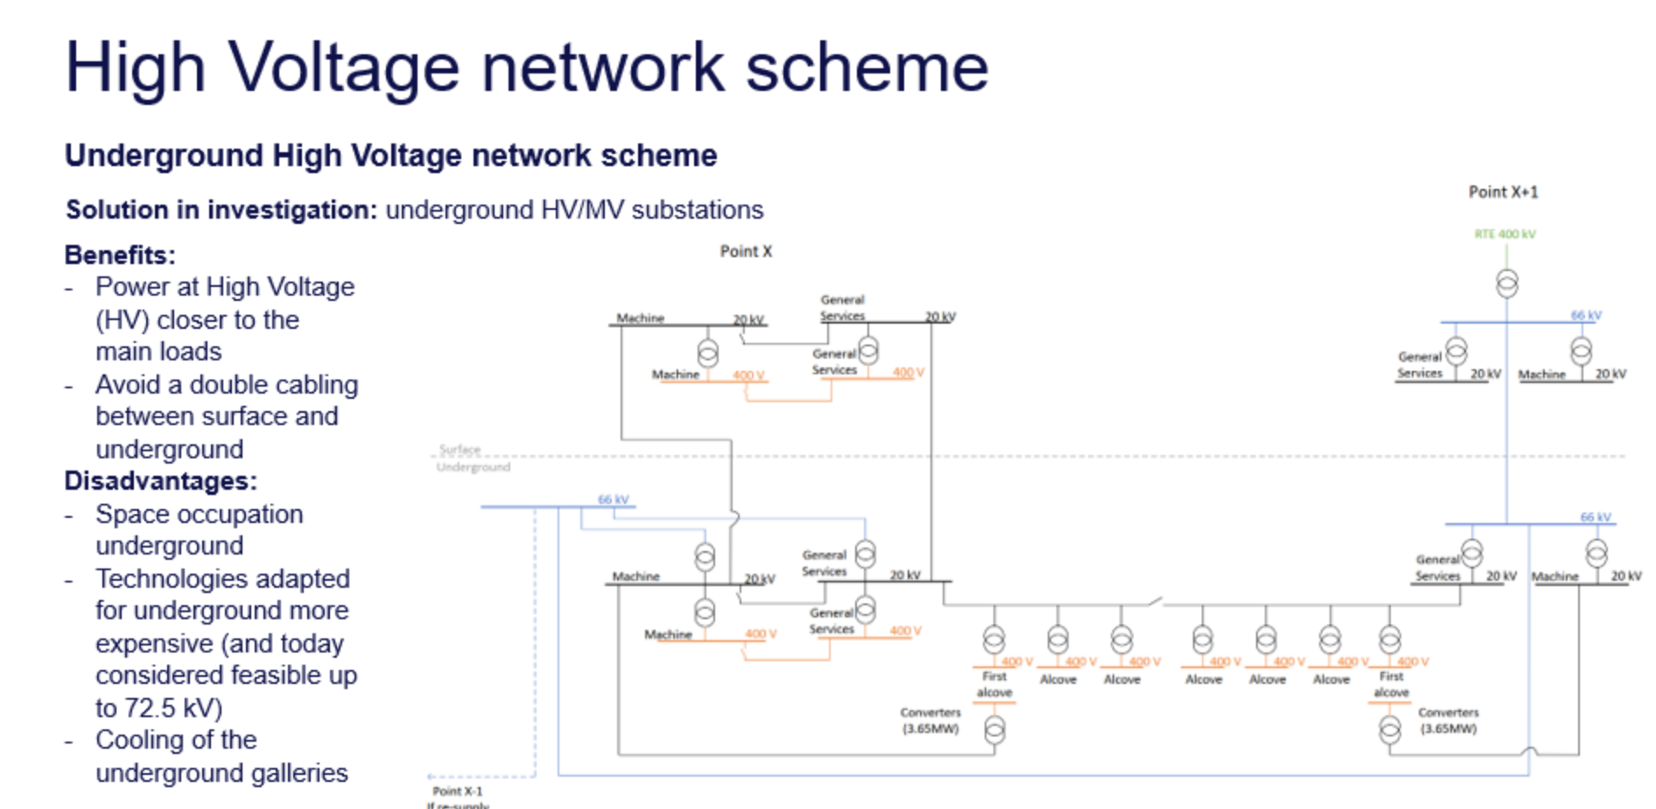
Klaus Hanke
17
Electrical distribution concept and layout
Charline Marcel
Innovation is to move the substations under ground

Slide 18
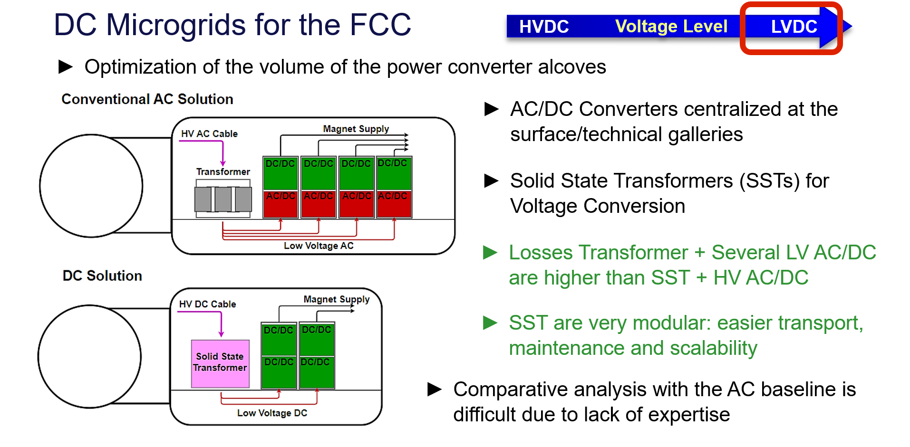
Klaus Hanke
18
DC Networks for the Powering of the FCC-ee and FCC-hh
Manuel Colmenero Moratalla

Slide 19
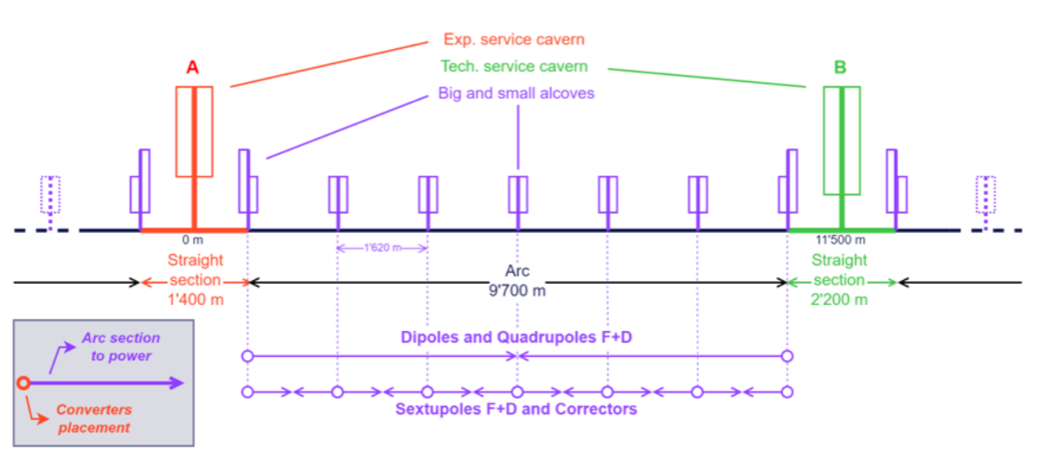
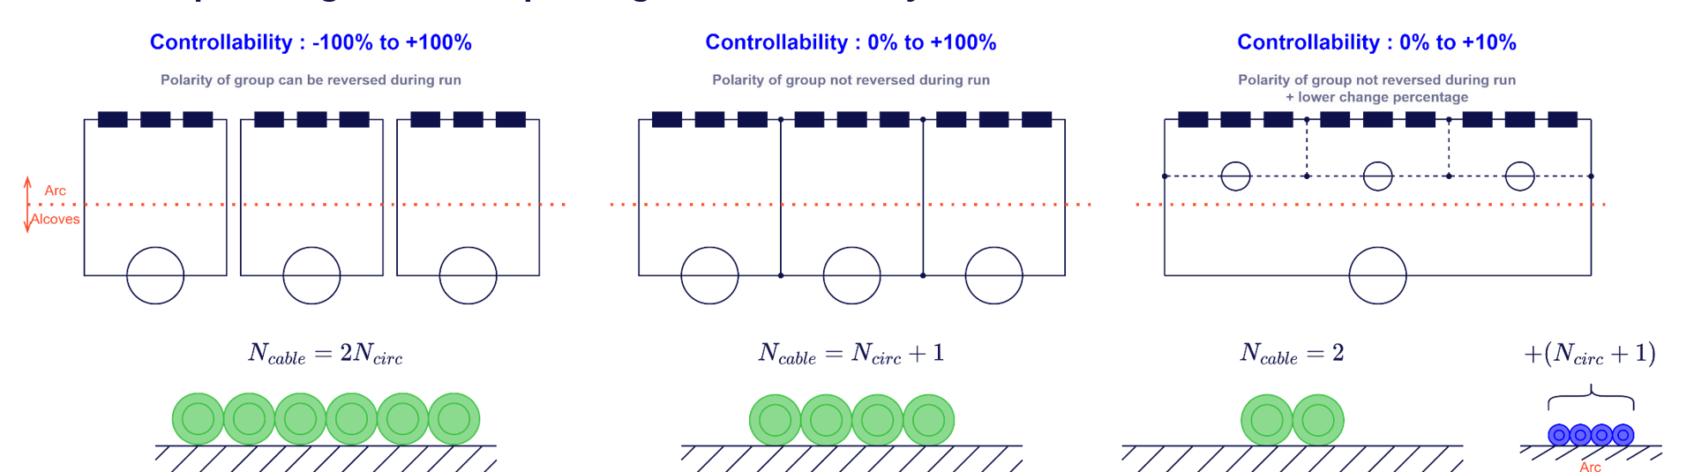
Klaus Hanke
19
Powering of magnet concept and requirements
Byamba Wicki
Large number of smaller power supplies (sextupoles, …)
Overall optimisation needed
Input for magnets needed
example:
sextupoles

Slide 20
Technical infrastructure safety, transport, survey
Klaus Hanke
20

Slide 21
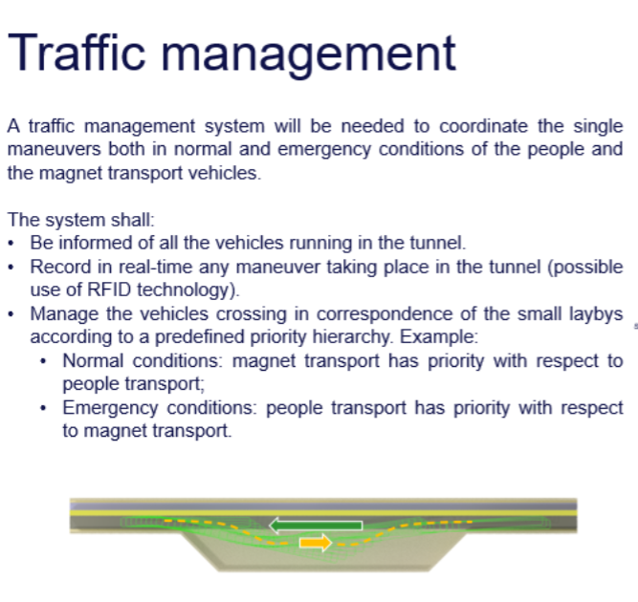
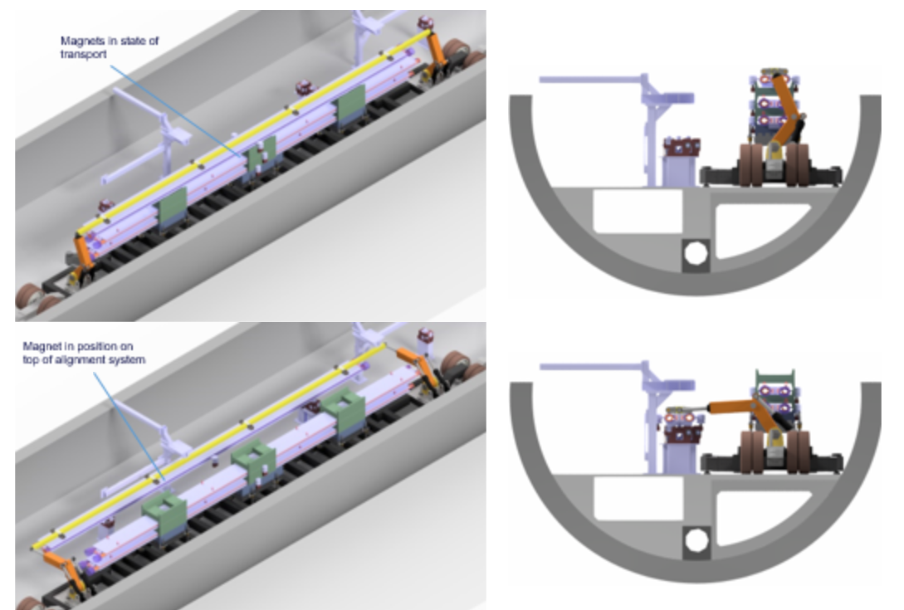
Klaus Hanke
21
Update of transport concept for personnel and material
Roberto Rinaldesi
Transport of accelerator components

Slide 22
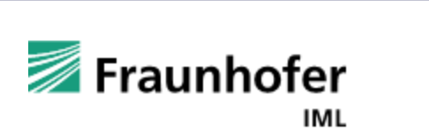
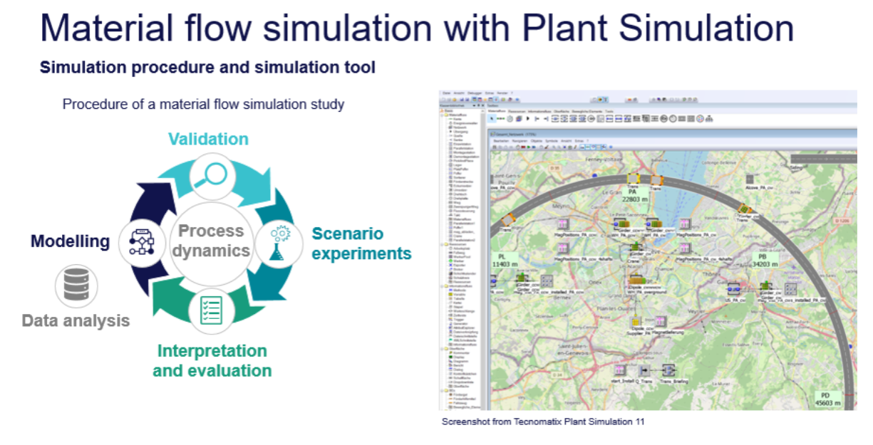
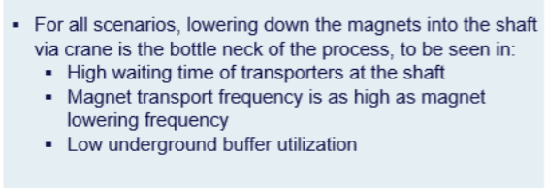
Klaus Hanke
22
Update on material logistic concept
Benedikt Oliver Müller
Summary | Scenario | 2s2v | 2s4v | 4s2v | 4s4v
 | KPI | Value | Value | Value | Value
General | Overall simulation time [h] | 5928* | 5496* | 2760* | 2760*
Magnet transport | Transport time [h] | 5424 | 4584 | 2304 | 2280
 | Magnets transported per day and shaft | 20 | 23 | 23 | 23
Magnet aligning and connecting | Aligning and connecting time [h] | 5904* | 5472* | 2736* | 2736*
 | Magnets aligned and connected per day and shaft | 18* | 19* | 19* | 19*
Transporters waiting at shaft for crane with magnet | No. of times waiting for magnet | 865 | 2440 | 865 | 1223
 | Accumulated total waiting for crane time [hh:mm:ss] | 735:21:59 | 3149:32:22 | 741:48:04 | 1734:48:20
 | Avg waiting for crane time [hh:mm:ss] | 0:51:00 | 1:17:27 | 0:51:27 | 1:25:07
Transporter waiting for other transporters to pass by | No. of encounters | 0 | 2449 | 0 | 1221
 | Accumulated total encounter waiting time [hh:mm:ss] | 0:00:00 | 2664:00:52 | 0:00:00 | 1866:18:18
 | Avg encounter waiting time [hh:mm:ss] | 0:00:00 | 1:05:21 | 0:00:00 | 1:31:56
 |  |  |  |  | s = shafts
 |  |  |  |  | v = vehicles per shaft

Slide 23
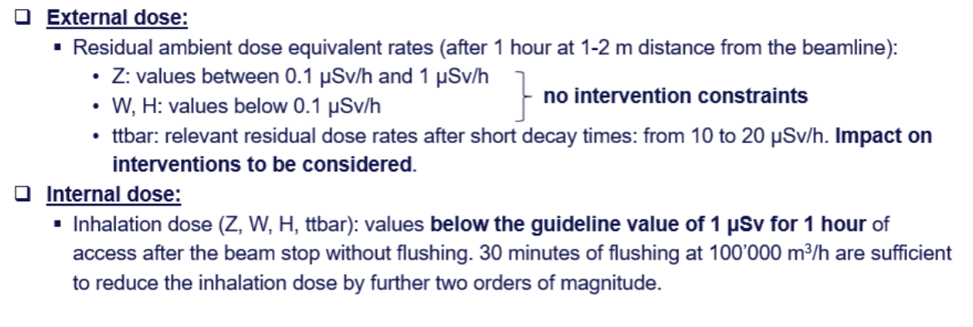
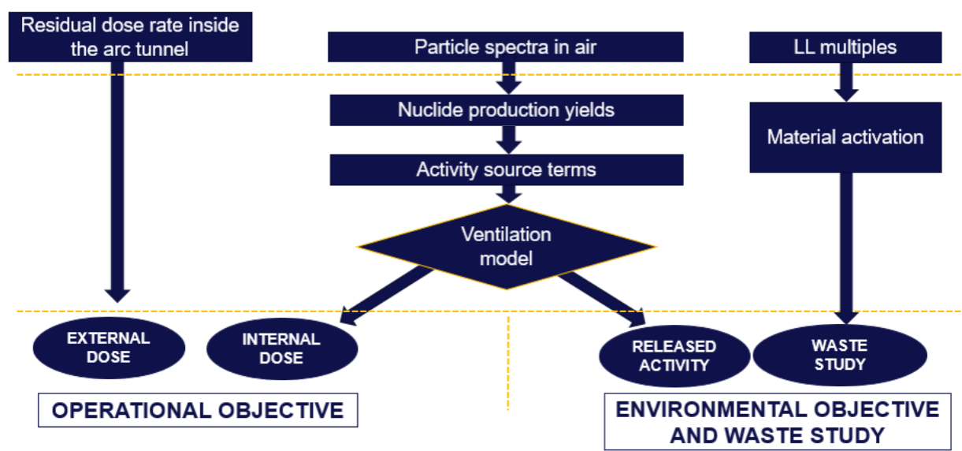
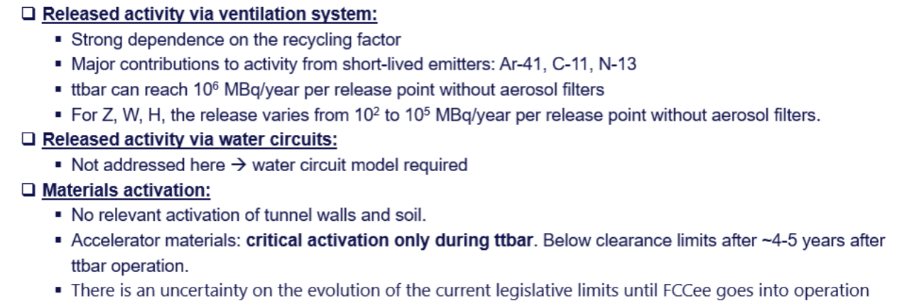
Klaus Hanke
23
Radiation protection studies for the FCC-ee
Giacomo Lavezzari
Evaluation concerns the arcs only. Contributions from the straight sections (experiments, collimators, beamstrahlung) are not yet estimated and will come in addition.

Slide 24
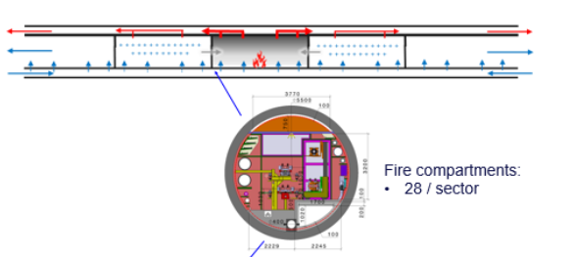
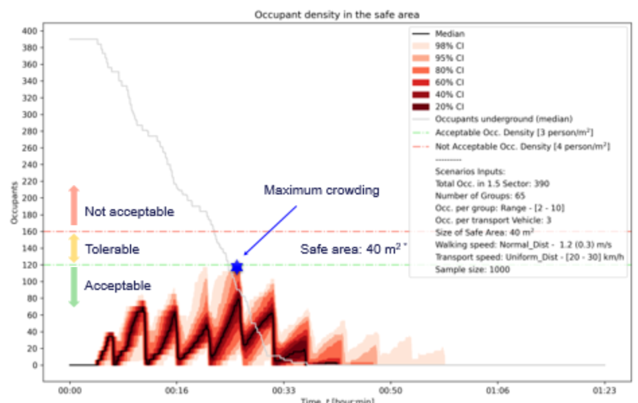
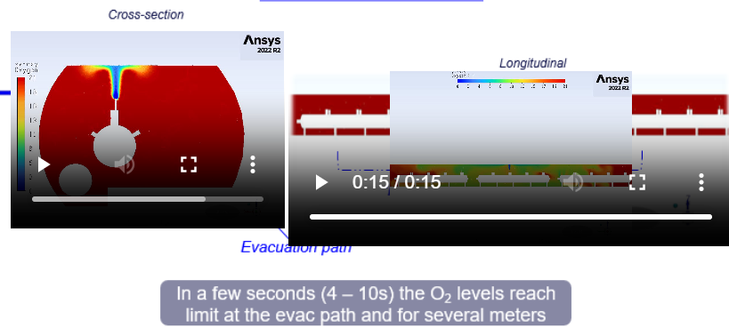
Klaus Hanke
24
Overview of safety systems and evacuation study in the FCC tunnel
Andre Henriques
Fire safety
Evacuation simulations
Cryo release

Slide 25
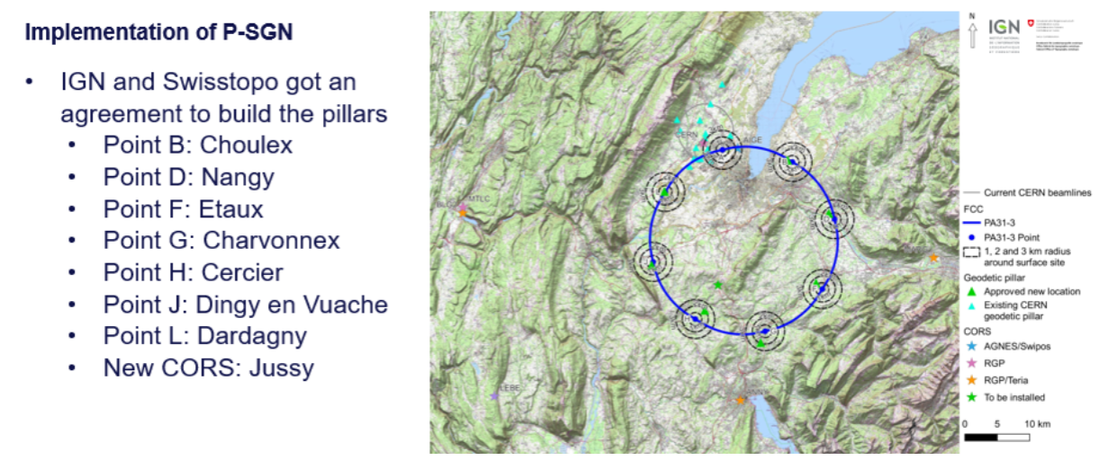
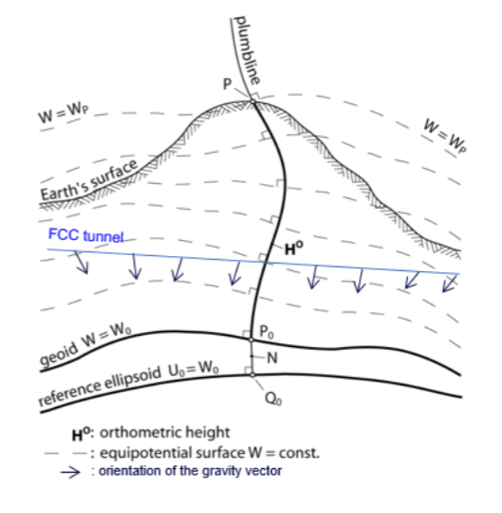
Klaus Hanke
25
Geodesy and survey update
Benjamin Weyer
Primary Surface Geodetic Network
Geoid modelling

Slide 26

Klaus Hanke
26
26
Thank you for your attention
Big thanks to all speakers and chairpersons of the Infrastructure Sessions

