Slide 1

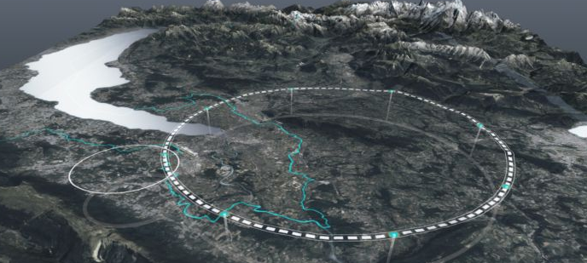





Paolo Craievich (PSI) on behalf of the CHART/FCCee Injector design collaboration
FCC-ee injector summary
FCC Week 2023, 5-9 June (London, United Kingdom

Slide 2
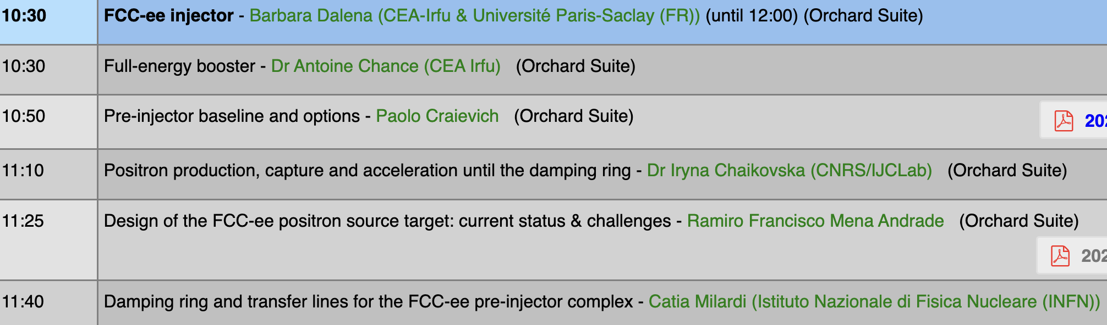
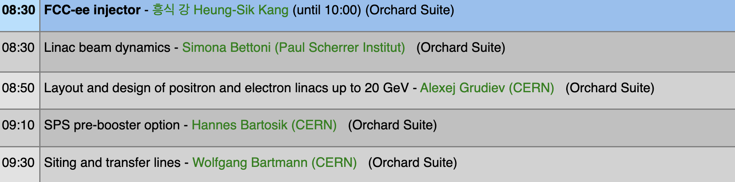
Injector (I and II) sessions
Wednesday 7 June
Thursday 8 June

Slide 3
FCCee Pre-Injector parameters (Z-pole)
K. Oide, H. Bartosik (SPS), FCC week 2023 talks
 | SPS | HE Linac | Unit
Injection energy | 6 | 20 | GeV
Bunch charge both species | 4.0* | 4.0* | nC
Repetition rate | 200 | 200 | Hz
Number of bunches | 2 | 2
Bunch spacing | 25 | 25 | ns
Normalized emittance (x, y) (rms) | 50,? | 10,10 | mm mrad
Bunch length (rms) | ~1? | ~1 | mm
Energy spread (rms) | 0.3 | ~0.1 | %
*Maximum charge to be injected into the collider rings during filling from scratch 4 nC (bunch pop. 2.5x10¹⁰ particles)
The bunch by bunch intensity will arbitrarily vary from 0 to 100%, depending on the intensity balance between the collider rings → to be verified the impact on the booster as well
New parameters:
  15000 bunches, 15 ns bunch spacing
  Charge for top-up 2.42 nC (2.5x10¹⁰ particles)
Question: How can we keep different versions of parameter tables?

Slide 4
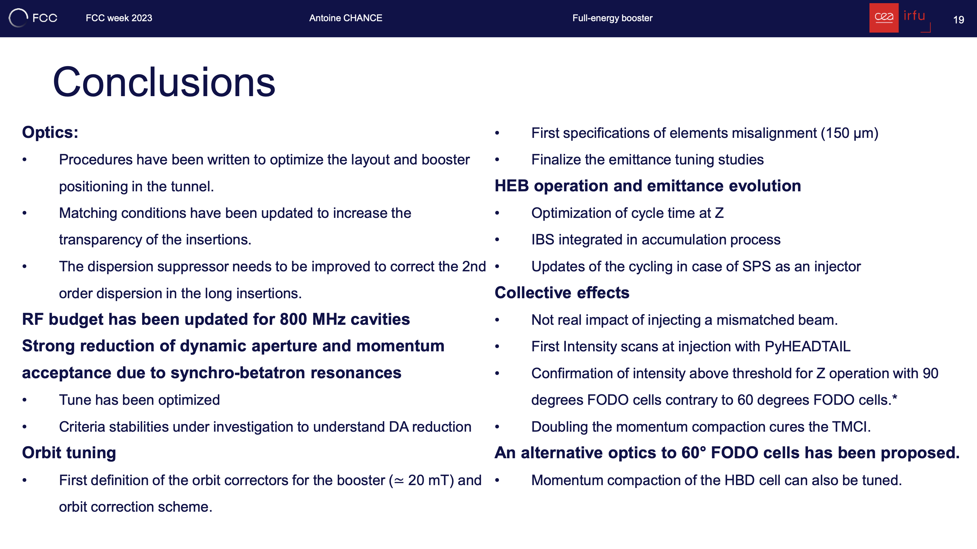

Full-energy booster (conclusion) – Antoine Chance
New Layout, some results are for the optics showed FCC week 2022
Resisitive wall wakes

Slide 5
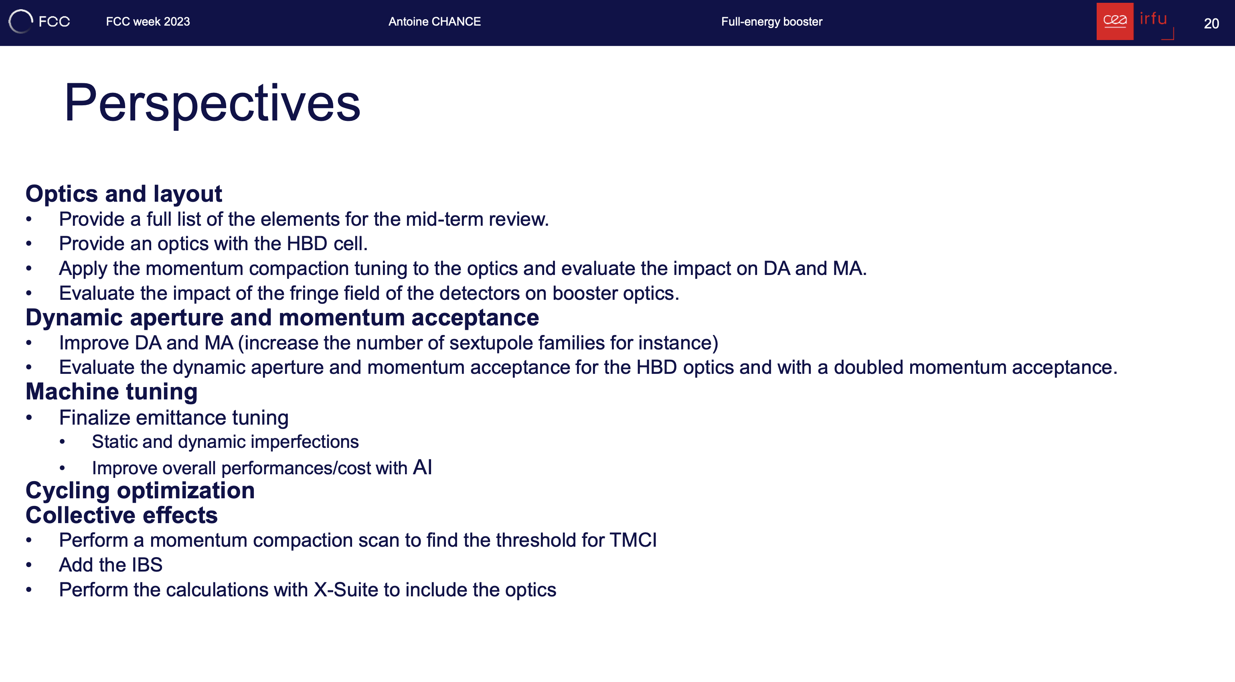
Full-energy booster (Perspectives) – Antoine Chance
Cost estimate due by end June
Including collimators, cavities etc..
Injection:
20 GeV: recheck the beam parameters (i.e., energy spread and bunch length…)
16 GeV: check if the BR can work at this energy
BR operation with a modulated train of bunches

Slide 6
Pre-injector layout (baseline)
A baseline for the pre-injector layout is ready for the mid-term review
Pre-Injector can fulfill the requirements for the collider rings (to be verified with the new parameters)
Submit the cost lines by June
Draft the document (deadline mid-Sept)

Slide 7
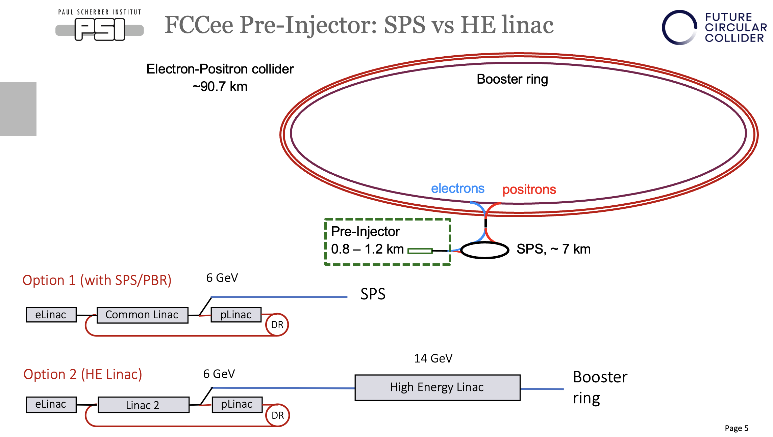
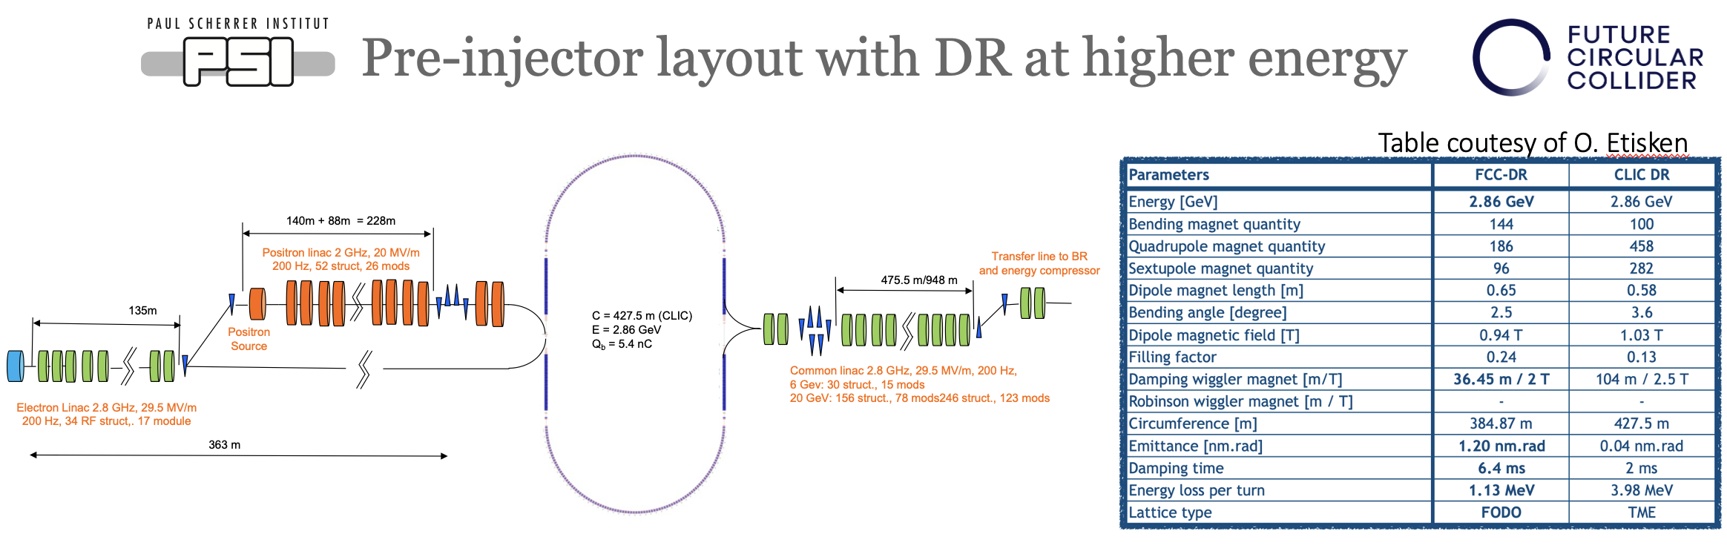
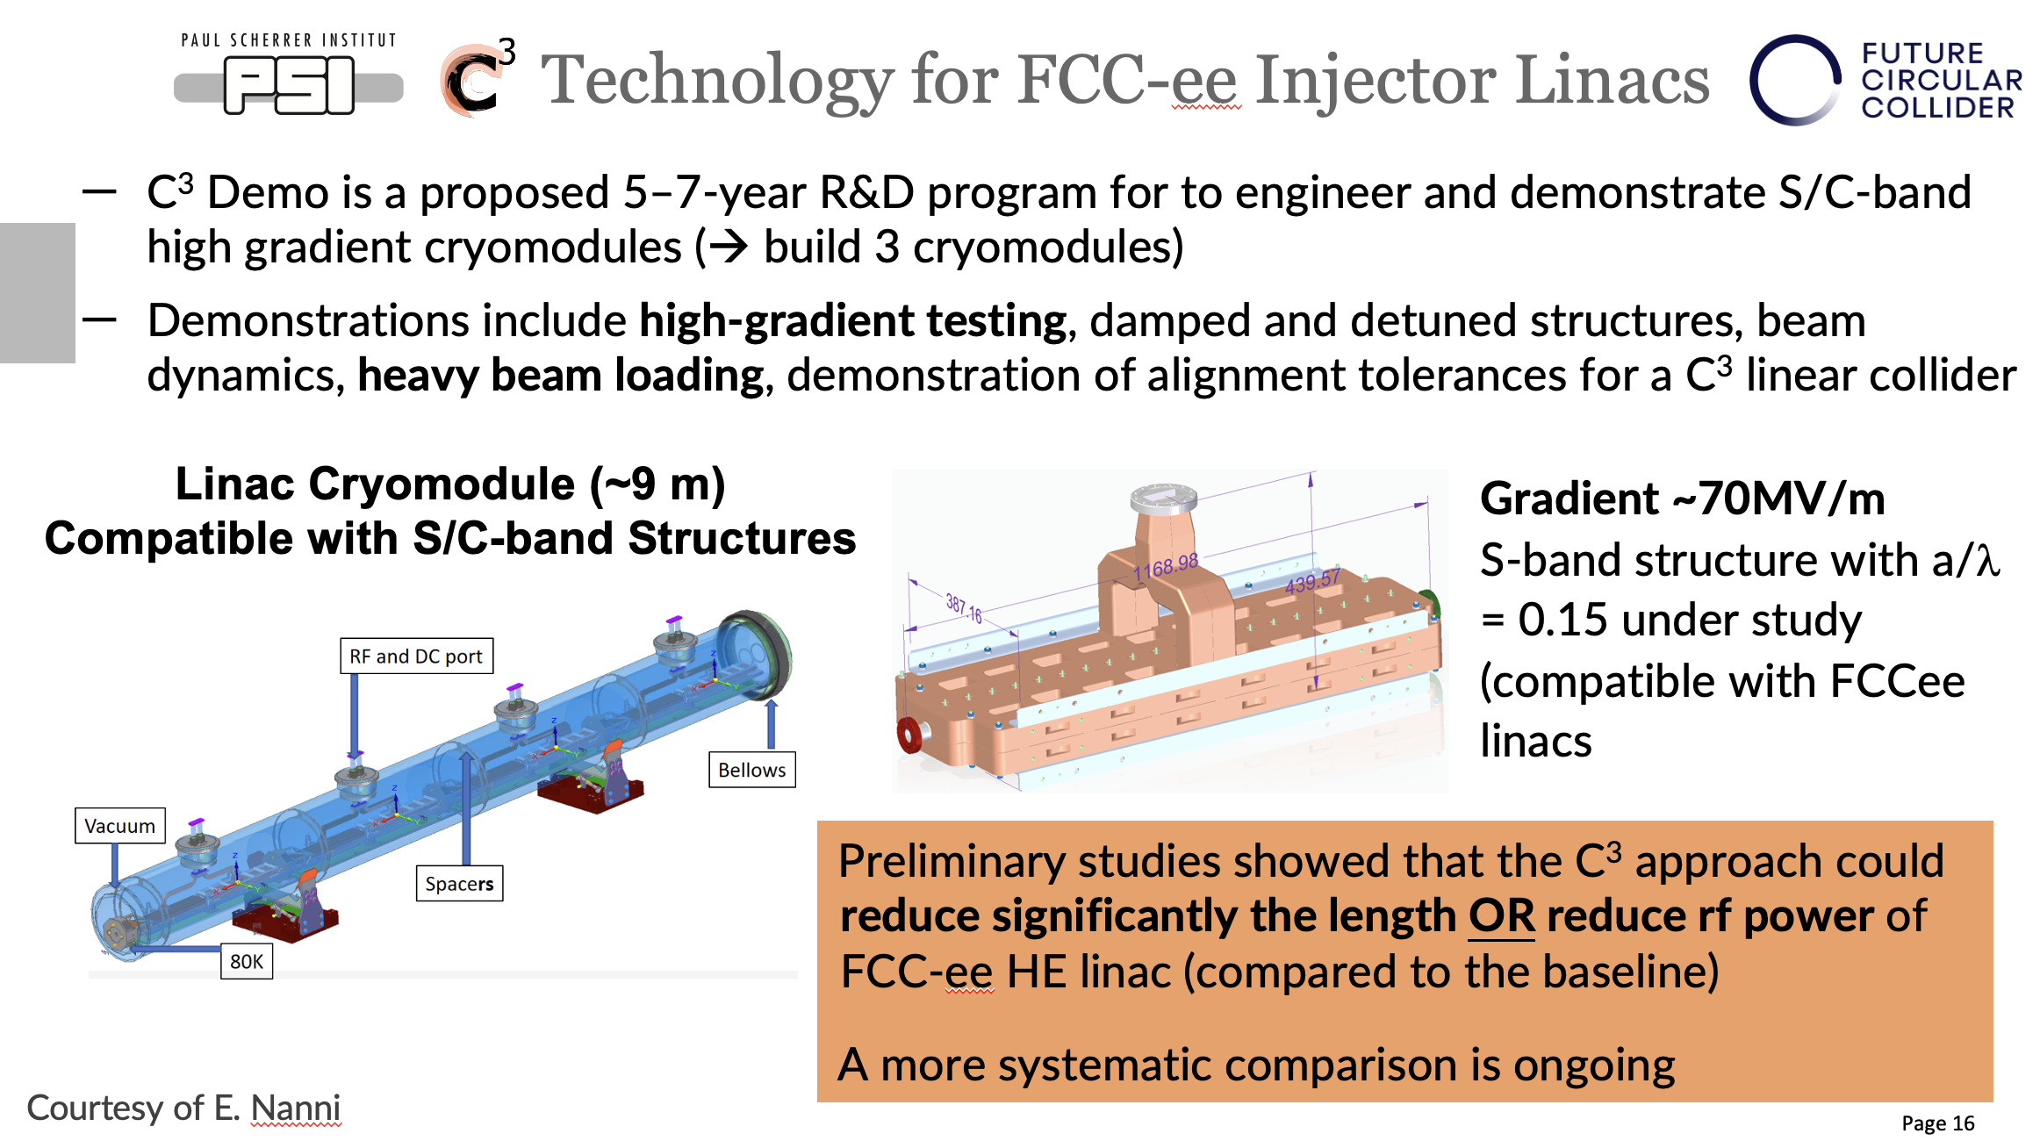
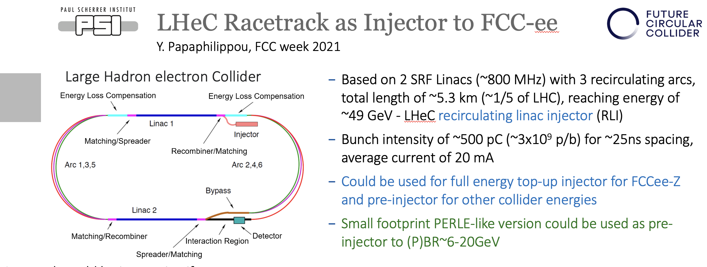
Pre-injector options

Slide 8
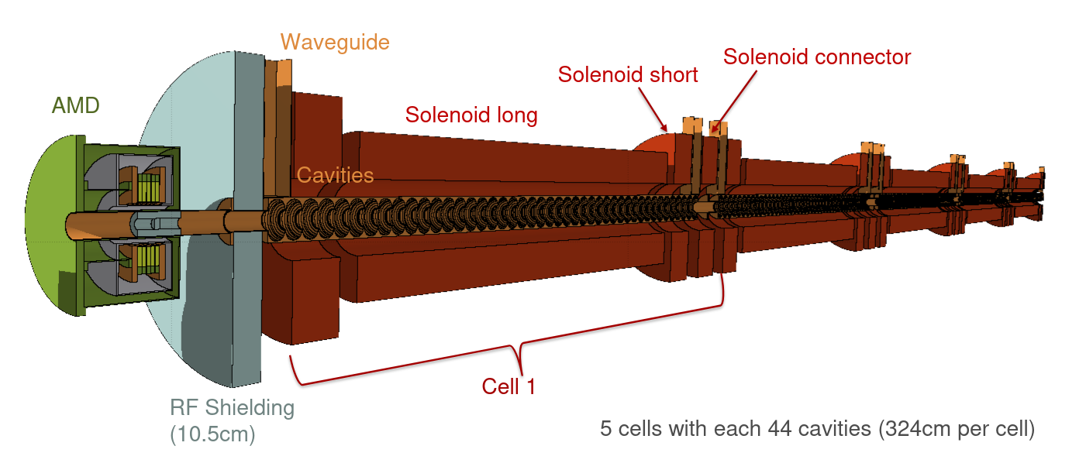
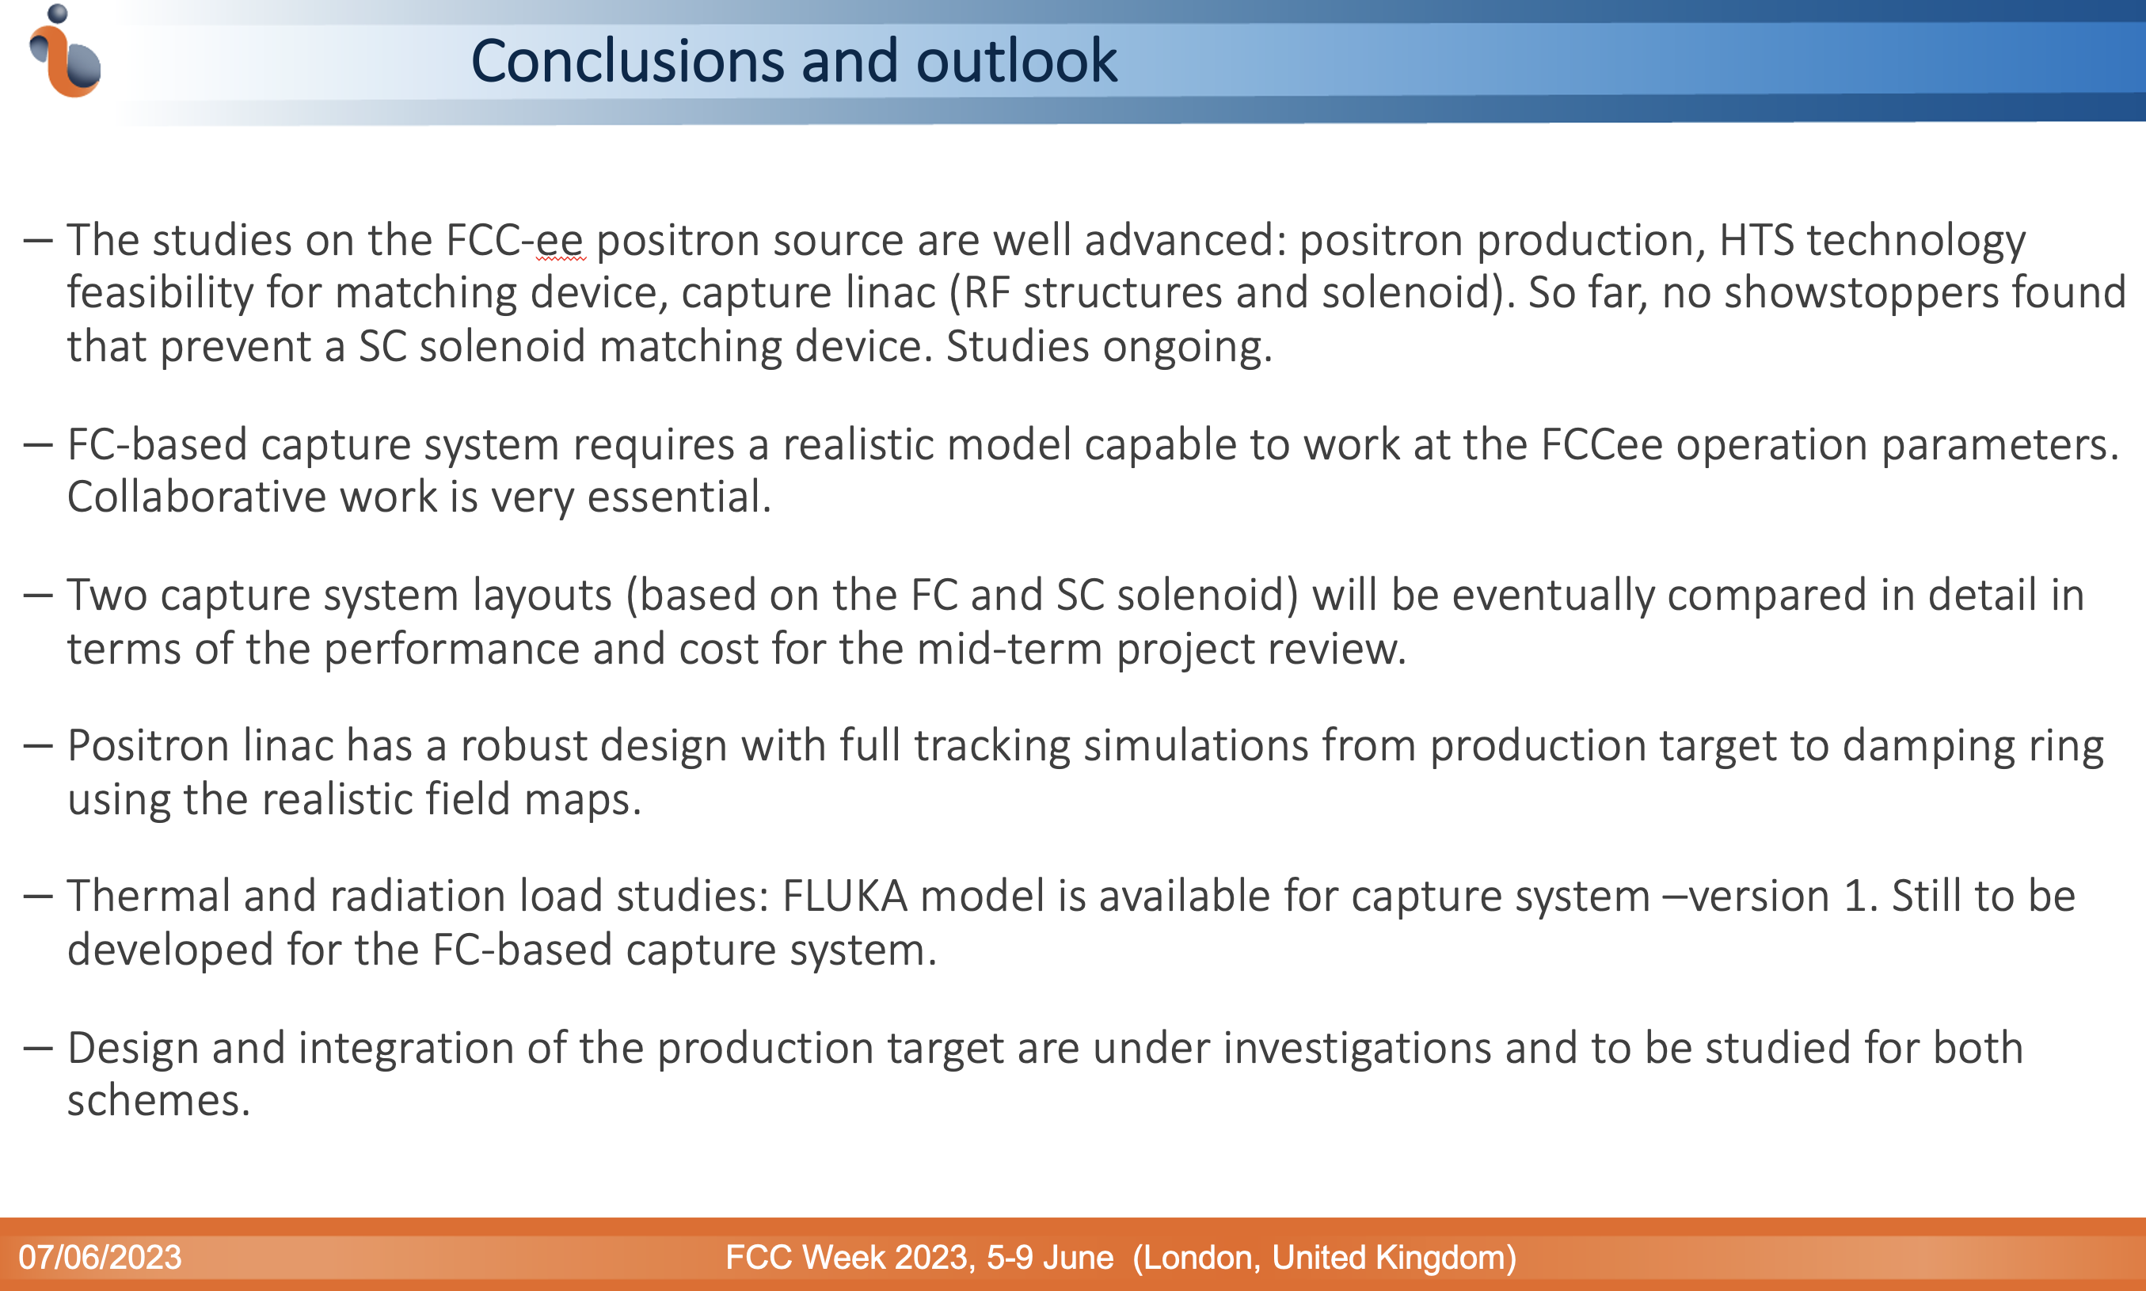
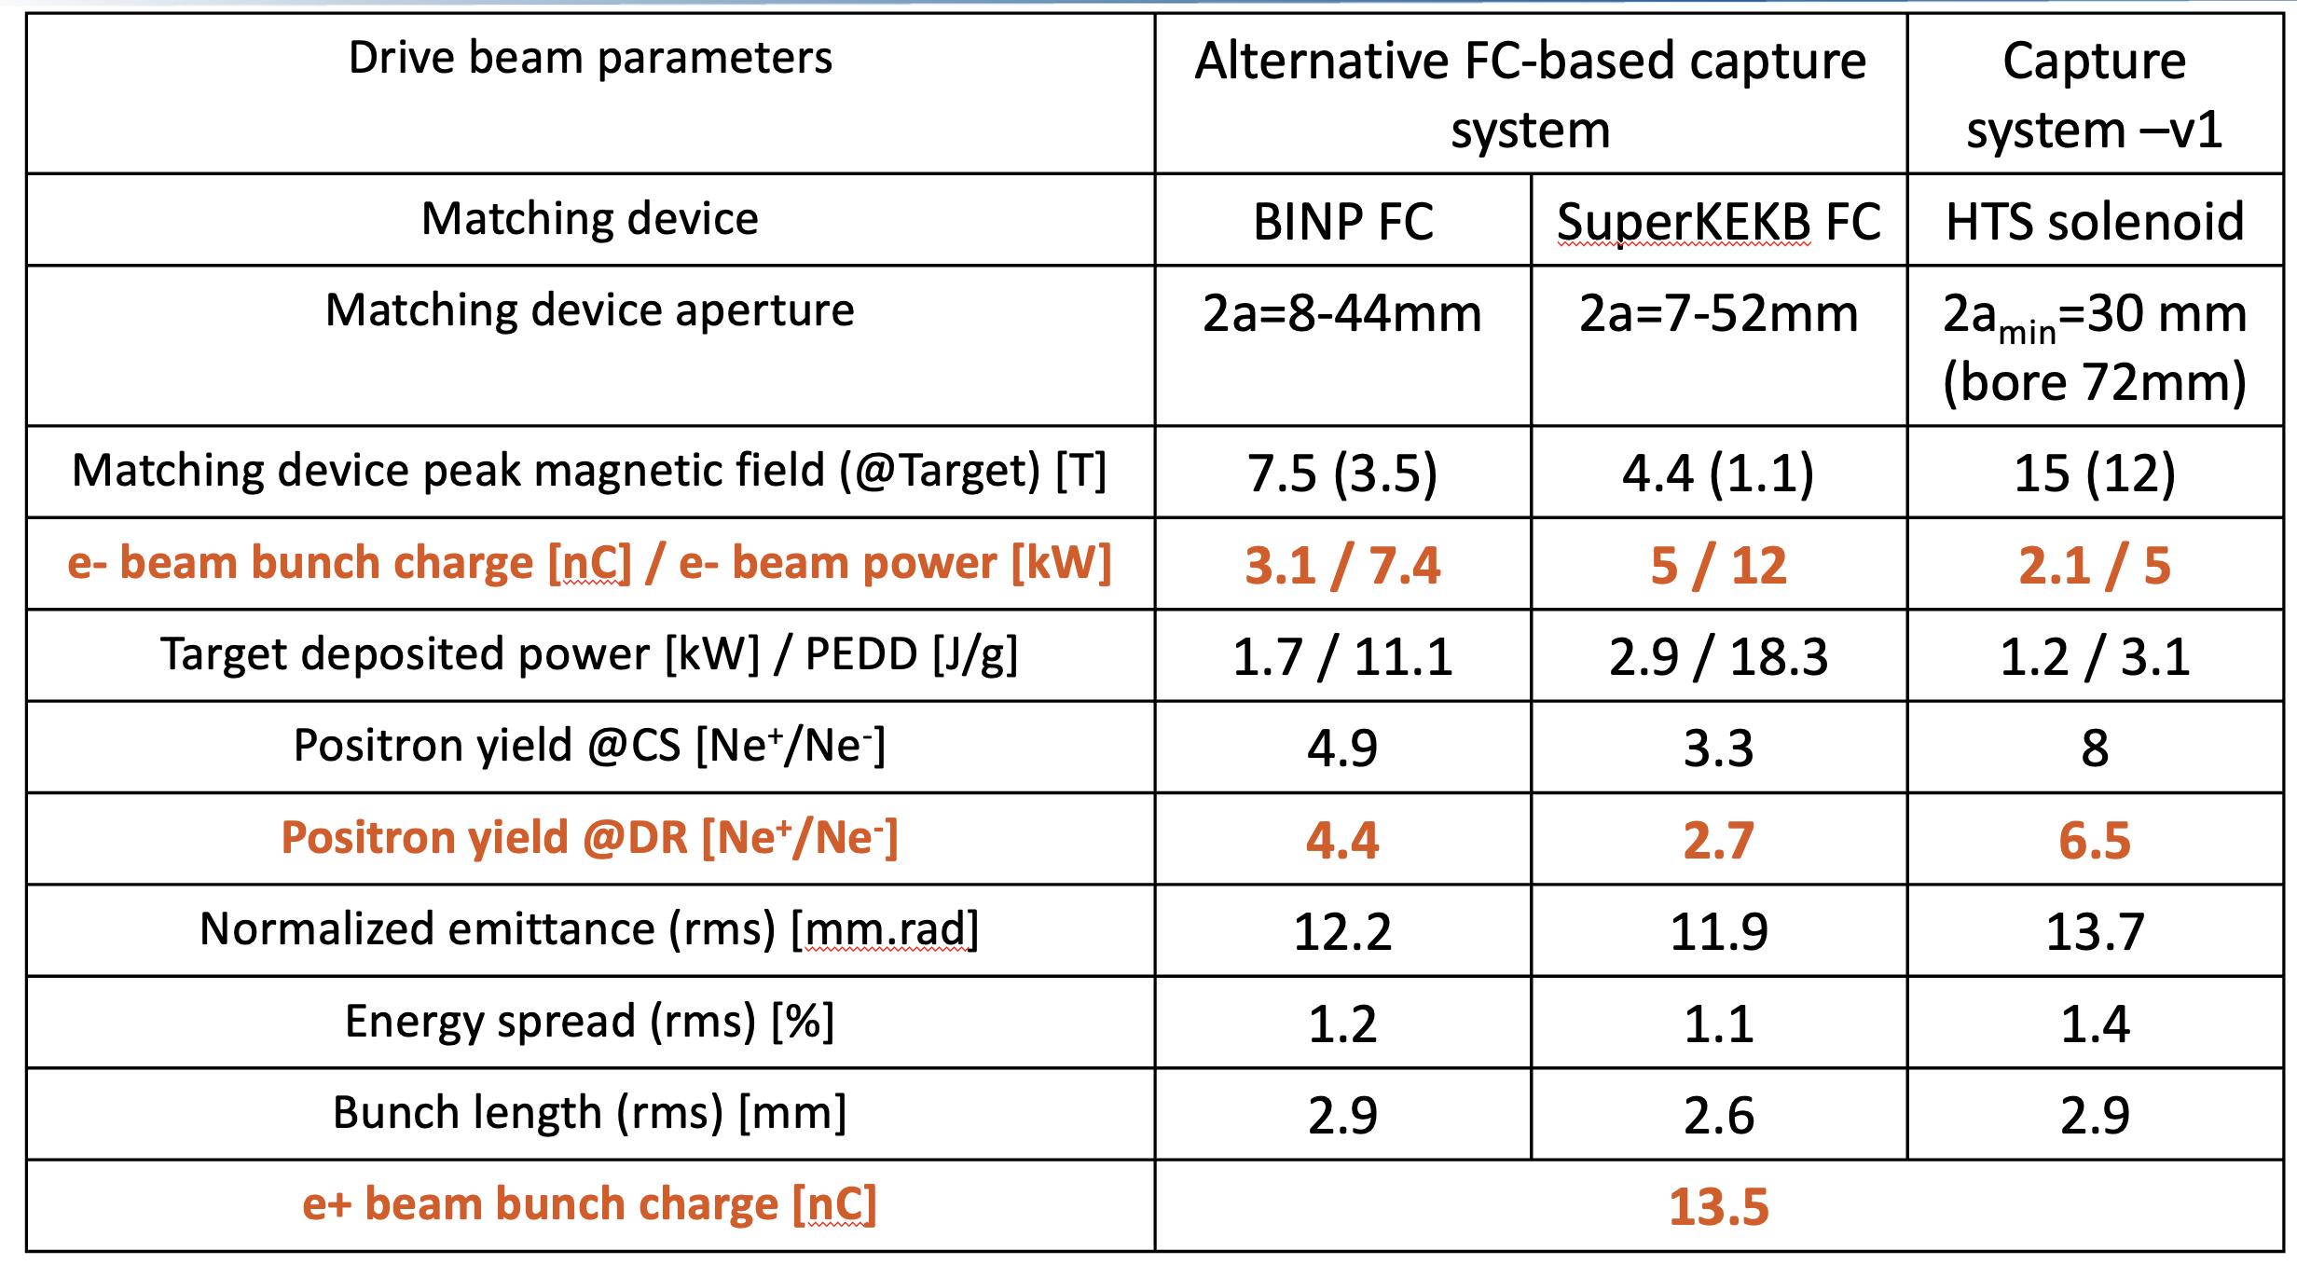
Positron production, capture and acc.
Positron production, capture and acceleration until the damping ring– Iryna Chaikovska

Slide 9
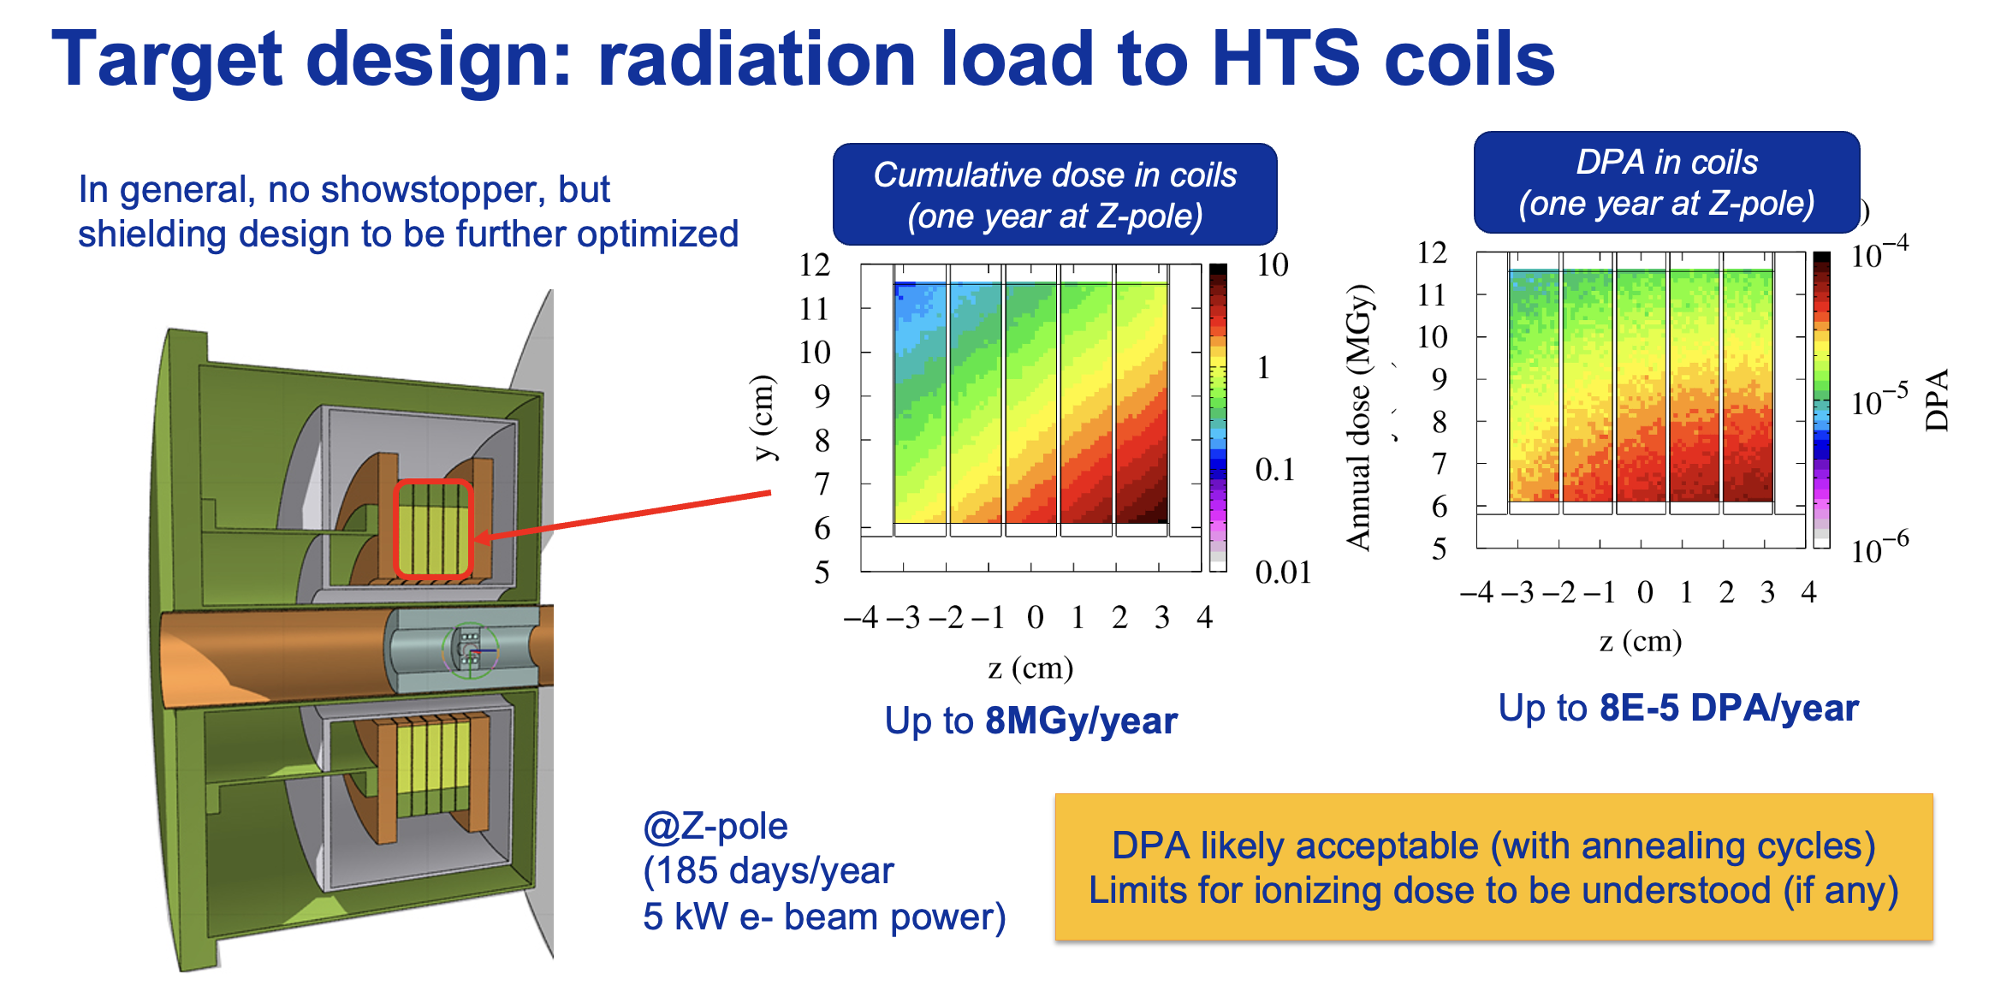
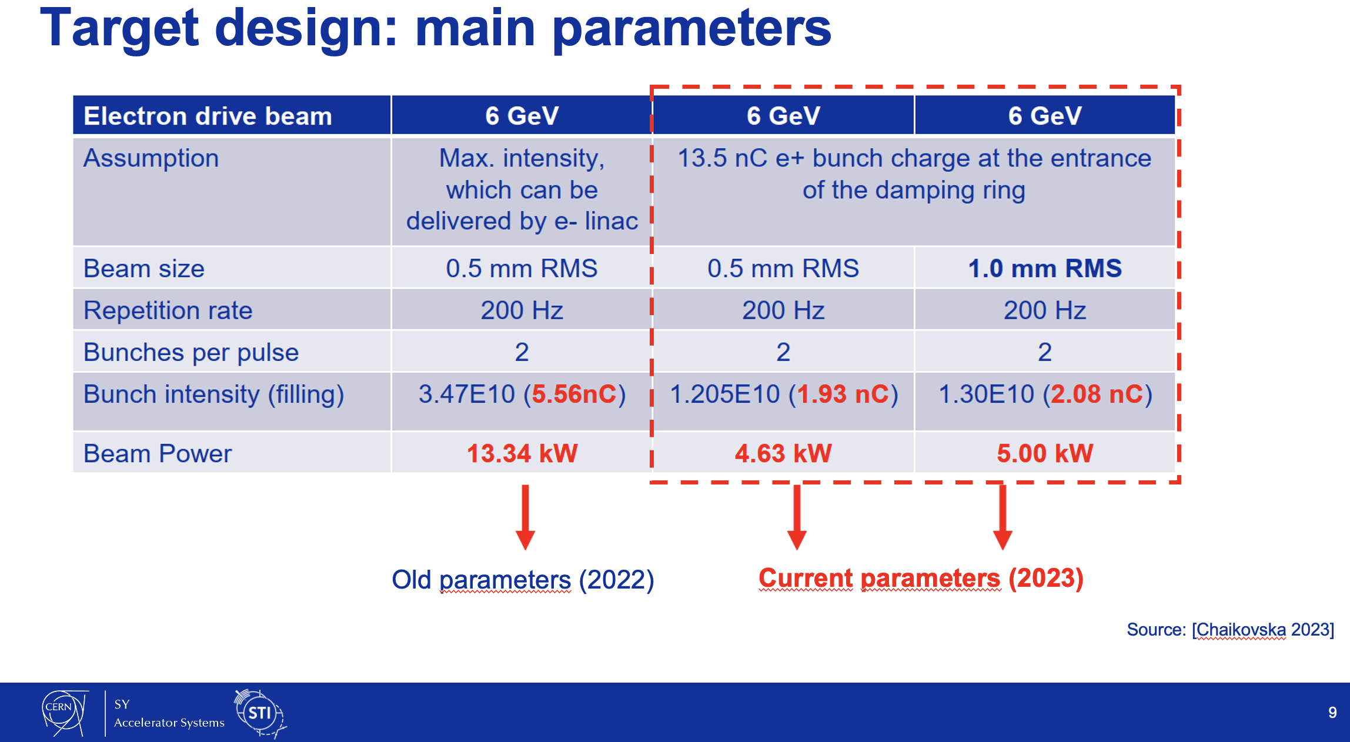
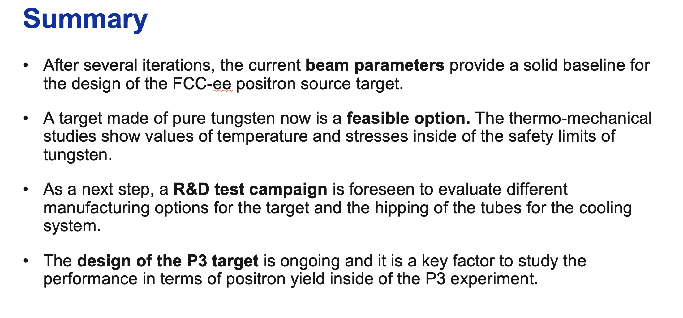
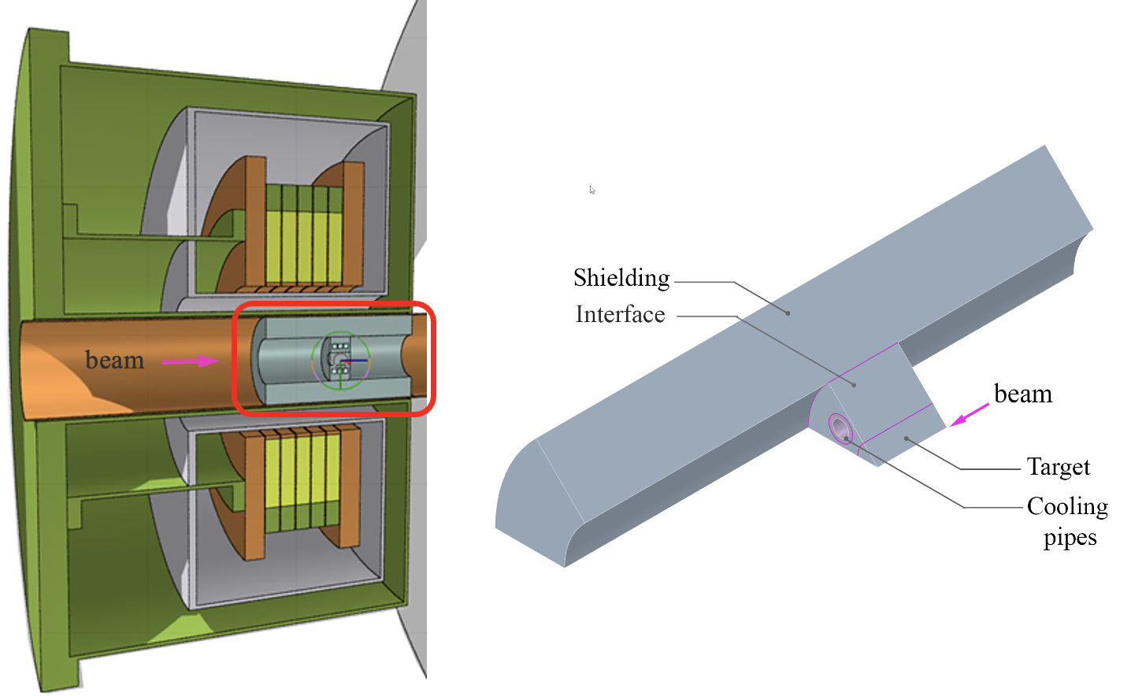
Design of the FCC-ee positron source target: current situation and challenges – Ramiro Mena Andrade
Preliminary cost estimate for the target system ready

Slide 10
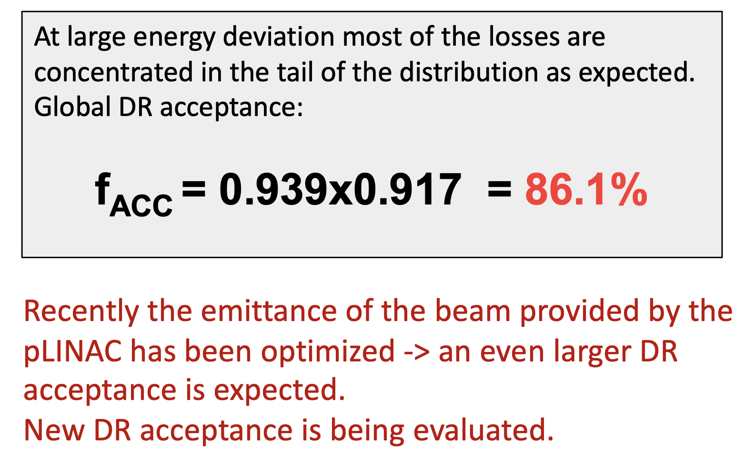
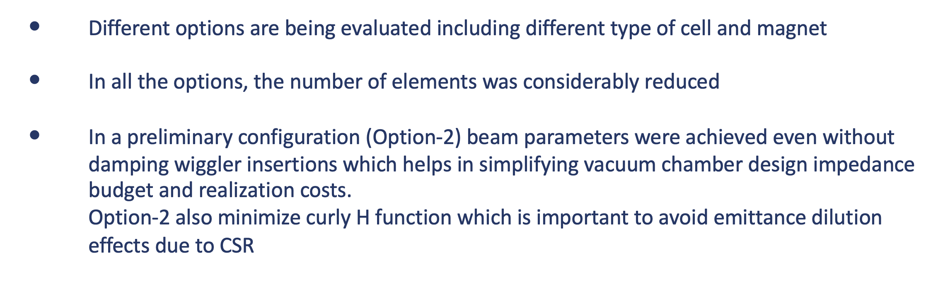
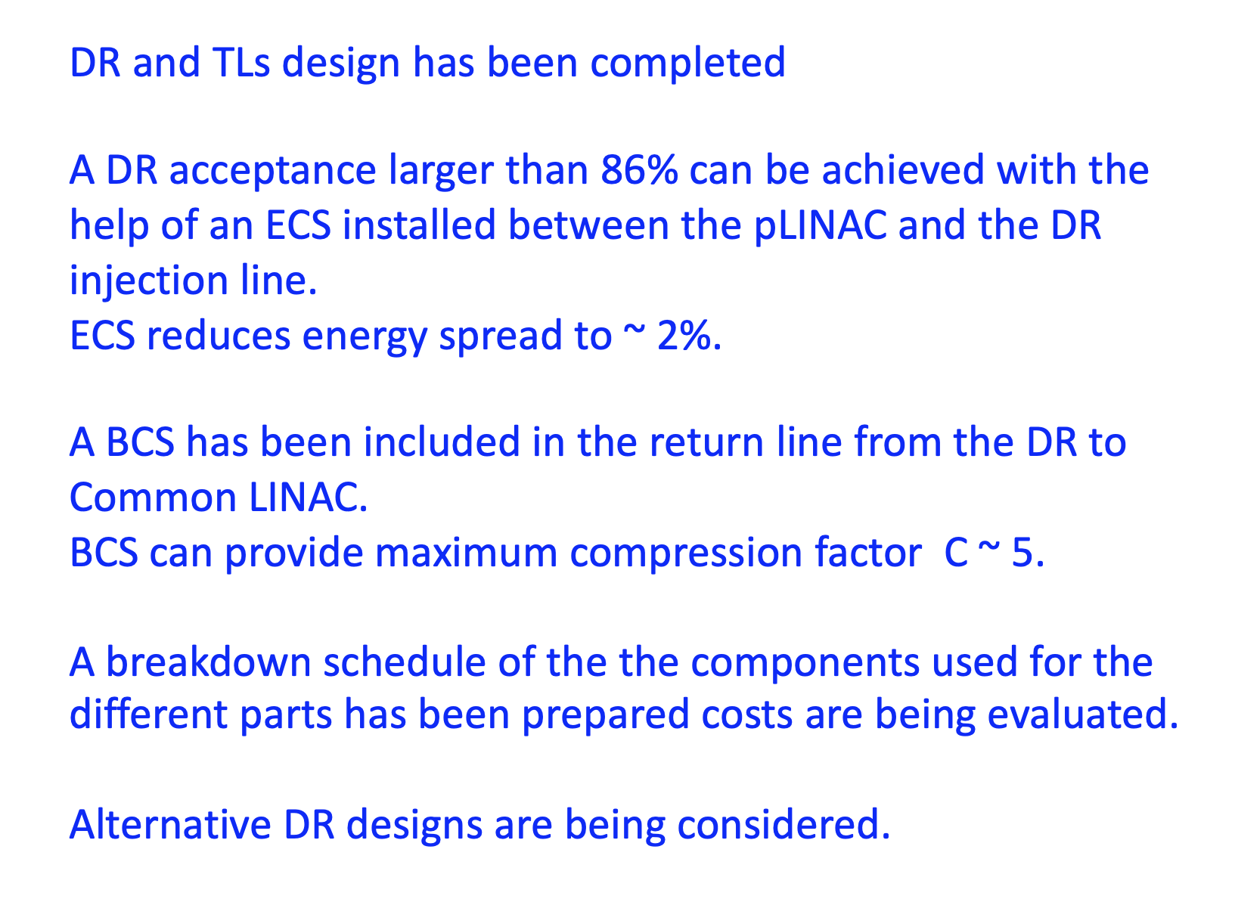
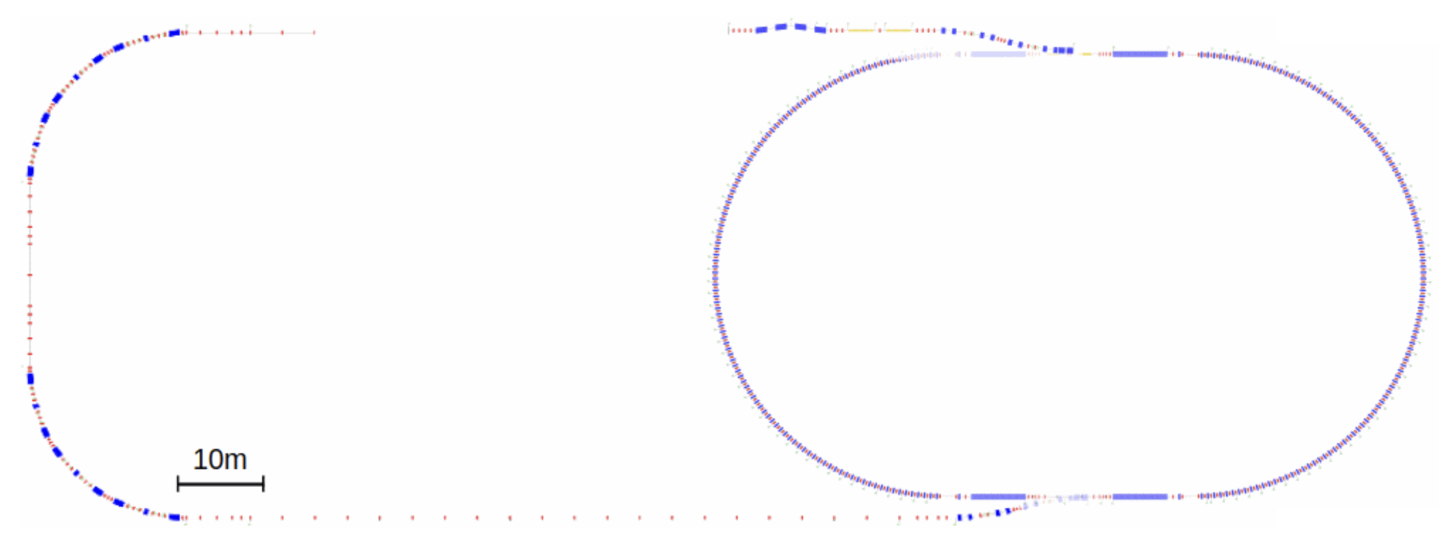
Damping Ring and Transfer Lines for the FCC-ee pre-Injector Complex – Catia Milardi
Alternative DR designs
DR acceptance
Layout ready
Cost estimate will be submitted by June
DR at 1.54 GeV (version CDR 0)

Slide 11
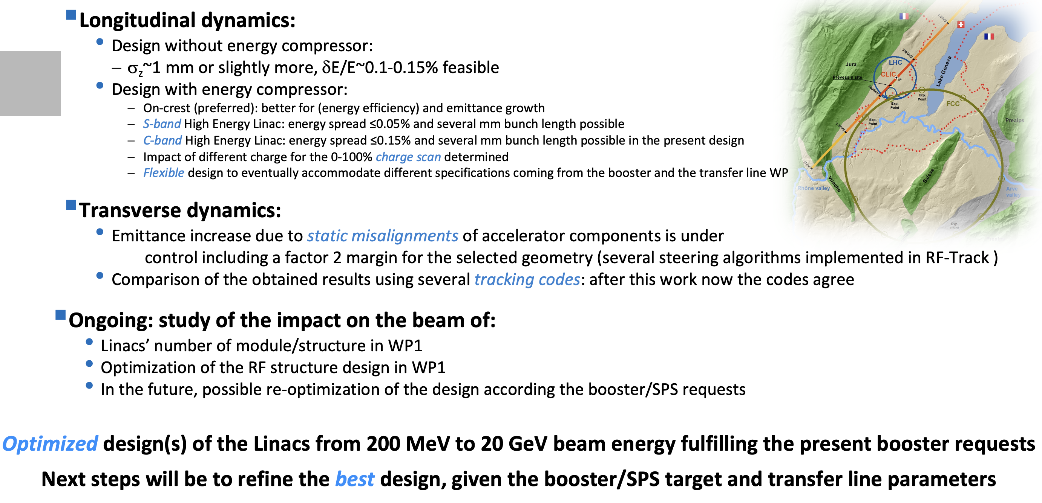
Linac Beam Dynamics – Simona Bettoni

Slide 12
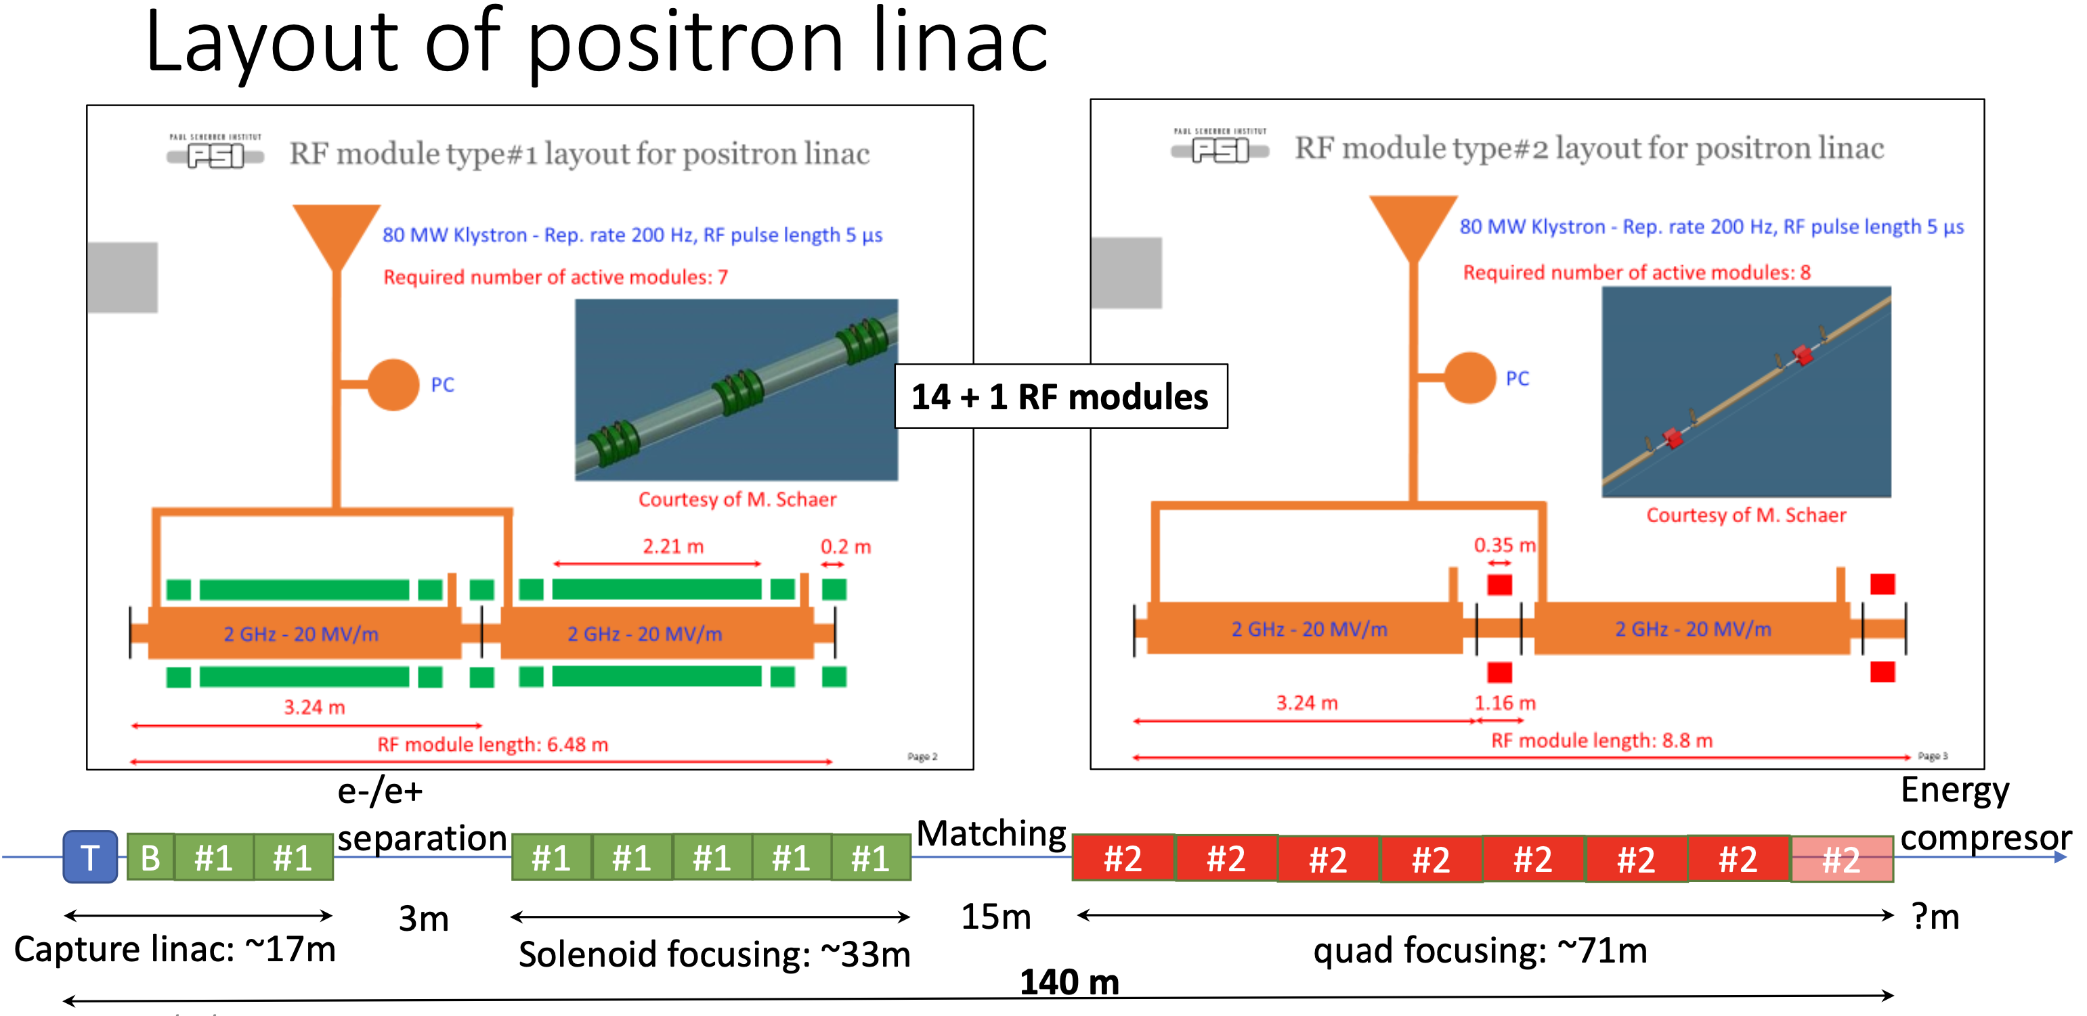
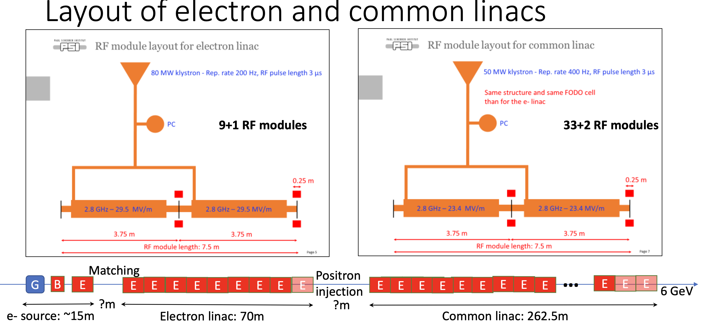
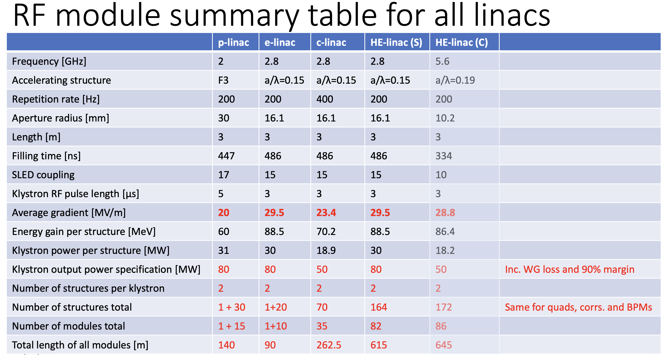
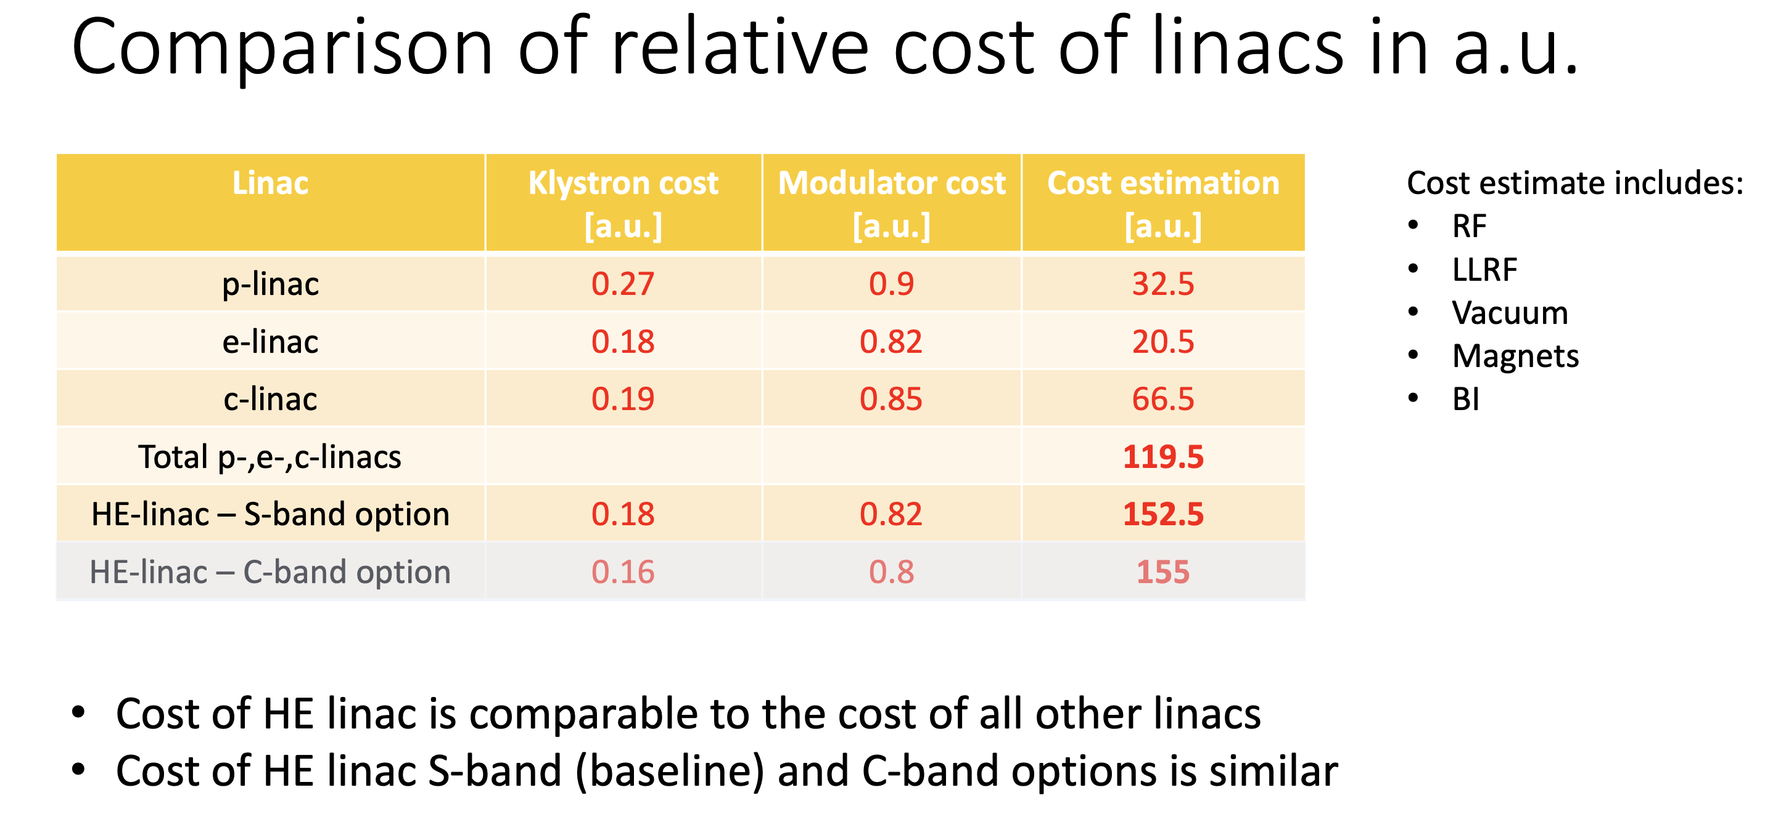
Layout and design of positron and electron linacs up to 20 GeV – Alexej Grudiev 1/2

Slide 13
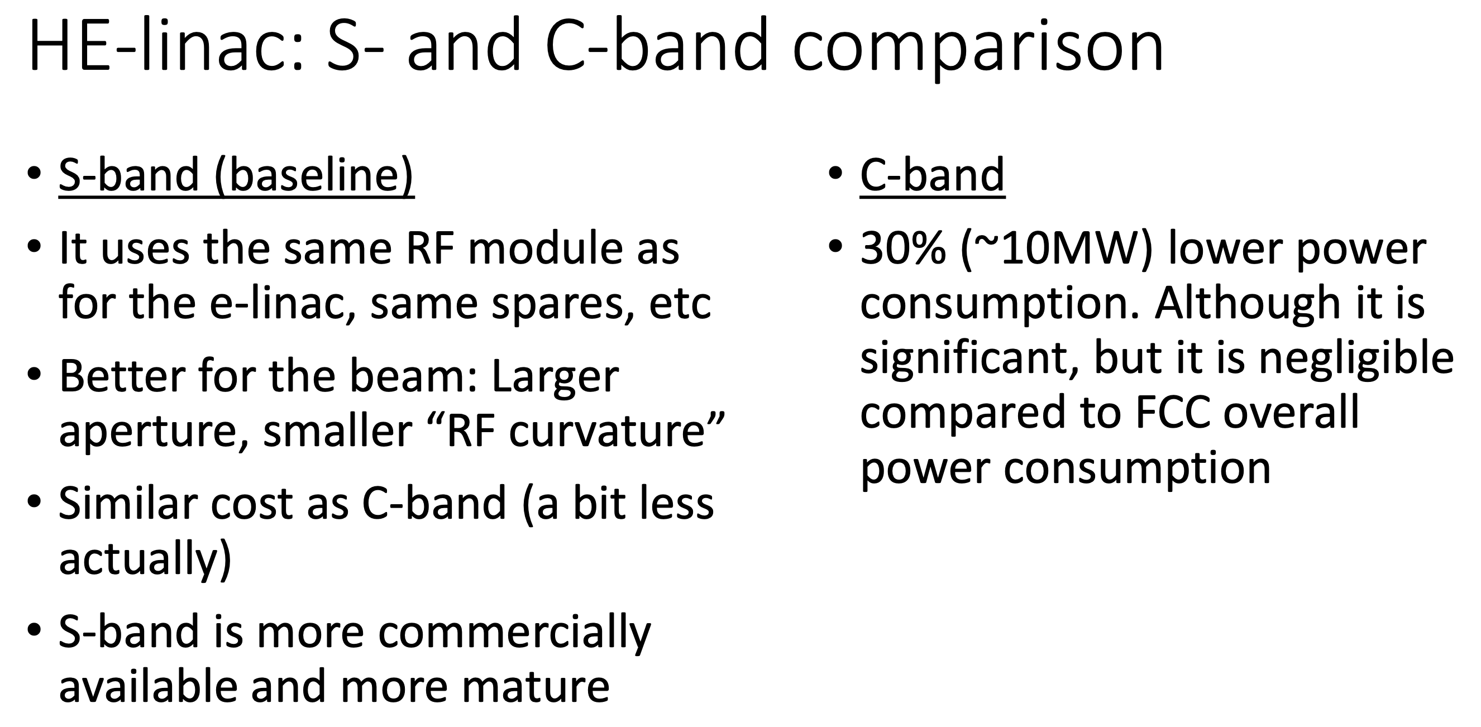
Layout and design of positron and electron linacs up to 20 GeV – Alexej Grudiev 2/2
General comments:
Increase accelerating gradient and repetition rate can put a limit on the on the available power source and dissipated power in the rf structures. A compromise is necessary.
Cost of the building and infrastructures have to be considered in the final decision of the RF module (i.e. 2 vs 4 rf structures per klystron)

Slide 14
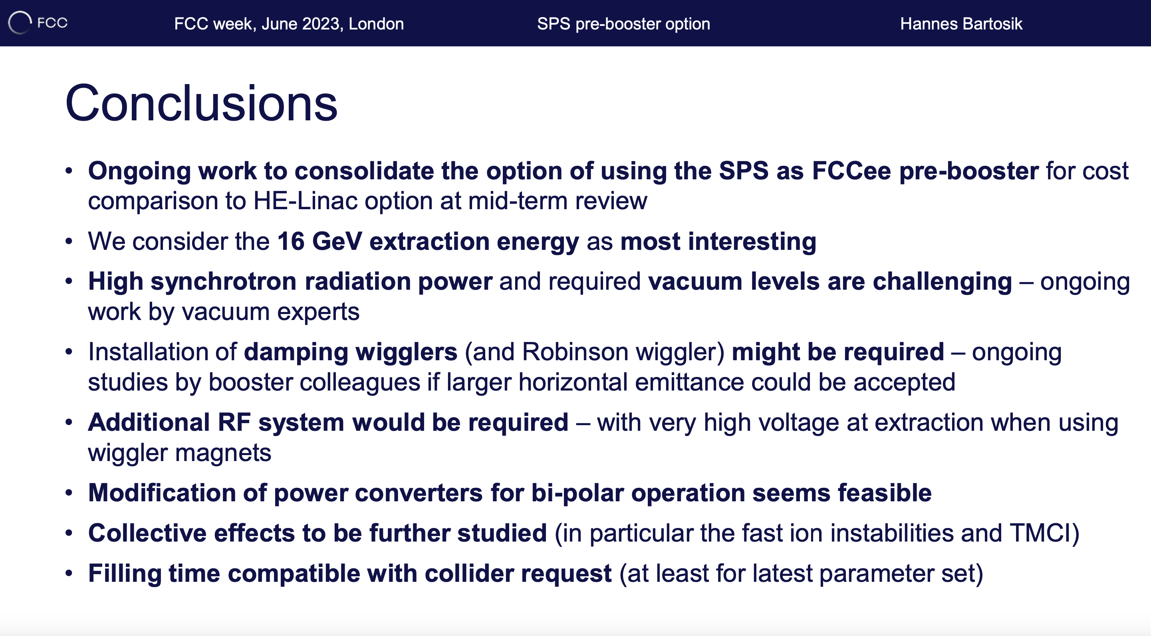
SPS pre-booster option – Hannes Bartosik
Horizontal Emittance at the extraction (16 GeV): 35 nm (w/o wiggler), 5.6 nm (w/ wiggler) (specs for linac ~0.25 nm at 20 GeV) – to be clarified
Plan for the protons at CERN and cost estimates will provide information for a final decision

Slide 15
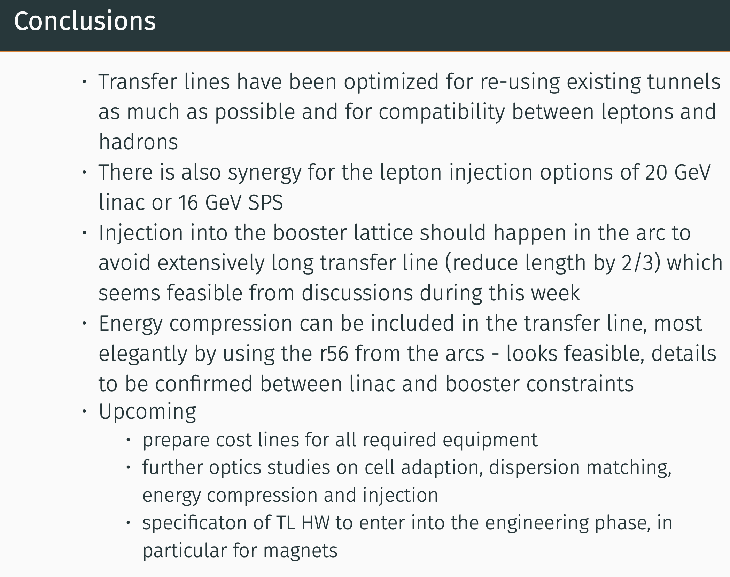
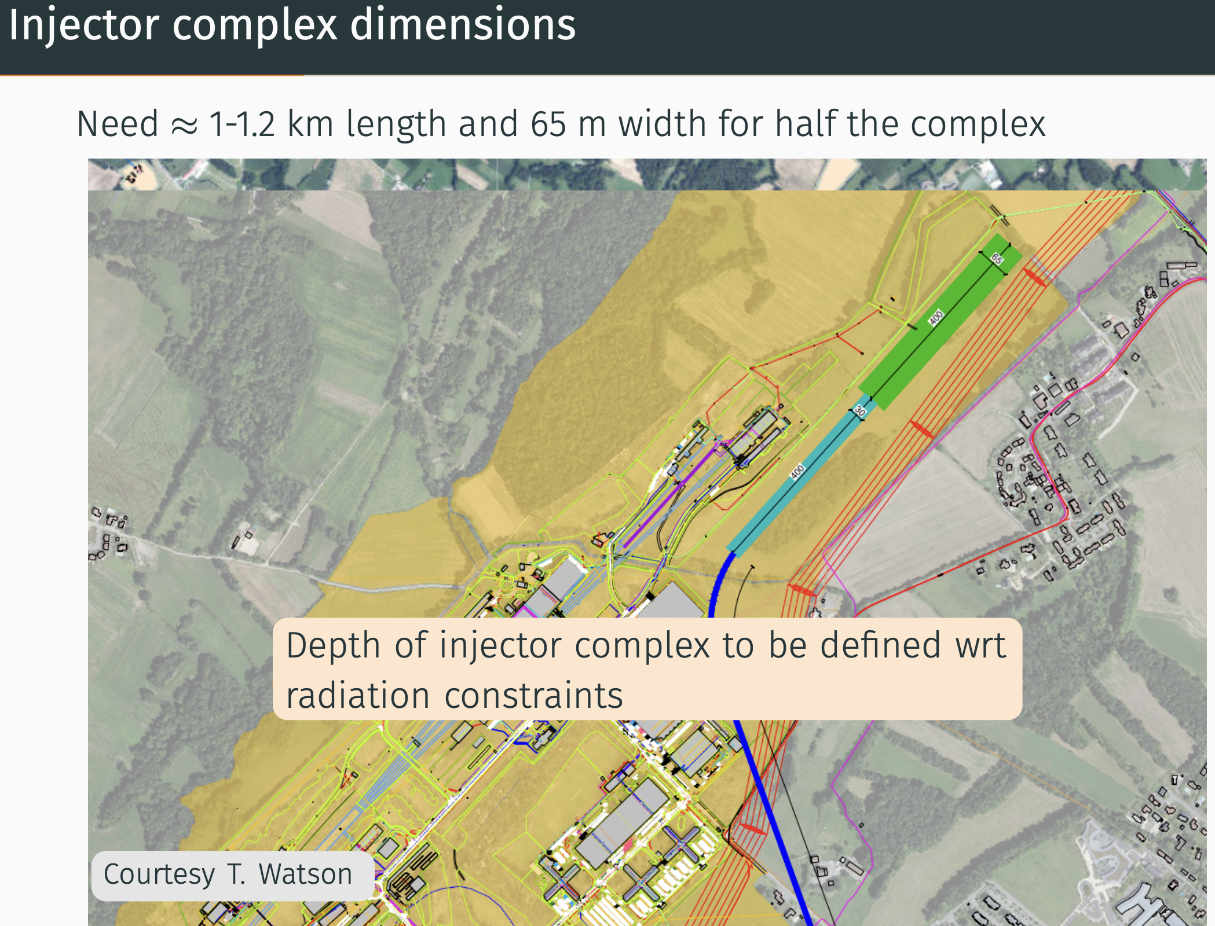
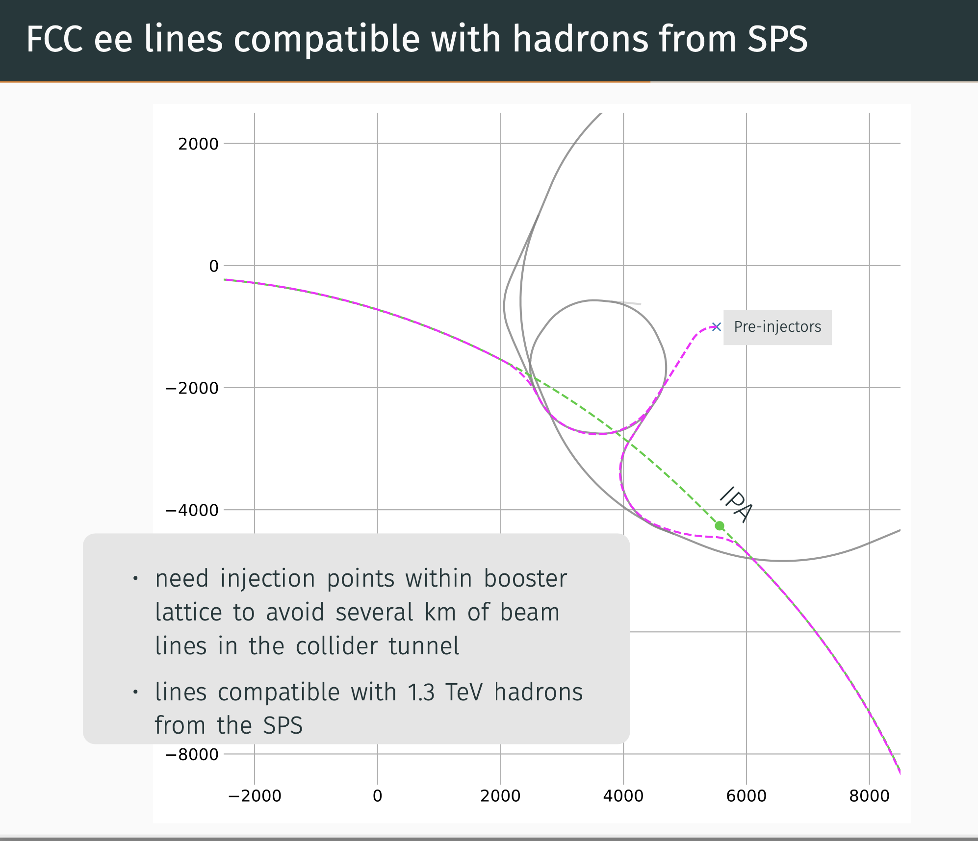
FCC-ee injector complex siting and transfer lines – Wolfgang Bartmann

Slide 16
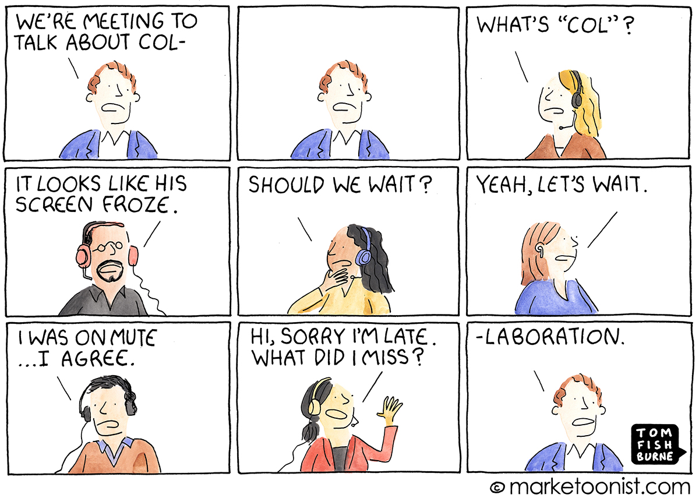
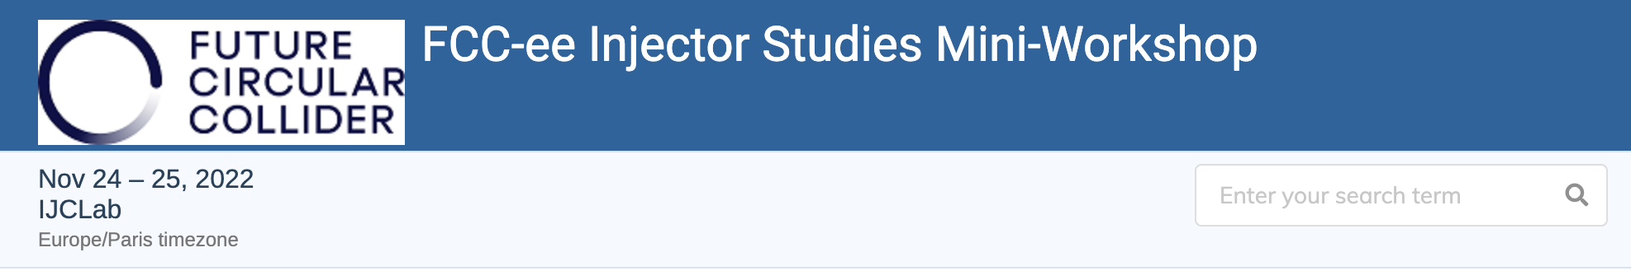
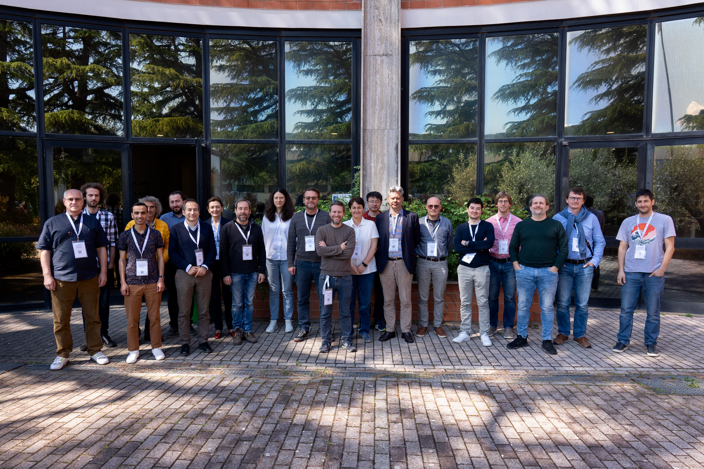

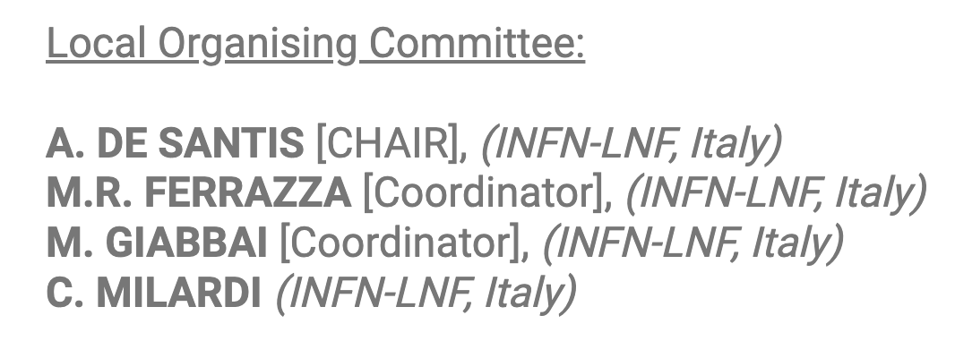
I would like to thank all colleagues involved in this collaboration in the framework of CHART.
In 2021 and 2022, most of the discussions were done on video meetings, and despite this, important progress was made.
Two mini-workshops were also organised to converge in preparation for the mid-term review. Many thanks to the organizers.
Chairman: Iryna Chaikovska

Slide 17
Credits
PSI | R. Zennaro, M. Schaer, N. Vallis, B. Auchmann, I. Besana, S. Bettoni, H. Braun, M. Duda, R. Fortunati, H. Garcia-Rodrigues, D. Hauenstein, E. Hohmann, R. Ischebeck, P. Juranic, J. Kosse, F. Marcellini, U. Michlmayr, S. Muller, G. L. Orlandi, M. Pedrozzi, J.-Y. Raguin, S. Reiche, M. Seidel, R. Rotundo, S. Sanfilippo, M. Zykova all the technical groups involved in the P3 experiment
IJCLab | I. Chaikovska, F. Alharthi, V. Mytrochenko, R. Chehab
CERN | A. Grudiev, A. Latina, S. Doebert, Z. Vostrel, Y. Zhao, B. Humann, A. Lechner, R. Mena Andrade, J.L. Grenard, A. Marcone, M. Calviani, W. Bartmann, Y. Duthell, H. Bartosik, K. Oide, F. Zimmermann, M. Benedikt
INFN-LNF | C. Milardi, A. De Santis, O. Etisken, S. Spampinati, P. Raimondi
CEA | A. Chance, B. Dalena, A Ghribi
SLAC | T. Rauberheimen, E. Nanni
KEK: | Y. Enomoto, K. Furukawa
and L. Bandiera, M. Soldani, A. Sytov (INFN/Ferrara), A. Bacci, M. Rossetti Conti (INFN/Milano)
This work was done under the auspices of CHART (Swiss Accelerator Research and Technology) Collaboration, https://chart.ch - CHART Scientific Report 2022: https://chart.ch/reports/
FCCIS: 'This project has received funding from the European Union's Horizon 2020 research and innovation programme under the European Union's Horizon 2020 research and innovation programme under grant agreement No 951754.'

