Slide 1

Procurement Strategies for LHC and a forward outlook for FCC
Anders Unnervik
FCC week 5-9 June 2023

Slide 2
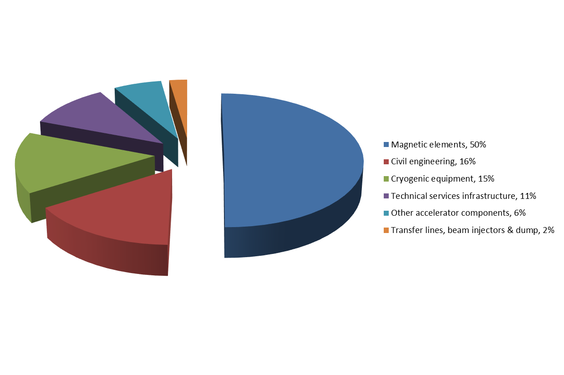
Cost structure of the LHC
Total material cost for the accelerator only: 3.8 BCHF

Slide 3
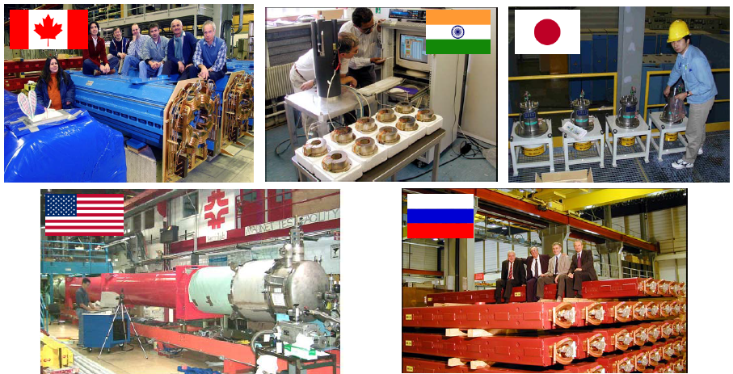
A global project spanning space…

Slide 4
…and time
Preliminary conceptual studies 1984
First magnet models 1988
Start structured R&D program 1990
Approval by CERN Council 1994
Industrialization of series production 1996-1999
Start civil works 1998
Adjudication of main procurement contracts 1998-2001
Start installation in tunnel 2003
Cryomagnet installation in tunnel 2005-2007
Functional test of first sector 2007
Commissioning with beam 2008
Operation for physics 2009
(HL-LHC (upgrade) operation 2029-2041)
AnSlide courtesy of Philippe Lebrun and Lucio Rossi

Slide 5

…and huge volumes
1 170 price enquiries and invitations to tender (> 50 kCHF each);
115 700 purchase orders (< 750 kCHF each)
1 040 contracts of various types and amounts;
6 364 different suppliers and contractors (not including subcontractors).
Covering
  standard off-the-shelf items
  the development and manufacturing of equipment in
  accordance with functional specifications
  Build-to-print items

Slide 6
90 high-tech industrial contracts in the world
AnSlide courtesy of Philippe Lebrun and Lucio Rossi

Slide 7
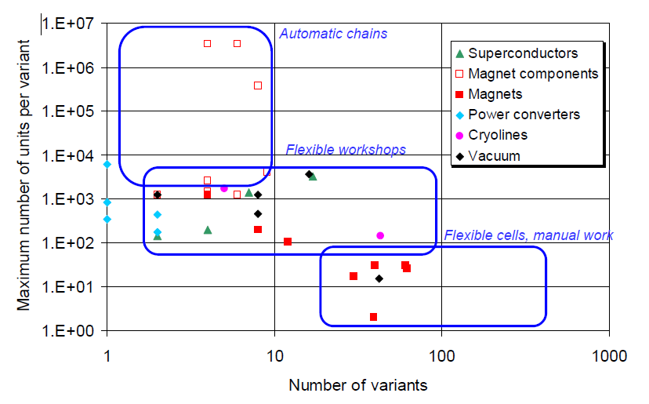
Production volumes of LHC components
AnSlide courtesy of Philippe Lebrun and Lucio Rossi

Slide 8
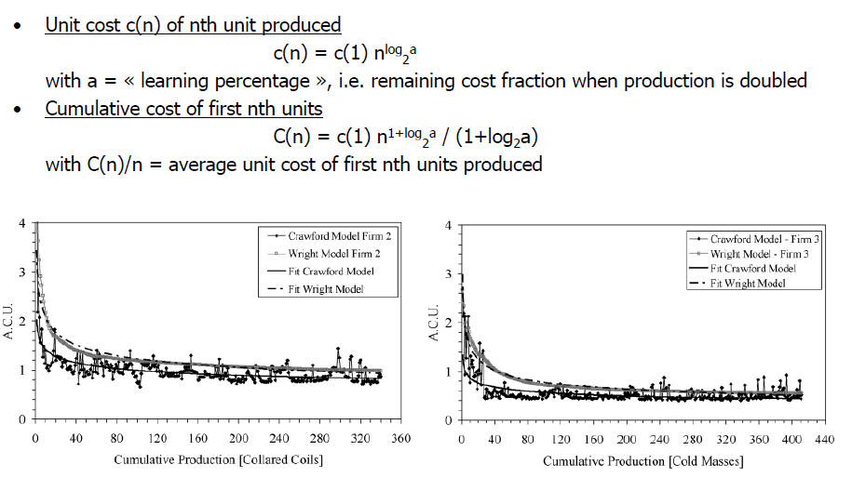
Experimental learning curves
LHC superconducting dipole magnets
AnSlide courtesy of Philippe Lebrun and Lucio Rossi

Slide 9
Experimental learning curves
Learning coefficients
AnSlide courtesy of Philippe Lebrun and Lucio Rossi

Slide 10
From LHC to HL-LHC and FCC
Specification & procurement strategy based on lessons learned
Legal/regulatory framework;
Procurement strategy and invitation to tender;
Contract.
What’s in it for the contractors?

Slide 11
Legal/regulatory framework
Available governance, funding, corporate culture, staff, rules and processes?
Seeking « fair return » among CERN Member States?
Handling special « in-kind» contributions:
  In-kind reduces contracts handled by one single procurement service;
  However, may be more difficult to handle changes;
  May reduce possibility for standardization.

Slide 12
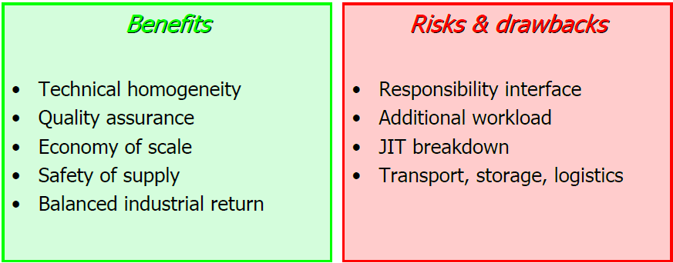
Procurement strategy and Invitation to tender
Manage Risk
Manage risk as this will help decide the strategy. Risks should be borne by the owner of the technology, i.e. the party who knows most about the risks concerned and has the possibility to control them.
Make or Buy? Taking into account potential suppliers and contractual risks
Technical specification: functional & interface vs. build-to-print?
Dual sourcing vs. Single sourcing? Security of supply & balanced return vs. additional follow-up
Act as general contractor managing the supply chain?
Different contracts require different strategies
AnCourtesy of Philippe Lebrun and Lucio Rossi

Slide 13
Procurement strategy and Invitation to tender
Ensure competition
Cooperation with industry is essential from early stages of a project in order to achieve success within business constraints.
Attract interest from industry by organizing workshops (e.g. HL-LHC Industry days, BSBF, etc).
Identify areas/domains with a lack of firms in order to source potential suppliers.
Publish information.
Select the right companies.
Building know-how & maintaining interest through prototyping, pre-series and series in a one-of, technically risky supply contract.
Competition with other products/markets.
Consider producing prototypes in-house and keep the production line as spare in case industry fails.

Slide 14
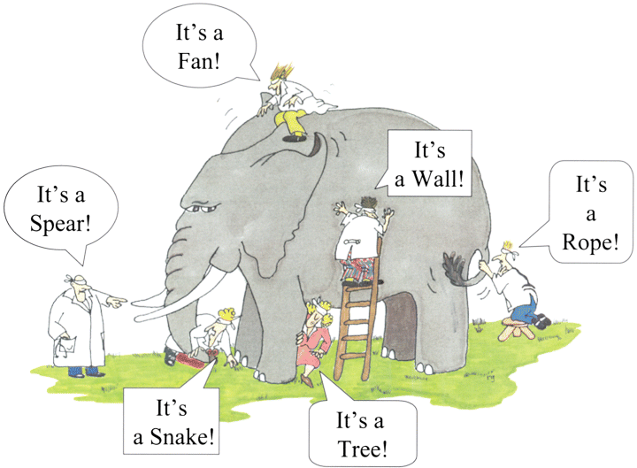
Procurement strategy and Invitation to tender
Specify the requirements
Technical specification: functional & interface vs. build-to-print?
Clear, unambiguous, realistic. Avoid gold plated specifications (in particular taking into account long series productions)
Identify responsibility for dealing with potential risks
Quality control, testing and acceptance procedures
Review by an “independent” specification committee
invitations to tender should not be issued until the requirements are well understood and can be clearly specified, because
Amendments cost time and money!

Slide 15
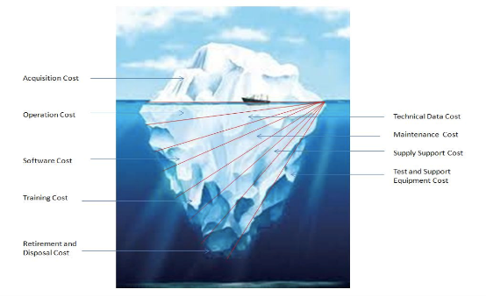
Procurement strategy and Invitation to tender
Drafting and issuing the tender documents
Total tender amount, include all relevant cost elements (TCO):
  Design
  Manufacture
  Installation
  Operation (including energy)
  Maintenance
  Spares
  Consumables, etc..
  training of personnel,
Learning curves?
Best value for money?
Sustainability criteria???

Slide 16

Contract
Avoid unreasonable contract conditions, e.g. concerning liability. Risks should be borne by the party in the best position to control them.
Achieving quality throughout the project involves the establishment and enforcement of a comprehensive QAP:
  Configuration management, engineering data management
  Manufacturing and test plan
  Inspection (QA inspectors?)
Maintaining sufficient resources in the home laboratory is necessary to cope with:
  tasks outside the interest and capabilities of industry
  unexpected technical or commercial difficulties
Be aware of a possible “grab-and-run” attitude from suppliers and contractors

Slide 17
…FCC time schedule
Conceptual design studies 2014-2018
Feasibility study 2021-2025
Approval by CERN Council ~2028
Start civil works ~2030
HL-LHC ends ~2041
Start of FCC-ee ~2045
Operation for physics of FCC-ee ~2048-2063
Construction of FCC-hh ~2058-2070
Operation for physics of FCC-hh ~2070-2095

Slide 18
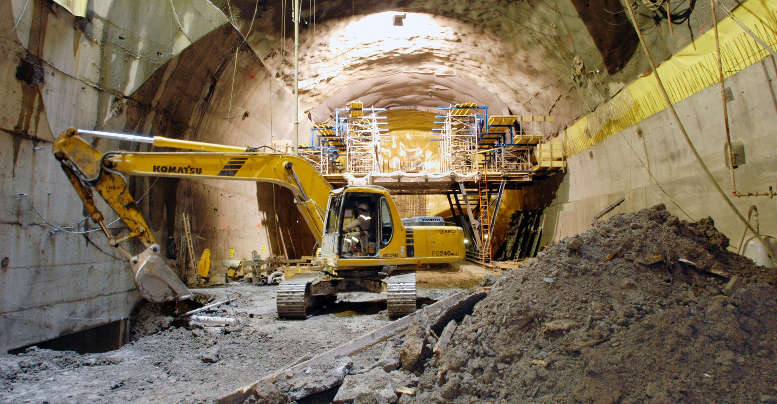
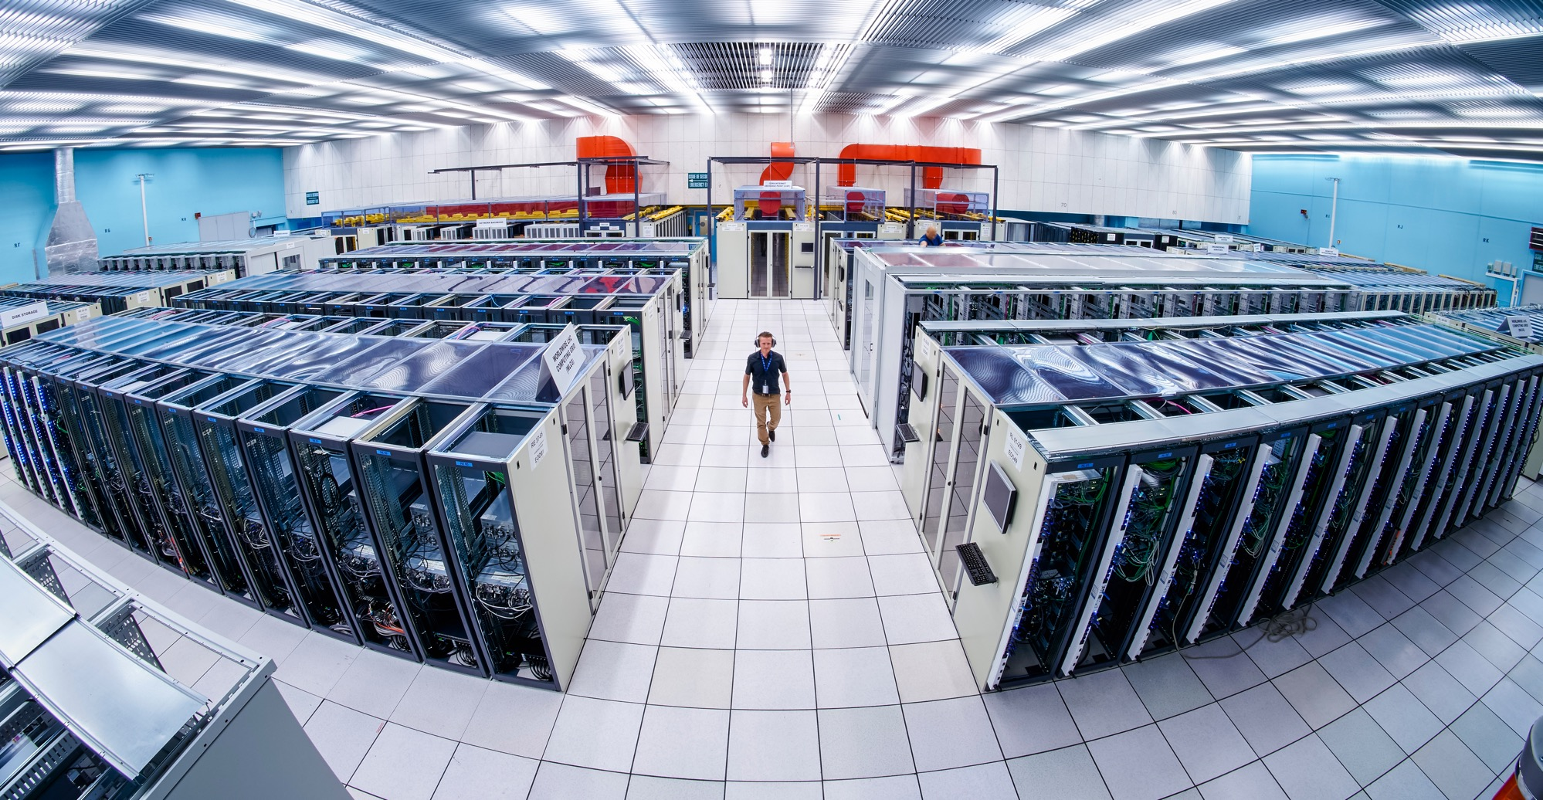
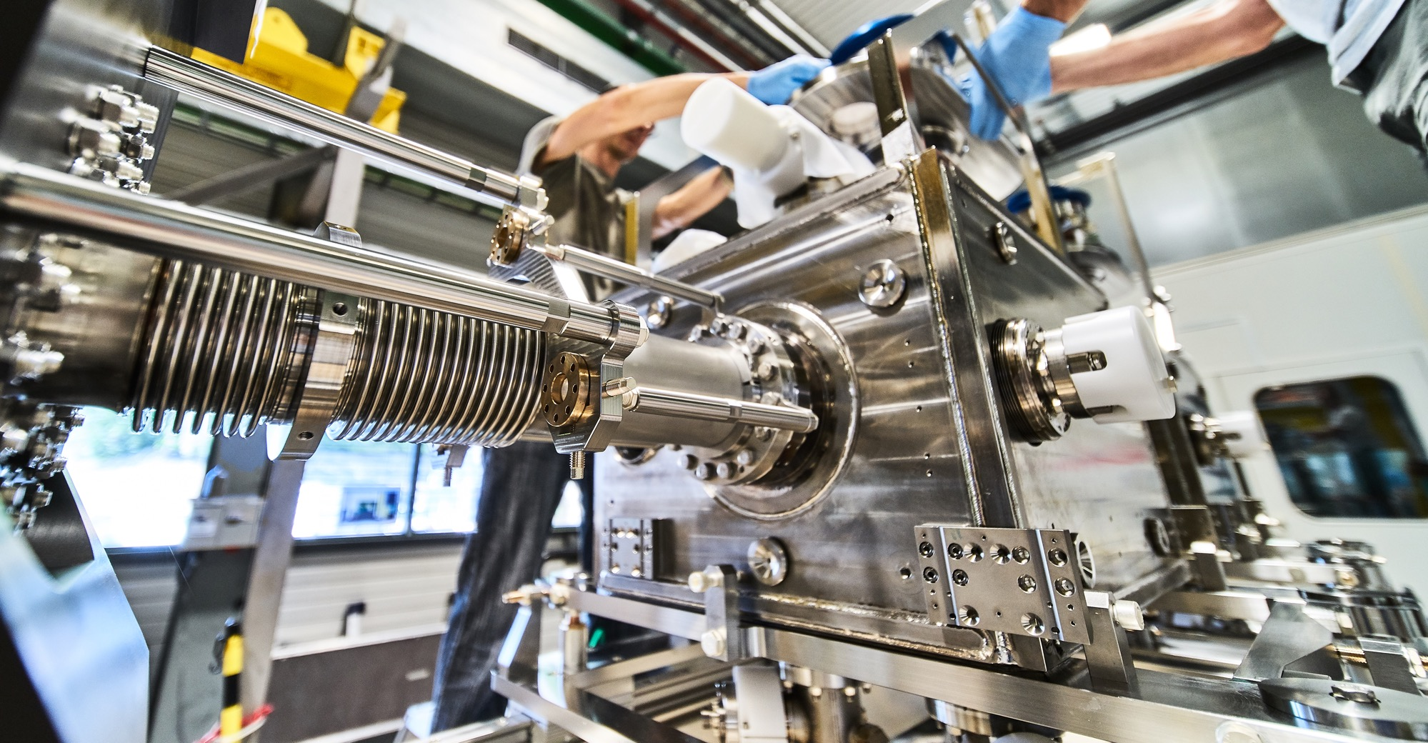
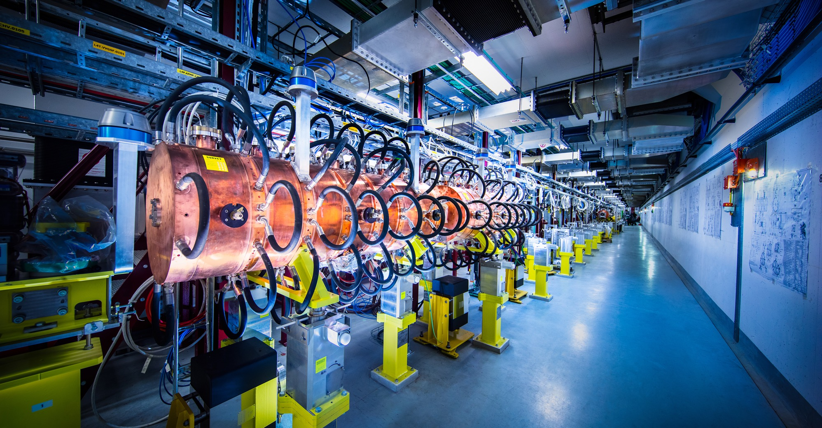
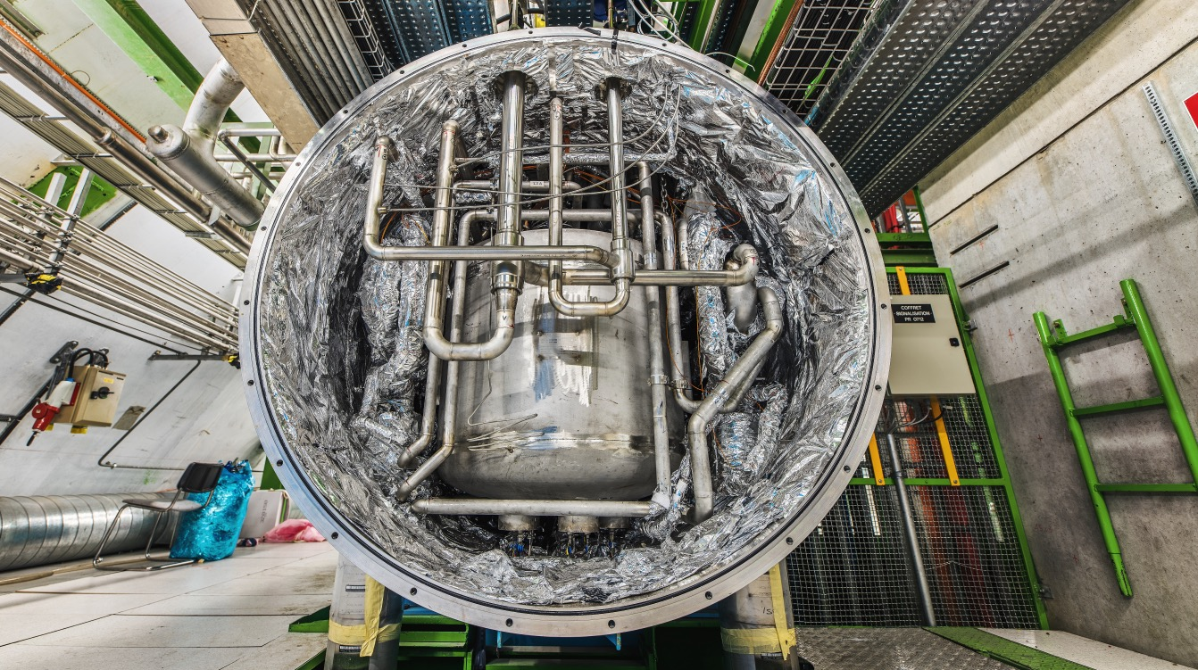
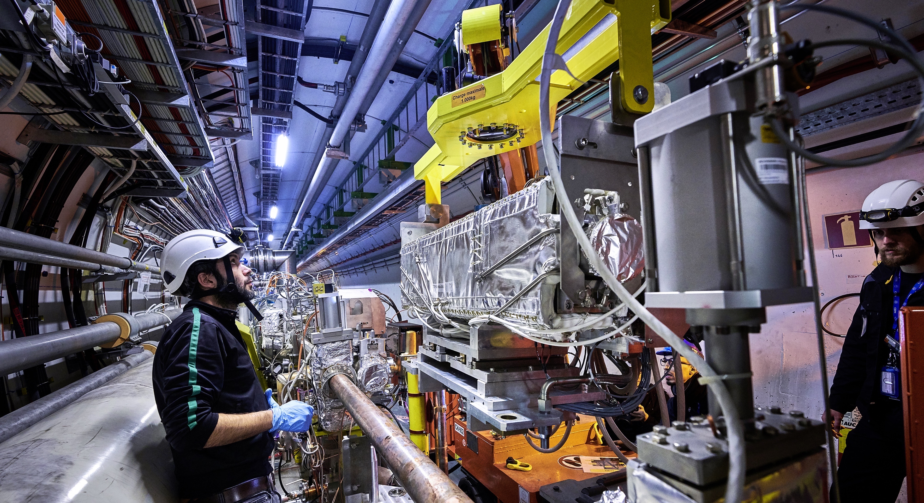
Examples of FCC items to be contracted
Injectors
Warm magnets
SC magnets
Power converters
Electricity distribution and material
Cooling, ventilation, water distribution (incl heat recovery)
Machine protection
Vacuum
RF
Collimators and absorbers
Beam transfer
Beam dump
Beam diagnostics and instrumentation
Supports and girders
Polarisation and energy calibration
Geodesy and survey
Cryogenics
Information, communication and controls
Robotics
Civil engineering
Experiments
Safety, environment and RP
Excavated materials management
logistics and transports

Slide 19
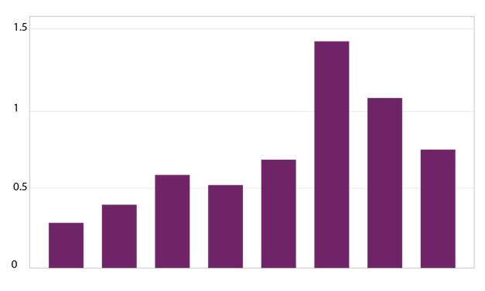
The economical impact of CERN Procurement on supplier’s performance (Castelnovo et al, 2018)
Empirical studies (by the analysis of financial data from 1995 to 2008 from 365 CERN suppliers for the LHC) show that after working with CERN on high-tech contracts, CERN suppliers out-perform their peers by:
Investing more in R&D and filing more patents
Higher productivity, revenue and profitability
Order/contract received from CERN
Increase in R&D
Innovation
Productivity growth
increase revenues & profitability
Patents per firm
More than
2 years before
2-1 years before
1,2 years later
3,4 years later
5,6 years later
7,8 years later
More than
8 years later
Date of order
Notes:
Average number of patents filed before and after the beginning of the procurement relationship with CERN
The X-axis shows the «relative years», that are the difference between a given year and the year the first order is received. Therefore, CERN(0) is, for each company, the year of beginning of the procurement relationship.

Slide 20
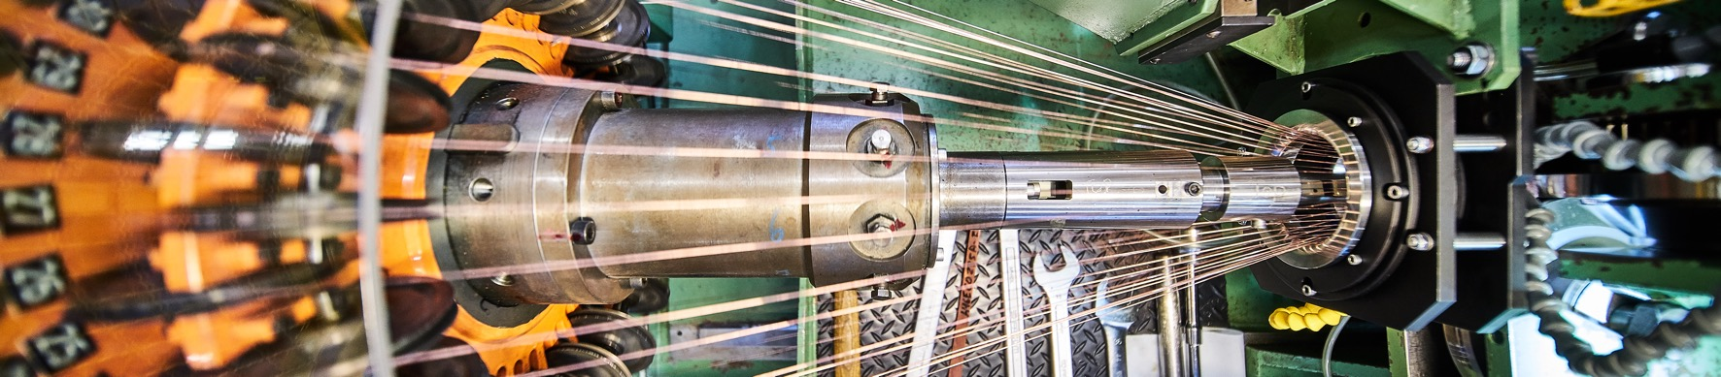
Doing business with CERN: the facts
Supplier survey (669 suppliers in 33 countries, 2017):
48%
improved products and services
42%
developed new products
55%
improved technical knowledge
in their field
18%
found or opened a new market to address
62%
used CERN as a marketing reference
Notes:
The key message here is that CERN is an open institution: open to its neighbours, and open to citizens from across the globe. We welcome them to CERN and go out to meet them
This slides summarises the outreach activities carried out by CERN.
It also includes a mention of CERN’s fundraising activities, for projects that are not part of CERN’s core activity. These fall into three categories: education & outreach, culture and creativity, innovation and knowledge exchange

Slide 21
Thanks for your attention!

