Slide 1
Integration update tunnel and arcs, caverns, service caverns, etc
06.06.2023 / FCC Week
F. Valchkova-Georgieva

Slide 2
06.06.2023 / FCC Week
F. Valchkova-Georgieva
  FCC-ee Underground Structure Overview
  Integration of FCC-ee Arc Cell
  FCC-ee Underground Structure point A and G
  Integration of FCC-ee Beamstrahlung dump
  Integration of FCC-ee Alcove and transport area
  Integration of FCC-hh Arc Cell
  Integration of FCC-hh Transfer line

Slide 3
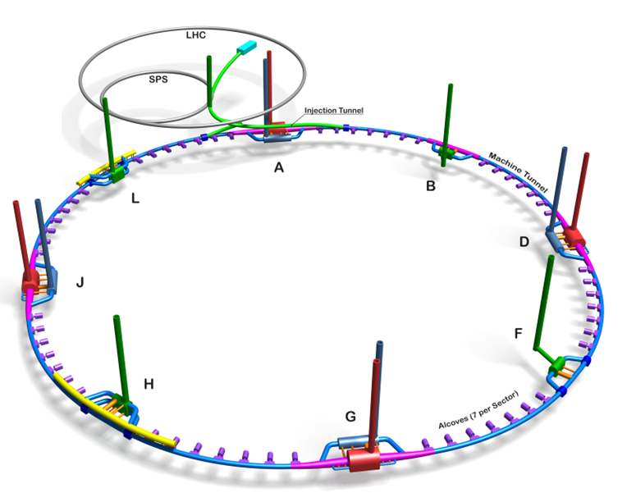
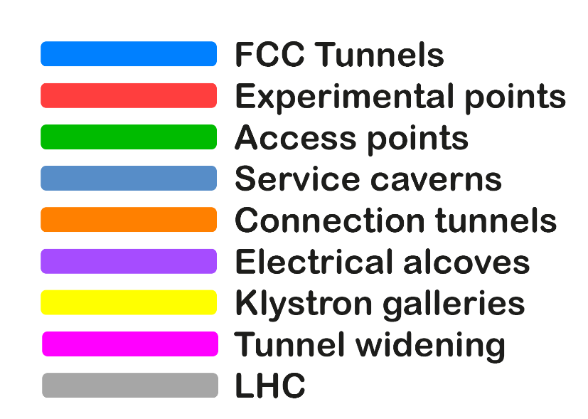
06.06.2023 / FCC Week
F. Valchkova-Georgieva
Only schematic, and not to scale.
  FCC-ee Underground Structure Overview
Courtesy A. Navascues Cornago

Slide 4
06.12.2022
F. Valchkova-Georgieva
  Integration of FCC-ee Arc Cell

Slide 5
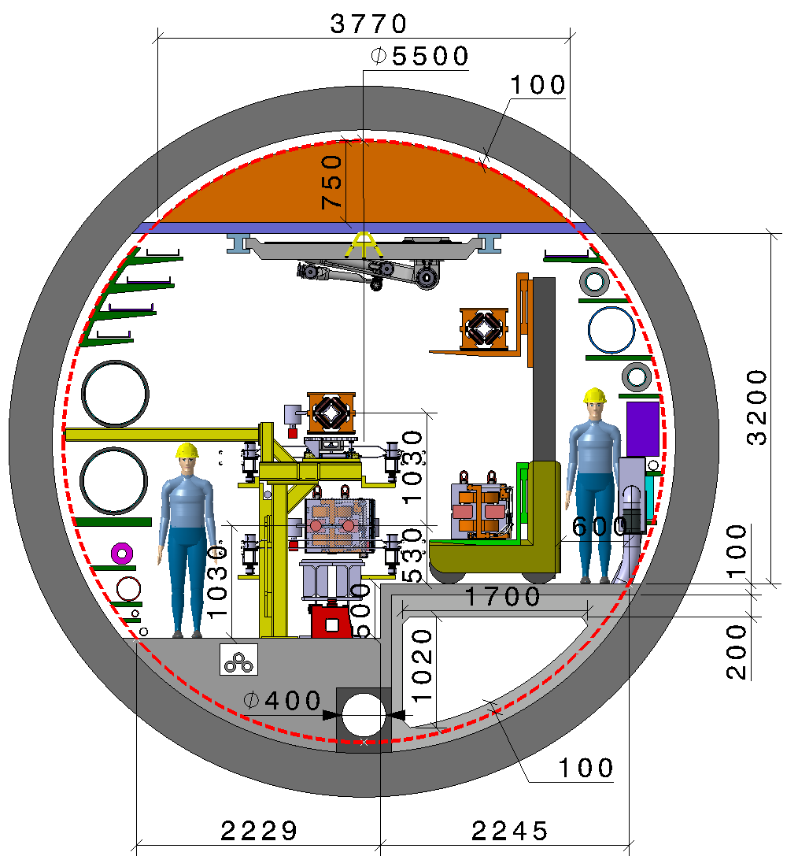
06.06.2023 / FCC Week
F. Valchkova-Georgieva
  Integration of FCC-ee machine elements (regular arc)
Machine tunnel 5.5m in diameter
Smoke/He extraction
Booster ring
Cable trays:
Fibre optic
LV distribution
Control cables
Cable tray:
MV distribution
Chilled water
Demineralized water
Firefighting/Row water
Leaky feed
Alignment space occupation
Warm He recovery
Compressed air
He
Fresh air diffused
Demineralized water felling
Collider ring
Electrical HV
power transmission
Fresh air duct
Main cross section as for FCC-hh
Main ring below of booster ring
Main ring and booster ring 1.3 m distant
Drain
Collider Center

Slide 6
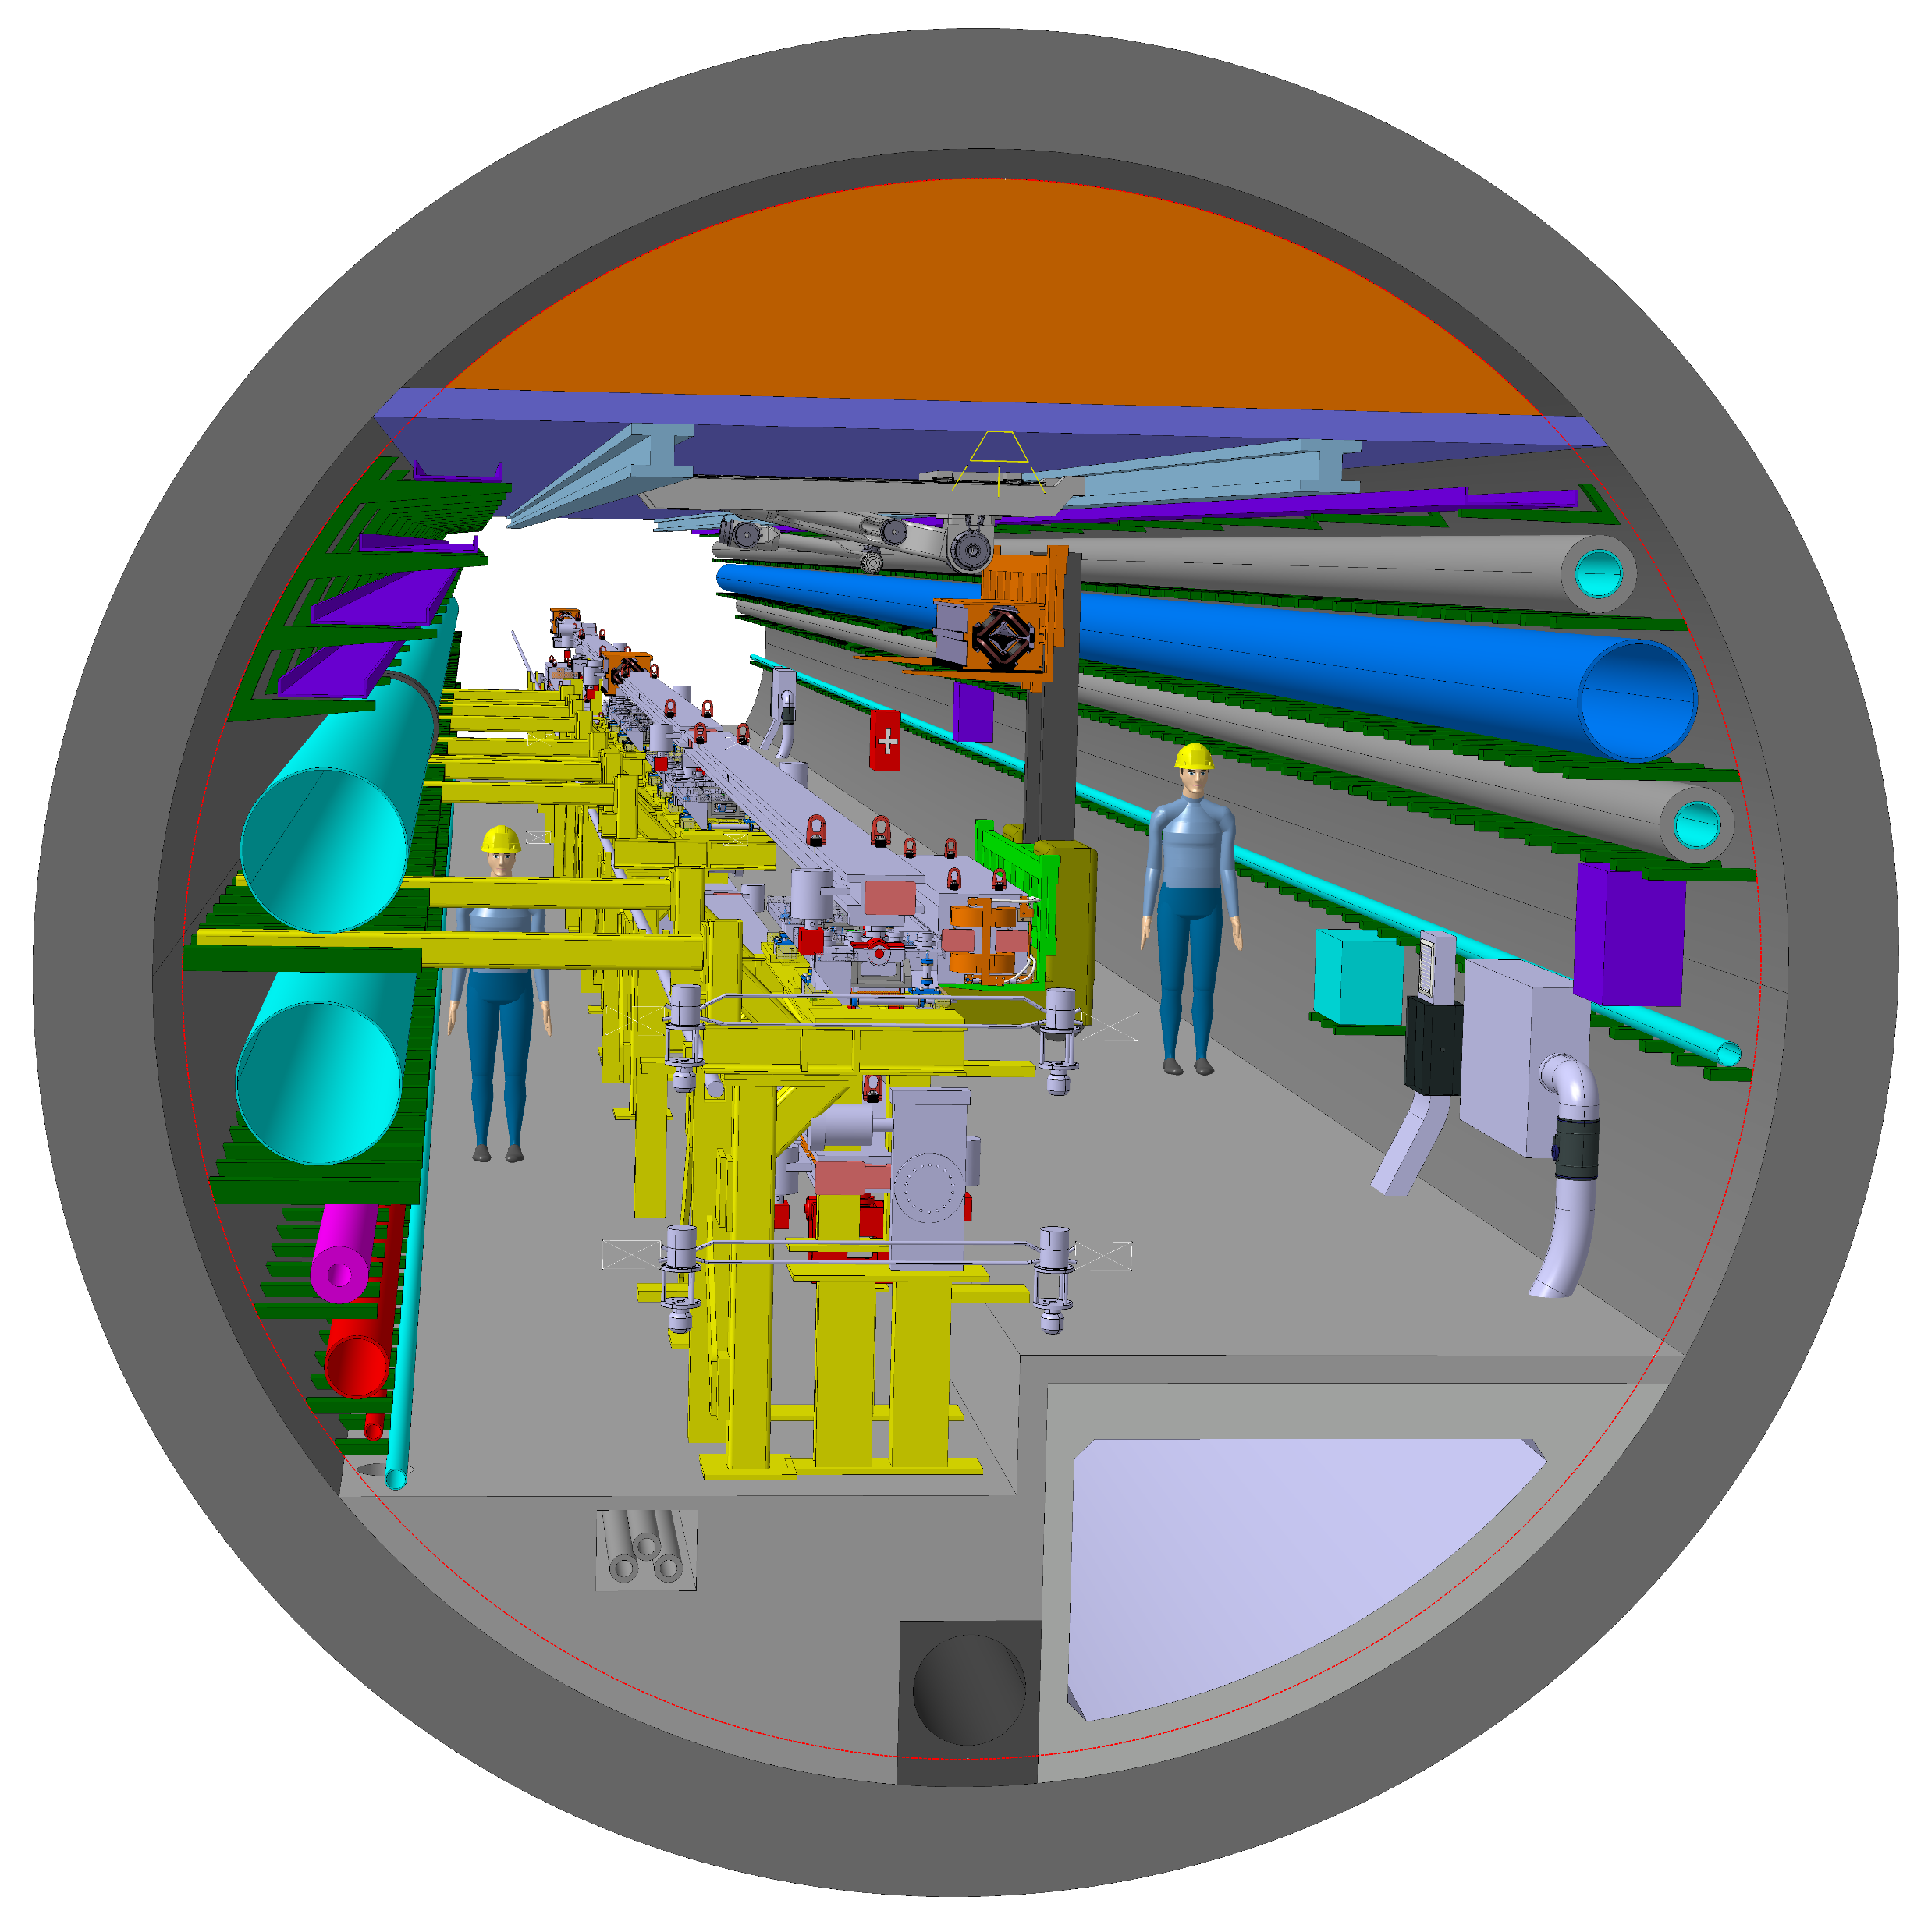
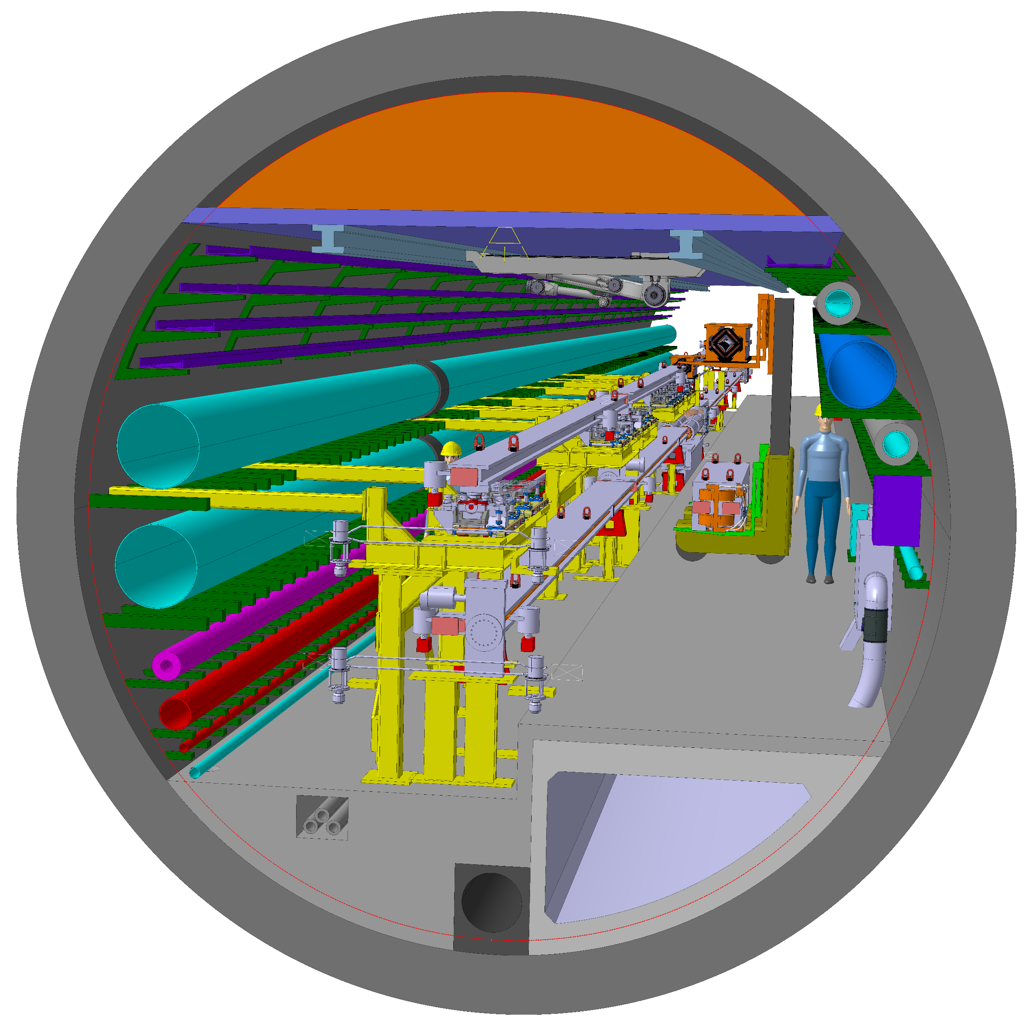
06.06.2023 / FCC Week
F. Valchkova-Georgieva
  Integration of FCC-ee machine elements (regular arc)
Machine tunnel 5.5m in diameter
Perspective view
Collider Center

Slide 7
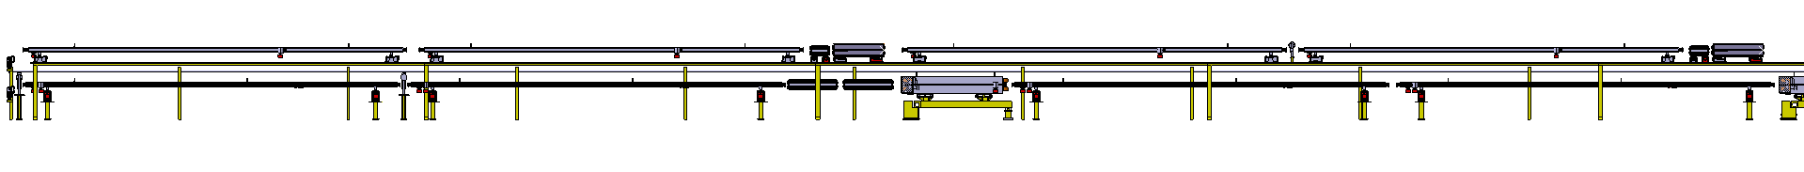
06.06.2023 / FCC Week
F. Valchkova-Georgieva
  Integration of FCC-ee machine elements (regular arc)
Front view
Dipole magnet
Dipole magnet
Booster ring
Sextuple magnet
Quadrupole magnet
Main ring
Sextuple magnet
Quadrupole magnet
Dipole magnet
Dipole magnet

Slide 8
06.06.2023 / FCC Week
F. Valchkova-Georgieva
  FCC-ee Underground Structure point A and G

Slide 9
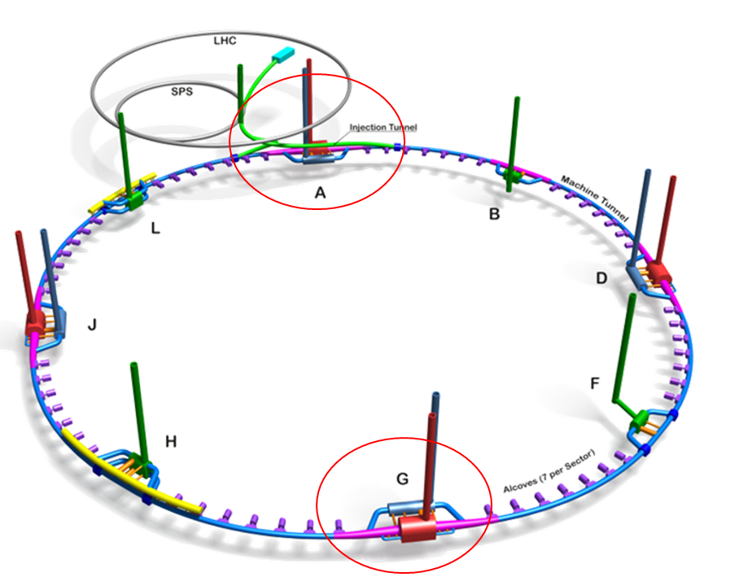
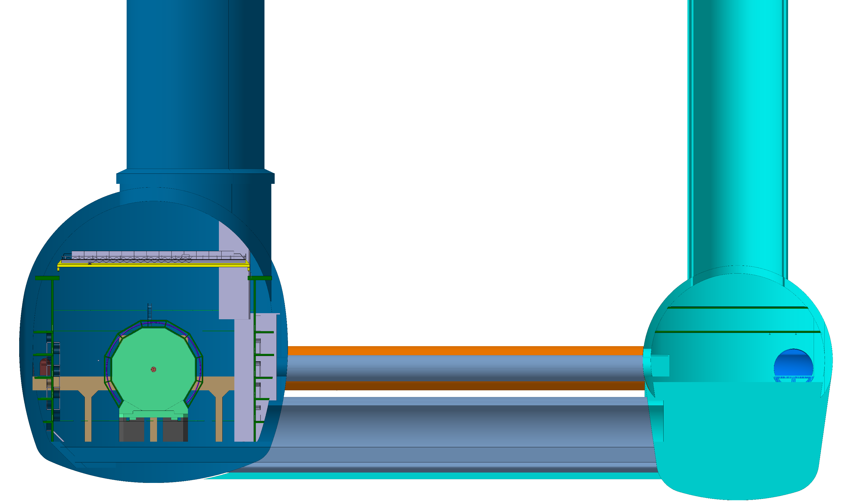
06.06.2023 / FCC Week
F. Valchkova-Georgieva
  FCC Experiment Underground Structure
Experimental Shaft ø18m
Elliptical Service Shaft
18x12
Booster ring
FCC-ee Detector
8000
35000
1030
12000
35000
Service Cavern
Extension

Slide 10
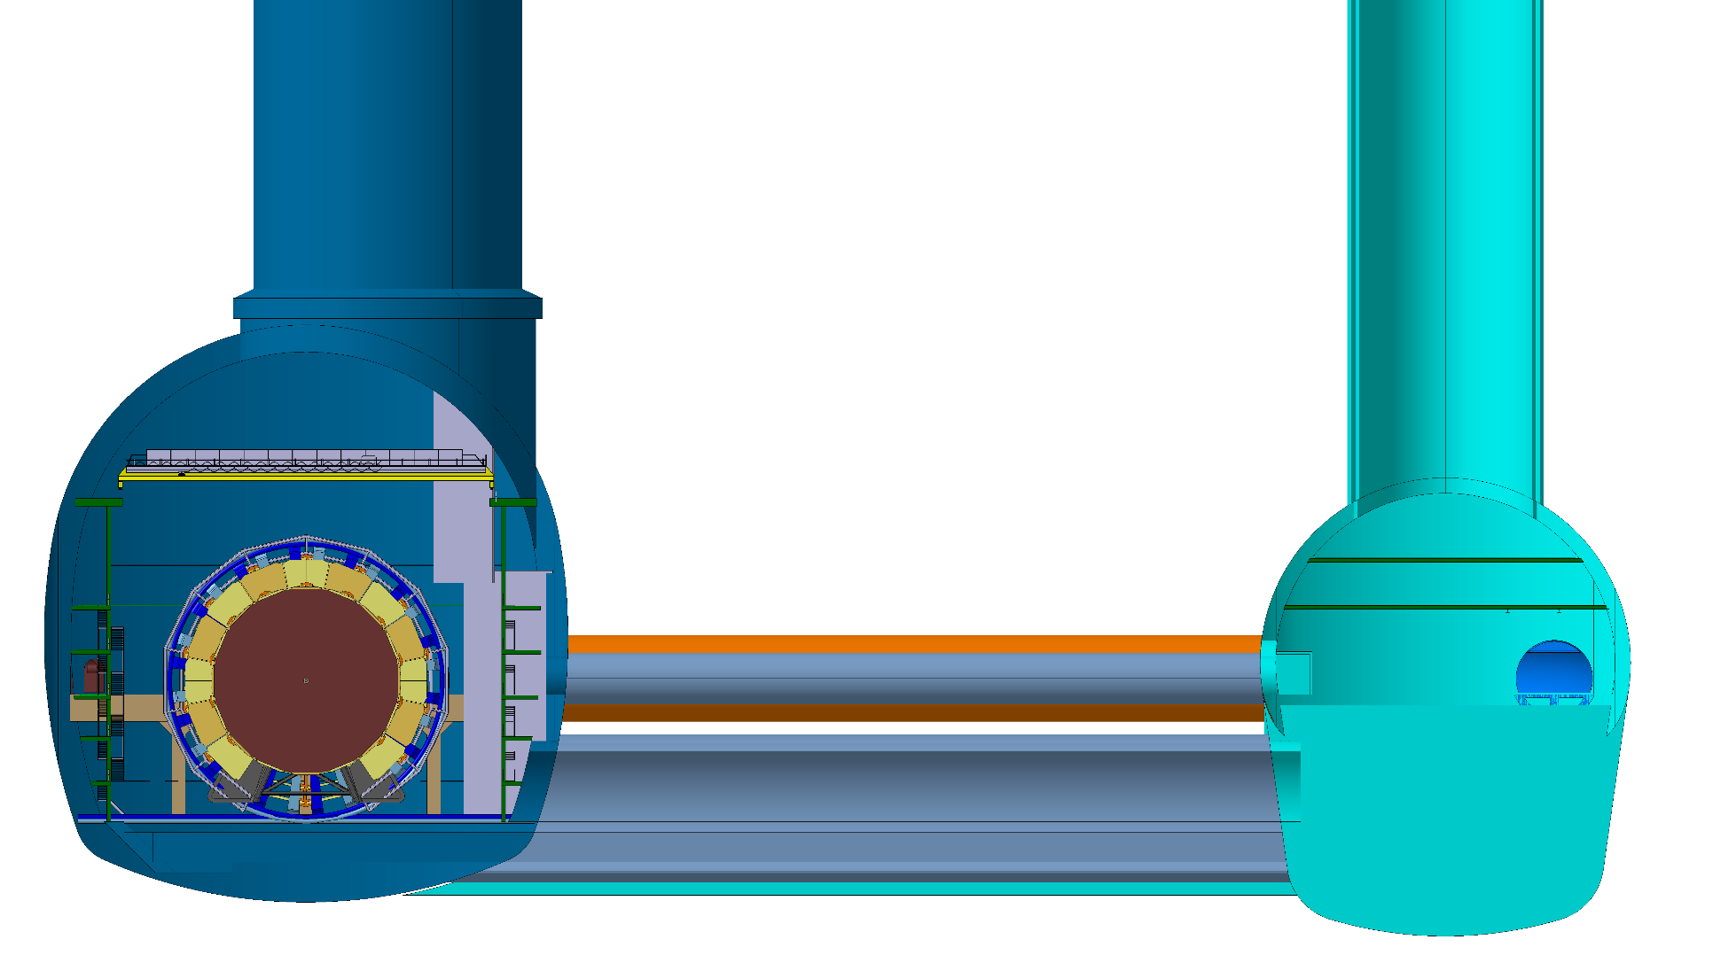
06.06.2023 / FCC Week
F. Valchkova-Georgieva
  FCC Experiment Underground Structure
FCC-hh Detector
Elevators and Stairs
Safety Area
Connection tunnel , two levels

Slide 11
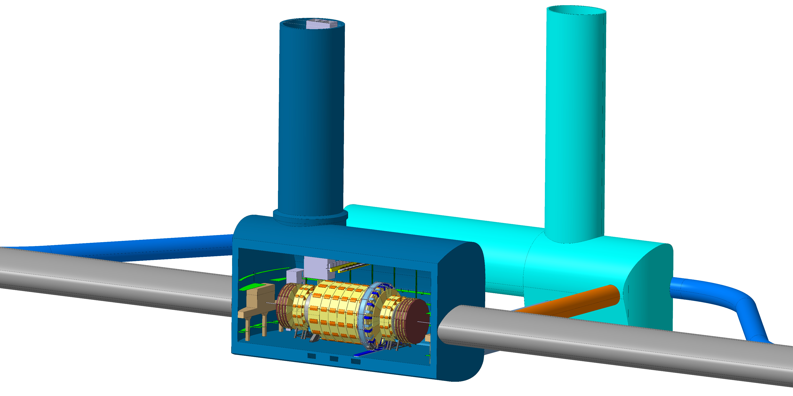
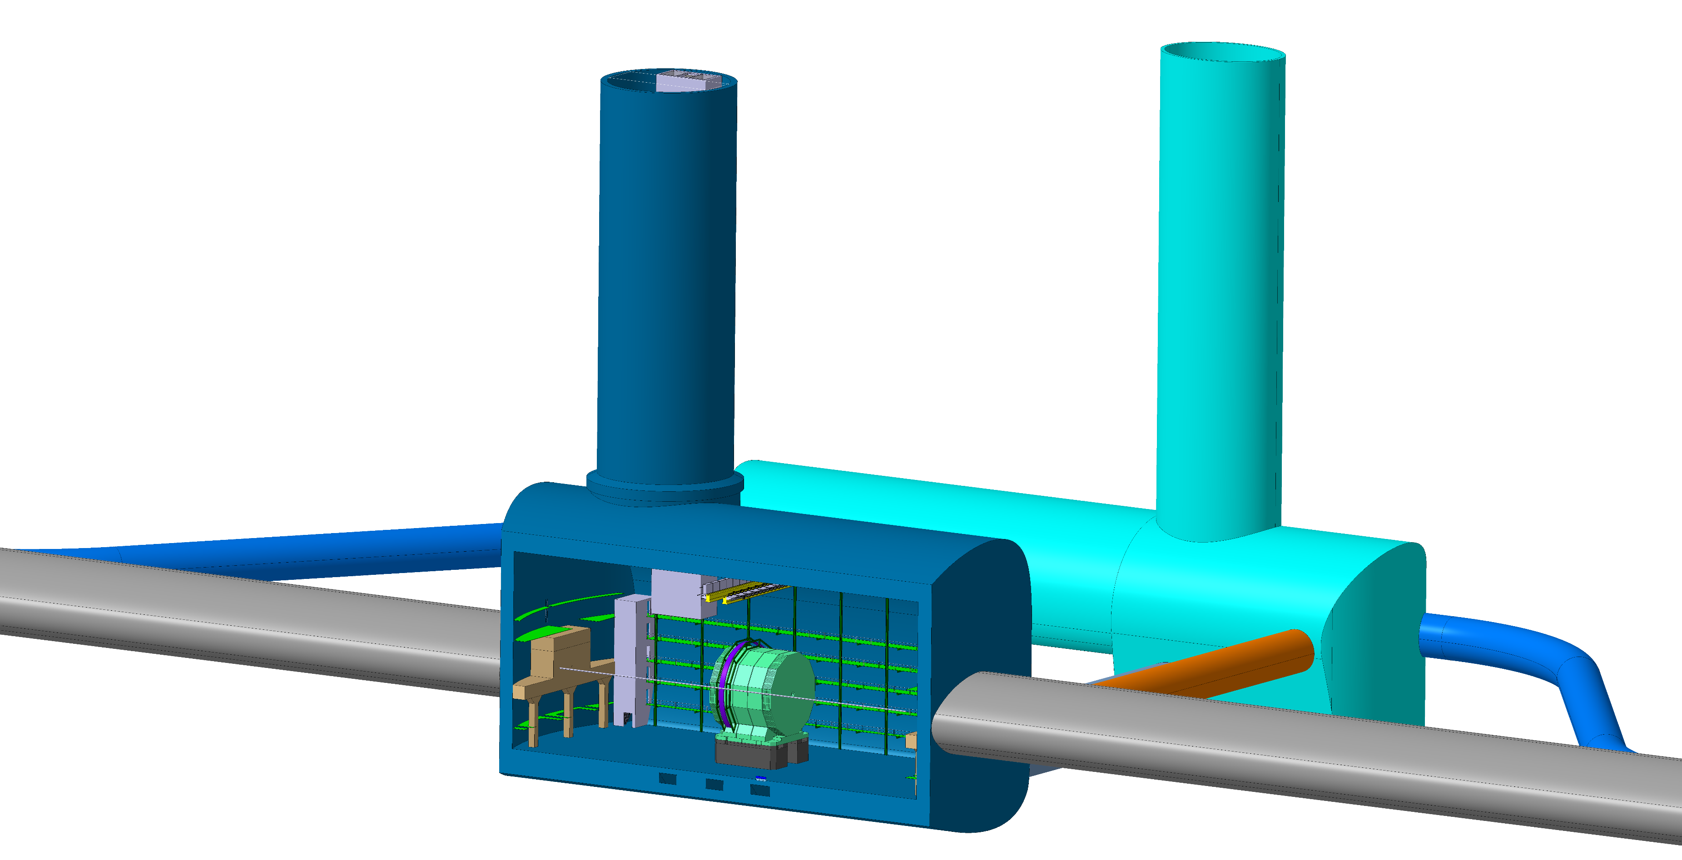
06.06.2023 / FCC Week
F. Valchkova-Georgieva
  FCC Experiment Underground Structure
FCC-ee Detector
FCC-hh Detector

Slide 12
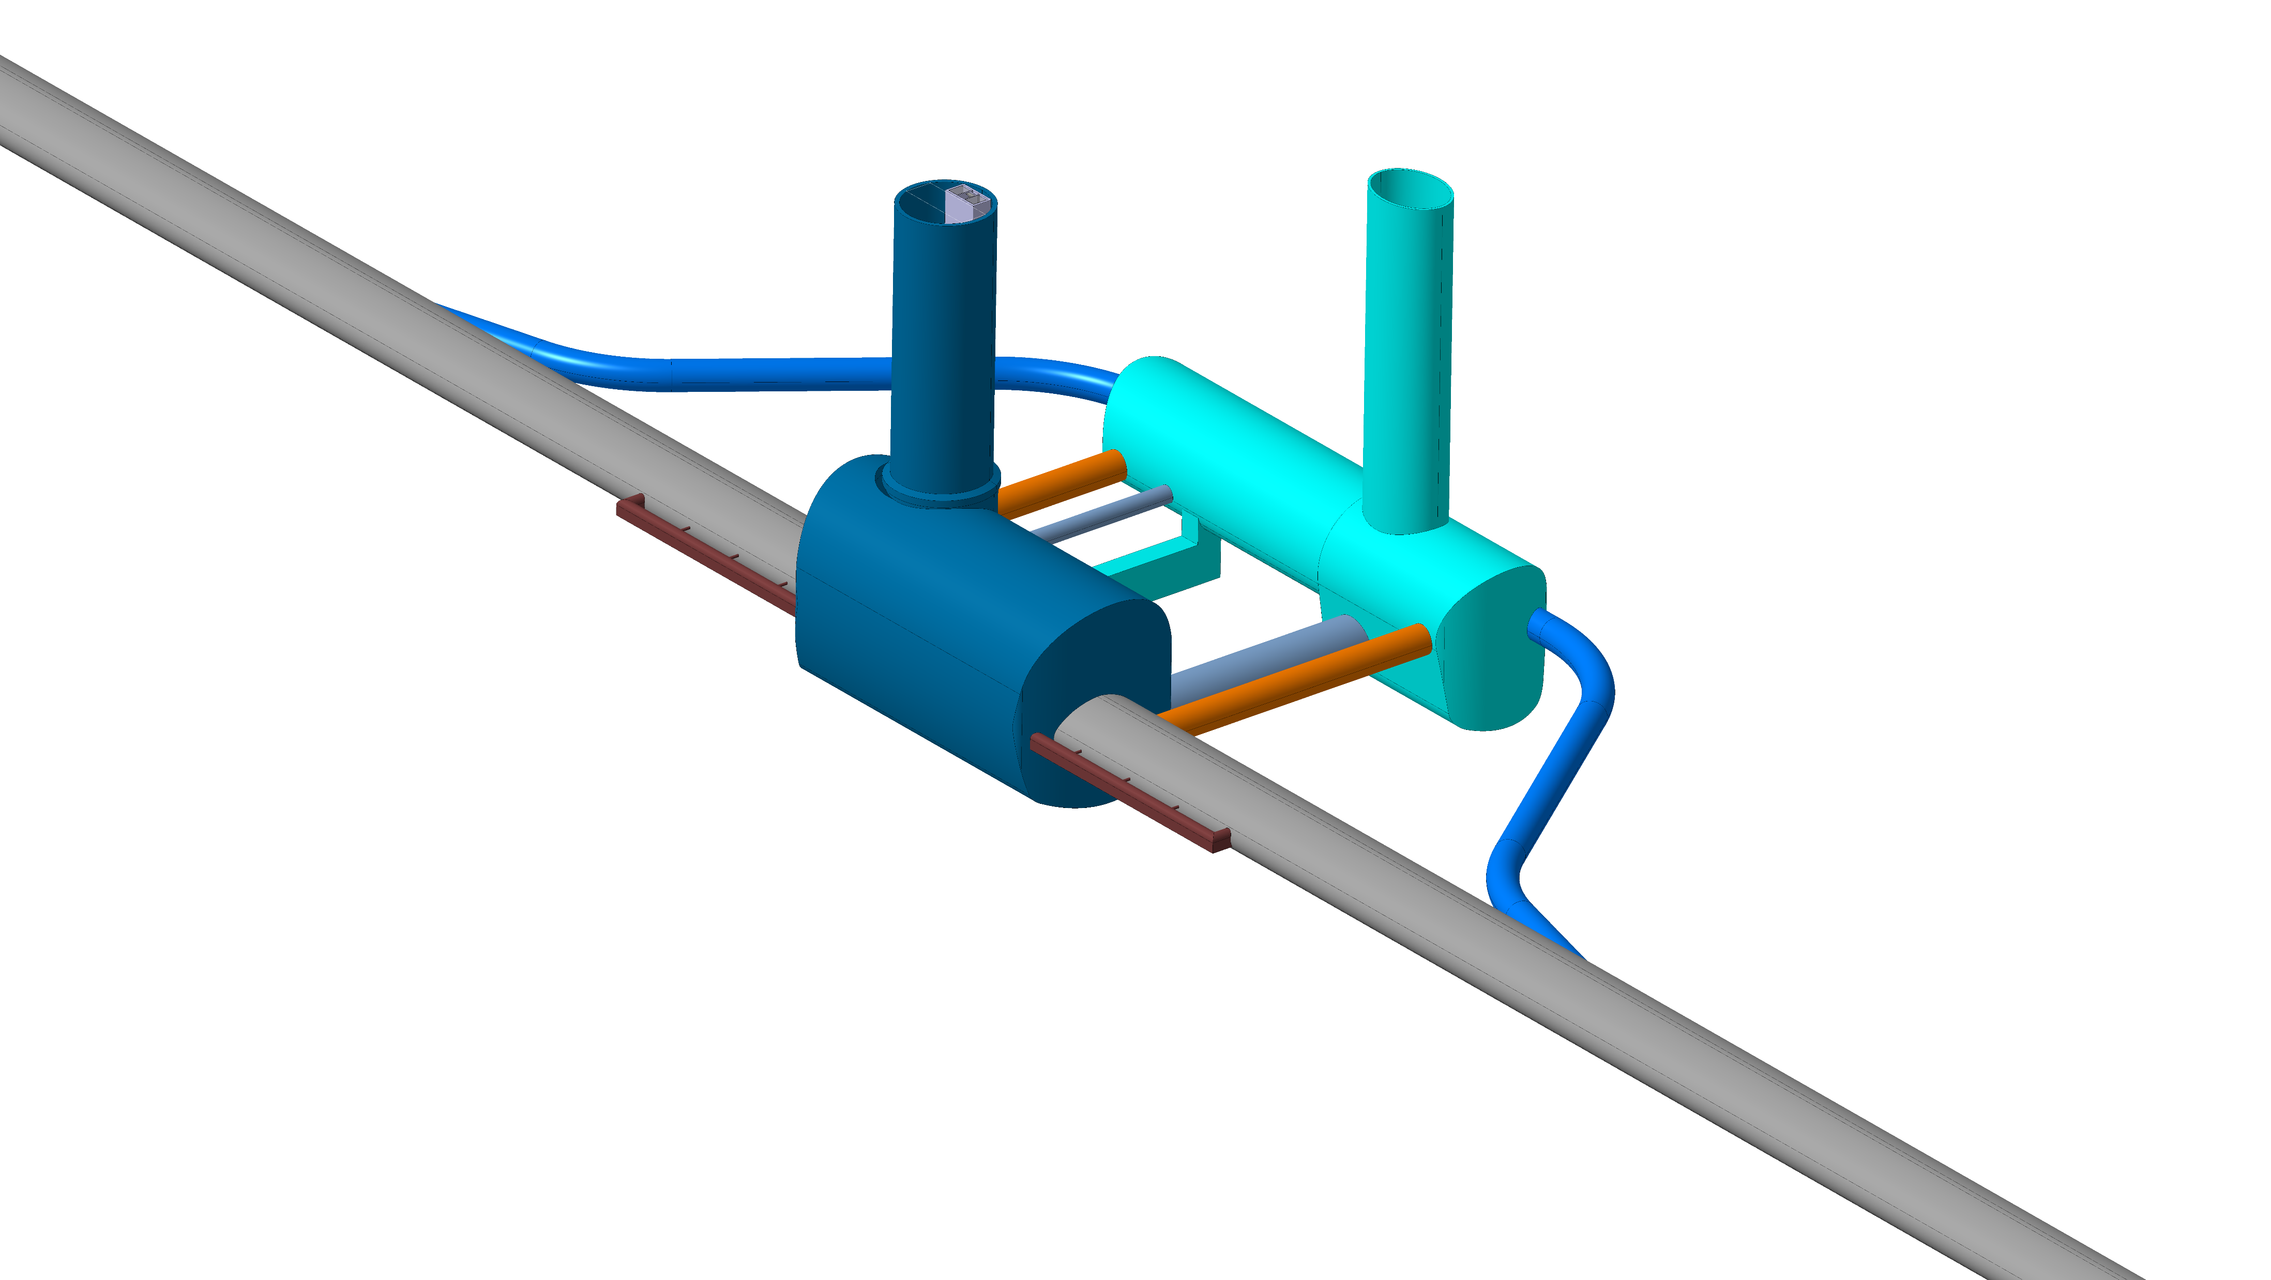
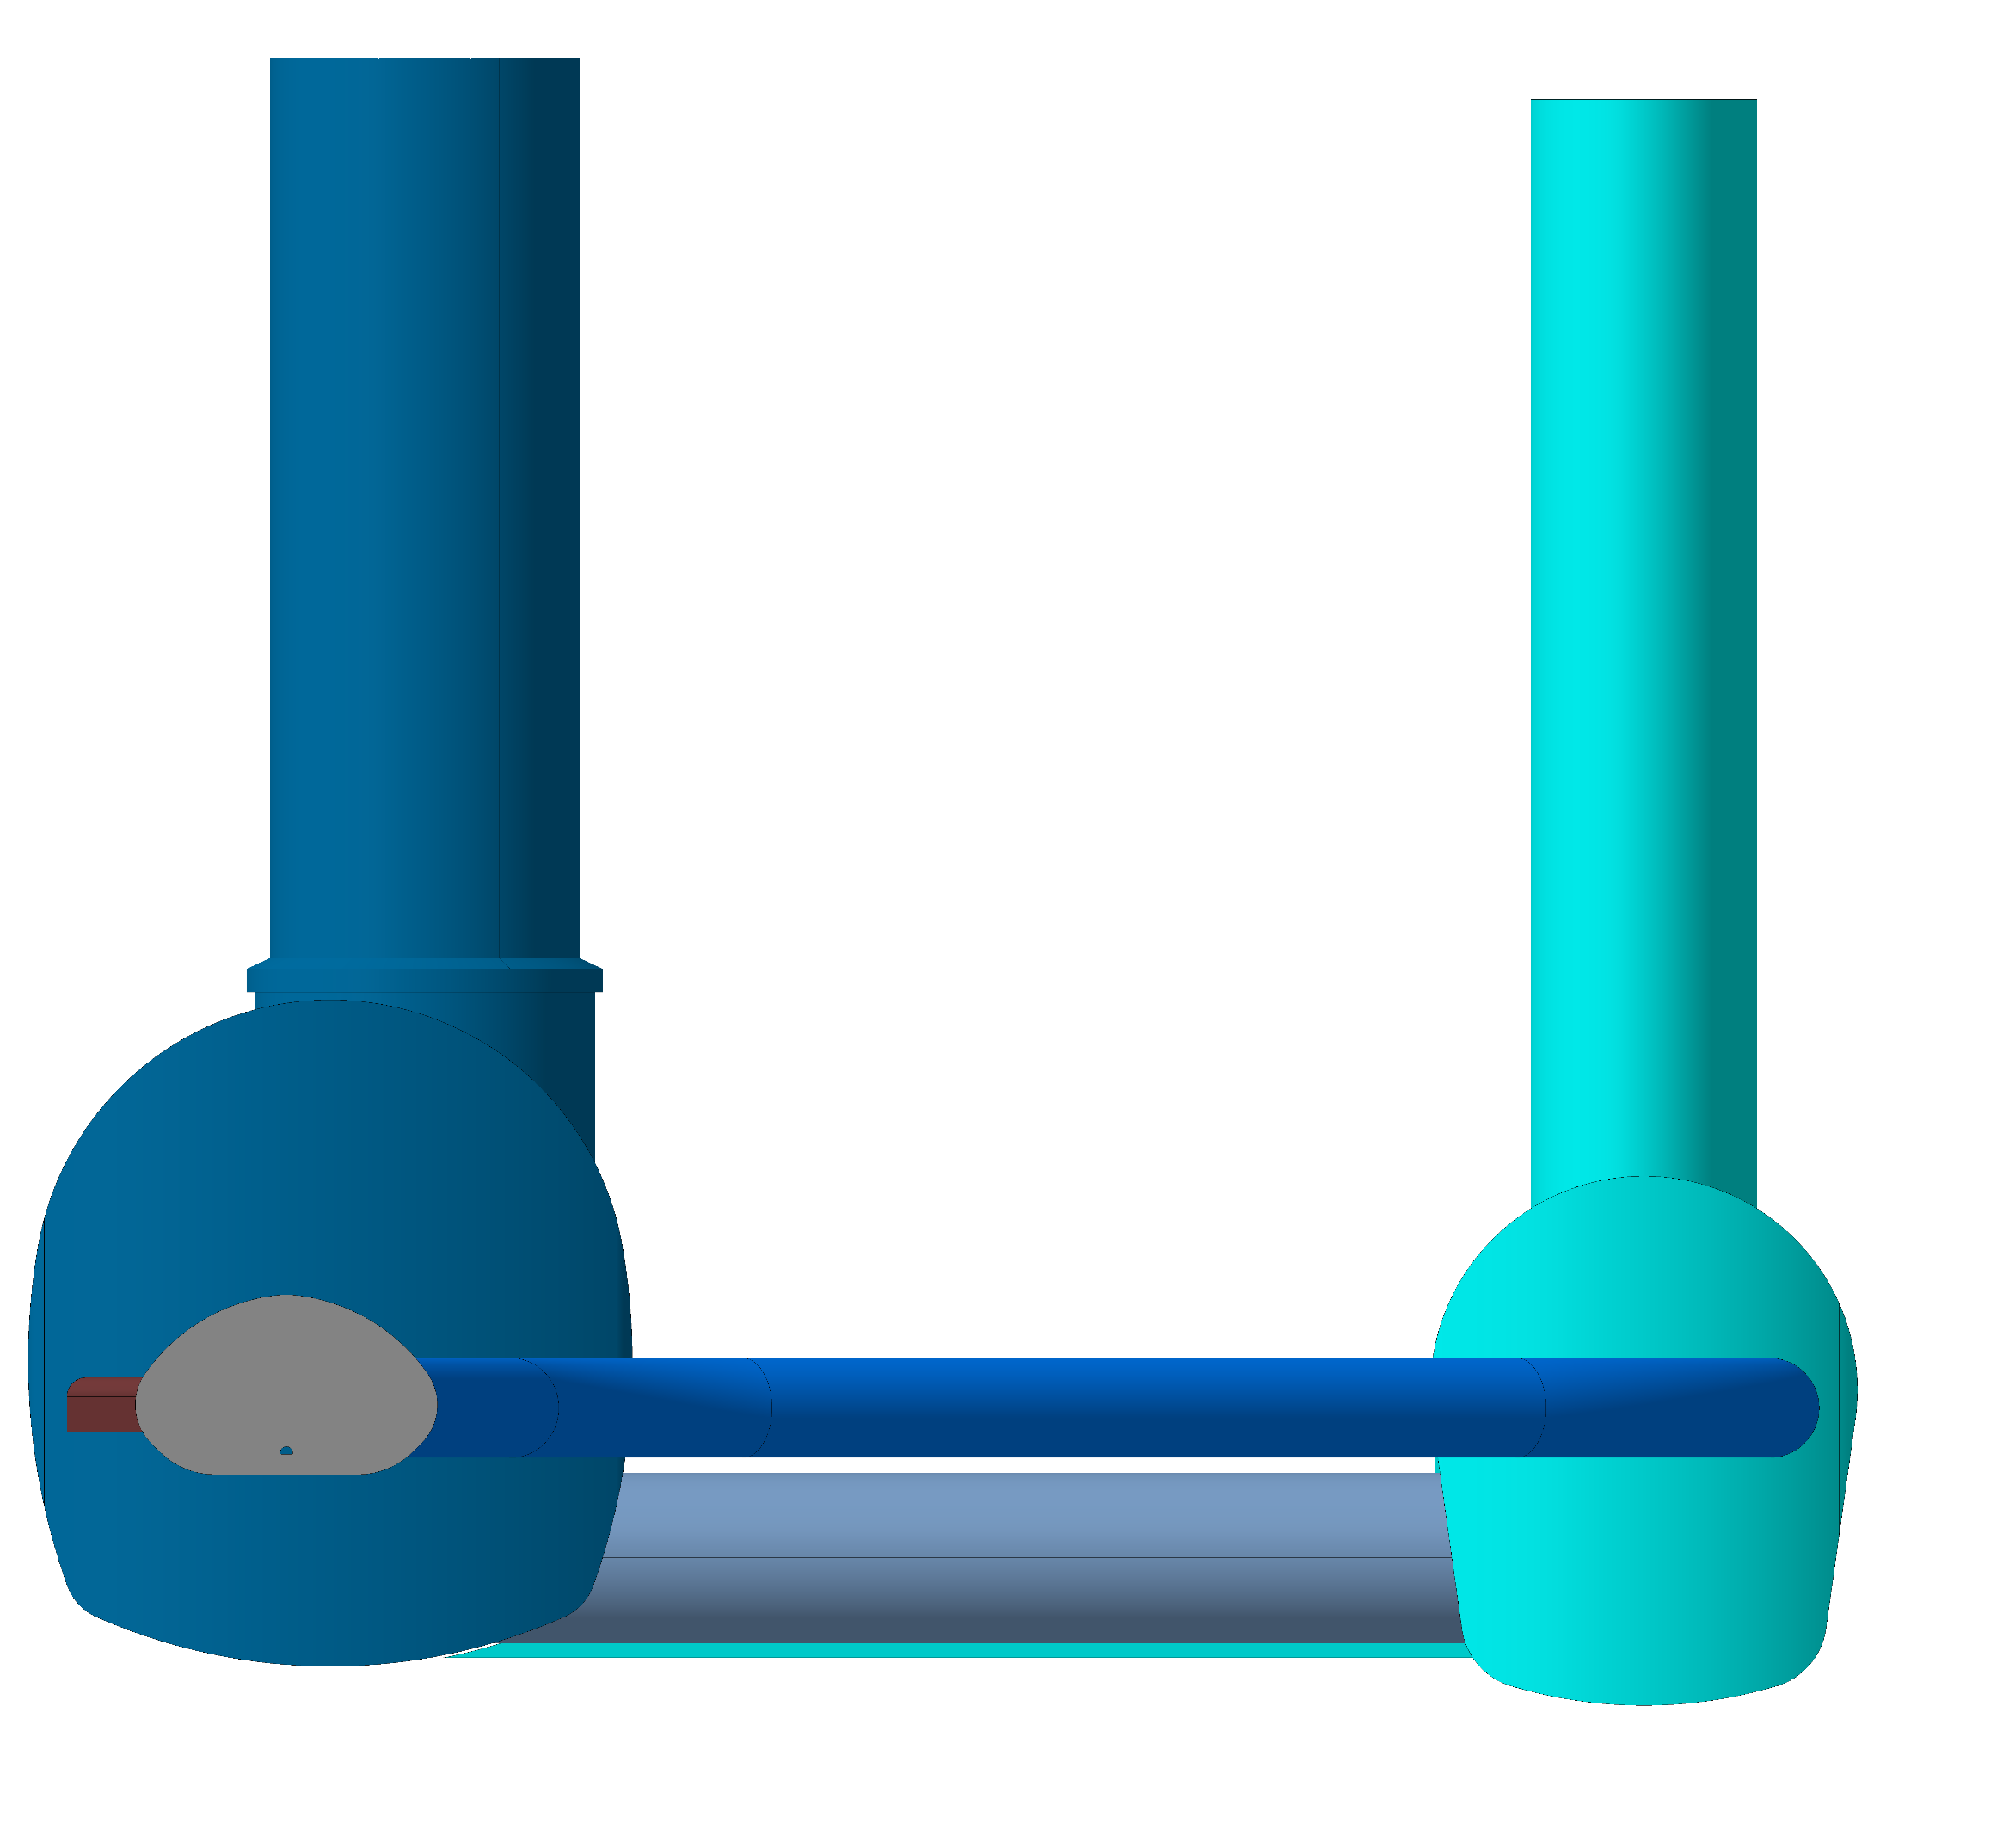
06.06.2023 / FCC Week
F. Valchkova-Georgieva
Elliptical Service Shaft
  FCC Experiment Underground Structure
Experimental Shaft ø18m
Evacuation
connection tunnel
Service Cavern
Connection tunnel ø 5.5m
Machine tunnel
Experiment Cavern
Survey Galleries
Connection tunnel ø 5.5m
Connection tunnel ø 10m

Slide 13
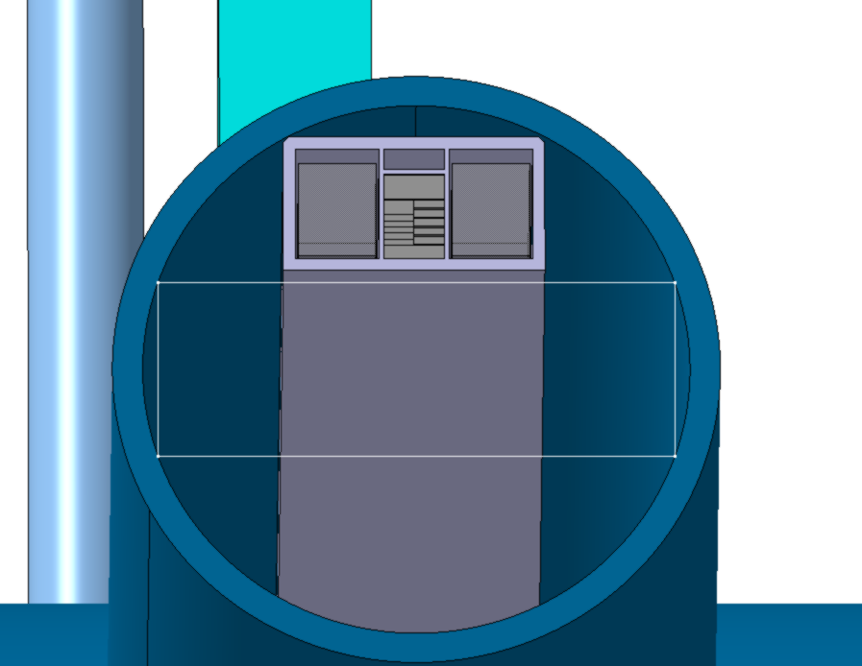
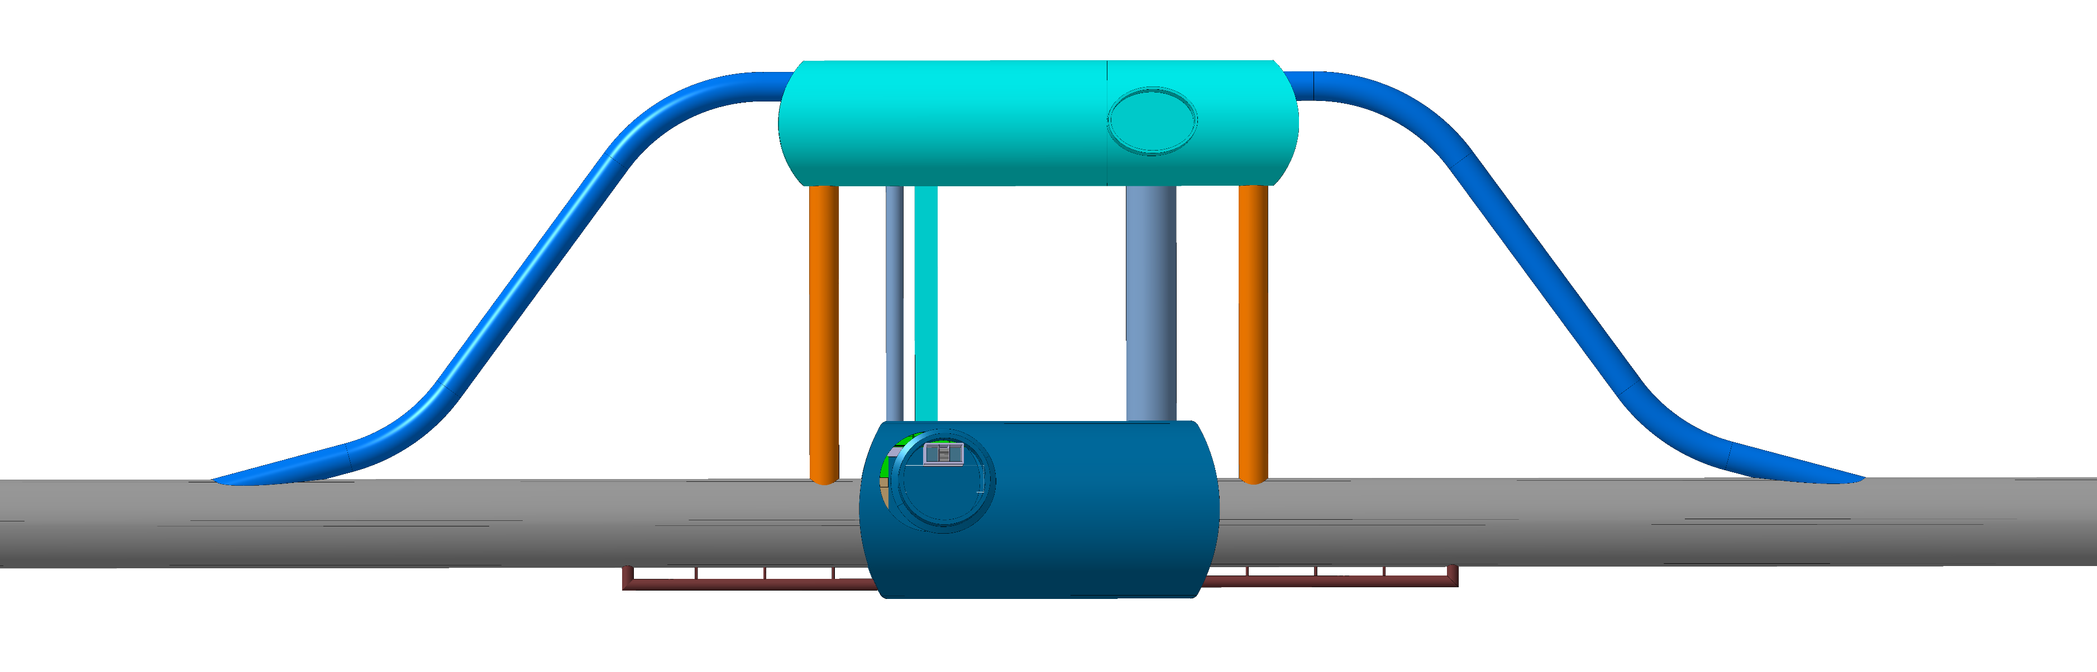
06.06.2023 / FCC Week
F. Valchkova-Georgieva
  FCC Experiment Underground Structure
Elevators and Stairs
8600
4500
5900
17000
Open Space for transport of detector parts
Experimental Shaft ø18m

Slide 14
06.06.2023 / FCC Week
F. Valchkova-Georgieva
  Integration of FCC-ee Beamstrahlung dump

Slide 15
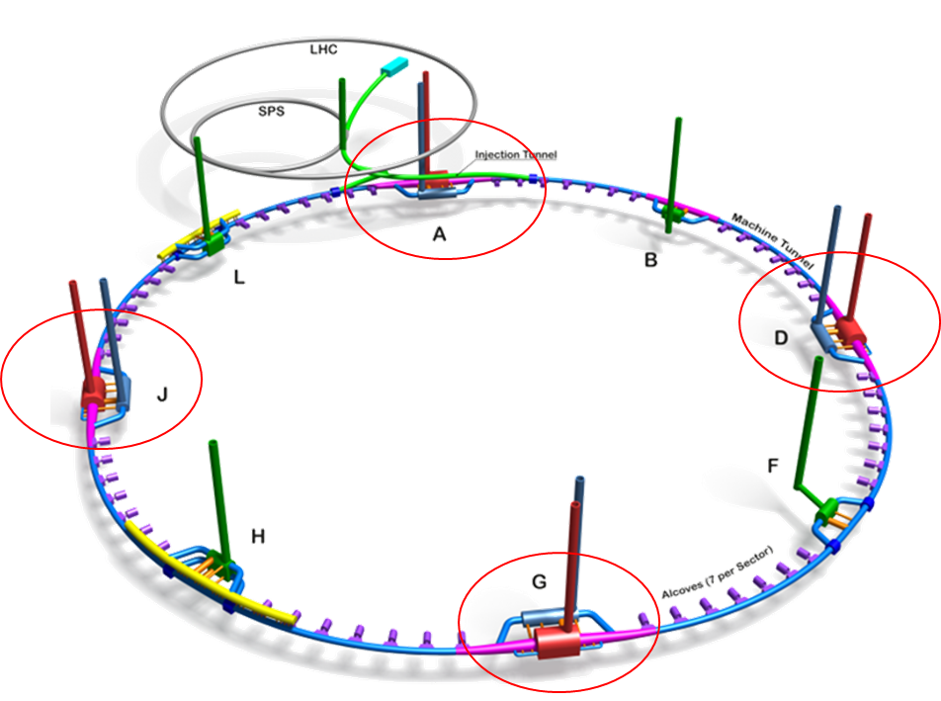
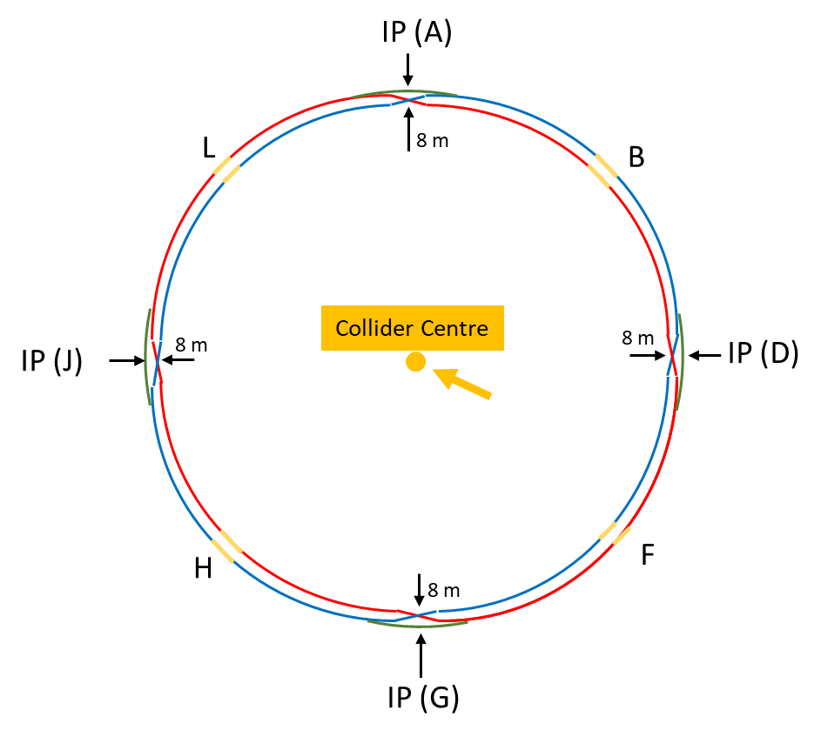
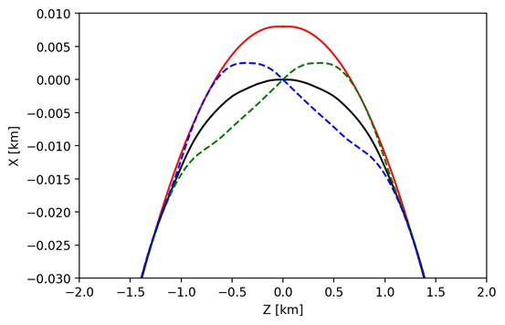
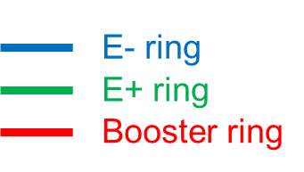
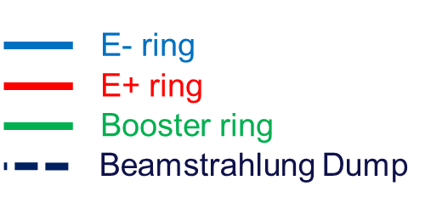
06.06.2023 / FCC Week
F. Valchkova-Georgieva
  FCC-ee main and booster rings Layout
Courtesy K. Oide/ A. Chance
The separation of 3 rings is about 12.7m
Wide tunnel in necessery around the IP for 0.8 km

Slide 16
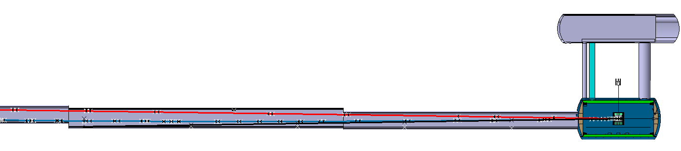
06.06.2023 / FCC Week
F. Valchkova-Georgieva
  FCC-ee beamstrahlung dump integration at point A
E- ring
E+ ring
Booster ring
IP
Beamstrahlung Dump
500m
400m
300m
200m
100m

Slide 17
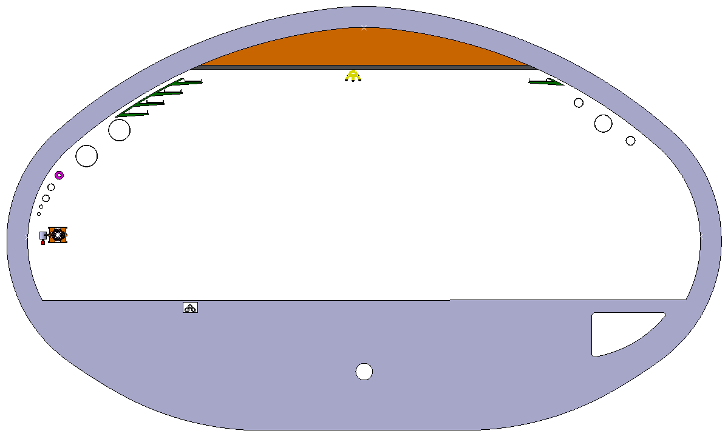
06.06.2023 / FCC Week
F. Valchkova-Georgieva
  FCC-ee beamstrahlung dump integration at point A
7500mm
2870mm
Beamstrahlung
5.5m
E+ ring
IP
Booster ring
225mm
1560m
E- ring
15.3m
500m
400m
300m
200m
100m

Slide 18

06.06.2023 / FCC Week
F. Valchkova-Georgieva
  FCC-ee beamstrahlung dump integration at point A
Beamstrahlung
5.5m
6000mm
5220mm
E+ ring
IP
Booster ring
810mm
E- ring
1560mm
15.3m
500m
400m
300m
200m
100m

Slide 19
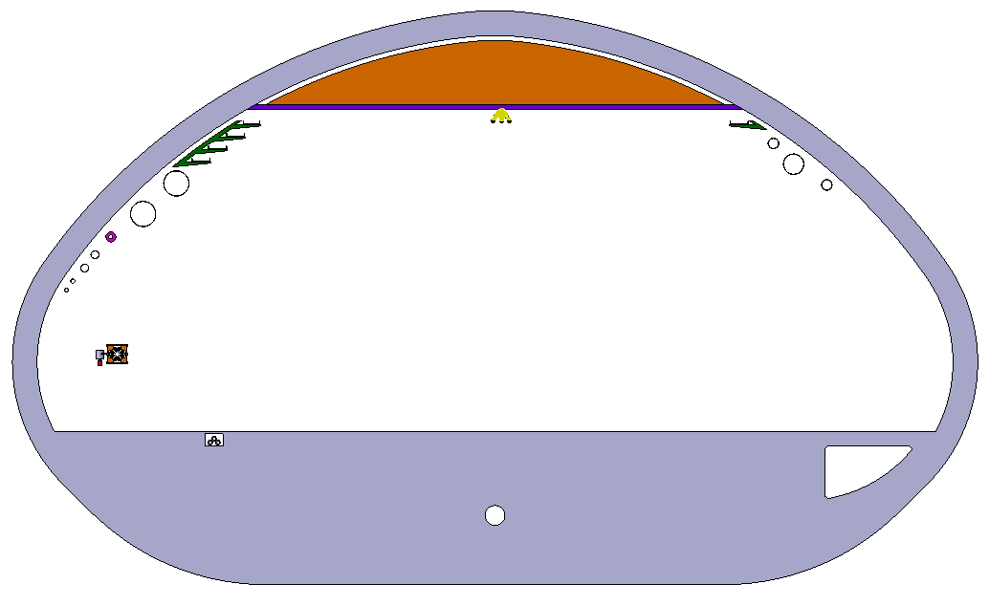
06.06.2023 / FCC Week
F. Valchkova-Georgieva
  FCC-ee beamstrahlung dump integration at point A
Beamstrahlung
4500mm
6890mm
6.5m
E+ ring
IP
2030mm
Booster ring
1560mm
E- ring
17.8m
500m
400m
300m
200m
100m

Slide 20
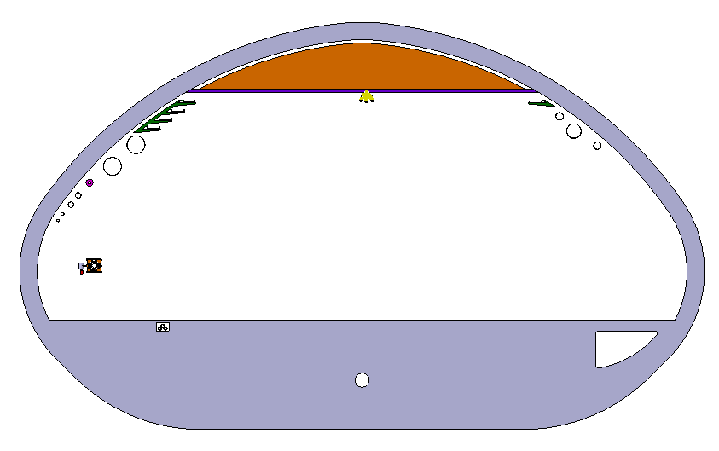
06.06.2023 / FCC Week
F. Valchkova-Georgieva
  FCC-ee beamstrahlung dump integration at point A
Beamstrahlung
4480mm
8290mm
6.5m
E+ ring
IP
3510mm
Booster ring
1560mm
E- ring
17.8m
500m
400m
300m
200m
100m

Slide 21
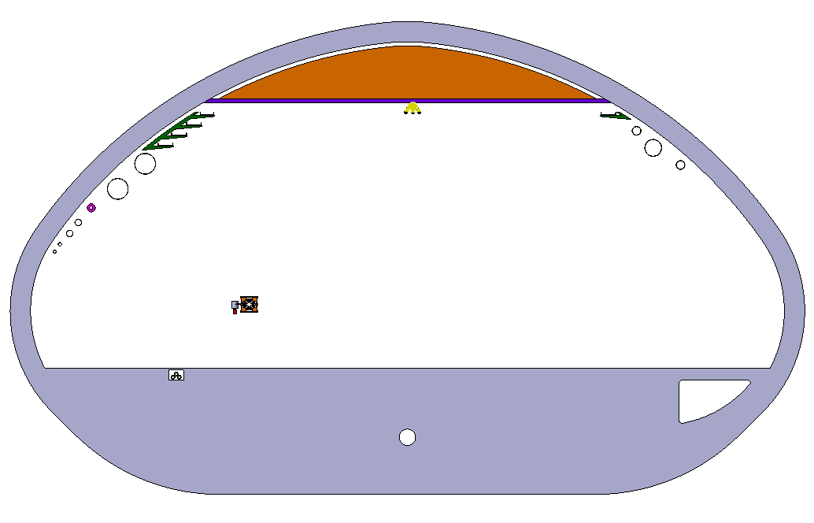
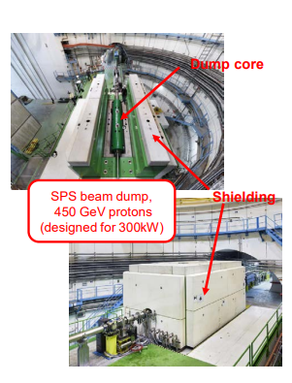
06.06.2023 / FCC Week
F. Valchkova-Georgieva
  FCC-ee beamstrahlung dump integration at point A
Booster ring
E- ring
6.5m
1500mm
9300mm
IP
3880mm
1560m
Beamstrahlung
E+ ring
17.8m
500m
400m
300m
200m
100m

Slide 22
06.06.2023 / FCC Week
F. Valchkova-Georgieva
  Integration of FCC alcove and transport Layby

Slide 23
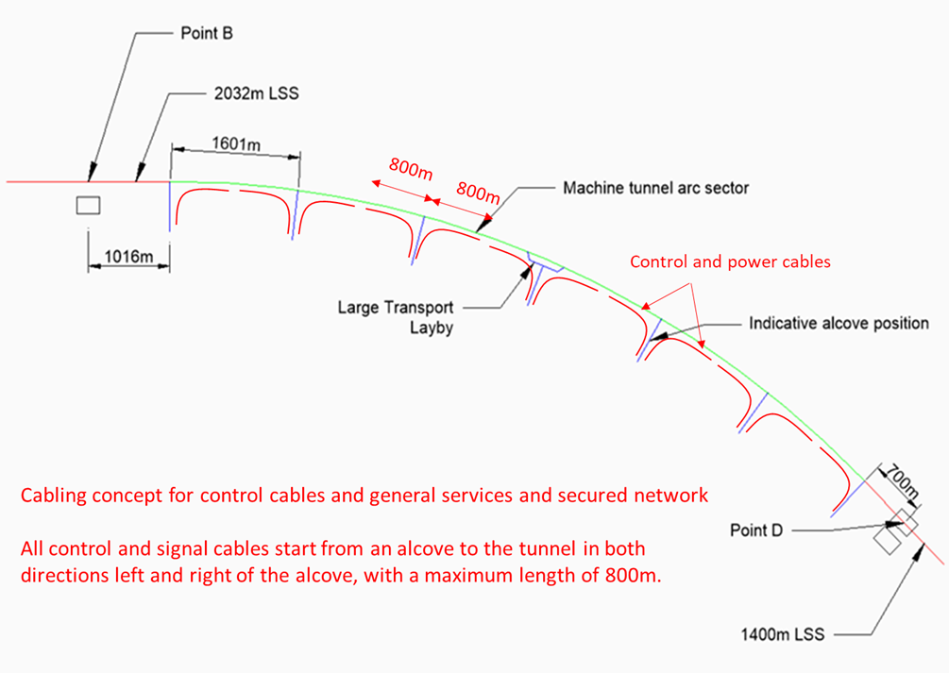
06.06.2023 / FCC Week
F. Valchkova-Georgieva
  FCC Alcove and transport Layby integration
Courtesy Jean-Paul Burnet
Schematic of the principle of cabling from the alcoves

Slide 24
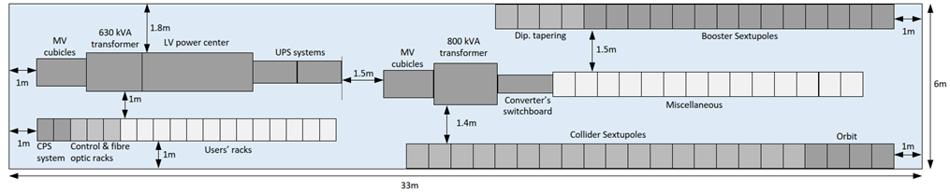
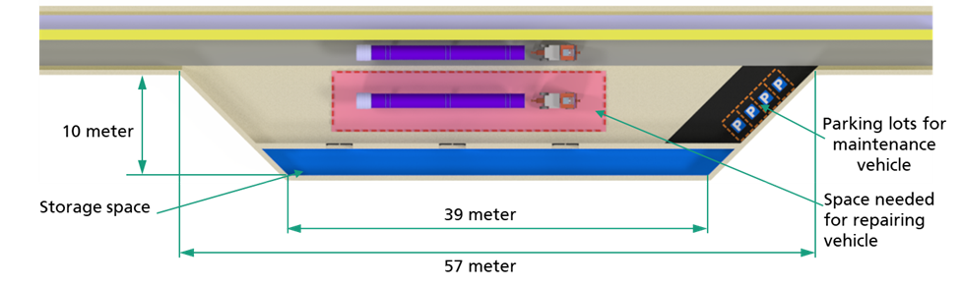
06.06.2023 / FCC Week
F. Valchkova-Georgieva
  FCC Alcove and transport Layby integration
  Requirements:
  Electrical equipment:
  Transport:
Big layby zone
Small layby zone

Slide 25
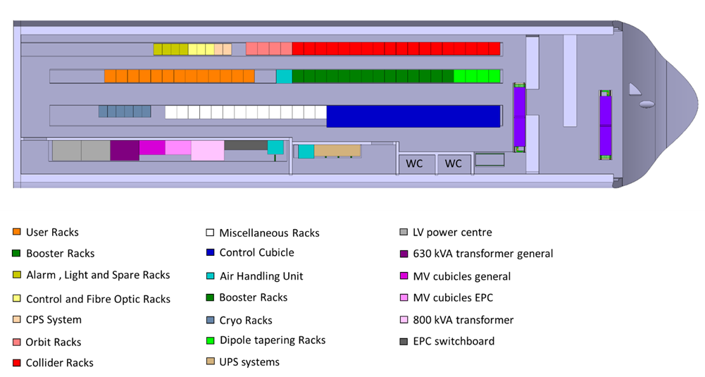
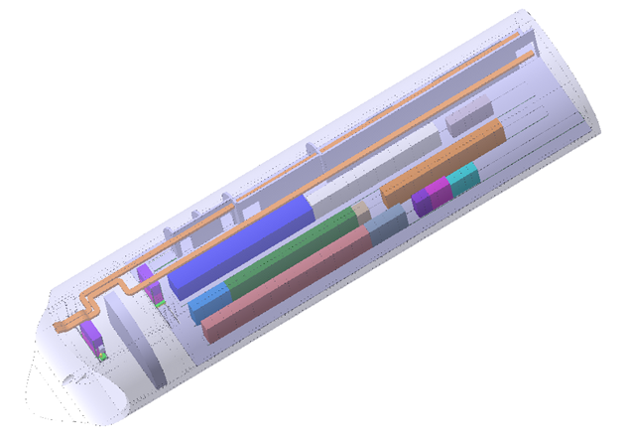
06.06.2023 / FCC Week
F. Valchkova-Georgieva
  FCC Alcove and transport Layby integration
Indicate the position of different electrical equipment in the FCC Alcove in the arc
Isometric view of FCC alcove in the arc

Slide 26
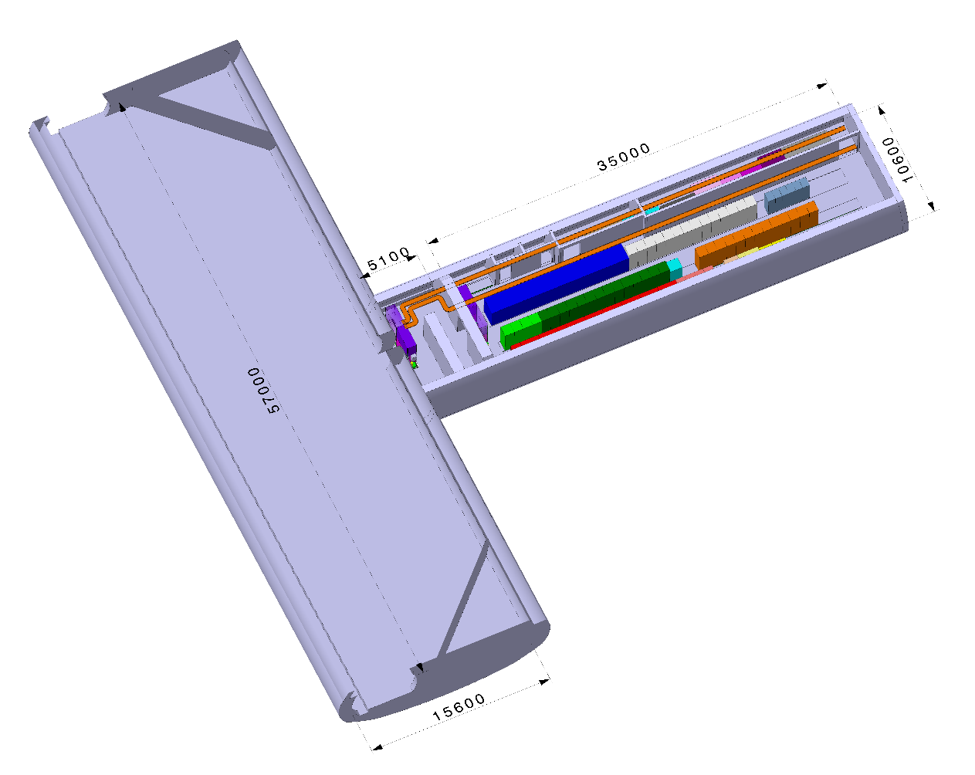
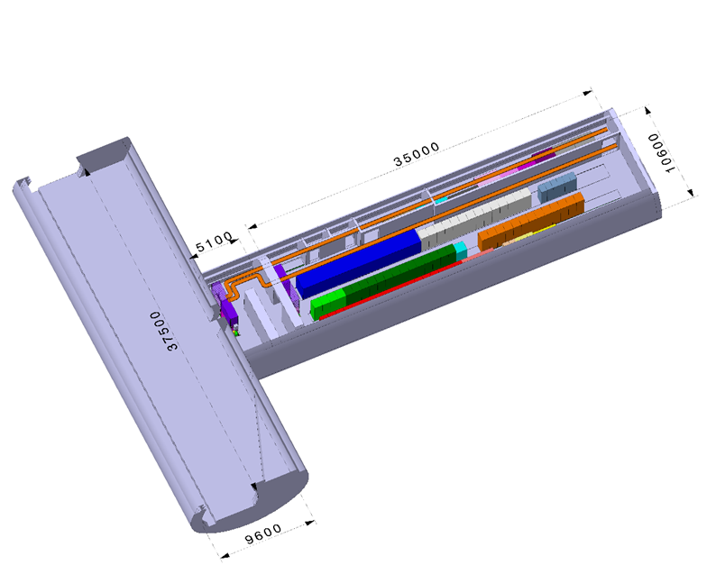
06.06.2023 / FCC Week
F. Valchkova-Georgieva
  FCC Alcove and transport Layby integration
Small transport Layby with standard FCC Alcove
Big transport Layby with standard FCC Alcove

Slide 27
06.06.2023 / FCC Week
F. Valchkova-Georgieva
  Integration of FCC-hh Arc Cell

Slide 28
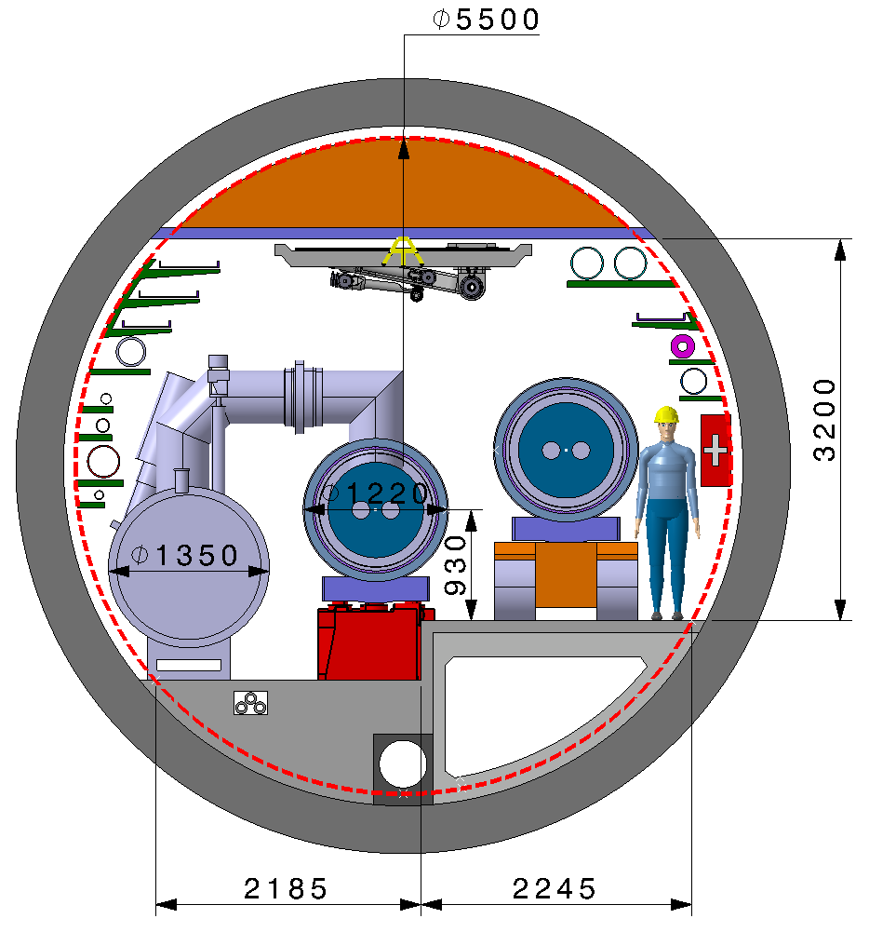
06.06.2023 / FCC Week
F. Valchkova-Georgieva
  Integration of FCC-hh machine elements (regular arc)
Machine tunnel 5.5m in diameter
Smoke/He extraction
Demineralized water DN250
Cable trays:
Fibre optic
LV distribution
Control cables
Cable tray:
MV distribution
Superconducting link DN250
Leaky feed
Demineralized water felling DN65
Firefighting DN200
Compressed air DN80
First aid equipment
Warm He recovery DN250
He DN100
QRL ø 1350
Machine cryostat ø 1200
Electrical HV
power transmission
Fresh air duct
Drain
Collider Center
Main cross section as for FCC-ee

Slide 29
06.06.2023 / FCC Week
F. Valchkova-Georgieva
  Integration of FCC-hh Transfer line

Slide 30
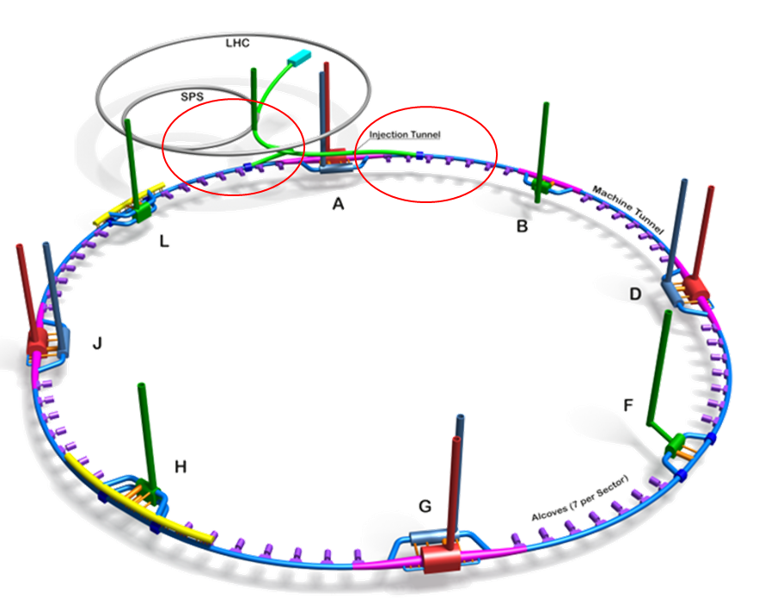
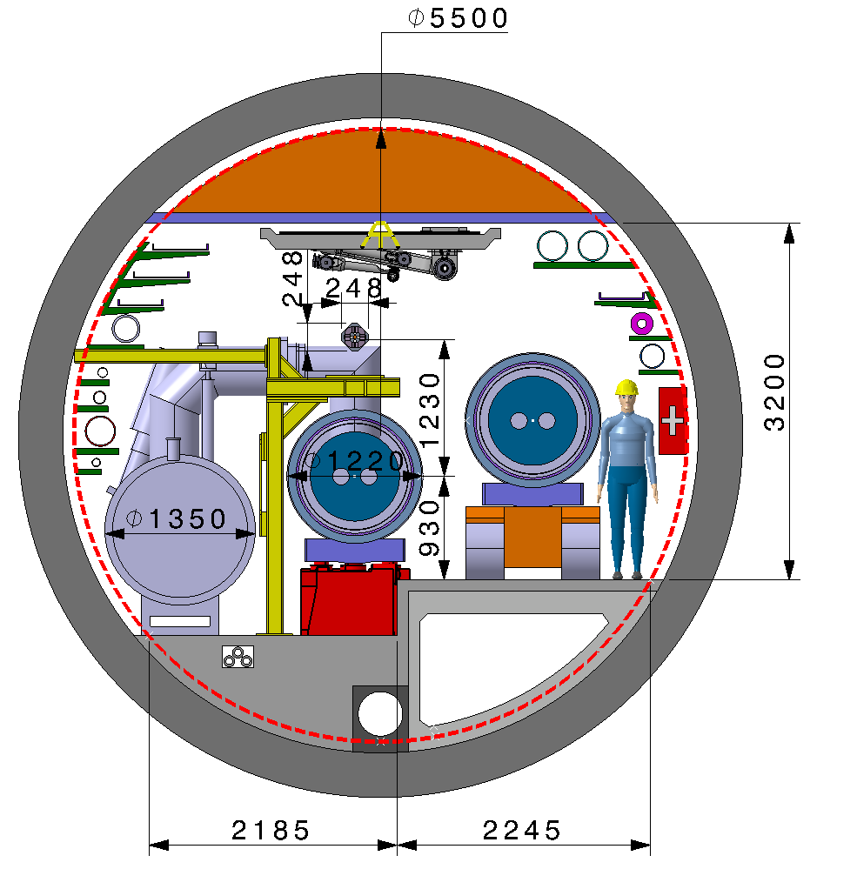

06.06.2023 / FCC Week
F. Valchkova-Georgieva
  Integration of FCC-hh transfer line
Machine tunnel 5.5m in diameter
Transfer line
Permanent quadrupole magnet
Transfer line
Normal conducting quadrupole magnet
Machine cryostat ø 1200
Machine cryostat ø 1200
For further details please refer to Massimo Giovannozzi's presentation "FCC-hh ring: an overview of the new layout" on Thursday at 10:30 am.
Collider Center

Slide 31
Thank you for your attention.
06.06.2023 / FCC Week
F. Valchkova-Georgieva
31

