Slide 1
Xboxes Update
14/12/2022

Slide 2
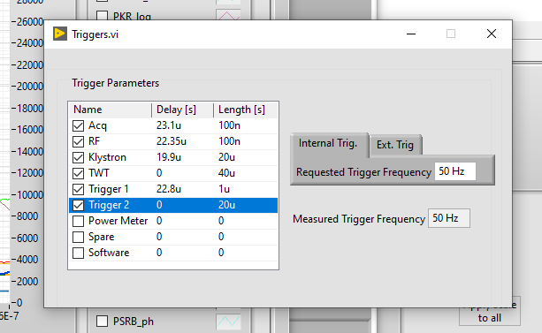
Measurement Proposal
We have had a request for pulse-to-pulse dark current data.
End of year measurement proposal:
~2 hour period in XB3 before the end of year (last afternoon?).
Reduce repetition rate to ~5Hz or less (TBC).
Change logging rate on GUI to save waveforms on every pulse.
Run at fixed gradient and pulse length until we have several BDs.
Switch back to old config and end measurement.
Compile data (Lee).

Slide 3
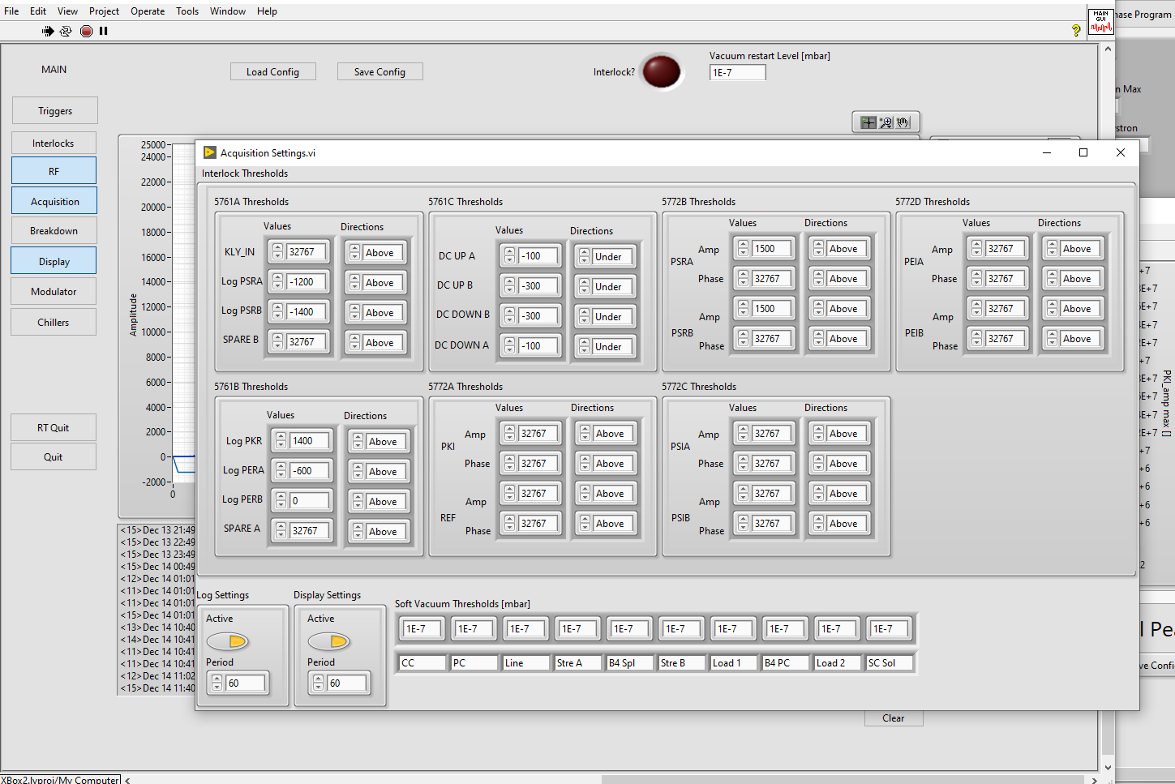
Measurement Proposal
We have had a request for pulse-to-pulse dark current data.
End of year measurement proposal:
~2 hour period in XB3 before the end of year (last afternoon?).
Reduce repetition rate to ~5Hz or less (TBC).
Change logging rate on GUI to save waveforms on every pulse.
Run at fixed gradient and pulse length until we have several BDs.
Switch back to old config and end measurement.
Compile data (Lee).

Slide 4
Measurement Proposal
We have had a request for pulse-to-pulse dark current data.
End of year measurement proposal:
~2 hour period in XB3 before the end of year (last afternoon?).
Reduce repetition rate to ~5Hz or less (TBC).
Change logging rate on GUI to save waveforms on every pulse.
Run at fixed gradient and pulse length until we have several BDs.
Switch back to old config and end measurement.
Compile data (Lee).

Slide 5
Measurement Proposal
Question (for Walter):
Does the post-breakdown ramping matter?

