Slide 1
National Institutes of Health
Center for Information Technology
Identity & Access Management
Jeff Erickson, Chief of NIH Identity and Access Management
Sumit Nanda, Technical Lead, NIH Identity and Access Management
December 2022

Slide 2
Contents | Identity & Access Management (IAM)
CIT SERVICES
What is IAM?
Why IAM Services?
By the Numbers
Spotlight: NIH Login and RAS
Challenges
Contact

Slide 3
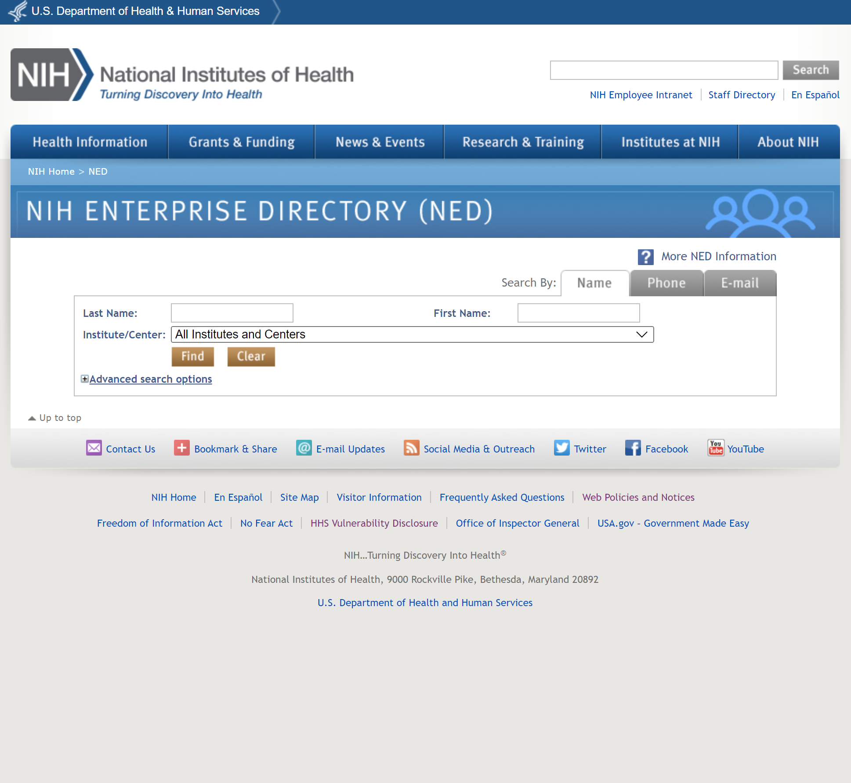
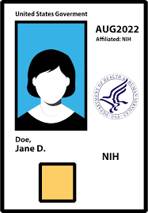
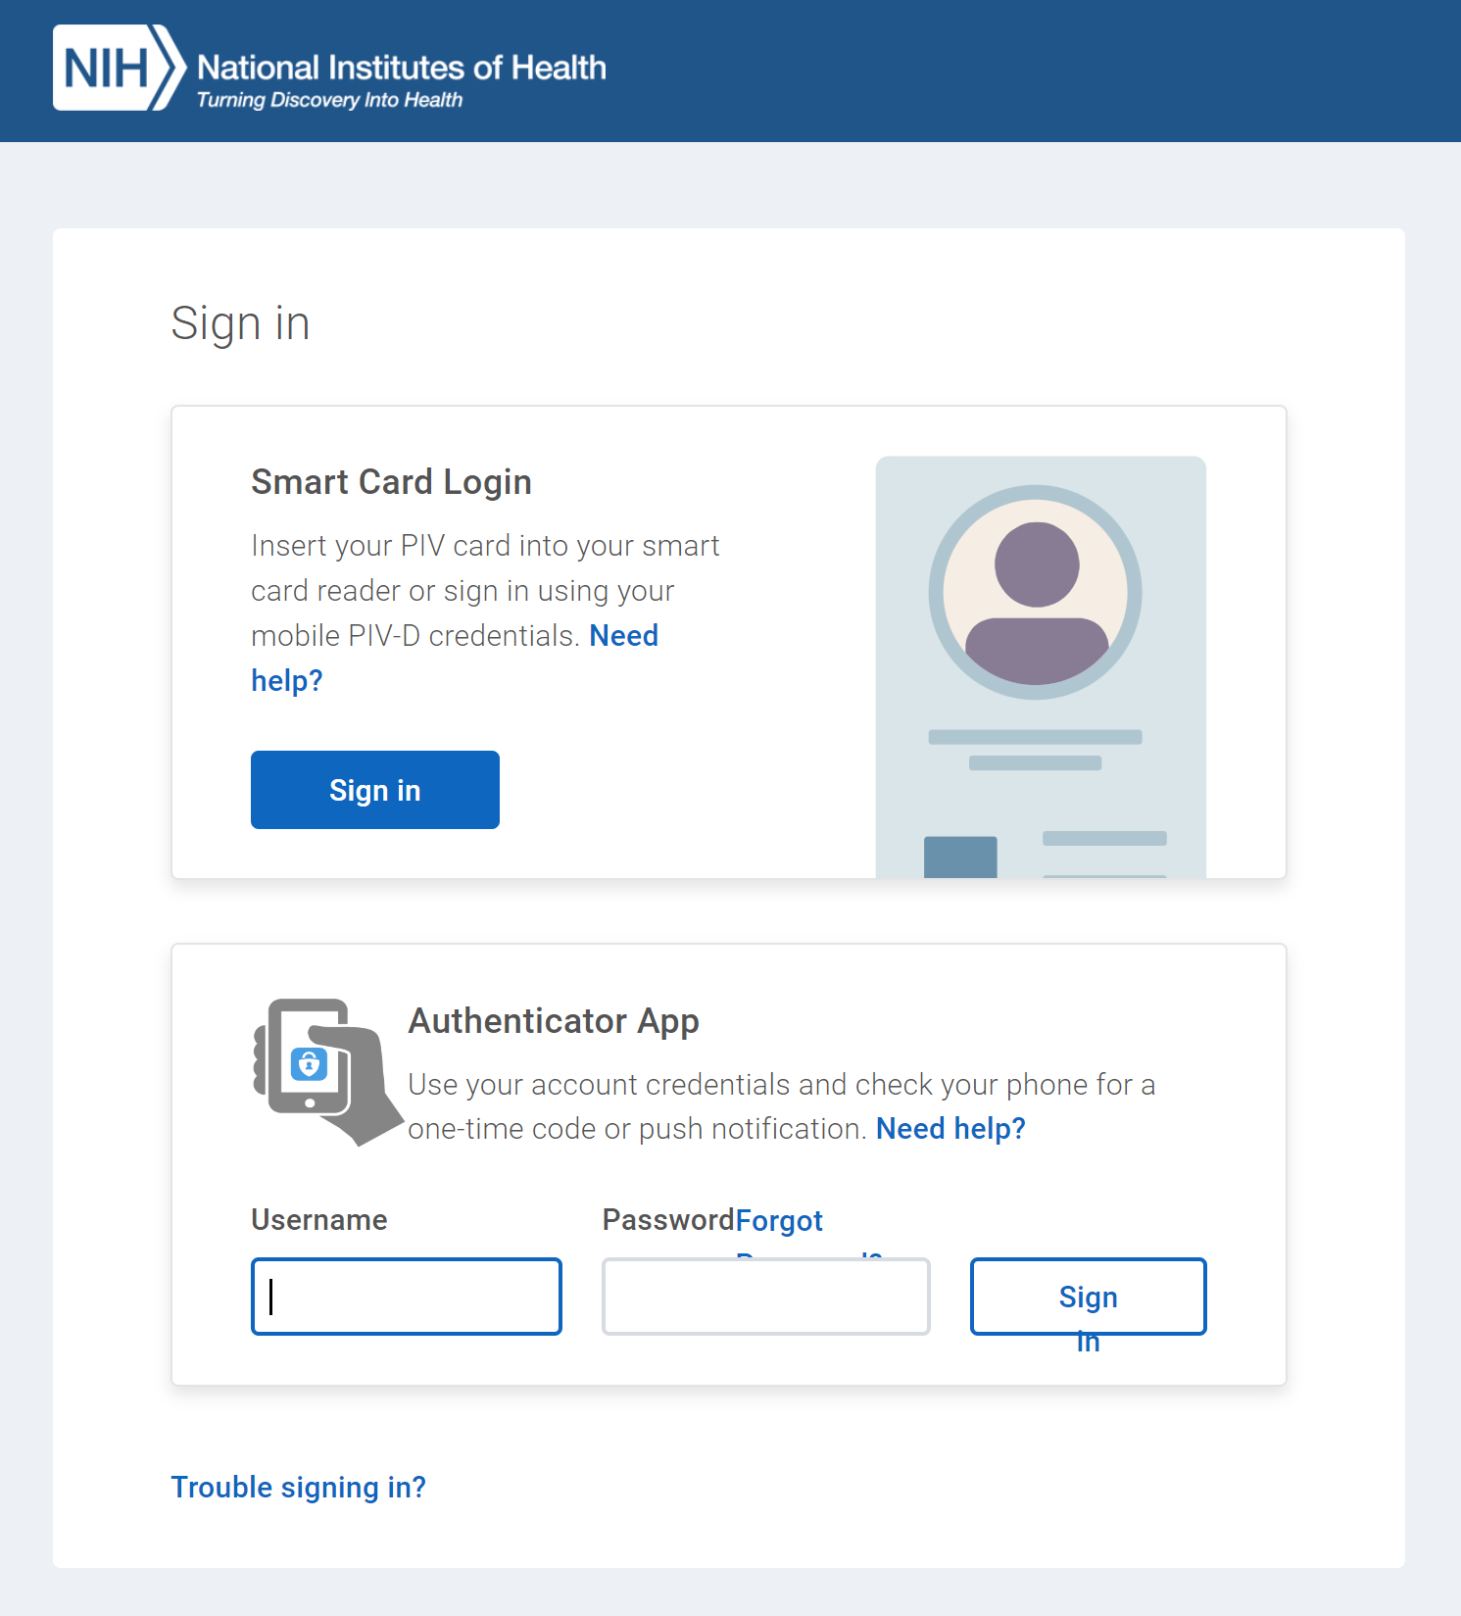
CIT SERVICES
What is Identity & Access Management?
A suite of products and services that ensure NIH staff and research collaborators have seamless, secure access to the data and resources they need.
Identity Management
Credential Management
How an agency collects, verifies, maintains, and terminates digital identities of people and things
How an agency issues, manages, and revokes credentials such as PIV cards, passwords, tokens, and certificates that individuals use to prove their digital identities online
Example: NIH Enterprise Directory
Example: PIV Card
Federation
Governance
How an agency facilitates the secure exchange of data about people and things by accepting external credentials for access to its systems and applications
How an agency establishes and uses standards for data about people and things, and how it aligns with Federal standards and policies
Access Management
How an agency authenticates credentials and authorizes appropriate access to protected services
Example: NIH Login

Slide 4



CIT SERVICES
Why Do We Provide IAM Services? | Identity & Access Management
❶
Protect People and Resources
NIH achieves the right balance of security, compliance, and ease of use to protect staff and intellectual property.
  ❸
Provide Transparent and Intuitive Experience
People get the access they need and expect in ways they understand and can use.
❷
Reduce Complexity and Increase Efficiency
NIH procures the services it needs so our institutes and centers don’t need to recreate or reproduce those capabilities.

Slide 5
By the Numbers | Identity & Access Management
CIT SERVICES
The metrics below demonstrate the impact our services have on the NIH community.
40K+
Simplifies the login experience for all 40K+NIH staff members
196
Streamlines the login experience for grantees at 150+ extramural institutions
1 million
Processes more than 1 million authentication requests per month for external and federated researchers and collaborators
38%
Self-service capabilities -reduces the rate of password changes requiring a call to the Service Desk by 38%
27
Supports all 27 NIH Institutes and Centers to conduct day-to-day business and meet program goals and objectives
11K+
Provides 11K+ members of the NIH community with a backup login mechanism
24x7x365
Provides 24x7x365 support to ensure robust operations of enterprise IT services and systems
400+
Improves the security of 400+ public-facing NIH sites and applications by enabling MFA

Slide 6
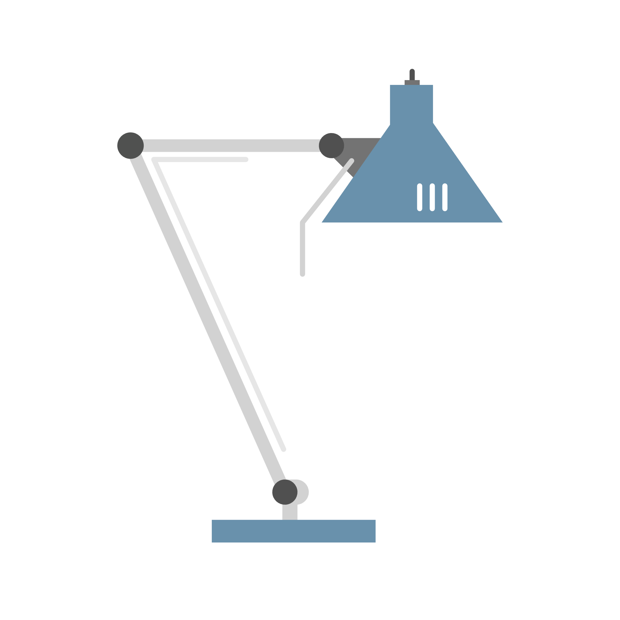
IAM Services Spotlight:
NIH Login &
Researcher Auth Service (RAS) Services
IAM SERVICES

Slide 7
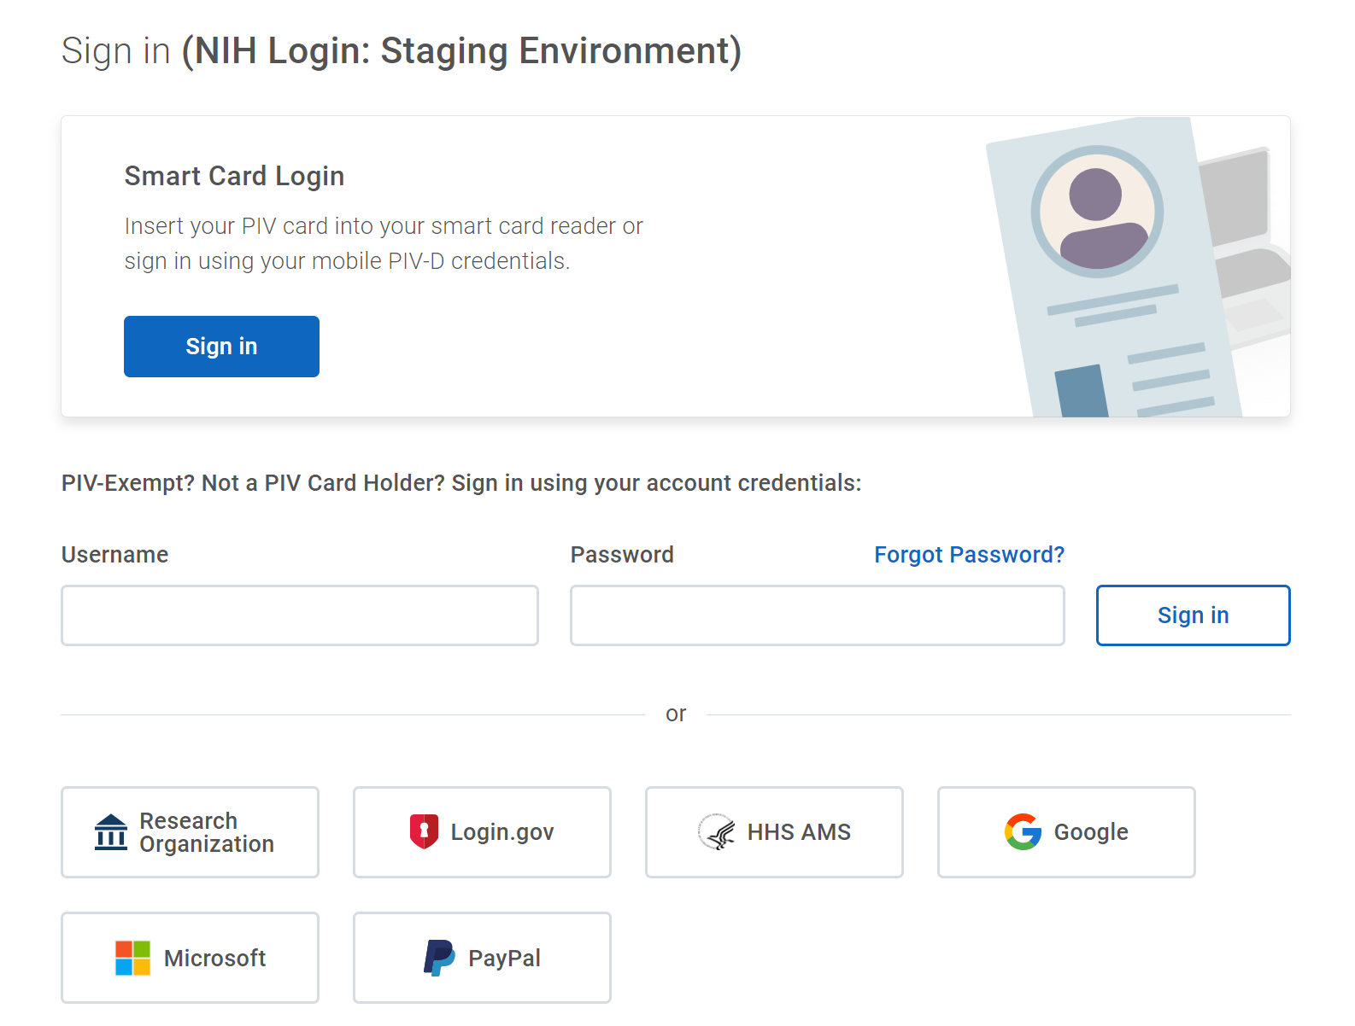
CIT SERVICES
What is NIH Login Service?
The National Institutes of Health (NIH) Login Solution is an NIH Identity and Access Management service offered by the Center for Information Technology (CIT) to provide centralized authentication and Single Sign On (SSO) capability for web-based applications.
The NIH Login is a "one-stop shop" which allows logins from all of NIH staff, Electronic Research Administration (eRA) Commons, Department of Health and Human Services (HHS) employees, and various federated partners.

Slide 8


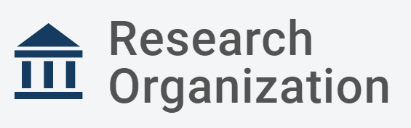





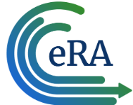



CIT SERVICES
NIH Login | Identity & Access Management
Who are you?
Internal NIH
Researchers
Log in with NIH credentials (PIV/MFA)
Access to authorized applications, datasets and tools in NIH and external systems
NIH Login
External
Researchers
Log in with preferred credentials
What are you authorized to do?
Researcher signs in with preferred credentials | Researcher has option to link and manage their identities in RAS | Enforced multi-factor authentication for platforms that require a higher level of assurance | Authorizations based on NIH Data Access Committee decisions are provided to partner systems

Slide 9
CIT SERVICES
What is RAS Service?
NIH Researcher Auth Service (RAS) is a unified, efficient, and secure authentication and authorization service that enables streamlined access by researchers to NIH-funded data resources across multiple systems and provides standardized methods of logging and auditing such access.
With RAS Service, researchers can log in once and then have their appropriate authentication and authorization information travel with them as they move between platforms.
AUTHENTICATION
No matter what preferred credentials researchers enter, their account identity is recognized
AUTHORIZATION
Researchers have access to the datasets they need and expect in ways they understand; web of trust
AUDITING
Trace and log data in a standard way to protect staff, intellectual property, and human data

Slide 10
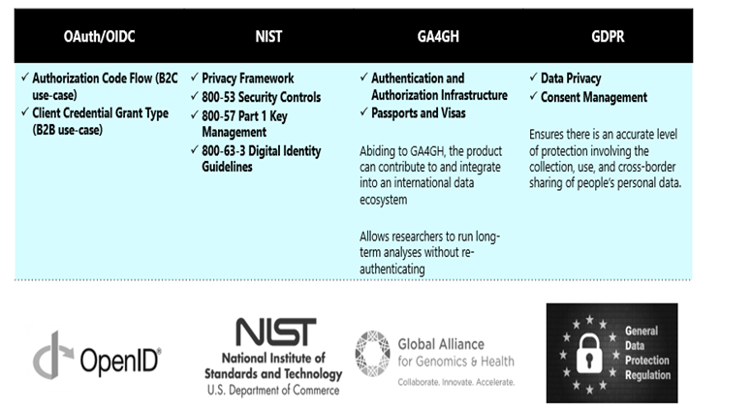
CIT SERVICES
RAS Service | Identity & Access Management
CUSTOMER PAIN POINTS
ENTERPRISE SOLUTION
USING VARIOUS INDUSTRY STANDARDS
Researchers login with duplicative credentials or provide consent to share their personal information multiple times to access data located in different cloud environment. It takes weeks to reflect user's access to data in distributed systems, thereby prolonging research to months
Researchers do not have a unified authentication experience
Lack of federated audit framework to monitor user activities across distributed data ecosystem
Lack of dynamic method to capture and transmit authorization decisions
Researchers cannot link their university credentials to access NIH data ecosystem
No secure way for authorization permission and audit activities to be federated
Cloud compute charge back model to researching institutes for NIH data ecosystem access
OAuth/OIDC | NIST | GA4GH | Data Privacy
Authorization Code Flow (B2C use-case) Client Credential Grant Type (B2B use-case) | Privacy Framework 800-53 Security Controls 800-57 Part 1 Key Management 800-63-3 Digital Identity Guidelines | Authentication and Authorization Infrastructure Passports and Visas Abiding to GA4GH, the product can contribute to and integrate into an international data ecosystem Allows researchers to run long-term analyses without re-authenticating | Consent Management NIH Privacy Policy M-10-22 Ensures there is an accurate level of protection involving the collection, use, and cross-border sharing of people’s personal data

Slide 11
CIT SERVICES
Federated Logins
eRA Login vs Non-eRA Login
Total Number of Unique Logins Between May – November 2022
196
FEDERATED ENTITIES HAVE SUPPORTED THE REFEDS MFA PROFILE FOR eRA
1,350
FEDERATED ENTITIES HAVE LOGGED IN TO NON-eRA APPLICATIONS WITH SINGLE FACTOR AUTHENTICATION
Key Takeaway: Federated partners should prepare to implement MFA and response signaling using the REFEDS MFA Profile

Slide 12
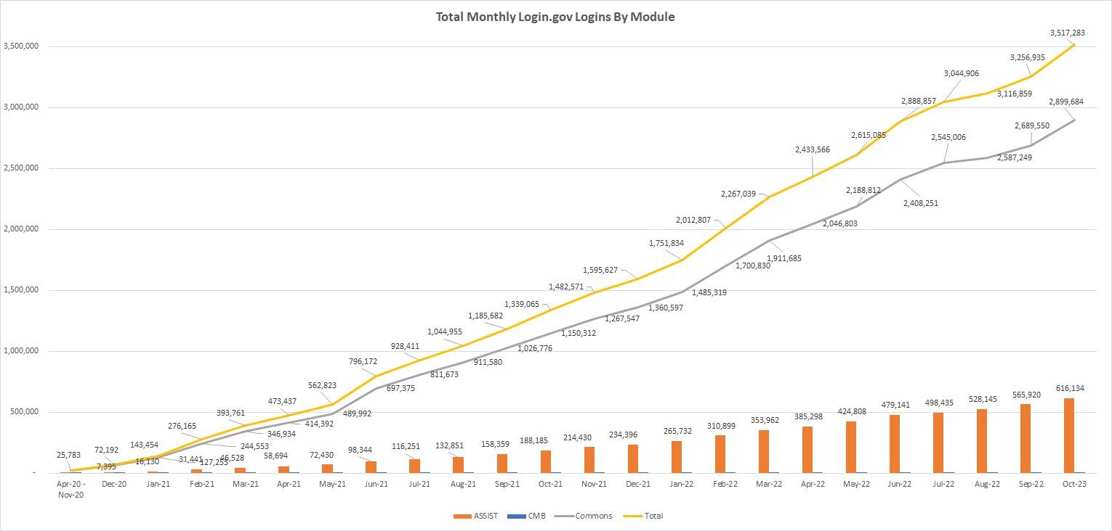
CIT SERVICES
Federated logins to eRA with Login.gov
Oct-22

Slide 13
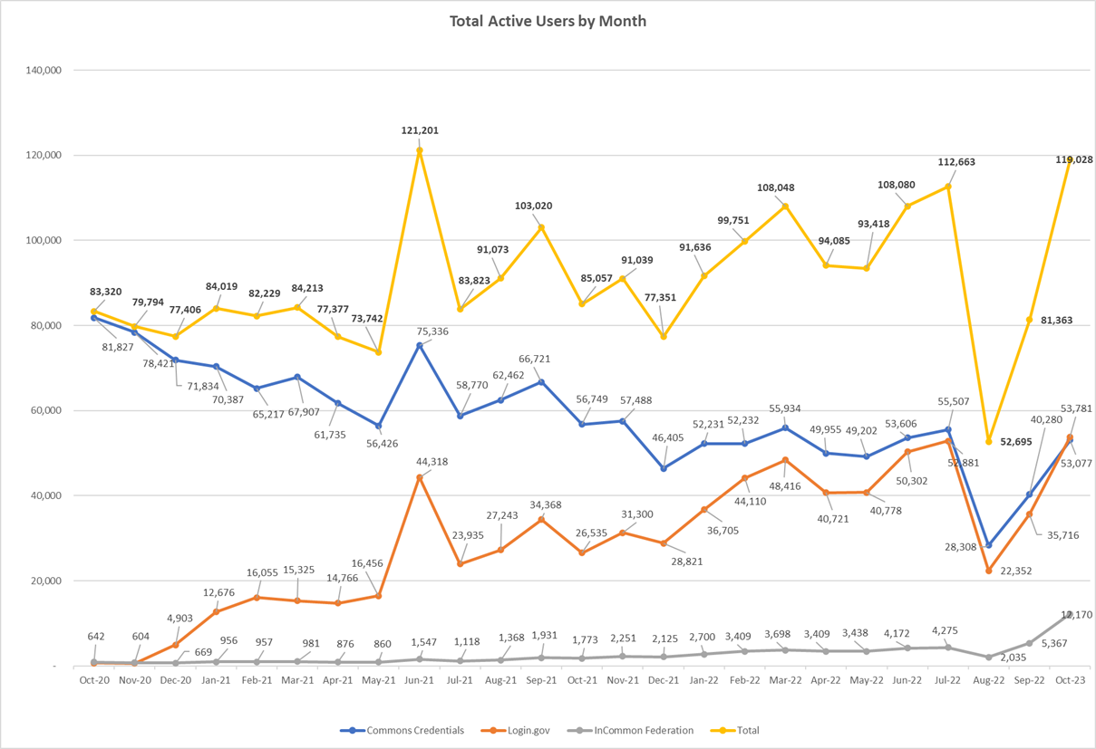
CIT SERVICES
Federated logins to eRA with different credentials
Oct-22

Slide 14
CIT SERVICES
Federated MFA logins to eRA relative to funding

Slide 15
Current challenges with federated MFA
CIT Services
Must have:
  Identity Assurance & Authenticator Assurance
    Increasing adoption of federated identity assurance + federated phishing-resistant MFA
  Organizational affiliation
Constraints
  Cost (ours and yours)

Slide 16
Contact | Identity & Access Management
CIT SERVICES
For more information about CIT’s Identity & Access Management offerings, contact NIHLoginSupport@mail.nih.gov or visit https://auth.nih.gov

Slide 17
Questions?
CIT SERVICES

