Slide 1


Slide 2

Summary
General Information
Registration(s)
  Participants
  Exhibitors
  Social Activities
Programme
  Visits
Organisation

Slide 3
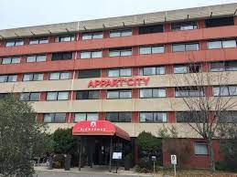
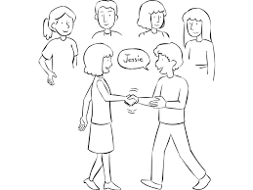
General Information
31st October to 4th November 2022
Appart’City Hotel in Ferney-Voltaire
106 Registrations in total so far
35 institutes from all over the world
74 contributions as posters and presentations
Start of the conference: Monday, 31st October 2022
  Registration of participants (distribution of badges) in Building 33 as from 5.30 pm
  Ice Breaking Cocktail in Restaurant 1 at CERN as from 6.00 pm

Slide 4
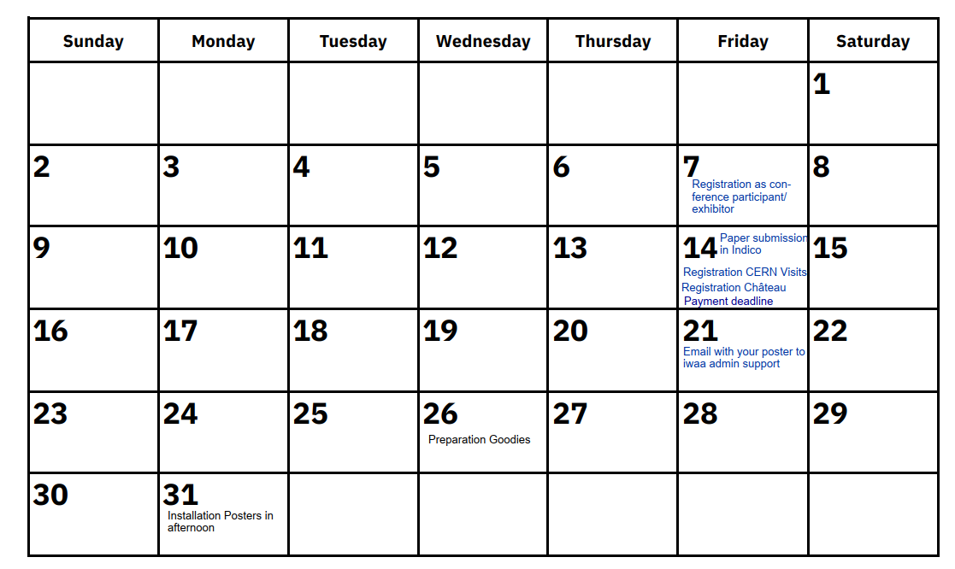
General Information – overview deadlines
October 2022
Visit CERN members Installations

Slide 5

Registration
Deadline: Friday, 7th October 2022
Missing: SCE, International Organizing Committee, GM members
2 Registration forms for participants:
  Full time participation:
  Day-to-day participation
2 Registration forms for exhibitors
  Main exhibitor
  Accompanying exhibitor
2 Registration forms for social activities:
  CERN Visits during the afternoon on 2nd November 2022
  Visit of the “Château de Ferney-Voltaire” during the evening on 3rd November 2022

Slide 6
Registration - Participants
Full-time participation | Day-to-Day participation
350 CHF for the entire week | 60 CHF per day
Form: CERN Participants | Form: CERN One Day participation
Confirmation email to be sent to your Group Administrative Officer for processing
Payment done via TID for all CERN members by the respective GAO
Local conference → particular conditions for CERN members
  Participation in social events in the evenings are at your own expense
    Label the payment: LAST NAME_First Name_IWAA2022_Social events
    Confirm participation in social events on CERNBox (file: BE-GM_Social diners)
  Travel request to be done, BC for GM members: 61417
  Register absence in EDH as Official trip
Indicate in the registration form any dietary restrictions!!

Slide 7
Registration – Exhibitors
Deadline: Friday, 7th October 2022
2 Registration forms for Exhibitors
  Main exhibitor: 500 CHF per person
  Any accompanying exhibitor: 400 CHF per person
  Hexagon will join
No news from API Metrology, Faro, Triumph, VMT GmbH, Hyp-Arc, Allnav, Geofit, Zöllner & Fröhlich,

Slide 8
Registration – Social Activities
For GM: Indicate your participation in social events in the evening here https://cernbox.cern.ch/index.php/s/RHUNXRkgWiygV5d
  (file: BE-GM_Social diners)
Deadline to register and pay your contributions: Friday, 14th October 2022
Monday, 31st October 2022 – «Ice Breaking Cocktail», CERN
  In R1, at the end, before the glass box
  Participation included in the conference fees
Tuesday, 1st November 2022 – «Fondue», Bains des Pâquis - Geneva
  50 CHF per person
  Open to accompanying persons
  Bus transport from hotel to Geneva downtown and back organised
Wednesday, 2nd November 2022 – «La table du Lac», Divonnes-Les-Bains
  77 CHF per person
  Open to accompanying persons
  Bus transport from hotel to Geneva downtown and back organised
Thursday, 3rd November 2022 – «Château de Ferney-Voltaire», Ferney-Voltaire
  Free of charge, included in the conference fees
  No transport is organised, accompanied visit by a volonteer (15 mins walking distance from Appart’City Hotel)

Slide 9
Programme
Welcome on Tuesday, 1st November by Malika MEDDAHI
Tight schedule to fit 74 contributions in terms of presentations and posters
Poster sessions will take place throughout the conference
Paper submission deadline: Friday, 14th October 2022
  Attach your paper directly to your contribution in the time schedule: https://indico.cern.ch/event/1136611/timetable/?layout=room#20221031.detailed
Key note speakers: Malika MEDDAHI et Werner RIEGLER

Slide 10
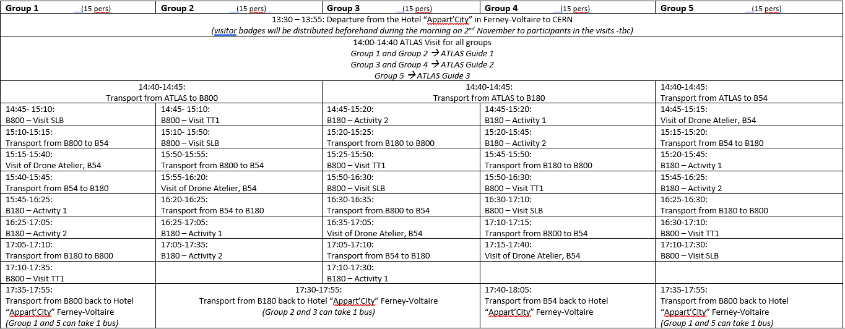
Programme - Visits

Slide 11
Programme - Visits
Visits for CERN members done on Monday, 31st October 2022 from 2.00 pm to 3.00 pm
  Training for guides
  Start at 2.00 pm at B800 with SLB and TT1
  2.20 pm at B180 to visit 2 activities
  2.40 pm at B54, Drone Atelier
Visits on Wednesday, 2nd November 2022 dedicated to external conference participants only.
  Rejection of BE-GM CERN members from the visits subscriptions
WhatsApp/Signal group for bus guides and visit point guides will be put in place
  CERNBox file to complete: https://cernbox.cern.ch/index.php/s/Rdpl97Zul6oXdeT
  Responsibilities clarified in slide 12

Slide 12
Organisation
Subscription to volunteers activities: https://cernbox.cern.ch/index.php/s/BNmuPb7gh5mtzgl
Installation of poster grids on Monday, 31st October and removal on Friday, 4th November in the hotel Apart’City.
  Looking for 3-4 volunteers to help setting up and to remove 22 grids for the posters + exhibitors
  Attach and detach posters to grids
Ice Breaking Party on Monday, 31st October
  Help of 5 persons needed to accompany external participants to the R1 after their registration in Building 33
Goodies
  Help of 3-4 persons needed to prepare >100 goodies + badges for CERN entry + CERN Visits
  Date: Wednesday, 26th October 2022
Posters
  Poster sessions throughout the conference in the coffee break conference room
  Print out of poster done in one single order for GM members. Deadline to send your posters to iwaa.2022@cern.ch by Friday, 21st October 2022 the latest!
  Installation of your posters on Monday, 31st October 2022 as from 2.00 pm until 4.30 pm only!
  Removal of your posters on Friday, 4th November 2022 between 2.00 pm and 4.00 pm.
Bus guides
  5 visitor groups finally with 1 accompanying person from CERN each. 3 persons still needed.
  time schedule is respected by the group and by the guide, inform about delays, inform about any urgencies, be the contact person for the bus driver

