Slide 1


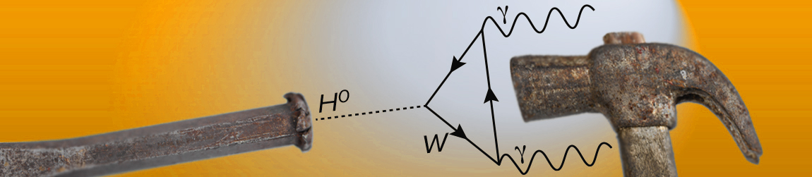
Image Denoising
… Not What You Think
Michael Elad
    Computer Science Department
    The Technion - Israel Institute of Technology
    Haifa 32000, Israel
Verily Research
November 1st 2023

Slide 2
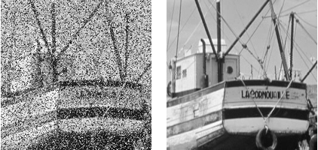
This Lecture is About …
Image Denoising
Image Denoiser
Noisy image
Denoised image
Removal of noise from images is a heavily studied
problem in image processing
In this talk we expand on recent discoveries and
developments around this seemingly dead topic

Slide 3
Our Agenda
        Brief Introduction & History
        Image Denoising: The Classic Era
        The Deep Learning Revolution
        Synergy: Classic + Deep Learning
        Our Focus Today: Denoising for …
          Solving general inverse problems
          Image Synthesis
          High perceptual quality recovery
        Summary

Slide 4
Introduction & History

Slide 5
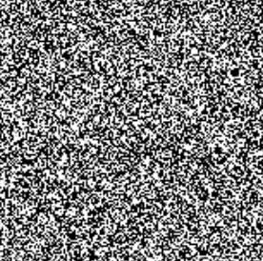


So, Let’s Talk About …
Image Denoising
or more accurately
Removal of White Additive Gaussian Noise from an Image
Image Denoiser
+
Original (clean) Image
Noisy image
$$σ$$
Denoised image
Gaussian Noise: $ℕ\left(0, σ^{2}I\right)$

Slide 6
Image Denoising is Challenging
Image denoising is far from trivial task! Why?
Because our goal is to remove noise as much as possible while preserving the details in the image
Denoising is essentially a highly ill-posed separation task
Image Denoiser
+
Original (clean) Image
Noisy image
$$σ$$
Denoised image
Gaussian Noise: $ℕ\left(0, σ^{2}I\right)$

Slide 7

Why Work on Image Denoising?
Practical: It is a real-world problem, arising in all cameras,
Front-Gate to Image Processing: Being the simplest inverse
problem, it is a platform for assessing new ideas in our field, &
Other Uses for the Denoiser Engine: Recent work has shown
that given a denoiser, there are other fascinating uses for it
that go far beyond noise removal
Noisy image
$$σ$$
Image Denoiser
Denoised image

Slide 8

Why Assume Gaussian Noise?
  The Gaussian case is more common and much more important
  When considering a Poisson noise,
    High count of photons – The distribution gets closer and closer
    to the Gaussian case
    Low-count Poisson-distributed image can be converted to a Gaussian-noisy one by Anscomb - Variance Stabilizing Transform
  Many of the developed ideas
  for the Gaussian case can be
  converted to other noise models
  MMSE denoisers for the
  Gaussian case are of extreme
  theoretical value (see later)
+
Noisy image
Original (clean) Image
Gaussian
Noise:
$$ℕ\left(0, σ^{2}I\right)$$

Slide 9
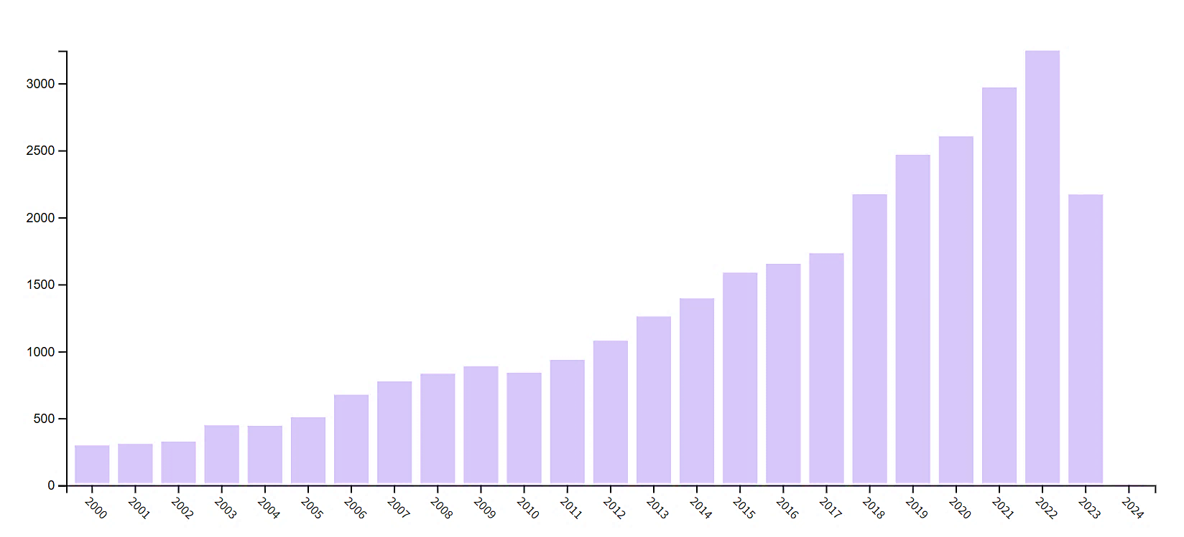

Image Denoising: Little bit of History
Roughly speaking, there are ~33,000 papers* on this subject, offering algorithms, theoretical analysis and so much more
* Search done on October 26th 2023 in WoS, topic: ((image or video ) and (denoising or (noise and remov) or clean))

Slide 10
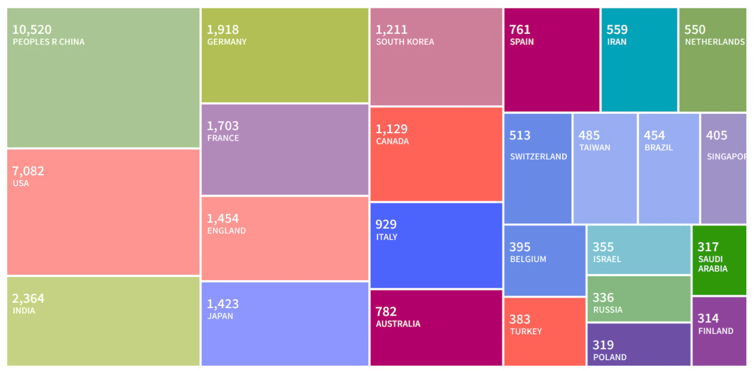
Image Denoising: Little bit of History
Citing Articles:
USA: 208188
China: 92111
France: 46506
Germany: 41808
England: 36459
Canada: 27033
Spain: 25317
Australia: 23502
Israel: 17711
India: 17604
Switz.: 17601
Japan: 17427
Italy: 16393
Nether.: 15609
Korea: 14119
Finland: 11969
Singapore: 9695
Belgium: 8383
Brazil: 7637
Taiwan: 6802
Iran: 5697
Russia: 4607
This research comes from all over the globe
… and it is heavily cited

Slide 11
The Classic Era

Slide 12




Design of Image Denoising Algorithms
How can we design a denoiser?
The classic Bayesian approach (1960-2014):
Model image content with a prior expression ρ(x) (e.g., forcing smoothness, sparsity, low-rank, self-similarity, … ), and
Formulate the denoising task as an optimization problem
$$P\left(x\right)=C⋅exp\left\{−ρ\left(x\right)\right\}$$
$$\hat{x}=\min_{x}{{ \left\|x−y\right\|}^{2}+ρ\left(x\right)}$$
This is the MAP estimate, which leads to an iterative or a direct algorithm for getting $\hat{x}$ from $y$
Likelihood
Prior
$y$: Given noisy image
$\hat{x}$: Denoised result

Slide 13
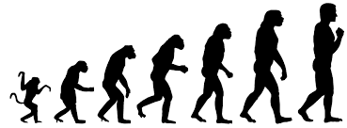
Image Denoising: Evolution
Sparsity Methods
L₂-based Regularization
Robust statistics
PDE-Methods
NCSR BM3D KSVD
Patch-Methods
Kernel-Regr.
EPLL
Anisotropic Diffusion
Wiener
Hubber-Markov
Beltrami
TV
Year
1970 1975 1980 1985 1990 1995 2000 2005 2010 2015
Heuristic: Bilateral
Low-Rank
Heuristic Spatially adaptive filtering
Self-Similarity Methods
Wavelet
WNNM
Thresholding
NLM-PCA
NL-LR
Cycle-Spinning
NLM
GSM
SURE
NL-Bayes

Slide 14
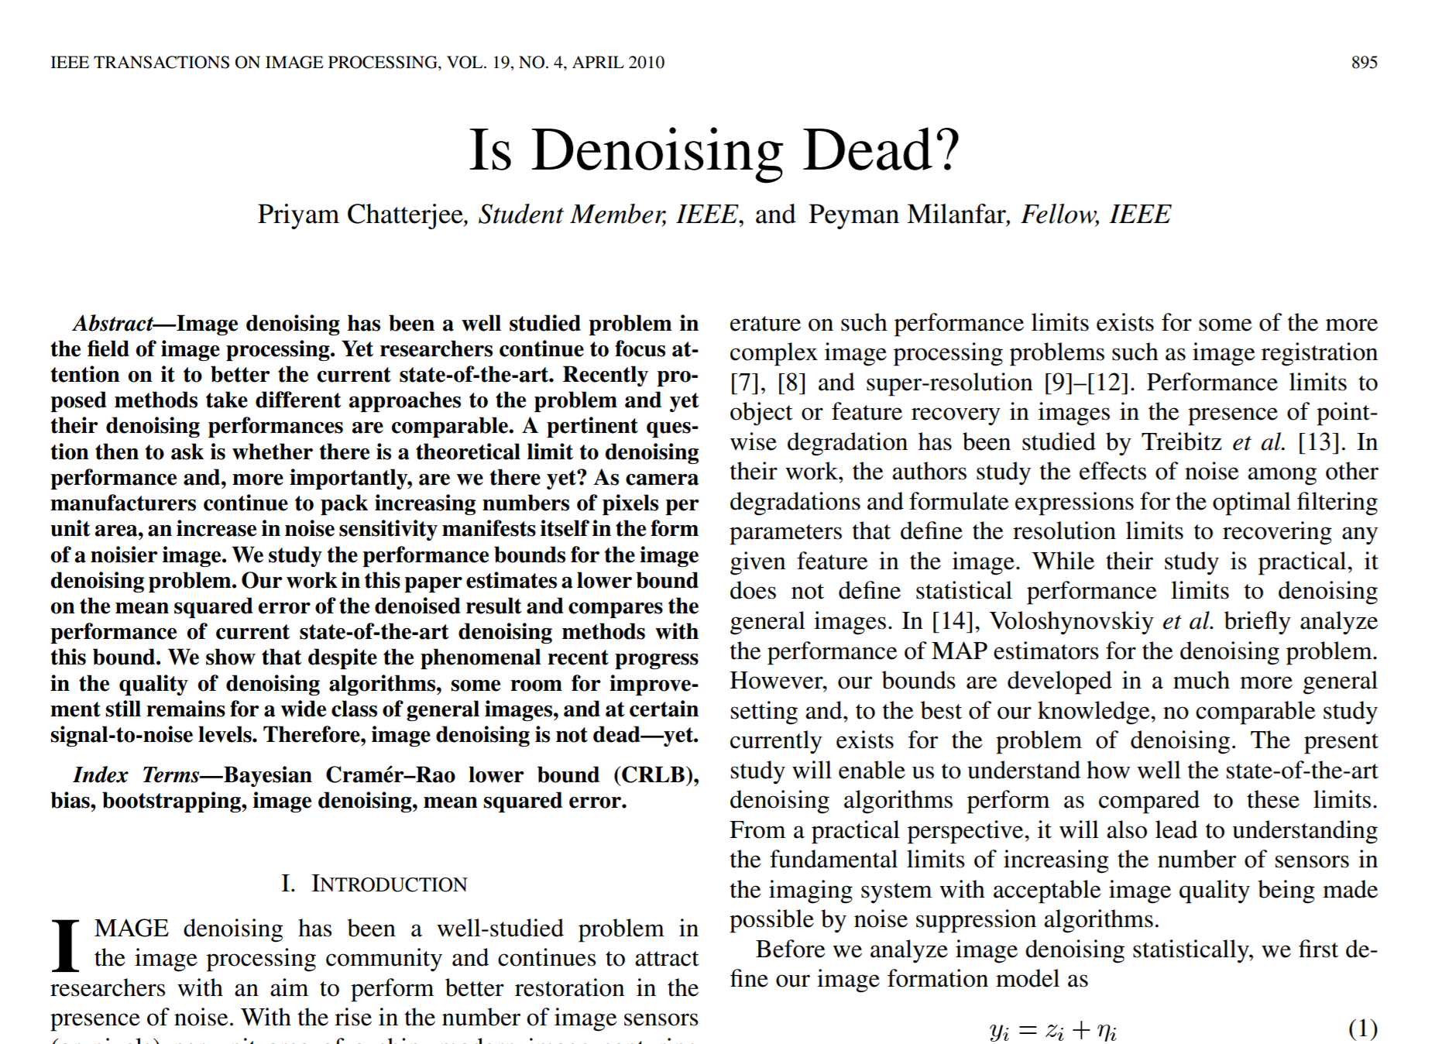
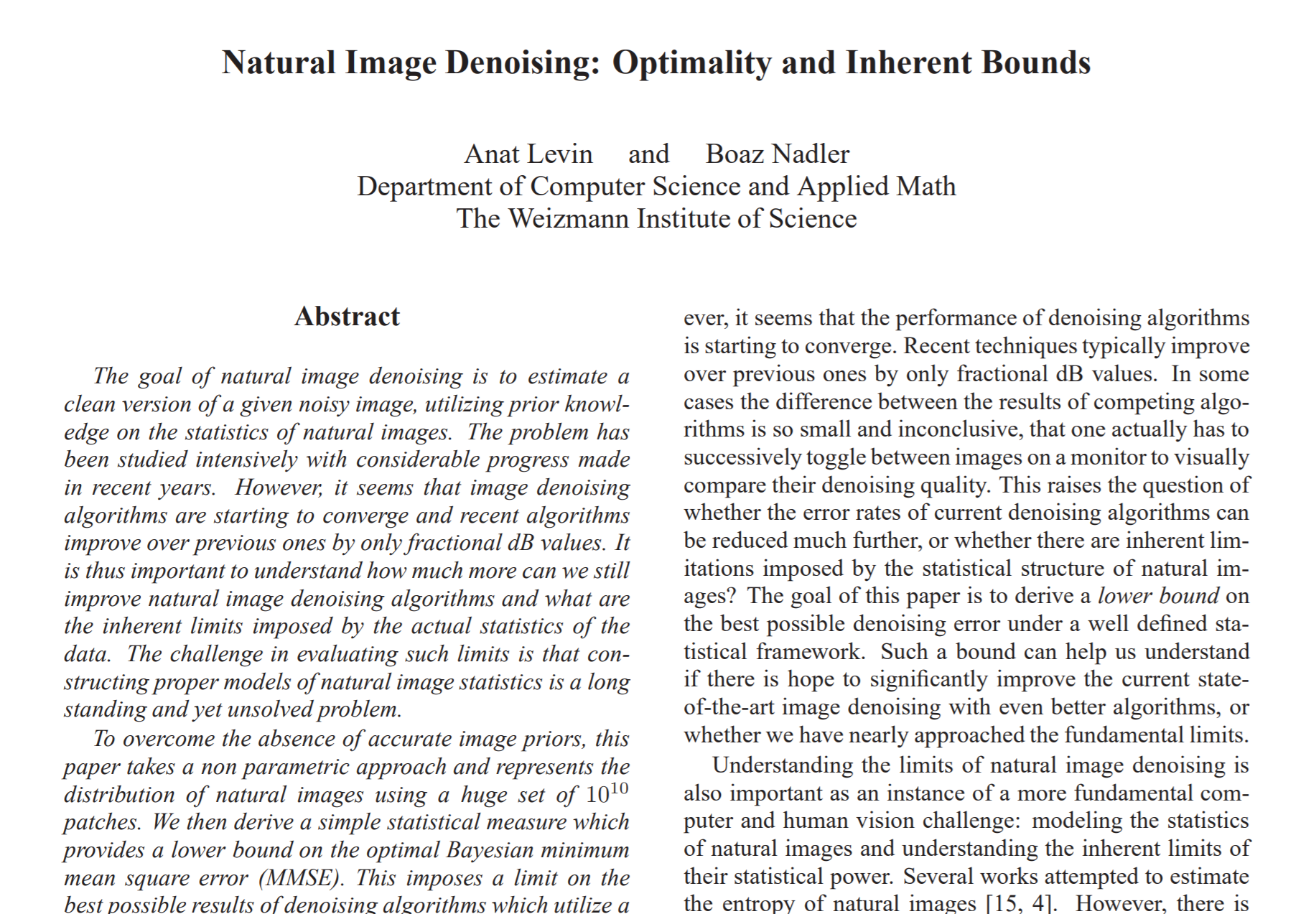
End of an Era?
This evolution of algorithms and the tendency of different methods to perform very similarly has led to a feeling that “Denoising is Dead”
CVPR 2011

Slide 15
End of an Era?
And so, somewhere around 2010-2012, the general
feeling in our community was that …
We are touching the ceiling in denoising performance
and chances of improving them are very slim
There is no point in devising new denoising methods
Work in this field has diminishing returns
Well, We Were Wrong !

Slide 16
End of an Era?
Wrong ? How?
The past decade has taught us that image denoising is still
very much alive and kicking
due to several branches of novel activity on:
Obtaining better performing denoisers with deep learning
New frontiers in denoising:
  Better adaptation to image content
  Denoising strategies that go beyond PSNR
  Identifying alternative methods for designing/training denoisers
  Extending the denoising task to realistic noise, and
Discovering new ways for leveraging denoisers for other needs

Slide 17
The Deep Learning Revolution

Slide 18


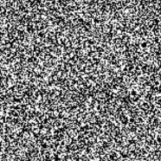




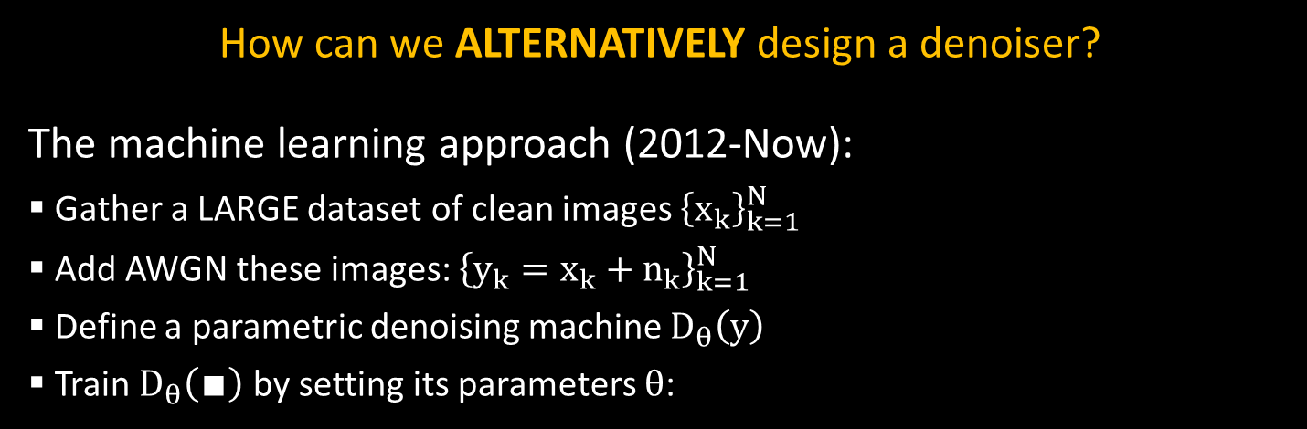
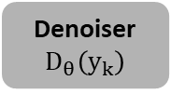



Design of Algorithms: Take 2
How can we ALTERNATIVELY design a denoiser?
The machine learning approach (2012-Now):
Gather a LARGE dataset of clean images ${\left\{x_{k}\right\}}_{k=1}^{N}$
Add AWGN these images: ${\left\{y_{k}=x_{k}+n_{k}\right\}}_{k=1}^{N}$
Define a parametric denoising machine $D_{θ}\left(y\right)$
Train $D_{θ}\left(∎\right)$ by setting its parameters $θ$:
$$\min_{θ}{\sum_{k=1}^{N}{{\left\|x_{k}−D_{θ}\left(y_{k}\right)\right\|}^{2}}}$$
+
Denoiser
$$D_{θ}\left(y_{k}\right)$$
$${\hat{x}}_{k}$$
$${\left\{x_{k}\right\}}_{k=1}^{N}$$
$${\left\{y_{k}\right\}}_{k=1}^{N}$$
$$σ$$
$${\left\{{\hat{x}}_{k}\right\}}_{k=1}^{N}$$
$${\left\{n_{k}\right\}}_{k=1}^{N}$$

Slide 19
Image Denoising: A Paradigm Shift
How can we design a denoiser?
By modeling image content and leveraging it for noise filtering:
Or by simply using:
Sparse Representation
Scale Invariance
Low Rank
Classics
Piecewise Smoothness
Non-Local Self-Similarity
GMM
Low dimensionality
Observe that with this
trend, all the knowledge
and knowhow accumulated carefully over decades in image processing became TOTALLY OBSOLETE
Learning
Supervised Training

Slide 20
Image Denoising: Recent Evolution
Initial Steps - MLP
(Burger et. al)
CVPR 2012
Deep Shrinkage
Isogawa et. al
IEEE-SPL 2017
Deep Image Prior
(Ulyanov & Vedaldi)
CVPR 2018
Noise2Void
(Krull et. al)
CVPR 2019
CNLNet
(Lefkimmiatis)
CVPR 2017
TNRD
(Chen & Pock)
IEEE-TPAMI 2016
Year
2012 2013 2014 2015 2016 2017 2018 2019 2020 2021
FFDNet (blind)
(Zhang et. al)
IEEE-TIP 2018
CBDNet -blind
(Guo et. al)
CVPR 2019
Batch Renormalization
(Tian et. al)
Neural Networks 2020
DnCNN
(Zhang et. al)
IEEE-TIP 2017
Denoising Auto-Encoder
(Cho)
ICML 2013
Attention-CNN
(Tian et. al)
Neural Networks 2020
GCBD
GAN-based
(Chen et. al)
CVPR 2018
Learned Prox
(Meinhardt et. al)
ICCV 2017

Slide 21
Synergy:
Classics + Deep Learning

Slide 22
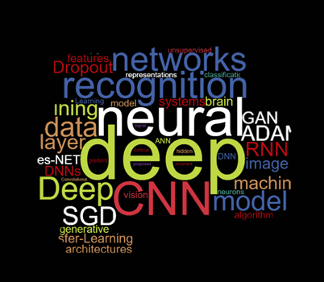
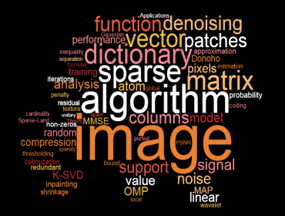
Image Denoising: Return of the Classics
In recent years deep learning is ruling the
image denoising domain, pushing aside
all the classical methods, along with
their great achievements
Recently, however, we do see a synergy
between the two paradigms
Recall: In building a supervised deep learning
denoiser solution, we operate along the following lines:
Gather training data to use
Define an architecture for the Denoiser
Define a cost function (loss) to optimize
Train and hope for good generalization

Slide 23
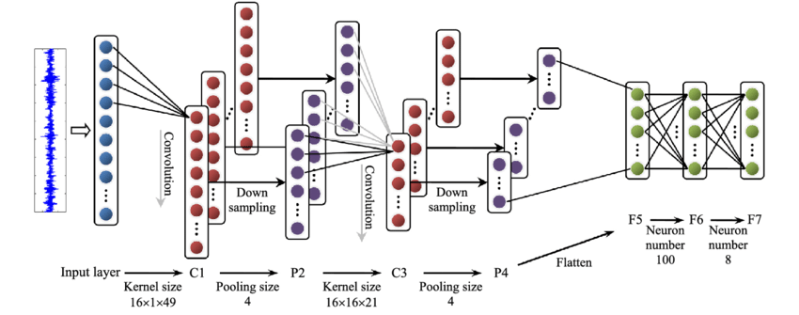
Image Denoising Architectures
So, how do we choose an architecture for a given task?
Option 1 - Copy an existing network that has shown good results in earlier work (VGG, U-Net, ...), and slightly modify it
Option 2 – Pile and Guess a series of steps that mix known pieces such as convolutions, fully connected layer, batch-norm, ReLU, pooling, stride, skips,
upscale/downscale,
connections, ...
and add new “tricks”
Option 3 – Neural
Architecture Search

Slide 24
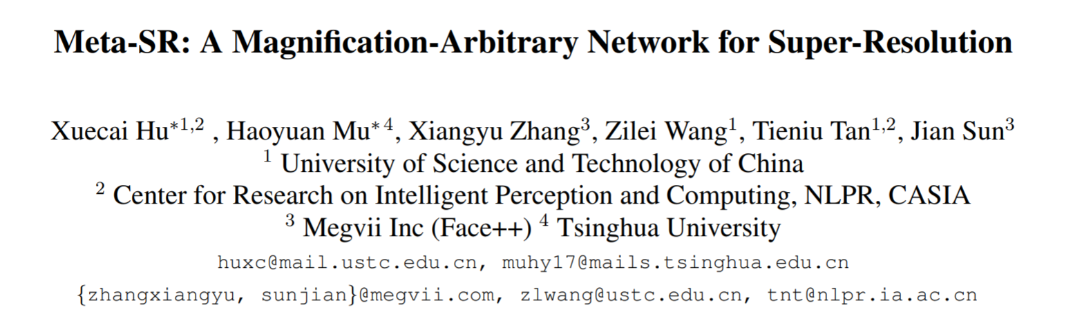
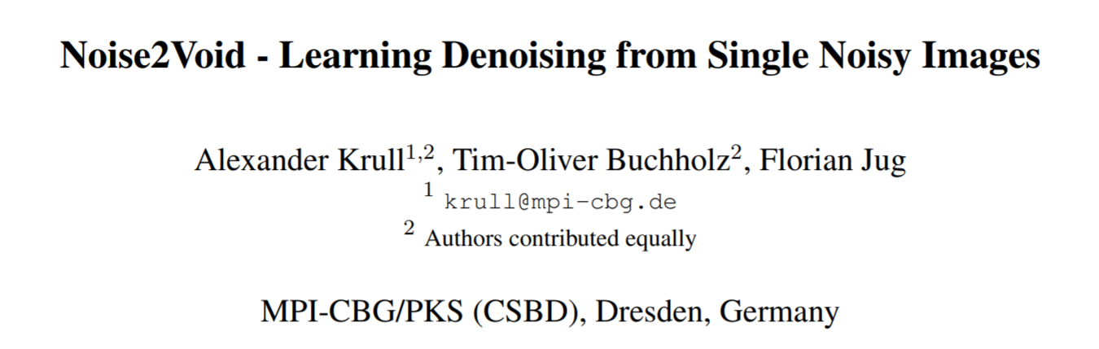
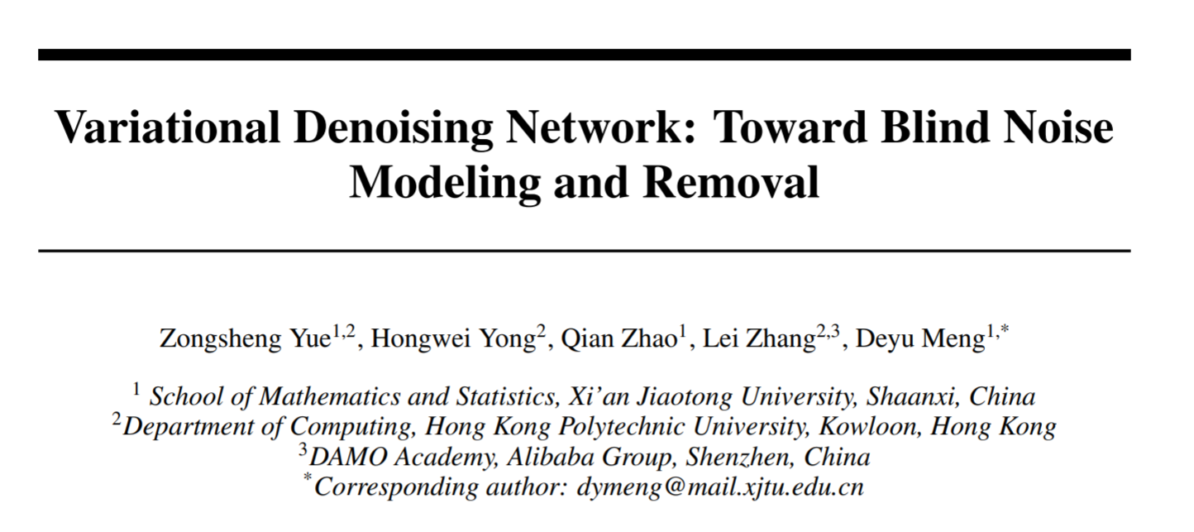
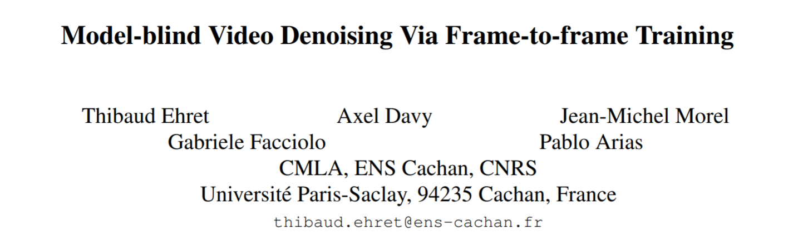
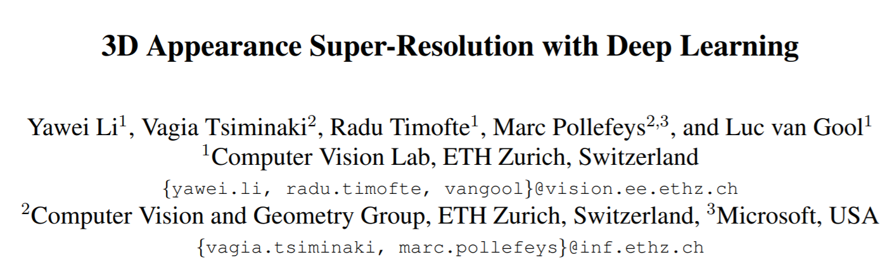
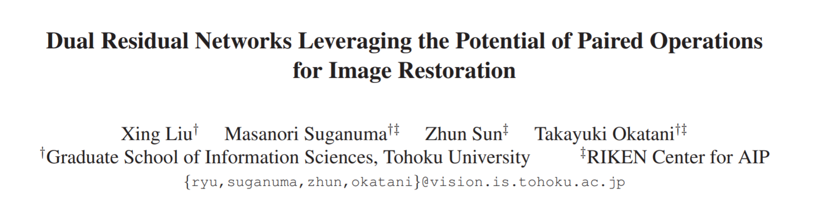
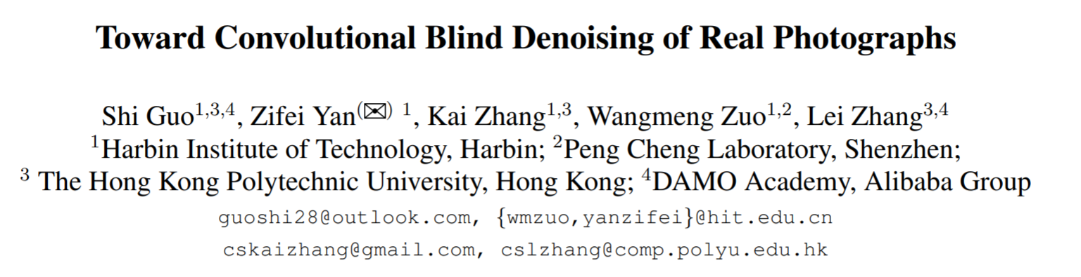
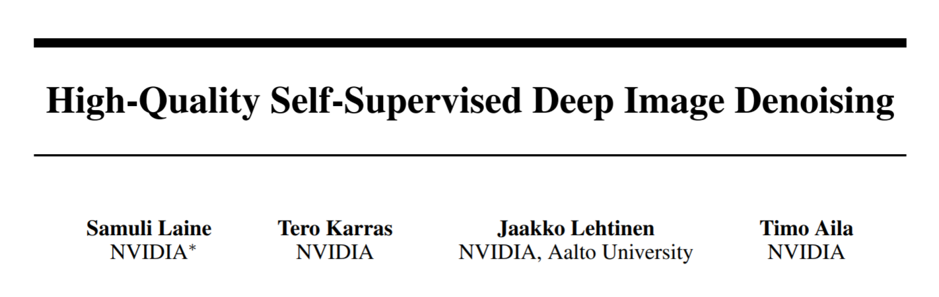
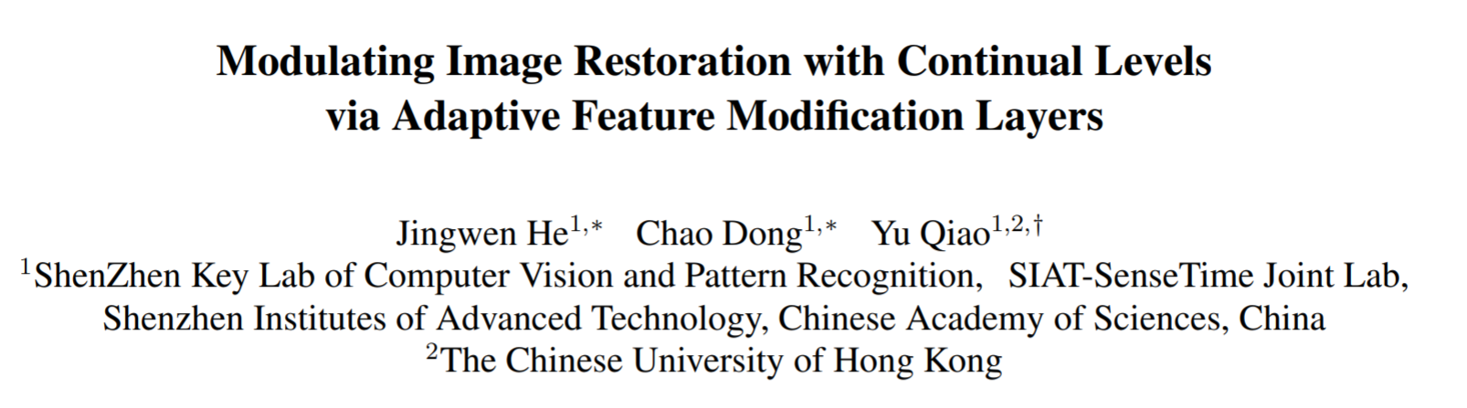
Image Denoising Architectures
Here are several paper examples from CVPR/NIPS 2019
that illustrate these architectures
CVPR 2019: Huge network with 2e6 params
CVPR 2019: U-Net-based with 3.8e6 params
CVPR 2019: DnCNN-based with 5.5e5 params
CVPR 2019: Huge network with 4e6 params
CVPR 2019: Big network with ~8e5 params
NIPS 2019: U-Net-based with 7e6 params
CVPR 2019: U-Net-based with 5.3e6 params
NIPS 2019: U-Net-based with 1.1e6 params
CVPR 2019: DnCNN-based with 1.2e6 params

Slide 25
Alternative Architecture Design
Message: Do far better in choosing architectures by relying on unfolding algorithms from the classics of image processing
The benefits in such architectures:
They are far more concise yet just as effective as leading methods
They are easier to train because they are lighter
They have the potential to break current performance barriers
They may bring better understanding and explainability
They enable better adaptation to out of distribution images
Here are few representative examples:
  Rethinking the CSC Model [Simon & Elad, NeurIPS `19]
  Non-Local & Multi-Scale Denoising [Vaksman, Milanfar & Elad, CVPR (NTIRE) `20]
  Deep KSVD Denoising [Scetbon, Milanfar & Elad, IEEE-TIP `21]
  PatchCraft: Non-Local Video Denoising [Vaksman, Elad & Milanfar, ICCV `21]

Slide 26
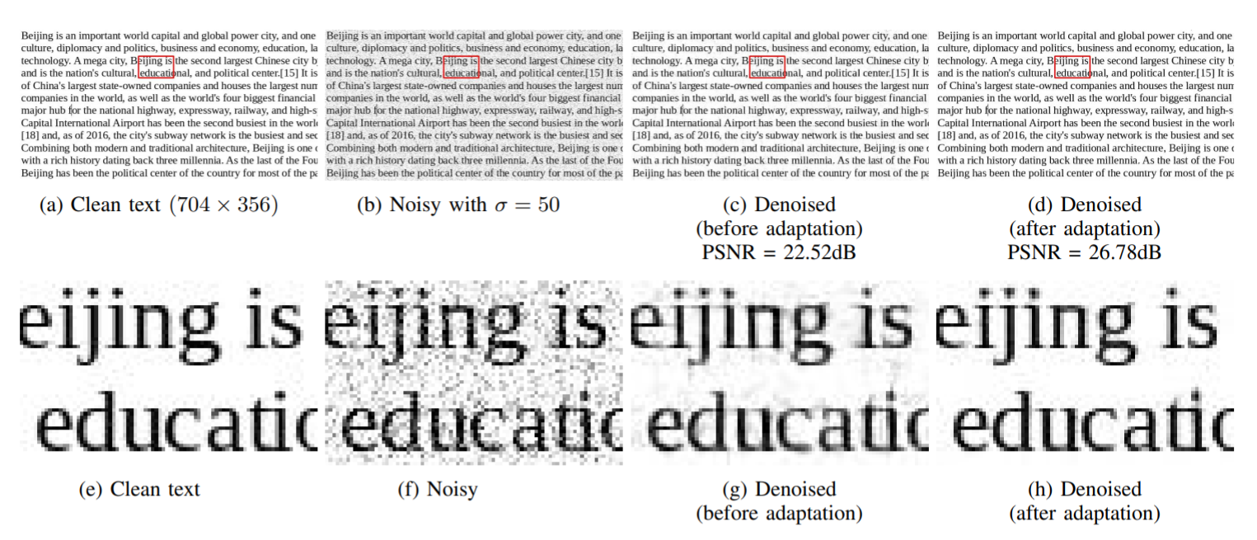
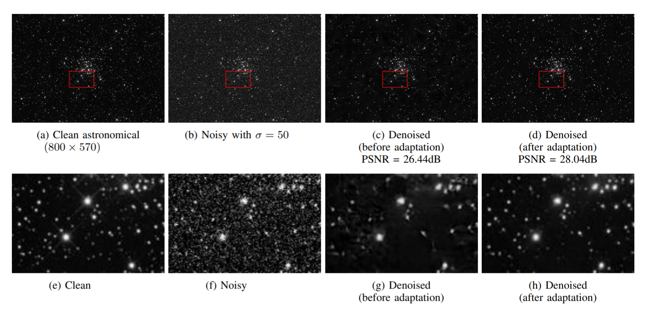
A Closer Look at Adaptation

Slide 27
Our Focus Today:
Recent Discoveries

Slide 28




Our Focus Today
Recent findings on using denoisers for other tasks:
Discovery 1: Solving general inverse problems [2013-]
Discovery 2: Image Synthesis [2019-]
Discovery 3: High perceptual quality recovery [2021-]
We turn to describe these results
Noisy image $y$
Image Denoiser $D\left(y,σ\right)$
Denoised image $\hat{x}$
$$σ$$

Slide 29
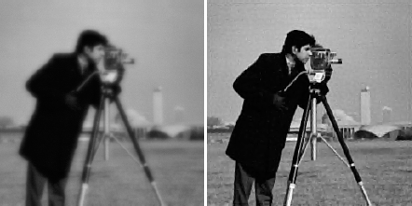
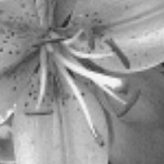
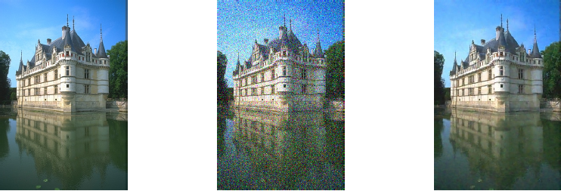
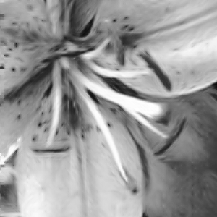
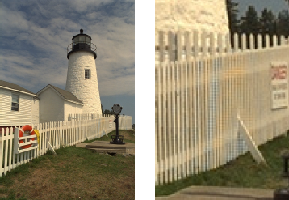
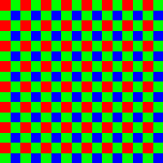
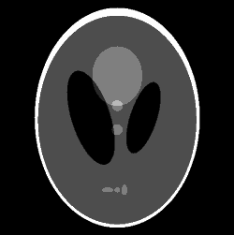
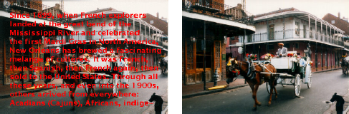
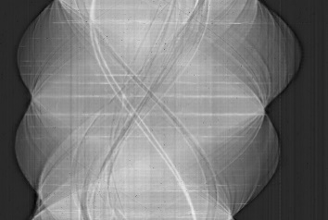
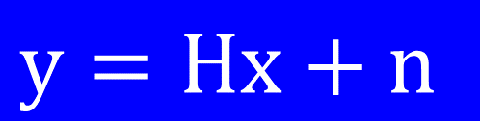
Discovery 1: Solving Inverse Problems
Inverse Problems: Recovery of images from corrupted measurements
De-Noising
De-Blurring
In-Painting
De-Mosaicing
Tomography
Image Scale-Up
& super-resolution
… and more …
$$y=Hx+n$$

Slide 30




Discovery 1: Solving Inverse Problems
How can we solve inverse problems?
We can return to the classic Bayesian approach:
Model image content with a prior expression $ρ\left(x\right)$ (e.g., forcing smoothness, sparsity, low-rank, self-similarity, … ), and
Formulate the inversion task as an optimization problem
This is known as MAP estimation
It is an extension of the classic
path for denoising, tailoring
methods for inverse problems
This approach leads to iterative algorithm for getting $\hat{x}$ from $y$
Is there a supervised learning alternative? Definitely!
$$\hat{x}=\min_{x}{{ \left\|Hx−y\right\|}^{2}+ρ\left(x\right)}$$
Likelihood
Prior
$y$: Given measurements
$\hat{x}$: Denoised result

Slide 31



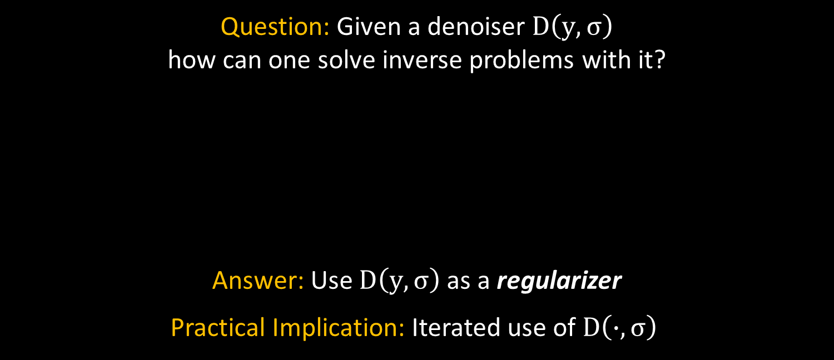





Discovery 1: Solving Inverse Problems
Question: Given a denoiser $D\left(y,σ\right)$
how can one solve inverse problems with it?
Answer: Use $D\left(y,σ\right)$as a regularizer
Practical Implication: Iterated use of $D\left(∙,σ\right)$
922
670
$$y$$
Simple Operation
Simple Operation
Simple Operation
Simple Operation
Simple Operation
$$\hat{x}$$
$$D\left(∙,σ\right)$$
$$D\left(∙,σ\right)$$
$$D\left(∙,σ\right)$$
$$D\left(∙,σ\right)$$
$$D\left(∙,σ\right)$$

Slide 32


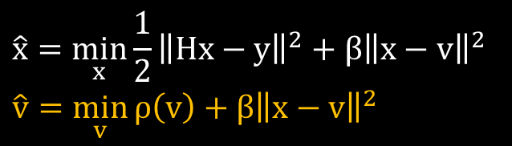


Discovery 1: Solving Inverse Problems
Here is (roughly) the PnP Perspective in a nutshell:
Recall: Inverse problems can be formulated as optimization tasks:
Let’s do something “stupid” and split the unknown:
Now, turn the constraint into a penalty*
And solve by alternating between $x$ and $v$
  Least-Squares:
  A denoiser:
$$\hat{x}=\min_{x}{{\frac{1}{2}\left\|Hx−y\right\|}^{2}+ρ\left(x\right)}$$
… and this way we got an iterated algorithm that keeps calling to a denoiser,
for solving the inverse problem
$$\hat{x}=\min_{x,v}{{\frac{1}{2}\left\|Hx−y\right\|}^{2}+ρ\left(v\right) s.t. x=v}$$
$$\hat{x}=\min_{x,v}{{\frac{1}{2}\left\|Hx−y\right\|}^{2}+ρ\left(v\right)+{β\left\|x−v\right\|}^{2}}$$
$$\hat{x}=\min_{x}{{\frac{1}{2}\left\|Hx−y\right\|}^{2}+{β\left\|x−v\right\|}^{2}}$$
$$\hat{v}=\min_{v}{ρ\left(v\right)+{β\left\|x−v\right\|}^{2}}$$
* The PnP uses the Augmented Lagrange which is more accurate and less sensitive to the choice of β

Slide 33




Discovery 1: Solving Inverse Problems
Here is the RED Perspective in a nutshell:
Let’s start again with the formulated optimization task,
and suggest a very specific regularization term:
… and this way we got an iterated algorithm that keeps calling to a denoiser,
and is guaranteed to achieve the global minimum
$$x^{T}(I−S)x$$
$$\hat{x}=\min_{x}{{\frac{1}{2}\left\|Hx−y\right\|}^{2}+ρ\left(x\right)}$$
$$=\min_{x}{\frac{1}{2}{\left\|Hx−y\right\|}^{2}+λx^{T}\left[x−D\left(x,σ\right)\right]}$$
Let’s use the Steepest Descent
Under mild conditions* the gradient of this is $\left[x−D\left(x,σ\right)\right]$
$${\hat{x}}_{k+1}={\hat{x}}_{k}−μ\left[H^{T}\left({H\hat{x}}_{k}−y\right)+λ\left[{\hat{x}}_{k}−D\left({\hat{x}}_{k},σ\right)\right]\right]$$
* Differentiability, local homogeneity, passivity and symmetric Jacobian (MMSE)

Slide 34
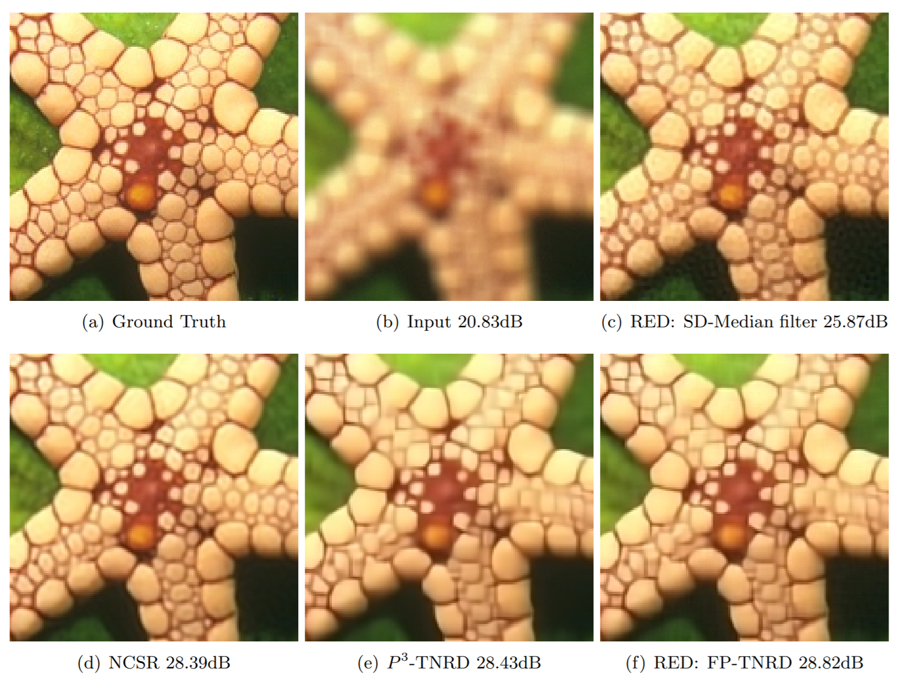
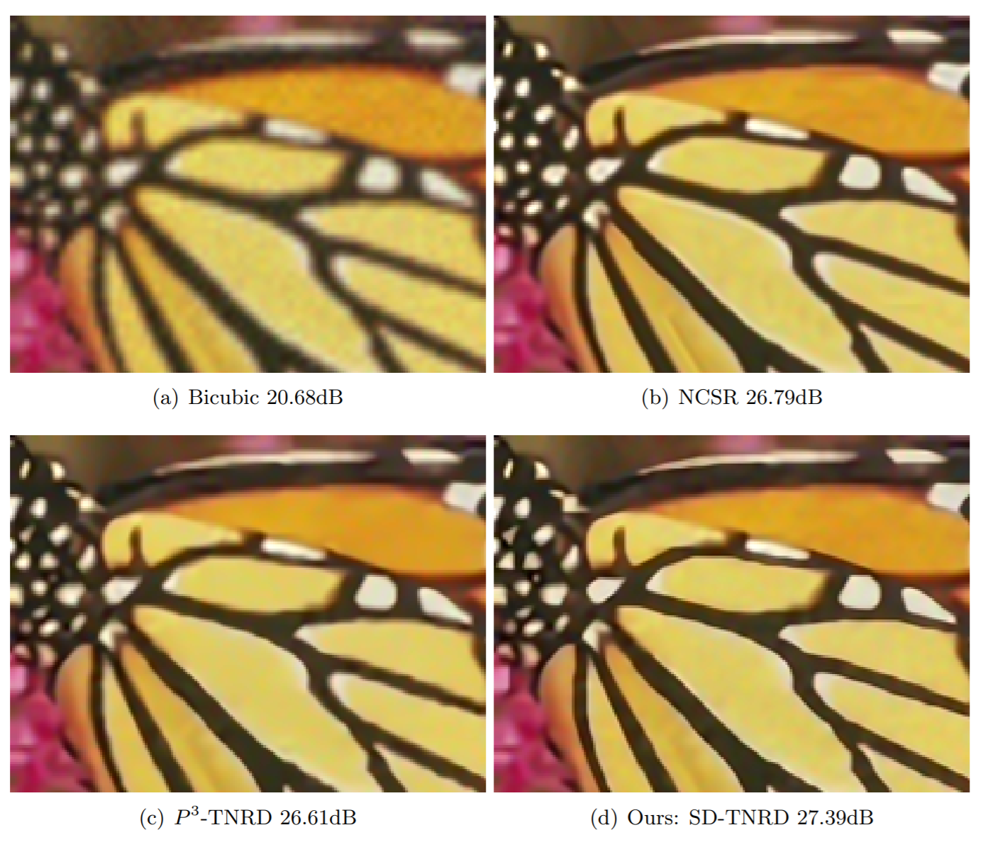
Discovery 1: Solving Inverse Problems
Here are some results for Deblurring and Super-Resolution
RED: SD-TNRD 27.39dB

Slide 35
Discovery 1: Solving Inverse Problems
PnP and RED are heavily
cited and extensively
studied, owing to their
generality and elegance
Follow-up work focuses on
  Proving convergence to the desired solution and tying these to properties of the permissible denoisers (e.g. MMSE …)
  Deployment in various applications
  Creation of new variants of these two methods … and …
PnP/RED can be used to define well-motivated architectures for solving general inverse problems, built around a core learned denoising engine
922
670

Slide 36
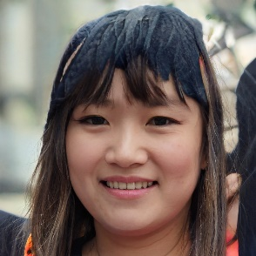
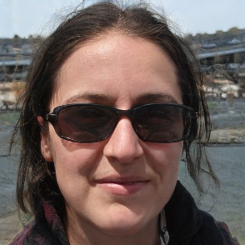
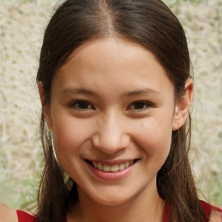
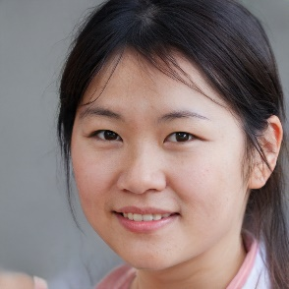
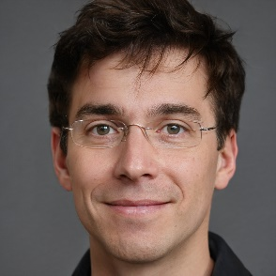
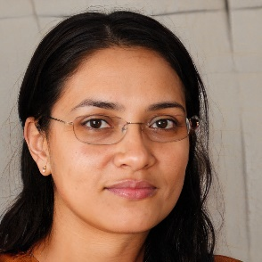
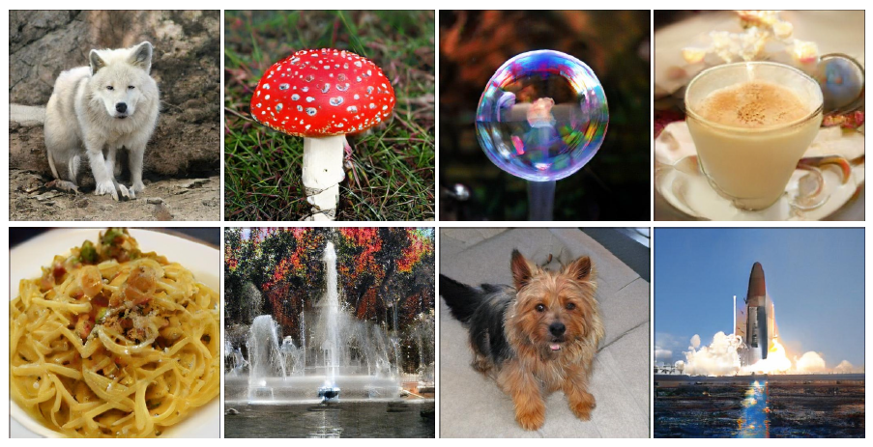
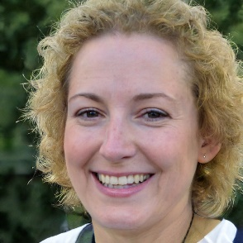
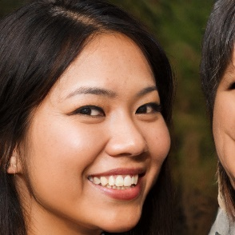
Discovery 2: Image Synthesis
In recent years, and with the deep-learning
revolution, there is a growing interesting is synthesizing images “out of thin air”
The popular tool of interest is called GAN –
Generative Adversarial Network, built of two competing networks – a generator and a critique
Why synthesize? Because
  We can, and it is fascinating
  It testifies that we have seized the distribution
  of images, and
  It could be used
  for other needs
Could we synthesize
images differently?
thispersondoesnotexist.com

Slide 37

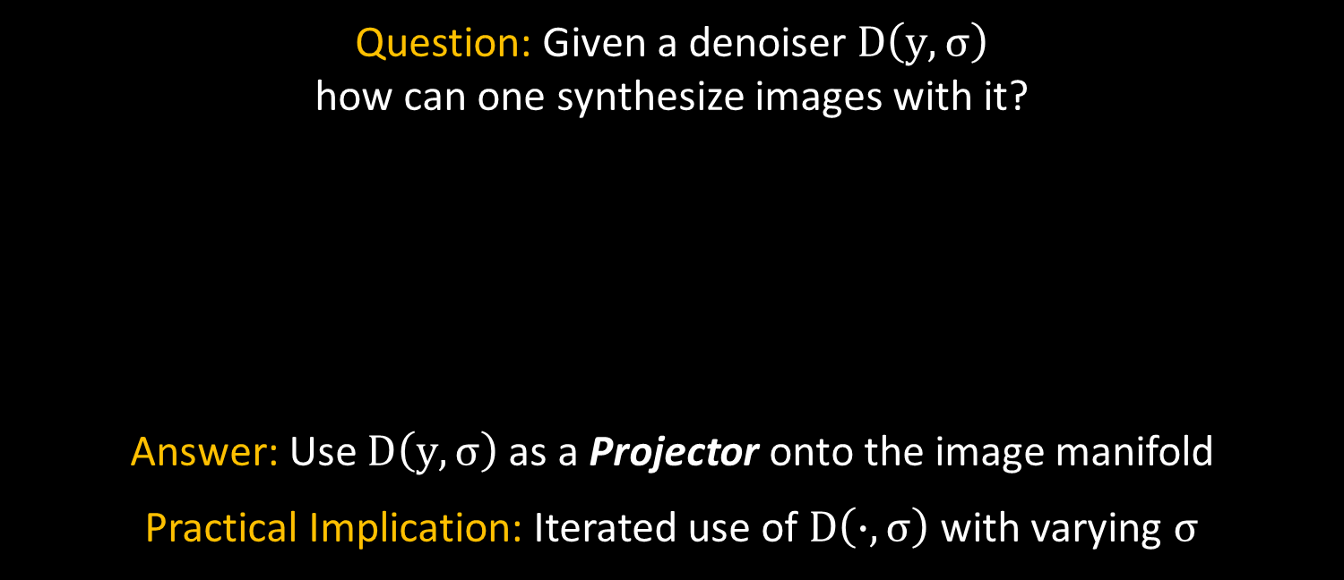




Discovery 2: Image Synthesis
Question: Given a denoiser $D\left(y,σ\right)$
how can one synthesize images with it?
Answer: Use $D\left(y,σ\right)$as a Projector onto the image manifold
Practical Implication: Iterated use of $D\left(∙,σ\right)$with varying $σ$
1548
528
56
Simple Operation
Simple Operation
Simple Operation
Simple Operation
Simple Operation
$$\hat{x}$$
noise
$$D\left(∙,σ1\right)$$
$$D\left(∙,σ2\right)$$
$$D\left(∙,σ3\right)$$
$$D\left(∙,σ4\right)$$
$$D\left(∙,σN\right)$$

Slide 38





Discovery 2: Image Synthesis
Here is the core idea in a nutshell:
Our goal: draw a sample from the distribution of images $P\left(x\right)$
Start with a random noise image ${\hat{x}}_{0}$
Climb to a more probable image by the iterative equation:
… and this way we got an iterated algorithm that keeps calling to a denoiser, and is guaranteed to obtain a sample from $P\left(x\right)$
$${\hat{x}}_{k+1}={\hat{x}}_{k}+a∙∇logP\left({\hat{x}}_{k}\right)$$
$$+b∙z_{k}$$
(Langevin Dynamics)
This is known as the Score
Function and it is approximately proportional to $\left[{\hat{x}}_{k}−D\left({\hat{x}}_{k},σ\right)\right]$
for a small value of $σ$
This suggests an implicit relation between MMSE denoisers and Priors: $D\left(x,σ\right)$ ↔ $P\left(x\right)$

Slide 39

Discovery 2: Image Synthesis
In practice, instead of the plain Langevin with a fixed (and
small) value of $σ$we use the Annealed Langevin Algorithm
that considers a sequence of blurred priors:
$P\left(x+v\right)$ for $v\sim ℕ\left(0, σ_{k}^{2}I\right)$
$=P\left(x\right) ⨂{c∙exp\left\{−\frac{1}{2σ^{2}}{\left\|x\right\|}^{2}\right\}}$
with $σ_{0}>σ_{1}>σ_{2} ⋯ >σ_{N}>0$
      The core idea: start by drawing
      from a wider distribution and
      gradually narrow it, leading to
      a faster sampling performance
Blurred Image Manifold

Slide 40


Discovery 2: Image Synthesis
Does it work? Here are some results
Kadkhodaie & Simoncelli
Song & Ermon

Slide 41



Discovery 2: Image Synthesis
Claim: diffusion-based methods are the best in image synthesis
BigGAN (FID 6.95) Diffusion (FID 4.59)

Slide 42






Discovery 2: Image Synthesis
Surely, you have heard of …

Slide 43






Discovery 2: Image Synthesis
Surely, you have heard of …

Slide 44




Discovery 3: Targeting Perceptual Quality
Suppose that we need to denoise the following image:
Should we be
pleased with this
result? It seems
to be a bit …
blurry, no? Why?
Image Denoiser
Noisy ($σ=100$)
$$σ$$
Denoised image
Original
Minimum Mean-Squared-Error (MMSE) denoisers are great for MSE result, but their result falls outside the manifold
Image Manifold
MMSE Result $E\{x|y\}$
Noisy Image

Slide 45


Discovery 3: Targeting Perceptual Quality
Question: How can we denoise an image
while targeting “High Perceptual Quality”?
    Answer: Denoise by sampling from the posterior $P\left(x|y\right)$
Practical Implication: We consider 2 methods
Training a deep denoiser via CGAN, or
Iterated use of an MMSE denoiser $D\left(∙,σ\right)$
23
41
These methods produce a multitude of possible solutions

Slide 46




Discovery 3: Targeting Perceptual Quality
Let’s have a closer look at the Stochastic Image Denoiser:
Task: Draw a sample from $P\left(x|y\right)$ where $[y=x+n, n\sim ℕ\left(0, σ_{0}^{2}I\right)]$
Start with a random noise image ${\hat{x}}_{0}$
Climb to a more probable image by the iterative equation:
$${\hat{x}}_{k+1}={\hat{x}}_{k}+a∙∇logP\left({\hat{x}}_{k}|y\right)+b∙z_{k}$$
Langevin with a conditional Score
$$=∇logP\left({\hat{x}}_{k}\right)+∇logP\left({y|\hat{x}}_{k}\right)$$
Bayes rule
$${=\hat{x}}_{k}−D\left({\hat{x}}_{k},σ\right)+∇logP\left({y|\hat{x}}_{k}\right)$$
Approx. Score
A Gaussian Distribution?

Slide 47





Discovery 3: Targeting Perceptual Quality
Let’s have a closer look at the Stochastic Image Denoiser:
As we use the Annealed Langevin algorithm, there are two noise signals to consider:
  Measurement’s noise: $n\sim ℕ\left(0, σ_{0}^{2}I\right)$
  Synthetic annealing noise: $v\sim ℕ\left(0, σ_{k}^{2}I\right)$ for $σ_{0}>σ_{1}>σ_{2} ⋯ >σ_{N}>0$
Implication: We recover
a sequence of gradually less
noisy images ${\hat{x}}_{k}$ where their
noise $v$is assumed to be a portion of $n$
$${∇logP\left({\hat{x}}_{k}|y\right)=\hat{x}}_{k}−D\left({\hat{x}}_{k},σ\right)+∇logP\left({y|\hat{x}}_{k}\right)$$
$$P(y|x_{k})=P(y−x_{k}|x_{k})$$
$=P(x+n−x−v_{k}|x_{k})$
$=P(n−v_{k}|x_{k}) !$
$∇logP\left({\hat{x}}_{k}|y\right)$=
$${=\hat{x}}_{k}−D\left({\hat{x}}_{k},σ_{k}\right)+\frac{y−{\hat{x}}_{k}}{σ_{0}^{2}−σ_{k}^{2}}$$

Slide 48


Discovery 3: Targeting Perceptual Quality
Stochastic Image Denoiser:
We start from a noisy image ($σ≈150$ in this example)
Then gradually denoise it using (conditional) annealed Langevin dynamics

Slide 49



Discovery 3: Targeting Perceptual Quality
Stochastic Image Denoiser:

Slide 50






Discovery 3: Targeting Perceptual Quality
Let’s have a closer look at the Conditional GAN Denoiser:
Typical design approach: Optimize a distortion measure (e.g. MSE) between
the denoised and the ideal images
Adversarial loss could be added to
improve the perceptual quality
However, when used together,
we get a compromise between
distortion and perceptual quality
Denoised
Clean
Noisy
Denoiser
Critic
$$MSE\left( , \right)$$
$$+$$
$$λ L_{adv}( )$$

Slide 51










Discovery 3: Targeting Perceptual Quality
Perception
For ill-posed restoration tasks, perceptual
quality performance comes at the expense
of its distortion [Blau & Michaeli 2017]
We aim for best perceptual quality
The posterior distribution attains perfect
perceptual quality, compromising 3dB
compared to the MMSE [Blau & Michaeli 2017]
We propose to sample from the posterior
via a Conditional GAN mechanism (PSCGAN)
3dB
MMSE
Possible Region
Alg. 1
Better visual quality
Alg. 2
Impossible Region
Alg. 3
Alg. 4
Less Distortion
Distortion
Samples from $P_{X|Y=y}$
$$x∼P_{X}$$
$$y∼P_{Y|X=x}$$

Slide 52






Discovery 3: Targeting Perceptual Quality
The PSCGAN Architecture:
Random noise $z$
Denoised
Noisy Image $y$
Randomized Denoiser
$$D_{θ}\left(y,z\right)$$
Critic
$$C_{ω}\left(x,y\right)$$
Noisy Image $y$
Why use $y$ in the critic? Without it, we check only the perceptual quality of the denoised result. With it, we also assess its denoising validity
Original

Slide 53

Discovery 3: Targeting Perceptual Quality
What about the Loss?
CGAN optimization leads to posterior sampling [Adler et al. 2018]:
$$\min_{θ}{\max_{ω}{𝔼_{X,Y}}\left[C_{ω}\left(x,y\right)\right]−𝔼_{D_{θ},Y,Z}[C_{ω}(D_{θ},y)]}$$
However, this requires an unavailable balanced dataset to train on
(many $x$’s for each $y$ and many $y$’s for each $x$)
On the other hand, we would like to avoid a penalty of the form
$$𝔼_{X,Y,Z}\left[{\left\|x−D_{θ}\left(y,z\right)\right\|}_{2}^{2}\right]$$
Our remedy: adding an MMSE oriented penalty term:
$$𝔼_{X,Y}\left[{\left\|x−𝔼_{z}\left[D_{θ} | y\right]\right\|}_{2}^{2}\right]$$
This gives the MMSE result “for free” (averaging many instances)

Slide 54

Discovery 3: Targeting Perceptual Quality
CGAN:

Slide 55
Oh … and One Last Thing

Slide 56












Back to Inverse Problems
Goal: Recovery from corrupted measurements
De-Noising De-Blurring
In-Painting De-Mosaicing
Tomography Image Scale-Up
& super-resolution
Can we suggest a “sampler” from
$P\left(x|y\right)$ for handling all these
problems, in order to obtain “perfect looking” results?
Answer: Yes! Use Langevin dynamics again, in an adapted form
$$y=Hx+n$$
77
215
Advances in Neural Information Processing Systems (NeurIPS) 2022

Slide 57


Back to Inverse Problems

Slide 58

Back to Inverse Problems
The idea is similar to our high-perceptual denoising, with necessary changes for considering the degradation operator $H$ …
Starting naively, using Bayes theorem, we need to calculate
$$∇log P\left(x_{i}|y\right)=∇log P\left(x_{i}\right)+∇log P\left(y|x_{i}\right)$$
We know that $y=Hx+n$ and $x_{i}=x+v_{i}$and thus:
    $$∇logP\left(y|x_{i}\right)=∇logP\left(y−Hx_{i}|x_{i}\right)=$$
    $$∇logP\left(Hx+n−Hx−Hv_{i}|x_{i}\right)=∇logP\left(n−Hv_{i}|x_{i}\right)$$
However, … while $n−Hv_{i}$ is a simple Gaussian, it’s dependency
on $x_{i}$ in non-trivial, so how do we proceed from here?

Slide 59




Back to Inverse Problems
Step 1: Use SVD for decoupling the measurements $H=UΣV^{T}$:
      $U^{T}y=U^{T}\left[UΣV^{T}\left(x_{i}−v_{i}\right)+n\right]$
  $y_{T}\left[k\right]=σ_{k}{\tilde{x}}_{T}\left[k\right]−σ_{k}{\tilde{v}}_{T}\left[k\right]+n_{T}\left[k\right]$
Thus, we can apply the Langevin dynamics algorithm on
${\tilde{x}}_{T}=V^{T}x_{i}$ given $y_{T}=U^{T}y$ and sample from the conditional
Bottom line: An MMSE denoiser is used for a novel solution of inverse problems, this time targeting best perceptual quality
$$=ΣV^{T}\left(x_{i}−v_{i}\right)+U^{T}n$$
$y=Hx+n$
Decouple ${\tilde{x}}_{T}\left[k\right]$ ↔ ${\tilde{v}}_{T}\left[k\right]$ by choosing
${\tilde{v}}_{T}\left[k\right]$ to be a portion of $n_{T}\left[k\right]$

Slide 60

Back to Inverse Problems
Noisy Inpainting: A portion missing and noise with $σ_{0}≈25$
Clean
Observed
Sample
Sample

Slide 61

Back to Inverse Problems
Super resolution: downscaling by 4 with additive noise of $σ_{0}≈25$

Slide 62













Back to Inverse Problems
Super resolution: downscaling by 4 with additive noise of $σ_{0}≈12$
Original
Degraded
Samples from our algorithm
Mean

Slide 63

Back to Inverse Problems
Deblurring: uniform $5×5$ blur with additive noise of $σ_{0}≈25$

Slide 64















Back to Inverse Problems
Compressive sensing (12.5%) with additive noise of $σ_{0}≈25$
Original
Degraded
Samples from our algorithm
Mean

Slide 65
Back to Inverse Problems
And just to remind you …
The proposed diffusion-based sampling scheme, while quite appealing, suffers from several key shortcomings:
  It is rather S L O W (many denoising activations)
  It is limited (as of now) to specific families of images
  Relying on SVD is cumbersome
See our recent work that answers (some of) these challenges:
215
Advances in Neural Information Processing Systems (NeurIPS) 2022

Slide 66
Time to Summarize

Slide 67


What Have we Seen Today?
Suppose that we are given an MMSE denoiser $D\left(y,σ\right)$
W E C A N U S E $D\left(y,σ\right)$ F O R . . . .
solving ANY inverse problem (PnP/RED)
synthesizing natural-looking images
denoising images while targeting high perceptual quality
solving ANY inverse problem with high perceptual quality
All the above are achieved by
simply applying $D\left(y,σ\right)$ iteratively

Slide 68
Summary
Image Denoising
… Not What You Think
There are so many opportunities and challenges in
better understanding, designing, and proposing
creative usage of image denoisers
Despite the fact that this has not been a talk about
Deep-Learning, the presence of this field in the
topics covered is prominent

Slide 69







Thank You
The content of this lecture relies on ~10 papers that my group has worked on and published in the past several years
Getting these results was enabled due to the amazing people
I had the pleasure of collaborating with:
Yaniv Romano
Bahjat Kawar
Guy Ohayon
Peyman Milanfar
Grisha Vaksman
Meyer Scetbon
Theo Adrai

