Slide 1
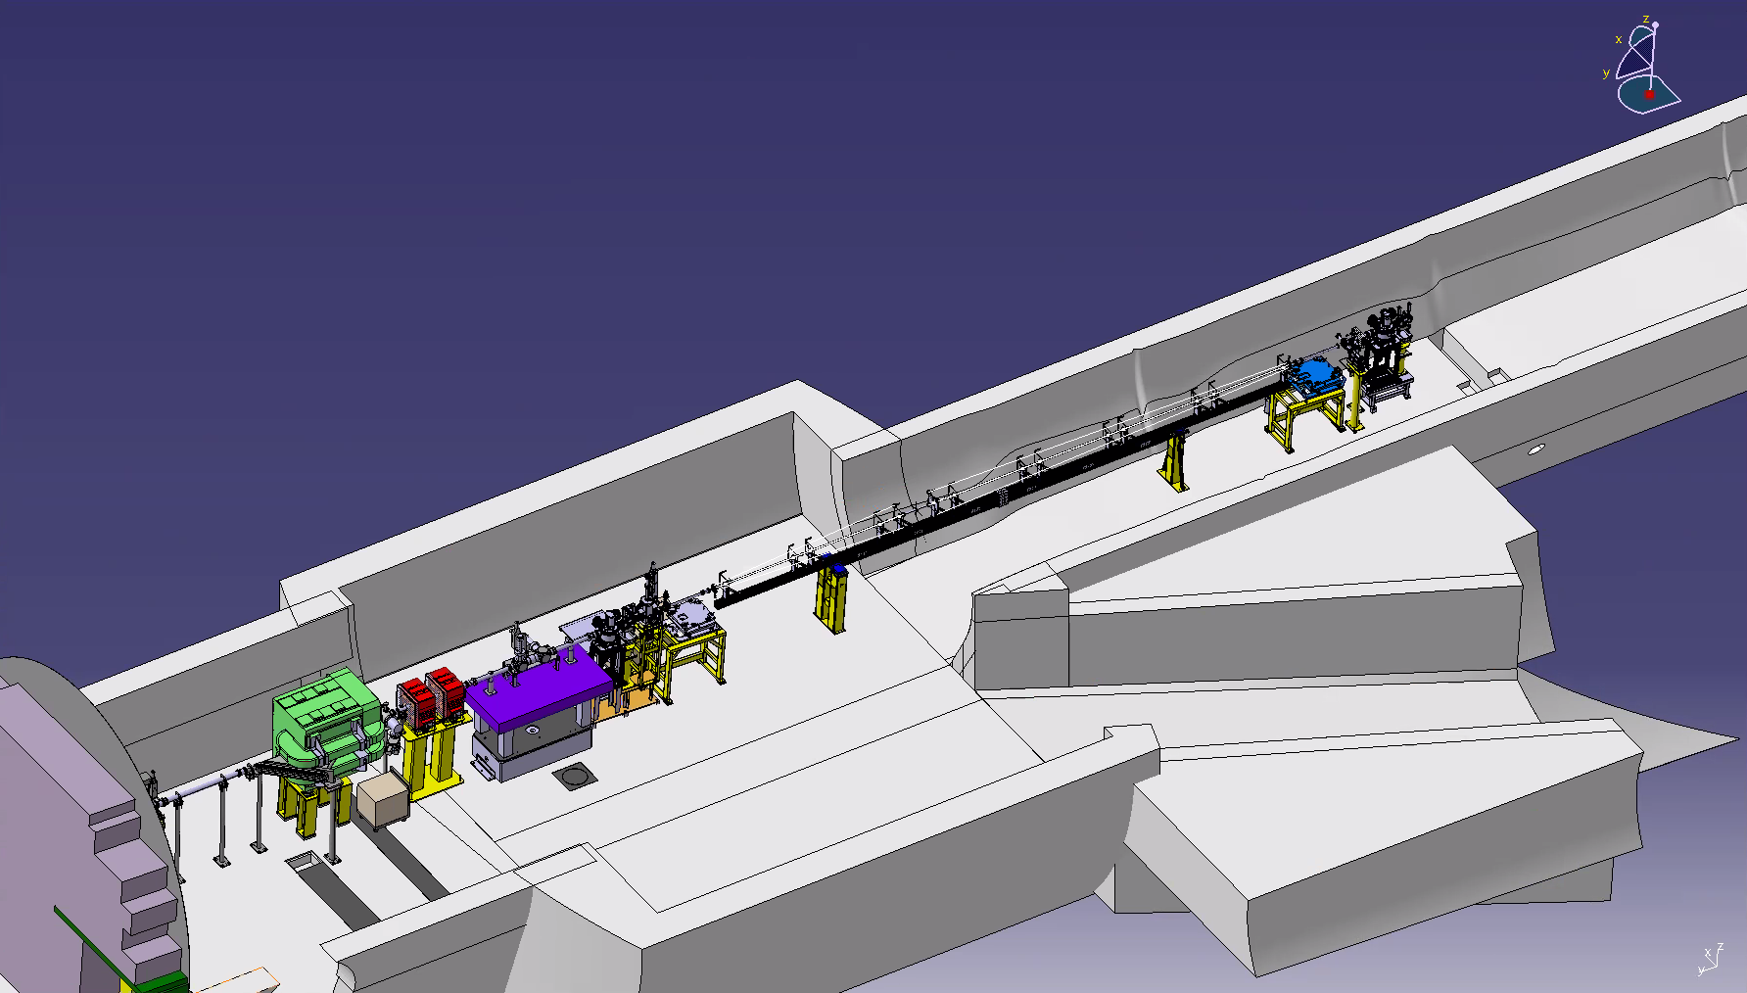




Status of the Discharge Plasma Source (DPS) for the 2023 Run
A. Sublet, on behalf of the DPS team
AWAKE Collaboration Meeting, 6th October 2022

Slide 2
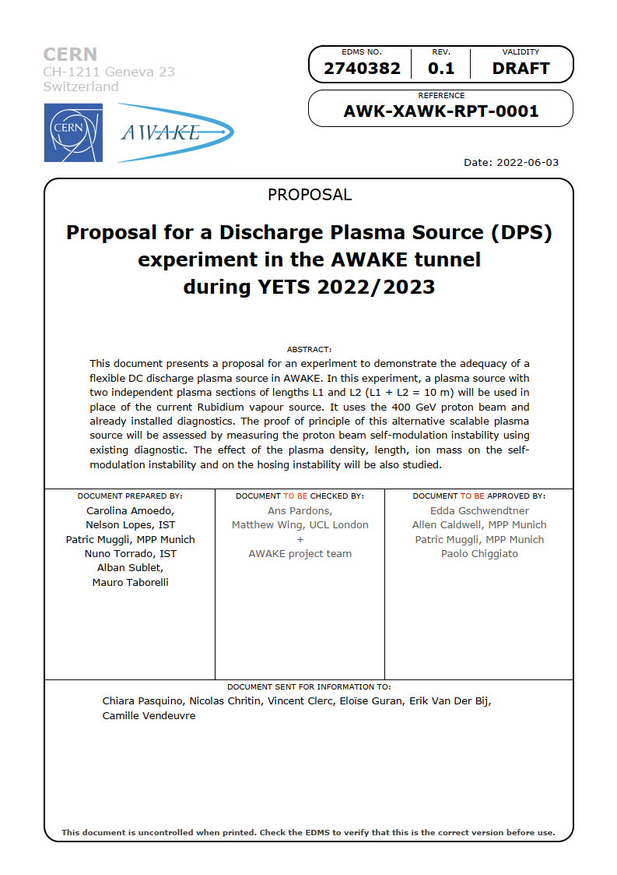
Project framework
Proposal → EDMS document: https://edms.cern.ch/document/2740382/0.2
3 decision points:
AWAKE project to endorse this approach → go/no go in June 2022 (release of proposal)
Yes, global resources are available for this plan → June 2022 (release of proposal)
10 m cell technical readiness → go/no go by November 2022
Main objectives:
to show that the propagation of the proton bunch in one plasma section results in the usual signature of proton bunch SMI
to determine the effect of plasma density and length L1, L2 and L1+L2 on SMI
to assess the effect of the ion mass on the self-modulation along the proton bunch by changing gas (Ar, He)
→ No laser and no electron beam, SMI only experiment
Time window: between run 2a and run2b, Rb-vapour density step cell swap mid-2023
Presented at AWAKE TB and PEB in February 2022 and last collaboration meeting in April

Slide 3
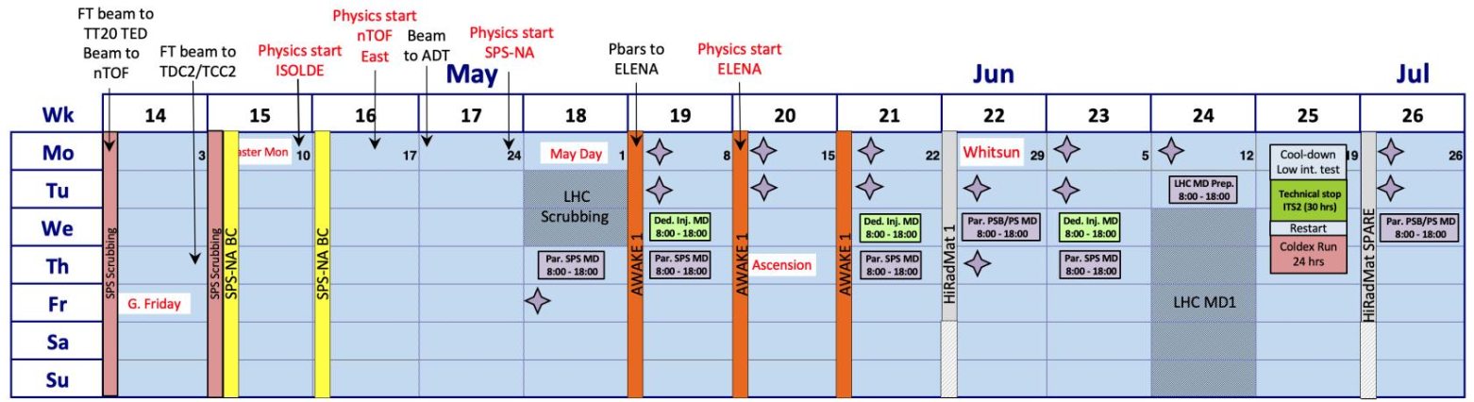
Draft 2023 runs plan → 1st run for AWAKE in May
DPS test over 8-9 weeks in the tunnel
Minor impact on the general program, step density Rb source available in June/July (see Patric/Eloïse’s talks)
DPS transport + installation
DPS decommissioning
DPS commissioning
3 weeks
DPS experiment
2-3 weeks

Slide 4
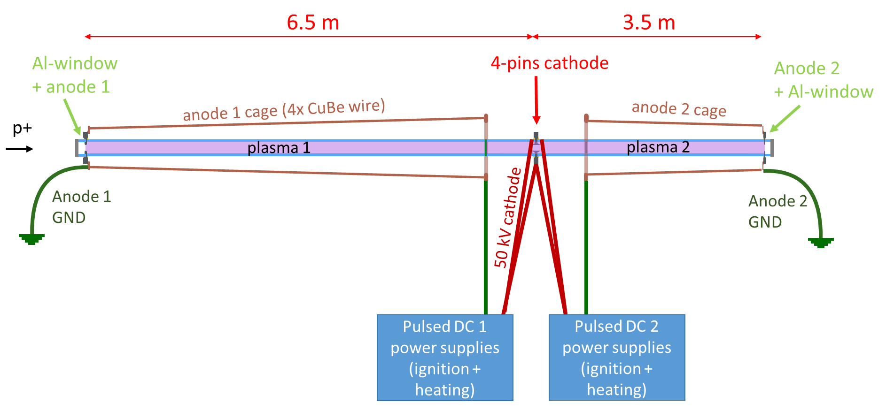
R&D program towards 2023 tunnel test

Slide 5
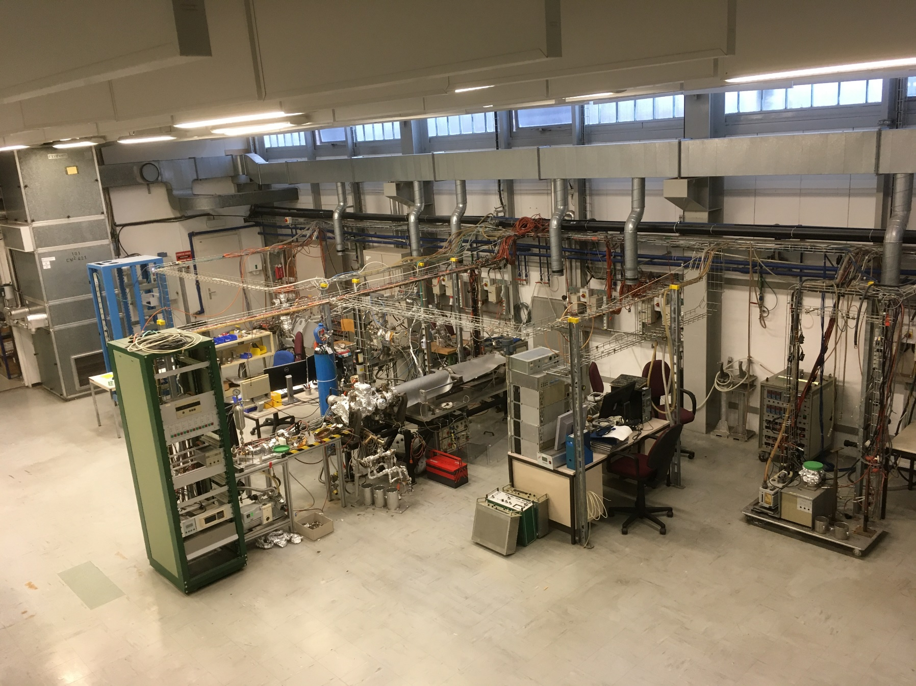
DPS lab (101/1-009) → before
～ 15 m

Slide 6
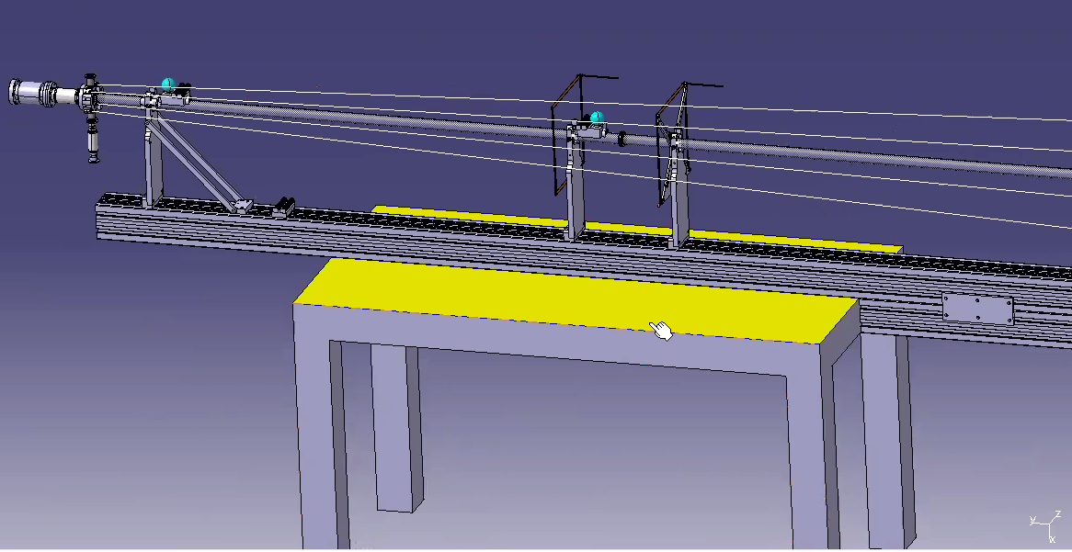
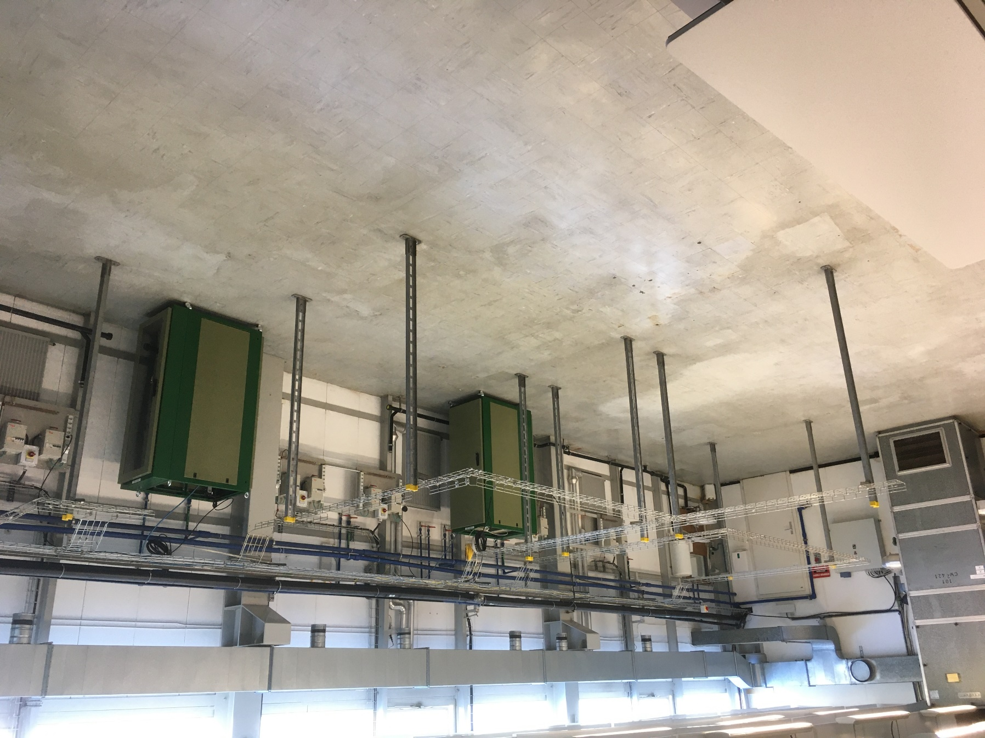
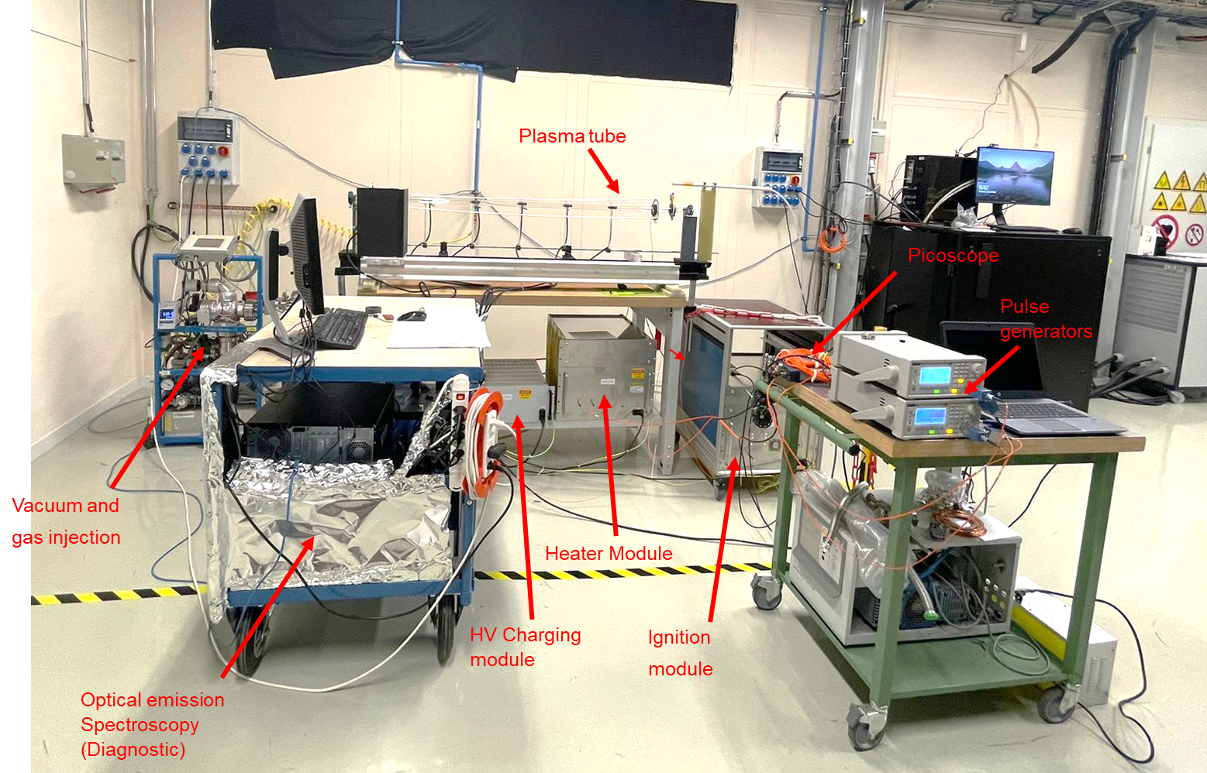
DPS lab (101/1-009) → now
10 m glass tubes ready (6x 1.5 m + 2x 0.5 m) ☑
For the lab, upscale 1.6 m setup: use existing tube supports + anodes and cathode parts ☑
Vacuum pumping groups and gas injection system to be installed ☑
HV cables and connectors ordered, to be assembled ☑
Aluminium profile supports 2x 5 m to be ordered (in stock) 
Lab setup ready by end of October
～ 15 m

Slide 7
R&D program towards 2023 tunnel test

Slide 8
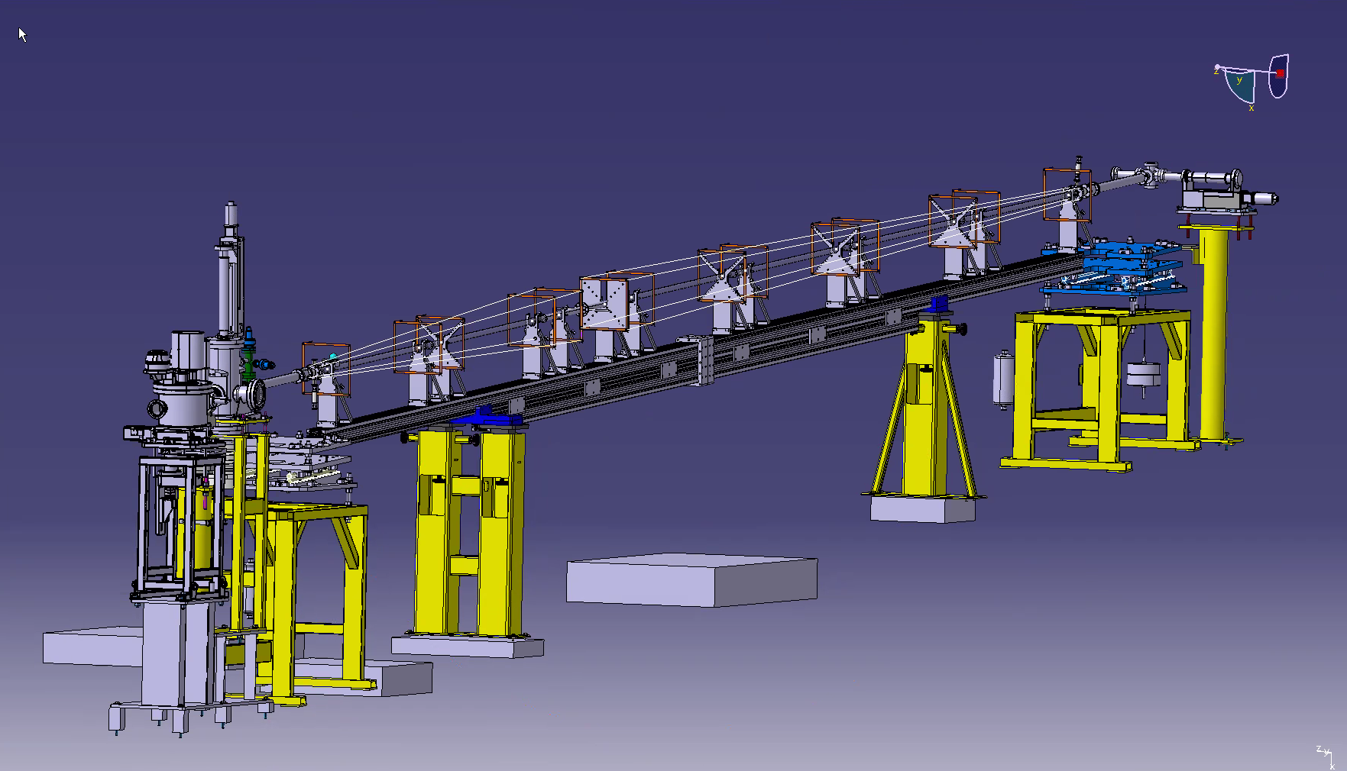
DPS design → 10 m tunnel cell
Use existing cell supports, add Al-windows to isolate cell from beam vacuum
10 m cell split in 2 plasmas sections of 6.5 m and 3.5 m that could be operated together or separately
Anode 1 (upstream)
Cathode
Plasma 1 - 6.5 m
Anode 2
Plasma 2 - 3.5 m

Slide 9
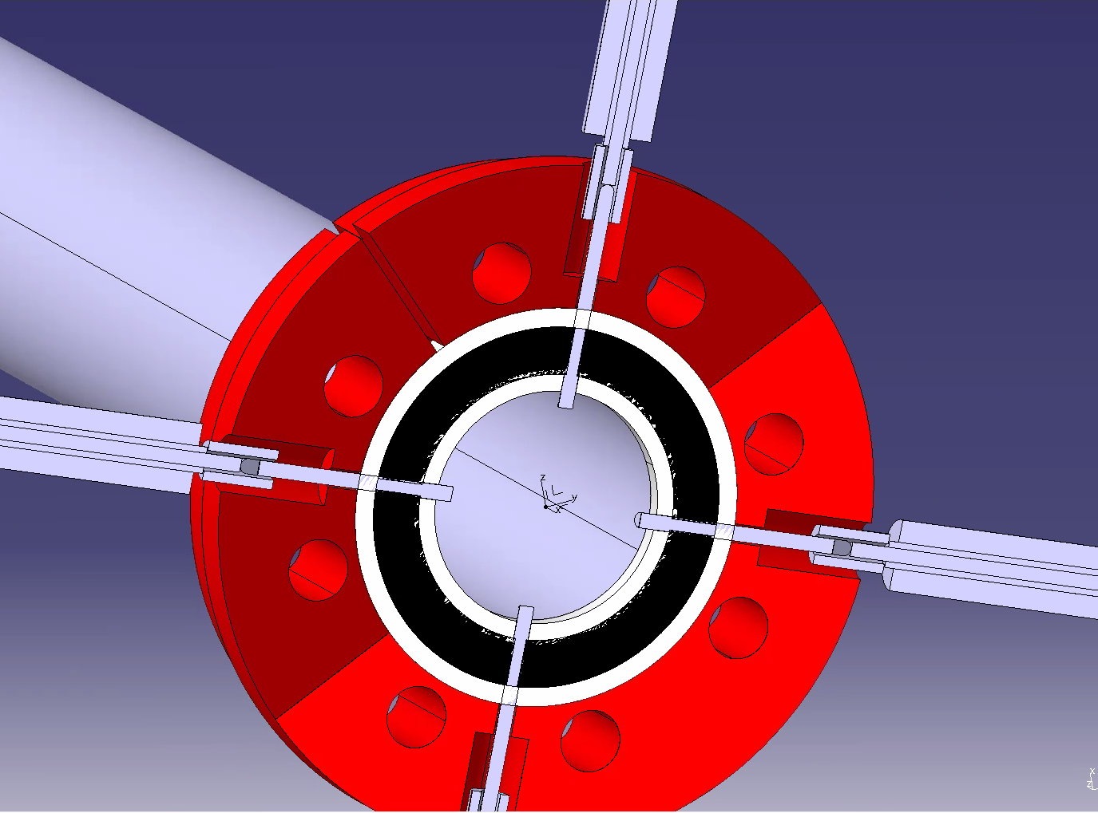
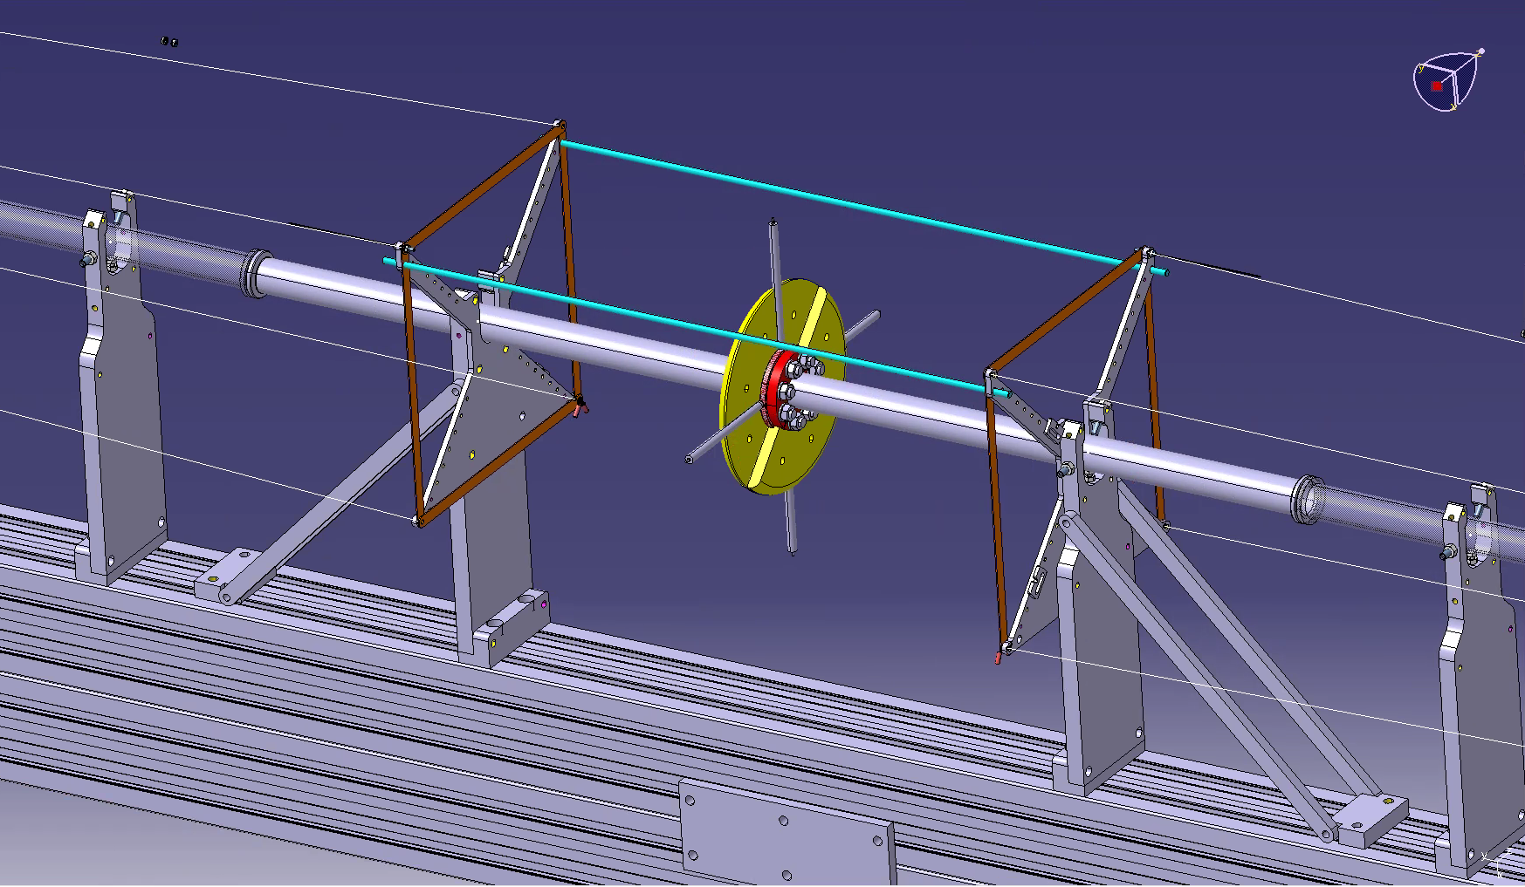
DPS design → tunnel cathode
Cathode part with 4 pins (2 pins/plasma)
4 HV connections (2/plasma) to pins going through the O-ring

Slide 10
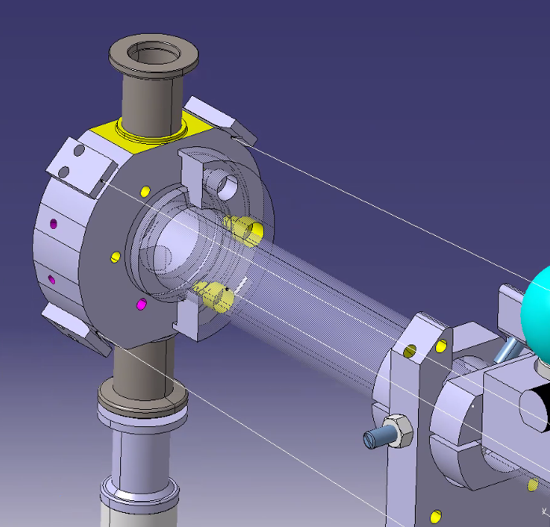
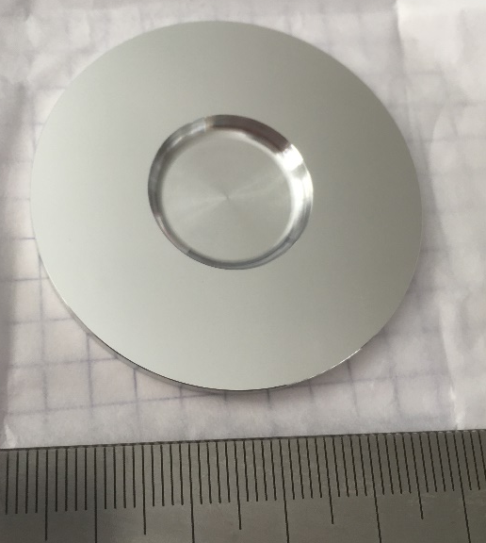
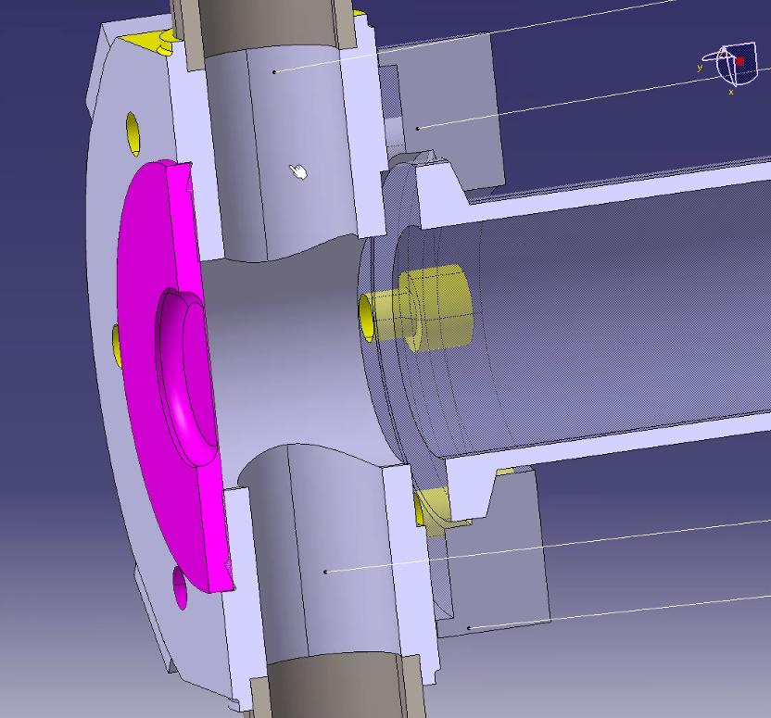
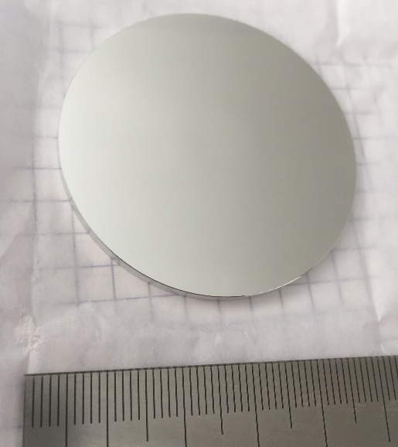
DPS design → tunnel anode
Anodes part with 0.2 mm thick aluminium window/gasket
Includes port for gas injection/pumping
26 mm
26 mm
Al-window vacuum leak tested and qualified up to 2 bars over pressure and 10 cycles ☑
All other parts to be fabricated, to be ready by end-November

Slide 11
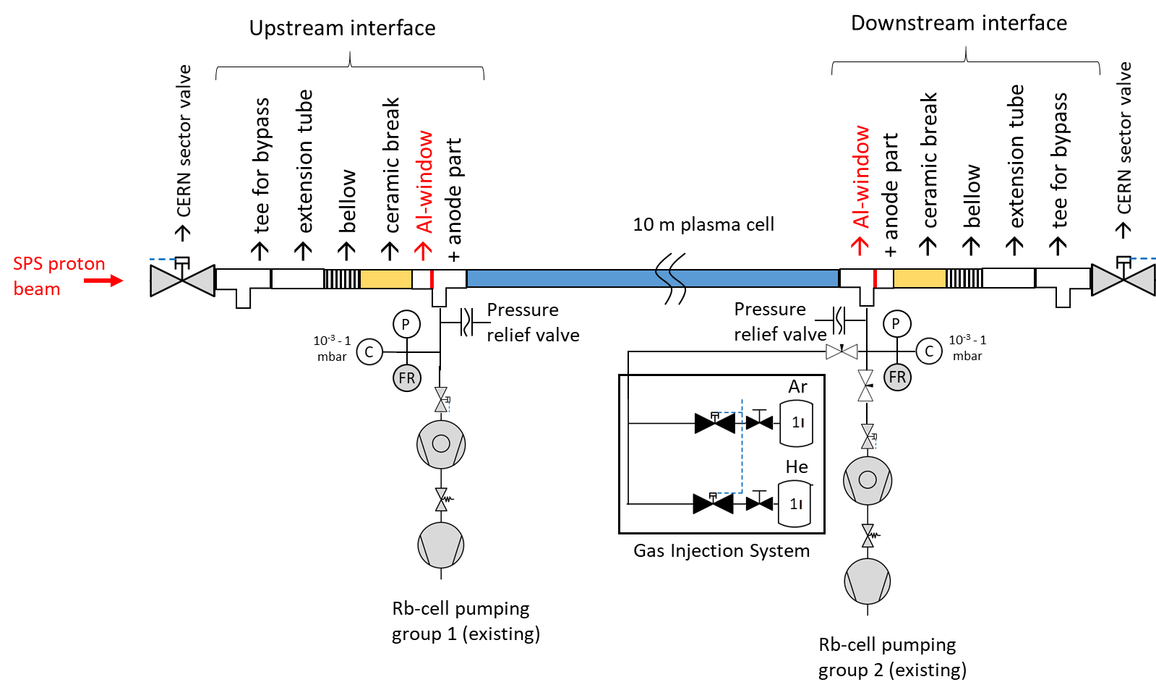
DPS vacuum → tunnel layout
Vacuum layout with downstream gas injection system and pumping groups at both ends (as for Rb source)
DPS vacuum control and gas injection system (GIS) update in SCADA + PLC for GIS by the end of the year

Slide 12
R&D program towards 2023 tunnel test

Slide 13
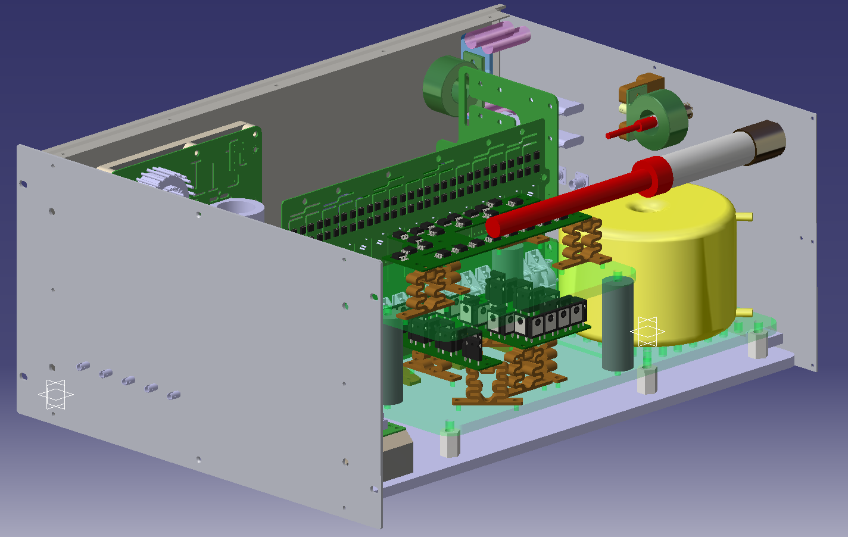
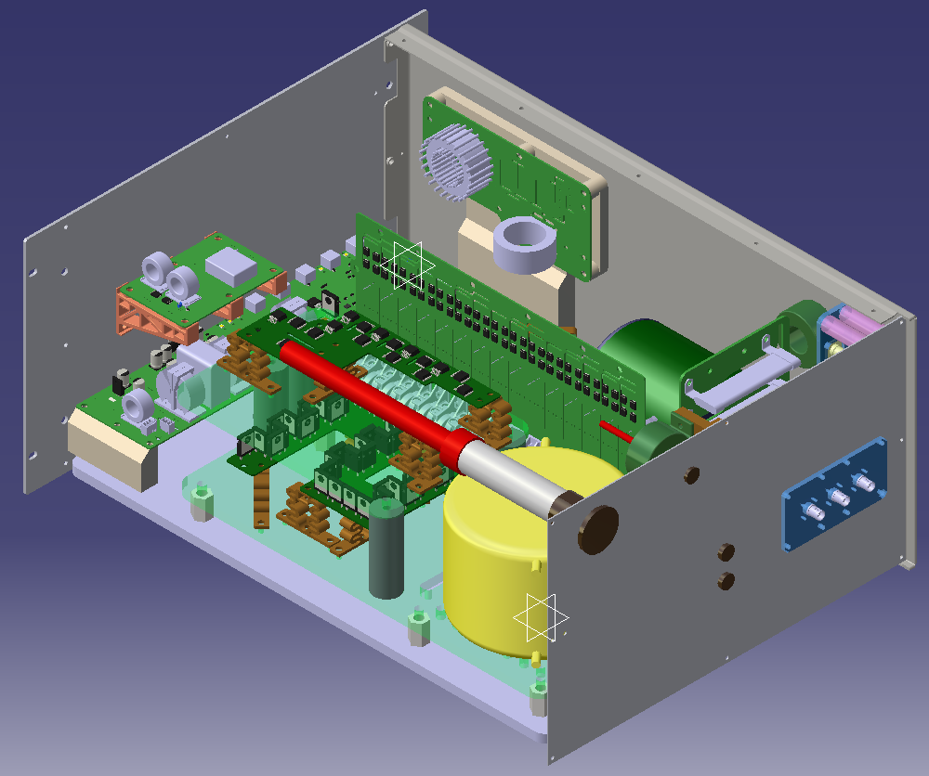
DPS pulsed DC power supplies (2x igniter + 2x heater)
Design finished, fabrication of boards on going
Boards to be shipped from IST-Lisbon to CERN by end October for integration in the 4 rack boxes
Plasma ignition with voltage up to 50 kV and plasma heating with current up to 1000 A.
Example, igniter box:

Slide 14
R&D program towards 2023 tunnel test

Slide 15
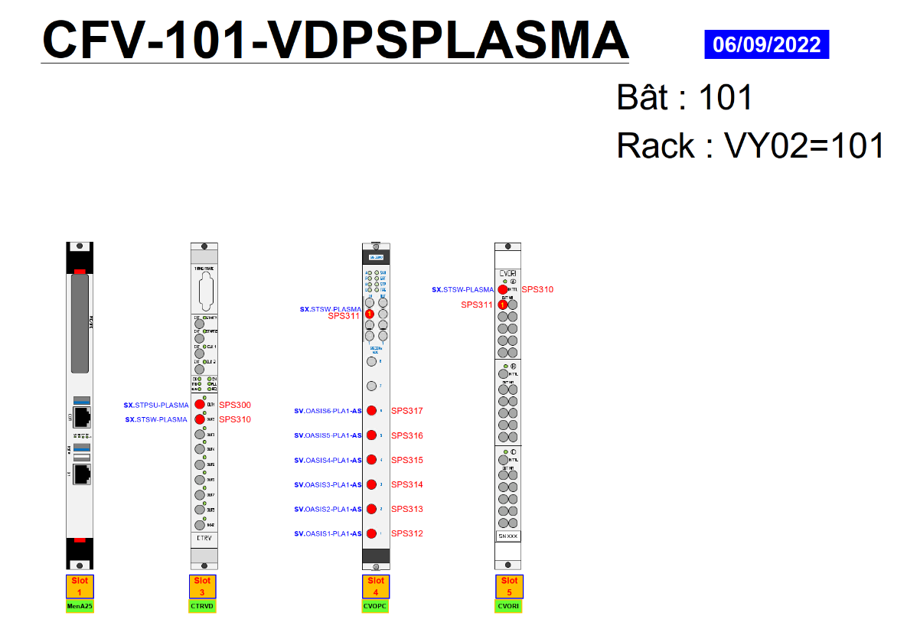
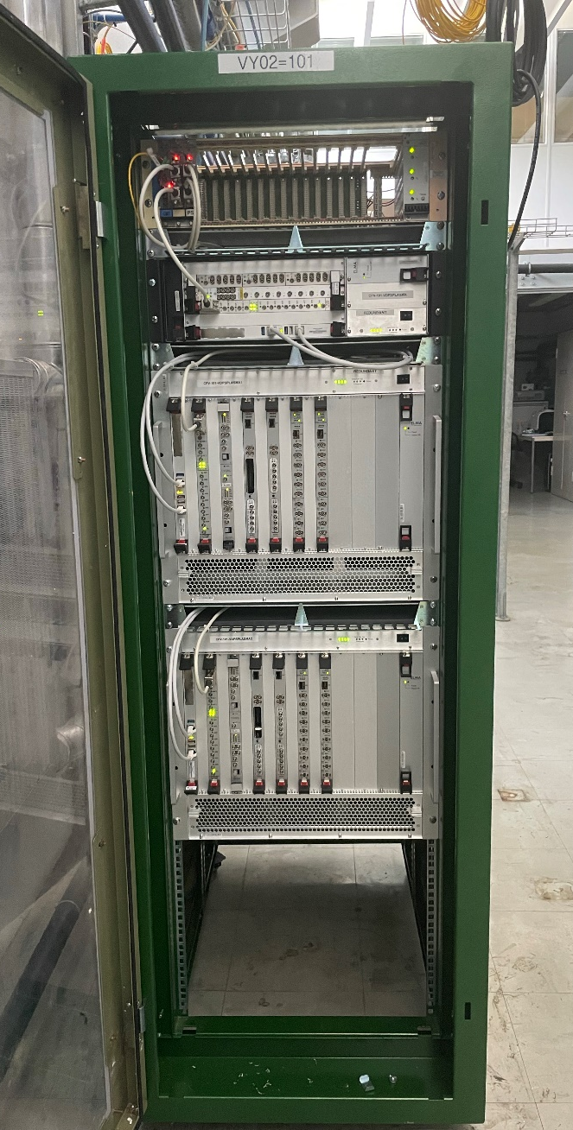
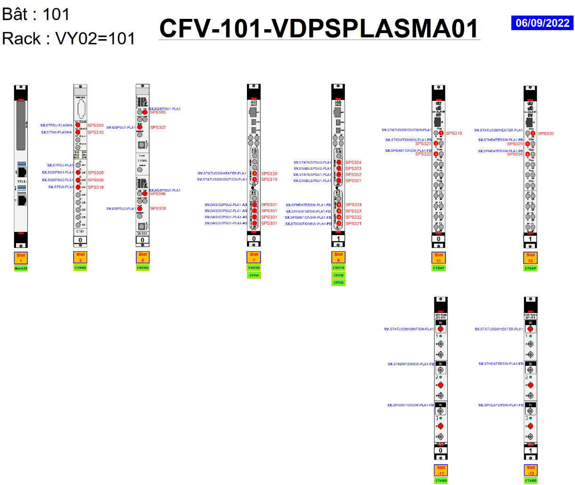
DPS control → lab and tunnel
SPS timing input for lab and tunnel
Optical fibre control for pulsed DC power supplies
Separate control of the 2 plasmas
Digitizer + OASIS for plasma current and beam monitoring
Integration to AWAKE control/interlock scheme to be discussed next week

Slide 16
R&D program towards 2023 tunnel test

Slide 17
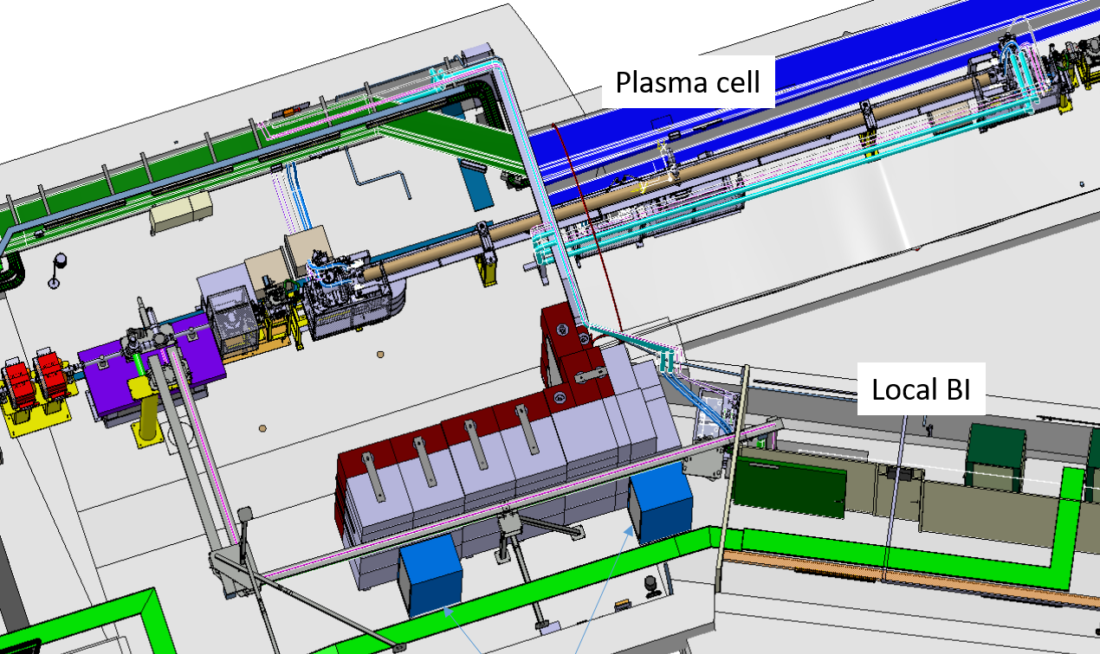
DPS integration
Tunnel cables layout
220V
GND
pulsed 50kV to cathodes
pulsed return
3.5 m + 6.5 m
Plasma 1 – 6.5 m
Transport of 2x 5 m cell supports through shaft
the rest fits in the with lift
Cabling scheduled
R2E: small steel wall to further shield racks
List of materials/quantities provided
HV cables qualified by HSE for fire/radiation risk
Plasma 2 – 3.5 m
Power supplies
rack
Control rack

Slide 18
Summary
Design of the DPS tunnel cell finalized, fabrication to be launched
Power supplies design finalized, fabrication ongoing
→ First 10 m plasma in the lab foreseen mid-November
Plasma density assessment with longitudinal interferometry in January 2023
→ 4 months test and qualification in the lab prior to move to the tunnel in April 2023
Integration validated, planning validation depending on SPS 2023 runs (see Eloïse’s presentation)
Start dedicated run 2b plasma sources (DPS/Rb) periodic meetings next week
Thank you for your attention!

Slide 19
10 m DPS cell schematic
6.5 m
3.5 m
Al-window
+ anode 1
4-pins cathode
Anode 2
+ Al-window
anode 1 cage (4x CuBe wire)
anode 2 cage
p+
plasma 1
plasma 2
Anode 1 GND
Anode 2 GND
50 kV cathode
Pulsed DC 1
power supplies
(ignition + heating)
Pulsed DC 2
power supplies
(ignition + heating)

Slide 20
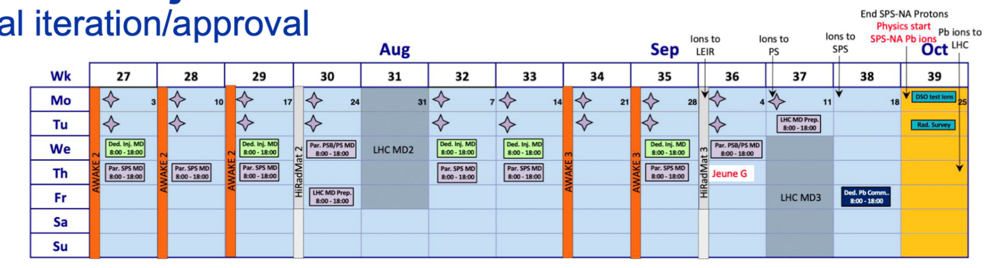
Draft 2023 runs plan, if 3 weeks in advance
Transport + installation
DPS commissioning
3 weeks
DPS run
3 weeks
decommissioning

Slide 21
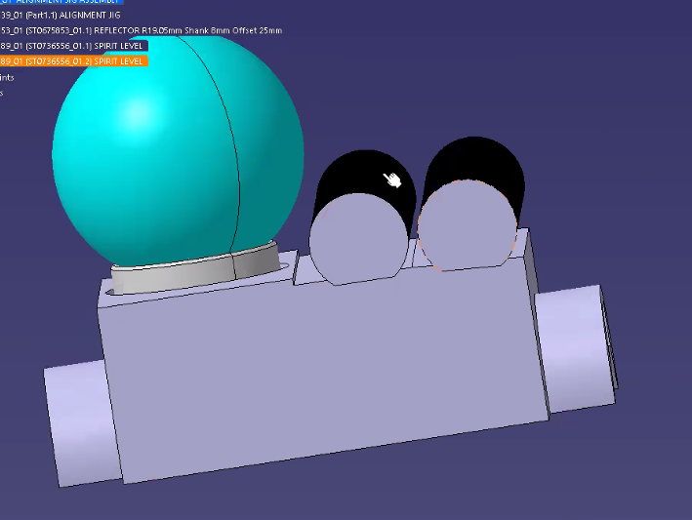
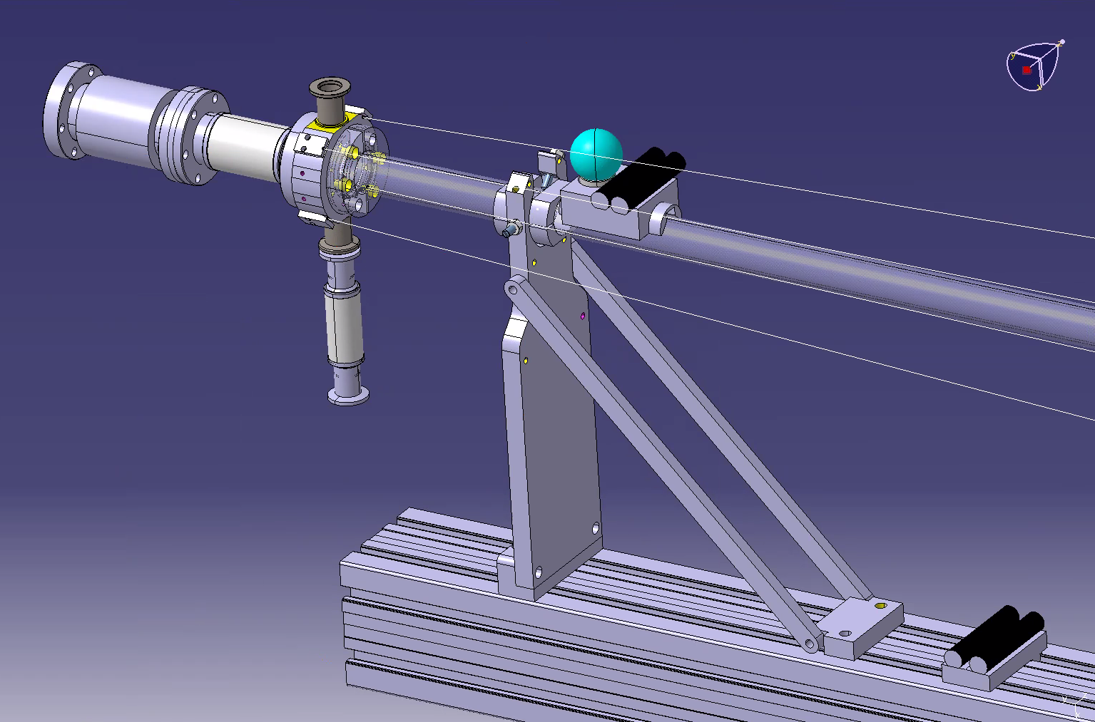
DPS design → tunnel survey
Anode upstream part and survey setup
Dedicated support for reference sphere above tube
Tube position adjustment with 3-screws on each support
3.24° slope
horizontal

Slide 22
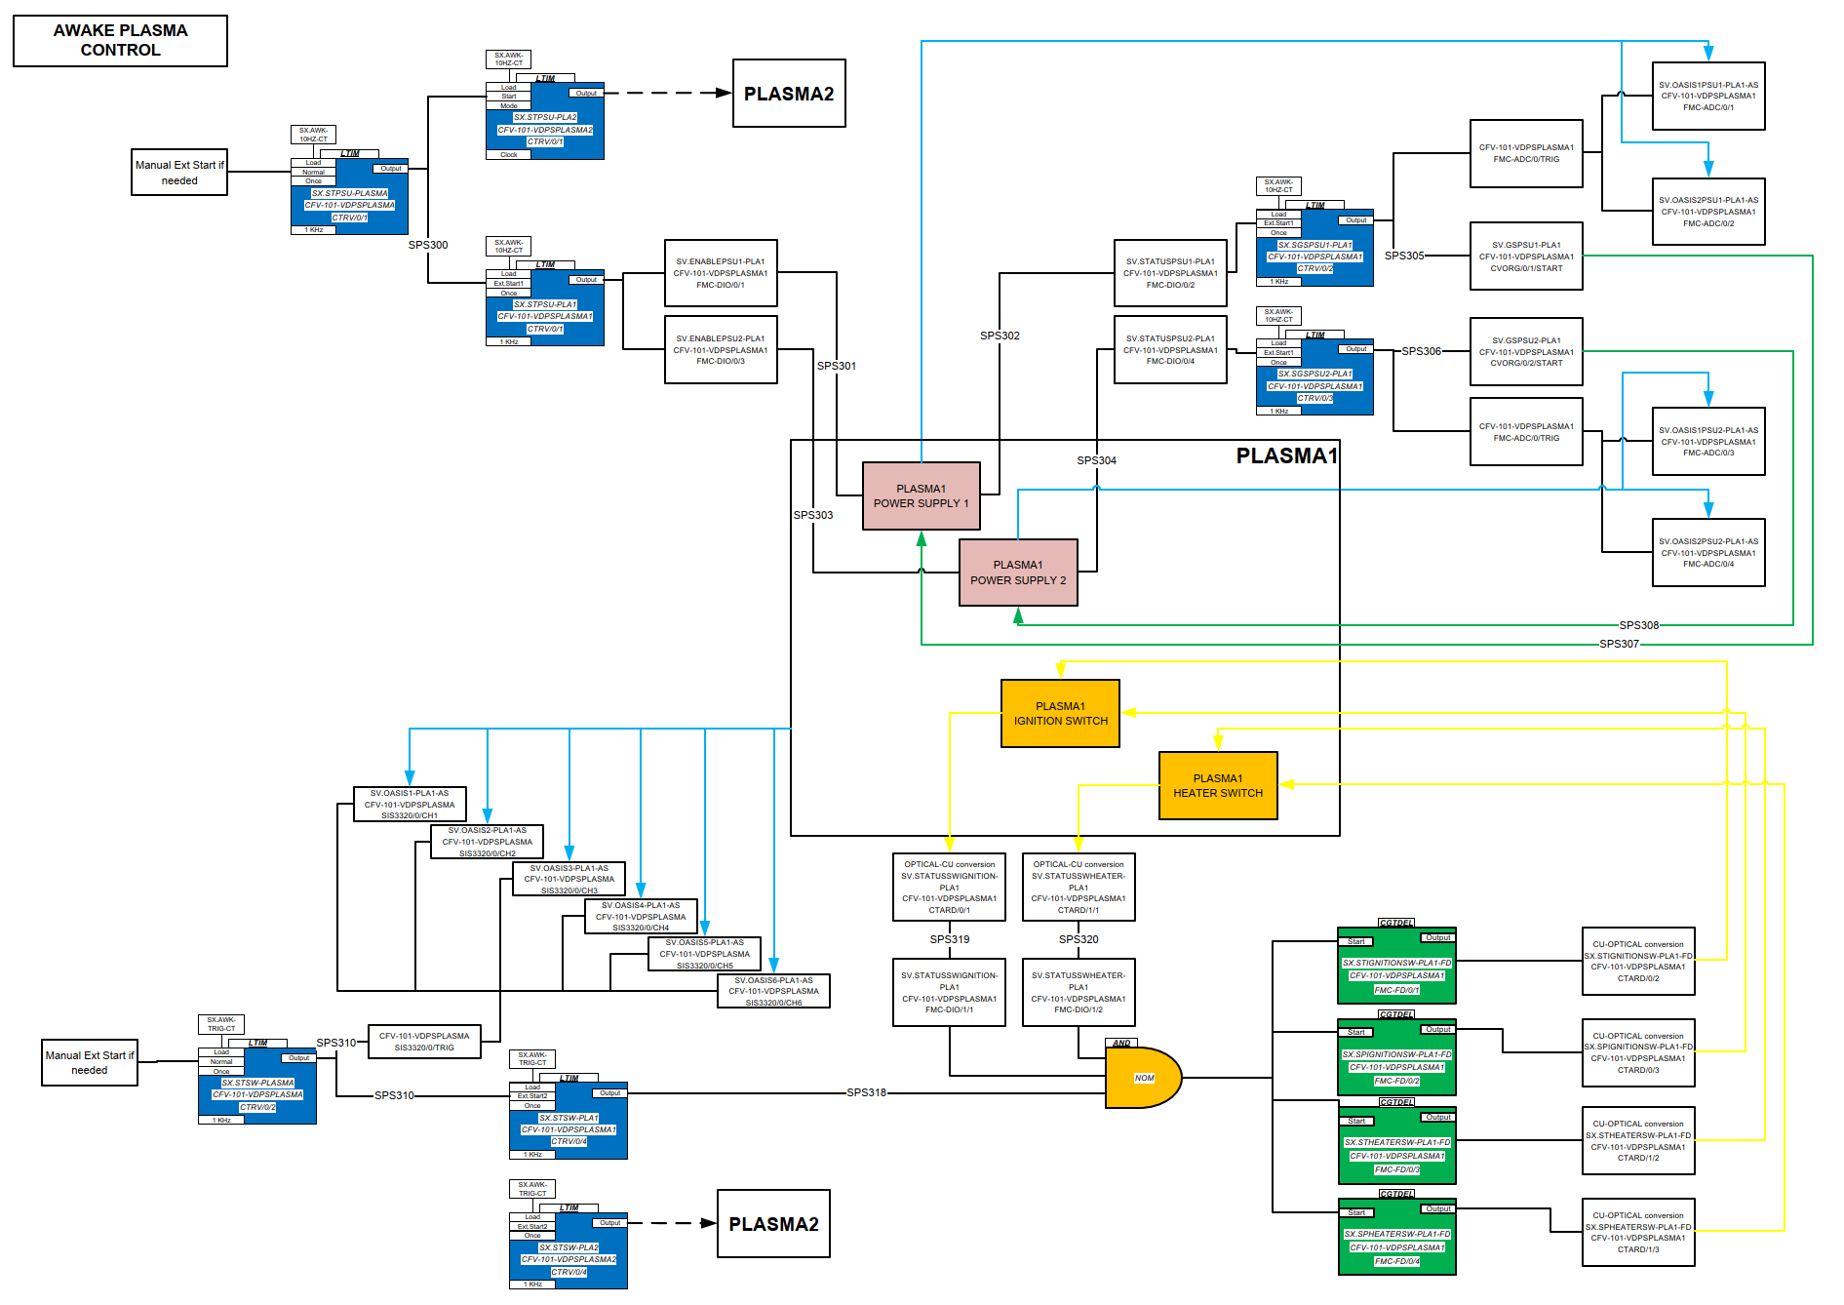
DPS control

Slide 23
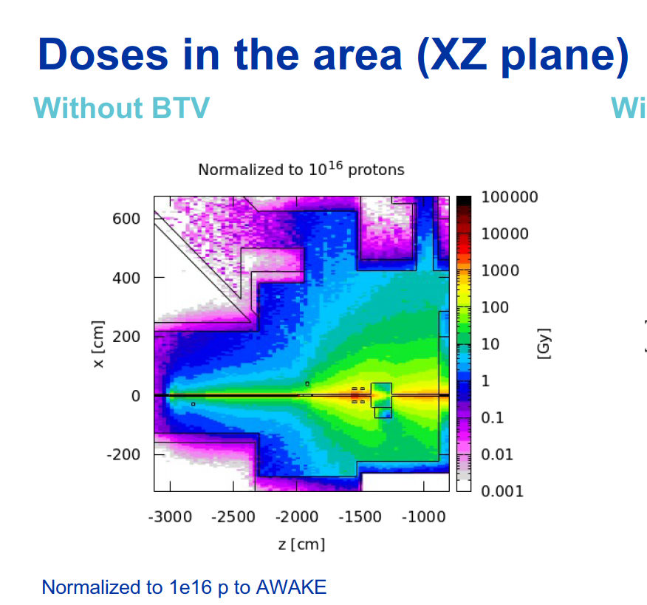
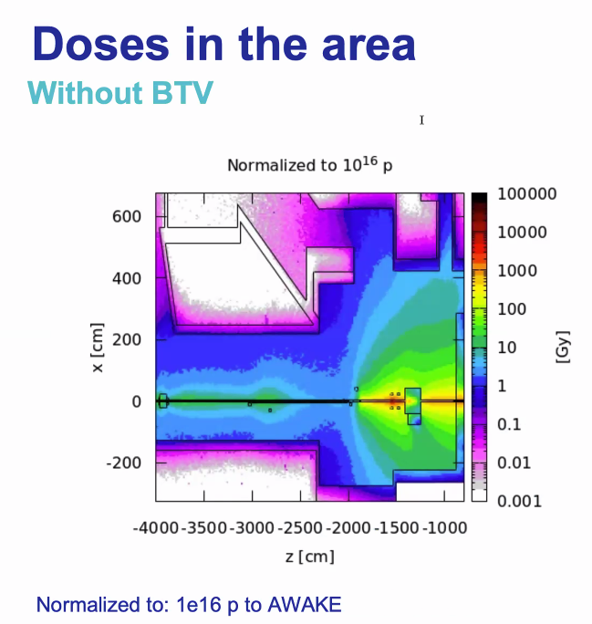
DPS integration
→ R2E
Simulation with baseline experiment (with laser beam dump before diagnostics, different Z-scale!)
DPS simulation (v2, 1x10^16 p) with 2x vacuum windows
Courtesy Samuel Niang

Slide 24
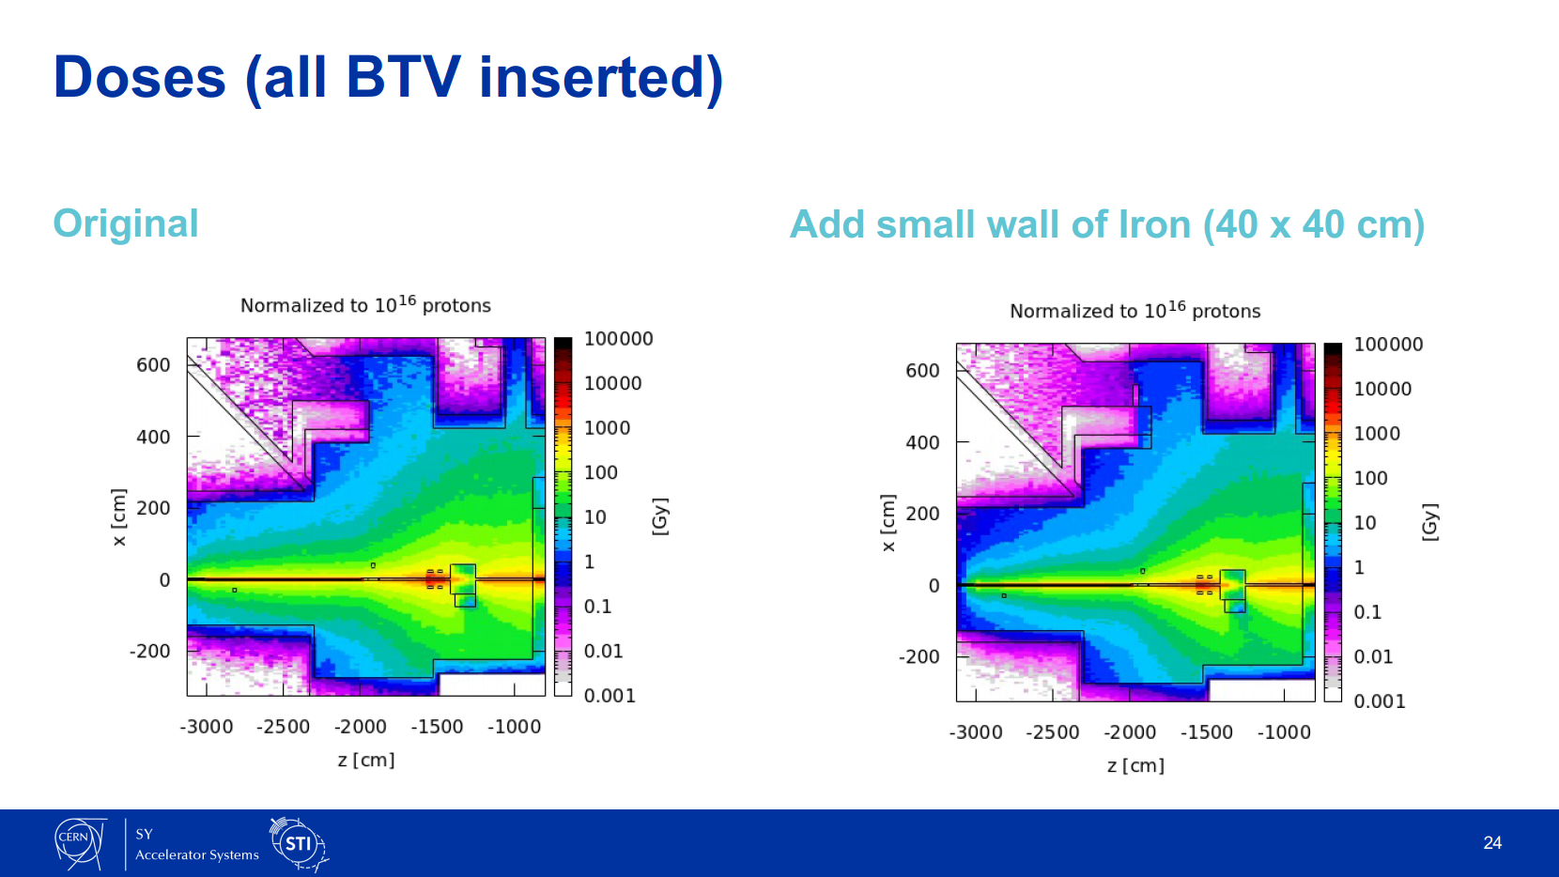
DPS integration
→ R2E
Courtesy Samuel Niang

