Slide 1


Preparation and planning for Run 2b 2023
Eloïse Guran, CERN
AWAKE Collaboration Meeting
6 October 2022

Slide 2
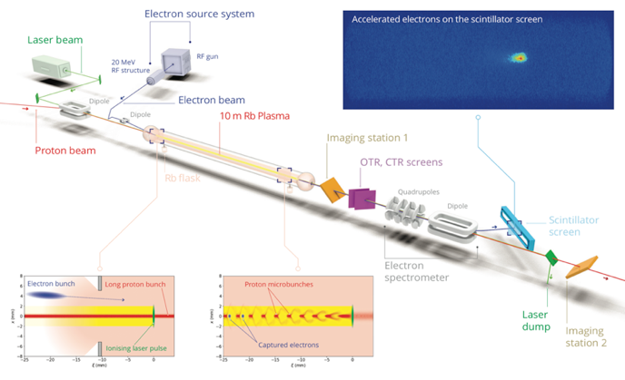
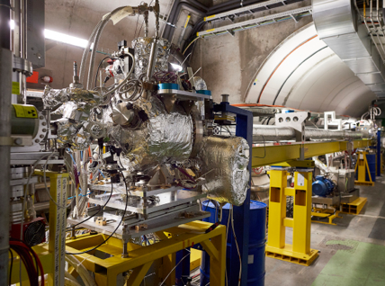
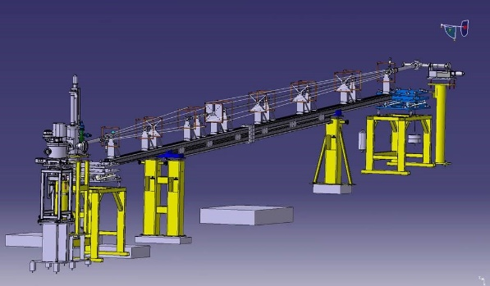
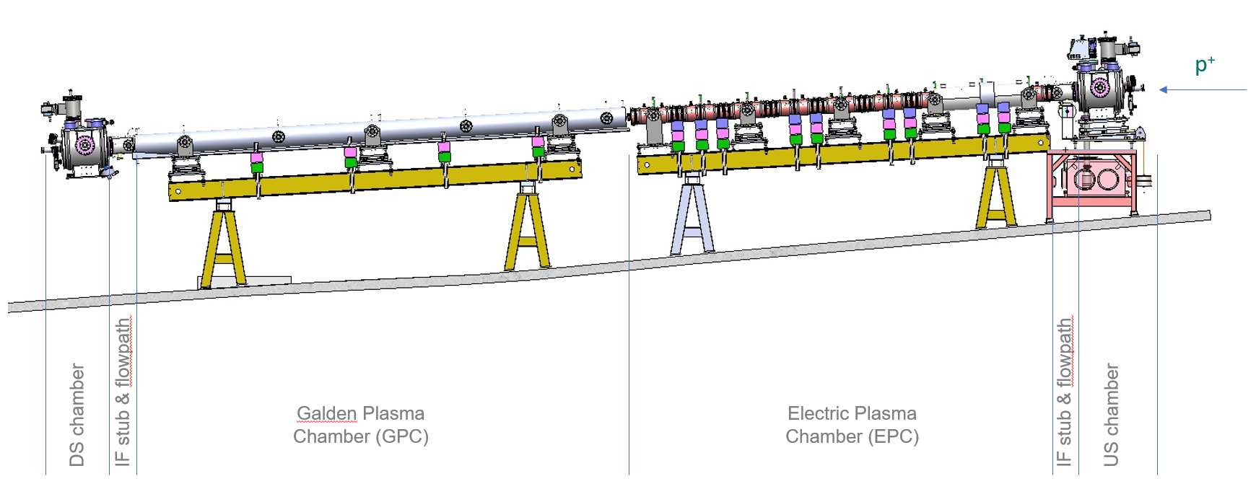
From Run 2a to Run 2b
Run 2a
Run 2a/b
1) Current configuration
2) Discharge plasma source (DPS)
3) Step density vapor source
Run 2b

Slide 3
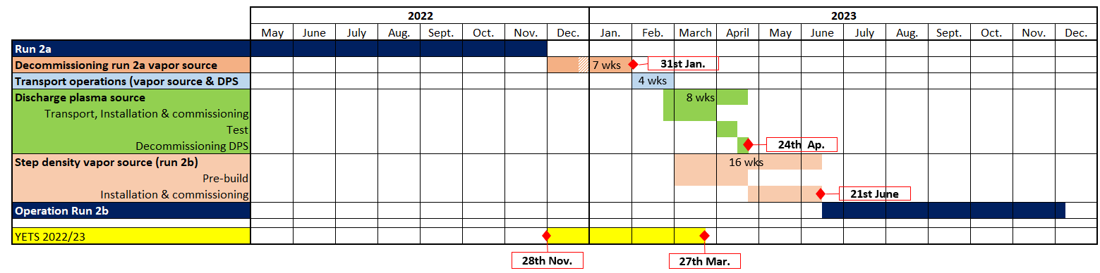
General planning
Planning status as originally produced this spring
  6-8 weeks for the decommissioning of the current vapor source
  4 weeks reserved for transport in February
  8/9 weeks for the Discharge Plasma source test (including transport)
  16 weeks for the installation of the step density vapor source

Slide 4
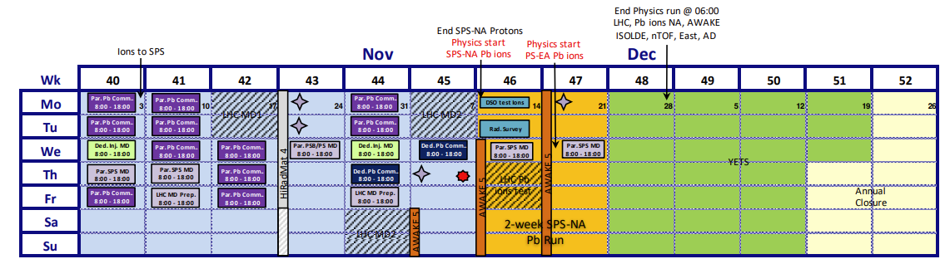
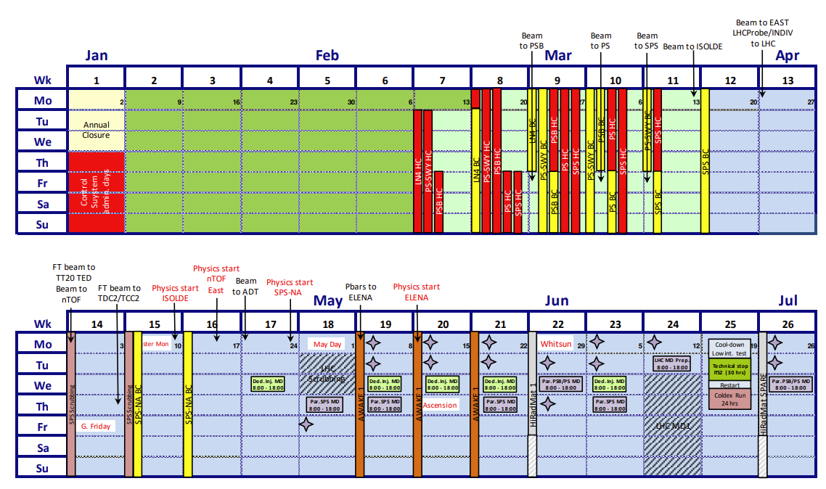
General planning vs Injector schedule
2022
Vapor source decommissioning
Draft injector planning for 2023 proposes 1st protons for AWAKE on May 8th
2023
→ To do the DPS test, we would need to shift the planning by 4 weeks
Vapor source decommissioning
Transport
DPS
4 weeks shift
First possible date for proton = end of June 2023
DPS
Step density vapor source installation

Slide 5
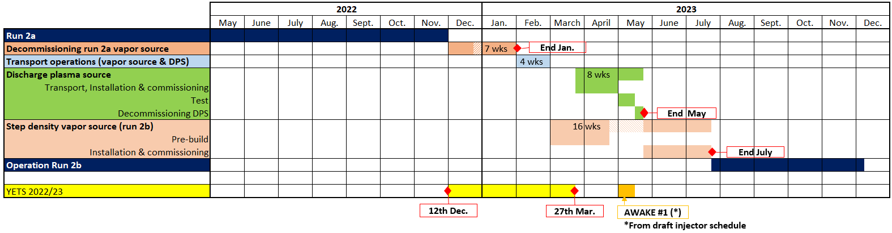
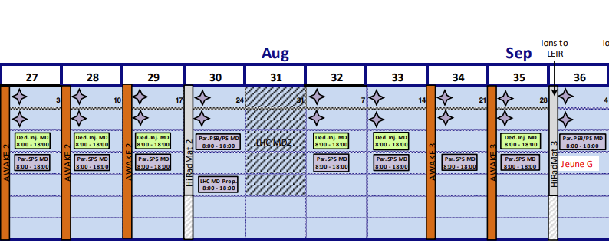
General planning vs Injector schedule
2022
Vapor source decommissioning
4 weeks shift → shift needed for awake #2 proton run (and probably for awake #3)
2023
Ready for protons = August 2023
Vapor source decommissioning
Transport
5 weeks shift
DPS
Step density vapor source installation
AWAKE #2
Shift AWAKE #3

Slide 6
General planning vs Injector schedule
2022
Vapor source decommissioning
Another possible scenario → if possible, shift awake #1 proton run 3 weeks earlier → only need a 1 week shift for awake #2
2023
Vapor source decommissioning
Transport
DPS
3 weeks shift
DPS
Step density vapor source installation
AWAKE #2
1 week shift

Slide 7
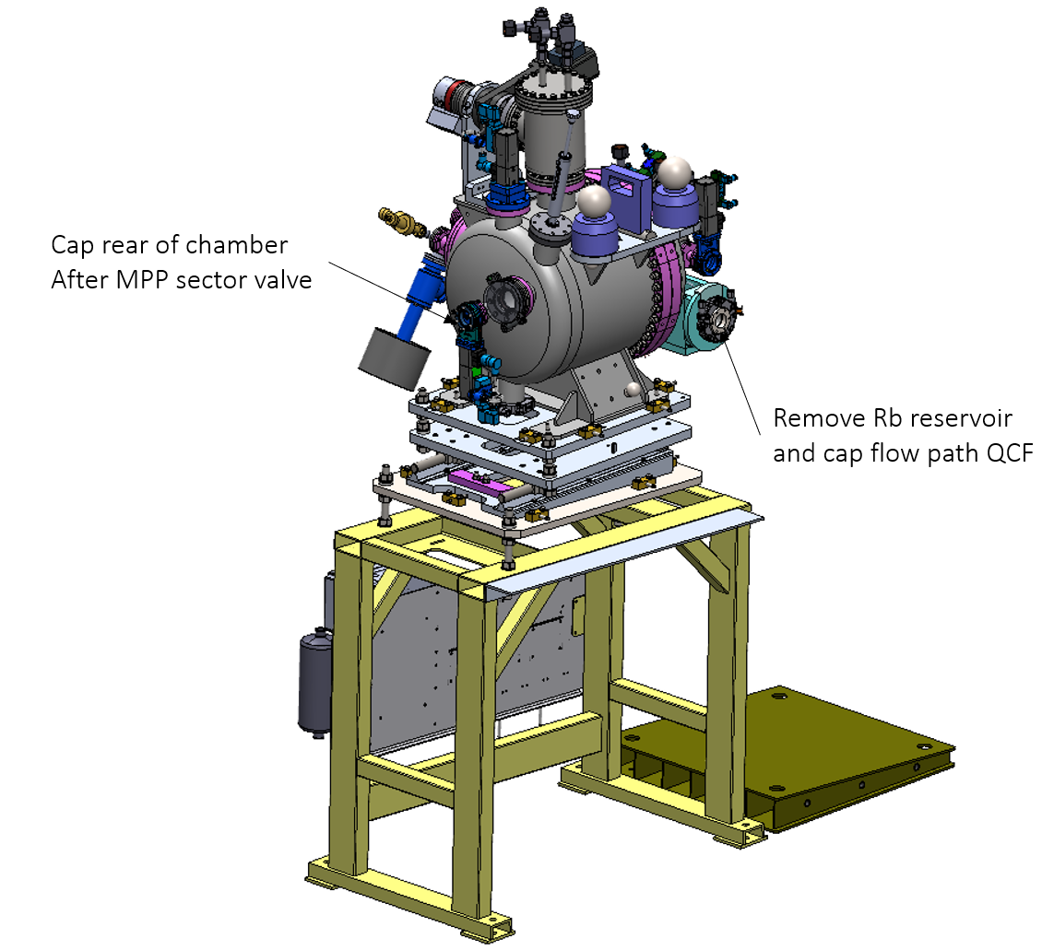
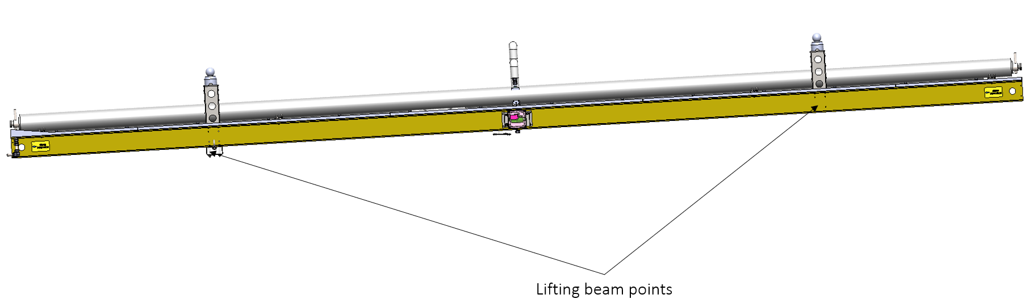

Detailed planning
2 weeks rubidium recycling
4 weeks preparation for removal
2 weeks transport & installation
3 weeks commissioning
2-3 weeks test
1 week decommissioning
8 weeks pre-build in a clean room
4 weeks installation
4 weeks commissioning

Slide 8
Detailed planning
Critical activities that might lead to a delay :
  Readiness of DPS
  Proton run dates for DPS
  Readiness of step density vapor source to go in the tunnel
Minimum duration between DPS test proton run and new vapor source ready for protons
  11 weeks (if 2 weeks proton run for DPS)
  12 weeks (if 3 weeks proton run for DPS)

Slide 9
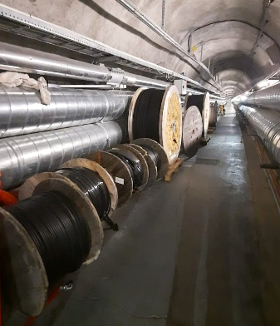
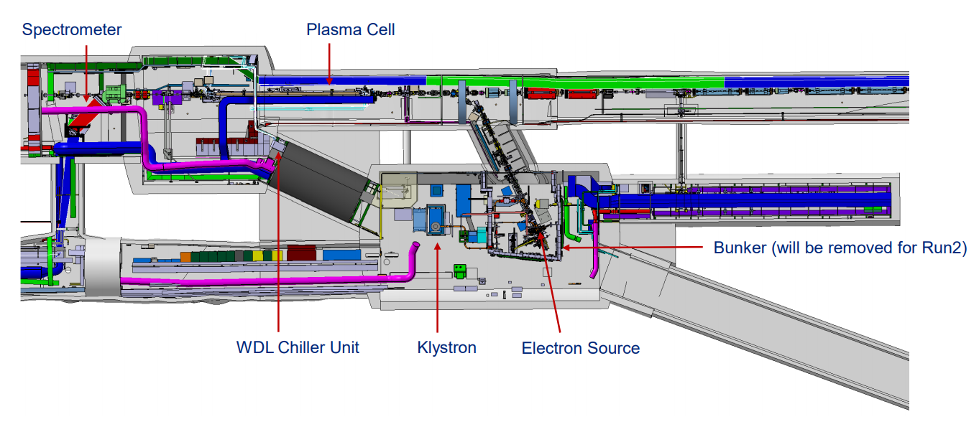
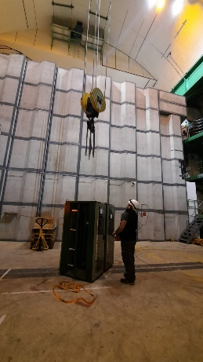
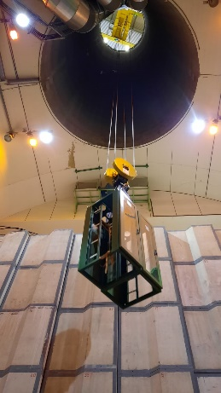
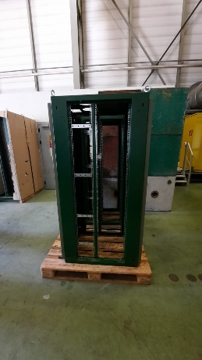
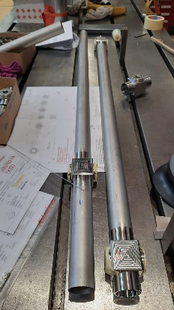
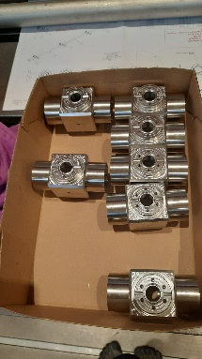
Preparation works – Who does what
Design & installation of step density vapor source
Design & installation of DPS
Decommissioning of current vapor source
MPP / WDL
Vapor source design
Vacuum
R&D Discharge plasma source
TE-VSC
EN-ACE
Coordination
CP4 – Infrastructure, Installation, Integration
EN-EL
Cabling & Electrical systems
Update 3D models & integration studies
EN-ACE-INT
Integration
BE-GM
Survey
Alignment of new equipement
EN-MME
EN-HE
Transport & handling
Supports
Mechanical Workshop
Mechanical supports & technical drawings
Manufacturing of new pieces

Slide 10
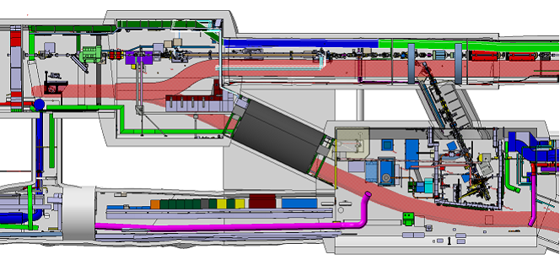
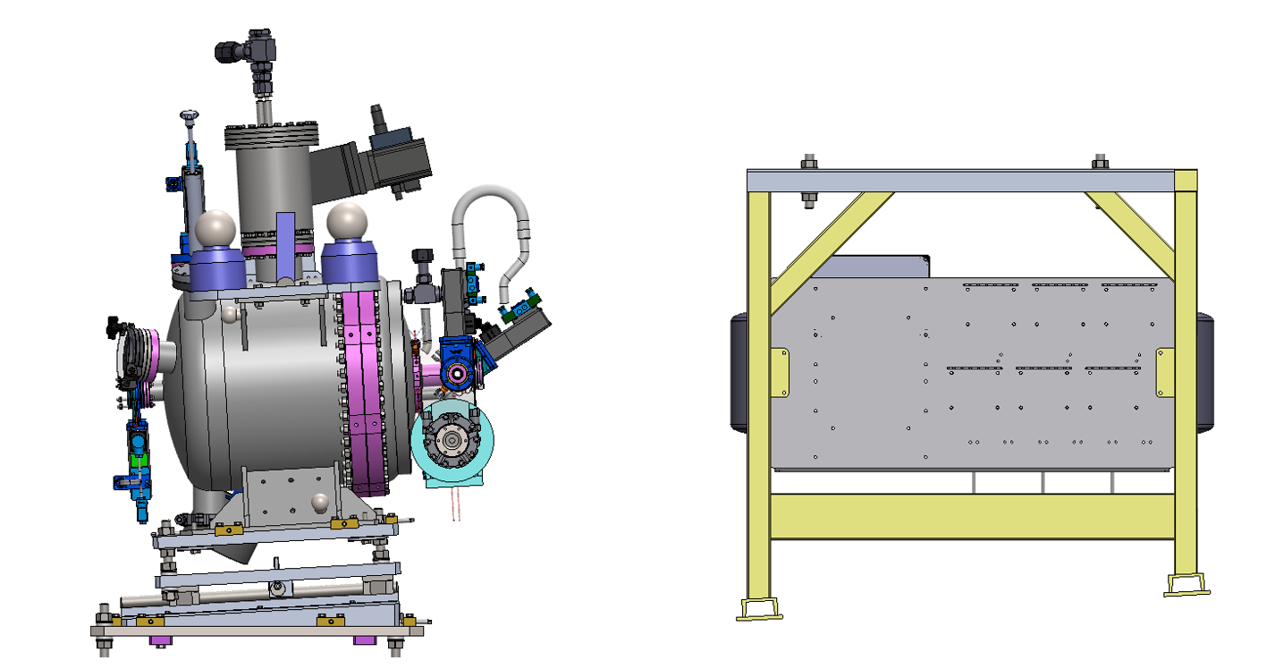
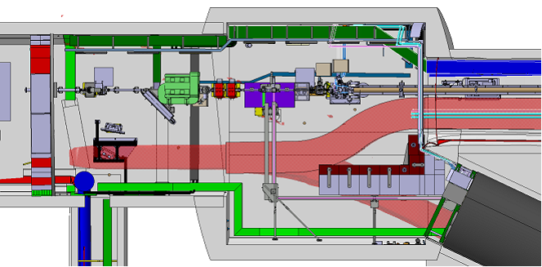
Challenges
Decommissioning of current vapor source comes with several challenges:
  Rubidium risk → recycling procedure
  Handling of the 10-meters long tube
    Need dismantling of some shielding blocks and BI equipment
  Separation of the cell in 3 parts under Argon Atmosphere

Slide 11

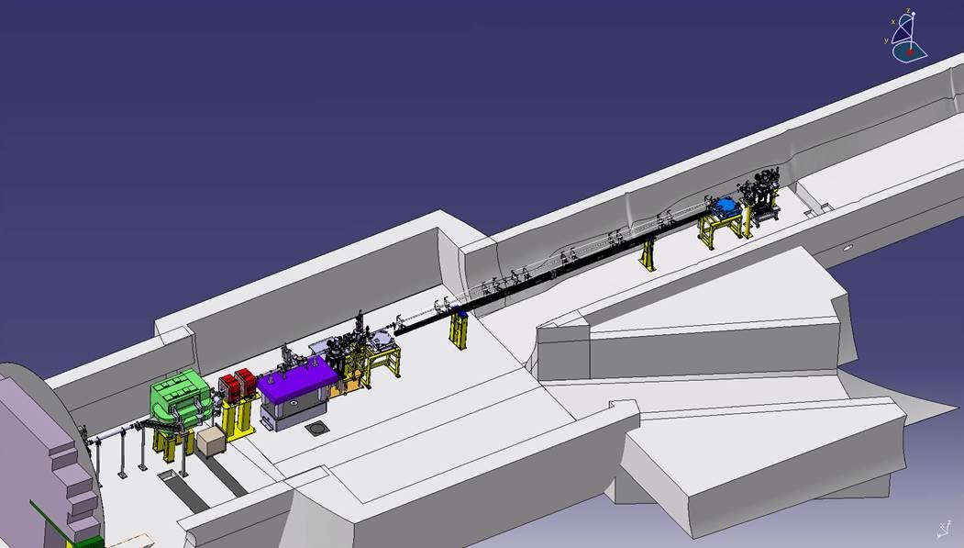
Challenges
The plasma cell “juggle”:
  Vapor source to take out
  DPS to install and un-install
  Step density plasma cell to install
  → All within a relatively short timeline and need to be ready for protons assignated to AWAKE
1)
2)
3)

Slide 12
Summary
Planning was established with inputs from the miscellaneous stakeholders. It is not fixed yet as it depends on proton slots, and system readiness for both the DPS and step density vapor source.
The milestones as of now (can still change):
  Decom. for December and January
  Transport Gen I out = February 2022
  DPS test = March->May
  Gen II Ready for protons → July 2022
The main challenge comes from the decommissioning of the current vapor source.

