Slide 1
High power RF system
06 Oct 2022
Kévin Pepitone, Dragos Dancila, Alireza M. Kasai,
Kristiaan Pelckmans, Piotr Szaniawski

Slide 2
Outline
Layout of the RF line
Solid state power amplifier
Low level RF mTCA

Slide 3
Layout of the RF line

Slide 4
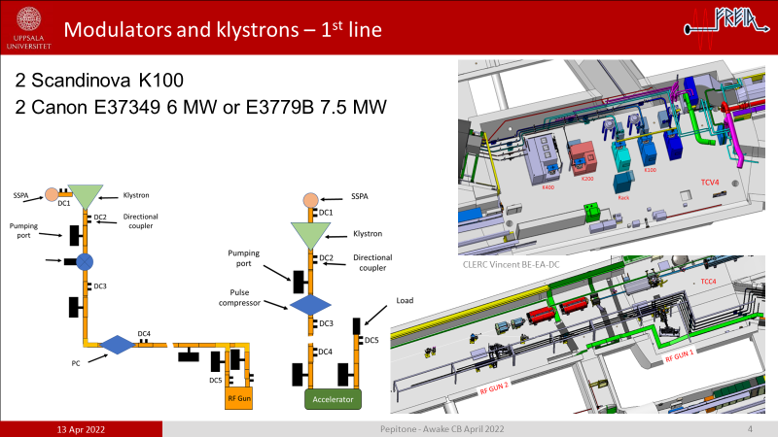
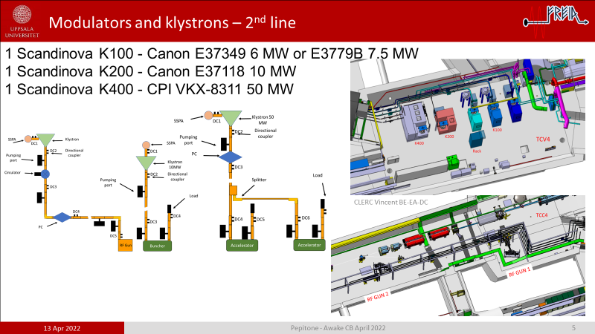
Last CB
3 GHz and 12 GHz
3 GHz

Slide 5
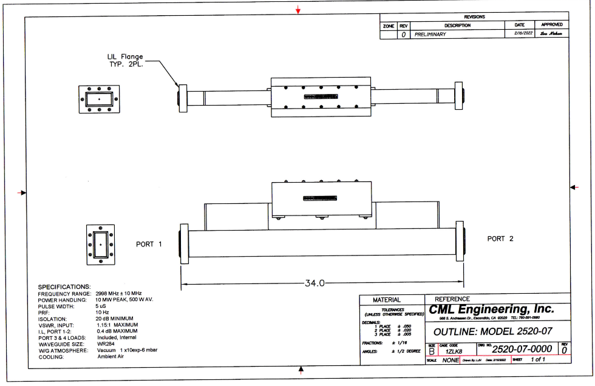
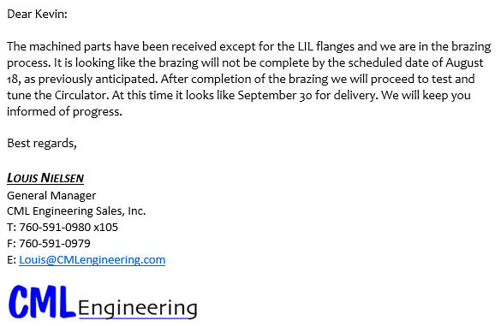
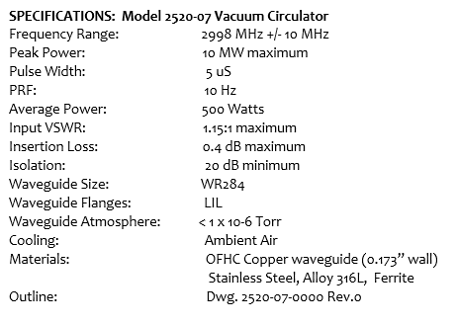
UHV circulator
Testing will be done at low power using laboratory test equipment. High Power testing is not included in or contemplated by this quotation. Swept test data for all relevant parameters is included.

Slide 6
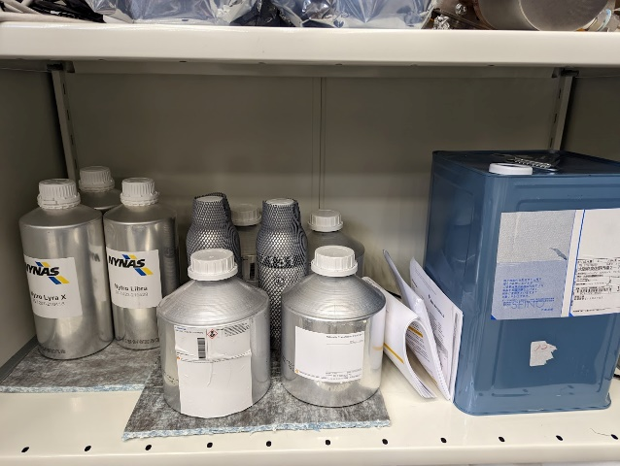
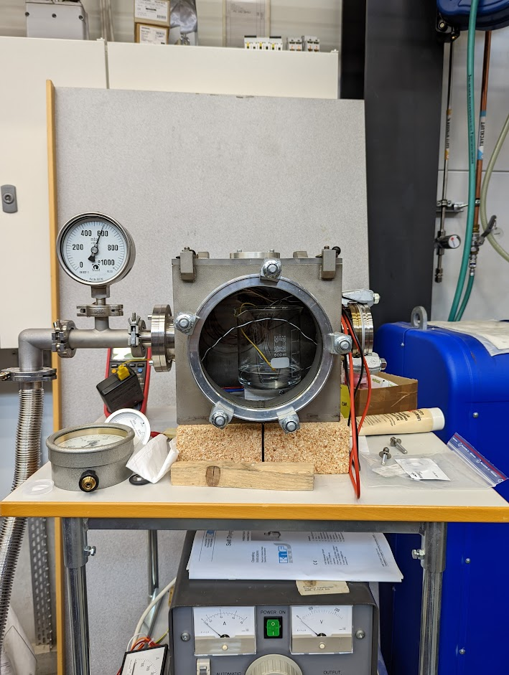
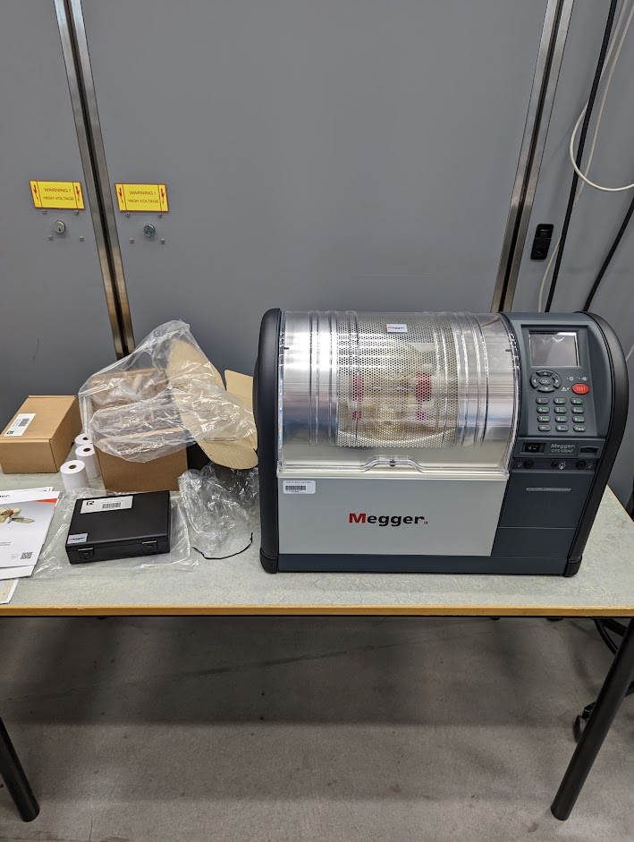
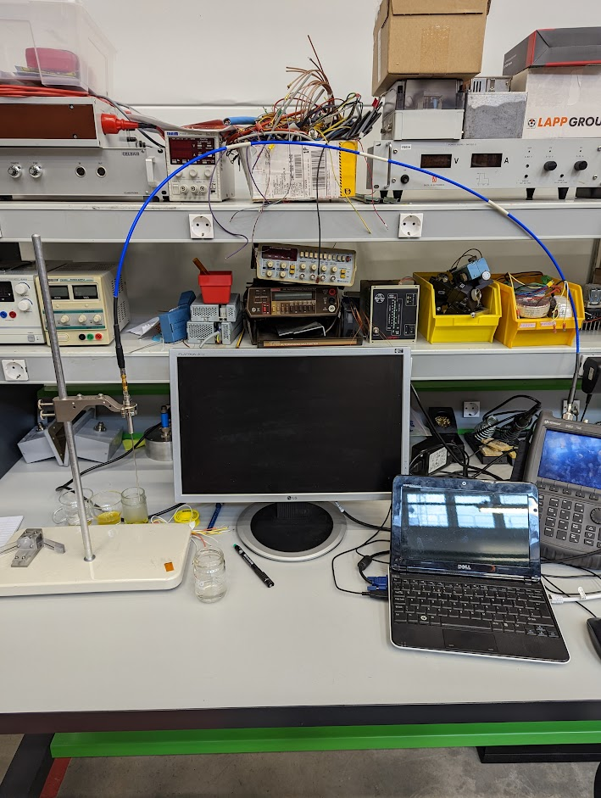
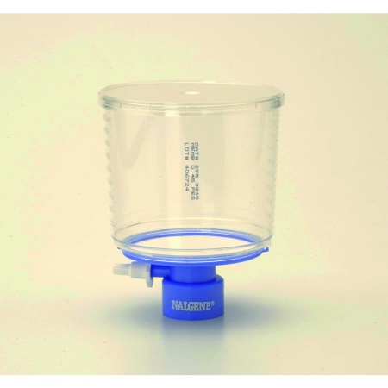
Oil tests
Dielectric measurements
Vacuum oven
100 kV HV tester
Mineral and ester samples

Slide 7
Oil tests – conclusions and ideas
After discussion with ScandiNova and VPdiagnose
Ester are more sticky, high viscosity. Circulation is slower than with mineral.
Ester oxidation is higher, faster not good for our application where the oil tank is not sealed and not designed for ester oils.
Need to redesign everything and train operators/industry if we want to use it
Shell S5 (biodegradable) is promising S4 is excellent
PFAE (Palm Fatty Acid Ester) - to be tested
Filtering before cooking the oil and keep it under vacuum as much as possible. Esters are real sponges
Brd produces alcohol, water and acids which helps to get more brd. Self running process
Ideas
Measure water content before and after the cleaning
Study the cleaning effect on ester oils
Understand the needed improvements on HV modulators to use ester oils

Slide 8
Solid state amplifiers

Slide 9
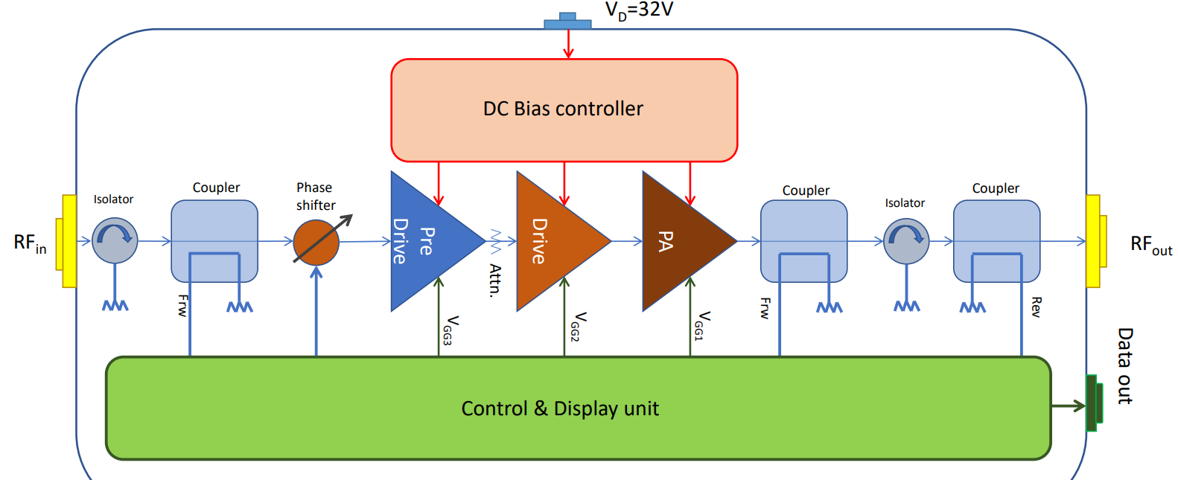
Block diagram of 250 W SSPA @ 3 GHz initial

Slide 10
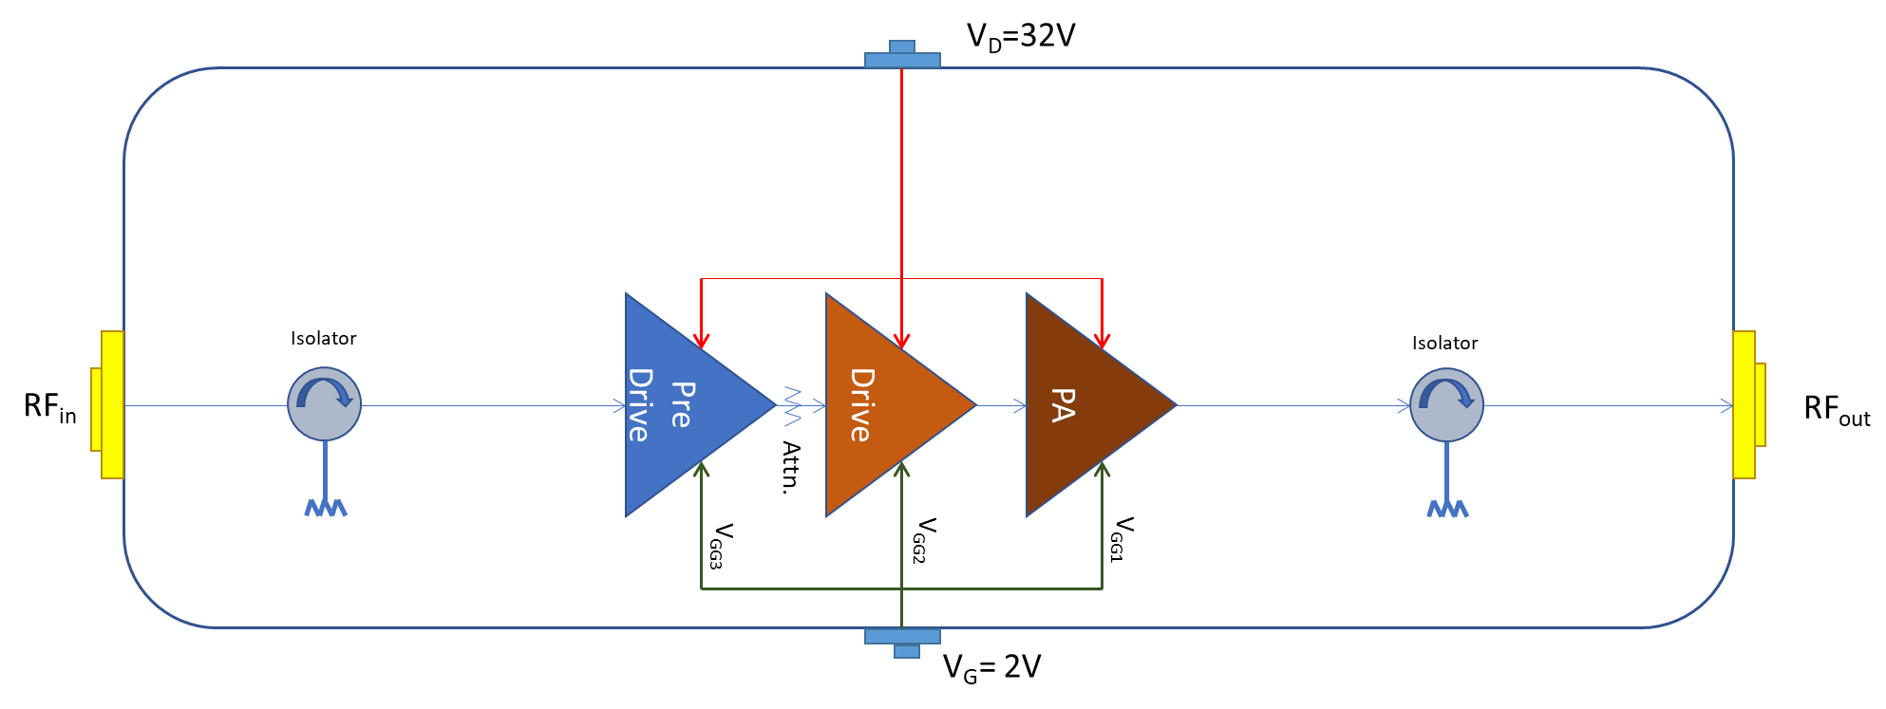
Block diagram of 250 W SSPA @ 3 GHz new

Slide 11
SSPA controlled by a PLC
We would need to add and integrate a UI, coms and control of DC power supply, input RF switch and duty cycle interlocks, etc…
DC power supply should have an enable input -> this would need to be shown on the UI and the TTL signal handled to enable the power supply
RF interlock via a Double Pole Double Throw
Duty cycle monitoring of 0.1 % to prevent operation with longer duty cycles – envelope detection or similar + interlock -> if too large duty cycle it stops and shows error message
UI and monitoring of output power and reflected power -> UI shows power levels
Choice of the range of the output power level -> this we will do by changing the drain supply voltage – virtual knob or similar UI and connection to command the DC power supply
Evaluation of efficiency via drain current read-out (current clamp) and to show this on the UI.

Slide 12
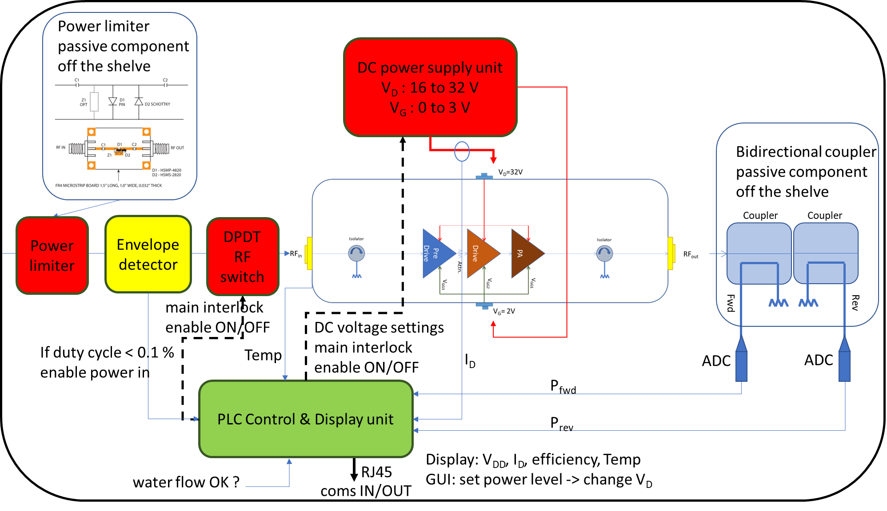
New layout with PLC

Slide 13
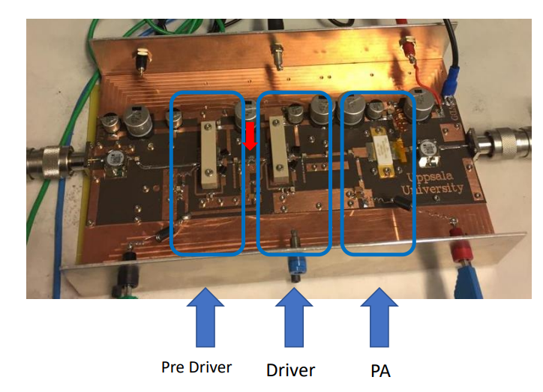
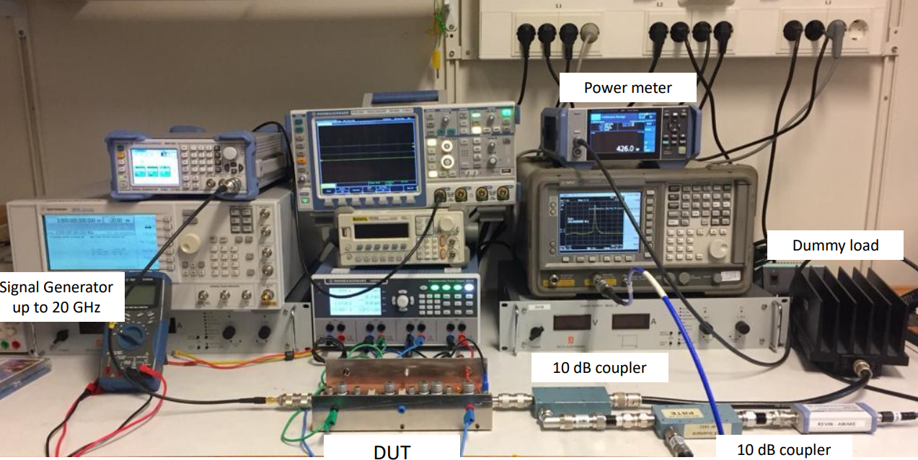

SSPA and test set-up
SSPA
Test set-up

Slide 14
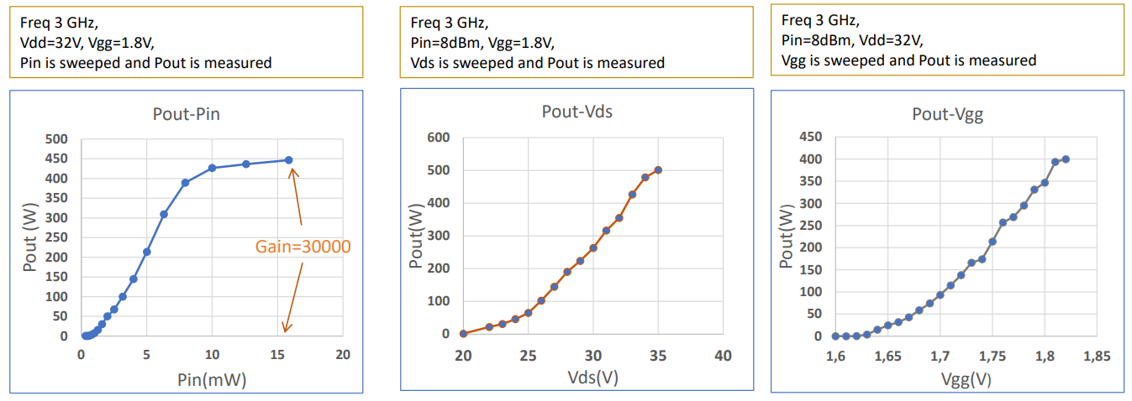
Results
8 dBm
32 V

Slide 15
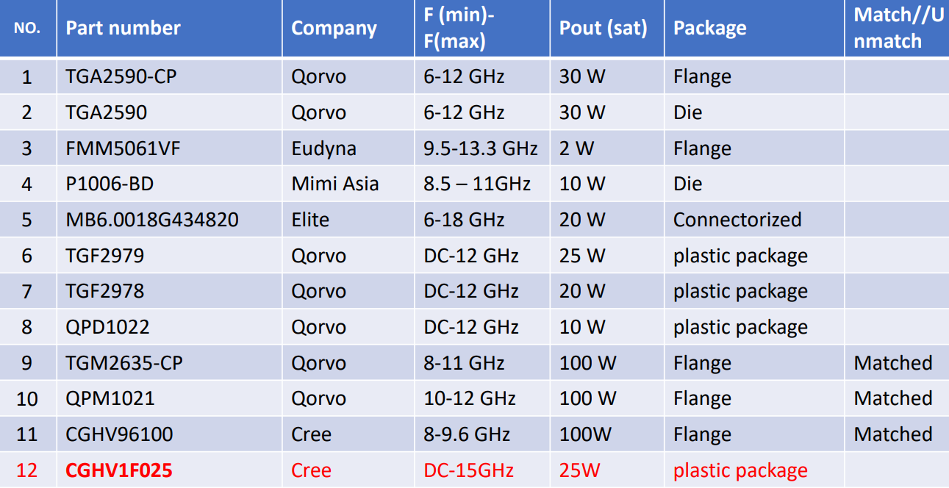
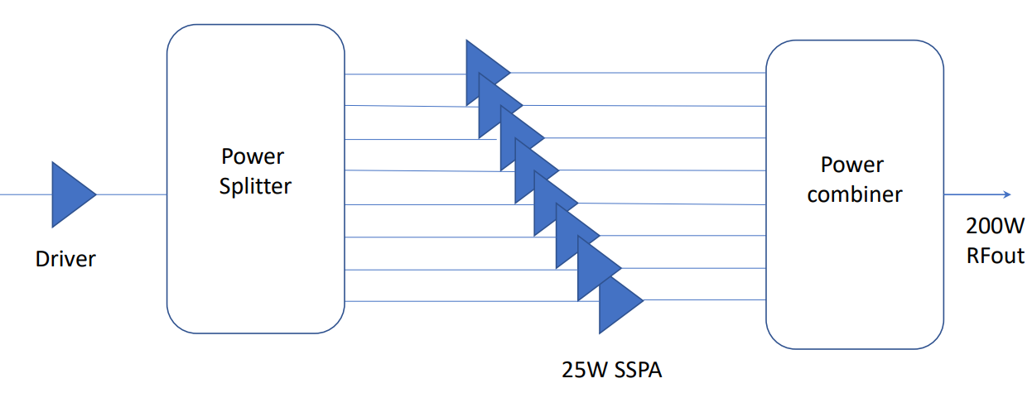
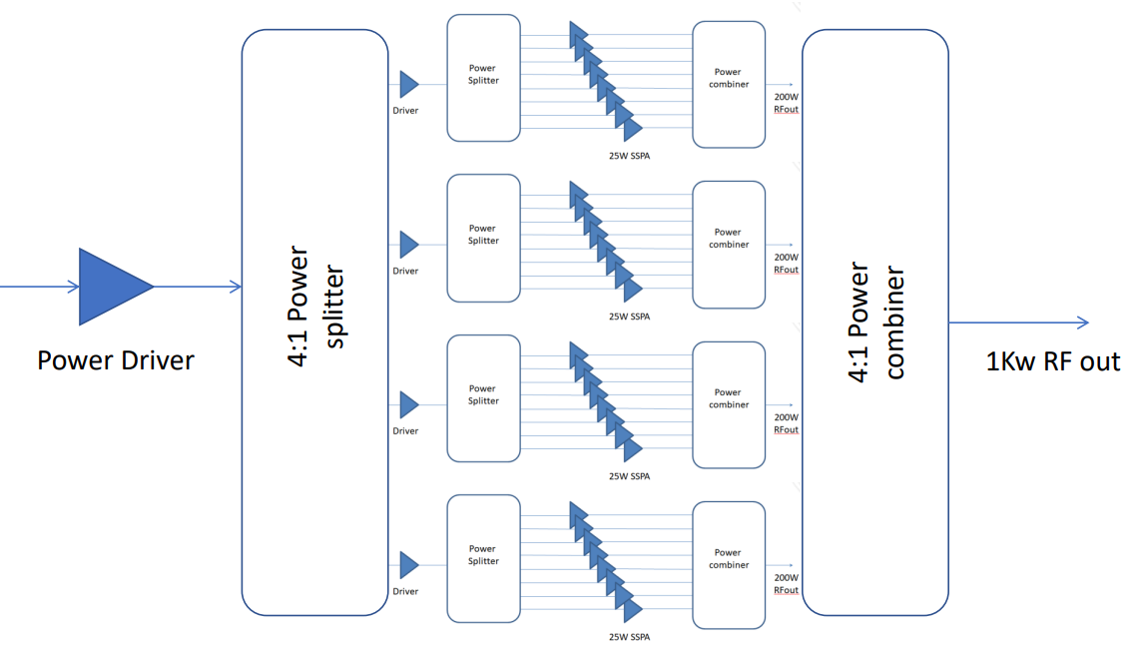
SSPA @ 12 GHz
Part number CGHV1F025S requires an export license from the United States Department of Commerce.
We will apply for the export license, but please be advise that the application process can take a minimum of 60 to 120 business days and there is no guarantee that the license will be granted.
Please advise on how you wish for us to proceed.

Slide 16
Low level RF - mTCA

Slide 17

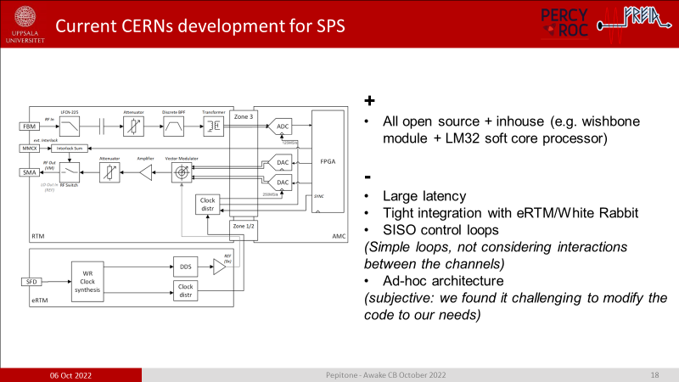
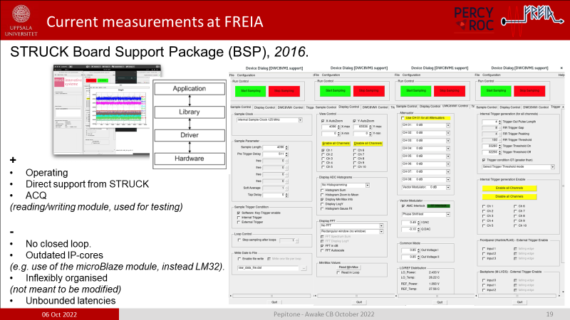
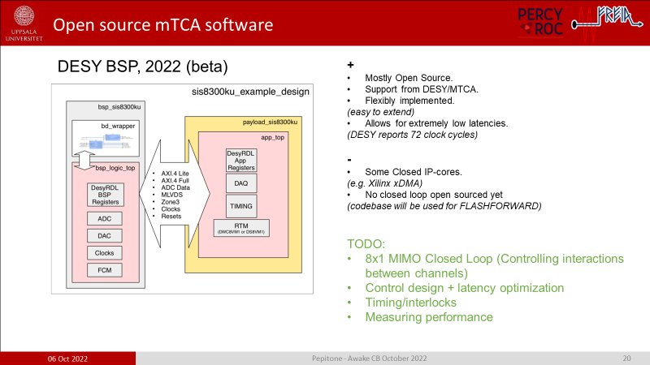
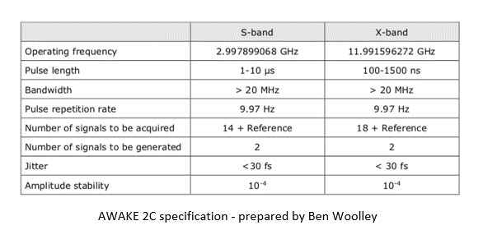
Last CB

Slide 18
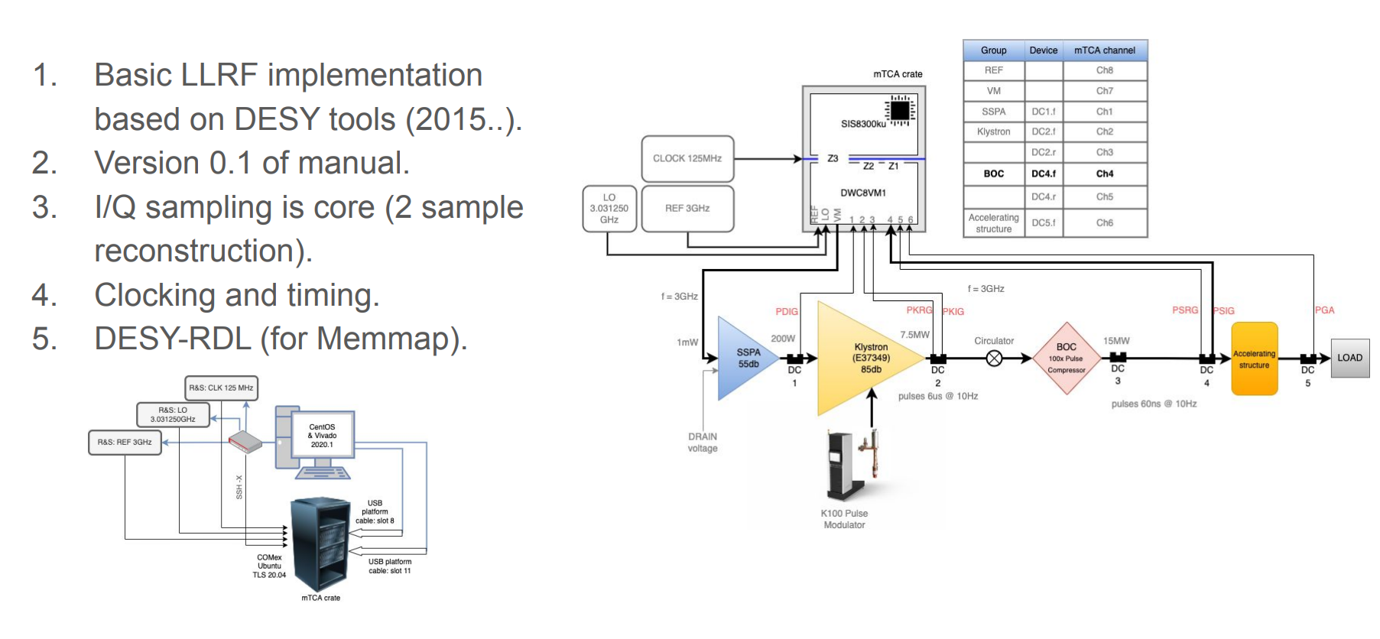
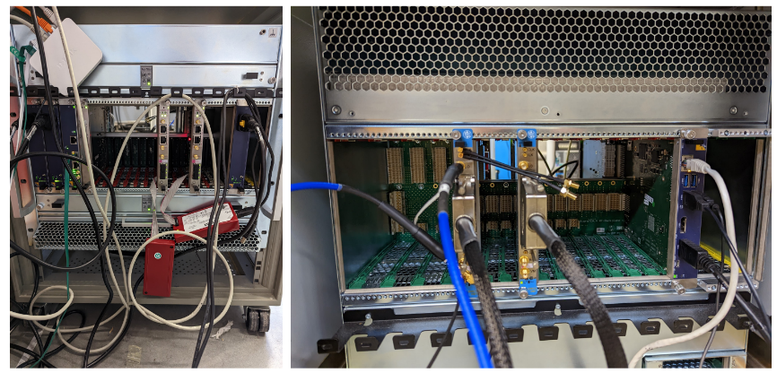
Now

Slide 19
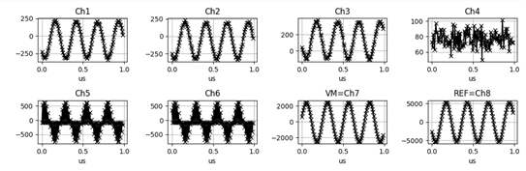
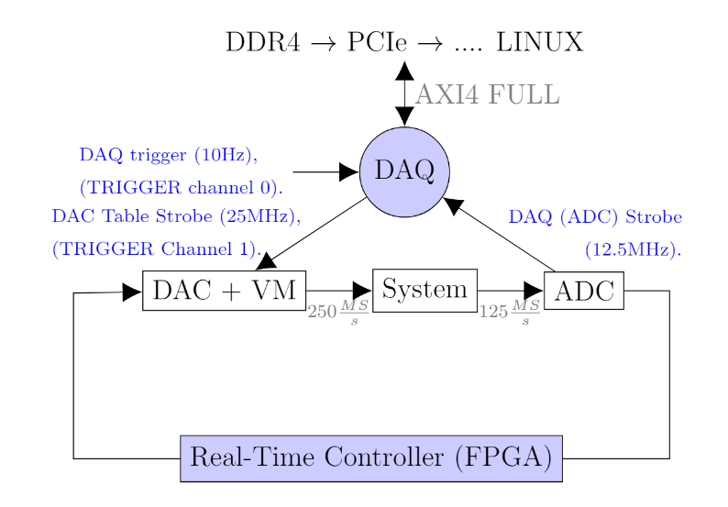
Measurements
125 MS/s
25 samples per cycle

Slide 20
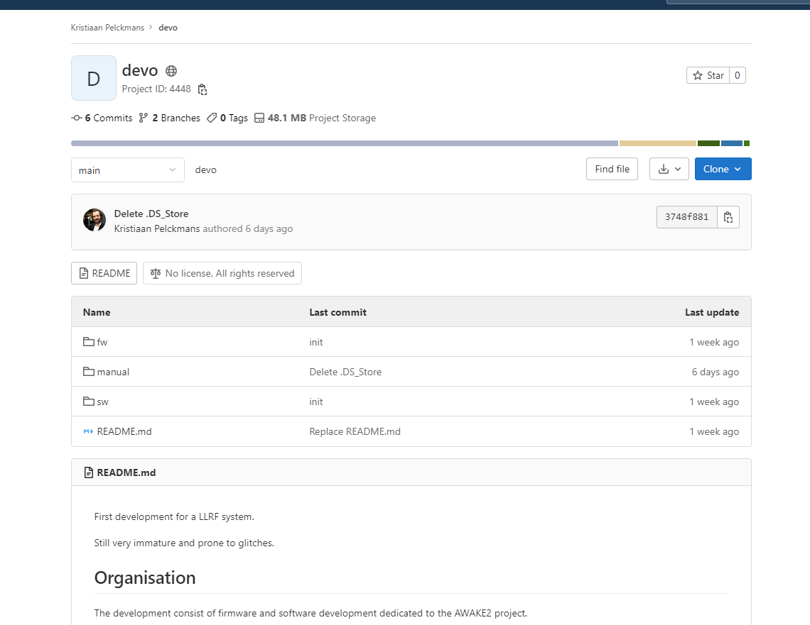
Open source
Work ongoing
Support from Desy https://gitlab.desy.de/fpgafw

Slide 21
Conclusions

Slide 22
Conclusions
RF lines well defined
The choice of the components is well advanced
R&D ongoing on different topics (oil,…)
Sband SSPA operational and tunable
Control system PLC under development
Integration ongoing
Work on the Xband started
Work ongoing on the LLRF
Data processing ongoing based on the measurements (I, Q sampling)
Support from Desy and open-source software

Slide 23
Thank you for your attention

