Slide 1
Beam Instrumentation for Run 2c
S. Mazzoni for the BI team
AWAKE collaboration meeting @ CERN, 5-7 October 2022

Slide 2
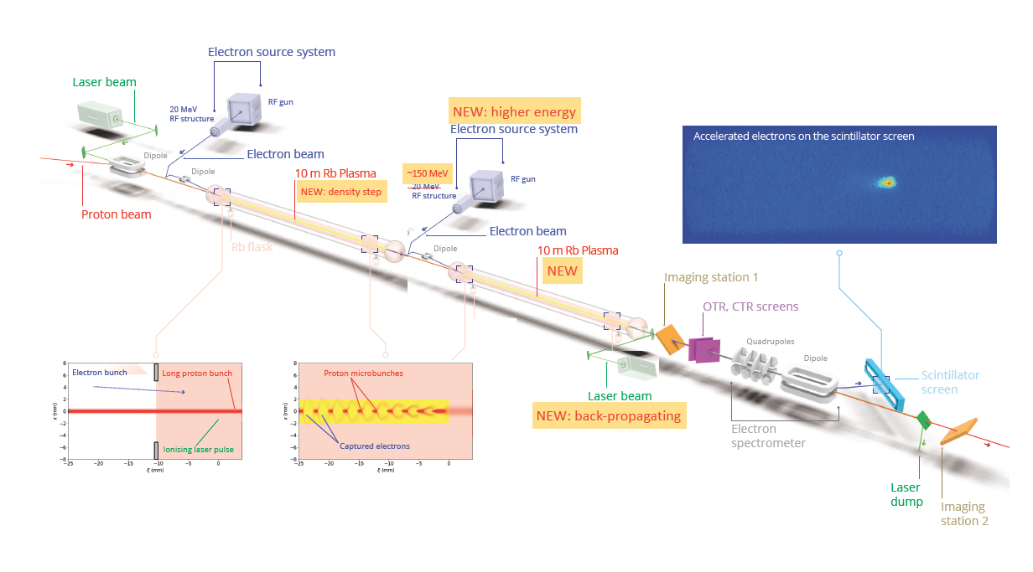
Beam instruments for Run 2c
Dismantle, store, move and reconnect existing instruments from
  18 MeV e- line
  common e+, p+ line (no new instruments wrt 2b)
  after plasma cell

Slide 3
Beam instruments for Run 2c
Dismantle, store, move and reconnect existing instruments from
  18 MeV e- line
  common e+, p+ line (no new instruments wrt 2b)
  after plasma cell
Instrumentation for new 150 MeV electron line and common line between plasma cells

Slide 4
Beam instruments for Run 2c
Dismantle, store, move and reconnect existing instruments from
  18 MeV e- line
  common e+, p+ line (no new instruments wrt 2b)
  after plasma cell
Instrumentation for new 150 MeV electron line and common line between plasma cells
Instrumentation for post acceleration diagnostics

Slide 5
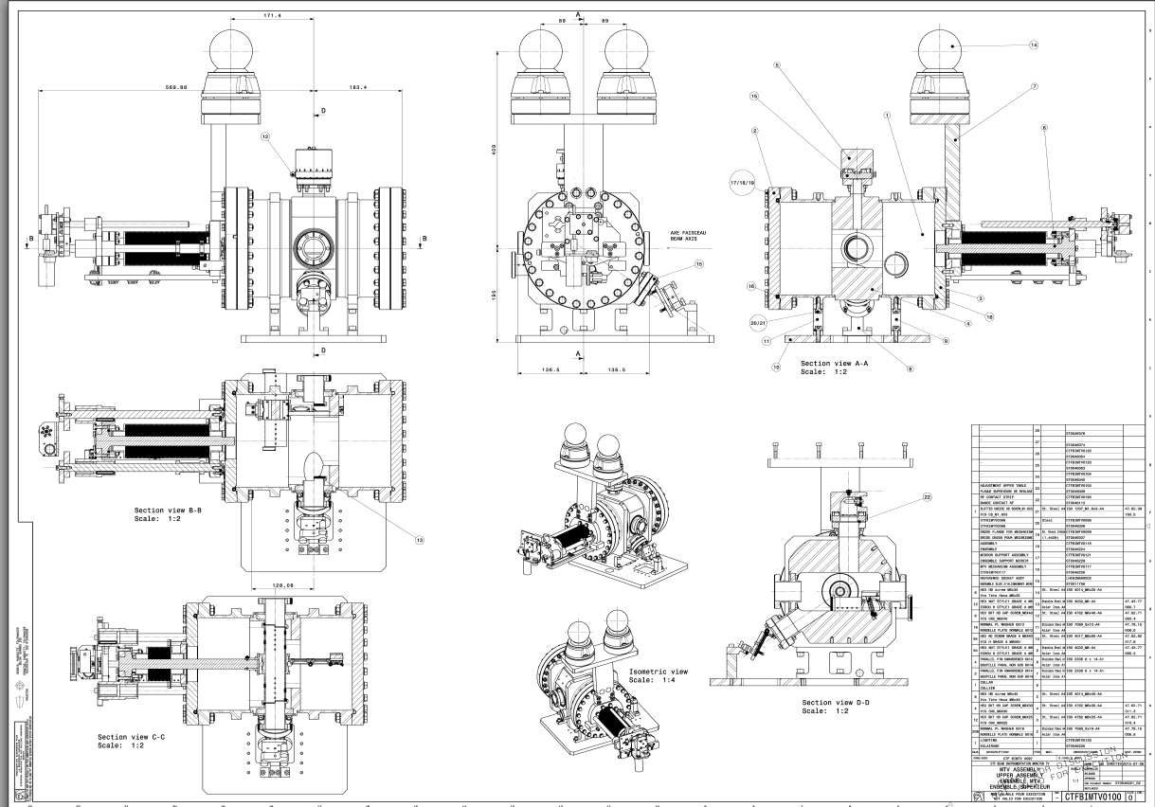
BTVs for new 150 MeV e- line
3+4 BTVs for new e- line gun and dogleg respectively. 1 BTV in gun with intensified camera TBD
present requirement for beam size:
  “injection BTV”: resolution up to 1 um (can be achieved with very high resolution, small field of view of typically 2 mm and OTR PSF technique – not a standard BTV).
  typical size of magnified pixel 20-50 um (achievable)
Proposal is to re-design CTFBIMTV
    20 deg screen
    separate optical target
    pointing accuracy when streak camera is needed
    synergies with FLASH project
5

Slide 6
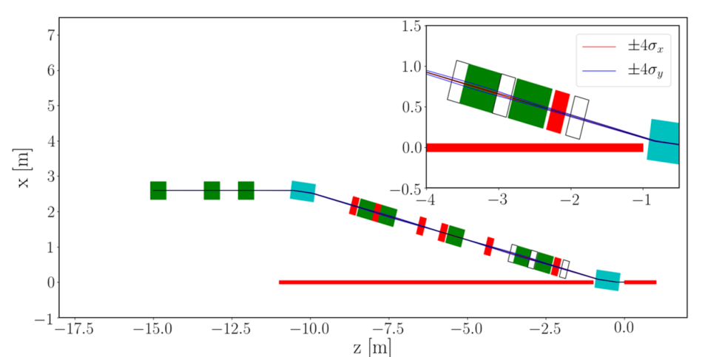
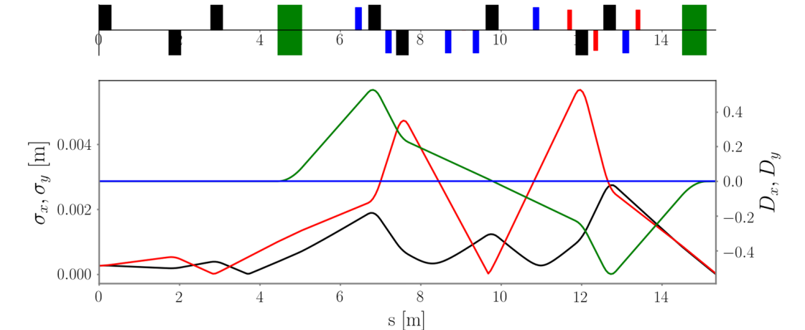
BTVs for new 150 MeV e- line
quads
dipoles
sextupoles
octupoles
R. Ramjiawan
V. Bencini
S Mazzoni | Beam instrumentation for Run 2

Slide 7
BTVs – expected σ
Position | x RMS [m] | y RMS [m]
BTV.0 | 0.000255839 | 0.000391439
BTV.1 | 0.000337465 | 0.000193263
BTV.2 | 2.45E-05 | 0.000631731
BTV.3 | 0.001557957 | 0.00236253
BTV.4 | 0.000385452 | 0.005781301
BTV.6 | 0.001478592 | 0.003208808
BTV.8 | 0.001814333 | 0.001056286
MERGE | 5.36E-06 | 6.20E-06
Middle of the dipole
x RMS [m] | y RMS [m]
0.001 | 0.0005
Inputs from V. Bencini

Slide 8
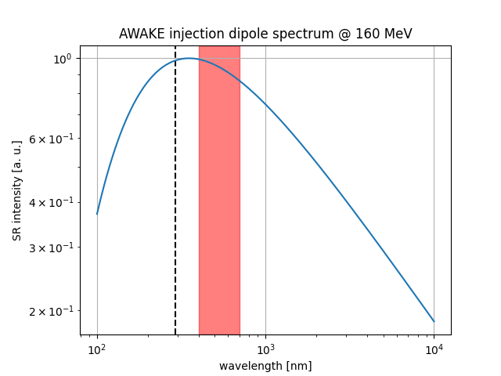
Beam size at plasma injection
Expected s at merging point 6 um. To be measured inside Rb vapour.
Back-up: measure beam size from SR produced in last dipole:
    magnetic length 0.6 m
    deflection angle 15 deg
    rho = 2.2918 m
    l_{critical} for 160 MeV = 280 nm > possible to measure in the visible at 400 nm
Beam size at merging point extrapolated from optics model
Proposal is to add a viewport (transmission down to THz)

Slide 9
BPMs for 150 MeV line
3+12 BPMs for new e- line gun and dogleg respectively.
present requirement 10 um resolution provided that BTVs have 1 um resolution
1st option refurbish inductive BPM (CTFBIPU)
  enough spare at CLEAR / CTF3 (37). Modification for single bunch requires new parts that are not in stock
  likely not to fulfil resolution requirements, would require more personnel for refurbishment, SW
2nd option replicate TRIUMF stripline BPMs
  existing design, <10 um resolution, electronics have obsolete components to be replaces (eg FPGA). Existing instrument in AWAKE, no new SW needed. APERTURE 40 mm
  V. Verzilov willing to share knowledge. Agree if formal or informal way

Slide 10
BPM for proton line
IBIC 2017 : https://accelconf.web.cern.ch/ibic2017/papers/tupcf06.pdf
Improvement of proton BPM resolution. Present system is “ALPS” prototype at 70 μm (RMS).
BI internal review on June 2022, two main options proposed to achieve an estimated of 20 μm RMS:
  refurbish present system (log> lin amplifiers). Cheapest option, actual improvement to be quantified, not in the way of moving towards a standard CERN BI system.
  replace with HL-LHC BPM currently under development. 20 um RMS resolution should be reachable. New BPM and new cables to be pulled (except last 5 BPMs). More expensive, standard BI system (performance, maintenance)

Slide 11
BLMs
present BLMs need to be refurbished. Additional ones due to longer p+ line
Estimated is between 12-15 new systems.

Slide 12
Contribution from Institutes
MPP will contribute to: 3rd streak camera, injection diagnostics, THz diagnostics (plasma)
AWAKE-UK (UCL, UMan, ULiv, RHUL, Strathclyde, UOxford):
  bunch length studies (UMan, Uliv, RHUL)
  emittance measurement (Uman, UCL via spectrometer)
  spectrometer upgrade (UCL)
TRIUMF involvement in BPM development to be defined
CERN BI will provide support.
(good) option: PhD students in BI (to be discussed in advance)

